Slide 1
The Standard Model & Beyond
John Ellis

Slide 2
Fundamental Particle Interactions
Strong, weak and electromagnetic
Three separate gauge group factors:
SU(3) × SU(2) × U(1)
Three different gauge couplings:
g₃, g₂, g ́
Similar structures, important difference
The carrier particles of the weak interactions are massive: m_{W} ~ 80 GeV, m_{Z} ~ 91 GeV
What is the origin of these masses (also electron, …)
Is the Higgs Boson the answer?

Slide 3
To Higgs or not to Higgs?
Need to discriminate between different types of particles:
Some have masses, some do not
Masses of different particles are different
In mathematical jargon, symmetry must be broken: how?
Break symmetry in equations?
Or in solutions to symmetric equations?
This is the route proposed by Higgs (et al.)
Is there any other way?

Slide 4
Where to Break the Symmetry?
Throughout all space?
Route proposed by Higgs
Universal Higgs field breaks symmetry
Or at the edge of space?
Break symmetry at the boundary?
Not possible in 3-dimensional space
No boundaries
Postulate extra dimensions of space
Different particles behave differently in the extra dimension(s)

Slide 5
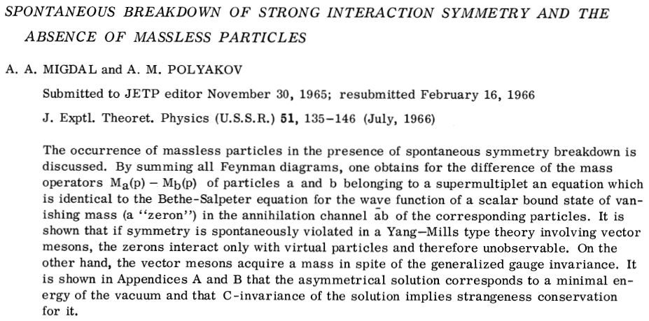
The (G)AEBHGHKMP’tH Mechanism
1964
The only one
who mentioned a
massive scalar boson

Slide 6
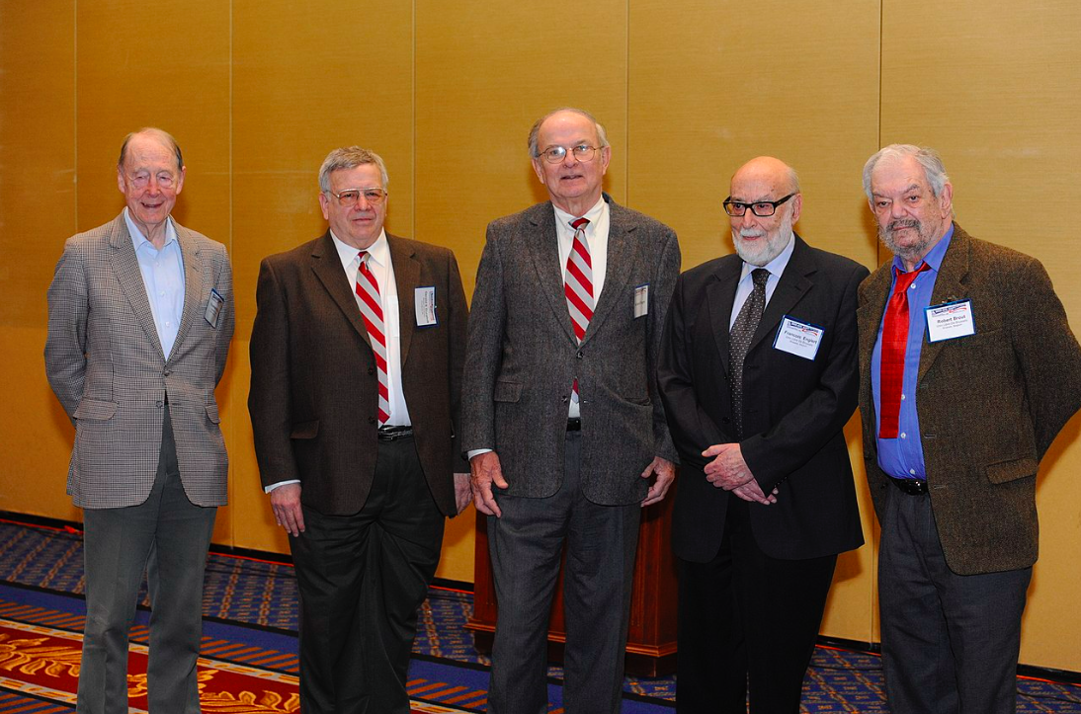
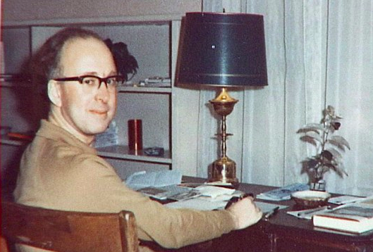
The Founding Fathers
1964
Tom Kibble
Gerry Guralnik
Carl Hagen
François Englert
Robert Brout
Peter Higgs

Slide 7
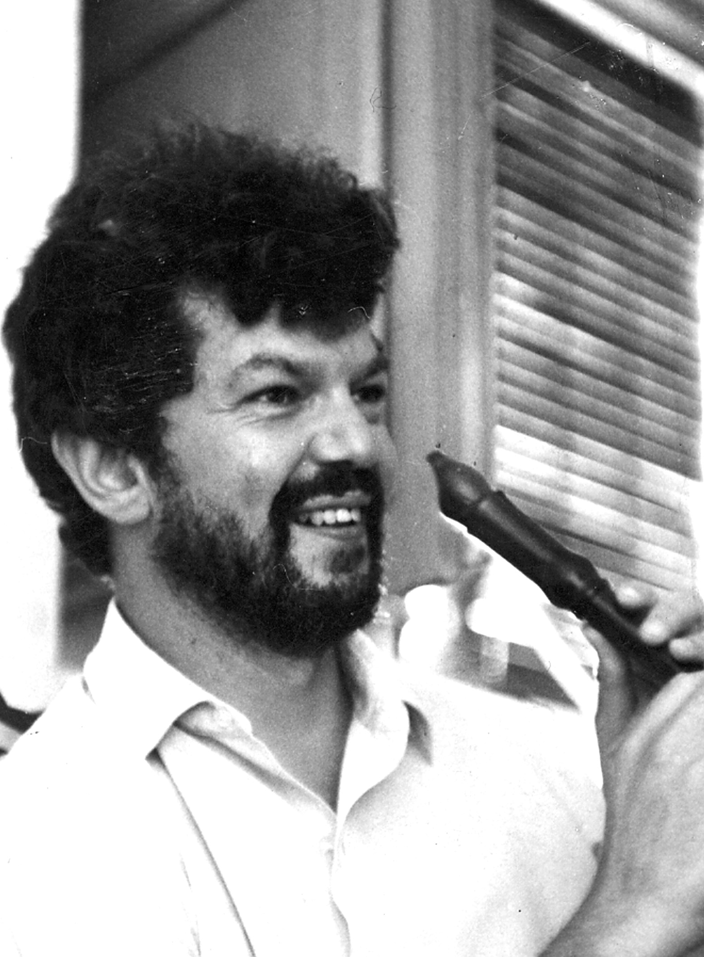
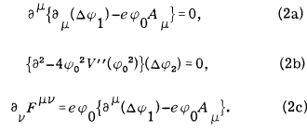
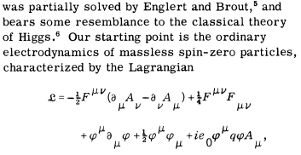
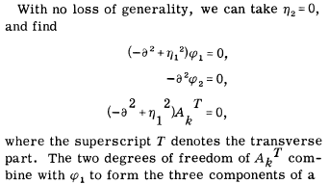
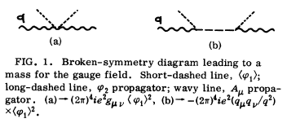
But the Higgs Boson
Englert & Brout
Higgs
Guralnik, Hagen & Kibble
Also Goldstone in global case?

Slide 8
The Englert-Brout-Higgs Mechanism
Vacuum expectation value of scalar field
Englert & Brout: June 26th 1964
First Higgs paper: July 27th 1964
Pointed out loophole in argument of Gilbert if gauge theory described in Coulomb gauge
Accepted by Physics Letters
Second Higgs paper with explicit example sent on July 31st 1964 to Physics Letters, rejected!
Revised version (Aug. 31st 1964) accepted by PRL
Guralnik, Hagen & Kibble (Oct. 12th 1964)

Slide 9
The Higgs Boson
Higgs pointed out a massive scalar boson
“… an essential feature of [this] type of theory … is the prediction of incomplete multiplets of vector and scalar bosons”
Englert, Brout, Guralnik, Hagen & Kibble did not comment on its existence
Discussed in detail by Higgs in 1966 paper

Slide 10
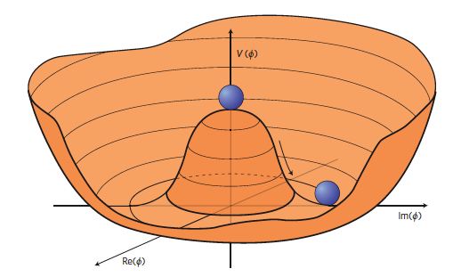
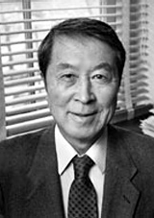
Nambu EB, GHK
EB, H, GHK
and Higgs
Spontaneous symmetry breaking: massless Nambu-Goldstone boson ‘eaten’ by gauge boson
‘eaten’ by massless gauge boson
Accompanied by massive particle

Slide 11
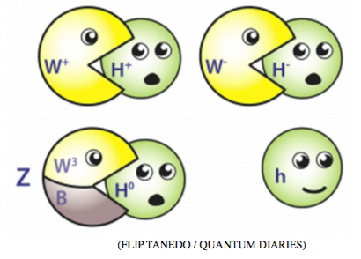
Hungry Higgs

Slide 12
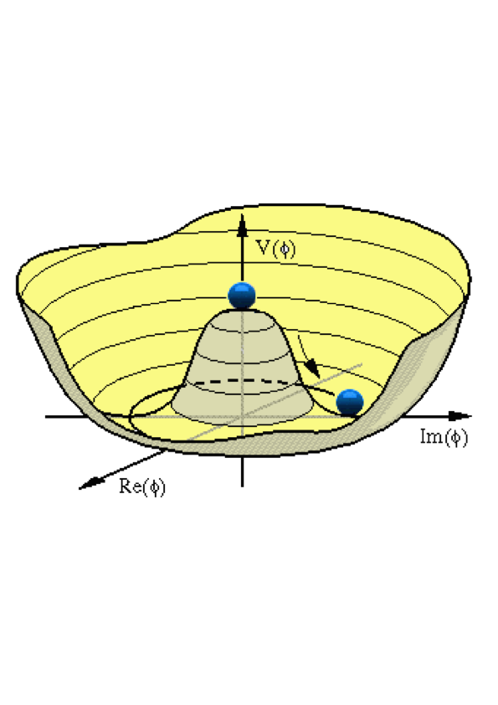
The Higgs Mechanism
Postulated effective Higgs potential:
Minimum energy at non-zero value:
Non-zero masses:
Components of Higgs field:
π massless, σ massive:

Slide 13
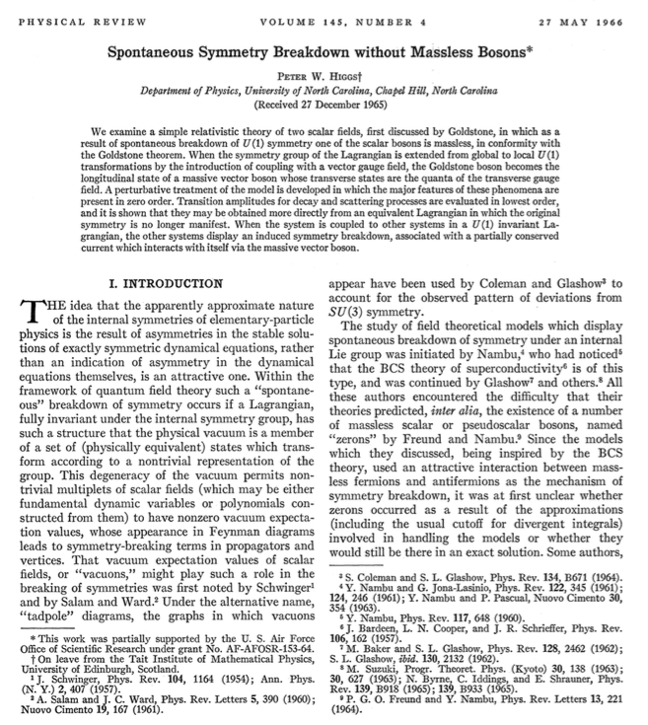
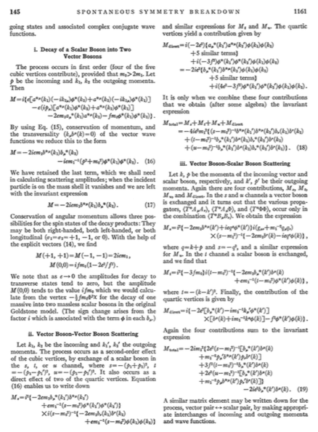
First Steps in Phenomenology
1965/6

Slide 14
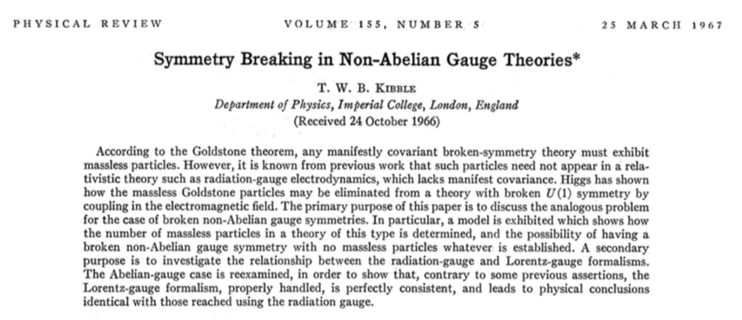
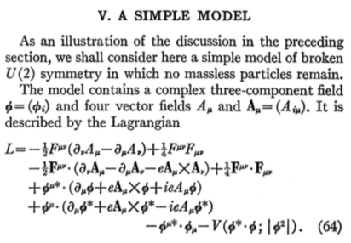
The Non-Abelian Case
1966/7

Slide 15
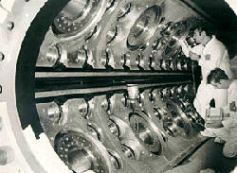
Gauge Theories taken Seriously
1971/2
`t Hooft and Veltman: renormalizable
Kobayashi and Maskawa show how to include CP violation in the Standard Model
Neutral currents in Gargamelle
J/Ψ discovered
Tau lepton and charmed particles discovered
1973
1973
1974
1975
1976

Slide 16
Parameters of the Standard Model
Gauge sector:
3 gauge couplings: g₃, g₂, g ́
1 strong CP-violating phase
Yukawa interactions:
3 charge-lepton masses
6 quark masses
4 CKM angles and phase
Higgs sector:
2 parameters: μ, λ
Total: 19 parameters
Unification?
Flavour?
Mass?

Slide 17
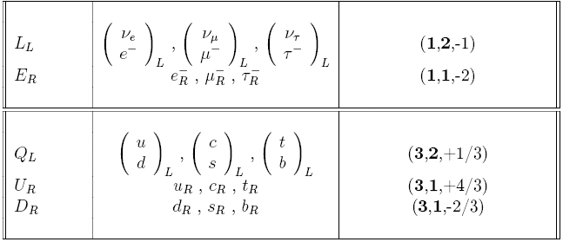
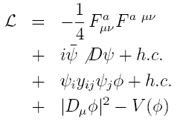
Summary of the Standard Model
Particles and SU(3) × SU(2) × U(1) quantum numbers:
Lagrangian: gauge interactions
matter fermions
Yukawa interactions
Higgs potential

Slide 18
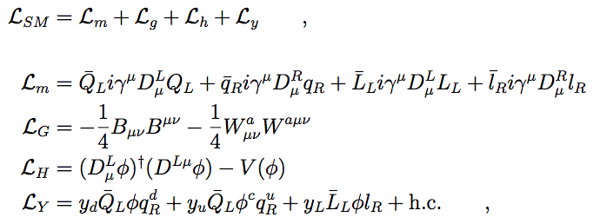
The Standard Model Lagrangian
✓ Experiment: accuracy < %
No direct evidence
until July 4, 2012
Notes:
Given the SM particle content and their quantum numbers that fixes all possible renormalizable terms consistent with lorentz and gauge symmetry. This is the SM that accounts so successfully for practically all collider experiments and more qualitatively the world around us. But L_h and L_y terms never seen directly (before july anyway), and a priori we still don’t know if this is the correct set of equations for the higgs sector.

Slide 19
Masses for SM Gauge Bosons
Kinetic terms for SU(2) and U(1) gauge bosons:
where
Kinetic term for Higgs field:
Expanding around vacuum:
Boson masses:

Slide 20
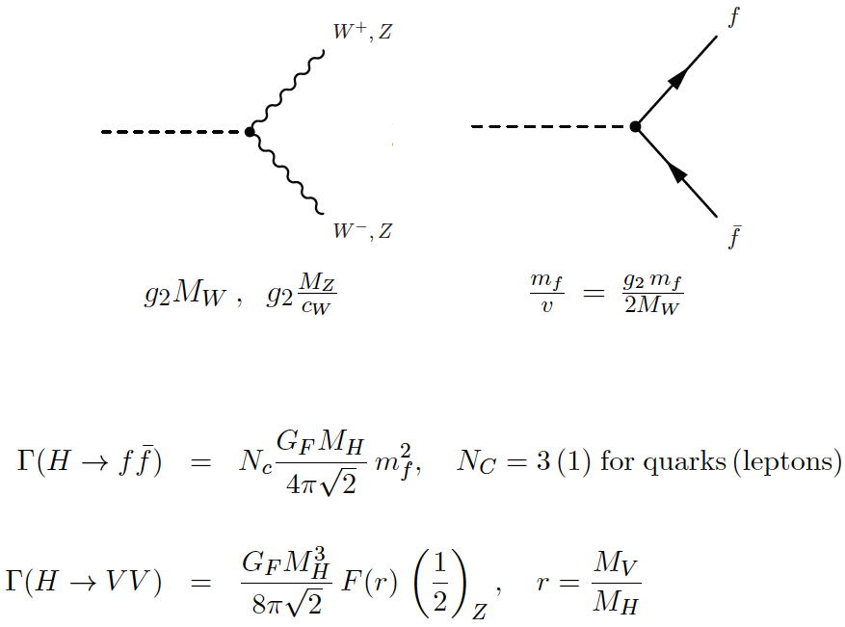
Higgs Boson Couplings

Slide 21
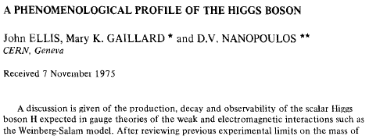
A Phenomenological Profile of the Higgs Boson
1975
First attempt at systematic survey

Slide 22
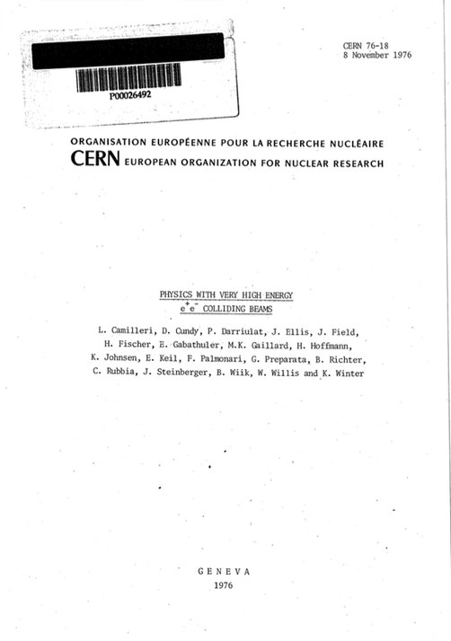
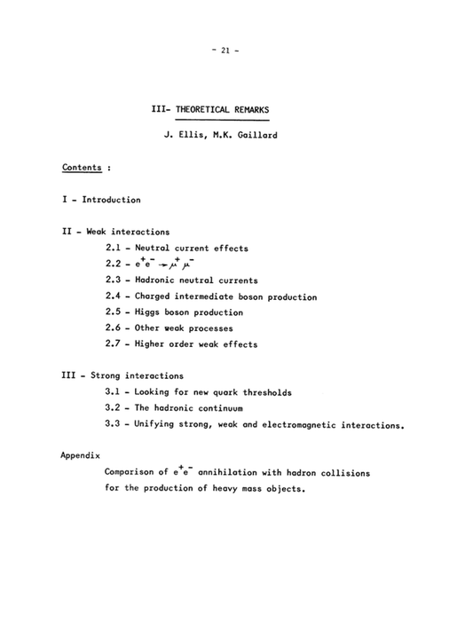
First LEP Study
1976

Slide 23
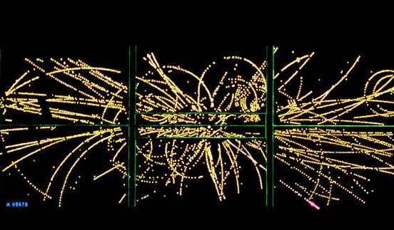
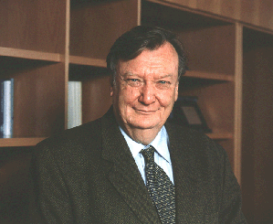
Discovery of the W and Z
1983
The top quark still undiscovered
The search for the Higgs moved up the agenda
How did it get so heavy?

Slide 24
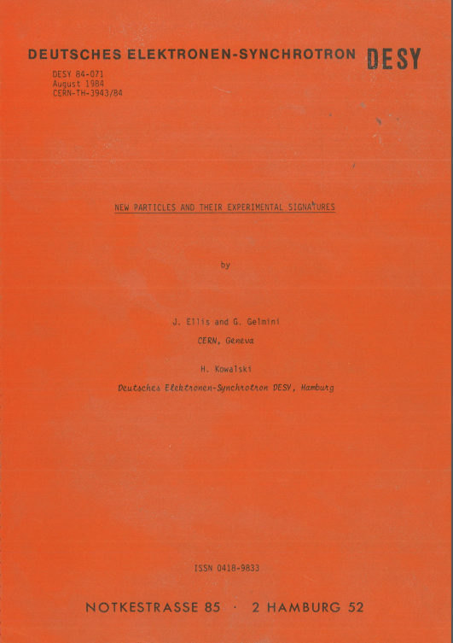
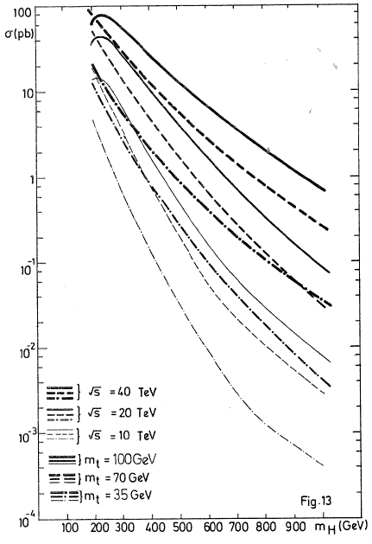
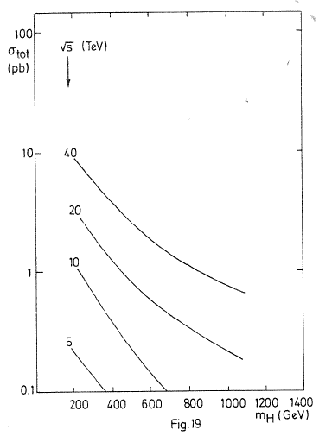
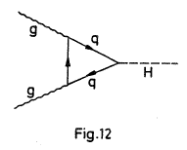
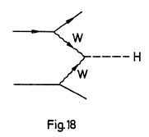
A Preview of the Higgs Boson @ LHC
1984
Prepared for LHC Lausanne workshop 1984
JE, Gelmini & Kowalski, 1984

Slide 25
Status of the Standard Model
Perfect agreement with all confirmed accelerator data
Consistency with precision electroweak data (LEP et al) only if there is a Higgs boson
Agreement seems to require a relatively light Higgs boson weighing < ~ 180 GeV
Raises many unanswered questions:
mass? flavour? unification?

Slide 26
Constraints on Higgs Mass
Electroweak observables sensitive via quantum loop corrections:
Sensitivity to top, Higgs masses:
Preferred Higgs mass: m_{H} ~ 100 ± 30 GeV
Compare with lower limit from direct search at LEP:
m_{H} > 114 GeV
and exclusion around (160, 170 GeV) at TeVatron

Slide 27
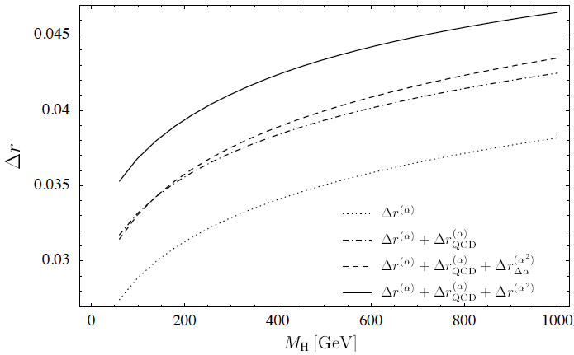
Sensitivity to Higgs Mass
Experimental uncertainty ΔM_{W} ~ 15 MeV
Theoretical uncertainty ~ 4 MeV

Slide 28
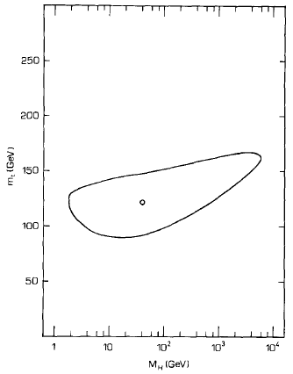
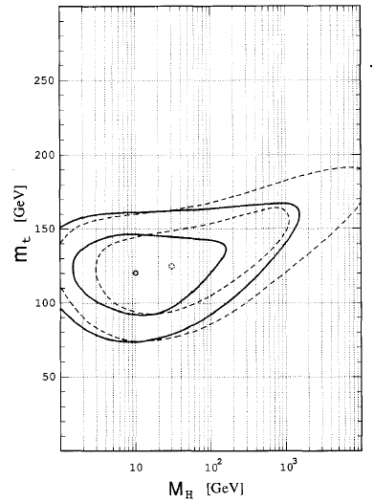
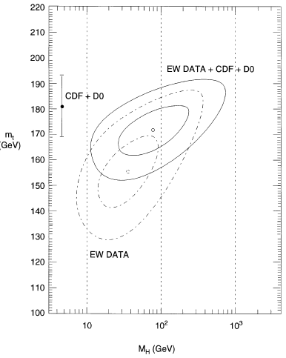
Estimating the Mass of the Higgs Boson
First attempts in 1990,
Easier after the discovery of the top quark
1991
JE, Fogli & Lisi

Slide 29
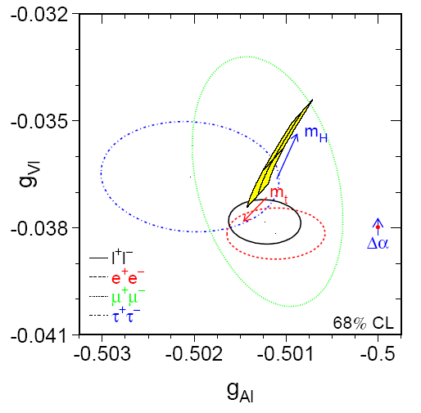
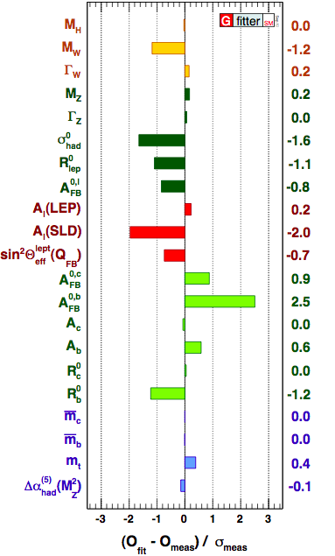
Precision Tests of the Standard Model
Lepton couplings
Pulls in global fit
It works!

Slide 30
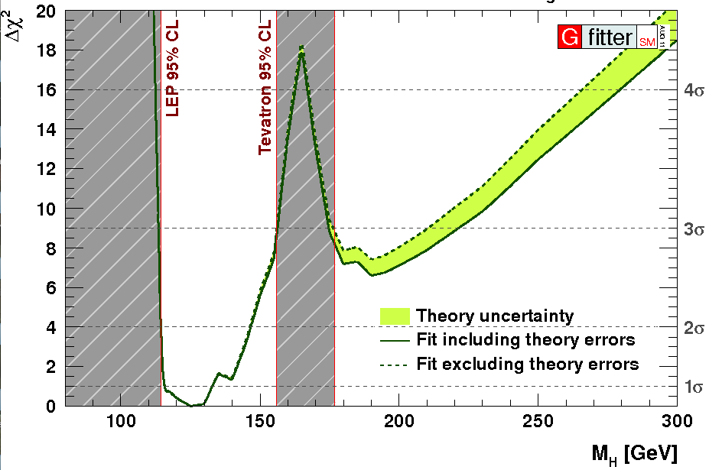
2011: Combining Information from Previous Direct Searches and Indirect Data
m_{H} = 125 ± 10 GeV
Gfitter collaboration

Slide 31
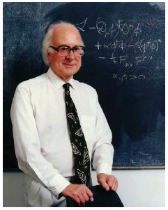
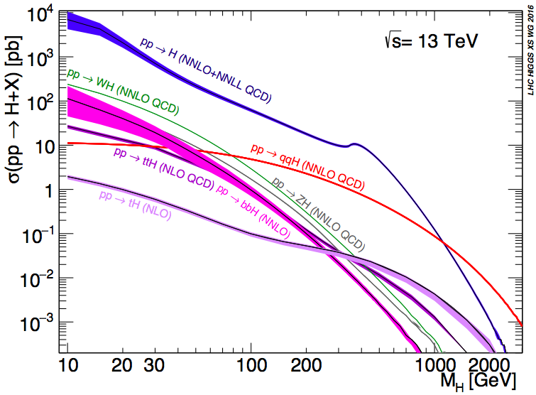
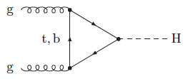
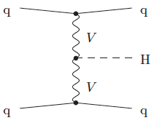
Higgs Production at the LHC
A la recherche du
Higgs perdu …
LHC Higgs Cross-Section
Working Group
(LHXSWG)
Many production modes measurable if M_{h} ~ 125 GeV

Slide 32
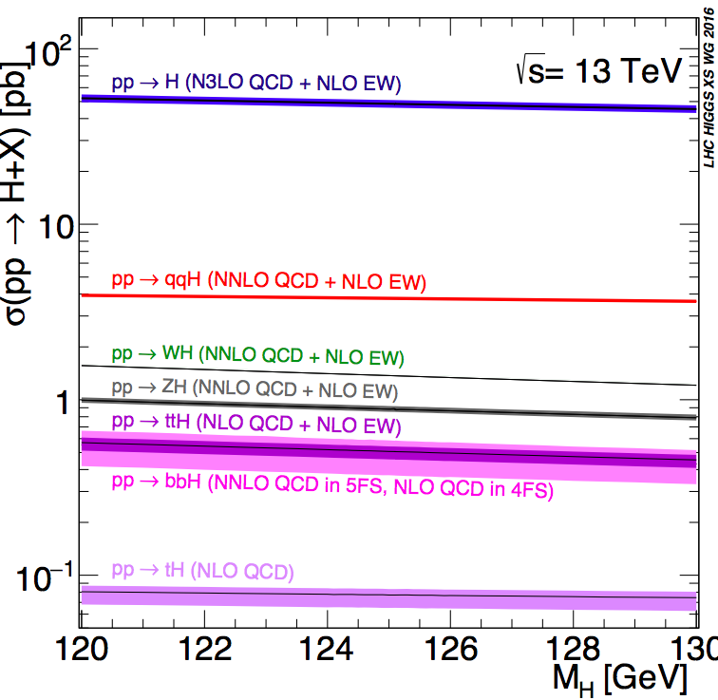
Higgs Production at the LHC
Cross sections for Higgs mass near 125 GeV
LHC Higgs Cross-Section
Working Group
(LHXSWG)

Slide 33
gg ➔Higgs Production at the LHC
Calculated at Next-to-Next-to-Next-to-Leading Order (N³LO) in limit of heavy t quark:
Contributions
at different
orders:
Breakdown of theoretical uncertainties:

Slide 34
VBF Higgs Production at the LHC
Calculated at NNLO including electroweak corrections at NLO
Good convergence of perturbation expansion
Small uncertainties in quark parton dist’ns

Slide 35
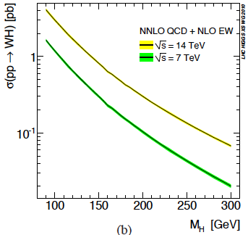
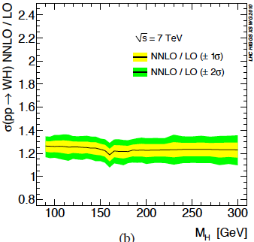
Associated V+H Production at the LHC
Calculated at NNLO including electroweak corrections at NLO
Good convergence of perturbation expansion

Slide 36
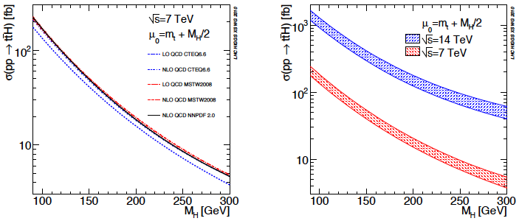
Associated tt+H Production
-
Calculated at NLO: uncertainties due to
Perturbation expansion
Choice of parton distributions

Slide 37
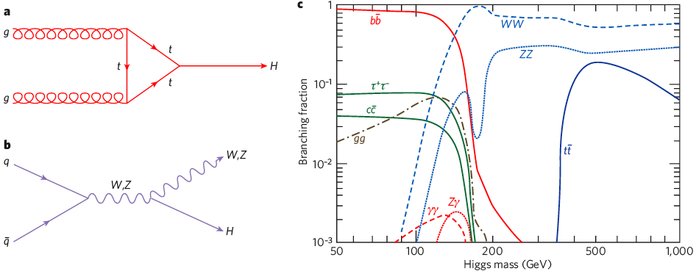
Higgs Decay Branching Ratios
Couplings proportional to masses (?)
Important couplings through loops:
gluon + gluon → Higgs → γγ
Many decay modes measurable if M_{h} ~ 125 GeV

Slide 38
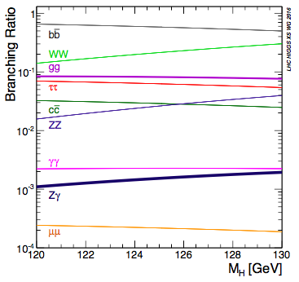
Higgs Decay Branching Ratios
Dominant decay branching ratios for m_{H} ~ 125 GeV
LHC Higgs Cross-Section
Working Group
(LHXSWG)

Slide 39
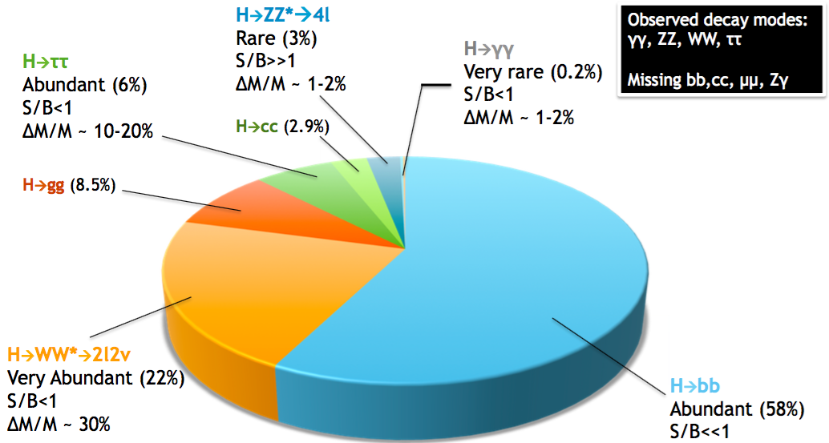
What we Expect
What do we know?

