Slide 1
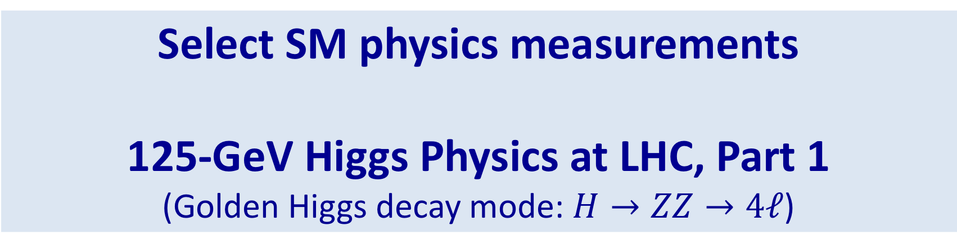
Select SM physics measurements
125-GeV Higgs Physics at LHC, Part 1
(Golden Higgs decay mode: $H→ZZ→4ℓ$)
Lecture 2:
Disclaimer: lectures are meant to be pedagogical,
not a comprehensive review of all recent results

Slide 2
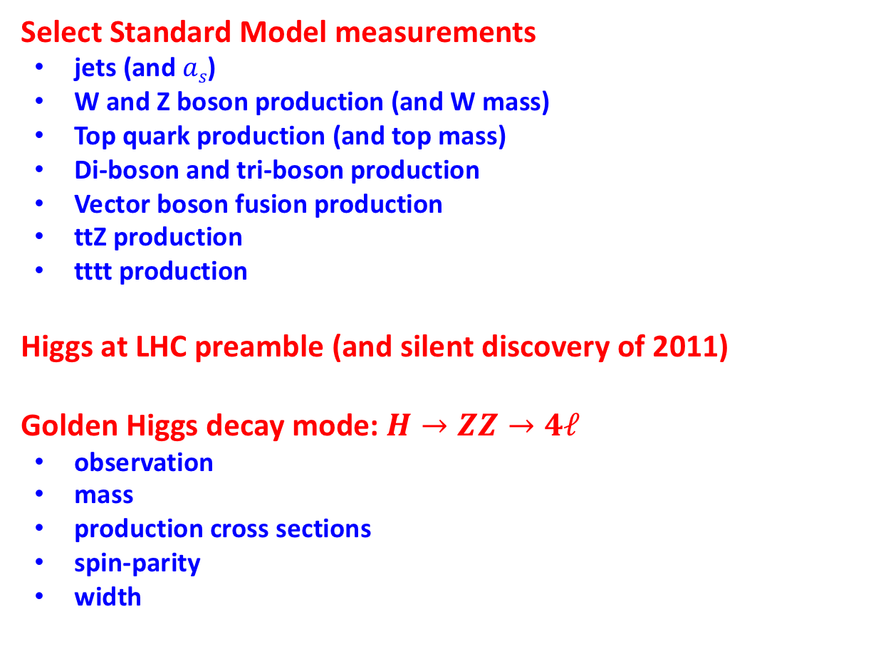
Outline
Select Standard Model measurements
  jets (and $as$)
  W and Z boson production (and W mass)
  Top quark production (and top mass)
  Di-boson and tri-boson production
  Vector boson fusion production
  ttZ production
  tttt production
Higgs at LHC preamble (and silent discovery of 2011)
Golden Higgs decay mode: $H→ZZ→4ℓ$
  observation
  mass
  production cross sections
  spin-parity
  width

Slide 3
LHC luminosity delivered (per experiment)
Run 1 | 2010-2011 | 7 TeV | 5 fb⁻¹
 | 2012 | 8 TeV | 25 fb⁻¹
Run 2 | 2015-2018 | 13 TeV | 160 fb⁻¹
Run 3 | 2021-2023 | 14 TeV | 300+ fb⁻¹
HL-LHC | 2026-2038 | 14 TeV | 3000+ fb⁻¹
As of today, Run 2 data are still being analyzed;
Many public results are based on less than
the full Run 2 data set.
HL-LHC is expected to deliver more than
the baseline number of 3000 fb⁻¹;
perhaps, 4500 fb⁻¹ (or even more).
Integrated luminosities shown are approximate (small differences between ATLAS and CMS)
The number of Higgs bosons produced in Runs 1 and 2 is about 9,000,000 per ATLAS/CMS experiment

Slide 4
Some Standard Model Measurements

Slide 5
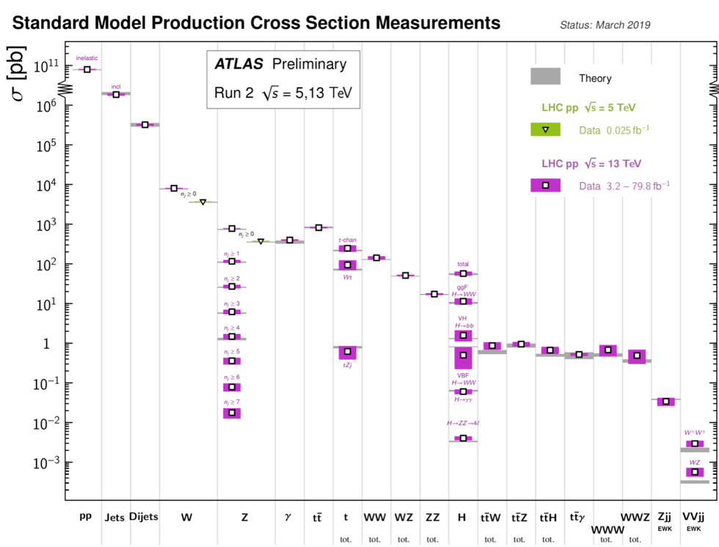
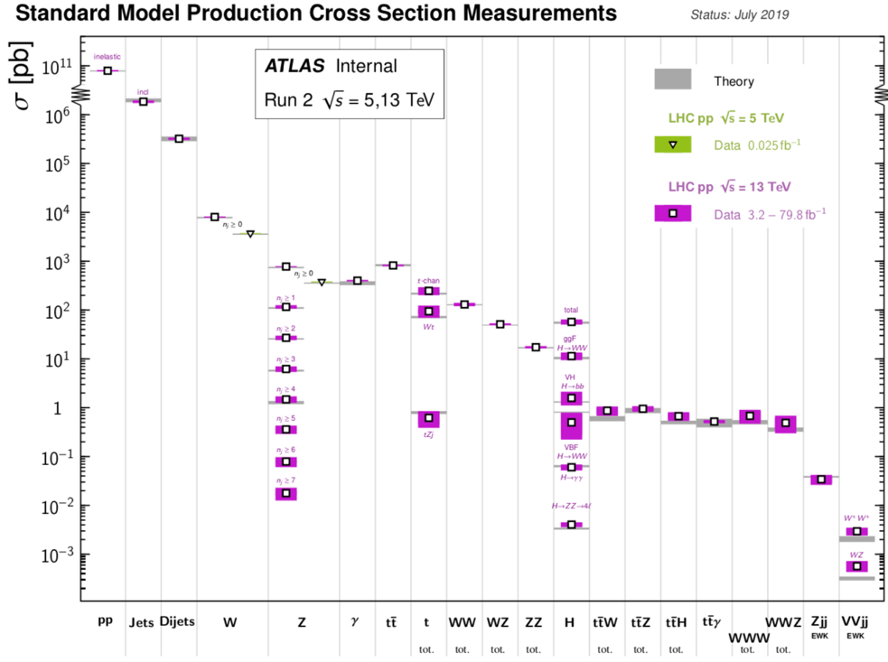
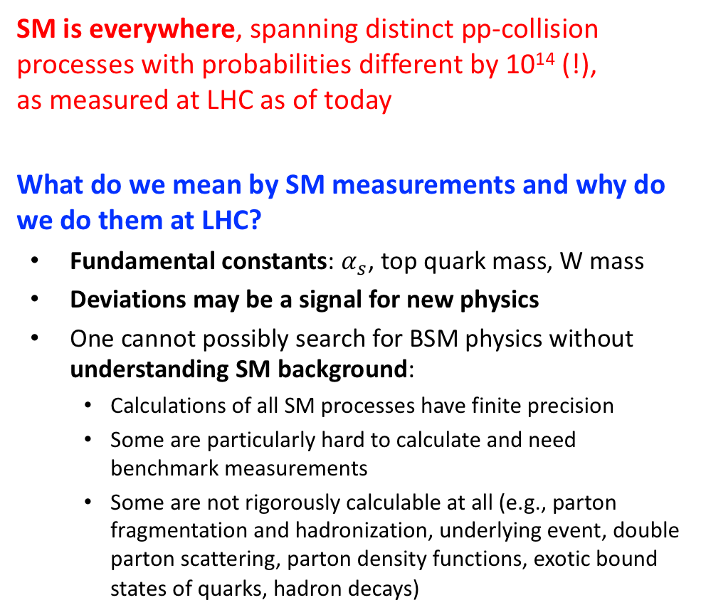
SM measurements
SM is everywhere, spanning distinct pp-collision processes with probabilities different by 10¹⁴ (!), as measured at LHC as of today
What do we mean by SM measurements and why do we do them at LHC?
  Fundamental constants: $α_{s}$, top quark mass, W mass
  Deviations may be a signal for new physics
  One cannot possibly search for BSM physics without understanding SM background:
    Calculations of all SM processes have finite precision
    Some are particularly hard to calculate and need benchmark measurements
    Some are not rigorously calculable at all (e.g., parton fragmentation and hadronization, underlying event, double parton scattering, parton density functions, exotic bound states of quarks, hadron decays)
ATL-PHYS-PUB-2019-012
Jets
W
Z
γ
top
VV
H
> 10¹⁴
ttV
VVV
VBF
VBS
LHC Run 2 results only

Slide 6
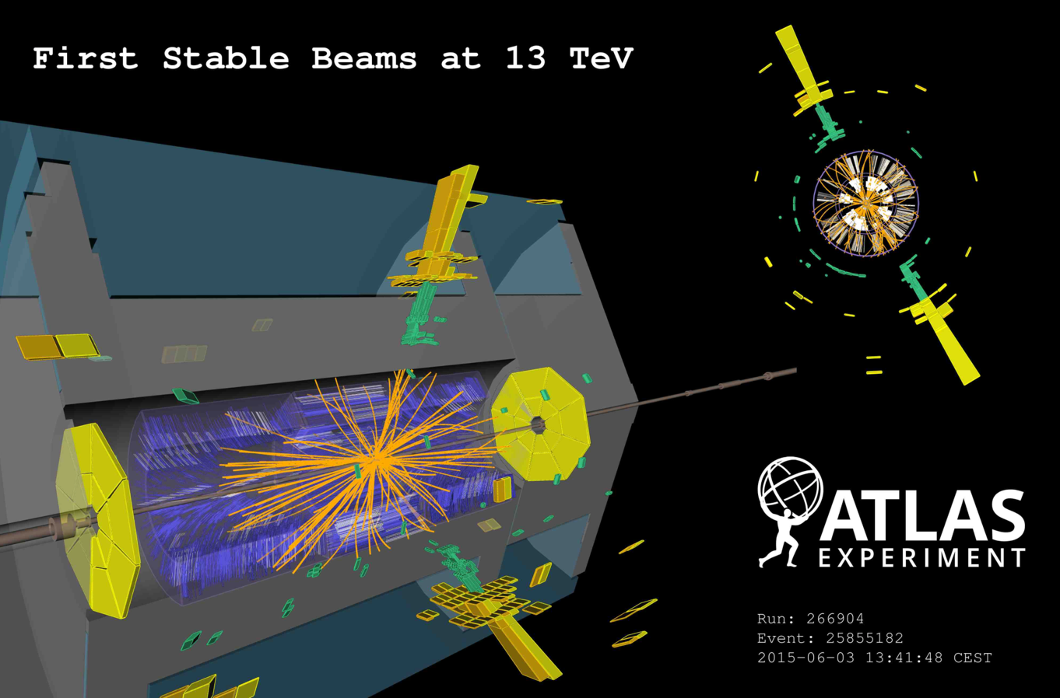
Jets

Slide 7
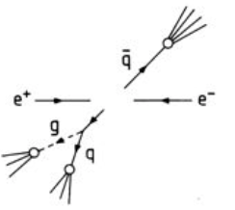
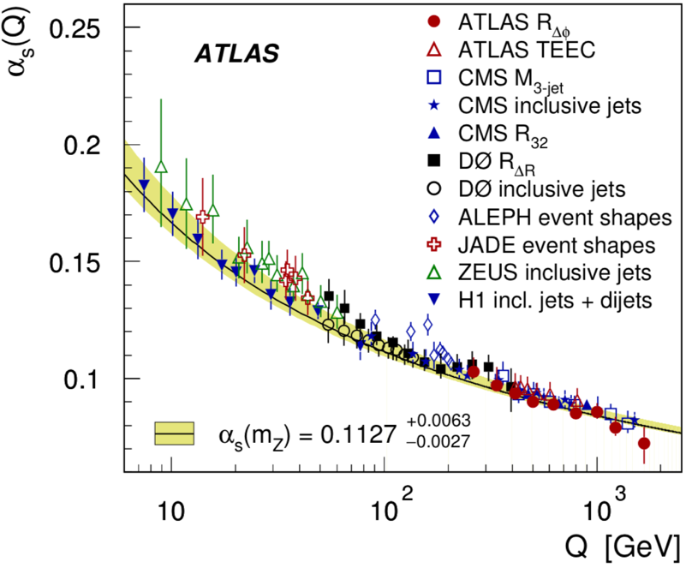
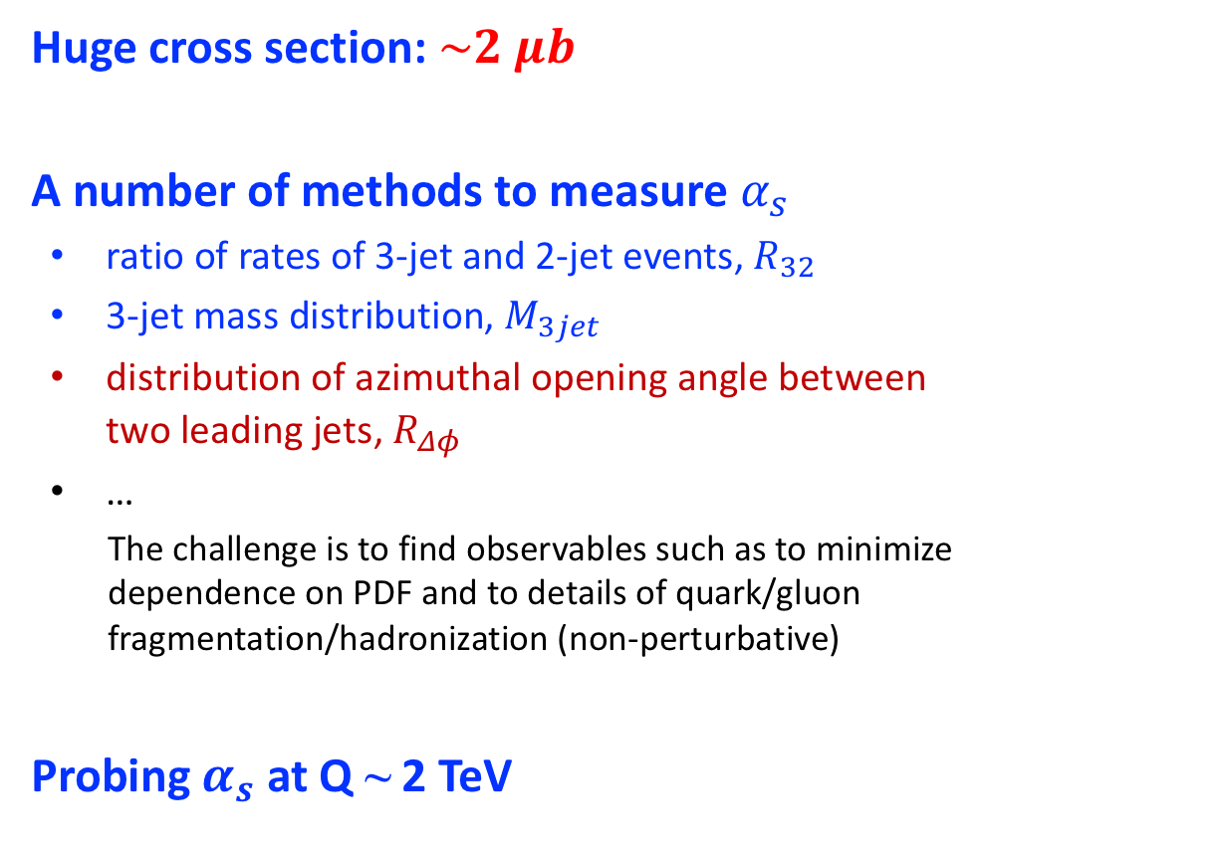


Jets
Huge cross section: $\sim 2 μb$
A number of methods to measure $α_{s}$
  ratio of rates of 3-jet and 2-jet events, $R_{32}$
  3-jet mass distribution, $M_{3jet}$
  distribution of azimuthal opening angle between two leading jets, $R_{Δφ}$
  …
The challenge is to find observables such as to minimize dependence on PDF and to details of quark/gluon fragmentation/hadronization (non-perturbative)
Probing $α_{s}$ at Q ~ 2 TeV
$$α_{s}$$
$$Δφ$$
PRD 98 (2018) 092004

Slide 8
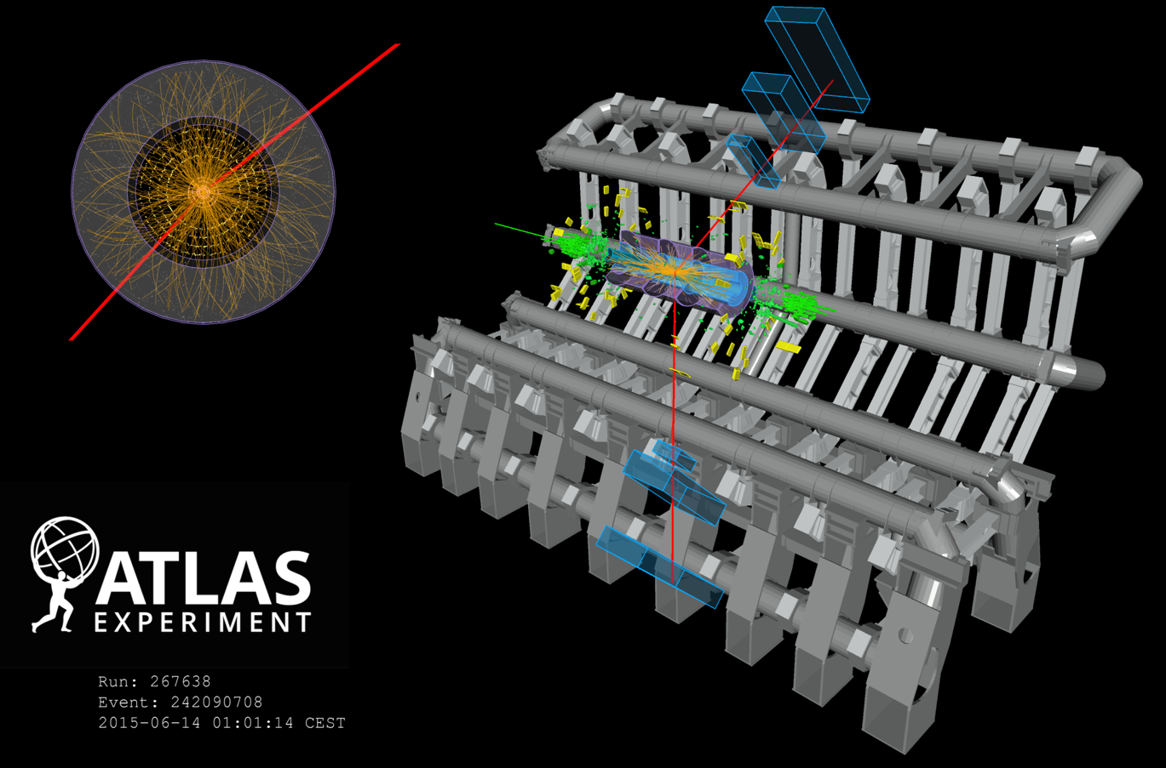

Z boson
$$Z→μμ$$

Slide 9
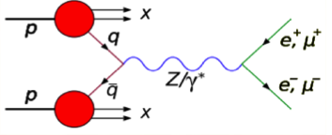
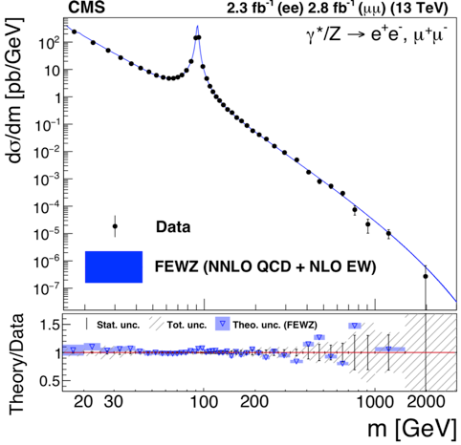
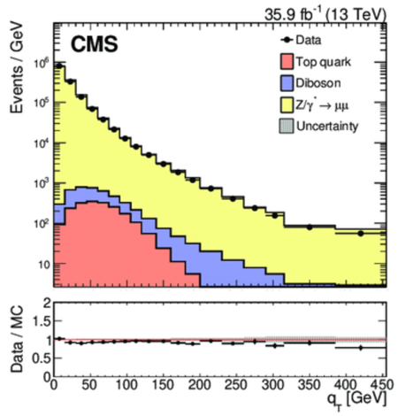
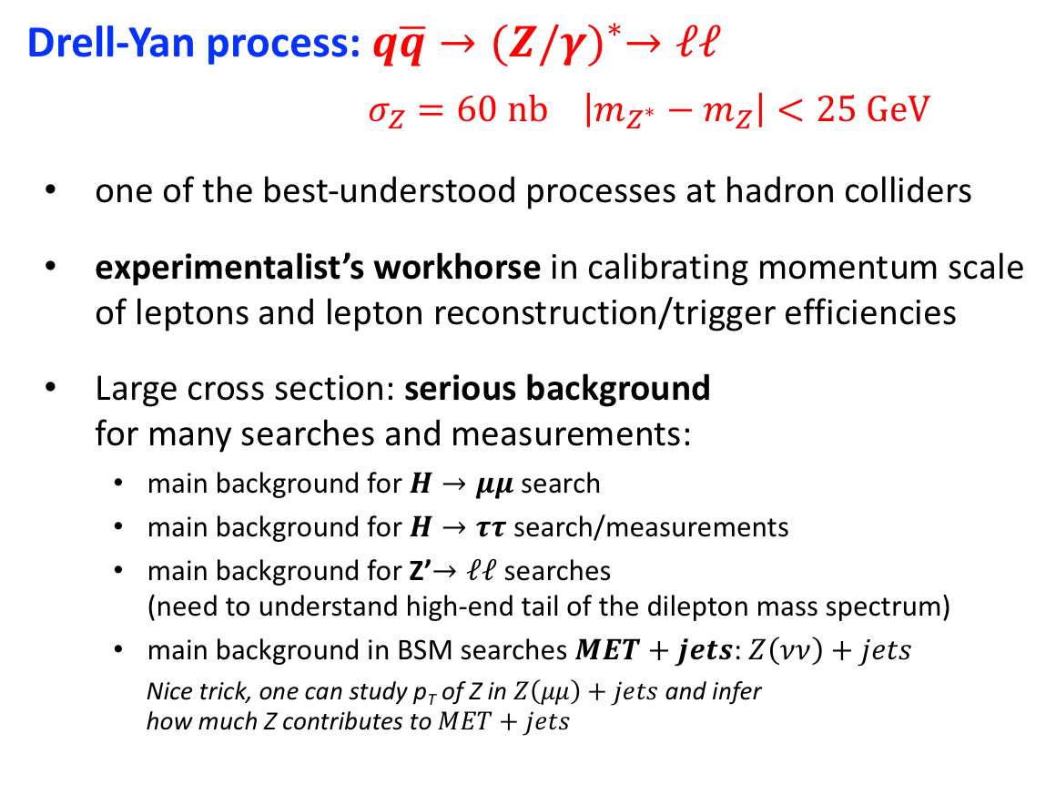
Z boson
Drell-Yan process: $q\overline{q}→{(Z/γ)}^{∗}→ℓℓ$
  $σ_{Z}=60 nb \left|m_{Z^{∗}}−m_{Z}\right|<25 GeV$
  one of the best-understood processes at hadron colliders
  experimentalist’s workhorse in calibrating momentum scale of leptons and lepton reconstruction/trigger efficiencies
  Large cross section: serious background for many searches and measurements:
    main background for $H→μμ$ search
    main background for $H→ττ$ search/measurements
    main background for Z’$→ℓℓ$ searches (need to understand high-end tail of the dilepton mass spectrum)
    main background in BSM searches $MET+jets$: $Z\left(νν\right)+jets$
    Nice trick, one can study p_{T} of Z in $Z\left(μμ\right)+jets$ and infer how much Z contributes to $MET+jets$

Slide 10
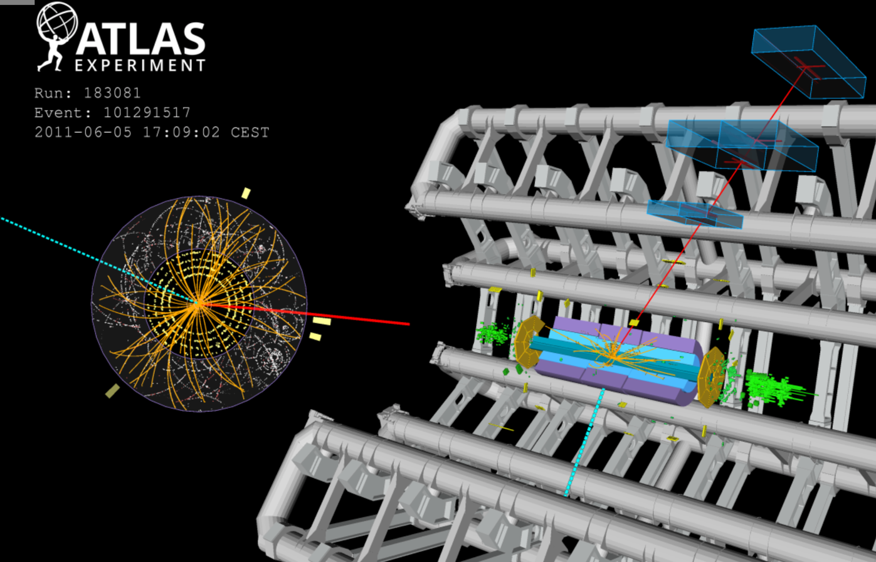

W boson
$$W→μν$$

Slide 11
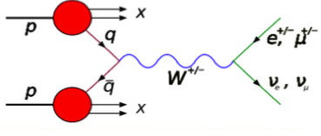
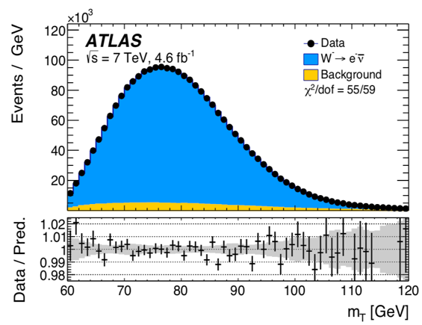
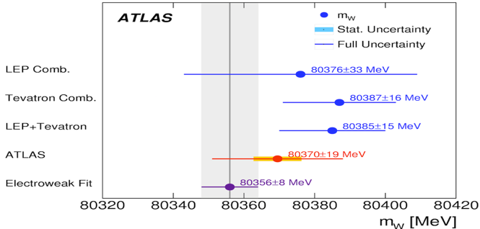
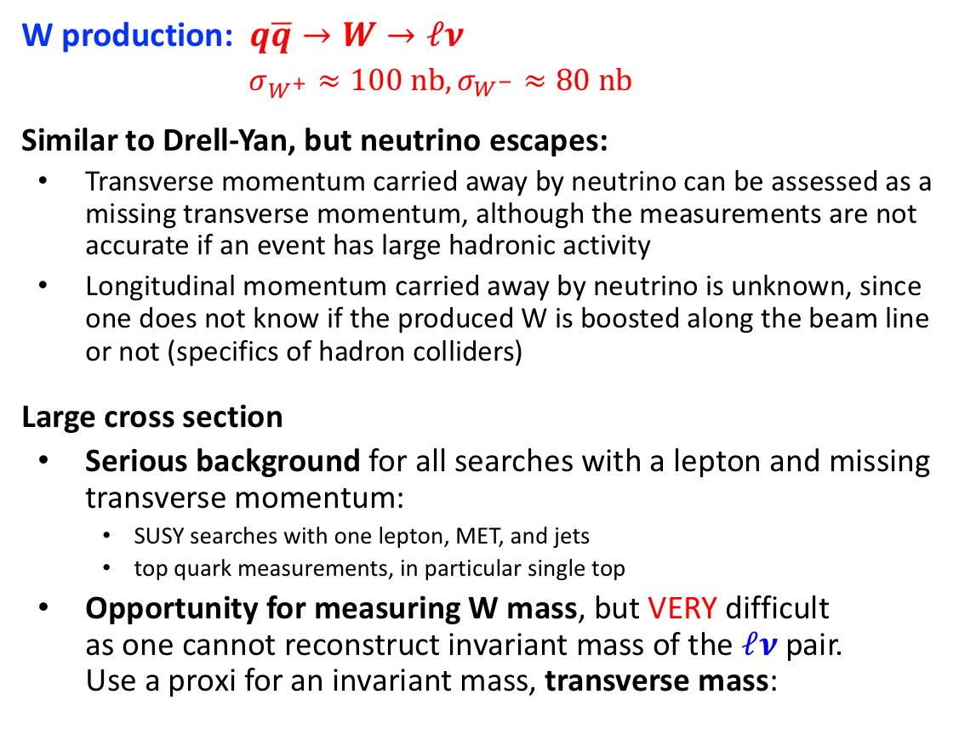
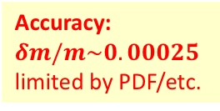
W boson
W production: $q\overline{q}→W→ℓν$
$σ_{W^{+}}≈100 nb, σ_{W^{−}}≈80 nb$
Similar to Drell-Yan, but neutrino escapes:
  Transverse momentum carried away by neutrino can be assessed as a missing transverse momentum, although the measurements are not accurate if an event has large hadronic activity
  Longitudinal momentum carried away by neutrino is unknown, since one does not know if the produced W is boosted along the beam line or not (specifics of hadron colliders)
Large cross section
  Serious background for all searches with a lepton and missing transverse momentum:
    SUSY searches with one lepton, MET, and jets
    top quark measurements, in particular single top
  Opportunity for measuring W mass, but VERY difficult as one cannot reconstruct invariant mass of the $ℓν$pair. Use a proxi for an invariant mass, transverse mass:
HW: Why different?
Estimate the fraction of Ws produced in collisions of sea quarks only.
Accuracy:
$$δm/m\sim 0.00025$$
limited by PDF/etc.
indirect

Slide 12
Top quark production at LHC
Pair production
Single top
Cross sections
(approximately, 13 TeV)
tW production
s-channel
t-channel
PROCESS | PAIR PRODUCTION | SINGLE TOP
 |  | t-channel (tq) | tW | s-channel (tb)
cross section | 840 pb | 200 pb | 80 pb | 10 pb

Slide 13

How do we see top quarks (e.g. di-top events)?
Di-tops ($t\overline{t}$) -- by far the largest top production mechanism for tops
Remember:
  $t→bW ≈$always
  W decays to $eν, μν, τν$ with ~11% probability each
  Dilepton + MET + 2 jets with b-tags: 4%, very clean ($eμ$ – golden!)
  Semi-leptonic + MET + 4 jets, 2 b-tags: 30% (main sensitivity)
  All-hadronic (6 jets, 2 b-tags): 46%, challenging!
  There are also events with taus: used, but not too often…
HW: why 11%?

Slide 14
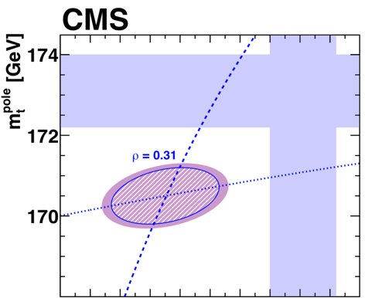

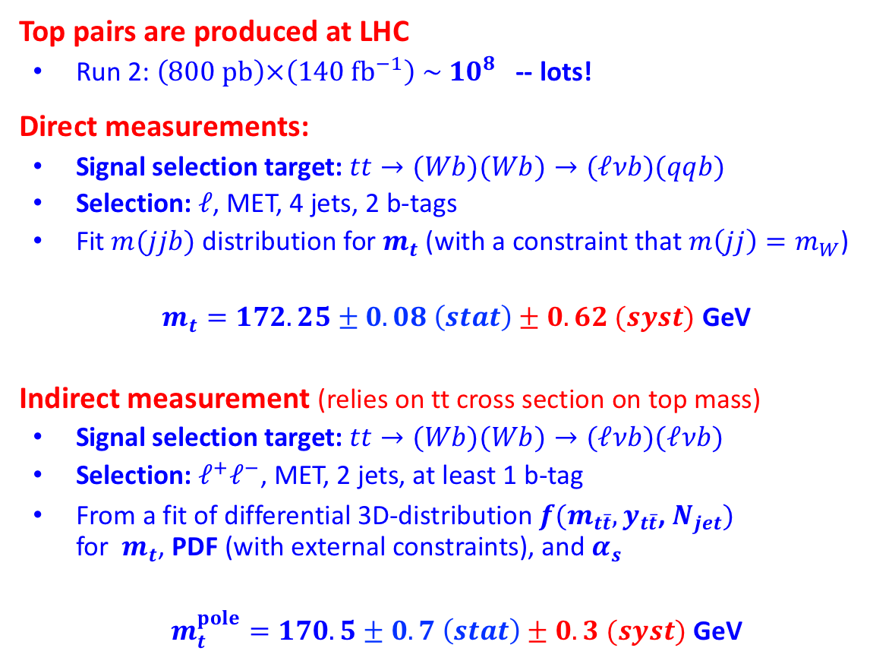
Top quark mass
Eur. Phys. J. C 78 (2018) 891
Top pairs are produced at LHC
  Run 2: $\left(800 pb\right)×\left(140 {fb}^{−1}\right) \sim {10}^{8}$ -- lots!
Direct measurements:
  Signal selection target: $tt→(Wb)(Wb)→(ℓνb)(qqb)$
  Selection: $ℓ$, MET, 4 jets, 2 b-tags
  Fit $m(jjb)$distribution for $m_{t}$(with a constraint that $m\left(jj\right)=m_{W}$)
  $m_{t}=172.25±0.08 \left(stat\right)±0.62 (syst)$ GeV
Indirect measurement (relies on tt cross section on top mass)
  Signal selection target: $tt→(Wb)(Wb)→(ℓνb)(ℓνb)$
  Selection: $ℓ^{+}ℓ^{−}$, MET, 2 jets, at least 1 b-tag
  From a fit of differential 3D-distribution $f(m_{t\overline{t}}, y_{t\overline{t}}$, $N_{jet})$ for $m_{t}$, PDF (with external constraints), and $α_{s}$
  $m_{t}^{pole}=170.5±0.7 \left(stat\right)±0.3 (syst)$ GeV
arXiv:1904.05237

Slide 15
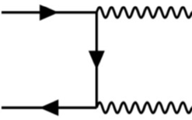
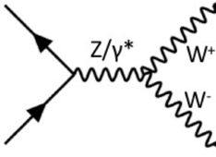
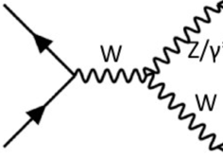
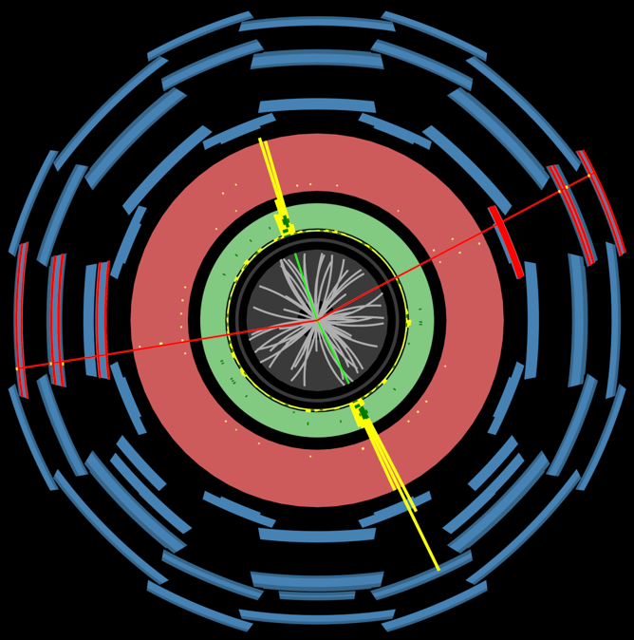
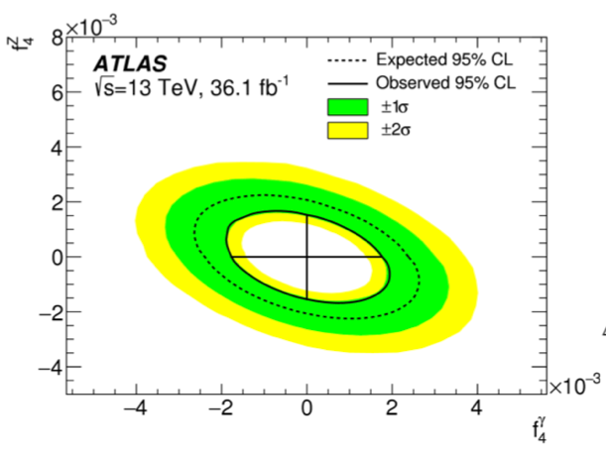
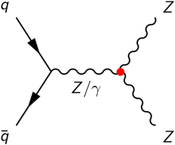
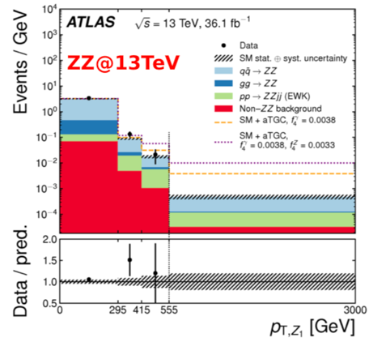


Di-boson production
$pp→VV$, a step down in cross section
$$σ_{WW}=140 pb{, σ}_{WZ}=50 pb{, σ}_{ZZ}=17 pb$$
Still very large, VV – main background in many Higgs boson searches/measurements
Allows one to probe anomalous triple gauge couplings, e.g., $Z→ZZ$ (not present in SM at all)
$$ZZ→(ee)(μμ)$$

Slide 16
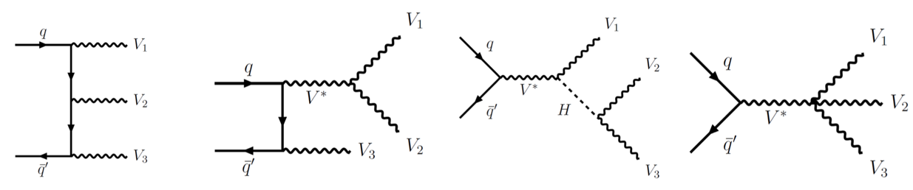
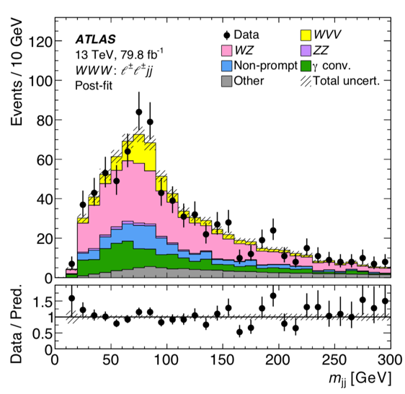
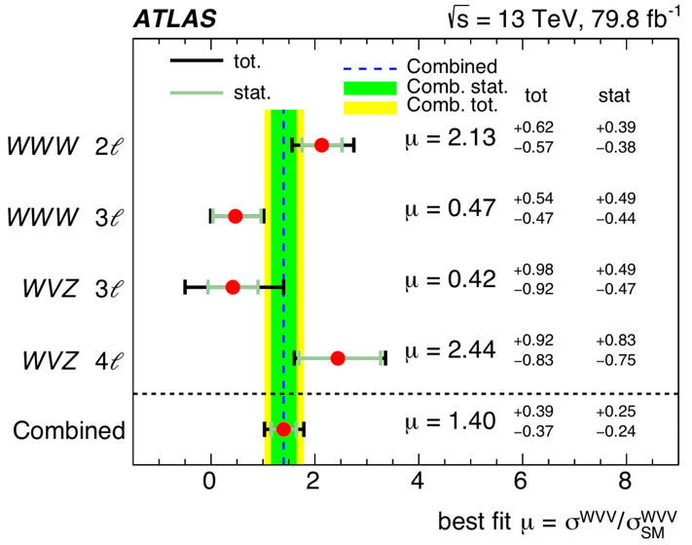




Tri-boson production
$pp→VVV$: very rare process, e.g.:
$$σ_{WWW}=0.50 pb{, σ}_{WWZ}=0.29 pb$$
Still a background to worry about in a number of BSM searches
Provides a probe of quartic boson coupling
Analysis: target a number of VVV
WWW: $ℓ^{±}ℓ^{±}+MET+\left(jj\right)$
WWW: $3ℓ+MET$
WVZ: $Z\left(ℓℓ\right)+ℓ+MET+(jj)$
WVZ: $Z\left(ℓℓ\right)+2ℓ+MET$
Results:
Excess with significance of 4.1$σ$

Slide 17
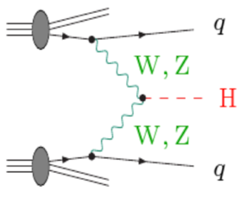


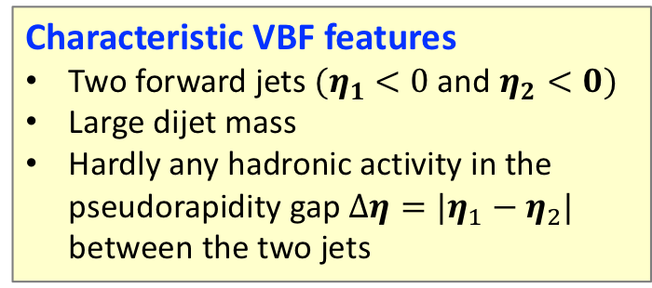

Vector-boson fusion (VBF)
Second largest Higgs boson production cross section
Some Higgs analyses explicitly rely on this production mode
Forward Jet ${(η}_{1})$
Characteristic VBF features
Two forward jets ${(η}_{1} <0$ and $η_{2}<0)$
Large dijet mass
Hardly any hadronic activity in the pseudorapidity gap ${{Δη=|η}_{1}−η}_{2}|$ between the two jets
green
Debris due to color connection
anti-green
UE
W/Z
VBF
W/Z
UE
red
Debris due to color connection
anti-red
Forward Jet ${(η}_{2})$

Slide 18
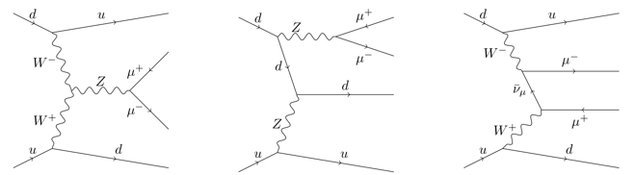
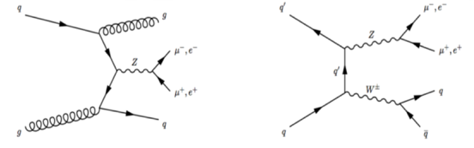
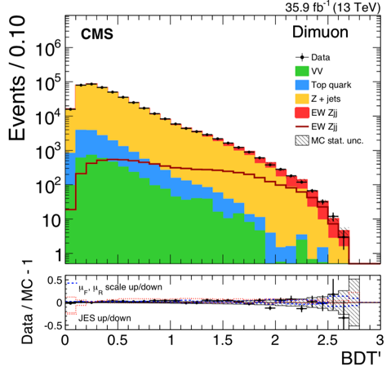
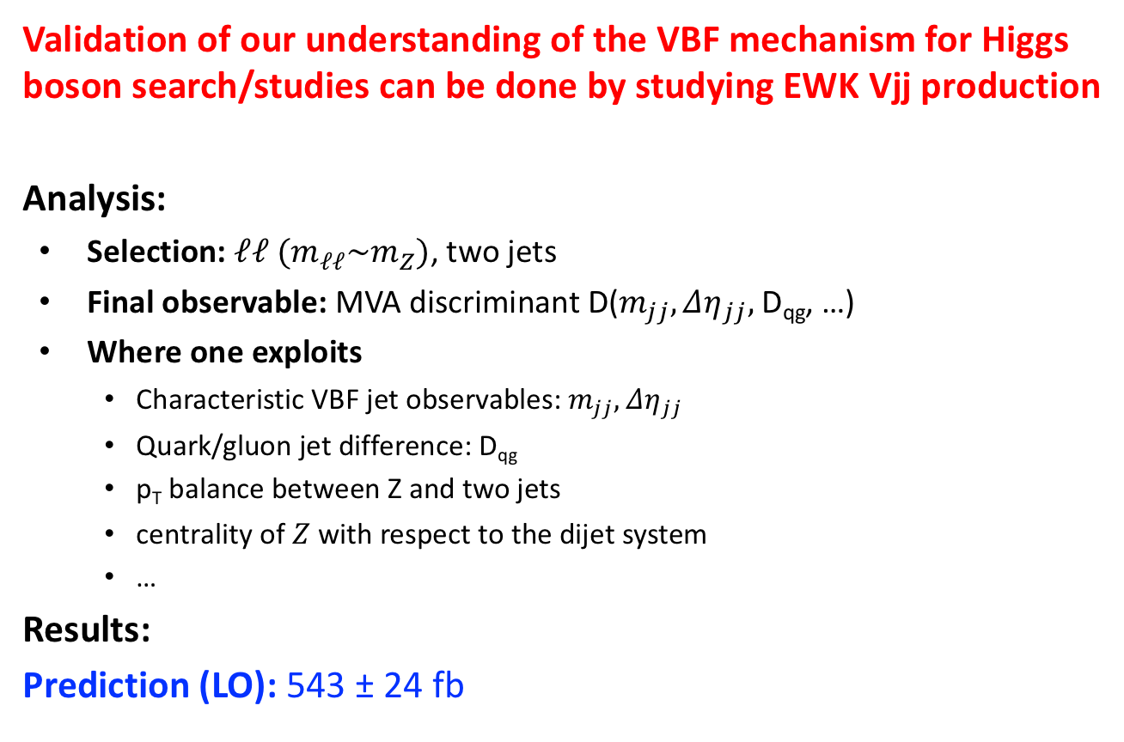
Electroweak Zjj production (no $α_{s}$)
CMS: Eur. Phys. J. C 78 (2018) 589
Validation of our understanding of the VBF mechanism for Higgs boson search/studies can be done by studying EWK Vjj production
Analysis:
  Selection: $ℓℓ (m_{ℓℓ}\sim m_{Z})$, two jets
  Final observable: MVA discriminant D($m_{jj}, Δη_{jj},$D_{qg}, …)
  Where one exploits
    Characteristic VBF jet observables: $m_{jj}, Δη_{jj}$
    Quark/gluon jet difference: D_{qg}
    p_{T} balance between Z and two jets
    centrality of $Z$ with respect to the dijet system
    …
Results:
Prediction (LO): 543 ± 24 fb
signal
(+interference)
HUGE backgrounds to worry about
Jets:
p_{T}>25 GeV, m_{jj}>120 GeV

Slide 19
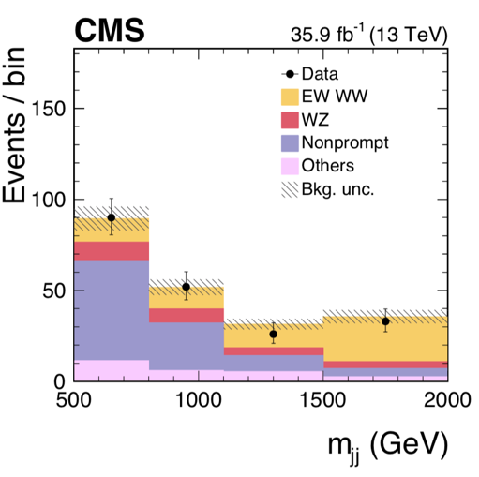

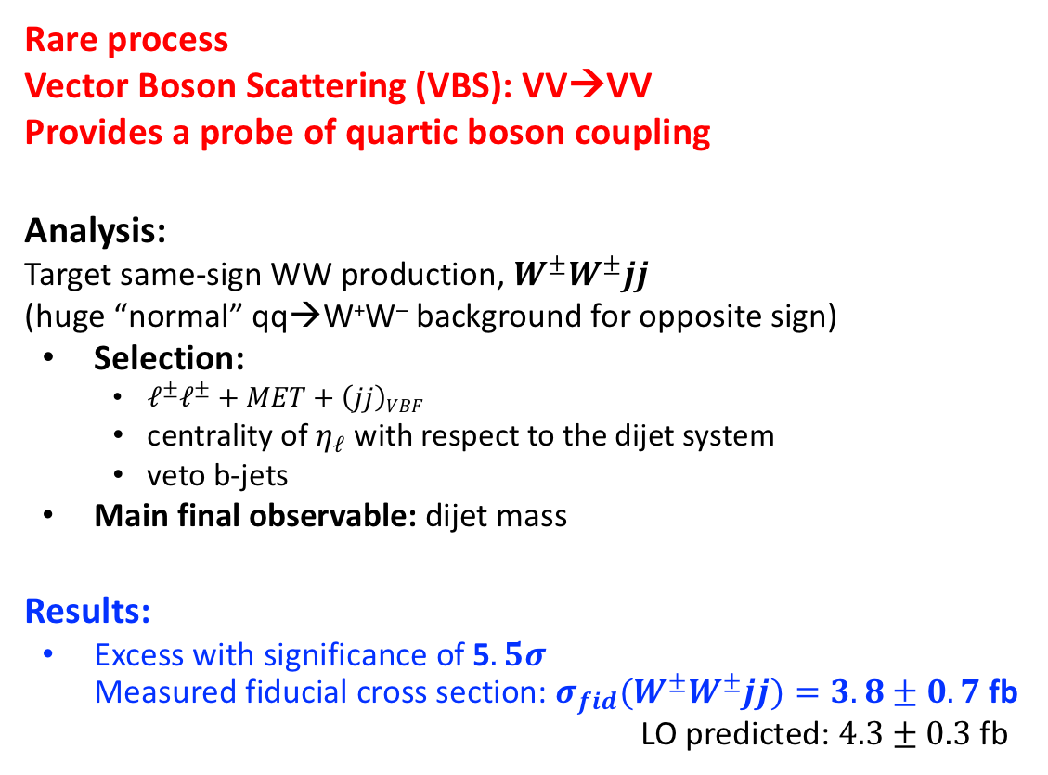
Electroweak VVjj production (no $α_{s}$)
PRL 120 (2018) 081801
Rare process
Vector Boson Scattering (VBS): VV→VV
Provides a probe of quartic boson coupling
Analysis:
Target same-sign WW production, $W^{±}W^{±}jj$
(huge “normal” qq→W⁺W– background for opposite sign)
  Selection:
    $ℓ^{±}ℓ^{±}+MET+\left(jj\right)VBF$
    centrality of $η_{ℓ}$ with respect to the dijet system
    veto b-jets
  Main final observable: dijet mass
Results:
  Excess with significance of 5$.5σ$ Measured fiducial cross section: $σ_{fid}(W^{±}W^{±}jj)=3.8±0.7$ fb
  LO predicted: $4.3±0.3$ fb
Vector Boson Scattering (VBS)
Electroweak VVjj production
Background
Fiducial volume
two leptons
two jets

Slide 20
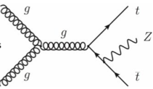
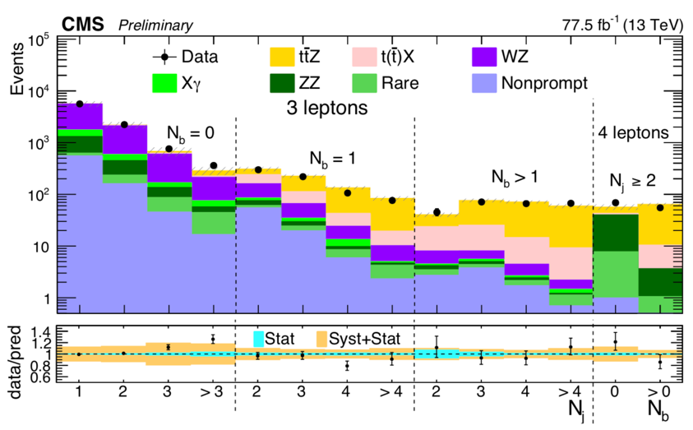
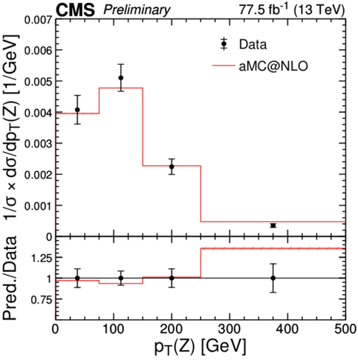

$$pp→ttZ$$
CMS-PAS-TOP-18-009
  Rare SM process: ~0.84 pb (NLO)
  Calibration of theoretical predictions for $pp→ttH$
  Can be enhanced in many BSM scenarios
  Analysis:
  three or four leptons, with proper charge/flavor combinations
  Only one pair has m(ll)~m_{Z}
  N jets, n b-tags
  Categorization based on numbers of jets and b-tags
  Main backgrounds: ZV, tt+X (e.g., ttW)

Slide 21
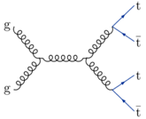
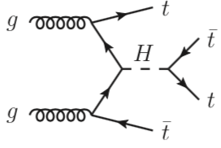


Search for $pp→tttt$ (yes, 4 tops!)
SM cross section (NLO): 12 fb
not yet observed
important background in many BSM searches
Analysis (full Run 2 dataset):
  Selection:
    two same-sign leptons, three leptons
    MET
    5 (4) or more jets
    2 or more b-tags
    Large HT (“transverse energy” of all hadronic activity)
  Main backgrounds: tt with a “fake” lepton, ttV
Results:
  Excess with significance of 2.4$σ$ [cannot claim an observation yet, but are getting close]
  Measured cross section: ${12.6}_{−5.2}^{+5.8}$ fb, <22.5 fb at 95% CL
  Constraints on top Yukawa coupling: $y_{t}$<1.7 at 95% CL [second diagram with Higgs contributes significantly for $y_{t}$ > 1]

Slide 22


Any discrepancies?
Yes, a few here and there, but not too disturbing yet…
  Top p_{T} (softer than predicted)
  We see it since Run 1, no one can chase the reason (experimentalists, theorists)
  ttbb production (higher than predicted)
  important background in
  many searches, e.g. tt+H(bb)
CMS-PAS-TOP-18-11

Slide 23
Higgs boson
the 125-GeV Higgs boson that is

Slide 24
Higgs boson
A very special particle of SM (it is not just yet another SM particle)
  Higgs mechanism is the most elegant way to generate masses of all other particles (in SM, one cannot introduce particle masses by hand without breaking everything)
  Higgs potential is very unusual - minimum of energy is achieved in presence of Higgs field (and, hence, vacuum must be literally packed with Higgs field)
  Higgs boson is the only fundamental scalar in SM (while scalars are not particularly friendly fields in QFT; e.g., loop corrections to its mass diverge quadratically, not logarithmically)

Slide 25
Higgs boson physics at LHC
Establish existence of a Higgs boson – achieved in 2012
Measure its mass (not predicted by theory)
Measure its spin-parity properties (predicted by SM)
Measure its couplings from studying various production and decay modes (predicted by SM)
Deviations of these measurements from the theory would be a signal for BSM physics
Look for exotic (forbidden by SM) production and decay modes
Look for additional Higgs bosons (certainly, BSM physics)

Slide 26





SM Higgs boson
In SM, there is only one Higgs boson:
  it is elementary
  spin – zero
  parity – even
  mass – free parameter
  its tree-level couplings to fermions (f), W/Z bosons (V), as well as trilinear (HHH) and quartic couplings (HHHH, HHVV) – defined by particles’ masses: the heavier the particles, the larger the coupling
  Higgs boson decay modes and BRs are set by its mass and couplings:
    Higgs boson “prefers” to decay to the heaviest particles it can decay to
    Decays to zero-mass particles ($γγ$, Z$γ$, gg, etc.) are also possible via loops
  Couplings also define the dominant productions mechanisms:
    one needs to produce a heavy particle first, to which Higgs boson couples willingly
    that heavy particle can actually be virtual and not present in the final state

Slide 27




Higgs boson production
  Couplings define the dominant productions mechanisms:
    one needs to produce a heavy particle first, to which Higgs boson couples willingly
    that heavy particle can actually be virtual and not present in the final state
m_{H} > 2m_{t}
gluon fusion (ggF)
(loop induced)
vector boson fusion (VBF)
associate with Z/W (VH)
associate with tt (ttH)

Slide 28






Higgs boson decays
  Higgs boson decay modes and branching fractions are set by its mass and couplings:
      Higgs boson “prefers” to decay to the heaviest particles it kinematically can decay to
      Decays to zero-mass particles ($γγ$, Z$γ$, gg, etc.) are also possible via loops
Branching fractions
Higgs width
larger phase space
loop induced H → $γγ$
H->VV thresholds

Slide 29

2011: Implications of not seeing Higgs boson early
Not seeing a Higgs boson
in the entire meaningful mass range
with production cross section < 2 x $σ$_{SM} implies
there are only 3 SM-like fermion generations

Slide 30





2011: Implications of not seeing Higgs boson early
Gluon fusion with the top quark in the loop is
the dominant Higgs boson production mechanism
BACK OF ENVELOPE:
For heavy quark of mass m (m>m_{H}), the amplitude is suppressed as 1/m
Higgs coupling to the quark is proportional to m, $λf$ ~ m
So, for a heavy quark loop, the amplitude is approximately independent of the quark’s mass m
Should there be a fourth generation of SM-like fermions,
In addition to the top quark t there would be two more heavy quarks, T and B.
However heavy T and B might be (and hence not seen directly), each of them would give its own contribution to the production amplitude very similar in magnitude to that due to the top quark.
The production amplitude then becomes 3 times larger.
The production cross section then becomes 9 times larger (wow!)
$$gs$$
m
$$λf$$
$$gs$$

Slide 31



2012: Discovery of the Higgs boson with mass near 125 GeV

Slide 32








H(125) production modes (pb)
 | ggF | VBF | WH | ZH | bbH | ttH | tHq | tHW
8 TeV | 19.5 | 1.60 | 0.70 | 0.42 | 0.20 | 0.13 | 0.019 | 0.0012
13 TeV | 44.1 | 3.78 | 1.37 | 0.88 | 0.49 | 0.51 | 0.074 | 0.0029
ratio | 2.3 | 2.4 | 2.0 | 2.1 | 2.5 | 3.9 | 3.9 | 2.4
ggF - loop induced
How accurate are these predictions?
[LHC Higgs Cross Section Working Group]
WH (3%)
ZH (2%)
bbH (1%)
Process | Perturbative calc. order | Theory | Parametric ($α_{s}$) | PDF
ggF | N³LO QCD + NLO EW | $$\sim 5\%$$ | $$\sim 3\%$$ | $$\sim 2\%$$
VBF | NNLO QCD + NLO EWK | $$\sim 0.4\%$$ | $$\sim 2\%$$
WH | NNLO QCD + NLO EWK | $$\sim 0.5\%$$ | $$\sim 1\%$$
ZH | NNLO QCD + NLO EWK | $$\sim 3\%$$ | $$\sim 2\%$$
ttH | NLO QCD + NLO EWK | $$\sim 8\%$$ | $$\sim 2\%$$ | $$\sim 3\%$$
VBF (7%)
ttH (1%)
ggF (86%)

Slide 33





H(125) production-decay modes
 | bb | WW | ττ | cc | ZZ | γγ | Zγ | μμ | gg + …
all | 58% | 21% | 6.3% | 2.9% | 2.6% | 0.23% | 0.15% | 0.022% | 9%
leptonic |  | 1.0% |  |  | 0.012% |  | 0.010%
Highlighted in red
are experimentally
established decays
loop induced $H→γγ$
cc (3%)
ZZ (3%)
γγ (0.2%), Zγ (0.2%), μμ (0.02%)
gg + other
(9%)
ττ (6%)
WW (21%)
The most prolific decay is $H→bb$ (about 60%), also very hard to observe
The most sensitive channels for observation are $H→ZZ→4l$ and $H→γγ$
bb (58%)
How accurate are these predictions?
Typically 1-2%, more accurate than production cross sections
[LHC Higgs Cross Section Working Group]

Slide 34
Analyses targeting specific Higgs boson decay modes

Slide 35

Event categorization
All analyses use event categorization, based on
  decay final states (e.g. H->ZZ->4l: 4e, 4$μ$, 2e2$μ;$ H->$ττ:$…, etc)
  quality of particles in the decay (e.g. photons)
  production mode tags (e.g. VBF-like jet pair, Z(ll) for ZH, etc)
Different categories have different S/B ratios, which helps improve search sensitivities and measurement accuracies
Production mode tags help disentangle contributions of different production mechanisms

Slide 36
$$H→ZZ^{∗}→4ℓ$$
Run 2: σ×B×L = 850 events
Analysis features to note:
low event yield: 850
best final S/B-ratio, better than 2:1
good mass resolution = 1-2%
Best channel to observe Higgs at 125 GeV (due to excellent S/B ratio, despite of low yield)
Best for Higgs mass measurement (very small systematics for muons)
Best for studying Higgs J^{P} properties (fully reconstructed four-body final state)
Best for studying Higgs width via ratio of off-shell to on-shell production rates
Second-best for measuring cross sections (after the diphoton channel)

Slide 37

$H→ZZ^{∗}→4ℓ$: analysis strategy
most forward lepton
four leptons ranked by p_{T}
Selection: four leptons (low p_{T} and forward leptons important!)
BUT: pp-collisions have plenty of leptons, real and fake, produced in jets!
Selection: require all four photons to be isolated and not displaced wrt IP. This will kill most of such background; it is hence called “reducible”
BUT: there is still large “irreducible” background, e.g. pp->ZZ->4l
Invariant mass of such four leptons will be all over the place
Selection: look for a narrow peak (dm/m = 1%) in four-lepton mass distribution
signal
“irreducible”
remnants of “reducible”

Slide 38





$H→ZZ^{∗}→4ℓ$: analysis strategy
”Irreducible” background $pp→ZZ/Z→4ℓ$ (no Higgs) has a very non-trivial shape (compared to, e.g., diphoton)
However: Being an EW process, it is well understood and calculable at NLO (+ NNLO gg->ZZ) with a few percent overall residual uncertainty

Slide 39





$H→ZZ^{∗}→4ℓ$: analysis strategy
”Reducible” background with one ore more leptons coming from jets (Z+jets, WZ+jet, tt), but sneaking the lepton selection cuts: probability of ”a jet faking a tight lepton” is not a trivial matter (one cannot trust MC)
Devise a data driven prediction using Tight-To-Loose Method:
1) measure probability ε for a non-prompt lepton to pass tight selection; use Z+(loose lepton) events
4) Solve for N₂₊₂ and N₃₊₁
5) Predict reducible bkg in the signal 4-Pass region:
N_{4P} = N₂₊₂ × ε² + N₃₊₁ × ε
2) Measure number of events in 2-Pass-2-Fail control region: N_{2P2F} = N₂₊₂ × (1-ε)²
N₂₊₂ - unknown # of events with 2 prompt and 2 non-prompt leptons
6) To validate the method,
Do it all over again for four-lepton events with wrong charge-flavor combinations
3) Measure number of events in 3-Pass-1-Fail control region: N_{3P1F} = N₂₊₂ × 2ε(1-ε) +
N₃₊₁ × (1-ε)
N₃₊₁ - unknown # of events with 3 prompt and 1 non-prompt leptons

Slide 40


$H→ZZ^{∗}→4ℓ$: analysis strategy
Introduce 2nd observable
Matrix Element (ME) based discriminant D_{bkg}
that helps separate signal from background
Use the ratio of LO matrix elements (A)
for H->ZZ->4l and qq->ZZ->4l as an
additional discriminating observable
For a practical convenience,
D is monotonically transformed
to be constrained between 0 and 1
Search for signal and do measurements in a 2D-pane: (m_{4l}, D)
Improvements:
in signal observation sensitivity: ~ 20%
in measuring cross sections – much smaller
HW: why improvements are so different?

Slide 41


$H→ZZ^{∗}→4ℓ$: analysis strategy
Introduce 2nd observable
Matrix Element (ME) based discriminant D_{bkg}
that helps separate signal from background
Use the ratio of LO matrix elements (A)
for H->ZZ->4l and qq->ZZ->4l as an
additional discriminating observable
For a practical convenience,
D is monotonically transformed
to be constrained between 0 and 1
Search for signal and do measurements in a 2D-pane: (m_{4l}, D)
Improvements:
in signal observation sensitivity: ~ 20%
in measuring cross sections – much smaller
Intuition: For m_{4l} around mH=125 GeV,
the signal-bkg discrimination is mostly due to the distribution of Z* mass. If Z is on-shell (most of the time), m(Z*) is bound to be lower than 35 GeV.
For bkg, “Z*” is then mostly $γ^{∗}$ and tends to be low
For signal, “Z*” has to be Z* and tends to be high
HW: why improvements are so different?

Slide 42


$H→ZZ^{∗}→4ℓ$ production: a subset results
$$μ=$$
All “event rate” measurements agree with the SM predictions

Slide 43



$H→ZZ^{∗}→4ℓ:$ Higgs mass measurement prerequisites
Per-event four-lepton mass resolution
  Four-lepton mass measurement uncertainty varies from event to event by as much as a factor of 3 for worse/best. It depends on how well lepton momenta are measured in a given event.
  Assign each event its own four-lepton mass uncertainty
  Validate understanding of per-event uncertainties using Z->ll events
Per-event ”Z₁” mass constraint
  “Z” in $H→ZZ^{∗}→4ℓ$is mostly an on-shell Z
  in each event, a pair of leptons with mass closest to Z is called a Z₁ pair
  Refit momenta of these two leptons by taking into account pdf_{Z1}(m_{ll}); this improves both measurements of lepton momenta and their uncertainties

Slide 44





$H→ZZ^{∗}→4ℓ:$ Higgs mass measurement
Mass measurement:
Three event categories: $4μ, 2e2μ, 4e$
Momenta of two leptons forming Z₁ are refit using pdf_{Z1}(m_{ll})
Fit is performed for m_{H} in 3D space: pdf$\left(m_{4l},D_{bkg}^{kin},σ_{m_{4l}} | m_{H}\right)$
With respect to using just mass distribution
  Z₁-refit improves m_{H} measurement by 10%
  per-event four-lepton uncertainties -- by 8%
  ME-based discriminant (signal-vs-background) -- by 3%
Run 2, 2016 result: $m_{H}=125.26±0.21=125.26±0.20\left(stat\right)±0.08\left(syst\right)$ GeV
This is the best Higgs boson mass measurement at the moment
Run 1
ATLAS+CMS ZZ+$γγ$ combination
125.09 $±$0.24 GeV
2016 dataset | H->ZZ->4l | H->$γγ$ | Combination
ATLAS | 124.79 $±$0.37 | 124.93 $±$0.40 | 124.97 $±$0.24
CMS | 125.26 $±$0.21 | 125.4 $±$0.3
Awaiting updates with full Run 2 dataset (stat errors are expected to improve by a factor of 2: $±$0.10)
HL-LHC: stat error will improve by a factor of 10: ~20 MeV
One needs to improve systematics proportionally to about 10 MeV, or 0.01% – huge challenge!

Slide 45



$H→ZZ^{∗}→4ℓ:$ Higgs boson mass implications (fun stuff)
Vacuum stability:
With no BSM up to the Plunk scale, the top quark and Higgs boson masses seem to imply we may be leaving in a metastable universe – what?!
If you about to get scared, you can relax a bit: with m_{t} = 173 GeV and m_{H} = 126 GeV, τ_{transition} ~ 10⁵⁸⁸ T_{Universe}
MSSM constraints:
In MSSM, at tree level, Higgs mass m_{H}<m_{Z}.
One can boost it somewhat higher (up to as much as 130 GeV or so) via loop corrections
Mass m_{H}=125 is fairly large and sets interesting constraints on the average mass of two stop quarks (SUSY partners of the top quark).
Degrassi et al. 2012
Hieu et al. 2017
$$m_{H}=125.1±5\left(0.24\right) GeV (very generous!)$$
$$tanβ=10 \left(very weak dependence\right)$$
$$μ=500 GeV (Higgsino masses, not yet excluded)$$

Slide 46




Spin-parity (J^{P}) properties
SPIN (J)
Spin – internal quantum number of a particle; its internal angular momentum. It is quantized, $J=\frac{1}{2}ℏ∙n$
Experimentally, we see $H→γγ$ decays:
Spin must be integer (it is a boson)
Spin cannot be 1 by the Landau-Yang theorem (a massive spin-1 particle cannot decay to two photons)
Can spin be 0?
Yes. In fact, for SM Higgs boson, J=0.
Can spin be 2?
Many theorists say don’t bother; a massive spin-2 particle cannot be elementary (QFT is a mess otherwise)
Experimentalists say… we must check
PARITY (P)
Parity -- internal quantum number of a particle, like its spin Allowed values: $P=±1 (or even/odd$)
Symmetry upon reflection in a mirror ($x→−x$)
For SM Higgs boson, P=+1, it is a scalar (as opposed to pseudo-scalar)
x → –x
P = +1
x → –x
P = –1

Slide 47







$H→ZZ^{∗}→4ℓ:$ Spin-Parity and more!
For a spin-0 boson, the most general amplitude describing its on-shell decay to two vector bosons (V) of mass m_{V} can be translated in the following effective Lagrangian:
SM Higgs 0⁺ ($κ=1)$
[tree level decays]
scalar 0⁺, decays via loop,
In SM, $α\sim β\sim O({10}^{−2})$
pseudo-scalar 0–, decays via loops,
In SM, appear only at 3-loop level, $γ\sim O\left({10}^{−11}\right)$
If exists (larger than SM), this term would provide
an additional source of CP violation
For a spin2 boson, the number of distinct terms is more than twice larger…

Slide 48


$H→ZZ^{∗}→4ℓ:$ Spin-Parity and more!
Essential kinematics of a four-lepton final state can be fully described by 7 observables.
Distributions and correlations of these observables are sensitive to the presence of all underlying decay amplitude terms.
With all four leptons reconstructed, one can identify which distinct terms are responsible for decays – this goes beyond just spin-parity study
Overall, this is reminiscent of the classic π⁰ → γ*γ* → 4e studies
4 leptons x (p_{x}, p_{y}, p_{z}) = 12
COM frame: P_{x}=0, P_{y}=0, P_{z}=0 (-3)
Phi rotation of the entire system is not essential: (-1)
E in COM frame = m_{H}: (-1)
-----------------------------------
12 - 3 - 1 - 1 = 7
Usually, these observables are:
5 angles shown in the figure +
invariant mass of dileptons associated with each V.
data agree with pseudoscalar hypothesis,
scalar excluded at 3.6σ
fractional scalar amplitude admixture < 0.033

Slide 49



$H→ZZ^{∗}→4ℓ:$ Spin-Parity studies methodology
In nut shell:
Construct a LO ME-based discriminant D of, e.g., pseudoscalar vs scalar. It is an observable calculated using momenta of four leptons (e.g., using CompHEP, JHGen, MadGraph – all the same, of course)
Simulation of Higgs H(0⁺) or X(0–) gives one pdf(D|H) and pdf(D|X)
For all events from the signal peak, build a test statistics (one number for the entire set of observed events)
$$q=2ln\prod{\frac{pdf(D_{i}|H)}{pdf(D_{i}|X)}}$$
The larger observed q, the more like the decaying particle is H(0⁺)
Simulation of H and X events can be used to quantify the consistency of the observed q with one or another hypothesis
H(0⁺)
X(0–)
PLOT: Test of X(0–) vs H(0⁺) in Run 1:
Observed q agrees with H(0⁺)
Pure X(0–) is excluded with 99.9% CL
By now,
all other pure J=0 and J=2 decay amplitudes
are excluded as well in one by one test against H(0⁺)
Studies continue to look for possible small contributions of exotic terms to the main SM Higgs term
E.g., $−0.19<γ/κ<0.21$, using datasets of Run 1 and 2017 + 2018 Run 2 in combination

Slide 50











$H→ZZ:$ Γ_{H} from off-shell to on-shell production
Breit-Wigner production $pp→H→ZZ$
On-peak cross sections:
Off-peak cross sections:
Off-peak to on-peak ratio
on-shell peak: $height\sim \frac{1}{Γ_{H}^{2}}$,
$width\sim Γ_{H}$
$$m_{H^{∗}}>{2m}_{Z}$$
both Z bosons
are on-shell
$$m_{H^{∗}}>{2m}_{t}$$
Effective coupling
to gluons increases
F(m) depends on:
huge boost for $m_{H^{∗}}>{2m}_{Z}$(both Z bosons are now on-shell)
Hgg coupling $g_{g}^{2}$ evolution (notice the bump for $m_{H^{∗}}>{2m}_{t}$)
partonic gg-luminosity drives F(m) down
tensor structure Hgg coupling (non-SM couplings tend to give a large boost to off-shell production)

Slide 51




$H→ZZ:$ Γ_{H} from off-shell to on-shell production
The picture gets more complicated due to interference with non-resonant gg→ZZ
Signal $gg→H→ZZ$
Non-resonant $gg→ZZ$
The two amplitudes have negative interference
Assuming constant yield for on-shell events, the event yield in the tail changes with Higgs width as
$N \sim 1−2α\sqrt{Γ}+α^{2}Γ$
RESULTS (ZZ$→$4l/2l2v; Run 1 + 2017+2018):
=
Compare to SM Higgs Γ_{H} = 4.0 MeV
[95% Conf. Interval]

Slide 52

Summary
SM measurements at LHC
  fundamental constants ($as,mt, mW$)
  possible deviations may signal something new and give directions for more targeted searches
  validation of our understanding of SM process rates is the prerequisite for BSM searches
Silent discovery of 2011
  there are not a 4th SM-like generation of fermions, even very heavy ones
125-GeV Higgs boson golden channel: $H→ZZ→4ℓ$
  most sensitive for observation
  best for Higgs boson mass measurement
  best for studying Higgs CP-properties
  allows for measuring Higgs boson width

