Slide 1
Lecture 4:
BSM Higgs Physics at LHC
Andrey Korytov
University of Florida
Disclaimer: lectures are meant to be pedagogical,
not a comprehensive review of all recent results

Slide 2
BSM Higgs boson physics: experimentalist’s point of view
Just discovered a new particle (well, seven years ago):
  It may have small deviations in the expected properties
  It also may have spectacularly unusual production and/or decay modes (even forbidden) that one may miss if not looking for them explicitly
  More Higgs bosons?

Slide 3
BSM Higgs boson physics: theorist’s point of view
Standard Model problems (without Higgs)
  gauge invariance principle → carriers of the forces must be massless
  parity violation by Weak force → fermions must be massless
SM Higgs boson – savior of SM
  complex scalar field doublet, Higgs Doublet (HD)
  gauge-invariant under SU(2)_{L}
  Mexican-hat potential
BSM Higgs boson(s)
  one can throw in more scalar fields, why not?
    singlets, doublets, triplets; more than one
    doing so, remarkably, can help address remaining SM problems
  is the 125-GeV Higgs boson elementary?
  BOOM!
  masses for Z/W
  ad hoc masses for fermions
  one physical Higgs boson
  more than one neutral scalar boson
  none has exact same properties of SM H (at least in principle)
  charged, doubly-charged scalar bosons
  Form-factor like couplings of h(125) properties?

Slide 4
More Higgs bosons: why?
Model | What is it good for? | Higgs bosons
SM: one doublet of complex scalar fields (HD) | 3 d.o.f. give mass to W± and Z bosons Yukawa couplings generate fermion masses | h
HD + real singlet | attractive in the context of DM, EWK baryogenesis, … | h, H
HD + 2nd doublet (2HDM: 2 Higgs Doublets Model) | prerequisite for SUSY natural in Grand Unifying Theories additional source of CP violation DM originating directly from 2HDM | h, H, A, H±
2HDM + complex singlet | Used in so-called nMSSM, next-to-minimal Super Symmetry resolves the μ-problem MSSM h(125) is unnaturally heavy in MSSM – not in nMSSM | h₁, h₂, h₃, a₁, a₂, H±
HD + triplet | can provide Majorana neutrino masses | h, H, A, H±, H±±

Slide 5
Before we start
General search strategies
Searches are conducted mostly (but not always) in a model independent ways, even though experimental signatures used are often inspired by some specific models.
Results are then interpreted in the parameter space of this or that model, the choice of which may be dictated by a fashion at the time.
Reminder: Run 2 datasets
~35 fb⁻¹: 2016
~80 fb⁻¹: 2016+2017
~140 fb⁻¹: 2016+2017+2018 (full Run 2)
← majority of results
← Very few
← None yet

Slide 6
Search for new SM-like Higgs bosons
(inspired by HD+S models)

Slide 7
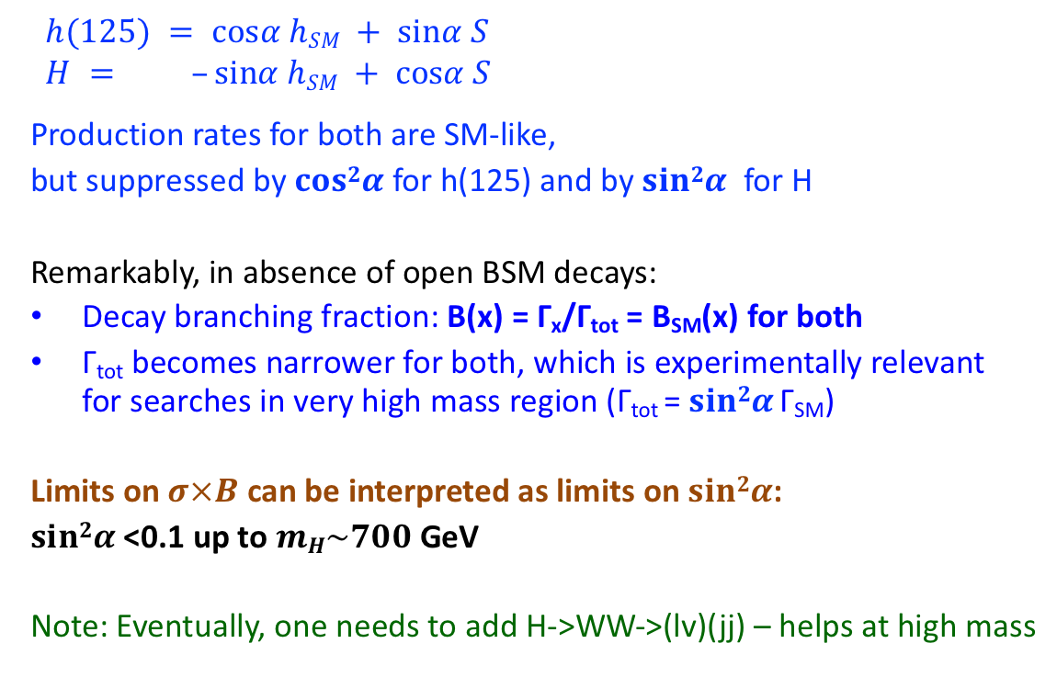
Search for SM-like heavy Higgs boson
ATLAS: xxx
CMS: xxx
Why bother? The inspiration comes from SM+Singlet models, where S does not couple to SM particles, but does mix with the would-be SM Higgs boson h_{SM} to yield two physical states, h and H
  $$h(125) = cosα hSM + sinα S$$
  $$H = –sinα hSM + cosα S$$
  Production rates for both are SM-like,
  but suppressed by $cos2α$ for h(125) and by $sin2α$ for H
  Remarkably, in absence of open BSM decays:
  Decay branching fraction: B(x) = Γ_{x}/Γ_{tot} = B_{SM}(x) for both
  Γ_{tot} becomes narrower for both, which is experimentally relevant for searches in very high mass region (Γ_{tot} = $sin2α$ Γ_{SM})
  Limits on $σ×B$ can be interpreted as limits on $sin2α$:
  $sin2α$<0.1 up to $mH\sim 700$GeV
  Note: Eventually, one needs to add H->WW->(lv)(jj) – helps at high mass

Slide 8
Searches inspired by 2HDM

Slide 9
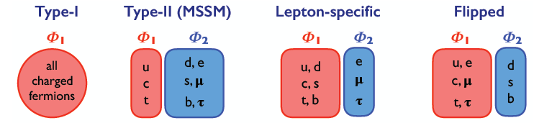
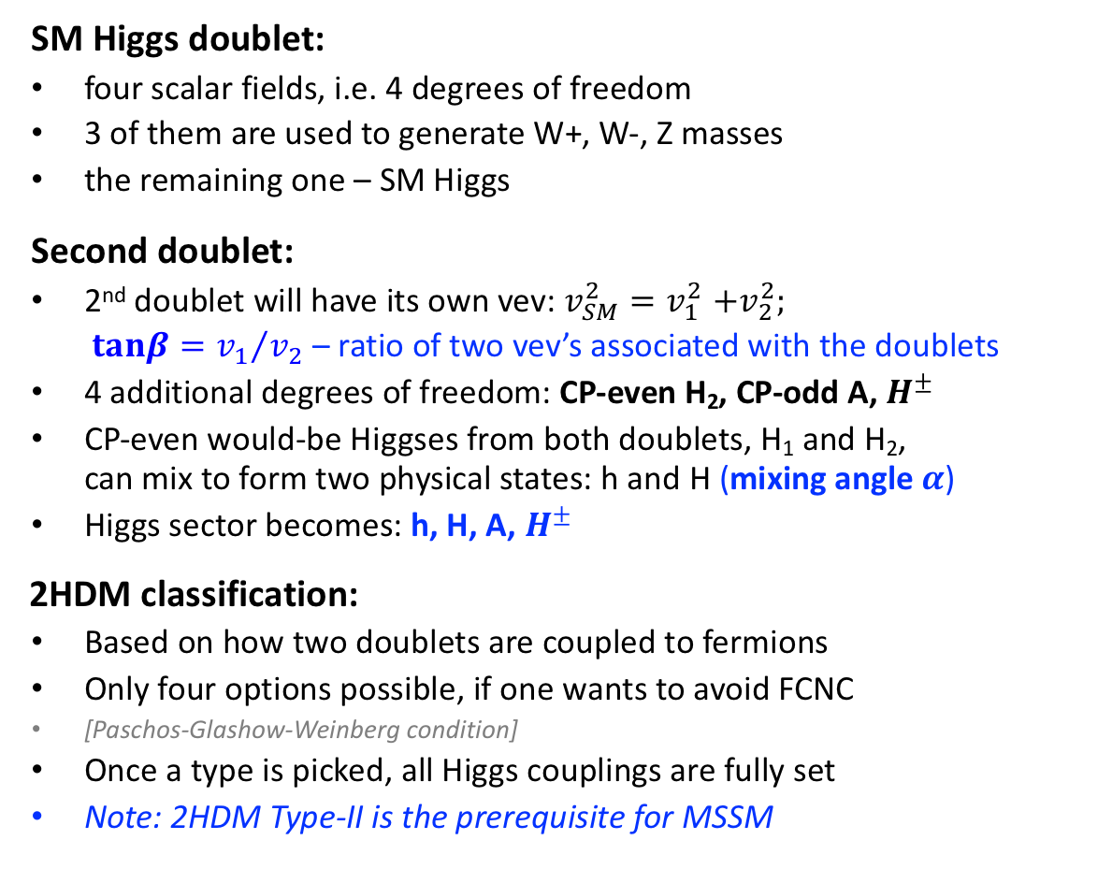
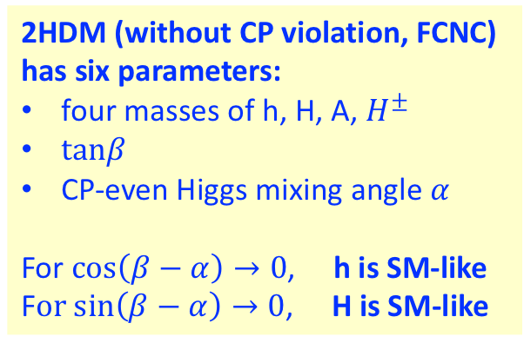
2HDM Phenomenology
SM Higgs doublet:
  four scalar fields, i.e. 4 degrees of freedom
  3 of them are used to generate W+, W-, Z masses
  the remaining one – SM Higgs
Second doublet:
  2nd doublet will have its own vev: $v_{SM}^{2}{=v}_{1}^{2}+v_{2}^{2};$
  $tanβ={v_{1}}/{v_{2}}$ – ratio of two vev’s associated with the doublets
  4 additional degrees of freedom: CP-even H₂, CP-odd A, $H^{±}$
  CP-even would-be Higgses from both doublets, H₁ and H₂, can mix to form two physical states: h and H (mixing angle $α$)
  Higgs sector becomes: h, H, A, $H^{±}$
2HDM classification:
  Based on how two doublets are coupled to fermions
  Only four options possible, if one wants to avoid FCNC
  [Paschos-Glashow-Weinberg condition]
  Once a type is picked, all Higgs couplings are fully set
  Note: 2HDM Type-II is the prerequisite for MSSM
2HDM (without CP violation, FCNC)
has six parameters:
four masses of h, H, A, $H^{±}$
$tanβ$
CP-even Higgs mixing angle $α$
For $cos\left(β−α\right)→0$, h is SM-like
F$or sin\left(β−α\right)→0$, H is SM-like
so-called alignment conditions

Slide 10
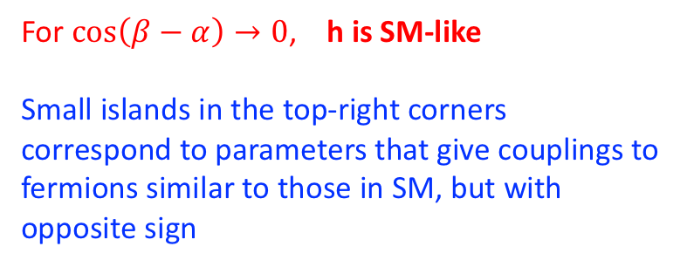
2HDM constraints from the h(125) properties
(i.e. event rates in different SM-like production-decay modes)
For $cos\left(β−α\right)→0$, h is SM-like
Small islands in the top-right corners correspond to parameters that give couplings to fermions similar to those in SM, but with opposite sign

Slide 11
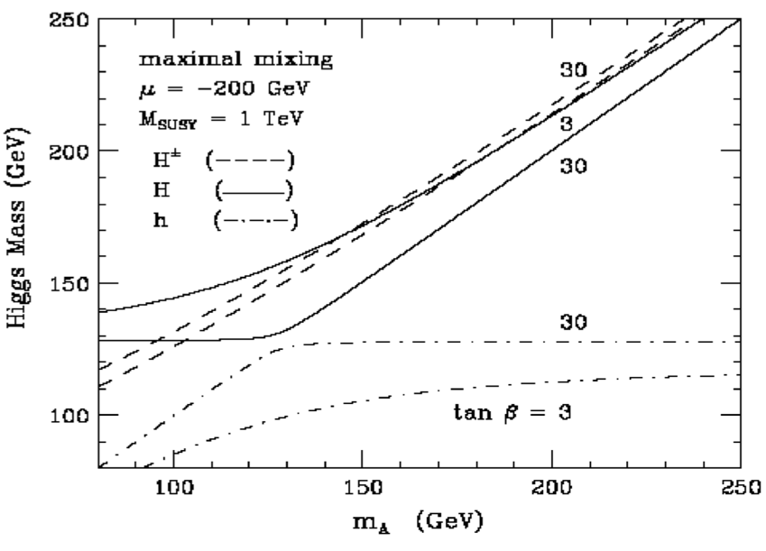
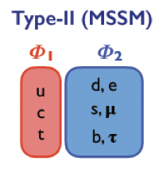
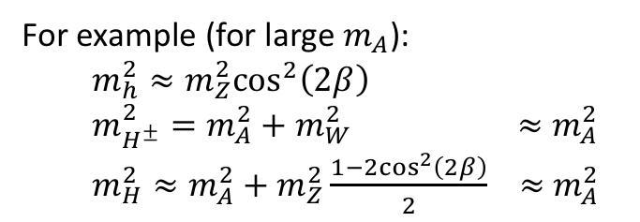




MSSM
2HDM of Type-II is a prerequisite for MSSM:
In MSSM,
quartic coupling $λ$ in Higgs potential is associated with the EWK scale (not a free parameter), which implies that masses of all Higgses are fully predicted at three-level, once one knows $β$ and $α$
Common convention to use tan$β$ and $m_{A}$ as free parameters (instead of $β$ and $α$)
In the limit of large tan$β$,
h is SM-like (large $m_{A}$)
H is SM-like (small $m_{A}$)
Large tan$β$ enhances couplings of A/H higgses to bottom-type fermions
$$Φ_{u}$$
$$Φ_{d}$$
h, H, A, $H^{±}$
For example (for large $m_{A}$):
  $$m_{h}^{2}≈m_{Z}^{2}\cos^{2}\left(2β\right)$$
  $m_{H^{±}}^{2}=m_{A}^{2}+$ $m_{W}^{2} ≈$ $m_{A}^{2}$
  $m_{H}^{2}≈{m_{A}^{2}+m}_{Z}^{2}\frac{1−{2cos}^{2}\left(2β\right)}{2}$ $≈$ $m_{A}^{2}$

Slide 12
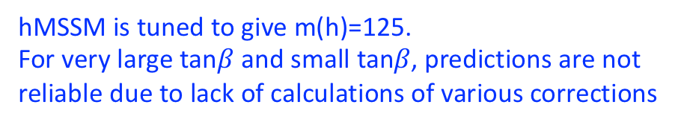
MSSM Higgs sector constraints from the h(125) properties
(i.e. event rates in different SM-like production-decay modes)
hMSSM is tuned to give m(h)=125.
For very large tan$β$ and small tan𝛽, predictions are not reliable due to lack of calculations of various corrections
For large $m_{A}$(and large tan$β),$ h is SM-like
Observed limit is more restrictive than expected
This is because the global fit gives k_{V}>1

Slide 13
Search for new neutral Higgs bosons
(2HDM-inspired)

Slide 14
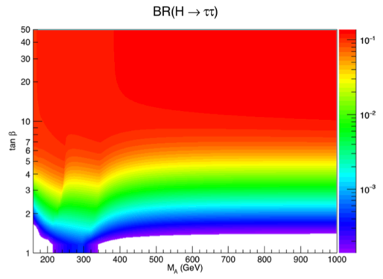
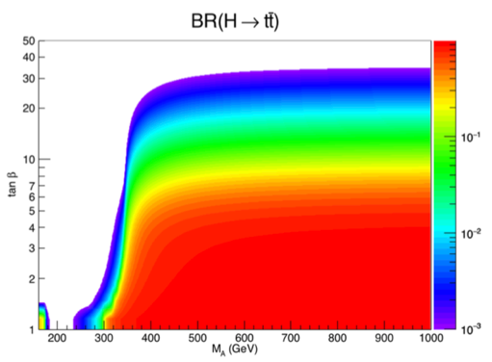
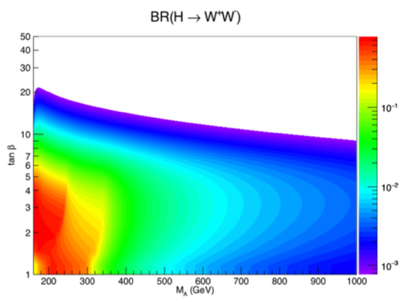
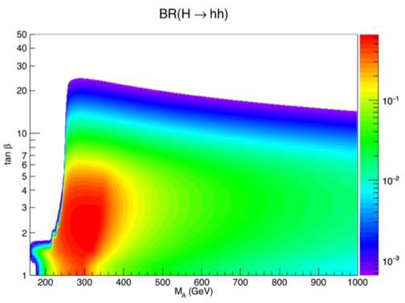
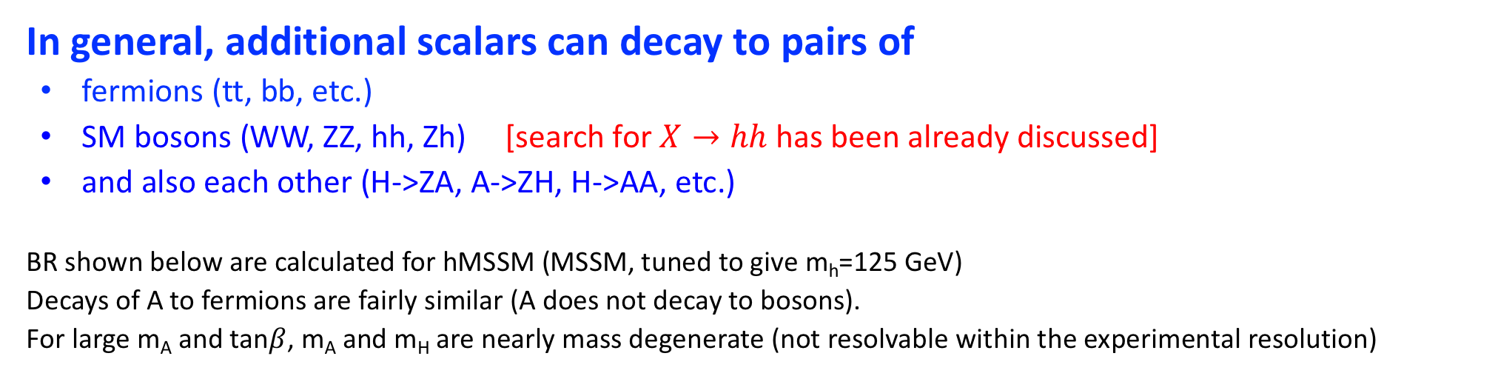
Search for additional neutral Higgs bosons
In general, additional scalars can decay to pairs of
  fermions (tt, bb, etc.)
  SM bosons (WW, ZZ, hh, Zh) [search for $X→hh$ has been already discussed]
  and also each other (H->ZA, A->ZH, H->AA, etc.)
BR shown below are calculated for hMSSM (MSSM, tuned to give m_{h}=125 GeV)
Decays of A to fermions are fairly similar (A does not decay to bosons).
For large m_{A} and tan$β$, m_{A} and m_{H} are nearly mass degenerate (not resolvable within the experimental resolution)
arxiv.org:1502.05653

Slide 15
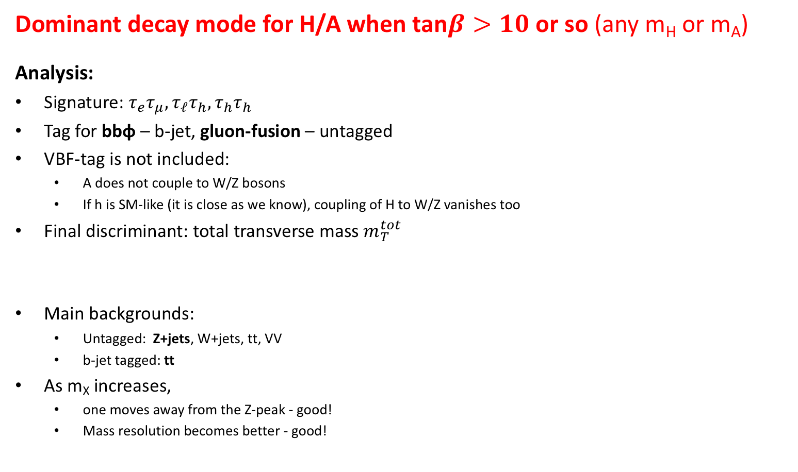

Search for $H/A→ττ$
ATLAS: JHEP 01 (2018) 055
CMS: JHEP 09 (2018) 007
Dominant decay mode for H/A when tan$β>10$ or so (any m_{H} or m_{A})
Analysis:
Signature: ${τ_{e}τ_{μ},τ}_{ℓ}τ_{h},τ_{h}τ_{h}$
Tag for bbφ – b-jet, gluon-fusion – untagged
VBF-tag is not included:
  A does not couple to W/Z bosons
  If h is SM-like (it is close as we know), coupling of H to W/Z vanishes too
Final discriminant: total transverse mass $m_{T}^{tot}$
Main backgrounds:
  Untagged: Z+jets, W+jets, tt, VV
  b-jet tagged: tt
As m_{X} increases,
  one moves away from the Z-peak - good!
  Mass resolution becomes better - good!
SM-like
dominates
for tan$β$>5

Slide 16
Search for $H/A→ττ$
ATLAS: JHEP 01 (2018) 055
CMS: JHEP 09 (2018) 007
MODEL INDEPENDENT

Slide 17
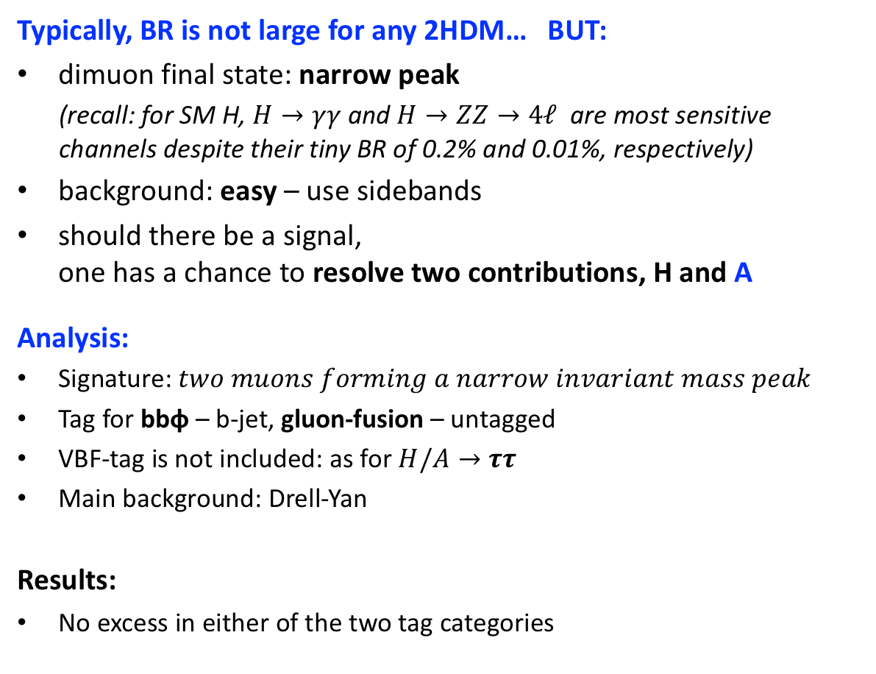
Search for $H/A→μμ$
CMS: CMS-PAS-HIG-18-010
Typically, BR is not large for any 2HDM… BUT:
dimuon final state: narrow peak
(recall: for SM H, $H→γγ$ and $H→ZZ→4ℓ$ are most sensitive channels despite their tiny BR of 0.2% and 0.01%, respectively)
background: easy – use sidebands
should there be a signal, one has a chance to resolve two contributions, H and A
Analysis:
Signature: $two muons forming a narrow invariant mass peak$
Tag for bbφ – b-jet, gluon-fusion – untagged
VBF-tag is not included: as for $H/A→ττ$
Main background: Drell-Yan
Results:
No excess in either of the two tag categories
Example:
signal
m_{A}=400 GeV
unknown rate

Slide 18
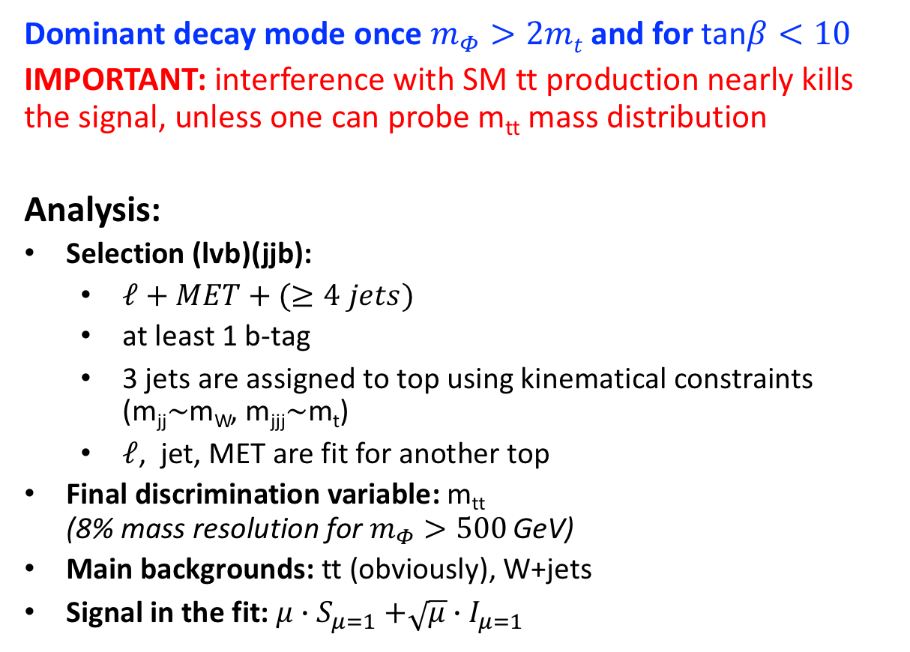
Search for $H/A→tt$
CMS: CMS-PAS-HIG-17-027
ATLAS: PRL 119 (2017) 191803
Dominant decay mode once $m_{Φ}>2mt$and for tan$β<10$
IMPORTANT: interference with SM tt production nearly kills the signal, unless one can probe m_{tt} mass distribution
Analysis:
Selection (lvb)(jjb):
  $ℓ+MET+(≥4 jets)$
  at least 1 b-tag
  3 jets are assigned to top using kinematical constraints (m_{jj}$\sim$m_{W}, m_{jjj}$\sim$m_{t})
  $ℓ$, jet, MET are fit for another top
Final discrimination variable: m_{tt} (8% mass resolution for $m_{Φ}>500$ GeV)
Main backgrounds: tt (obviously), W+jets
Signal in the fit: $μ{∙S}_{μ=1}+\sqrt{μ}∙I_{μ=1}$

Slide 19
Search for $H/A→tt$
CMS: CMS-PAS-HIG-17-027
ATLAS: PRL 119 (2017) 191803

Slide 20
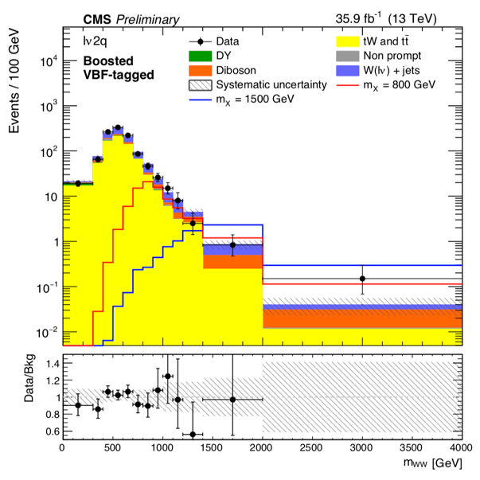
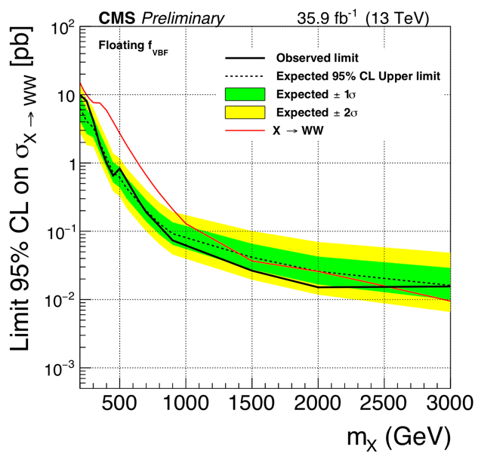
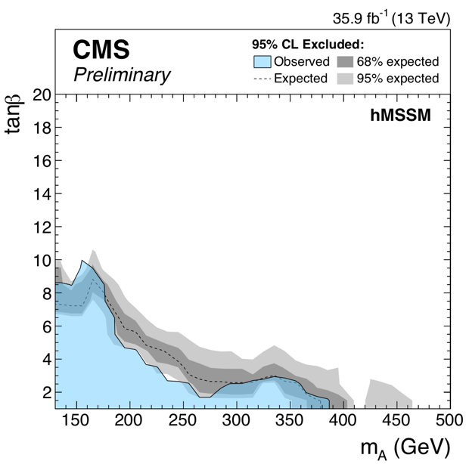

Search for $H→WW$
High BR for low tan$β$ (and m_{H}<2m_{t})
Analysis:
  Final states: (lv)(lv), (lv)(jj) and (lv)j_{fat} for low/high m_{H}
  Main backgrounds: tt, WW
MODEL INDEPENDENT

Slide 21

Search for $A→Zh$
CMS: CMS-PAS-HIG-18-005
Analysis:
Signature: Z(ee/μμ/νν) + h(bb)
Tags for bbφ and gluon-fusion production modes
Main backgrounds: Z+jets, tt, VV
Events with m(jj) not compatible with h(125) – nice control region
dominates
for tan$β$>5
MODEL INDEPENDENT

Slide 22
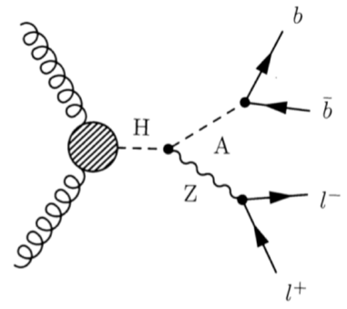
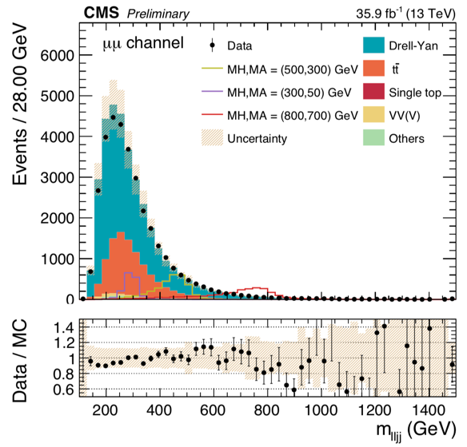
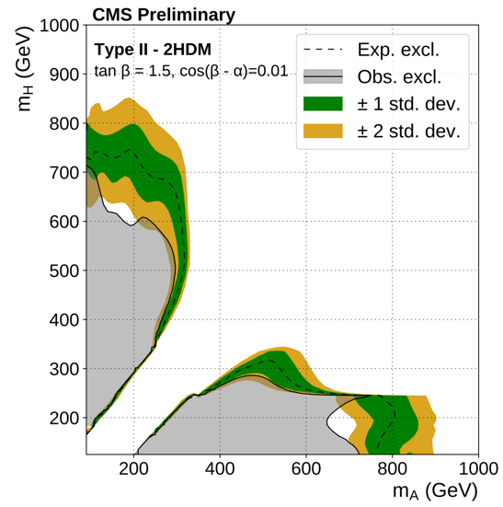
Search for $H→ZA, A→ZH$
CMS: CMS-PAS-HIG-18-012
Largest BR in 2HDM when cos(β − α) → 0, i.e. when h is SM-like
Analysis:
Main discriminants are mjj (2 b-tagged jets) and mlljj
Two event categories: ee and μμ
Z+jets (largest bkg) estimated from simulation
Data-driven estimate of tt with eμ control region
MODEL INDEPENDENT

Slide 23
Search for charged Higgs bosons
(2HDM-inspired)

Slide 24
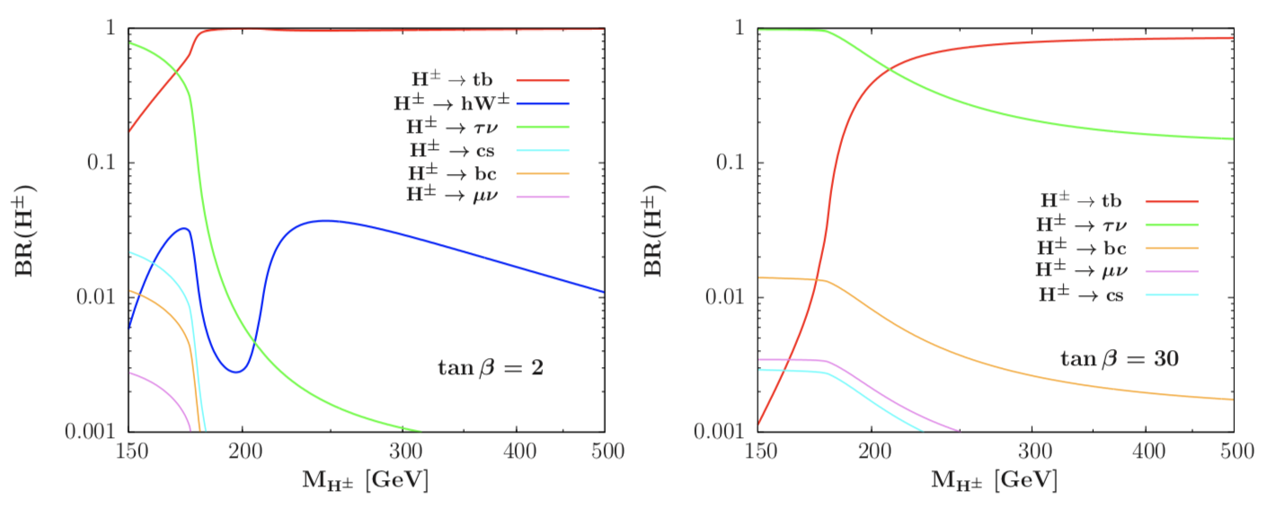
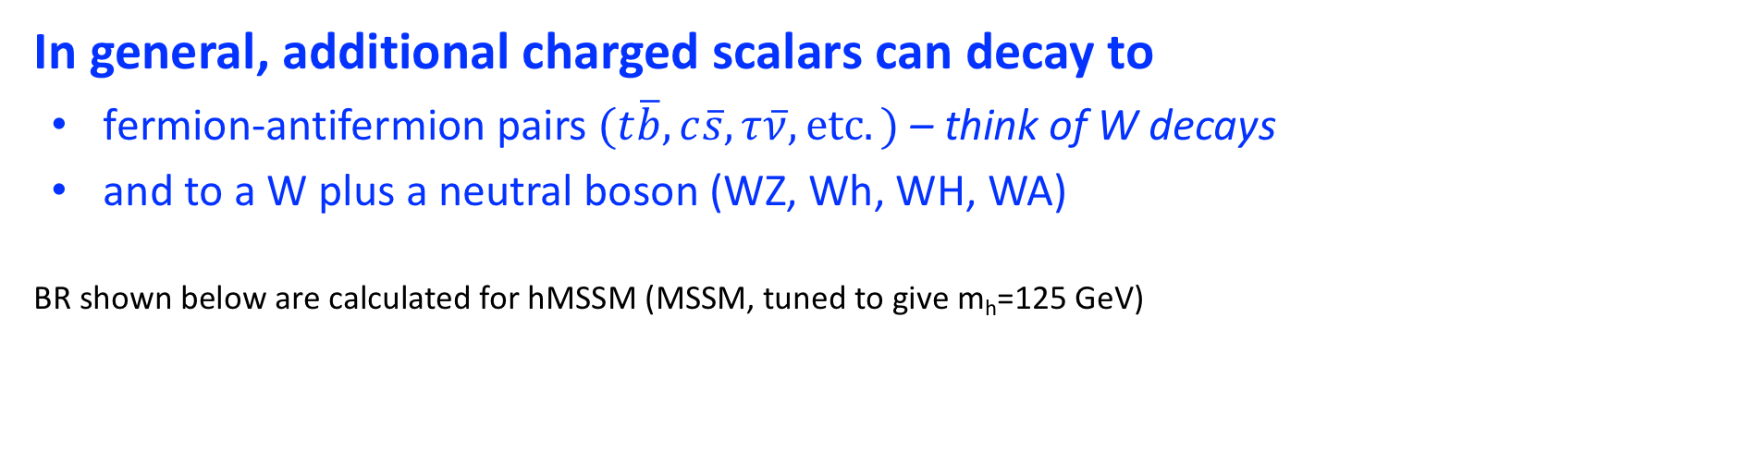
Search for a charged Higgs boson
In general, additional charged scalars can decay to
  fermion-antifermion pairs $(t\overline{b},c\overline{s}, τ\overline{ν}, etc.)$ – think of W decays
  and to a W plus a neutral boson (WZ, Wh, WH, WA)
BR shown below are calculated for hMSSM (MSSM, tuned to give m_{h}=125 GeV)
arxiv.org:1502.05653

Slide 25
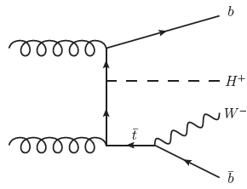
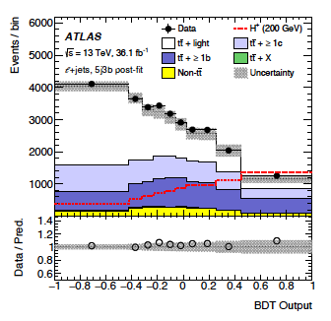
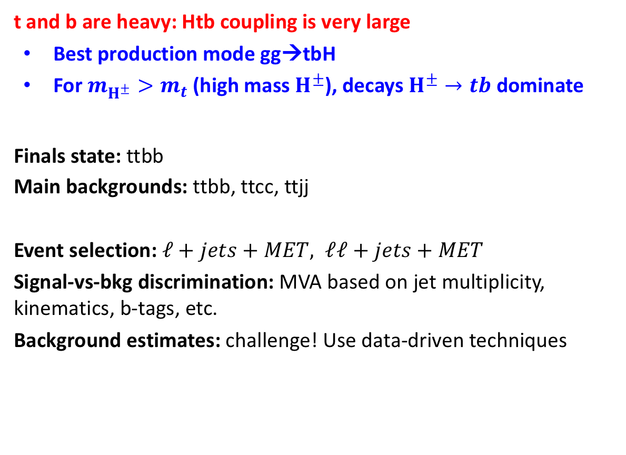
Direct search for high mass $H^{±}→tb$
ATLAS: JHEP 11 (2018) 085
CMS: CMS-PAS-HIG-18-004
t and b are heavy: Htb coupling is very large
  Best production mode gg→tbH
  For $m_{H^{±}}>m_{t}$ (high mass $H^{±}$), decays $H^{±}→tb$ dominate
Finals state: ttbb
Main backgrounds: ttbb, ttcc, ttjj
Event selection: $ℓ+jets+MET, ℓℓ+jets+MET$
Signal-vs-bkg discrimination: MVA based on jet multiplicity, kinematics, b-tags, etc.
Background estimates: challenge! Use data-driven techniques
Run 2 (2016)

Slide 26
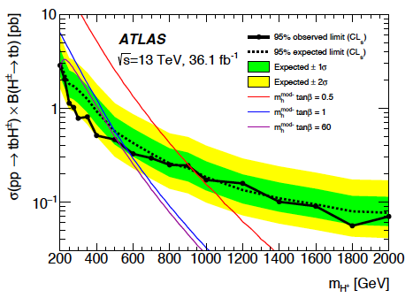
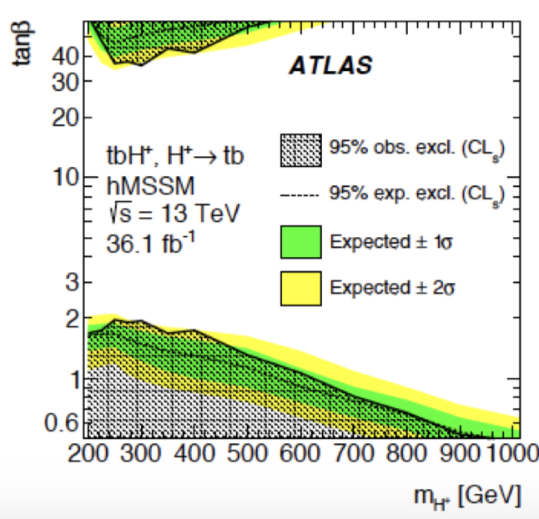
Direct search for high mass $H^{±}→tb$
MODEL INDEPENDENT
MSSM interpretations

Slide 27
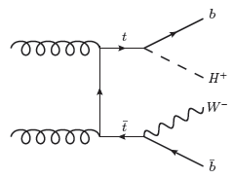
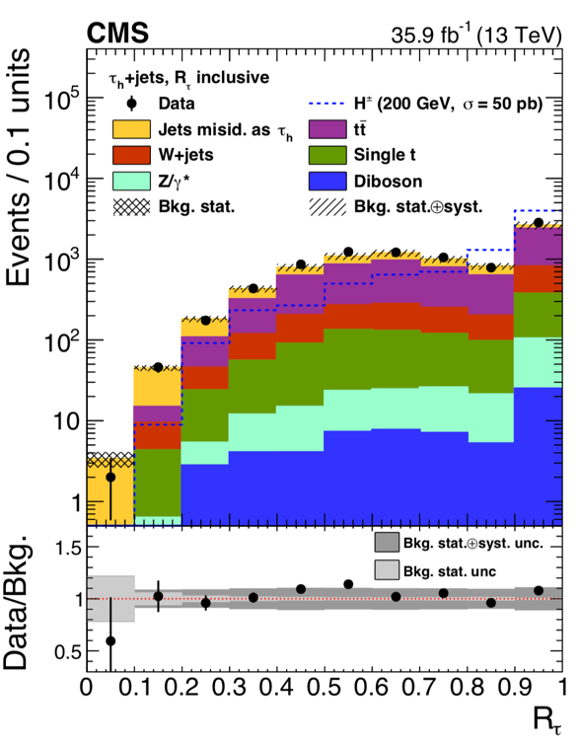
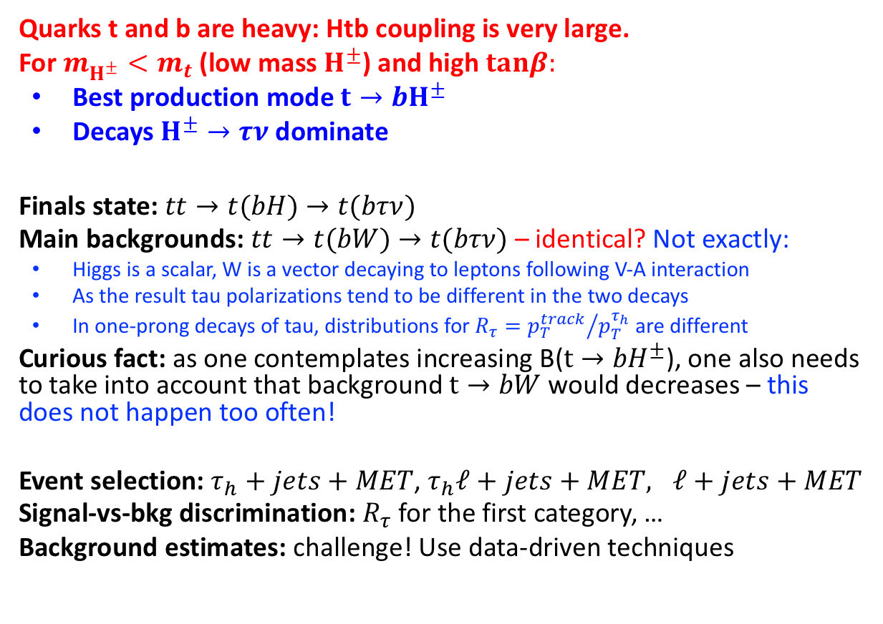
Direct search for $H^{±}→τν$
ATLAS: JHEP 09 (2018) 139
CMS: Accepted JHEP, CMS-HIG-18-014
Quarks t and b are heavy: Htb coupling is very large.
For $m_{H^{±}}<m_{t}$ (low mass $H^{±}$) and high $tanβ:$
  Best production mode ${t→bH}^{±}$
  Decays $H^{±}→τν$ dominate
Finals state:$tt→t(bH)$ $→t(bτν)$
Main backgrounds: $tt→t(bW)$ $→t(bτν)$ – identical? Not exactly:
  Higgs is a scalar, W is a vector decaying to leptons following V-A interaction
  As the result tau polarizations tend to be different in the two decays
  In one-prong decays of tau, distributions for $R_{τ}={p_{T}^{track}}/{p_{T}^{τ_{h}}}$ are different
Curious fact: as one contemplates increasing B(${t→bH}^{±}$), one also needs to take into account that background $t→bW$ would decreases – this does not happen too often!
Event selection: $τ_{h}+jets+MET$, $τ_{h}ℓ+jets+MET, ℓ+jets+MET$
Signal-vs-bkg discrimination: $R_{τ}$ for the first category, …
Background estimates: challenge! Use data-driven techniques

Slide 28

Direct search for $H^{±}→τν$
ATLAS: JHEP 09 (2018) 139
CMS: Accepted JHEP, CMS-HIG-18-014
Model-independent results
Results do not stop at $m_{H^{±}}=m_{t}$
MSSM interpretations
MODEL INDEPENDENT

Slide 29

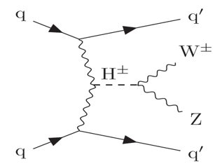
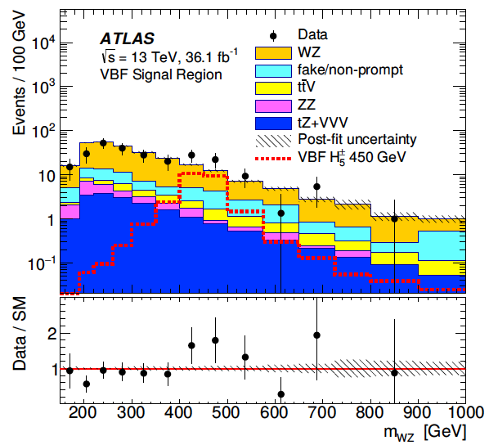
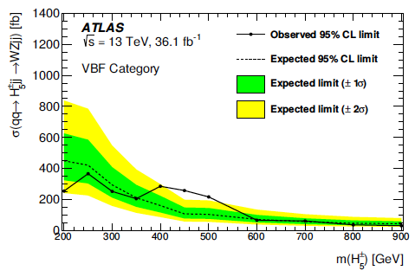
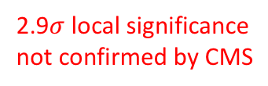
Search for high mass $H^{±}→W^{±}Z$
ATLAS: Submitted to PLB, arXiv:1806.01532
CMS: CMS-PAS-SMP-18-001
Inspired by Georgi-Machacek model: SM H complex doublet + scalar triplet + complex triplet
that gives rise to five-plet of Higgses that couple to WZ bosons only
Charged Higgs can be produced via VBF fusion and would decay to WZ
Use VBF tag (large mjj), 3 leptons, MET,
veto against tt-bar, non-prompt leptons, Drell-Yan
Backgrounds estimated using a mix of simulation and data-driven techniques
2.9$σ$ local significance
not confirmed by CMS

Slide 30
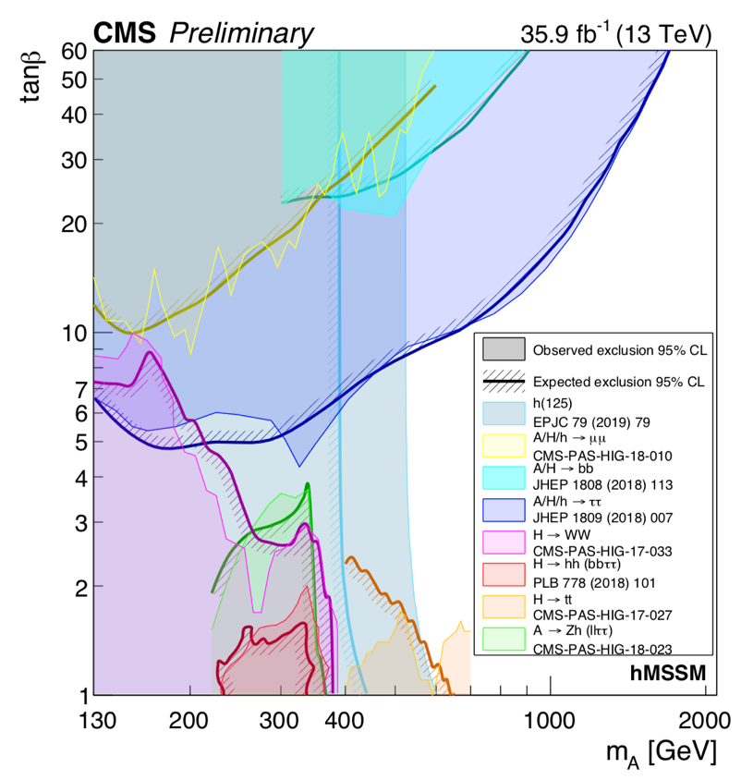
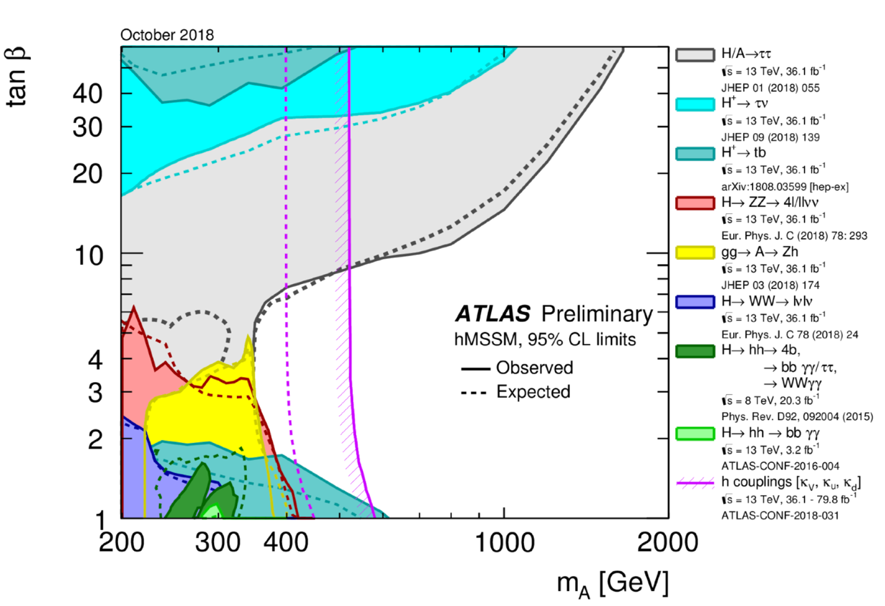
MSSM Higgs sector constraints

Slide 31
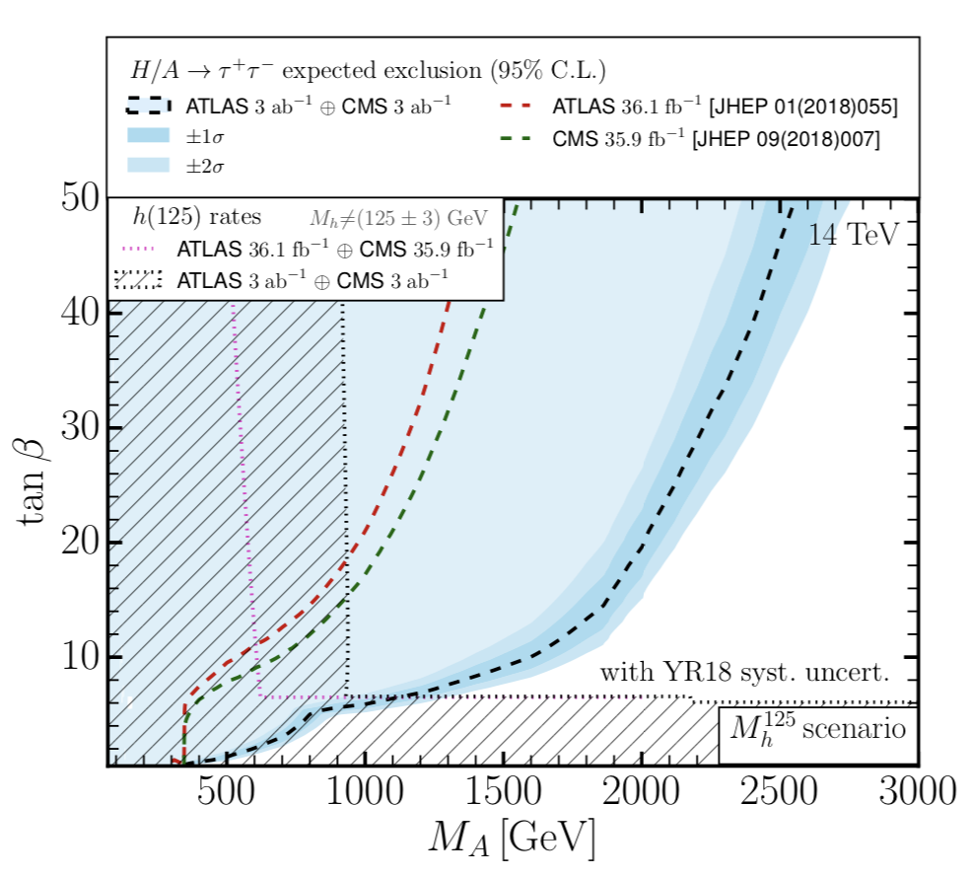
Far future projections – HL-LHC (by experimentalists)
arxiv.:1902.00134
x

Slide 32
Search for doubly-charged Higgs bosons
(inspired by HD+Triplet models)

Slide 33
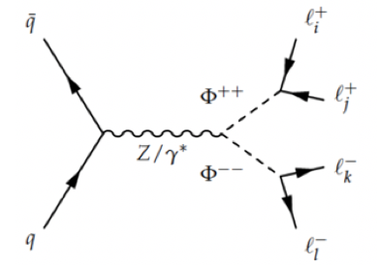
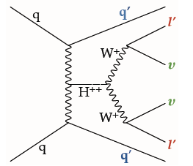
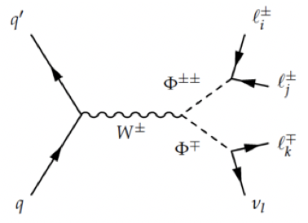
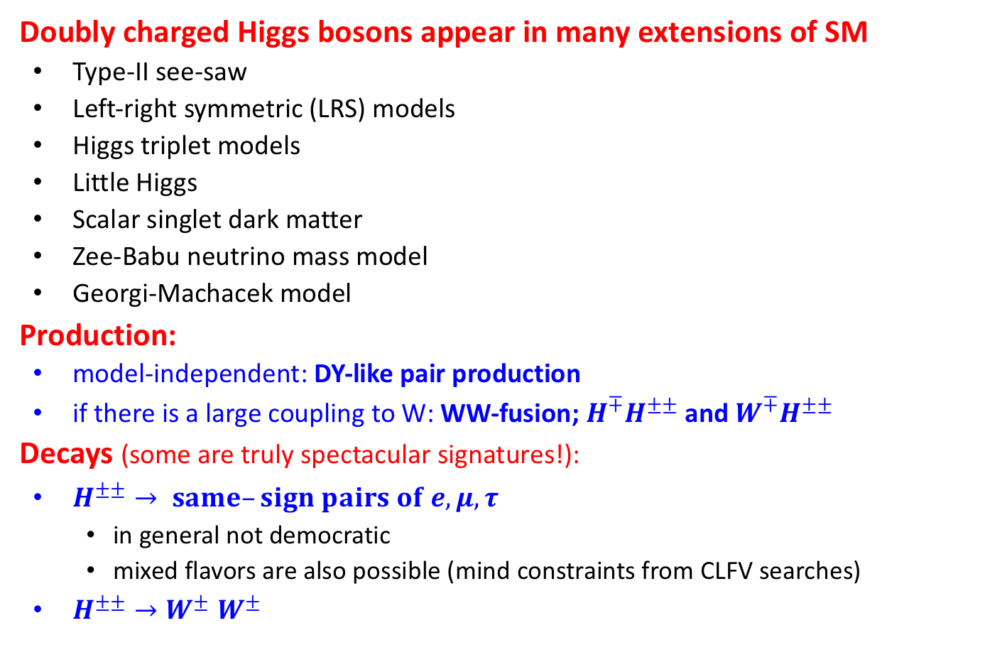
Doubly charged Higgs boson: $H^{±±}$
Doubly charged Higgs bosons appear in many extensions of SM
  Type-II see-saw
  Left-right symmetric (LRS) models
  Higgs triplet models
  Little Higgs
  Scalar singlet dark matter
  Zee-Babu neutrino mass model
  Georgi-Machacek model
Production:
  model-independent: DY-like pair production
  if there is a large coupling to W: WW-fusion; ${H^{∓}H}^{±±}$ and ${W^{∓}H}^{±±}$
Decays (some are truly spectacular signatures!):
  $H^{±±}→ same–sign pairs of e, μ, τ$
    in general not democratic
    mixed flavors are also possible (mind constraints from CLFV searches)
  $H^{±±}{→W}^{±}W^{±}$

Slide 34
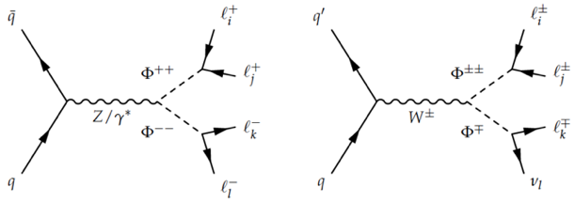
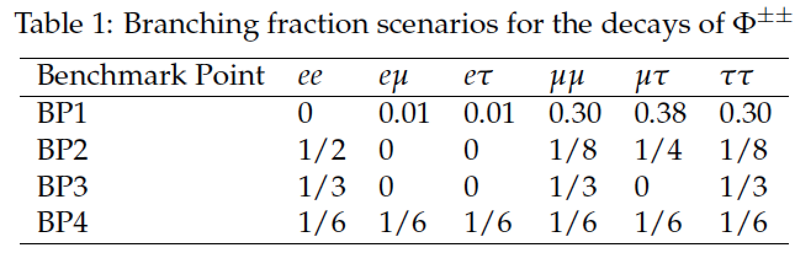
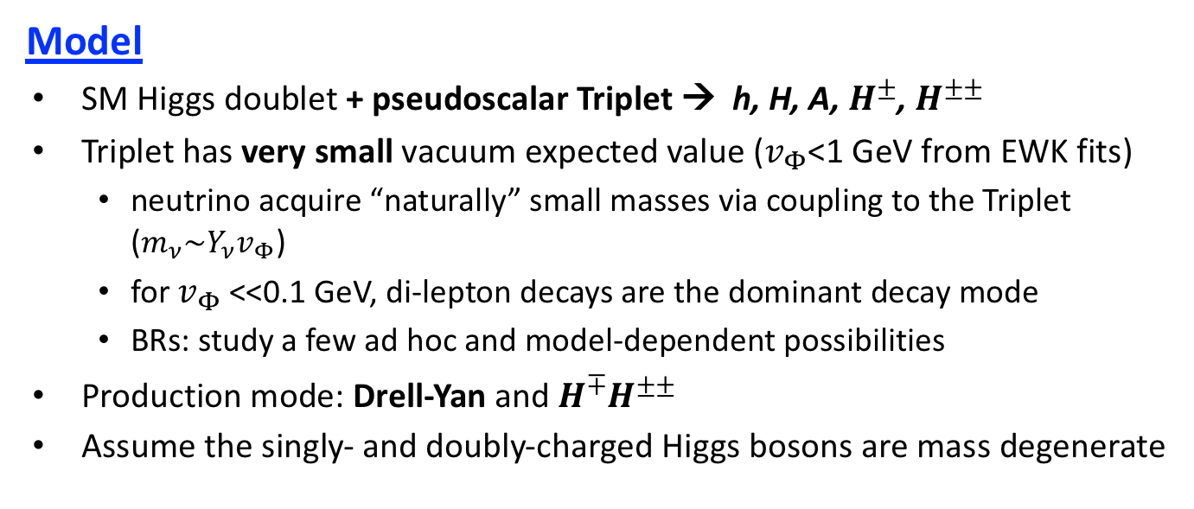
Search for $H^{±±}→$ same-sign pairs of $e, μ, τ$
CMS PAS HIG-16-036
Model
  SM Higgs doublet + pseudoscalar Triplet → h, H, A, $H^{±}$, $H^{±±}$
  Triplet has very small vacuum expected value ($v_{Φ}$<1 GeV from EWK fits)
    neutrino acquire “naturally” small masses via coupling to the Triplet ($m_{ν}\sim Y_{ν}v_{Φ}$)
    for $v_{Φ}$<<0.1 GeV, di-lepton decays are the dominant decay mode
    BRs: study a few ad hoc and model-dependent possibilities
  Production mode: Drell-Yan and ${H^{∓}H}^{±±}$
  Assume the singly- and doubly-charged Higgs bosons are mass degenerate
Ad hoc B=100%: for each kind dilepton pair
Benchmark Point 1: normal mass hierarchy, m(ν_{e})=0
Benchmark Point 2: inverted mass hierarchy, m(ν_{τ})=0
Benchmark Point 3: nearly degenerate masses, m(ν)≈0.2 eV
Benchmark Point 4: ad hoc B=1/6 for all

Slide 35


Search for $H^{±±}→$ same-sign pairs of $e, μ, τ$
CMS PAS HIG-16-036
Analysis:
  Selection:
    4$ℓ, \text{Z}\text{(}ℓℓ)$-veto, cut on dR($ℓℓ$)
    3$ℓ$ + MET, $\text{Z}\text{(}ℓℓ)$-veto, cut on dR($ℓℓ$)
  Final observables: count events in a mass window for same-sign lepton pair
  Background: nearly none after selection
preselection

Slide 36
Search for pair-produced scalars
(inspired by 2HDM+S models)

Slide 37




Searches inspired by 2HDM+S
Two Higgs Doublets + pseudoscalar field S (singlet)
Two more degrees of freedom: two more neutral higgses, CP-even/odd
The Higgs sector content is now: $h1, h2, h3, a1, a2, H±$
$h1$ can be associated with the discovered 125 GeV Higgs boson
2HDM+S is used in so-called next-to-Minimal Super Symmetry Model, nMSSM, to resolve MSSM tensions and fine tunings
Phenomenology:
The lightest pseudo-scalar, a₁, can be very light
As all Higgses, it has smaller couplings to lighter fermions -> hard to produce at pp/ee colliders (and hence it has evaded detection so far)
However, $BR(h→aa)$ can be appreciable (for two of three $h$ bosons)
$a$-bosons likes to decay to the heaviest fermions it can decay to: $a→bb, a→ττ, a→μμ,$ plus loop induced $a→γγ, a→gg$
Searches are performed in various pairing combinations. Lots of analyses, too many to cover all in this talk… Some are in backup
$$ℒ \sim ξv{|h|}^{2}s$$

Slide 38

Summary of $H→aa$ searches at 13 TeV
Search results for $H→aa$ in different final states
with branching fractions $B(a→ff)$ calculated for 2HDM (Type II) + S model and $tanβ=2$
Results can be easily rescaled for other 2HDM Types and other $tanβ$
limits in this area imply no search sensitivity,
assuming the SM Higgs production cross section
this range of B(h->BSM) is excluded in a combination of results for h(125) decays to SM decay modes

Slide 39
Outright exotic decay and production modes of the h(125) boson

Slide 40



Search for $H(125)→τμ,τe,μe$
Charged lepton flavor (CLF) is not protected by any fundamental symmetry
Many experiments were built and to search for $μ→eγ,μ→3e, τ→3μ, etc.$
New big dedicated experiments are under construction now…
Can H(125) give rise to a CLFV process?
Yes, if Yukawa coupling matrix is not diagonal (remember that all Yukawa couplings are introduced by hand). E.g., off-diagonal term $y_{τμ}≠0$ will result in $H→τμ$(and, consequently, to $τ→3μ, μγ$)
There was some excitement after Run 1, when CMS and ATLAS saw some excesses (2$σ$ and 1$σ$) in their $H→τμ$ decay searches

Slide 41



Run 2 search for $H(125) →τμ,τe$
CMS: JHEP 06 (2018) 001
ATLAS: Eur. Phys. J. C (2017) 77
The search is very similar to SM $H→ττ$ analysis:
  Except that it becomes simpler as one decay leg is a muon or electron of high p_{T} with no missing momentum
  Main backgrounds remain $Z→ττ$ and W(lv)+jets
  VBF remains by far the most sensitive category
Results (CMS):
  No significant accesses observed
  B($H→τμ$)<0.25% (exp 0.25%)
  B($H→τe$)<0.61% (exp 0.37%)
  Search for $H→eμ$ is not competitive with $μ→eee/eγ$
Limits on off-diagonal Yukawa couplings

Slide 42

Search for $H→XX→4ℓ$
ATLAS: JHEP 06 (2018) 166
  Dark sector models:
  Dark matter may be due to a host of particles with their own gauge/higgs interactions.
  U_{D}(1) and higgs bosons in the dark sector, Z_{d} and H_{d}, can mix with SM Z and H
  This can lead to H decays to two narrow di-lepton resonances (if Z_{d} is heavier than dark fermions and mixes with Z, Z_{d} will decay to SM particles like a heavy photon)
  Analysis strategy:
  Selection:
    $4ℓ$
    m$4ℓ≈mH$
    m$12≈m34$
    Z-veto for 4e and 4$μ$: m$14$<75; m$23\text{<75}$
  Final observable: m$12$
  Background:
    virtually none
    Well understood $H→ZZ→4ℓ, ZZ→4ℓ$

Slide 43




$$H→XX→4ℓ:\text{search} \text{results} \text{interpretation}$$
arxiv.:1902.00134
(NEARLY) MODEL INDEPENDENT:
limits on $B(H→Z_{d}Z_{d})$
INTERPRETATION:
limits on H_{SM} and S_{D} mixing ($κ$)
Assumprions are made on $B(Z_{d}→2ℓ)$
JHEP 06 (2018) 166
JHEP 06 (2018) 166

Slide 44




Search for $t→Hc, Hu$
ATLAS: Phys. Rev. D 98, 032002 (2018)
CMS: JHEP 06 (2018) 102
FCNC with Higgs appear in many SM Higgs extension models leading to off-diagonal Yukawa couplings
Event selection:
Top quark: l, MET, b-jet (and top mass)
Higgs: $H→WW, ττ$, ZZ (multi-leptons)
Two event categories: SS dileptons, tri-leptons
Main backgrounds: ttV, ttH (!), tt (with non-prompt l)
Results (ATLAS):
  No significant accesses observed
  B($t→Hc$)<0.16%
  B($t→Hu$)<0.19%
ttH is background!

Slide 45
BSM Higgs Summary
Sorry, we did not find anything…
But we will keep looking…
  more data are coming…
  advance analysis techniques…
  improve trigger/detectors: upgrades!
  be guided by old/new models, check difficult corners of model parameter space…
  be open minded; ignore what theorists say…
The longer we have to wait, the more exciting the discovery is going to be!

Slide 46
Backup

Slide 47
Outline
Preamble:
  what is a BSM Higgs search?
  what kinds of BSM Higgs physics one might expect?
Search for new SM-like Higgs boson, inspired by Higgs Doublet +Scalar models
Searches inspired by 2 Higgs Doublet models (2HDM)
  what we already know from the h(125) properties
  searches for additional neutral Higgs
  searches for charged Higgses
Search for doubly-charged Higgs bosons, inspired by HD+Triplet models
Searches for pair-produced scalars, inspired by 2HD+S models
Search for outright odd decays and production modes of h(125)

Slide 48


Two-parameter fit: ${(κ}_{V},κ_{F})$
Consider one modifying factor for vector bosons ($κ_{V}$) and another common modifying factor for all fermions ($κ_{F}$).
Couplings to gluons and photons are loop induced via t/b and W, and are not independent
SM values are in blue
  Γ_{gg} (loop induced: t and some b)
  $κ_{V}$Γ_{WW}
  $κ_{V}$Γ_{ZZ}
  $κ_{F}$Γ_{tt}
  $κ_{F}$Γ_{bb}
  $κ_{F}$Γ_{ττ}
  Γ_{γγ} (loop induced: W and t)
  $κ_{F}$Γ_{μμ}
  $κ_{V}$Γ_{invisible}
  Γ_{TOT} = (sum of all Γ listed above) +$κ_{F}$(sum of all other SM Γ) + Γ_{BSM}
All other Γ are for light fermions

Slide 49




Eight-parameter fit: ${(κ}_{W},κ_{Z},κ_{t},κ_{b},κ_{τ},κ_{μ}), BR\left(H→inv\right), BR\left(H→undected\right)$
Open a possibility for new physics contributing to invisible/undetected decay modes
This leads to a degeneracy predicted rates on the fit parameters (if something depends on the ratio of a/b, one cannot constrain a and b as independent parameters)
To break the degeneracy, assume ${{ κ}_{W}, κ}_{Z}≤1\text{ (}\text{from} \text{the} \text{theory} \text{side}\text{, }\text{it} \text{is} \text{virtually} \text{impossible} \text{to} \text{push} \text{these} \text{coupling} \text{above}\text{ 1)}$
SM values are in blue
  Γ_{gg} (loop induced: t and some b)
  $κ_{W}$Γ_{WW} ${ (κ}_{W}≤1)$
  $κ_{Z}$Γ_{ZZ} ${ (κ}_{Z}≤1)$
  $κ_{t}$Γ_{tt}
  $κ_{b}$Γ_{bb}
  $κ_{τ}$Γ_{ττ}
  Γ_{γγ} (loop induced: W and t)
  $κ_{μ}$Γ_{μμ}
  Γ_{invisible}
  Γ_{TOT} = (sum of all Γ listed above) + (sum of all other SM Γ) + Γ_{BSM}
At 95% CL CMS ATLAS
BR( H $→$ invisible ) < 0.22 <0.30
BR( H$→$undetected ) < 0.38 <0.22
  $κ_{t}$Γ_{cc}+$κ_{b}$Γ_{ss}+(the rest is irrelevant)

Slide 50






Other searches for low-mass $H^{±}$ ($t→H^{±}b)$
$$H^{±}→cs$$
$$H^{±}→bc$$
$H^{±}→WA$, $A→μμ$
Type II and lepton-specific 2HDM
For tan$β<1, B\left(H^{±}→cs\right)\sim 100\%$
Flipped 2HDM
$$B\left(H^{±}→bs\right)\sim 100\%$$
2HDM with CP violation
$$B\left(H^{±}→WA\right) can be \sim 100\%$$
MODEL INDEPENDENT
MODEL INDEPENDENT
MODEL INDEPENDENT

Slide 51



Search for $H^{±±}→W^{±}$ $W^{±}$
ATLAS: Eur. Phys. J. C (2019) 79: 58
Model:
  Same as before, but the triplet vacuum expectation value of ~0.1 GeV
    $H^{±±}→W^{±}$ $W^{±}$ is the dominant decay mode (di-lepton decays become irrelevant)
    Dominant production mode: Drell-Yan
Analysis:
  Selection:
    (same-sign $ℓℓ$, MET)+($≥$3 jets, b-jet veto)
    3$ℓ$ + MET + ($≥$2 jets, b-jet veto)
    4$ℓ$ + MET + $0$ jets
    further kinematic cuts (m_{H}-dependent)
  Final observables: event counts in 6 categories
  Background: nearly none

Slide 52







Searches for $h(125)→aa$, $(15<m_{a}<60$ GeV$)$
$$h(125)→aa→(bb)(ττ)$$
$$h(125)→aa→(bb)(μμ)$$
$$h(125)→aa→(ττ)(μμ)$$
JHEP 11 (2018) 018
arXiv:1812.06359
PLB 785 (2018) 462
Different analyses target
decays with higher branching fractions (bb), ($ττ$)
or
try to take advantage advantage of
high mass resolution, but rarer, decays ($μμ$), ($γγ$)
$$h(125)→aa→(bb)(bb)$$
$$h(125)→aa→(bb)(μμ)$$
$$h(125)→aa→(γγ)(gg)$$
JHEP 10 (2018) 031
PLB 790 (2019) 1
PLB 782 (2018) 750

Slide 53



Searches for heavy $h→aa→(γγ)(γγ)$
ATLAS: arXiv:1808.10515
Analysis:
For very small-mass a, m_{a}/m_{h} < 0.007,
  pairs of photons experimentally cannot be resolved
  the signature look like $X→(γ)(γ)$
  The analysis strategy: classical $mγγ$ bump hunt
For somewhat larger m_{a}/m_{h}
  photons showers become wider
  allowing this in the analysis brings large background of pi0
  Search sensitivity quickly deteriorates
HW: What is a typical angle between photons for m_{a}/m_{h} = 0.007?
Compare it to the granularity of the ATLAS ECAL calorimeter

Slide 54


Searches for $aa→(μμ)(μμ)$
CMS: CMS-PAS-HIG-18-003
Analysis:
Look for two pairs of muons with small opening angles (long decay flights are also allowed in this analysis)
Examine 2D plot: $m_{{\left(μμ\right)}_{2}} vs. m_{{\left(μμ\right)}_{1}}$
Signal would manifest itself as an accumulation of events at some point along the diagonal
The search is nearly background free. No cuts on m₄$μ$ _{is} imposed, i.e. the pair of aa does not need originate form h(125), it may come from decays of a heavier h as well
HW (left plot): Shaded area represents event density for expected background. What is the origin of dark vertical and horizontal lines?
HW: From these plots alone, estimate the experimental efficiency to reconstruct signal events within the acceptance ($αgen)$?

