Slide 1
Status of Application of Machine-Learning Techniques at CRYRING@ESR
Wolfgang Geithner (GSI), Frank Herfurth (GSI), Vitaly Rapp (GSI), Gleb Vorobyev (GSI), Andor Németh (Avato Consulting AG)

Slide 2
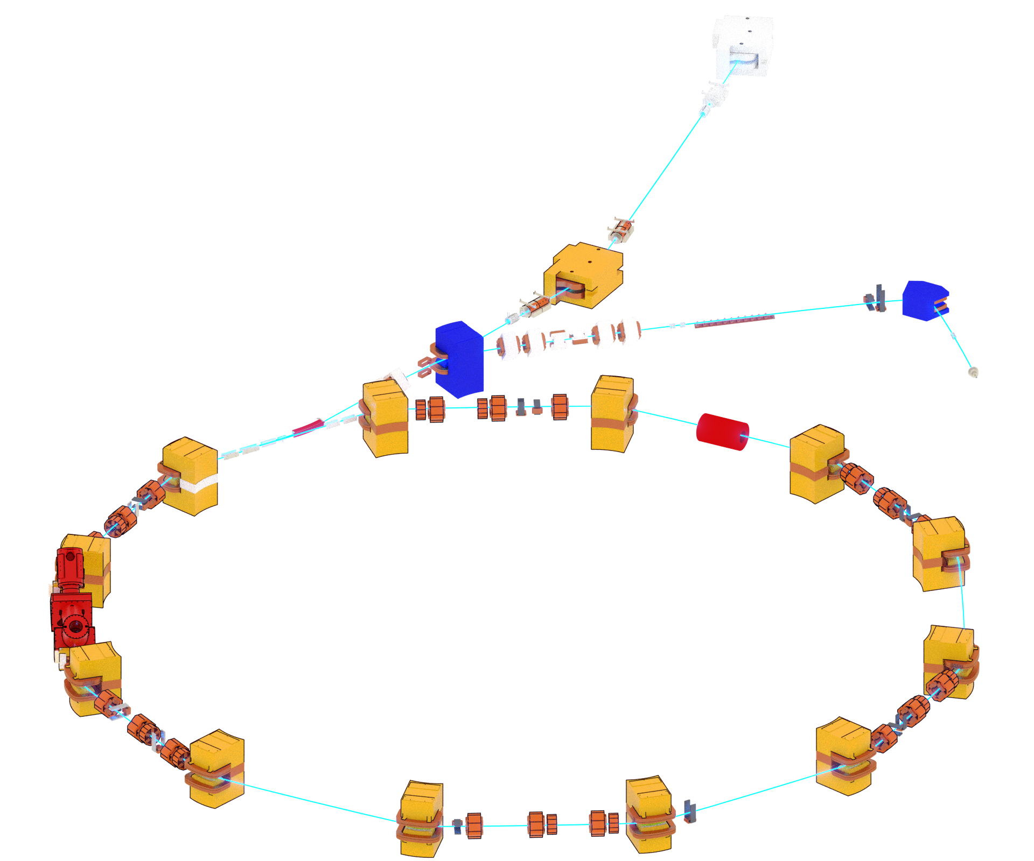
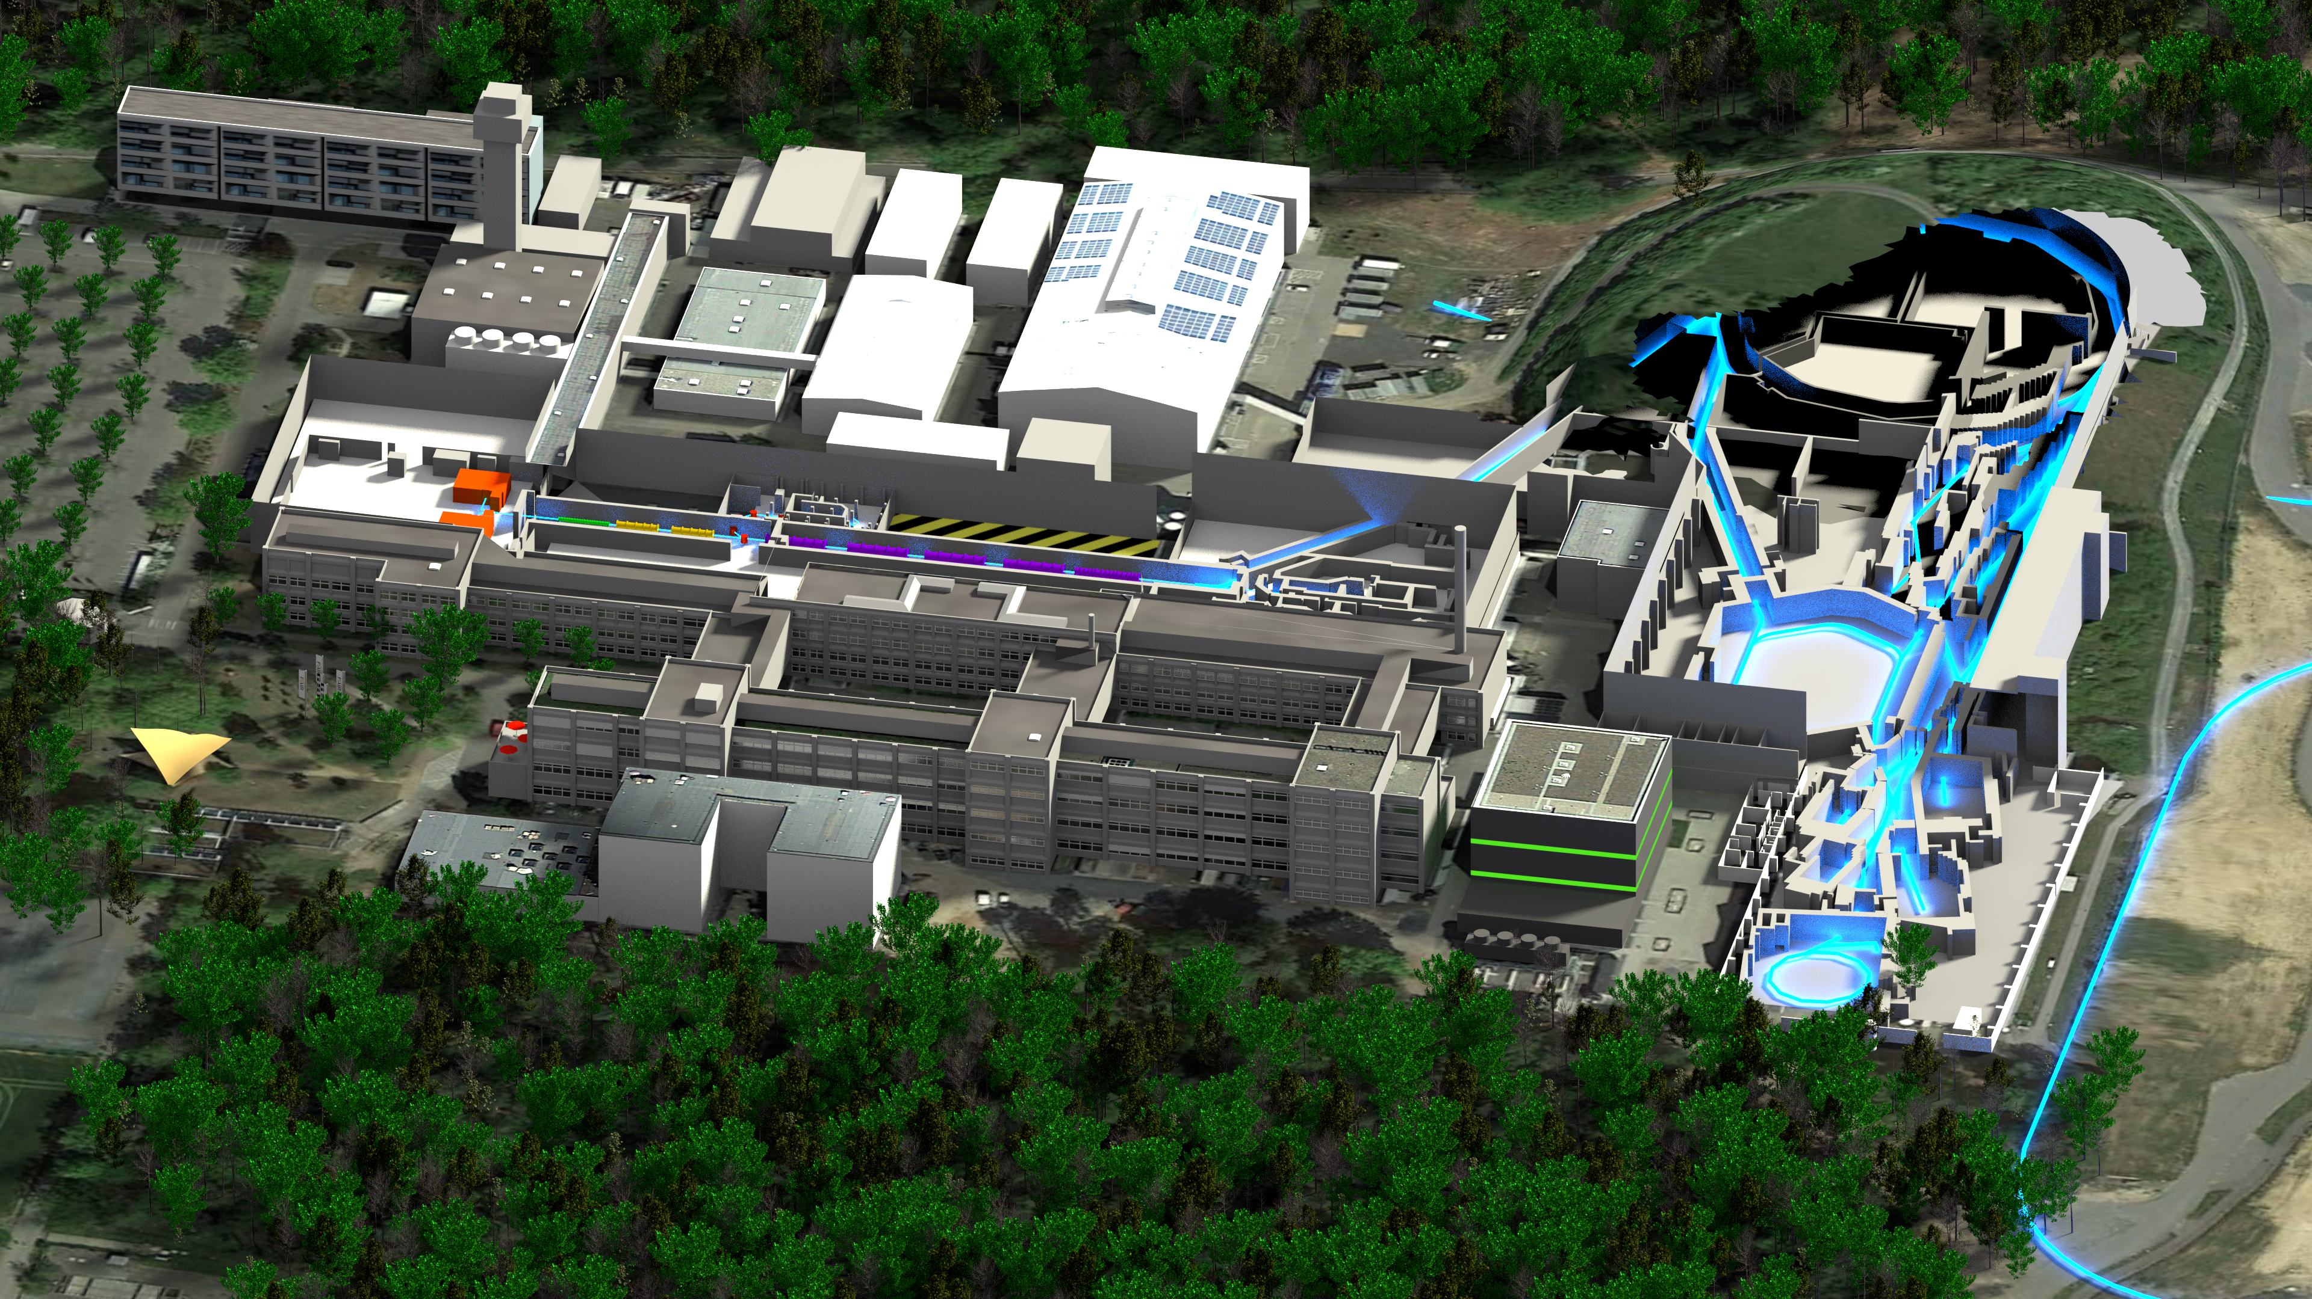
CRYRING@ESR: FAIR Phase0 Machine
Beam from ESR
E ~ 4 MeV/u
Local injector
30 keV < E < 300 keV/u
p-Linac
SIS18
Multiturn injection
UNILAC
Plasma ion source
ESR
~1.6 KeV/u → 30 MeV/u (protons)
CRYRING@ESR
HESR
CRYRING Use cases:
Atomic & nuclear physics experiments
Test bench for FAIR concepts
Ahead-development of FAIR prototypes

Slide 3
One word on „Machine Learning“
Where machine learning is a research field on it‘s own, I see it as a tool.
I want to provide computer-based tools helping my team and operators to run CRYRING@ESR more efficiently.
Hence, I am not interested in machine learning in itself (in the first place):
I value robustness and outcome over scientific sophistication

Slide 4
„Machine Learning“: Genetic Algorithm
„genotype“ = vector of N parameters with value ranges
„chromosome“ = genotype with actual values („gene expressions“)
„fitness“ = relevant readout parameter of the machine
„phenotype“ = vector of„chromosome“ + „fitness“
„population“ = vector of M phenotypes
No
0. Init optimization: Random values for chromosomes in the population + corresponding fitness
1.+N Optimize:
Keep good individuals
Fill population with cross-breeding good individuals
and by „mutation“
Optimization goal reached?
Actual fitnes >= goal fitness?
Done

Slide 5

Genetic Algorithm in FAIR Control System Stack
Device-Automator:
JAVA-Program,
initially built to perform
simple automation tasks
Genetic Algorithm plugin built on „Jenetics“ Java framework^{[1]}
“Genotype” consists N LSA devices for parameter setting
“Fitness” derived from readout of JAPC-devices
Evolution process is drive via the JAVA stream() interface
Evolution stop and convergence criteria are realized by implementing stream().limit(<criteria>)
Maven:
<dependency>
<groupId>io.jenetics</groupId>
<artifactId>jenetics</artifactId>
<version>4.4.0</version> <-------- Version 5.0.1 available
</dependency>
Custom application:
Sends value
set requests
data readout by subscription
LSA-layer (JAVA)
Physics/model layer:
Java Interface layer:
JAPC (JAVA)
Middleware
Frontent-Software
Device layer (hardware):
dev
dev
dev
dev
dev
dev
dev
dev
[1] Jenetics - Advanced Genetic Algorithm, Evolutionary Algorithm and Genetic Programming library: http://jenetics.io/

Slide 6
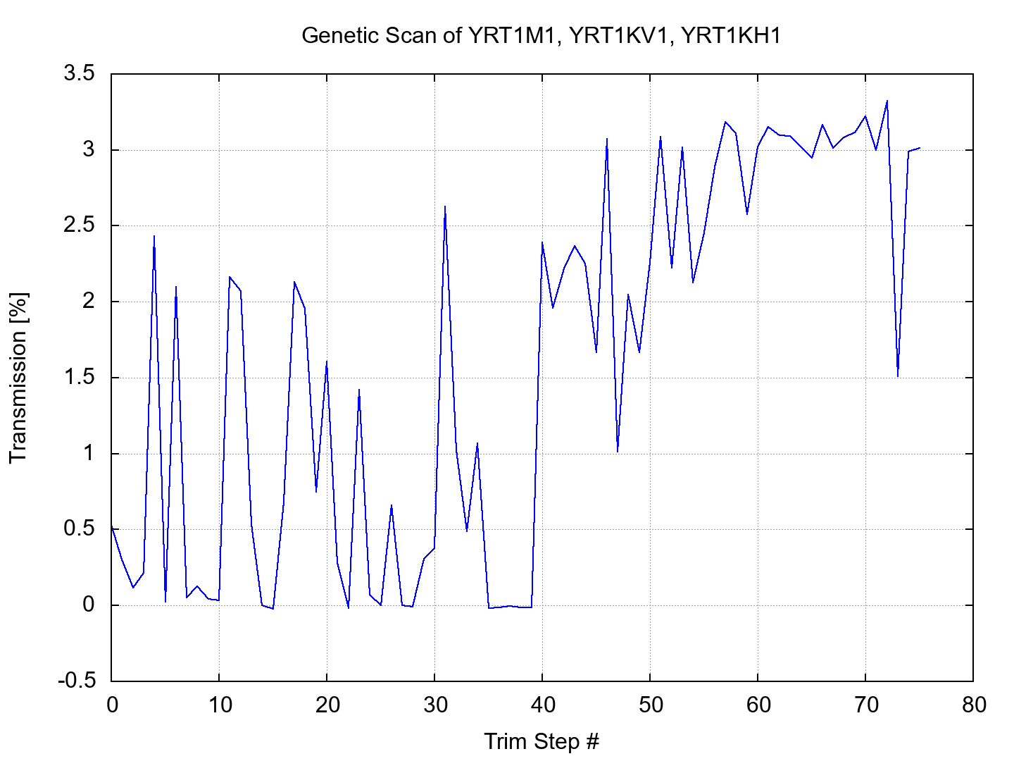
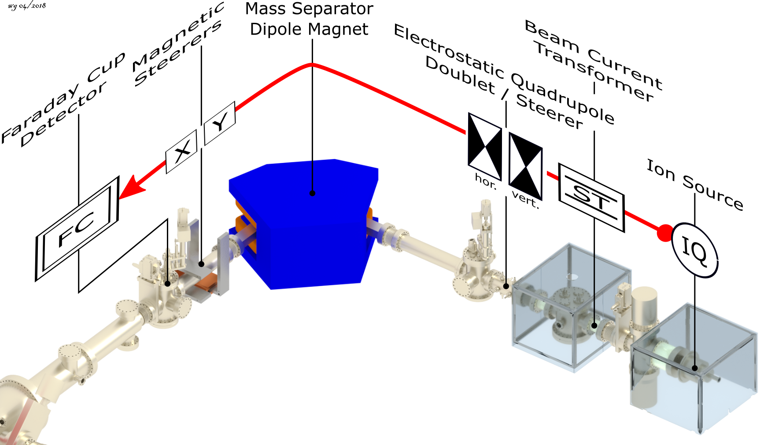
Applying Genetic Algorithms: Injector Optimization[1]
x-axis
Optimization of 3 devices:
Main dipole
horizontal, vertical corrector
Scan converged after 75 steps ~ minutes
y-axis = T = I(FC)/I(ST)

Slide 7
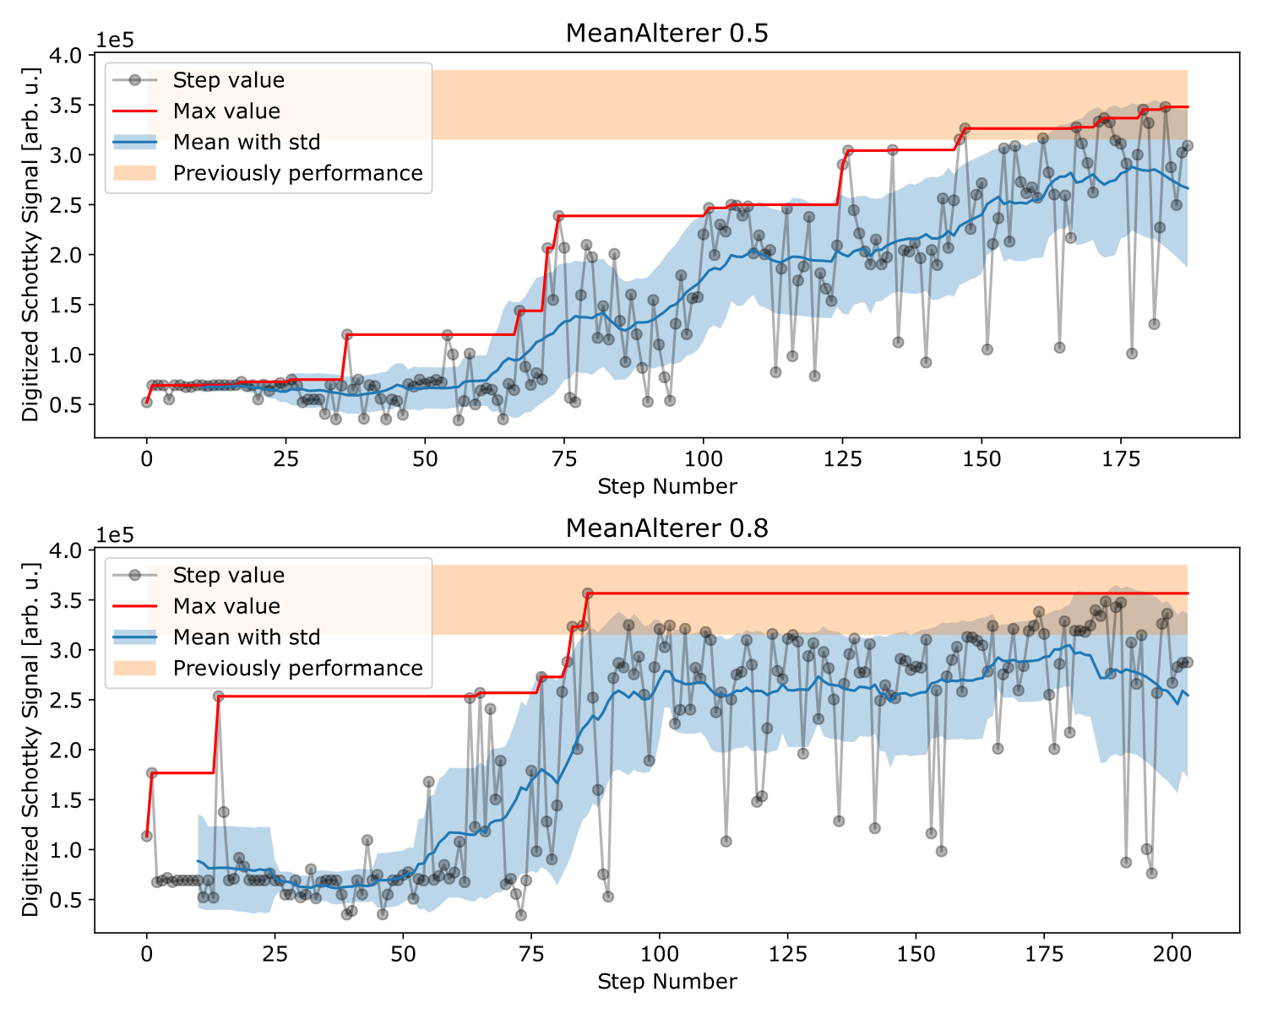
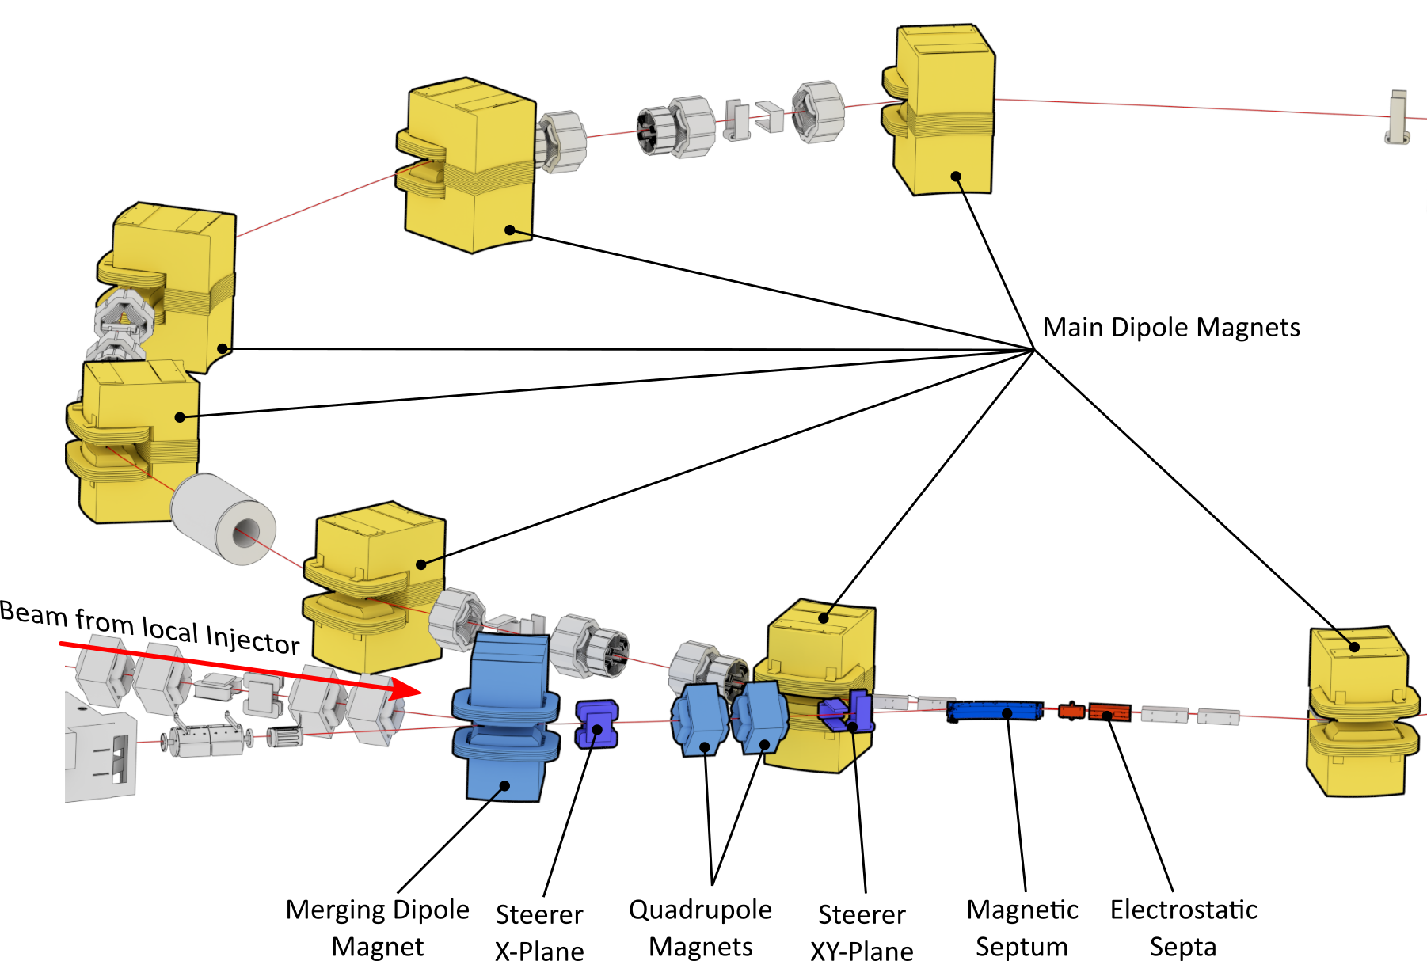
Applying Genetic Algorithms: Injection Optimization^{[1]}
Genetic algorithm controls 10 parameters
Goal parameter: beam intensity measured by Schottky signal normalized to ion source intensity
Result:
Genetic algorithm is capable to optimize injection
Optimization Performance comparable to human operator.
[1] S. Appel, W. Geithner, et al.: “Optimization of heavy-ion synchrotrons using nature-inspired algorithms and machine learning”, 13th Int. Computational Accelerator Physics Conf., doi:10.18429/JACoW-ICAP2018-SAPAF02

Slide 8
Outlook / Perspectives
Systematic study of algorithm process parameters
Investigate / mitigate algorithm sensitivity to noise and fluctuating signals
Add more complex readout signals as target properties
Investigate Particle Swarm Optimization (PSO) algorithm

Slide 9


On the long way to machine learning…

Slide 10
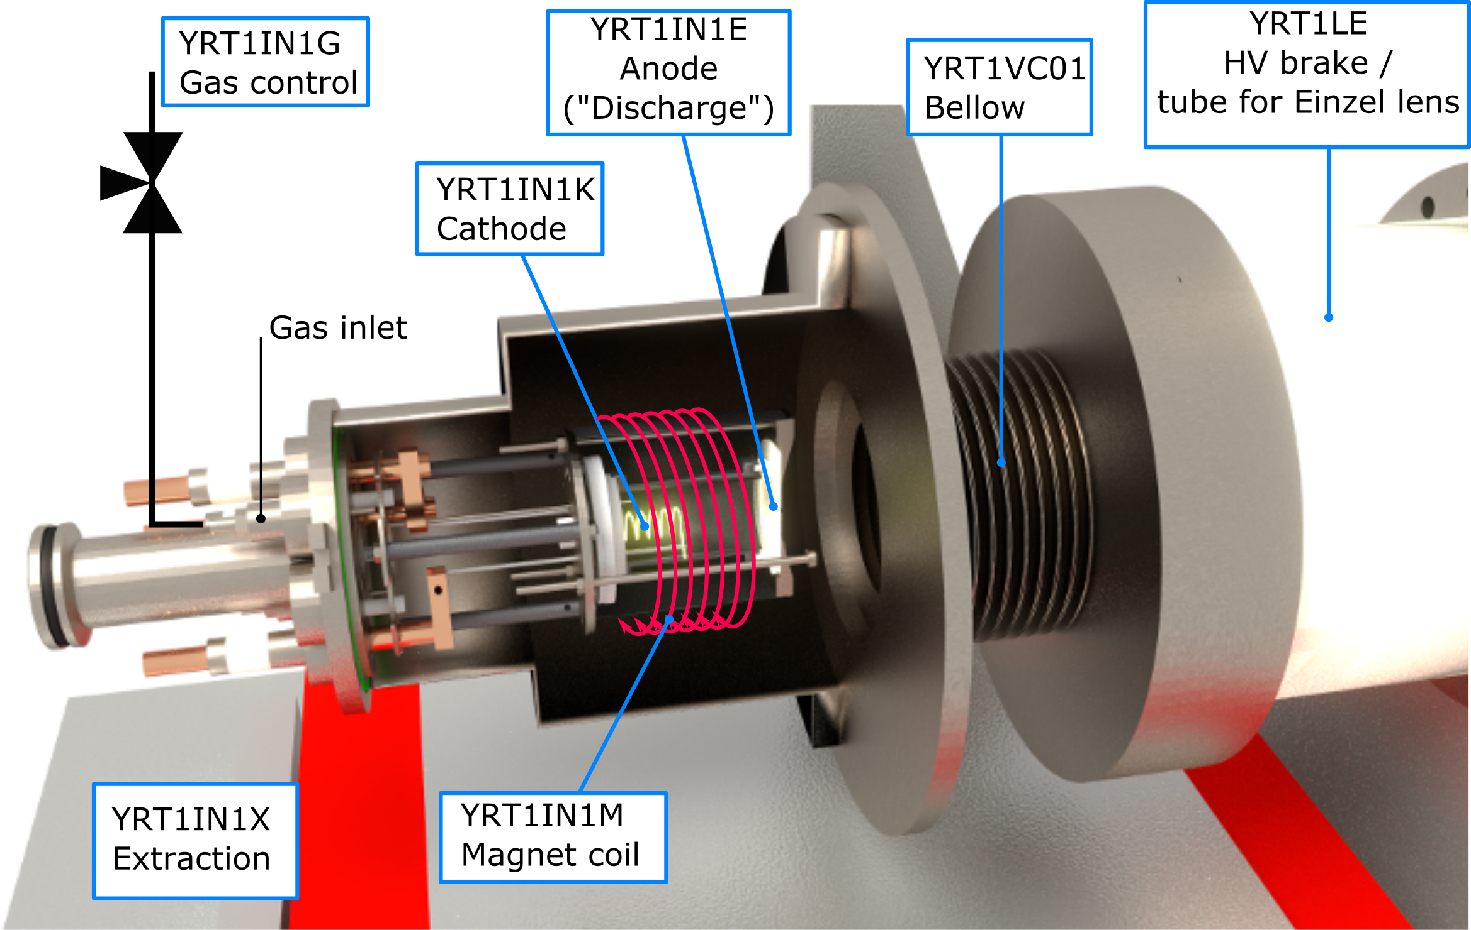
Machine Learning Guinea pig: CRYRING@ESR Ion Source
Control / input variables:
anode voltage (YRT1IN1E, pulsed)
gas flow (YRT1IN1G)
cathode current (YRT1IN1K)
solenoid current (YRT1IN1M)
acceleration high voltage (YRT1IN1X)
Output observable:
pulsed ion current, measured with beam transformer, f ~ 0.3 Hz, L_{pulse} ~20-30 μs
Signal: 30.000 samples at 10 MHz rate.
t = 3 ms

Slide 11

Strategy for Applying Machine Learning to Ion Source
Project outline:
Make data flow: create infrastructure to work with training data efficiently
Determine signals allowing prediction of source failure
Investigate machine learning algorithms allowing extraction of features and prediction of source failure and/or time to failure
Transfer trained algorithm to control-system environment
→ Can algorithm be ported to JAVA?
Build end user-application to monitor ion source
…
Investigate re-enforced learning for automated ion-source control
I am here
- somewhere…

Slide 12
Starting Point: Current data provisioning infrastructure
In context of FAIR project, a lot of ground work has been done:
Broad availability of control system standard data sources for SIS18, ESR, CRYRING
Beam instrumentation and device monitoring applications allowing „real-time“ data visualization
Archiving project ongoing with go-life goal 2020

Slide 13
Data provisioning infrastructure: personal wish list
Connect data in monitoring applications to persistence layer
Integrate “non-standardized” data sources to archiving
Flexible integration of new data sources with low effort
Extraction of data from archive in very performant manner
As soon as possible

Slide 14





Make Data Flow: Data Provisioning Architecture
(Developed in cooperation with AVATO Consulting)
e.g. machine-learning components
Visualization: GRAFANA
…
Data User
Data User
Data User
Time-Series database: InfluxDB
HTTP
Data Canonizer & Router
DBxy
Data Broker: ActiveMQ
Requires Coding
Message
Message
Idea/not realized
…
Device Data Collector
Device Data Collector
Device Data Collector
Open Source Product
Could be/should be
containerized

Slide 15
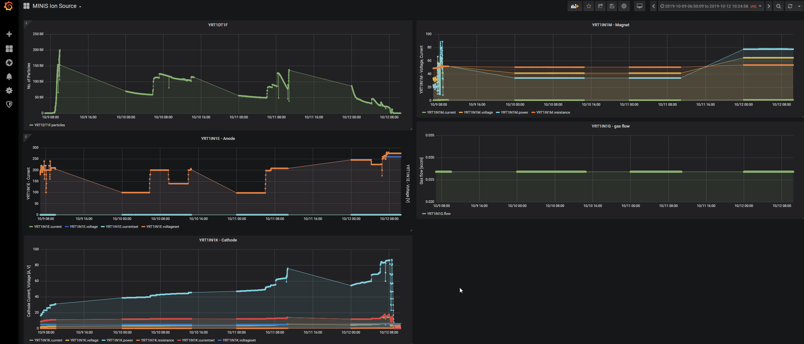
By-Product: Grafana-based Data Visualization
Visualization: GRAFANA
Time-Series database: InfluxDB
Data Canonizer & Router
Data Broker: ActiveMQ
Open to (m)any programming languages
→ integration of non-standard data sources
Allows quick creation of data dashboards
Allows to define warning thresholds
User friendly
CS Data Collector
JAPC
Archiving Data Collector
Python Device Data Collector

Slide 16
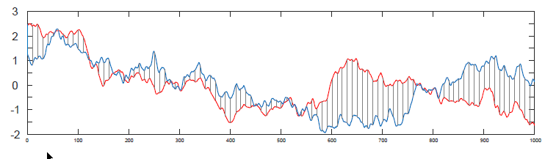
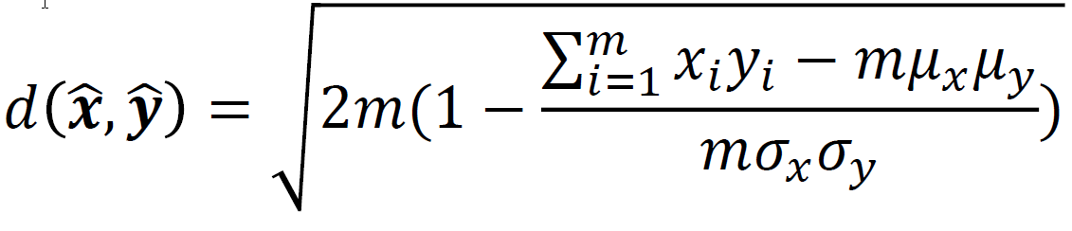
Matrix Profile^{[1]}: Time Series Motif and Discord Extraction^{[2]}
“time series” = collection of observations made sequentially in time
y
y_{i}
x
x_{i}
Simple measure for similarity of two time series
z-normalized Euclidean distance:
[1] Chin-Chia Michael Yeh, Yan Zhu, et al.: Matrix Profile I: All Pairs Similarity Joins for Time Series: A Unifying View That Includes Motifs, Discords and Shapelets, IEEE ICDM 2016, https://doi.org/10.1109/ICDM.2016.0179
[2] See: Abdullah Mueen: „The First Matrix Profile Tutorial Part 2”, https://www.cs.ucr.edu/~eamonn/Matrix_Profile_Tutorial_Part1.pdf

Slide 17
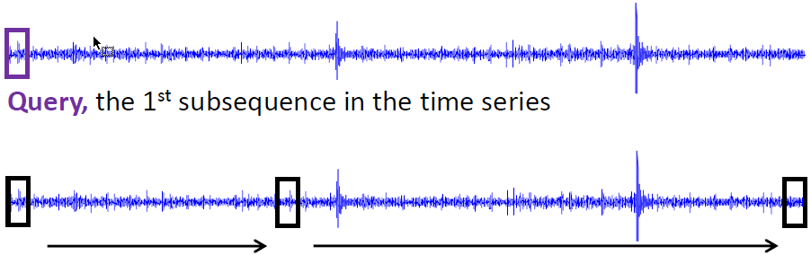

Correlation of Sub-Sequences of a Time Series
Take a subset (length m) of the total series of length n
Move the subset over the original series and calculate for each window
for i^{th} subset of length m
d_{1, 1} | d_{1, 2} | … | d_{1, n-m+1}
d_{2, 1} | d_{2, 2} | … | …
… | … | … | …
d_{n-m+1, 1} | … | … | d_{n-m+1, n-m+1}
Min(D₁) | Min(D₂) | … | Min(D_{n-m+1})
This is „the“ matrix profile
low values = subset has similar subsets in series
high values = subset has no similar subsets in series
for j^{th} step along series

Slide 18
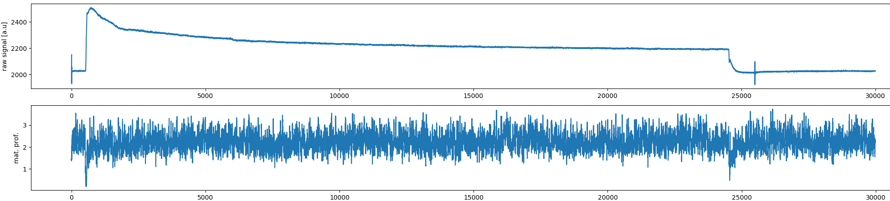
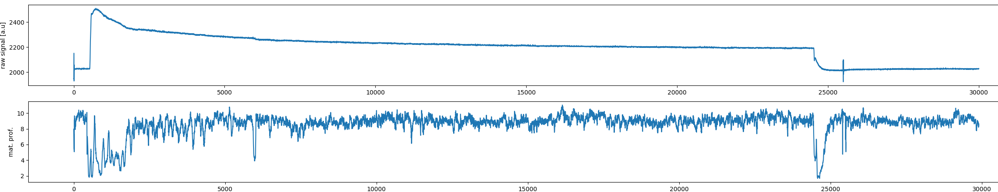
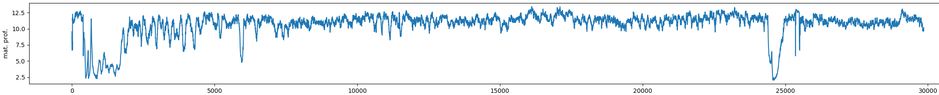
Application to Ion Source Time Series Data: „One Shot“
original series
m = 20 samples t = 2μs
m = 100 samples t = 10μs
m = 143 samples t = 14.3μs
(f = 70 kHz)

Slide 19
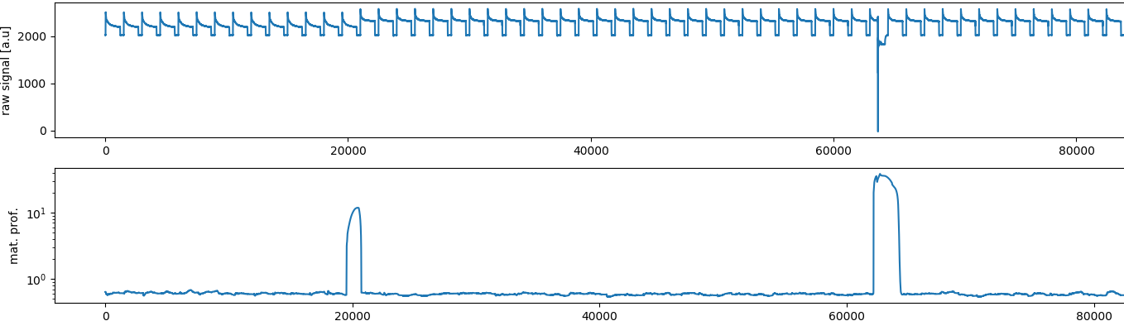
Application to Shot Sequence
data of 55 shots in a row
each shot has been down sampled by a factor of 20
window size = 1500 samples
1500 samples
= 3 ms
3 seconds skipped
something happened!
low = smooth running

Slide 20
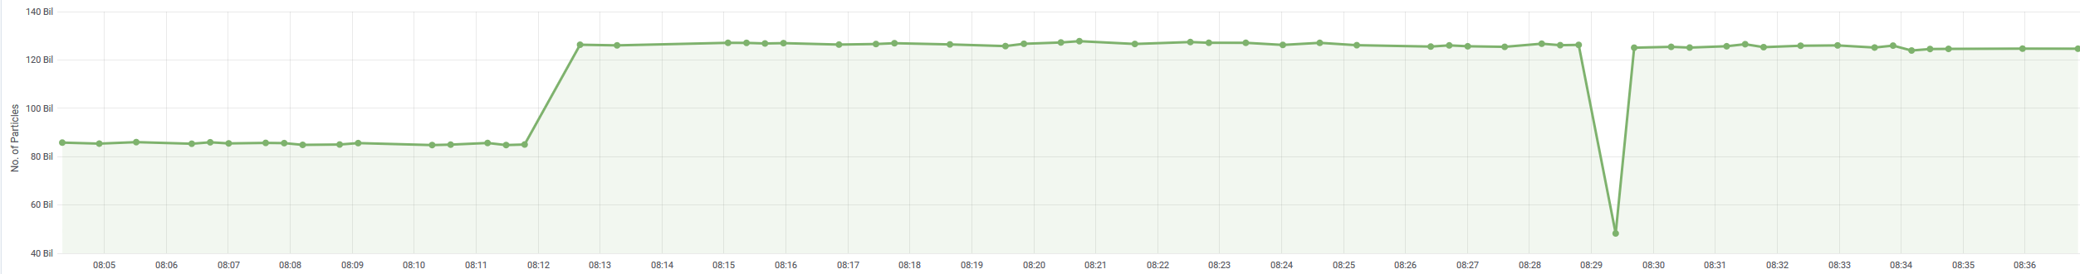
This happened…
particle count from transformer

Slide 21

Steps/Achievements up to Here
Data extraction from FAIR archiving prototype
Provisioning of an infrastructure allowing efficient handling of data
Implementation of python prototype to apply matrix profile to existing data
Next steps:
Move data provisioning framework to dedicated hardware
Extraction of reliable signals by tuning matrix profile and implementation of server
Evaluate XGBoost for outlier recognition to make reliable predictions of ion source failure probability

Slide 22

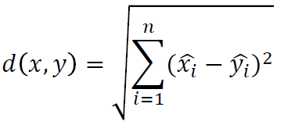
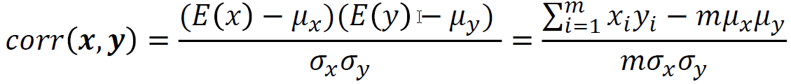


Matrix Profile^{[1]}: Time Series Motif and Discord Extraction^{[2]}
“time series” = collection of observations made sequentially in time
z-normalized Euclidean distance:
1.
2.
y
x
Pearson‘s Correlation Coefficient^{[3]}
where
[1] Chin-Chia Michael Yeh, Yan Zhu, et al.: Matrix Profile I: All Pairs Similarity Joins for Time Series: A Unifying View That Includes Motifs, Discords and Shapelets, IEEE ICDM 2016, https://doi.org/10.1109/ICDM.2016.0179
[2] See: Abdullah Mueen: „The First Matrix Profile Tutorial Part 2”, https://www.cs.ucr.edu/~eamonn/Matrix_Profile_Tutorial_Part1.pdf
[3] https://en.wikipedia.org/wiki/Pearson_correlation_coefficient

Slide 23

Relationship Correlation and Euclidean Distance
Distance and correlation
relation:
➔
where „m“ is the length of the sequence
„similarity“ of two time series can be expressed by one number:
    „small“ = very similar
    „large“ = not so similar
Example: m = 100

