Slide 1
ARW 2019:
Performance Tracking & Round-Table Discussion
benjamin.todd@cern.ch
v22

Slide 2
About the session…
Performance tracking related to reliability and availability, not considering “beam performance”.
Regardless of our backgrounds, all machines consist of similar technical equipment and operators exploiting this equipment to create beams of light or particles for their final users.
higher MTBF: can come from designing more reliable equipment based on operation and past experience.
lower MTTR: comes by effectively managing repairs and equipment concerned
higher availability = a higher MTBF and shorter MTTR.
availability: is a kind of “Key Performance Indicator”

Slide 3
Motivation…
The aim of our workshop is to share information and techniques related to reliability and availability
Despite all coming from diverse machines Equipment + Operations = Beams
We can learn from each other
We can share our lessons learned and ideas
We can swap best practices
To do this we have to understand a little bit about each others’ worlds…

Slide 4
Format of the Session
  ≈10:35 – 11:30: introduction to cross-section of institutes ≈8 minutes each
    BNL – Gregory MARR gmarr@bnl.gov
    Australian Synchrotron – Nicholas RAE nicholas.rae@synchrotron.org.au
    GSI – Oksana GEITHNER o.geithner@gsi.de
    SOLEIL – Thomas MARION thomas.marion@synchrotron-soleil.fr
    IHEP – Weibin LIU liuwb@ihep.ac.cn
    DESY – Michael BIELER bieler@desy.de
    Institut Curie – Samuel MEYRONEINC samuel.meyroneinc@curie.fr
    CERN – Benjamin TODD benjamin.todd@cern.ch
  ≈11:30 – 12:00: round table discussion

Slide 5
BNL
Gregory MARR

Slide 6
  C-AD (BNL): Collider-Accelerator Department (Brookhaven National Laboratory)
Accelerator Complex: LINAC/EBIS/Tandem → Synchrotrons → flagship Relativistic Heavy Ion Collider (RHIC)
  End Product: colliding particles; ions – p, d, h, Al, Cu, Ru, Zr, Au, U, polarized protons
  RHIC colliding at beam energies 3.85-100 GeV ions, 255 GeV protons
BNL

Slide 7
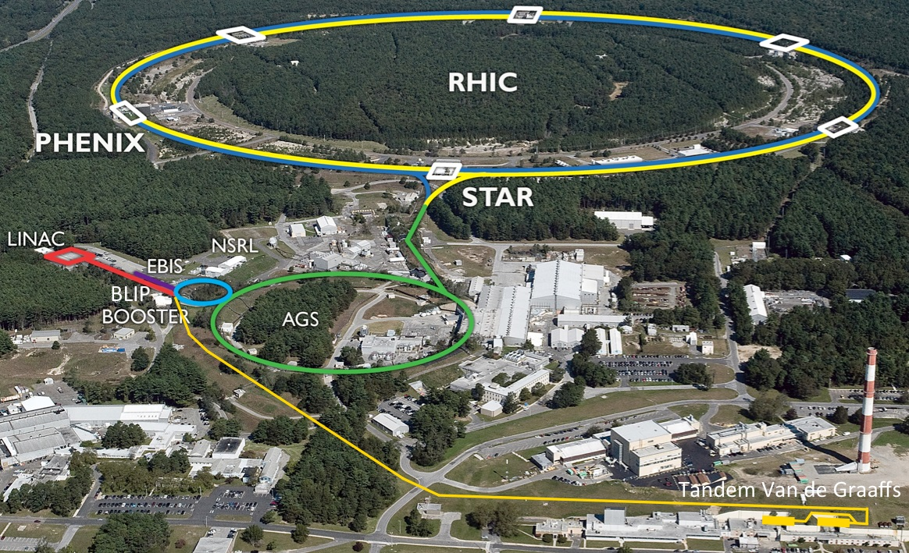
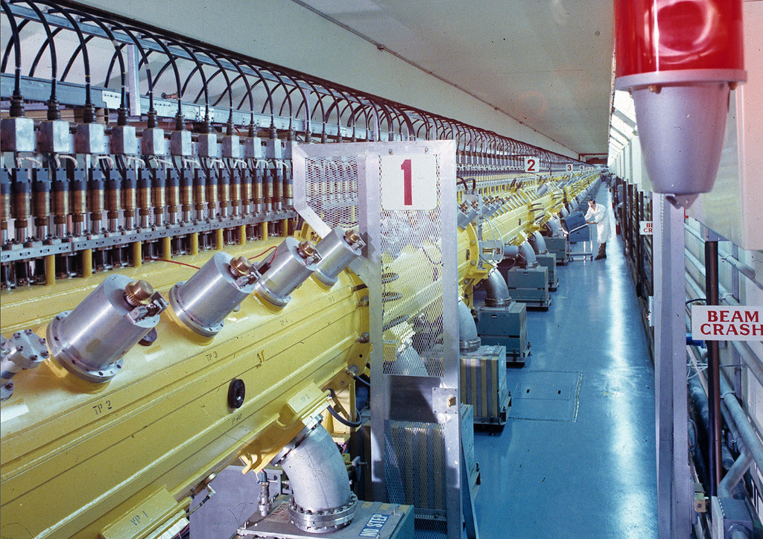
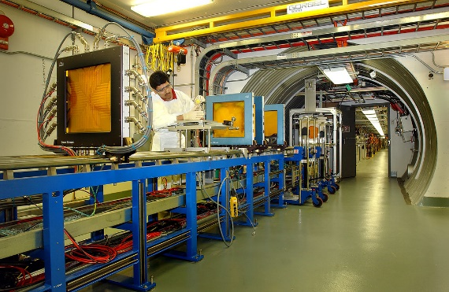
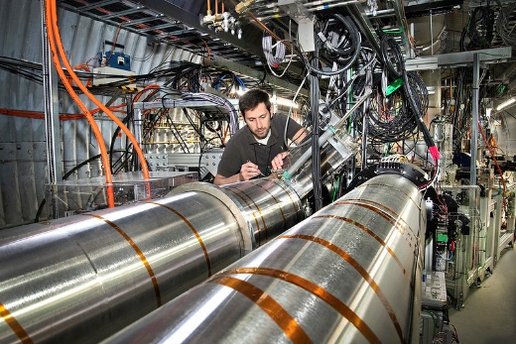
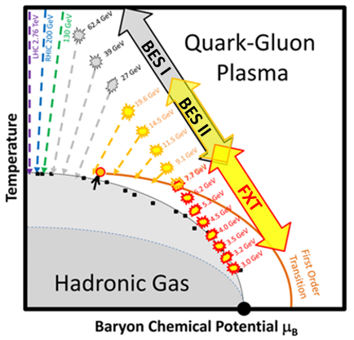
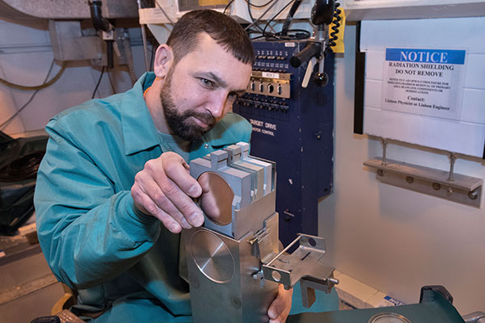
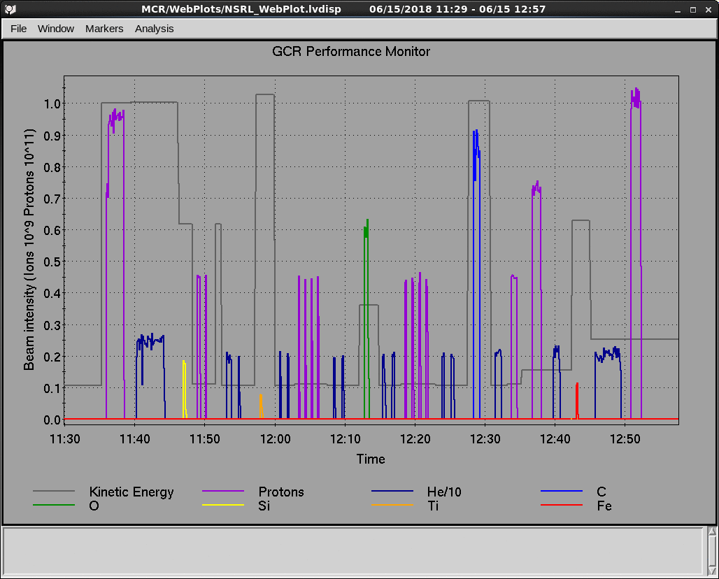
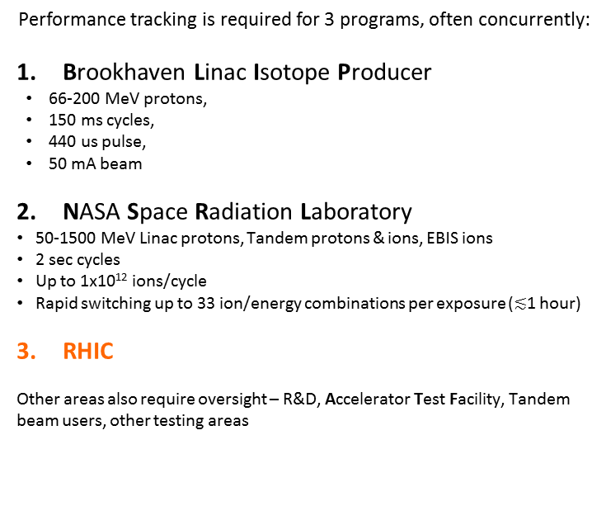
BNL Collider-Accelerator Complex
Performance tracking is required for 3 programs, often concurrently:
Brookhaven Linac Isotope Producer
  66-200 MeV protons,
  150 ms cycles,
  440 us pulse,
  50 mA beam
NASA Space Radiation Laboratory
  50-1500 MeV Linac protons, Tandem protons & ions, EBIS ions
  2 sec cycles
  Up to 1x10¹² ions/cycle
  Rapid switching up to 33 ion/energy combinations per exposure ($≲$1 hour)
RHIC
Other areas also require oversight – R&D, Accelerator Test Facility, Tandem beam users, other testing areas
(NSLS-II)

Slide 8
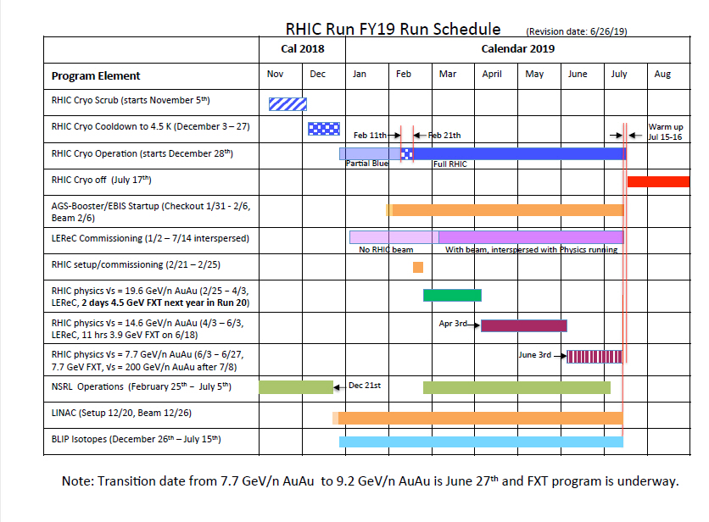
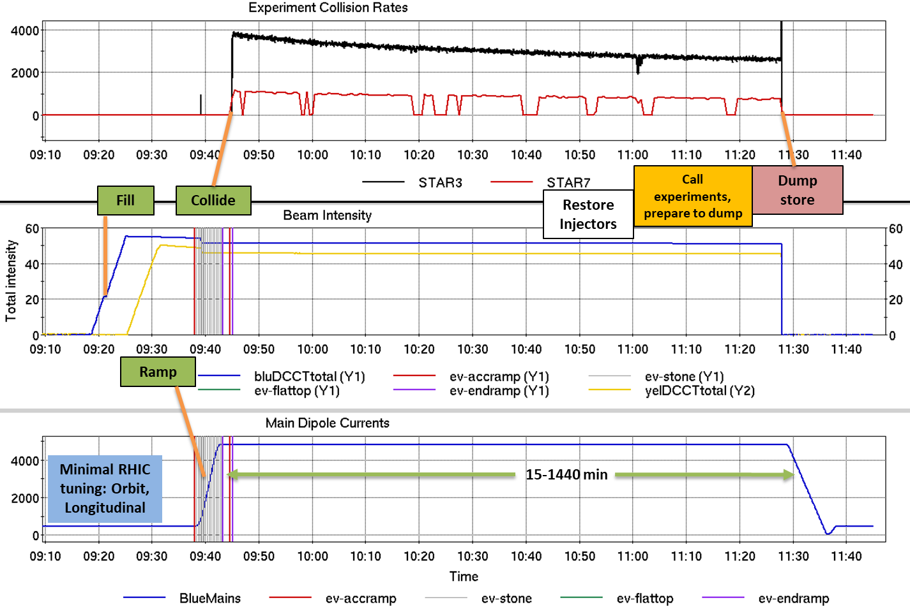
RHIC Operational Cycle
Daily: 0.25-24 hours colliding
Yearly: 20-30 weeks operation, summer shutdown
Monthly: Scheduled Maintenance every 2 weeks, ~8-16 hours

Slide 9
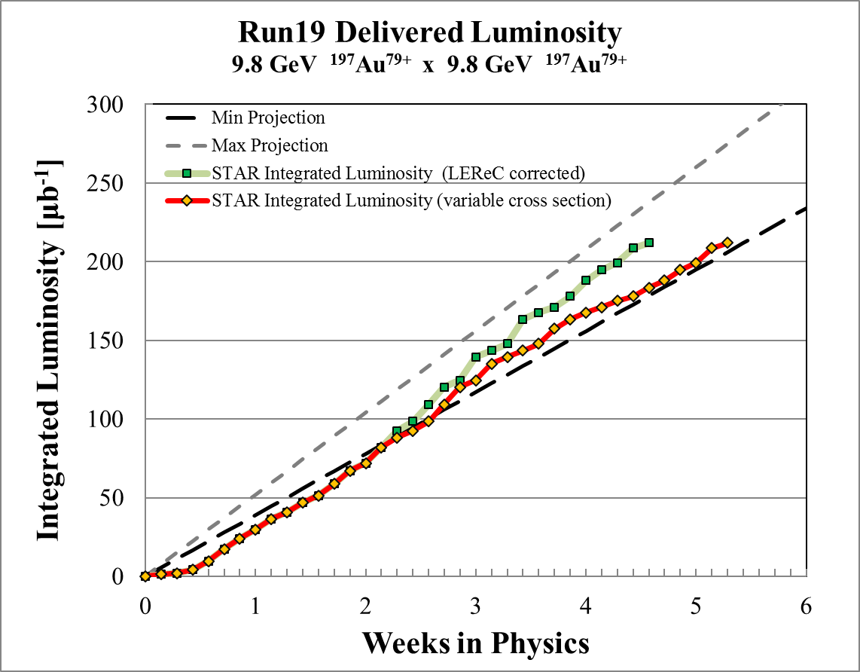
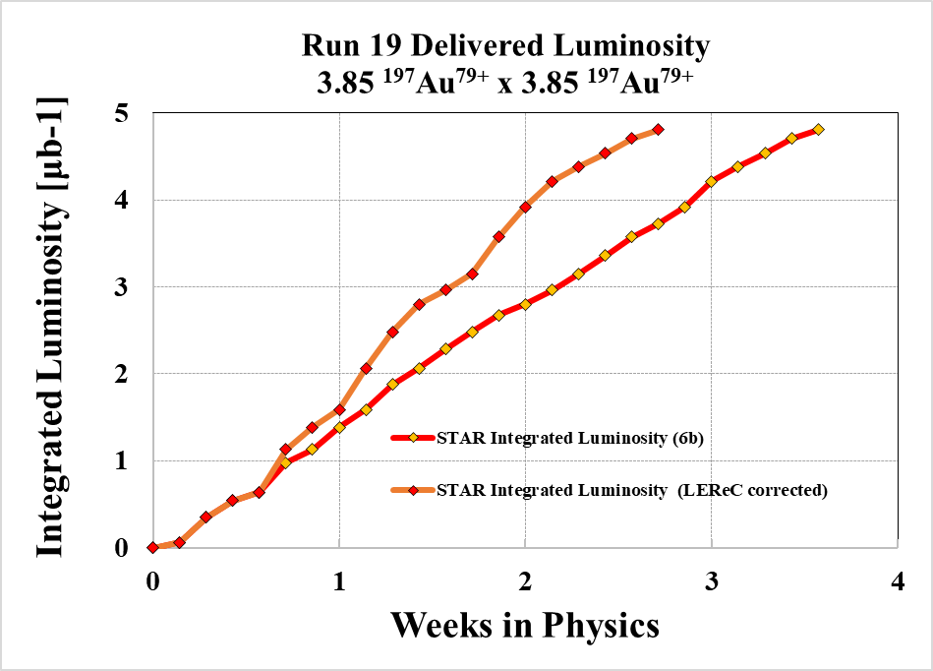
Key Performance Indicators
Courtesy P. Ingrassia
Luminosity is the major metric for RHIC performance. Projections are estimates made prior to the year’s Run.
Isotope production depends upon the availability of the Linac.
NSRL subscribes users and reports performance to NASA; like RHIC, we track availability.

Slide 10


Collider Availability
Courtesy P. Ingrassia
$$RHIC Availability=\frac{Physics+Machine Development+Machine Setup+Experiment Setup+Accelerator Experiments}{(Physics+Machine Development+Machine Setup+Experiment Setup+Accelerator Experiments)+Failures}$$
$$Availability=\frac{Beam use time}{Calendar time−scheduled interruptions}$$
$$Availability=\frac{Beam use time}{Scheduled time}$$
Goal: 80% average for Run, set by US Department of Energy.
Goal is being reset up to 82.5% for upcoming years…

Slide 11
Downtime Root-Causes
Courtesy P. Ingrassia
Root Cause System | Root Cause Duration [h] | % Total Scheduled Operations
Low Energy Electron Cooling | 84.1 | 3.6
RHIC RF | 62.7 | 2.7
RHIC Power Supplies | 49.3 | 2.1
AGS Fast Pulsed Power Supplies | 29.2 | 1.2
AGS Power Supplies | 22.5 | 0.9
Run19 total failure hours = 480 (all systems)

Slide 12
Australian Synchrotron
Nicholas RAE

Slide 13
  Australian Synchrotron - Melbourne, Australia
  3 GeV Synchrotron, 200 mA electrons, beam in top-up
  9 x-ray beamlines, 2 infrared, ODB, XDB
  8 new x-ray beamlines commissioned
  End Product: photons 5000 hours / year
Australian Synchrotron

Slide 14
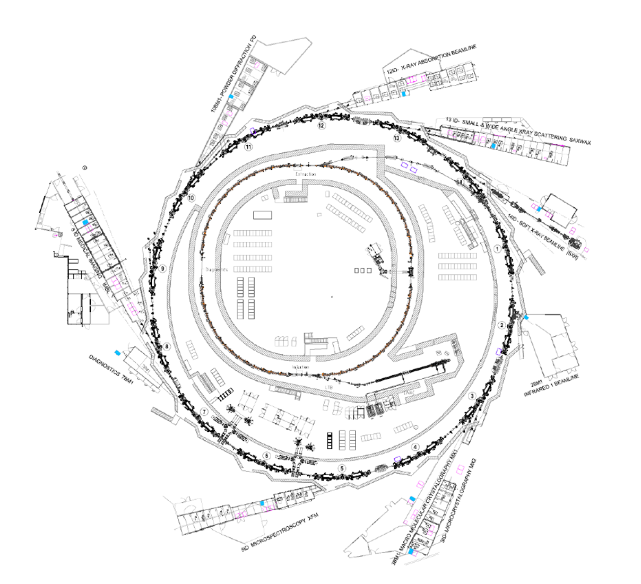
Booster
100 Mev – 3 Gev Booster
3 Cav IOT RF
Storage ring
3 GeV Storage Ring
4 RF Cavities
3 operating, 1 spare
250 kW Klystrons
LINAC
90 KeV Gun
100 MeV linac
2 Klystrons + SLED
1 Hot spare klystron

Slide 15
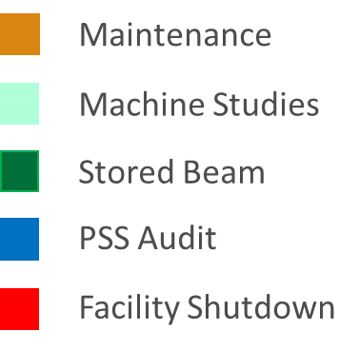
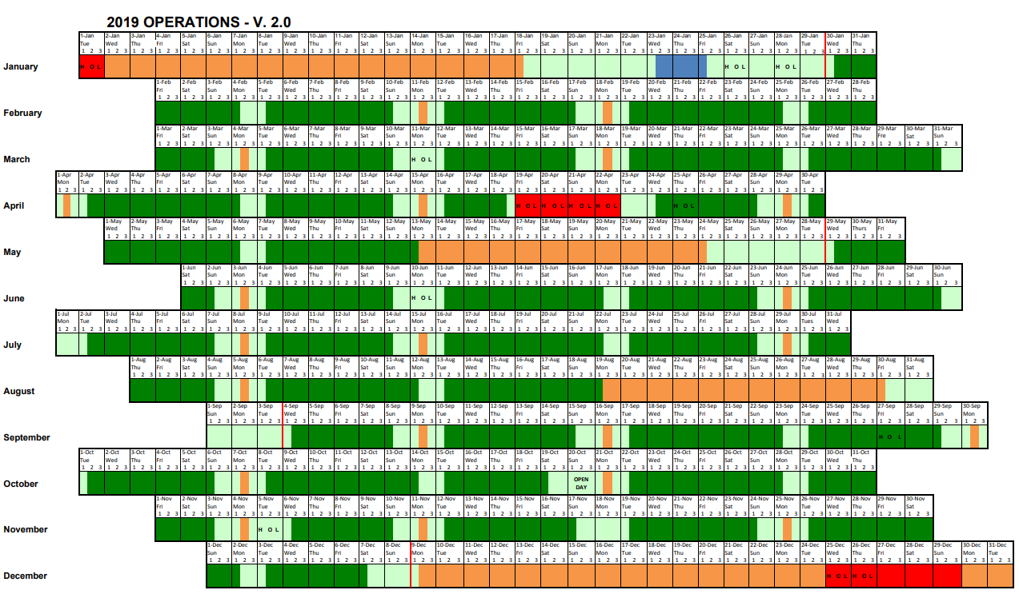
Operational Cycle

Slide 16
Operational Cycle
Maintenance
  Every 2nd Monday
  3 shutdown period per year
  Additional week for new x-ray 8 new beamline commissioning.
Machine studies
  Every Sunday
  Accelerator physics studies
  Testing and maintenance requiring beam
Stored Beam
  X-ray beamline available users
  Operators provide beamline support outside 9-5 hours
  Operate in topup mode

Slide 17
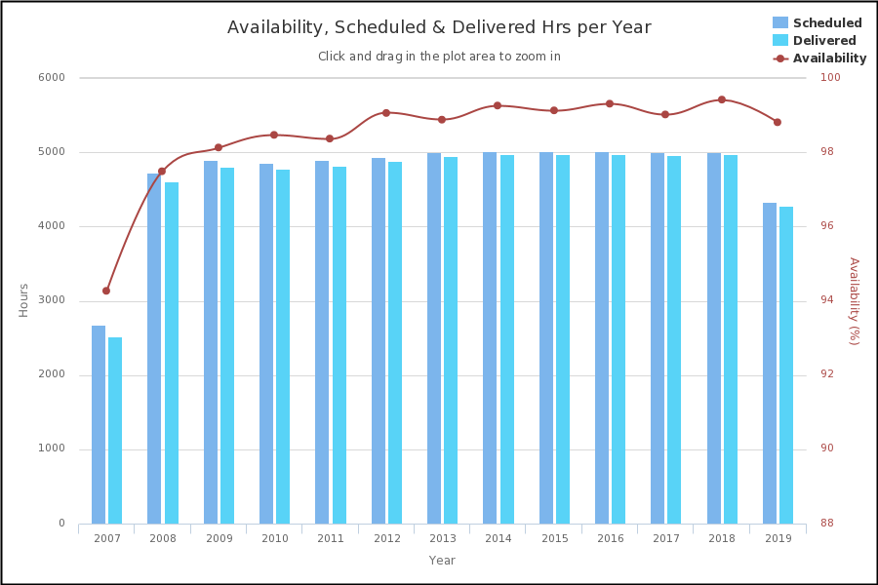
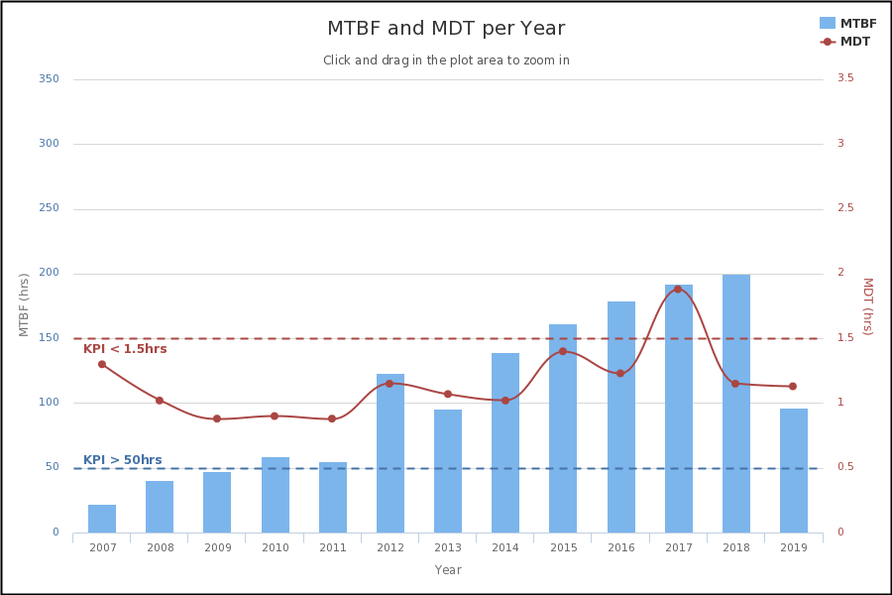
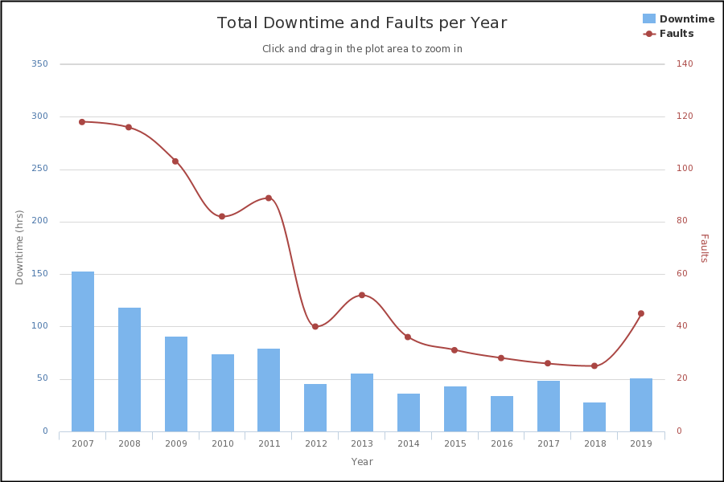
Key Performance Indicators
Beam availability
  16 week Availability > 97 %
Mean Time Between Failure (MTBF)
  16 week MTBF > 50 Hrs
Mean downtime (time to recovery)
  16 week & 12 months < 1.5 Hrs

Slide 18
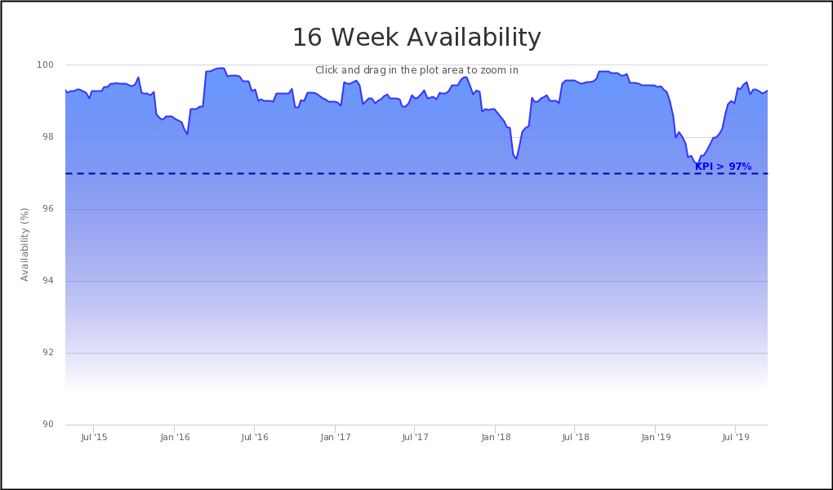
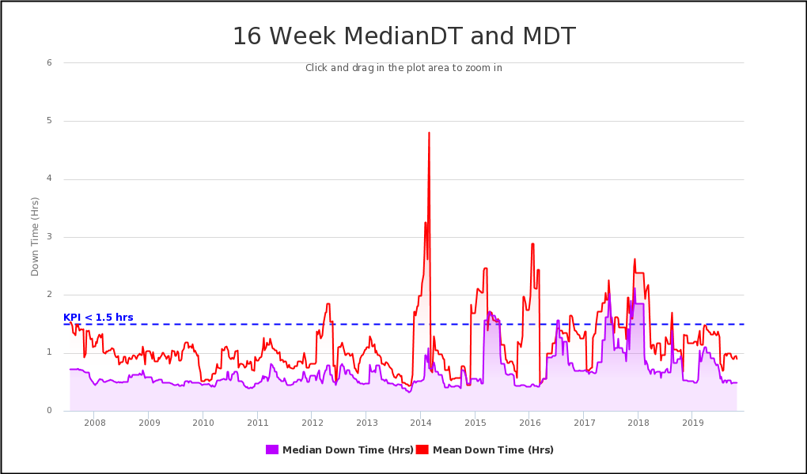
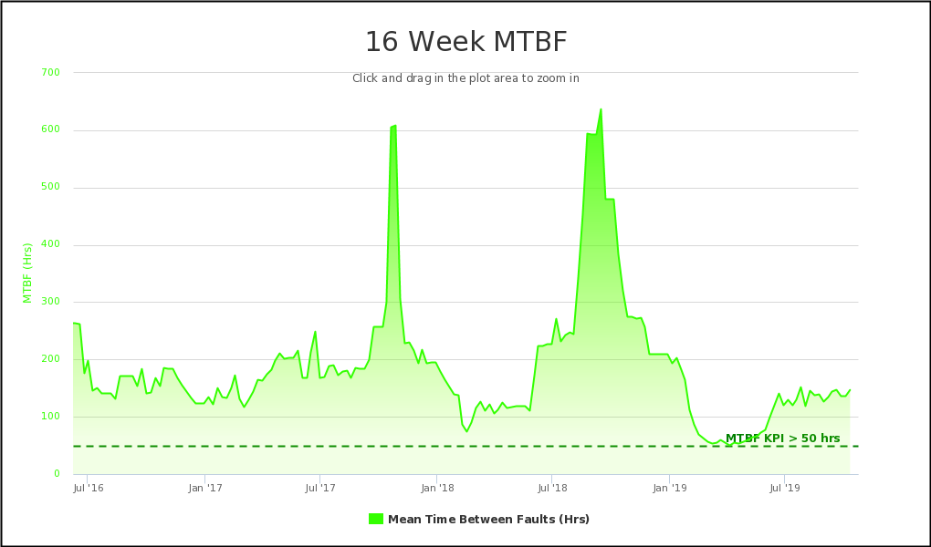
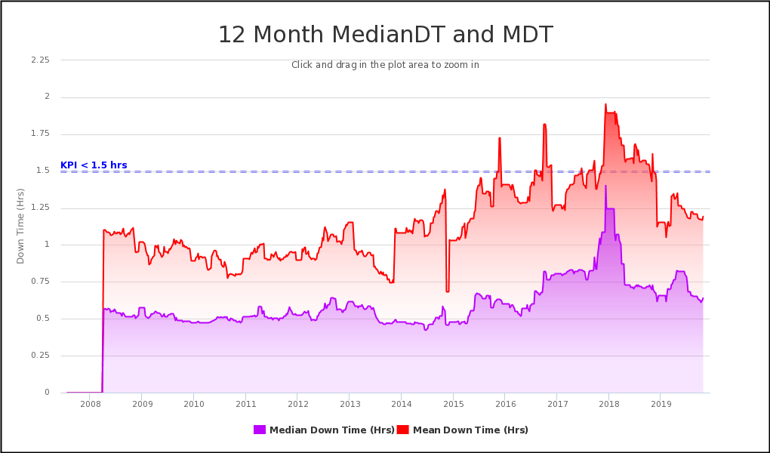
Availability Figures

Slide 19
Top Downtime Root-Causes
Currently:
2018: 25 beam dumps, 28.5 hours downtime
2019(8 weeks): 21 beam dumps, 30.5 hours downtime
Causes
  Plant upgrade to water cooling
  RF system
  Magnet power supplies
Past:
~2012: Implementation of UPS and diesel generator greatly reduced previous root cause: power interruptions. Blackouts, brownouts local lightening strikes etc.

Slide 20
Top Downtime Root-Causes
1. Plant upgrade project
2. Storage ring RF issues
  End of life components
  PSS upgrade
3. Magnet power supplies
  End of life (expected ~ 10 years)
  Being replace as fast as we can source them (lead time 6-18 months)
4. Future: Disruptions from commissioning new beamlines
Thank You

Slide 21
GSI
Oksana GEITHNER

Slide 22
  GSI: Helmholtzcenter for Heavy Ions GmbH
  End Product: Ions
GSI

Slide 23
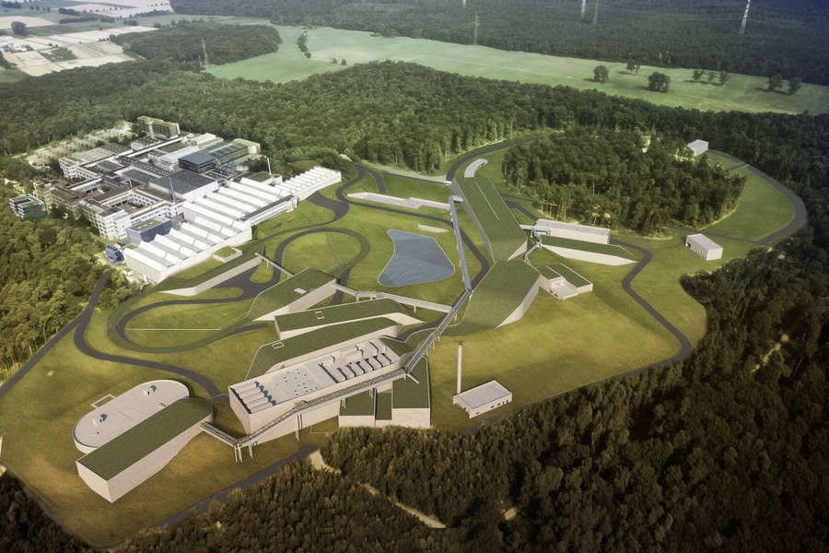
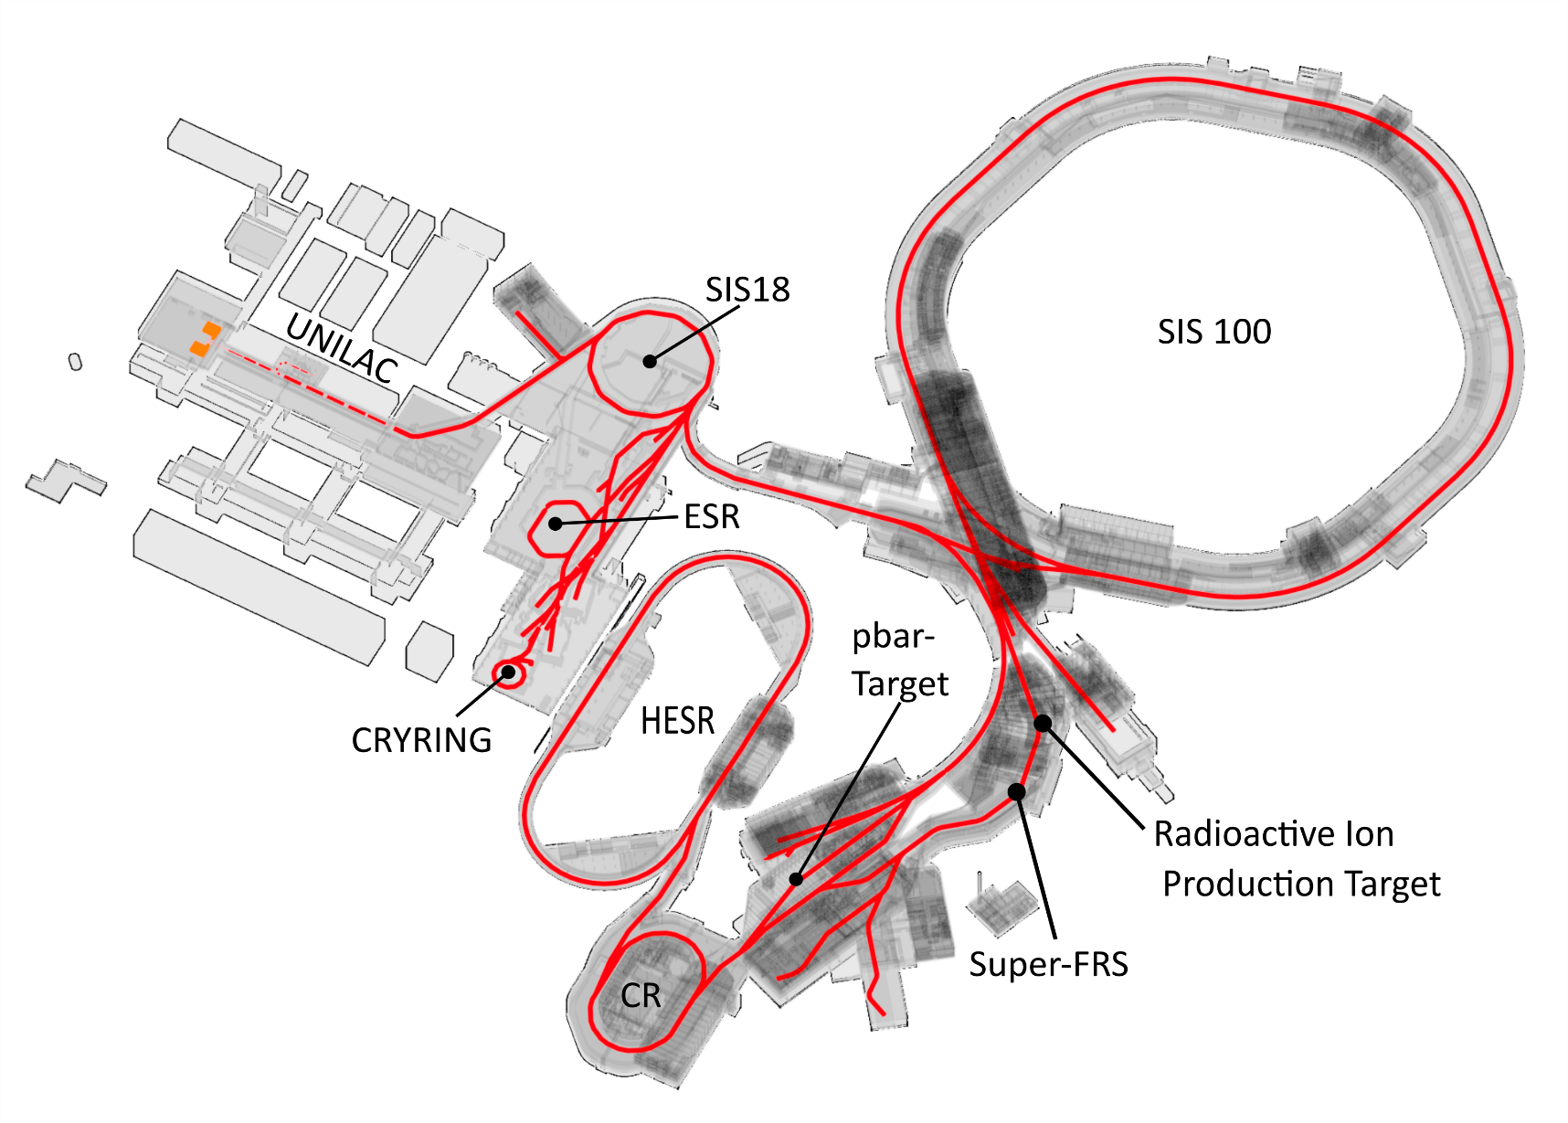
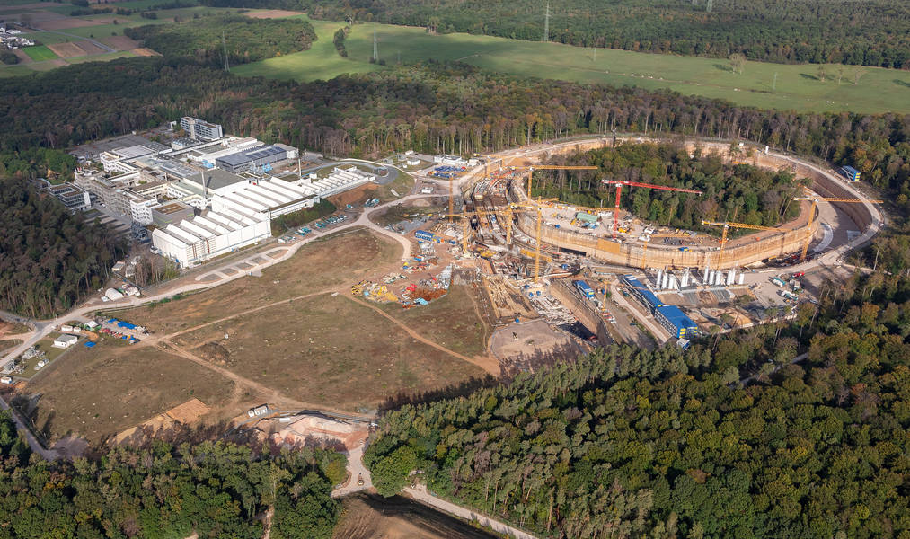
Facility Overview

Slide 24
Operational Cycle
Organisation of main control room, on-call duty, communication
and meetings
Beam Time Periods (ENG RUN, PHYS RUN)
Shutdown Phases
O. Geithner, ACC Operation ARW 2019

Slide 25
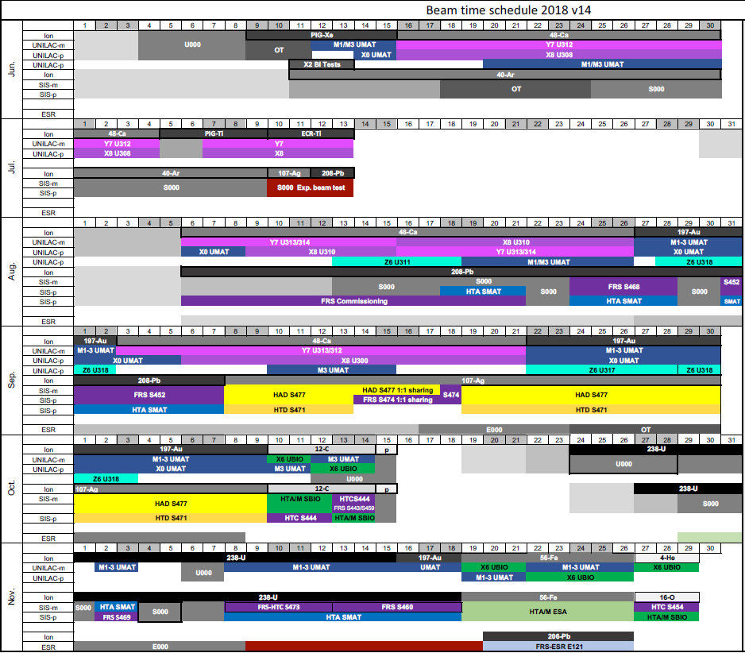
Complex Parallel Operation
O. Geithner, ACC Operation ARW 2019

Slide 26
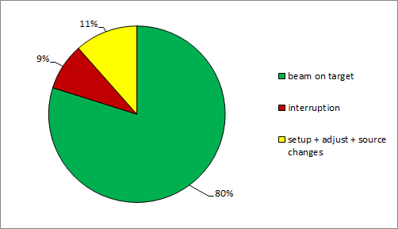
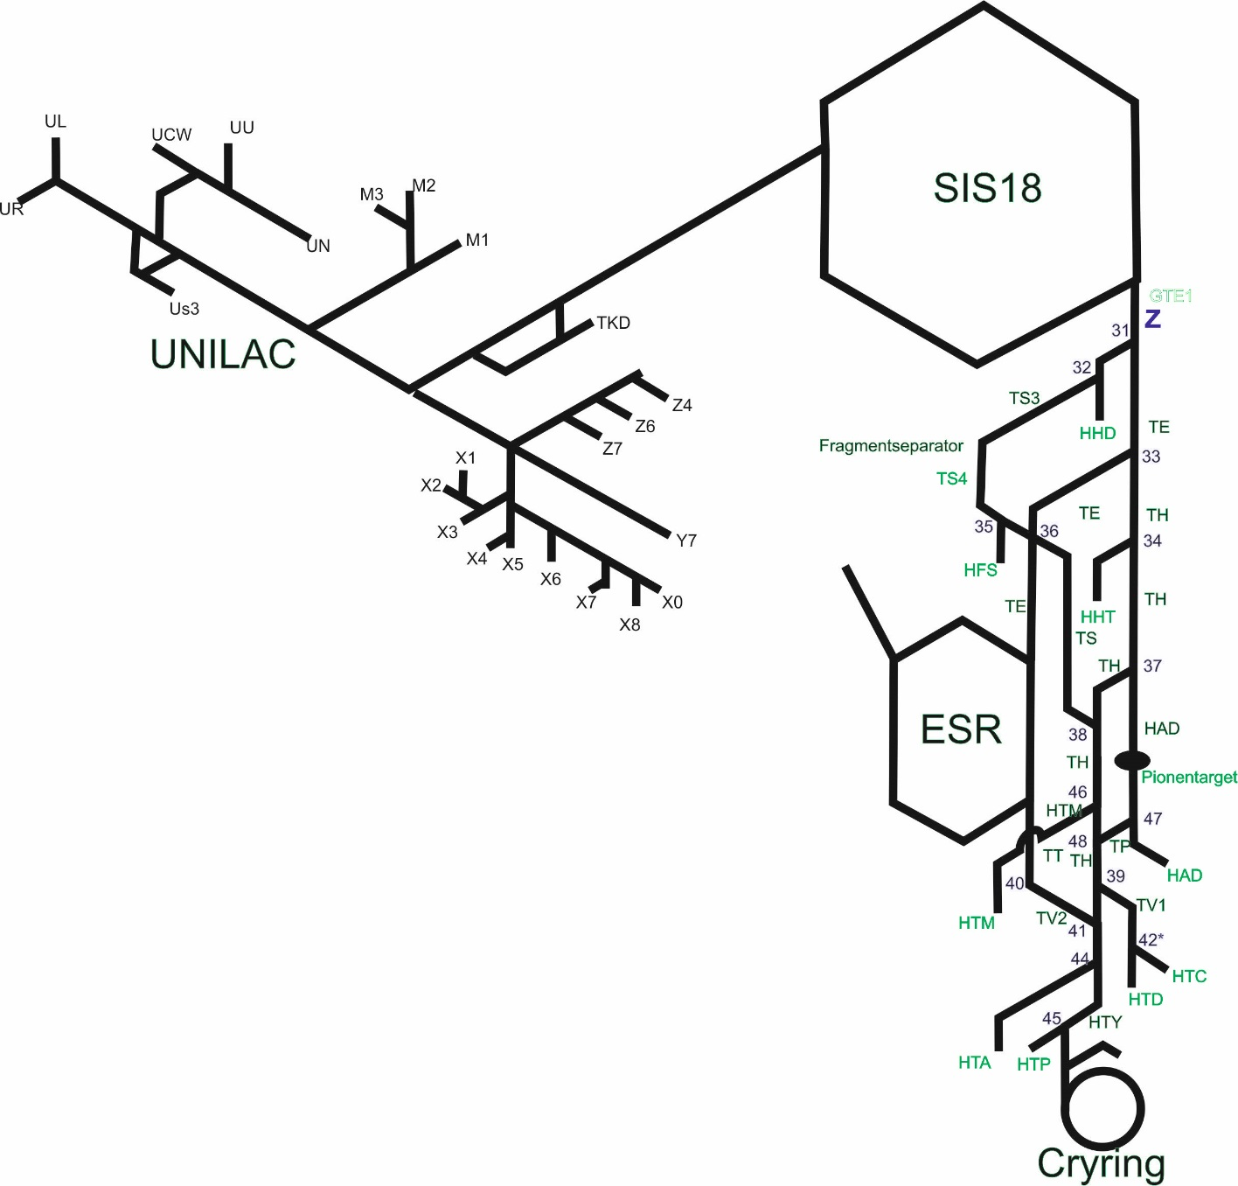
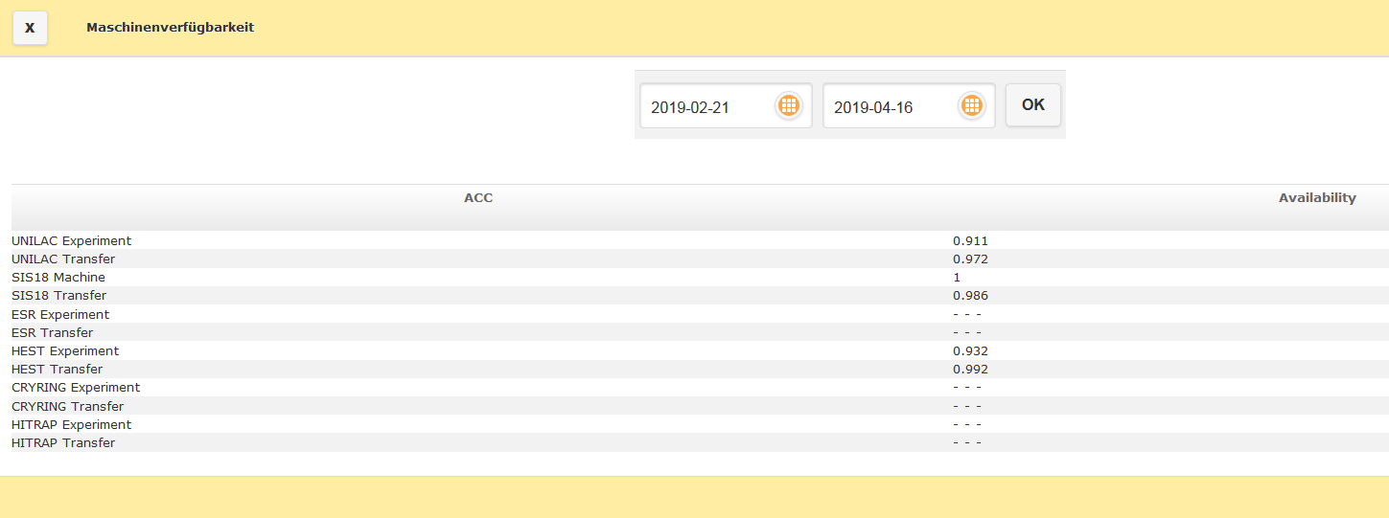
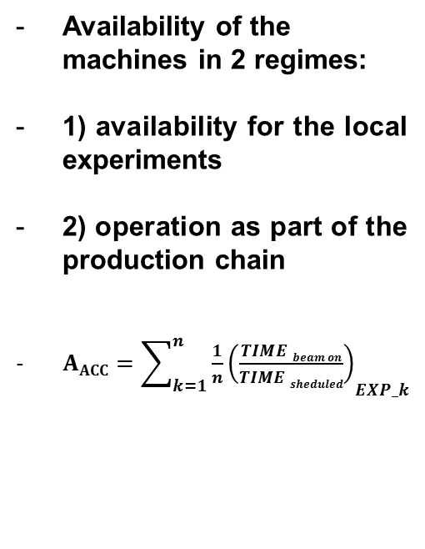
Availability Calculation: experiments and machines
Availability of the machines in 2 regimes:
1) availability for the local experiments
2) operation as part of the production chain
${AACC=\sum_{k=1}^{n}{\frac{1}{n}\left(\frac{TIME beam on}{TIME sheduled}\right)}}_{EXP_k}$
O. Geithner, ACC Operation ARW 2019

Slide 27
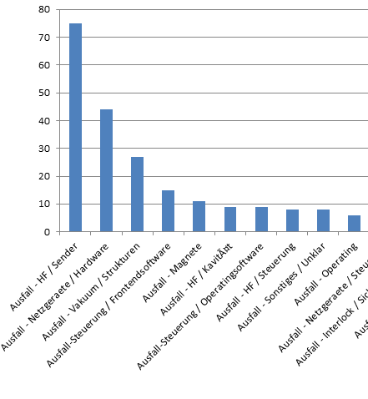
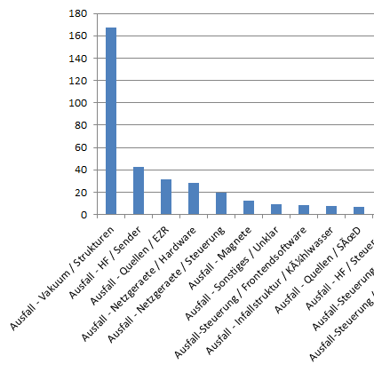
Failure Statistics 2019
Failure Counts
Failure Duration [h]
Magnets
Magnets
RF Cavity
RF Controls
Operating
Vacuum HW
Not identified
Vacuum HW
Not identified
RF Transmitter
Controls Apps
RF Transmitter
Power Supply HW
Ion Source ECR
Ion Source South
Controls Frontend
Power Supply HW
Controls Frontend
Power Supply Controls
Infrastructure Cooling Water
O. Geithner, ACC Operation ARW 2019

Slide 28
Goal: General Comments
As GSI + FAIR is going to be quite large facility, automated failure tracking is a legitim requirement for the future accounting.
Such complex task cannot be achieved over night. Stepwise approach would be
a good way.

Slide 29
Next Steps
Increase the quality of the manually maintaned (by operators) failure data
=> establish an Availability Working Group (AWG).
Members: myself, operator and representatives of the expert groups
Goal: meet every 2 weeks, go through the failure events and complement the data.
AWG Meetings are already sheduled for the end of this year (Engineering Run 2019)
Introduce Beam Performance Factor in Availability Calculation (intensity, macri/micro spill structure, position stability, beam size, dp/p)

Slide 30
Next Steps
Automated generation of the failure events in the E – Logbook (OLOG)
for further manuel processing by Availability Working Group (AWG)
?
Archiving
System
Interlock
System
Interlocks
Buffer
OLOG
ALARM
System
?
AWG

Slide 31
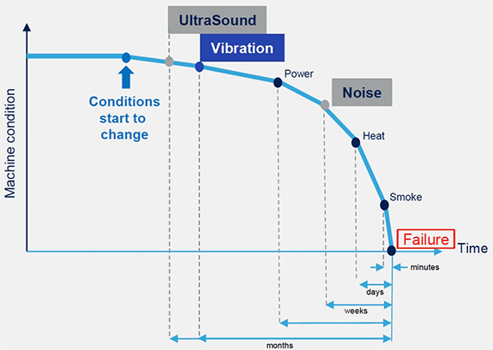
Christmas Wish: Failure Prediction

Slide 32
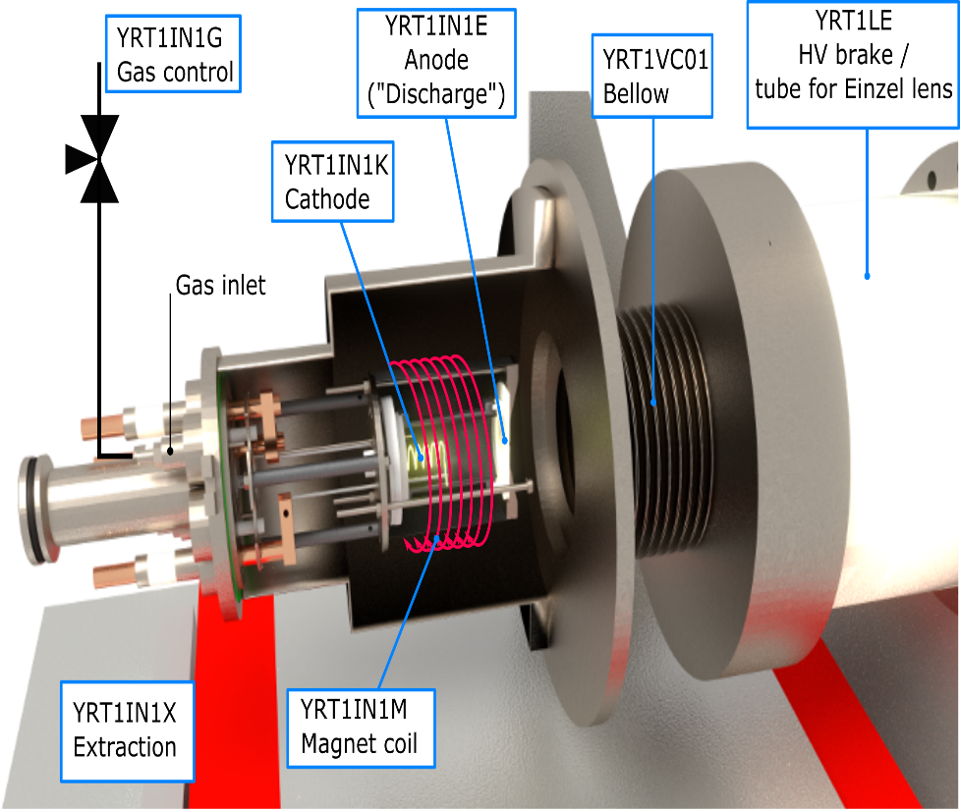
Prototype: Failure Prediction CRYRING@ESR Ion Source
Control / input variables:
anode voltage (YRT1IN1E, pulsed)
gas flow (YRT1IN1G)
cathode current (YRT1IN1K)
solenoid current (YRT1IN1M)
acceleration high voltage (YRT1IN1X)
Output observable:
pulsed ion current, measured with beam transformer, f ~ 0.3 Hz, L_{pulse} ~20-30 μs
Status of Application of Machine-Learning Techniques at CRYRING@ESR:
Talk by W Geithner

Slide 33
SOLEIL
Thomas MARION

Slide 34
  Synchrotron SOLEIL
  30 km South of Paris, France
  End Product: Photons
SOLEIL

Slide 35
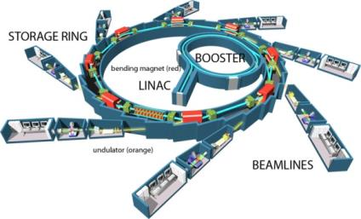





Facility overview
Synchrotron light source of 3rd generation
3 accelerators
  LINAC : 0 → 110MeV
  BOOSTER : 0.11 → 2.75 GeV
  Storage ring : 2.75 GeV
Circumference : 354m
29 Beamlines
27 Undulators
5 Filling modes
Uniform : 500mA
Hybrid : 445 +5mA
1 bunch : 16mA
8 bunches : 100mA
Low alpha : 18mA

Slide 36
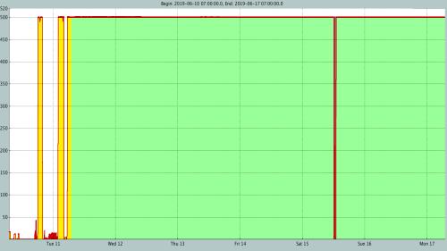
Operational Cycle
In 2019 :
5 RUNs
5 Shutdown periods
35 weeks for users
5100 h of beam for users
1200 h of beam for accelerators
24/7 operation
Every RUN:
5/6 days scheduled to restart & check machine
Shutdown
Machine session
A typical week:
Machine session Monday 7am to Tuesday 7am
1h or more dedicated for maintenance on Mondays (in 2018 – 280 interventions)
144h of beam given to users (6 days - 24h/24)
In case of failure in User session :
The operator reinjects the beam as soon as possible (after diagnostics and analysis)
If the failure needs emergency fix, in each group there is a person on call

Slide 37
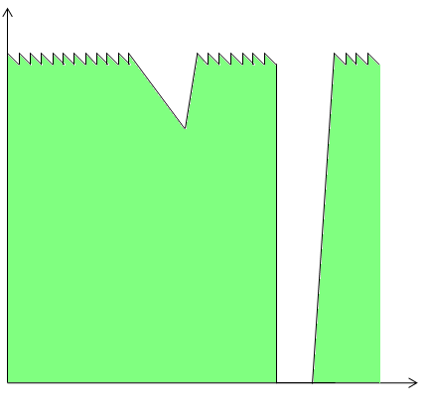
Key Performance Indicators
  Objectives:
    5000h of beam delivered to the user every year
    99% Beam availability
    MTBF 100h
    Beam stable in flux and brilliance
      Beam stable in intensity
      Beam stable in position
      Beam stable in size (10 µm in vertical plane, sub-micrometric stability at 2%)
KPI: Availability, MTBF, MTTR
For No Beam and Top-Up
Inom = 500mA
499,5mA
470mA
  Top-Up failure:
  Current < 99,9% of Nominal
  If Current < Nominal – 30mA (for 500mA)
  close the frontend to reinject → No Beam
Front-End closing for reinjection
  No Beam failure:
  Beam loss
  All Front-End closed
Top-Up failure
  Beam Line failure:
  If beam position and size > 10% of nominal size
  All incident blocking photon use for one or more beamlines (Frontend or undulator)
No Beam Failure

Slide 38
Availability Figures

Slide 39
Top Downtime Root-Causes
59h of Downtime in 2018
Fluid (7 failures - 9h01): Flowmeter default -> clogged filters, bad setting
      Cleaning of all the Magnets & powersupply filter
Others (16 failures - 8h27): Beam blow-up (collective effect) due to a bad local vacuum, after installation of new vacuum chamber.
Human (6 failures - 7h33) : involuntary stop of fluid and forced openning of beamline hutch
Beamlines (8 failures - 6h41) : Electronics of the Personal Safety System

Slide 40
IHEP
Weibin LIU

Slide 41
  IHEP: Institute of High Energy Physics
  Accelerator complex of BEPCII: LINAC → flagship Beijing Electron Positron Collider
  End product: colliding particles, photons
IHEP

Slide 42
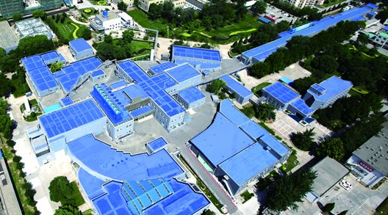
BEPCII Complex
BEPCII — An upgrade project of Beijing Electron Positron Collider (2008)
— A double-ring factory-like machine (1×10³³ cm⁻²s⁻¹ @1.89 GeV)
— Deliver beams to both HEP (1.0 GeV — 2.3 GeV e+, e-)
& SR (2.5 GeV e-, 250 mA)
e+
Linac
Storage Ring
BESIII
e-
BSRF

Slide 43
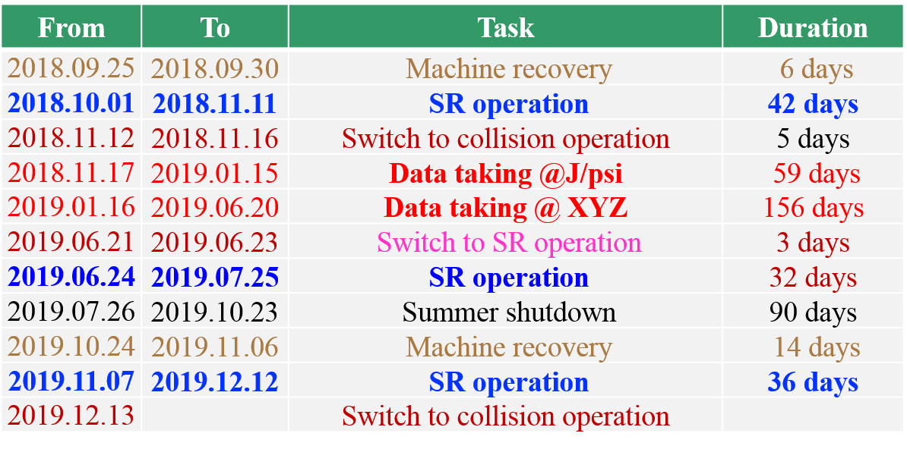
BEPCII Operational Schedule 2018/19
1200 pb⁻¹
3800 pb⁻¹
{
Superconducting 3W1
Beam energy upgrade
Top-up upgrade
Data taking @ E_{beam}>2GeV
9 energy points

Slide 44
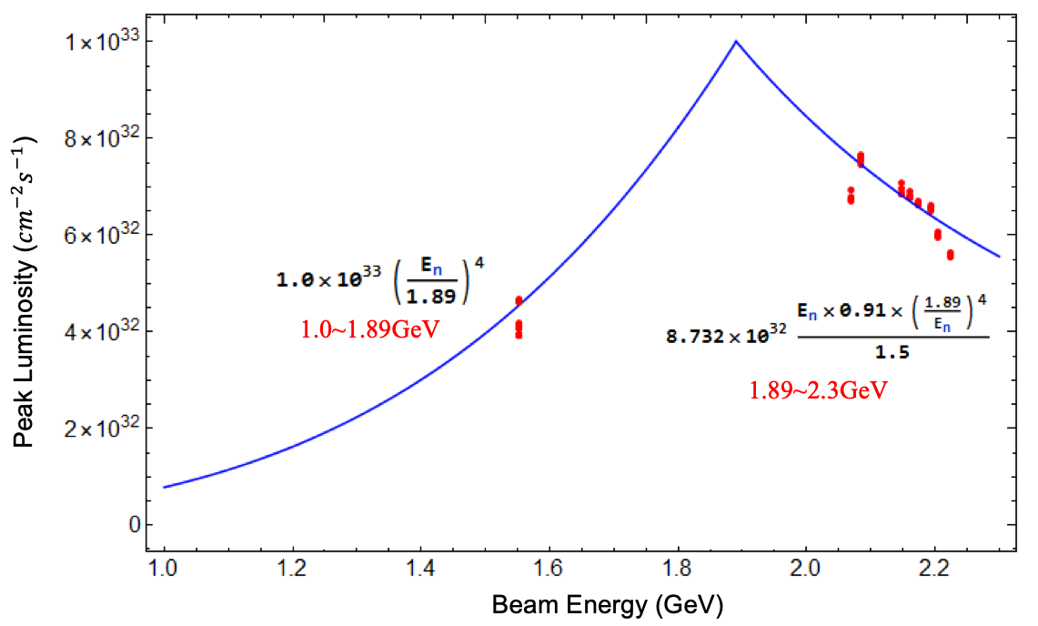
Luminosity of BEPCII 2018/19
The luminosity is the major metric of BEPCII.
Peak Luminosity:
7.666×10³²cm⁻²s⁻¹ @ 617mA*627mA
(Mar. 10, 86 bunches, @XYZ)
4.674×10³²cm⁻²s⁻¹ @ 707mA*723mA
(Jan. 14, 112 bunches, @J/psi)
94.94%
Physics Achieved [pb⁻¹]
Availability [%]

Slide 45
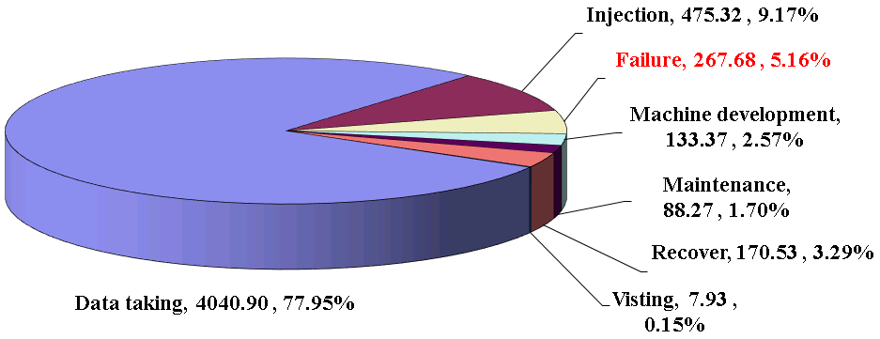
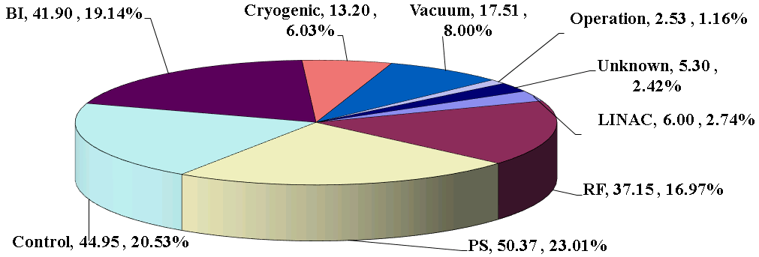
BEPCII Status of Collision Operation 2018/19
Machine statistics
Accelerator failure: 267.68 hrs., 422 times
The faults of kicker power supply were a little more than before. Kicker power supply faults: 7 times, 18.41 hrs.
The failure of the air conditioner in the equipment room caused the feedback system to work in an unstable state.

Slide 46
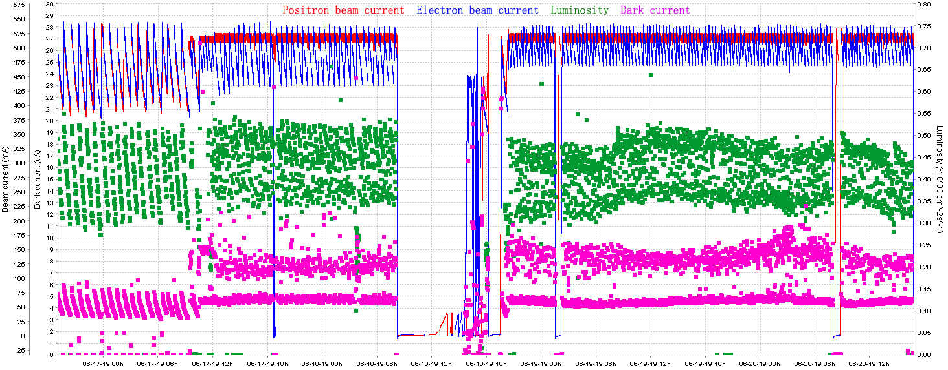
Top-up Upgrade Testing of Collision Operation
e+: 510 — 525mA, e-: 470 — 535mA
Continuous Top-up operation
from Jun. 17 to Jun. 20, 2019
Fully automatic, works well, stable enough.
Average integral luminosity increased by 25%.

Slide 47
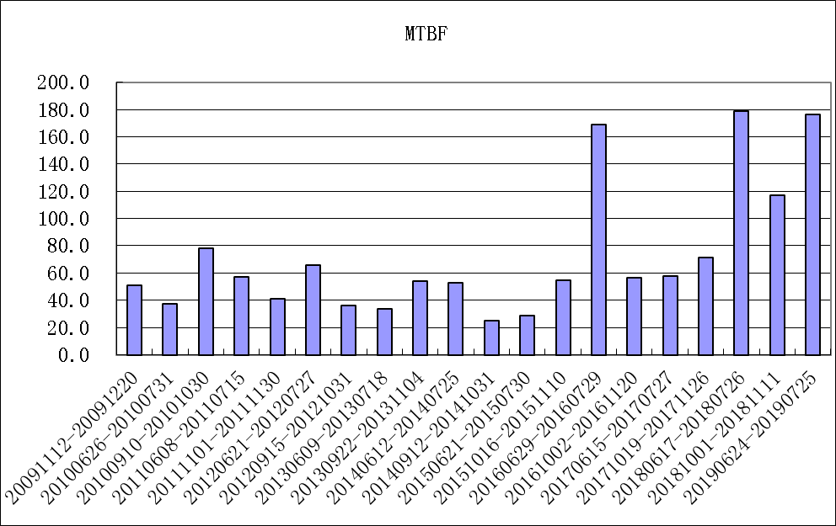
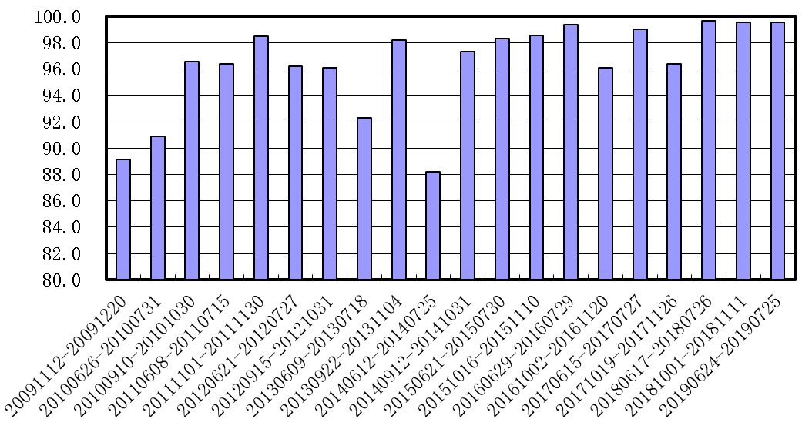
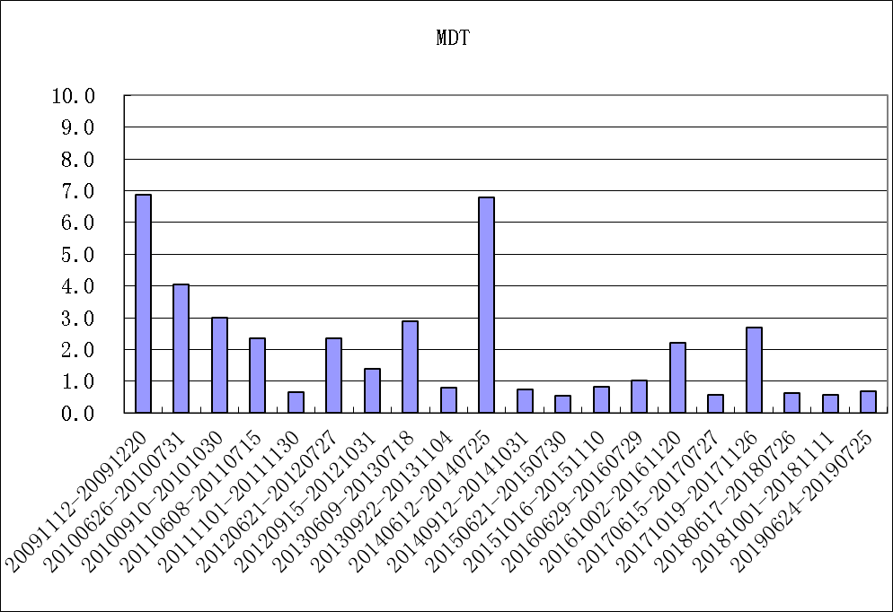
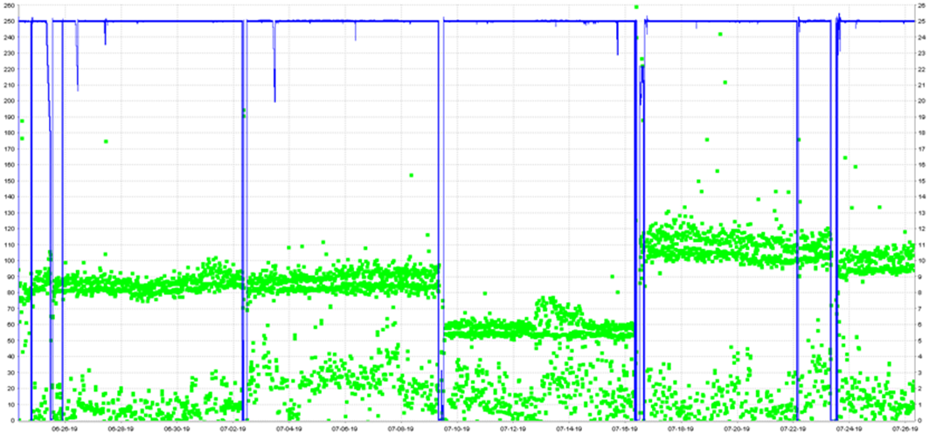
BEPCII Availability of SR Operation 2018/19
Availability: 99.54%, MTBF: 129.77 hrs., MDT: 0.6 hrs.
Availability
MTBF
MDT
A photon absorber was misaligned in the installation direction. Which caused one beam line (4B9) to fail to see light.
When solving the control problem of wiggler 4W2, an incorrect magnet gap was set. This leaded to the decrease of beam life time.
Thank you!
Top-up @2.5 GeV, 250 mA

Slide 48
DESY
Michael BIELER

Slide 49
  DESY: Deutsches Elektronen Synchrotron
  Accelerator Complex: Flagships PETRA III, FLASH, European XFEL
  End product: Photons
DESY

Slide 50
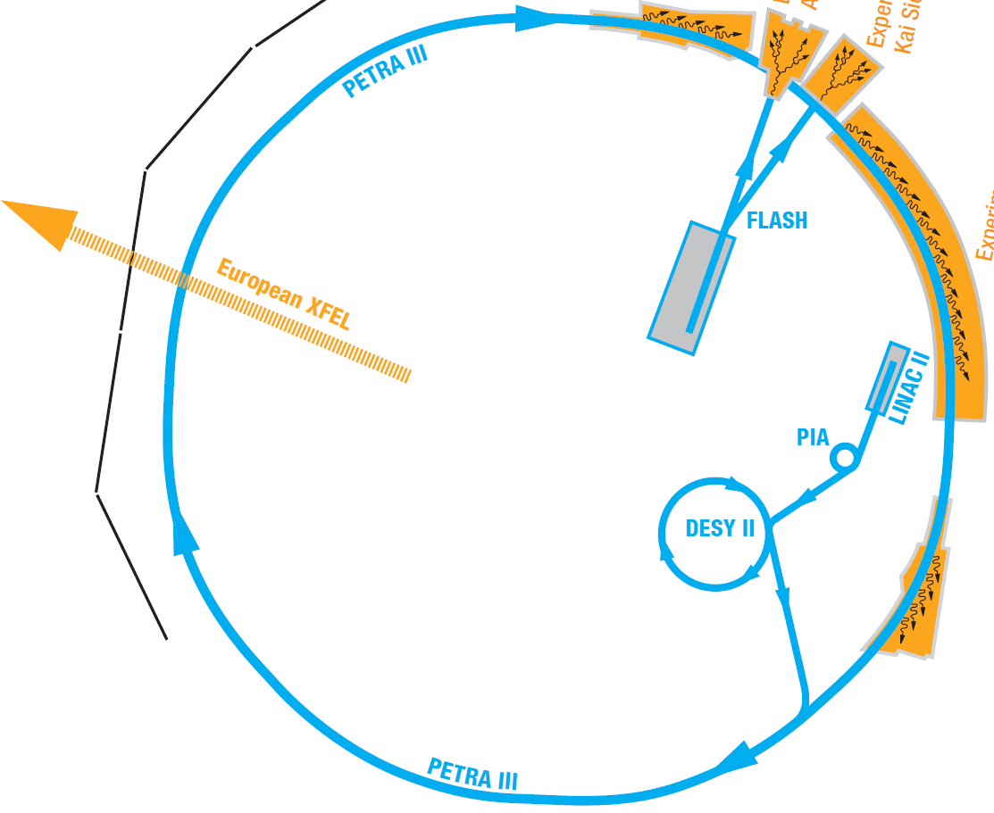
DESY’s Accelerators
Linac II 1970 450 MeV e+/e-
PIA 1970 450 MeV e+/e-
DESY II 1990 7 GeV e+/e-
PETRA III 2009 6 GeV e+/e-
FLASH 2003 1.2 GeV e-
XFEL 2016 17.5 GeV e-

Slide 51
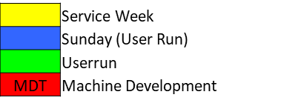
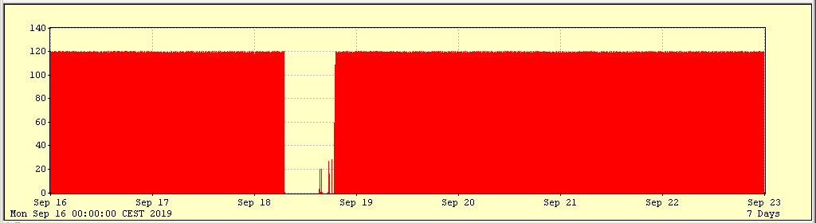
PETRA III Operational Cycle
  Winter Shutdown
  Summer Break
  4800 User hours per year
  Machine development on Wednesdays
  Top Up operation for the rest of the week

Slide 52

PETRA III Key Performance Indicators
  PETRA III delivers the brightest high energy electron beam: 1.2 nm rad x 12 pm rad @ 6 GeV
delivered beam time
KPI: Availability =
scheduled beam time
Definition:
Fault: Every beam loss of more than 25%

Slide 53

PETRA III Availability 2019
98,44 %
2018:
96,37 %
as of Oct. 13
Power Glitch
Service Week
Summer
Break

Slide 54


Top Downtime Root-Causes
  Main causes of downtime in 2019:
  Power Glitches
  Kicker Magnets
  Magnet Power Supplies
as of Oct. 13

Slide 55
Institut Curie - Protonthérapie
Samuel MEYRONEINC

Slide 56
  Institut Curie –Centre de Protonthérapie d’Orsay
  Accelerator Complex: 1 cyclotron for 3 treatments rooms
  End product: Protons
PARIS

Slide 57


Centre de Protonthérapie d’Orsay
1957 Research physical center
----------------------------------------
1990: Creation of CPO (network)
1991: 1st Ocular treatment
1 Room – Fix. Line
1993: 1st intracranial treatment
2 Rooms – Fix. Lines
2004: Integration
into the Institut Curie
2006 1st General Anesthesia
2010 New cyclotron + 1 Gantry
2011 1Gantry +2 rooms (Horiz line)
2019 11 000 fractions/year - %PBS
Cyclotron
230 Mev
(IBA)
Gantry Room:
All tumors
(IBA)
Y2 Room: Ophthalmic Tumors
(Home made)
Y1 Room: Intracranial tumors
(Home made)

Slide 58






Centre de Protonthérapie d’Orsay
Gantry room

Slide 59
CPO Operational
Typical day
6h30 - 7h30 technical startup and warm-up
2 days per week with 30 minutes of maintenances
7h30 - 8h30 Beam checks (by users)
8h30 – 19h15 – use for clinics (treatment or Quality Control) -11 hours of operations
after 19h15 several options
Extra-time to finish the clinical activity (if case of large activity or delays during the days)
evening session for Periodic Tests
evening session for experimentations (physics, or mainly radiobiology in vitro or in vivo)
Typical week
  5 days of operation
  Some saturday morning or week-end of maintenance
Typical year
  52 weeks of treatment
  Only 4 fridays + week-end for large quarterly maintenance sessions

Slide 60
General Key Performances Indicators (CPO)
Branding
external
- number of sessions of treatment done
- medical publications (local control, survival rate)
- Annual green light from authorities (Medical/ Nuclear Safety / Quality Assurance)
- patient satisfactions (formular filled)
Analysis
internal
Happy Users
internal

Slide 61



3 Technical Key Performances Indicators (CPO)
% patient treated the day scheduled
Branding
external
1
Detailed Uptime:
sum of downtimes/
Normal time of operations
Analysis
internal
2
Feedback from medical users:
are you OK ? List of top-problems
Happy Users
internal
3
Prioritar target: avoiding events with TTR >2h >>> 0,5day >>> 1 day

Slide 62

CPO Latest Availability informations
Treatments session done and % done the D Day
Years
nb sessions
report 3 rooms
% Done the D Day

Slide 63
Top Downtime sources (for accelerator)
Branding
external
1. Regular Ions source problems
2. long duration events on the deflector
3. General capacity of diagnosis for some systems
Analysis
internal
Happy Users
internal

Slide 64
CERN
Benjamin TODD

Slide 65
  CERN: European Organisation for Nuclear Research
  Accelerator Complex: LINAC → Synchrotrons → flagship Large Hadron Collider
  End Product: colliding particles, hadrons or ions
CERN

Slide 66


Slide 67

  LS = Long Shutdowns for Upgrades
  Run = Production Period
  White = Shutdown
  Green = Production
  Blue = Development
  Production Fault recover and refilling

Slide 68


Key Performance Indicators

Slide 69
2018: Availability Figures

Slide 70
2018: Top Downtime Sources

Slide 71
2018: Top Downtime Sources
Root Cause System | Root Cause Duration [h] | % of Total Duration
Injector Complex | 237.9 | 23.7
Cryogenics | 187.3 | 18.6
Power Converters | 101.0 | 10.1
Quench Protection | 75.2 | 7.5
Radio Frequency | 49.2 | 4.9
= 650.6 hours
= 64.7%

Slide 72
Round Table

Slide 73
Questions
  How are operations and faults managed? Together / separately?
  What level of integration has equipment with operations?
  What authorities manage faults and fault information?
  Who ensures that the faults which are recorded are consistent?
  Who is using the fault information, and what for?
  How are dependencies figured out between faults?
  What examples are there of reliability driven improvements?
  Are people making use of predictive models based on fault data–
  e.g. identifying hidden sequences / dependencies forewarning larger issues…

