Slide 1
Configuration control
Methods of checking and maintaining
Proper DEVICE configurations

Slide 2
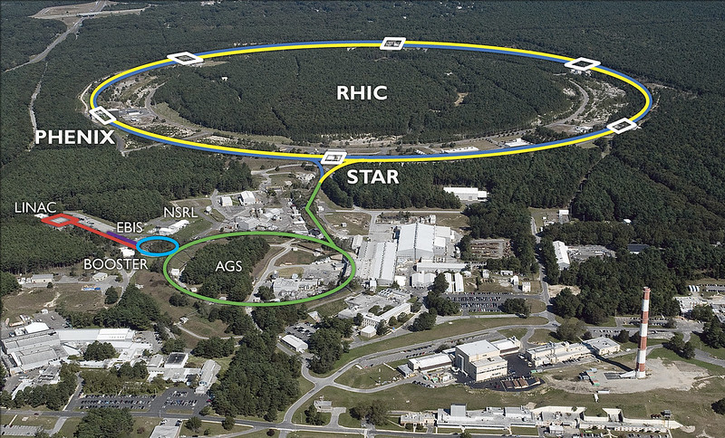
BNL’s Collider-Accelerator Complex
~2 million control points
“World first” systems alongside elderly ones.
Multiple concurrent programmes.
Frequent configuration changes.
“Open door” policy for accessing controls.

Slide 3
Programmes
BLIP (Brookhaven Linac Isotope Producer)
Continuous high intensity proton beams require precise control to avoid potentially serious radiation incidents.
NSRL (NASA Space Radiation Laboratory)
Slow extracted beam with varied ion species, charge states, and energies.
Quick changes, reliability, and repeatability are critical.
RHIC (Relativistic Heavy Ion Collider)
Beam energy scan project requires repeated mode switches for collider and parts of the injector chain. Consistency is critical.

Slide 4
Specific times of vulnerability
Collider/Injector mode changes
Changes made to thousands of devices—must be consistent every time.
Complex-wide maintenance
Changes to many systems that interact in many different ways.
Mistakes made in maintenance activities.
Power disruptions
Can cause hundreds of mini-failures, often breaking things in unexpected ways.
Spontaneous changes
Old equipment can degrade or change with no warning.
New equipment is not always well understood, and can act in unexpected ways.

Slide 5
Configuration Control Tools
Reactive
Proactive/preventive
Settings archives (through “Pet”)
Device lists with values.
Saved on a timer or by users.
Set History
All settings saved to database.
pscompare
Saved on a timer or by users.
Creates a list of greatest to smallest differences among power supplies.
“TAPE” scripting language
Provides consistency in mode switching.
watchManager
Separate devices with user set limits.
Sends alarms when limits are exceeded.
Permit Reference Display
For Machine Protection or Beam Permit systems.
Highlights configuration problems.

Slide 6
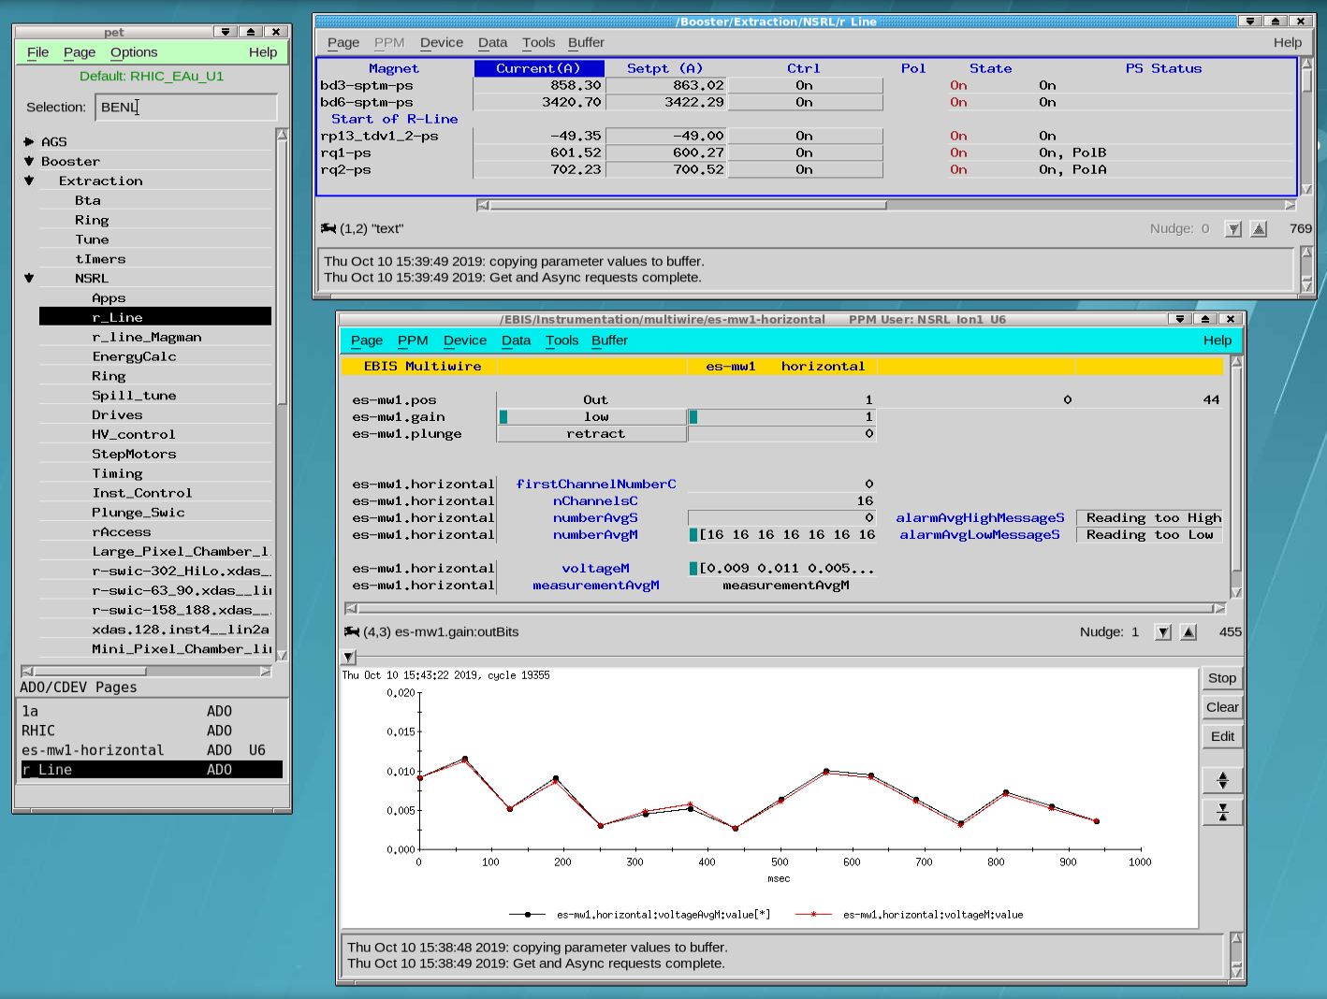
Pet—Parameter Editing Tool
Basic interface used to control most devices in the complex.
Very powerful. Looks like it was made with cardboard, markers, and a glue stick.
Features like nudge, graph, setting history and archives are a click or two away.
Hundreds of pages.

Slide 7
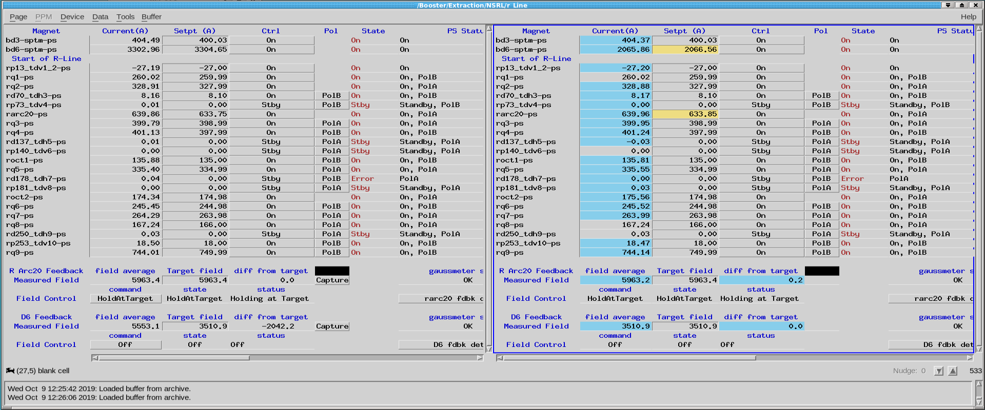
Archive Comparisons
Archives saved periodically and manually as needed.
Measurement differences show up in blue, setting differences in yellow.

Slide 8
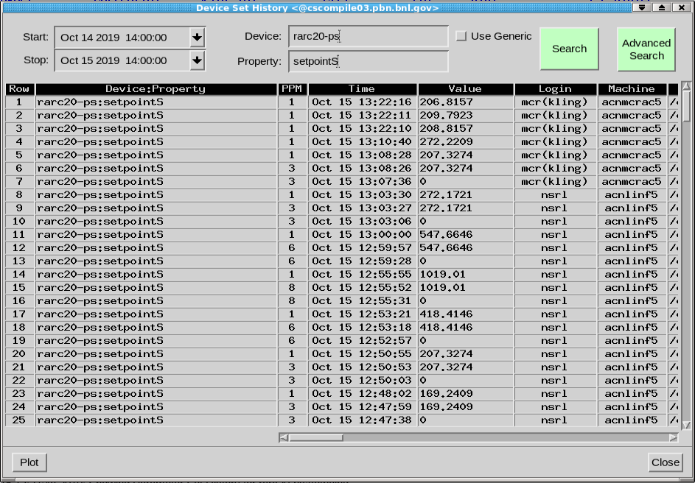
Set History
All setting changes (regardless of how they are made) are recorded to a searchable database.
Very helpful for finding rogue changes—and rogue users.
Tends to get choked, so careful filtering is required. This slows down investigations a lot.

Slide 9
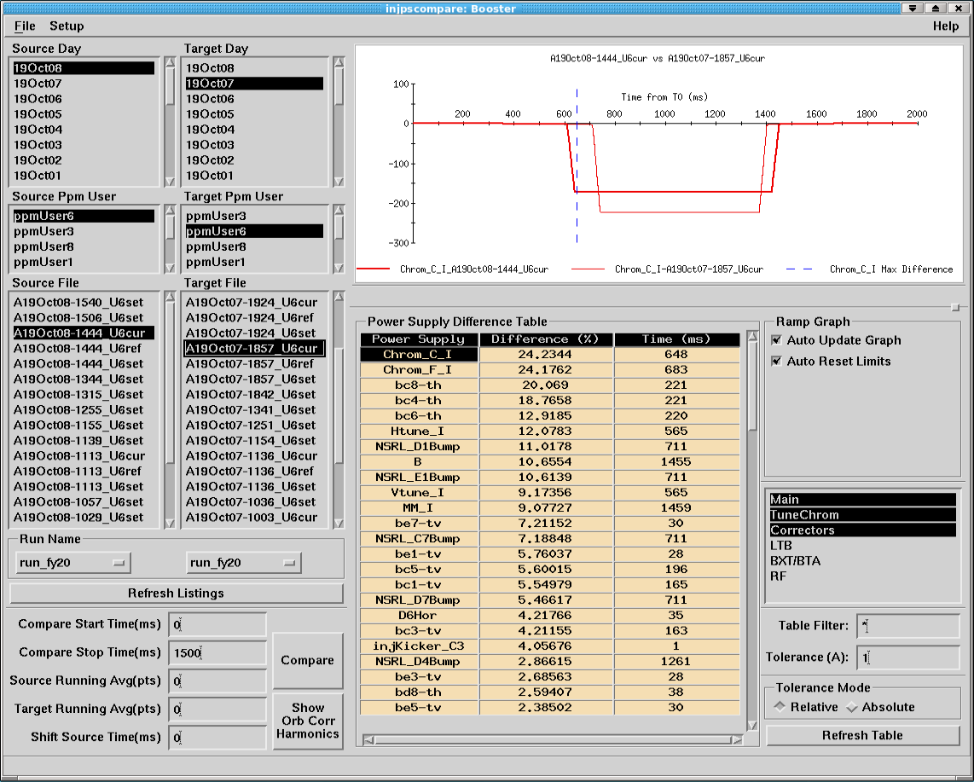
pscompare
Available for EBIS, Booster, AGS, and RHIC.
Captures functions and readbacks for comparison.
Highly configurable and filterable.
Cumbersome. Gives no sense of the relative importance of different deviations.

Slide 10
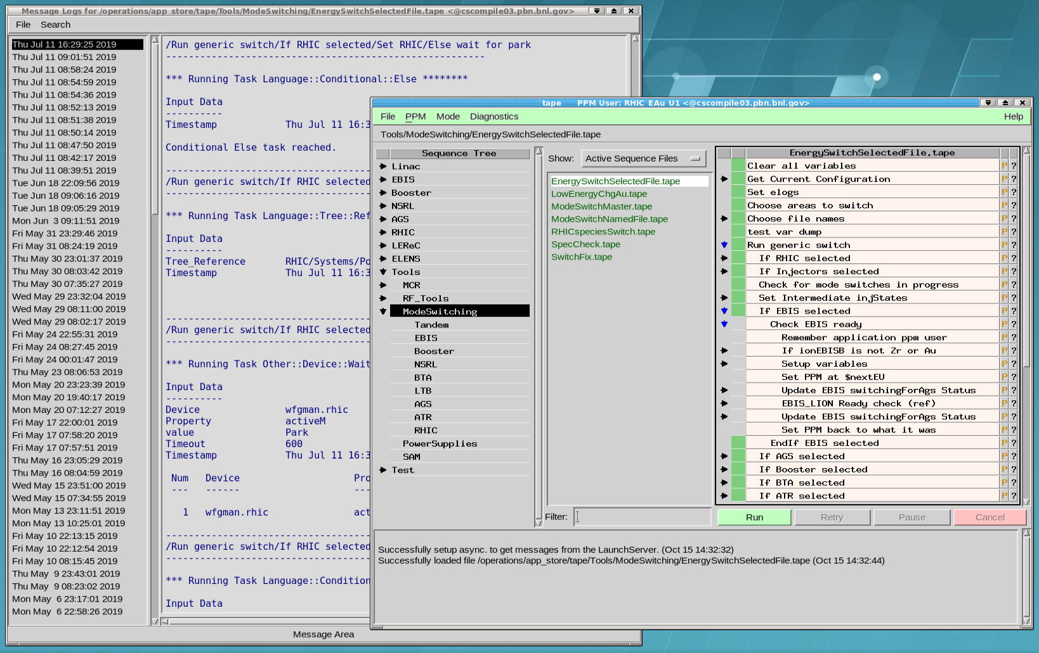
TAPE—Tool for Automated Process Execution
Highly configurable scripting system.
Allows for hundreds of settings in seconds.
Every step is visible as it executes. Every step is logged.
Critical to rapid mode switching.
Used to restore to known good configurations.

Slide 11
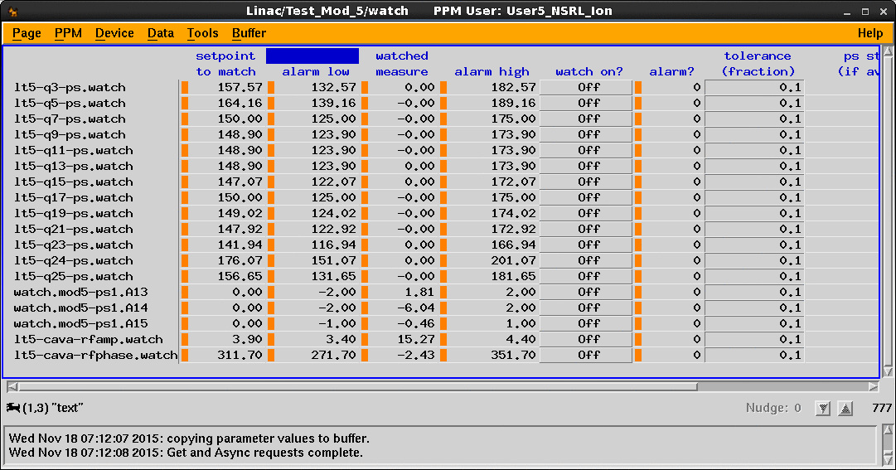
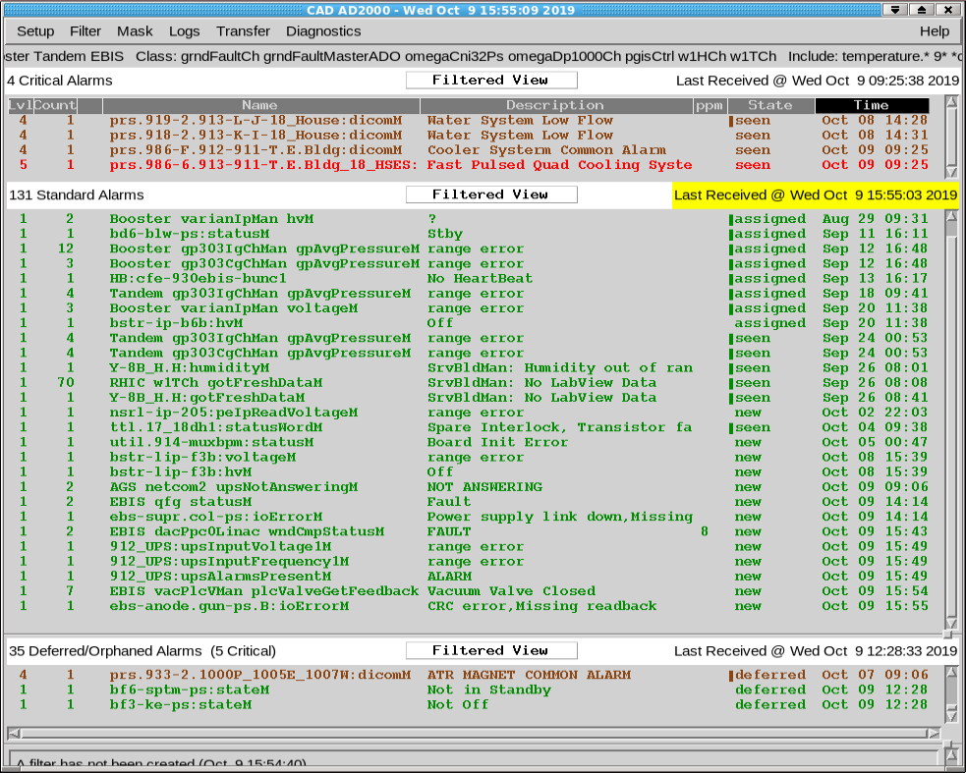
watchManager
Instances can be created for any steady-state supply.
Highly configurable, with offsets, scaling ratios, etc.
Can be tweaked individually by Operators or Specialists.
Generates alarms for Operator response.
Static supplies only.

Slide 12
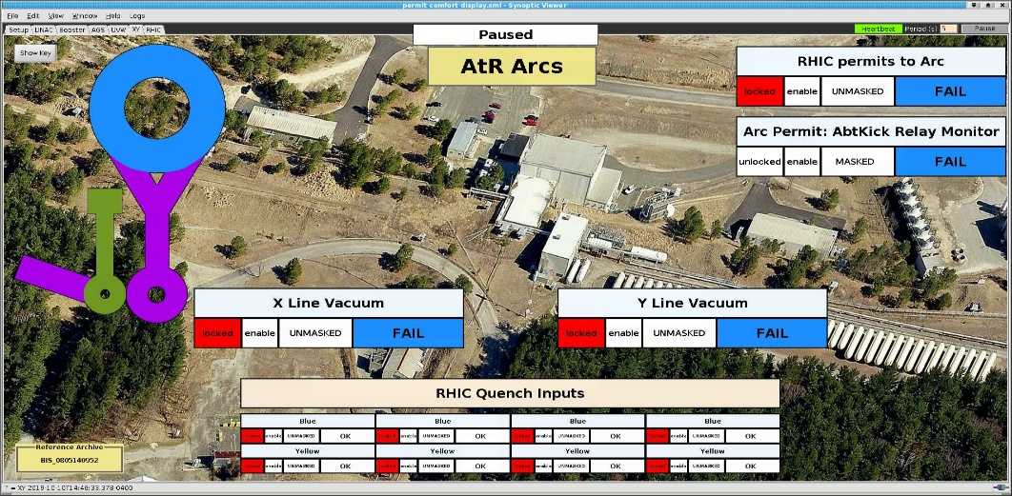
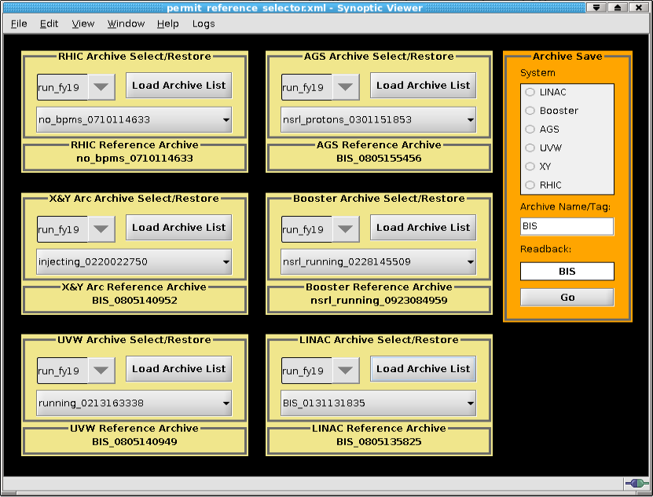
Permit Reference Display
Built using custom manager software and FermiLab/BNL’s “Syndi” application.
Standard permit configurations are saved by users. Each subsystem has a reference configuration loaded.
Inconsistencies show up in red.
Failed permits show up in blue.

Slide 13
Future Plans/Upgrades
A version of watchManager to look at array values (pulsed power equipment, etc) should be available soon.
Bug fixes and shading subtleties in Pet archive comparisons will be implemented.
Permit Reference Display upgrade to include additional Machine Protection Systems.
Resurrect “spy” page to show who is making changes in real time.

Slide 14
Conclusions
Proper configuration control can prevent hours of downtime or days of degraded performance.
It can also help prevent catastrophic failure.
It’s a very low-cost/high-impact principle.
It’s not very exciting.
When it’s working properly, no-one notices.

Slide 15
Examples (1)
Power dips take out kickers. They do not come back the same. Timing can be scrambled. Pulse shapes or heights can change.
Random lurches of power supply outputs. Often all we see is a loss of efficiency in an accelerator or transfer line. Then we find ourselves scrambling to find the culprit.
Physicist taking measurements from his office without requesting permission. Naughty!
“Activate” sent from a stale application left an idle machine in the wrong state. Why is “start pulsing” also “send this function?”

Slide 16
Examples (2)
Return from machine studies. Configurations can be wildly different and documentation of changes can be poor!
FEC self-reset with a bad cache. Some values reverted to defaults with no indications! Expert intervention was required.
A vacuum valve permit was disabled to allow vacuum and kicker work simultaneously. Then it was forgotten about.
A specialist modified MPS settings without a proper understanding of the effect and consequences.
Incorrect power supply settings used in initial setup. Experimenters’ cross-check used the wrong analysis file.

