Slide 1
LHC BLM system: Fault detection methods
Accelerator Reliability Workshop Nov 2019
Christos Zamantzas on behalf of the BLM team.

Slide 2
Contents
System Overview
System Checks
Documentation & Planning
Availability Statistics
Future Developments
Conclusions

Slide 3
System overview

Slide 4
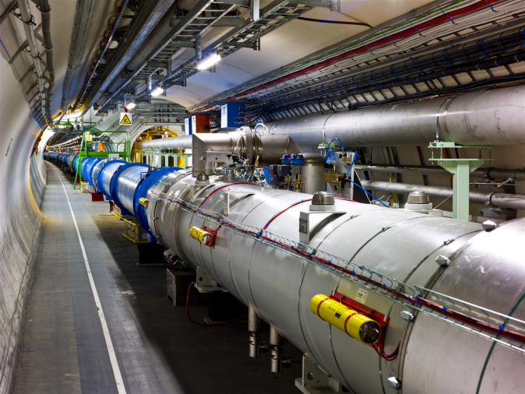
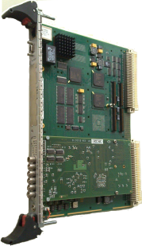
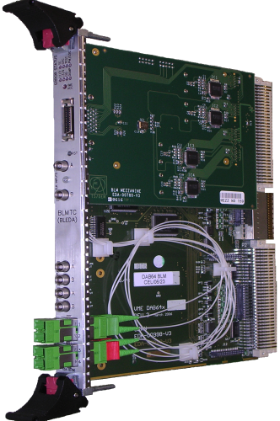
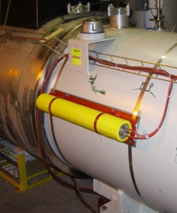
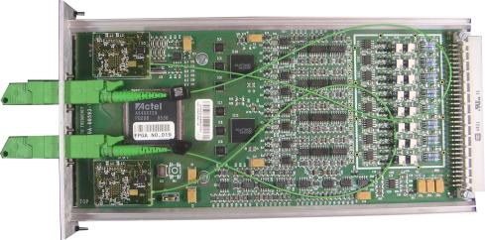
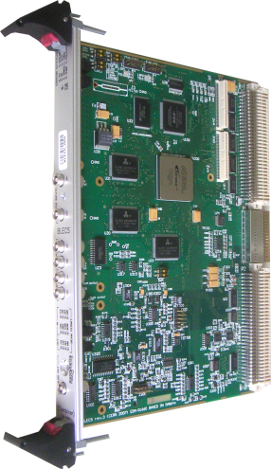
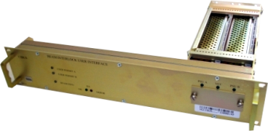
LHC BLM System Overview
Highly critical system for the protection of LHC
Deployed all around the 27 km of the tunnel
Speed, Reliability, Fail-safety is required
Large amount of measurement data are published continuously
Settings and Thresholds
Front-end CPU
Databases, fixed displays…
Processing, Analysis & Decision Modules
Beam Loss Monitors
x27
Acquisition Modules
Combiner and Survey
Beam Interlock Interfaces
x400
x4000
x700
around the LHC ring
x27
x16
Tunnel
Surface

Slide 5
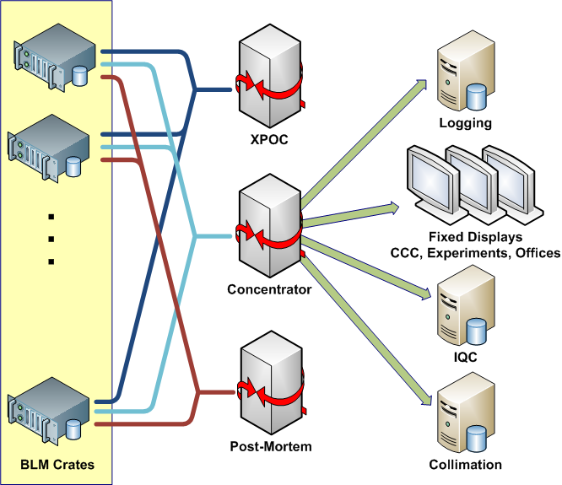
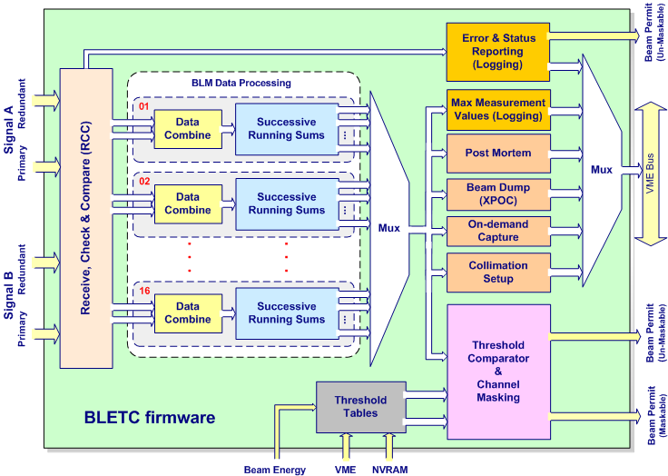
LHC BLM System Data
High data volumes & multiple applications
8.6 billion records/day , 100’000 variables, 300 GB/day
Recording at 1Hz in a Logging DB via a Data Concentrator
Measurements and Thresholds used
System statuses and diagnostic data
Designed system monitoring processes to protect and predict failures from degradation and aging
System is self-tested continuously
Automatic external regular checks

Slide 6
System Checks

Slide 7
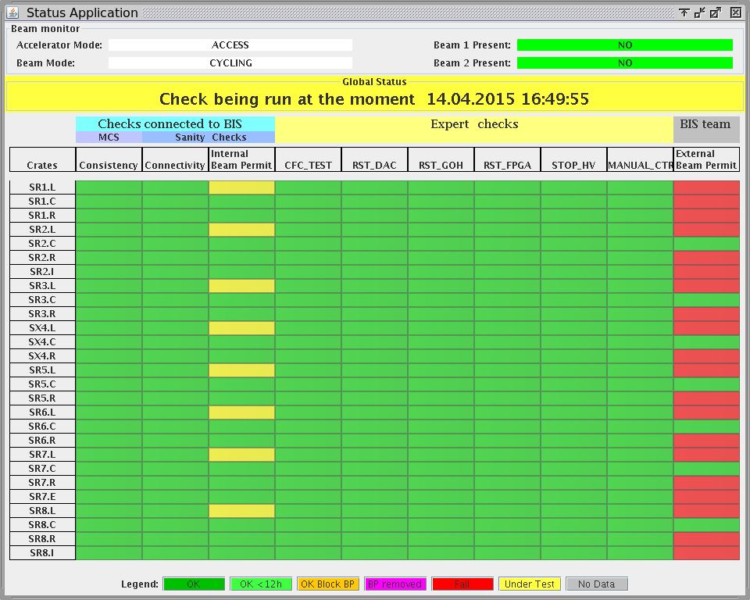
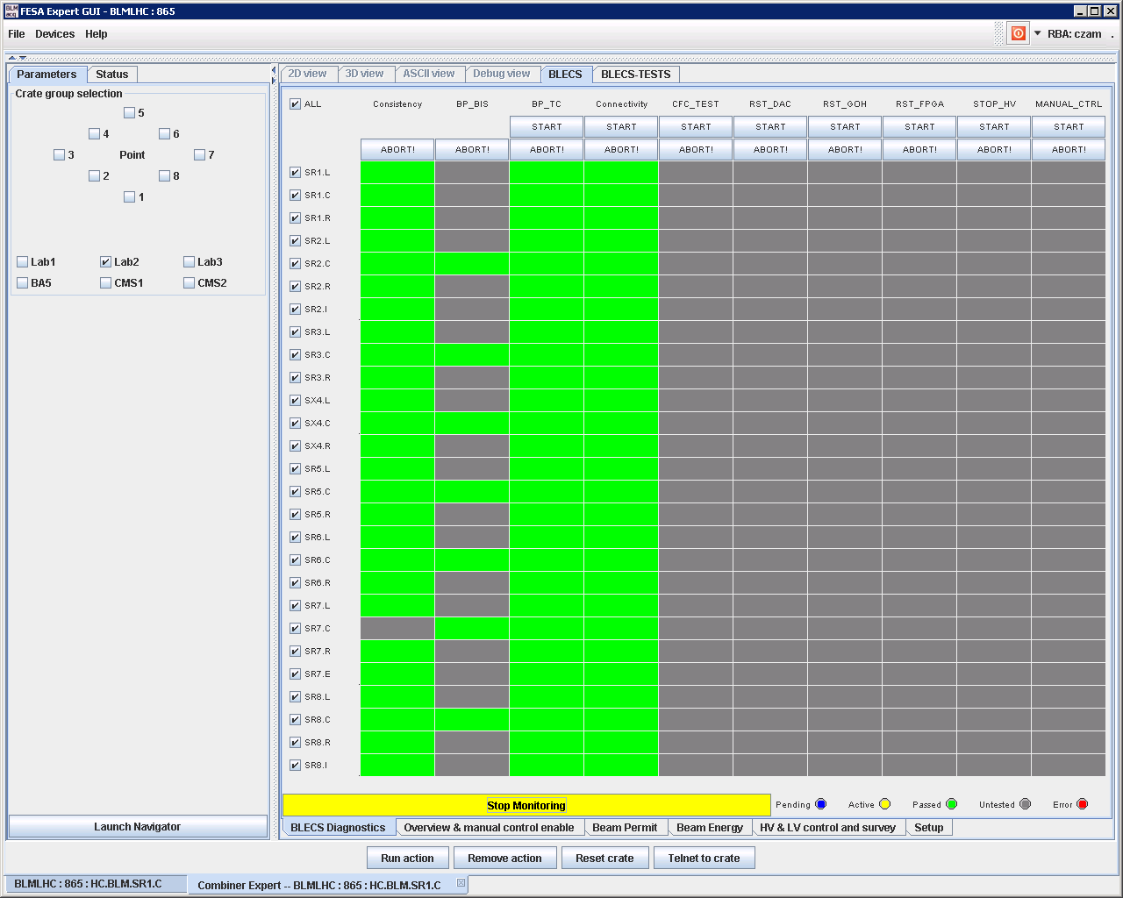
System Sanity & Expert Checks
Three groups of checks to validate at any time the system remotely:
Each group assigned to different teams, i.e.
Operations crew & System Expert
System Expert
Beam Interlock System team
1
2
3
Expert Application
Status Display
The Sanity Checks verify the consistency of the parameters, the connection & operation of all elements and ability to create interlocks
These can be executed by the LHC Sequencer or manually by a system expert
The BLM system ensures that this happens at least once every 24 hours.

Slide 8
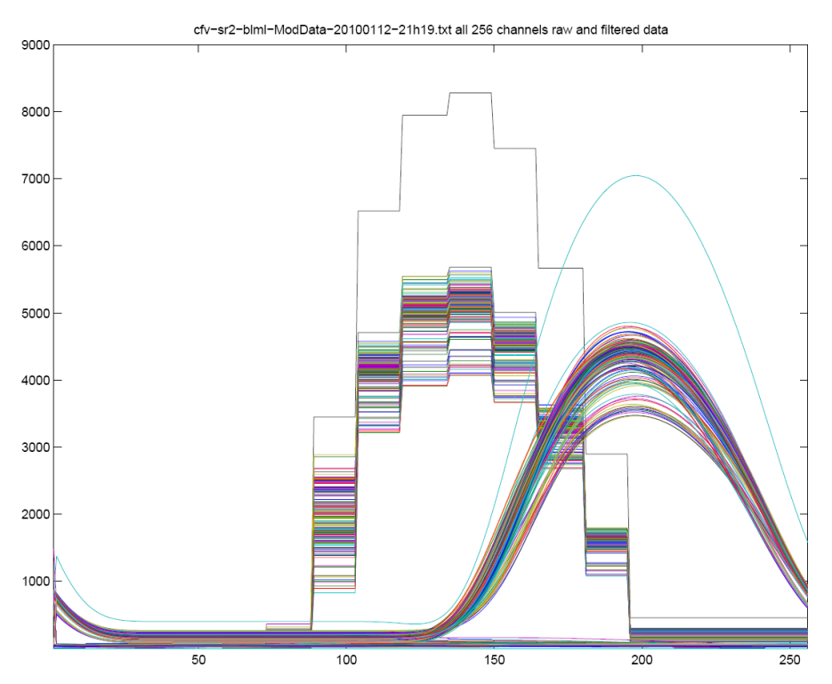
Modulation Check (1/2)
View on the LHC BLM system for the connectivity check.
The high voltage supply to the monitors is modulated with a 60mHz 30V sinusoidal signal.
A current on the monitors is induced by the HV modulation and can be measured by the normal BLM acquisition chain.
The Combiner & Survey module uses the running sum (RS_09) from the Threshold Comparator modules to determine the amplitude and phase of each monitor (256 channels per crate).
This results are compared to predefined limits to permit or block the next injection if a non conformity is detected.
The signals of each monitor is stored to the Logging DB and can be further analysed with the dedicated application.
The limits are unique for each monitor. They are calculated out of multiple measurements.
View of the SRAM data containing the original (stairs) and filtered RUNNING SUM 9 data of each channel (256 in total) of one crate. This plots represent one period of the modulation.

Slide 9
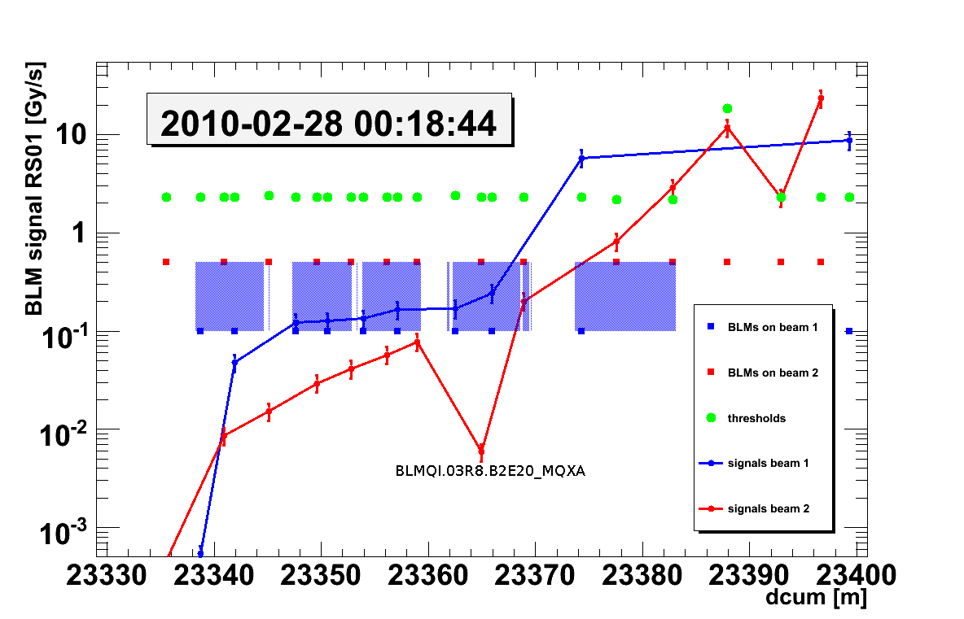
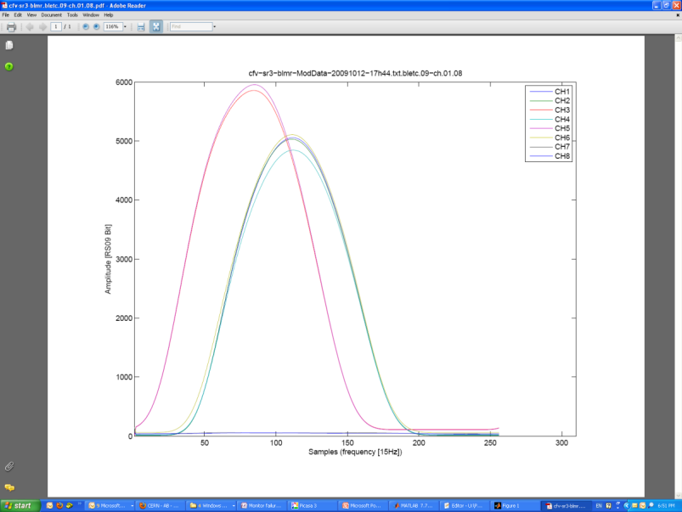
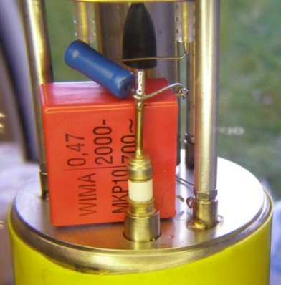
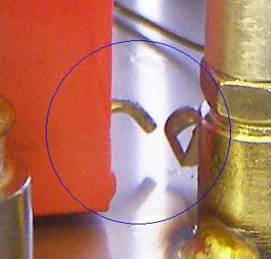
Modulation Check (2/2)
Main tool for checking the connection & performance of each detector
During operation/run: discovery of installation degradations
Type of non-conformities | Occurrences | Deviation from the expected behavior
Chamber filter disconnected or badly soldered | 27 | 9%-33%
Tunnel card (BLECF) non-conform behavior on one or more channel | 4 | 10%-30%
High voltage distribution box | 1 | Large
Connection of monitor on the wrong channel | 2 | Large
Monitor not supplied with high voltage | 4 | Large
Capacitor missing or disconnected
Normal behavior
Amplitude [RS09_Bit]
Samples
A sensitivity issue was noticed with beam and confirmed with the connectivity check measure.
Non-conformity discovered during commissioning (top).

Slide 10
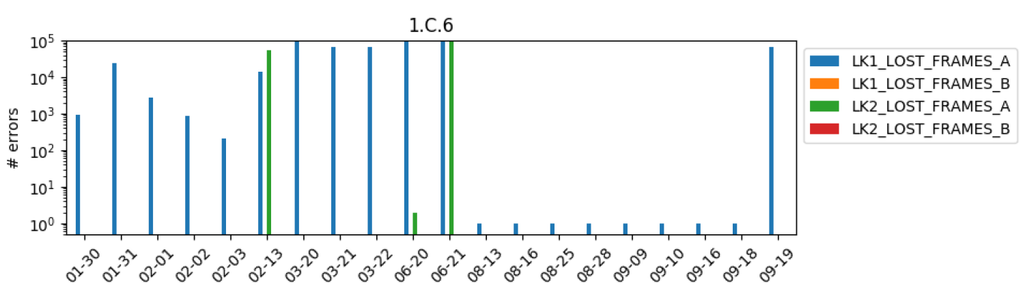
Daily reports: Optical Links
Daily checks introduced with the aim of detecting link degradation
Experts refer to it to identify the location or piece of equipment failing
Process can give ‘hints’ of upcoming issues and help also in predictive maintenance
Daily report on number of errors per Optical link

Slide 11
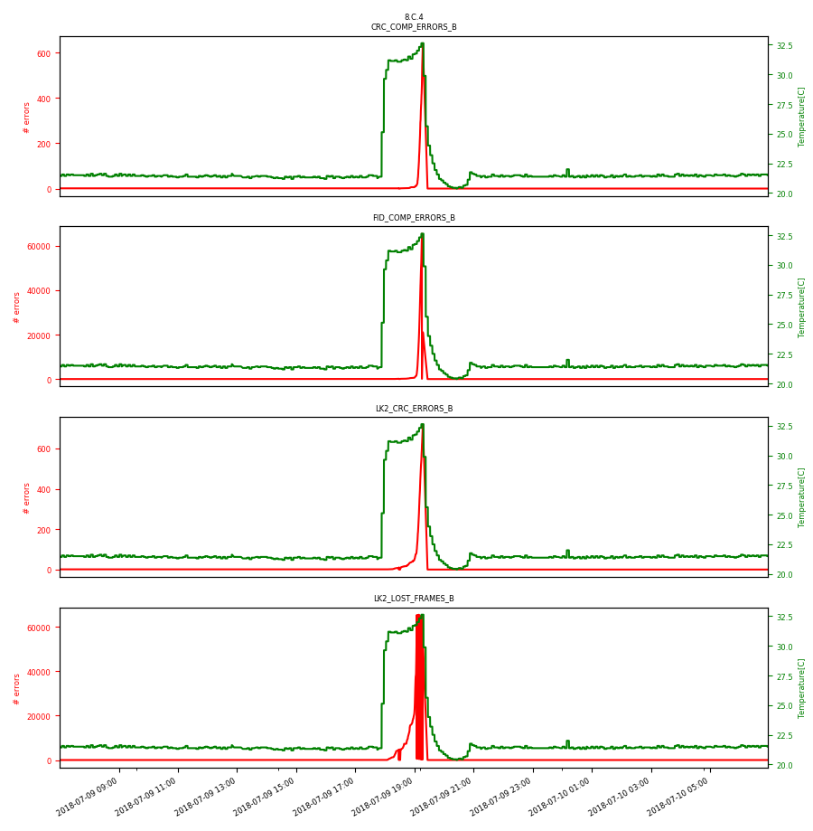
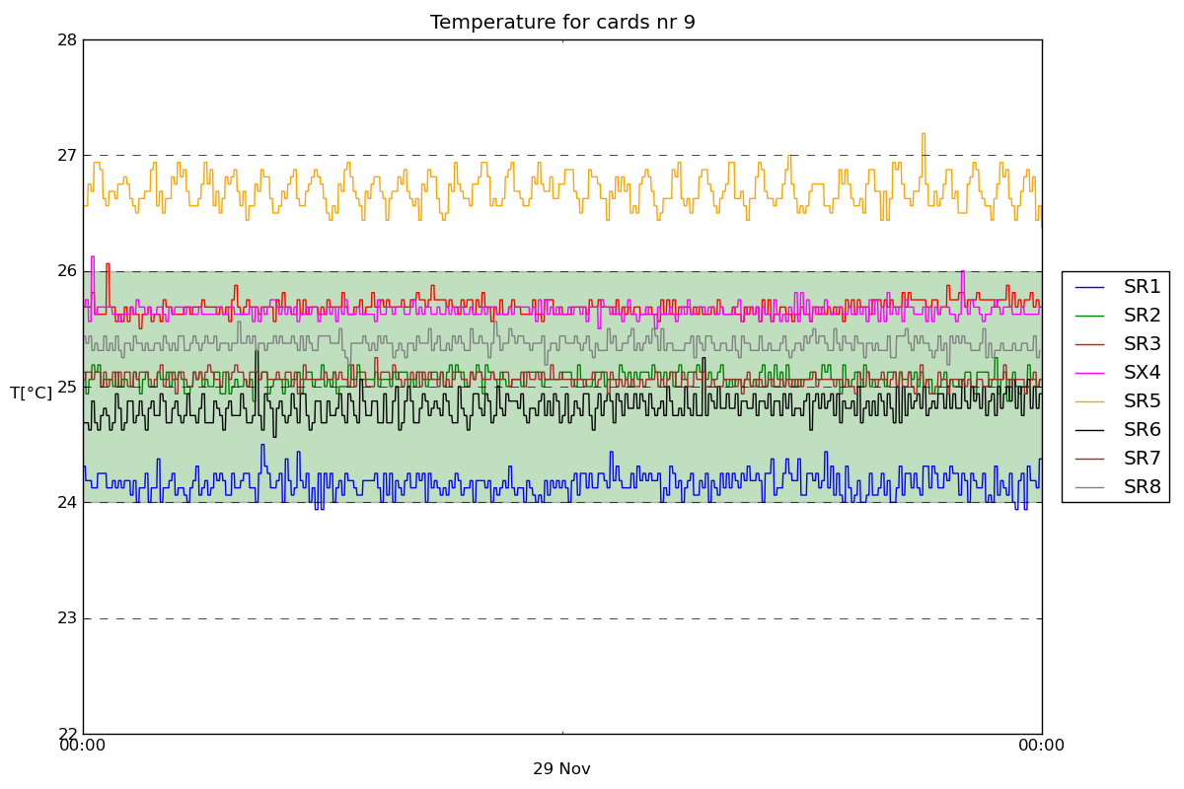
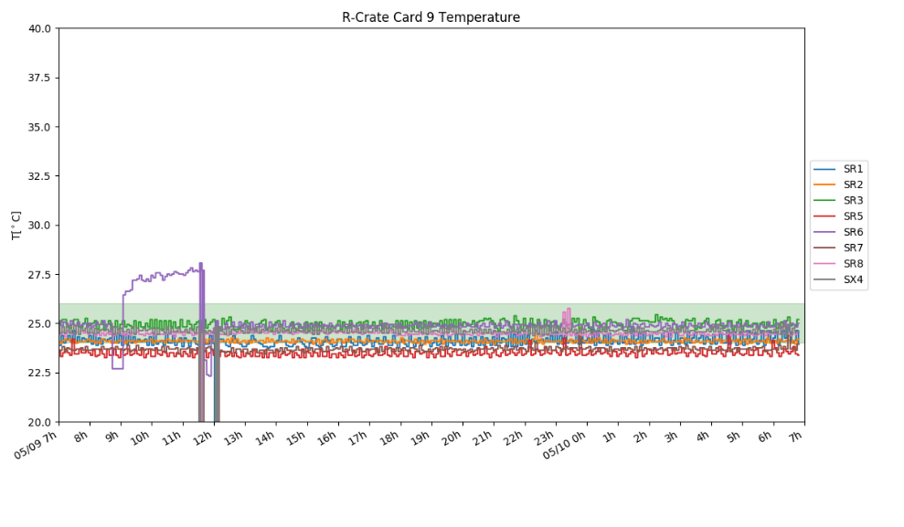
Daily reports: Rack Temperature
Daily (& weekly) reports showing the operational temperature of the electronic racks
Stability of the temperature and configuration of the PID controller
In some cases it can help to identify the root cause of an issue/fault
Some examples:
PID controller needs optimisation
Cooling system at fault
Module with link weakness

Slide 12
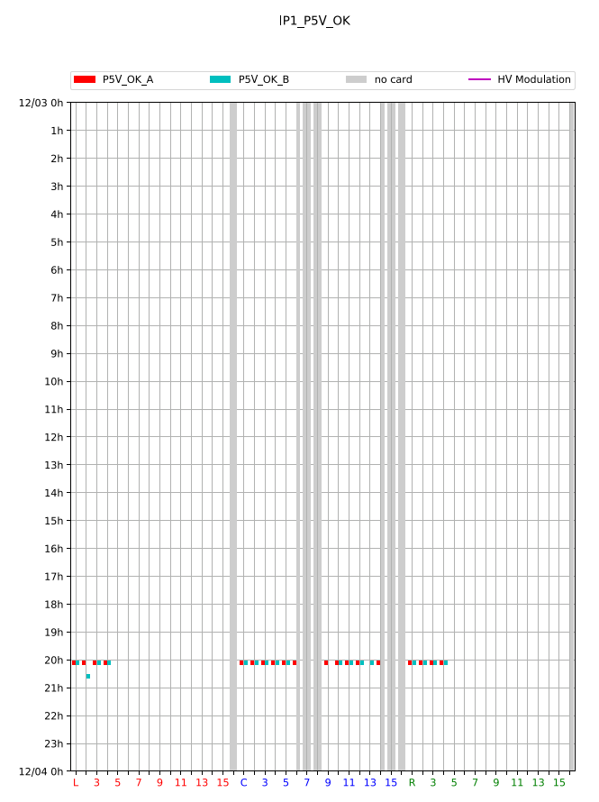
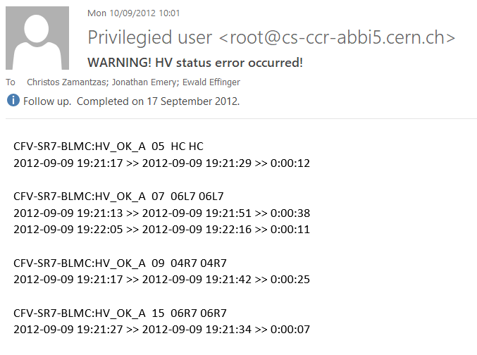
Daily reports: Power Supplies
Daily report showing instabilities of the of the LV and HV power supplies.
Stability of the detectors’ bias is very critical i.e. drop of voltage for long periods can compromise protection
Profited from the long commissioning period to evaluate best strategy to balance availability & reliability
Finally, interlocked through the Software Interlock System
example: Evolution of reporting

Slide 13
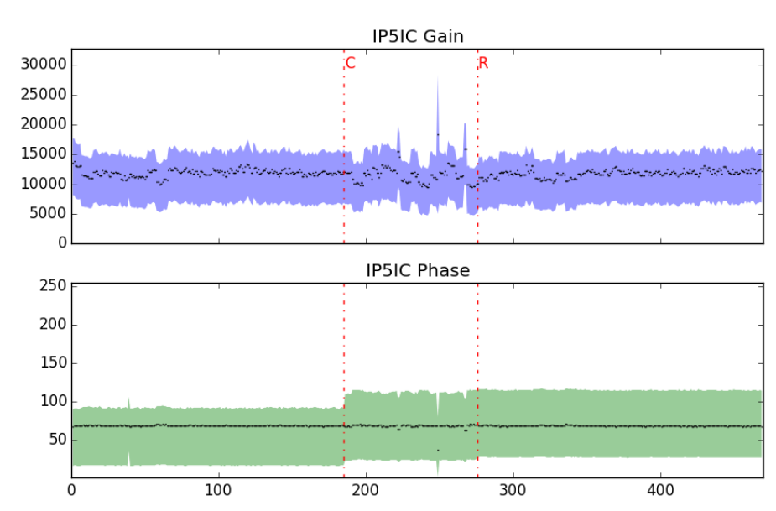
Daily reports: Measurement offset
An autonomous circuit at the acquisition card checks and injects a constant 10 pA current to monitor the connection
The DAC values (which injects the current) are recorded and last variations from day to day are reported

Slide 14
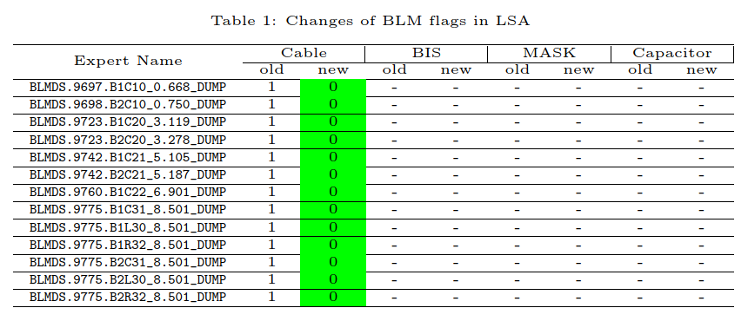
Daily reports: Threshold Values
Detailed view of any BLM Threshold changes
Dual functionality:
Check by Threshold experts that only the changes foreseen has been applied
Alerts On-call experts on the change and assists them to identify reasons of interlocks.
example: Change of threshold values
example: Disconnection of a set of monitors
Note: The system needs approx. 3.5 million threshold values to fulfil its specifications

Slide 15
Documentation & Planning

Slide 16
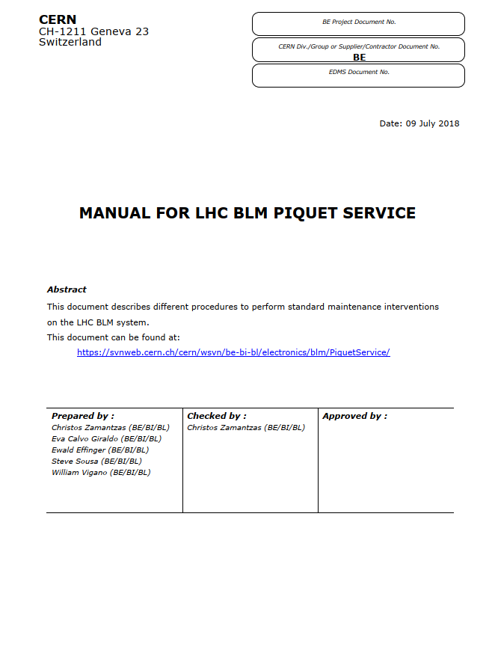
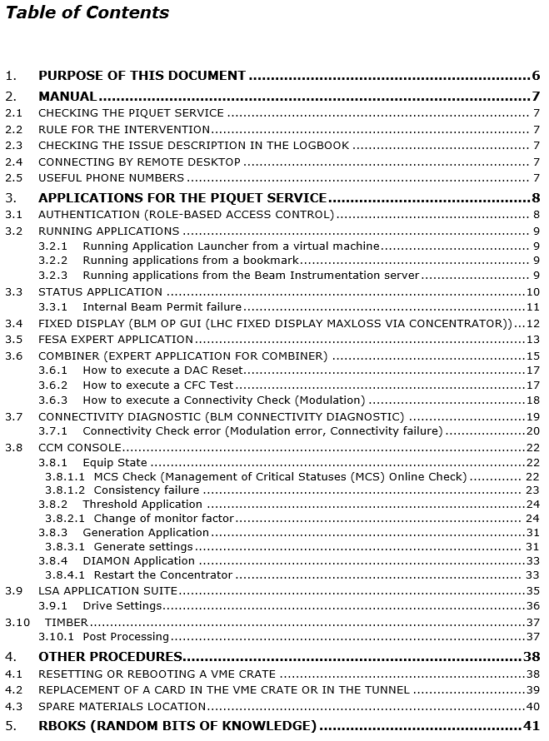
Documentation & Training
Most of the diagnostic tools have been created or grown along with the project development.
Now systems are installed but due to the size and complexity many tools are needed for identifying the source of each issue.
Creation of a on-call service
Training by shadowing and stops
Preparation of a ‘Service Manual’
Learning from past failures
Reduction in time taken to resolve issues
Future improvements?
Create exercises for training
Easier identify location of assets
Develop a workflow for the interventions
issue tracking,
record steps and actions to resolve the issue
link to maintenance requests

Slide 17
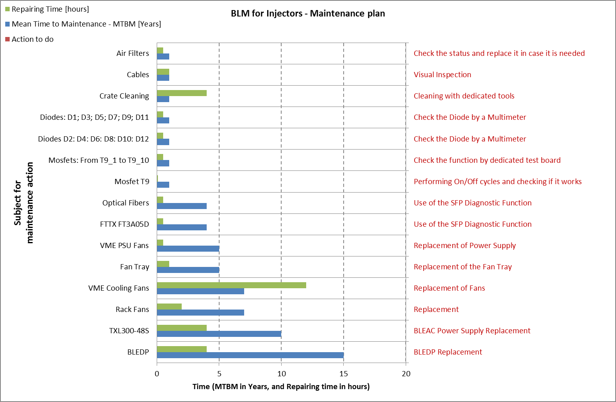
Maintenance planning
For projects with Prediction and Failure mode analysis done, a maintenance plan is automatically obtained as one of the results.
Future improvements?
Centralise all needed actions
Alert team members of upcoming needs
Include actions at the Technical Stops planning
Currently manual addition in the plan by experts.
Type of intervention

Slide 18
Availability statistics
Statistics and major issues of the two LHC Runs

Slide 19
Run 1 Availability
During Run 1 a large portion of downtime was attributed to the communication between the acquisition and processing electronics
Several mitigation actions during LS1

Slide 20
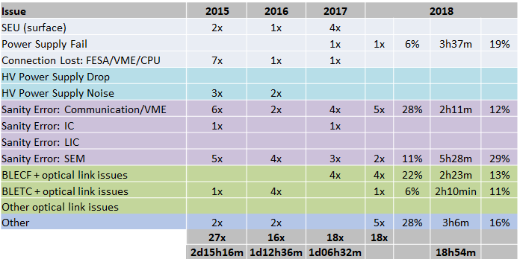
Run 2 Availability
During Run 2 the communication issues became manageable
Less than 5 issues per year
Additional monitoring and preventive actions during Technical Stops implemented
Assignment of a piquet team with daily tasks
Better organisation during stops and interventions
Issues with highest impact during 2018:
Power Supply failure (3h30min)
Tunnel/Surface cards (5x) (4h30min)
Sanity Check (7x) (7h45min)
Other (5x) (3h)

Slide 21
Future Developments
Additional plans and wishes

Slide 22
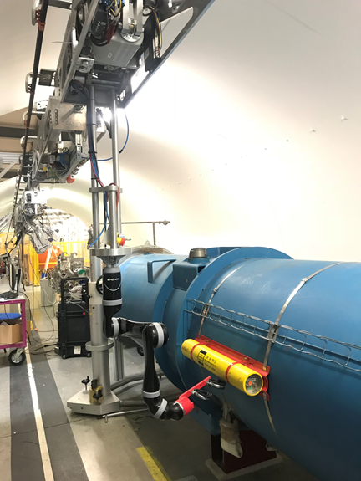
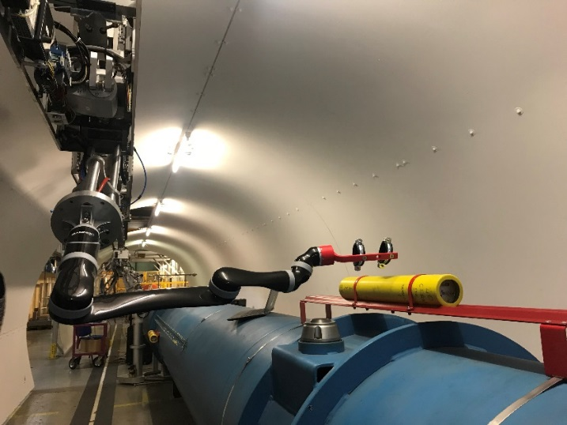
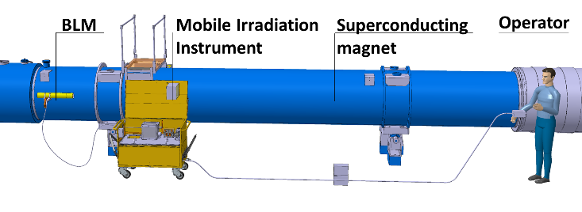
Radiation Source Measurements
Aim: Make use of robotic solutions where possible
Every Long Shutdown (i.e. 4 years) the system needs a complete revalidation wrt its connections.
Dmitry Gudkov (BE-BI)
Mario Di Castro (EN-SMM)
A complete redesign has been made to the LS1 BL trolley aiming to reduce failures and dose to operators.
Previous run needed > two weeks per sector (+ delays when need to cross doors)
Complex issues: slow, needs two people for operation, rad. source transportation and daytime storage. Great as a backup plan..
Will have two completely new trolleys available next year.
Work on-going to replace the trolley based solution with the Train Inspection Monorail (TIM)
Objective is to build an autonomous system for the complete BLM system validation
Train to move from previous BLM + vision recognition + arm placement + arm alignment
Supervision system to analyse measurements online and report pass/fail
Estimated test time per detector ~ 3 minutes, i.e. < 4 days per sector

Slide 23
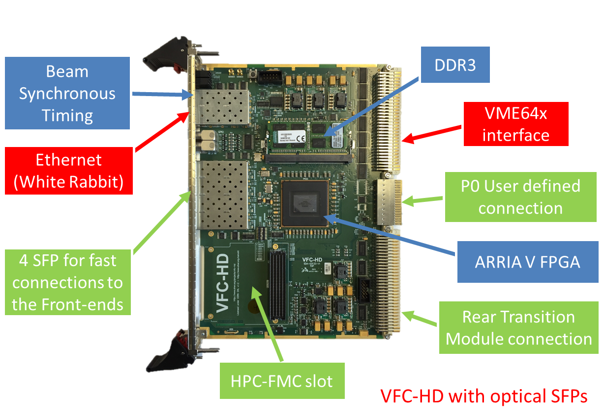
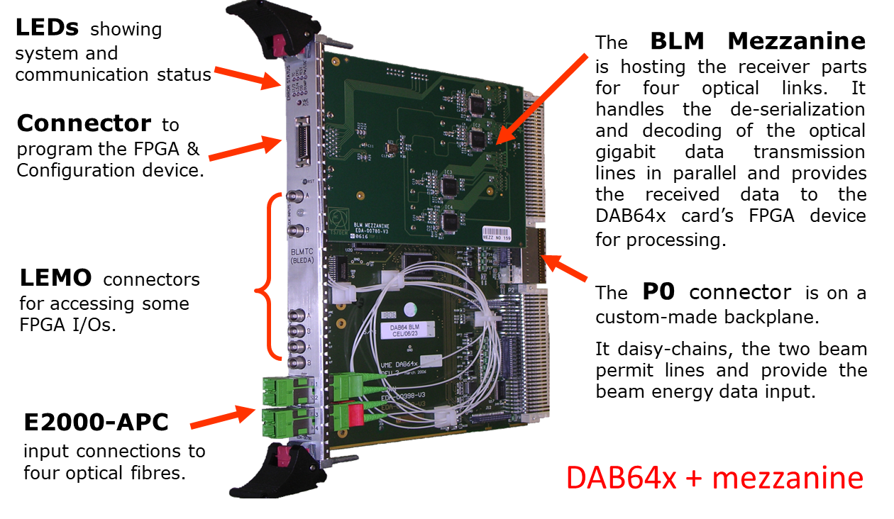
Processing Module Development
Aim: Harmonise electronics where possible
A generic processing board for all BLM installations (and majority of BI systems)
Currently at 90% of the production (1150 units)
Extensive testing that includes functional, burn-in and run-in cycles on-going
Plan to replace the current board in stages:
All functionality is being replicated and to be verified on a vertical slice (LS2)
Replace (post LS2) the operational units
Add new functionalities (LS3)

Slide 24
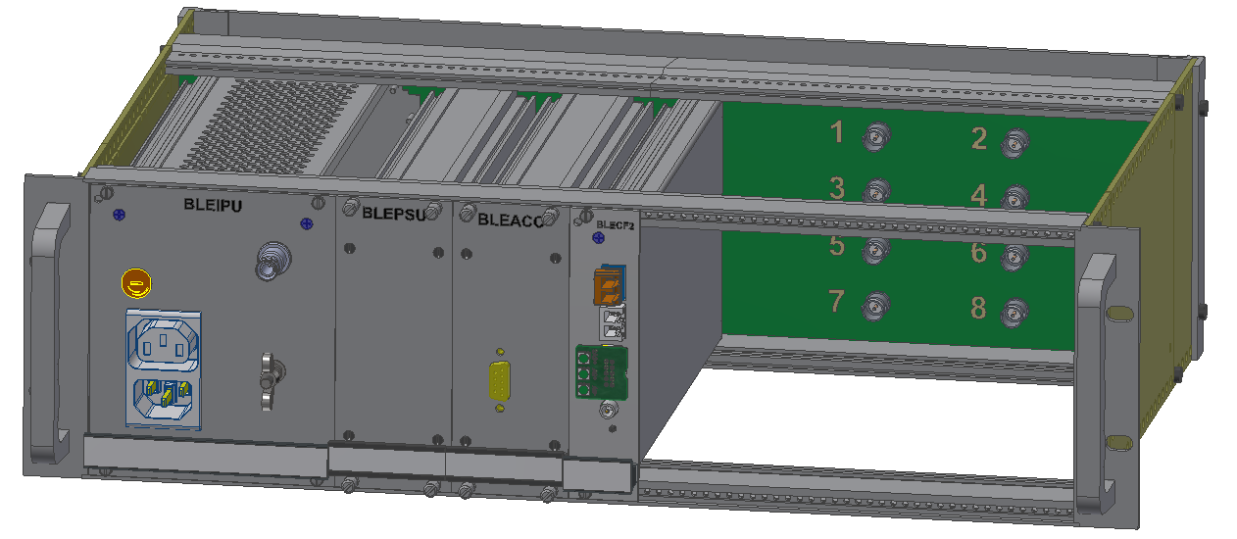
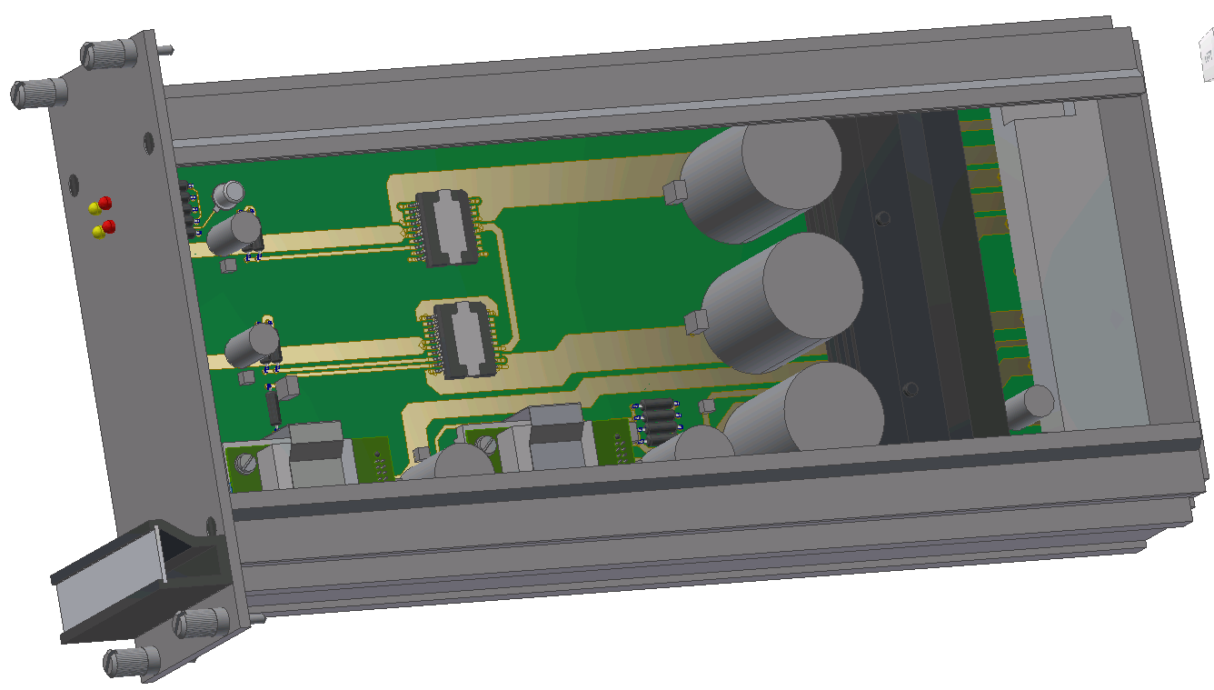
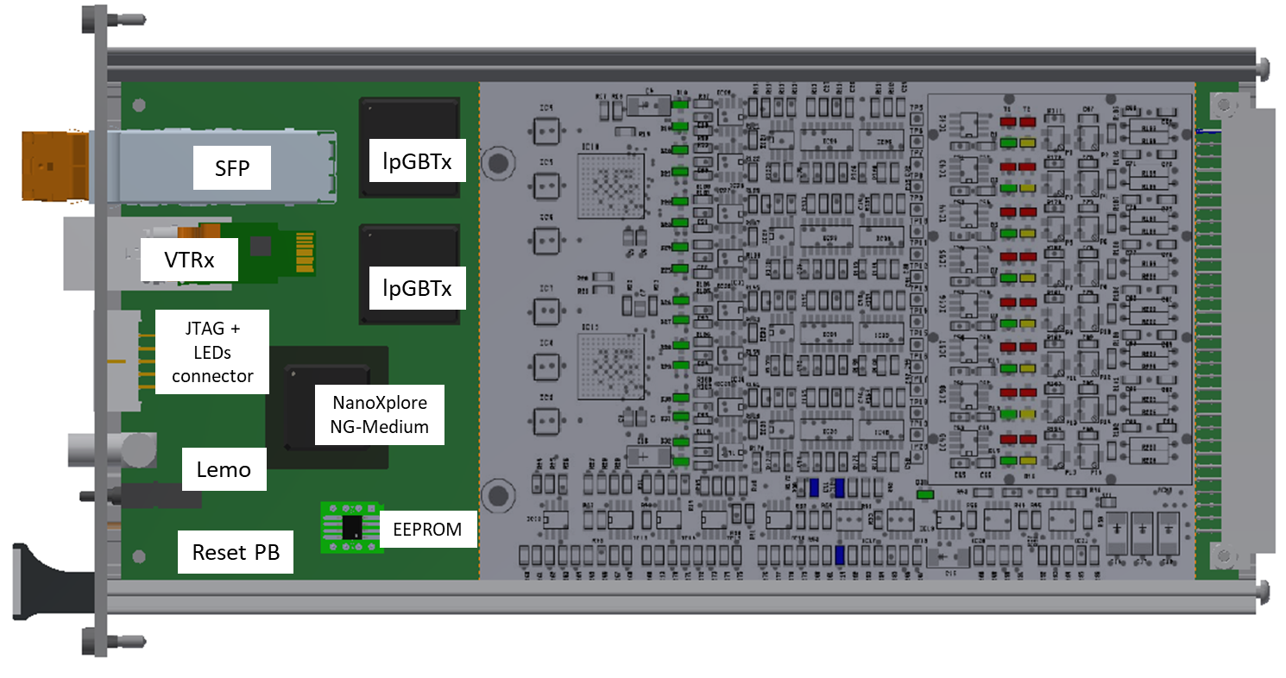
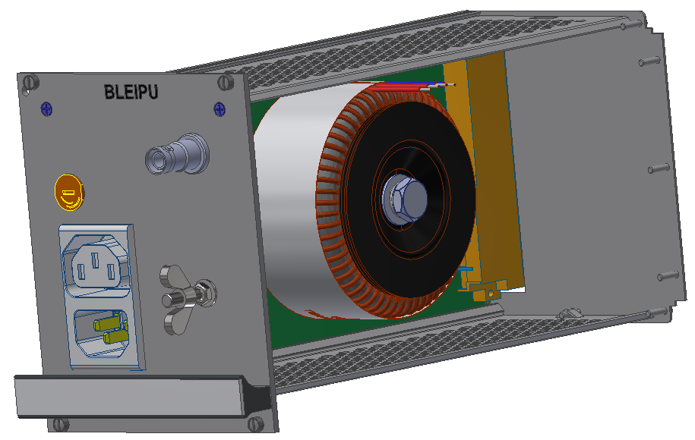
Acquisition Crate Upgrade
Aim: Harmonise electronics where possible
For the future upgrade of BLM acquisition systems in SPS and LHC a new acquisition crate is under design
Height = 3U , Depth = 280mm
Fully shielded
No HV or 230V_{AC} inside the chassis
All maintenance and repair actions from the front
Same crate to be used for the future BPM system with the only differences the backplane and the acquisition card.
More than 1000 instances to be produced
Power Supply Unit
BLM Acquisition Card
Input Power Unit

Slide 25
Conclusions

Slide 26
Conclusions
Achieving the required performance when developing a system is not enough for an operational system
Failure mode analysis can identify weak spots and for each a counter measure can be added
Statuses, diagnostics and system self-checks need to be integrated from the design time
Dedicated tools can then be developed to monitor the health of the system
Create & standardise a workflow for the interventions
Issue tracking
Record steps taken and each action performed
Integrate links to asset management and maintenance requests
Combine forces with other teams
Harmonise platforms (crates, boards, software etc)

Slide 27
Thank you

