Slide 1
CSNS Accelerator Operation Status and Reliability Improvement
Yuliang Zhang
On behalf of the CSNS accelerator team
ARW'2019.Guangzhou

Slide 2
Outline
1
Brief Introduction of CSNS
2
Accelerator Operation Status
3
Reliability Assurance and Improvements
4
Summary

Slide 3
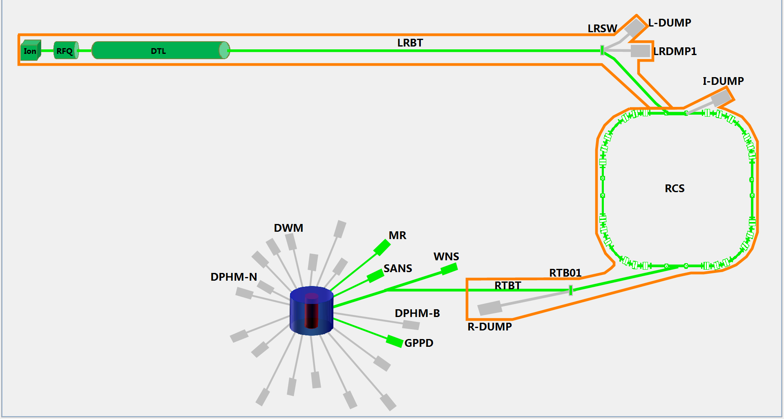
Brief Introduction of CSNS
80Mev H⁻ LINAC
1.6GeV
25Hz
100kW
25Hz,1.6GeV
Tungsten target
3 beam lines/20
in phase-I

Slide 4
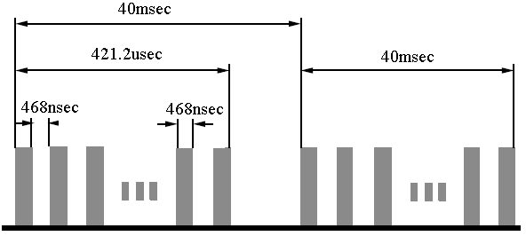
Brief Introduction of CSNS
Linac Design
Electrostatic chopper in LEBT
 | Ion Source | RFQ | DTL
Input Energy（MeV) |  | 0.05 | 3.0
Output Energy(MeV) | 0.05 | 3.0 | 80
Pulse Current (mA) | 20/40 | 15/30 | 15/30
RF frequency (MHz) |  | 324 | 324
Chop rate (%) |  | 50 | 50
Duty factor (%) | 1.3 | 1.05 | 1.05
Repetition rate (Hz) | 25 | 25 | 25

Slide 5
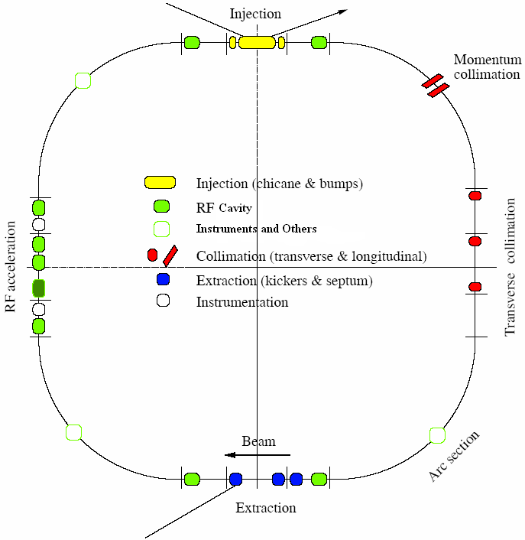
Brief Introduction of CSNS
RCS Design
Lattice of 4-fold symmetry, triplet.
227.92m circumference.
Four long straight sections for injection, acceleration, collimation and extraction.
24 main dipoles with one power supply.
48 main quadrupoles with 5 power supplies.
Ceramic vacuum chambers for the AC&pulsed magnets.
8 RF ferrite loaded cavities to provide 165 kV.

Slide 6
Brief Introduction of CSNS
August 2017, first proton beam delivered to target and first neutron beam generated.
August 2018, the whole project passed the national acceptance.
10kW
20kW
30kW
40kW
50kW
80kW
Problem of RFQ power source
Spark of RFQ cavity
Summer shutdown
50kW machine study
80kW machine study
Summer shutdown & 80kW machine study
CSNS commissioning and operation overview(2017.11~2019.10)

Slide 7
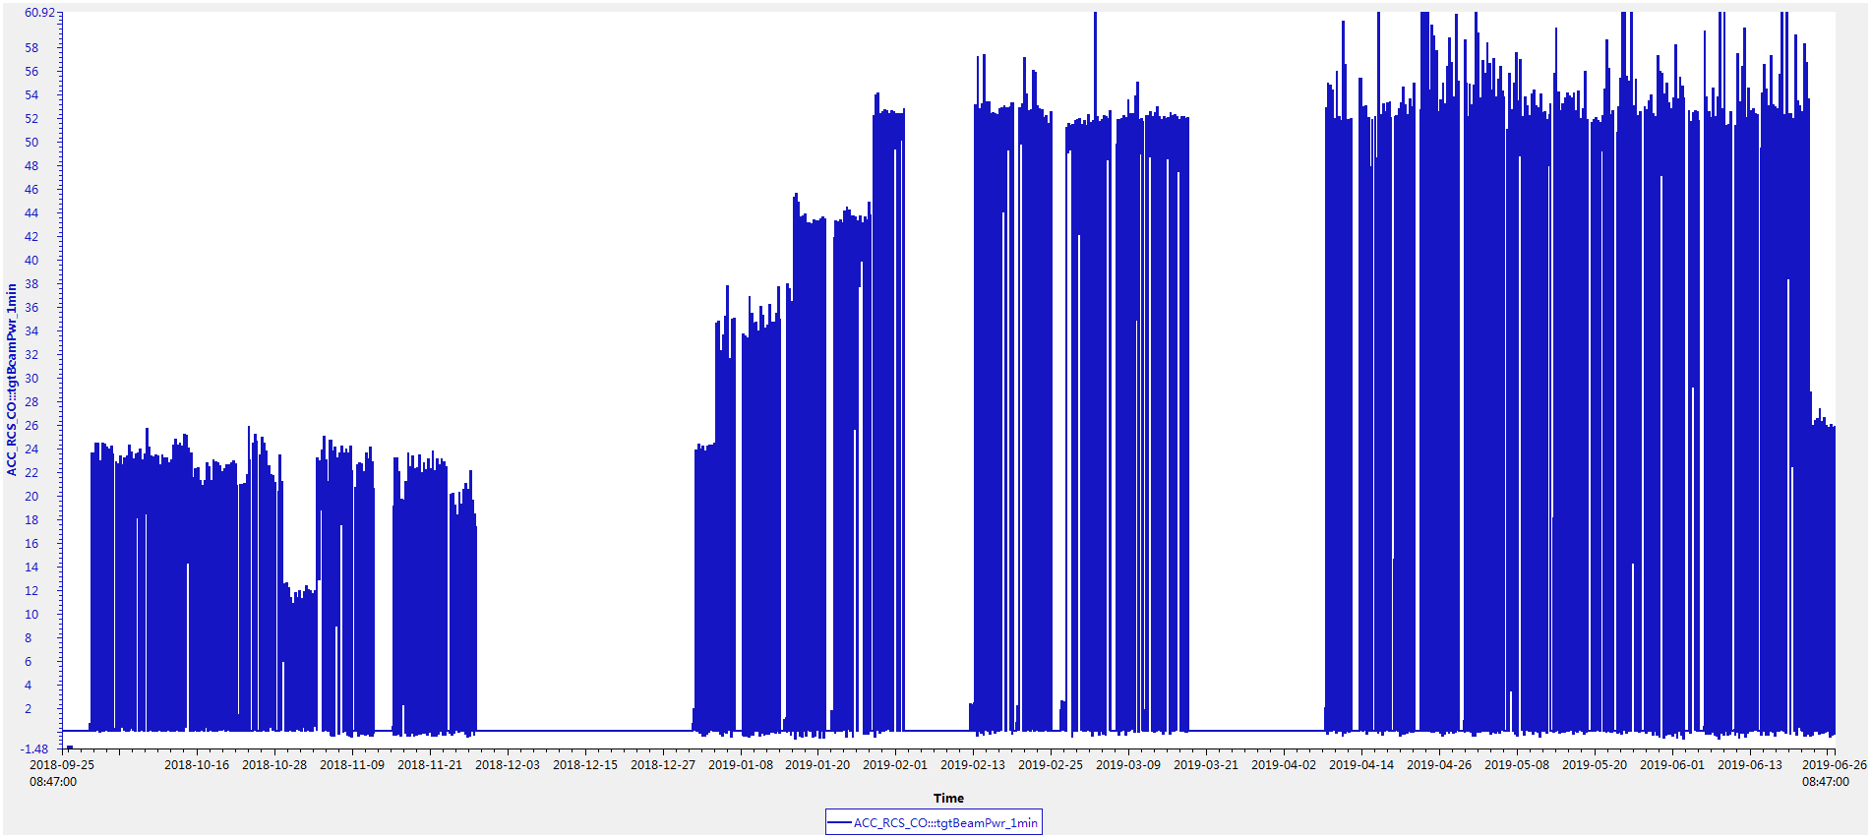
CSNS Accelerator Operation Status
First round(2018.9.30-2019.6.26) open run of user experiments completed.
Beam power increased from 25kW to 50kW step by step.

Slide 8
CSNS Accelerator Operation Status
Beam availability was 91.8% in the first round of open run of user experiments
Scheduled beam time on target is 4000 hours, completed 4055 hours
Availability=$\frac{Beam Time}{Beam Time+Downtime}$
First round operation statistics(in hour)

Slide 9
CSNS Accelerator Operation Status
Second open run of user experiments until now, availability is nearly 95%
Second round operation statistics(in hour) until now

Slide 10
CSNS Accelerator Operation Status
Beam power increases from 10kW to 80kW and beam availability is also increased.
Knowledge of operating a high intensity proton machine and skills of operators are promoted a lot in the past year.
50kW
80kW
25kW
10-25kW

Slide 11
CSNS Accelerator Operation Status
Downtime statistics in hours by system during user experiments(Sep. 2018 to Oct. 2019)

Slide 12
CSNS Accelerator Operation Status
Main failures by system:
Linac RF: crowbar, HV modulator、spark of klystron、4616 tetrode, LLRF.
Ion source: discharge chamber, instability of extracted beam
Power supply: RCS injection，extraction and RTBT power supplies
RFQ&DTL：cavity arc, VSWR
Ring RF：LLRF, bias power supply, cavity arc, amplifier, etc.
Vacuum：Valve gate interlock caused by small leak
Magnet：high voltage discharge, mis-trigger by temperature sensors
Other：Thunder and lightning, beam loss interlock, etc.

Slide 13
Reliability Assurance and Improvements

Slide 14
Machine Protection System
Machine protection system consists of Normal MPS and Fast MPS, NMPS consists of two independent systems(MPS-A and MPS-B).
Both NMPS and FPS use independent cable route to stop beam.
PPS
Fault
Fault
Interlock
Interlock
MPS A
RMS
MPS B
Beam Off
/RST
Beam Off
/RST
RST
Interlock
FPS
Interlock
IS Timing
Stop Beam
RFQ LLRF
IS HV
Stop Beam
Relations among the CSNS protection systems

Slide 15
Machine Protection System
Beam stop and recovery process
Major fault beam stop procedure(Manual recover)
MPS
2
LRF LLRFs
Block LRF beam gate timing
Fault
1
FPS
3
RFQ LLRF
RFQ RF power off
~150nsec
drop IS 50kV HV
~4 sec
4616
Turn off IS Ext timing
5
After IS 50kV HV drop down to <5kV
RF power to RFQ again
4
50kV HV
6
Timing
RFQ
IS

Slide 16
Machine Protection System
Beam stop and recovery process
Major fault beam stop procedure(Auto recover next or few cycles)
2
LRF LLRFs
Block LRF beam gate timing
Fault
1
FPS
3
RFQ LLRF
RFQ RF power off
~150nsec
Kly
RF power to RFQ again next cycle
50kV HV
4
Timing
RFQ
IS

Slide 17
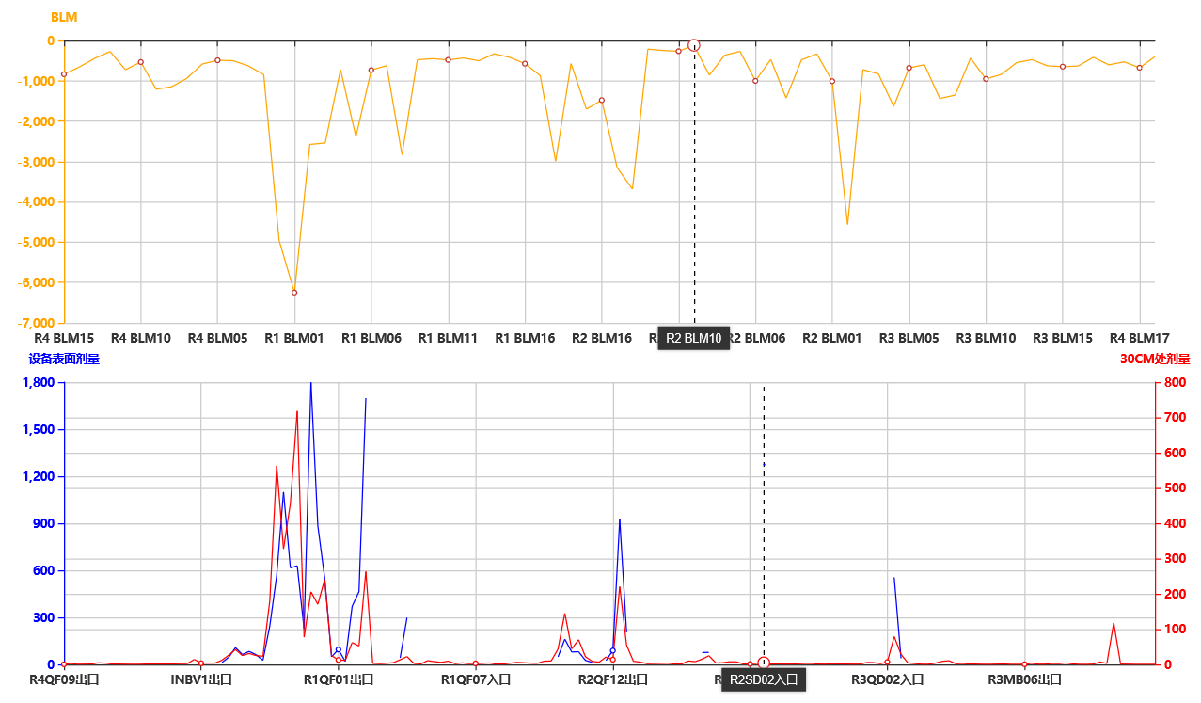
Beam Loss and Control
Beam loss control is one of the key tasks to operation the high intensity proton machine
Regular residual dose measurement every week and the residual dose database has been built
Accumulate big data to establish the relation between beam loss and residual dose and to optimize the operation.
Beam loss
Injection area
Collimator downstream area
Residual dose

Slide 18
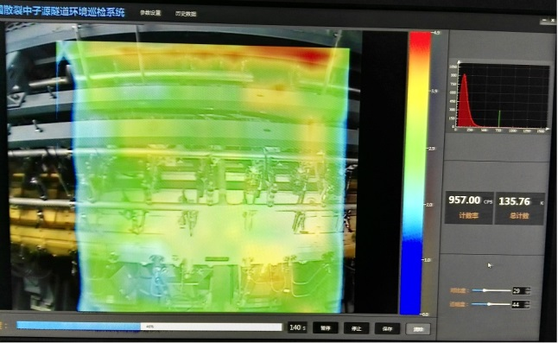
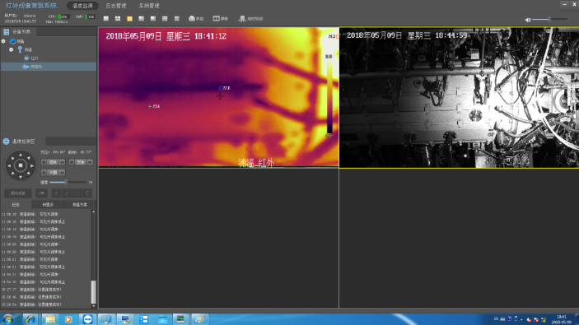
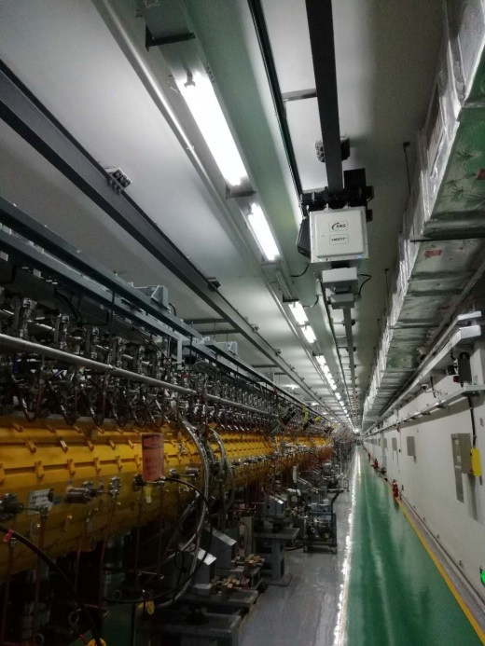
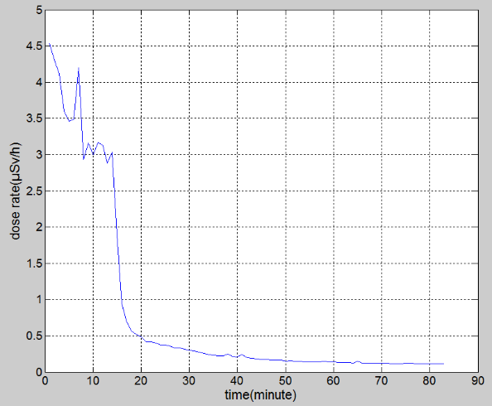
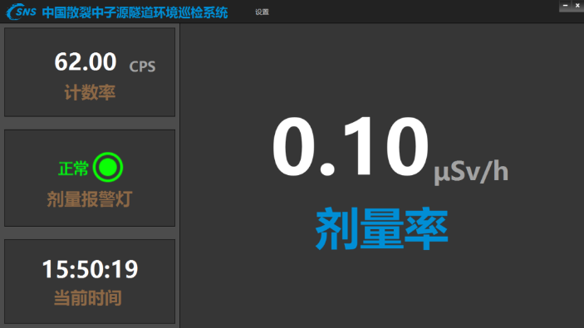
Moving Monitoring System in Linac Tunnel
A moving monitoring system was mounted on the crane of the Linac tunnel, with a NaI detector to monitor gamma dose, a gamma imager and a temperature safety monitoring camera.
Gamma imaging
Temperature monitoring
Shut down
Gamma dose monitored at DTL2 by the NaI detector.
18

Slide 19
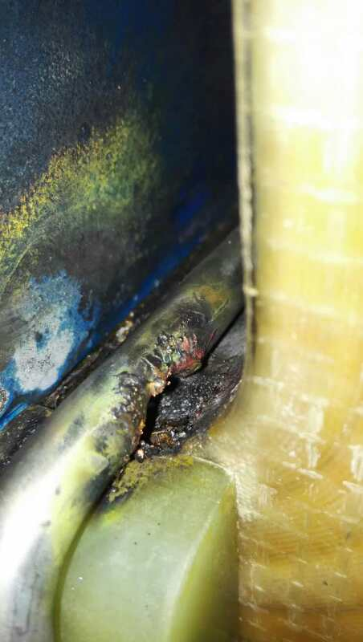
RCS Dry running
A week per time, 2 times, many problems occurred and solved:
Water leakage was found in one cavity.
Cooling tubes of two AC magnets were burned.
17 chokes had strong vibration and had been returned to the manufacture factory to repair.
Ceramic vacuum chamber cracked
Arc of extraction kicker
……

Slide 20
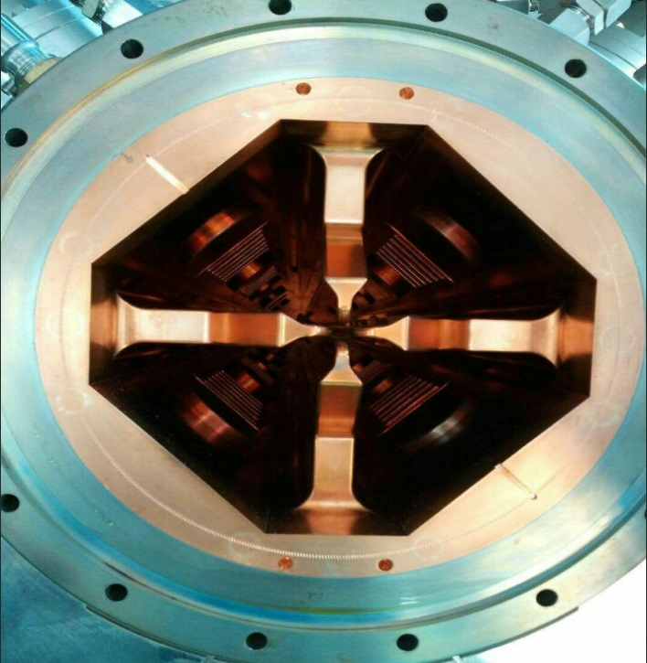
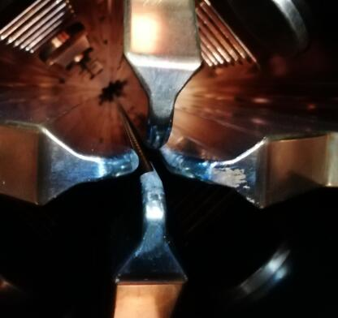
Solve the Problem of RFQ Spark
The chopped beam lost in the vane of RFQ, is confirmed to be the reason of RFQ spark
By rotating the chopper 45 degrees, most of the chopped beam passed through the slit between to adjacent vanes.
RFQ cavity before beam
2018.06 open RFQ cavity

Slide 21
Solve the Problem of RFQ Spark
Number of RFQ cavity spark per day

Slide 22
Upgrade the RF Power Source of RFQ
The stability of the RFQ 4616 tetrode is one of the main cause of failure.
The lifetime and price of 4616 tetrode.
The retired klystron from DTL, can be used for RFQ, zero cost.
Circulator
Arch waveguide
LLRF
Magic T
RFQ
CPI klystron
Dummy Load

Slide 23
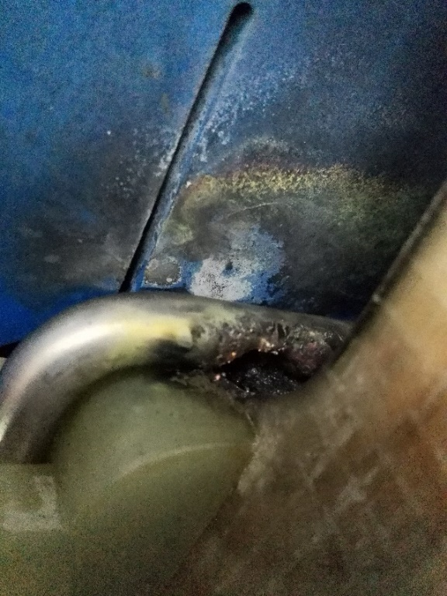
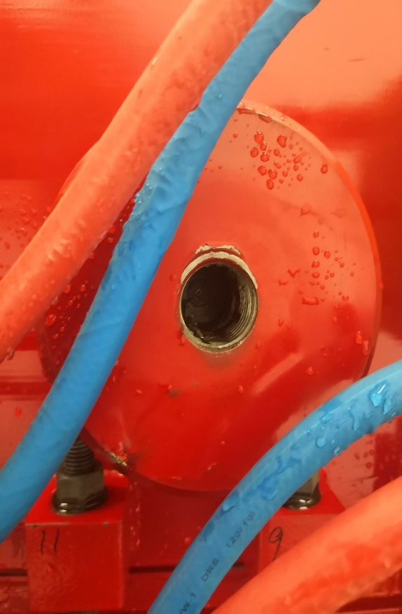
Insulation Enhancement for RCS Quadrupole
High voltage discharging has caused insulation failures of RCS-272Q quadrupole magnets due to several reasons.
Corresponding measures had been carried out to enhance the insulation.
U-type fixture problem
Discharge between water tube and magnet
Coil abrading due to vibration
Notes:
Nce

Slide 24
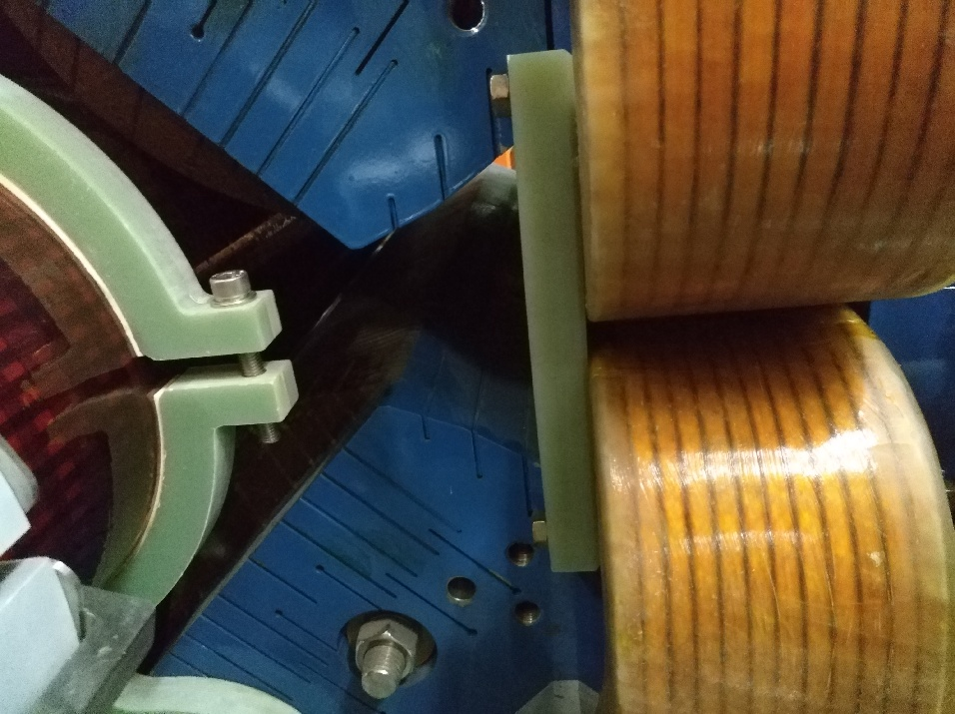
Insulation Enhancement for RCS Quadrupole
All the U-type fixtures of the quadrupole magnets were replaced by the special ones with increased insulation distance.
Insulation for 8 sets of 6kV 272Q magnets was improved this September.
Newly designed U-type fixture
Rectangle reshaped to round rectangle of 272Q magnet core

Slide 25
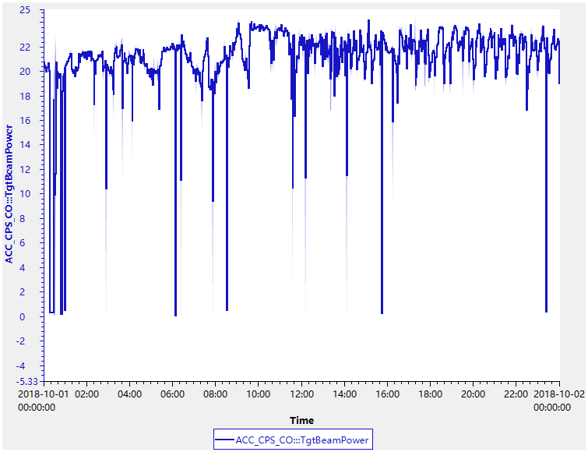
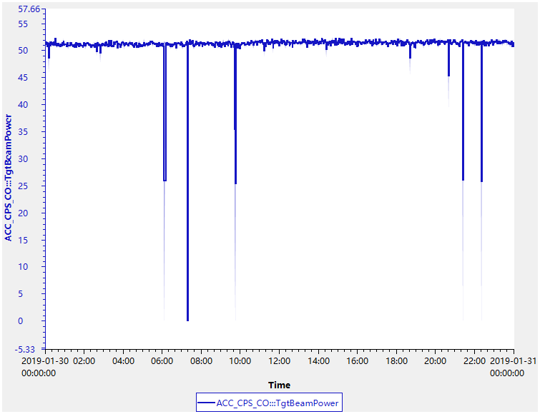
Reliability Improvement of Ion Source
To keep the consistency of each discharge chamber, strict fabrication and checking procedure was determined.
To ensure that at least one ion discharge chamber has been tested at the test stand as the hot standby spare.
Adopting the novel dual high voltage output extraction power supply to reduce the cesium deposition on the surface of anode, so as to decrease the arcing.
Developed the auto adjusting application to suppress the long period fluctuation.
Beam power auto adjusting

Slide 26
Improvement of RCS Extration Power Supply
Building the online monitoring system，key signals of each extraction power supply are monitored
Improving the grounding of the extraction hall
Changing timing signal link from cable to fiber to eliminate signal transition interfering
Minimize the pulse width of high voltage charging for thyratron anode

Slide 27
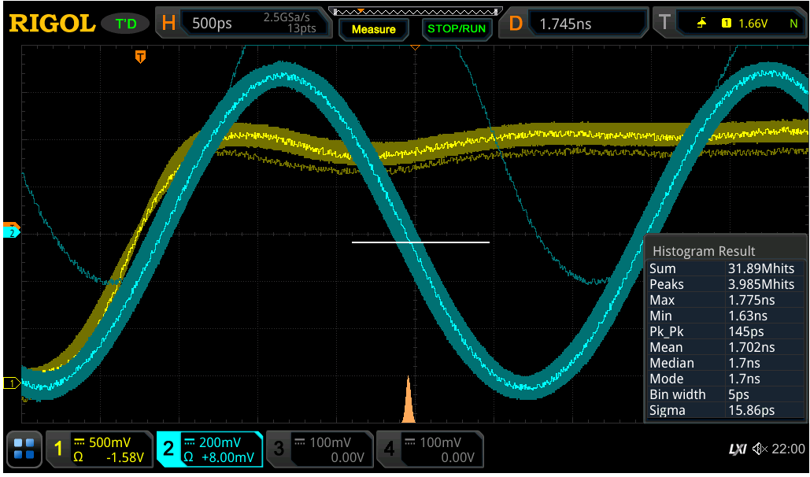
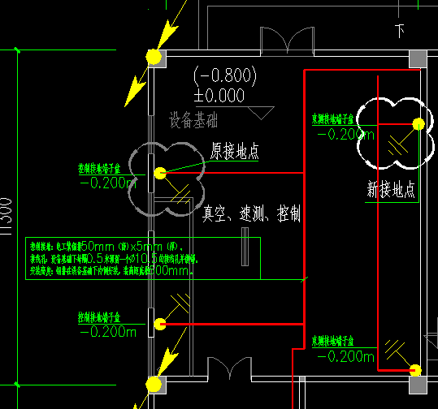
Grounding Improvement for Timing System
CSNS is located in south china, thunder and lightning occurs frequently every summer, so well-grounding is one of the key issues for high reliability operation.
New
grounding
point
Lightning
conductor
Original
grounding
Point
Reference line
signal shift

Slide 28
Summary and Future Plan
CSNS accelerator has entered the stage of user experiments operation since Sep. 2018. After then, the beam power was ramped from 25kW to 80kW step by step.
The overall accelerator reached high reliability availability in the first round of CSNS user operation, while accelerator machine study and demands of user experiments operation need to find a balance .
Still needs further work to keep high reliability operation, and also the high availability will be a challenging task as the devices aging year by year.
Collaboration with other labs are welcomed.

Slide 29
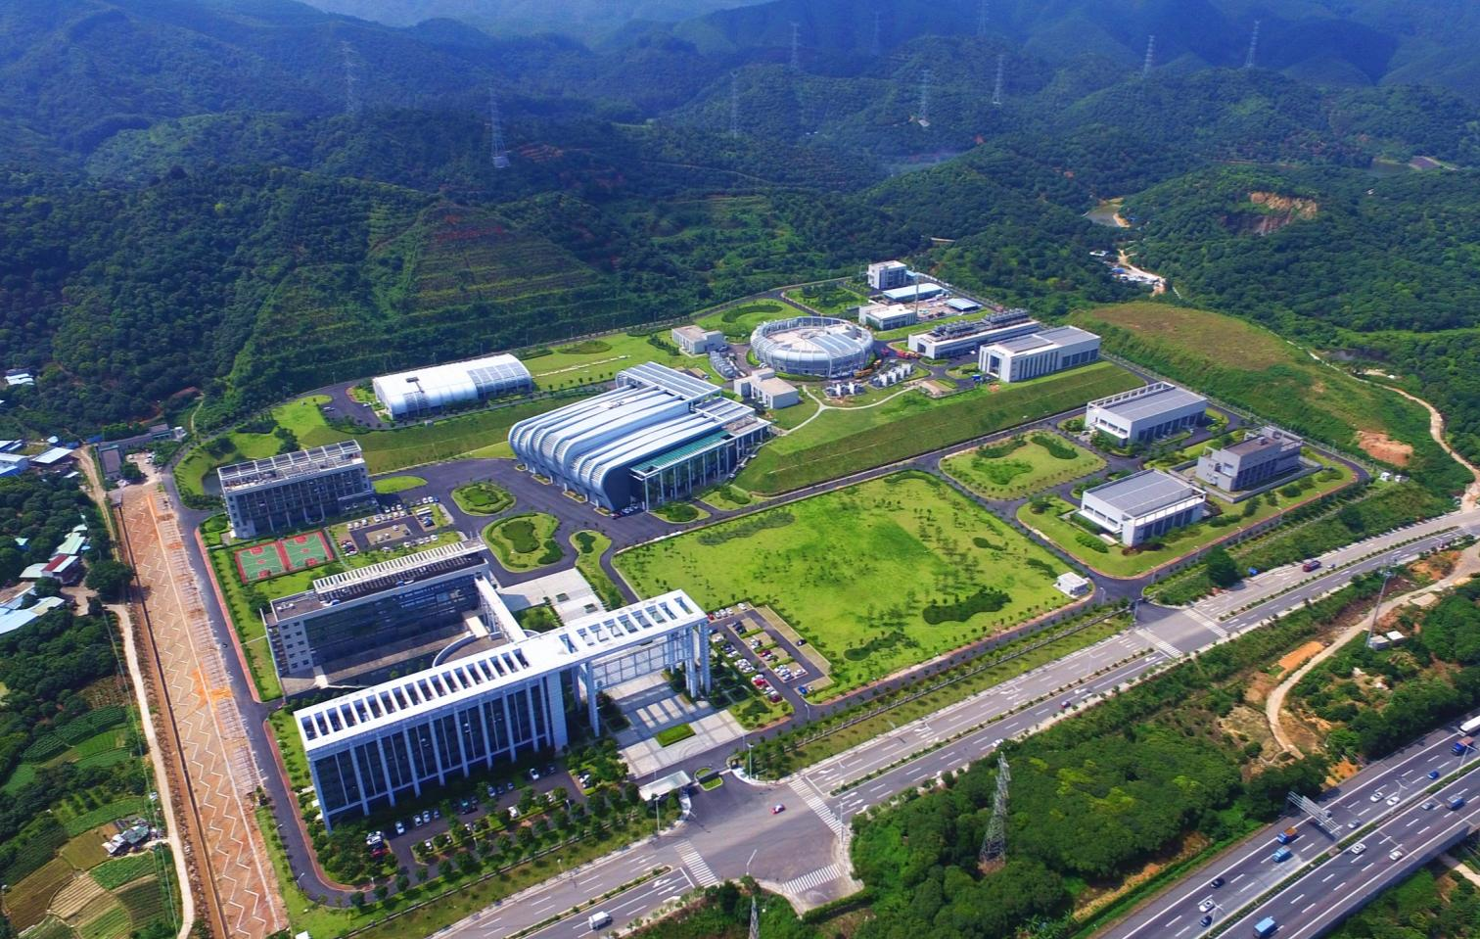
Thank you for your attention!

