Slide 1
Why Change our fault logging system.

Slide 2
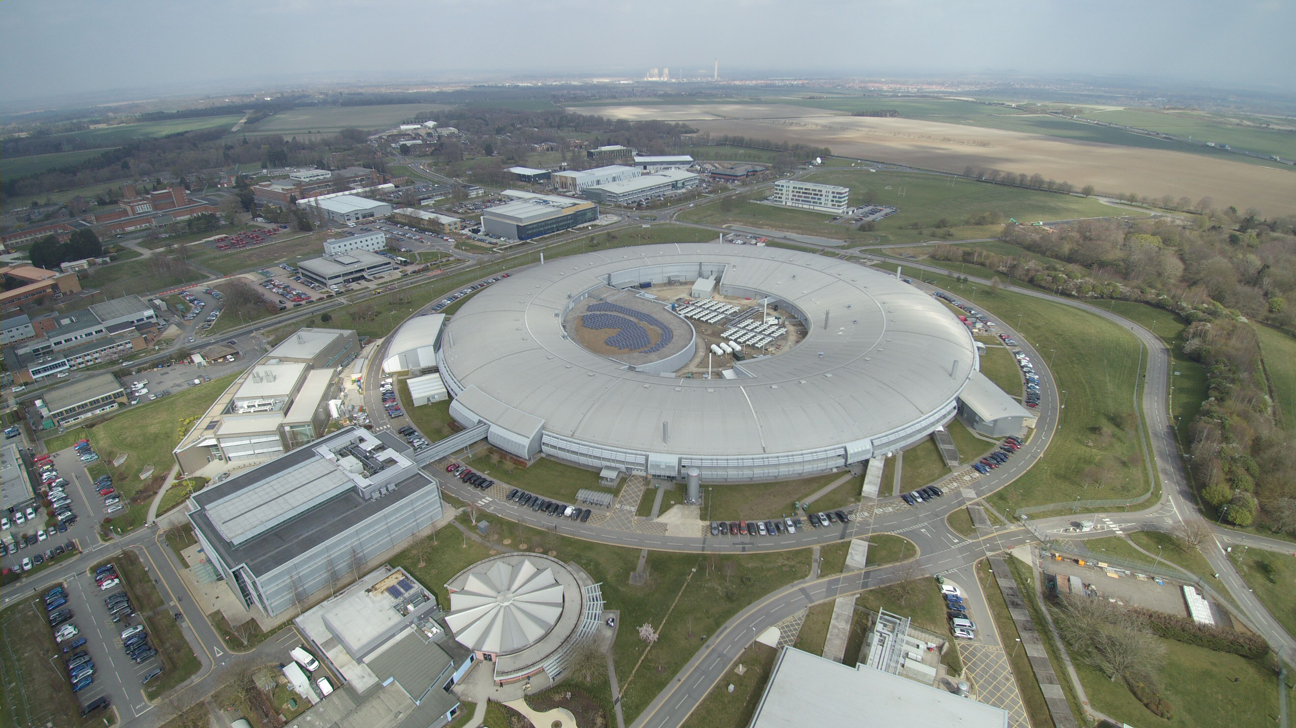
Outline
Diamond including reliability history.
Our original fault log
Why Change?
Why JIRA?
Where are we now / migration process.
What more would we like to do?
Conclusions

Slide 3
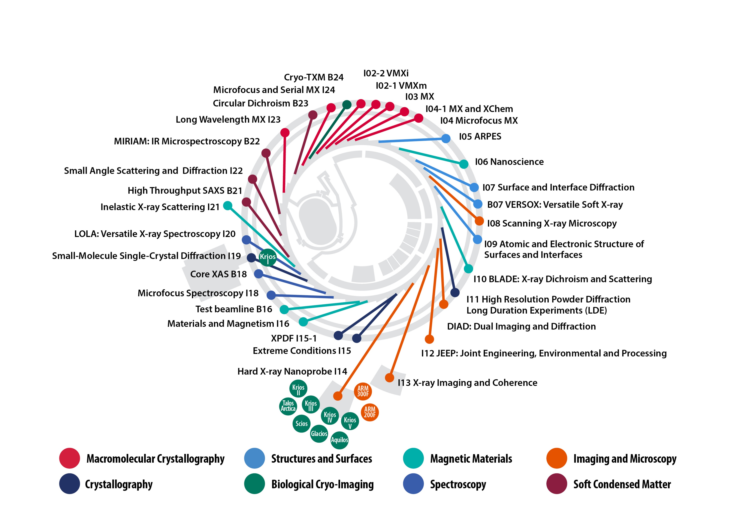
Diamond.
History:-
Opened in 2007 with 7 beamlines.
2 more phases of beamlines: Now 35 beamlines, including independent branches
Top-up from late 2008, Running 300 mA Since April 2012.
~5000hrs/ yr user beam.

Slide 4
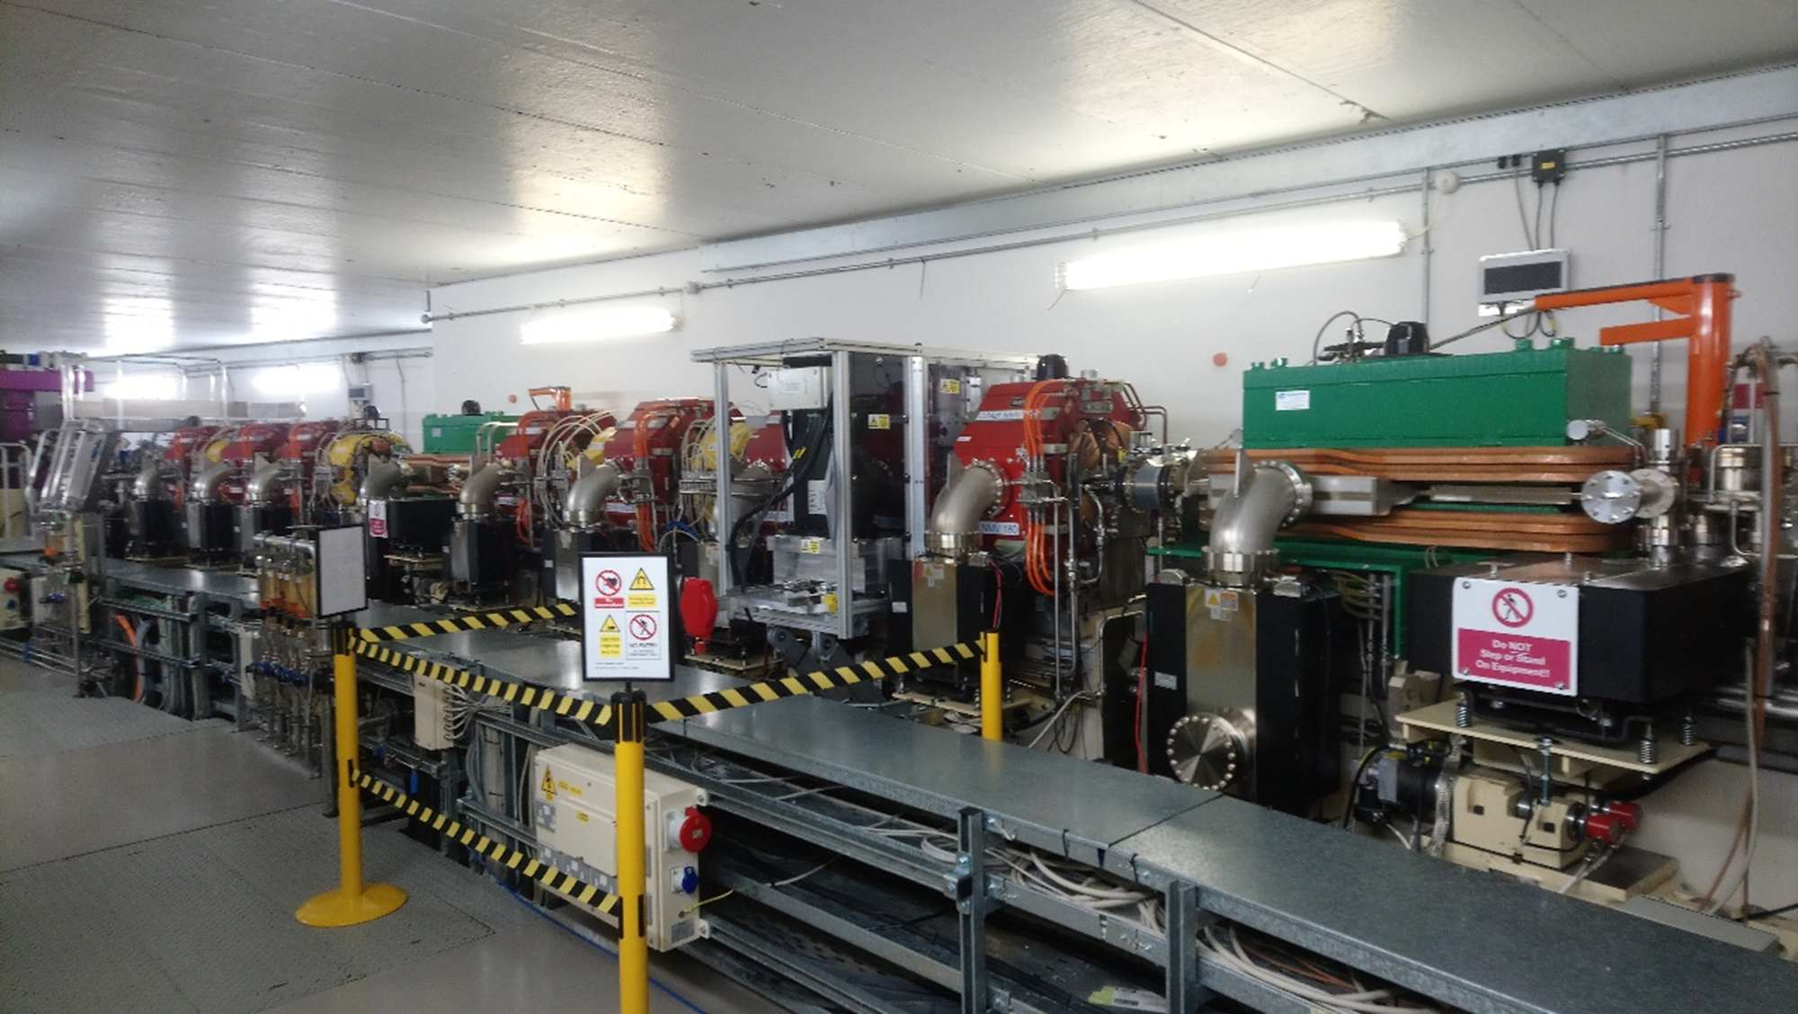
Beamlines added by making changes to lattice: DDBA & DIAD DDBA diagram:- DIAD is normal cell with sextupole replaced by Wiggler.

Slide 5
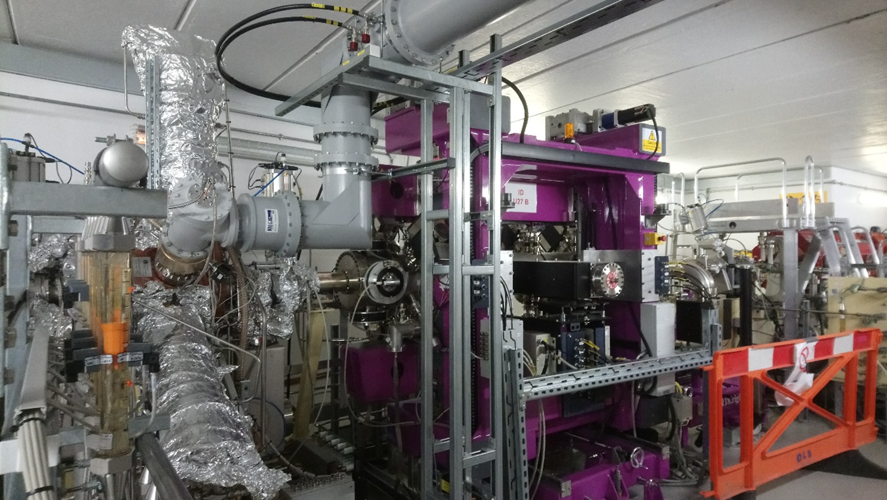
These Changes have meant that nice to have systems have become essential particularly, Transverse multibunch feedback
Added Normal conducting cavities squeezed into straights along with shorter ID’s

Slide 6
Diamond II
Use of mid straights:
16 for insertion devices or 3PWs
4 for RF
4 currently unused
Standard Straights
Long Straight
ML
SM
Mid straights
6 Fold Symmetry (supercells) for complete ring
6 Long straights
18 Standard straights
24 Mid straights
4 Girder/vessel configurations (LM SM MS ML)
MS
LM
Most design work is currently on Diamond II, limited carry over between accelerators, with a target date for installation shutdown beginning in 2025.

Slide 7
Diamond Reliability
Step changes on:-
Top-up -2008
Review of Interlock strategies -2011
Changed operation strategy for Superconducting Rf Cavities -2015
Current main issues:-
More than 55% RF, and more than 50% of these Power tubes or their protection circuits
~20% Beamline or beamline interface

Slide 8
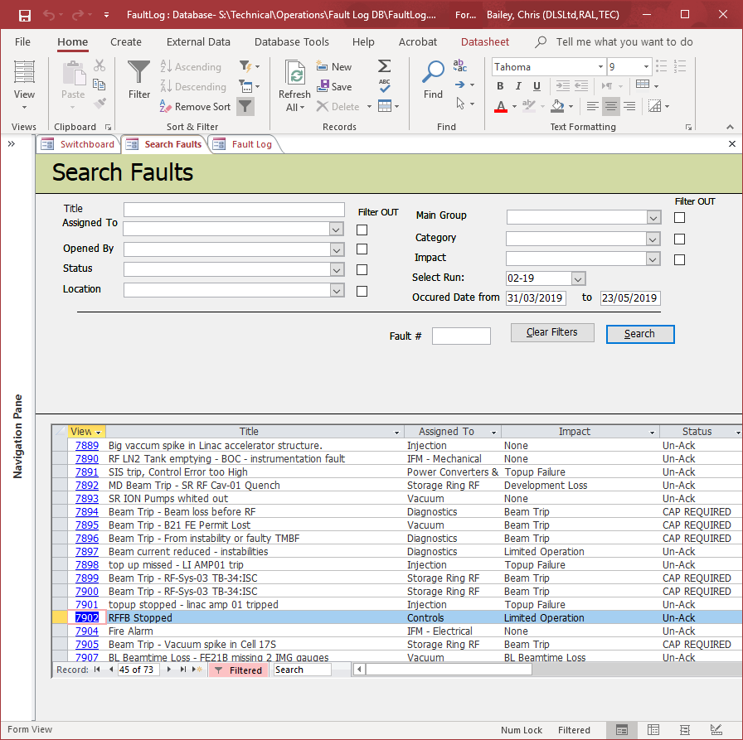
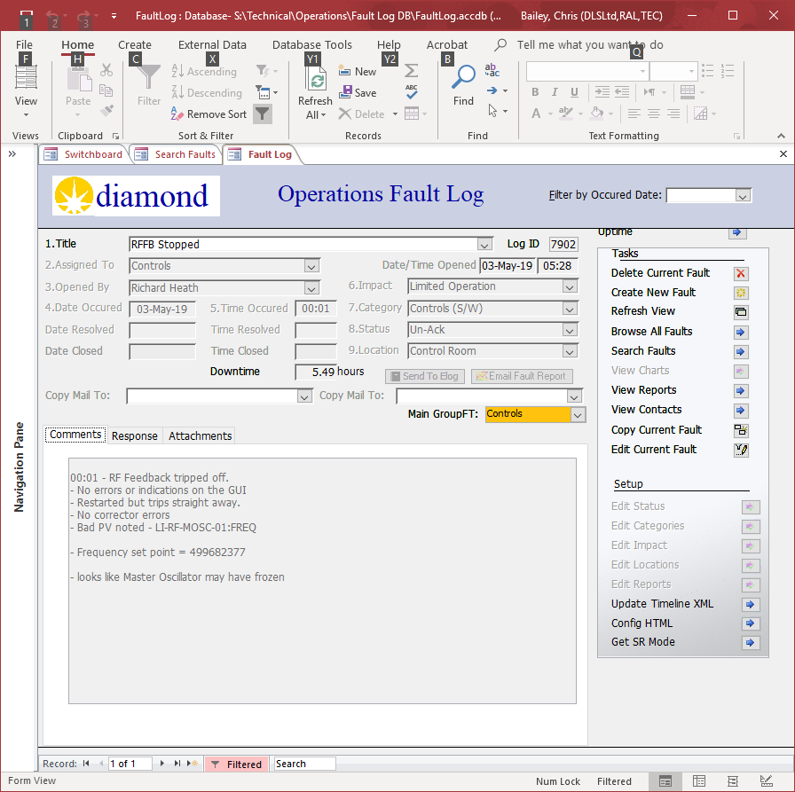
Original fault log
Microsoft Access database initially written in 2006 and developed with facility.
Developed by 2 different operators.
Communication via email and posting in elog. Fault log is completely separate system.

Slide 9
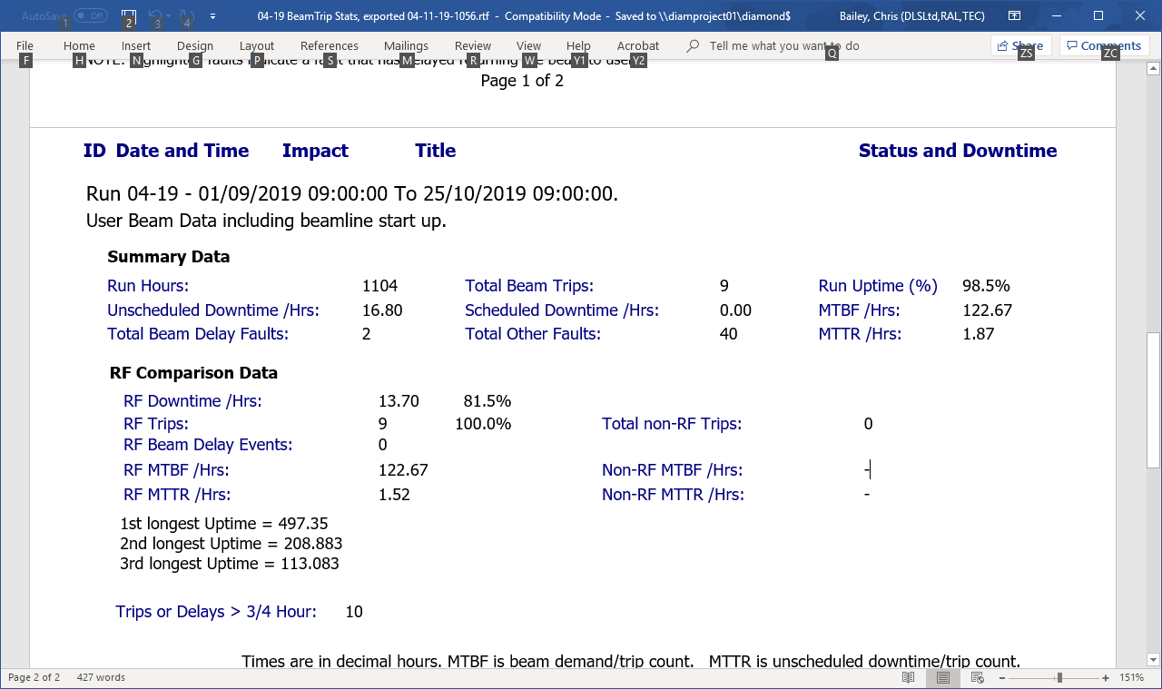
Reports
Autogenerate text and excel graph reports.

Slide 10
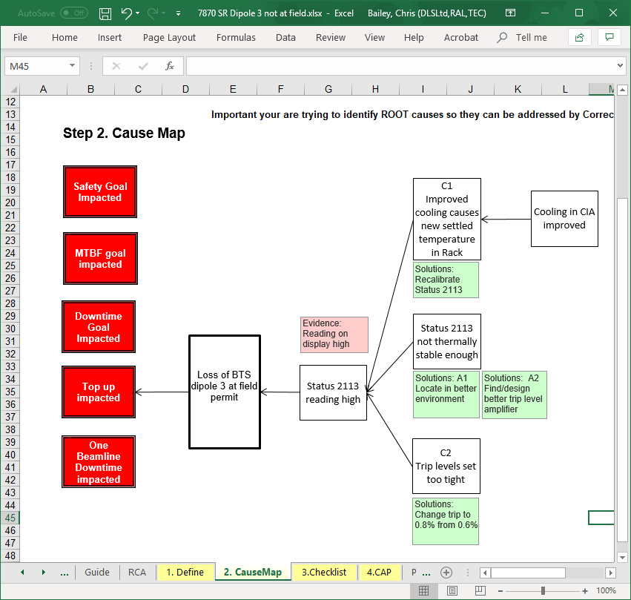
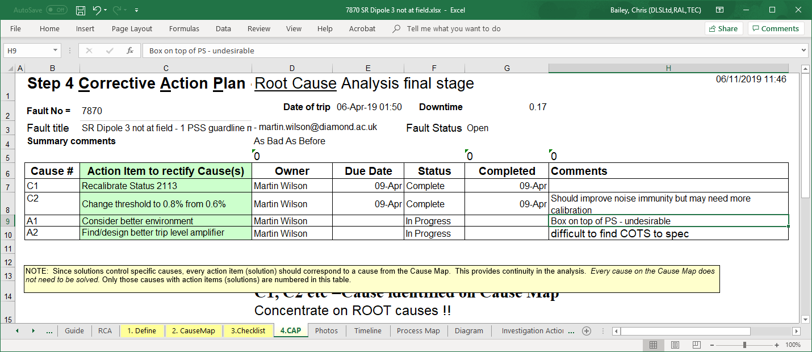
Corrective action plans.

Slide 11
Why change?
Lost responses
Difficulty of linking information between similar faults
Has not provided a resource for operators in understanding or diagnosing faults

Slide 12
What do we want?
Web communications
Automatic capture of all responses
Greater ability to link faults and browse to related ones
More support

Slide 13
Why JIRA
Effort into postgress db – support issues
In use for many projects within the Diamond – Familiarity
Possibility to link issues within and across projects
Available tools to enable piecewise migration.
Support has been available developing project to our requirements.

Slide 14
Where are we now
First 3 runs of this year running as pilot with 2 groups
1 group already using JIRA internally had no issues
Other group less enthusiastic (one with most issues)
Significant effort into control of Notification emails and ensuring response in JIRA
Last run in ‘full use’
All groups but majority of faults with group included in pilot
As a result of pilot this year is hybrid, which will make some of the Year end reports more complex

Slide 15
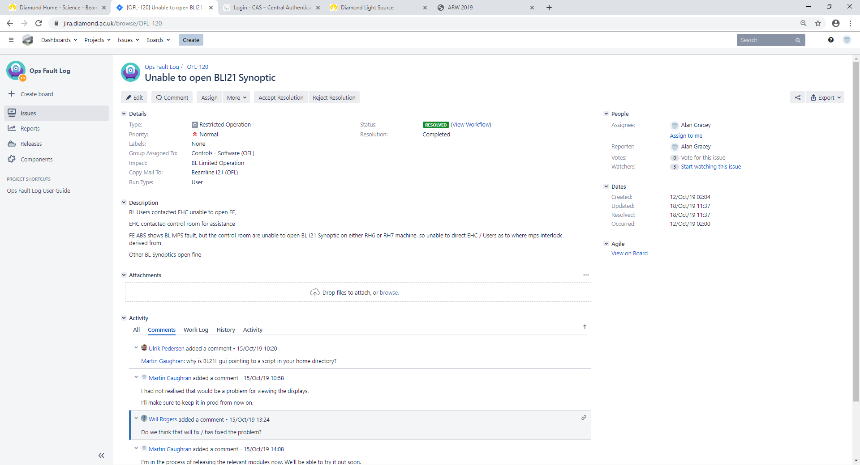

Slide 16
Automatic Summaries (query results in confluence pages)

Slide 17
What more would we like to do?
Get all groups using facilities within JIRA
Move CAP system into JIRA to exploit issue linking
Learn how best to use some of the facilities within JIRA particularly with respect to repeating faults.
Move report generation off old db
Build automated dashboards for fault status
Decide whether what to do with old database: Keep using JIRA as front end, separate the 2, or migrate old data into JIRA?

Slide 18
Conclusions
Providing required basic functionality
All communication regarding faults is now being captured
Not yet using the full capabilities of JIRA to track status of response to faults
Beginning to get use out of prebuilt searches
Looks to be promising for full set of requirments

Slide 19
Acknowledgments
Development of system V. Winter – Operator at Diamond.
JIRA support M. Taylor – Contractor(no longer at Diamond)
Initial Access development A. Dixon – Operator no longer at Diamond

