Slide 1
Shutdowns at TRIUMF:
The systematic approach
Kathleen Genge
Accelerator Operations Coordinator, Driver Beams
TRIUMF

Slide 2
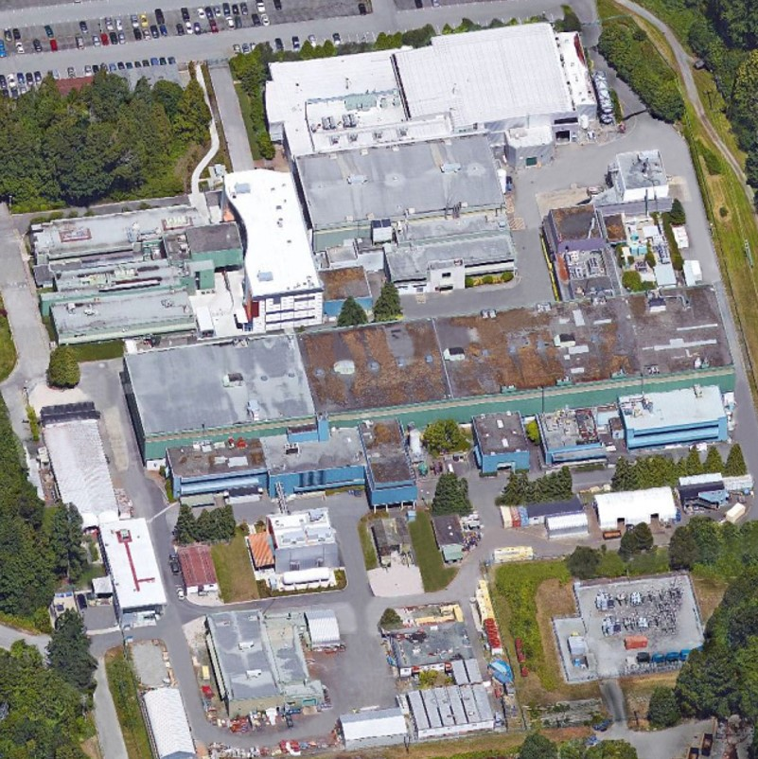
Outline
TRIUMF
Maintenance overview
Shutdowns
  Scheduling Committee
  Work flow
  Future

Slide 3
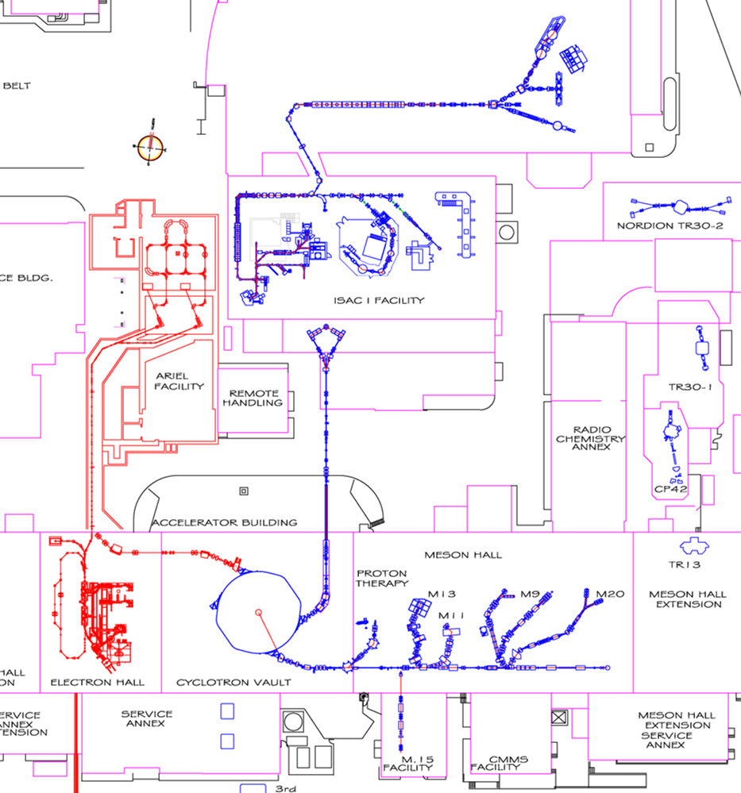
TRIUMF
520 MeV Cyclotron
  simultaneous p+ extraction
ISAC I & II
  rare isotope beam (RIB) production
E-LINAC (commissioning)
  10mA 30 MeV E-LINAC
ARIEL (commissioning & construction)
  RIB production
4 x medical isotope cyclotrons
  13 MeV, 2 x 30 MeV TR series
  CP42
  Different personnel

Slide 4
Maintenance at TRIUMF
YES: Accelerator maintenance, potential to cause beam delivery interruptions
NO: Non-beam delivery-related/interruptive site infrastructure work
Regular maintenance
  8 hrs starting at 08:30
  Every Tuesday
  Routine jobs, fault fixes, extra time goes to Operations
  Every third Tuesday dedicated to beam development
Double maintenance day
  36 hrs starting at 08:30
  Twice a year: June & mid-August
Winter Shutdown
  3-4 months, starting at 00:00 Dec. 22nd
Mini-Shutdown
  1 week, first week of October

Slide 5
What drives the schedule?
520 MeV Cyclotron
80 K & 4 K cryopanels (10⁻⁸ T)
  Defrost ~2 months during production
    Winter Shutdown
    double maintenance days – June & August
    Mini-shutdown
  LINDE 1630 helium compressor rebuild every ~6 months
    Winter shutdown
    Mini-shutdown
Ion source filament changes
  Lifetime: 3 weeks, 4+ months
ISAC
Experimental program requirements for RIB beam
  RIB target changes
    Target lifetime (3-8 weeks)

Slide 6
Who plans maintenance & how
Overall responsibility: Accelerator Division
  Maintenance days:
    TRIUMF standard operating procedures: Configuration Management & Operations Management
    Accelerator Operations Maintenance Coordinator
      One per Operations Group (2)
      Complies a list of jobs, schedules, identifies conflicts, presents at weekly meeting
  Shutdowns
    “Systematic Approach to Shutdown”/SAS Committee

Slide 7
SAS: The beginning
Before:
  Shutdown jobs on a lists, rough schedule formed, ad hoc
  two personnel managed scheduling, weekly planning meeting
2012: SAS Task Force formed
Goals:
  Develop a formal process to efficiently and predictability plan, review, approve, manage job readiness, resources, job scheduling, and communication for shutdowns.
  Use the framework for managing new installations and changes to commissioned systems
  Define the roles of the personnel involved with SAS
Result:
SAS Committee: roles, processes drafted
  First shutdown: 2013

Slide 8
SAS: Purpose and Composition
SAS Committee Terms of Reference:
“The scope of the SAS Committee is to plan and coordinate shutdown activities, follow the progress of various jobs, produce reports, statistics and lessons learnt, and announce the dates and milestones for shutdowns.”
Long term membership is encouraged: “continuity and experience are extremely valuable”.

Slide 9
SAS: Purpose and Composition
Members: Assigned by the Accelerator Division Associate Lab Director
  Chairs: Operations Manager – SAS process, planning, reporting
  Co-chair: Head of Beamlines Group – multi-facility/site-wide jobs
  Accelerator Systems Department Head – general oversight & 520 MeV Cyclotron
  Driver Operations Maintenance Coordinator – Cyclotron **extra
  ISAC Operations Maintenance Coordinator - ISAC
  Remote Handling Group Technologist – remote handling activities
  RIB Targets Production & Operations, Head of – ISAC Target Hall
  Meson Hall Coordinator – Meson Hall work (beamlines & shielding removal)
  Document Coordinator – recordkeeping
  Project Coordinator – scheduler

Slide 10
SAS Committee Duties
During shutdown:
Monitor and track job progression
Report progress at a weekly shutdown scheduling meeting
React to schedule changes: new or altered jobs
After shutdown:
Post-mortem, lessons learned:
“Some reoccurring tasks not captured”
“Commissioning time (where needed) not scheduled”
“Improved SAS templates”
Party!
Between shutdowns:
Improving processes and tools
Planning for next shutdown

Slide 11
SAS Committee Duties
During shutdown:
Monitor and track job progression
Report progress at a weekly shutdown scheduling meeting
React to schedule changes: new or altered jobs
After shutdown:
Post-mortem, lessons learned:
“Some reoccurring tasks not captured”
“Commissioning time (where needed) not scheduled”
“Improved SAS templates worked well”
Between shutdowns:
Improving processes and tools
Planning for next shutdown
PARTY!!!

Slide 12
SAS Committee Duties
During shutdown:
Monitor and track job progression
Report progress at a weekly shutdown scheduling meeting
React to schedule changes: new or altered jobs
After shutdown:
Post-mortem, lessons learned:
“Some reoccurring tasks not captured”
“Commissioning time (where needed) not scheduled”
“Improved SAS templates”
Party!
Between shutdowns:
Improve processes and tools
Plan the next shutdown

Slide 13
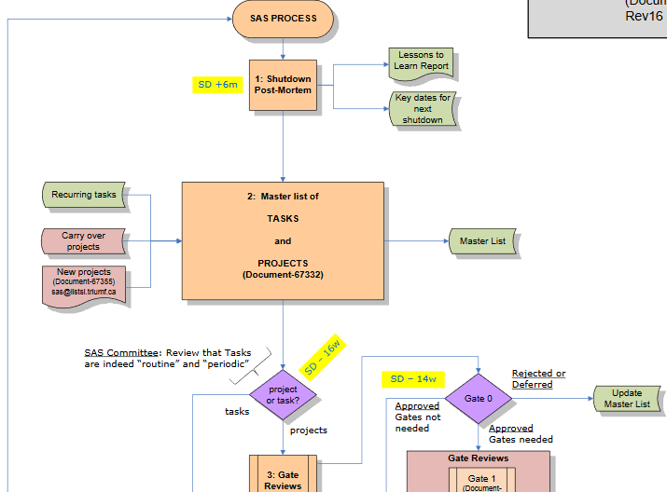
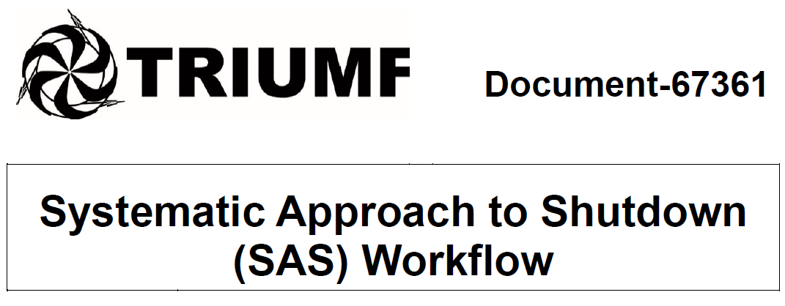
SAS work flow: Overview
Controlled document
Tools used:
Excel
Project
Word/PDF fillable Forms

Slide 14
SAS work flow: Overview
Job submission
Master List
SAS Assessment
Accelerator Division Leadership support along the way:
Provides lab and shutdown goals
Stipulate constraints (schedule, budget, resources, etc.)
Approves dates and schedules
Job escalation to TRIUMF Upper Management
Leadership Assessment
Gate 1 & 2
Job Readiness
test
Schedule

Slide 15
SAS work flow: Overview
Job submission
Master List
SAS Assessment
Defer
or
Cancel
Budget
Resources
Lab goals
Leadership Assessment
Gate 1 & 2
Project Readiness
test
Schedule

Slide 16
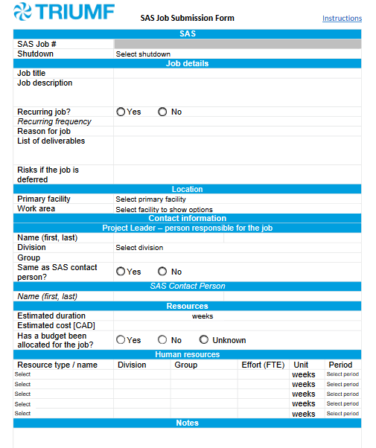
Work flow: Job Submission Sheet
Collect enough data for SAS to evaluate the next step
Filled out by the job leader/proponent
Late submissions must be approved by the job leader’s Associate Lab Director/Division Head & Accelerator Division Leadership
(Due 16 weeks before the start of shutdown)

Slide 17
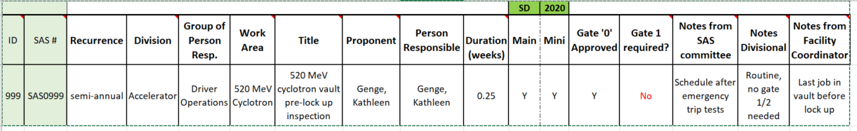
Work flow: Master List
Excel Spreadsheet of all jobs from every year
Jobs assigned a unique number
Used to track status of reviews & approvals, occurrence
Managed by the SAS Document Coordinator and Project Coordinator

Slide 18
Work flow: SAS Assessment
(16 weeks before the start of shutdown)
Assessed Variable | Rating
Risk of performing a job | None (0), Low (1), Medium (2), High (3)
Risk of deferring a job
Number of groups involved | 1-2 (1), 3-5 (2), >5 (3)
Personnel required (FTE days) | 1-2 (1), 3-10 (2), >10 (3)
Time to complete | >1 day (1), 1 day-1 week (2), 1 week–month (3), > 1 month (4)
Aggregate score | Result
< 8 | Scheduled
8 - 10 | Further analysis required by SAS
> 10 or highest rank | Requires Accelerator Leadership assessment

Slide 19
Work flow: Leadership Assessment
(14 weeks before the start of shutdown)
Assessment by Accelerator Leadership: Gate Zero
Approve or reject jobs
Provide a list of jobs that do (not) require gate reviews
  Gates: Use definitions set in TRIUMF Standard Operating Procedure for Project Governance
  Gate 0: Does the project have merit for TRIUMF? Is it in-line with TRIUMF strategy and capabilities?
  Gate 1: Are criteria for Gate 1 fulfilled? Is the project ready for the Planning (and concept development) phase?
  Gate 2: Are criteria for Gate 2 fulfilled? Is the project ready for Detailed Design?
Assign gate review committee chairs for each job

Slide 20
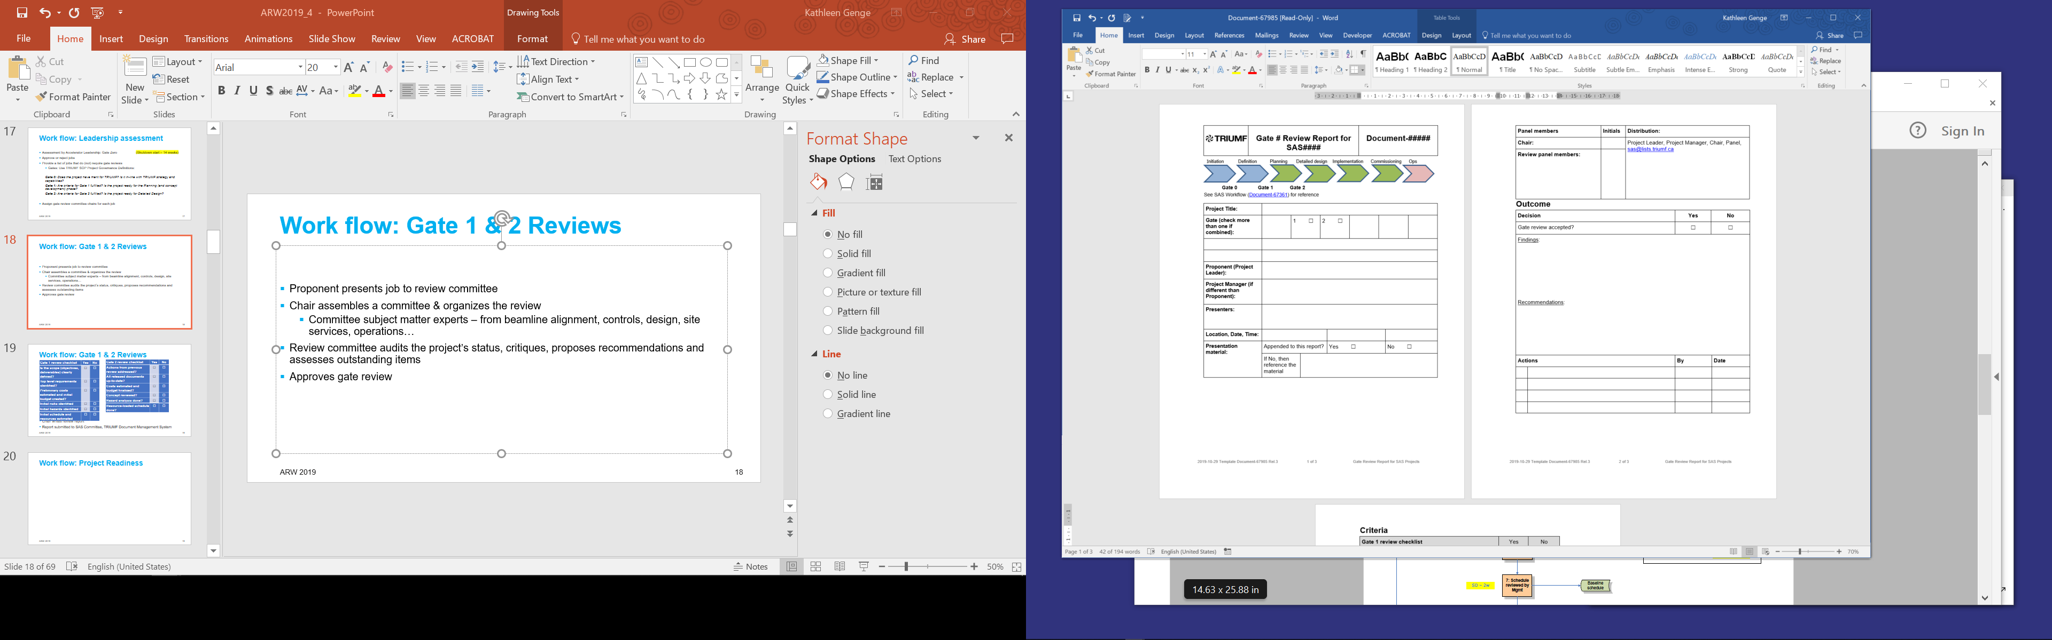
Work flow: Gate 1 & 2 Reviews
Chair assembles a committee & organizes the review
  Subject matter experts: Beamlines, Controls, Design, Site Services, Operations…
Proponent presents job to review committee
Review committee audits the project’s status, proposes recommendations and assesses outstanding items
Set list of questions

Slide 21
Work flow: Gate 1 & 2 Reviews
(8 weeks before the start of shutdown)
Gate 1 review checklist
Are the objectives, deliverables defined?
Top level requirements identified?
Preliminary costs/budget estimated
Initial risks identified
Initial hazards identified
Initial schedule and resources estimated
Gate 2 review checklist
Actions from previous review addressed?
All released documents up-to-date?
Costs estimated and budget finalized?
Concept reviewed?
Hazard analysis done?
Resource-loaded schedule done?
Chair writes review report
Committee approves or rejects job
Can be combined gate 1 & 2
Report submitted to SAS Committee, TRIUMF Document Management System

Slide 22
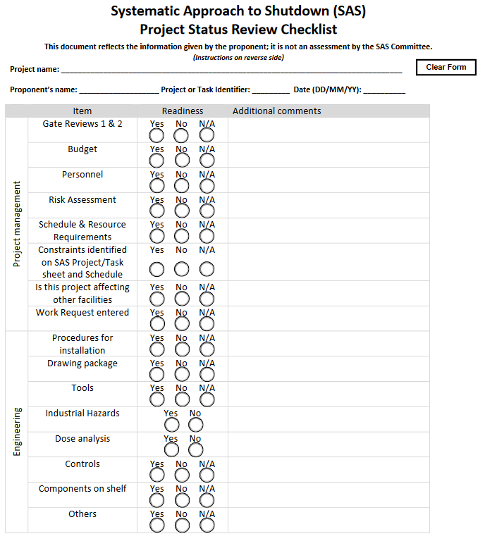
Work flow: Project Readiness
Double-check of jobs gone through gate reviews:
Is everything ready to go?
Filled out by job proponent
Tool used by SAS to decide whether all aspects of the job will be ready for shutdown
Result:
  Add or remove from draft schedule
(4 weeks from the start of shutdown)
(3 weeks before the start of shutdown)

Slide 23
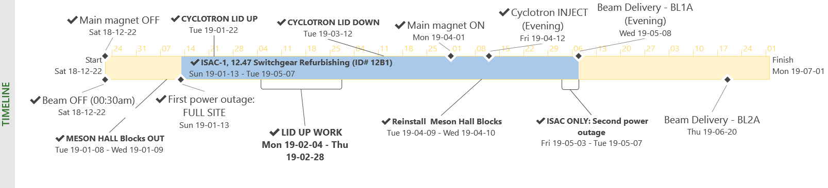
SAS work flow: Approved Schedule
Prior to final publish:
  Resource loaded
  Approval by Accelerator Division Associate Lab Director
  (2 weeks before the start of shutdown)
Published:
  Dynamic throughout the shutdown

Slide 24
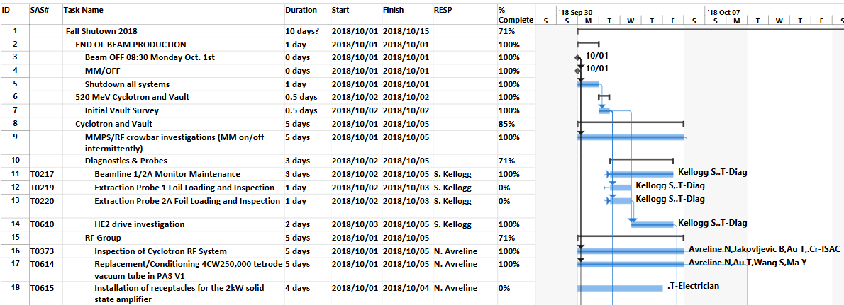
Shutdown Schedule
Winter shutdowns:
100 -150 jobs
3000 – 4000 FTE days
Jobs always added, dropped
595 lines in 2019

Slide 25
SAS: The Future
The Plan: Year-round beam delivery model
  Two driver accelerators: 520 MeV Cyclotron & E-LINAC
  Two RIB production facilities: ISAC & ARIEL
2020: First shutdown during E-LINAC/ARIEL commissioning
  Many jobs planned will interrupt E-LINAC/ARIEL
    Shared systems - water, compressed air, personnel
    E-LINAC very sensitive to cyclotron magnet and overhead cranes
  Proposed schedule:
    December 22: All Accelerator systems off
    January 22: E-LINAC start-up (3 weeks for cryogenics cooldown)
April ??: 520 MeV cyclotron start-up
1 month power savings + maintenance overlap

Slide 26
SAS: The future
Future: Will always need some overlapping shutdown period
  Possible solutions:
    Shutdowns for each Driver/RIB facility staggered
    One month overlap?
    Longer maintenance days for one facility during longer shutdown of the other?
? ? ? ? ? ?

Slide 27
Thank you!
Acknowledgements:
Violeta Toma
Doug Pretty
The SAS Committee
If your lab has different accelerator complexes with shared systems (LCW, raw water, compressed air, HVAC...), how are your maintenance periods planned?
www.triumf.ca

