Slide 1
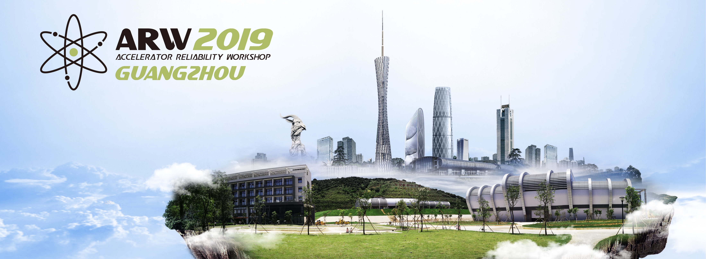
Maintenance Strategies for Reaching and Maintaining top Performance of Accelerator Facilities How to reach high beam availability and short time to recover Practical Lessons
Laurent S. Nadolski
Accelerator Coordinator
Synchrotron SOLEIL
13 November 2019
Maintenance?
Notes:
Maintenance strategies for reaching and maintaining top performance of accelerator facilities

Slide 2
Contents
Maintenance: a short Introduction
A few examples across the world
Facility Survey
Key players for an efficient maintenance
Hints and thoughts towards a maintenance for high MTTF, low MTTR…
Conclusions

Slide 3
Acknowledgement
Hadron Machines (6)
A. Savalle (GANIL), D. Preddy (TRIUMF), K. Bagget (J-Lab), P. Samson and G. Marr (BNL/RHIC), R. Giachino (CERN), D. Newhart (Fermilab)
Synchrotron Light Sources (21)
M. Pont (CELLS/ALBA), F. Sanibale (ALS), C. Bailey (DIAMOND), H. Tanaka, M. Takao (SACLA/Spring-8), J. Thanell (MAX-IV), M. Schuh, R. Ruprecht, A. S. Müller (KIT-KARA-FLUTE), S. Kreric (ELETTRA), A. Wawrzyniak (SOLARIS), L. Hardy, J.-L. Revol (ESRF), S. Shin (PLS-II), J.-.P. Jensen (DESY), J. Gao (BEPC2), M. Boege, A. Lüdeke, (PSI-SLS), K. Hsu (TPS), R. Farias (LSLS, SIRIUS), J. Safranek (SSRL), Q. Qin (HEPS), G. Wang (NSLS-II), M. Borland (APS), E. Tan (ANSTO/AS), A. Abeillé, A. Buteau, J.-F.Lamarre, E. Dupuys, F. Bouvet, A. Nadji, Y.-M. Abiven, H. Rozelot, G. Schaguene (SOLEIL),
Neutron Sources (5)
G. Dodson (SNS), J. Brower (ISIS), Y. Zhang (CSNS), P. Cara (IFMIF), K. Baggett (JLAB)
Medical Accelerators (1)
S. Meyroneinc (Institut Curie/CPO)
Other Facilities/specific, small (3)
V. Le Flanchec (CEA-DAM/ELSA), J. Nielsen (Astrid2), M. Attal (SESAME)
Industries (0)
Many thanks to the contributors from 37 laboratories!

Slide 4
Maintenance: Definitions
Actions necessary for retaining or restoring a piece of equipment, machine, or system to the specified operable condition to achieve its maximum useful life.
Any activity—such as tests, measurements, replacements, adjustments, and repairs—intended to retain or restore a functional unit in or to a specified state in which the unit can perform its required functions.
The routine recurring work required to keep a facility (plant, building, structure, ground facility, utility system, or other real property) in such condition that it may be continuously used, at its original or designed capacity and efficiency for its intended purpose.

Slide 5
Maintenance Purposes
Quality Assurance
Equipment categories
Equipment not requiring maintenance (consumables: cables, etc.)
Equipment with a friendly design for maintenance
Others
Good
Maintenance
Diagnostic capability
Reliability, availability
Reduced Back to business time
Weibull/”Bathtube” Distribution
If we operate our equipment/software/service:
- Regular maintenance
- Upgrade of equipment
Wear-out phase is most of the time out of reached
New infant mortality phase after each significant maintenance

Slide 6
Friendly design for maintenance
Easy access to components
Independent components
In-house maintenance possible
Standard tools – Everybody
Design against easy maintenance
All components soldered/stick together with the motherboard
Not possible to replace individual components
Need to dismantle many parts to access one part
No in-house maintenance → send back to certified expert
Specific tools
Notes:
Le processeur, la RAM et la mémoire flash sont soudés à la carte mère. Les réparations et les mises à niveau ne seront pas pratiques, voir impossibles.
Le boîtier supérieur, y compris le clavier, la batterie, les haut-parleurs et la barre tactile sont collés l'un à l'autre. Il est donc impossible de remplacer séparément tous ces composants.
Le capteur Touch ID sert également de bouton de marche et est couplé à la puce T2 de la carte mère. La réparation d'un bête bouton de marche défectueux risque de nécessiter l'aide d'Apple ou une nouvelle carte mère.

Slide 7
Disaster Gallery
Examples of Maintenance

Slide 8
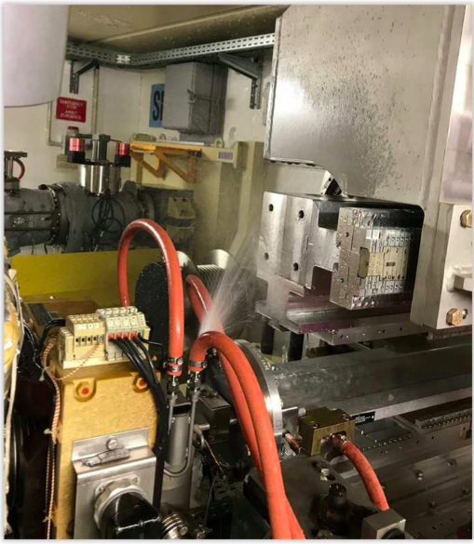
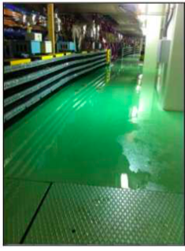
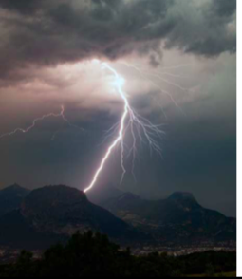
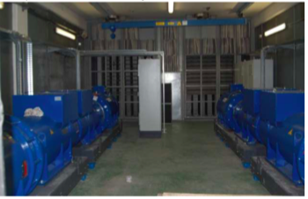
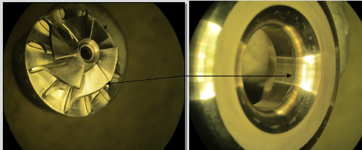
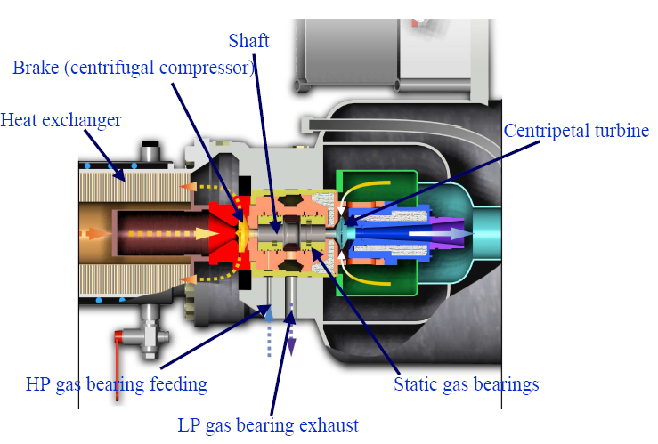
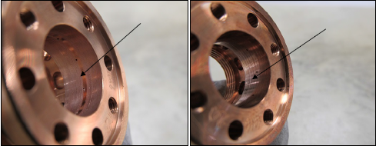
How Maintenance can help?
water leak (ESRF)
PLS-2
HQPS (ESRF)
SRF: Water pollution/LN2 circuit/Turbine Broken
Several weeks/month shutdown

Slide 9
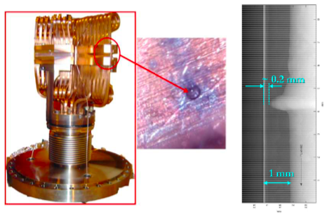
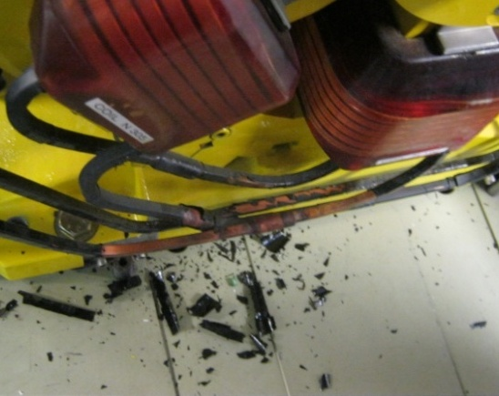
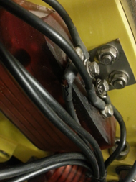
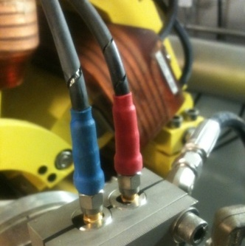
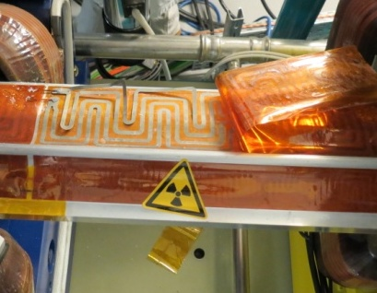
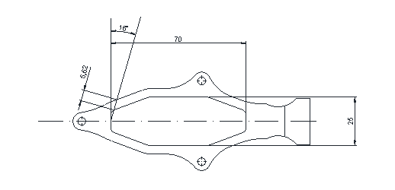
Radiation Induced Aging of Equipment
Cable insulators become rigid and brittle (SOLEIL)
Sextupoles (downstream/upstream)
ESRF Crotch Absorber / radiation induced corrosion
Quadrupole vacuum chambers are made of aluminium
Minimum thickness is 3 mm
Radiation aging of the glue that sticks together baking out film kapton foils
Preventive maintenance is not an option
BPM cables
Fluorescence X
SOLEIL
Notes:
2005: 5 days lost due to a water leak in the ID15 crotch, 2 cells vented
Thin copper thickness (1mm) of the cooling channel tube in the copper intercepting the X rays eroded by a complicated chemical process, systematic process for all.
==> ID15 replaced, all crotches displaced by 2mm, new design, all crotches replaced, better control of the water chemical properties (Ph,..)

Slide 10
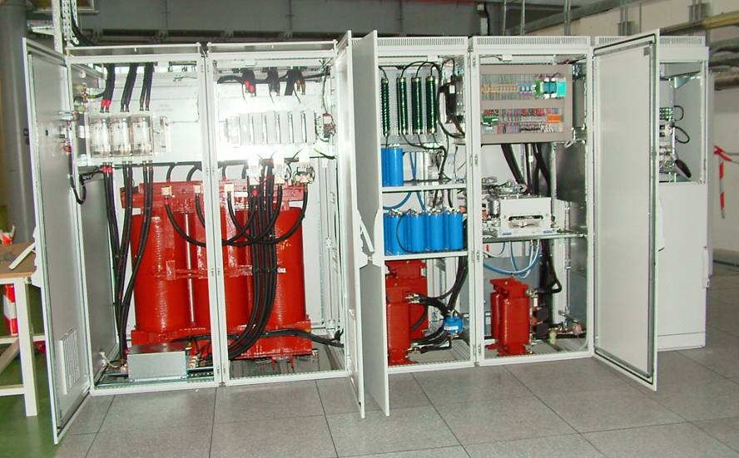
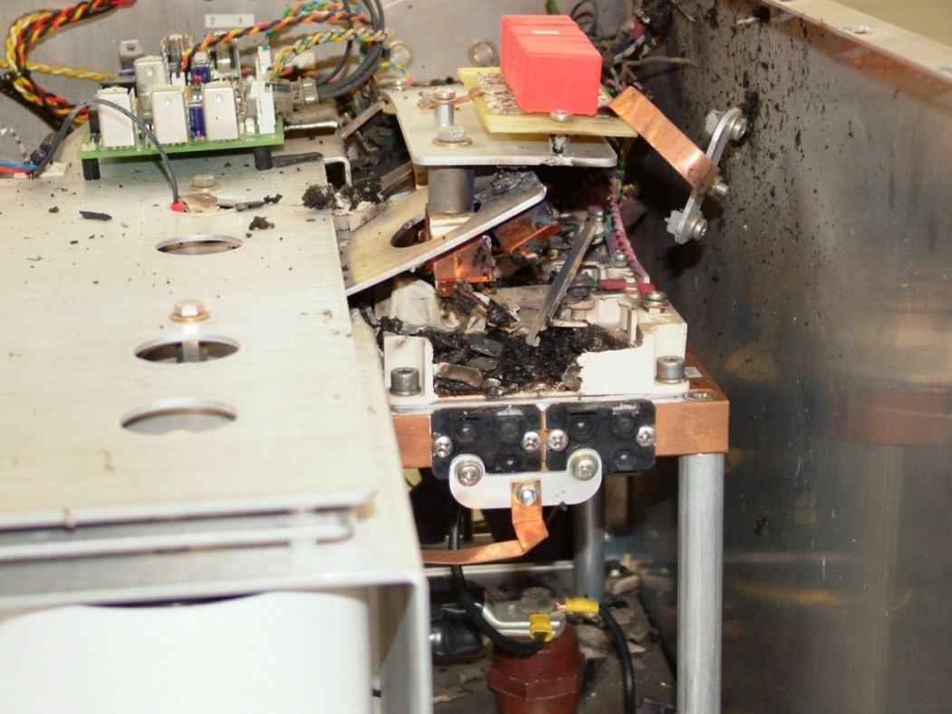
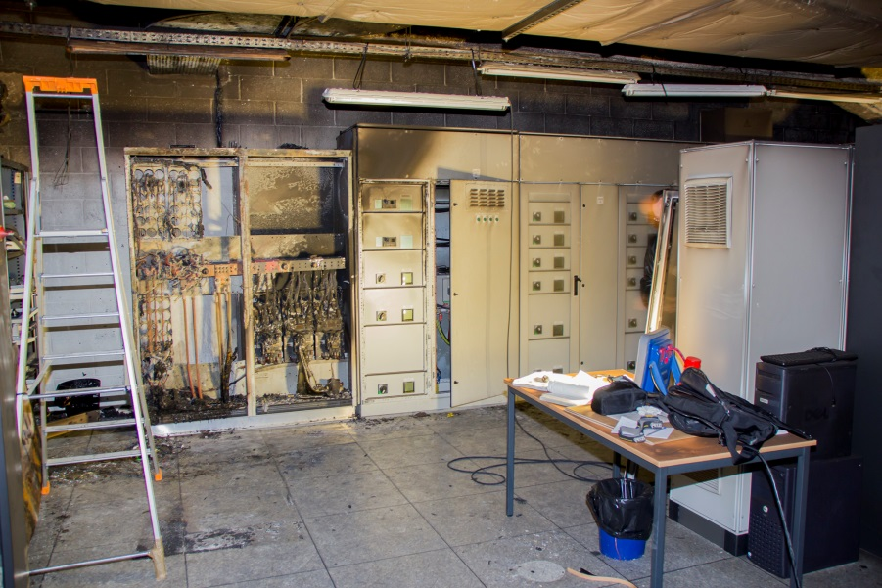
Power Supply
Expensive SPOF equipment
Cheap design from industry
(very) Low margin on components (IGBT, capacitors, etc.)
Spare Dipole Power supply (SOLEIL)
SOLEIL
Actions
1/ Understanding/diagnostics
2/ Corrective maintenance
2/ New design implementation
Explosion and Mechanical impact of
IGBT (Insulated-gate bipolar transistor)
3 Hz SOLEIL Booster Power Supplies
Include in your lifetime
Operation time
Machine Study/Start-up time (1 Day = 1 RUN of Operation)
Explosion and Fire in Cabinet (SOLEIL)
Notes:
2005 – 2014: Many failures on the 3Hz Booster power supplies
=> Interruption of the Top-Up operation for at least 2 hours (minimum time for repairing)
Lifetime of the IGBT (Insulated-gate bipolar transistor) modules used in the
4-Q output stage of the Dipole power supplies < 3 years!
Cause: High thermal stress generated by the 3Hz excursion of the IGBT
chip's junction temperature => Poor power cycling capability ( < 25 million 3Hz cycles)
Spare Storage Ring dipole power supply (400 kW):
Switching from the original power supply to the spare one takes less than 15 minutes (can be fulfilled by the machine operator)
Since its installation, many hours of beam saved (breakdowns of the original dipole power supply occured in 2015 and 2017)
Fire occurred in an electric rack of the technical building T3 for the utilities
One capacitance exploded and burned
Fire lead to damage of the equipment located in the same room
- No cooling system available
- No compressed air
Compressors for helium had to be stopped
3 weeks have been necessary for :
Cleaning
Decontamination
Repair of all the equipment
Waiting for Green light from our Insurance Company

Slide 11
S-RF system: Cryomodule cold tuning system screw damages (SOLEIL)
Screw & nut
gear-box
2
motor
1
Maintenance triggered by number of operation cycles
3
4

Slide 12
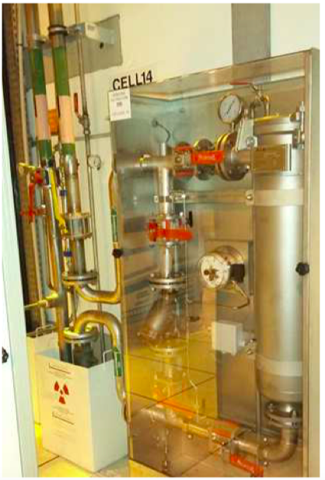
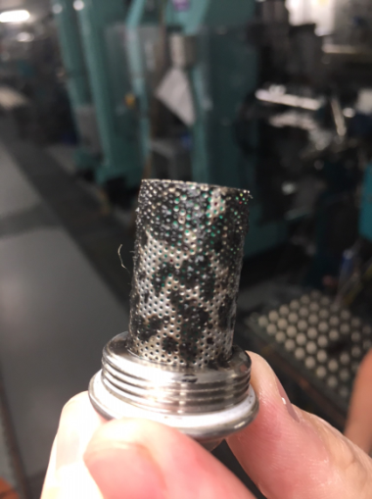
ESRF
SOLEIL
Eletta flowmeters for EBS keeping the 1µm filtering on all cells
By-pass for maintenance
Remove filters of equipment inside the tunnel !!! (?)
Magnet/ PS filters

Slide 13
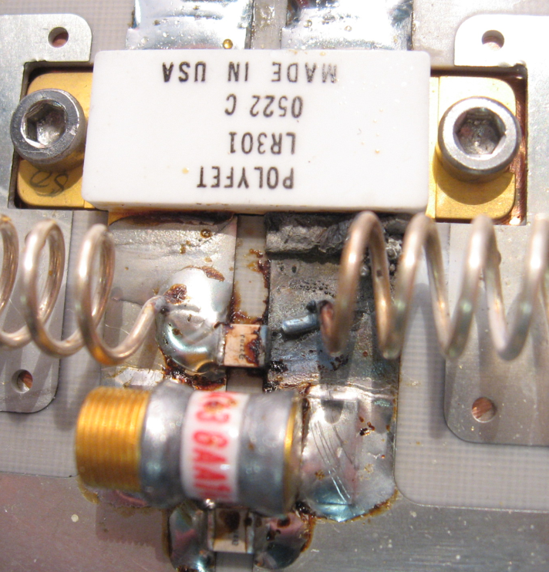
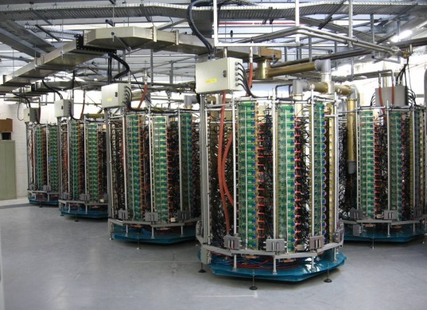
Solid State Power Amplifiers: Modular Approach
The SR SSA’s proved to be very reliable : after ~ 40 000 running hours over 7 years,
only 5 short beam dead times → ~ 100 % operational availability, MTBF > 1 year
→ ~ no impact on the operation, mainly a matter of maintenance
2 types of failures : - transistor breakdown
- damaged soldering due to thermal fatigue
Preventive maintenance
* Full year extrapolation
The two 180 kW SSA’s (2 x 4 towers), which power the two cavities of CM1 (SOLEIL)
*

Slide 14
Facilities w/ Different Objectives, Operation Schedules
Maintenance strongly related to the facility objectives and constraints
Accelerator Driven System (ADS)
MYRRHA: 10 unexpected interruptions longer than 3 s per 3-months operation cycle
Medical Accelerators (therapy, isotope production, etc.)
Proton Therapy Center of Orsay/France: 4 x Friday+week-end per year)
High Energy Physics (Colliders, hadrons, ions based facilities)
Industries
Neutron Facilities
Synchrotron Light Sources
availability 99%, MTTR < 1h, MTBF > 100h): Tens of beamlines working simultaneously
Turn Key System Accelerators
Emerging Countries (SESAME, etc.)

Slide 15
Strategy for Defining the Maintenance Types
Can we afford loosing the beam (availability, MTTR, MTBF)?
Impact of downtime
On-call staff and qualified staff, ready to be used spare equipment
Identified shutdown periods for maintenance
Redundancy of equipment
Human resources (project, internal, contractors)
Budget resources (cost of operation/maintenance/downtime)
Time resources (long, short, periodicity of shutdown, technical stop, use of the accelerator, etc.)
Environment
Isolated facility, expertise on site, weather and natural forces
Temperature, humidity, dust, Accessibility, Repair and maintenance friendly design
Inside shielded area, activated area
Age of equipment/legacy equipment
In-house equipment, purchased equipment, in-kind equipment
Notes:
Medical treatment: cannot interrupt treatment for clients/patients
Light source : 30-60 beamline out of work
Maintenance outsource : how much time to intervene
Earth quake (PLS; Japan)
Strom, lightning area (ESRF)
Inkind projet in big collaboration (ESS, MYRRHA, SESAME, etc.)

Slide 16
Maintenance Types and Strategies
Do we need maintenance?
Do we need filters, fans, etc.?
Work till failure?
Low budget facilities, legacy equipment
Maintenance free design
Corrective / Emergency Maintenance
Unscheduled
No choice, done by all facilities
Any time when it happens (at least a corrective to be back in business)
Regulatory or legal Maintenance
Done by all installations without exception
Necessity of dedicated / long shutdown periods
Preventive Maintenance
Maintenance performed while the equipment is still working well, so that it does not break down unexpectedly.
Synchrotron Light sources, Medical, etc.
Manpower/budget/time required not affordable by all facilities
Condition based / predictive Maintenance
Proactive maintenance based on a response to system observations, measurements and previous experience.
“Opportunist maintenance”
maintenance feasible thanks to special funding

Slide 17
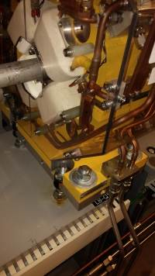
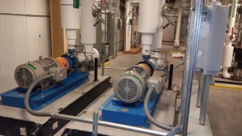
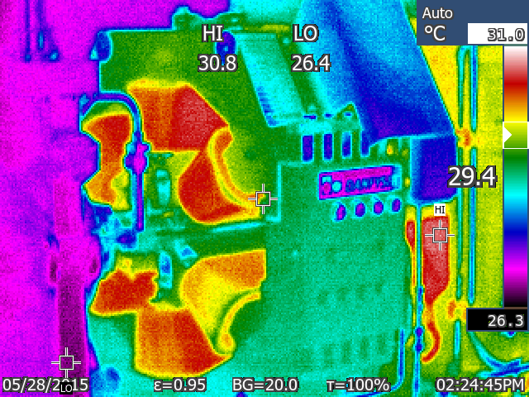
Categories of Equipment where Maintenance should be focused on?
Safety system (fire protection system, etc., PSS, MSS, EPS)
Critical technologies
RF-systems, power supplies, undulators
Equipment working on critical condition
Injection systems
Expensive Equipment without a spare
Long lead time (procurement time) Equipment
Water cooled equipment (corrosion issues, copper oxides…)
Rotating equipment (using vibration spectrum detector)
External supplier networks (water, electricity, IT, etc)
Single point of failure systems (SPOF)
Systems done by non permanent staff
Under vacuum equipment (derivative of the pressure is monitored to detect any early vacuum leak)
Most equipment fed by high power including transformer (infra red camera to detect abnormal heating issues during functioning)
…
Repair water leak
Inspect weekly
Rotate pumps weekly
Sextupole Thermography
Check P, change filters when required
Image credit (NSLS-II)

Slide 18
What Events Trigger a Maintenance Action?
Continuous monitoring
A least of critical parameters
Detect an anomaly (drift, deviation from nominal performance, increase of noise, performance degradation…).
Intervene before it fails (light sources)
Archiving data automatic processing
Large amount of data
Not enough automation
Machine Learning will definitively be a MUST in the close future
Failure metrics + criticality matrices
Past experience
Communication with other facilities
Dates (regulatory)
Frequency of occurrence (same fault, problem…)
Analyze of lifetime of components
Running time (PSs, motors, cryogenics, capacitors, etc.)
Integrated Dose
Obsolescence of component(electronics, FPGA, etc.)
Analysis and understanding of a fault
…
Notes:
Online Monitoring, weekly based analysis of performance
Persistent, frequency of problems, faults

Slide 19
Anecdote by G. Dodsong (SNS Deputy Director)
As to maintenance not going well, an RF Group leader once said to me that “there might be something in this equipment tracking business”
I asked why?
He said that we had 5 RF pre-amps failed in the last 2 years.
I said that seems like a lot, even though we had 81 of them operating.
He said, “Oh and 4 of them were in the same cabinet”.
We went out and opened the cabinet.
It must have been 130°F (54°C) in there.
I asked him when was the last time that they changed the air filters on the cabinet.
He said “these cabinets have air filters?

Slide 20
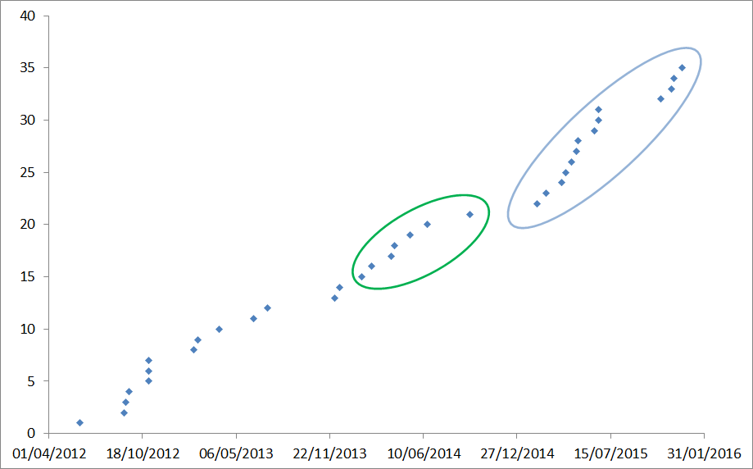
Preventive Maintenance in Action
Diagnostics
Embedded in Equipment (PSs)
Noise detection, drifts, etc.
Data exploitation
Produce a lot, but use to little
Machine Learning
On a regular base
Systematic test of detecting performance degradation of an equipment
Automation
Inspection
Bad cabling, bad connectors
Thermal Cartography
Wrong maintenance of the racks/cabinet hosting equipment (interface issues)
Wrong location
Arc Detection (ESRF)
Graph of cumulative number of failures versus date

Slide 21
Maintenance and Management
How to explain to the management that the consolidated cost of equipment should be considered when designing and purchasing a new equipment?
Management may be far from operation focus mainly cares about to delivery time, performance and budget expenses at a given time
Make management aware of the real impact and cost of uptime, downtime, maintenance
Provide management with statistics
Maintenance has a cost
A forced technical stop has a cost as well
How much cost a day of operation?
How much cost a day of downtime?
People not working on the machine?
Downtime impact, recovery time
Cost of a spare equipment?
User facility (10-60 beamlines out of work)
464k€/day for 29 beamline (SOLEIL)
Valorization of maintenance work
Purchasing policy
Something cheap is expensive at the enD
integrated cost (tech. support, training, reliability, maintenance., etc.)
Sufficient Maintenance budget is known to be the key for top performance (e.g. Light sources)
Avoid having human resources in fierce competition with other projects

Slide 22
Maintenance and Organization
Dedicated manager for maintenance (regulatory, ..) at group level, at accelerator level
Educate technical staff, explain impact, etc.
Each equipment/service should have its own system owner
especially shared systems between groups.
define Responsibility at the interfaces of equipment (PSS/Vacuum group)
Maintenance Committee, Task Force
Risk assessment (at HW and SW levels)
Documentation, procedures, Knowledge database
Easy access
Easy maintenance, update
Standardize
Spare equipment
A non tested (+ maintenance) equipment is not a spare equipment
Rotation of equipment
Ready to use
Reduced time to put BACK in operation
Powered on/off (operational cost)
Hot swap (reliability of the full chain, fast response to be transparent for operation)
Trained staff (operator), procedures
Storage space has a cost

Slide 23
How to Make the Maintenance Easier
General Rule : “Cheaper products are usually more expensive on the long term”
Consider practical experience of engineer in the design phase (design review intern/extern)
Avoid components what need to be changed on a periodic basis (fans → forced air/water cooled, etc.)
Avoid too cheap connectors…
Reduce heat production
Consider buying an UPS (HQPS, inertia wheel): to make your design cheaper, more robust to power dip, etc.
Overdesign the equipment to extend their lifetime
…
Equipment with a good accessibility
Avoid over density of components (soldering, etc.)
Avoid dismantlement of half an equipment to change a capacitor!
Avoid mixing water/electronics
Use a commercial modules (Plug&Play)
a complex system can be built from a set of simple products
PSs, SSPA, etc.
Avoid in-house solution when commercial solution is suitable
Fast replacement
Automation
Automation of motion control maintenance
Efficient diagnostic tools and user-friendly HLAs, GUIs

Slide 24
Maintenance Work
In-house / using internal staff
Too specific, in house-developed equipment
High level of complexity, technology (high voltage equipment, lasers, etc.)
Keep know-how
Fast response
Flexibility
Team on call
But, are the support team large enough?
Outsourced / using external companies
May be restricted by local regulation (DOE, etc.)
Low-technology equipment
Regulatory maintenance
Most facilities: Utilities, (HVAC, cooling system, electricity, power breakers, security system, radiation safety system, legionella, etc.)
Exceptional maintenance (response to a disaster, peak load, etc.)

Slide 25
How Involving Subcontractors in Maintenance
Maintenance not allowed by subcontractor inside the tunnel outside shutdown periods.
Using in-house resource or external company to make the maintenance
Both. ESRF has an external company on site (Vinci) for all concerning fluids and general services (high voltage, etc). They are even on standby 24/24 7/7 365/365.
For electrical mains, ESRF dedicated group is composed of technicians and engineers supervising all equipment but in case of maintenance or emergency maintenance, an external company is used.
If objective are met, extra money for the company
Can it work for small accelerator (low penalty, influence power…)?
Service contract negotiated during purchase phase
Capacity to follow the work of subcontractors
How to define the handover point between the outsourced company and the laboratory?
How contractor log their maintenance work? (paper, software of the company/of the laboratory).
How to spread the knowledge and lesson learned?

Slide 26
How to Deal with Captive Market?
Is it inevitable for some component or product (VME crates, some UPS systems, very specific HW, cooling system), etc.?
How to deal with facility with a lot of in-kinds (international such as MYRRHA, ESS, IFMIF, CERN, SESAME, etc.)?
Market monopole / captive market (a single and unique contractor, a laboratory, a company)
Loss of cost control
Loss of schedule control
Part of the solution: request to have maintenance on the site instead of remotely
Build as much as possible expertise in situ working with contractor

Slide 27
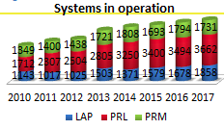
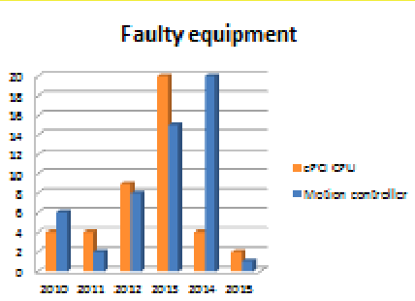
Maintenance of Software (Controls, firmware, etc.)
Maintenance eased-up
By a good asset management (CMMS, what is deployed, where, in what version)
By choosing well proved open source solutions
Analysis of Lifecycle of equipment
Security patch is a MUST
Business Continuity Plan should not be an option (high availability, single point of failure)
Documentation, etc.
Obsolescence (OS, etc.)
Software factory (automatic compilation, code analysis)
Dump analysis (breakpad, etc.), logging
Monitory capability
Computer Servers (changed every 5 years when 24/7 support become more expensive than buying new ones).
Virtualization of services to separate HW to SW.
Notes:
Never wait for aging the step for upgrade will be too large.

Slide 28
Maintenance of Software (2)
”Unwanted upgrade” (time back to business, side effect, driver compatibility, legacy components, etc.)
Strategy with a risk analysis
Roll-back, back out plan
Automation and non-regression tests
Continuous deliveries, small deliveries
Agility Methods
How to have a win-win interaction together with the Machine groups (Agility, DevOps, etc.)
Developing, testing together
IT are evolving fast. Crucial to keep it reasonably up-to-date
Benefit from development and bug fixes from other laboratories (EPICS, TANGO, WEB-APPS, Python-apps, etc.)
National and international collaborations.

Slide 29
Conclusions: Maintenance Strategy “machine type” dependent
Maintenance is a Culture.
Starting at Design Level (Design, Change review)
In Purchasing / Call for tenders
Qualified personal
Suitable and ease-to)use tools
Continuous education, training and spreading knowledge
Management, Purchasers, Experts, etc.
Operators (education, background, first response team)
Planification and organization
Documentation (risk analysis, procedure, tech. doc, etc.)
Updated data based and regular reviews
Knowledge evaporation (retirement, people leaving, changing division, when tech. doc is a person, recruitment policy)
Prevent as much as possible deferred maintenance
Shared equipment between laboratories?
Ex MAX-IV 1.5 GeV Ring / SOLARIS
Shared knowledge about failures, fault investigations,
At industry level (same equipment in different sites)
At laboratory level (inter and intra)
Do we need to start from scratch?
Knowledge Database? Procedures for our community? Dont’s, Do’s
Templates for procurement, calls for tender…

Slide 30
ANNEXES

Slide 31
Survey Send to 50 facilities/industries
What is the maintenance strategy of your installation? (predictive, corrective, emergency, conditioned based, regulatory maintenance)
What event trigger a maintenance action?
How to explain to the management that the consolidated cost of equipment including maintenance cost and running cost should considered when designing and purchasing a new equipment?
Hidden cost of maintenance and captive (monopole) market
Using in-house resource or external company to make the maintenance
How to conceive equipment easy to maintain? needing little time to be fixed, replaced, etc.?
Categories of equipment where the maintenance should be focused?
How to handle large system maintenance like as the cooling plant when the facility is aging?
Maintenance of software (controls, equipment firmware, etc.)
Maintenance impact on the planning of the shutdown periods (what strategy?)
Maintenance strategy and prioritization the resources in a large accelerator complex
Maintenance and regulation (Nuclear Base installation, Medical installation, etc.)

Slide 32
Drivers to Perform Maintenance at NSLS-II
Primary drivers for maintenance tasks | Time based | Metering | In Service Surveillance | Event Based | Fault reports
Controls | 10% | 0% | 30% | 10% | 50%
Diagnostics | 0% | 0% | 25% | 0.25% end of long shutdown" | 50%
Electrical, Power Distribution | 60% | 5% | 20% | 13% | 2%
Electrical, Power Supply | 5% | 30% | 20% | 15% | 30%
Electrical, Pulsed Magnets | 20% | 20% | 20% | 20% | 20%
Electrical, Safety (EPS/PPS) | 60% | 5% | 5% | 10% | 20%
Insertion Devices | 50% | 0% | 20% | 10% | 20%
Mechanical, Front End | 70% | 10% | 0% | 0% | 20%
Mechanical, Magnet | 80% | 10% | 0% | 0% | 10%
RF | 10% | 0% | 50% | 15% | 25%
Utilities, Cryo | 85% | 5% | 5% | 0% | 5%
Utilities, Water | 70% | 5% | 5% | 15% | 5%
Vacuum | 10% | 0% | 50% | 0% | 40%
Periodic (Time Based)
Classical mechanical systems, Time based and use based reminders (weekly, monthly, quarterly…, # cycles)
Front Ends and Insertion Devices, actuator lubrication, motion and travel inspection,
Utilities, Seal inspection, Valve operation
Metering and In Service Surveillance
Front Ends and Insertion Devices, wear limits, vibration, actuation time
Utilities, differential pressure monitoring, flow Monitoring, motor vibration,
In Process Surveillance
RF system
Vacuum
Event Based
End of Shutdown-ready for operations checklists (Diagnostics Group)
Fault Reports
Regular review of faults to identify repeating problems and areas for improvement (RF and PPS Groups)
Courtesy of G. Wang (NSLS-II)

Slide 33
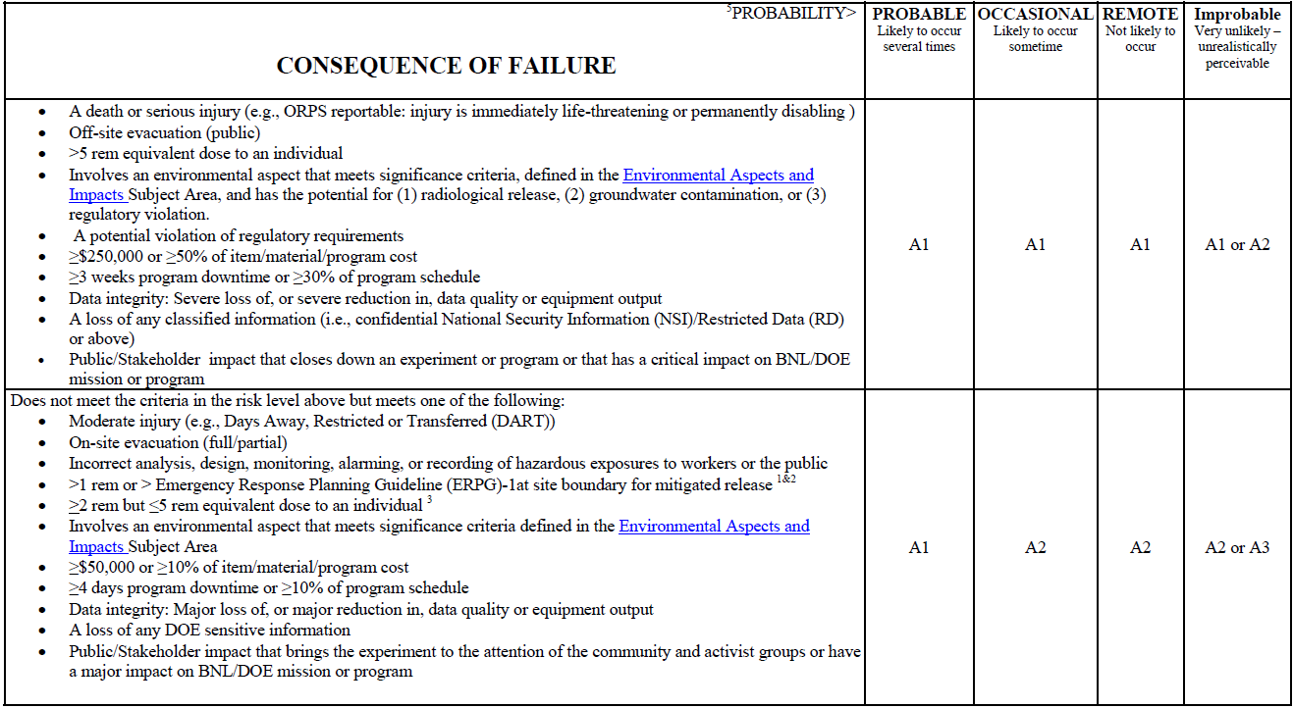
Graded Approach Risk Level Matrix at NSLS-II
Quality Classification
Injury
Radiation exposure
Cost
Delay
Courtesy of G. Wang (NSLS-II)

Slide 34
Minimum Requirements by Quality Class (NSLS-II)
Courtesy of G. Wang (NSLS-II)
Elements | Quality Class Designation
 | A1 Critical | A2 Major | A3 Minor | A4 Negligible
Written Maintenance Procedures | x | x
Equipment-specific Trained | x | x
Initial and Post-Maintenance Testing | x | x
Equipment Repair History and Vendor Information | x | x | x
Requisitioning/Procurement | x
Materials Control | x
Condition Assessment Surveys | x | x | x | x
Preventive Maintenance | x | x | x
Predictive Maintenance | x | x
In-Service Surveillance | x | x
Corrective Maintenance | x | x | x | x
Breakdown Maintenance or Run-to-Failure |  |  |  | x

Slide 35
How to Handle Large System Maintenance like as the Cooling Plant when the Facility is Aging?
Usually done during the long shutdown period of the machine and is performed by a mixed team of in-house and external resources.
Follow recommendations of the manufacturer
Partial maintenance – piece-wise maintenance
Avoid full facility back-out, etc.
Make more transparent maintenance operation
Design bypass system for inspection, diagnostics, cleaning filters in parallel to operation
Close and daily monitory of the facility (internal or external resources)
How is it done in other facilities?

Slide 36
Maintenance Impact on the Planning of the Shutdown Periods (What Strategy?)
Only time
For utilities, power-supplies, long enough testing periods, cryogenics systems, etc.
Thermography of connectors, waveform monitoring and recording
…
Pluriannual maintenance
Regulatory Maintenance
Saving running cost (winter period, holidays, weather conditions, etc.)
How the maintenance strategy involves when building a new facility in parallel of a running facility (reduction of human resources, and of life of some equipment)?
Management of coactivity/resource conflict

Slide 37
Selected Feedbacks (1)
On the other hand, for the magnets power supplies , a system of hot swap has been designed (patent) so that we can remove / repair / exchange a power supply or a channel whilst a magnet is powered by another channel. So, hot redundancy is feasible in some cases but costs a lot of money. (ESRF)
At ESRF, downtime and reliability are a priority. For that reason, Management has not so much difficulty to understand that the price must be paid right from the beginning
hot swap redundancy for magnet power supply for EBS project.
32 times 1 µ-filters (total 150 000 euros) installed at the entrance of each cell, to catch particles of water oxides and avoid they remain blocked in the magnets.
Most of the equipment was designed and built in house and most of the time the tight budget led to the choices we made in the past (Brazil).
Difficulty to purchase abroad (very long time to get an product, uncertainty about custom time, remote location, etc.)

Slide 38
Selected Feedbacks (2)
« Overall, I would say that the most important way we guarantee reliable operations at SSRL is experienced and knowledgeable staff maintaining our various accelerator systems. We rely on our staff’s deep system knowledge to identify potential problems before they cause significant downtime and to address problems quickly when the accelerators do go down. It helps that staff tend to stay on the SSRL accelerator team for decades. » J. Safranek (SSRL)
« As to maintenance not going well, an RF Group leader once said to me that “there might be something in this equipment tracking business” I asked why. He said that we had 5 RF pre-amps fail in the last 2 years. I said that seems like a lot, even though we had 81 of them operating. He said, “Oh and 4 of them were in the same cabinet”. We went out and opened the cabinet. It must have been 130°F in there. I asked him when was the last time that they changed the air filters on the cabinet. He said “these cabinets have air filters? » G. Dodsong (SNS)

Slide 39
Raised Questions (1)
What is the strategy to track the maintenance?
Recovery strategy after a scheduled maintenance (check equipment/software)?
What is the organization of other facility for the maintenance of fluids and electricity?
When a machine is running 6000h/year, how is maintenance effectively realized?
How the maintenance strategy is affected
When Building in parallel a new accelerator?
When a upgrade is planned in a few year
How your maintenance strategy has evolved over time and why?
Strategy to determine the number of spare equipment and replacement parts.
What strategy to modernize old or very large facilities?
EPS is always an evolving important piece of equipment in the accelerators, how to ensure maintenance of EPS?

Slide 40
Raised Questions (2)
How has the maintenance strategy to be changed in case changing from 24/7 operation to block operation of a few days and long shutdowns in between?
Are there new aspects of maintenance caused by “cycling” the facility by operation of a few days and long shutdowns in between?
Tools
What tools can be used to help predicting the breakdown of the system?
Is there common software used to monitoring trends; anomalies of the system behaviour; alarming e.g. Building Management System?
Is the machine learning commonly used to analyse the trends and machine parameters behaviour in order to help avoiding/predicting system breakdown? what is development in this direction and approaches of the facilities?
Is there need of building the database of the spares for accelerator facilities which are expensive and have long period of delivery (klystrons; RF equipment; ceramic chambers; special power supplies) that are used in other facilities to share the spares. Is it possible? Example Solaris and MAXIV which using the same systems for RF; vacuum; power supplies; diagnostics electronics

Slide 41
Maintenance and Industry: What Can We Learned?
World Class Manufacturing
10 technical pillars
10 management criteria
Total Productive Maintenance
8 pillars

Slide 42
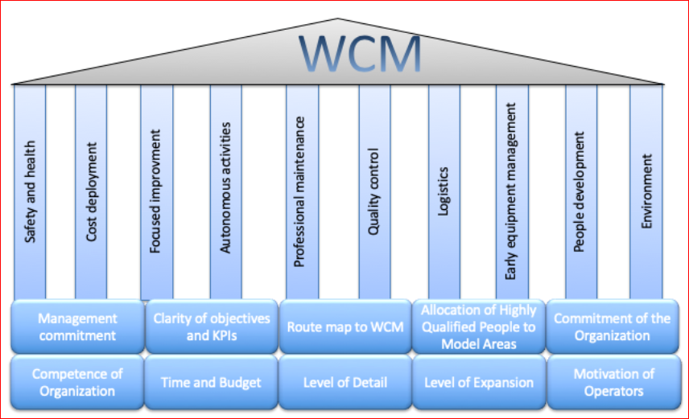

Slide 43
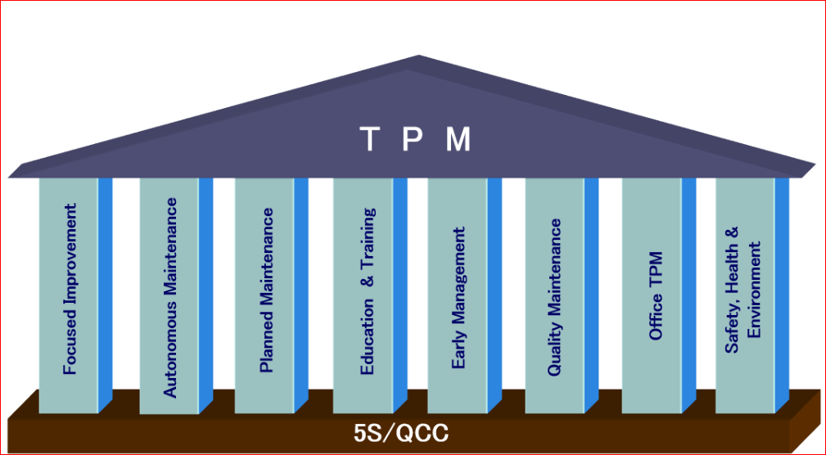

Slide 44
