Slide 1

Fault investigation tools at the ALBA synchrotron light source
Ferran Fernandez
ARW2019
Notes:
ALBA is a third generation synchrotron light source near Barcelona (Spain). In operation for users since 2012, we aim at continuously improve the beam availability by increasing the mean time between failures (MTBF) and decreasing the mean time to recover (MTTR). In order to reduce the MTTR a good set of tools to quickly diagnose what has caused the incidence is a must. From the timing or PLC logs to the BPMs buffers; here we report our sources of information to investigate the failures. But, it’s not only a matter of having the information, but being able to quickly access to it. Thus, the Operator oriented tools to extract the data in the Control Room will also be presented. Finally different examples of failures will be given to illustrate our means and a list of "what we would like to have" will be discussed.

Slide 2
Outline
2
Introduction
Sources of information
“Operator friendly” tools to get the data
Wishlist
Examples: Fail Modes Simulator
Notes:
asdfasdf

Slide 3
  Introduction
BOOSTER
100 MeV – 3 GeV
STORAGE RING
3 GeV
+ 8 Beamlines
+ 4 BLs in construction
LINAC
100 MeV

Slide 4
Introduction
4

Slide 5

Introduction
PERSONAL SAFETY SYSTEM
5
Tango Control System
Equipment Protection System
CCG, IP, TC, Valves
Magnets & PS
Cooling
BPMs
RF
Machine Protection System
DI
ID

Slide 6
Sources of information
6
FAST ARCHIVING
&
ONLINE DATA AUTOMATICALY SAVED
ONLINE DATA TO BE SAVED
ARCHIVING

Slide 7
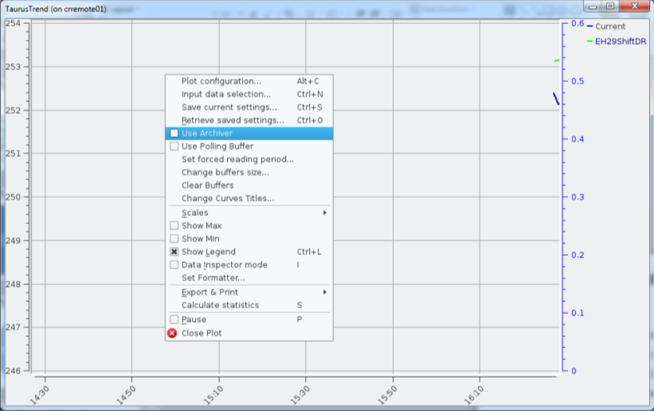
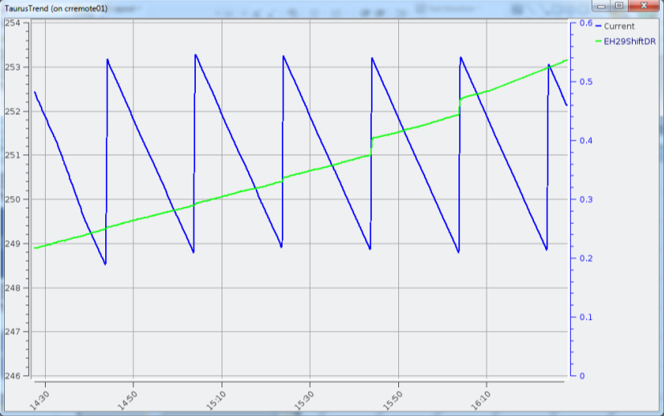
Sources of information
7
ARCHIVING
Control system variables that are recorded periodically or “on change”
“Large” time resolution: from 1s to 1min typically
12 “kattributes” being recorded (600 Gb/month)
Easily accessible through the same GUIs as the control system, however...

Slide 8
Sources of information
8
ARCHIVING
Power supplies: current, voltage,…
Vacuum: pressures, valves state, thermocouples,…
RF: forward/reverse power, cavity voltage,…
Cooling: temperature, flow, pressure,…
Radiation monitors: dose rates, accumulated dose
Insertion devices: gap, phase, correction coils current,…
Diagnostics: BPMs, Beam Loss Monitors, tune, current, lifetime, filling pattern, emittance (pinhole),…

Slide 9
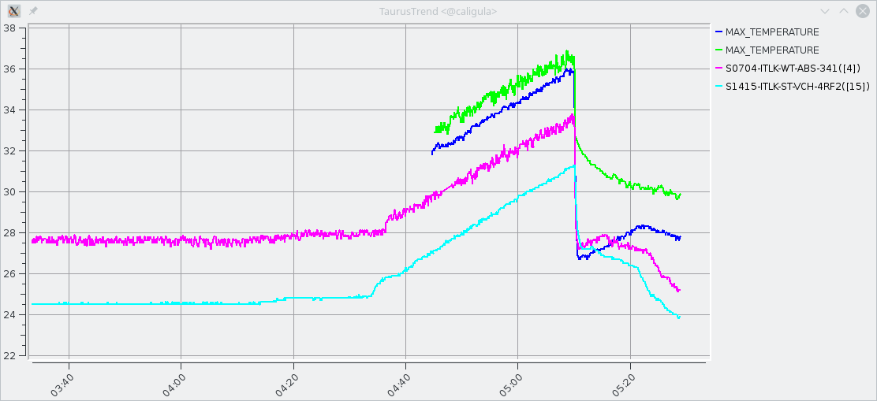
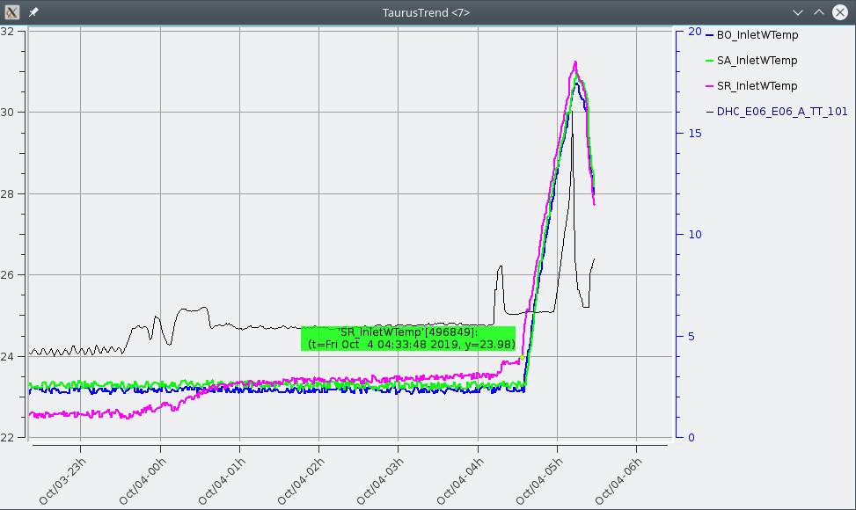
Sources of information
9
ARCHIVING
Useful to see:
Which were the general conditions of the accelerator when an incident happen
Long term drifts

Slide 10
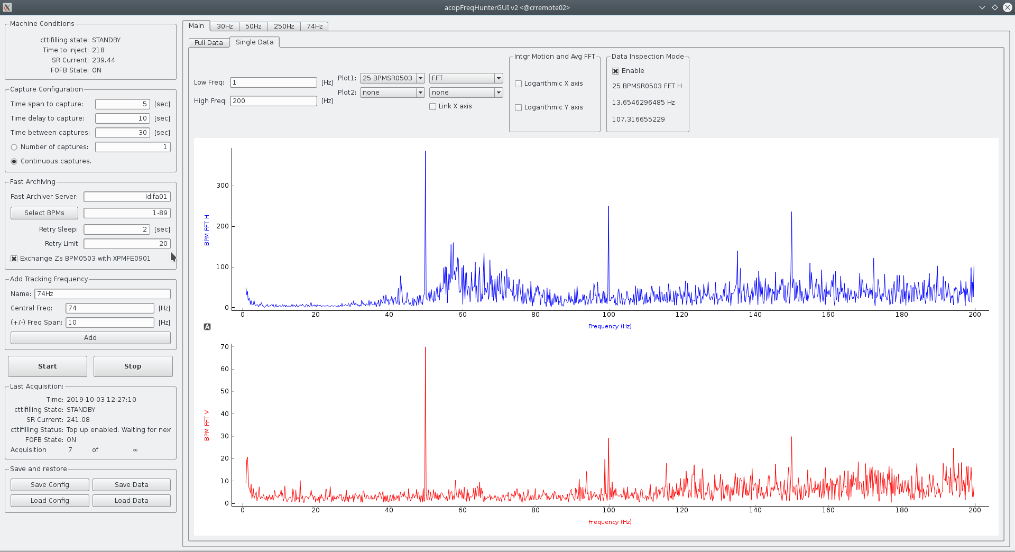
Sources of information
10
BPMs FAST ARCHIVING
14days
BPMs at 10kHz
MADE IN OPERATIONS

Slide 11
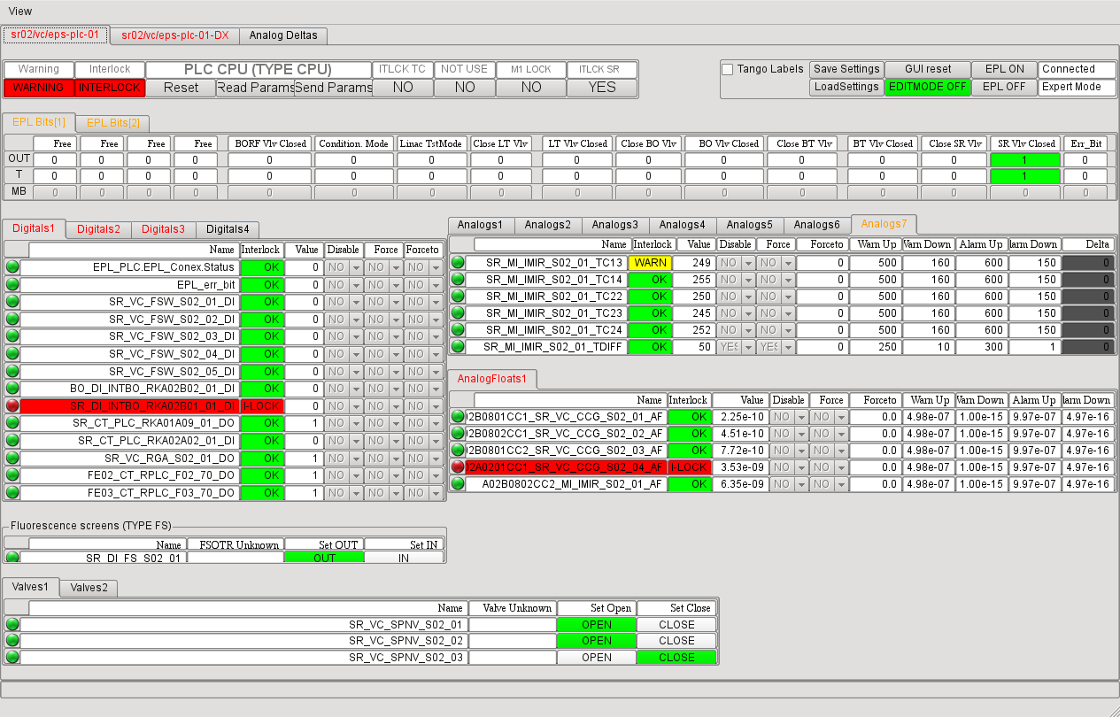
Sources of information
11
ONLINE DATA AUTOMATICALY SAVED
Timing logs (timestamps) saved during reset
PLC log files saved during the reset
SR correctors at 5kHz during the last 14s saved each time FOFB stops
RF Fast Interlock Module and LLRF buffer saved during reset

Slide 12
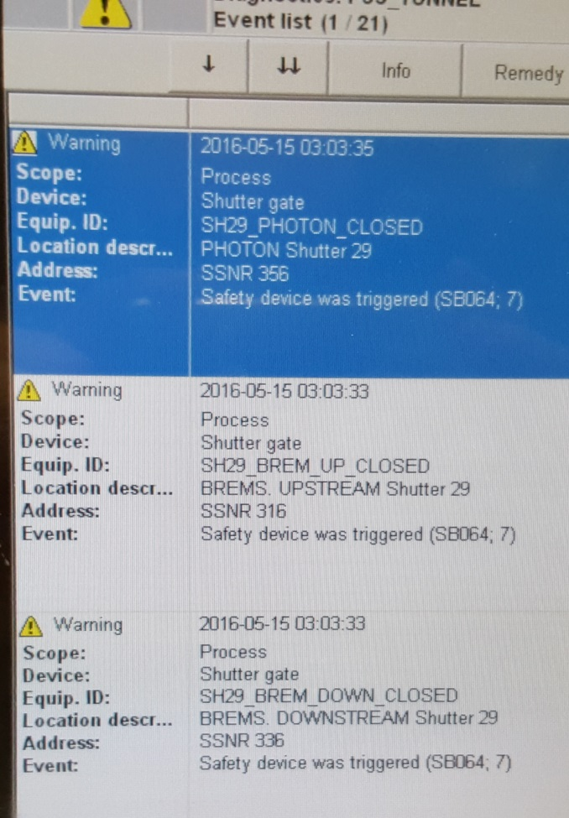
Sources of information
12
ONLINE DATA TO BE SAVED
Data “generated” under certain conditions (typically a Beam loss) that is erased after a Reset. These are:
BPMs turn by turn data; 250000 turns buffer
Personal Safety System info shown in its panel (Rack in the Control Room)
Status messages from the devices (Ex.: PS leakage current ITLK)

Slide 13
“Op. friendly” tools to get the data
13
The most important after a Beam Loss is to quickly access to the protection systems (MPS and EPS) data
  acopTrip.py
    Timing Logs (Orbit trip, RF, VC itlk and SCW quench)
    RF info(IOTs status and trips,RF Fast Interlock Module, RF EPS)
  EPS GUI
    Summarizes in one view the general status of the Equipment Protection Systems PLCs
MADE IN OPERATIONS

Slide 14
acopTrip.py
06a (HVON, HVON)
FIM: Timing, Revers Cavity, Forward Load
EPS: no interlocks
Tx01: FaultRfon {RFON is not enabled from EPS}
Tx02: FaultRfon {RFON is not enabled from EPS}
06b (AUX, HVON)
FIM: Timing, Revers Cavity, Forward Load
EPS: no interlocks
Tx01: not in operation
Tx02: FaultRfon {RFON is not enabled from EPS}
10a (HVON, HVON)
FIM: Timing, Revers Cavity, Forward Load
EPS: no interlocks
Tx01: FaultRfon {RFON is not enabled from EPS}
Tx02: FaultRfon {RFON is not enabled from EPS}
10b (HVON, HVON)
FIM: Timing, Revers Cavity, Forward Load
EPS: no interlocks
Tx01: FaultRfon {RFON is not enabled from EPS}
Tx02: FaultRfon {RFON is not enabled from EPS}
Timing Log:
Event description Local time Timestamp [ns]
BPMs Interlock - SR S02 2019-05-19 02:20:31 213077001
RF Plant 14A Fast Interlock 2019-05-19 02:20:31 213080716
RF Plant 10B Fast Interlock 2019-05-19 02:20:31 213080796
RF Plant 6A Fast Interlock 2019-05-19 02:20:31 213081020
RF Plant 14B Fast Interlock 2019-05-19 02:20:31 213081044
RF Plant 10A Fast Interlock 2019-05-19 02:20:31 213081436
RF Plant 6B Fast Interlock 2019-05-19 02:20:31 213081628
RF Plant BO Fast Interlock 2019-05-19 02:20:31 213100786
BPMs Interlock - SR S15 2019-05-19 02:20:31 213641728
BPMs Interlock - SR S13 2019-05-19 02:20:31 213648204
BPMs Interlock - SR S16 2019-05-19 02:20:31 213648445
BPMs Interlock - SR S11 2019-05-19 02:20:31 213653464
BPMs Interlock - SR S01 2019-05-19 02:20:31 213655425
BPMs Interlock - SR S12 2019-05-19 02:20:31 213658363
BPMs Interlock - SR S07 2019-05-19 02:20:31 213659532
BPMs Interlock - SR S08 2019-05-19 02:20:31 213661478
BPMs Interlock - SR S03 2019-05-19 02:20:31 213675792
BPMs Interlock - SR S06 2019-05-19 02:20:31 213845733

Slide 15
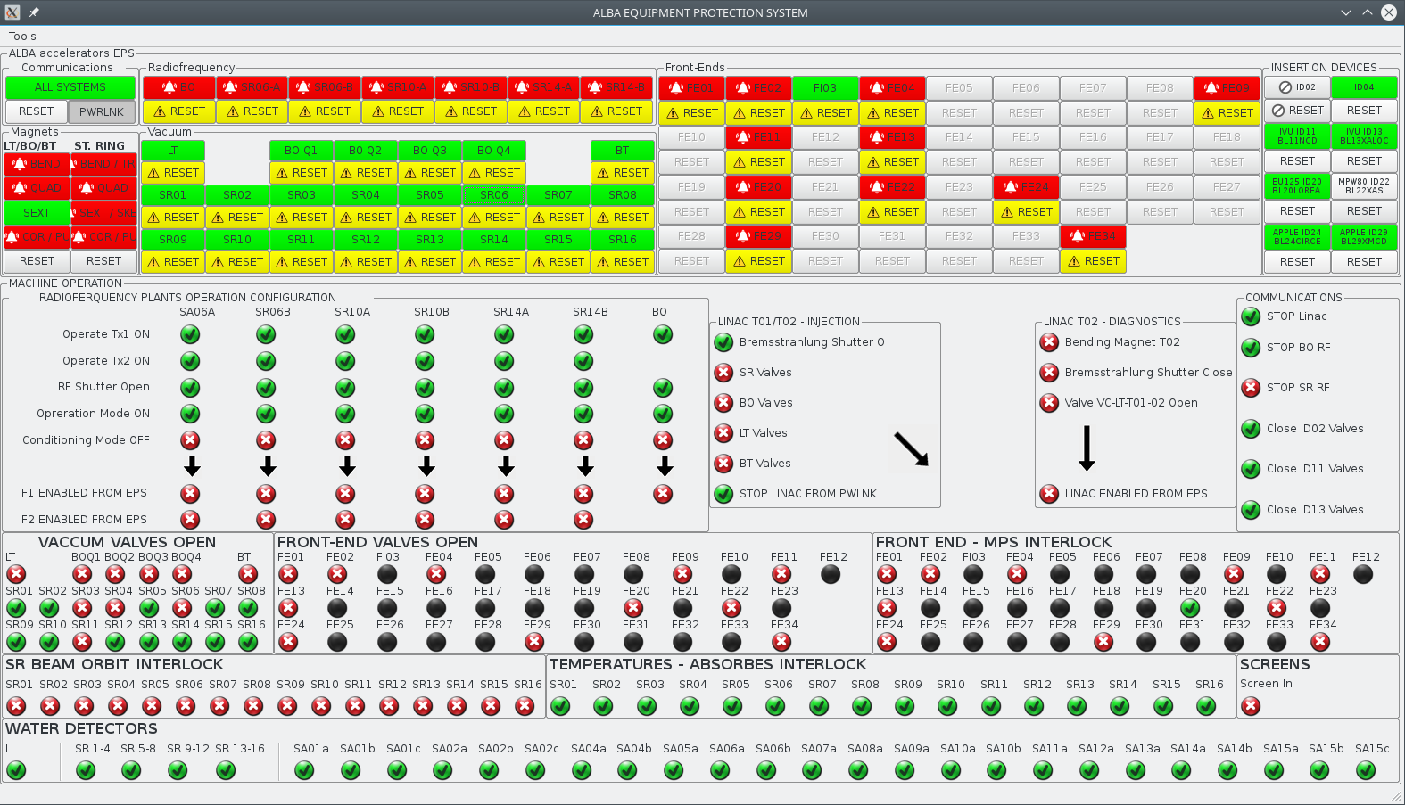
EPS GUI

Slide 16
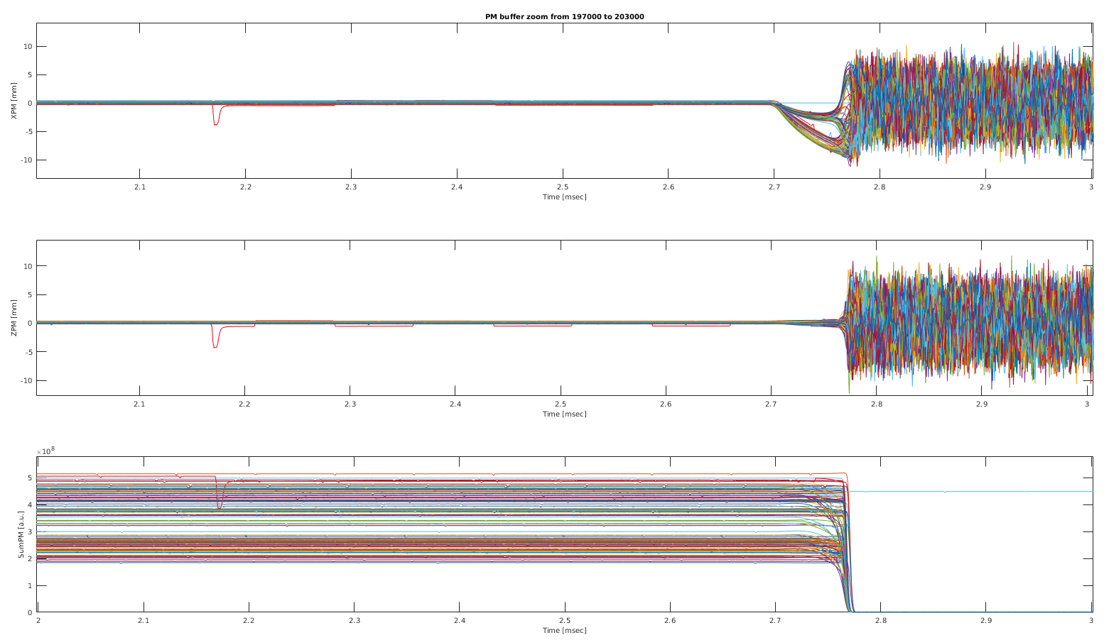
“Op. friendly” tools to get the data
16
BPMs postmortem: plotPM.m

Slide 17
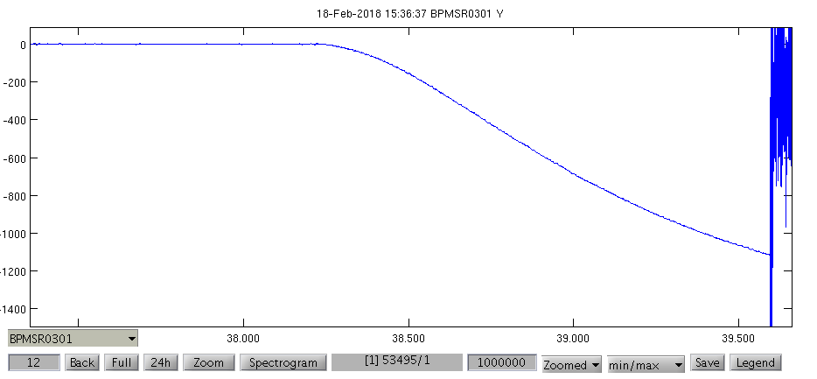
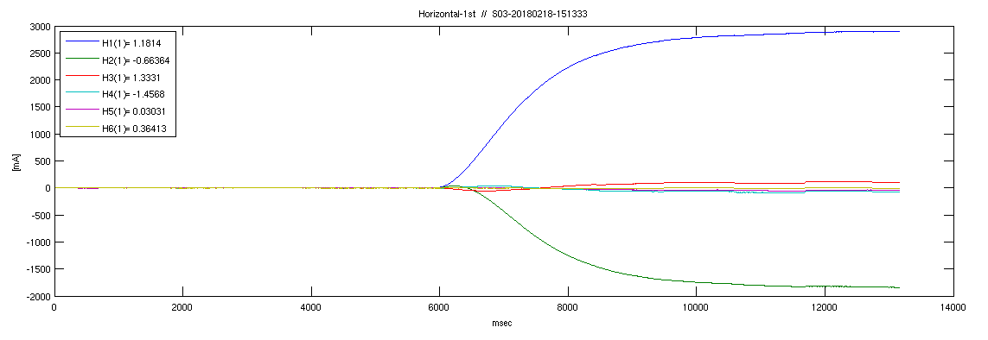
“Op. friendly” tools to get the data
17
BPMs & Correctors
Fast archiver matlab GUIs
Turn OFF SCW magnetic field
FOFB OFF -> BPMs change
FOFB ON -> CORR change

Slide 18
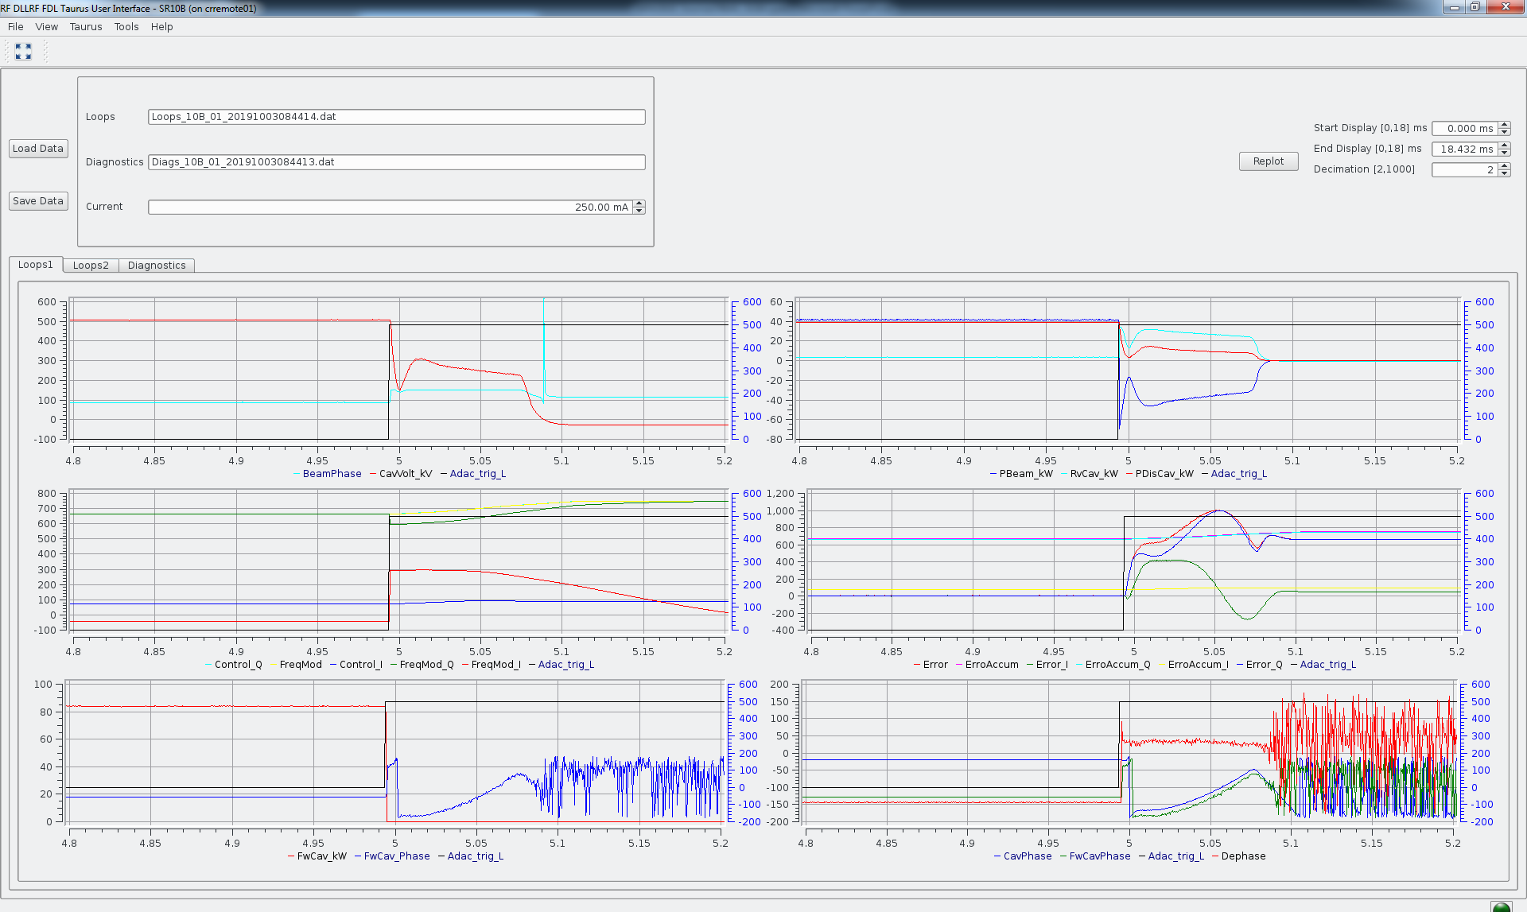
18
LLRF Fast Data Logger

Slide 19
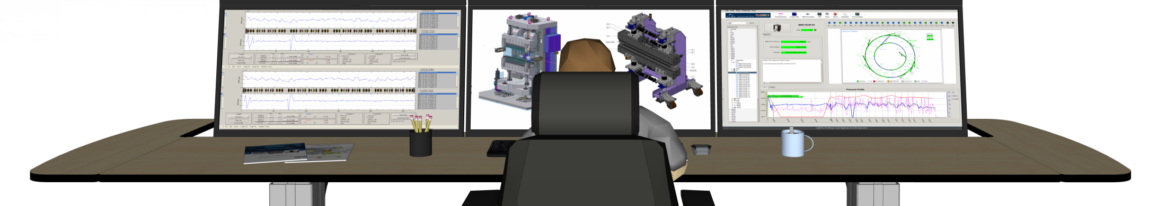
Example 1
BEAM CURRENT LOST
START

Slide 20
WHAT DO YOU WANT TO CHECK ?
EPS
GUI
InfoTrip.py
PCGRID
Post Mortem
RF
GUI
General water cooling trend
What happened ?
NEXT

Slide 21
WHAT HAPPENED ?
RF Body Current
Beamline Ebutton
SR Kicker FAIL
SR Quad water ITLK
BPM FAIL
RF ARC CAVITY
CPCI REBOOT
SR Corr -> orbit -> Vacuum trip
SR QUAD CTRL FAILURE
Water cooling system fail

Slide 22

Ex. 2
End

Slide 23

TRY AGAIN

Slide 24
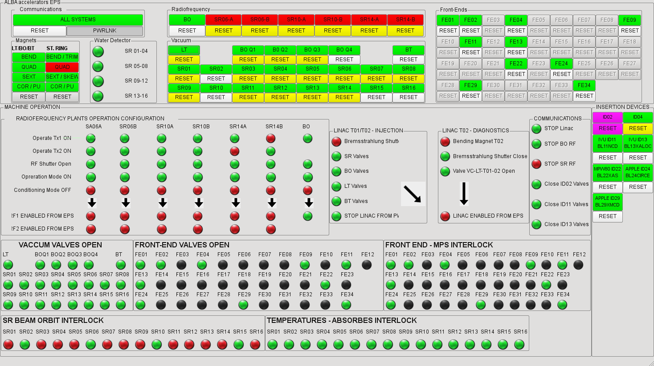
BACK

Slide 25
06a (HVON, HVON)
FIM: Timing, Revers Cavity, Forward Load
EPS: no interlocks
Tx01: FaultRfon {RFON is not enabled from EPS}
Tx02: FaultRfon {RFON is not enabled from EPS}
06b (AUX, HVON)
FIM: Timing, Revers Cavity, Forward Load
EPS: no interlocks
Tx01: not in operation
Tx02: FaultRfon {RFON is not enabled from EPS}
10a (HVON, HVON)
FIM: Timing, Revers Cavity, Forward Load
EPS: no interlocks
Tx01: FaultRfon {RFON is not enabled from EPS}
Tx02: FaultRfon {RFON is not enabled from EPS}
10b (HVON, HVON)
FIM: Timing, Revers Cavity, Forward Load
EPS: no interlocks
Tx01: FaultRfon {RFON is not enabled from EPS}
Tx02: FaultRfon {RFON is not enabled from EPS}
14a (HVON, OFF)
FIM: Timing, Revers Cavity, Forward Load
EPS: IOT2_WF_ALRM
Tx01: FaultRfon {RFON is not enabled from EPS}
Tx02: not in operation
Timing Log:
Event description Device description Local time Timestamp [ns]
BPMs Interlock - SR S02 SR02/TI/EVR-CDI0201-A 2019-05-19 02:20:31 213077001
RF Plant 14A Fast Interlock SR14/TI/EVR-CRF1402-A 2019-05-19 02:20:31 213080716
RF Plant 10B Fast Interlock SR10/TI/EVR-CRF1002-A 2019-05-19 02:20:31 213080796
RF Plant 6A Fast Interlock SR06/TI/EVR-CRF0602-A 2019-05-19 02:20:31 213081020
RF Plant 14B Fast Interlock SR14/TI/EVR-CRF1401-A 2019-05-19 02:20:31 213081044
RF Plant 10A Fast Interlock SR10/TI/EVR-CRF1001-A 2019-05-19 02:20:31 213081436
RF Plant 6B Fast Interlock SR06/TI/EVR-CRF0601-A 2019-05-19 02:20:31 213081628
RF Plant BO Fast Interlock BO04/TI/EVR-CRF1602-A 2019-05-19 02:20:31 213100786
BPMs Interlock - SR S15 SR15/TI/EVR-CDI1501-A 2019-05-19 02:20:31 213641728
BPMs Interlock - SR S13 SR13/TI/EVR-CDI1301-A 2019-05-19 02:20:31 213648204
BPMs Interlock - SR S16 SR16/TI/EVR-CDI1601-A 2019-05-19 02:20:31 213648445
BPMs Interlock - SR S11 SR11/TI/EVR-CDI1101-A 2019-05-19 02:20:31 213653464
BPMs Interlock - SR S01 SR01/TI/EVR-CDI0101-A 2019-05-19 02:20:31 213655425
BPMs Interlock - SR S12 SR12/TI/EVR-CDI1201-A 2019-05-19 02:20:31 213658363
BPMs Interlock - SR S07 SR07/TI/EVR-CDI0701-A 2019-05-19 02:20:31 213659532
BPMs Interlock - SR S08 SR08/TI/EVR-CDI0801-A 2019-05-19 02:20:31 213661478
BPMs Interlock - SR S03 SR03/TI/EVR-CDI0301-A 2019-05-19 02:20:31 213675792
BPMs Interlock - SR S06 SR06/TI/EVR-CDI0601-A 2019-05-19 02:20:31 213845733
BPMs Interlock - SR S09 SR09/TI/EVR-CDI0901-A 2019-05-19 02:20:31 213852714
BPMs Interlock - SR S05 SR05/TI/EVR-CDI0501-A 2019-05-19 02:20:31 213860776
BPMs Interlock - SR S04 SR04/TI/EVR-CDI0401-A 2019-05-19 02:20:31 213863241
BPMs Interlock - SR S10 SR10/TI/EVR-CDI1001-A 2019-05-19 02:20:31 213864394
BPMs Interlock - SR S14 SR14/TI/EVR-CDI1401-A 2019-05-19 02:20:31 214381064
BACK

Slide 26
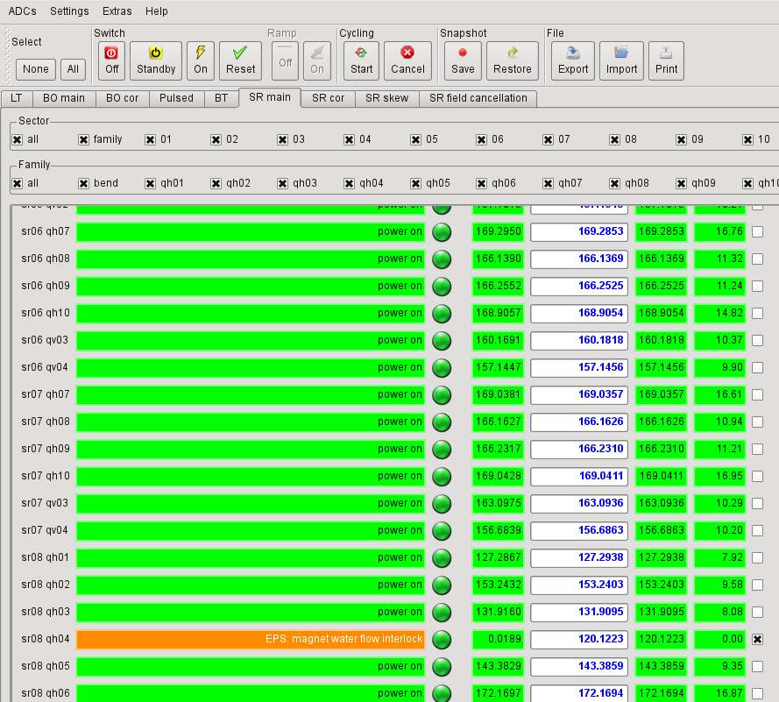
BACK

Slide 27
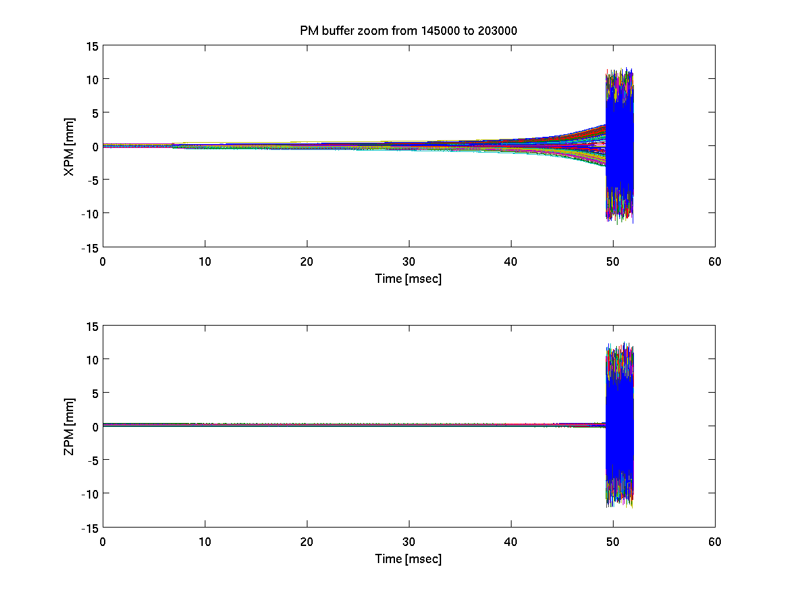
BACK

Slide 28
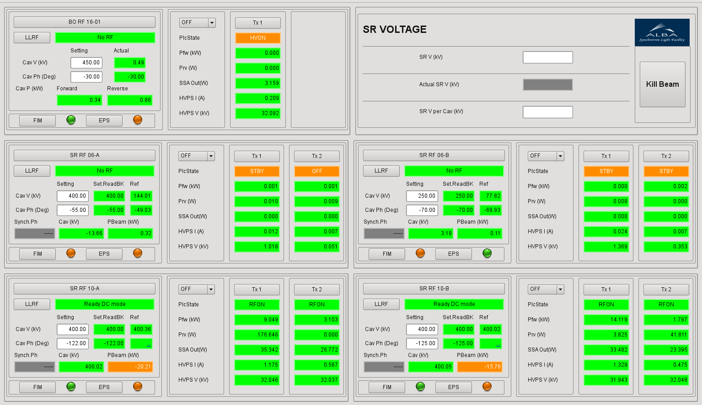
BACK

Slide 29
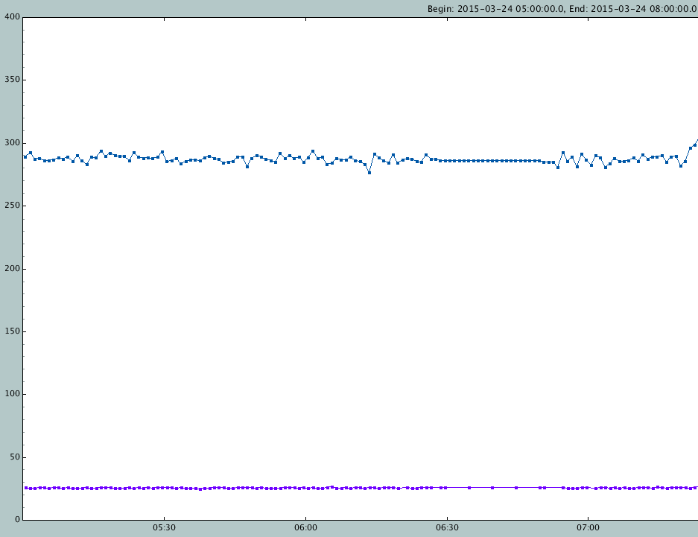

BACK

Slide 30

Example 2
BEAM CURRENT LOST
START

Slide 31
WHAT DO YOU WANT TO CHECK ?
EPS
GUI
InfoTrip.py
PCGRID
Post Mortem
RF
GUI
General water cooling trend
What happened ?
NEXT

Slide 32
WHAT HAPPENED ?
RF Body Current
Beamline Ebutton
SR Kicker FAIL
SR Quad water ITLK
BPM FAIL
RF ARC CAVITY
CPCI REBOOT
SR Corr -> orbit -> Vacuum trip
SR QUAD CTRL FAILURE
Water cooling system fail

Slide 33
Ex. 3
End

Slide 34
TRY AGAIN

Slide 35
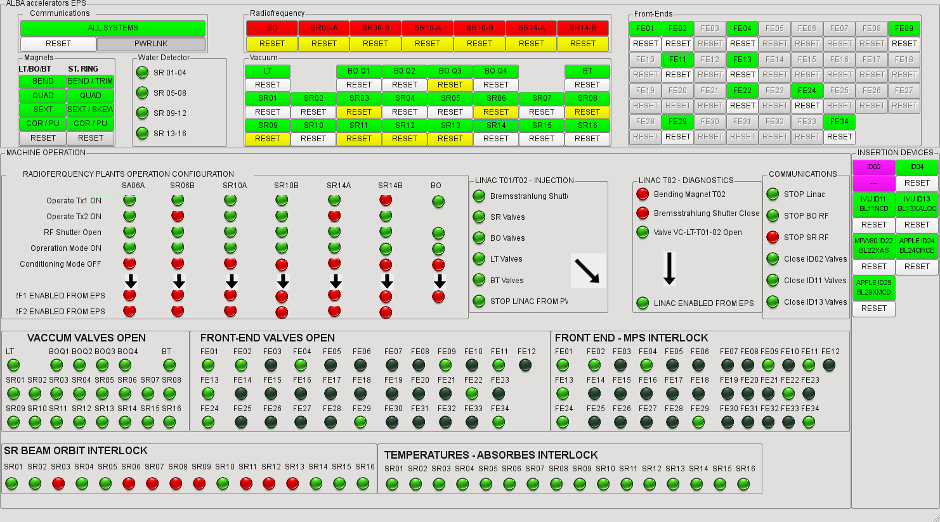
BACK

Slide 36
06a (HVON, HVON)
FIM: Timing, Revers Cavity, Forward Load
EPS: no interlocks
Tx01: FaultRfon {RFON is not enabled from EPS}
Tx02: FaultRfon {RFON is not enabled from EPS}
06b (AUX, HVON)
FIM: Timing, Revers Cavity, Forward Load
EPS: no interlocks
Tx01: not in operation
Tx02: FaultRfon {RFON is not enabled from EPS}
10a (HVON, HVON)
FIM: Timing, Revers Cavity, Forward Load
EPS: no interlocks
Tx01: FaultRfon {RFON is not enabled from EPS}
Tx02: FaultRfon {RFON is not enabled from EPS}
10b (HVON, HVON)
FIM: Timing, Revers Cavity, Forward Load
EPS: no interlocks
Tx01: FaultRfon {RFON is not enabled from EPS}
Tx02: FaultRfon {RFON is not enabled from EPS}
14a (HVON, OFF)
FIM: Timing, Revers Cavity, Forward Load
EPS: IOT2_WF_ALRM
Tx01: FaultRfon {RFON is not enabled from EPS}
Tx02: not in operation
Timing Log:
Event description Device description Local time Timestamp [ns]
BPMs Interlock - SR S12 SR12/TI/EVR-CDI1201-A 2015-03-19 16:14:00 348812922
RF Plant 10B Fast Interlock SR10/TI/EVR-CRF1002-A 2015-03-19 16:14:00 348816861
RF Plant 14A Fast Interlock SR14/TI/EVR-CRF1402-A 2015-03-19 16:14:00 348816941
RF Plant 6B Fast Interlock SR06/TI/EVR-CRF0601-A 2015-03-19 16:14:00 348817029
RF Plant 10A Fast Interlock SR10/TI/EVR-CRF1001-A 2015-03-19 16:14:00 348817157
RF Plant 6A Fast Interlock SR06/TI/EVR-CRF0602-A 2015-03-19 16:14:00 348817477
RF Plant 14B Fast Interlock SR14/TI/EVR-CRF1401-A 2015-03-19 16:14:00 348817590
RF Plant BO Fast Interlock BO04/TI/EVR-CRF1602-A 2015-03-19 16:14:00 348839036
BPMs Interlock - SR S16 SR16/TI/EVR-CDI1601-A 2015-03-19 16:14:00 348994600
BPMs Interlock - SR S09 SR09/TI/EVR-CDI0901-A 2015-03-19 16:14:00 349101458
BPMs Interlock - SR S13 SR13/TI/EVR-CDI1301-A 2015-03-19 16:14:00 349191712
BPMs Interlock - SR S08 SR08/TI/EVR-CDI0801-A 2015-03-19 16:14:00 349212879
BPMs Interlock - SR S04 SR04/TI/EVR-CDI0401-A 2015-03-19 16:14:00 349216442
BPMs Interlock - SR S01 SR01/TI/EVR-CDI0101-A 2015-03-19 16:14:00 349285449
BPMs Interlock - SR S15 SR15/TI/EVR-CDI1501-A 2015-03-19 16:14:00 349285585
BPMs Interlock - SR S03 SR03/TI/EVR-CDI0301-A 2015-03-19 16:14:00 349303126
BPMs Interlock - SR S07 SR07/TI/EVR-CDI0701-A 2015-03-19 16:14:00 349304615
BPMs Interlock - SR S05 SR05/TI/EVR-CDI0501-A 2015-03-19 16:14:00 349314670
BPMs Interlock - SR S10 SR10/TI/EVR-CDI1001-A 2015-03-19 16:14:00 349321386
BPMs Interlock - SR S11 SR11/TI/EVR-CDI1101-A 2015-03-19 16:14:00 349385919
BPMs Interlock - SR S06 SR06/TI/EVR-CDI0601-A 2015-03-19 16:14:00 349391899
BPMs Interlock - SR S02 SR02/TI/EVR-CDI0201-A 2015-03-19 16:14:00 349424265
BPMs Interlock - SR S14 SR14/TI/EVR-CDI1401-A 2015-03-19 16:14:00 349969651
BACK

Slide 37
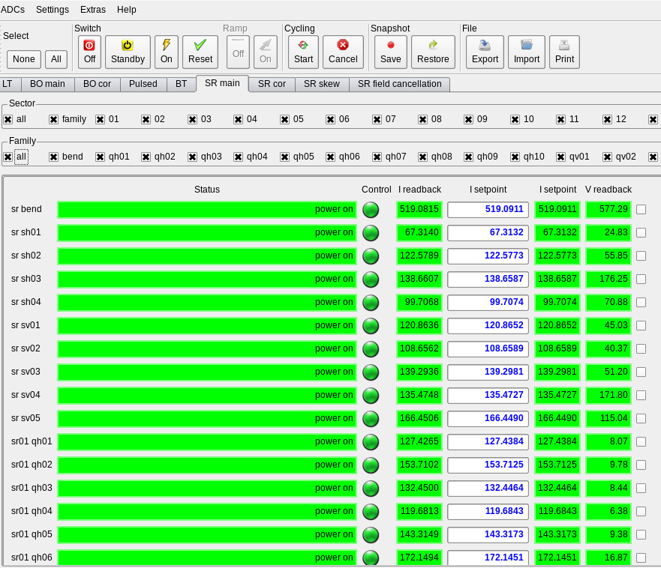
BACK

Slide 38
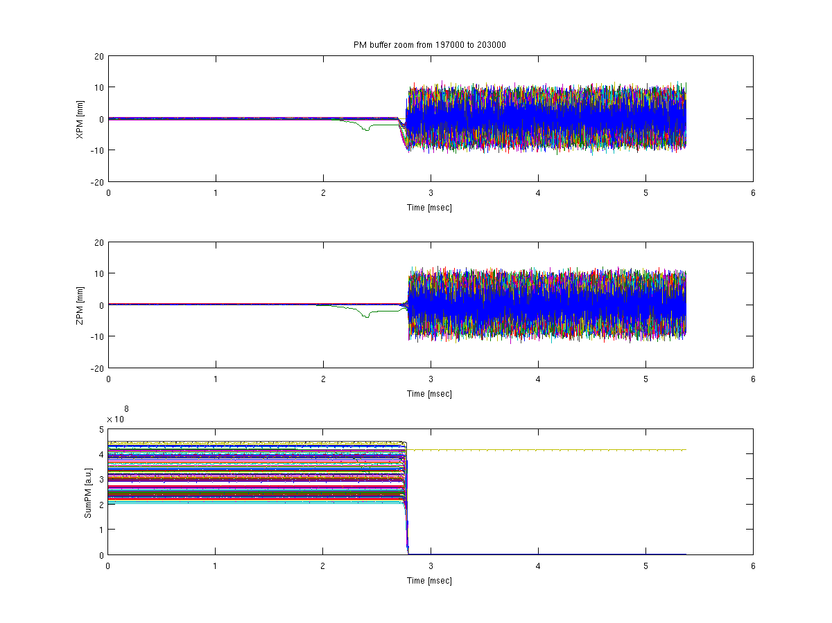
BACK

Slide 39

BACK

Slide 40
BACK

Slide 41
Example 3
BEAM CURRENT LOST
START

Slide 42
WHAT DO YOU WANT TO CHECK ?
EPS
GUI
InfoTrip.py
PCGRID
Post Mortem
RF
GUI
General water cooling trend
What happened ?
NEXT

Slide 43
WHAT HAPPENED ?
RF Body Current
Beamline Ebutton
SR Kicker FAIL
SR Quad water ITLK
BPM FAIL
RF ARC CAVITY
CPCI REBOOT
SR Corr -> orbit -> Vacuum trip
SR QUAD CTRL FAILURE
Water cooling system fail

Slide 44
End

Slide 45
TRY AGAIN

Slide 46
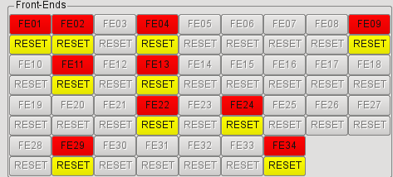
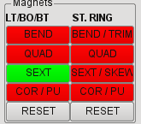
BACK

Slide 47
06a (HVON, HVON)
FIM: Revers Cavity, Forward Load, Timing
EPS: CAV_WF_Outlet_ALRM
Tx01: FaultRfon {RFON is not enabled from EPS}
Tx02: FaultRfon {RFON is not enabled from EPS}
06b (AUX, HVON)
FIM: Forward Load, Revers Cavity, Timing
EPS: no interlocks
Tx01: not in operation
Tx02: FaultRfon {RFON is not enabled from EPS}
10a (STBY, STBY)
FIM: Revers Cavity, Forward Load, Arc Watrax, Arc Cavity, Timing
EPS: CAV_WF_Outlet_ALRM
Tx01: FaultRfon {RF Reverse power interlock, RFON is not enabled from EPS}
Tx02: FaultRfon {RF Reverse power interlock, RFON is not enabled from EPS}
10b (STBY, STBY)
FIM: Forward Load, Arc Watrax, Arc Cavity, Timing
EPS: no interlocks
Tx01: FaultRfon {RF Reverse power interlock, RFON is not enabled from EPS}
Tx02: FaultRfon {RF Reverse power interlock, RFON is not enabled from EPS}
14a (HVON, OFF)
FIM: Revers Cavity, Forward Load, Timing
EPS: IOT2_WF_ALRM
Tx01: FaultRfon {RFON is not enabled from EPS}
Tx02: not in operation
Timing Log:
Event description Device description Local time Timestamp [ns]
RF Plant 10A Fast Interlock SR10/TI/EVR-CRF1001-A 2015-03-24 07:22:02 38882186
RF Plant 10B Fast Interlock SR10/TI/EVR-CRF1002-A 2015-03-24 07:22:02 70570819
RF Plant 6B Fast Interlock SR06/TI/EVR-CRF0601-A 2015-03-24 07:22:02 70714086
RF Plant 14B Fast Interlock SR14/TI/EVR-CRF1401-A 2015-03-24 07:22:02 70721651
RF Plant 6A Fast Interlock SR06/TI/EVR-CRF0602-A 2015-03-24 07:22:02 70727543
RF Plant 14A Fast Interlock SR14/TI/EVR-CRF1402-A 2015-03-24 07:22:02 70728008
RF Plant BO Fast Interlock BO04/TI/EVR-CRF1602-A 2015-03-24 07:22:02 70791131
BPMs Interlock - SR S02 SR02/TI/EVR-CDI0201-A 2015-03-24 07:22:02 71144544
BPMs Interlock - SR S06 SR06/TI/EVR-CDI0601-A 2015-03-24 07:22:02 71151941
BPMs Interlock - SR S11 SR11/TI/EVR-CDI1101-A 2015-03-24 07:22:02 71154999
BPMs Interlock - SR S01 SR01/TI/EVR-CDI0101-A 2015-03-24 07:22:02 71156889
BPMs Interlock - SR S07 SR07/TI/EVR-CDI0701-A 2015-03-24 07:22:02 71164342
BPMs Interlock - SR S12 SR12/TI/EVR-CDI1201-A 2015-03-24 07:22:02 71166871
BPMs Interlock - SR S03 SR03/TI/EVR-CDI0301-A 2015-03-24 07:22:02 71168168
BPMs Interlock - SR S13 SR13/TI/EVR-CDI1301-A 2015-03-24 07:22:02 71170050
BPMs Interlock - SR S16 SR16/TI/EVR-CDI1601-A 2015-03-24 07:22:02 71170866
BPMs Interlock - SR S16 SR16/TI/EVR-CDI1601-A 2015-03-24 07:22:02 71170882
BPMs Interlock - SR S09 SR09/TI/EVR-CDI0901-A 2015-03-24 07:22:02 71170930
BPMs Interlock - SR S10 SR10/TI/EVR-CDI1001-A 2015-03-24 07:22:02 71173508
BPMs Interlock - SR S08 SR08/TI/EVR-CDI0801-A 2015-03-24 07:22:02 71176414
BPMs Interlock - SR S15 SR15/TI/EVR-CDI1501-A 2015-03-24 07:22:02 71177999
BPMs Interlock - SR S04 SR04/TI/EVR-CDI0401-A 2015-03-24 07:22:02 71179904
BPMs Interlock - SR S05 SR05/TI/EVR-CDI0501-A 2015-03-24 07:22:02 71180193
BPMs Interlock - SR S14 SR14/TI/EVR-CDI1401-A 2015-03-24 07:22:02 71743991
BACK

Slide 48
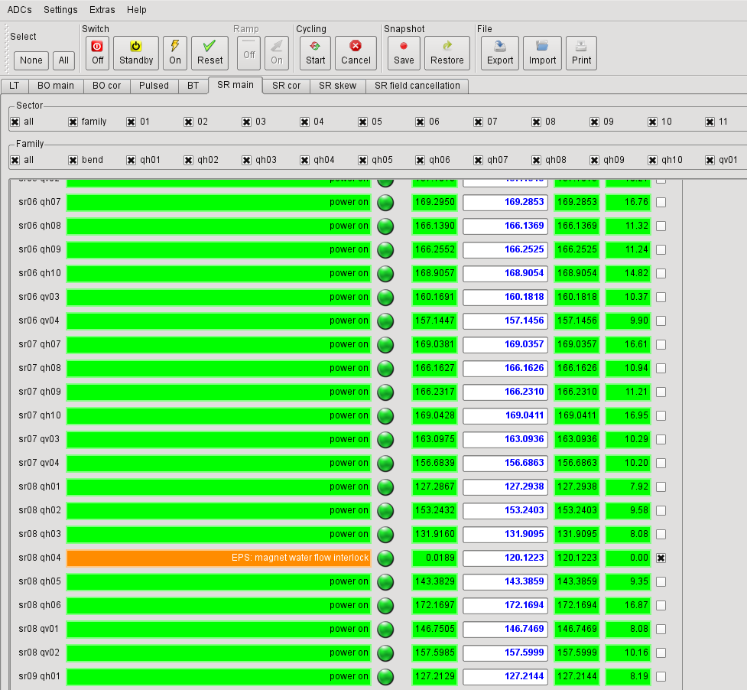
BACK

Slide 49
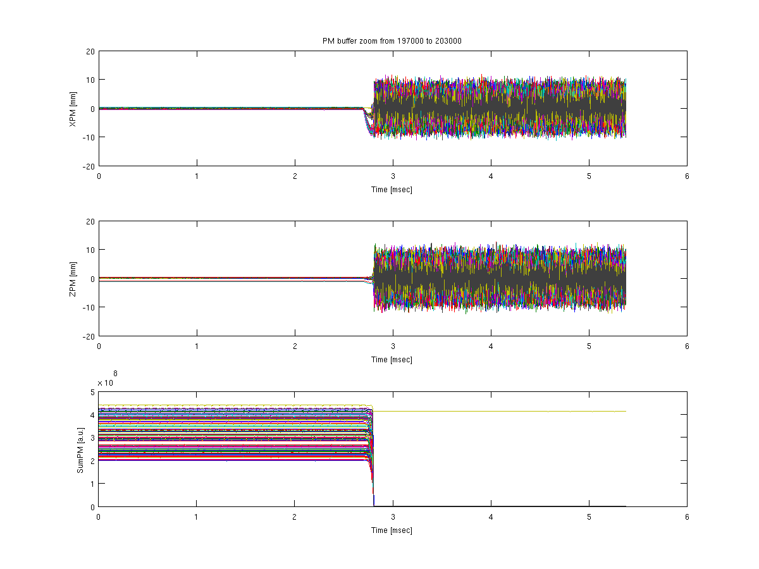
BACK

Slide 50

BACK

Slide 51
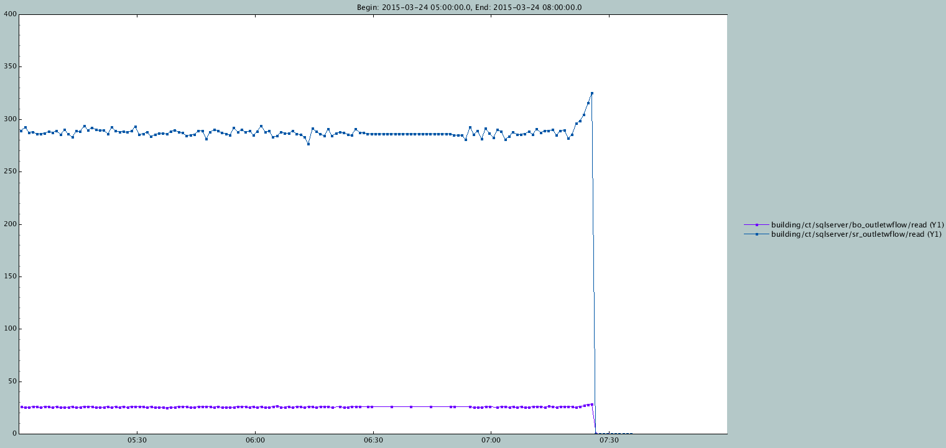
BACK

Slide 52

Whishlist
52
Personal Safety System scada messages readable from the Control System
A “user oriented” EPS and MPS GUI:
  Different tabs from general view to detailed subsystem ITLKs
  Shows the logic with online data and alarm levels
  Integrates “save logs” and “reset” functions
  Integrates timing logs, RF FIM, …
In other words; a GUI that integrates the different tools to diagnose and recover the machine after a beam loss

Slide 53
  Questions?

