Slide 1

Construction of Compact Heavy Ion Medical Accelerator with a Superconducting Rotating Gantry
H. Souda, T. Kanai, Y. Ieko, Y. Miyasaka, T. Iwai,
K. Nemoto, H. Yamashita, T. Kayama
Yamagata University

Slide 2
Contents
Introduction of the facility
Accelerator and Irradiation System
Reliability Improvement of Heavy Ion Accelerator
Staffs and Human Factor
Future issue

Slide 3
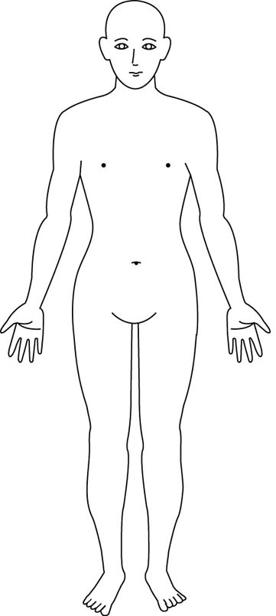
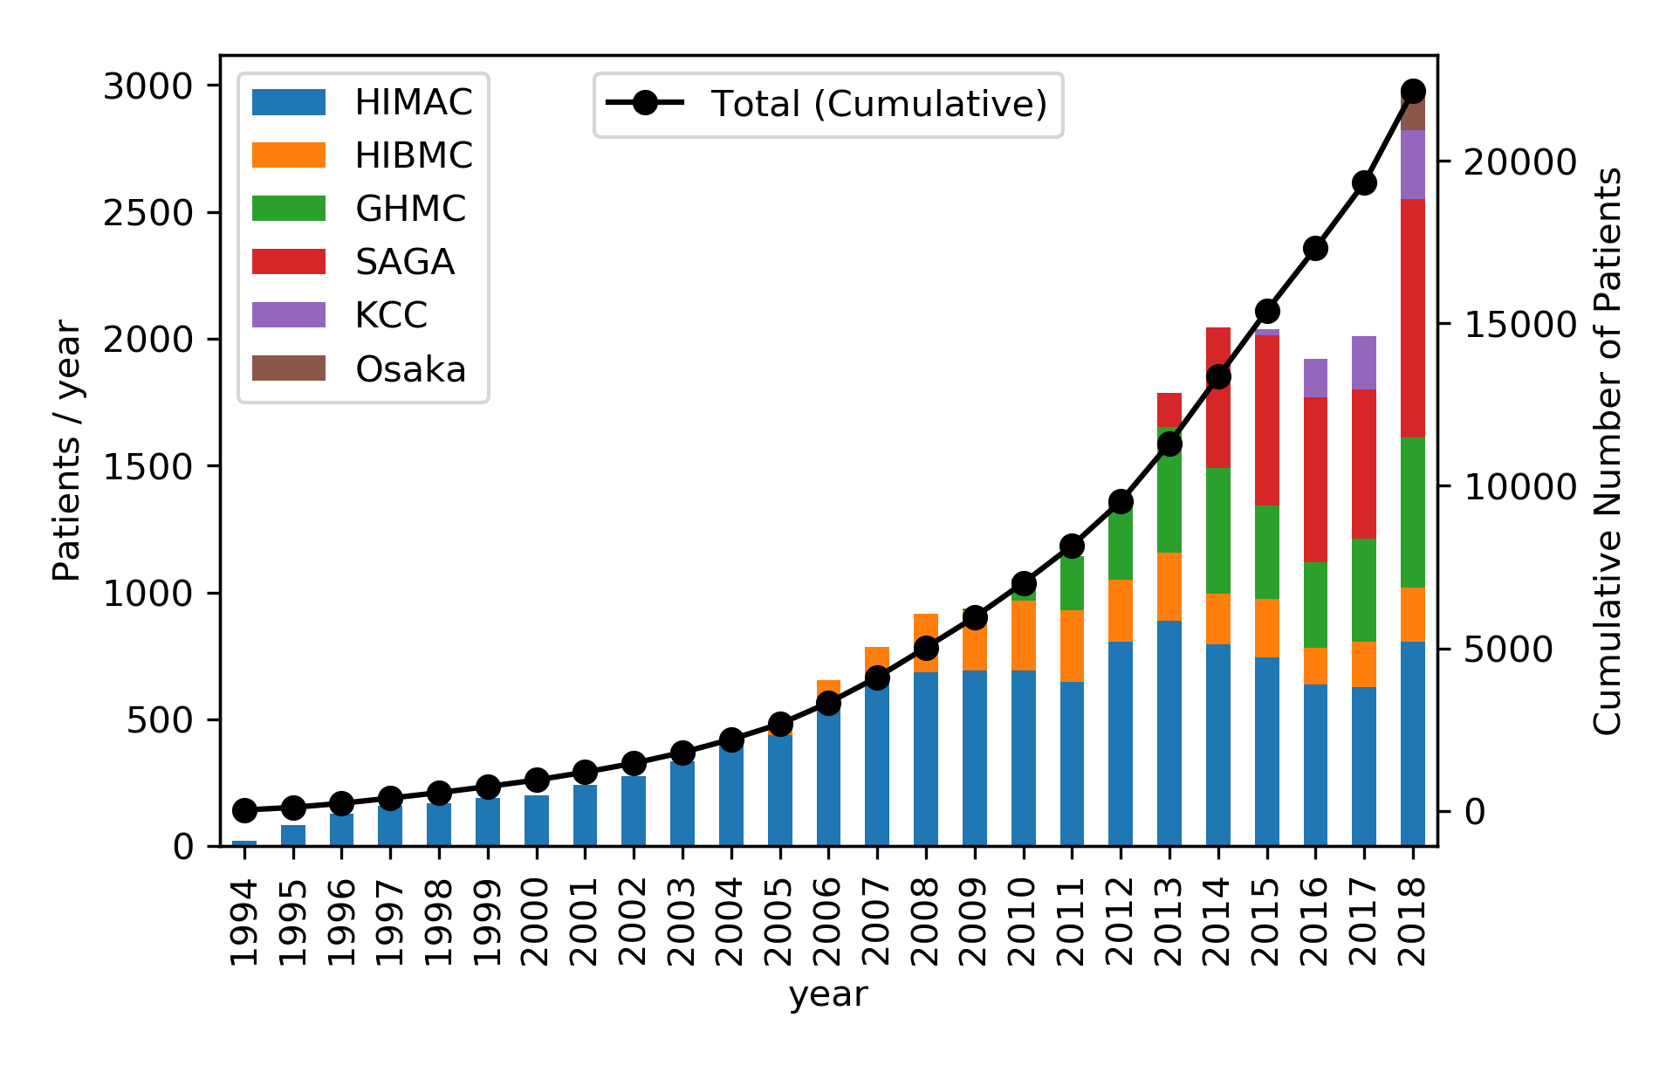
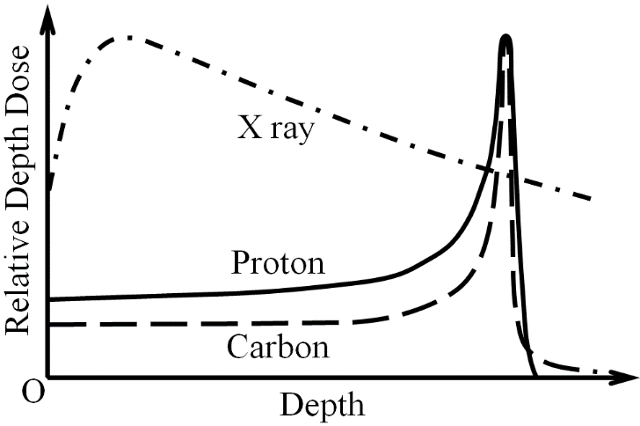
Heavy Ion Therapy in Japan
Heavy Ion Therapy started at HIMAC in 1994.
>20000 patient treated by 6 facilities
Bone & Soft Tissue, Head & Neck, and prostate cancer are covered by national health insurance
Cancer sites treated by Heavy Ion Therapy
In Gunma University
Head & Neck
6%
Lung
7%
Liver
7%
Pancreas
5%
Prostate
60%
Bone
6%
Rectum
3%

Slide 4
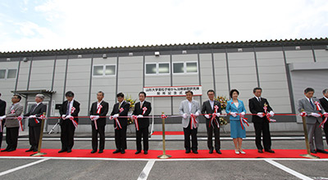
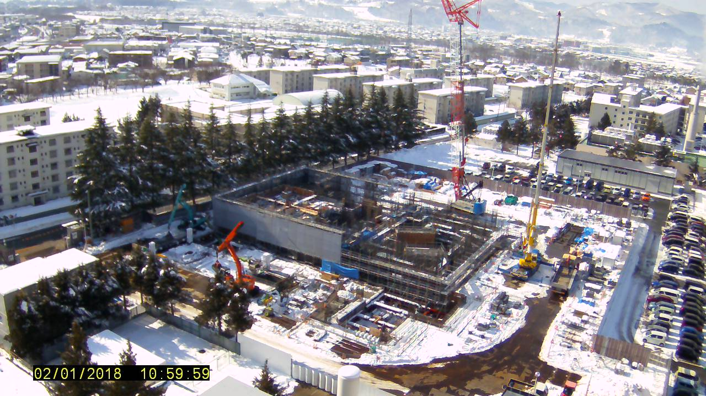
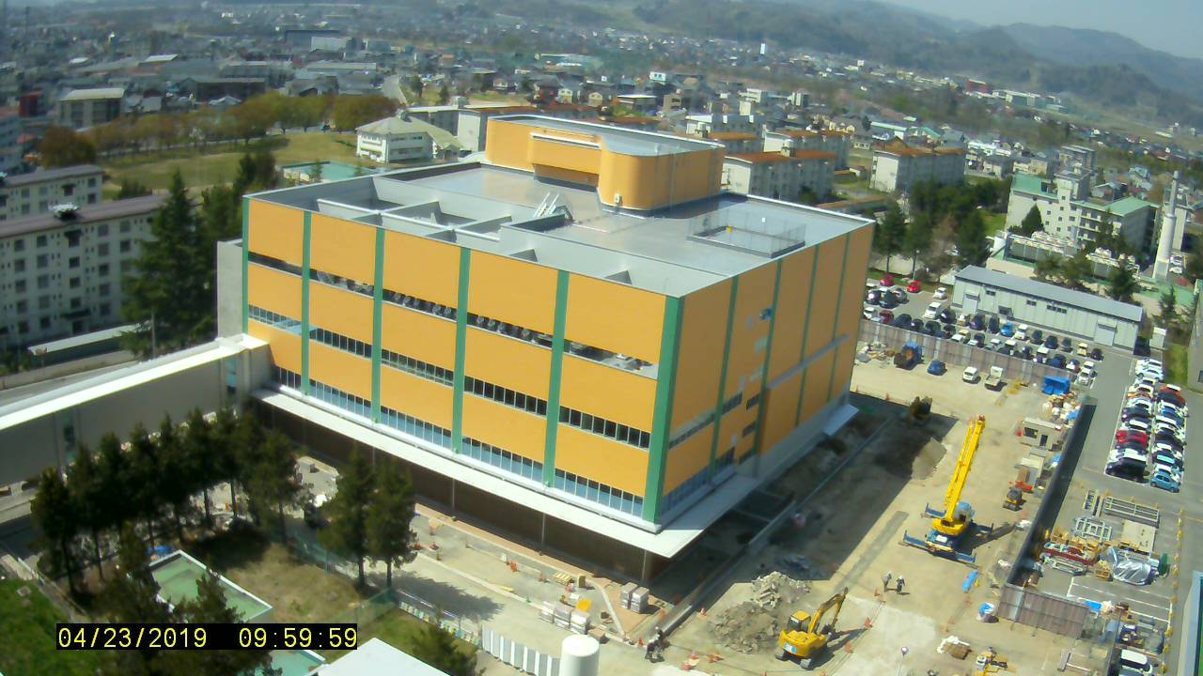
Heavy Ion Therapy Project in Yamagata University
2004 Heavy Ion Facility Project Started
2014 Research Building constructed
  Research of Energy-saving Operation, Injector Improvement
2015 Design of building and machine
  Design: Nihon Sekkei Co. Ltd.
  Construction: Takenaka Co. Ltd.
  Machine: Toshiba Energy Systems & Solutions Co. Ltd.
2017 Construction Started
2019 Building construction Completed
2020 1st Treatment

Slide 5
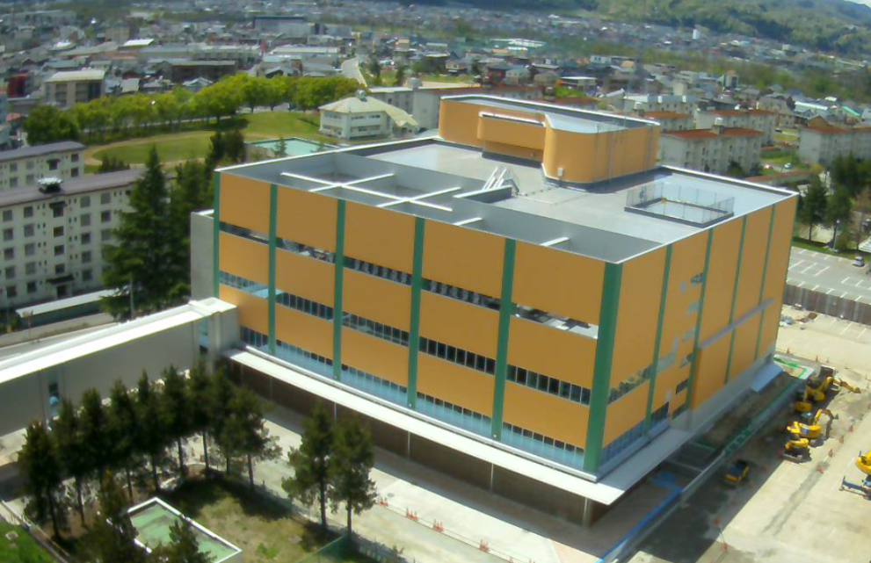
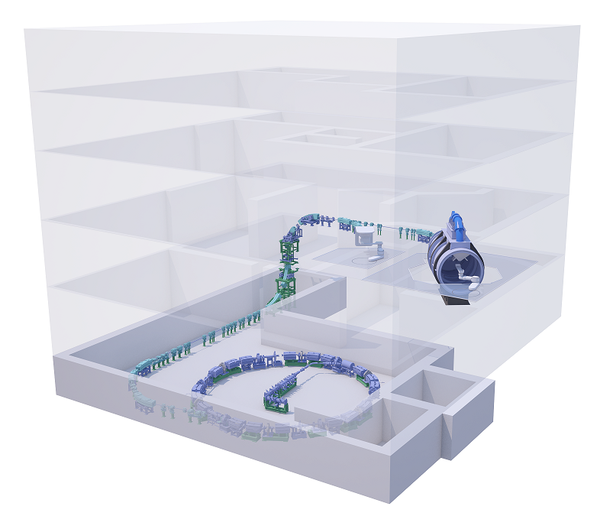
East Japan Heavy Ion Center
Heavy Ion Therapy Facility
Feature of the facility
Compact Building
  45 x 45 m footprint (World Smallest!)
Superconducting Rotating Gantry
  World First model in compact facility
Energy Saving Operation
  Natural Air Cooling
  Reduction of Magnet Current
Teleconference for patient consultation
  Connected with >60 hospitals in Northern Japan Area

Slide 6
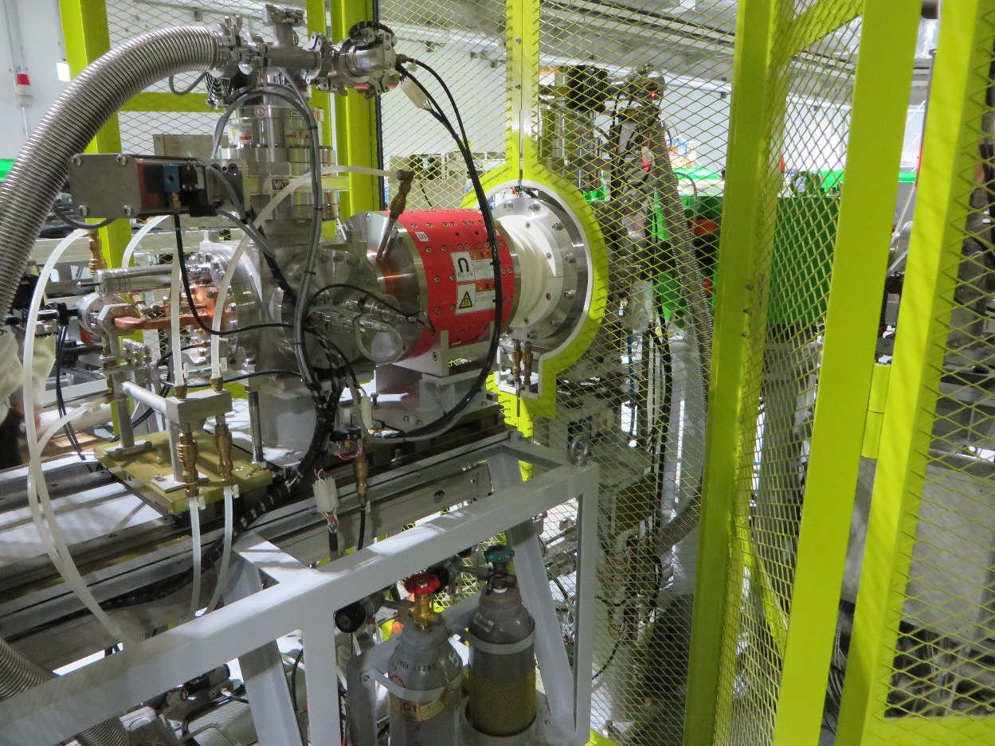
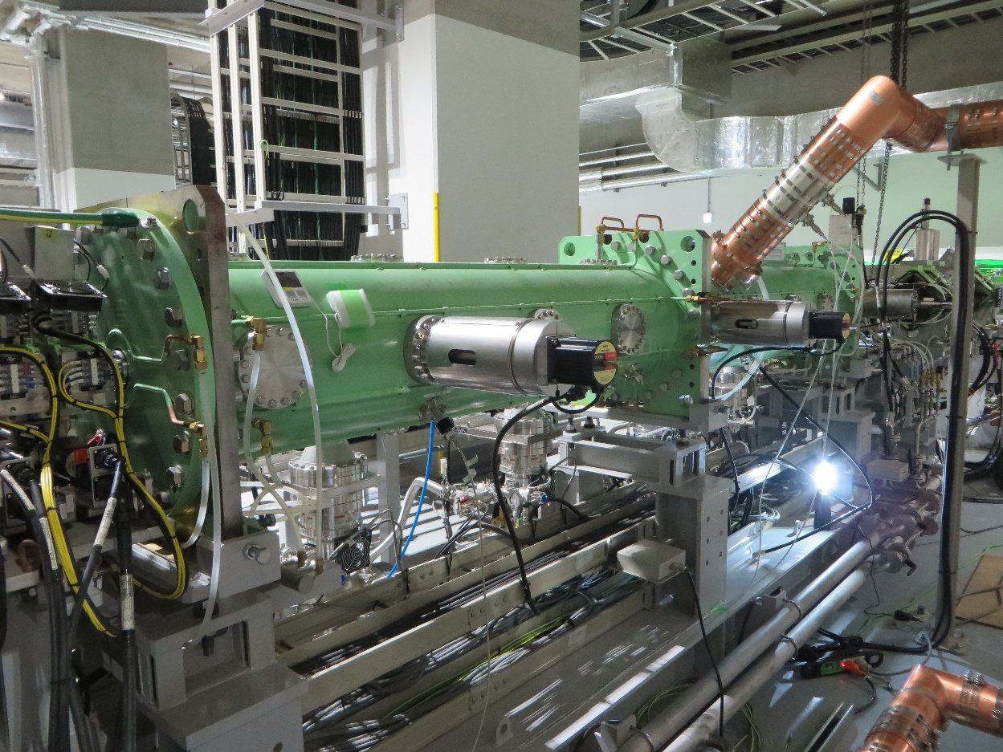
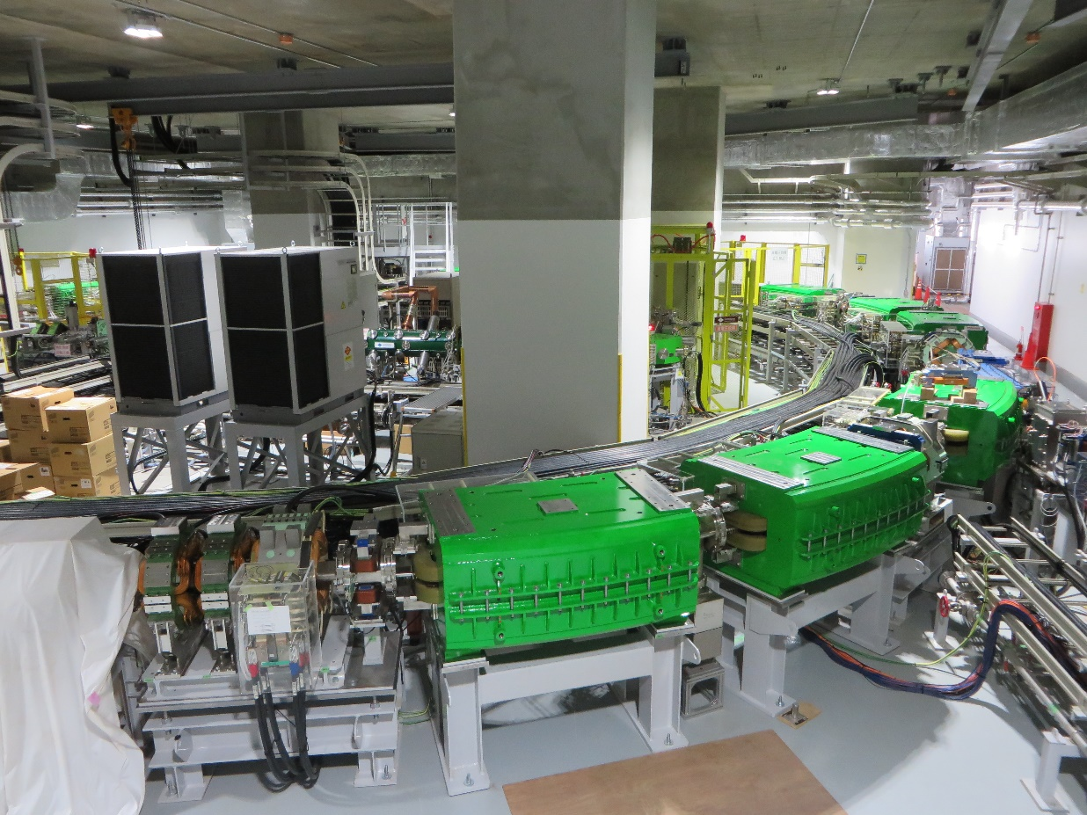
Compact Accelerator for Heavy Ion Therapy
The basic design is the same as preceding compact facilities.
ECR Ion Source
RFQ + IH Linac
Synchrotron
C⁴⁺ 10 keV/u ~200 eμA
CH₄ + He gas mixing
Permanent Magnet (~0.8 T)
C⁶⁺ 4 MeV/u ~200 eμA
RFQ: Solid State Amplifier (150 kW)
IHL: SSA(50 kW)→Tetrode(500 kW)
Alternative Phase Focusing IHL
C⁶⁺ 50-430 MeV/u C ~ 63 m
Extended flattop operation
Slow extraction
600 energy (~0.5 mm) step

Slide 7
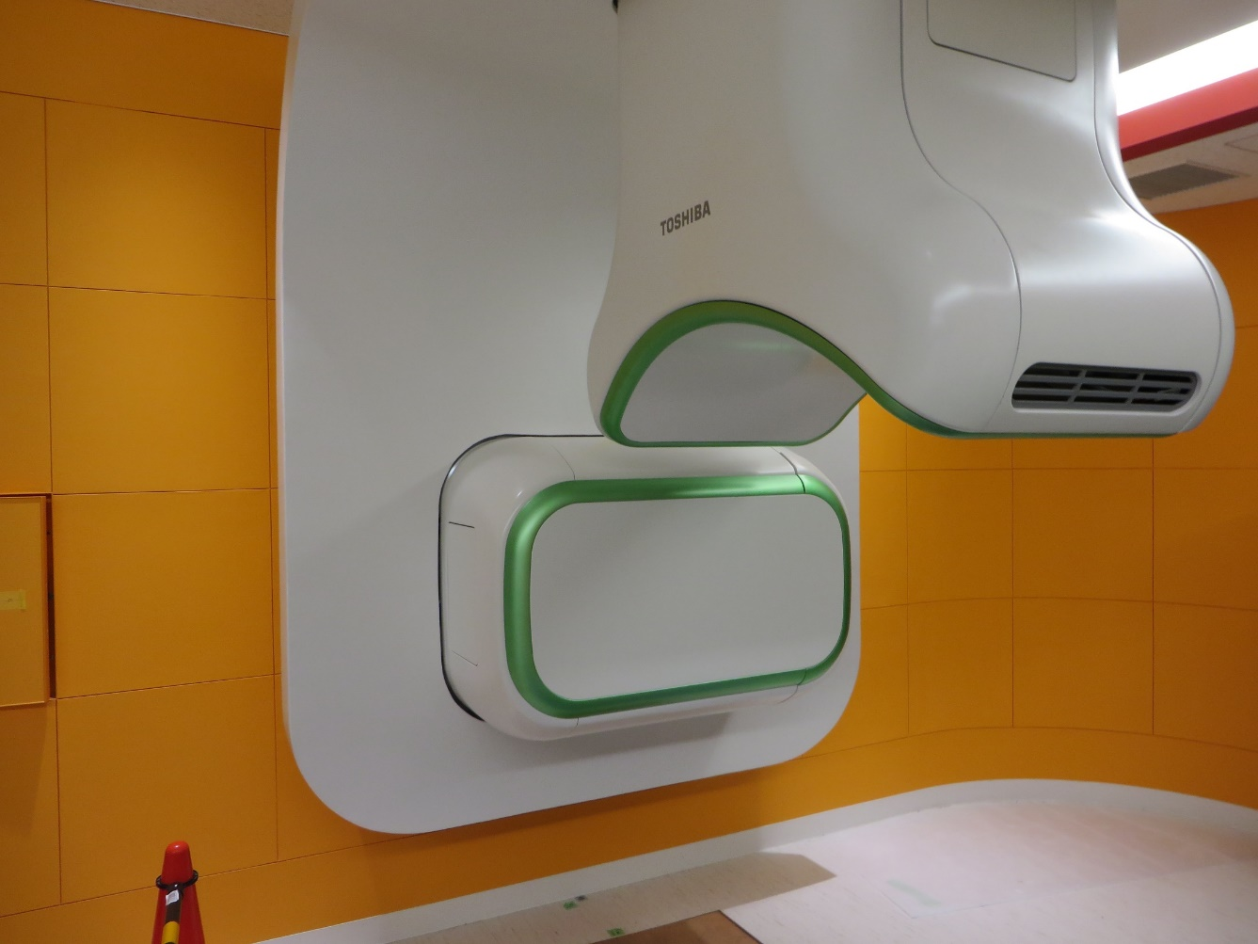
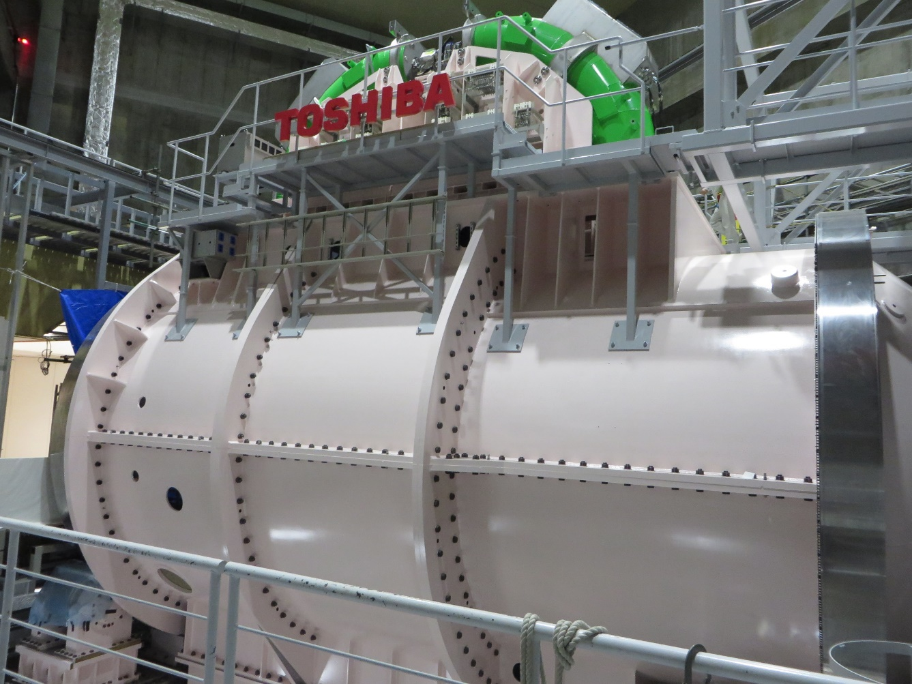
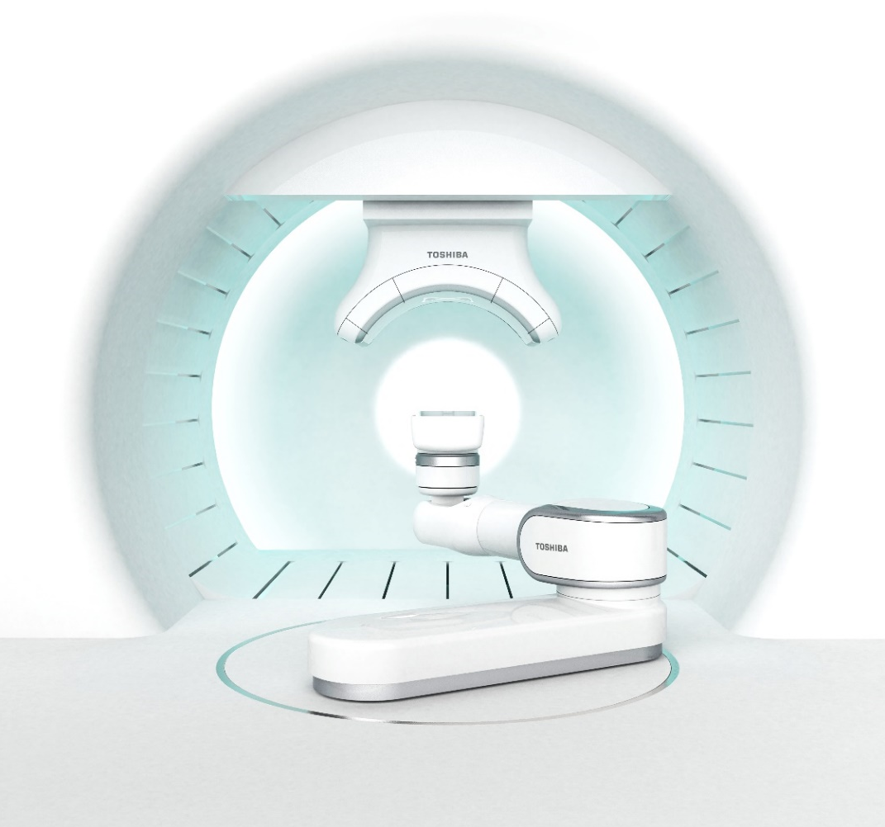
Irradiation system with Rotating Gantry
2 Irradiation Rooms
Fixed Horizontal Irradiation Room
Rotating Gantry Irradiation Room
Active Beam Scanning
Dose Rate: 2 Gy/min for 1 L
Field Size: 200×200 mm
No Physical Range Shifter
Crossed X-ray Positioning
(w X-ray respiratory gating)
Gantry length: ~ 8 m
Weight: ~200 t
Rotating speed: 0.5 rpm
6 Superconducting magnet ~3 T
(combined function)
x/y emittance compensator

Slide 8
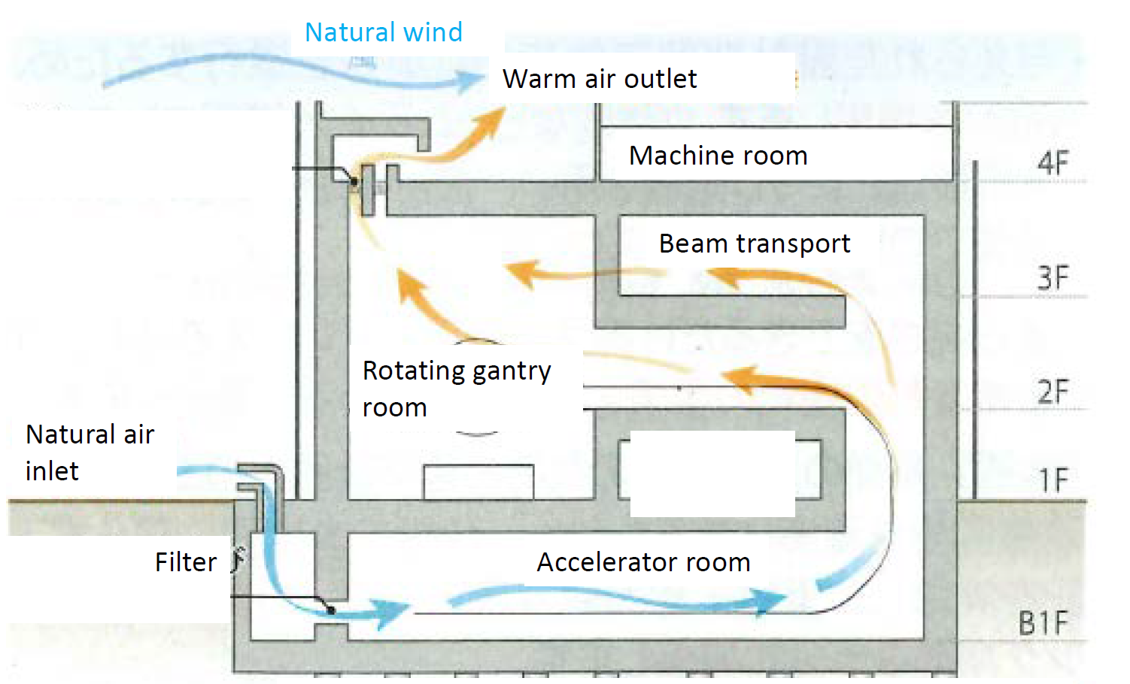
New Challenge and Reliability
Compact Building
  45 x 45 m footprint (World Smallest!)
  Severe condition for Cooling Water (High Pressure in Lower floor)
Natural Air Conditioning
  1/6 energy consumption for air conditioning
  Need test for Temperature Stability, Humidity, Dust

Slide 9
Staff of Carbon Ion Therapy
Steering Committee,
East Japan Heavy Ion Center
Chair: Prof. T. Kayama
East Japan Heavy Ion Center Director: Prof. K. Nemoto
Medical Doctor
9
(3 trained in NIRS)
Radiological Technologist
4→6
(All trained in NIRS)
Medical Physicist
5
Prof. T. Iwai
(Manager, Total System)
Dr. H. Souda(Gunma 6yr)
(Accelerator)
Dr. T. Kanai (NIRS 1yr)
(Dosimetry/RIS)
Y. Miyasaka(KCC 1yr)
(Treatment Planning)
Y. Ieko
Nurse
4
(1 trained in Gunma-U)
Operator
6
(To be contracted)
Staff trained in the same treatment system (NIRS, KCC)
No staff with long experience of Heavy Ion Therapy (Trained for 0.5-1 yr)

Slide 10
Operation Schedule (Preliminary)
No Annual maintenance
(all weekend maintenance)
600 patients/year expected
4 treatment days / week
Operator Shift A (2)
Operator Shift B (2)
 | 0 |  |  |  |  |  | 7:00 | 7:30 | 9:00 |  |  |  | 12 13 |  |  |  | 18 |  |  |  |  |  | 21 22
Monday |  |  |  |  |  |  |  |  | Weekly Inspection |  |  |  |  |  |  |  | Shutdown
Tuesday |  |  |  |  |  |  | Startup | Machine QA | Treatment |  |  |  |  |  |  |  | Patient QA |  |  |  |  |  | Shutdown
Wednesday |  |  |  |  |  |  | Startup | Machine QA | Treatment |  |  |  |  |  |  |  | Patient QA |  |  |  |  |  | Shutdown
Thursday |  |  |  |  |  |  | Startup | Machine QA | Treatment |  |  |  |  |  |  |  | Patient QA |  |  |  |  |  | Shutdown
Friday |  |  |  |  |  |  | Startup | Machine QA | Treatment |  |  |  |  |  |  |  | Patient QA |  |  |  |  |  | Shutdown
Saturday |  |  |  |  |  |  |  |  | Maintenance
Sunday |  |  |  |  |  |  |  |  | Maintenance
15 ~ 30 min /patient
Accelerator is standby
during patient positioning
40-50 irradiations/day
4-12 irradiations/patient

Slide 11
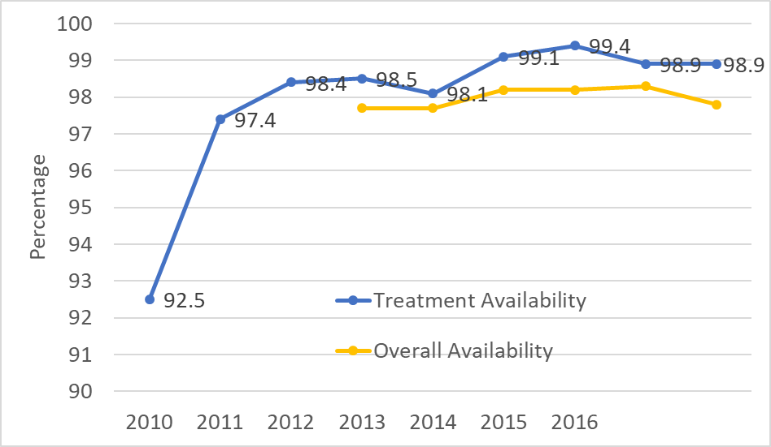

Availability of preceding facilities
Gunma
2010(1st yr): 92.4%
2018(9th yr): 98.9%
HIMAC
2018(25th yr) 98.3%
(incl. experiment)
1st year of Gunma (1st facility of compact model): 92% due to initial troubles
Following facilities: 98% in 1st yr
Yamagata: Target = 99% in 1st yr
Saga
2013(1st yr): 97.7%
KCC
2016(1st yr): 98.4%
2017(2nd yr): 99%

Slide 12
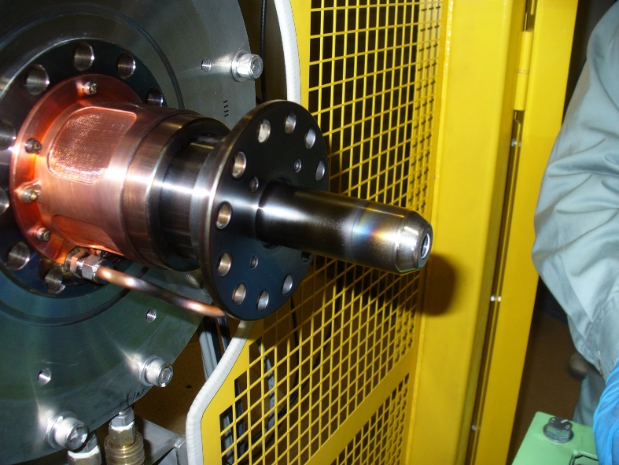
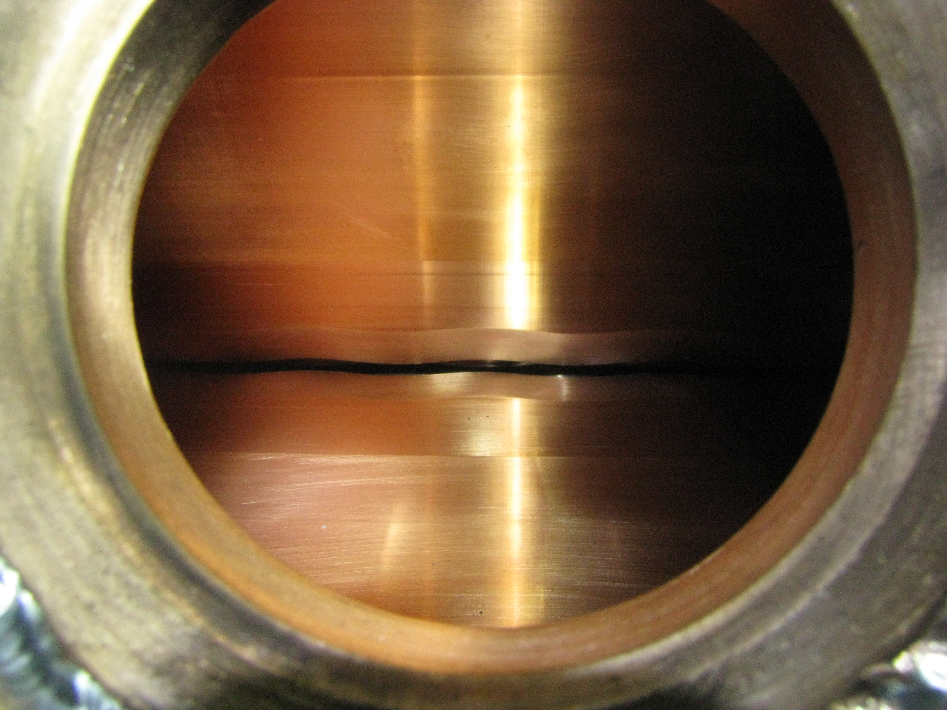
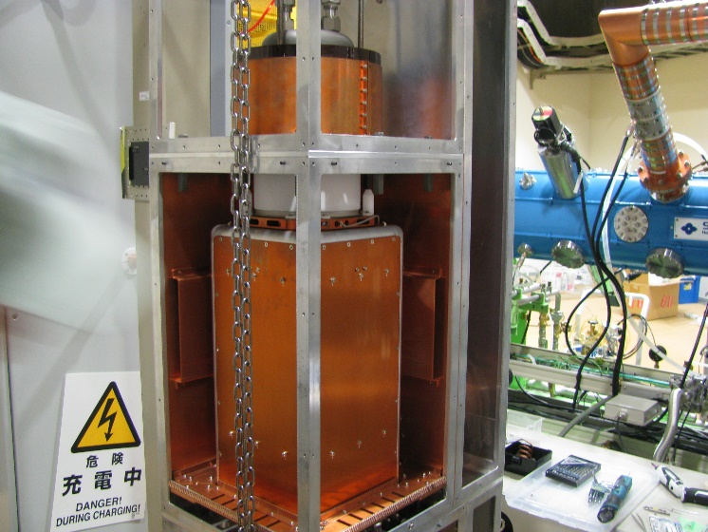
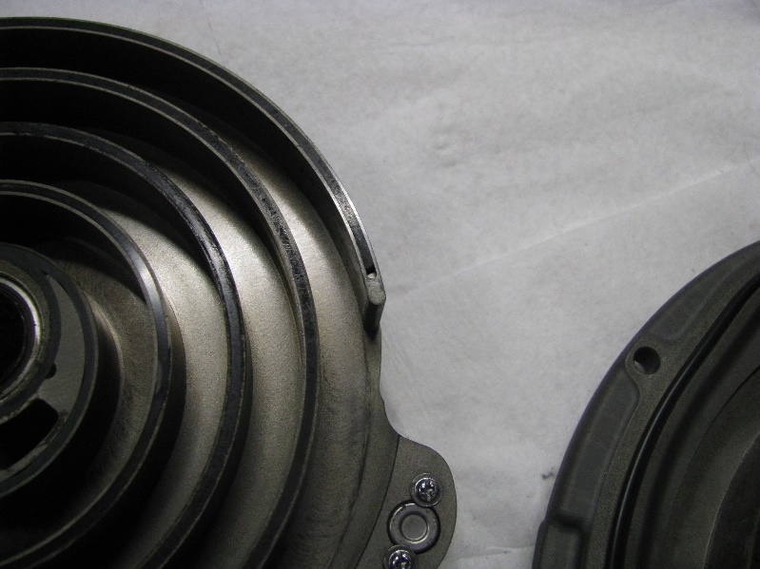
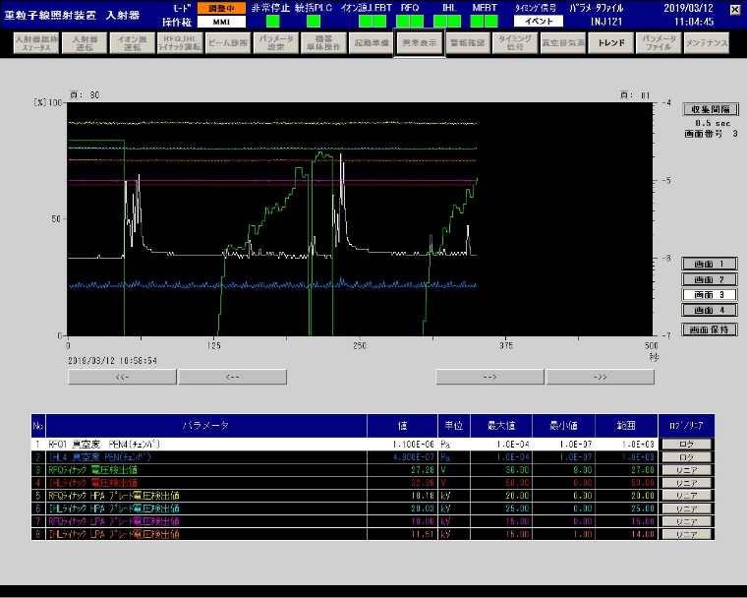
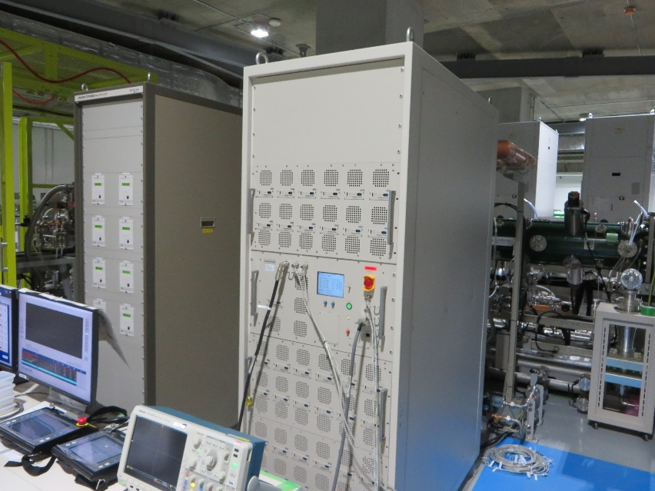
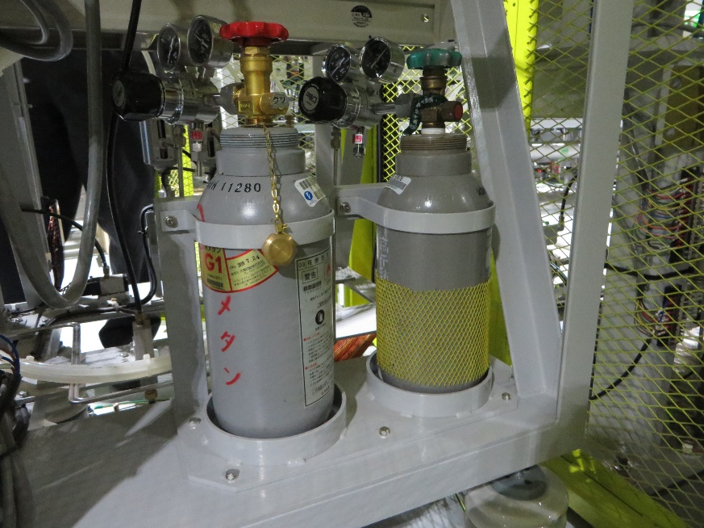
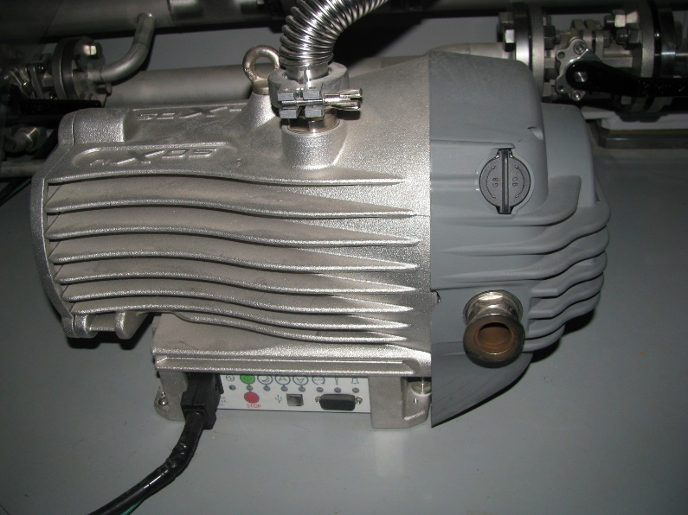
Improvement of Accelerator Reliability
Ion Source
Biannual Maintenance
Due to discharge
Linac surface
Many Discharge
Scratched by buffing
RFQ Tetrode
Gain changed by
voltage fluctuation
Scroll Pump
Performance degradation
By Damage of Chip Seal
Ext. Electrode of Gunma Univ.
RFQ Vane
of Gunma Univ.
RFQ-HPA
of Gunma Univ.
Scroll Pump
of Gunma Univ.
CH4+He gas mixing
1-2 year lifetime
Full Solid State Amp
Another vendor(Edwards)
User can change chip seal
Electropolishing
→less discharge

Slide 13
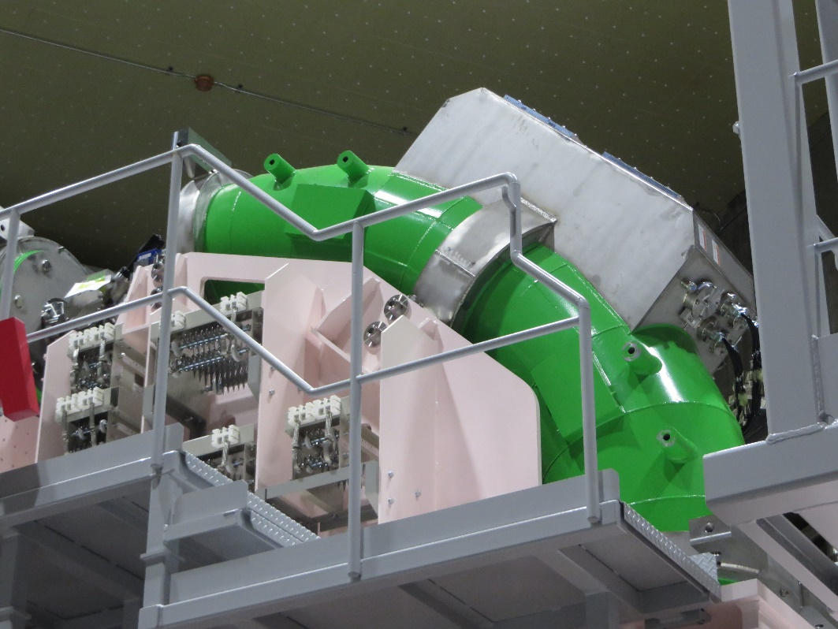
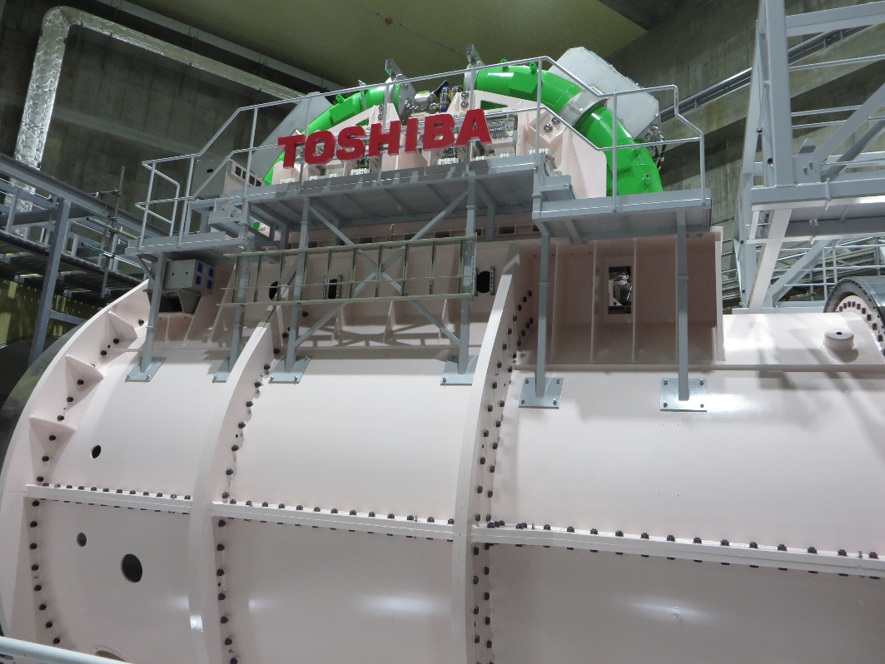
Reliability of Superconducting Rotating Gantry
Magnet Cooling
LHe-free Cryocooler system
3 Cryocooler for 1 magnet
Sufficient Cooling with Rotation
Redundant system
  SC kept if 1 cooler broken
Mechanical device
Cable spool to prevent entangling and friction damage
Weekly inspection for beam line (High Place Work) and inside the gantry by operators and medical physicists
S. Takayama et al.
J. Phys. Conf. 871 (2017) 012083

Slide 14
Long-span Maintenance Issue
Availability of Tetrode (THALES RS2042SK)
  Long Lead Item (~1 year)
  Price Increase (x1.4 in 6 Years)
  Replace to Solid State Amp (with Other Facilities)
Replace of Computers of the control systems (after ~10yr)
Replace of Electrolytic Capacitor in Power Supplies (after ~20yr)
Turnover of operator/physicist (skill leveling)

Slide 15
Future Development
New Treatment Technique
Multi-Ion Irradiation for High LET irradiation to the tumor
Advance 3-dimensional Positioning using In-room CT
Real-time MRI guided Heavy Ion Therapy
Intraoperative Irradiation of Heavy Ion Therapy
Reliability Improvement
Gain (Supplied Voltage) stabilization of Tetrode amplifier
Robust beam optics against temperature change

Slide 16
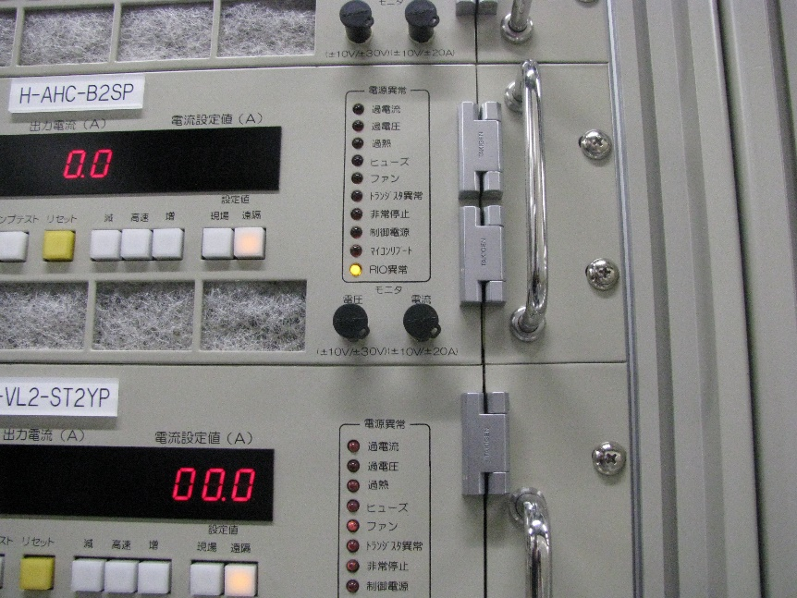
“Reliability” in medical accelerator
1st priority: Patient’s safety
  Abnormal Irradiation is critical to patients.
  Duplicated dose monitor, Interlock for magnet power source
2nd priority: Minimum Downtime
  Downtime is inconvenience for patients and medical staffs
  Scheduled maintenance, Immediate recover from trouble
But Sometimes they conflicts.
  e.g. Remote control failure
    We can irradiate by local control, but the actual value is not checked…
    Shall we stop? or start treatment with human double check?

Slide 17
Decision Making for Clinical Irradiation
Final decision concerning clinical irradiation (e.g. Irradiate if the beam parameters are out of tolerance or not) is made by a medical doctor.
But if the doctors do not understand machine status, they cannot make correct decision
Operator/Vendor
Dose monitor response changed by increased noise.
Need Change of circuit parts.
Medical Doctor
Is it safe?
How large is dose error?
When we can restart treatment?
Failure Evaluation
Medical Physicist
In this case, dose error <1%
For parts change, 4 hours to repair and beak check.
Medical Doctor
OK, It is better to continue treatment and fix it after today’s treatment
Medical Physicists translate machine status for medical situations

Slide 18


Human Factor in Particle Therapy
Different Culture, Different background
  for Medical Doctor, Nurse, Radiological Technologists, Medical Physicist, and Accelerator Physicist
“Commissioning” “Quench”
For Medical Doctor and
Radiological Technologist:
For Accelerator Physicist:
Quench Detected.
It needs 1 hour to recover…
Quench !?
It needs several weeks to recover!
For Accelerator Physicists:
(Machine) Commissioning
User Operation
In Superconducting magnets, “Quench” means temporal loss of superconducting state
And will recover soon.
For MRI (with Liquid He), Quench means emergency stop with exploding vent of helium gas.
For Medical Physicists:
Acceptance Test(Vendor’s matter)
(Clinical) Commissioning
To Avoid Miscommunication…
Documentation for common rules
Frequent Meeting (Daily Briefing for machine status, Weekly conference for treatment plan, Emergency meeting on trouble…)

Slide 19
Quality Assurance Program
Quality Assurance program is established in each facility, discussed among Doctors, Radiological Technologists, and Physicists.
At 2019, particle therapy physics guideline is available only for broad beam irradiation, not for scanning irradiation.
QA program in Yamagata Univ. will follow that of the Scanning/Gantry system at QST-NIRS.
Daily
・Dose/Monitor calibration
・Range Check
・Beam Position Check
・All Energy Irradiation Check
・Positioning System
Weekly
・Detailed Patrol (incl. Gantry)
・Profile/Range Measurement
・Respiratory Gating System
Annual
・Beam data compared
with commissioning

Slide 20
Recover from Machine Trouble
For appropriate decision … Clinical Effect by the trouble is important
Role of each staff and workflow will be prepared.
Trouble
Operator
Physicist
Find trouble in earlier stage
Search database for similar trouble
Investigate possible clinical effect
Estimate how long downtime
Action to prevent recurrence
Radiological Technologist
Investigate effect for positioning
Re-scheduling of the irradiation
Medical Doctor
Nurse
Investigate possible clinical effect
Final decision of restart the treatment
Re-scheduling of the irradiation
Communicate patients for schedule
Team Work
Not only act as a specialist
But also communicate with other specialists
Recover

Slide 21
Operator Skill Training – Two Way
Operators are outsourced, company can change operators (e.g. skilled operator move to new facility and covered by new operator)
How to keep the reliability of operation for long-term?
Manual-based Basic Skill
For daily operation and quality assurance, minimum level must be kept by manual and training.
Knowledge-based Advanced Skill
For improvement of machine performance, unusual operation based on the knowledge of accelerator is important
But, If we know only manual…
It is difficult to handle unknown trouble if we do not have deep understanding of the machine.
But, If we ignore basic manual…
It is very dangerous to operate without basic rules. It will result in critical failure.
子曰、学而不思則罔、思而不学則殆
Confucius said, Learning without thinking leads to confusion, thinking without learning ends in danger.

Slide 22
Operator Training in Medical Facility
In Medical Facility, Manual-based training is important to avoid critical mistake. Usually, 100% of operator training was Manual-based.
High uptime requirement, no miss requirement – stressful work
No opportunity for thinking physics in accelerator
“Operator’s Machine Time” - machine study time, the theme is set by operator themselves (sometimes accelerator physicist advice about theme) will greatly help understanding the accelerator.
Both Learning and Thinking !

Slide 23
Summary
Yamagata University is constructing a Heavy Ion Therapy Facility with a Superconducting Rotating Gantry as a 7th Heavy Ion Therapy facility in Japan.
Many improvement has been done in the accelerator using the information of troubles of preceding facility.
For the medical accelerator, difference of the background of medical staff must be considered.
Operators of medical accelerator tend to learn only manuals, but understanding accelerator is also important.
謝謝！

