Slide 1
Web Applications for Operations
Nina He
RIB Operations Group @ ARW2019

Slide 2
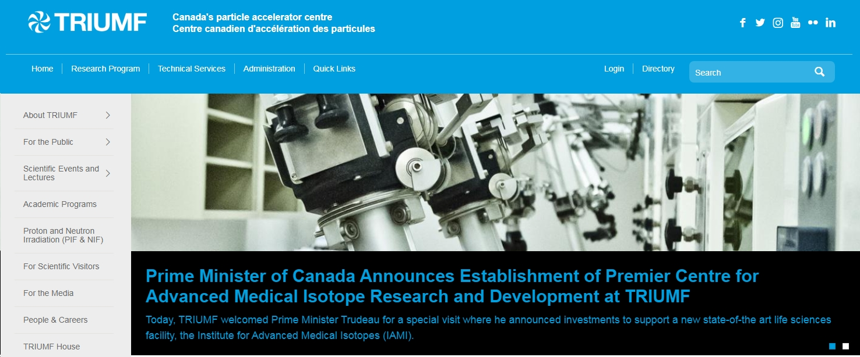
Questions:
or
- Tools for a small group people such as operations
What are Web Apps?
Why use Web Apps?
How to make Web Apps?
Interaction available between:
- people
- users and machines
Browsers are the most widely used tools cross OS
New technology, open source tools make development easier and quicker.
Users can learn and design, with low cost.
Notes:
Let’s start with questions. Today if someone ask what are web apps, the most people will think about website and webpage. Like google which has millions of visits everyday, TRIUMF website, and ARW2019 webpage. However, web apps also can be very useful tools for inside of company, for group of people in operations.
That is why we want to use web apps for operations. Because browsers are most widely used tools now. They are crossover the OS from all computers or mobile devices. By using apps it is easily to build the connections between people, users and machines.
New technology and open source tools make development easier and quicker. Users make web apps become possible.

Slide 3
How do web apps improve operational reliability?
Reduce Down Time
Accelerator operation has two key factors.
Human work:
Efficient organization and management
Reduction of human errors
Machine reliability:
Preventive maintenance
Monitoring weak points of systems
Notes:
From my point of view, operations reliability has one target: reduce down time. Accelerator operations have two key factors: one is Human tasks , which includes organizing, managing efficiently, and reducing human errors. 2nd is machine reliability. We can increase machines reliability by having preventive maintenance work, and improving the weak points of system.

Slide 4
Web Applications Improving TRIUMF Operations
Training programs
Paperless by using Database
Reduction of tuning time and human errors
Work Scheduling
Notes:
These are some examples of web apps to improve human tasks. And they have been used in our RIB operation group for years.

Slide 5
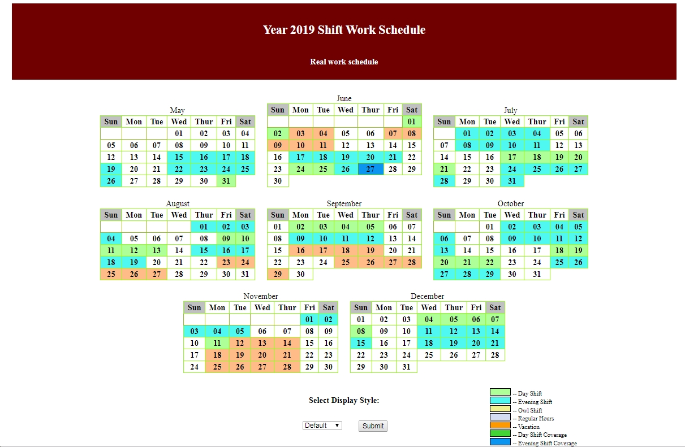
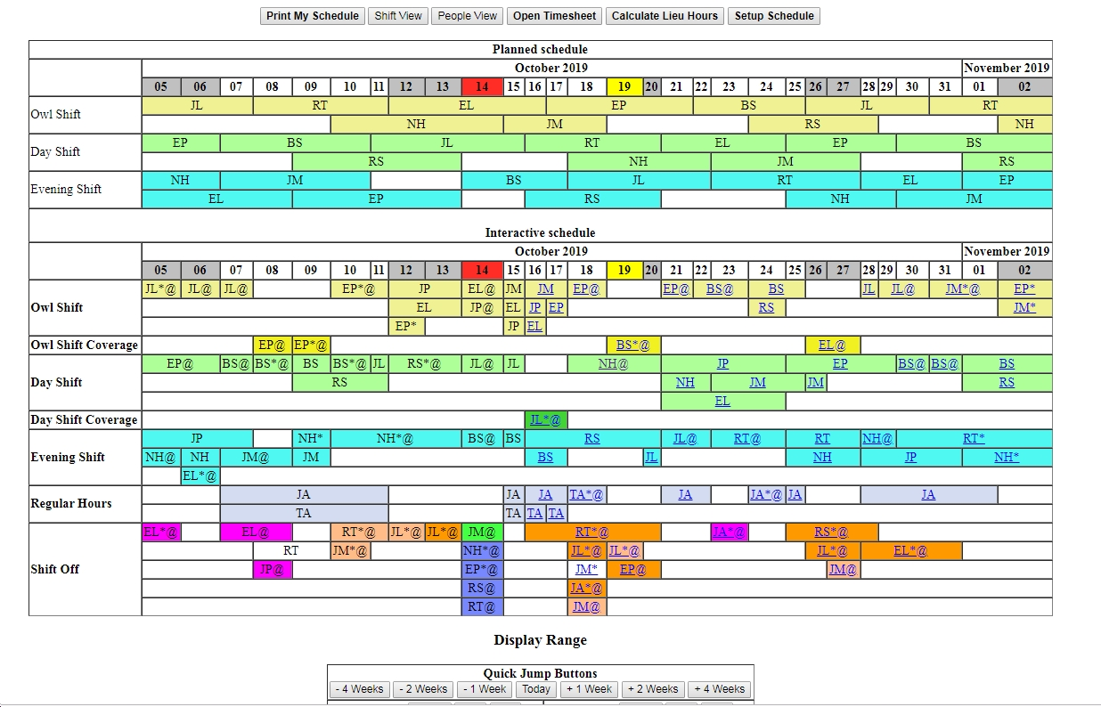
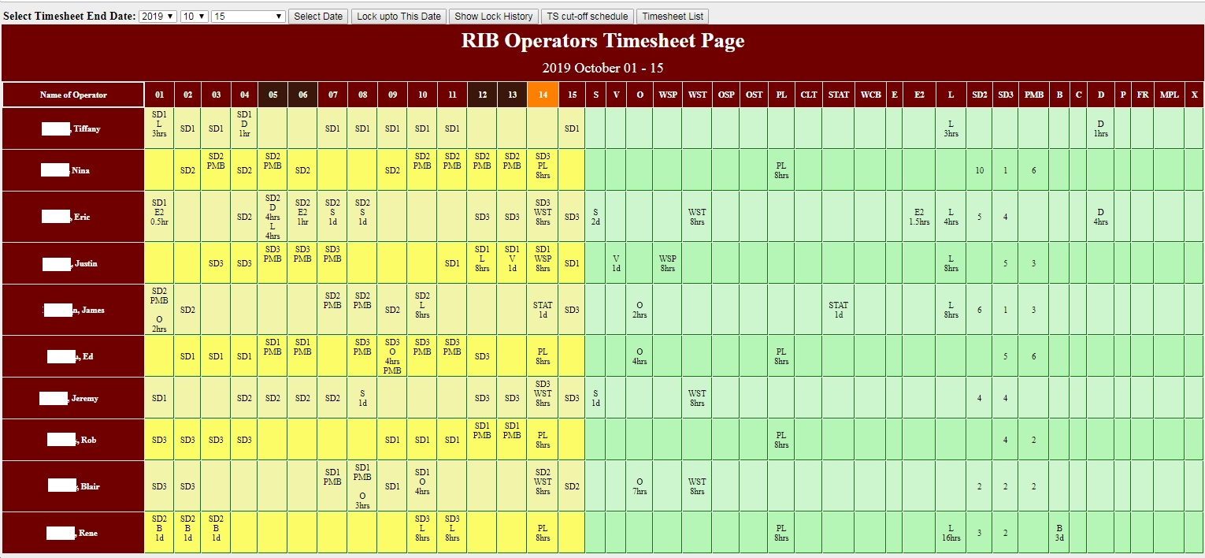
Web Applications Improving TRIUMF Operations
Scheduling
Training programs
Paperless
database
Faster tuning
Personal Real Time Schedule For Current Year
Group Work Schedule
Time Sheet Generated automatically
Interactive Work Schedule
Notes:
Scheduled work is our operators daily life and the most importance thing to keep operation running. By using our interactive schedule we can manage our work time efficiently and saved a lot of time. This app functions include group schedule, personal schedule, and timesheet generation.

Slide 6
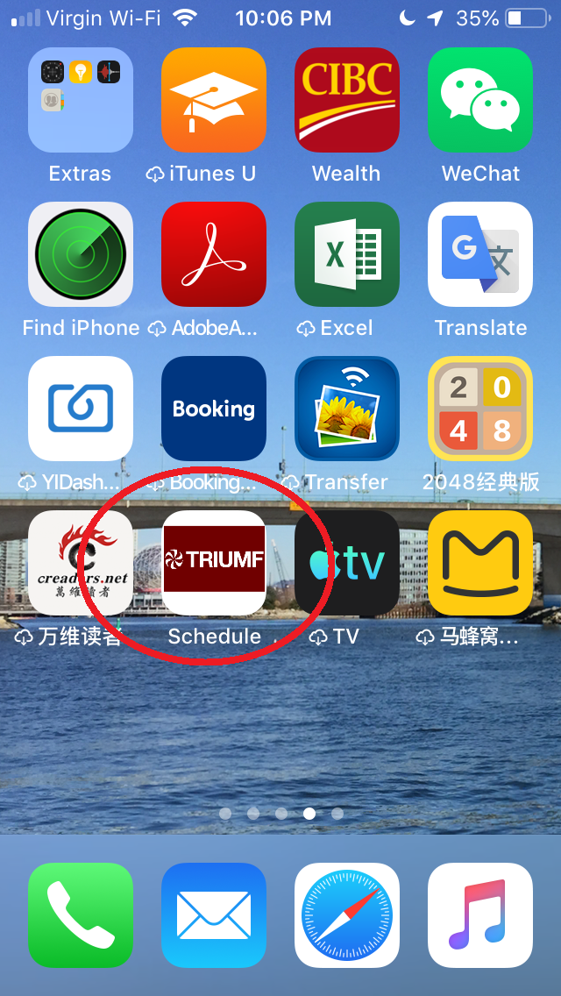
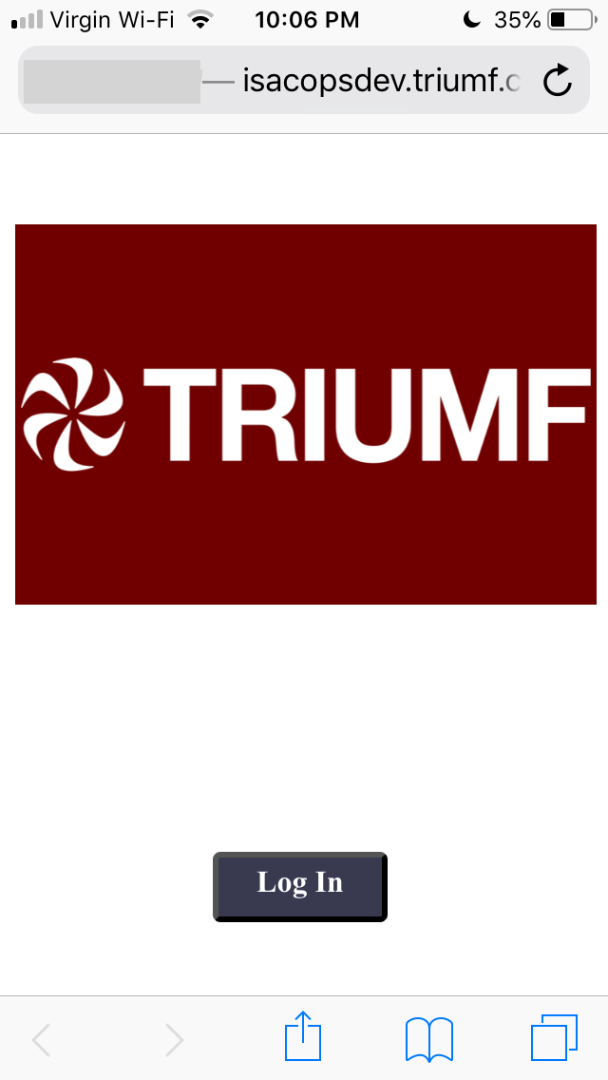
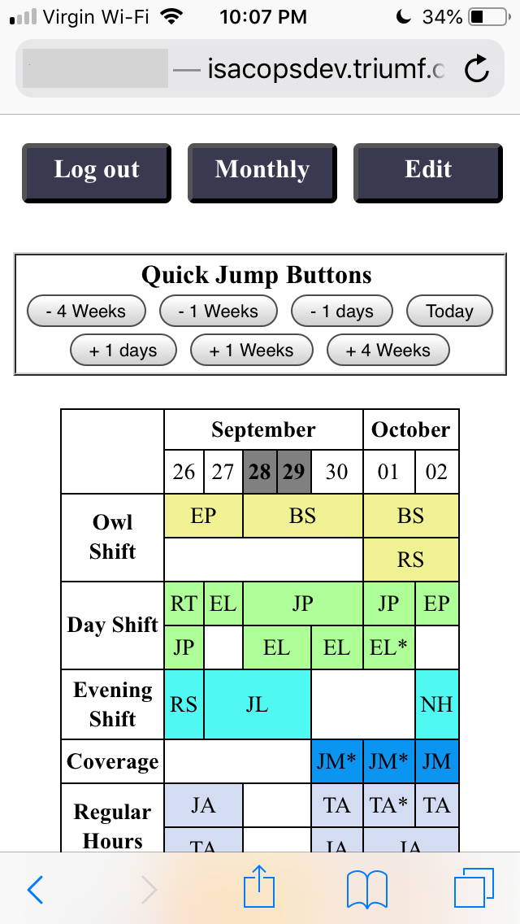
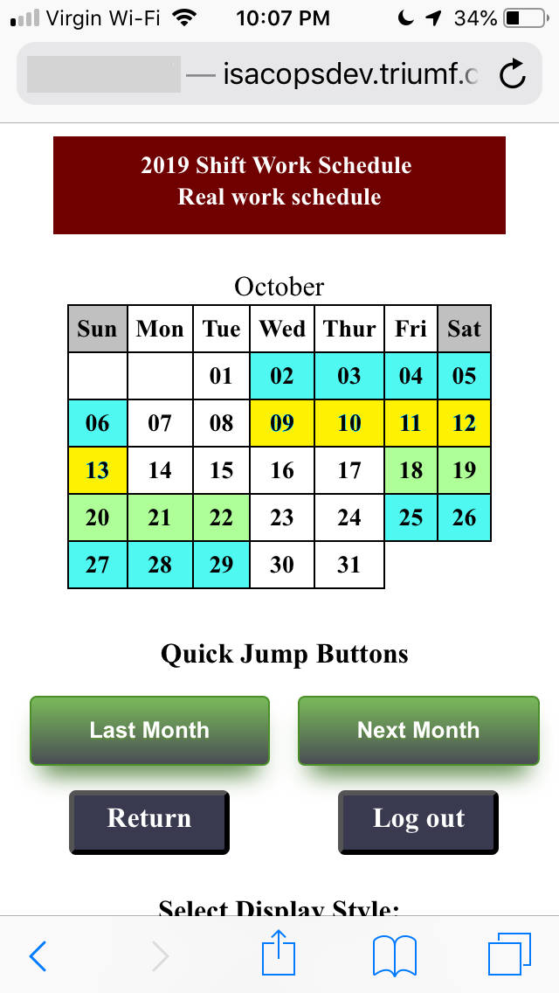
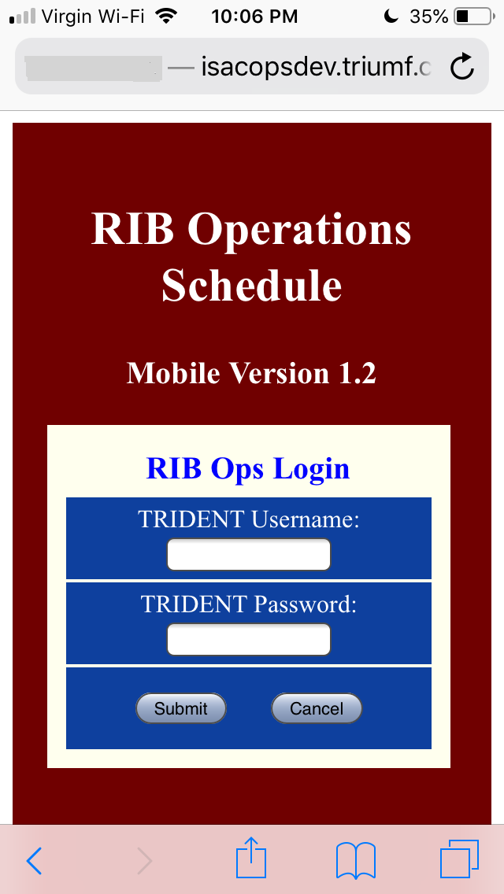
Web Applications Improving TRIUMF Operations
Scheduling
Training programs
Paperless
database
Faster tuning
Work Schedule Phone Application
Notes:
We put app on the phone so operators can check and plan the work schedule more easier at any time.

Slide 7
Web Applications Improving TRIUMF Operations
Scheduling
Training programs
Paperless
database
Faster tuning
Web App Benefits for training
Easy to use, to build and modify, time-saving.
Can use images, sounds, & videos.
Notes:
Web App for training. The benefits to use web apps for training: easy to use and convenient for time. Can be created by using images, sounds or videos. Easy to build the pages and modifying them if needs. We already have many apps and still have more projects can be done.

Slide 8
Web Applications Improving TRIUMF Operations
Scheduling
Training programs
Paperless
database
Faster tuning
Paperless databases
Save The Environment!
E-log
E-fault
Work Permit System
More to come …
Notes:
We used to use paper to keep records but they are hard to find the information that you want later. By using web apps and database we can search and find information easily. Still go paperless is for save the environment. Our operations have put the effort for many years trying to reduce paper work. We have e-log, e-fault, work permit systems to cover basic major jobs. However we still need more works to get paperless.

Slide 9
Interlock Defeat/Device Disable Management System
Web Applications Improving TRIUMF Operations
Scheduling
Training programs
Paperless
database
Faster tuning
Operators Acknowledge
Active
Removed
Notes:
One of Web Apps we recently completed and started to use is Defeat/Device Disable App. It uses database to restore the data then totally eliminate paper works. Our operator Rob Shanks developed this DDDB system. The system can show active, or removed disable/defeat devices, and acknowledge status from operators. The system not only saved paper works but also saved us a lot of time. Make search the history become easy.

Slide 10
Tuning
Web Applications Improving TRIUMF Operations
Scheduling
Training programs
Paperless
database
Faster tuning
Tuning the beam to experimenters is our primary function.
Delivering high quality beam with efficiency is our objective.
Tune setup was time-intensive and prone to input errors.
Required manual entry from tables and spreadsheets.
Notes:
Tuning is our operators major job and it requests time frames. Delivery high quality beams to experimenters is our objective. It is time efficiency and beam spot accuracy related. We used to setup the tunes by using reference tables and calculation spreadsheets which provided by beam delivery experts, input into system manually. The way was not only cost a lot of time but also easy to get input human errors.

Slide 11
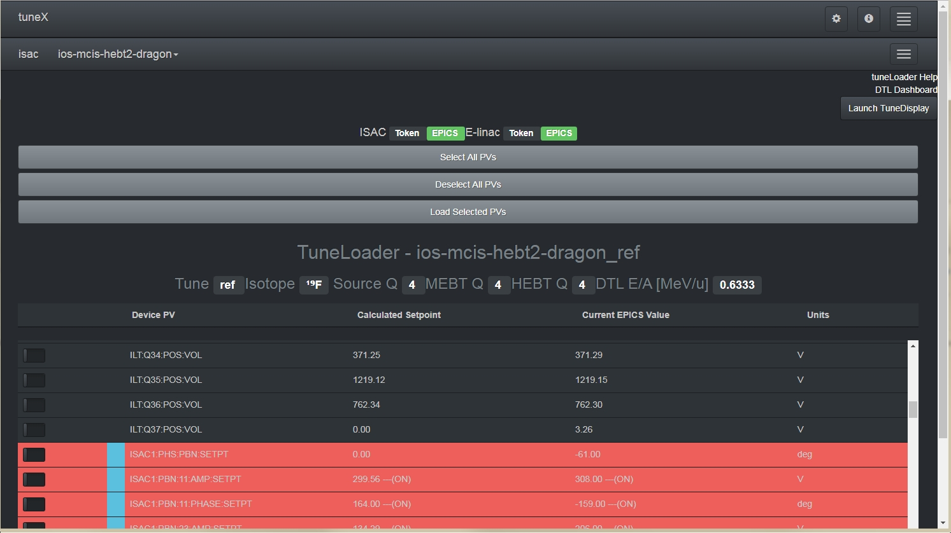
TuneX (Beam Delivery Group)
Web Applications Improving TRIUMF Operations
Scheduling
Training programs
Paperless
database
Faster tuning
Reduced tune loading time and human errors
Notes:
This example app was developed by our beam delivery group but the purpose is for improve our operators tuning experience. By using TuneX app we setup a tune become very easy and quick. If it was 30 minutes job by manually input, we can finish in a few minutes now, and it really reduced human errors.

Slide 12
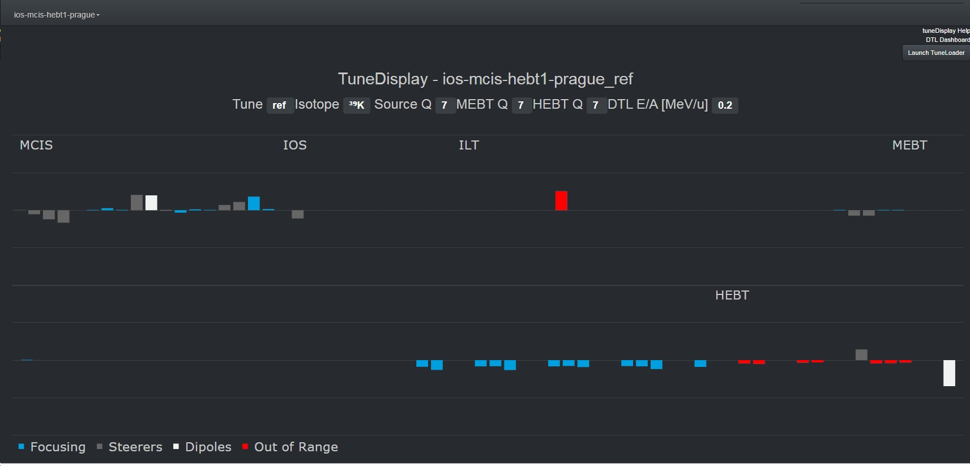
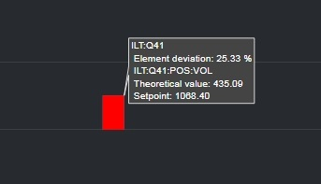
TuneDisplay (Beam Delivery Group)
Web Applications Improving TRIUMF Operations
Scheduling
Training programs
Paperless
database
Faster tuning
Shows tune status and devices out of range
Notes:
This is another web app name Tune Display which comes along with TuneX . This program can display the tune status. If a device setup point was out of theoretical range, the device shows as red bar. Put mouse on it will shows how far away it was. It helps to do diagnostics to a tune setup.

Slide 13
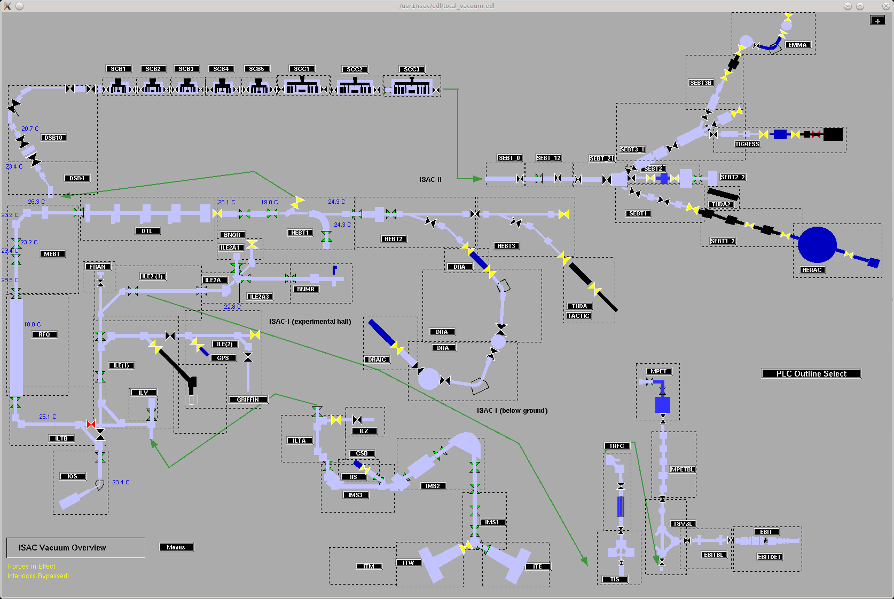
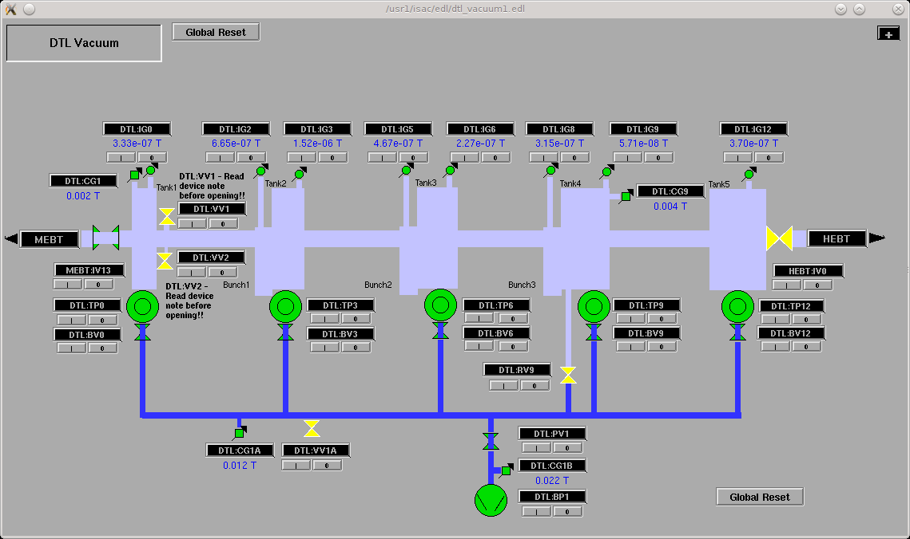
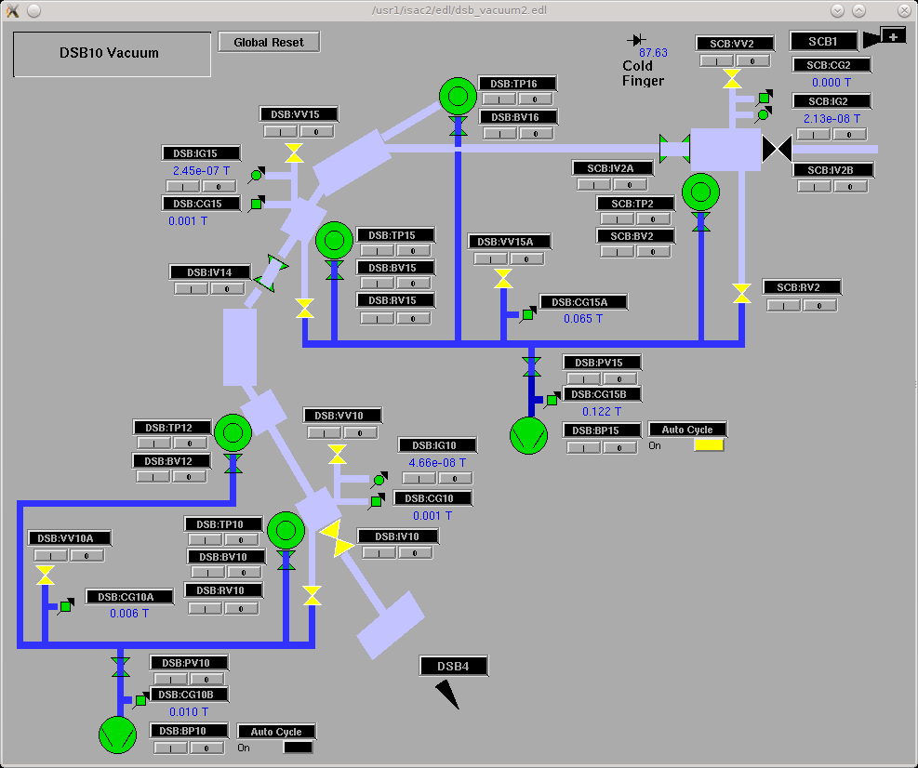
Web Applications Improving Machine Reliability
Preventive maintenance
Monitoring weak points
Backing Pumps Monitoring System
Notes:
Preventive Maintenance is important for machine reliability. If we can recognize machines faults before the faults become significant we will reduce the down time significantly. This example shows backing pumps monitoring system app. Big picture is our isac vacuum system overview. Backing pumps will usually not be noticed until we need to start a turbo pumps. Like pictures on the right, we need to go into every sections to get backing pumps readings.

Slide 14
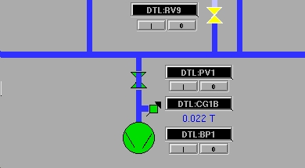
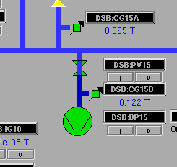
Web Applications Improving Machine Reliability
Preventive maintenance
Monitoring weak points
Backing Pumps Monitoring System
Notes:
Usually 50 mT is TP start limit. If we find TP can’t start because backing pump can not work to get pressure below 50mT, then work on the back pump first, get delay to start TPs and make unnecessary downtime.

Slide 15
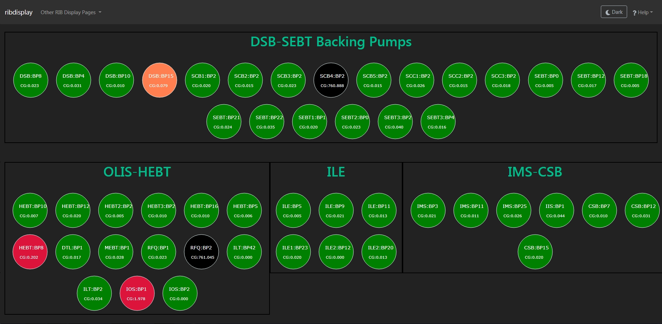
Web Applications Improving Machine Reliability
Preventive maintenance
Monitoring weak points
Backing Pumps Monitoring System
Notes:
This web app to display all backing pumps in the IASC area. Color code shows the pump’s status. Green color is for pressure below 50mT. Orange color is for above 50mT but below 100 mT. Red color is for above 100 mT. Black color is for atmosphere, means pump is off. That makes us to know all backing pumps status and we can make e-fault to report the bumps become red color. This way we can do monitoring for any devices which have the parameters can be used as devices status. This way can find the situation of the devices gradually to get worse and do the maintenance before they are broken.

Slide 16
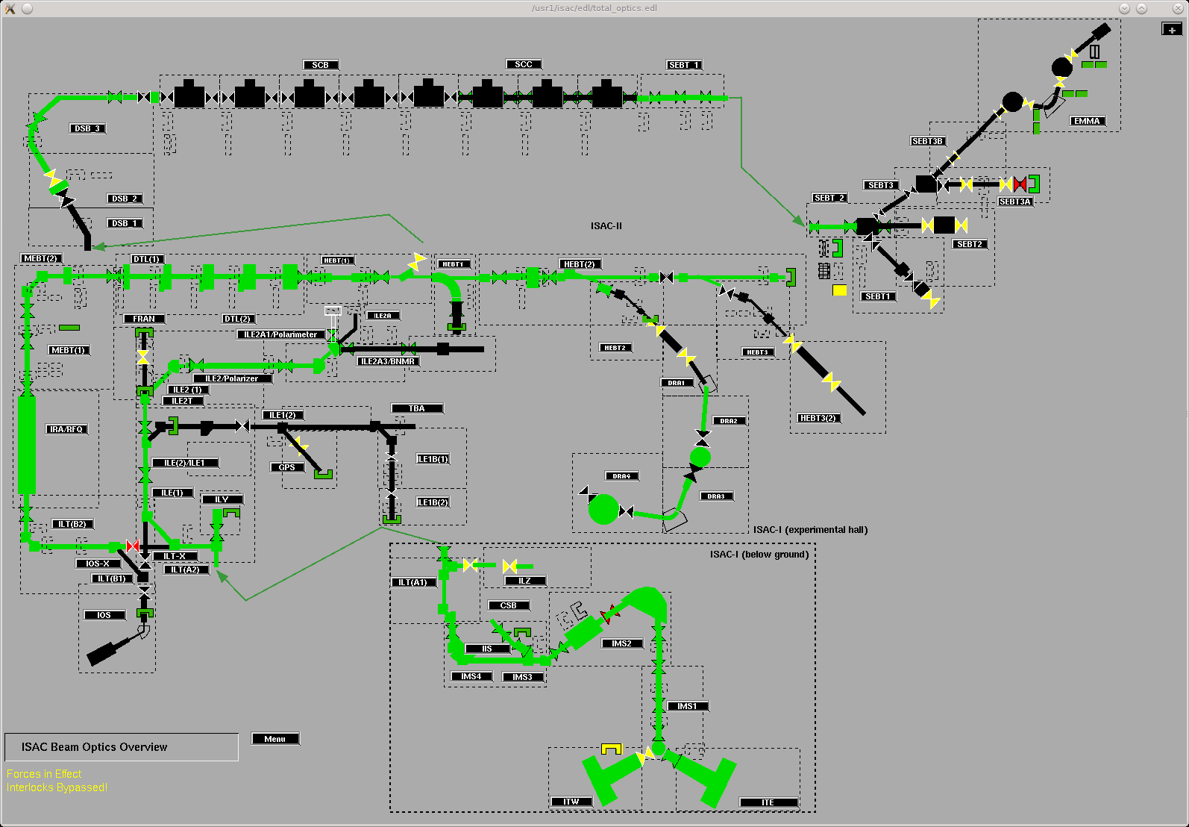
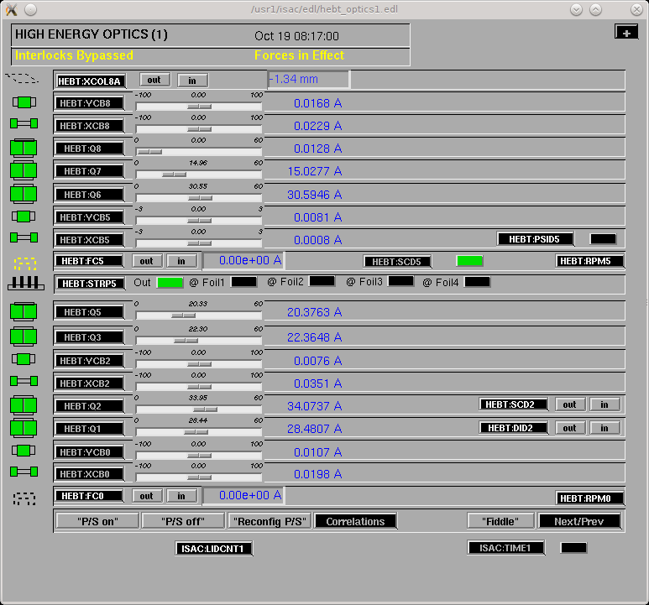
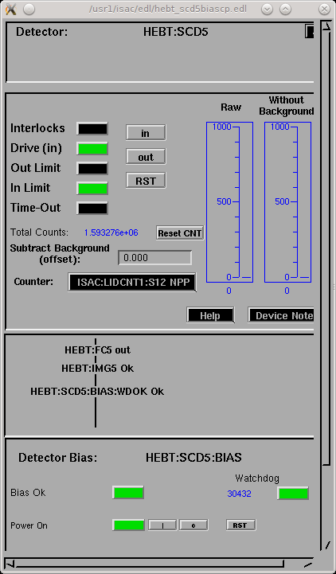
Web Applications Improving Machine Reliability
Preventive maintenance
Monitoring weak points
Reducing Beam Delivery Down Time from Intercepting Devices
Notes:
When we deliver the beam our system overview, some times it doesn't show every piece of device on the path. Some low diagnostics devices could put in and forget to move out. Like this beam line from HEBT1 section. From overview we can not see the device HEBT:SCD5 in. It only shows on section page as small green color. However if we forget to remove it from beam line, not only block the beam delivery but also get risky to damage the device.

Slide 17
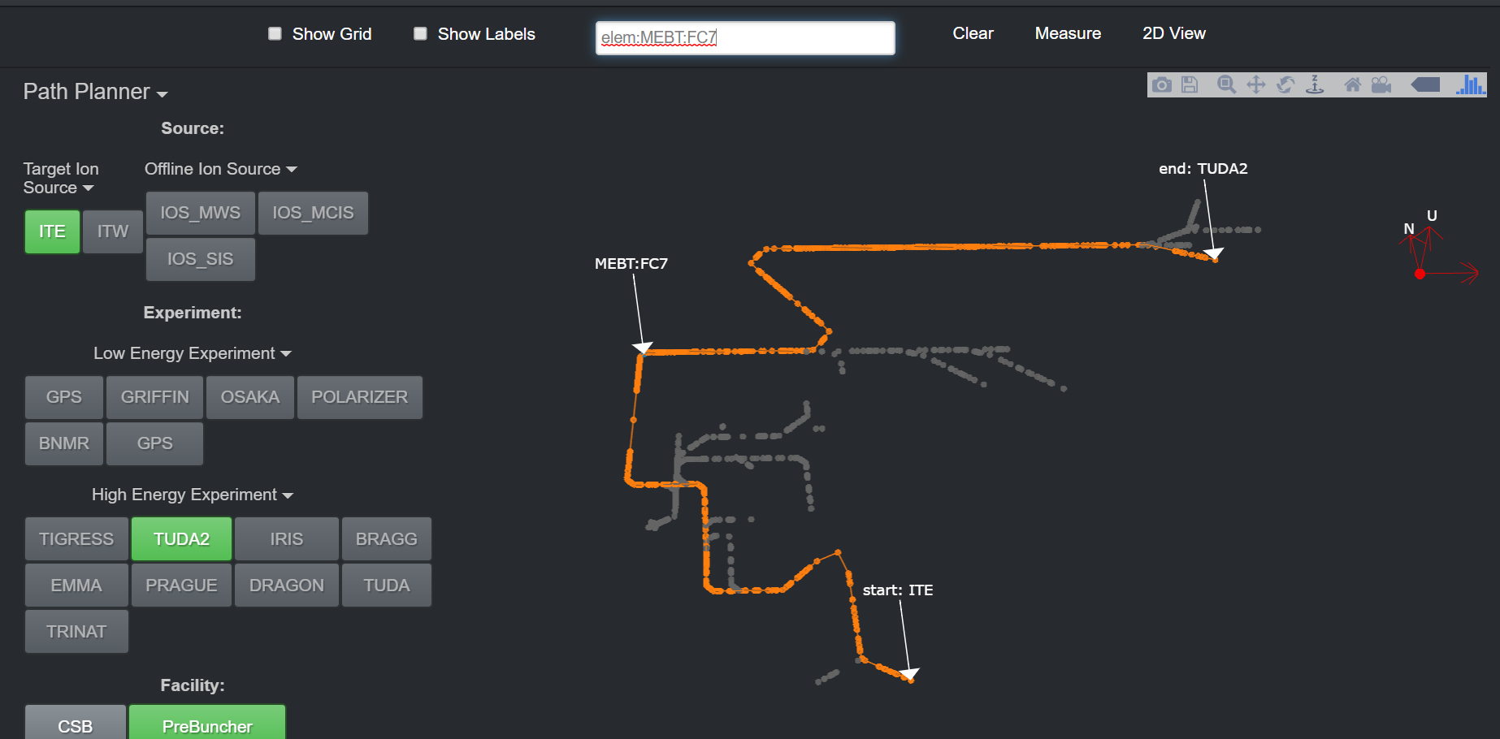
Web Applications Improving Machine Reliability
Preventive maintenance
Monitoring weak points
Reducing Beam Delivery Down Time from Intercepting Devices
Notes:
On our beam path any of diagnostics devices in the way or slits failed to calibration could make beam delivery difficulty and delay. We planed to have the app to show the only beam path which can be selected from beam path list, with all possible blocking devices status. If a cup or channeltrom in, or a slit failed calibration, it will show as red color and beam stopped by it. If we remove the cup the beam will go ahead to get next stop. This display will help to find beam position quickly and reduce down time caused by intercepting devices.

Slide 18
Web Applications Improving Machine Reliability
Preventive maintenance
Monitoring weak points
Reducing Beam Delivery Down Time from Intercepting Devices
Notes:
On our beam path any of diagnostics devices in the way or slits failed to calibration could make beam delivery difficulty and delay. We planed to have the app to show the only beam path which can be selected from beam path list, with all possible blocking devices status. If a cup or channeltrom in, or a slit failed calibration, it will show as red color and beam stopped by it. If we remove the cup the beam will go ahead to get next stop. This display will help to find beam position quickly and reduce down time caused by intercepting devices.

Slide 19
Technology stack for developing web apps
Perl + PostgreSQL + CSS + JavaScript
Operators Work Interactive Schedule System
Interlock Defeat / Device Disable Management System
Python (Framework Flask) + LiteSQL + Bootstrap (CSS) + Javascript
TuneX
Backing Pump Reading Display
Faraday Cups and Blocking Devices Position Display
Notes:
We used to create our web apps by using Perl language + PostgreSQL. Now Python has become popular and more operators are interested in learning python. We have projects using Python framework now that have proved it is really a quick tool for creating a web app.

Slide 20
Web App development from Python Framework
Implementation
Data File
Data Pressesing Module
Free Python framework download
Control Module
Online Tutorial
CSS File
HTML File Template
Virtual Server and Version Control
Web Page
Javascript
Get your idea to go!
Notes:
Here is a sample chart to explain how Python framework does the job.

Slide 21
Web Applications usefulness for operations
Easily used with various devices and platforms
Browsers are Must-have tools for all computer-like devices
Can cross platforms (Windows, MAC, LINUX, Mobile devices) if needed.
Display and Realize ideas
Users can conceptualize their ideas into reality.
Web apps are tools to get requests done for a small group of people
Learning and implementation are feasible
Free resources available
Web apps development possible and task-focused.
Conclusion
Web Apps are popular and useful tools to save the environment and increase operation reliability.
Notes:
Web Apps can become very useful because of widely used program browsers. When we develop a web app we don’t particularly concern which OS it run on. The computer-like devices only need browser and internet connection. Another important point is web apps can help small group people to get idea into reality quickly.

Slide 22
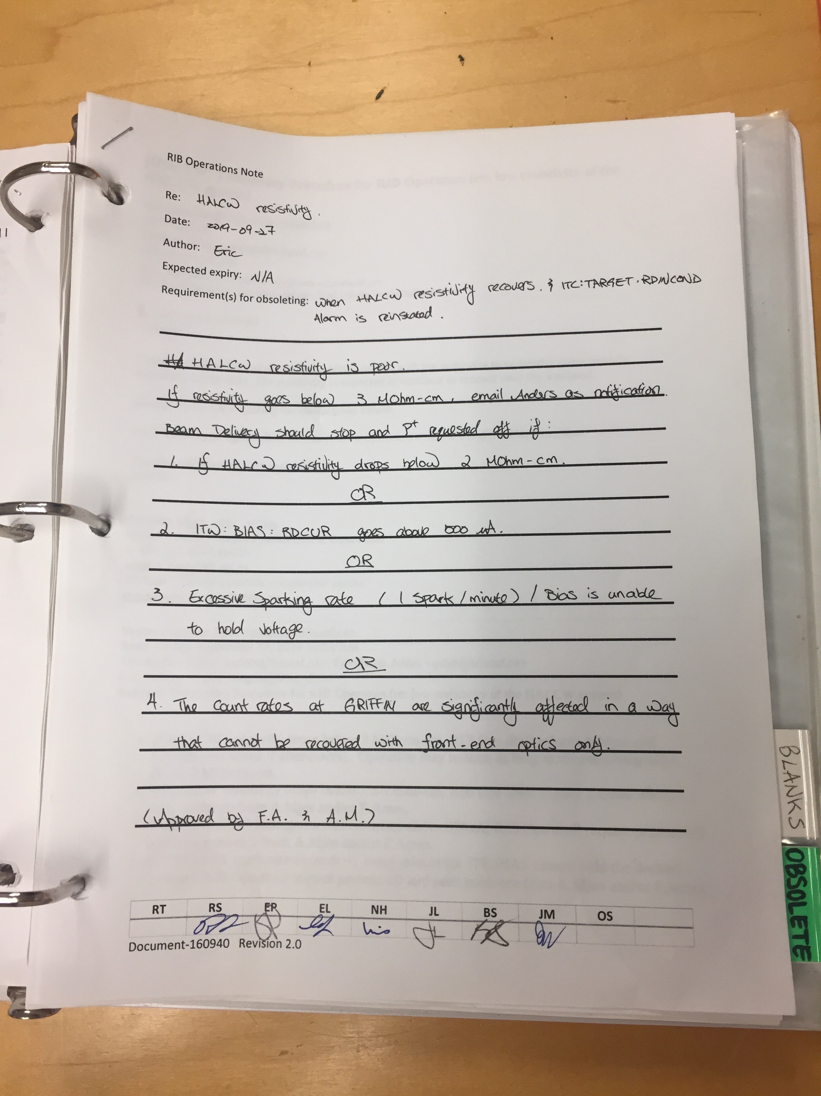
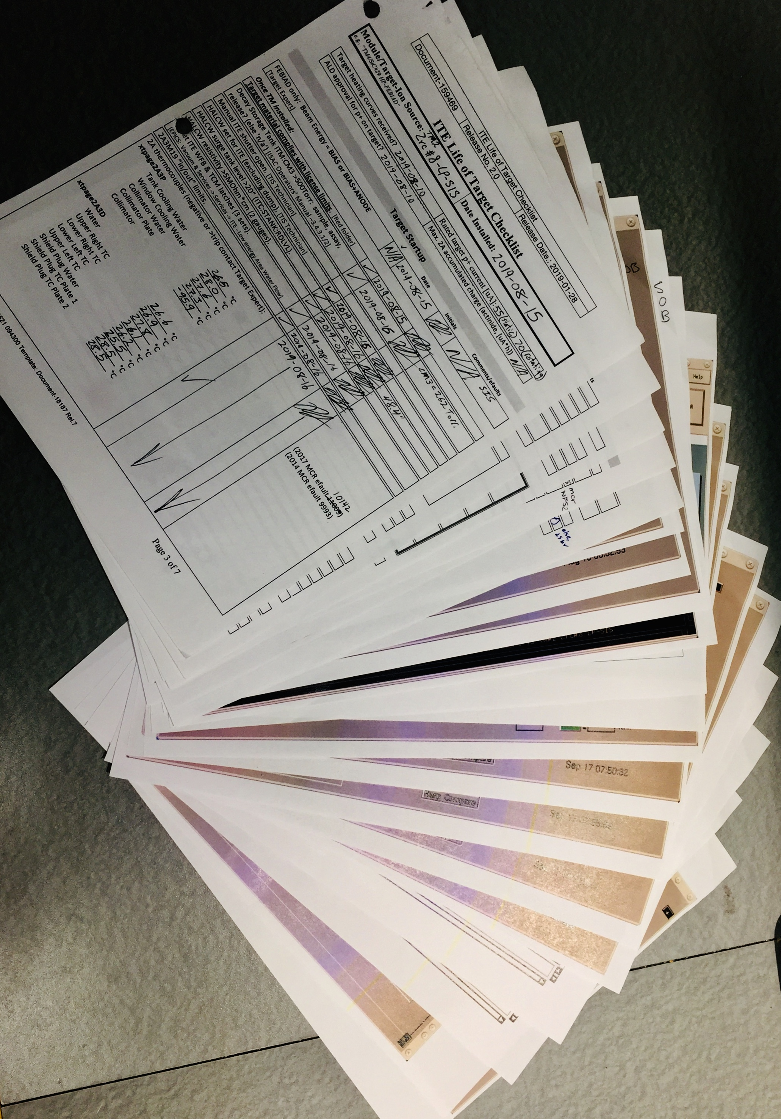
Future Web Apps for Operations
More paperless database
Life of target checklist
Target startup,waterflow,pre-shutdown
RIB Operation Notes
For temporary change or until made procedure.
Notes:
We will have more projects coming.

Slide 23
Future Web Apps for Operations
Collaborate on projects with Beam Delivery Group
Automatic Faraday Cup Readings
Bean delivery path display
Important as more beamlines coming!
Make standard modules
Easy to maintain Apps
Easy to train new developers
Notes:
We will keep to collaborate with beam delivery group people to finish more projects. We are going to try to standardize our modules. By that way we will keep maintenance our program and training new developers.

Slide 24
For contributions of examples:
Thanks to Spencer Kiy (Beam Delivery Group) and Olivier Shelbaya (Physics Group)
Special thanks to our operations team, specially Rob Shanks.

Slide 25
Thank you for attention!
@ AWR 2019

Slide 26
Thank you Merci
www.triumf.ca
Follow us @TRIUMFLab

