Slide 1
C-AD (BNL): Collider-Accelerator Department (Brookhaven National Laboratory)
Accelerator complex: LINAC/EBIS/Tandem → Synchrotrons → flagship Relativistic Heavy Ion Collider (RHIC)
End product: colliding particles: ions – p, d, h, Al, Cu, Ru, Zr, Au, U, polarized protons
RHIC colliding at beam energies 3.85-100 GeV ions, 255 GeV protons
BNL

Slide 2
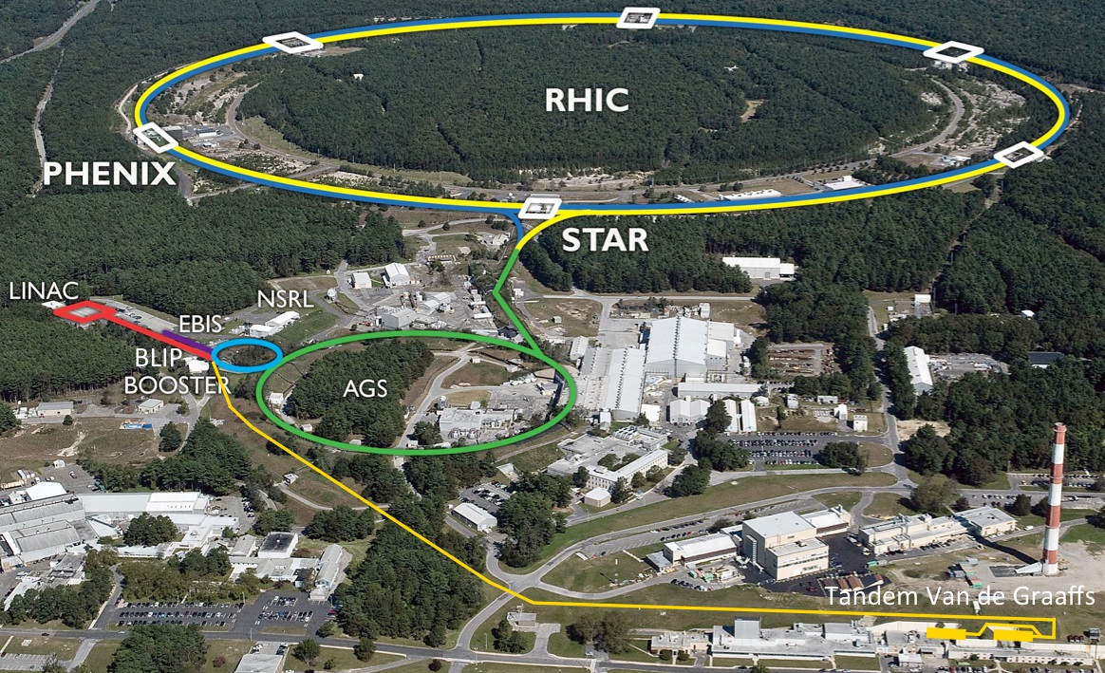
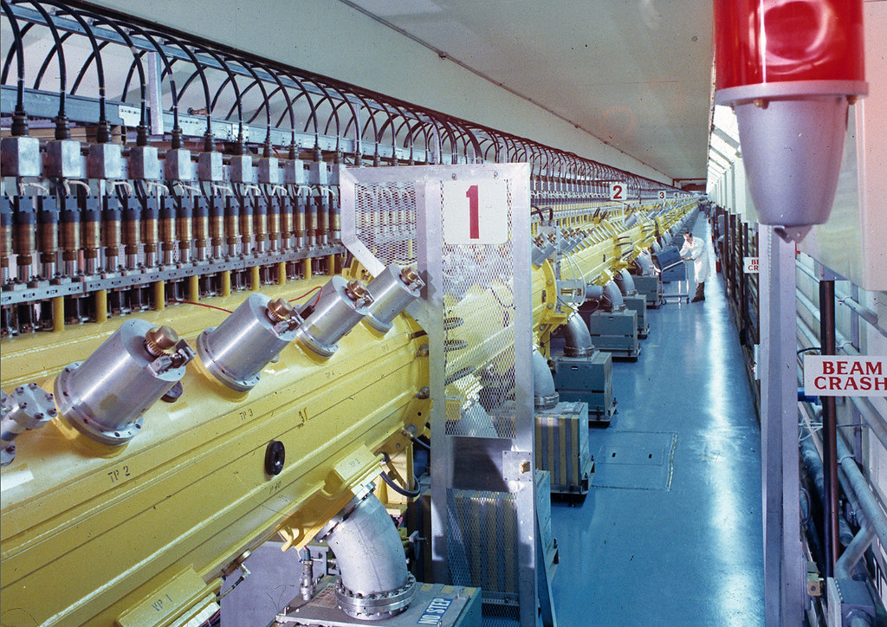
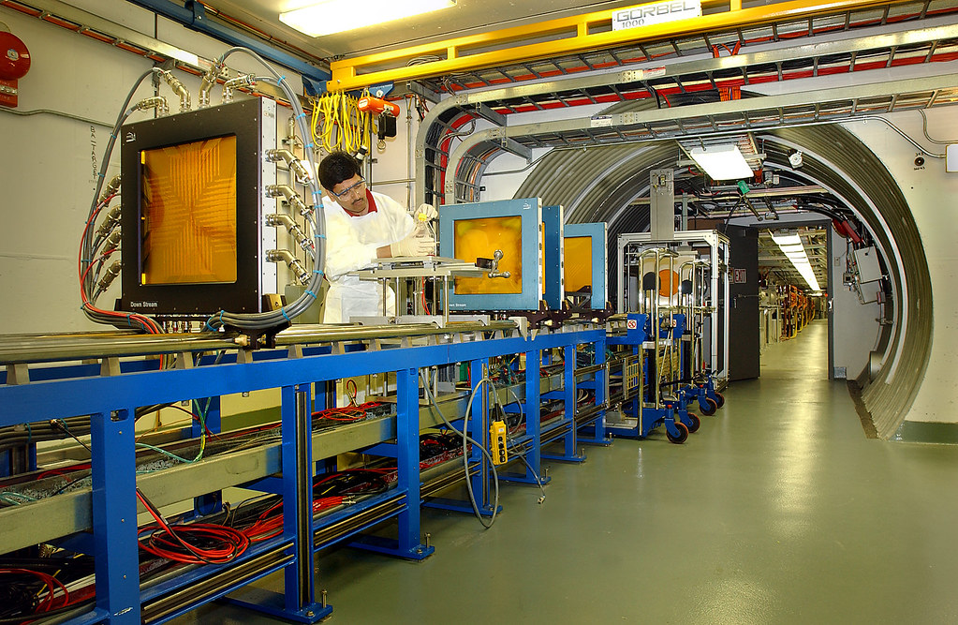
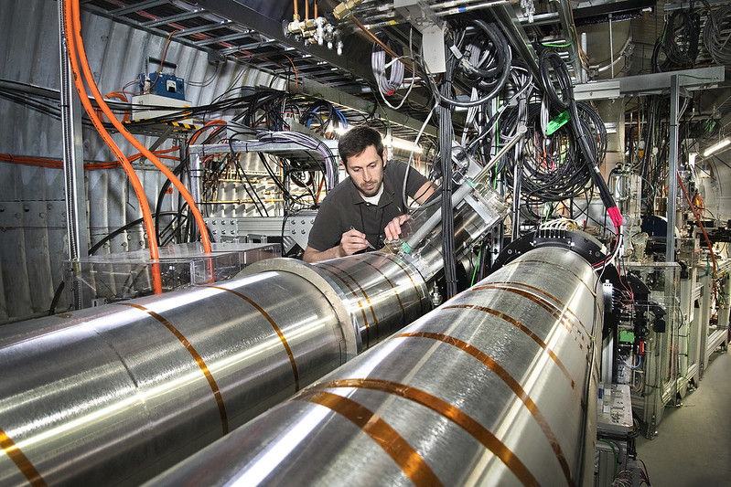
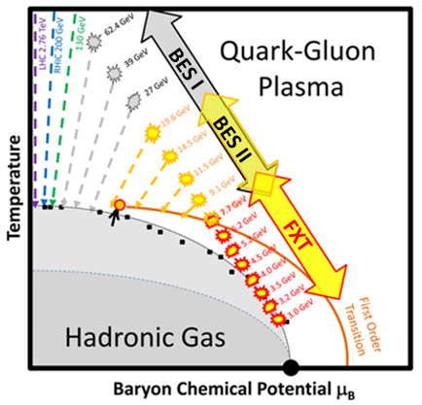
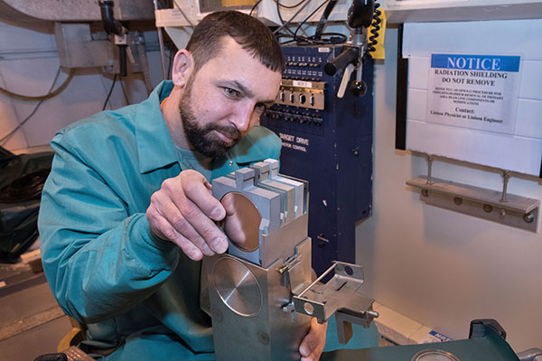
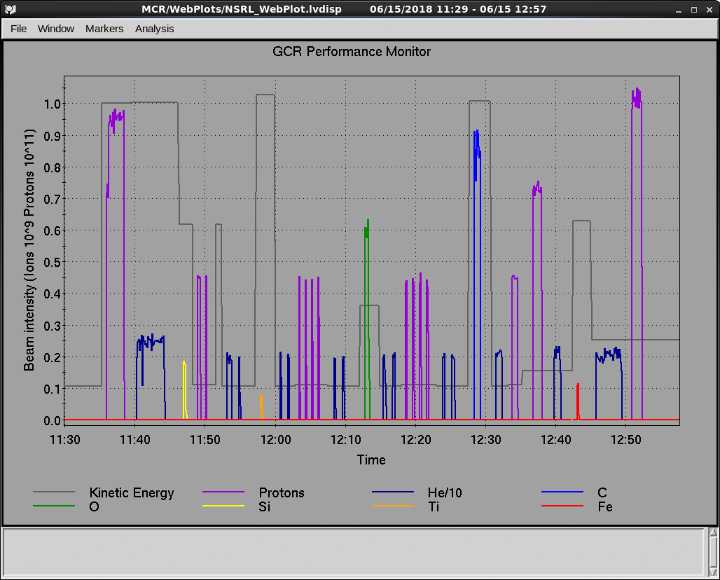
The Collider-Accelerator Complex at BNL
Performance tracking is required for 3 programs, often running concurrently:
Brookhaven Linac Isotope Producer
66-200 MeV protons,
150 ms cycles,
440 us pulse,
50 mA beam
NASA Space Radiation Laboratory
50-1500 MeV Linac protons, Tandem protons & ions, EBIS ions
2 sec cycles
Up to 1x10¹² ions/cycle
Rapid switching up to 33 ion/energy combinations per exposure ($≲$1 hour)
RHIC
Other areas also require oversight – R&D, Accelerator Test Facility, Tandem beam users, other testing areas
(NSLS-II)

Slide 3
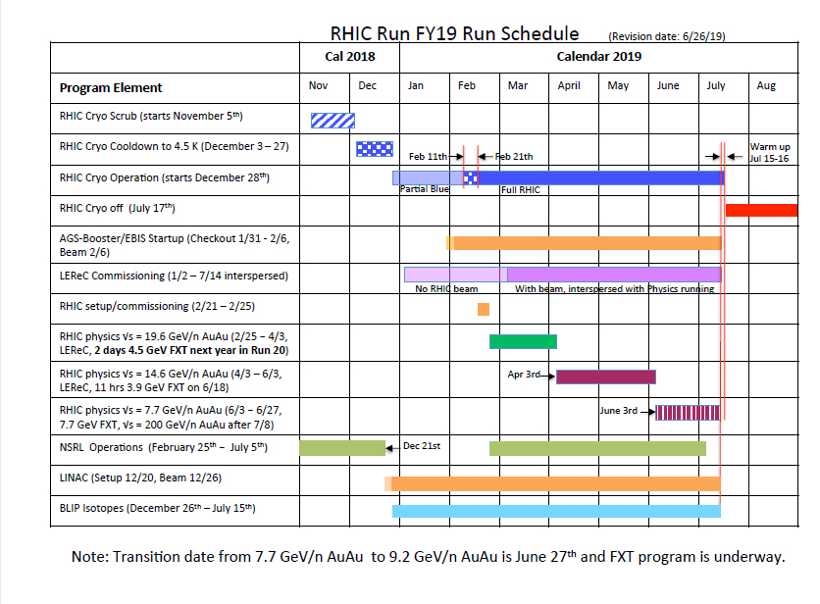
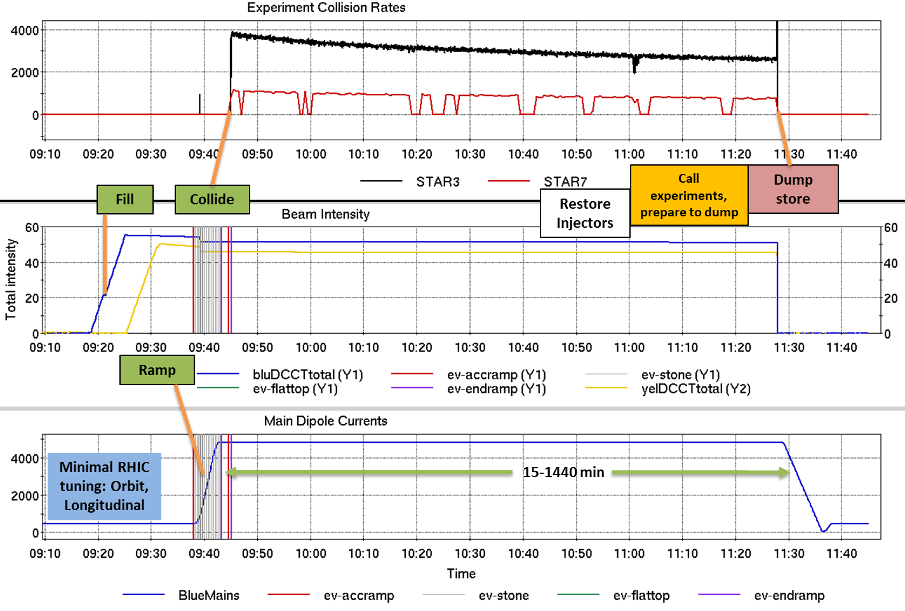
RHIC Operational Cycle
Daily: 0.25-24 hours colliding
Yearly: 20-30 weeks operation, summer shutdown
Monthly: Scheduled Maintenance every 2 weeks, ~8-16 hours

Slide 4
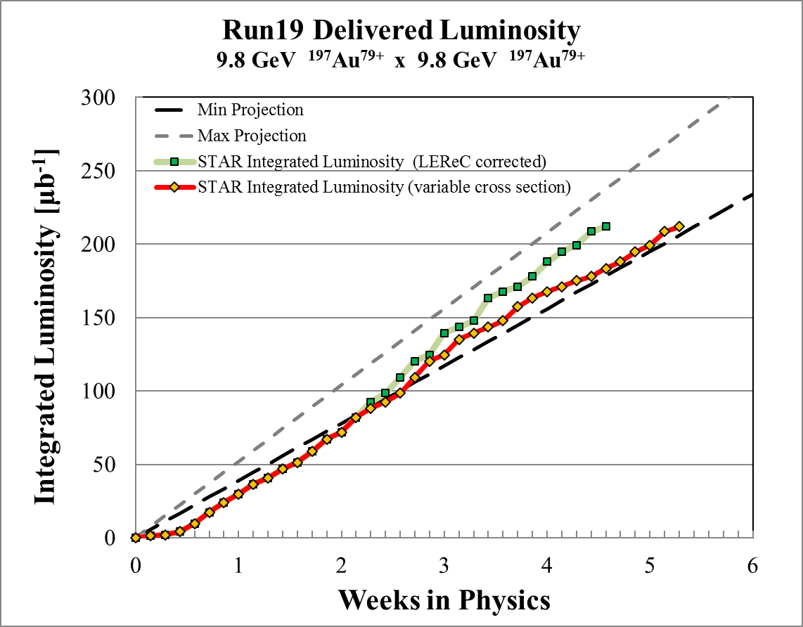
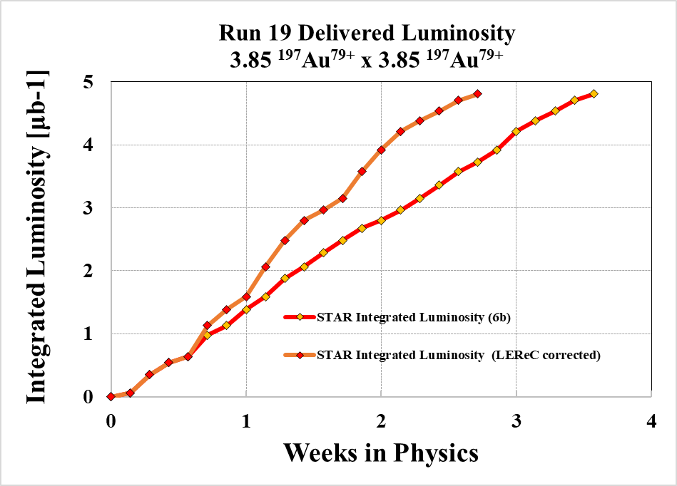
Key Performance Indicators
Courtesy P. Ingrassia
Luminosity is the major metric for RHIC performance. Projections are estimates made prior to the year’s Run.
Isotope production depends upon the availability of the Linac.
NSRL subscribes users and reports performance to NASA; like RHIC, we track availability.

Slide 5
Collider Availability
Courtesy P. Ingrassia
$$RHIC Availability=\frac{Physics+Machine Development+Machine Setup+Experiment Setup+Accelerator Experiments}{(Physics+Machine Development+Machine Setup+Experiment Setup+Accelerator Experiments)+Failures}$$
$$Availability=\frac{Beam use time}{Calendar time−scheduled interruptions}$$
$$Availability=\frac{Beam use time}{Scheduled time}$$
Goal: 80% average for Run, set by US Department of Energy.
Goal is being reset up to 82.5% for upcoming years…

Slide 6
Downtime Root-Causes
Courtesy P. Ingrassia
Root Cause System | Root Cause Duration [h] | % Total scheduled Operations
Low Energy Electron Cooling | 84.1 | 3.6
RHIC RF | 62.7 | 2.7
RHIC Power Supplies | 49.3 | 2.1
AGS Fast Pulsed Power Supplies | 29.2 | 1.2
AGS Power Supplies | 22.5 | 0.9
Run19 total failure hours = 480 (all systems)

