Slide 1
LIPAc Reliability & Availability improvement
Philippe Cara
ARW2019
Guangzhou – 10/11/2019

Slide 2
Outline
Introduction
LIPAc Reliability & Maintenance
Impact on LIPAc Operation
How to improve our Reliability
Personnel and Organisation Improvement
Conclusions
1
2
3
4
5
6

Slide 3
Outline
Introduction
Conclusions
IFMIF/EVEDA Status
LIPAc: Accelerator Facility
LIPAc: Commissioning Status
Outlook
1

Slide 4
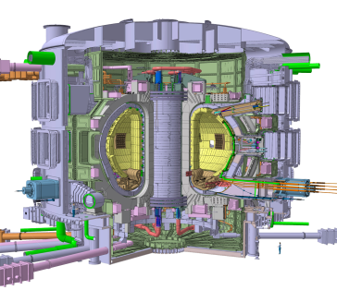
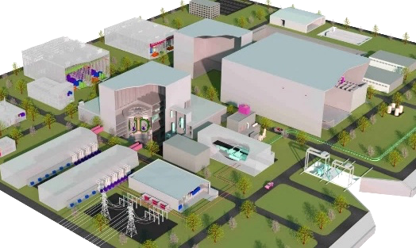







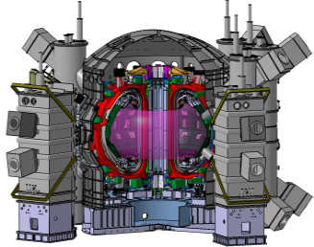
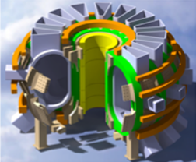

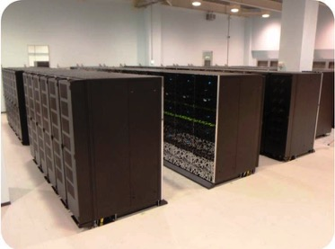
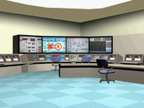

Broader Approach
Broader Approach
Experiment reactor
- Present -
DEMO
(Engineering demonstration and economical feasibility)
（Scientific and engineering feasibility）
After signature ITER
November 2006
BA Signed in February 2007
Entered into force on June 2007
ITER (International Thermonuclear Experimental Reactor
Fusion DEMO
Demonstrate sustainment of burning plasma 500MW
ITER Org.、
7 Parties
Site： France
Saint-Paul-lès-Durance
Fusion Power
of 0.5GW
Electricity generation
Economical prospects
Support ITER
Complement ITER
JA-EU Collaboration
Establish Engineering Basis for DEMO
JT-60SA project
IFERC project
IFMIF/EVEDA project
Accelerator type
Neutron source
（for Material R&D）
In Japan
【Rokkasho in Aomori】
【Naka in Ibaraki】
Broader Approach activities for Fusion Energy

Slide 5
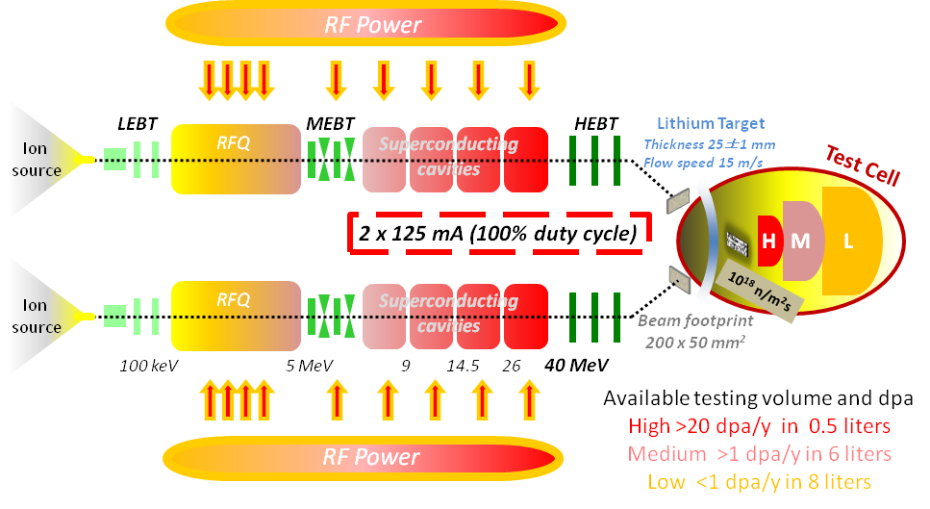
IFMIF Concept
Two concurrent deuterons beam of 125 mA CW at 40 MeV
Impact on a liquid Li screen
flowing at 15 m/s
Generating a footprint of 200 x 50 mm²
A flux of neutrons of ~10¹⁸ n/m²s is generated in the forward direction with a broad peak at 14 MeV and irradiate three regions:
>20 dpa/fpy in 0.5 liters (H)
>1 dpa/fpy in 6 liters (M)
<1 dpa/fpy in 8 liters (L)
→ Availability of facility >70%

Slide 6
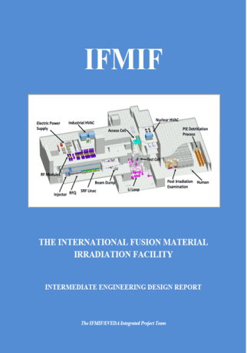
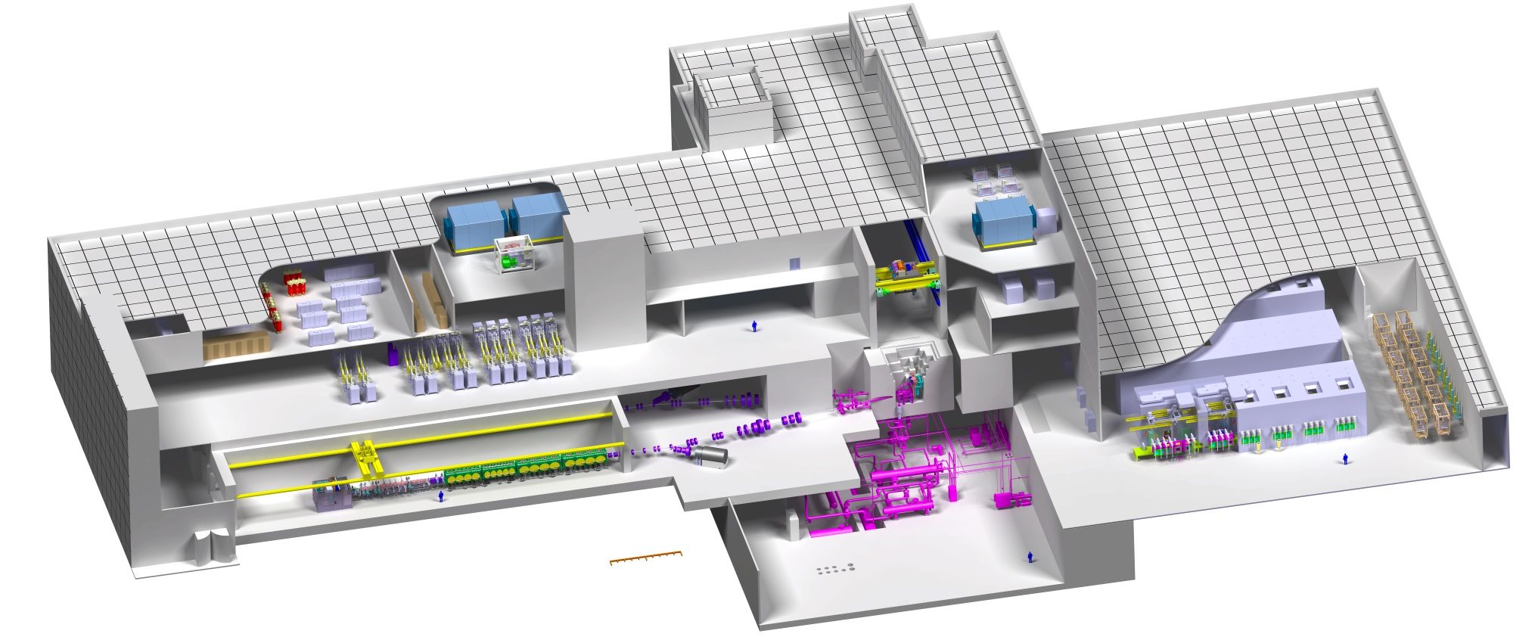
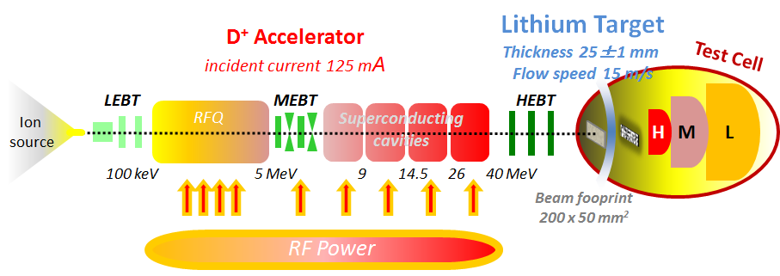
EVEDA = EDA +EVA Phases
Engineering Design Activities – EDA phase
Validation Activities – EVA phase
Successfully delivered on schedule
Electric Power Supply
Industrial HVAC
Nuclear HVAC
Access Cell
PIE Detritiation Process
Test Cell
RF Modules
Beam Dump
Post Irradiation Examination
Human
SRF Linac
Li Loop
Injector
RFQ
0
10m

Slide 7
Japan-Europe scientific collaboration
Equipment designed and constructed in Europe, Installed and commissioned in Rokkasho

Slide 8
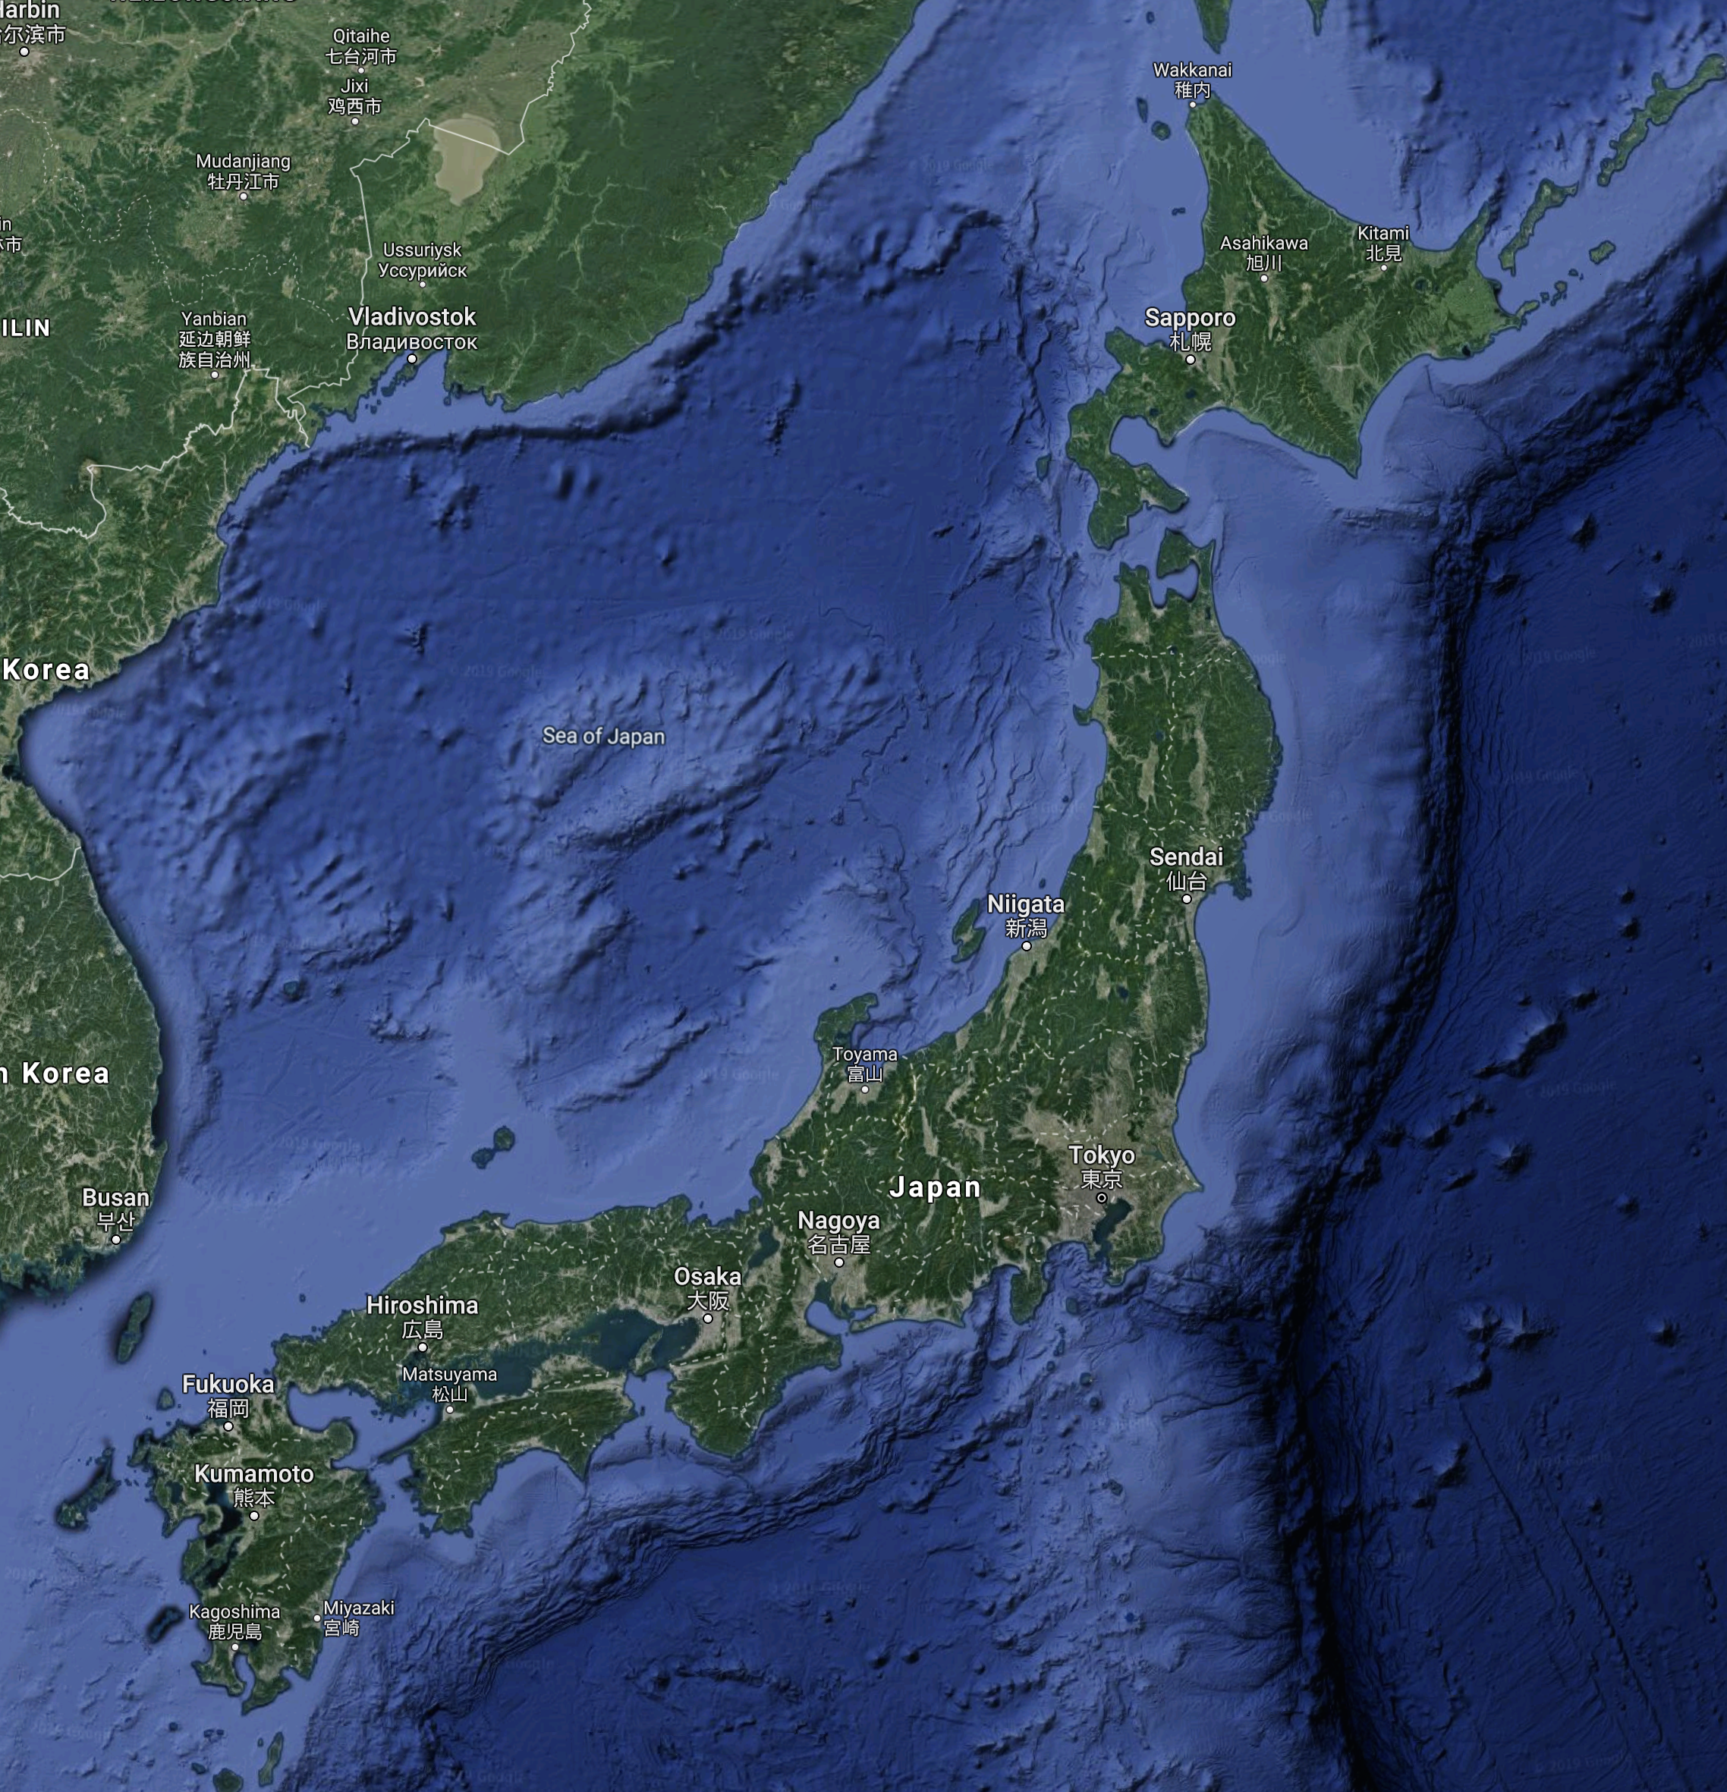
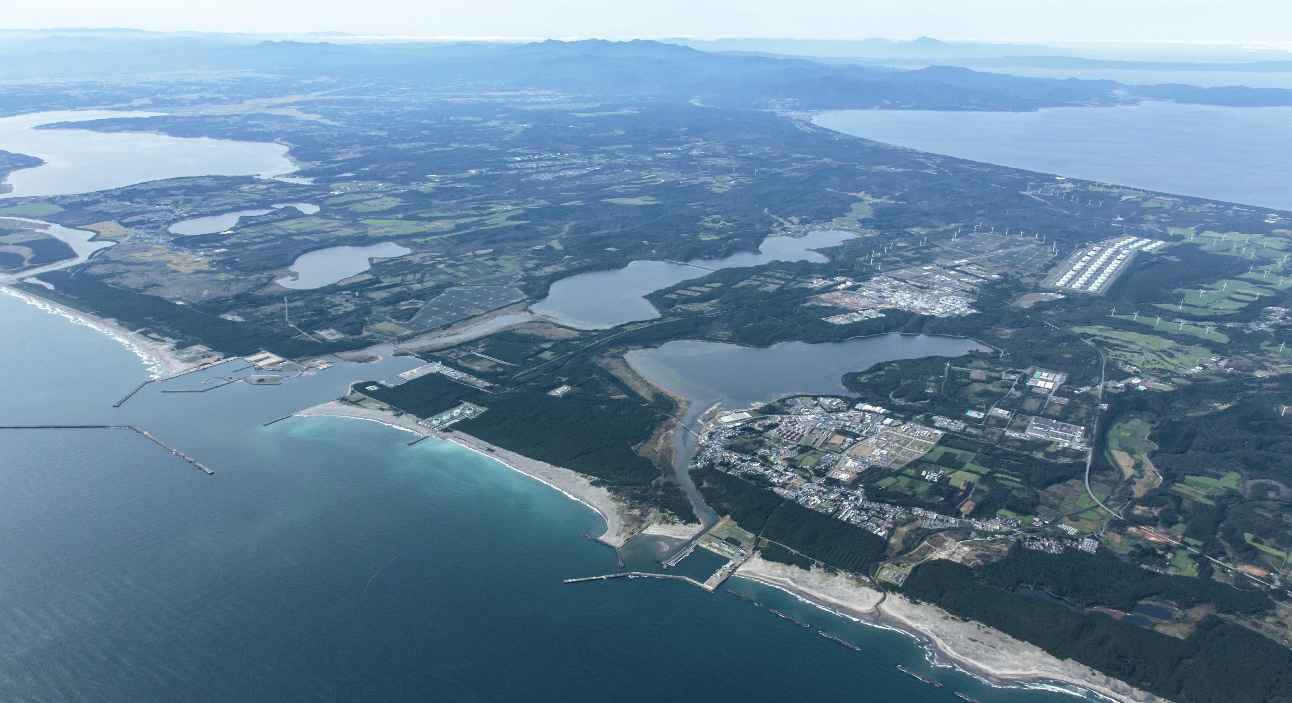

Rokkasho
Mutsu Bay
IFMIF/EVEDA
JNFL
Rokkasho
Pacific Ocean
to USA

Slide 9
Outline
Introduction
LIPAc Reliability & Maintenance
Conclusions
-
-
-
2

Slide 10
Reliability
From a Project Point of view the topic was not enough considered at the initial steps of the project mainly due to:
Project Organization,
Not assigned as main objective,
No definition of the requirement,
Cost effect with respect to the in kind procurement scheme.
  → How the sharing and the field of expertise was considered between the stakeholders

Slide 11
LIPAc Maintenance Plan Management
No clear maintenance strategy define at the early stage of the project:
No full maintenance plan for the different systems provided by Europe…especially the accelerator components (i.e. Injector, Diagnostics, …),
Availability of individual maintenance plan for some conventional components,
→ But was not enough considered the final place of installation (i.e. MV Breakers, Pumping system, …) to ensure the maintenance can be carried out properly.
Maintenance plan available on the conventional systems,
  → Relevance of the maintenance was disregarded

Slide 12
Outline
Introduction
IFMIF/EVEDA Status
Impact on LIPAc Operation
Outlook
Conclusions
-
3

Slide 13
Commissioning with staged approach
4 configurations tested in 5 main phases to validate the LIPAc performances

Slide 14

Commissioning with staged approach
4 configurations tested in 5 main phases to validate the LIPAc performances
Phase A
100 keV - 125 mA
12.5 kW
COMPLETED
Injector
CW
Diagnostic Box + Beamstop
(Apr.2015 - Aug.2017)

Slide 15
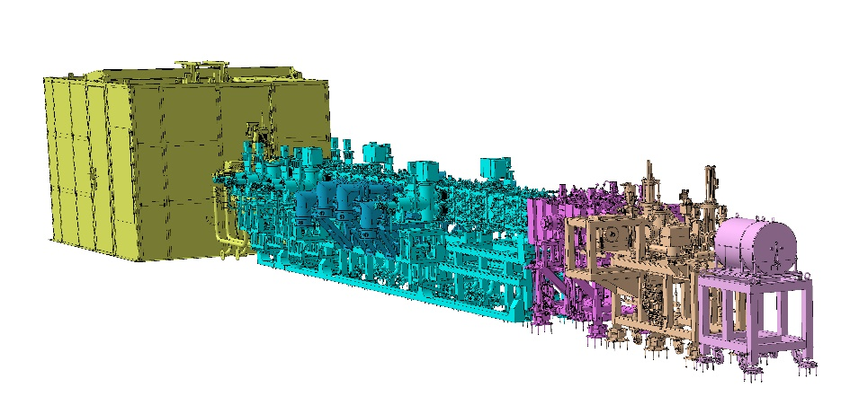
Commissioning with staged approach
4 configurations tested in 5 main phases to validate the LIPAc performances
Phase A
Phase B
5 MeV - 125 mA
625 kW – low DC
COMPLETED
Injector
CW
Diagnostic Box + Beamstop
(Apr.2015 - Aug.2017)
Injector
RFQ + MEBT
D-Plate+BD
0.1-1ms
(June 2018 – August 2019)
Diag.-Plate + Low Power Beam Dump

Slide 16
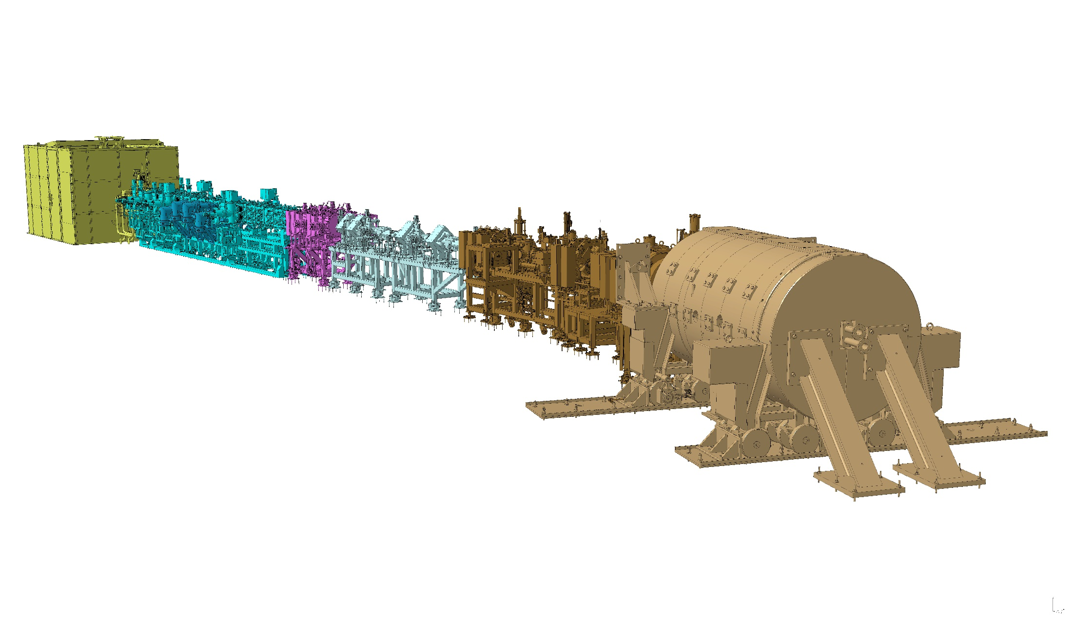
Commissioning with staged approach
4 configurations tested in 5 main phases to validate the LIPAc performances
Phase A
Phase B
Phase B+
STARTED
5 MeV - 125 mA
625 kW – high DC
Injector
CW
Diagnostic Box + Beamstop
(Apr.2015 - Aug.2017)
Injector
RFQ + MEBT
D-Plate+BD
0.1-1ms
(June 2018 – August 2019)
Diag.-Plate + Low Power Beam Dump
Injector
RFQ + MEBT
Drift line + HEBT/D-Plate
1ms-CW
Final Beam Dump

Slide 17
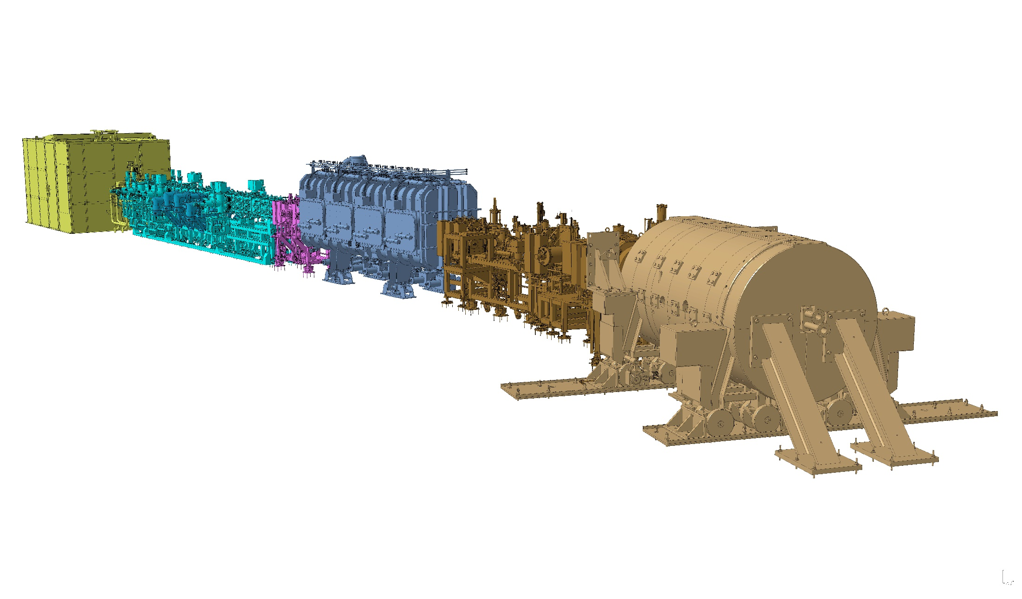
Commissioning with staged approach
4 configurations tested in 5 main phases to validate the LIPAc performances
Phase A
Phase B
Phase B+
Phase C/D
9 MeV - 125 mA
1.125 MW – low and high DC
FINALE STAGE
Injector
CW
Diagnostic Box + Beamstop
(Apr.2015 - Aug.2017)
Injector
RFQ + MEBT
D-Plate+BD
0.1-1ms
(June 2018 – August 2019)
Diag.-Plate + Low Power Beam Dump
Injector
RFQ + MEBT
Drift line + HEBT/D-Plate
1ms-CW
Final Beam Dump
Injector
RFQ + MEBT
SRFL + HEBT/D-Plate
1 ms/CW
Final Beam Dump

Slide 18
Impact on LIPAc Operation
The lack of maintenance has a serious impact on the reliability of the LIPAc and the schedule:
Injector commissioning: Started in Nov. 2014 and completed Aug. 2017 thanks to deep maintenance and design change performed in Sept. 2016 (i.e. First maintenance plan issued, Realignment of the accelerator column, Design check of the electrode),
→ Emergency, corrective & regulatory maintenance
First beam commissioning campaign in 2018 (H+) impacted by the availability of the RF system,
→ Emergency & regulatory maintenance
Second beam commissioning campaign in 2019 (H+ & D+) was more effective thanks to the maintenance activities of some key equipment but not yet satisfactory,
→ Emergency, predictive, corrective, conditioned based, regulatory maintenance
Importance of having a full and detailed maintenance plan!

Slide 19
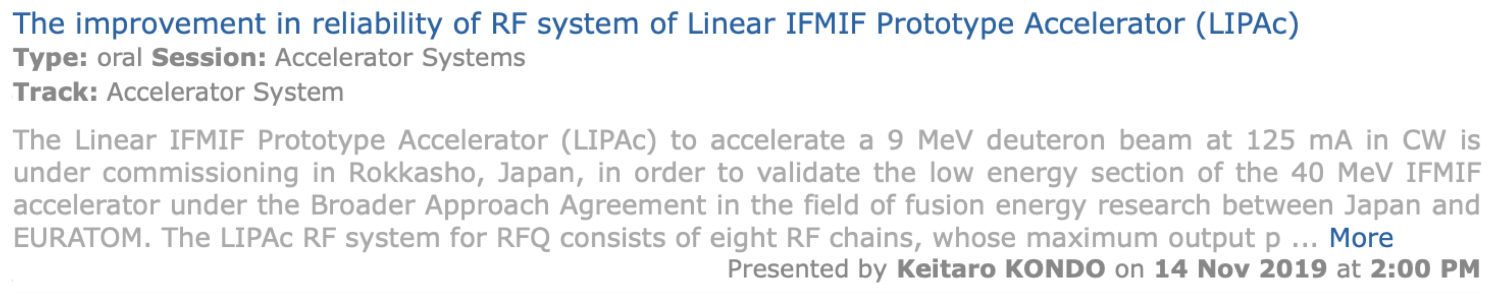
Impact on LIPAc Operation
Highlight on the Phase B Operation
H⁺ Beam:
From 13/06/2018 to 08/08/2018: 14 days of operation over 42 days planned (33% Availability)
From 20/02/2019 to 26/04/2019: 37.5 days of operation over 47 days planned (80% availability)
D⁺ Beam:
From 24/06/2019 to 09/08/2019: 17.5 days of operation over 34 days planned (51% availability)
Which conclusion ?
High availability of the injector (Design robust and mature maintenance plan)
Maintenance performed between the 2 H⁺ phases has an important impact(corrective)
Still some emergency maintenance carried out…

Slide 20
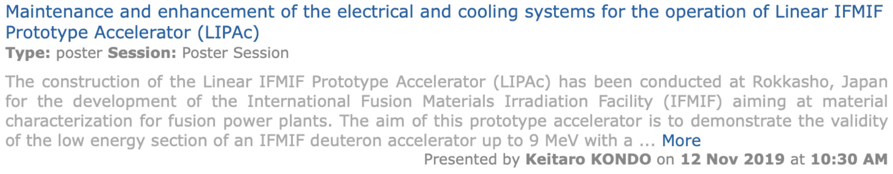
Event Report Trendline
Injector & RFQ: effect of the maintenance on the reliability
Auxiliaries: Conventional system regularly maintained
RF Power System:
System complex,
No real maintenance plan,
Increase of the event related also to the operational time
  Necessity to define a proper strategy for the maintenance
  &
  to improve some management processes and organization

Slide 21
Outline
Introduction
IFMIF/EVEDA Status
LIPAc: Accelerator Facility
How to improve our Reliability
Outlook
Conclusions
4

Slide 22
LIPAc Maintenance Plan
Development of a maintenance plan
Management of Maintenance and Maintenance plans:
Regular meetings are carried out by the Maintenance Group leader with the individual system group leaders,
Development of the maintenance plan (using a Common Template) for each system and integrated in the Master Schedule. All record of meeting uploaded in our Data Management System,
The priority is to carry out a curative maintenance along with a detailed preventive maintenance to ensure reliable operation of all subsystems in the next Phase,
High Priority is given to the RF/RFQ maintenance.

Slide 23
LIPAc Documents Management
Availability of documentations by system
scope
usage
PBS (system, subsystem…) what and where?
phase (design, manufacturing, B+, C…) when?
purpose (definition, operation…) why, how?
Clarify Applicability
Objective:
Gain in efficiency

Slide 24
LIPAc Documents Management
Quality Assurance: Data Management System
Harmonization: unique naming, location and review procedure (BA_D_23H5VT)
Document
Ancillaries / Utilities Requirements
(System) Action List / Workplan
Design change proposal
System document
Project document
How the documentation is structured is essential when looking for an information/data and to ensure that it will be used
Engineering Dossier
Manufacturing
(system) Assembly and Installation
LIPAc Preparation for Operation
System engineering dossier
Project engineering dossier
Example of document types
Objectives:
Create Document Production Plans and identify missing documents
Baseline the lifecycle of LIPAc systems and allow configuration management

Slide 25


Quality Assurance Plan
The Quality Assurance management is crucial but:
Shall be simple and practical,
Documents readable,
Review Process to be optimized.
Risk Cost
Quality Cost
Should be adapted to the project scale/scope & needs
→ Tailoring is important

Slide 26
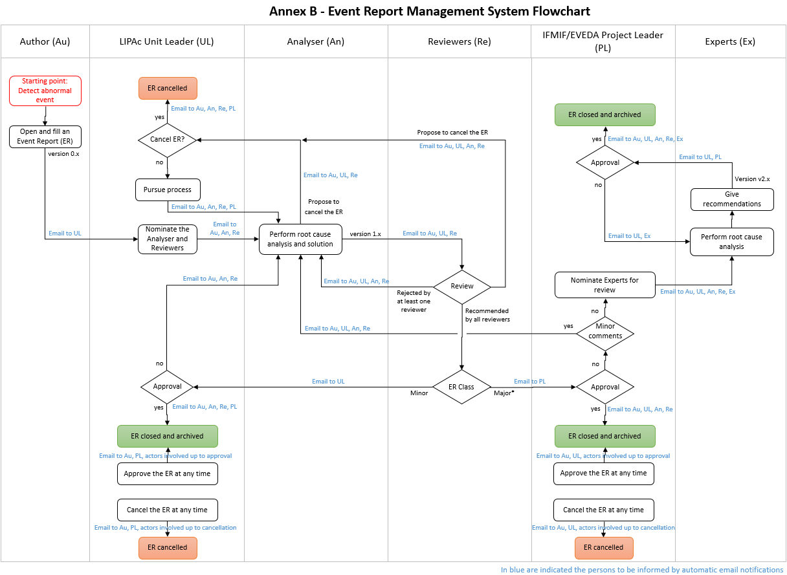
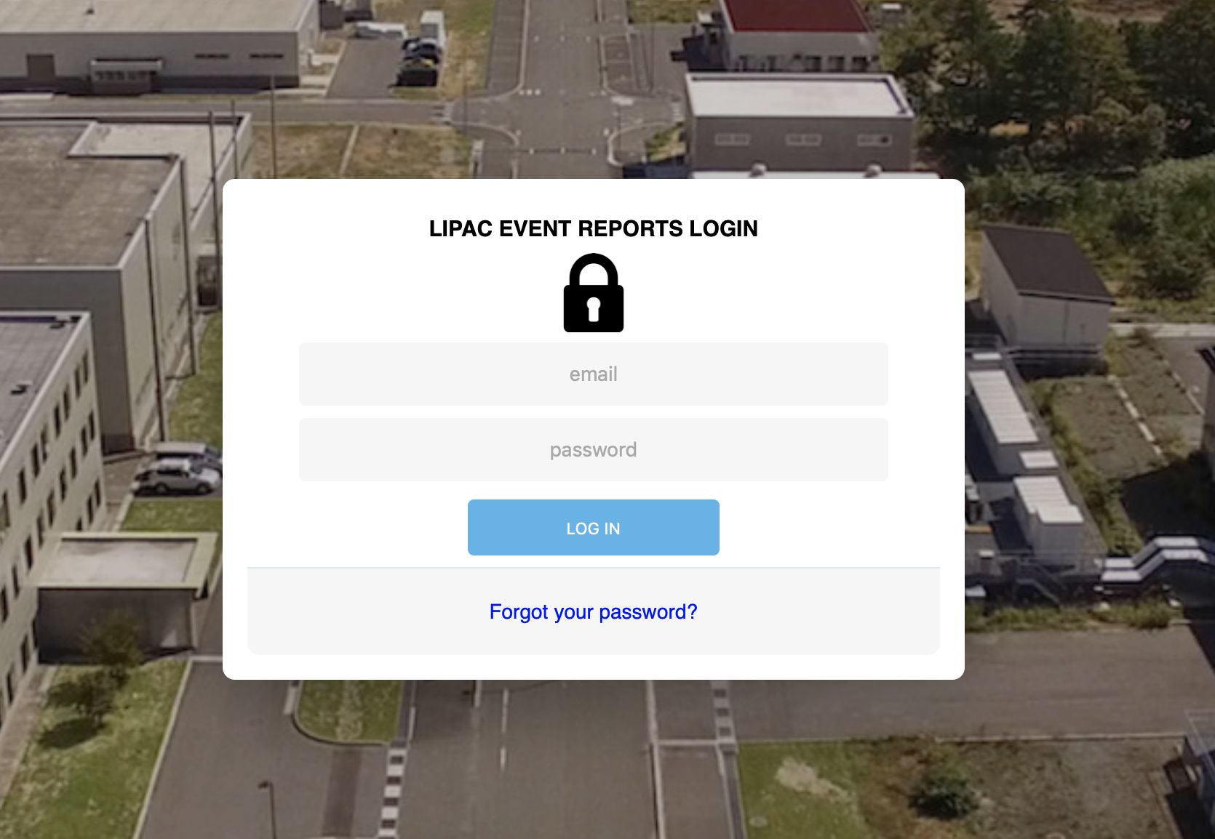
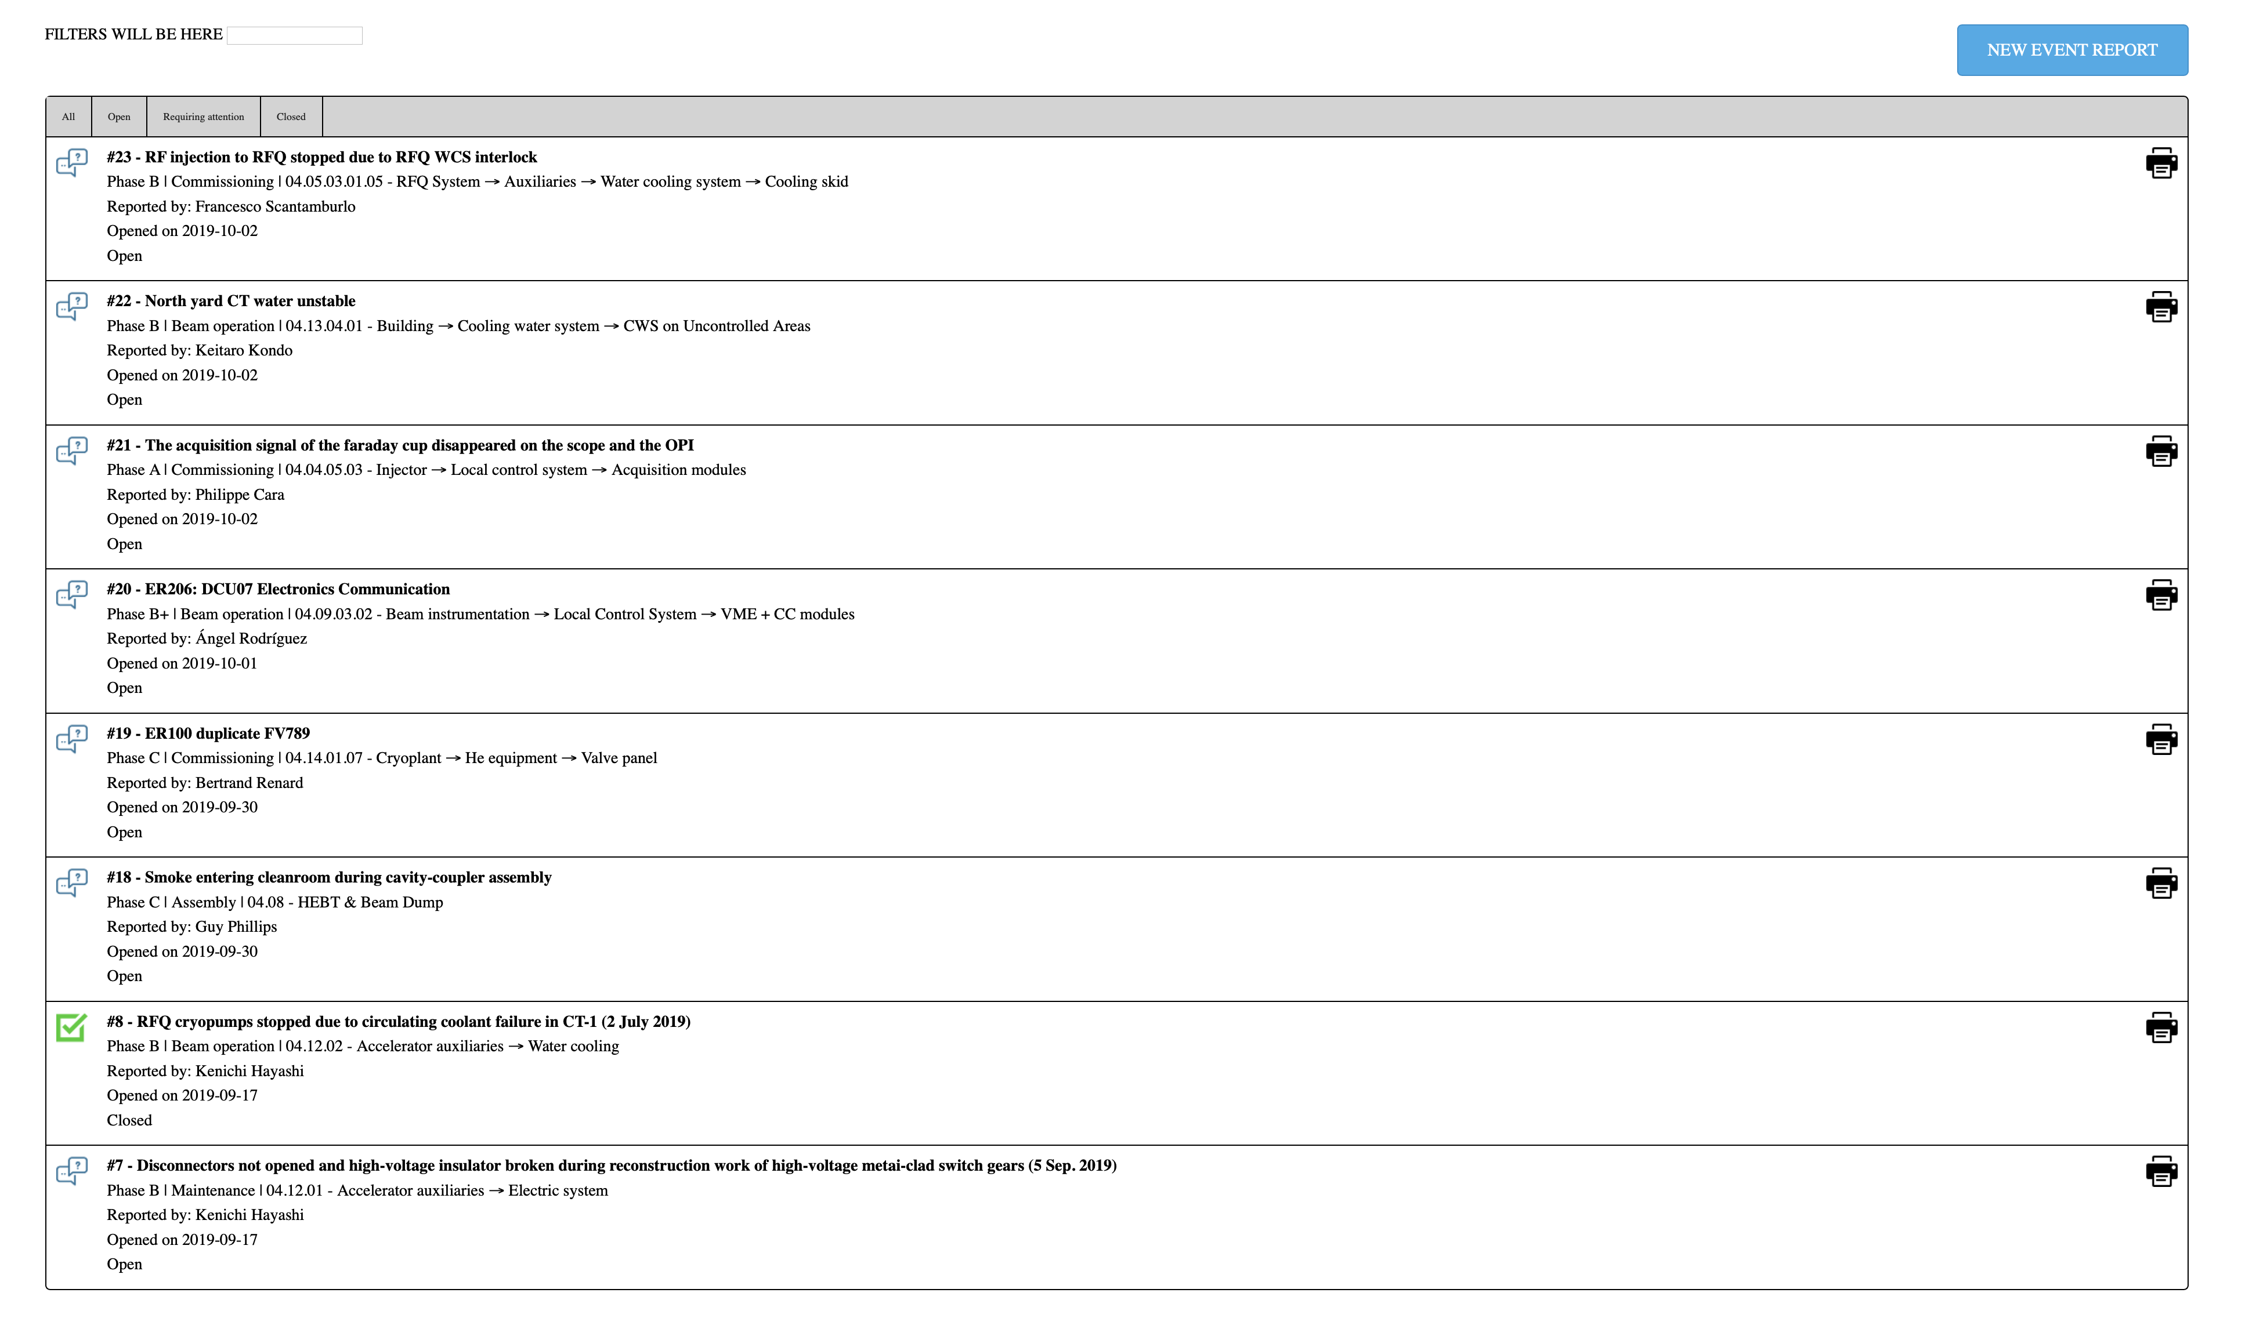
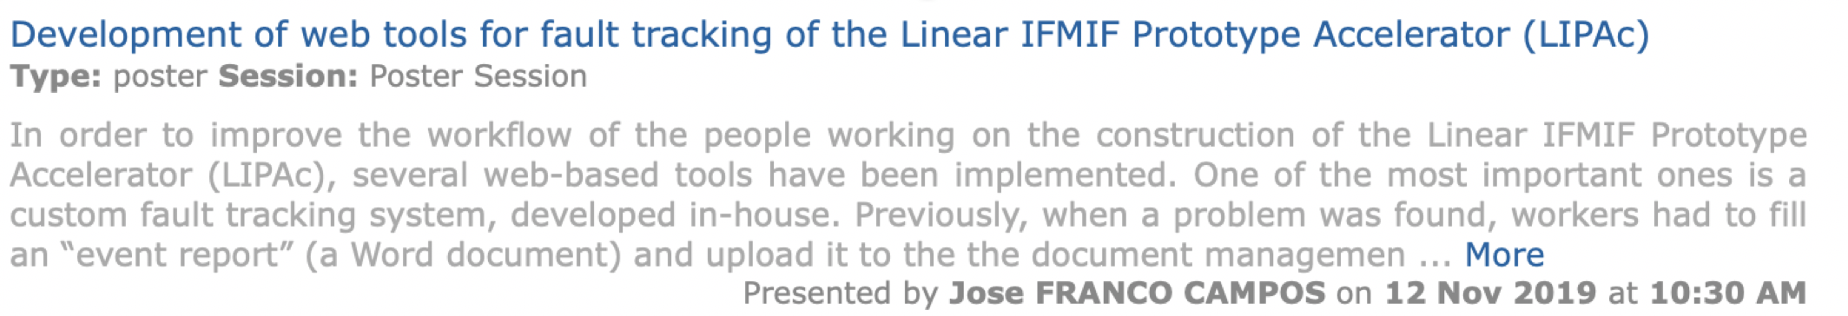
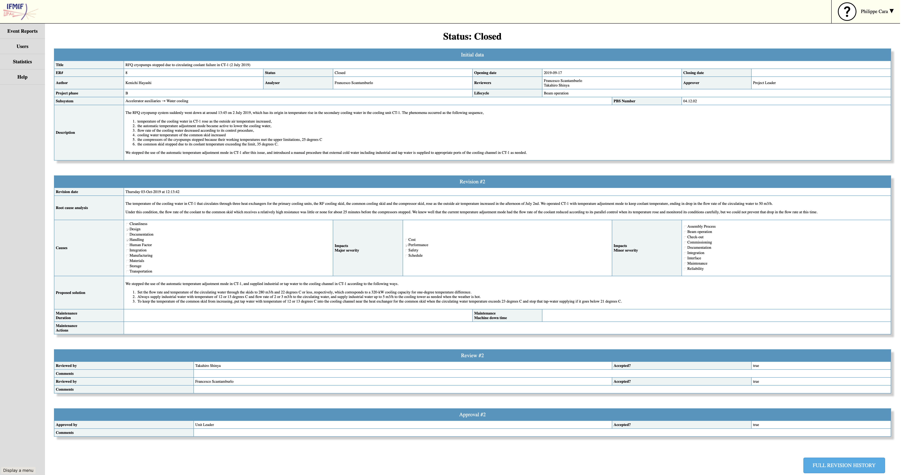
LIPAc Organisational Improvements
New Even Report Tools
Started on 13/09/2016…
More than 200 ER Opened….. But not really practical and efficient from a management point of view!!
Web Interface developed in House to ease:
The incident report,
The follow-up,
The mitigation actions.

Slide 27
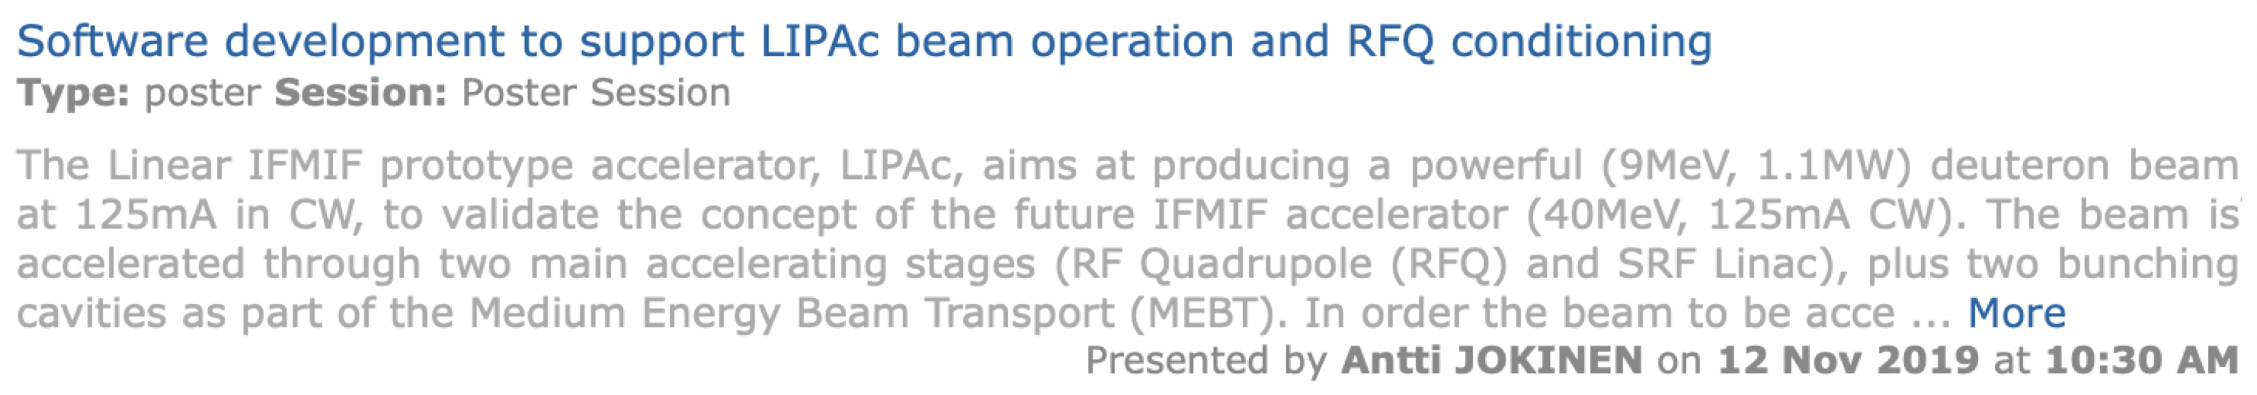
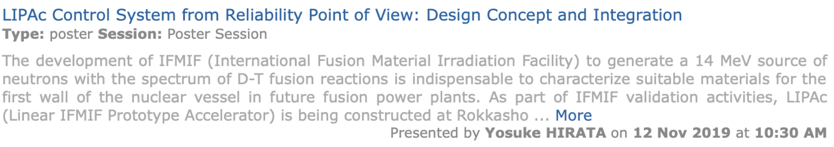
LIPAc Control System

Slide 28
Outline
Introduction
IFMIF/EVEDA Status
LIPAc: Accelerator Facility
LIPAc: Commissioning Status
Personnel and Organisation Improvement
Conclusions
5

Slide 29
LIPAc Organisational Improvements
Assessment of the personnel available considering:
Skill available,
Skilled needed,
Ensure a proper redundancy.
Ongoing activities for a better management of the HR available
Seeking for essential skill
Trainings

Slide 30
Project Organization
It is normal, it should and …
it will continue to evolve over the project lifecycle to adapt to needs and objectives of the project
LIPAc Organization evolved since 2007….

Slide 31
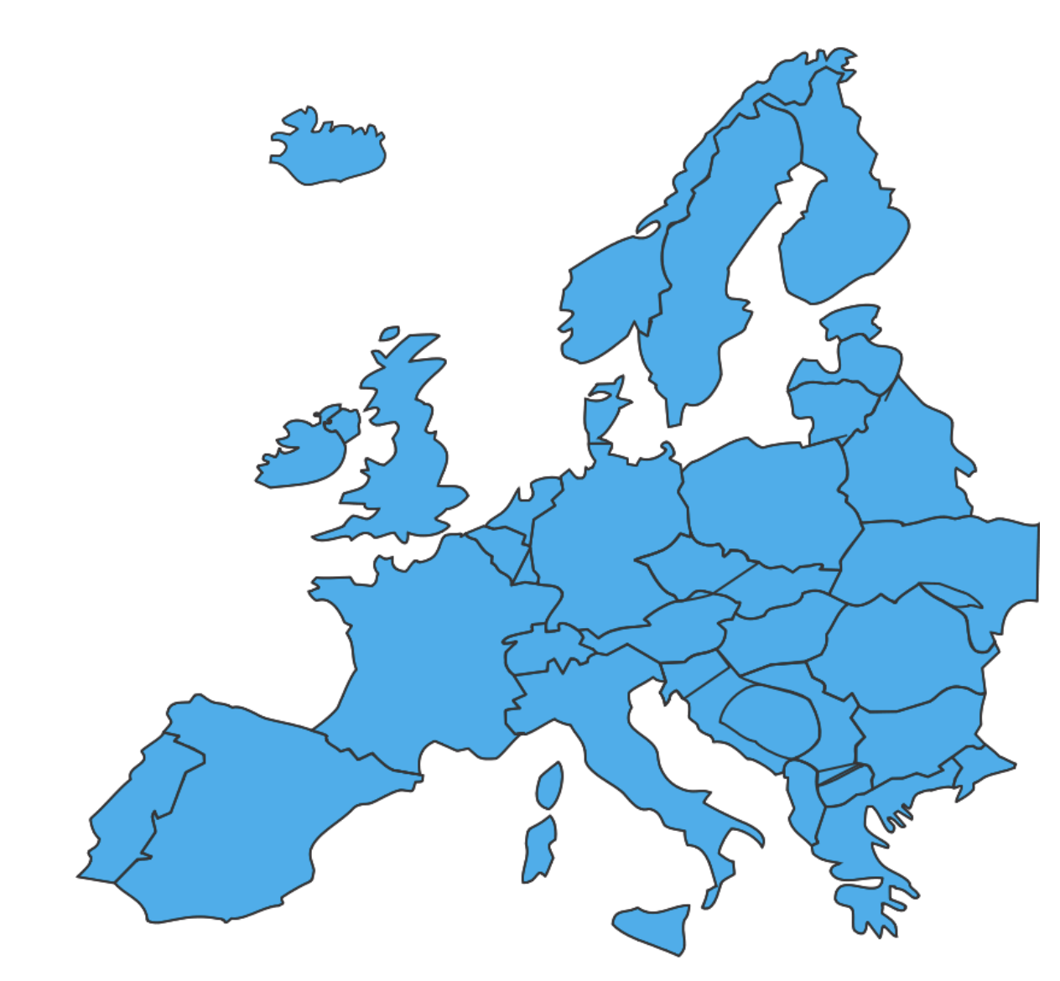




Project Organization
Project Coordinated by IFMIF/EVEDA Project Leader
In liaise with 2 Home Teams
LIPAc Organization Since 2018:
Beam Operation,
Maintenance,
Installation & Commissioning...
System Installation, Checkout, Start-up, Commissioning
LIPAc Unit in Rokkasho
~50 people

Slide 32
Knowledge Management
Essential to develop and maintain skills and competences of the staff over the whole project lifecycle (concurrent engineering)
Some key skills and competences have to be developed and maintained for a long term in collaboration with partners (institutes, industries, other projects)
Database should be maintained and shared
Organizational know-how is as important as technical know-how (OBS, WBS, PBS, QA System, etc.)

Slide 33
Outline
Introduction
IFMIF/EVEDA Status
LIPAc: Accelerator Facility
LIPAc: Commissioning Status
Outlook
Conclusions
6

Slide 34
Conclusions
From LIPAc operation we are learning a lot ….. Main objective of the IFMIF/EVEDA Project,
Already significant scientific breakthrough but …..still a lot to be achieved which is only possible with high reliability and availability of the LIPAc systems
Importance of the design, the manufacturing and the maintenance for the reliability of a machine,
The reliability of a machine is to be considered at earlier stage of a project within the design and the maintainability (i.e. redundancy of components, spare parts management, …)
Reliability and Maintenance is a philosophy/concept to be adopted by all versus the cost and operation time required!!

Slide 35

Thanks for your attention
ご清聴ありがとうございます！
http://www.ifmif.org/

Slide 36
LIPAc Maintenance Plan

Slide 37
LIPAc Maintenance Plan

