Slide 1
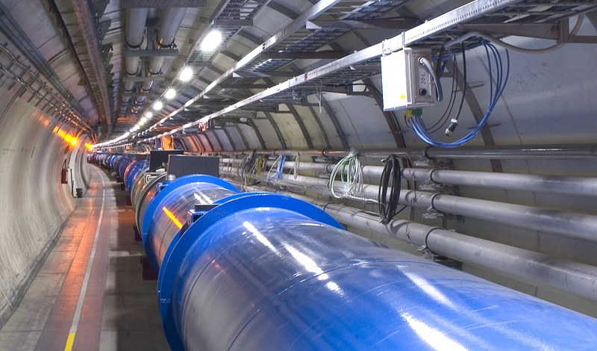

The LHC Long Shutdowns
impact on availability, reliability and routine operation
M. Solfaroli
CERN
Beams department
Operation group

Slide 2

outline
The LHC & its superconducting circuits
The Long Shutdown 2 (LS2)
LHC maintenance and upgrade
Conclusions

Slide 3
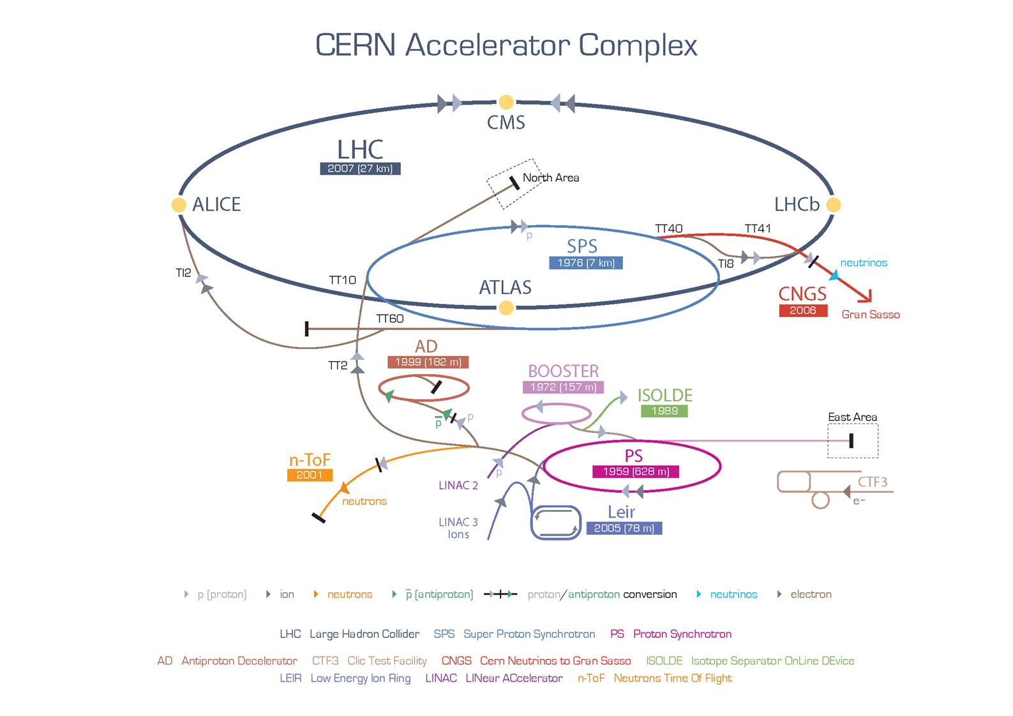
The CERN accelerator complex
LINAC4 will replace LINAC2

Slide 4

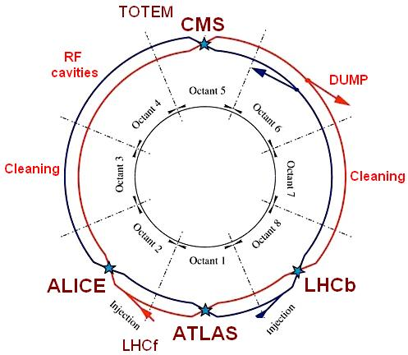
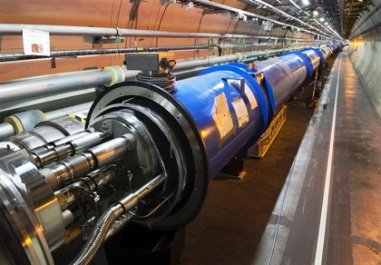
The LHC layout
27 km circumference
~100 m underground
4 interaction points
6 experiments
2 counter-rotating beams
14 TeV design collision energy

Slide 5
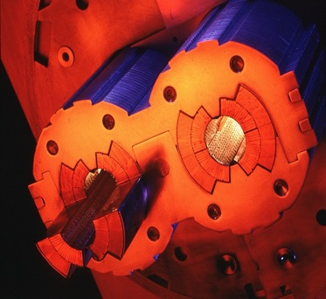
The superconducting circuits
Almost 1600 superconducting circuits operating at 1.9 K
8 sectors cryogenically and electrically separated
Per sector a unique cryostat containing:
One 13 kA dipole circuit (154 magnets)
Two 13 kA quadrupole circuits (49 magnets)
Large variety of corrector magnets
LHC FODO cell

Slide 6
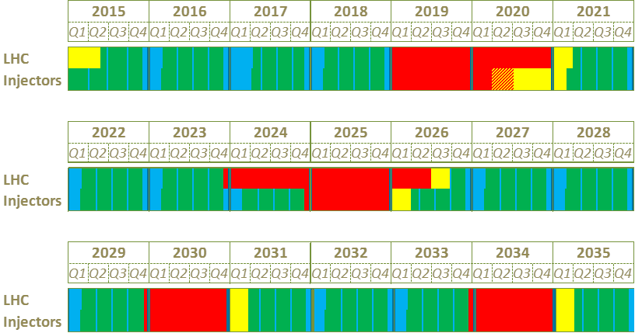
CERN accelerators roadmap
Physics
Shutdown
Beam commissioning
Technical stop
Run 2
LS 2
LS 3
LS 4
Run 5
LS 5
6

Slide 7
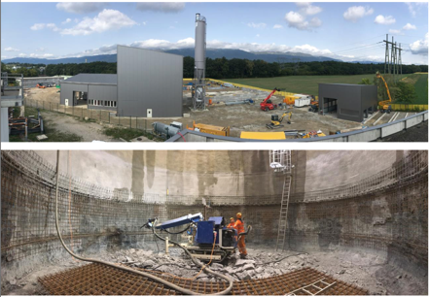
LS2 main tasks
IN ADDITION:
Large upgrade of the experiments
1200 new HW installations for computer system
Major release of software infrastructure
  LHC Injector Upgrade (LIU)
Major maintenance & consolidation:
  Diode Insulation and Superconducting MAgnet Consolidation (DISMAC)
  Maintenance of technical systems (cryogenics, electricity, cooling,…)
Accelerators upgrade:
  a major upgrade of LHC (HL-LHC) will take place in LS3, but anticipation of some works is mandatory:
    Devices installation (collimators, absorbers, shielding, …)
    Civil Engineering
    Cryogenics upgrade

Slide 8
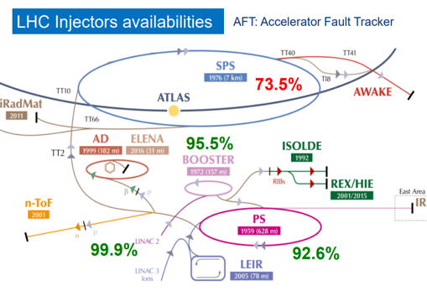
LIU (for HL-LHC)
Performance: aims at matching the beam parameters at LHC injection with HL-LHC target => need to overcome performance limitations in all injectors!
Sustainability/availability: ensure and improve injectors’ availability/reliability well into the HL-LHC era by upgrading and improving sensitive/ageing equipment
LHC time loss for injectors’ fault is ~5% of operation time
Beam properties @LHC injection
 | Intensity | emittance
Present | 1.3 x 10¹¹ p/b | 2.7 mm
HL-LHC target | 2.3 x 10¹¹ p/b | 2.1 mm

Slide 9
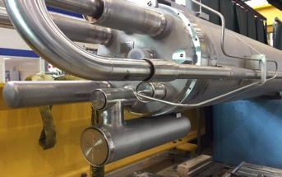
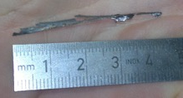
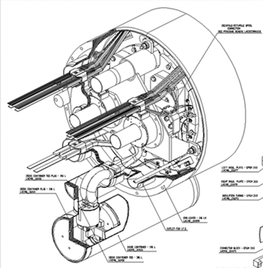
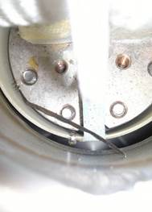
Short – the problem
Metal debris, present in the dipole cold mass, transported by helium flow (cooldown, warm-up, quenches), can create a short to ground between the diode tube and the half-moon connection:
7 times during cool-down/flushing
2 times at cold during training quench campaign

Slide 10
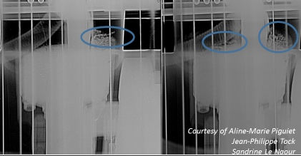
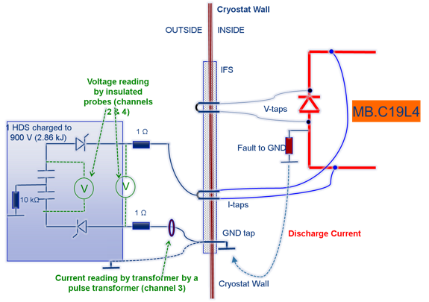
Short – the (partial) solution
Dissipated energy ~1.5 kJ
Discharge voltage 906-578 V
Short resistance ~1 Ω
Energy dissipated in short ~500 J
Discharge time ~11.5 ms
The 2 shorts to ground that appeared at cold were removed by the means of an Earth Fault Burner (EFB), avoiding to warm-up the circuit.
LHC experienced so far slightly more than 200 quenches ➔ probability 1%
About 600 quenches are estimated to train the machine to 7 TeV
Probability of 10⁻⁴ to have a double short, which would have catastrophic consequences

Slide 11
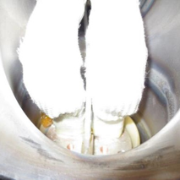
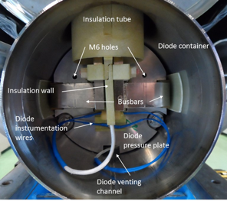
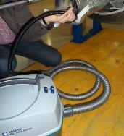
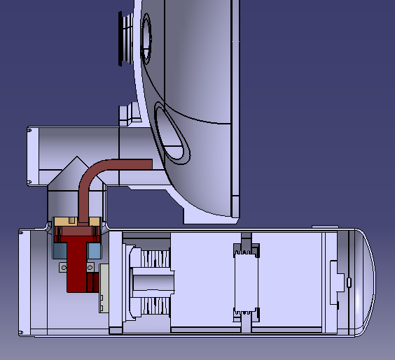

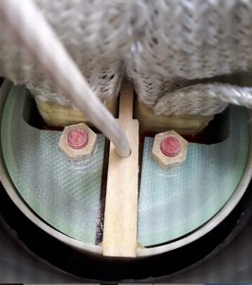
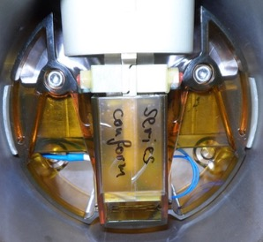
Consolidation
Half-moon connection consolidation
Diode box consolidation
Cleaning

Slide 12
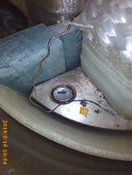
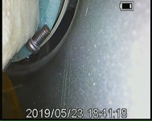
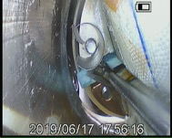
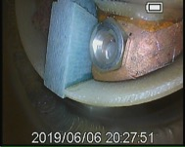
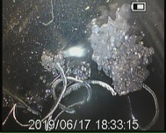
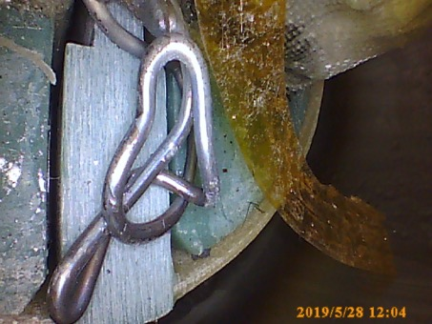
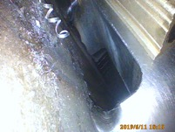
Is it worth it?

Slide 13
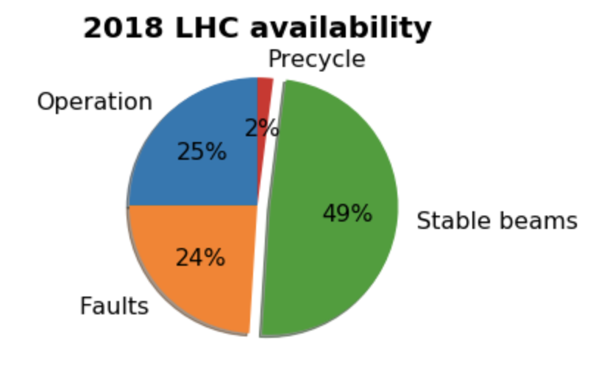
A powerful machine
Remarkable performance thanks to continuous effort and gained experience:
Since 2016 the LHC is running well beyond its design luminosity
Every year we manage:
  Higher peak luminosity
  Shorter time to reach it
After LS2, we estimate about 6 months recovery time and many things will have to be “learned” again, so…
WHY DO WE STOP?!?!?!

Slide 14
CERN accelerators roadmap
Physics
Shutdown
Beam commissioning
Technical stop
Run 2
LS 2
LS 3
LS 4
Run 5
LS 5

Slide 15
The Long Shutdowns
The Long Shutdowns are mainly defined by regular maintenance of technical systems (cryogenic, electrical infrastructure, cooling, ect)
However, they are not planned to maximize performance
  They are generally defined by collaboration agreements
  They are used for upgrade:
    LS1 was fundamental to allow full exploitation of LHC
    LS2 for LIU project & superconducting diode consolidation
They are very important to maintain technical knowledge

Slide 16
The Year End Technical Stops
A “long” yearly stop is needed to comply with regulatory obligation (preventive maintenance of safety systems, cooling towers, etc)
The critical path of the Year End Technical Stop (YETS) is defined by the regular maintenance of the cooling towers required by law ➔ 9 weeks (+4 weeks to stabilize cryo system and re-cooldown)
Whenever needed, (i.e. 2016/2017) the length is extended to solve non-conformities

Slide 17
The Technical Stops
Large effort was spent in the last years to critically review duration and number of Technical Stops (performed during the runs)
A study performed in 2011 indicates no clear correlation between the length of a TS and its recovery time
Very difficult analysis:
  Subjective recovery time definition
  Complexity makes it difficult to correlate faults with activities performed
We profit of the recovery time to perform regular critical checks of machine protection to ensure high quality standard of LHC operation

Slide 18
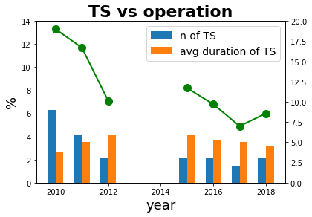
The Technical Stops
Visible improvement:
  Experience gained
  Increased flexibility allows to perform intervention when punctual faults occur
  Critical review of maintenance needs
  Increased “risk” in proximity to LS2
Present (optimized?) situation:
First Technical Stop: mainly fixing YETS related problems
Second Technical Stop: mainly to cope with summer/heat-related issues
Third Technical Stop: prepare for the Ions run (not always present)

Slide 19
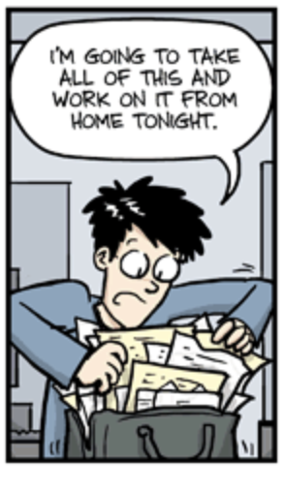
There is time, let’s do something more!
The Technical Stop effects
I’m going to do this, it’s transparent!
How shall we cope with them to avoid/limit their consequences?
Screen all interventions
Improved tracking of SW maintenance
Follow-up and testing asap
Building culture about consequences (there is no such a thing as a transparent intervention!!)
…

Slide 20
The Technical Stops
i.e. Can we perform a TS when a fault occurs or when beam is not available??
Can we operate the machine in a yet more flexible way??
😱

Slide 21
The Technical Stops
i.e. Can we perform a TS when a fault occurs or when beam is not available??
Can we operate the machine in a yet more flexible way??
Running in such a flexible way would require a sort of window to ensure the TS happens. Main constraints for TSs are:
Resources organization: many activities are performed by contractors ➔ need to define the schedule
Resources limitation: loss of efficiency if last minute schedule
Week-end effect
Running in degraded situation entails risk of fault cascade

Slide 22
Conclusions/questions
The way to operate such a large complex is NOT trivial…we are still learning
Long stops are painful and require long recovery time, but are mandatory to maintain availability/reliability standards. They are also fundamental to maintain technical knowledge
Obviously the longer they are the higher the risk for the operational knowledge to “fade out”
What is the ideal length of TSs/YETSs/LSs?
Given the length of intervention, what is the correct balance between them?
Thank you for the attention!

Slide 24
DISMAC in a nutshell
Diode investigation and consolidation
Maintenance of all current leads and superconducting chimneys
Exchange of 22 magnets:
  Non-conformities fix (weak magnet, damaged correctors, degraded instrumentation,…)
  HL-LHC upgrade
  Installation of additional beam induced heat load instrumentation

Slide 25
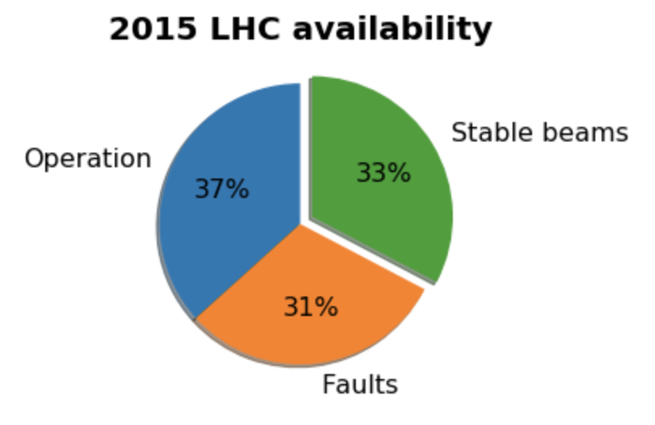
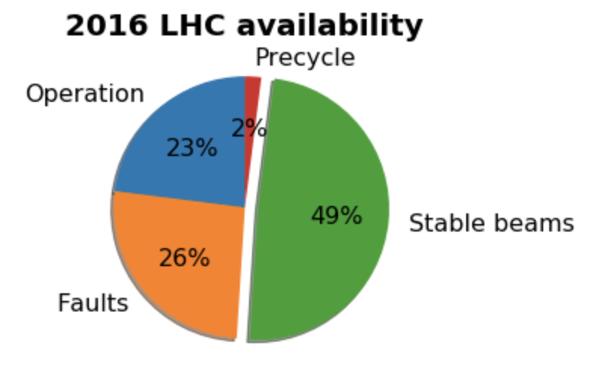
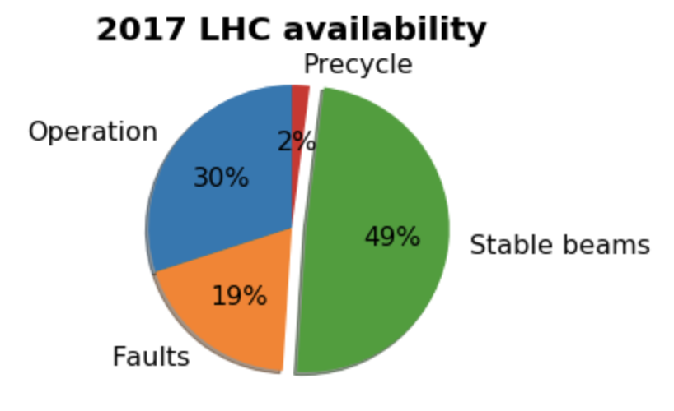
LHC availability in Run2

Slide 26
LS2 in the LHC experiments
Besides maintenance plan (significant impact on system resources), the LHC experiments will undertake major upgrades
LHCb experiment major upgrade:
  Replacement of almost all front-end electronics and several detector parts
  New Hardware Trigger
  Electronic readout almost completely exchanged
ALICE experiment major upgrade:
  New Inner Tracking System
  New Muon Forward Tracker
  electronic readout almost completely exchanged
ATLAS and CMS pursue the upgrade in two phases, spread over 2 shutdowns with the most intense detector activities during LS3, but vital preparations during LS2

Slide 27
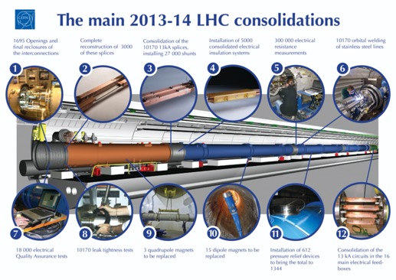
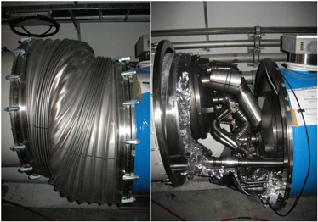
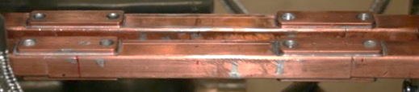
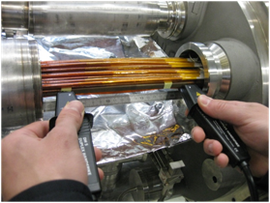
The LS1 consolidation
The 2008 incident:
600 MJ energy released
6 tons of He released
Consolidation of 10170 superconducting splices by installation of a bypass shunt
6 consolidation steps
5 Quality Assurance steps
> 2700 shunts installed
> 400.000 electrical measurements

Slide 28
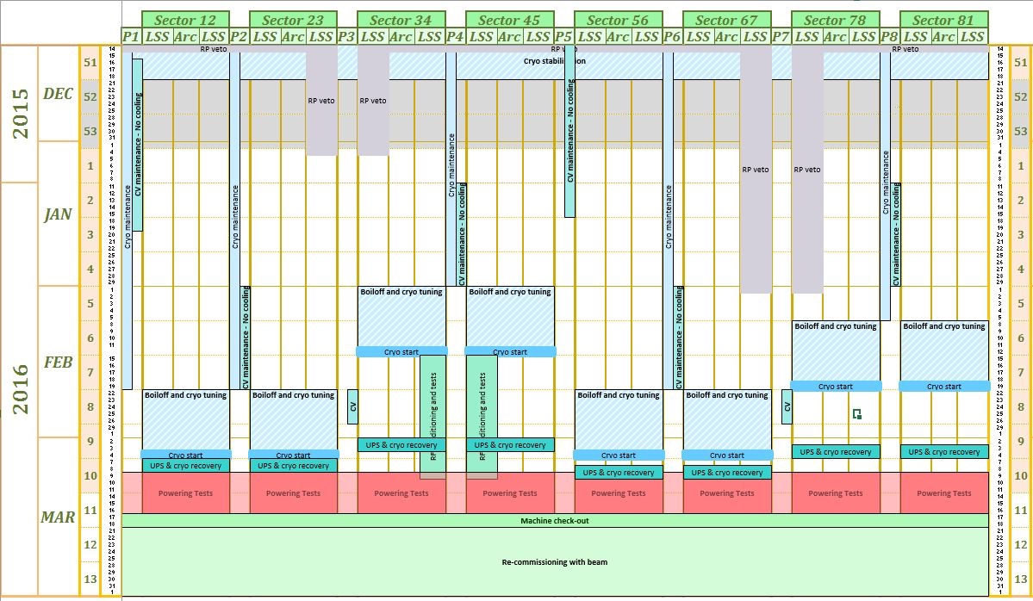
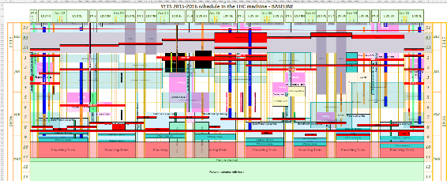
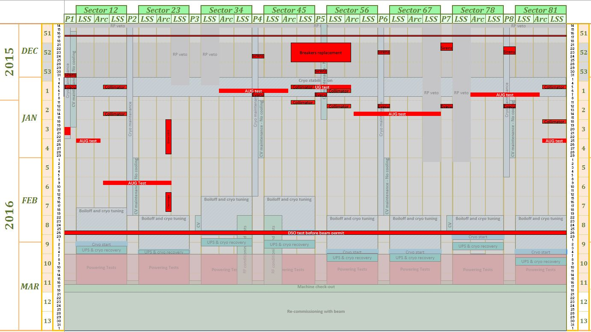
Planning definition
Sequence to define the planning
Priority definition
Baseline definition
Global view
Validation

