Slide 1
MDI assembly
Haijing Wang
March 11, 2019, IHEP

Slide 2
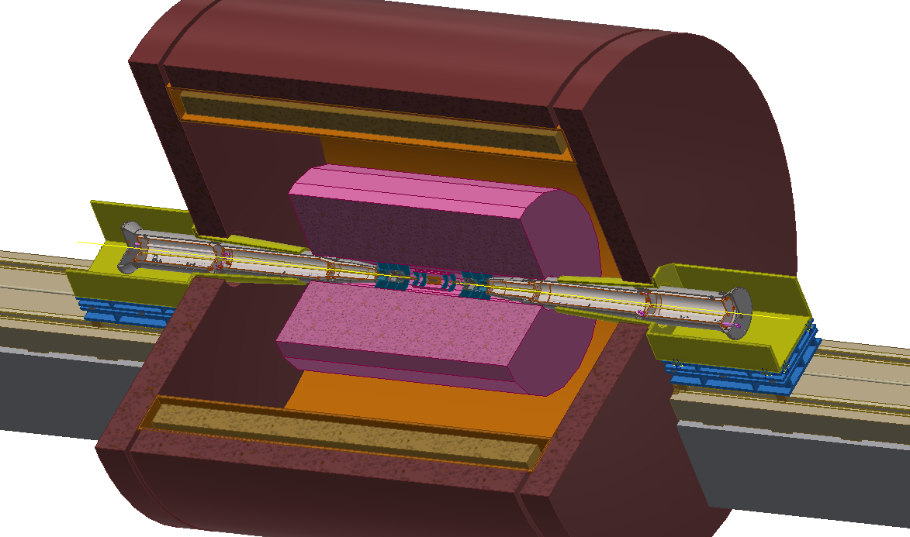
Layout of MDI
Yoke
Solenoid
Detector
IP
SC magnets
Support system

Slide 3
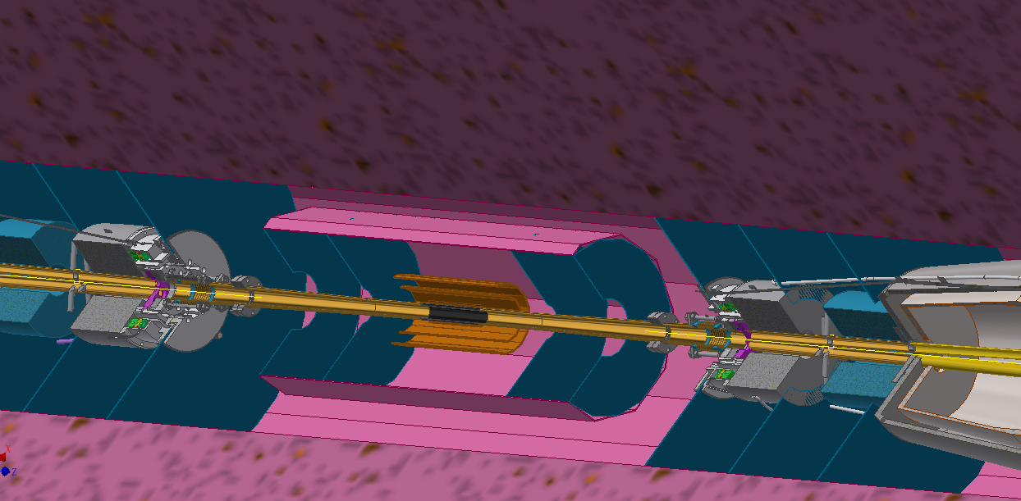
Layout of MDI
Silicon inner tracker
Forward tracking detector
Time projection chamber
Vertex detector
IP
Be-Cu IP chamber
Remote vacuum connector
HOM absorber
Lumical

Slide 4
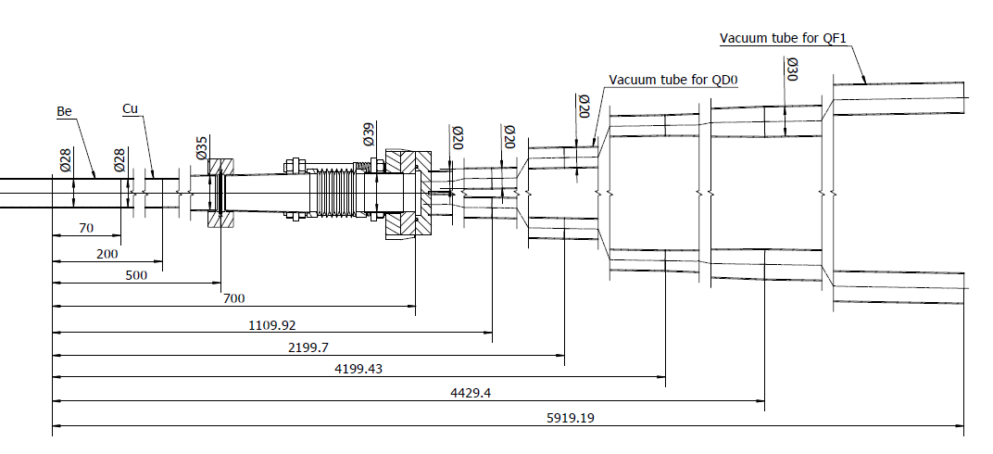
Layout of MDI
Vacuum tubes at MDI

Slide 5
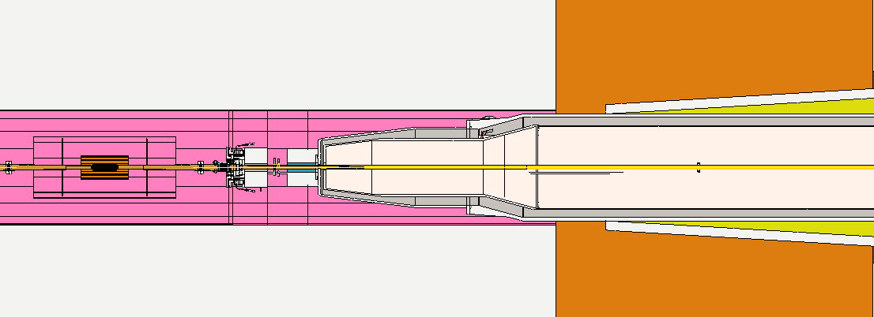
Installation scenario
Basic conditions
Both sides of IP chamber are fixed to VTX transversally and are free longitudinally.
The IP chamber, VTX, SIT and FTD can be considered as one assembly.
The assembly above can be supported by TPC and be aligned transversally.
Remote vacuum connector can be used.
Little transversally space & long longitudinally distance. It is impossible to connect flanges by hands.

Slide 6
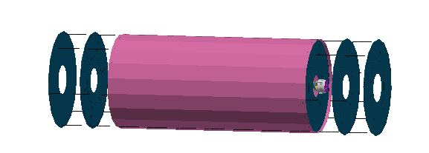
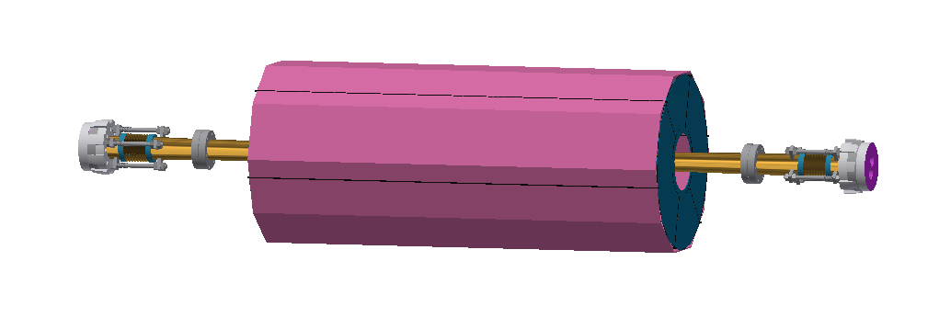
Installation scenario
Assembly from IP chamber to FTD: relatively easy, needs to be confirmed.

Slide 7
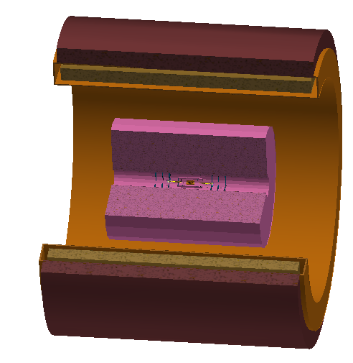
Installation scenario
IP chamber assembly installation
Support and fixing.
Alignment.
Space interference.
All the above items should be solved before the vacuum connection.

Slide 8
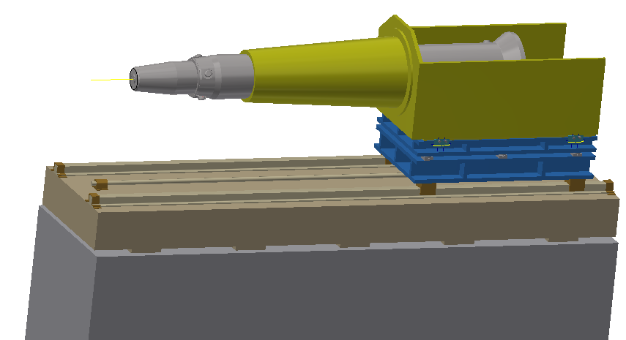
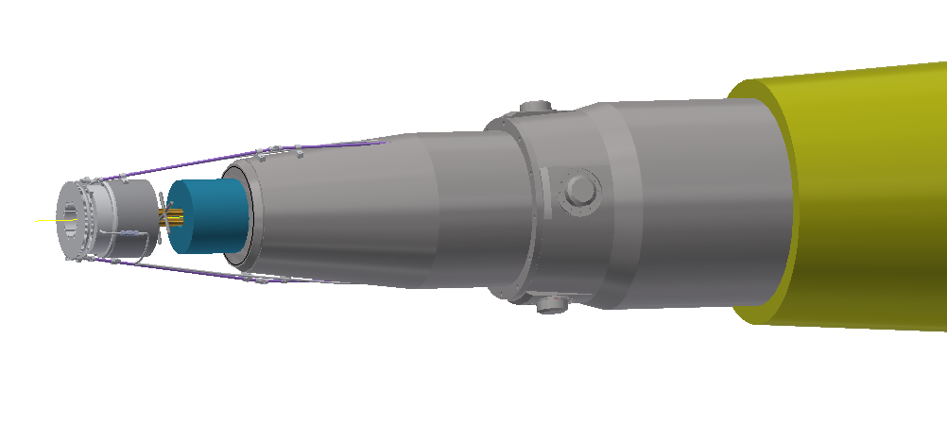
Installation scenario
Assembly of detector side and accelerator side.
Suppose the IP chamber assembly has been fixed to TPC.
Pre-alignment of SC magnet: cryomodule in working condition.
Installation of Lumical, BPM, HOM absorber and RVC.
Including the support mechanism.

Slide 9
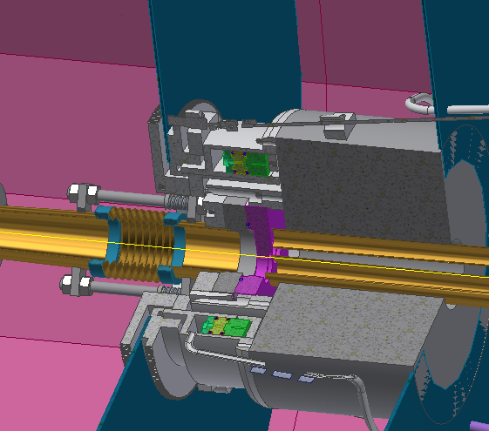
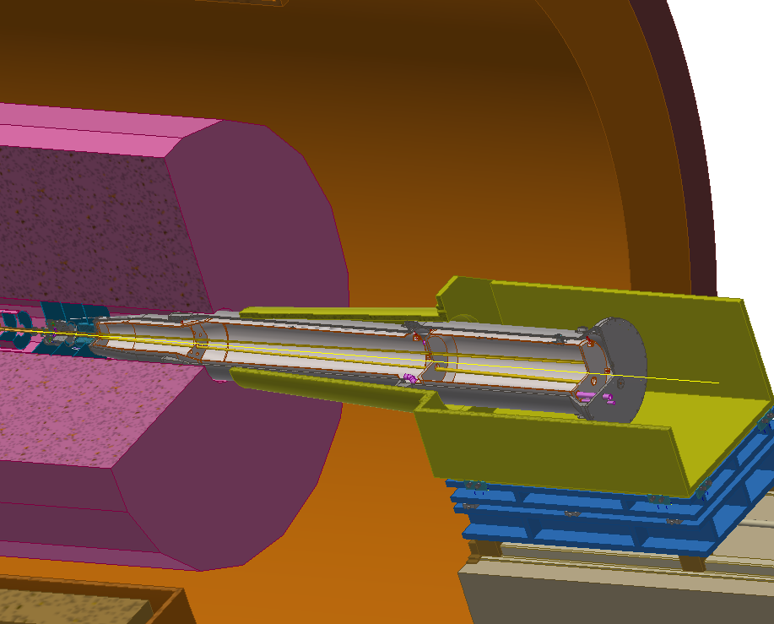
Installation scenario
Move the SC magnet to working location. Connect the flanges using RVC, do the alignment.
Requirements: accuracy: ≤(30 μm), leak rate ≤2e-10 Torr.L/s

Slide 10
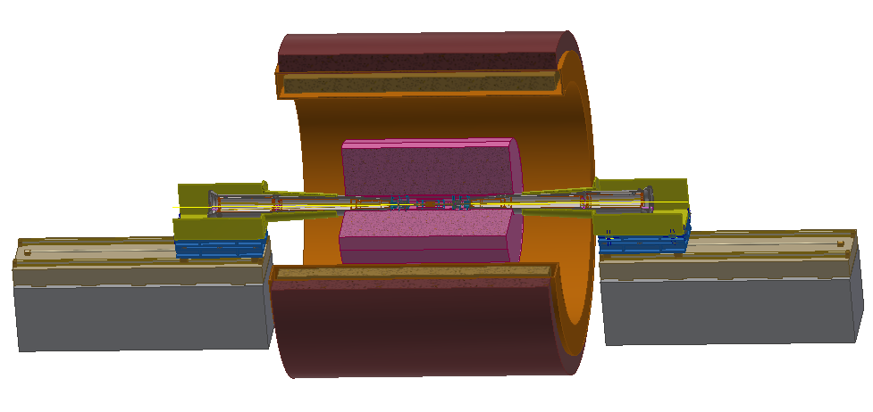
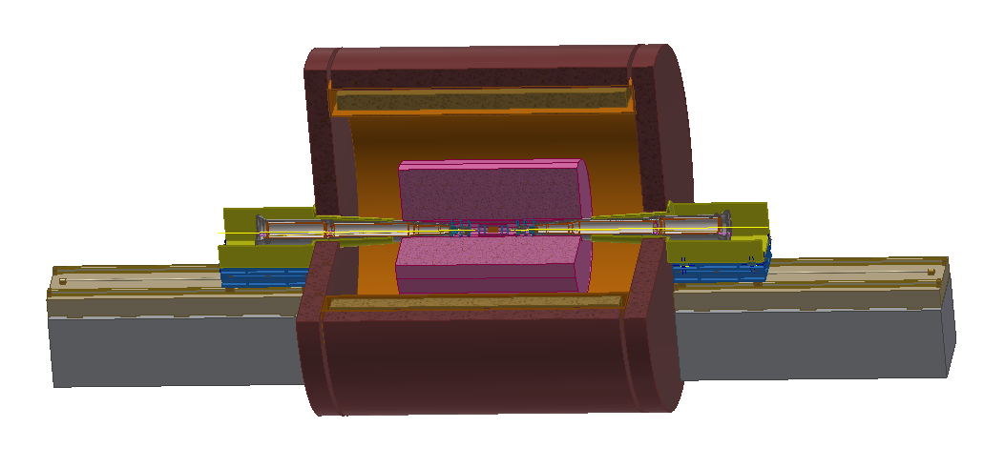
Installation scenario
Finish the connection and alignment for both sides, install the yoke walls.
We need holes through the yoke walls for alignment, or to open them.

Slide 11
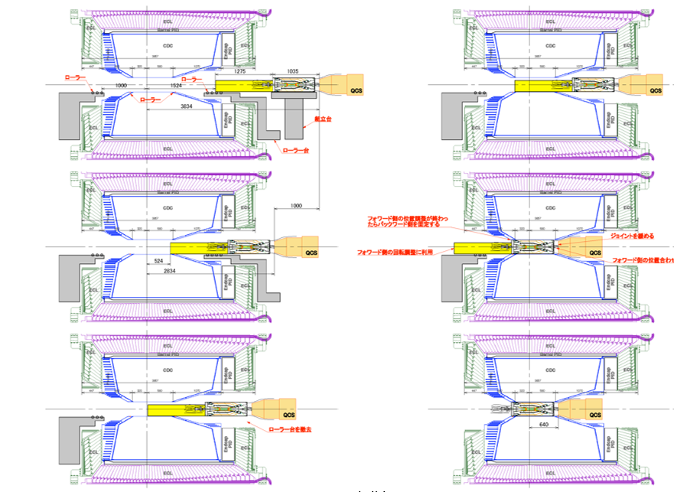
Installation scenario
An alternative scenario.
KEKB didn’t take this method and used RVC finally.
“Some people feel uneasy on the situation that VXD unit is pushed by QCS” may be the reason.
From K. Kanazawa of KEKB, the 18th KEKB Accelerator Review Committee, 2013

Slide 12
Difficulties and problems
Lumical:
The main body of Lumical is fixed to the front side of cryomodule, is the alignment accuracy acceptable (eg. 30 μm ) ?
We have no model of the high precision part, is it acceptable to fix it to the IP chamber?
Devices in front of Lumical: flanges, HOM absorber, BPM, RVC.
Detector:
Is it making sense that the IP chamber, VTX, SIT and FTD are considered as one assembly?
There has some space interference to be solved. (SIT & TPC, FTD & TPC, FTD & accelerator, FTD & Lumical)
If the TPC can move longitudinally, the installation will be much easier (RVC may be not needed), but the inner radius should be larger than 900 mm (can be tapered, 300-900).

Slide 13
Difficulties and problems
Accelerator:
We are searching for alternative methods instead of RVC, but it is very hard, we are still taking RVC as baseline.
We are trying to find methods to reach the extremely high requirements of alignment (≤ 30 μm or even higher), but we haven’t get a clear idea.
We want the HOM absorber located near the bellows, it that possible?

Slide 14
Thanks for your attention!

