Slide 1


Status of Semi-Digital HCAL
Haijun Yang (SJTU)
(on behalf of the CALICE SDHCAL Group)
CEPC Calorimetry Workshop
IHEP, Beijing, March 11-14, 2019

Slide 2
Outline
SDHCAL Technological Prototype
  Description, Test Beam, Hadronic Shower Studies
R&D for Large SDHCAL Modules
  Electronics, Mechanical, Gas Distribution
New PCB Readout Scheme
  less readout channels, less power consumption
MRPC with good time resolution
  about 30ps time resolution, help to identify neutrons
Summary and Conclusion

Slide 3
SDHCAL Prototype

Slide 4
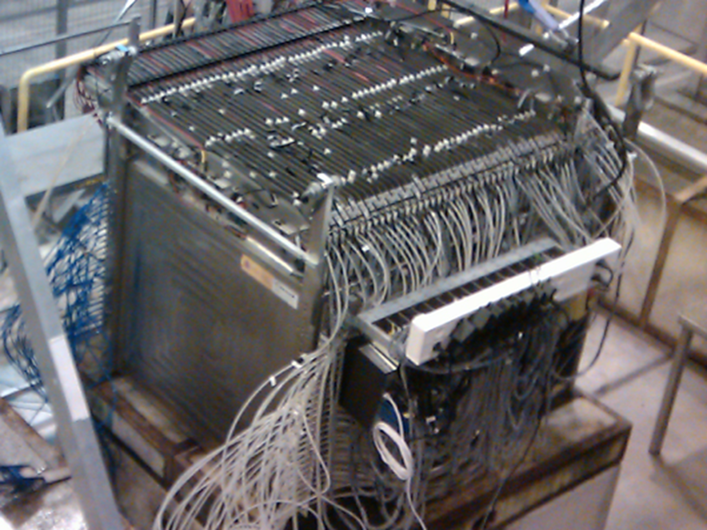
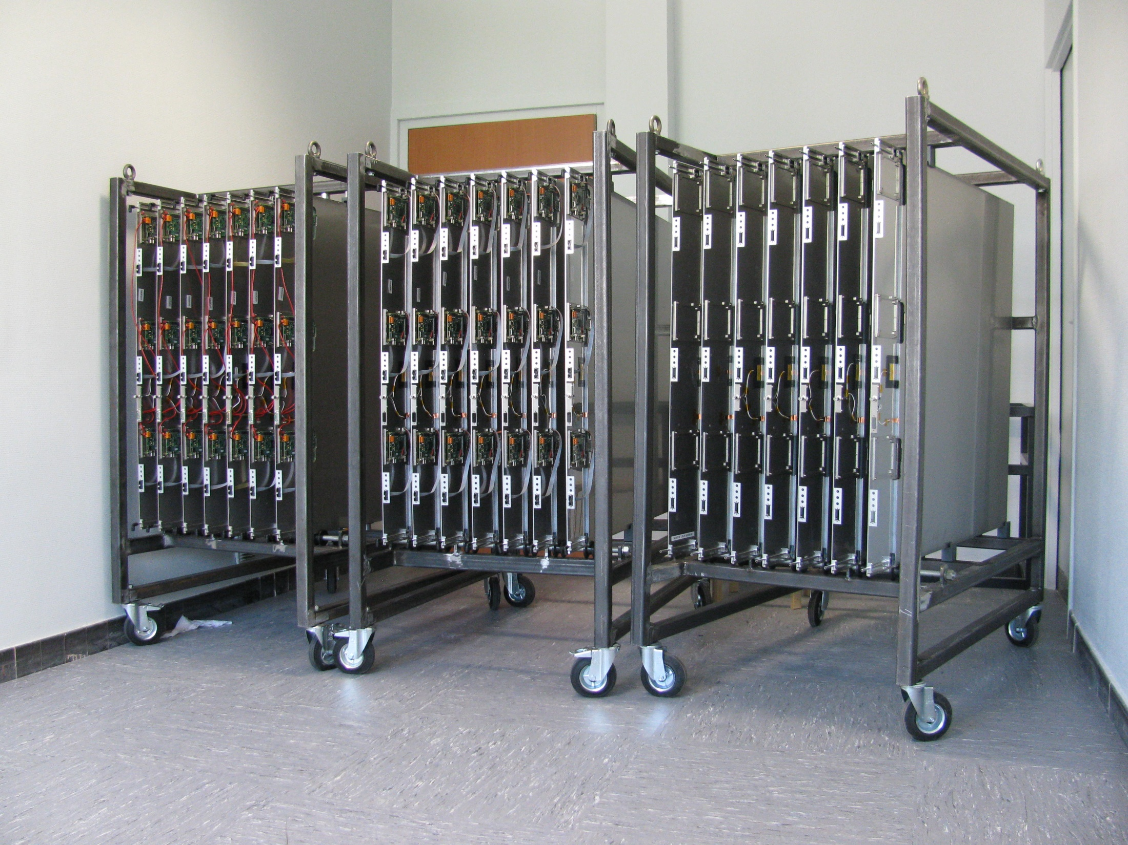
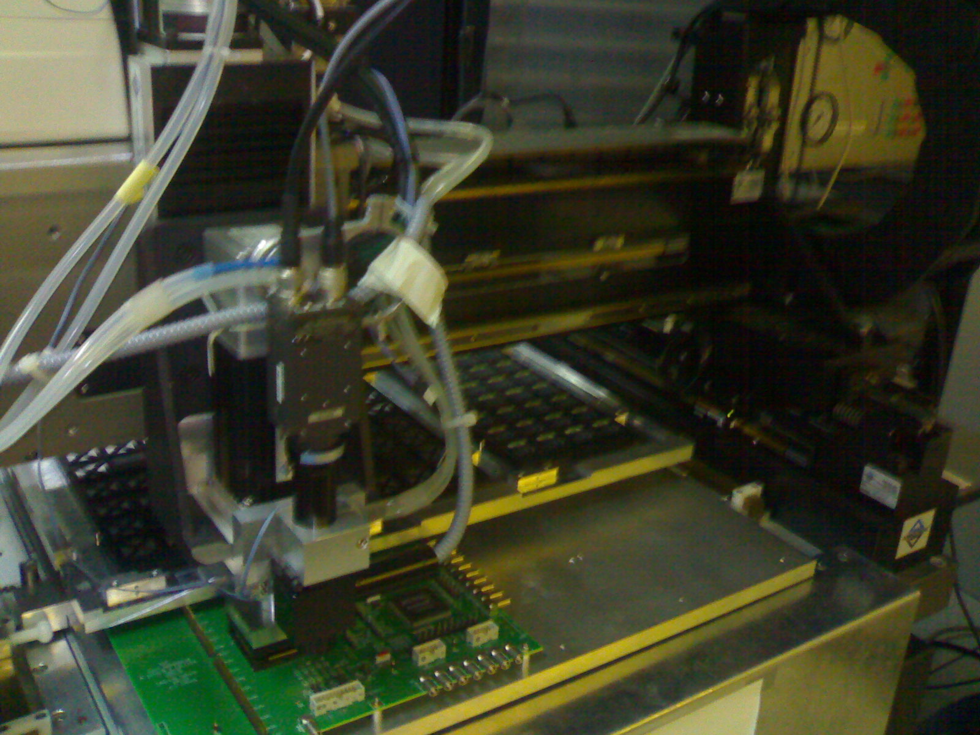
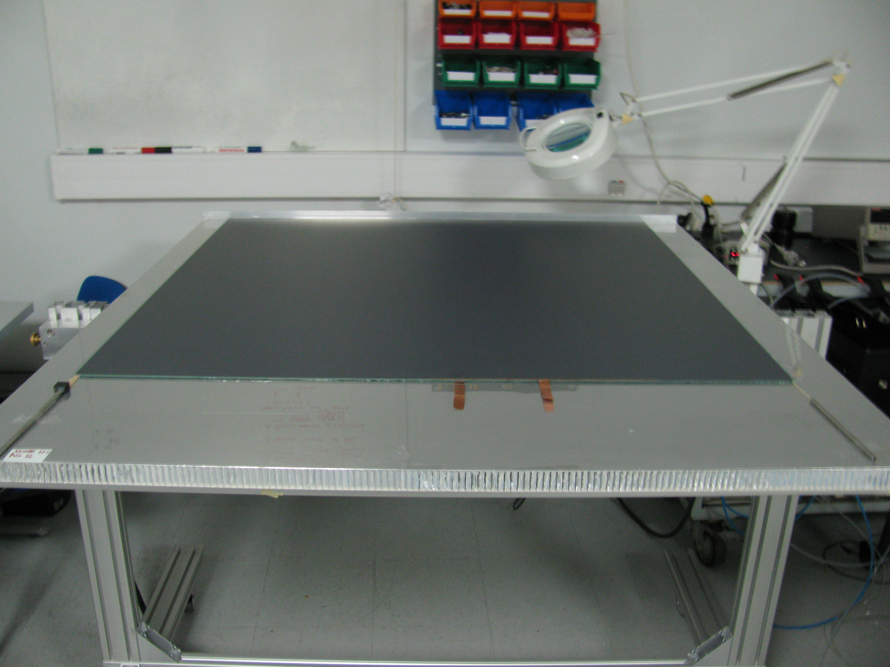
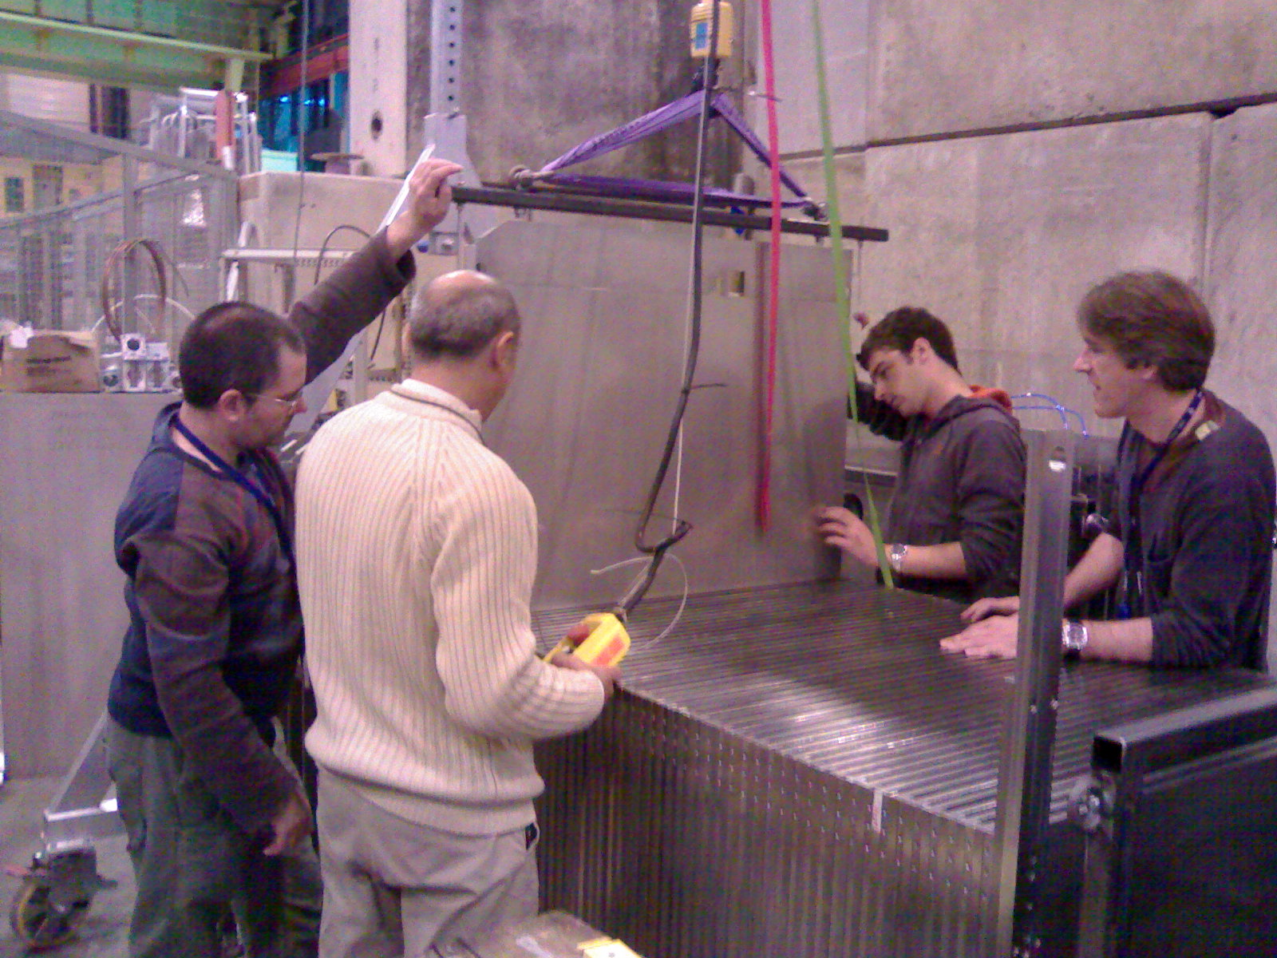
SDHCAL Prototype Construction
10500 64-ch ASICs were tested and calibrated using a dedicated ASICs layout.
310 PCBs were produced, cabled and tested, assembled by sets of six to make 1m² ASUs
170 DIF, 20 DCC were built and tested.
50 detectors were built and assembled with electronics into cassettes.
DAQ system using both USB and HTML protocol
was developed and used.
Self-supporting mechanical structure.
Full assembly and 5 test beam at CERN since 2012.
JINST 10 (2015) P10039

Slide 5
SDHCAL Performance
The SDHCAL prototype was exposed to hadron, muon and electron beams
in 2012, 2015 and 2016, 2017 on PS, H2, H6 and H8-SPS lines.
Power-pulsing using the SPS spill structure was used to reduce the power consumption.
Self-triggering mode is used but external trigger mode is possible
The threshold information helps to improve on the energy reconstruction by better
accounting for the number of tracks crossing one pad
2018 TB with SiW ECAL prototype
Hit time spectrum
for 40 GeV pion
Noise Hits

Slide 6
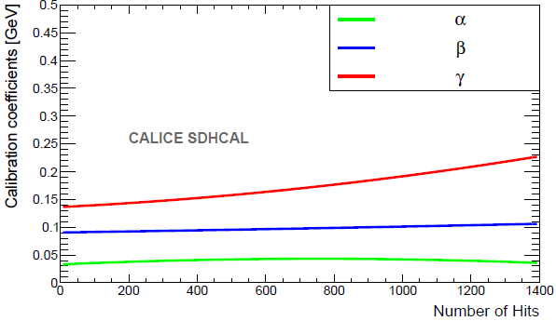
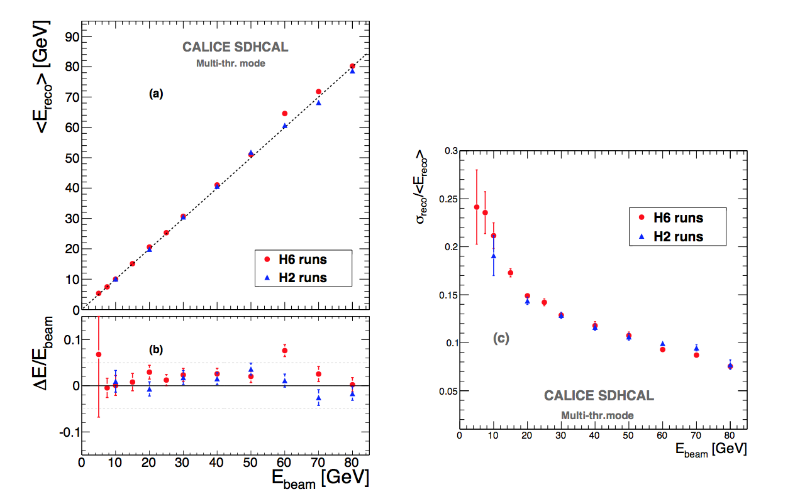
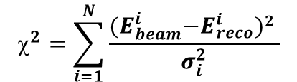





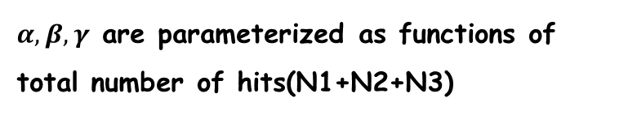
Energy Reconstruction (χ²)
Energy reconstruction formula:
$E_{reco}=αN_{1}+βN_{2}+γN_{3}$
$α,β,γ$ are parameterized as functions of total number of hits(N1+N2+N3)
$$α=α_{1}+α_{2}N_{total}+α_{3}N_{total}^{2}$$
$$β=β_{1}+β_{2}N_{total}+β_{3}N_{total}^{2}$$
$$γ={ γ}_{1} +{ γ}_{2}N_{total}+{ γ}_{3}N_{total}^{2}$$
optimizer
$$^{2}=\sum_{i=1}^{N}{\frac{{(E}_{beam}^{i}−E_{reco}^{i})2 }{σ_{i}^{2}}}$$
$σ_{i}=\sqrt{E_{beam}^{i}}$.

Slide 7
Energy Reconstruction (MVA)
In Progress
Energy shift reduces from
3% to 1% level using BDTG
Energy resolution improves
about 10-15% using MVA
Besides 4 Nhits variables,
We add 8 new variables to
describe hadronic showers

Slide 8
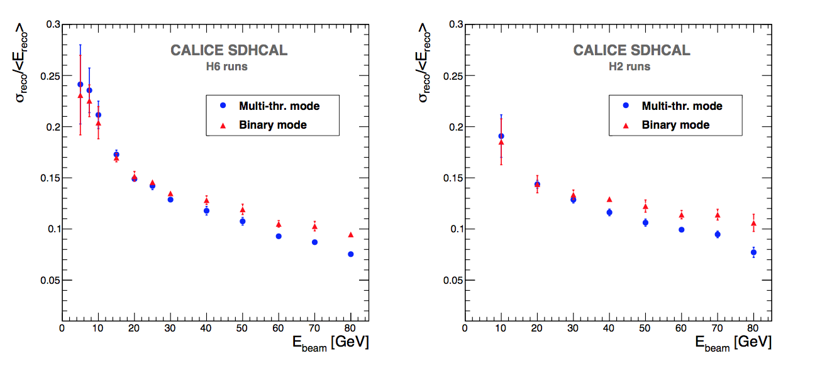
Energy Resolution (Binary vs 3-threshold)
Comparison of semi-digital versus binary readout
E_{rec} (binary) = C N _{tot} + D N² _{tot} + F N³_{tot}
E_{rec} (semi-digital) = α (N_{tot}) N₁ + β(N_{tot}) N₂ + γ(N_{tot}) N₃
JINST 11 (2016) P04001
π⁺(p)
π⁻
➔ Multi-threshold mode performs better than binary mode for energy > ~ 40 GeV

Slide 9
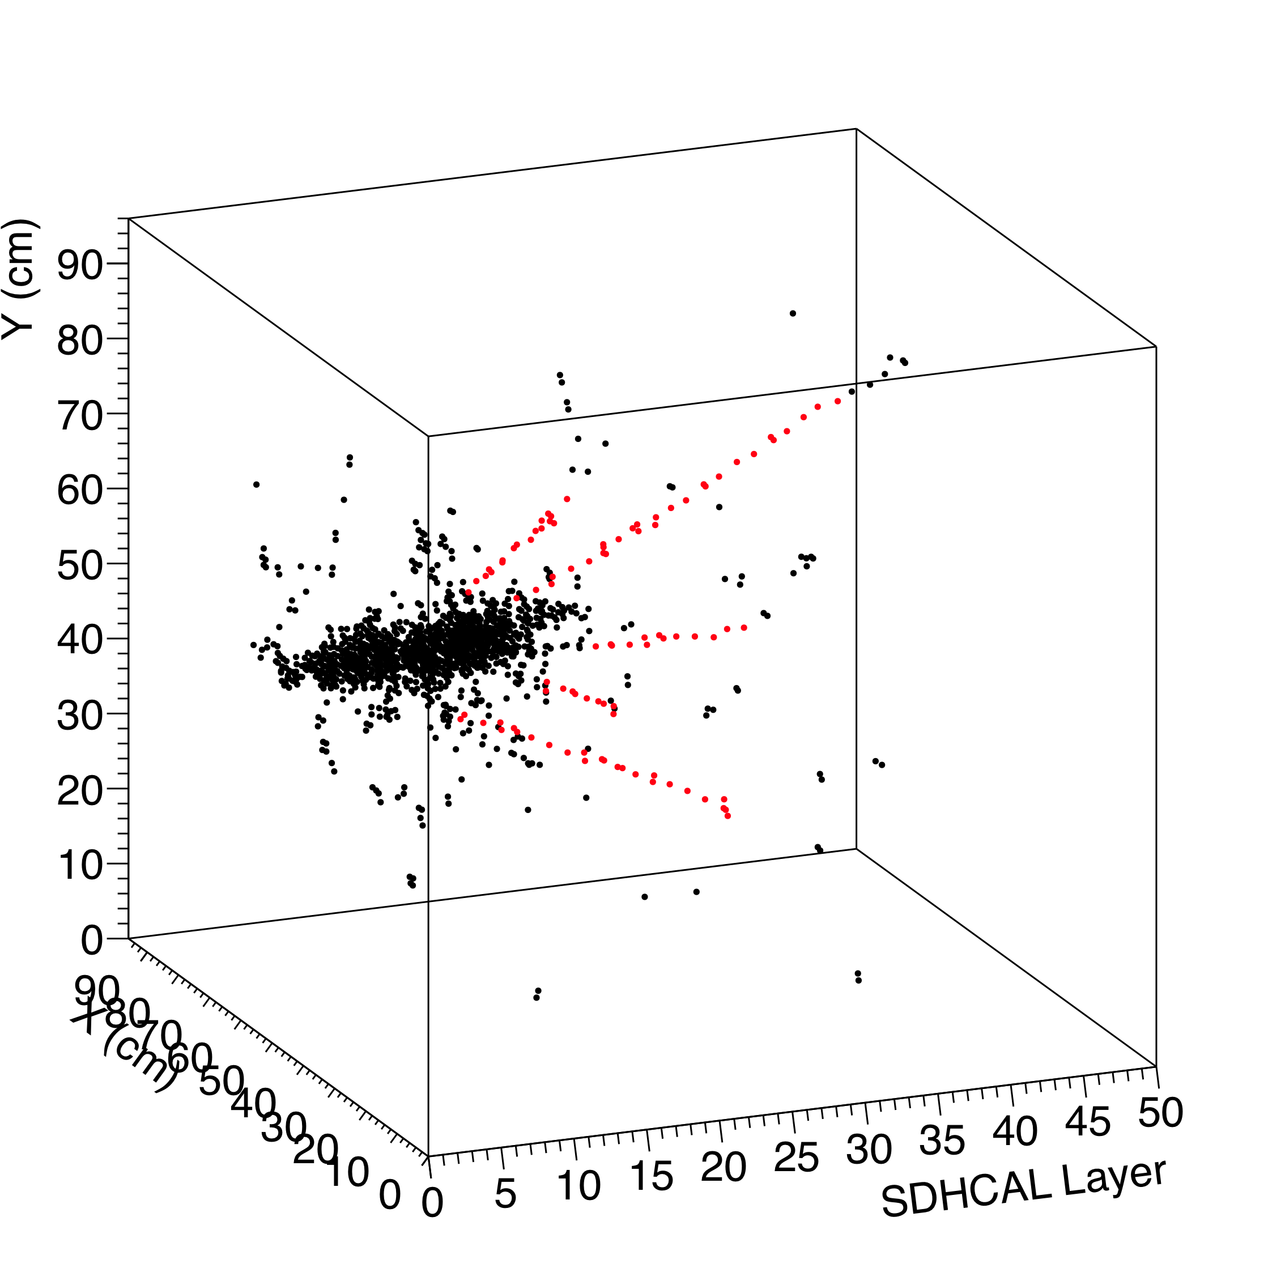
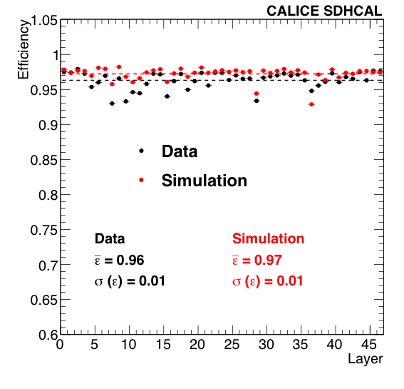
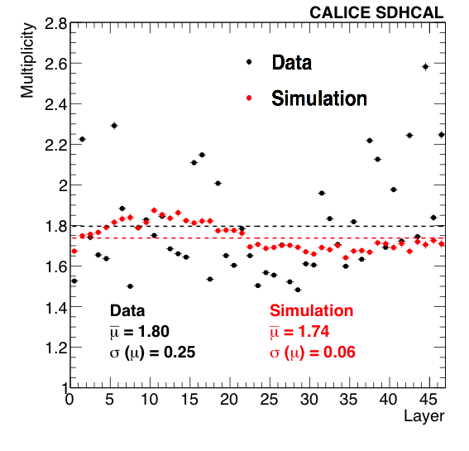
Data vs MC：Efficiency and Multiplicity
SDHCAL Efficiency (Data/MC): 96% / 97%
SDHCAL Multiplicity (Data/MC): 1.8 / 1.74
40 GeV pion
Good Data/MC agreement for
efficiency and multiplicity obtained with
cosmic muons and test beam muons.
JINST 10 (2015) P10039
40 GeV pion
80 GeV hadron

Slide 10
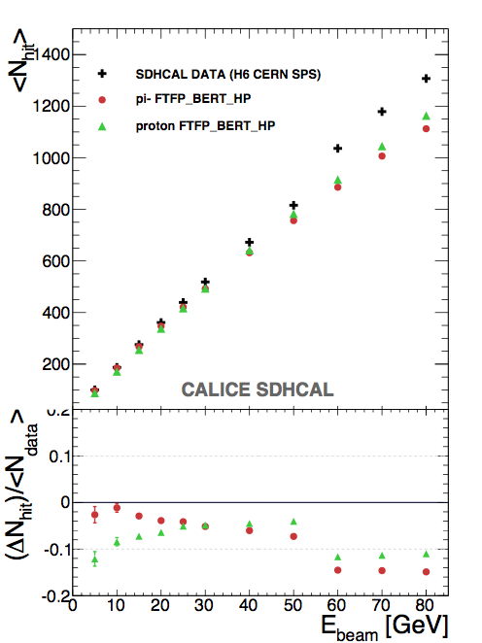
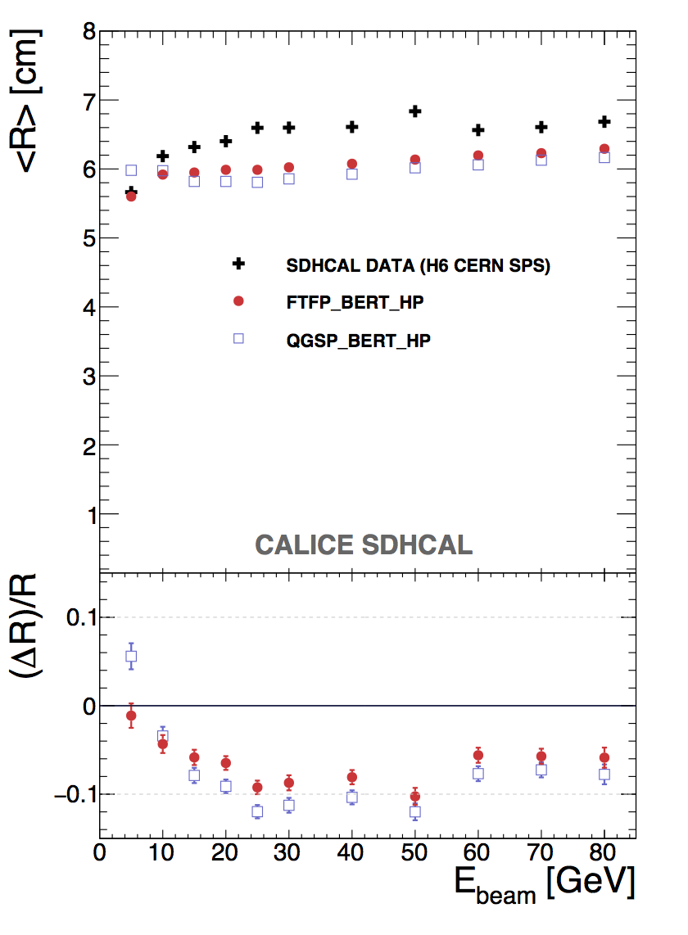
Data vs MC
JINST 11 (2016) P06014
Hadronic shower is more compact in MC than in data

Slide 11
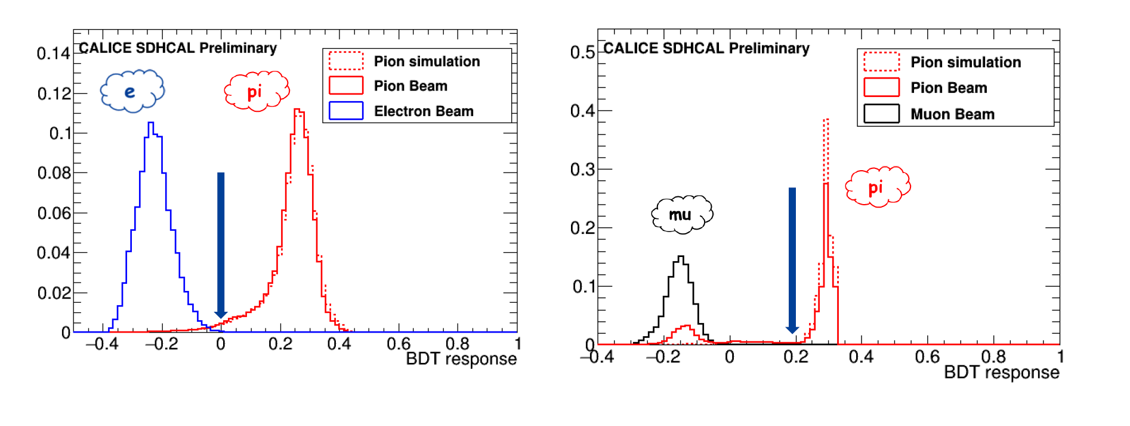
Pion/e, mu ID using BDT
CALICE-CAN-2019-001
SDHCAL is a powerful tool to identify pion/e/mu
BDT helps to improve the hadron/e/mu PID

Slide 12
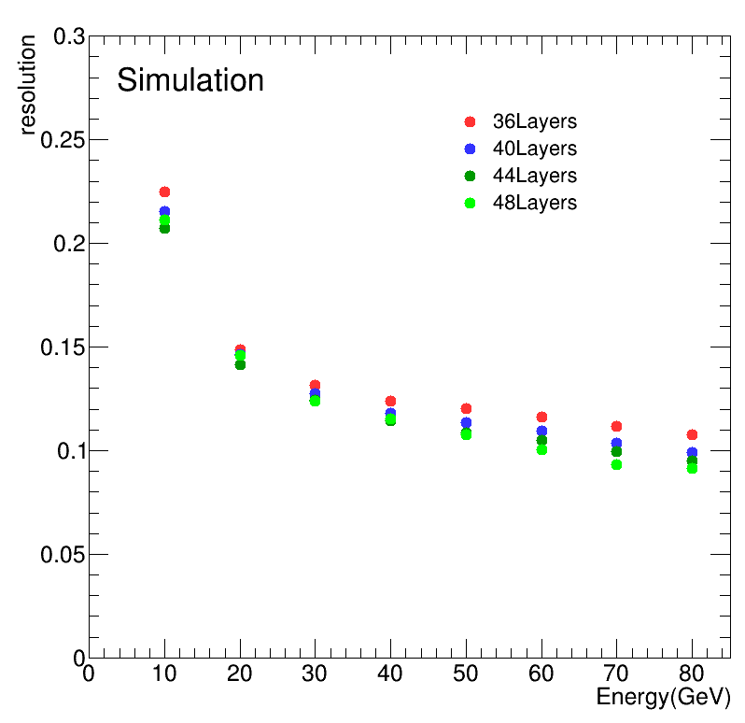
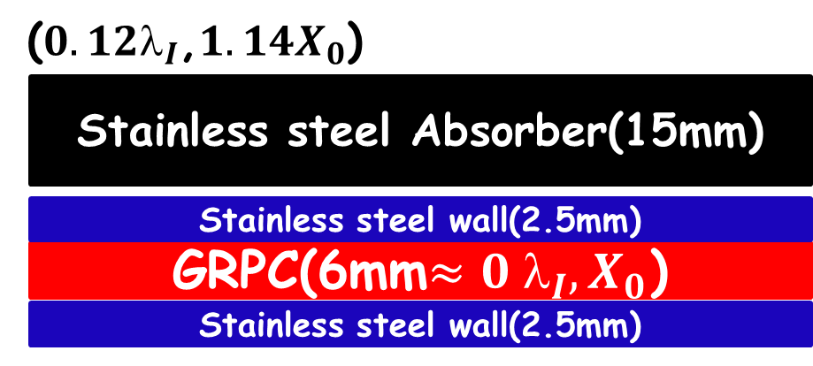
Energy Resolution vs No. of Layers
➔SDHCAL has 48 layers which
aims for ILC Detector
6mm gRPC + 20mm absorber
Optimization no. of layers for CEPC at 240GeV
➔40-layer SDHCAL yields decent
energy resolution.

Slide 13
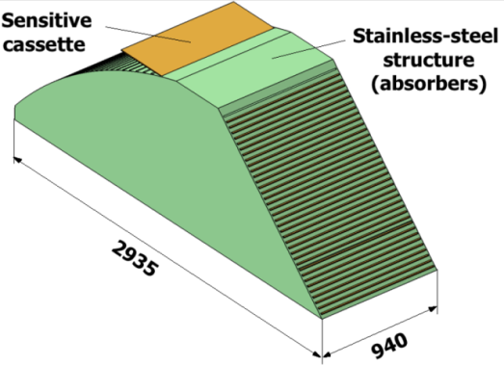
SDHCAL for Future Experiments
Detectors as large as 3m × 1m need to be built
Electronic readout should be the most robust with
minimal intervention during operation.
DAQ system should be robust and efficient
Mechanical structure to be similar to the final one
Envisage new features such as timing, etc..
GRPC
Glass Resistive Plate Chambers
SDHCAL
ILD Module
Goal: to build new prototype with few but large GRPC
and new components

Slide 14
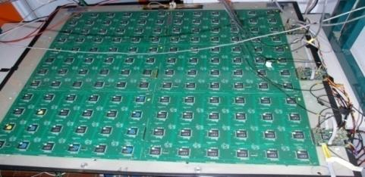
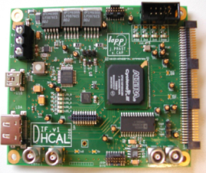
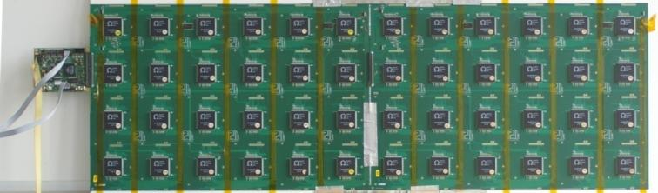
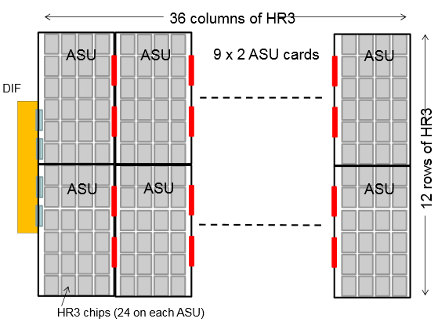
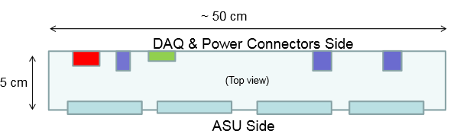

New Electronics
Electronics readout for the 1m³ prototype
HADROC chip
(ASIC)
1m² board ➔ 6 ASUs hosting 24 ASICs
3072 ch
DIF #1
144 ASICs= 9216 channels/1m²
USB
ASU1
ASU2
33 cm
DIF #2
HDMI
DIF
100 cm
DIF #3
1 DIF (Detector InterFace) for 2 ASU (Active Sensor Unit.- PCB+ASICs) ➔ 3 DIFs for ONE 1m² GRPC detector
Electronics readout for the final detector
Only 1 DIF per GRPC (any size) with small dimensions to fit in the small space available at the ILD detector
DIF dimensions

Slide 15
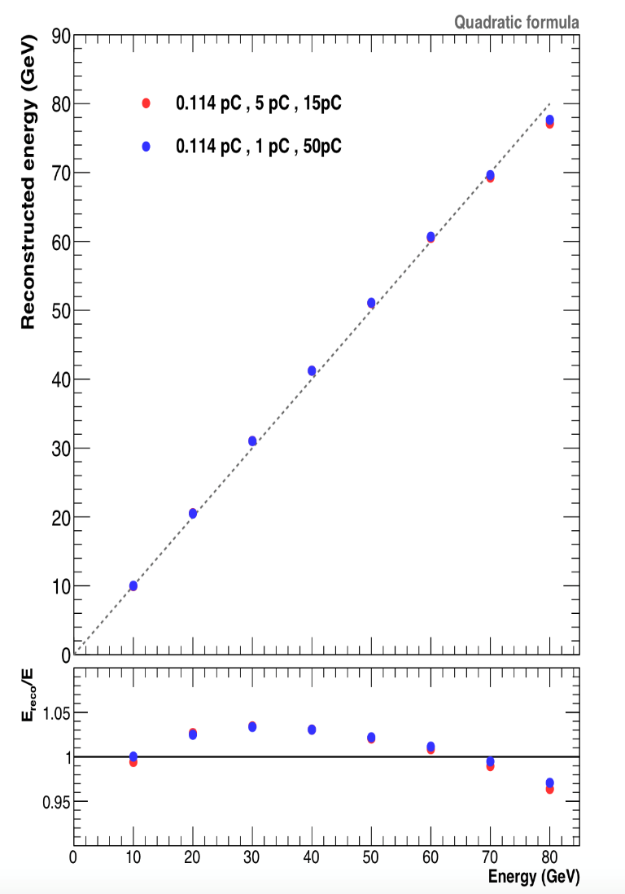
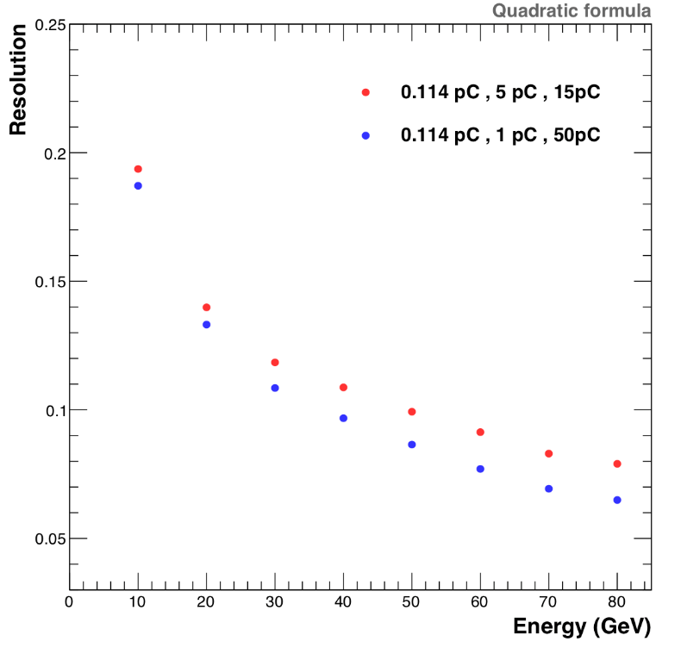
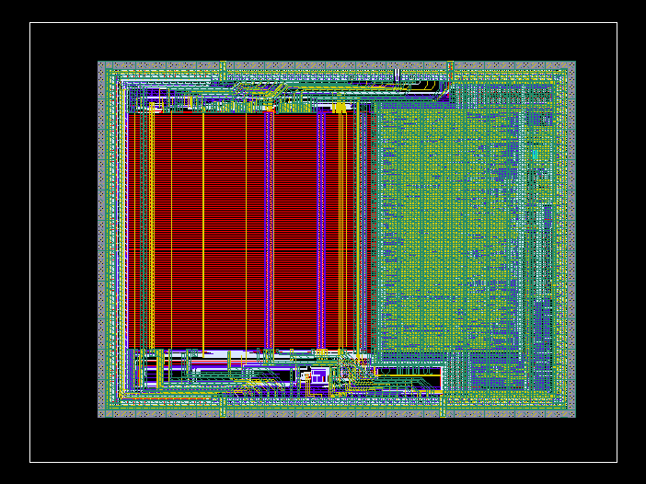
New Electronics: ASICs
HARDROCR3 main features:
  Independent channels
  Zero suppress
  Extended dynamic range (up to 50 pC)
  I2C link with triple voting for slow control par.
  packaging in QFP208, die size ~30 mm²
  Consumption increase (internal PLL, I2C)
6,3 mm
HARDROC2
HARDROC3
4,7 mm
Up to 20% improvment is expected

Slide 16
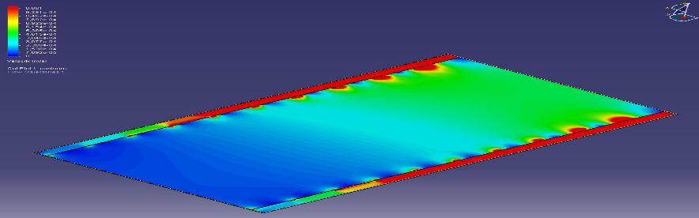
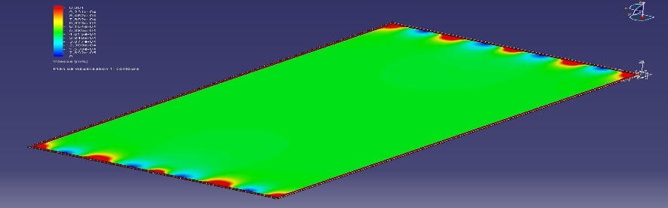
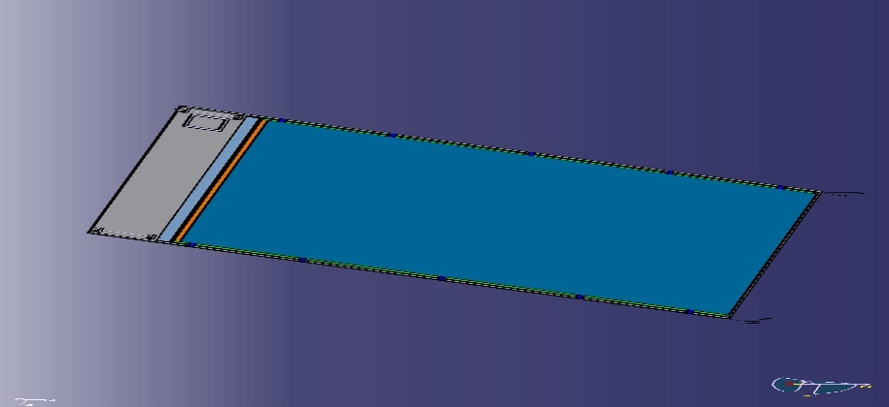
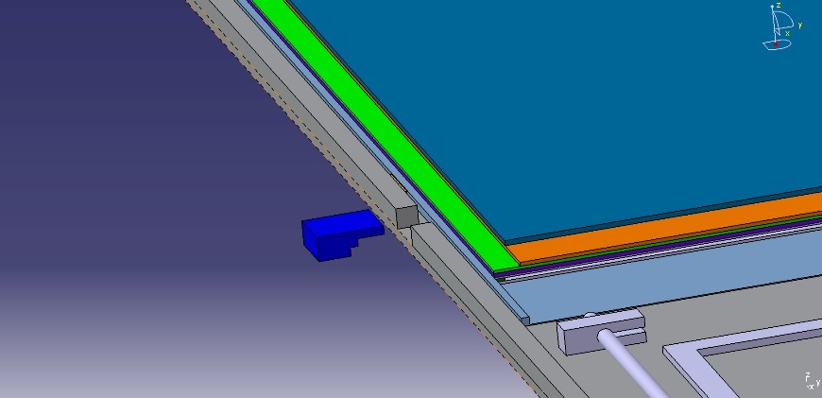
New Gas Distribution
Construction and operation of large GRPC need some improvements with
respect to the present scenario. Gas distribution : new scheme is proposed
Prototype circulation system
New circulation system
inlet
outlet
1 m
2 m
Cassette conception to ensure good contact between the detector and electronics is to be improved
Construction of a few large RPCs has started

Slide 17
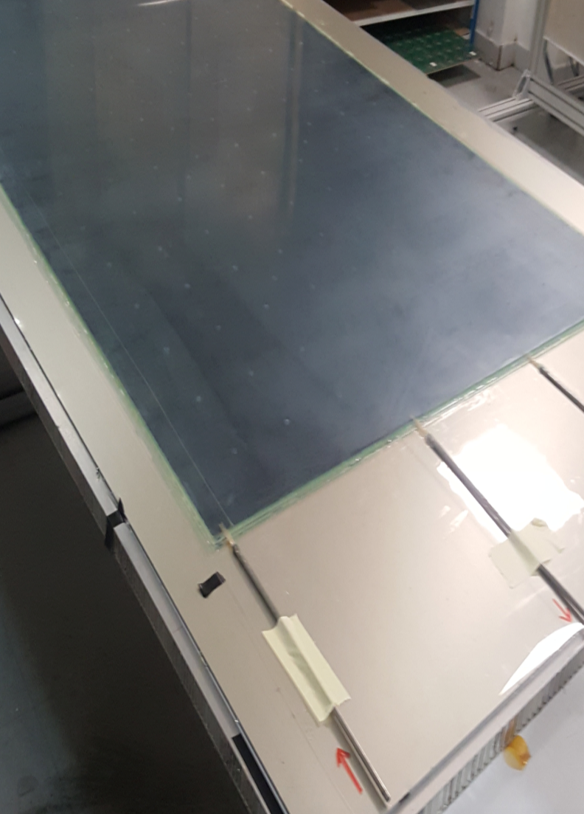
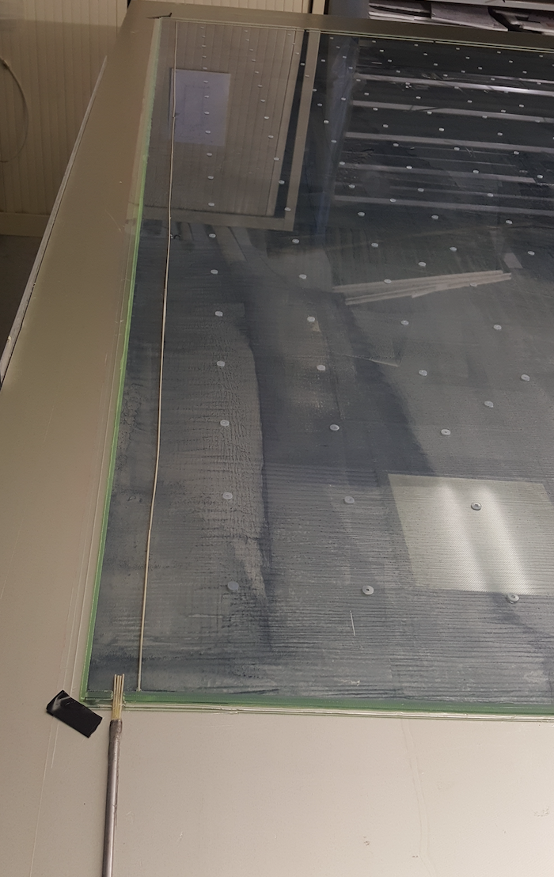
Construction of Large RPC
First 2x1 m² RPC chamber was successfully built with a new gas circulation system

Slide 18
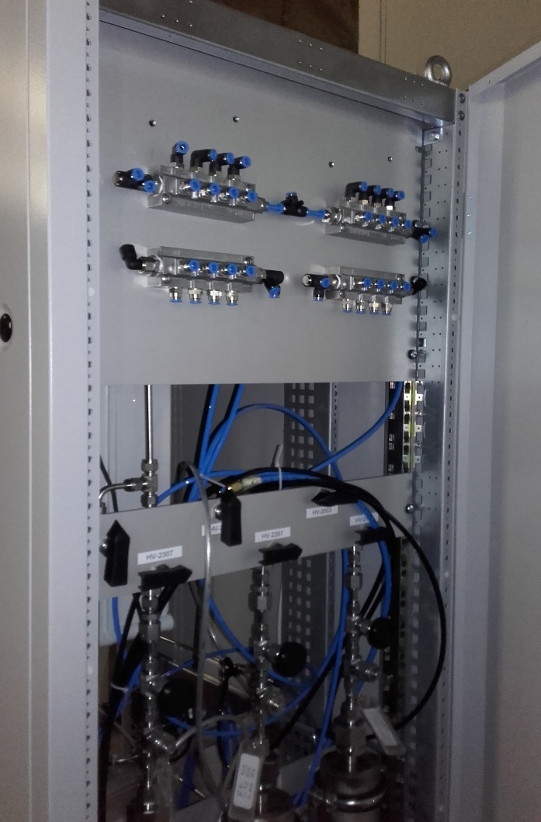
Recycling Gas System
Successfully tested recycling gas system.
A reduction of gas consumption by a factor up to 7 was achieved on a subset of the prototype.

Slide 19
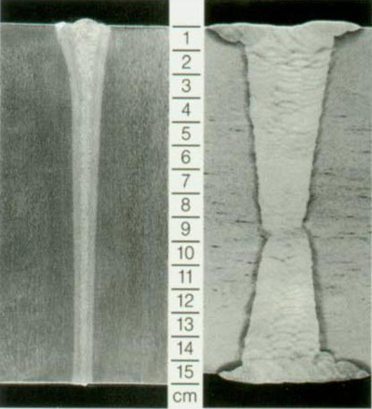
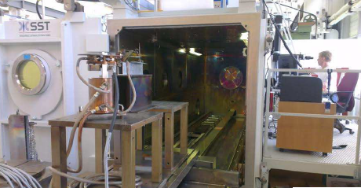
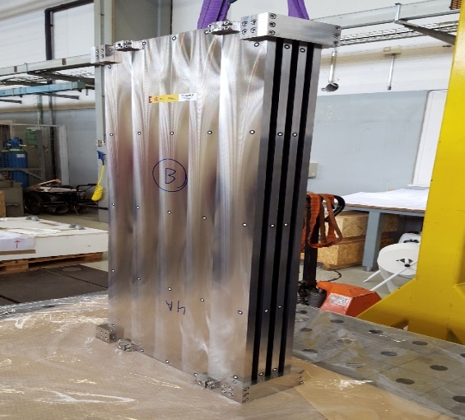
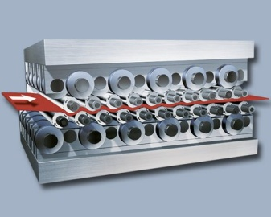
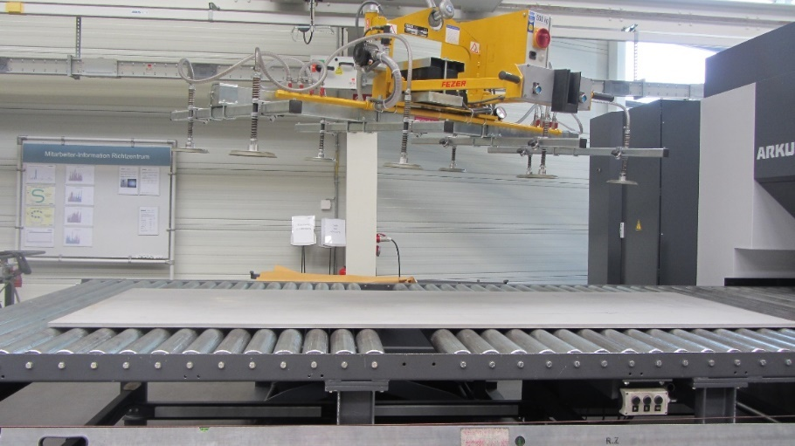
Mechanical Structure
Improvement on the present system is being made by using Electron Beam Welding rather than bolts to reduce the deformation and the spacers thickness.
Industrial production of flat large absorber plates (3 m X 1 m) by roller leveling process

Slide 20
Major Challenges
CEPC bunch spacing is 690ns/210ns/25ns for H/W/Z) ➔ operating at continuous mode
High granularity for SDHCAL ➔ ~66M channels
Estimated power consumption ➔ ~110kW
➔ Possible solutions:
  Active cooling
  To reduce electronic channels

Slide 21
Estimated HCAL Channels
- HCAL Barrel, R_{in} = 2.3m, R_{out} = 3.34m, length = 2.67*2=5.34m, N_{layer}=40
Area of HCAL barrel = 2*PI*[(R_{in}+R_{out})/2]*L*N_{layer} = 3782 m²
- HCAL Endcap (2), R_{in} = 0.35m, R_{out} = 3.34m, N_{layer}=40
Area of HCAL endcap = 2*PI*(R_{out}*R_{out} – R_{in}*R_{in})*N_{layer} = 2772 m²
Cell Size \ channels | HCAL Barrel | HCAL Endcap | Channels (N_{ch}) | Power AHCAL | Power SDHCAL
1cm x 1cm | 37.82M | 27.72M | 65.5M |  | 110 kW
2cm x 2cm | 9.455M | 6.93M | 16.4M |  | 52 kW
3cm x 3cm | 4.2M | 3.08M | 7.3M | 110 kW | 43 kW
4cm x 4cm | 2.36M | 1.73M | 4.1M | 88 kW
5cm x 5cm | 1.51M | 1.11M | 2.6M | 77 kW
Power Consumption (rough estimation):
AHCAL: 7mW/ch * N_{ch3} + 9W/DIF/m² * 6554 (59kW)
SDHCAL: 1mW/ch * N_{ch1} + 5.4W/DIF/m² * 6554 (35.4kW)

Slide 22
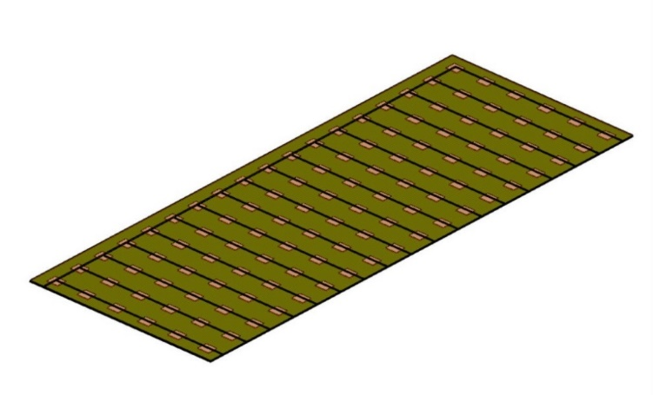
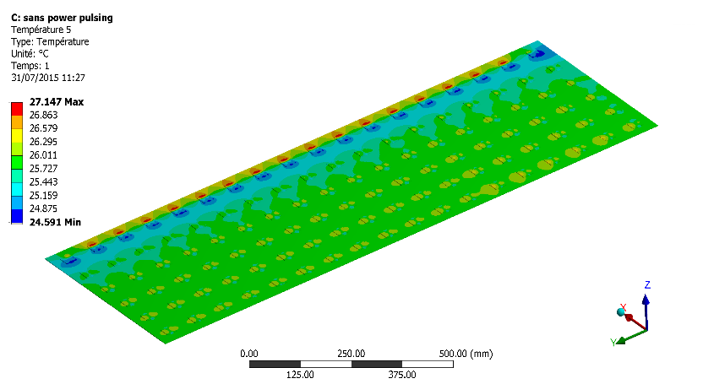
Active Cooling
Cooling may become necessary if it is operating at continuous mode (CEPC)
0.5 m
108 chips
27.147 (max) – 24.591 (min) =2.556 ºC
Rectangular section tubes : 2x1 mm
1.5 m
Copper plate over: 1.5 mm
Flow out
symmetry
Flow in
PCB plate under: 1.4 mm
symmetry
A water-based cooling system inside copper tubes in contact with the ASICs to absorb excess heat.
Temperature distribution in an active layer of the SDHCAL.
To simulate temperature distribution in an active layer
To simulate temperature distribution for multi-layer SDHCAL
optimize tube size and geometry
optimize water flow rate and cooling capacity
Water cooling : h = 10000 W/m²/k
Thermal load : 90 mW/chip

Slide 23
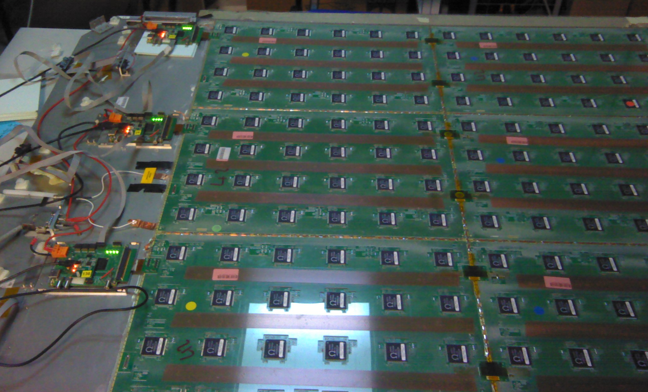
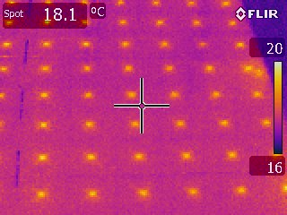
Simulation of Active Cooling
In Progress
ANSYS Simulation of RPC+PCB
With copper plate & water tubes
Temperature test of RPC+PCB

Slide 24
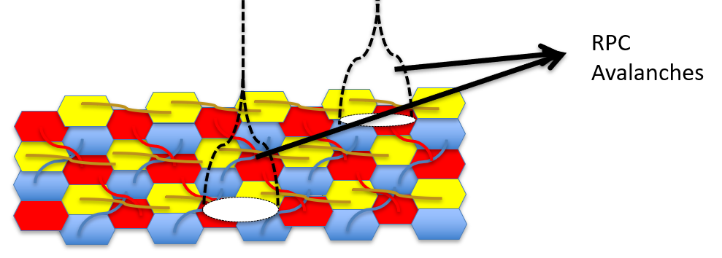
New PCB Design: reduce channels
SDHCAL for CEPC is ~65M channels, only 2-5K will be fired for each collision, most of channels are idle almost all of the time.
Reducing no. of cells will lead to less granularity ➔ bad PFA
➔ Solution (Imad Laktineh @IPNL):
The principle: charge is shared among several cells. The cells are inter-connected in a smart way so that one can identify the position of the impinging particle by identifyingfired strips and find hit as crossing points.
At least 3-directions strips ➔ no ambiguity

Slide 25
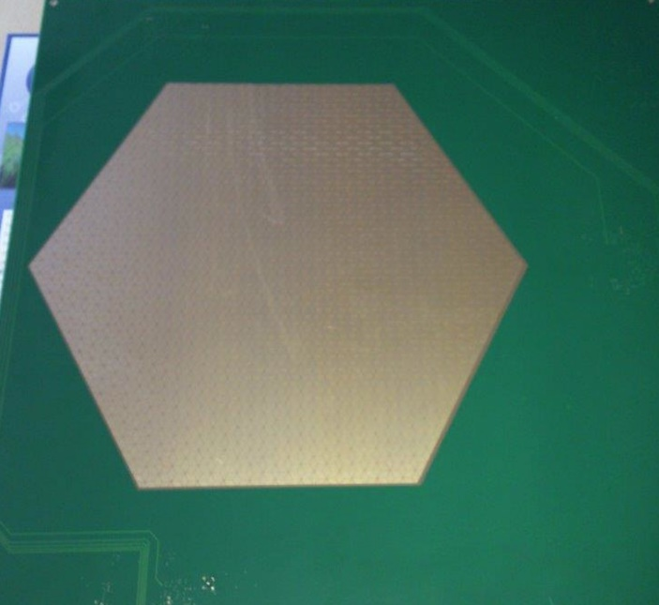
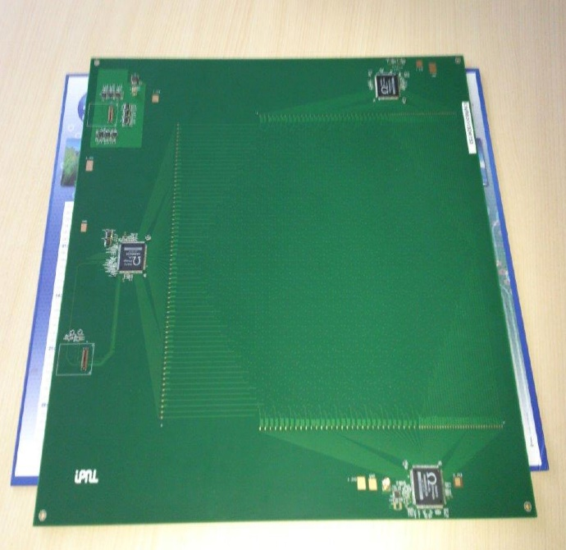
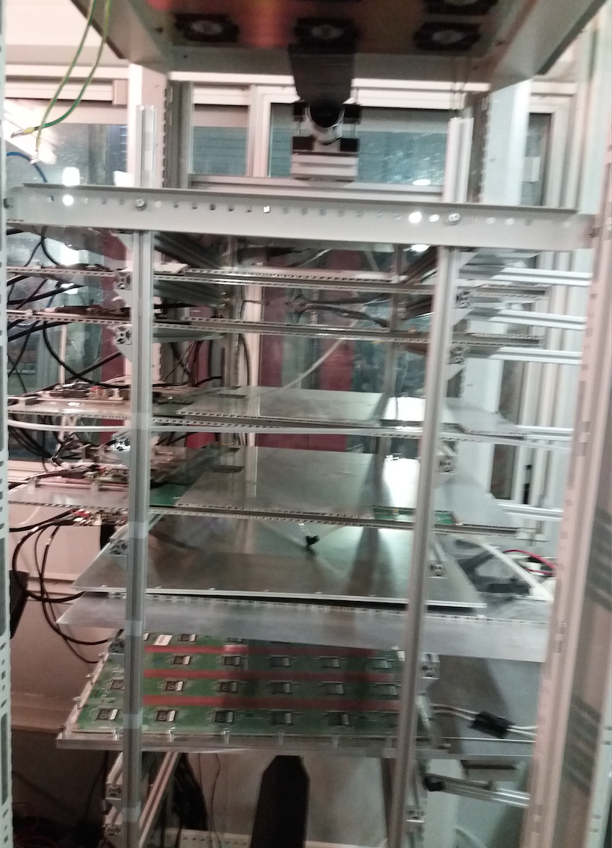
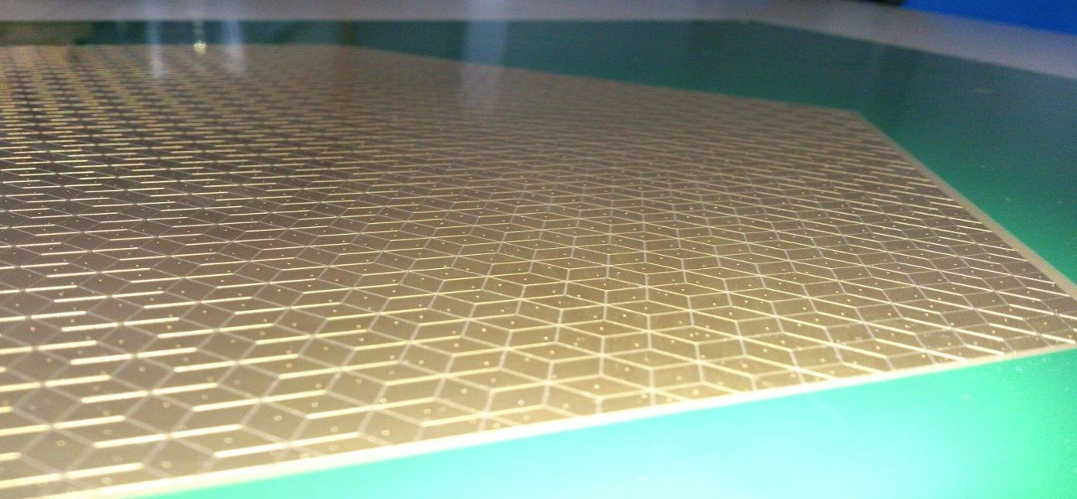
New PCB Design
30 cm
3 HR2 ASICs rather than 20 for the same surface
Better granularity
The scheme was used to design a new PCB with lozenges structure and 3 directions.
Setup with 5 detectors equipped with new PCB
Lozenge’s large diagonal : 1 cm

Slide 26
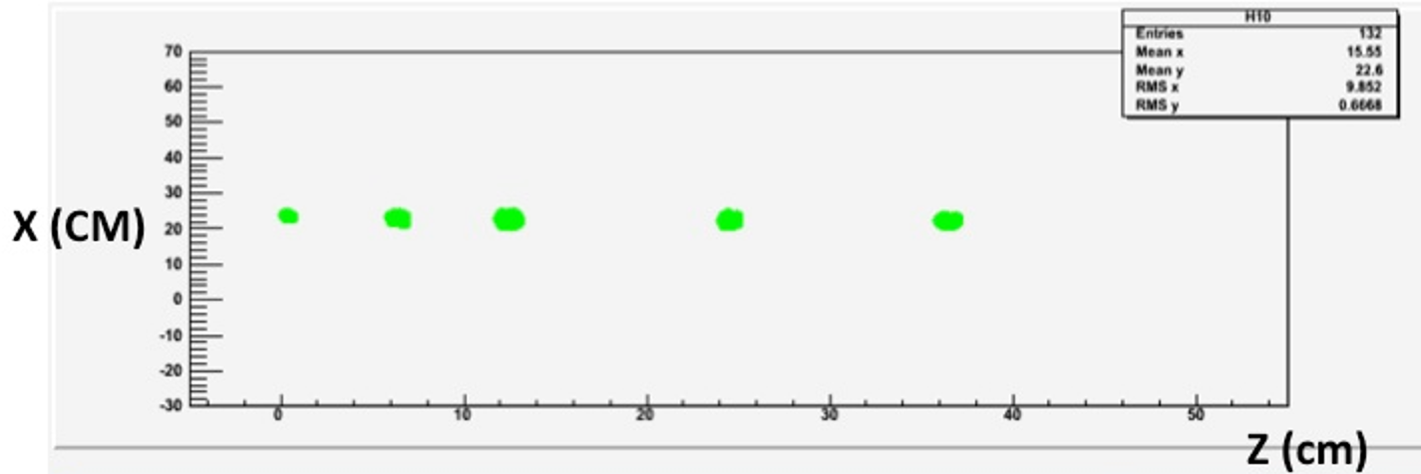



New PCB Design
Threshold ≈ 60 fC

Slide 27






Better Timing: MRPC
In Progress
Timing could be an important factor to separate showers and better reconstruct their energy
Multi-gap RPC are excellent fast timing detectors
Several MRPC were designed and built . Excellent efficiency when tested with HARDROC ASICs.
Next step use PETIROC (< 20 ps time jitters) to single out neutron contributions.

Slide 28

MRPC designed by Tsinghua U.
arXiv:1805.07922
Item | dimension/mm
Honeycomb | 90×265×7.5
Outer PCB | 120×298×0.6
Middle PCB1 | 120×298×1.2
Middle PCB2 | 120×328×1.2
Strip length | 268
Strip width | 7
Mylar | 90×268×0.25
Glass | 80×258×0.5
Carbon | 72×250
Gas gap width | 0.104
Number of gas gap | 32
Time Resolution is
about 30ps

Slide 29
Cost Estimation: SDHCAL
- HCAL Barrel, R_{in} = 2.3m, R_{out} = 3.34m, length = 2.67*2=5.34m, N_{layer}=40
Area of HCAL barrel = 2*PI*[(R_{in}+R_{out})/2]*L*N_{layer} = 3782 m²
- HCAL Endcap (2), R_{in} = 0.35m, R_{out} = 3.34m, N_{layer}=40
Area of HCAL endcap = 2*PI*(R_{out}*R_{out} – R_{in}*R_{in})*N_{layer} = 2772 m²
CEPC SDHCAL: 6550 m²
Unit Cost: 40K RMB/m²
Total Cost: 262M RMB

Slide 30
Summary and Conclusion
SDHCAL (since 2011) is the first technological and still the unique complete prototype built for future experiments.
Results of beam tests validate the concept. Many results are obtained.
There is still a place for improvement by using genuine techniques (MVA, …)
New features such as PCB design, timing and cooling will play important role in future colliders calorimetry R&D.
Many thanks for great efforts from CALICE SDHCAL working group !

Slide 31
Backup Slides

Slide 32



PFA and Imaging Calorimeter
60%/√E
30%/√E
Simulation of W, Z reconstructed masses in hadronic mode.

Slide 33


CALICE: Imaging Calorimeter
https://twiki.cern.ch/twiki/bin/view/CALICE/CalicePapers
Readout cell size:
144 - 9 cm² → 4.5 cm² → 1 cm² → 0.25 cm² → 0.13 cm² → 2.5x10⁻⁵ cm²
Technology:
Scintillator +
SiPM/MPPC
Scintillator +
SiPM/MPPC
Gas detectors
Silicon
Silicon
Silicon
Silicon (MAPS)

Slide 34


SDHCAL Prototype
The SDHCAL-GRPC is one of the two HCAL options based on PFA and proposed for ILD. Modules are made of 48 RPC chambers (6λ_{I}), equipped with semi-digital, power-pulsed electronics readout and placed in self-supporting mechanical structure (stainless steel) to serve as absorber.
Proposed structure for SDHCAL:
  Very compact with negligible dead zones
  Eliminates projective cracks
  Minimizes barrel and endcap separation
Challenges:
  Homogeneity for large surfaces
  Thickness of only a few mm
  PCB cell size of 1cm X 1cm
  Services from one side
  Embedded power-cycled electronics
  Self-supporting mechanical structure

Slide 35




Schematic of RPC
Assembling procedure
Mylar layer (50μ)
Readout pads
(1cm x 1cm)
PCB interconnect
PCB (1.2mm)+ASICs(1.7 mm)
Readout ASIC
(Hardroc2, 1.6mm)
PCB support (polycarbonate)
Gas gap
Mylar (175μ)
Cathode glass (1.1mm)
+ resistive coating
Ceramic ball spacer (1.2mm)
Glass fiber frame (≈1.2mm)
Anode glass (0.7mm)
+ resistive coating
Ran Han (BISEE)
Haijun Yang (SJTU)
Large area gRPC:
Negligible dead zone
(tiny ceramic spacers)
Large size: 1 × 1 m²
Cost effective
Efficient gas distribution system
Homogenous resistive coating
6mm(active area) + 5mm(steel) =
11 mm thickness
35
Notes:
35

Slide 36




DHCAL with RPC
Prototypes of DHCAL based on RPC
ANL (J. Repond, L. Xia et.al.)
1m³, 1 threshold, TB at CERN/Fermilab
IPNL (I. Laktineh et.al.)
1m³, 3 thresholds, TB at CERN since 2012
80 GeV Pion

Slide 37




Readout Electronics for RPC
Imad Laktineh (IPNL)
Assembling procedure
4.7 mm
ASICs : HARDROC2
64 channels
Trigger less mode
Memory depth : 127 events
3 thresholds
Range: 10 fC-15 pC
110fC, 5pC, 15pC
Gain correction → uniformity
4.3mm
Printed Circuit Boards (PCB) were designed to reduce the cross-talk with 8-layer structure and buried vias.
Tiny connectors were used to connect the PCB two by two so the 24X2 ASICs are daisy-chained. 1×1m² has 6 PCBs and 9216 pads.
DAQ board (DIF) was developed to transmit fast commands and data to/from ASICs.
6mm(active area) + 5mm(steel) =
11 mm thickness
Notes:
37

Slide 38

Electronics channels / m²
➔ SDHCAL for CEPC has 40 layers
Each layer: 3 mm RPC
+ 1.2 ∼ 1.4 mm PCB
+ 1.6 mm ASIC (Hardroc)
20mm steel absorber (2.5+2.5+15mm)
6 PCB to cover 1m² RPC
Each PCB size: 31 cm * 50cm ~ 1536 channels
Each ASIC chip (Hardroc) has 64 channels, size 4.3mm*4.7mm
Each PCB with 1536-channel needs 24 ASIC chips (4*6)
Power: 1.4mW/ch * 64 ch = 90 mW/Chip
Power: 1.4mW/ch * 6*24*64 ch = 1.4mW/ch*9216ch/m² = 13W/m²
4.7 mm
4.3mm

Slide 39


New Electronics: ASIC
HARDROCR3 main features:
Independent channels
Zero suppress
Extended dynamic range (up to 50 pC)
I2C link with triple voting for slow control parameters
packaging in QFP208, die size ~30 mm²
Consumption increase (internal PLL, I2C)
6,3 mm
4,7 mm
H3B TESTED : 786, Yield : 83.3 %
FSB2
Up to 50 pC

Slide 40


ASU (Active Sensor Unit)
One important challenge is to build a PCB up to 1m length with good planarity to have a homogeneous contact of pads with RPCs in order to guarantee an uniform response along all the detector. After investigation in some companies,
1x0.33 m2 with 13 layer ASUs have been built.
ASU
The ASU-ASU (= ASU-DIF) connections also produced

Slide 41


New Electronics: DIF
DIF sends DAQ commands (config, clock, trigger) to front-end and transfer their signal data to DAQ. It controls also the ASIC power pulsing
• Only one DIF per plane (instead of three)
• DIF handle up to 432 HR3 chips (vs 48 HR2 in previous DIF)
• HR3 slow control through I2C bus (12 IC2 buses).
Keeps also 2 of the old slow control buses as backup & redundancy.
• Data transmission to/from DAQ by Ethernet
• Clock and synchronization by TTC (already used in LHC)
• 93W Peak power supply with super-capacitors
(vs 8.6 W in previous DIF)
• Spare I/O connectors to the FPGA (i.e. for GBT links)
• Upgrade USB 1.1 to USB 2.0
TEXAS TM4C1294U
FPGA XC7A35TFGG484
POWER
POWER
POWER

Slide 42



Event Selection of Hadron Beams
No containment selection.
No Cerenkov detector
Triggerless mode
Power pulsed mode

Slide 43

Energy Reconstruction (χ²)
JINST 11 (2016) P04001

Slide 44



Separation of electron/hadron
10 GeV
30 GeV
80 GeV
It improves on the energy reconstruction by dealing with the hits belonging
to the track segments independently of their threshold.
The technique could be
extended to hadronic showers in magnetic field.
Energy Resolution
JINST 12 (2017) P05009

Slide 45




Arbor PFA
CALICE note CAN054
SDHCAL high granularity is desirable
It helps to optimize the connection of hits belonging to the same shower
by using the topology and energy information
ArborPFA algorithm:
It connects hits and clusters using distance and orientation information, then correct tracker momentum information.
Efficiency
Purity

Slide 46
Pion eff. vs Backgrounds eff.
For same Pion efficiency, we compare electron & muon efficiencies from “simple cut” and “BDT” methods.
BDT has modest improvement for electron suppression and significant improvement for muon suppression.
CALICE note CAN059

Slide 47
DAQ System
Implementation of a GBT-based communication system for ROC chips. This aims to reach higher performance using robust and well maintained system in the future
Global system architecture
Front-End control and data collection
SLC
Async cdes
PC
data
GLIB
DIF
Roc based ASU
gEth
GBT
For now, KC705
HR2, HR3, Petiroc..
GLIB
PC
GBT
gEth
Clk
Sync cdes
Veto, trg
Clocking and main FSM

Slide 48
New PCB Design
Several shapes of pixels/pads can be used: triangles, lozenges, pentagons, hexagons the most convenient is the triangular shape
The pixel/pad size should be a slightly smaller to charge extension to feed at least two
Having 3 or more directions allow one to eliminate ambiguities ( ghost particles)

Slide 49
Ongoing work
How to build larger PCB?
Using PCB-unit, A PCB-unit will be equipped with connectors allowing:
Either to connect two PCBs
Or to plug a mezzanine that host the ASICs and the DIF’s FPGA as well as Ethernet or wireless communication protocols
FEB mezzanine
connector
The connector should have a low inductance. In this case long strips of several meters (maybe tens of meters) could be used as far as the signal reduction is acceptable. This will represent a huge reduction of electronic channels.

Slide 50




More Gas Flow Simulation
In Progress
to optimize RPCs gas distribution system

