Slide 1
CEPC项目组TDR讨论会及所创新基金总结汇报会 -直线注入器
张敬如
2018.12.26

Slide 2
主要内容
直线加速器介绍
需要解决的技术问题，本系统在TDR阶段需要解决的关键技术
TDR研究阶段各系统时间安排

Slide 3
直线加速器简介
The baseline design of the linac
Electron linac
Gun and Bunching System (BS) : 50 MeV && 3nC for electron
LINAC-1: Electron beam @ 4 GeV && 3 nC
Electron Bypass Transport Line (EBTL): Electron beam @ 4 GeV && 3 nC
LINAC-3: Electron beam to 10 GeV && 3 nC
Positron linac
Positron Source and Pre-Accelerating Section: Positron beam larger than 200 MeV
LINAC-2: Positron beam to 4 GeV. A 1.1 GeV damping Ring (DR) with circumference of 75.4 m
LINAC-3: Positron beam to 10 GeV && 3 nC
EBTL
Gun
BS
DR
Section-1
Section-3
Section-2
(3nC/10nC)
4GeV
50MeV
(3nC/10nC)
200MeV
(3nC)
1.1GeV
4GeV
(3nC/3nC)
10GeV

Slide 4
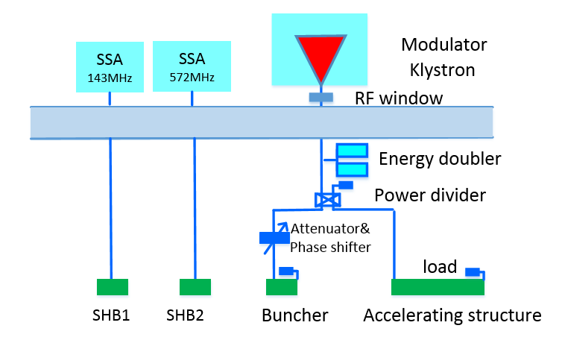
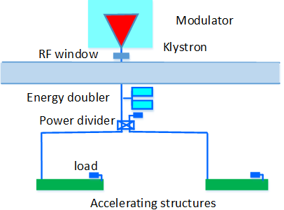
直线加速器简介

Slide 5
需要解决的技术问题
List of events to be completed Issues
Accelerating structure
Positron source
Electron gun
SHB1
SHB2
Buncher
Big hole accelerating structure
Pulse compressor
650MHz RF cavity
……

Slide 6
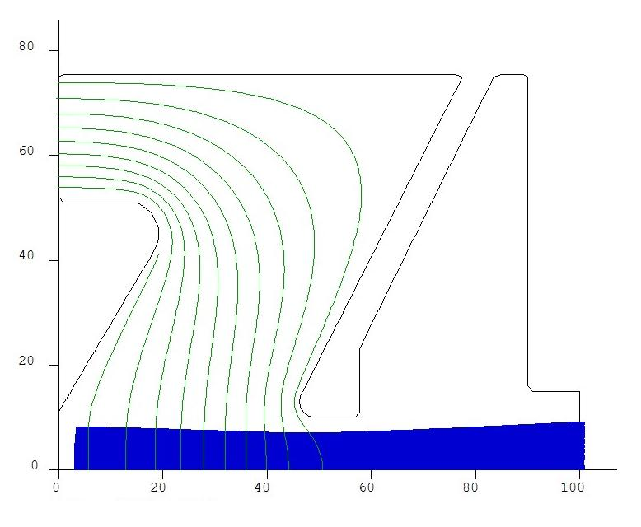
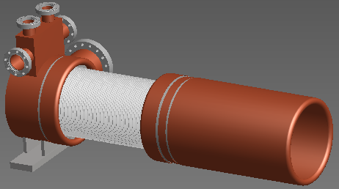
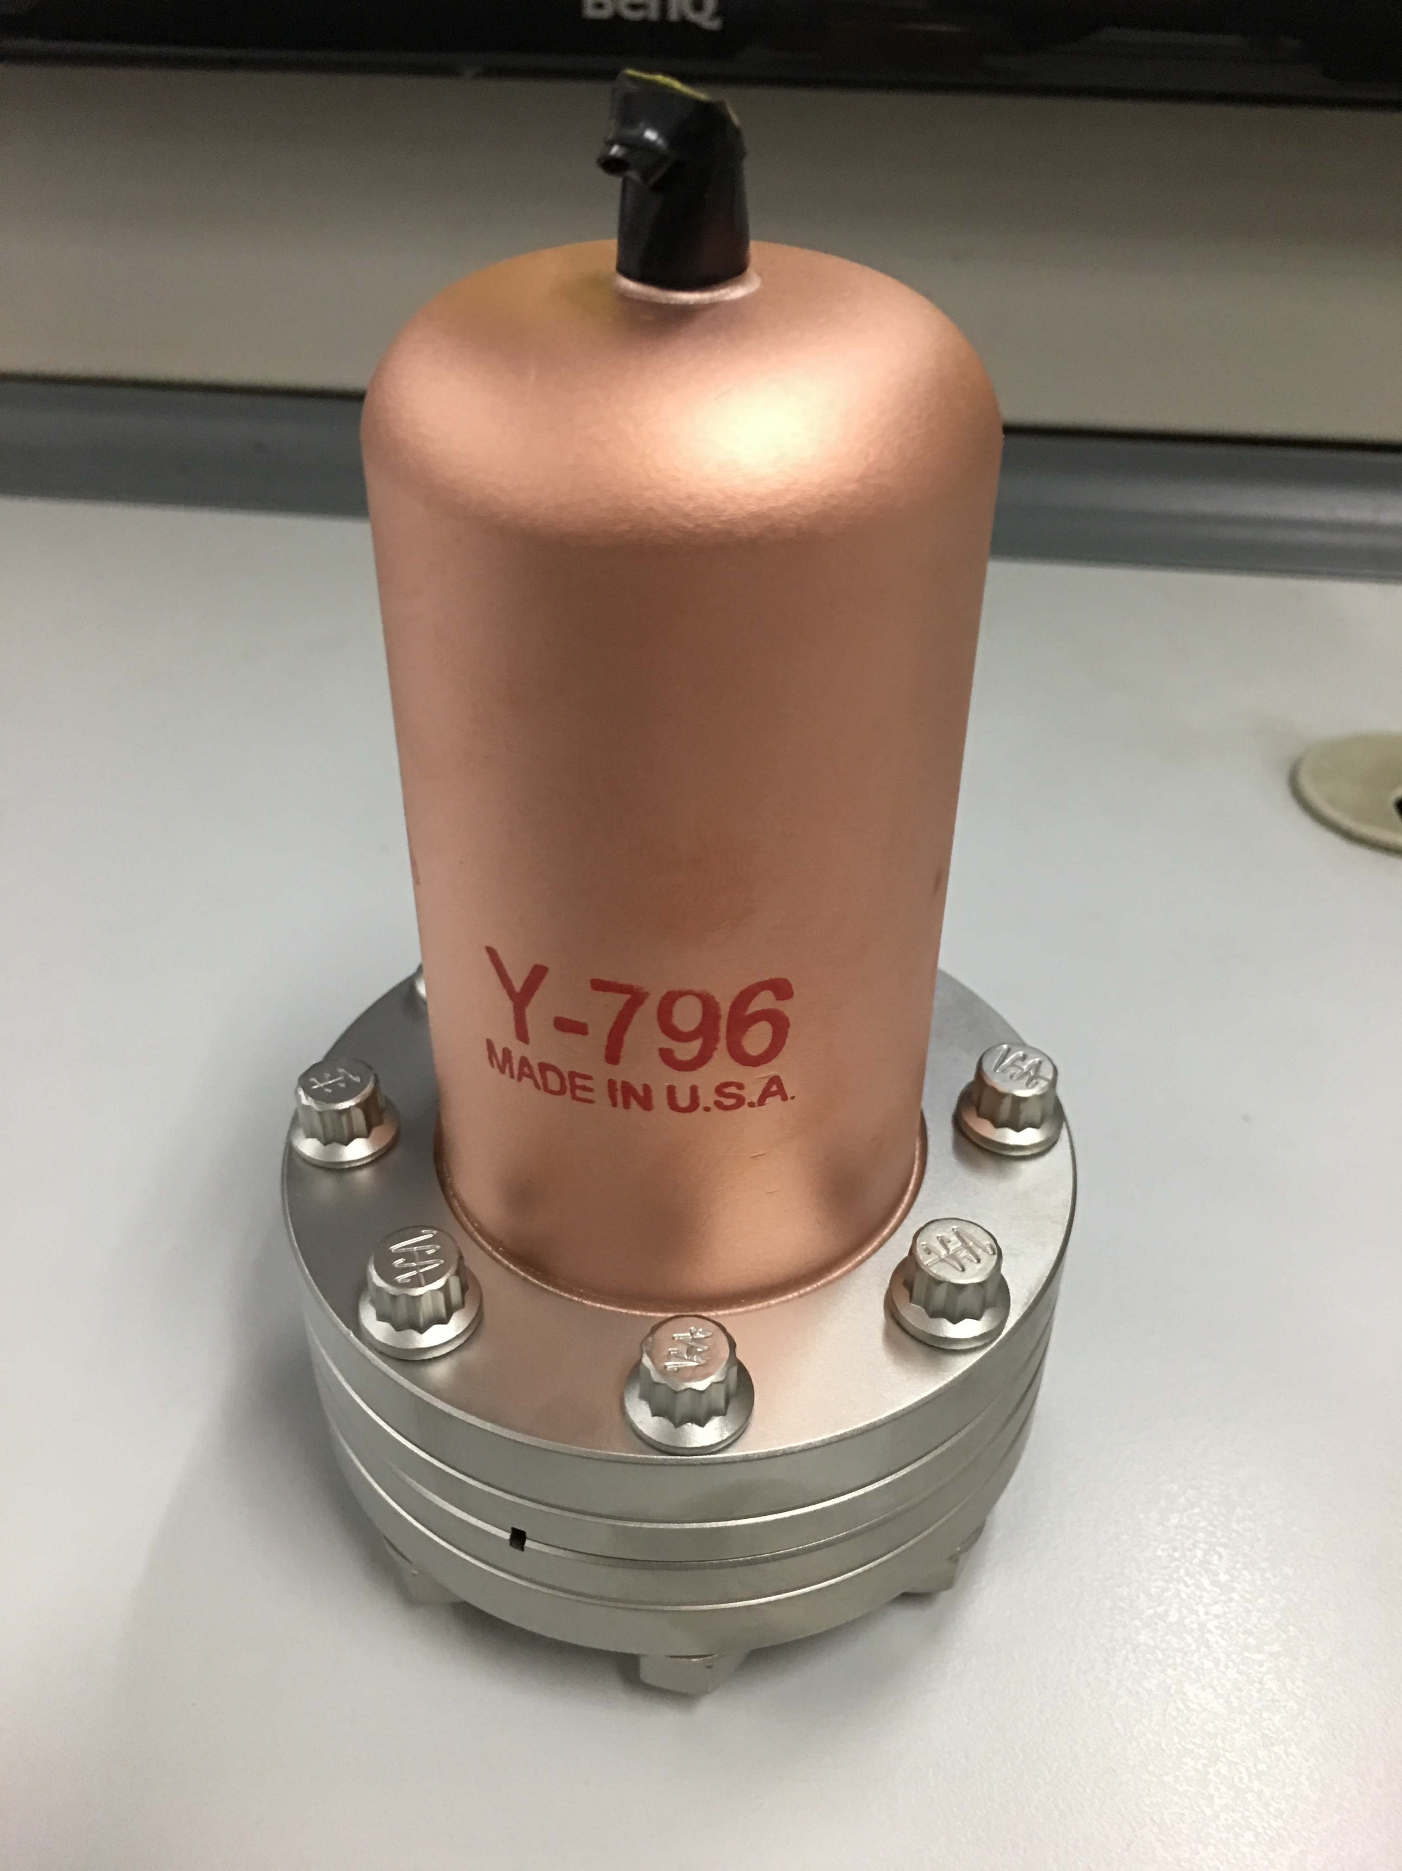
需要解决的技术问题
Thermionic electron gun
Pulser System
High Voltage System
Parameters | Values
Type | Triode
Maximum Beam Current(A) | 10
Anode High Voltage(kV) | 120~200
Filament voltage(V) | 6~8
Filament current(A) | 5~7.5
Grid bias voltage(V) | 0~200
Pulse width (ns) | 1
Pulse rate (pps) | 100
Beam trajectory of the injector electron gun
EIMAC-Y796 cathode-grid assembly
Cathode grid assemble
Current situation: EIMAC(USA) monopoly, price increase year by year and embargo at any time.

Slide 7
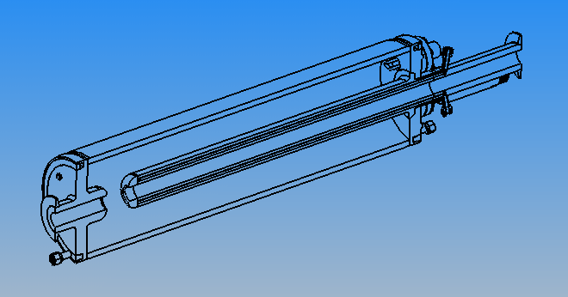
需要解决的技术问题
SHB1
It is successfully used at BEPCII
The frequency is deferent
Need re-design
First sub-harmonic pre-buncher
Type | Re-entrant
Frequency | MHz | 143
Unloaded Q |  | 8175
Shunt impedance | MΩ | 1.4
E_{surface, max}/E_{gap, max} |  | 2.53
SHB1 assembly
SHB1 cut view

Slide 8
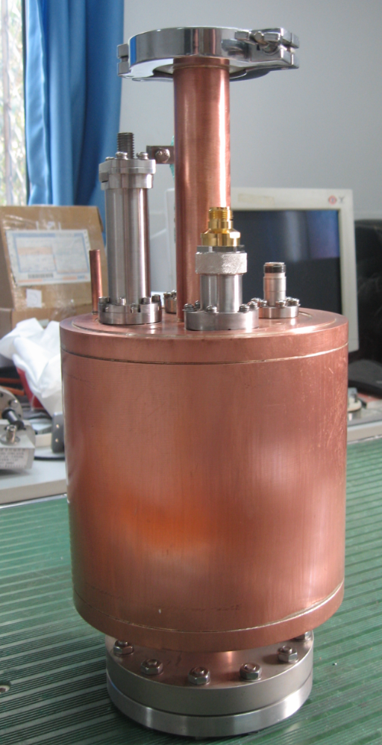
需要解决的技术问题
SHB2
It is successfully used at BEPCII
The frequency is deferent
Need re-design
Second sub-harmonic pre-buncher
Frequency | MHz | 572
Unloaded Q |  | 13000
Shunt impedance | MΩ | 3.7
E_{surface, max}/E_{gap, max} |  | 2.44

Slide 9
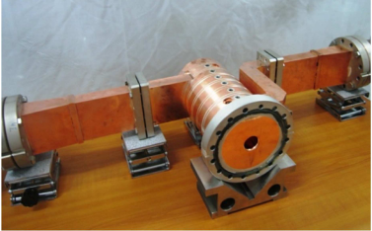
需要解决的技术问题
Buncher
It is successfully used at BEPCII
The frequency is deferent
Need re-design
parameters | value | unit
frequency | 2860 | MHz
mode | 2π/3 | -
Cell number | 6 | -
vp | 0.75 | -
a | 24 | mm
vg | 0.0193 | -
τ | 0.147 | Np/m
Shunt impedance | 33.2 | MΩ/m
Q | 11083 | -
VSWR | ≤1.1 | -
Input power | 2.5 | MW
type | 行波等阻抗 | -

Slide 10
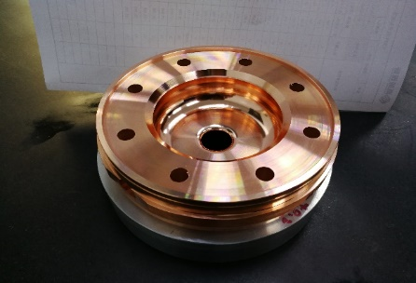
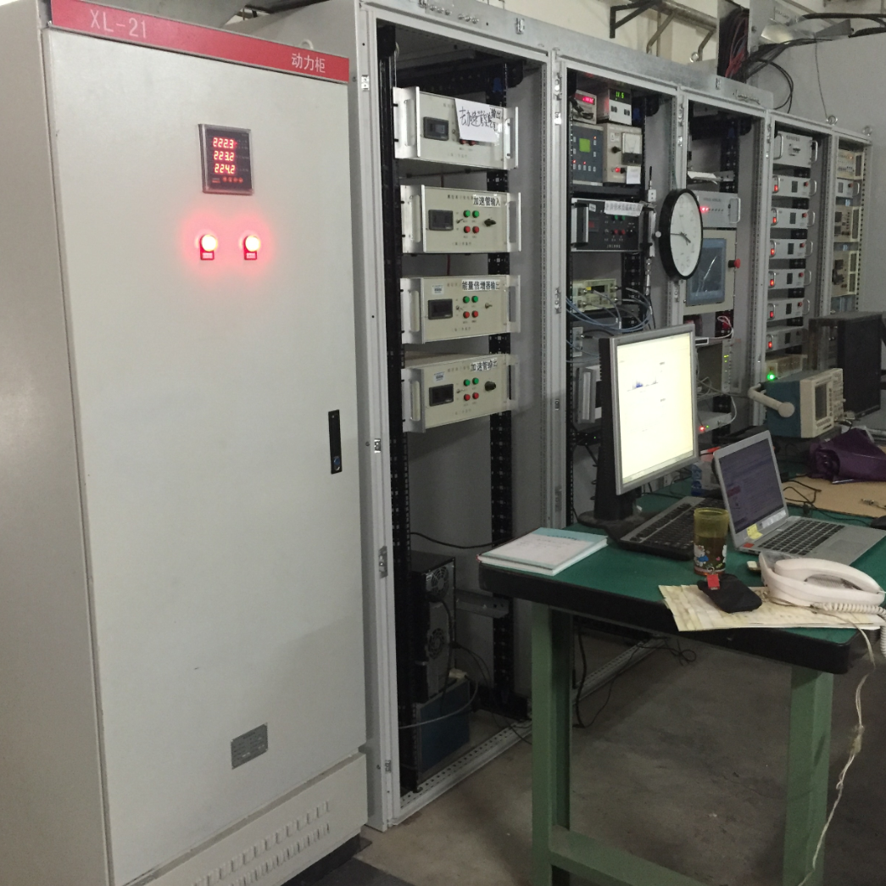
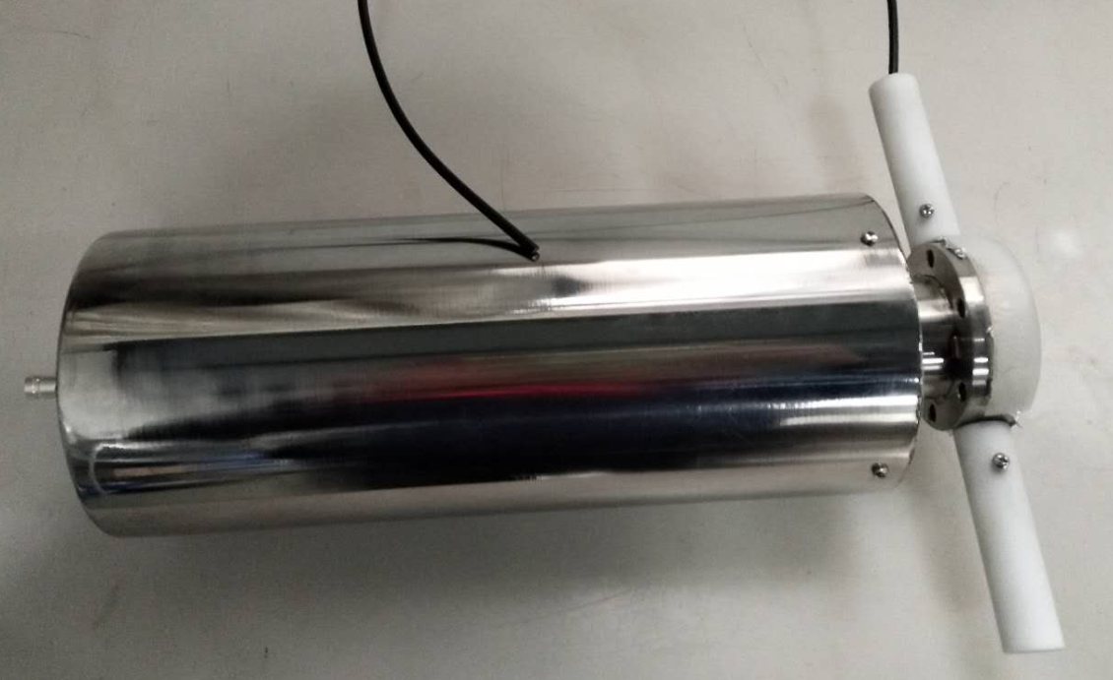
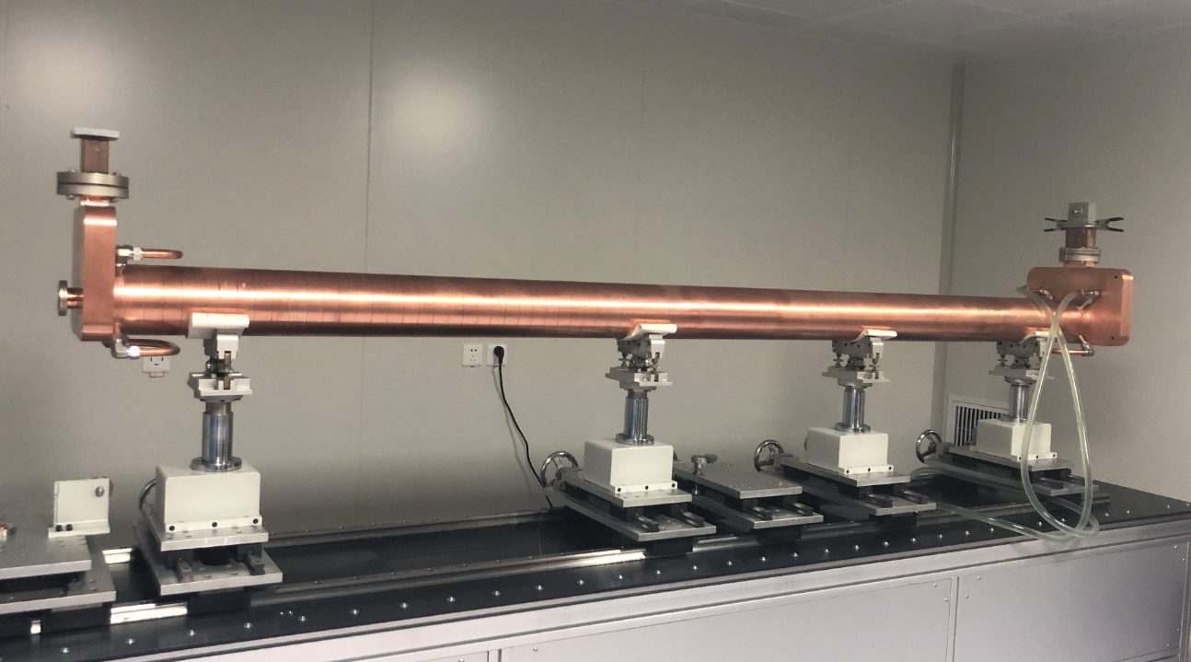
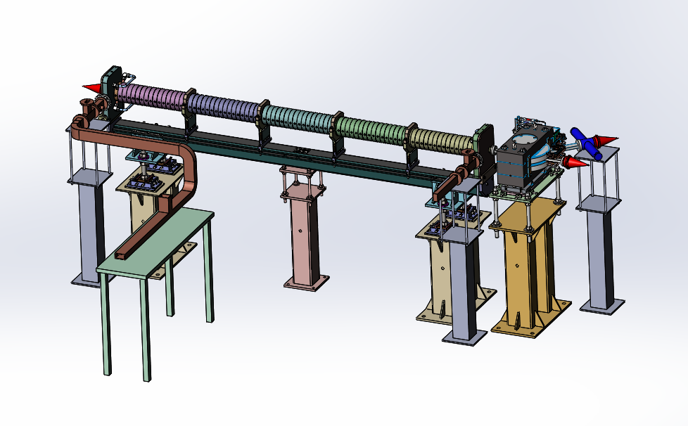
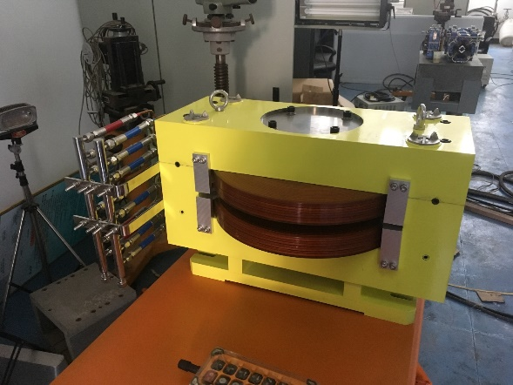
需要解决的技术问题
S-band accelerating structure design
Mechanical design
High power test bench
The power source is available at IHEP
The high power test will begin recently

Slide 11
需要解决的技术问题
Big hole accelerating structure
Constant impedance
Processing technology is similar as the regular 3m long accelerating structure
Preliminary design parameters
Parameters | value | Unit
Operating frequency | 2860 | MHz
Operating temperature | 30.0 ± 0.1 | ºC
Number of cells | 55 +2 coupler cells
Section length | 2 | m
Phase advance per cell | 2π/3 - mode
Cell length | 34.966 | mm
Disk thickness (t) | 5.5 | mm
Iris diameter (2a) | 25 | mm
Cell diameter (2b) | 89.475 | mm
Shunt impedance (r0) | 60.8 | MΩ/m
Q factor | 15448
Group velocity (vg/c) | 0.019
Filling time | 336 | ns
Attenuation factor | 0.195 | Neper

Slide 12
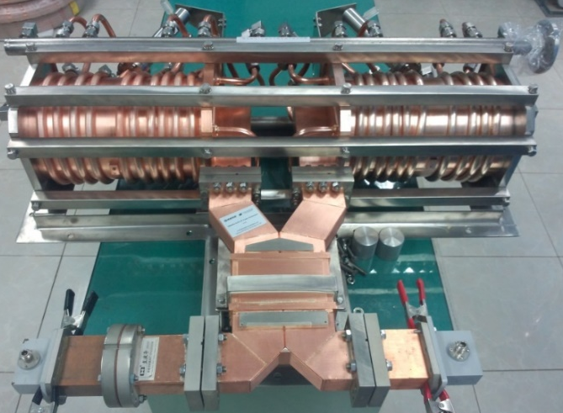
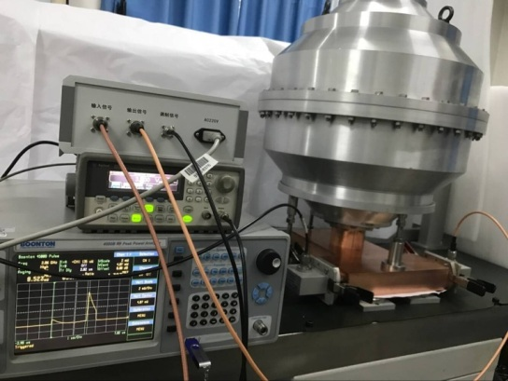
需要解决的技术问题
Pulse compressor
According to the performance of the accelerating tube, determine the parameters of the pulse compressor
The spherical cavity is a new type of design in recent years
Advantages:
Low temperature stability requirements
Almost no radiation
Two cavities
Parameters | value
frequency | 2860MHz
VSWR | ≤1.1
Tuning range | ≥±500kHz
Peak power | ≥80MW
Repetition frequency | 100Hz
Pulse length | ~4µs
Output pulse length | ~0.8µs
Work temperature | 30±0.1ºC
Vacuum leakage rate | ≤ 2×10⁻¹⁰ Torr.L/Sec
Spherical cavity

Slide 13
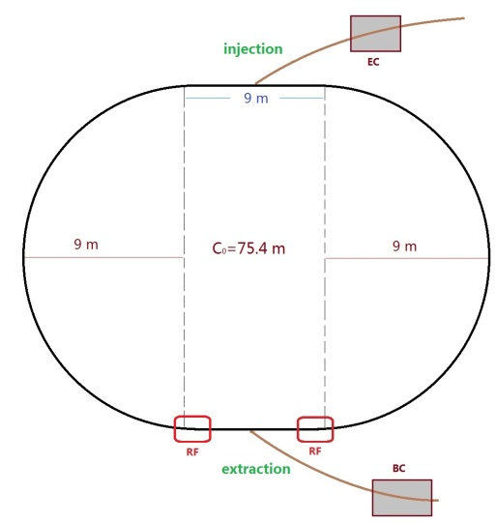
需要解决的技术问题
Damping ring
DR V2.0 | Unit | Value
Energy | GeV | 1.1
Circumference | m | 75.4
Storage time | ms | 20
Bending radius | M | 3.565
Dipole strength B₀ | T | 1.03
U₀ | keV | 36.3
Damping time x/y/z | ms | 15.2/15.2/7.6
δ₀ | % | 0.05
ε₀ | mm.mrad | 376.7
σ_{z，inj} | mm | 5.0
Nature σ_{z} | mm | 7.5
ε_{inj} | mm.mrad | 2500
ε_{ext x/y} | mm.mrad | 530/180
δ_{inj} /δ_{ext} | % | 0.2/0.05
Energy acceptance by RF | % | 1.0
f_{RF} | MHz | 650
V_{RF} | MV | 2.0
D, Wang

Slide 14
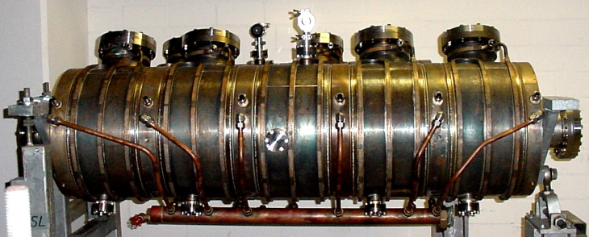
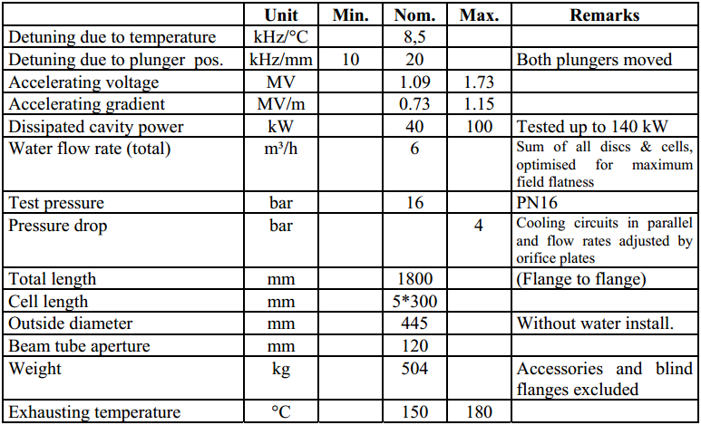
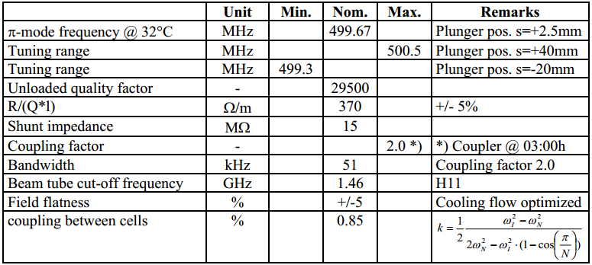
需要解决的技术问题
DESY 500MHz, 5-cell cavity
Frequency: 499.7MHz
Accelerating voltage: 1.09MV
Accelerating gradient: 0.73MV/m
Length: 1800mm
Without HOM damper
DatenblattVers.2.0,500MHz,5-cellCavity HERA-Type, 2010

Slide 15
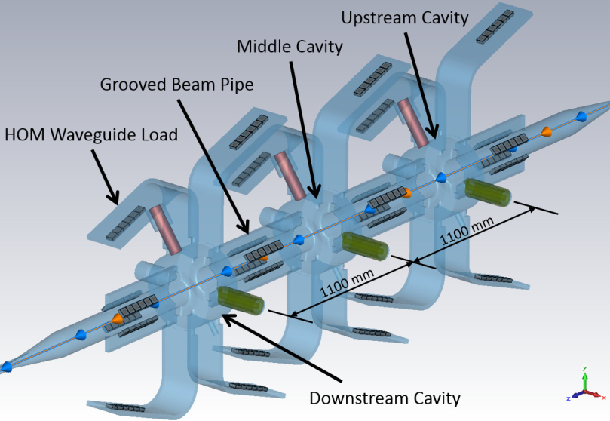
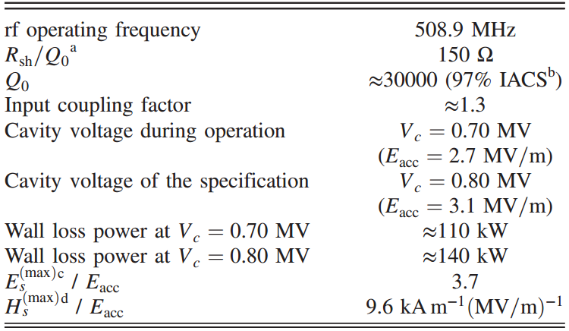
需要解决的技术问题
SuperKEKB DR 509MHz RF cavity
Frequency: 508.9MHz
Accelerating voltage: 2MV(total)
Accelerating gradient: 2.7MV/m
Length: 1100mm
With HOM damper
1. RF Cavities for SuperKEKB MRs and DR, 2014
2. PHYSICAL REVIEW ACCELERATORS AND BEAMS 19, 102001 (2016)

Slide 16
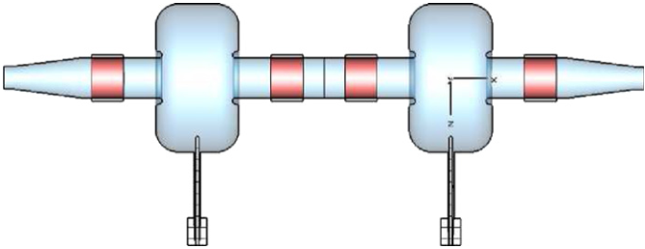
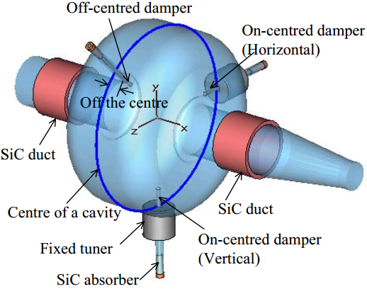
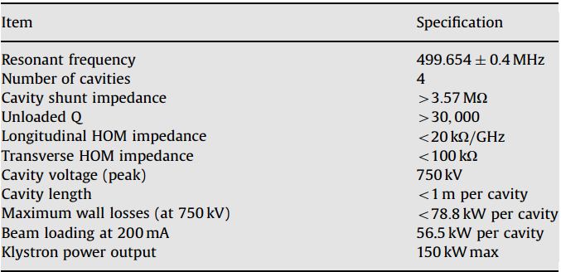
需要解决的技术问题
Australian synchrotron 500MHz RF cavity
Made by Toshiba
Frequency: 499.7MHz
Accelerating voltage: 750kV
Accelerating gradient: 0.75MV/m
Length: <1m
With HOM damper
1. Nuclear Instruments and Methods in Physics Research A 592 (2008) 224– 229
2. HIGHER ORDER MODE (HOM) DAMPER OF 500MHZ DAMPED CAVITY FOR ASP STORAGE RING, EPAC 2006

Slide 17
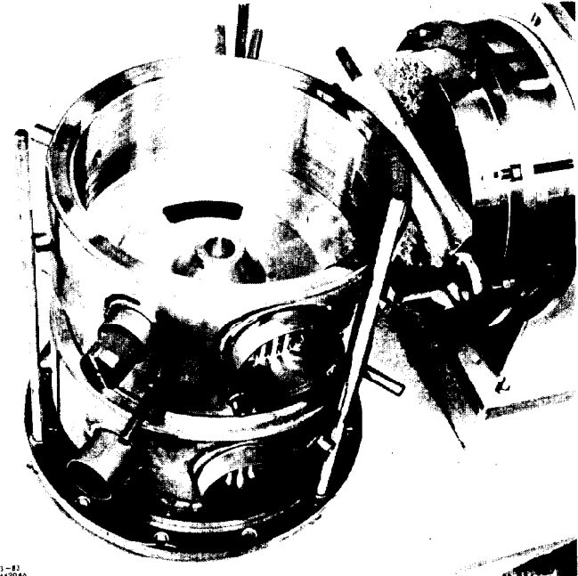
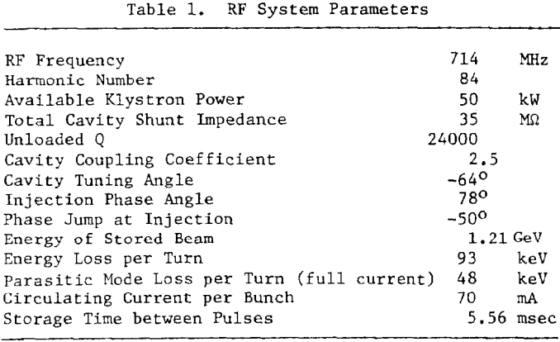
需要解决的技术问题
SLC DR 714MHz RF cavity
2 cell RF cavity
Frequency: 714MHz
Accelerating voltage: 800kV
Number of cavities: 2
DAMPING RING RF SYSTEM FOR SLC IEEE Transactions on Nuclear Science, Vol, NS-30, No. 4, August 1983

Slide 18
TDR阶段各系统时间表
Time: 2019.1-2022.12
Accelerating structure
Based on the high power test, optimize the accelerating structure continuously
Complete the TDR
Electron gun & SHB1 & SHB2 & buncher & Big hole accelerating structure
Finish the RF simulation, physical design, thermal analysis and mechanical design
Complete the TDR
pulse compressor
Finish the RF simulation and physical design and mechanical design
Complete the processing of one prototype cavity
Complete high power test
Complete the TDR
650 MHz RF cavity
Physical design
Finish the RF simulation and physical design and mechanical design
Complete the processing of one prototype cavity
Complete high power test ？
Complete the TDR

Slide 19
谢谢！

