Slide 1
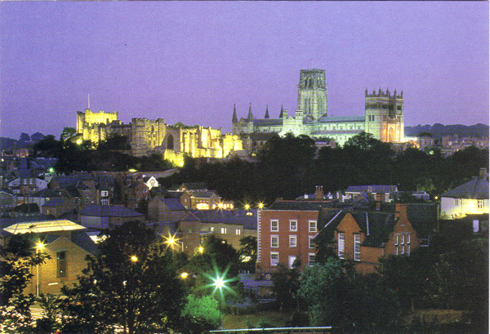
Broadband spectra of AGN
Chris Done, University of Durham
Martin Ward, Chichuan Jin, Andreas Schultz
Kouchi Hagino, Aya Kubota, Misaki Mizumoto, Hirofumi Noda…

Slide 2
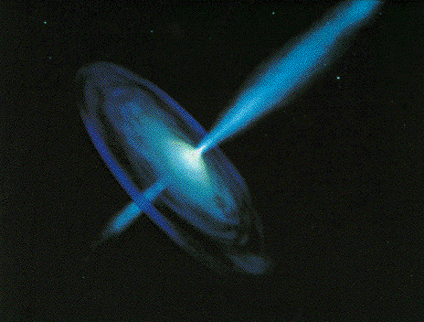
Supermassive black holes
Understand the accretion flow
And AGN feedback via jet & winds from flow
And cosmology..
3 fundamental parameters
Mass, Mdot, spin
Plus maybe some second order effects from non steady state or history or environment

Slide 3

Scaling Black holes
3 fundamental parameters
Mass, Mdot, spin
BONUS SET – BHB
Same mass (factor 2)
Same spin CC SNR (?) low/moderate GW (??)
One main parameter: Mdot

Slide 4
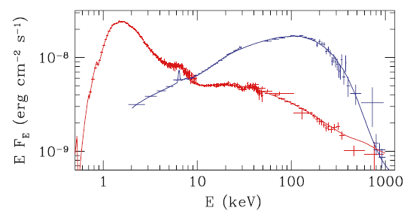
Two types of spectra in stellar BH
Disk dominated
Comptonised spectrum
Cyg X-1
Gierlinski et al 1999

Slide 5
Compton dominated low/hard
Hard spectra can’t have disc underneath isotropic X_ray emission
Reprocessing Γ>1.95
•
m_{c} →L_{c}
thermal
•
m_{d}→L_{d}
Haardt & Maraschi 1991,1993
Malzac et al 2005
Poutanen et al 2017

Slide 6
Theory of accretion flows
IR opt UV X-ray
IR opt UV X-ray
Log ν fv(ν)
Log ν fv(ν)
Log ν
Log ν
Discs – geometrically thin, cool, optically thick SS73
Plus X-ray tail/corona
‘ADAF’– geometrically thick, hot, optically thin
Only low L/Ledd Narayan & Yi 1995

Slide 7
BHB accretion
Complex around Ledd?
Disc dominated state –Shakura-Sunyaev disc equations!!
X-ray corona
Complex transition ~0.02LEdd
ADAF – X-ray hot flow, disc truncated at >20Rg
L/LEdd
Notes:
The disc models assumed that the emission thermalised. That’s not necessarily true at low L/Ledd where the flow is not very dense. If its not thermalising then its not cooling as efficiently so the flow heats up. This can lead to a hot, optically thin, geometrically thick inner flow replacing the inner disc. The hot electrons in this flow can compton upscatter any low energy photons from a residual outer disc, but there are not many of these, so the spectrum is hard

Slide 8
Spectral states - BHB
Dramatic changes in continuum – single object, different days
Underlying pattern in all systems
High L/L_{Edd}: soft spectrum, peaks at kT_{max} often disc-like, plus tail
Lower L/L_{Edd}: hard spectrum, peaks at high energies, not like a disc (McClintock & Remillard 2006)
Gierlinski & Done 2003

Slide 9
Scaling black hole accretion flow
Scale up to AGN
Bigger mass!
Disc temp lower – peaks in UV (more power, but more area!)
ATOMIC PHYSICS
Radiation pressure dominant, smaller disc…
Larger RANGE in mass –from 10⁵-10¹⁰M
And maybe bigger range in spin??

Slide 10
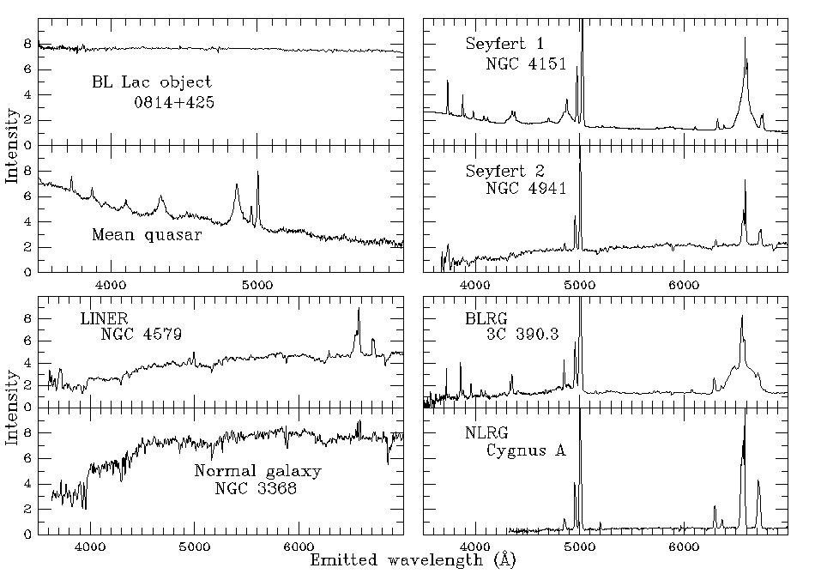
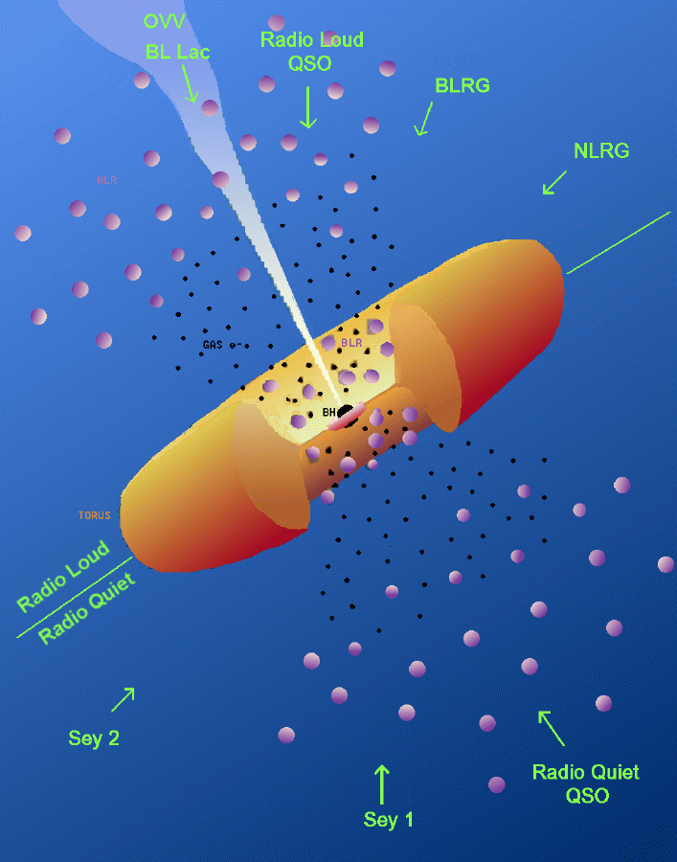
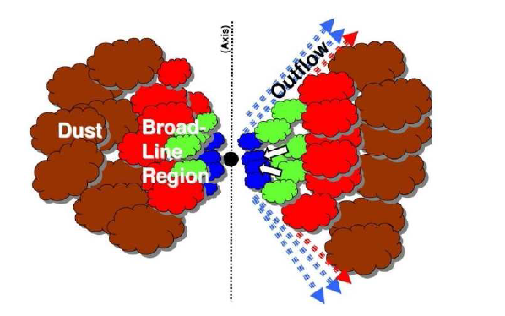
And Inclination
AGN: complex environment
From now on take only
UNOBSCURED

Slide 11
Spectral states - BHB
Dramatic changes in continuum – single object, different days
Underlying pattern in all systems
High L/L_{Edd}: soft spectrum, peaks at kT_{max} often disc-like, plus tail
Lower L/L_{Edd}: hard spectrum, peaks at high energies, not like a disc (McClintock & Remillard 2006)
Gierlinski & Done 2003

Slide 12
Spectral states – AGN
T⁴ ~ (Mdot/M)
10Msun to 10⁸ Msun
E (eV)
Gierlinski & Done 2003

Slide 13
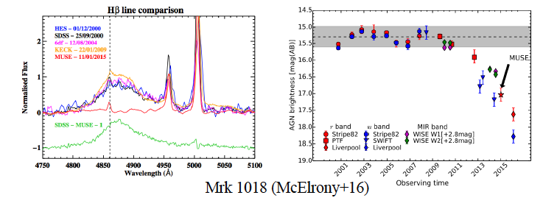
Changing look (state!) AGN
Broad lines disapear/drop substantially
Disc continuum (opt/UV) drops substantially

Slide 14
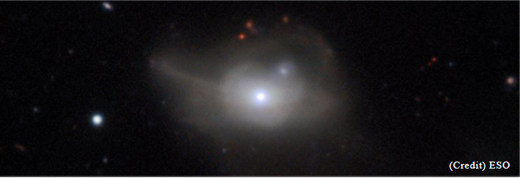
Host galaxy contaminates optical

Slide 15
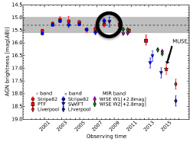
Changing-look (state!) AGN
Noda & Done 2018

Slide 16
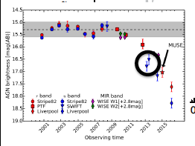
Changing-look (state!) AGN
Noda & Done 2018

Slide 17
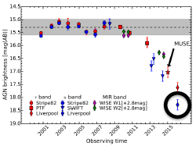
Changing-look (state!) AGN
Noda & Done 2018

Slide 18
Two types of spectra in stellar BH
AND IN CL-AGN
Disk dominated
Comptonised spectrum
Cyg X-1
Gierlinski et al 1999

Slide 19
Sample of changing state AGN ~ 0.01Ledd
Ruan et al 2019
Squares – type 1
Circles - change

Slide 20
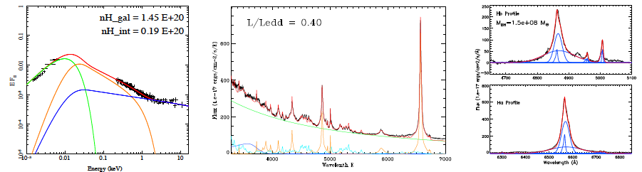
Need M and L/LEdd – SDSS!
Range in mass 10⁵-10¹⁰
BH mass from optical spectra (Hb & Lopt)
Line peaks at ξ_{c} = Lion/n_{c}R²
R α Lion^{1/2} α L₅₁₀₀^{1/2} ?
Ionising flux for Hb and LIL fairly close to 5100A..

Slide 21
Need M and L/LEdd – SDSS!
Disk T with L/Ledd monochromatic L increases less than Lbol
L₅₁₀₀ α (M Mdot)^{2/3} cos i SS73, Collin et al 2004 Davis & Laor 2011
M = 20.1 (L_{5100,44}/μ)^{1.5} M₇⁻² η
Log ν f(ν)
Wang, Du et al 2014…
Log ν

Slide 22
All within factor 2 of same mass!
L/Ledd~0.03 0.1 0.3
NGC5548
Mrk509
PG1115
Clear change in SED with increasing L/Ledd
UV disc increases more than X-rays (Lusso & Risaliti 2017)
If X-rays are only optical/UV variability then MUCH more at low mdot than at high as larger Lx/LUV

Slide 23
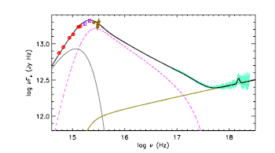
What is the accretion flow?
Mkn 509 - 10⁸M L/LEdd~0.1 (take out warm abs!)
Not disc dominated - far too low temperature! Plus strange soft X-ray excess….What is this????
Medhipour et al 2011

Slide 24
Classic QSO?
Single low temperature, optically thick compton component connecting UV-SX (Mehdipour et al 2011)
3 regions:outer standard disc, soft X-ray excess, hot flow
Medhipour et al 2011

Slide 25
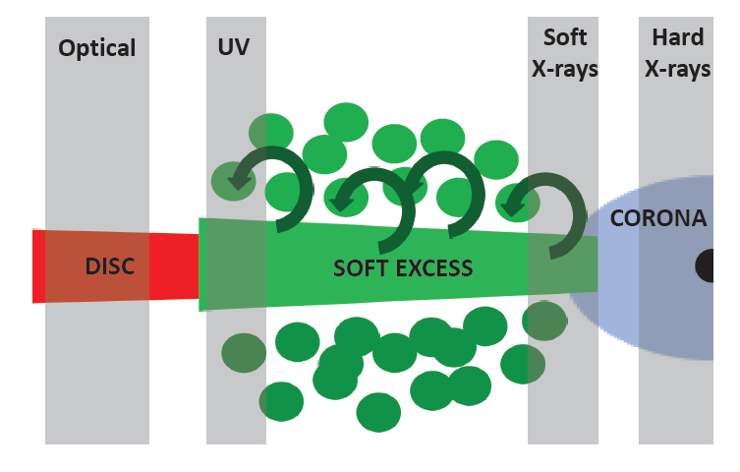
Nature of soft excess region?
Why??
UV bright region of disc, 10⁴K?
Failed UV line driven disc wind?? Or Fe opacity bump at 10⁵K …but powered by gravity
Gardner & Done 2017 Mehdipour et al 2015
Optical UVW1
hard X soft X FUV

Slide 26
How to describe this globally?
L/Ledd~0.03 0.1 0.3
NGC5548
Mrk509
PG1115
Lx/Ledd ~0.02 ~0.02 ~0.02
Luv/Ledd~0.01 ~0.08 ~0.28

Slide 27
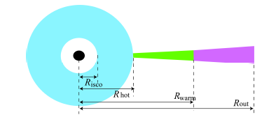
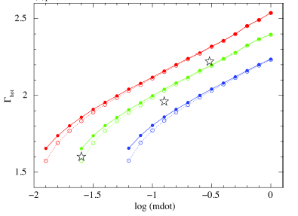
Lx- 0.02LEdd!! Lseed/Lx sets Γ
Kubota & Done 2018
Describe the global correlations if Lx=0.02LEdd
Stronger disc at high L/Ledd (Lusso & Risaliti 2017)
Lx/LUV sets high energy Compton spectral index L/Ledd - Γ
0.01 0.02 0.05

Slide 28
QSOSED – mass and mdot (spin)
Model incorporating all global relations - Kubota & Done 2018
UV disc increases more than X-rays (Lusso & Risaliti 2017)
Lx/LUV sets high energy Compton spectral index L/Ledd - Γ
LEdd
LEdd
2x10⁸Msun
2x10⁶Msun
0.03LEdd
0.03LEdd

Slide 29
QSOSED – mass and mdot (spin)
L/Ledd is biggest factor (eigenvector 1)
Mass has smaller BUT STILL IMPORTANT effect (eigenvector 2)
alpha-OX or alpha –UX is mass dependent!
Use qsosed to guess your broadband continuum if all you have is F5100!
Publicly available in xspec – or pyxspec

Slide 30
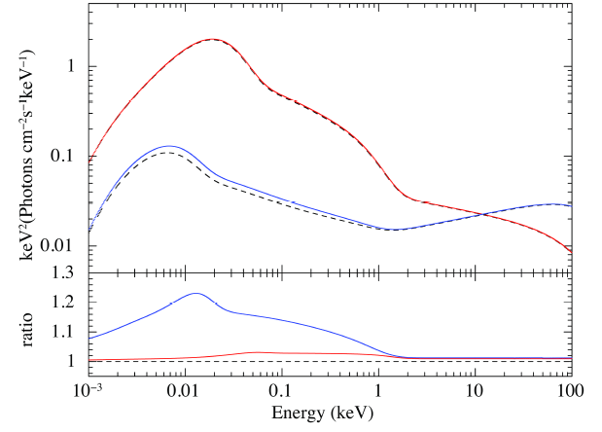
Spectral change with Mdot
Kubota & Done 2018
Lx illuminates disc – predicts variable Lopt from reprocessing
Larger contribution from reprocessing at low L/Ledd so higher variability !!
Lx/L_{UVO} sets max reprocessing
SO PLOT SPECTRUM
L/LEdd =1
0.03

Slide 31
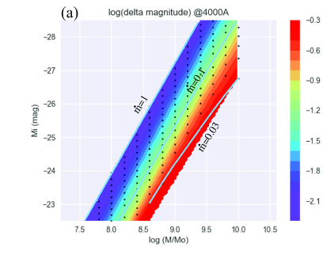
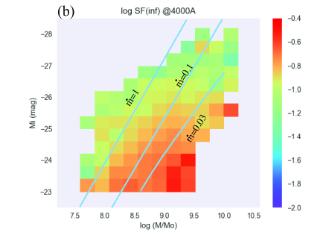
Spectra change mass and Mdot
Predicted variability in optical from changing X-rays by factor 2
Observed (SDSS 82) !!
Need intrinsic disc variability at high L/Ledd
Changing look: 0.02LEdd
Kubota & Done 2018
Macleod et al 2010

Slide 32
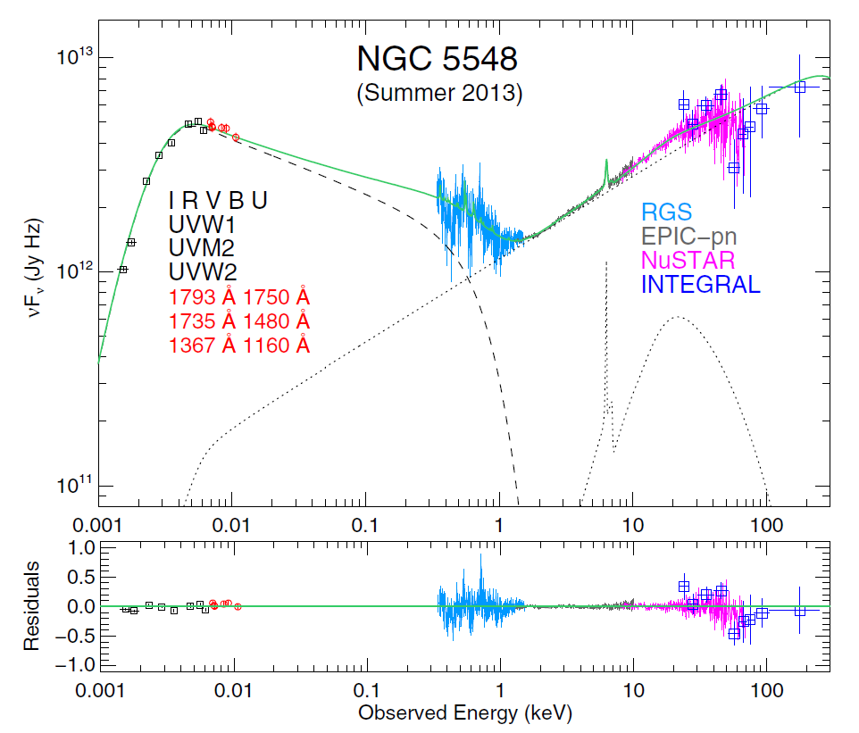
Most Opt variability – LEAST DISC
Hard X-ray source has no disc underneath
Need all gravitational power from <50Rg to power Lx
UVW1
BAT
Mahmoud
& Done
2019
NGC4151

Slide 33
Most Opt variability – LEAST DISC
often complex variable absorbion!
UVW1
BAT
Mahmoud
& Done
2019
NGC4151

Slide 34
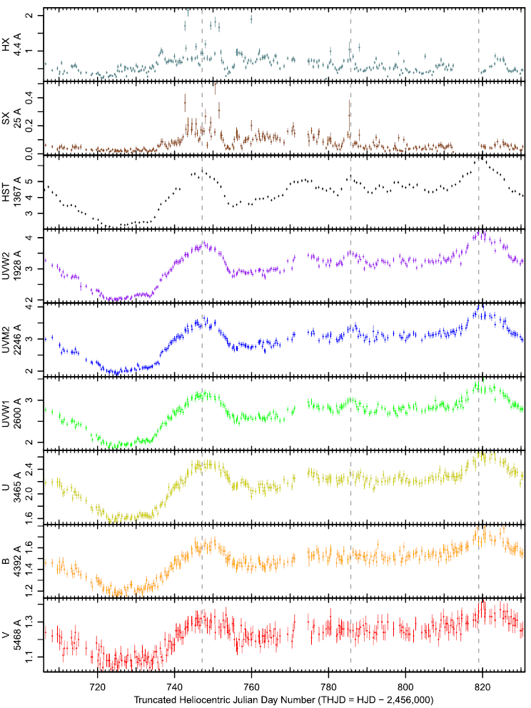
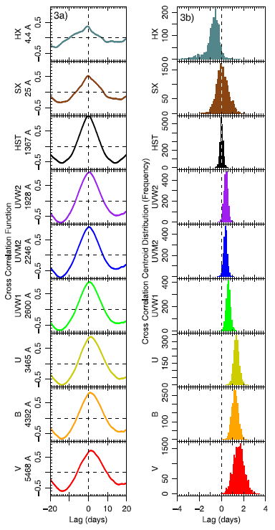
Test with RM UVW1 – NGC5548
SX/HX fast var – not in UV/opt
Hard X
Soft X
FUV
UVW1
V

Slide 35
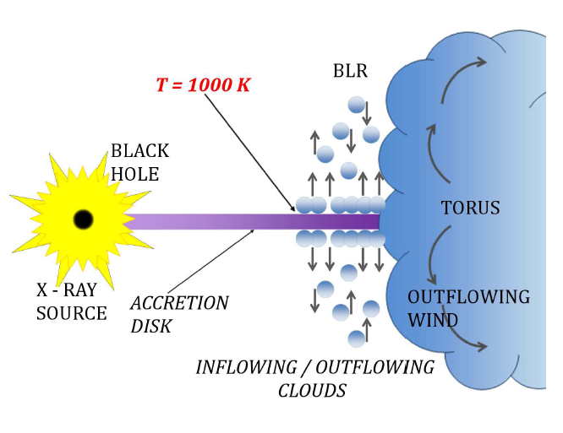
1-3 ld lag not disc as <1 ld not BLR as 15ld
Clouds Re-emit Flux as Lines AND CONTINUUM
UV region illuminates
Outer disc and BLR
Gardner & Done 2017
Czerny et al. 2015
Gardner & Done 2017

Slide 36
Contamination from the BLR?
1-3 ld lag - BLR is 5ld
Clouds Re-emit Flux as Lines AND CONTINUUM
UV region illuminates
Outer disc and BLR
Czerny et al. 2015
Gardner & Done 2017

Slide 37
Contamination from the BLR?
No response <500-1500Rg in NGC5548
Clouds Re-emit Flux as Lines AND CONTINUUM
UV region illuminates
BLR
Czerny et al. 2015
Gardner & Done 2017

Slide 38
Conclusions
Black hole flows depend on mass, L/Ledd and spin.
BHB transition : Disc to ADAF around 0.01Ledd
AGN: Use optical spectra to get M and M
AGN transition CLQ: UV collapses at around 0.01LEdd
Systematic shape change of SED with L/Ledd controls maximum opt/UV variability from hard X-rays
SHOW THE SED!!!
NGC5548 clearly see LARGE FRACTION of UV/opt from BLR scales NOT from accretion flow
models are MISSING an important variable component!
Notes:
The disc models assumed that the emission thermalised. That’s not necessarily true at low L/Ledd where the flow is not very dense. If its not thermalising then its not cooling as efficiently so the flow heats up. This can lead to a hot, optically thin, geometrically thick inner flow replacing the inner disc. The hot electrons in this flow can compton upscatter any low energy photons from a residual outer disc, but there are not many of these, so the spectrum is hard

