Slide 1
Selected Results from the Monitoring of AGN with Hβ Asymmetry (MAHA) Campaign
J.N. McLane
Collaborators: Michael Brotherton, Du Pu, Wang Jain-Min, Hu Chen, Yan-Rong Li, Ming Xaio, Dong-Wei Bao, Bixuan Zhao, Kianna Olson, and the MAHA Collaboration
Notes:
Test notes

Slide 2
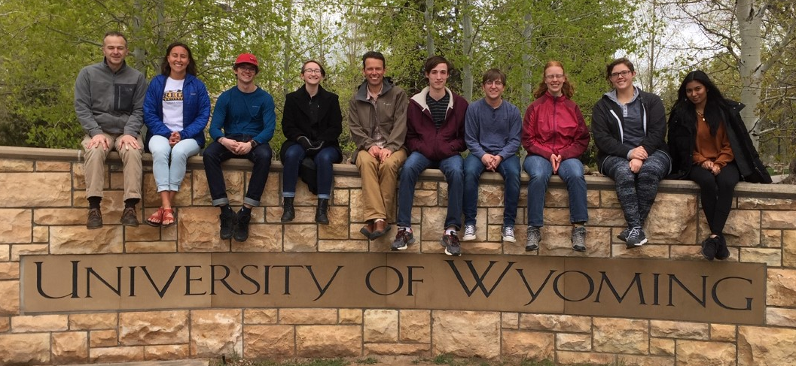
REU Students

Slide 3
MAHA Refresher
~60 AGN with z < 0.4, V < 17:
Asymmetric Hbeta profiles
Double-Peaked Hbeta profiles
Binary Black Hole Candidates (e.g., periodicities, line shifts)
Other Interesting Behavior (e.g., changing asymmetries)

Slide 4
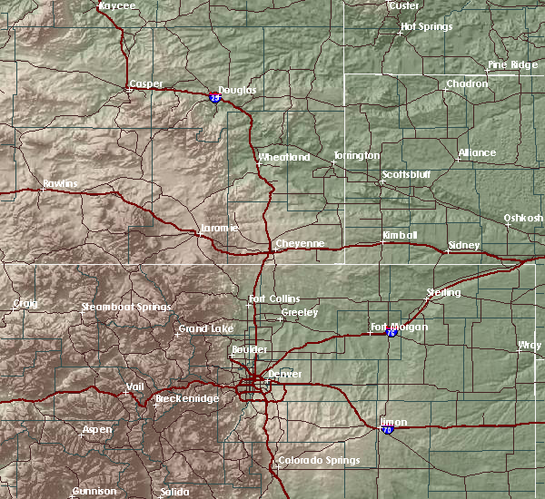
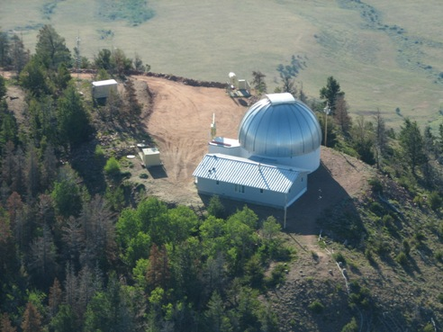
MAHA Refresher

Slide 5
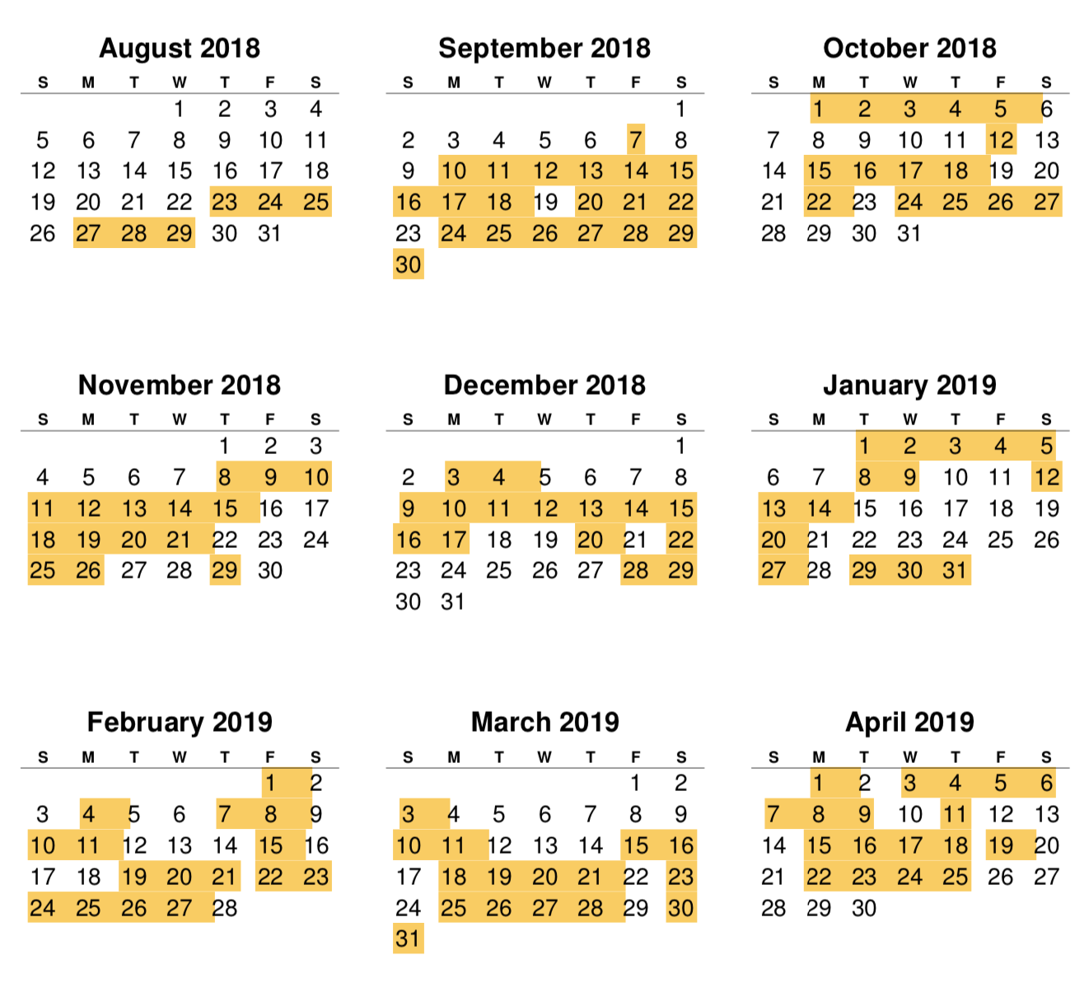
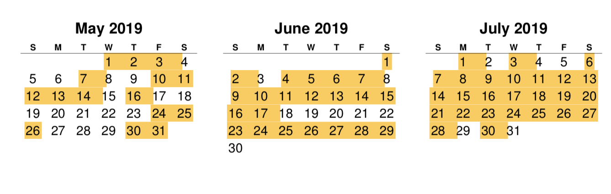
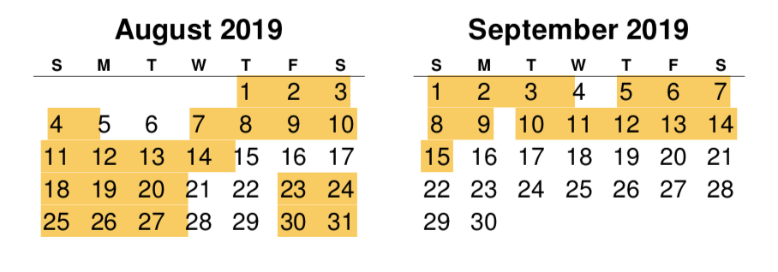
Observing – Season 3+
255 nights observed out of 389 (~66%).
Notes:
Explain 3+

Slide 6
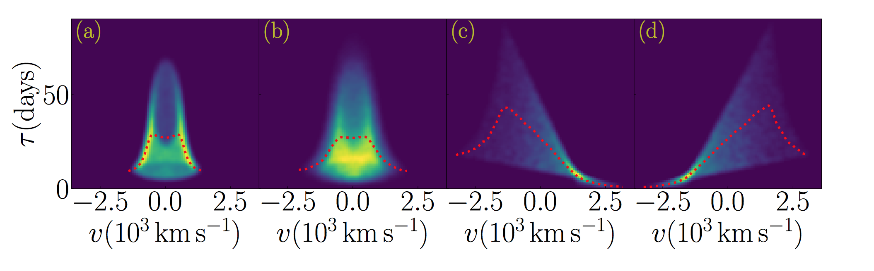
Example Theoretical 2D Velocity-Delay Maps
Thin Disk Thicker Disk Inflow Outflow
Wang et al. 2018
Notes:
Inflow and outflow, longer lags are farside, shorter near. If near (short redshifted, inflow, far (long) redshifted then outfolw
Material closer in faster, shorter timelags, material farther out slower

Slide 7
Targets
NGC 7469
Mrk 841
NGC 3227
Mrk 79
1ES0206+52

Slide 8
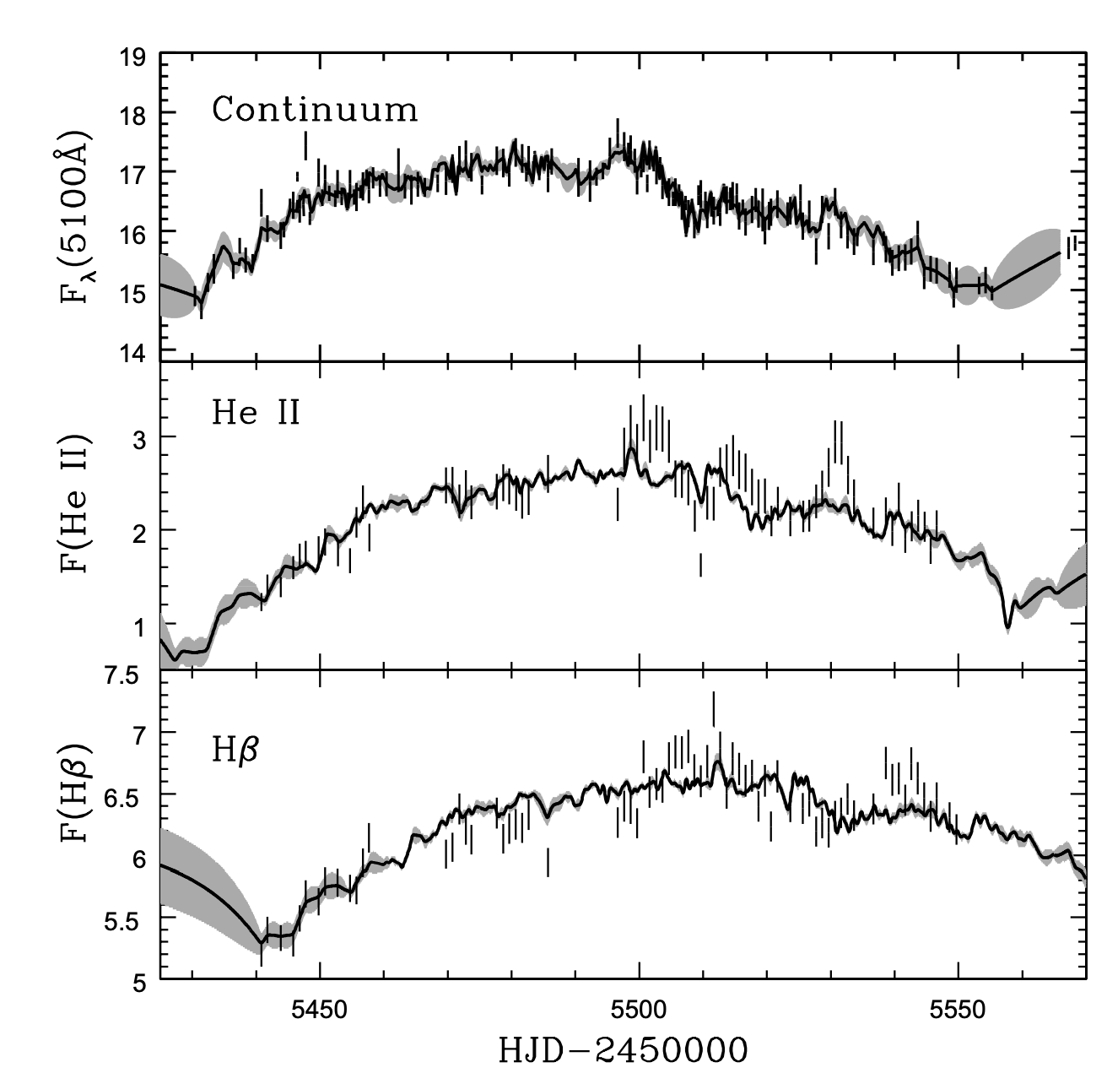
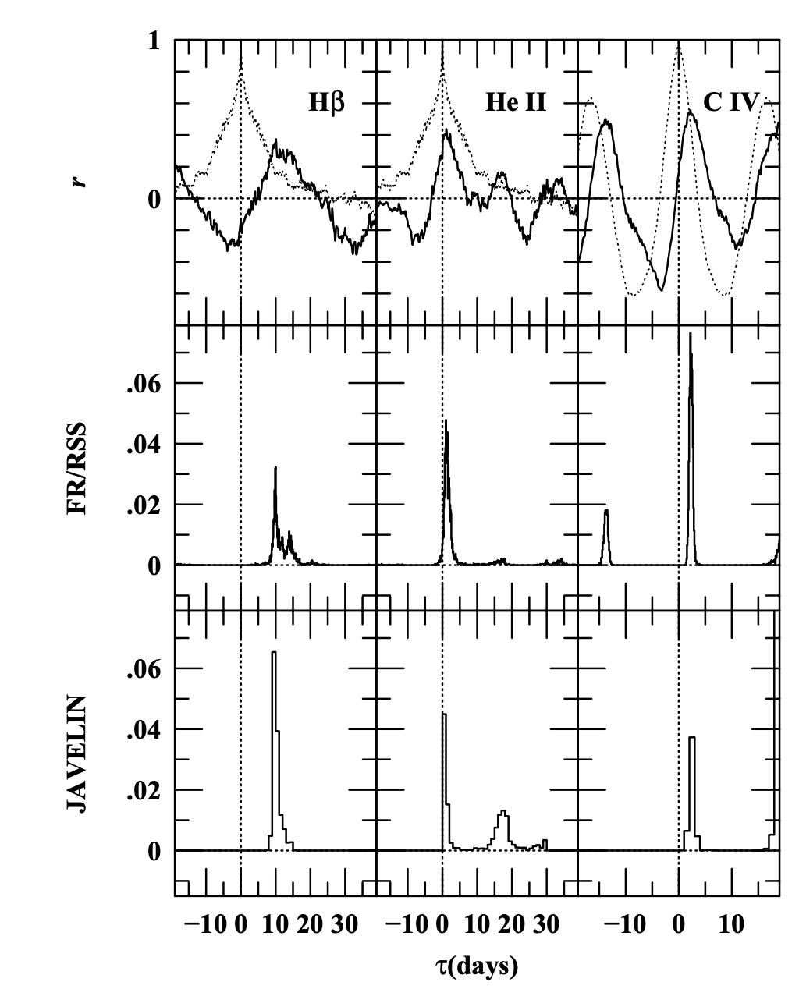
NGC 7469
Peterson et al. 2014

Slide 9
NGC 7469 – Season 3
τ_{cent} = 20.698 days

Slide 10
NGC 7469 – Season 3

Slide 11
NGC 7469 – Season 3+

Slide 12
Mrk 841 – Season 1
Brotherton et al. 2019
Notes:
Marginal result, not a clear velocity delay map

Slide 13
Mrk 841 – Season 2

Slide 14
Mrk 841 – Season 3+
τ_{cent} = 27.787

Slide 15
Mrk 841 – Season 3+

Slide 16
NGC 3227
Denney et al. 2009

Slide 17
NGC 3227
Top: Denney et al. 2009
Bottom: Brotherton et al. 2019

Slide 18
NGC 3227 – Season 1
Left: Denney et al. 2009
Right: Brotherton et al. 2019

Slide 19
NGC 3227 – Season 1
Left: De Rosa et al. 2018
Right: Brotherton et al. 2019

Slide 20
NGC 3227 – Season 1
See Xiao et al. 2018a,b for modeling info.
Brotherton et al. 2019
Notes:
Xaio ming, horne et al. 1991, yan-rong li has dynamical models in his talk for 3227 later today
V^2tC/G = m

Slide 21
Mrk 79 – Season 1
Brotherton et al. 2019
Notes:
Mention Assassin, Lu discussed yesterday

Slide 22
Mrk 79 – Season 1
Brotherton et al. 2019
Notes:
Mention Assassin

Slide 23
Mrk 79 – Season 1
Brotherton et al. 2019

Slide 24
Mrk 79 – Year 1
Brotherton et al. 2019

Slide 25
Mrk 79 – Year 1
Brotherton et al. 2019
Notes:
inner and outer radii (Rin and Rout), the fractions of the virial, inflow, and outflow velocities (Fvirial, Fin and Fout), the inclination angle and the opening angle (θin and θo), and the spatial emissivity distribution factor γ of the BLR clouds (Rγ ) for the two disks.

Slide 26
1ES0206+52 – Season 3
τ_{cent} = 51.116
Notes:
Long timelags like this require the ammount of time we have

Slide 27
1ES0206+52 – Year 3

Slide 28
1ES0206+52 – Season 3+

Slide 29
Future Work
MAHA will be finishing in April of 2020
Brotherton et al. 2019 (MAHA Paper 2) should be submitted imminently.
I will be traveling to IHEP to learn Yan-Rong Li’s dynamical modeling code
Thank you

