Slide 1
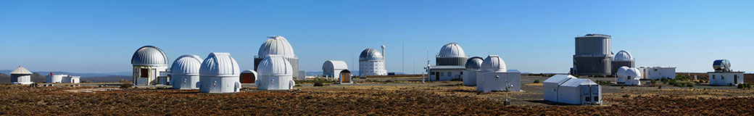



Reverberation mapping of AGN and related observations at the
South African Astronomical Observatory
Mapping the central regions of AGN workshop,
20 September 2019, Guilin, China
Hartmut Winkler, University of Johannesburg, South Africa
Other contributors to this programme:
王建民 {Wang JM}, 杜璞 {Du P}, 胡晨 {Hu C}, 李彦荣 {Li YR}, 姜伯为 {Jiang BW}, 肖铭 {Xiao M}, 李莎莎 {Li SS} (IHEP, Chinese Academy of Sciences, Beijing), Oknyansky V (Lomonossov U, Russia), Van Wyk F, Paul B (UJ), Hlabathe M, Romero Colmenero E, Potter S (SAAO), …
H Winkler, Mapping central regions of AGN, Guilin, China, 2019

Slide 2
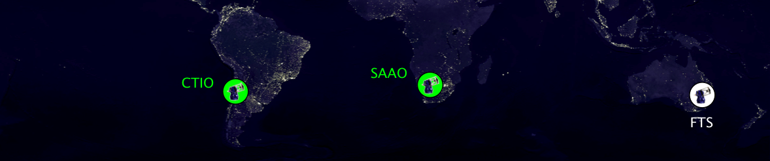
SAAO Instrumentation and its application to AGN studies
Locational advantage and opportunities as the only major southern optical site between Australia & Chile
Several global telescope networks have stations here that are frequently employed for AGN monitoring:
e.g. LCO, MASTER, (MONET, …)
(OLD!) Las Cumbres Observatory map (from LCO website)
H Winkler, Mapping central regions of AGN, Guilin, China, 2019

Slide 3
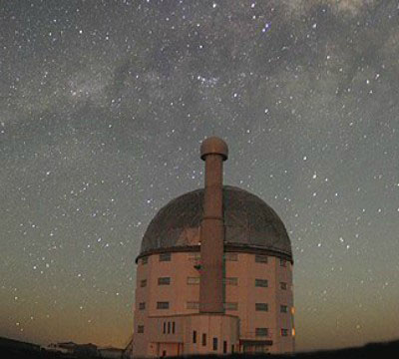
SAAO Instrumentation and its application to AGN studies
South African Large Telescope (SALT)
11 m telescope, now with a variety of instruments fully operational
Some time-intensive AGN campaigns, e.g. variability campaign of changing look AGN HE 1136-2304 (Kollatschny et al)
Oversubscribed, completion rate ~50%
H Winkler, Mapping central regions of AGN, Guilin, China, 2019

Slide 4
SAAO Instrumentation and its application to AGN studies
SAAO 1.9 m – grating spectrograph
SAAO 1.0 m – CCD photometer
Ideal for AGN observations in the range V = 13-17 mag
Unfortunately no slit rotation, i.e. calibration through [O III] lines
Both telescopes are now remotely operable from SAAO headquarters in Cape Town, with plans to expand this capacity to other sites, i.e. helps if observations required every few days
Often undersubscribed!
H Winkler, Mapping central regions of AGN, Guilin, China, 2019

Slide 5
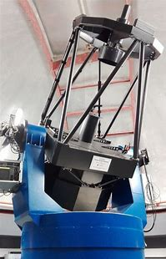
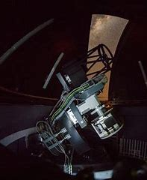
SAAO Instrumentation and its application to AGN studies
New 1 m telescopes: MeerLICHT & Lesedi
(revamped old 20 & 30 inch domes)
In commissioning phase:
Lesedi – to also run in service mode; initially for photometry only, with spectrograph envisaged for later
Now operational:
MeerLicht – 1 square degree field, always pointing in direction of MeerKAT radio telescope (SKA)
H Winkler, Mapping central regions of AGN, Guilin, China, 2019

Slide 6
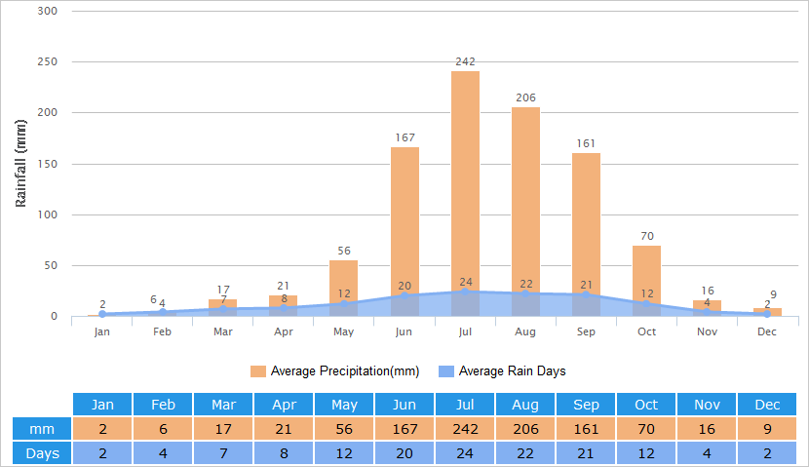
Lijiang-SAAO(-WIRO-Calar Alto) AGN reverberation mapping programme
Two factors highlight a useful synergy between SAAO and some of the northern hemisphere sites where AGN reverberation mapping work takes place
1. In the (southern) winter months, ~3 hours of extra evening or morning observing are possible each night, i.e. the ‘season’ for tracking specific AGN can be 1-2 months longer at SAAO
2. Sites such as Lijiang
experience a shutdown of
several months due to
monsoon-linked weather.
SAAO is then fully
operational
Lijiang rainfall statistics
travelchinaguide.com
H Winkler, Mapping central regions of AGN, Guilin, China, 2019

Slide 7
Lijiang-SAAO(-WIRO-Calar Alto) AGN reverberation mapping programme
List of targets:
SAAO observations:
Attempted cadence of 2 days
Typically 2x600s integrations
Medium resolution, spectral range ~3500-6300 Å
Used wide slit: 4 arcsec
Flux calibration with spectro-photometric standard
Calibrate by normalizing the [O III] lines
H Winkler, Mapping central regions of AGN, Guilin, China, 2019

Slide 8
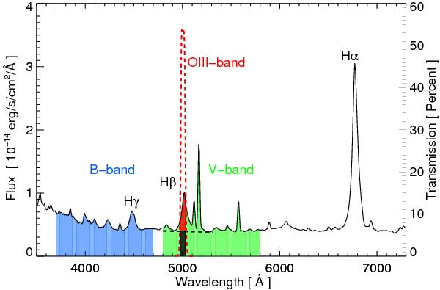
Lijiang-SAAO(-WIRO-Calar Alto) AGN reverberation mapping programme
Photometric reverberation mapping on the SAAO 1.0m telescope
Use of [O III] filter to track Hβ broad
Started in July 2019, current season ongoing until mid-October
Pozo Nunez et al, 2012, 2013
H Winkler, Mapping central regions of AGN, Guilin, China, 2019

Slide 9
Early results: PG 2130+099 (II Zw 136)
(mostly the work of Chen Hu & co-workers at the Chinese Academy of Sciences – Hu et al, 2019, under review at Ap. J.)
Spectroscopic observations, mostly at Calar Alto from 2017, with
supplementation
at Lijiang and
SAAO in 2018
continuum
(Introduced in yesterday’s talk by Hu Chen)
H-beta
2017
2018
Most points from Calar Alto (black); others from Lijiang (green) and SAAO (blue)
H Winkler, Mapping central regions of AGN, Guilin, China, 2019

Slide 10
Early results: PG 2130+099 (II Zw 136)
This AGN has had several RM campaigns, but these have had inconsistent outcomes. The H-beta time lags were found to be ~188 days (Kaspi et al, 2000), ~23 days (Grier et al, 2008) and ~10 days (Grier et al, 2012)
Note that while the 2017 and 2018 mean spectra look extremely similar, the rms spectra for these two years are very different
While the He II in 2018 is still responding to the continuum changes, the same cannot be said for the Balmer/He I lines
H Winkler, Mapping central regions of AGN, Guilin, China, 2019

Slide 11
Early results: PG 2130+099 (II Zw 136)
In 2017 the time lags were consistent with an ‘onion’ structure, with an anti-correlation between lag and line upper-level energy.
In 2018 that pattern had broken down
2017
2018
H Winkler, Mapping central regions of AGN, Guilin, China, 2019

Slide 12
Early results: PG 2130+099 (II Zw 136)
In 2017 the time lag Balmer line profile is symmetrical, with the biggest lag for high v, indicating a flattened disk geometry
In 2018 the blue-shifted parts of the Balmer lines displayed a larger lag than the redshifted sections, i.e. evidence of infall
This is another case (others were reported in previous talks) of an AGN where the RM patterns & behavior vary from year to year
2017
2018
H Winkler, Mapping central regions of AGN, Guilin, China, 2019

Slide 13
NGC 1566 changing look event
After many years of relative inacti-vity, the nearby NGC 1566 experienced a strong oubursts
(for more details please view the poster paper by Oknyansky et al outside)
H Winkler, Mapping central regions of AGN, Guilin, China, 2019

Slide 14
NGC 1566 changing look event
G
H Winkler, Mapping central regions of AGN, Guilin, China, 2019

Slide 15
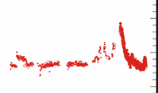
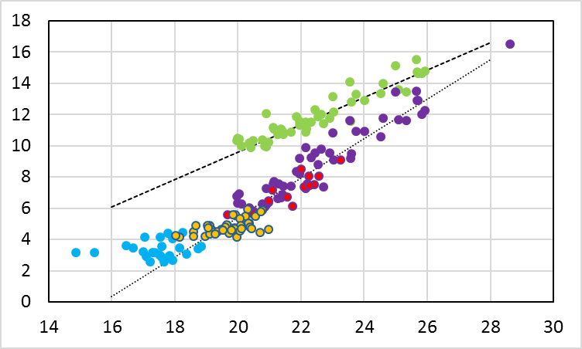
NGC 1566 changing look event
Magnified V-curve of the period 2014-Jun 2019
The highest peak is on or just prior to 1 Jul 2018
Note the flare-like nature of the light curve, which also includes smaller brightening spikes
Plots of the U-flux & B-flux vs V-flux plots, which are consistent with small reddening (but not for the earlier pre-event period?)
B vs V
U vs V
(only for Swift points)
H Winkler, Mapping central regions of AGN, Guilin, China, 2019

Slide 16
NGC 1566 changing look event
How do we interpret what we have seen?
The NGC 1566 changing look is almost certainly due to a relatively sudden brightening of the accretion disk
A scenario based on variable obscuration is less likely
Within 1 month this led to not only a dramatic broad line strengthening, but also the appearance of coronal and Fe II lines not normally evident in the spectrum
The brightening may be due to the capture of a clump of matter
NGC 1566 is very close (z = 0.005) and intrinsically faint. Perhaps a good analogy is a dripping tap, where matter is builds up on the accretion disk in small chunks, whereas the buildup is more steady in luminous AGN
H Winkler, Mapping central regions of AGN, Guilin, China, 2019

Slide 17
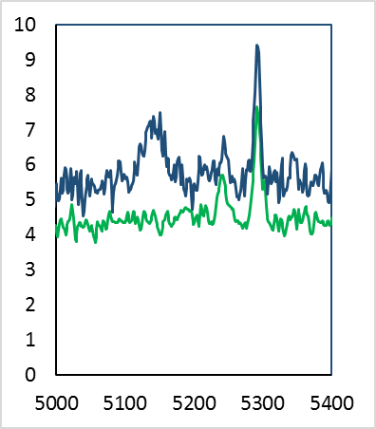
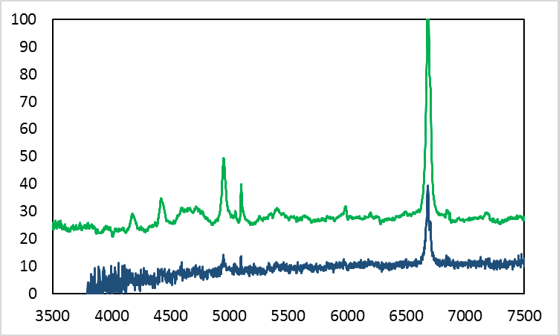
Search for changing look AGN, reobserving AGN after 20 years (MSc project, Daymore Makope)
68 not-so-well-known AGN with previous spectra taken at SAAO between 1997-1999 re-observed in 2018-2019
Example of new changing look AGN: 2E 2124-1459
Seyfert 1.5 in 1997, now a Seyfert 1.9
While technically not a changing look AGN, IC 1524 is very bright now (and nearby)
6 Oct 1997
IC 1524, z = 0.0192
21 Dec 1998
9 Jul 2019
4 Jul 2019
2E 2124-1459
H Winkler, Mapping central regions of AGN, Guilin, China, 2019

Slide 18
Variability characteristics of IZw1-type objects (PhD project of Bynish Paul)
Narrow-line Seyfert 1 with strong Fe II emission show a smaller variation range. What changes, and how?
H Winkler, Mapping central regions of AGN, Guilin, China, 2019

Slide 19

Variability characteristics of IZw1-type objects (PhD project of Bynish Paul)
“I Zw 1-type AGN Grand Spectrum”
Combination ~60 hours of integration of 15 targets with narrow broad lines & unusually strong FeII emission
Thank you
Exceptional S/N gives opportunity to compile most detailed list of FeII lines & relative strengths yet
H Winkler, Mapping central regions of AGN, Guilin, China, 2019

