Slide 1
Measurement of the absolute BRs of $D_{s1}(2536)$ and $D_{s2}(2573)$
Wang Hongpeng ,Yuan Changzheng
B410,IHEP

Slide 2
Outline
Motivation
Data Set
Study in $e^{−}e^{+}→D_{s}D_{s1} (2536)/D_{s2}(2573)$
Study in $e^{−}e^{+}→DsD_{s1}/D_{s2} ,D_{s1}/D_{s2}→DK$

Slide 3
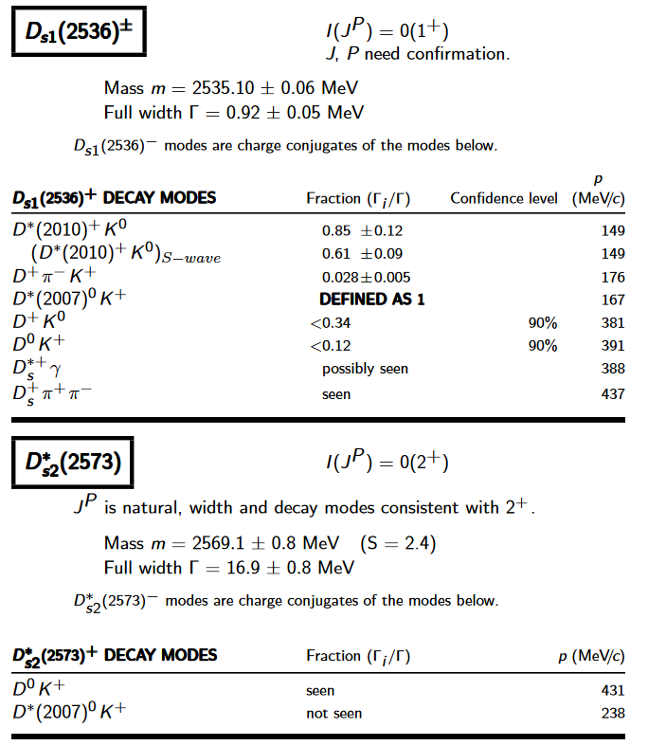
Motivation
In the $D_{s}$ spectrum ,$D_{s1}\left(2536\right) and D_{s2}\left(2573\right)$, are the 1st and 2nd particle above the DK threshold . Their absolute branching fractions have not been reported up to now.
The datasets in BESIII,4.6GeV (587$pb^{−1}$) , make it possible to measure the inclusive decay $e^{−}e^{+}→D_{s}D_{s1} (2536)/D_{s2}(2573)$. And The exclusive decay $e^{−}e^{+}→DsD_{s1}/D_{s2} ,D_{s1}/D_{s2}→DK$has been reported recently.
The inclusive cross sections also can help us to study the $c\overline{c}$ even find new states when we get higher Energy Data in future .
Notes:
In fact many DK decay modes from Ds1 Ds2 has been foundx ,fortunately,we have the its near the threshould of DsDs1, indeed the exclusive dk mode has been measured recently

Slide 4
Data set
BOSS 7.0.3
4.6 GeV 586.9 $pb^{−1}$
MC sample :
20,0000 $e^{−}e^{+}→D_{s}+ D_{s1} (2536)/D_{s2}(2573)$
10,0000 $e^{−}e^{+}→D_{s}+ D_{s1}/D_{s2}$
$D_{s1}/D_{s2}→D^{∗}0K/D^{0}K$
$D_{s}→KKπ$ D_DALITZ

Slide 5
Selection
$\left|dVz\right|<10cm$, $\left|{dV}_{xy}\right|<1cm$
$\left|cosθ_{track}\right|<0.93$
PID: Using the dE/dx, and the TOF
$π: prob (π)$ >0 & $prob (π)$ > $prob (K)$
$K: prob (K)$ >0 & $prob (K)$ > $prob (π)$
$D_{s}$ : $K K π→1C to D_{s} mass$
Notes:
The approaching points of the good tracks are restricted within 1 centim in the transverse
<
plane and ±10 cm along the z axis. The energy loss dE/dx measured by MDC and the time-
Good charged tracks are required to be within the angular acceptance ofMDC

Slide 6
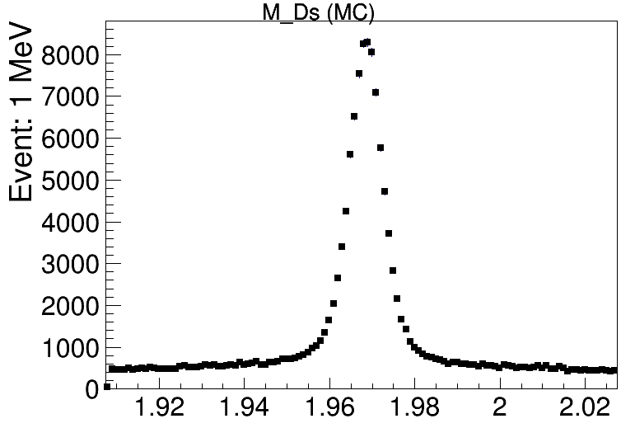
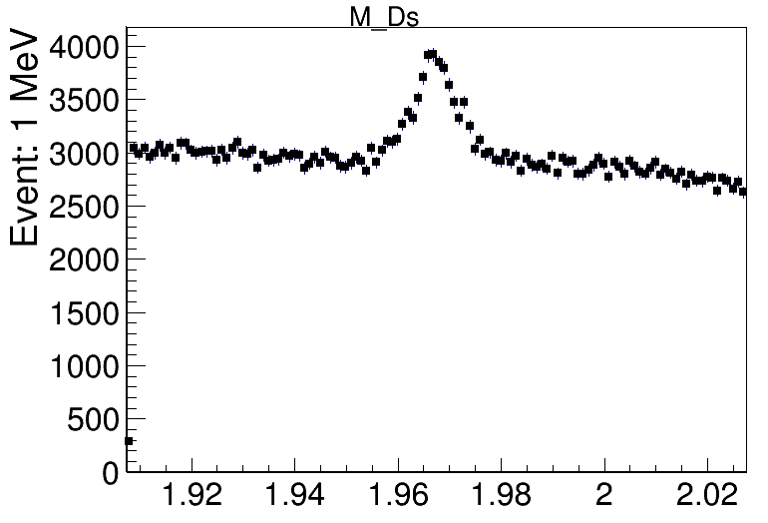
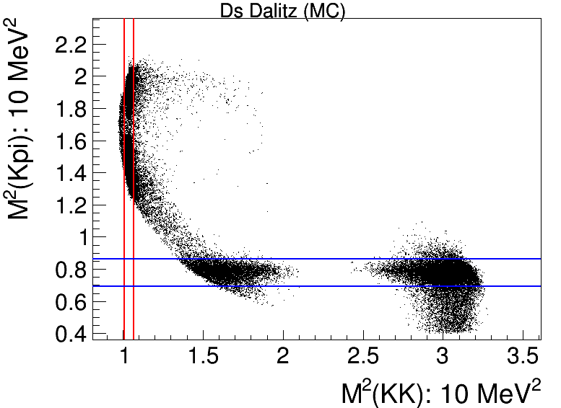
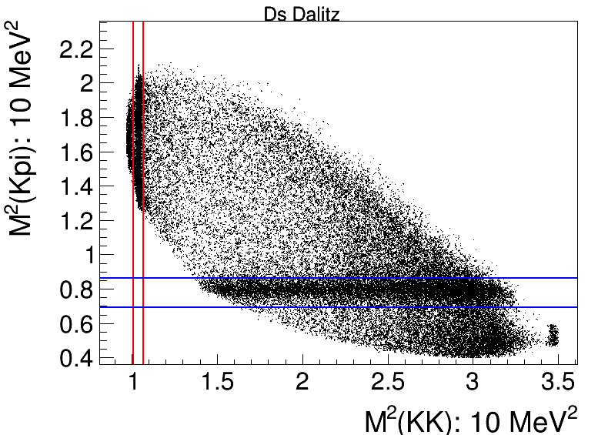
$D_{s}→KKπ$ MC vs Data
$D_{s}→φπ$ and $D_{s}→K^{∗}K$
lie in the region between Red lines and Blue lines .
Notes:
Firstly ,we study in the inc Dk, beyond all questions ,the key of this mesm is the getin the clean Ds,

Slide 7
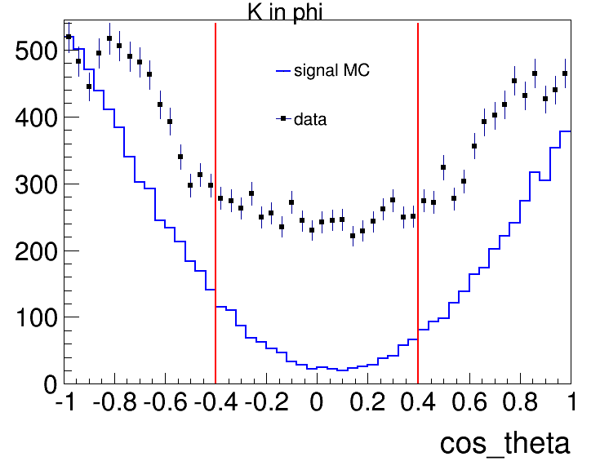
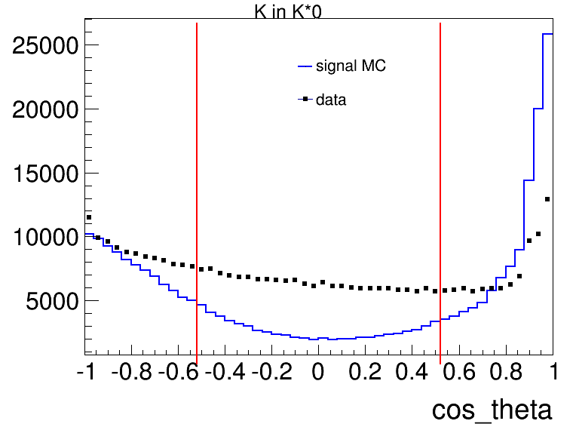
$\cos{θ_{helicity}} :K in φ \& K in K^{∗}$
For $D_{s}→φπ$ and $D_{s}→K^{∗}K$
cut the $\left|cosθ\right|>0.4 \&\left|cosθ\right|>0.52$to improve S/B ratio
.
Notes:
addtly

Slide 8
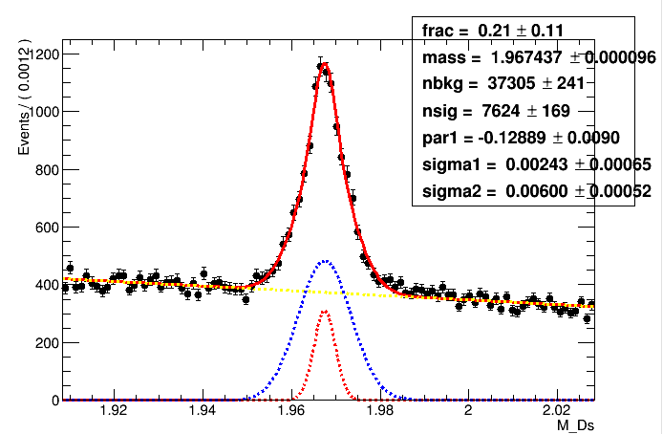
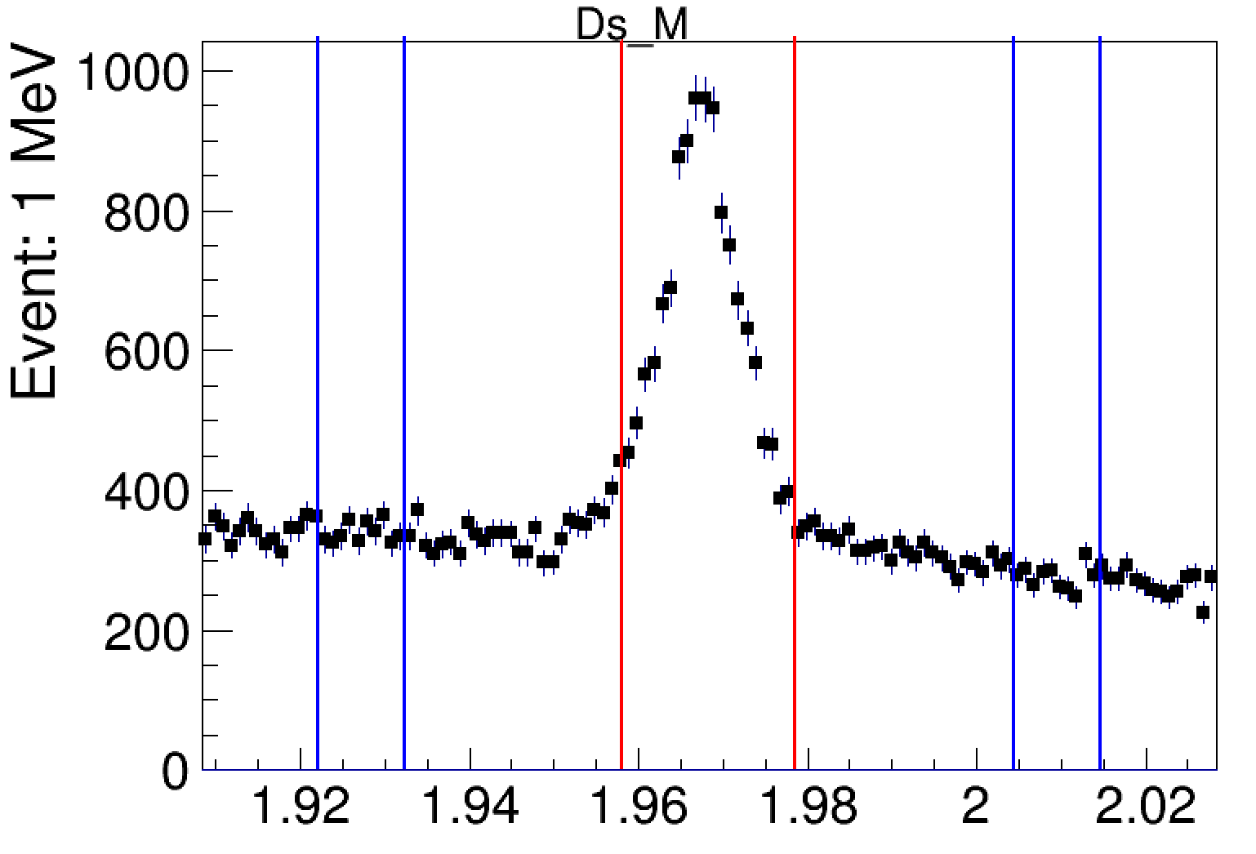
Signal region and sideband
Fit the $D_{s}$’s mass spectrum get the $σ=0.514$,
Set the signal region: $M_{Ds}±2σ$ kinematic fit to $M_{Ds}$
Side band region : $\left\{M_{Ds}±7σ,M_{Ds}±9σ\right\}$kinematic fit to $M_{Ds}±8σ$
Cut $χ_{1C}^{2}$<15
Notes:
After these cuts we get the cleaner Ds candidates, all the candidates will do kinematic fit to mean value constaint should less than

Slide 9
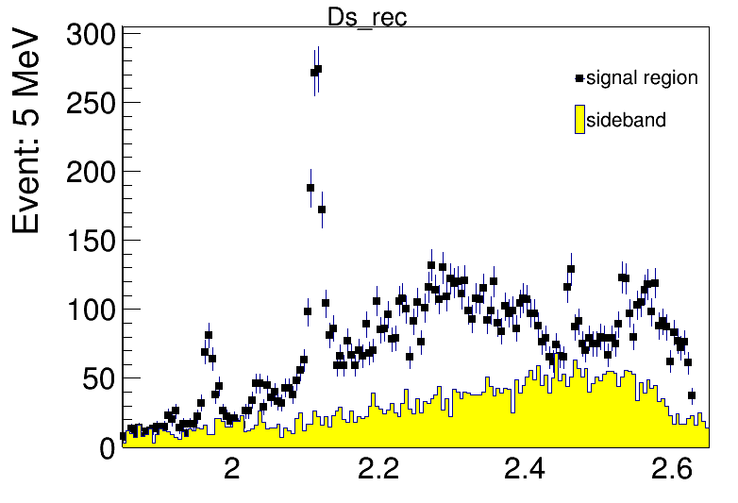
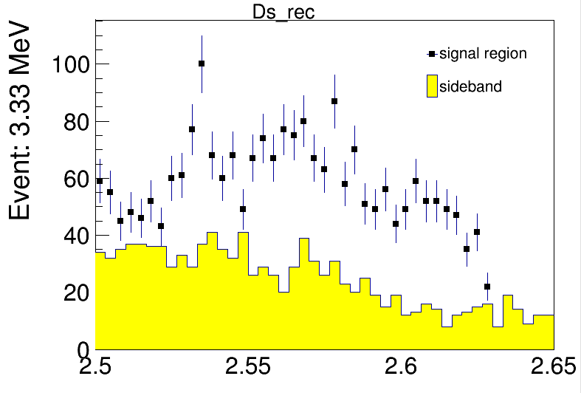
Spectrum of $D_{s}$ recoil mass
DsDs*
DsDs1(2460)
Ds*Ds*
DsDs
Notes:
After that , we can study in the spect of ds recoi ,I and in the red box, we can find the trace of Ds1 Ds2, but there are much blank under their peak

Slide 10
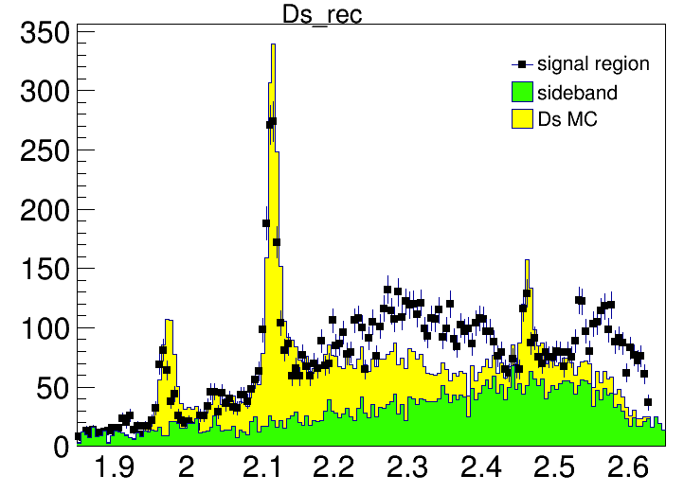
Try to fill the spectrum
The ISR decay always lied in the tail of the recoil spectrum.
Using the cross section published or proceeding of Ds to make MC sample filling the spectrum.
Try to describe the background under the Ds1&&Ds2.
DsDs by Li Ke
DsDs* by Sun Zhentian
Ds*Ds* by Sun Wenyu
DsDs1(2460) by Qi Tianyu
Notes:
For descrbin the bkg under the signal regi . Perhaps the others modes ‘s Isr tail can make up the bkg of the sig seem tobe useles

Slide 11
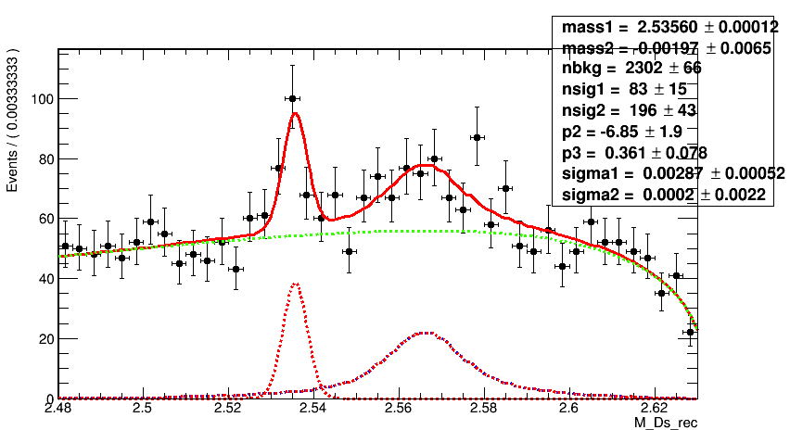
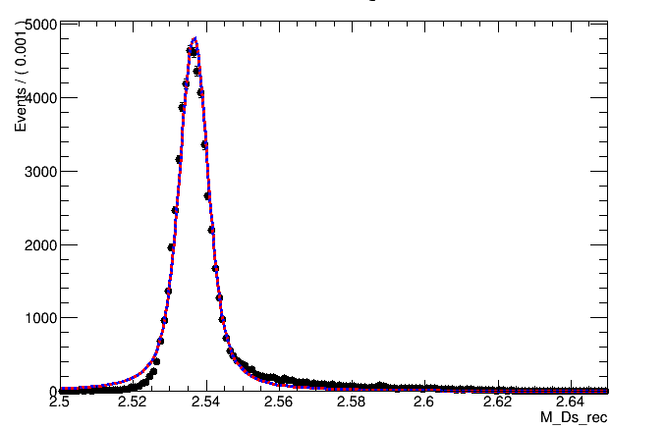
Fit to the data
Bkg: Argus shape
$D_{s1}\left(2536\right):$gaussian shape
$D_{s2}\left(2573\right):$ MC shape convolved
by gaussian shape
Ds1 Signal MC
Ds2 Signal MC
Notes:
So we have to fit the data by commom func,in . This is fit result

Slide 12
Exclusive Decay
Use the $D_{s}→KKπ$constrained to $M_{Ds}$
Tag another K has the opposite charge to $D_{s}$
Missing a track with mass $M_{D^{∗0}}$ for $D_{s1}$ or $M_{D^{0}}$ for $D_{s2}$
5 tracks constrained to $P_{initial}$

Slide 13
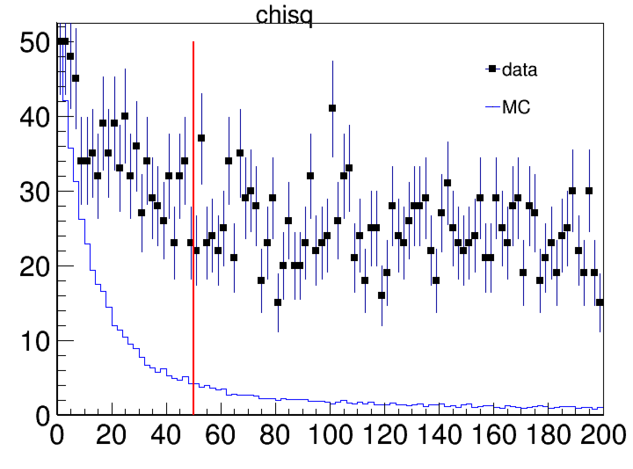
Cut $χ^{2}$
Ds1 $χ^{2}<100$
Ds2 $χ^{2}<50$
Notes:
And then we get the chi Ds1 d*0 K Ds2 d0k

Slide 14
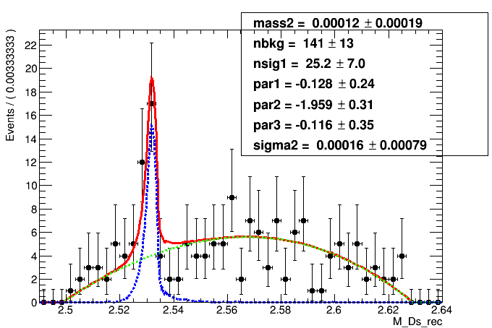
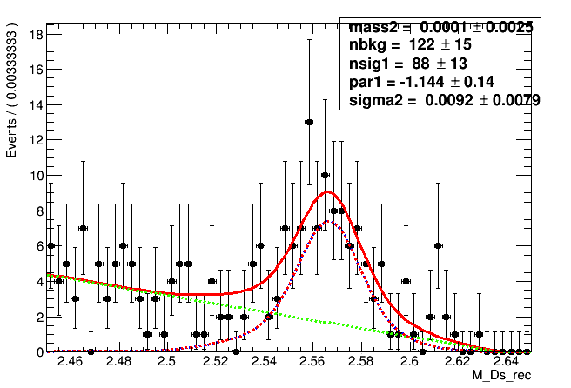
Fit to Data
Use MC shape convolved a Gaussian to fit signal, Use 3rd/1st order Chebyshev to fit Bkg

Slide 15
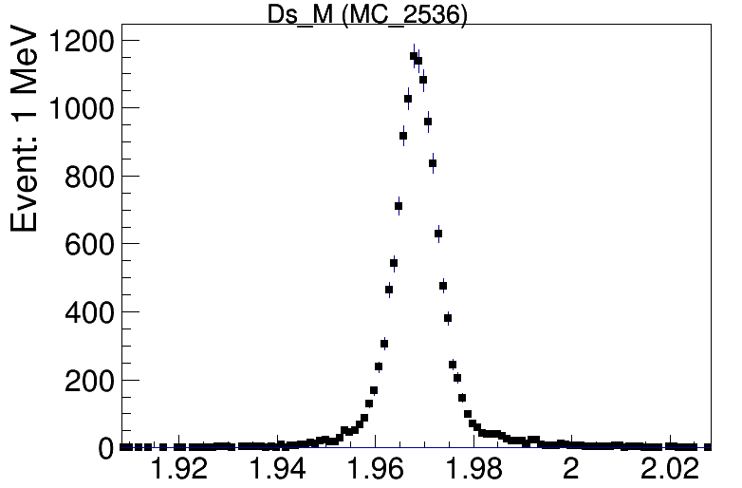
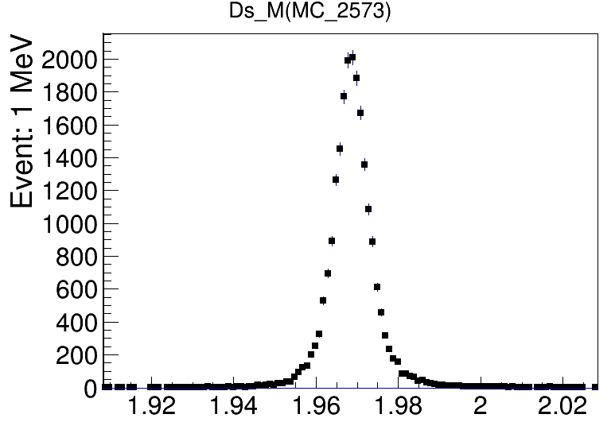
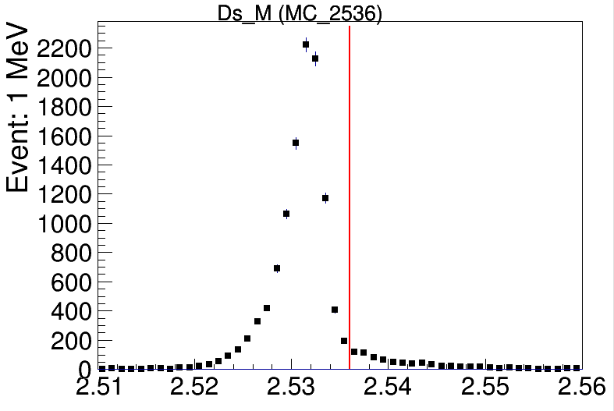
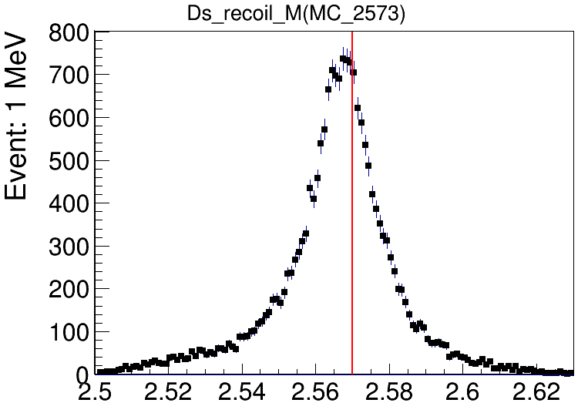
MC sample $D_{s1}\&D_{s2}$
Notes:
These are mc sample but we find on the Ds rec spectrum peaks move away from wh the sd be, red lines are on Ds1 mass Ds2 mass

Slide 16
Summary & Next to do
 | inclusive EVT. | inclusive EFF. | exclusive EVT. | exclusive EFF. | Abs BRs
$$D_{s1}\left(2536\right)$$ | $$83±15$$ | 0.282 | $25.2±7.0$ | 0.118 | $0.727±0.33$
${ D}_{s2}(2573)$ | $196±43$ | 0.286 | $88±13$ | 0.194 | 0.686$±0.251$
Optimize the cut and fit
Test more decay modes or methods
Study the Bkg more

Slide 17
Thank You !!

Slide 18
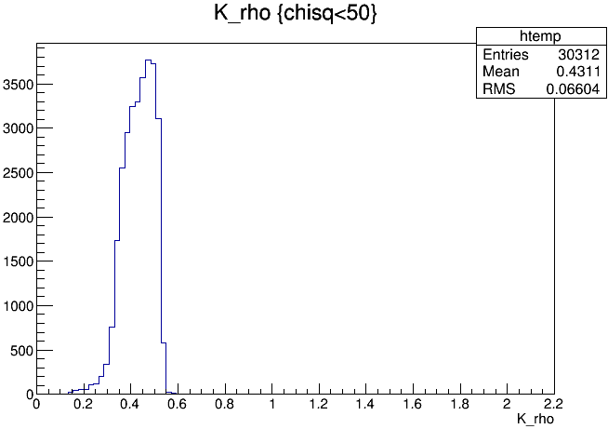
Momentum of $K_{tag}$ from $D_{s1} \&{ D}_{s2}$

Slide 19
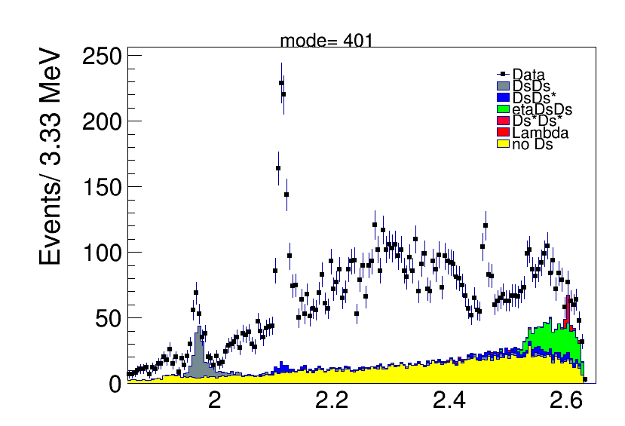
INC MC

Slide 20
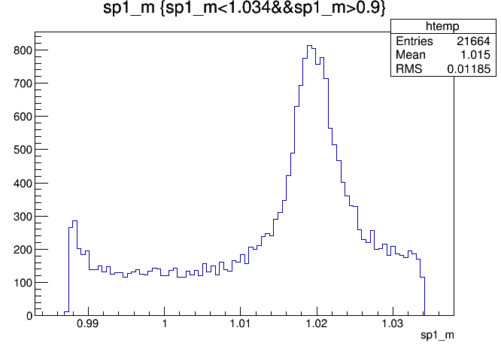
Ds in phi

Slide 21
SIGMC

