Slide 1
CBM Computing
Overview and Status
V. Friese, GSI Darmstadt
CBM-China Workshop, Yichang, 14 April 2019

Slide 2
Computing in CBM
CBM Computing has to provide the software and related tools required to
operate the experiment
  configuration, control, DAQ, online data processing, data storage
analyse data
  reconstruction, PID, data access
simulate the detector setup
  detectors, electronics, data acquisition
That‘s generic. So, what‘s particular for CBM?

Slide 3
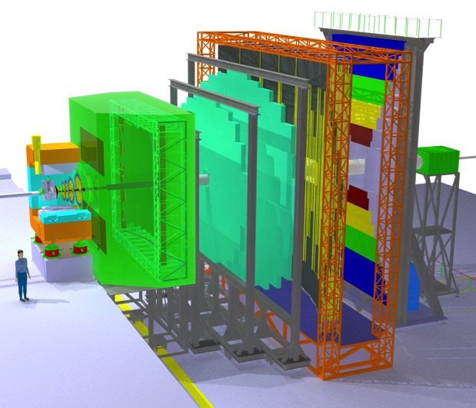
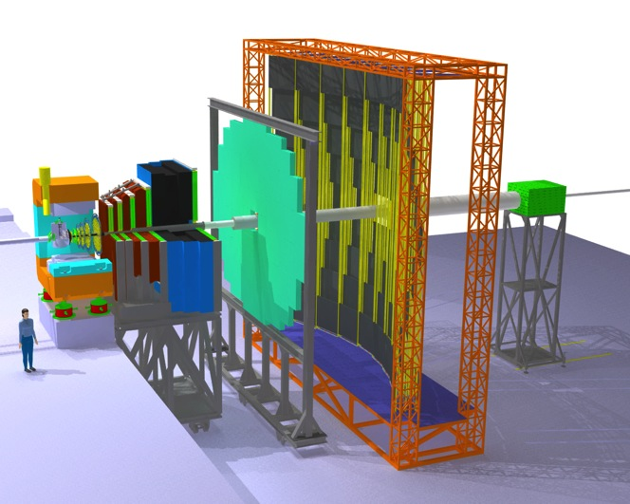
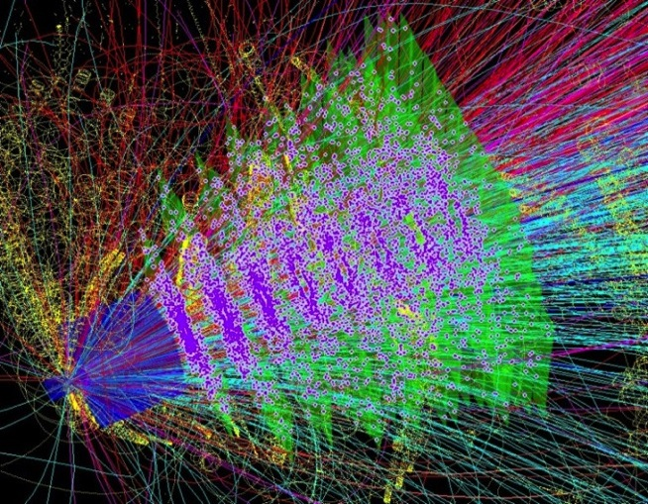
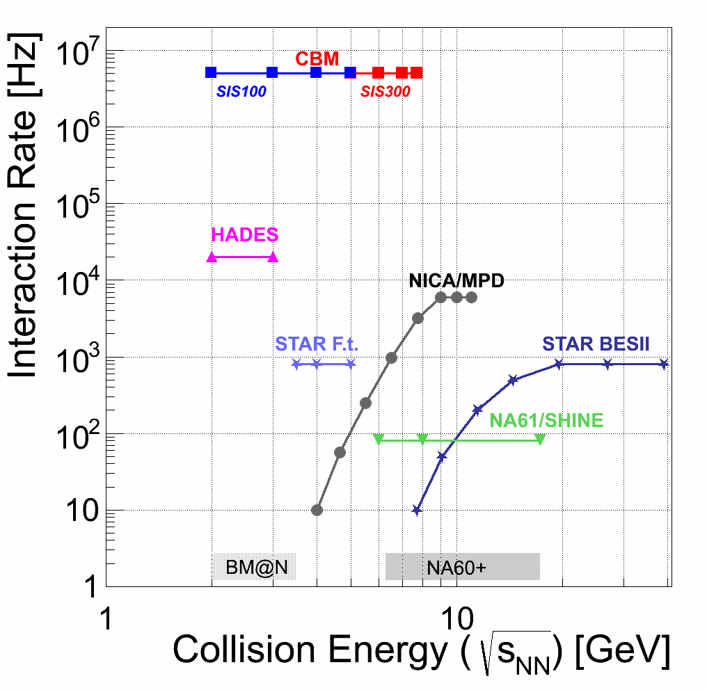
CBM Characteristics
Versatility: exchange or replace detector systems according to physics aim (e.g. electrons / muons) or conditions (beam energy)
Central Au+Au @ 10A GeV
electron + hadron setup
muon setup
Complexity: up to 600 charged tracks per collision in the acceptance
Capability: up to 10⁷ collisions per second
Software systems for CBM must cope with these specific requirements.

Slide 4
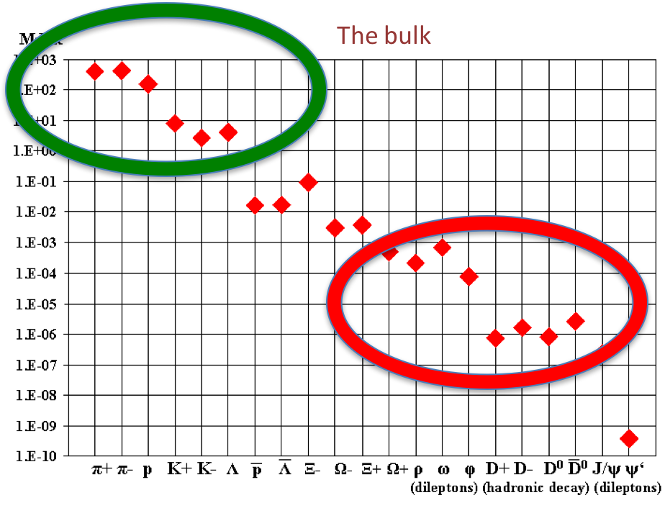
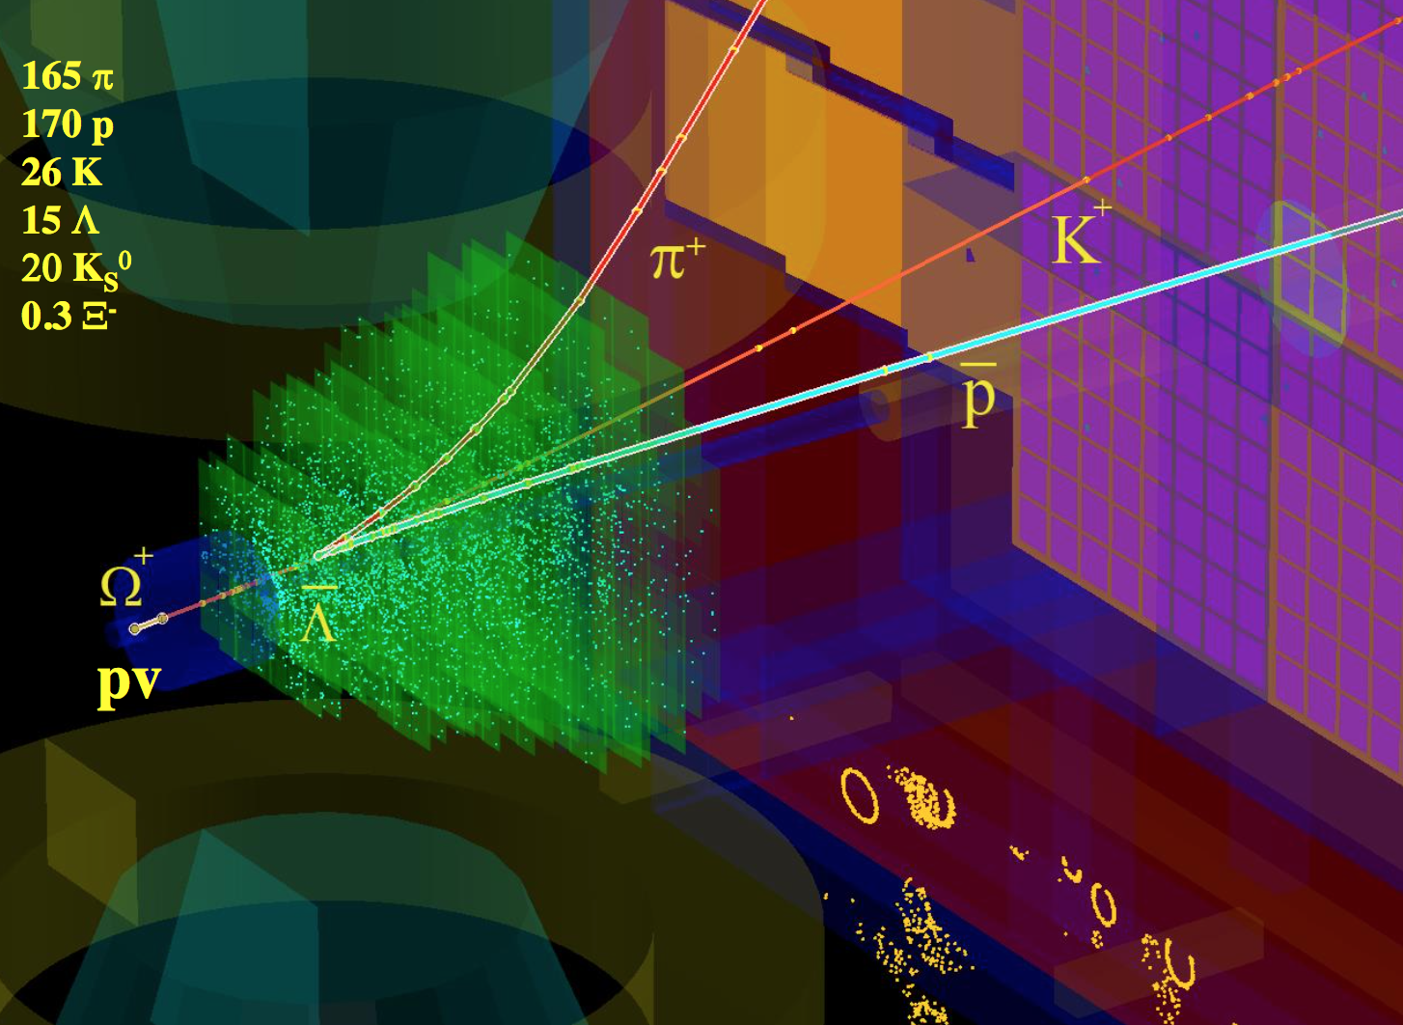
Needles in the Haystack
CBM targets at extremely rare probes, which necessitates very high interaction rates
(design rate 10 MHz).
That entails a raw data rate of up to 1 TB/s.
To be reduced online to a storage rate of several GB/s.
Trigger signatures are mostly complex (e.g. weak cascade decays) and cannot be realized in hardware.
Readout concept:
  No hardware trigger
  Self-triggered front-end electronics deliver time-stamped data
  Data-push architecture to online compute farm
  Event reconstruction and –selection to be performed on CPU
Central Au+Au @ 10A GeV

Slide 5
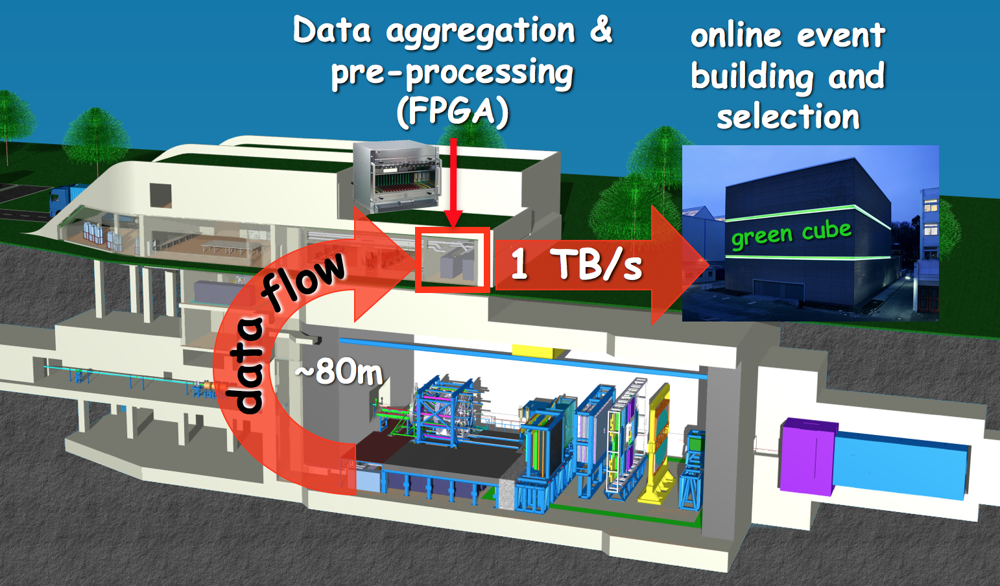
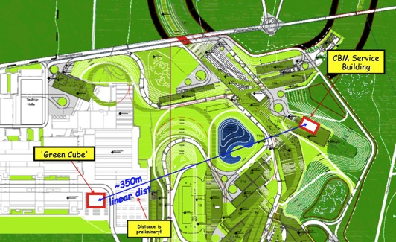
Online Data Flow
Data are aggregated and pre-processed in an FPGA layer near the experiment.
Time-slice building is performed on CPU (input nodes, in service building).
Event reconstruction and –selection is performed in real-time on CPU (compute nodes) in the GSI ”Green Cube” (already existing at GSI).

Slide 6
Data Rates
Raw data event size: 50 kB / min. bias event (Au+Au, p = 12 GeV, hadron setup)
At 10 MHz event rate: raw data peak rate 500 GB/s
  plus not event-correlated noise (electronics, beam-target, beam-pipe)
Archival rate:
  technologically possible are rates of 100 GB/s and above
  limiting factor are the storage costs
  typical runtime scenario 2 effective months / year (5 x 10⁶ s)
  At 1 GB/s: gives a storage volume of 5 PB/year
We aim at an data archival rate of a few GB/s, meaning that the raw data volume has to be suppressed online by factors > 200.

Slide 7
Computing Projects
INF
Software Development Infrastructure
EDC
Experiment and Detector
Control Systems
Computing
Board
SIM
Simulation Software
ODM
Online Data Management
OAE
Offline Analysis Environment
DPF
Data Processing Framework
ALG
Data Analysis Algorithms

Slide 8
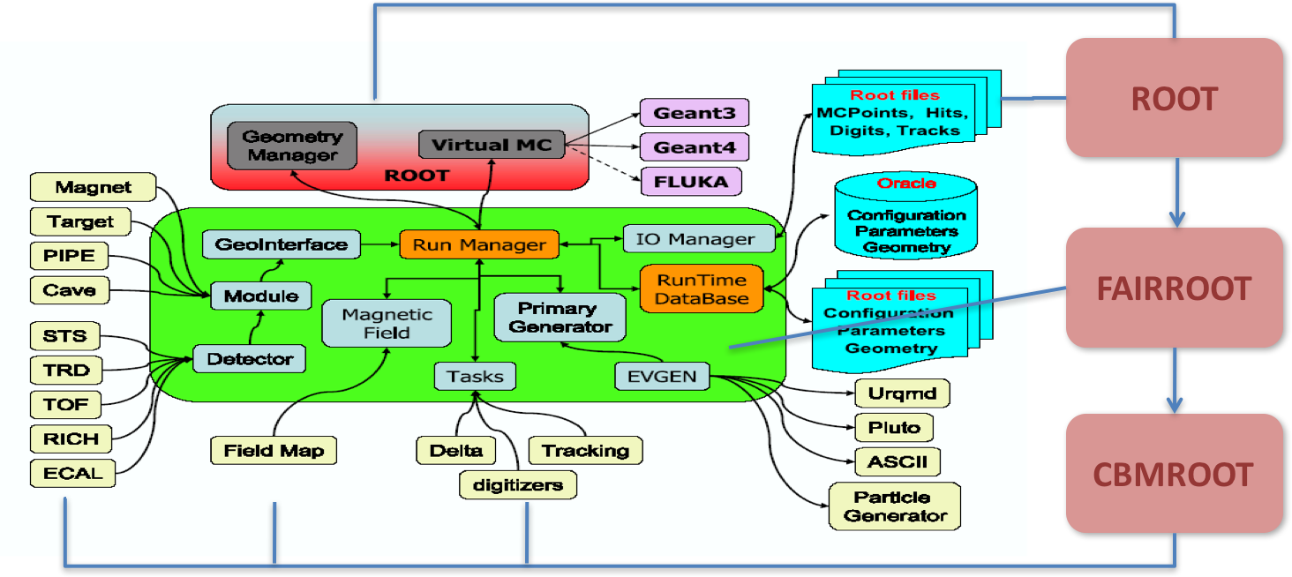
Data Processing Framework
DPF
PL: F. Uhlig, GSI
Mission: to provide a flexible and efficient environment for data analysis and simulation (regulate data model, I/O, run configuration, execution of processing graph)
For both offline and online purposes
Since many years, the CbmRoot framework is used, using ROOT as a platform and the FairRoot software layer (synergy with PANDA, ALICE, ...)

Slide 9
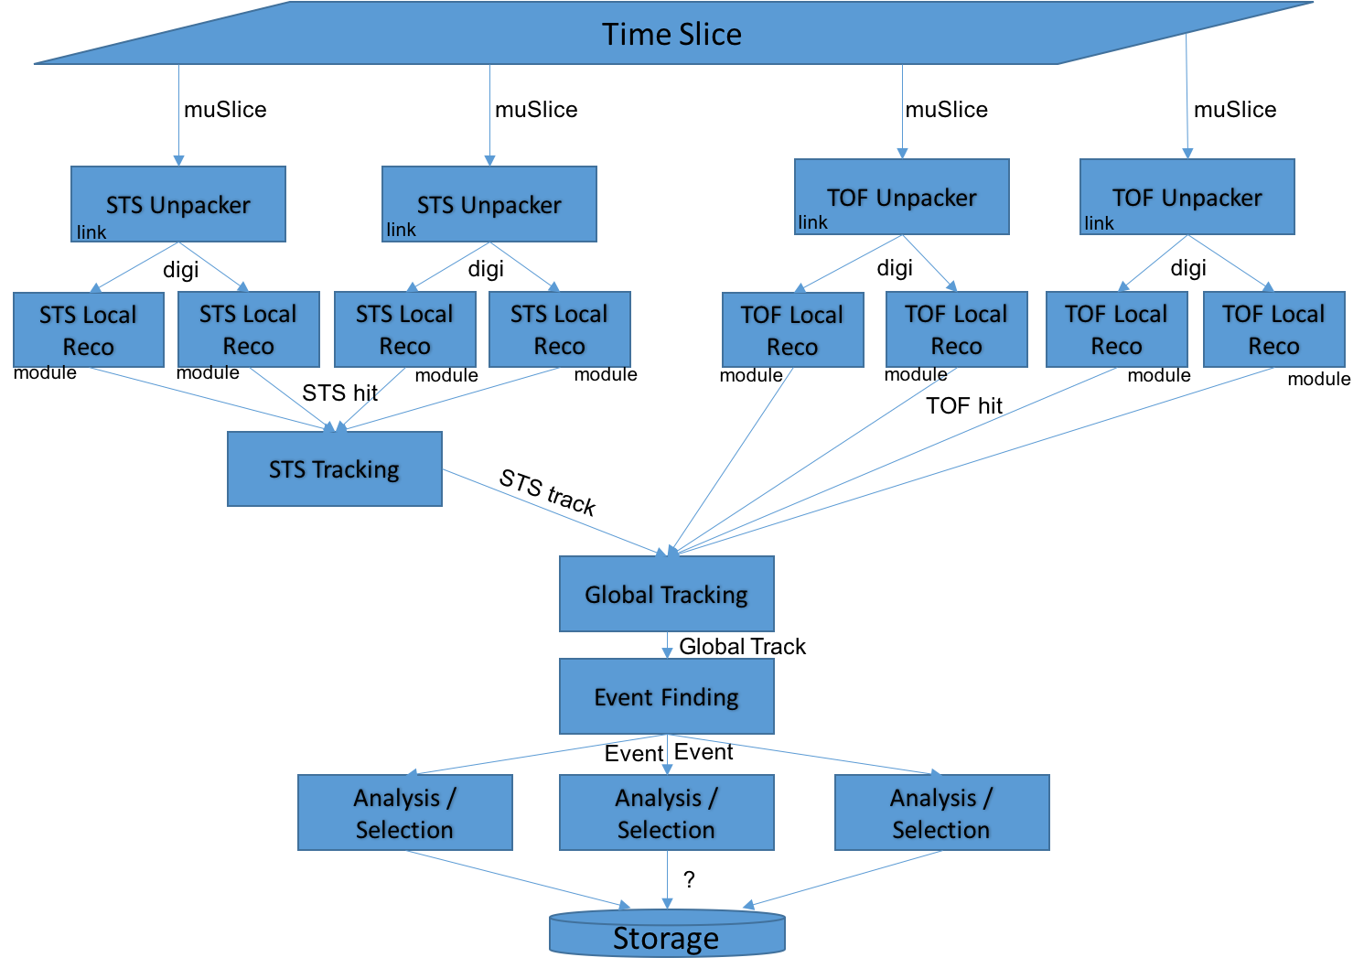
Example: Simple Process Graph (STS + TOF)

Slide 10
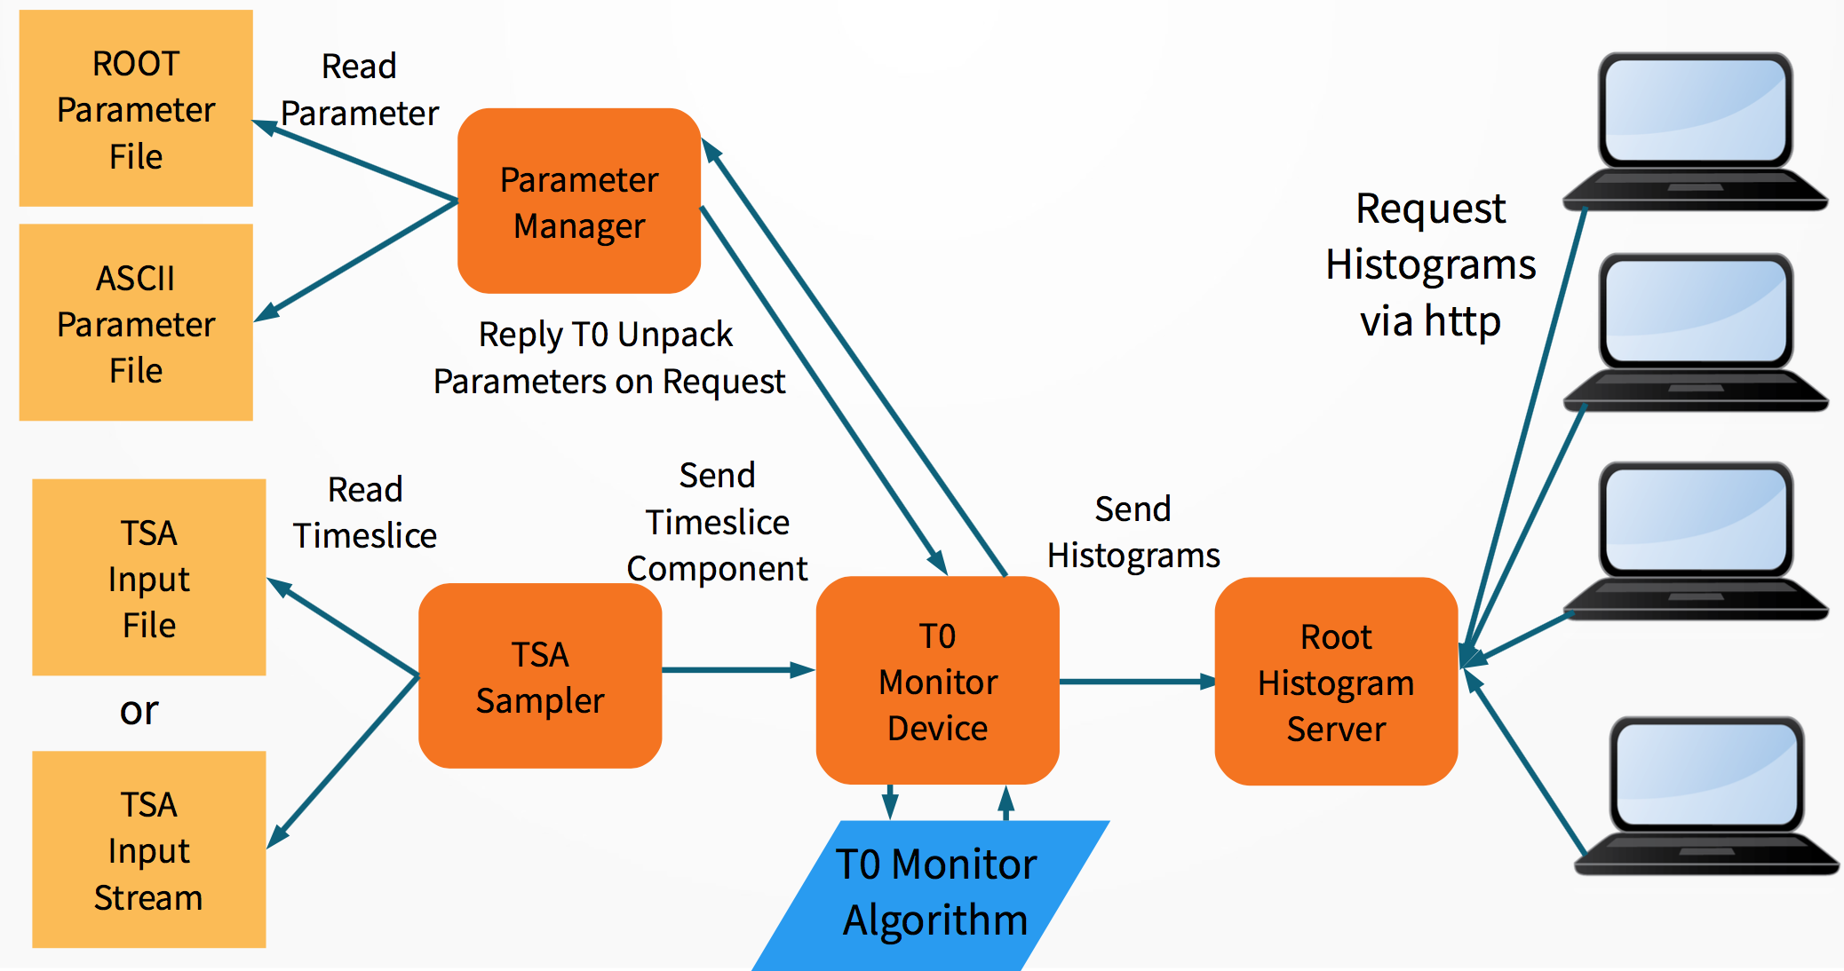
Data Processing Framework
Shortcoming of the current framework: linear task queue, no concurrency features -> not well suited for online data processing
Moving to message-queue-based system (FairMQ); intra-node and inter-node data transport possible
First deployment (proof-of-principle): online monitoring for mCBM
Progress is moderate; project suffers from serious understaffing

Slide 11
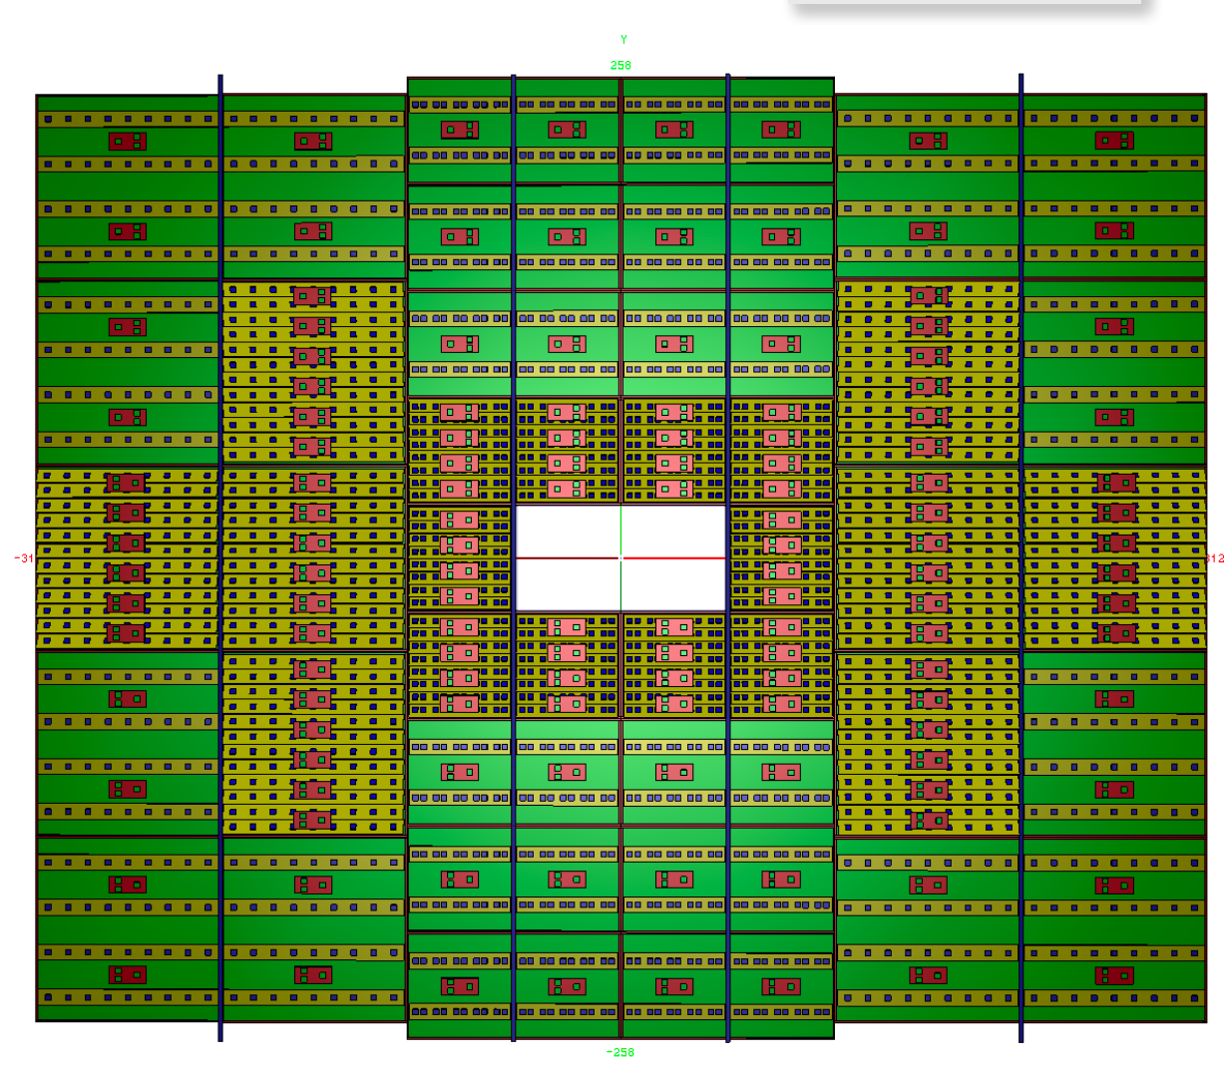
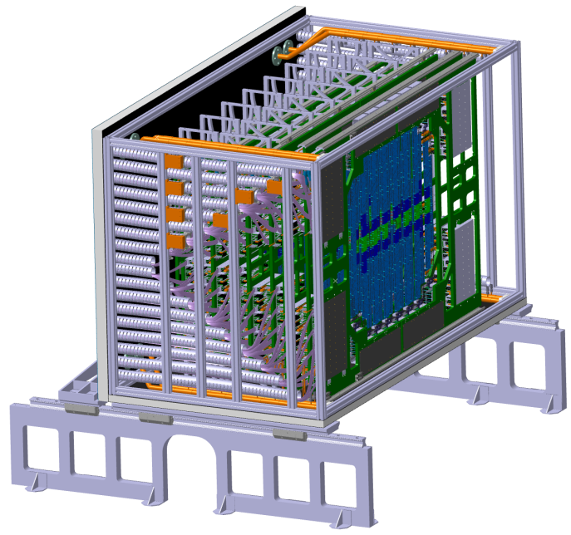
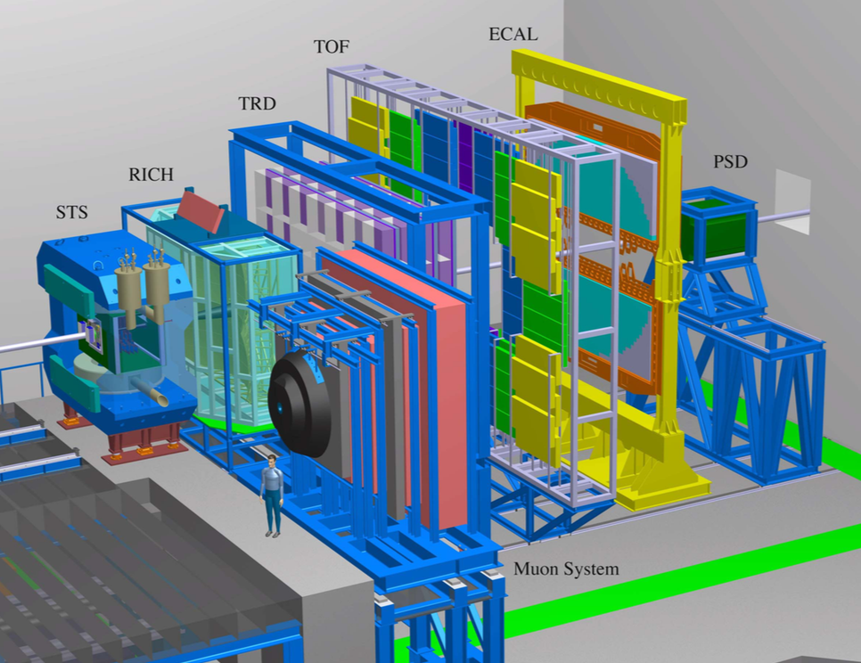
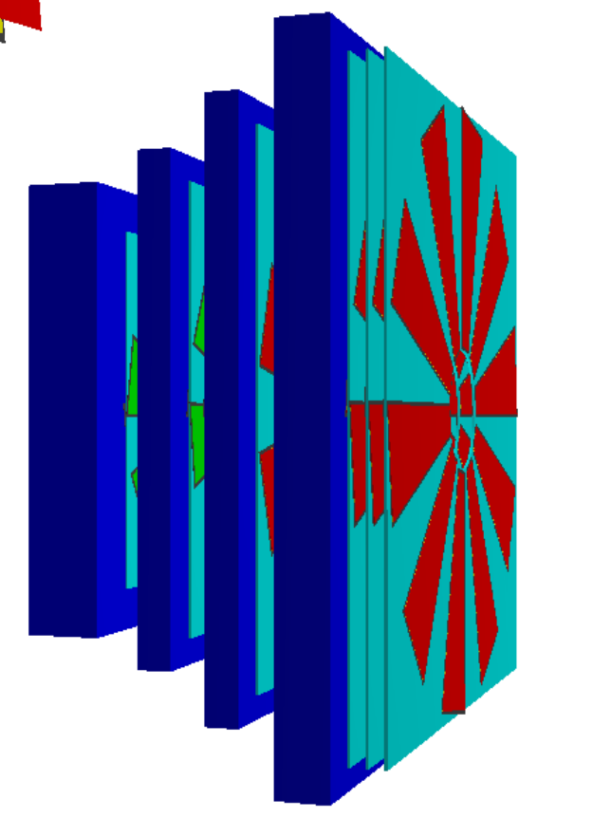
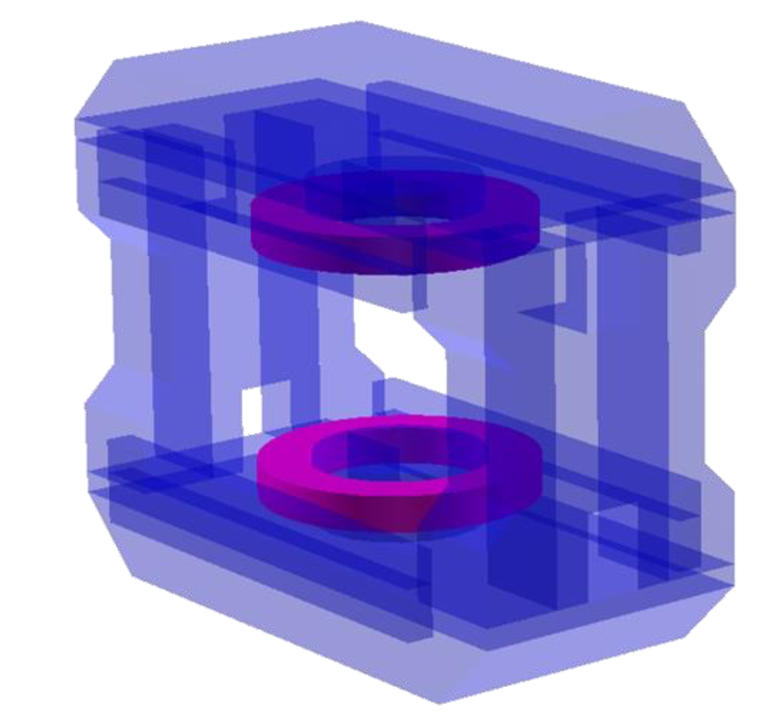
Simulation Software
SIM
PL: V. Friese, GSI
Detector geometry model
  according to current technical planning
  comprising all relevant contributors to the material budget
  format: TGeo
  subject to continuous adjustments / improvements

Slide 12
Events and Time Slices
Time
Slice
Experiment
Collision
Detector
Event Generator
Simulation
Event
Analysis
Reconstruction

Slide 13
Simulation Software
Example: STS
energy loss fluctuations (Urban model)
drift to readout surface in bias field
Lorentz shift
Thermal diffusion
Collection on read-out strips
Cross-talk
Detector response model:
  analogue response in sensitive detector elements
  digital response (R/O ASIC): free-streaming
    model timing response
    interference between different events
  thermal noise
DAQ emulation (time-slice building)
Goes far beyond conventional event-by-event simulation
  framework extensions implemented; full data stream can be simulated
    not yet in real (compressed) raw data format, but logically equivalent
    combining different sources at different rates (events, beam)
Simulated STS data (w/o thermal shielding),
Au+Au @ 10A GeV, beam rate 10⁹/s, event rate 10⁷/s

Slide 14
Data Analysis Algorithms
ALG
PL: M. Zyzak, GSI
Mission: Provide algorithms for reconstruction and analysis of experiment data
  both for online data selection and for offline analysis
Reconstruction in CBM does not start from events (hardware triggers), but from a continuous data stream
  time information is essential (“4D reconstruction”)
  events have to be established by reconstruction
  events can overlap in time
For application in real-time, all algorithms have to be very fast
  online algorithms have to be precise enough to make a physics decision

Slide 15
Data Analysis Algorithms
Algorithms for event reconstruction are being developed since many years, with emphasis on fast algorithms suitable for online usage.
Developments started with the event-by-event case (proof of principle). Full reconstruction of simulated events is available.
Migration to reconstruction of free-streaming data done for the most compute-intensive tasks (track finding); in progress for others.
Software for online event selection (KFParticle, KFParticleFinder) developed; is already in use by other experiments (STAR, ALICE)

Slide 16
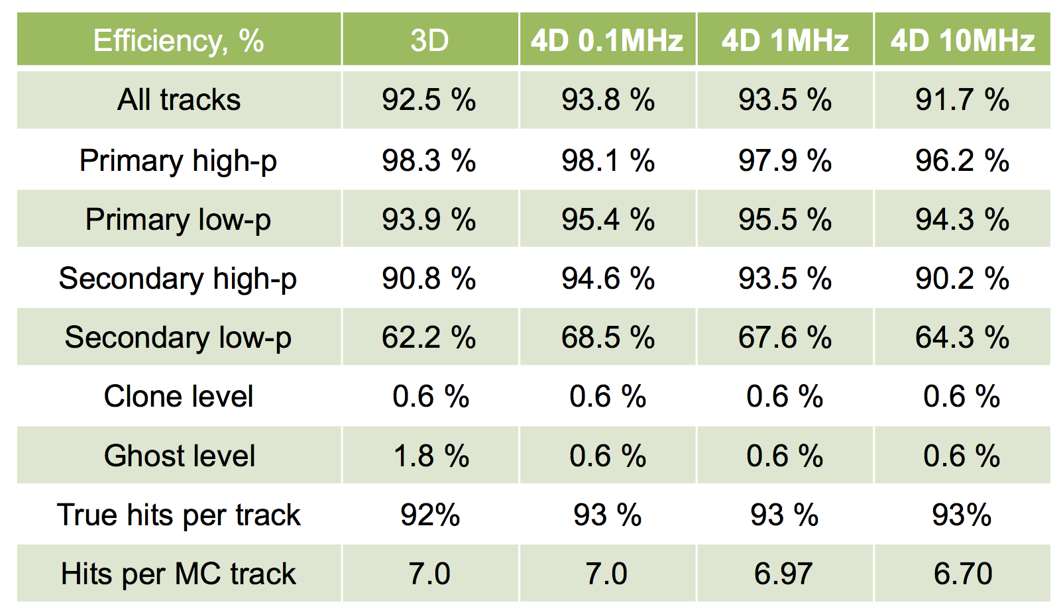
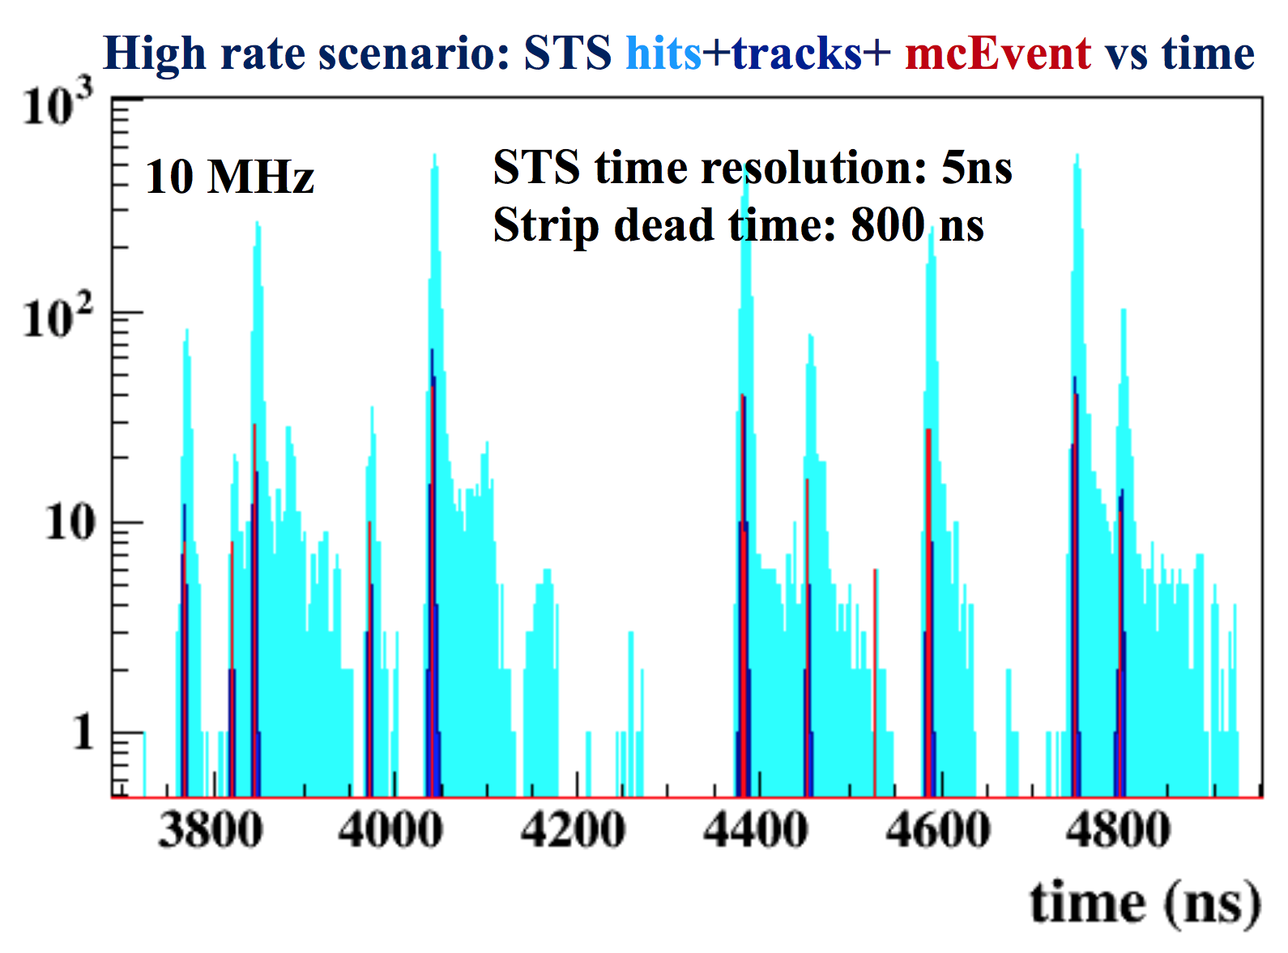
Event reconstruction in STS
Cellular Automaton-based track finder
Good track reconstruction efficiency; rate effects become visible around 1 MHz, but still tolerable at 10 MHz.
Events can be defined based on reconstructed tracks (track time resolution about 1 - 2 ns)
80% of all events are resolved at 10 MHz (99% at 1 MHz)
Reconstruction time about 9 ms per event

Slide 17
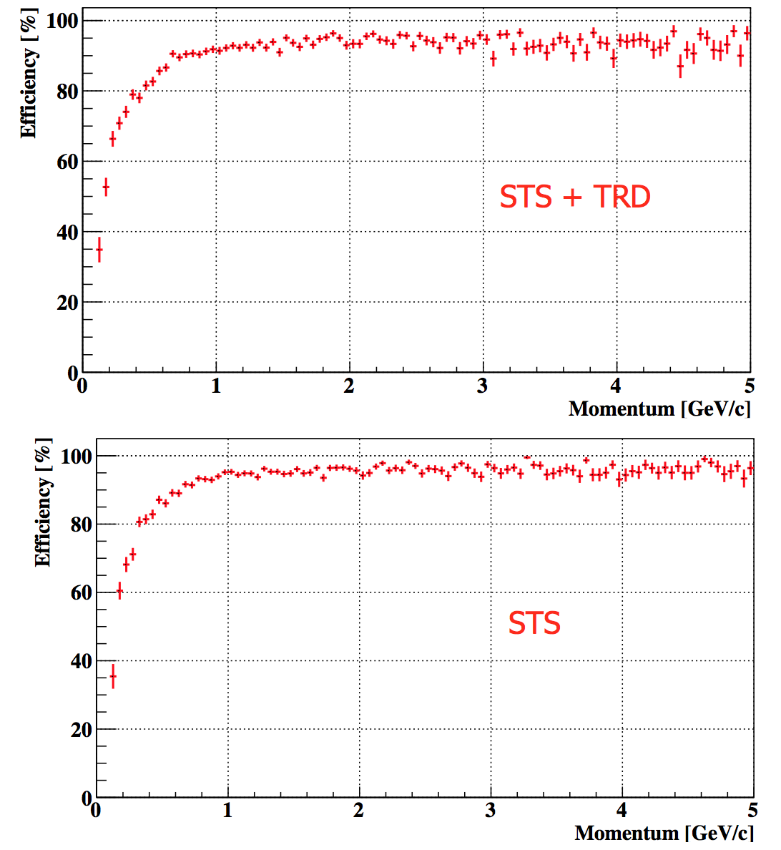
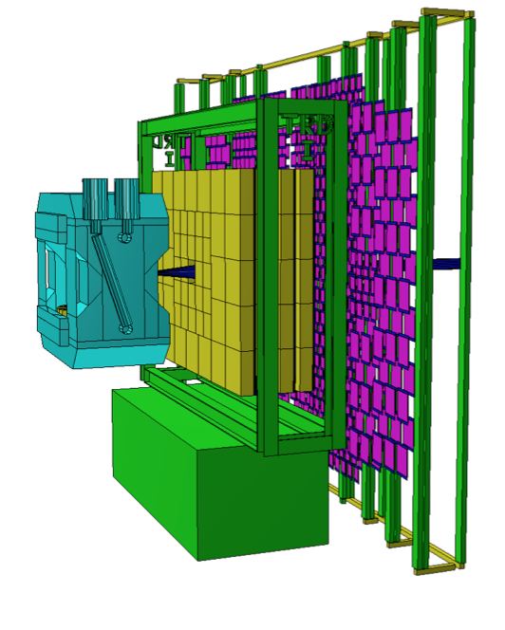
Global reconstruction
Current implementation: track following (hit pick-up) from STS to downstream detectors
Not very fast algorithm
Current development: extend the CA track finding approach to downstream detectors (work in progress)

Slide 18
Data Analysis Algorithms: Open Issues
Fast global tracking through all detector systems (in progress)
Event pile-up (not resolved by tracking)
  can potentially harm highly selective software triggers
  Solutions:
    detect by time-structure and eliminate
    resolve event vertices in transverse plane
    resolve event vertices longitudinally (segmented target
Optimize local reconstruction (cluster finder, hit finder, RICH ring finder)
Goal: Apply online reconstruction (demonstrator) for mCBM run 2020.

Slide 19
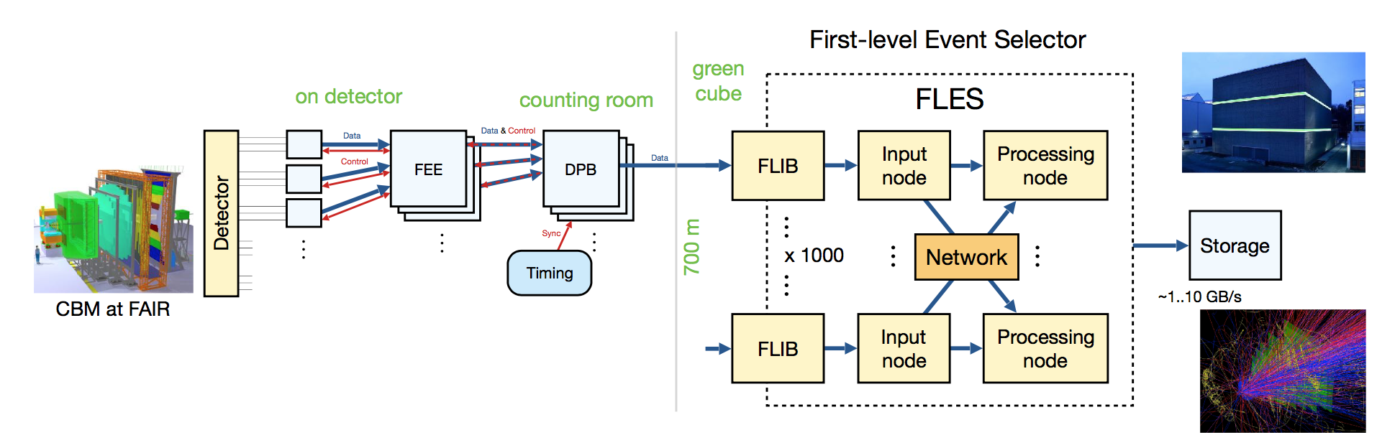
Online Data Management
ODM
PL: J. de Cuveland, FIAS
Mission: receive data from the DAQ into the FLES entry nodes; build time slices; distribute time slices to the FLES processing nodes

Slide 20
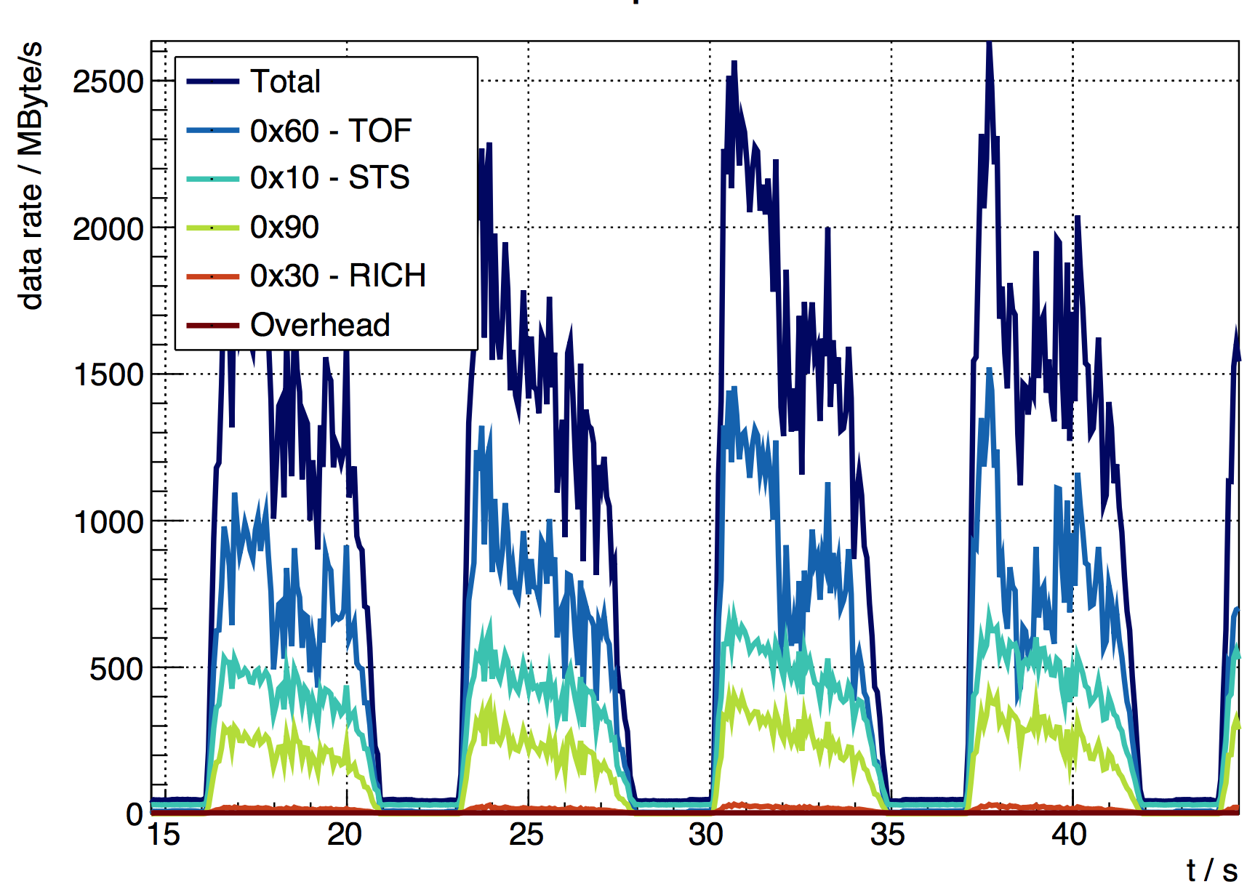
Online Data Management: Status
Global system and software architecture designed
Data model developed
Demonstrator data chain established
Critical network performance optimised
Successful data taking with mCBM March 2019
mFLES
with 2 entry nodes and 7 processing nodes
Full flesnet chain

Slide 21
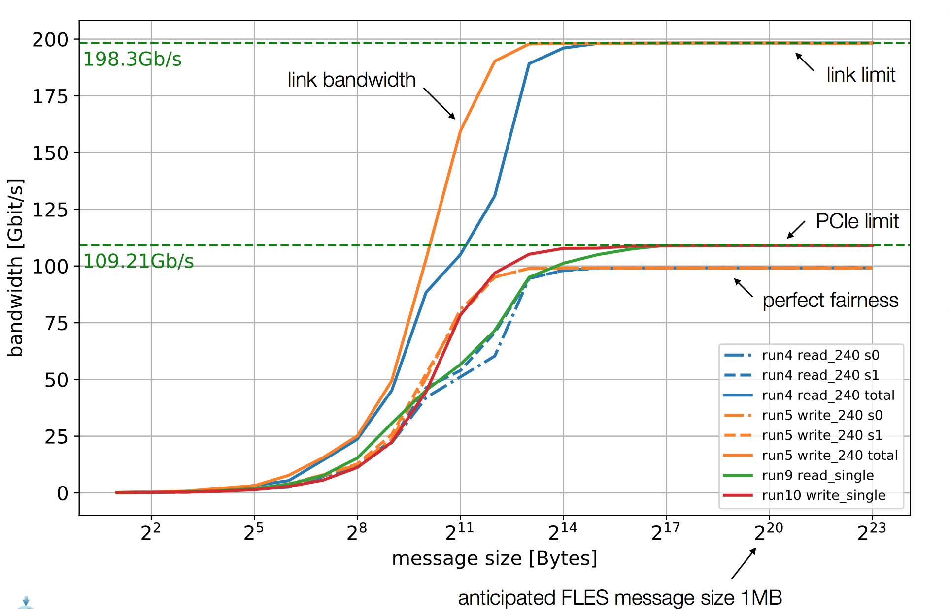
Online Data Management: Status
Throughput measurements with InfiniBand HDR (alpha firmware)
Link bandwidth of about 200 Mbit/s achieved
Open issues:
  Monitoring (processes, data rates, buffers)
  Automation (start-up)
  Interfaces to DPF (online analysis), ECS (controls, monitoring)

Slide 22
Experiment and Detector Controls
EDC
PL: P.-A. Loizeau, GSI
Mission: Configure and monitor the different detector systems and the data acquisition
Developments started with mCBM
Configuration:
  Custom, stand-alone solutions for each detector system (IPBus, Python, C++, ...)
  Was ok for first run of mCBM, but hardly scalable
Monitoring:
  custom implementations (mostly EPICS)
  in most cases no trending or archiving

Slide 23
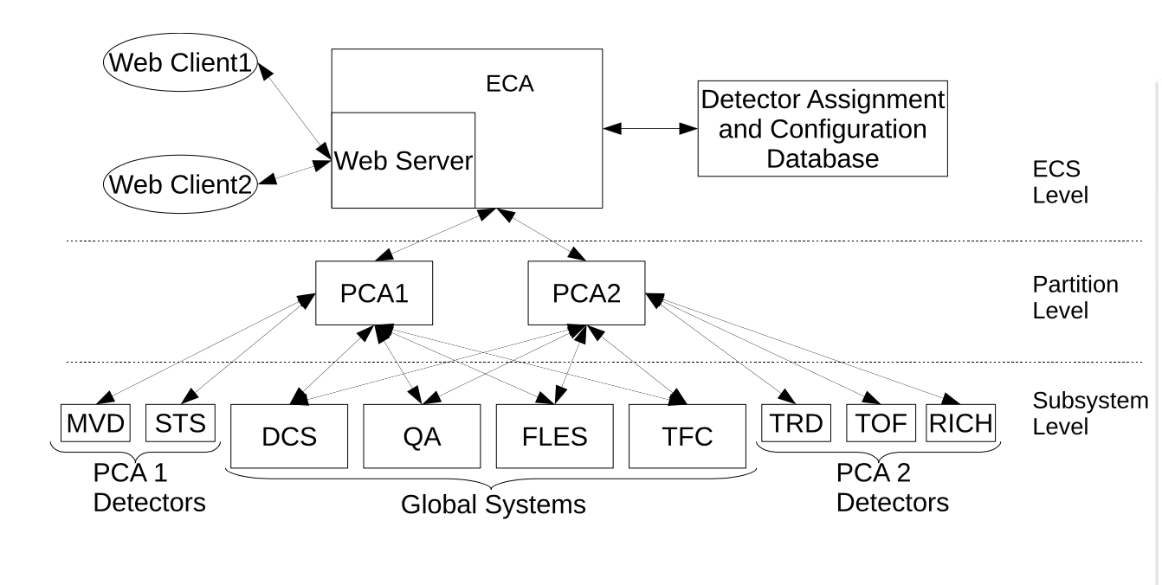
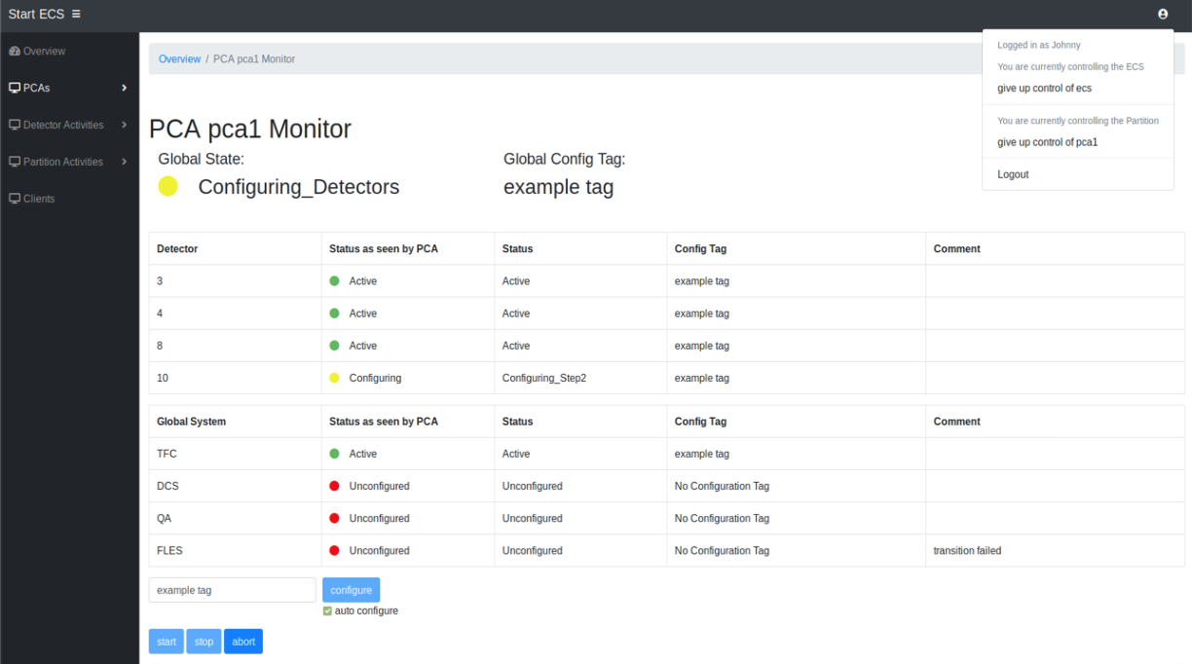
ECS Prototype
Working prototype
Implemented in Python as state machine
Deployed on mCBM cluster
Subsystems are controlled via bash scripts
Only FLES connected in March 2019
Integration of detector systems for next mCBM run campaign

Slide 24
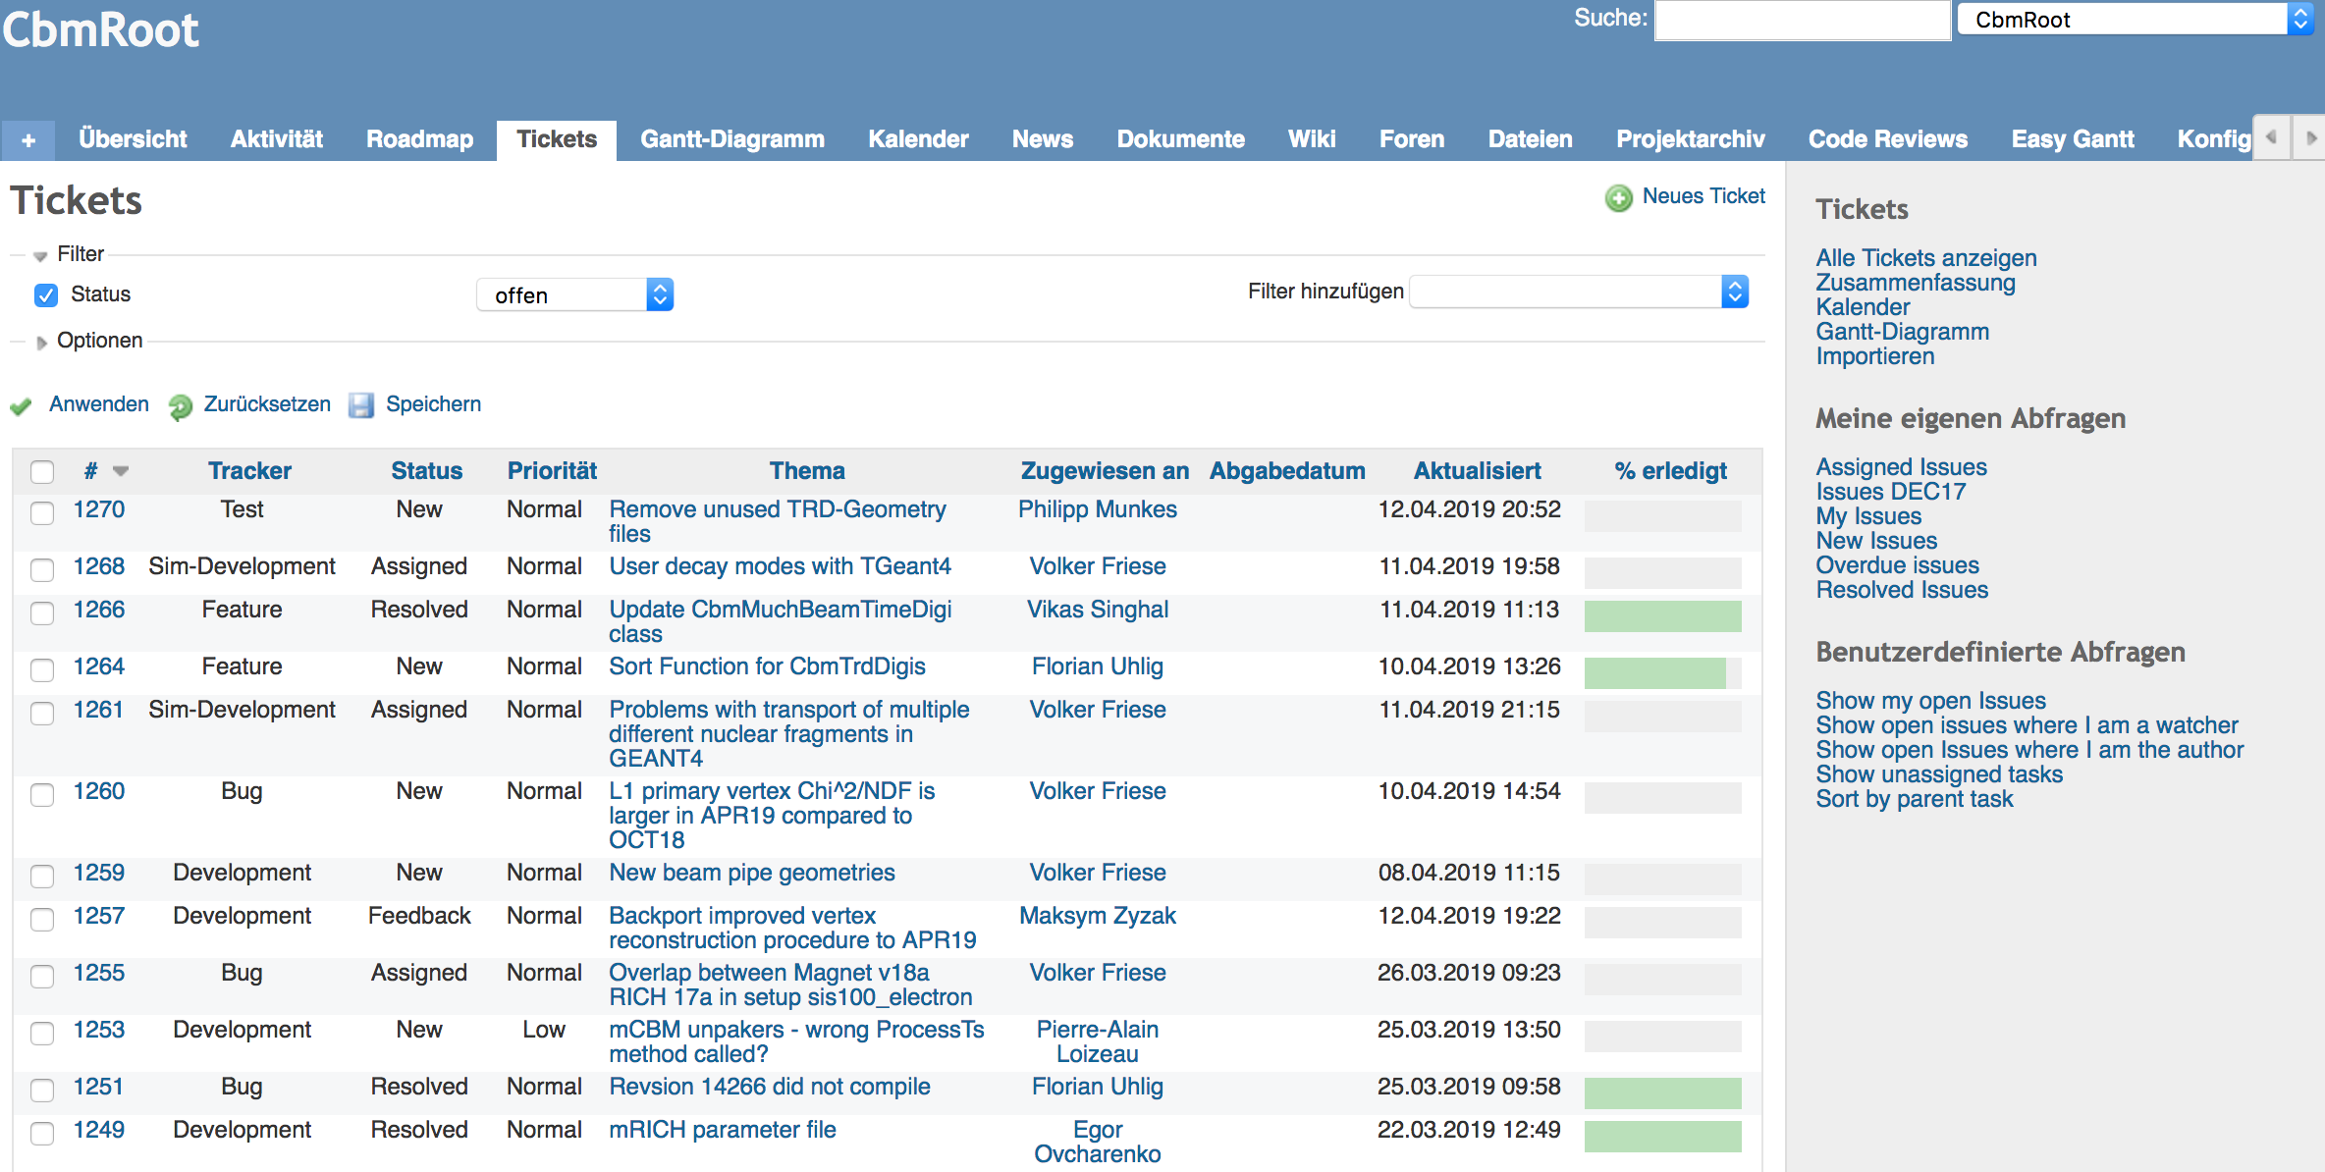
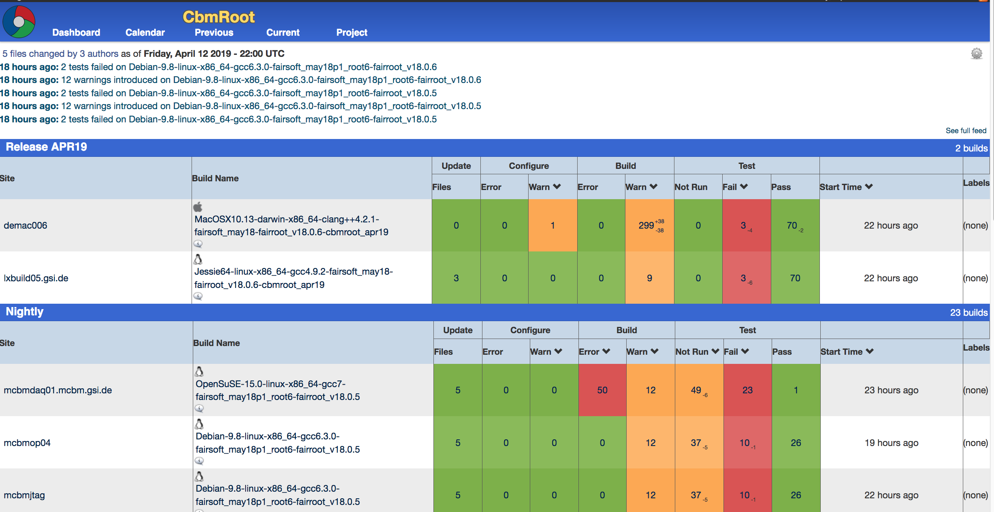
Software Development Infrastructure
INF
Software repository: subversion
  Migration to git planned
Build system: CMake
Regular test system: CDash
  Checks software integrity on commit and nightly
Project platform: Redmine
  Organisation and communication: repository browser, ticket system, code reviews, planning tools, news, forum

Slide 25
Offline Analysis Environment
OAA
P.L.: N.N.
Organise the offline analysis of experiment data on the scale of several PB per run campaign.
Status: no activities yet. Medium-scale data processing (simulated data, several 10 TB) on GSI cluster (some at FRRC cluster).
To be developed: offline data model (raw / reco / AOD), distribution of data to computer centres (TIER model), user access to data
Offline computing model has to be developed together with other FAIR experiments: FAIR computing model
Milestones: Data challenges with simulated data on 10% and 50% level.

Slide 26
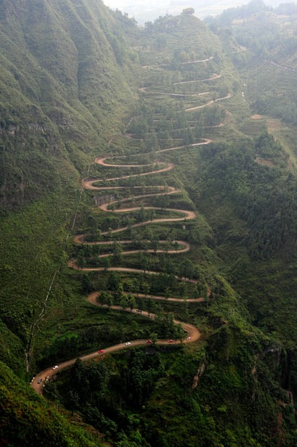
Upshot
A long way gone, some miles are still ahead...
Based on the current achievements, it appears plausible, but is not yet proven that CBM can take data at 10 MHz.
Manpower for software development is a very critical issue.

Slide 27
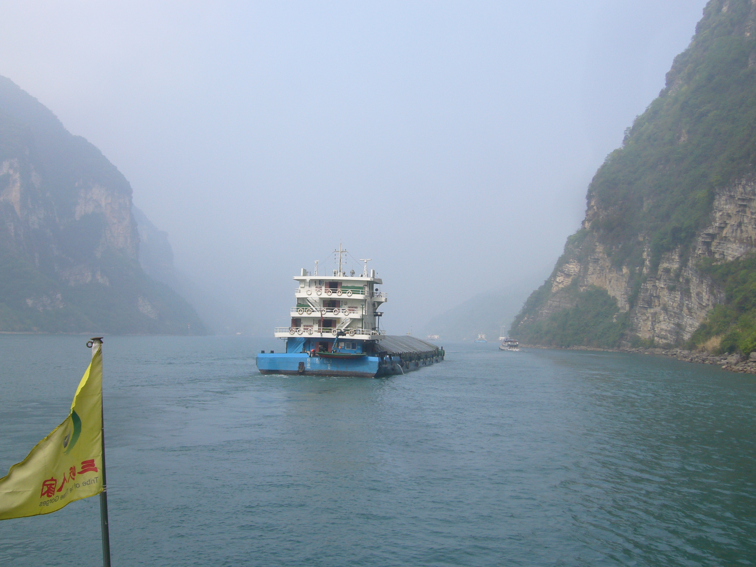


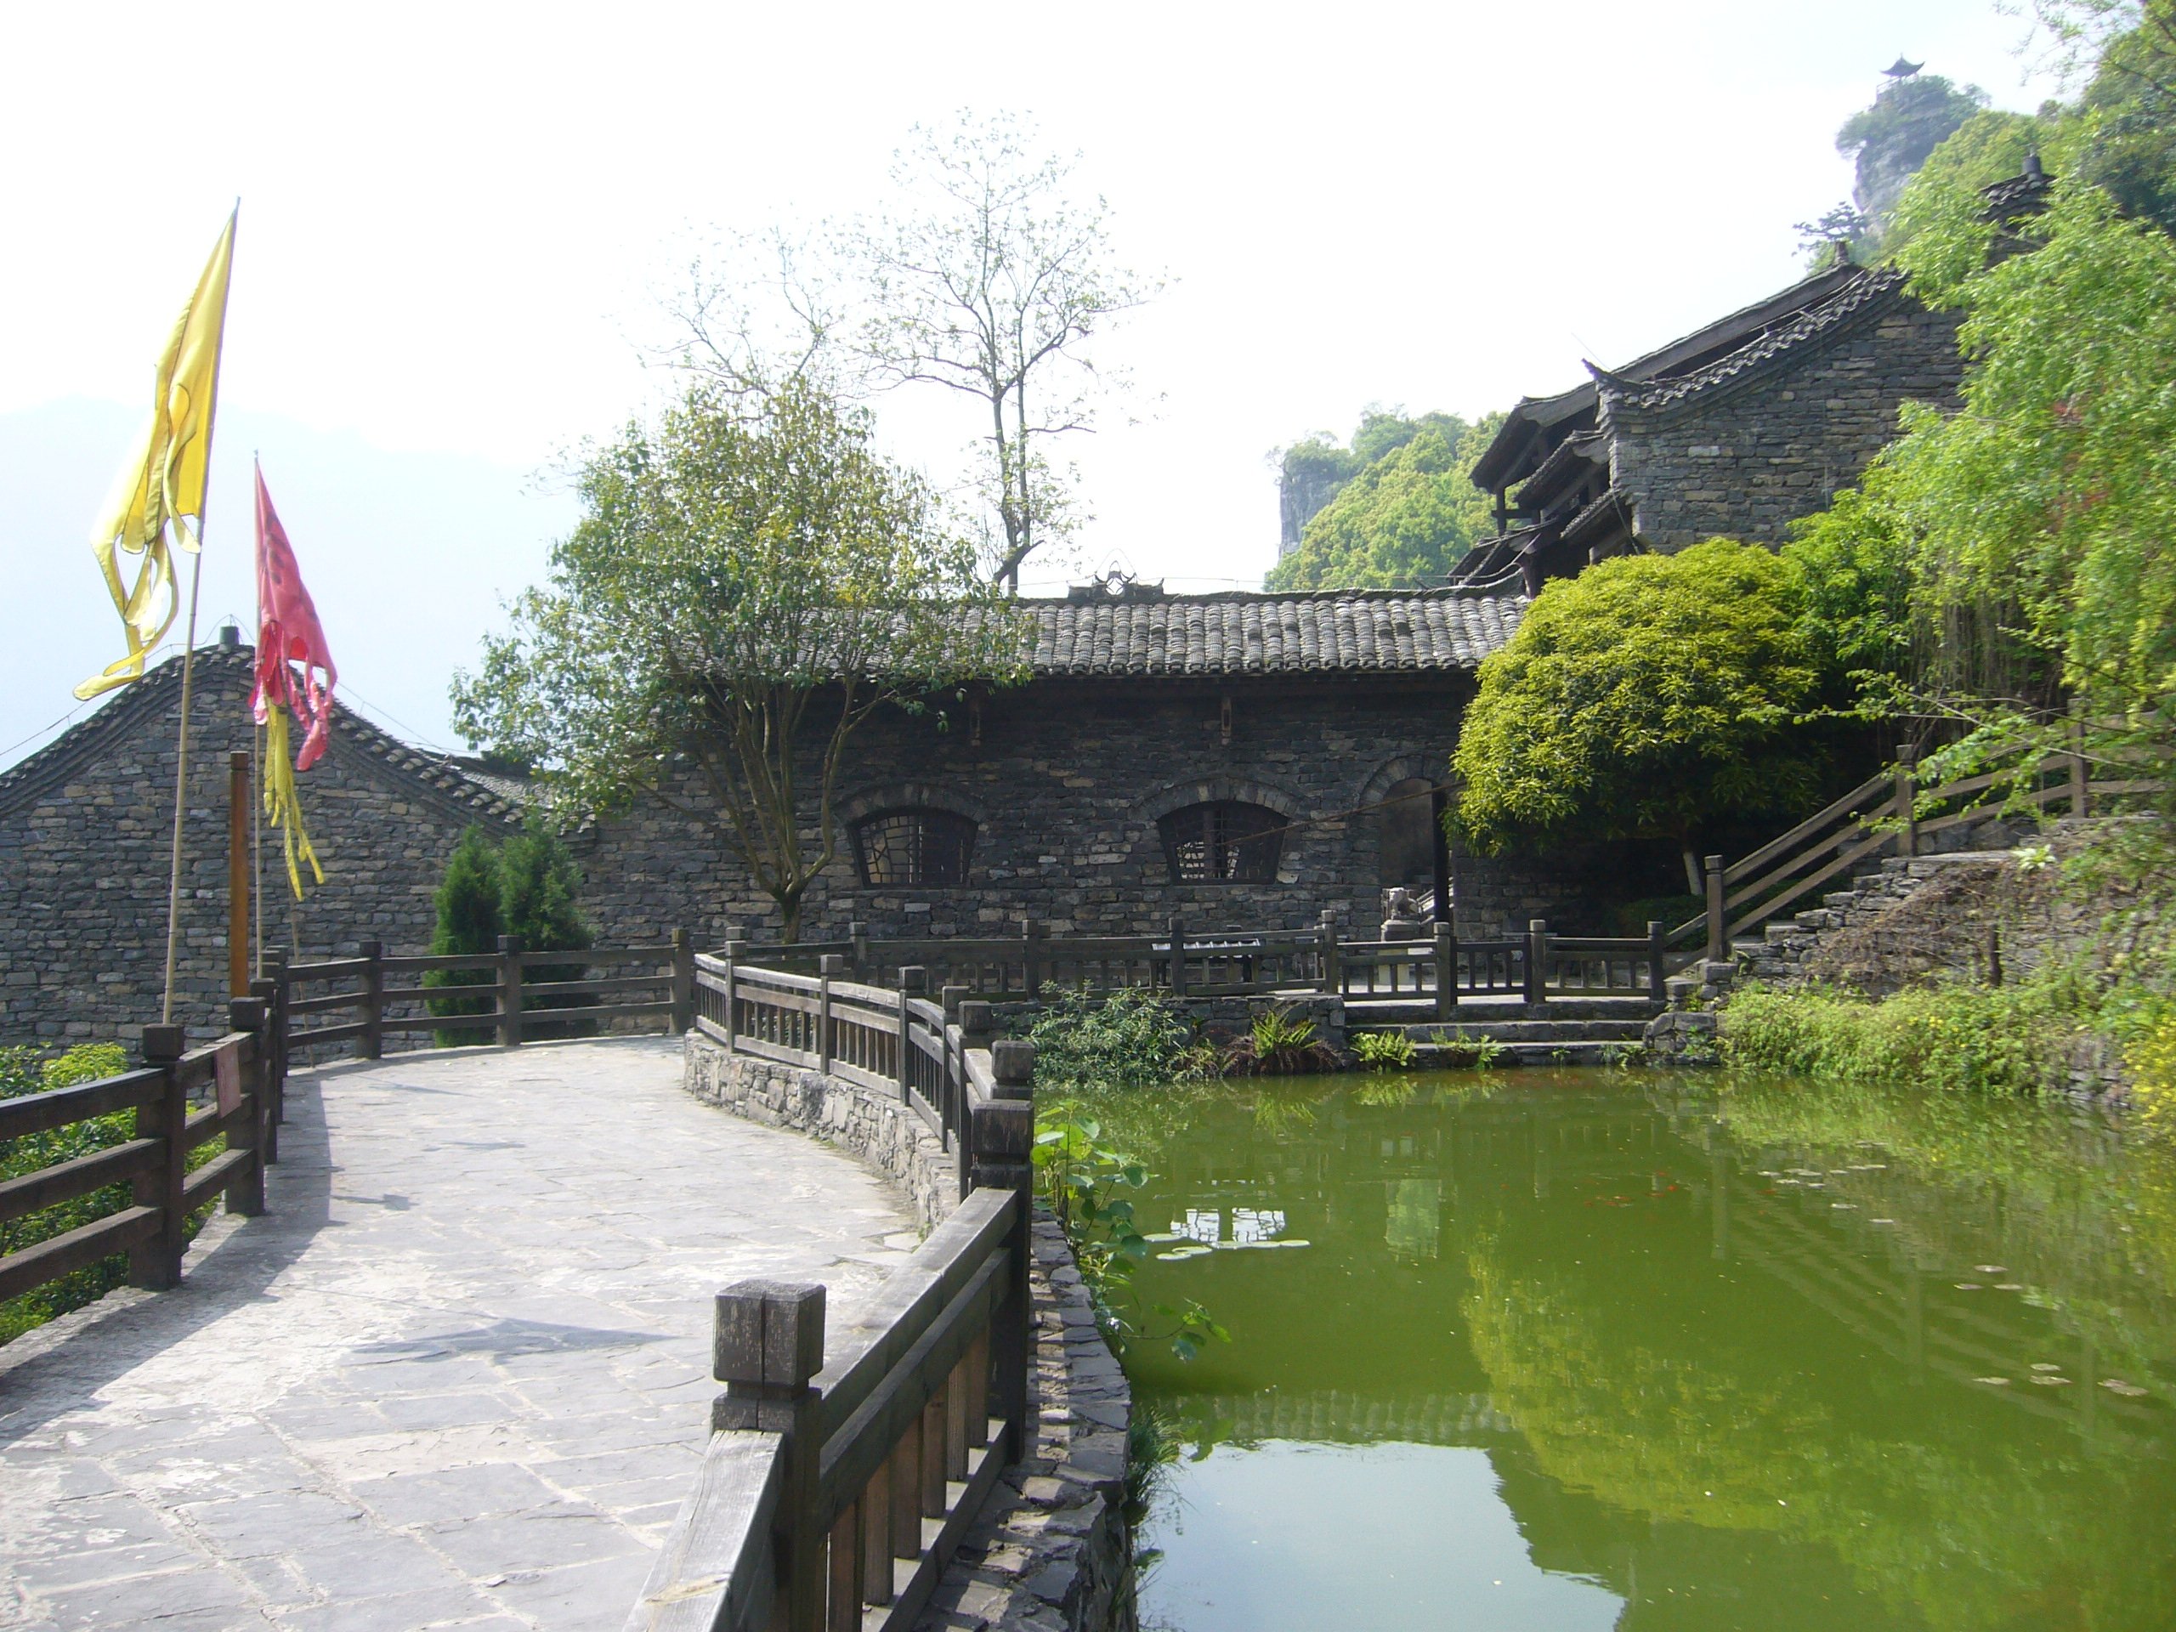
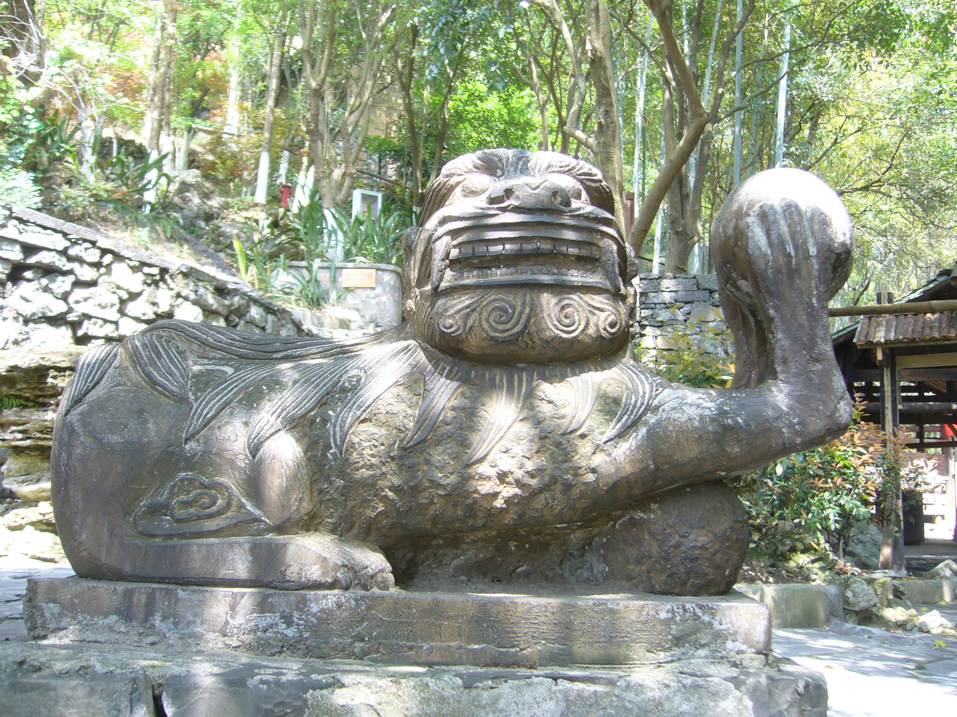

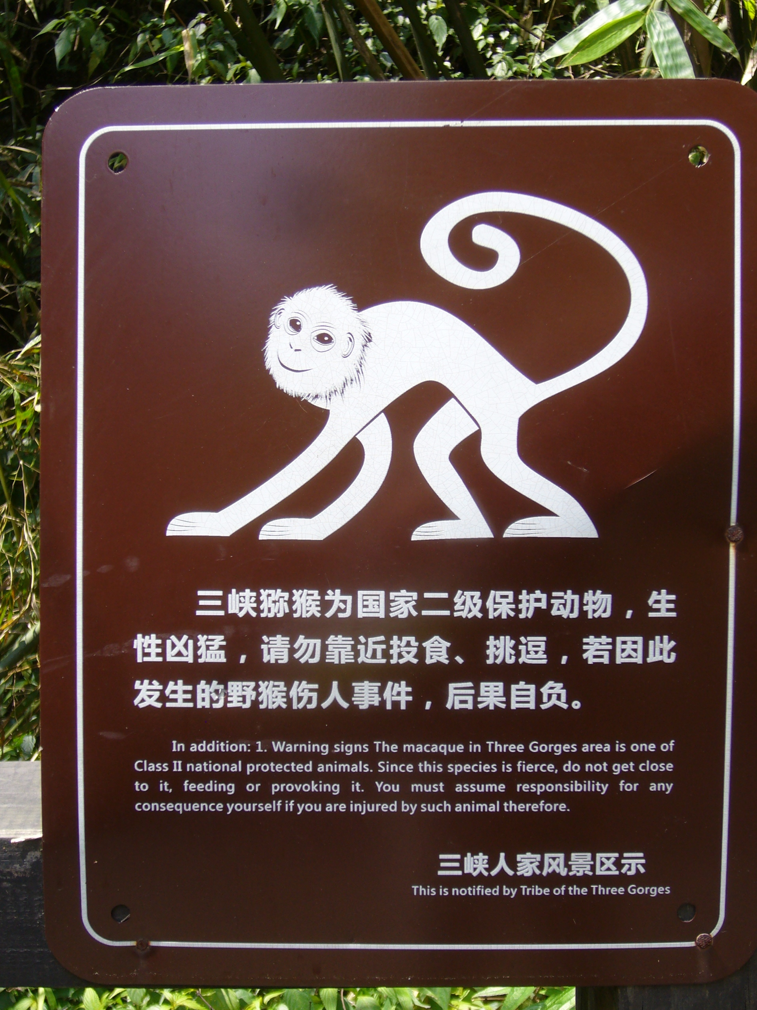
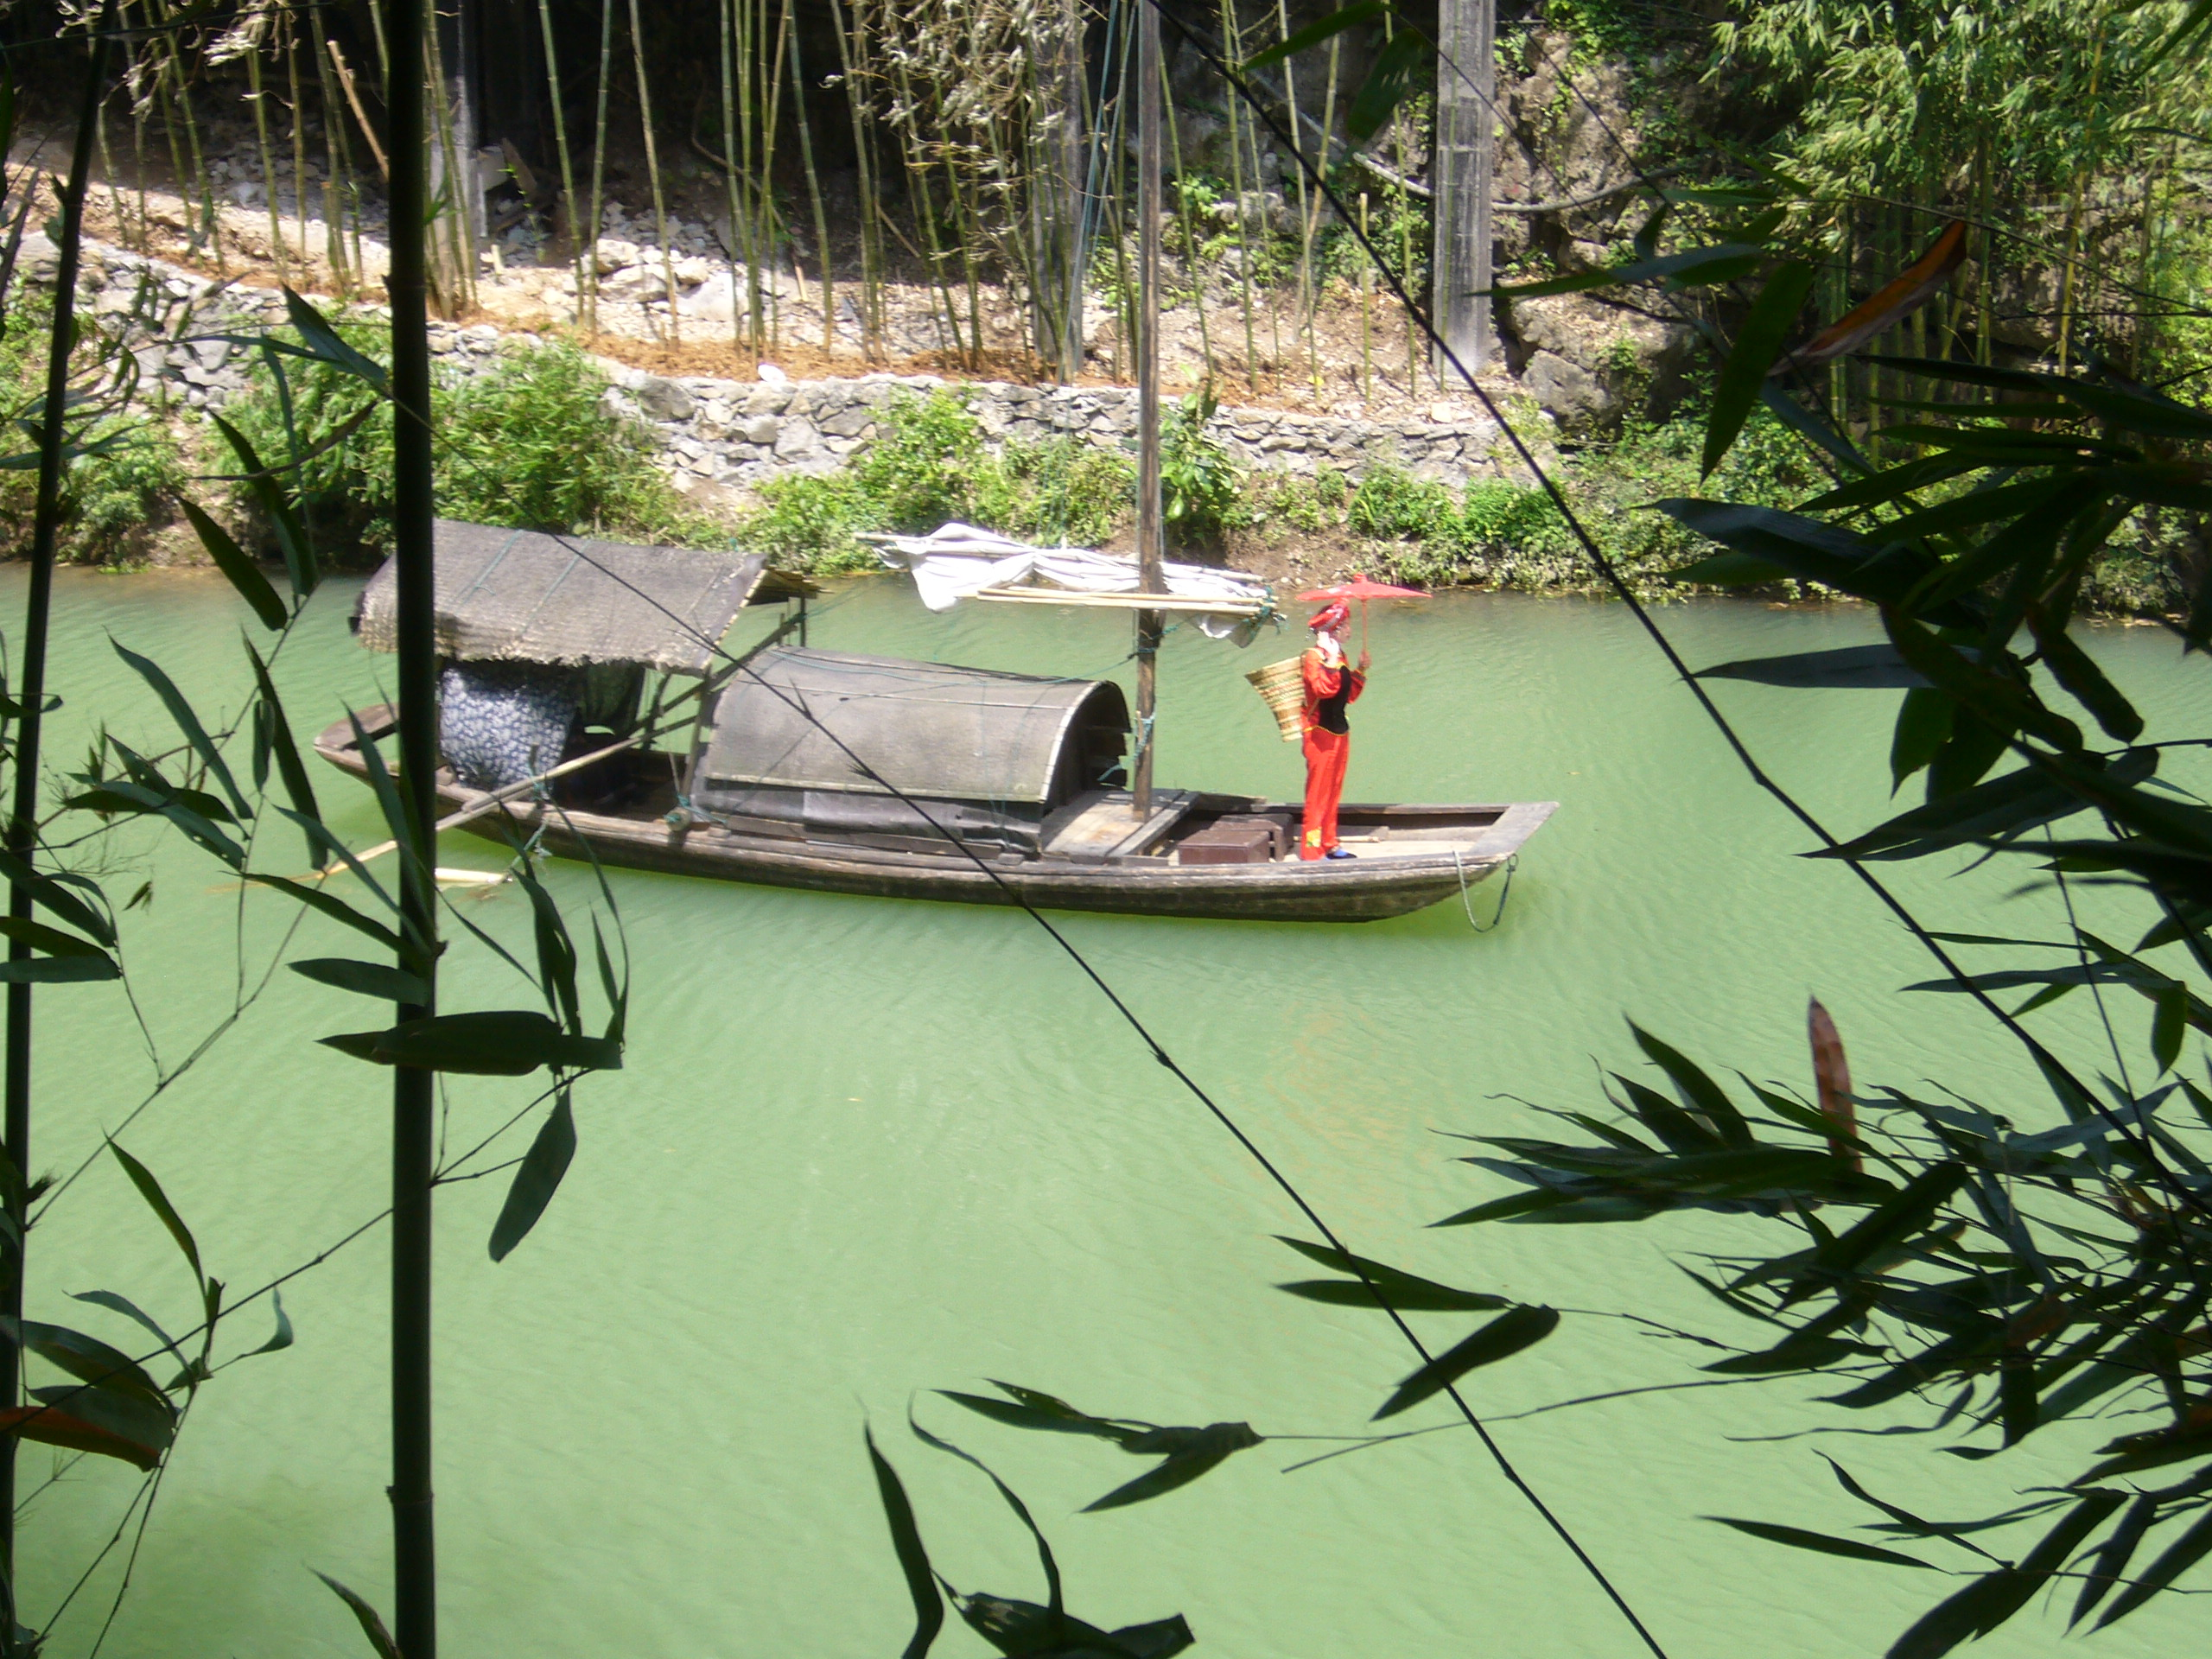

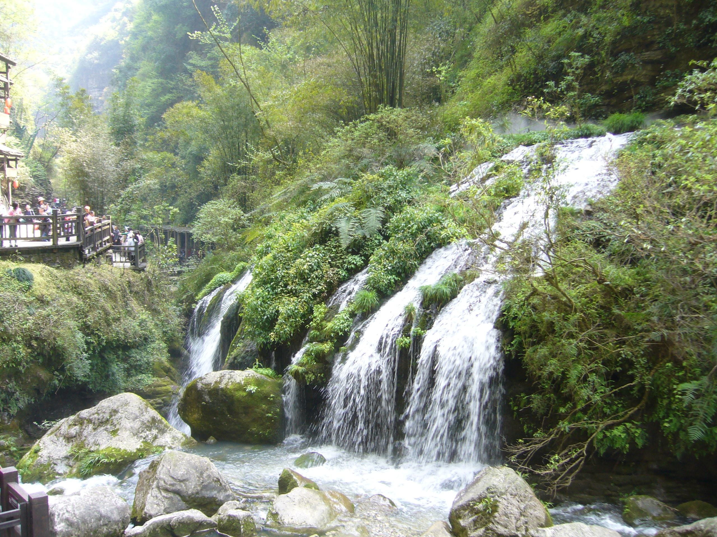

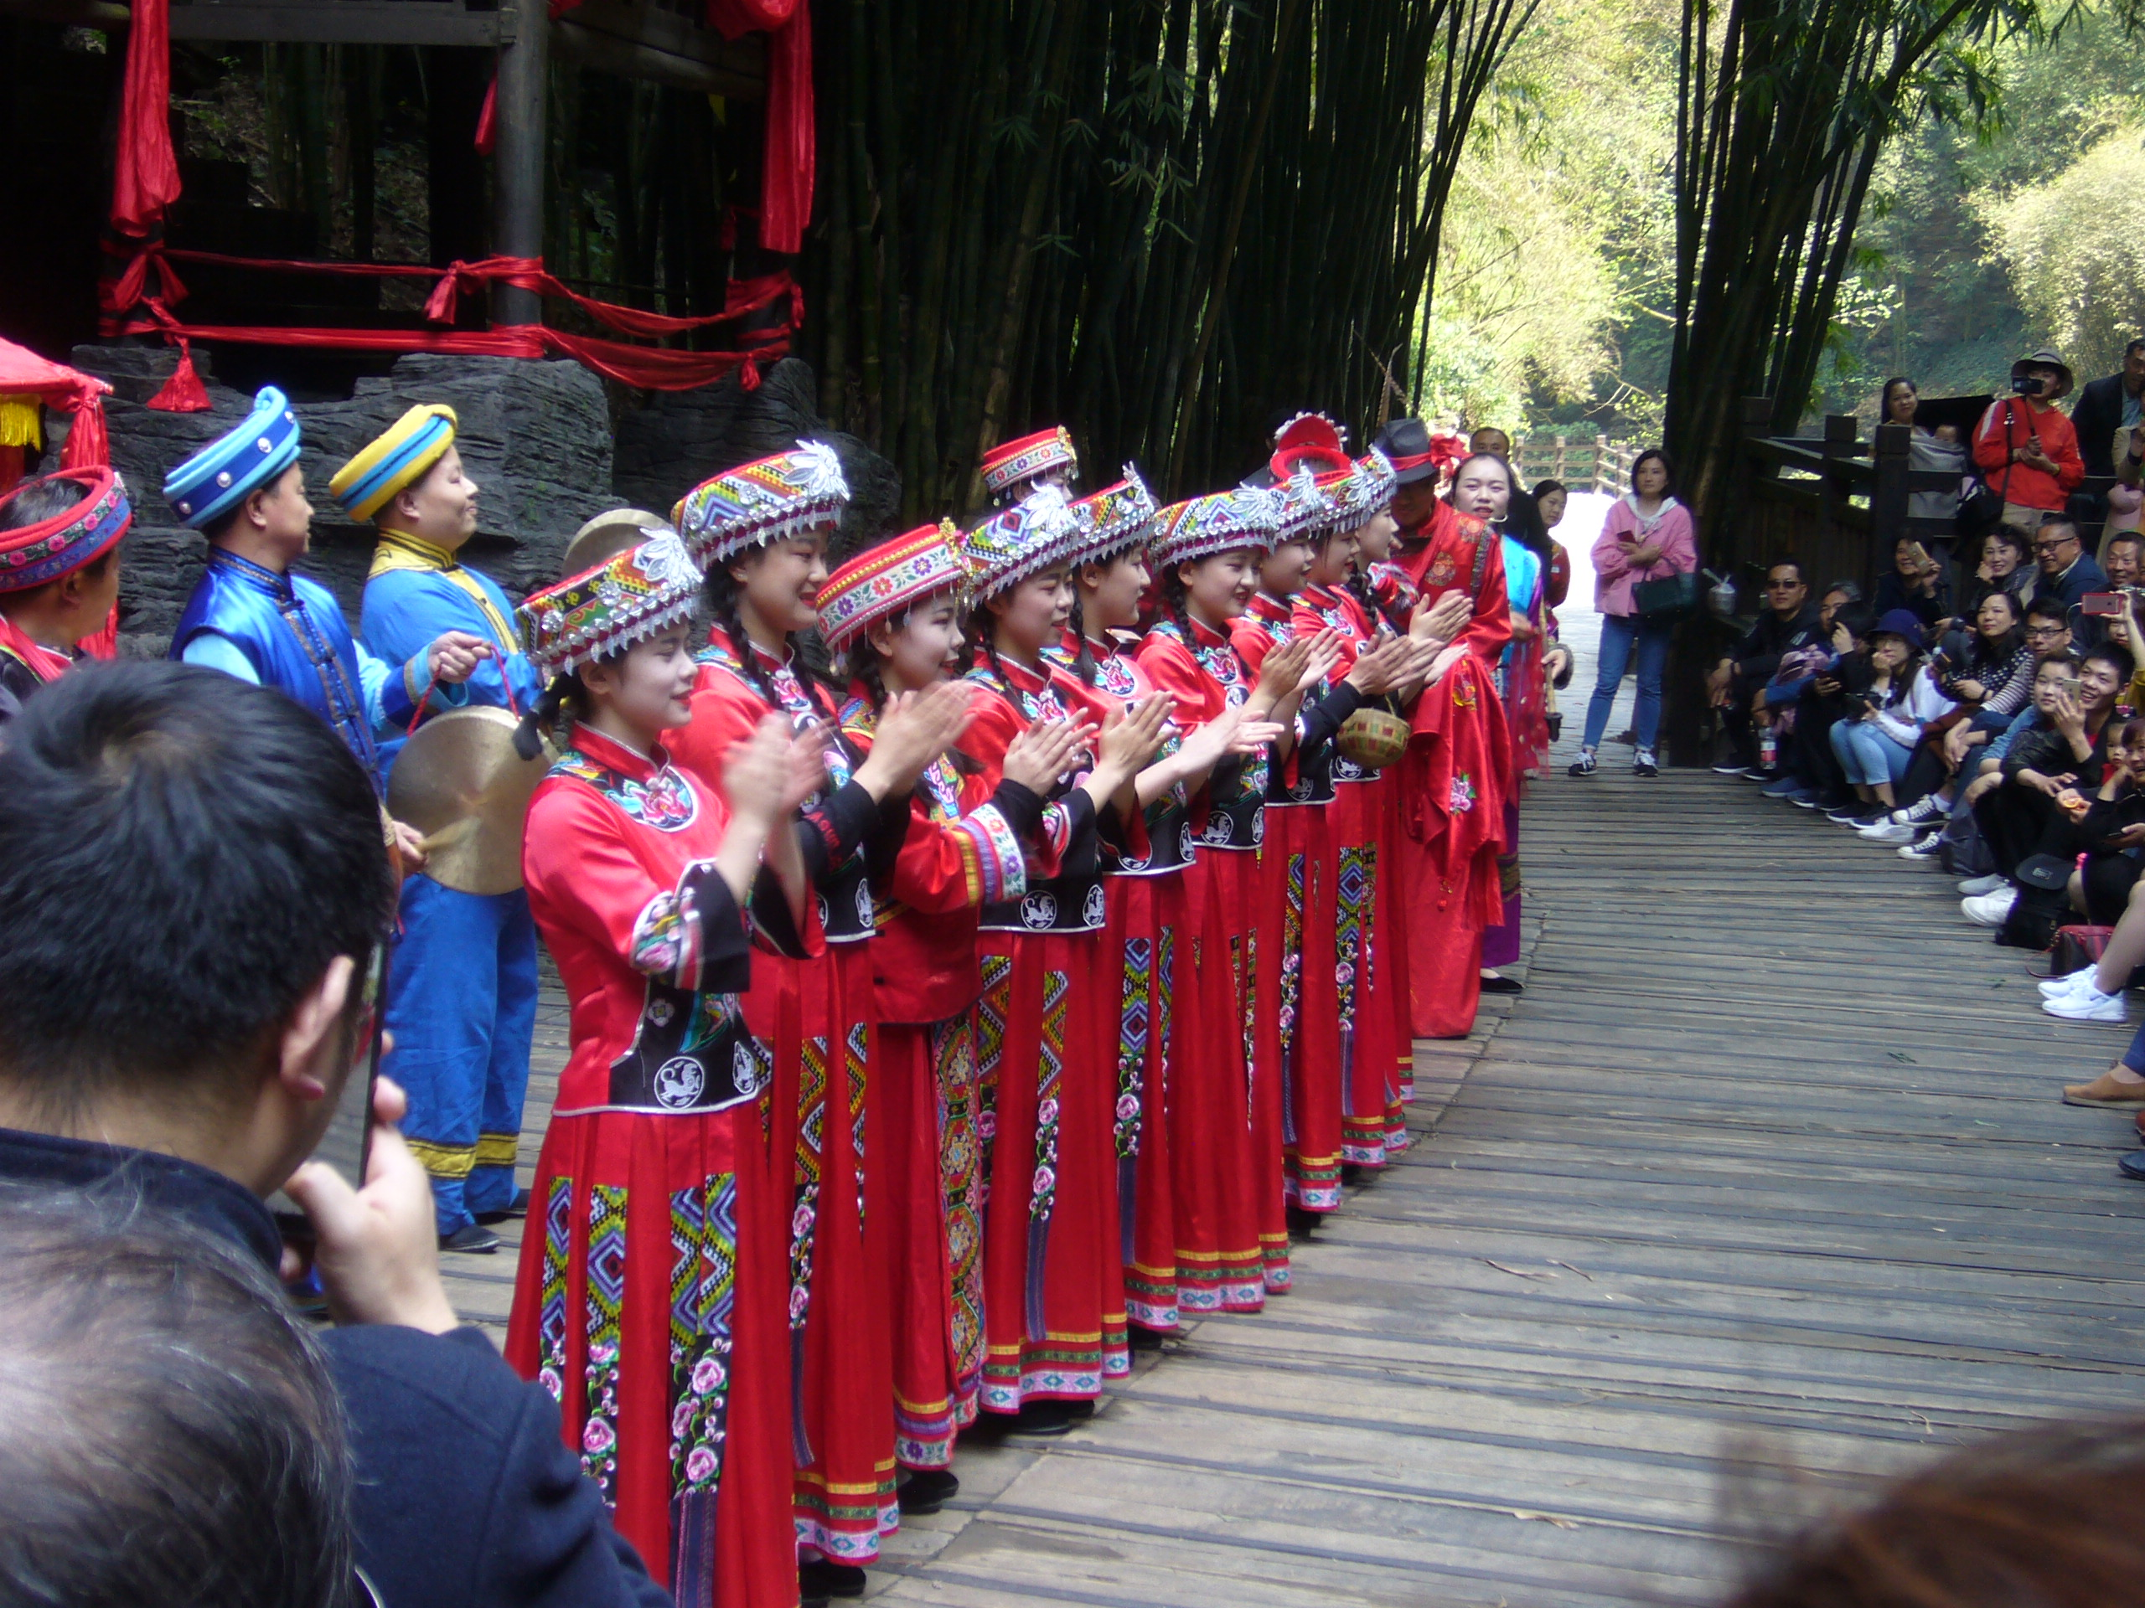

but if we manage...
Be prepared
for discoveries!

