Slide 1

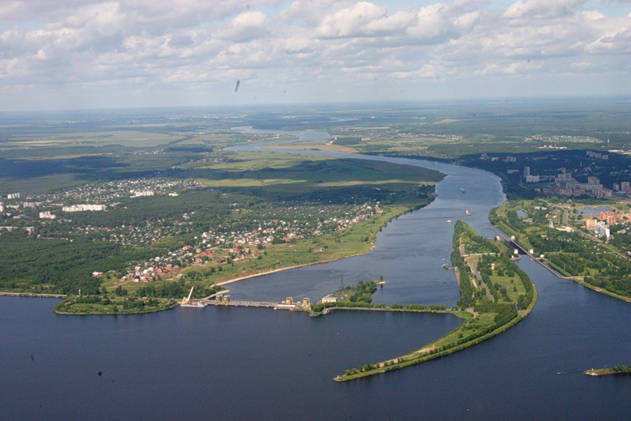

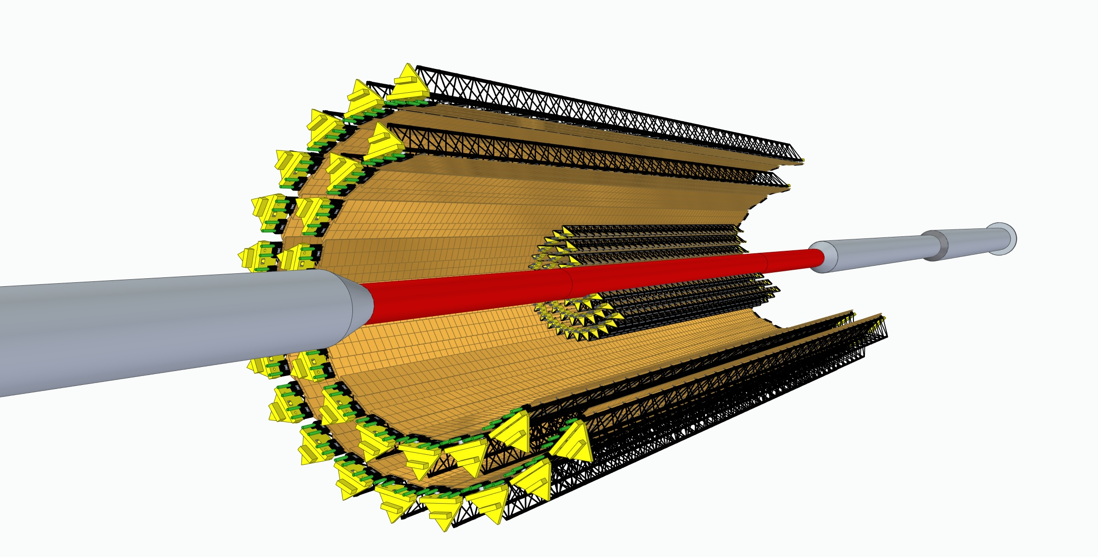
MPD-ITS PROJECT
Physics case,
status
and perspectives
NICA
NICA
Volga
Volga
river
Yangtze
Yuri Murin, VBLHEP JINR
murin@jinr.ru
Notes:
Good afternoon! First of all I would like to express my gratitude to organizers for the opportunity to give a short presentations on the NICA project and related physics

Slide 2
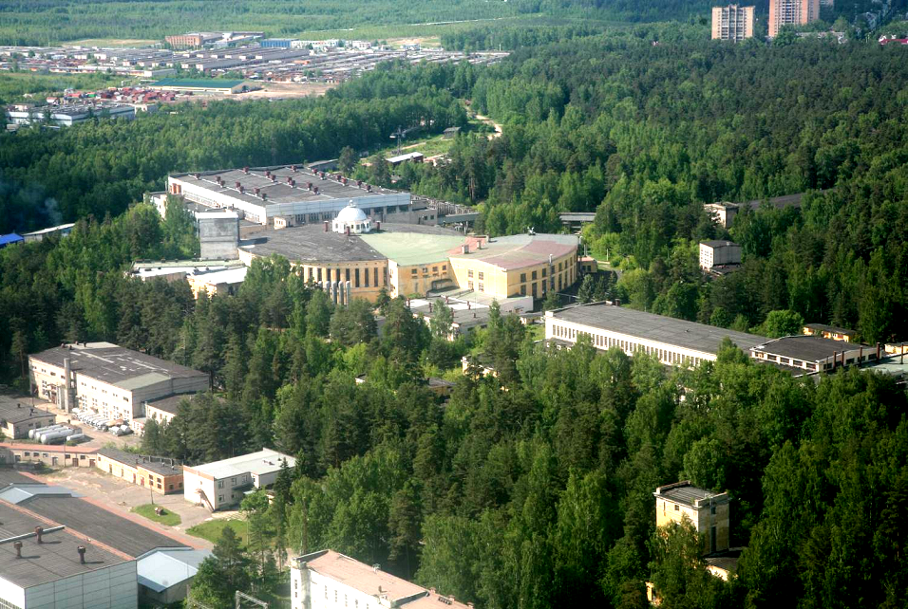
NICA (Nuclotron based Ion Colider fAcility)
Main targets:
study of hot and dense baryonic matter
at the energy range of max net baryonic density
investigation of nucleon spin structure, polarization phenomena
modernization of existing accelerator facility
construction of Collider to collide
  relativistic ions from p to Au at energy range √S_{NN}= 4 - 11 GeV
  polarized p and d at energy up to √S =27 GeV (p)
Notes:
NICA is a Nuclotron … The main targets of the project are: ..
That has required a development of accelerator facility and construction of

Slide 3
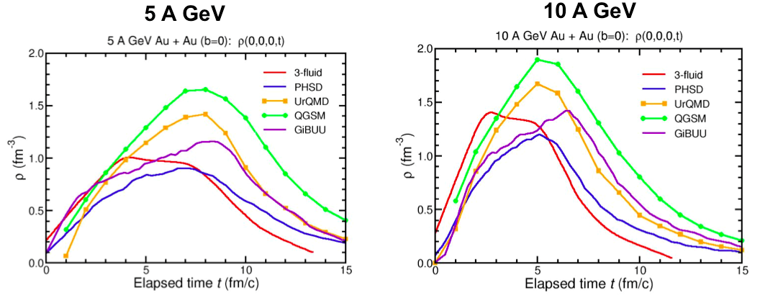
Net Baryonic density to be reached
in Au + Au collisions
FAIR SIS-100
NICA
8 ρ₀
5 ρ₀
I.C. Arsene at al., Phys. Rev. C75 (2007) 24902.
Notes:
Net baryonic density to be reached in Au+Au collisions according various models is 5 and 8 standard densities at FAIR and NICA energies correspondingly

Slide 4
Mixed phase matter at the NICA energies:
maximum in the net baryon density – density frontier;
maximum in Κ⁺/π⁺ ratio;
maximum in Λ/π ratio;
maximum yield of hypernuclei
transition from a Baryon dominated system
to a Meson dominated one;
maximum of the Λ polarization;
1-st order transition & mixed phase creation;
Critical Endpoint ?

Slide 5
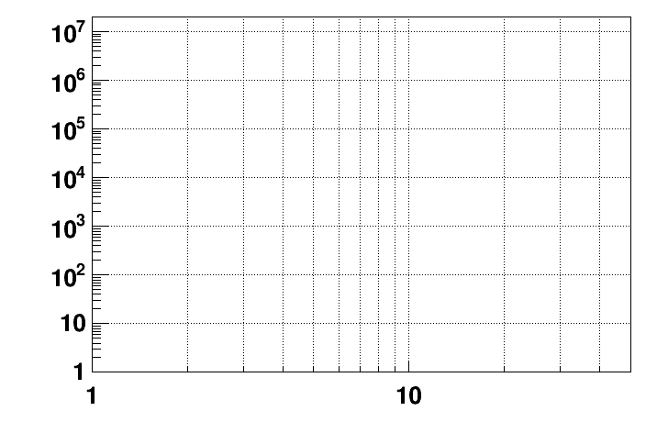
Current and future experiments on CBM
energy region of max.
baryonic density
CBM
2022 – 2025: SIS-100 FAIR
NICA/BM@N II
HADES
NICA/MPD
Interaction rate [Hz]
STAR F.T.
STAR BES II
NA-61/SHINE
Collision energy √S [GeV]
NN
Notes:
Concerning fixed target experiments –there are several ones including NICA/BMN. CBM/FAIR will provide extremely high interaction rate.

Slide 6
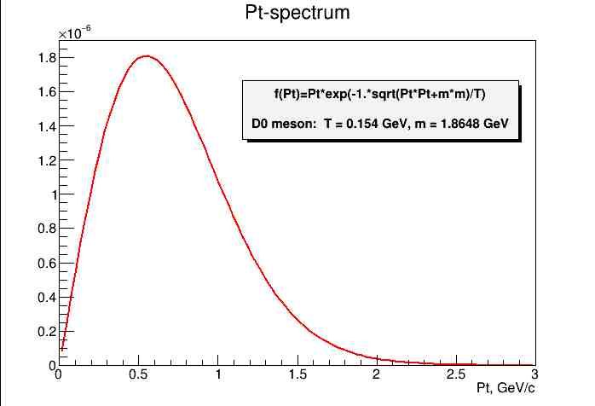
Current limitations of eхperimental data on D meson
Identificaion achieved
Thermal generator: D meson’s p_{t} - spectrum
Abdel Nasser TAWFIK† and Ehab ABBAS
Thermal Description of Particle Production in Au-Au Collisions at STAR Energies
Physics of Particles and Nuclei Letters. November 2013

Slide 7
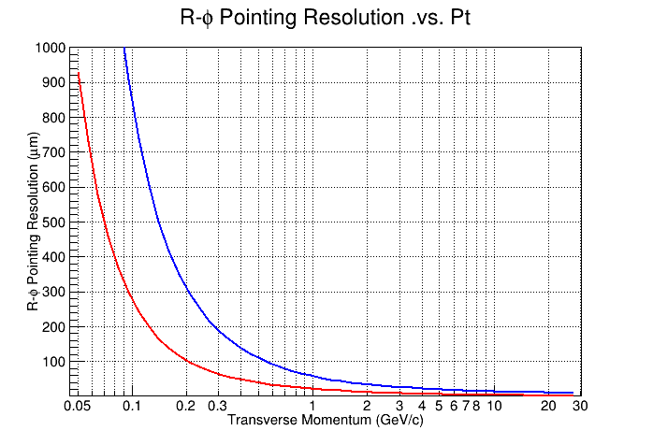
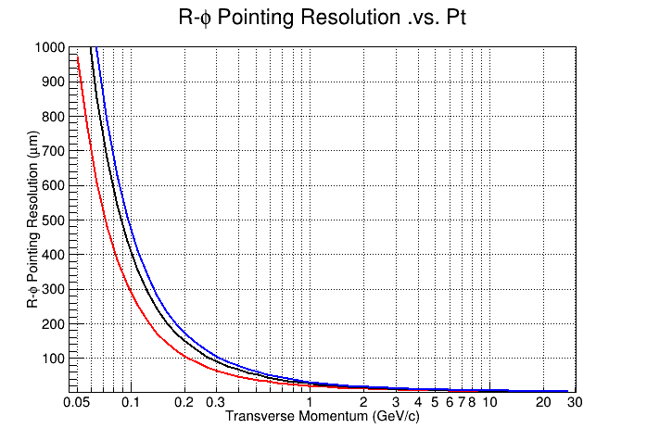
ITS pointing resolution within STAR-ALICE toy model
ALICE
MPD
Pions
Pions
New ITS
Ø = 40 mm
Old ITS
Ø = 50 mm
Ø = 60 mm

Slide 8
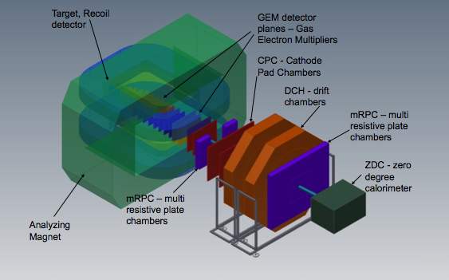


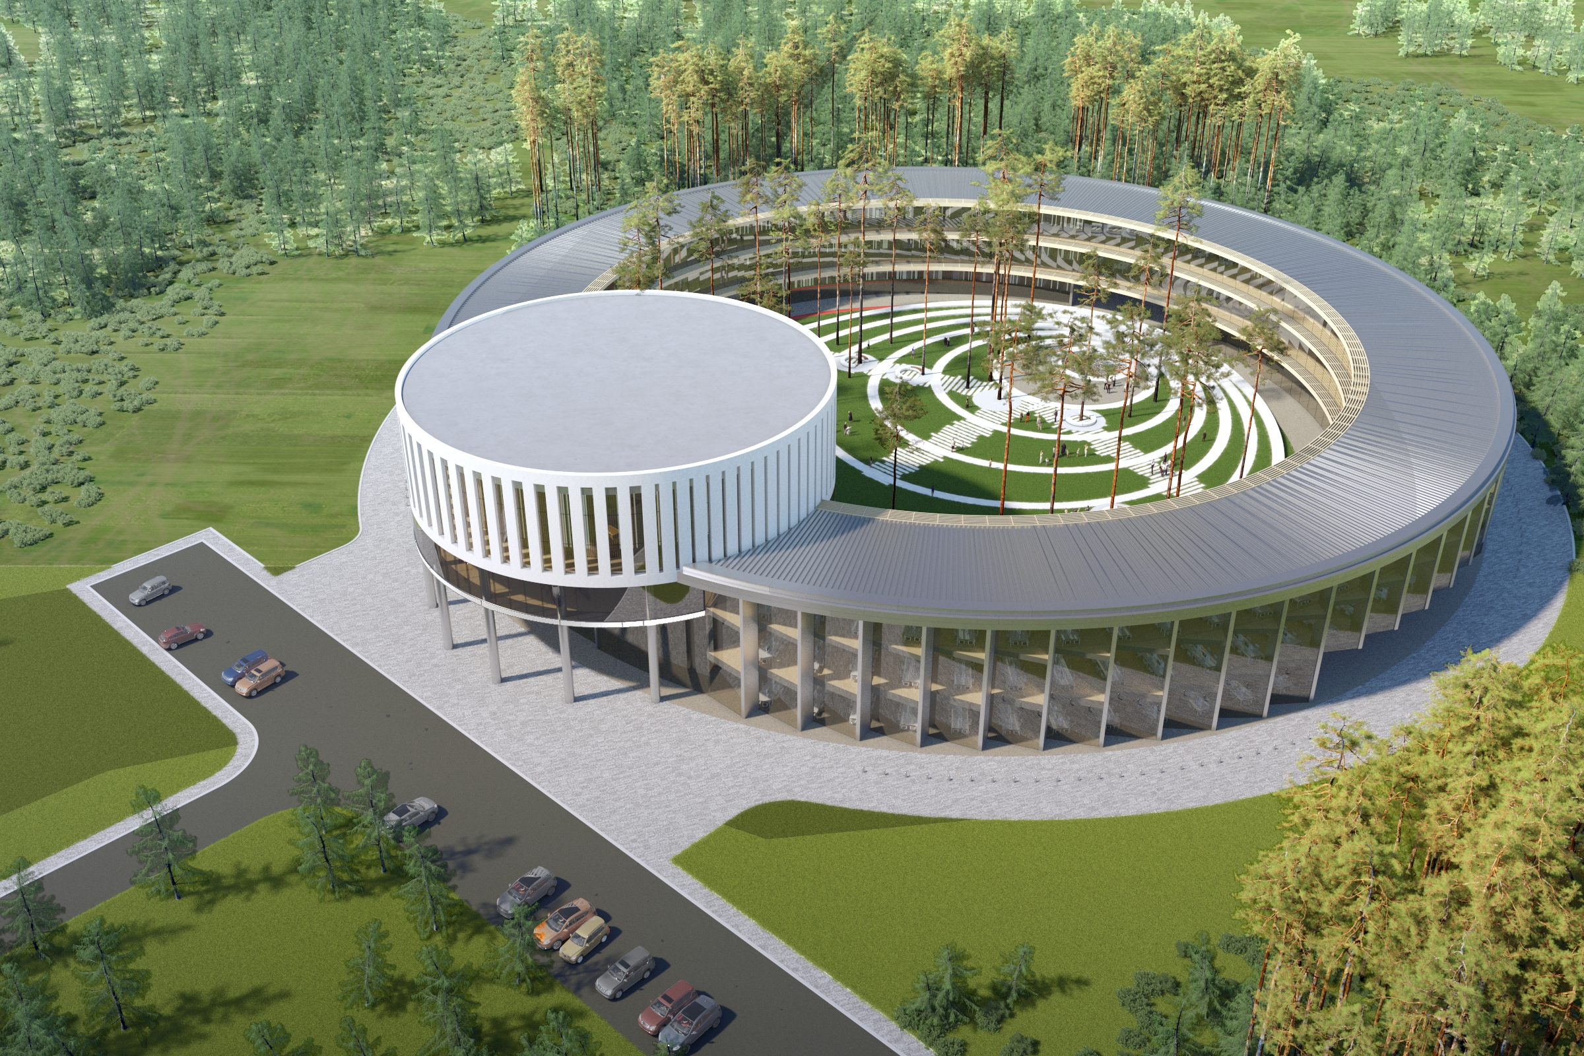
basic facility
2 major milestones in 2018
BM@N
the first
physics run
SPD
Collider ring (c=503 m)
Booster commissioning
Center NICA
MPD
Nuclotron ring (c=251,5 m)
Notes:
This is a view of major NICA facilities. The Nuclotron – supercoducting synchrotron with circumference of 250 meters was put in operation 24 years ago. The beams from Nuclotron are extracted to the experimental hall, where the first experiment of NICA program BM@N is located. The plan is to put in operation a booster in 2019, and collider - in 2020 simultaneously with the MPD.

Slide 9
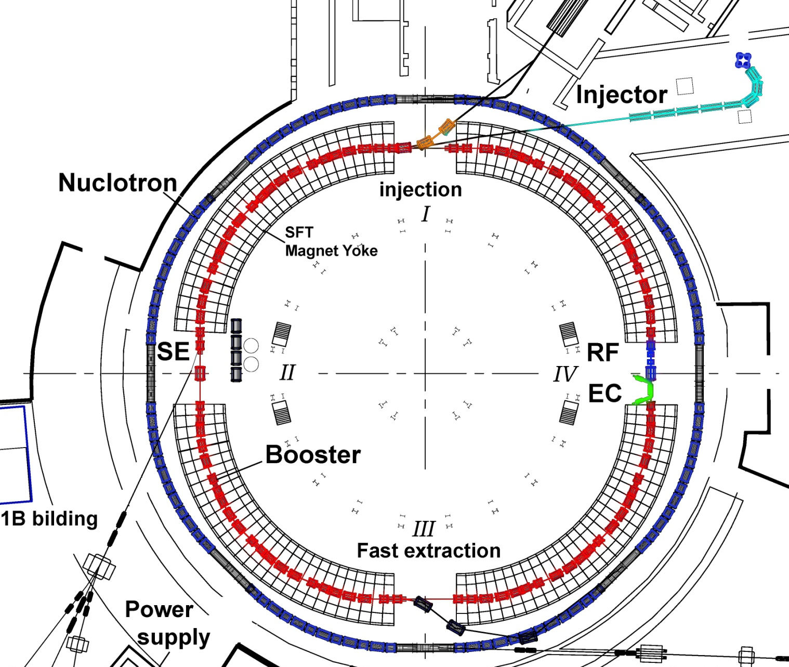
milestone II: Booster status
Assemblies | # | tested / ready %
dipoles | 40 | 100/30
qdr doublets | 24 | 80/5
BPM stations | 24 | 80/0
magn.joint kits | 45 | 100/50
bypass for coolant liquid | 2 | 60/0
warm sect. | 4 | 70/50
refererence magnet sec. | 2 | 90/50
feed box | 2 | 10/0
vac. station (cryostat) | 26 | 50/50
vac. station (beam pipe) | 24 | 90/30
ref. mag. sec.
Booster
PS
RF
Ecool

Slide 10

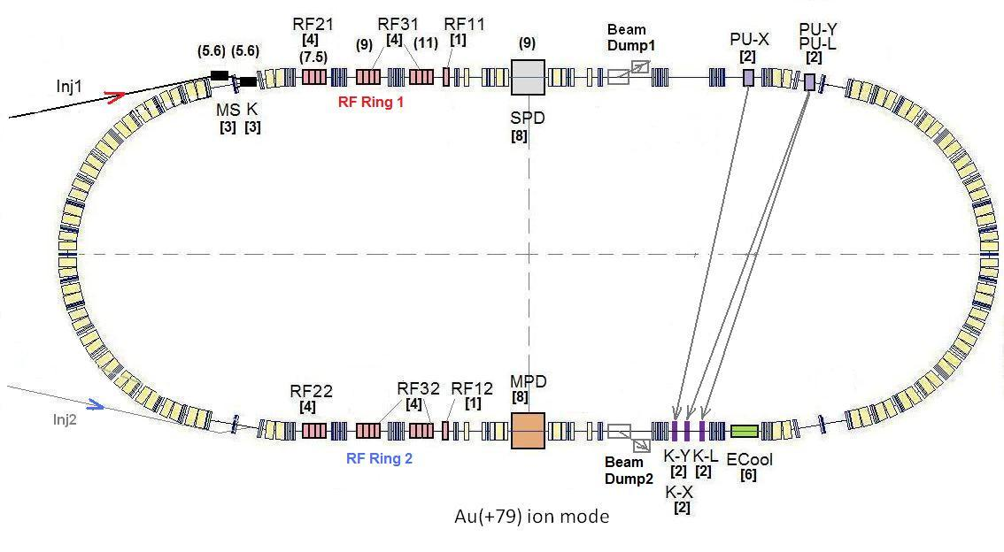
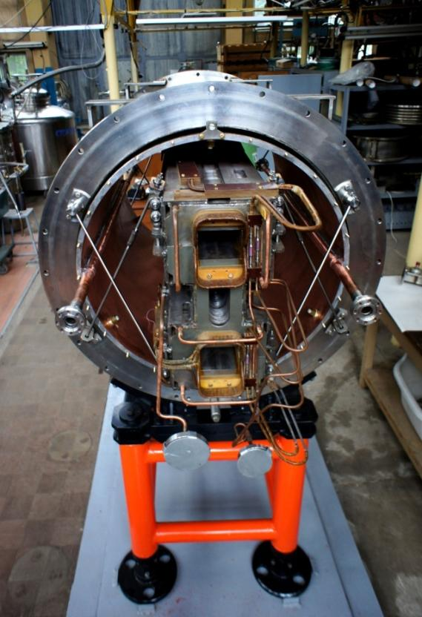
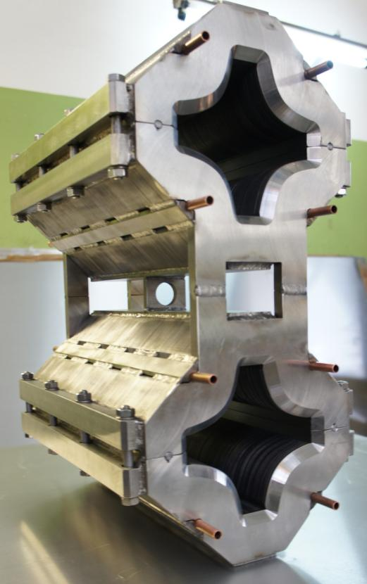
The Collider
45 T*m, 4.5 GeV/u for Au⁷⁹⁺
SPD
Ring circumference, m | 503,04
Number of bunches | 22
r.m.s. bunch length, m | 0,6
β, m | 0,35
max. int. Energy, Gev/u | 11,0
r.m.s. Δp/p, 10-3 | 1,6
IBS growth time, s | 1800
Luminosity, cm⁻² s⁻¹ | 1x10²⁷
MPD
Double aperture magnets:
dipole & quadrupole
prototypes
Notes:
The lattice design and prototyping of most collider elements are completed. The ring circumference is twice as one of the Nuclotron. For the gold beam a Luminosity at the energy above 10 GeV per nucleon will be 10 to the 27

Slide 11
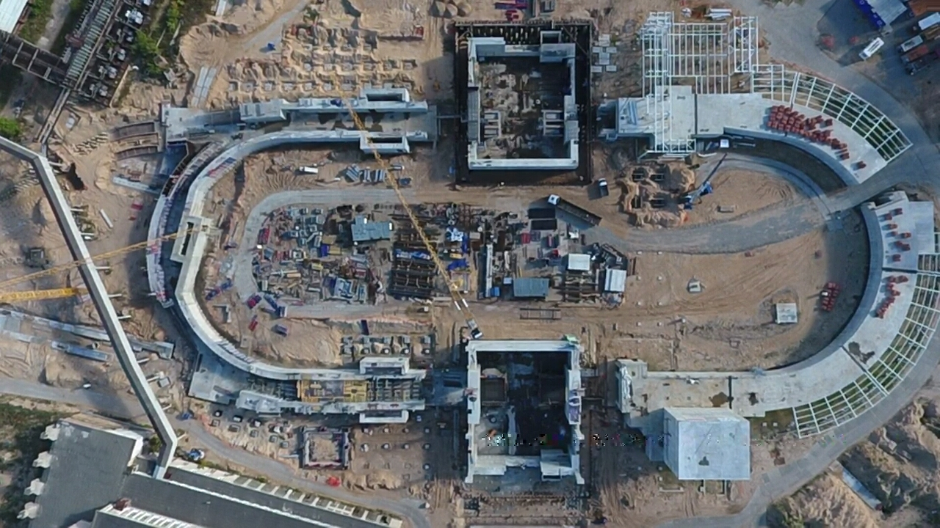
Civil Construction, bld17
September 2018
SPD
Hall
Western
semiring
MPD
Hall
readiness for equipment installation in the MPD Hall - 2019

Slide 12
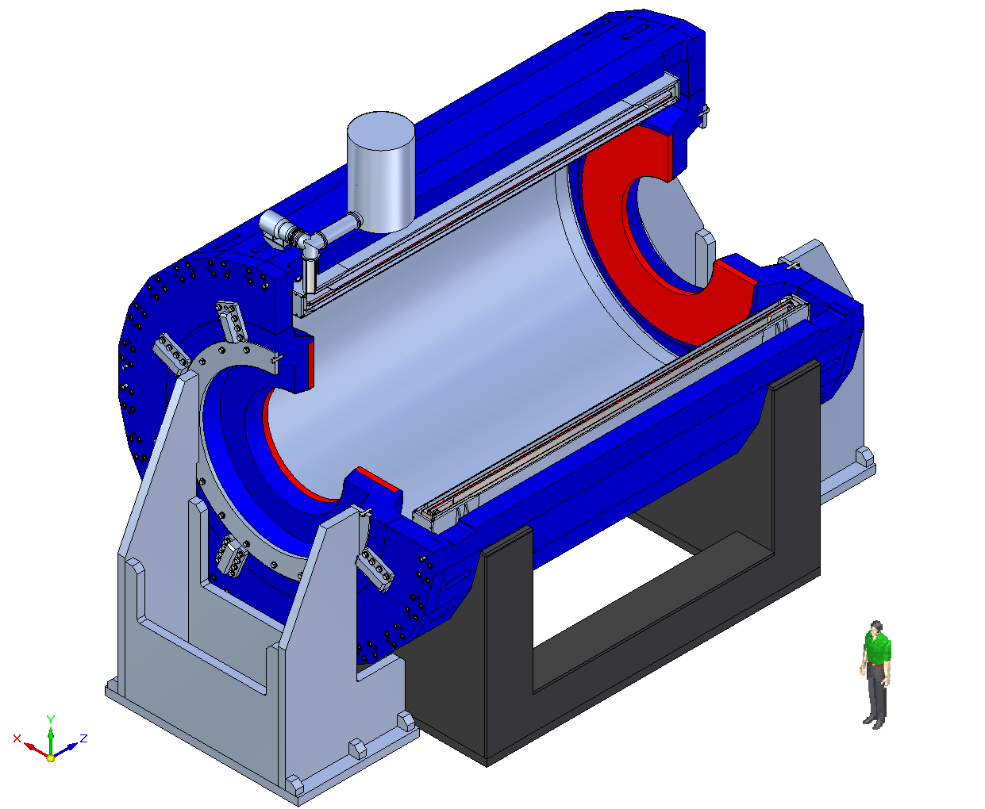
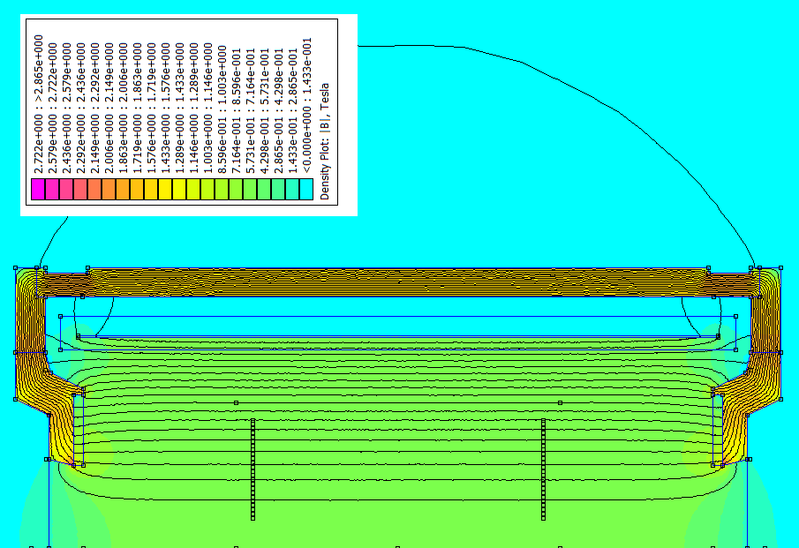
superconducting Solenoid
B₀=0.5 T
weight ~ 900 t
Rated current: 1790 A
Stored energy: 14.6 MJ
Control Dewar,
pipe lines
SC coil
Trim Coil
TPC region
Cryostat
high level (~ 3x10⁻⁴) of magnetic
field homogeneity
MF measurement in 8×10³ points: cooperation with CERN
ASG superconductors,
(Genova) general responsibility:
Cold Mass + Cryostat
Trim Coils
Vacuum System
Control System + PS +…
HM Vitkovice, Czech Republic:
fabrication of yoke & supports
Notes:
The major part of MPD is SC solenoiodal magnet. It is a challenging project due to very high requirement for the magnetic field homogeneity – better that a permill.
After long negotiations a contract is signed with the ASG sc company – the one which produced a big solenoid for CMS. The ASG is responsible for production of coils, cryostat control system etc. In addition the company takes responsibility for the overall supervision and final characteristics.

Slide 13
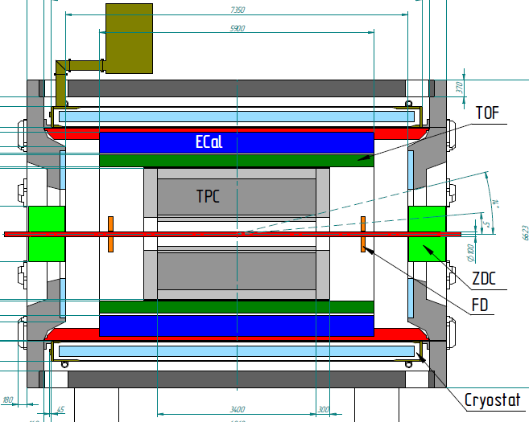
MPD-ITS (OB) is now recognized at Stage I
Stage I: TPC, TOF, ECAL, ZDC, FFD + ITS(OB)
Stage II : ITS(IB) + EndCap (CPC, Straw, TOF, ECAL)
Transfer of High Tech Instrumentation
Know-How from CERN to NICA-MPD
FHCal
FFD
Stage I: overall commissioning
starts in 2022 (t.b.c.)
Notes:
The MPD will be put in operation at two stages. At the first one the barrel part will be equipped with major tracking detector TPC, TOF end ECAL. FHC and FD will be operational as well.
At the second stage the detector will be supplemented with IT and end cap subdetectors.

Slide 14




Items to be shipped from CERN formulated in Addendums to the Protocol
CERN will procure, test and deliver to NICA
19’000 ALPIDE Monolithic Active Pixel Sensors for the MPD ITS
4’500 SAMPA electronic circuits for the TPC readout
5’000 FEAST DC/DC converters for the ECAL MPD
Jigs and fixtures for module and supermodule assembly for the MPD ITS
Training of personal for assembly and QA certification modules and supermodules of the MPD ITS
Provision of complete technical and commercial information on parts of the
new ALICE Inner Tracking System, including drawings, internal technical reports, quotes, etc.

Slide 15
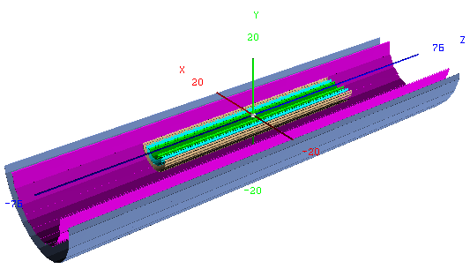
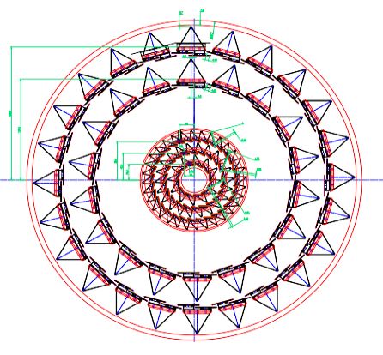
MPD ITS based on the ALPIDE MAPS CERN technology
Beam pipe Ø = 38 mm
Layer | Number of staves | Number of ALPIDEs per a stave | R_{min}, mm | R_{max}, mm | Ladder active length, mm
1 | 12 | 12 | 22.4 | 26.7 | 360
2 | 22 | 23 | 40.7 | 45.9 | 608
3 | 32 | 37 | 59.8 | 65.1 | 708
4 | 18 | 196 | 144.5 | 147.9 | 1190
5 | 24 | 196 | 194.4 | 197.6 | 1468
Notes:
The MPD TPC bore of 500 mm diameter allows installation of 5-layer system based on ALPIDE MAPS of size 15х30 mm²
ALPIDE has 512х1024 active pixels (524’288 pixels!) of 50 um (Inner barrel) and 100 um(Outer) thickness
The active area of ITS is 4,17 m2 (IB=0,76 ;OB=3,41) with 10 416 sensors (IB=1184; OB=8232) to placed in space with
аccuracy better 0,5 mm !
The OB will be built out existing technology developed by ALICE ITS Upgrade team (L.Musa et al)
The IB is a subject of joint R@D will be based on the idea of ALICE for the Supper ITS involving stiching technolodgy
For long super-ALPIDES sensors
OB is to be build and commissioned by the end of 2022
IB is to be installed together with the beampipe of reduced diameter later 2025 (?)

Slide 16
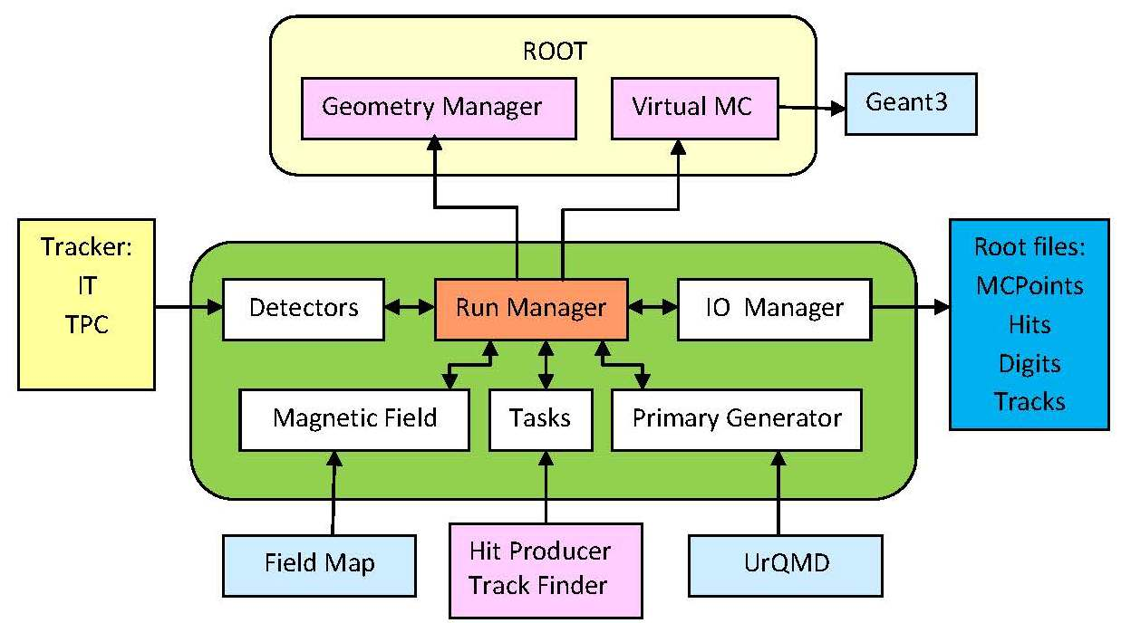
ITS Monte-Carlo simulation scheme within MpdRoot
Event MC generator:
LAQGSM
Particle MC transport
through ITS: GEANT3
Hit generation
Track finding: KF
MC generator
Vertices reconstruction
At the reconstruction stage the main simulation tasks include:
generation of detector responses (Hit Producer);
reconstruction of particle tracks using generated hits (Track Finder) ;
reconstruction of the primary and secondary interaction vertices (Track Analysis).

Slide 17
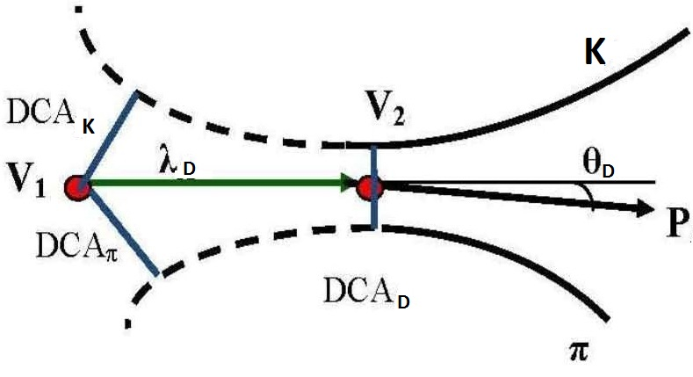
Selection criteria
Dº → K⁻ + π⁺
D⁰ selection parameters:
distances of closest approach to the collision vertex DCA_{π,K} ,
two-track separation DCA_{D} ,
decay path λ_{D},
pointing angle θ_{D}.
Selection criteria:
DCA_{π} > С₁ && DCA_{K} > С₂ && DCA_{D} < С₃ && λ_{D} > С₄ && θ_{D} < С₅
The parameters of the corresponding selections are optimized by maximizing
the signal significance :
where S and B are the estimated numbers of the signal and background events.

Slide 18
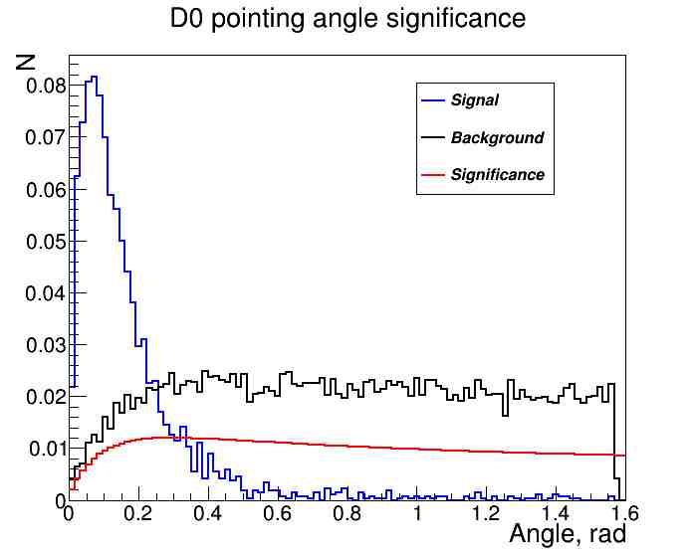
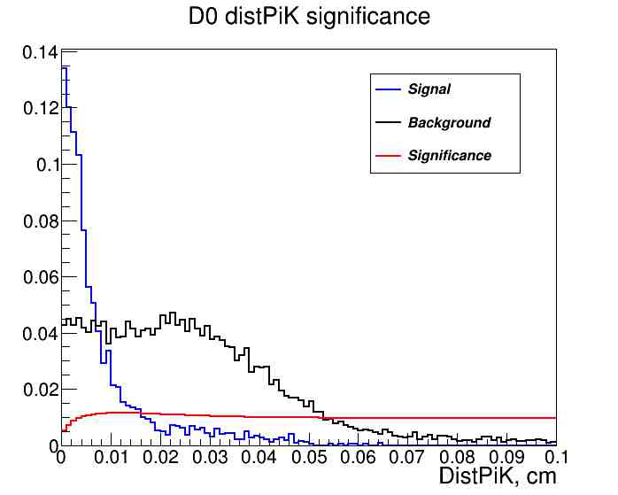
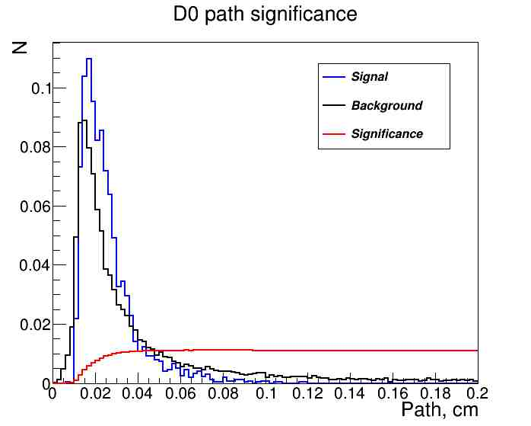
D⁰ reconstruction – cut selection
dcaK>0.01 сm & dcaPi>0.01 сm & distPiK < 0.02 cm & path(D⁰) > 0.025 сm & angle(D⁰) < 0.2 rad

Slide 19
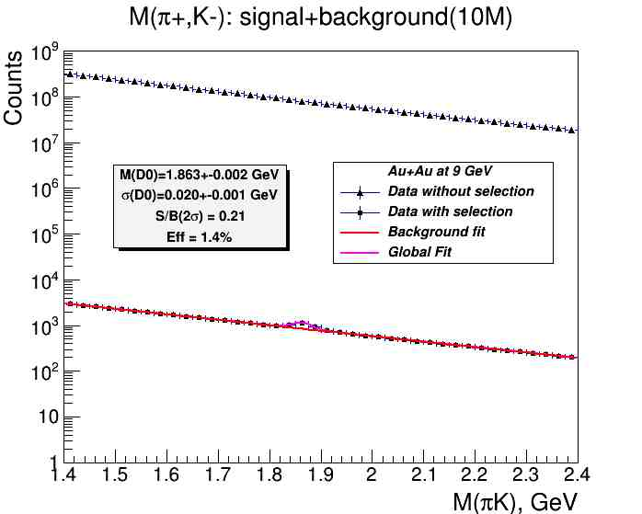
D⁰ reconstruction – invariant mass spectrum for ITS#1
ITS – option#1:
t1=t2=t3=50μ
t4=t5=700μ
D⁰→ K‒ + π ⁺

Slide 20
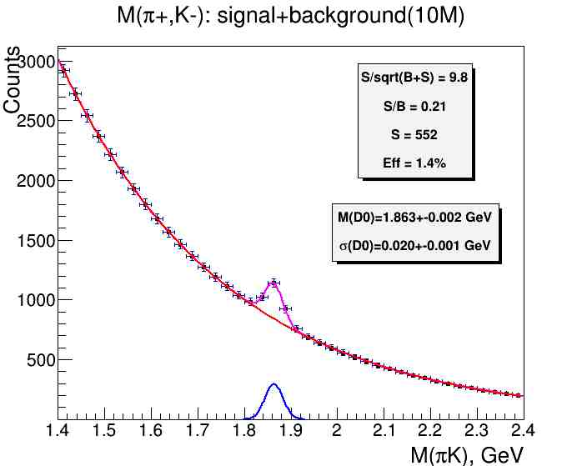
D⁰ reconstruction – invariant mass spectrum for ITS #1
t1=t2=t3=50μ
t4=t5=700μ
D⁰→ K‒ + π ⁺

Slide 21
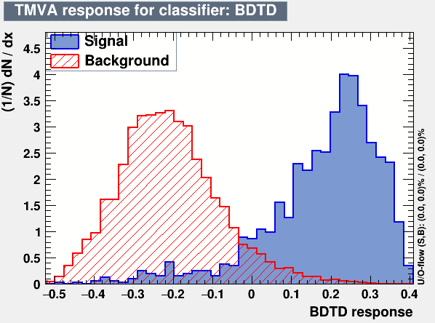
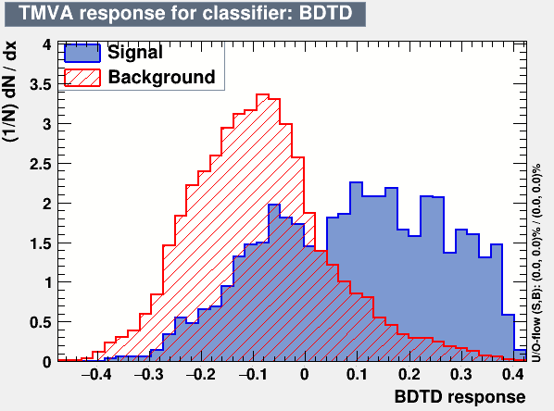
D⁰ reconstruction – TMVA selection
IT – option#1:
t1=t2=t3=50μ (IB ITS3)
t4=t5=700μ (ОВ ITS2)
IT – option#2:
t1=t2=t3=200μ (IB ITS2)
t4=t5=700μ (OB ITS2)
DCA(π, K,D⁰), path(D⁰),angle(D⁰) cuts
BDTD cut

Slide 22
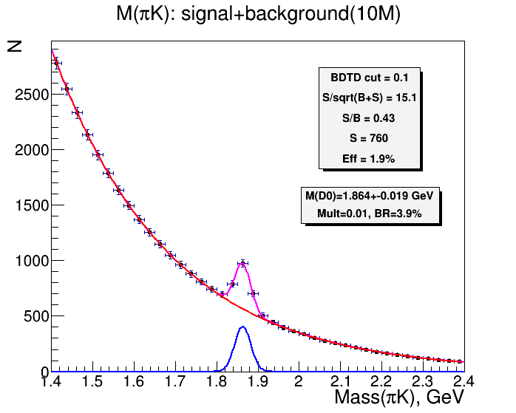
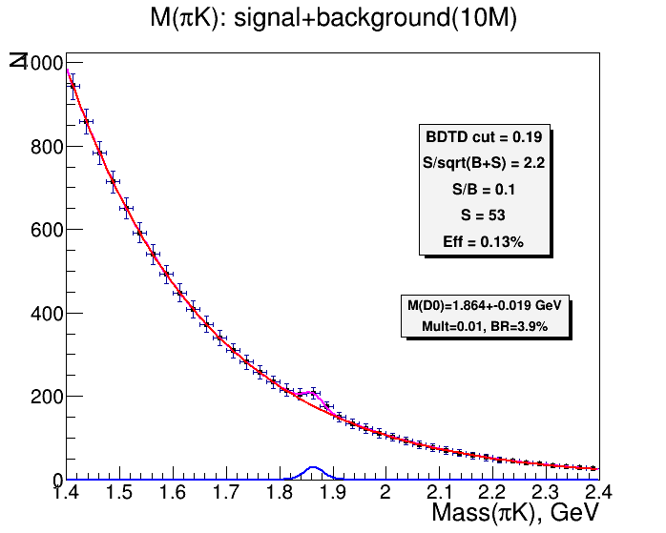
D⁰ reconstruction – invariant mass spectrum
ITS – option#1:
t1=t2=t3=50μ (IB ITS3)
t4=t5=700μ (OB ITS2)
ITS – option#2:
t1=t2=t3=200μ (IB ITS2)
t4=t5=700μ (OB ITS2)
D⁺→ K‒ + π ⁺ + π ⁺
Preliminary results of TMVA-BDTD simulations of 10M 9 GeV central Au-Au central collisions (V. Kondratiev)

Slide 23
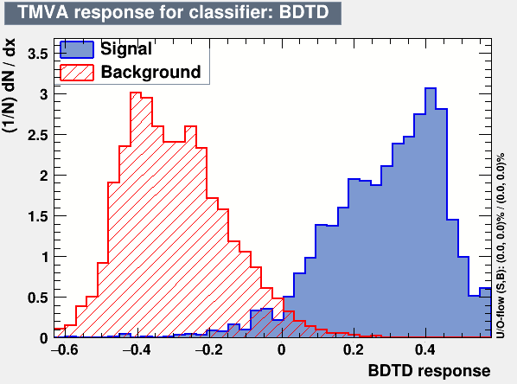
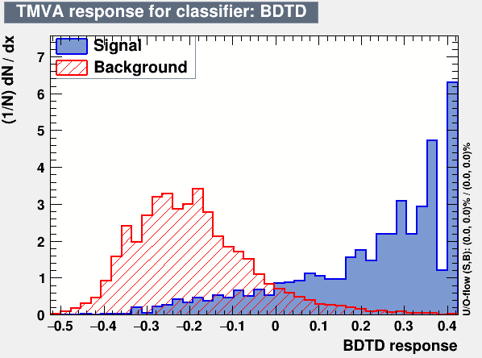
D⁺ reconstruction – TMVA selection
ITS – option#1:
t1=t2=t3=50μ (IB ITS3)
t4=t5=700μ (OB ITS2)
IT – option#2:
t1=t2=t3=200μ(IB ITS2)
t4=t5=700μ (OB ITS2)
DCA(π, K,D⁺), path(D⁺),angle(D⁺) cuts
BDTD cut

Slide 24
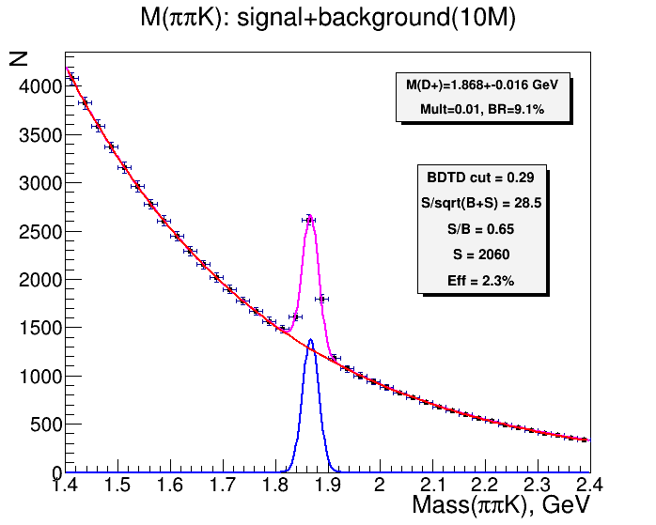
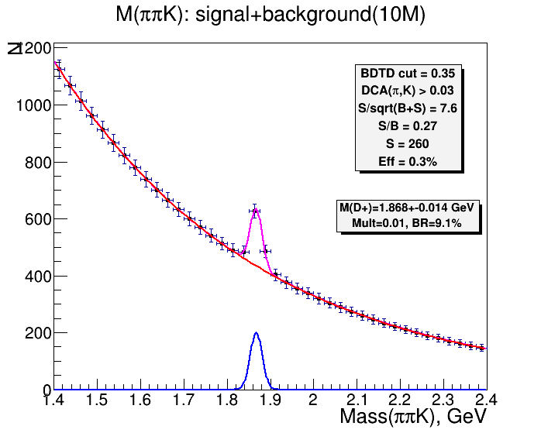
D⁺ reconstruction – invariant mass spectrum
ITS – option#1:
t1=t2=t3=50μ (IB ITS3)
t4=t5=700μ (OB ITS2)
ITS – option#2:
t1=t2=t3=200μ (IB ITS2)
t4=t5=700μ (OB ITS2)
D⁺→ K‒ + π ⁺ + π ⁺
Preliminary results of TMVA-BDTD simulations of 10M 9 GeV central Au-Au central collisions (V. Kondratiev)

Slide 25
D-meson parameters in 10М central Au+Au collisions at = 9 ГэВ
Particle | D⁰ |  | D⁺
Decay channel | D⁰→ K⁻ + π ⁺ |  | D⁺→ K⁻ + π ⁺ + π ⁺
Multiplicity (HSD | 10⁻² |  | 10⁻²
BR,% | 3.9 |  | 9.1
IT option | #1 | #2 | #1 | #2
S/B(2σ) | 0.43 | 0.10 | 0.65 | 0.27
Significance | 15.1 | 2.2 | 28.5 | 7.6
Efficiency,% | 1.9 | 0.13 | 2.3 | 0.3

Slide 26
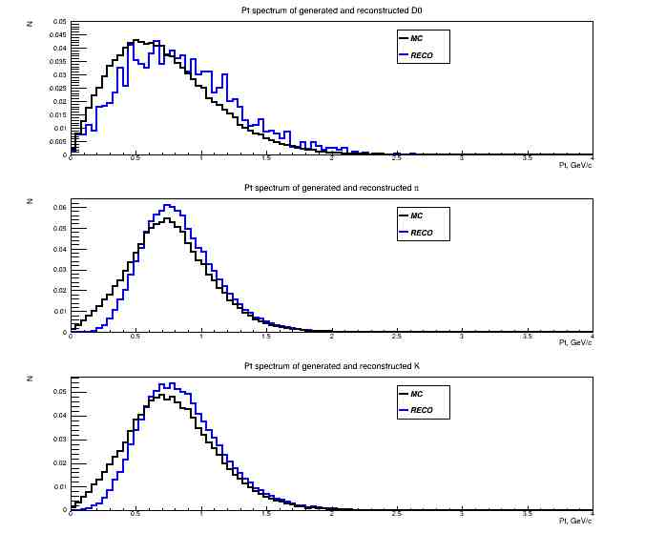
MC and reconstructed p_{t}-spectra of D⁰-mesons and their decay products
D⁰ mesons
Pions
Kaons
Yu.Murin. 4-th CBM-China Meeting

Slide 27
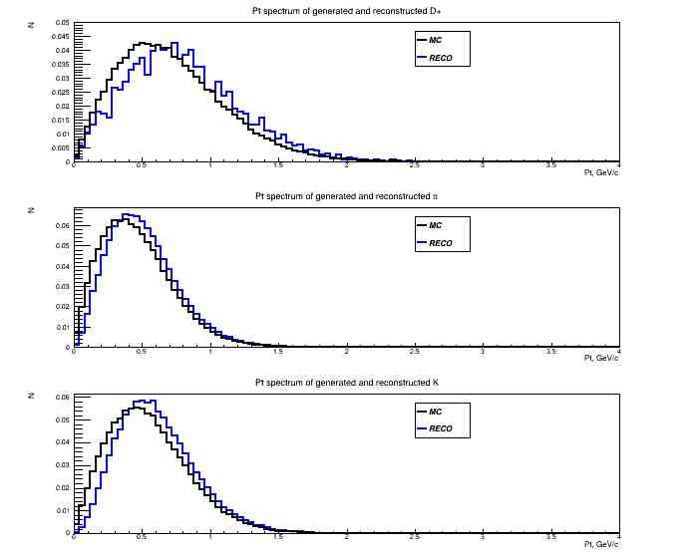
MC and reconstructed p_{t}-spectra of D⁺-mesons and they decay products
D⁺ mesons
Pions
Kaons

Slide 28
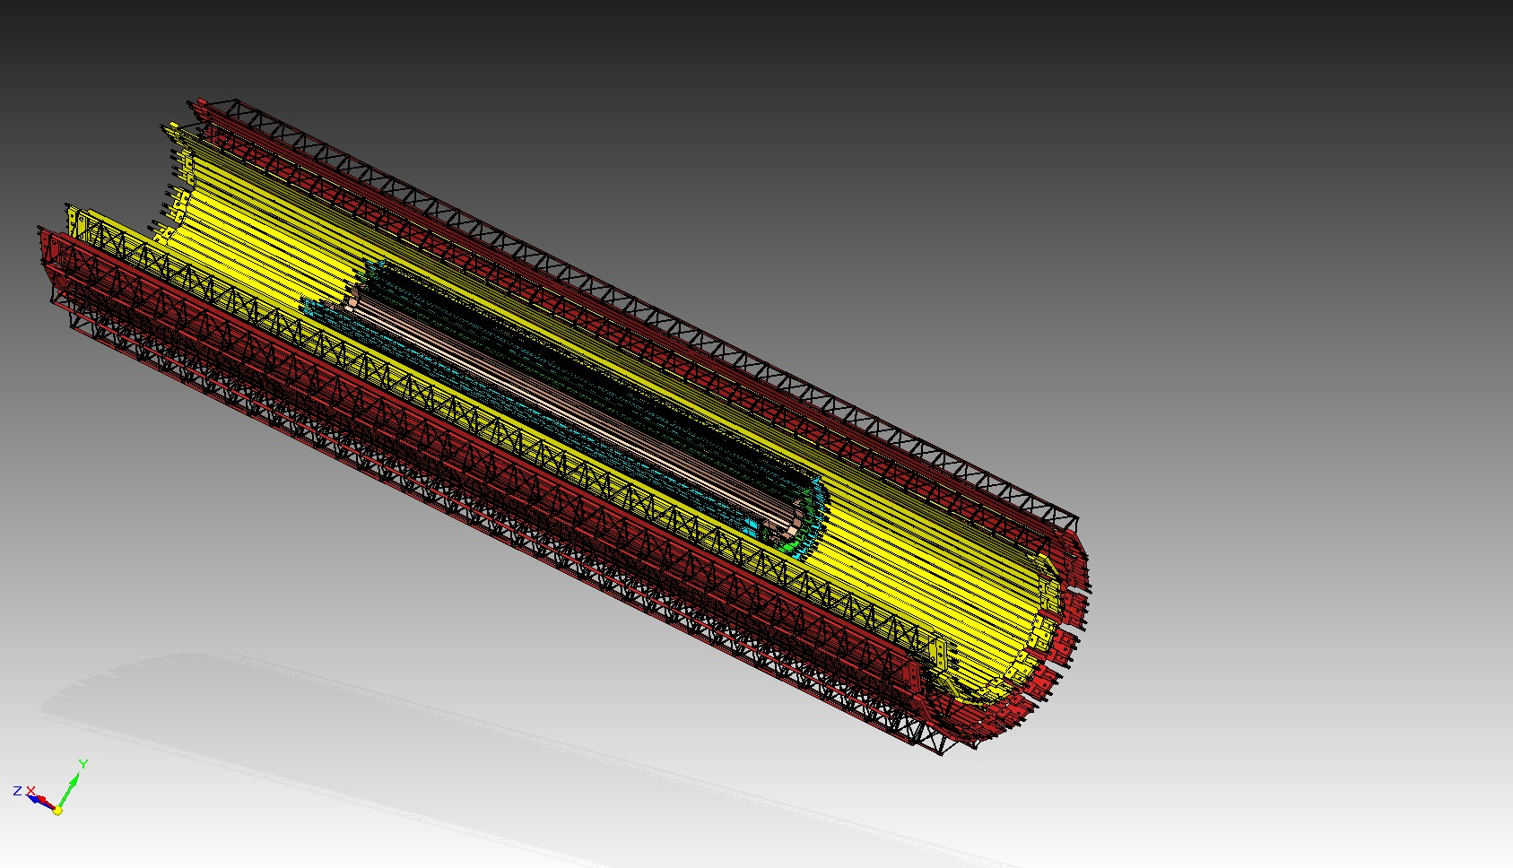
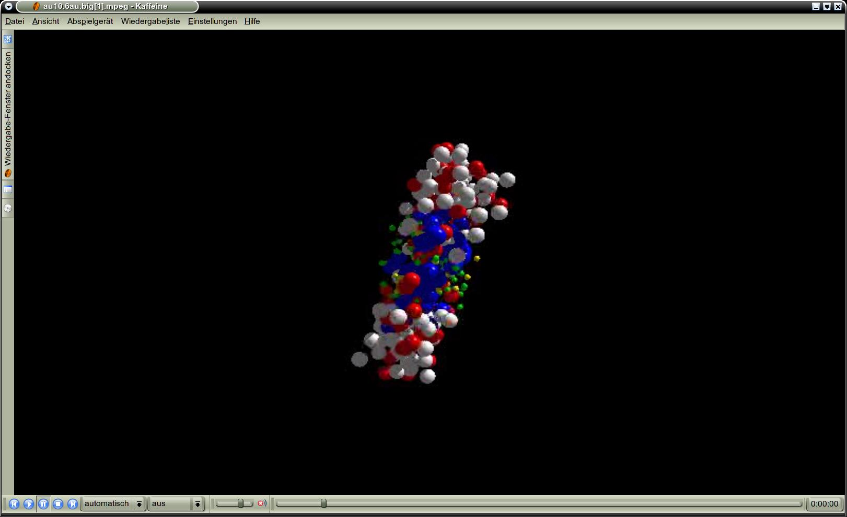
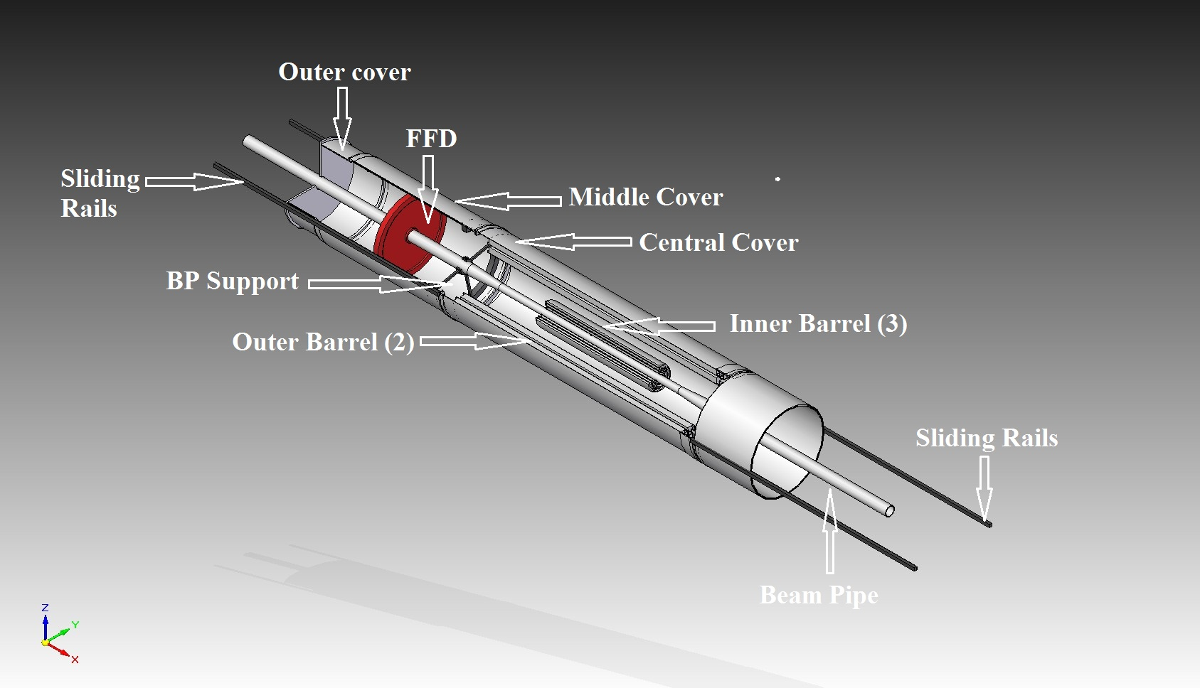
ITS realization in two Steps (OB first) due to BP sequence
Stage I: Installation of OB (2022)
D⁺
K⁻
Stage II: OB+IB (2022+3) ?
π⁺
π⁺
~ 9 500
ALPIDE MAPS
in 5 cylinders of 2 barrels
tentative assembly
layout
4,9۰10⁹ pixels, active area 3,9 m².
MPD beam pipe
Stage II:
38 mm in diameter
Stage I: 64 mm in diameter

Slide 29
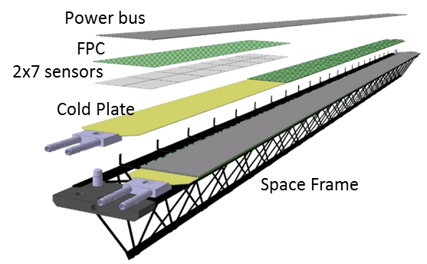
Task 1: Assembly of HICs and OB Staves (60 pcs incl.)
JINR & CCNU
Truss length is 1540 mm. Modules (HICs) are are located on two cooling plates .
OB stave carriers 196 sensors.
The MPD ITS need is 42 OB staves.

Slide 30
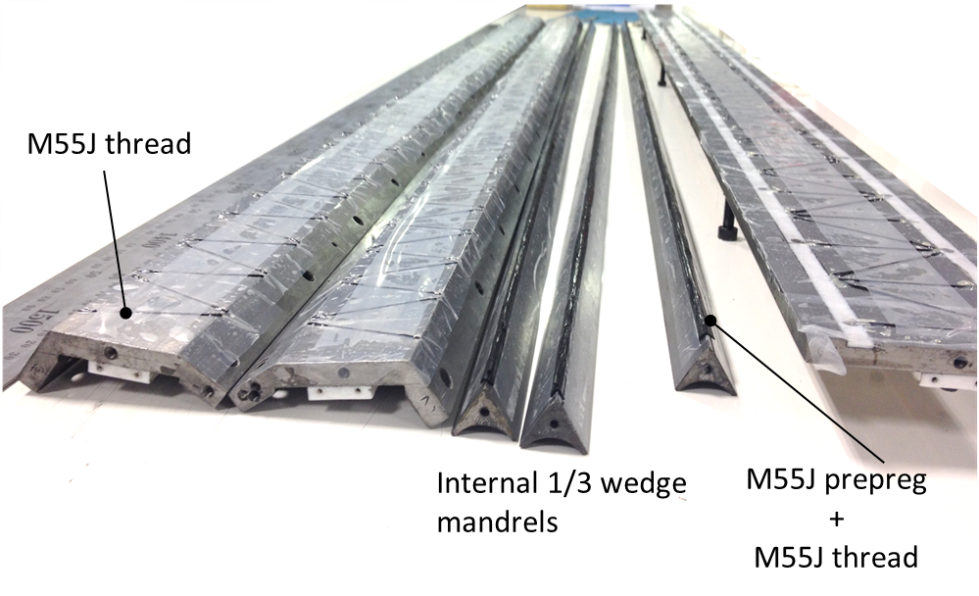
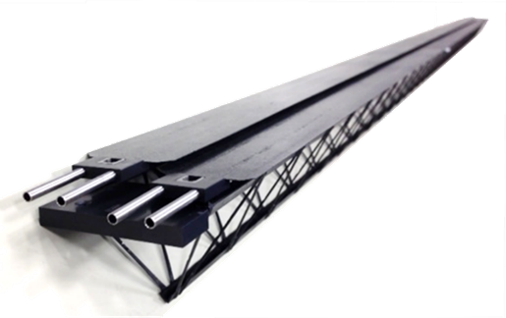
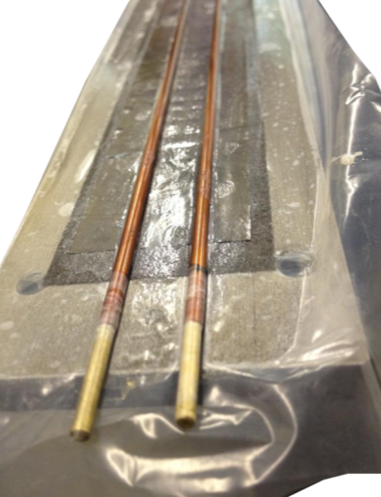
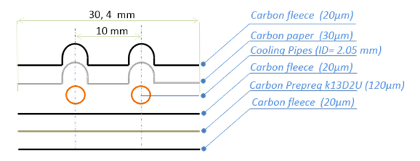
Task 2 . FC trusses (60), cooling plates (120)
JINR &SPbSU

Slide 31
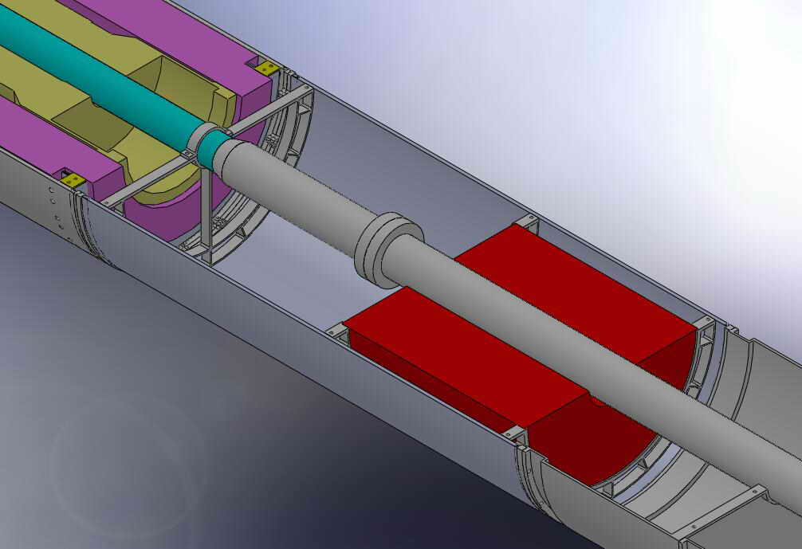
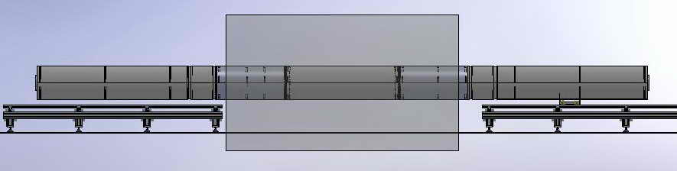
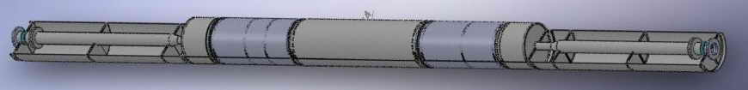
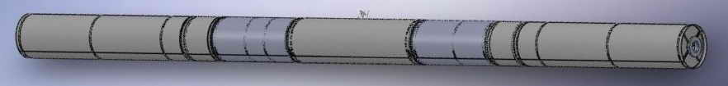
Task 3 . Mechanics for integration with the TPC - JINR

Slide 32
solving of the “GBTx problem”
Task 4. Updating the readout electronics
Task 5. Assembly the System and bench and in-beam
tests of the parts
Task 6. Writing the TDR

Slide 33
Task 7. R@D for the IB as part ALICE ITS3 upgrade plan
(under supervision of CERN)

Slide 34
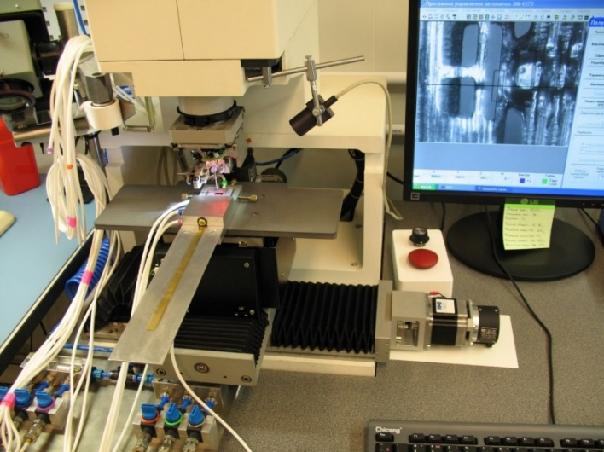







VB LHEP existing Infrastructure: Two Clean Rooms (ISO-7 and ISO-8) equipped for assembling modules and of the MPD ITS
3 pillars of assembling process:
Infrastructure
Trained stuff
Custom designed fixtures
iBond5000
Planar EM-4370
SuperDry SD-702-02
Memmert UFP-800

Slide 35
Conclusions
and summary
Yu.Murin. 4-th CBM-China Meeting
Notes:
Few words on the NICA …

Slide 36
major milestones of the MPD ITS project (tentavily!)
2018 – paper work and infrastructure
2018 –2019 – simulations and start of delivery of parts from CERN
2019 – organization of the Russian-Chinese Consortium
2019 – Writing TDR ( Version 1)
2019 – Production of first HICs at VBLHEP
2020 –2021 – Mechanics including parts for integration
2020 –2021 – updating the readout chain
2020 –2022 – R@D effort on IB together with ALICE
2020 –2022 – Production HICs, assembly of OB staves
2022 (?) – ITS-OB assembly, bench testing, commissioning
2025( ?) – ITS-OB+IB commissioning (Stage I)

Slide 37
summary
The MPD-ITS project is both scientific- and time-wise well justified
The project has a solid reason to be accomplished in two stages
The MPD-ITS(OB) (stage 1) one is now recognized and approved for financing at JINR
The MPD-ITS(IB) (stage 2) contains R@D proposed to be performed under the supervision of ALICE Collaboration (ITS3)
The project effort due to its technical complexity cannot be undertaken by JINR alone and calls for organization of a Consortium of Institutes from Russia and China functioning at least till 2025

Slide 38
Thank you

