Slide 1

The Equation of State of Dense Matter in the Multimessenger Era
Lie-Wen Chen (陈列文)
School of Physics and Astronomy, Shanghai Jiao Tong University, China
(lwchen@sjtu.edu.cn)
Nuclear matter EOS and the symmetry energy (Esym)
Dense nuclear matter from Nuclear experiments + Observed neutron star largest mass +
Tidal deformability from GW170817
Summary and outlook
Main Reference: Ying Zhou (周颖)/LWC/Z. Zhang(张振), arXiv:1901.11364
“4th CBM-China Workshop”,
April 12-14, 2019, Yi-Chang, China

Slide 2
Outline
Nuclear matter EOS and the symmetry energy (Esym)
Dense nuclear matter from Nuclear experiments + Observed neutron star largest mass +
Tidal deformability from GW170817
Summary and outlook

Slide 3
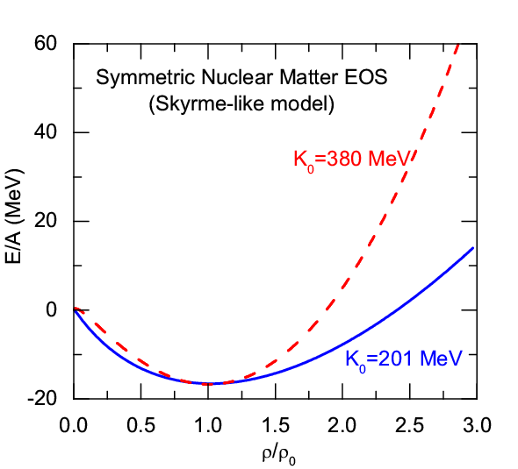
The Symmetry Energy of Nuclear Matter
EOS of Isospin Asymmetric Nuclear Matter
(Parabolic law)
Symmetric Nuclear Matter
(relatively well-determined)
Isospin asymmetry
Symmetry energy term (poorly known)
Nuclear Matter Symmetry Energy
LWC, EPJ Web of Conf. 88, 00017 (2015)
Nature of the nuclear
force?
Structure and stability
of nuclei?
Dynamics of heavy
ion collisions?
Nature of compact stars
and dense nuclear matter?
p. 1

Slide 4
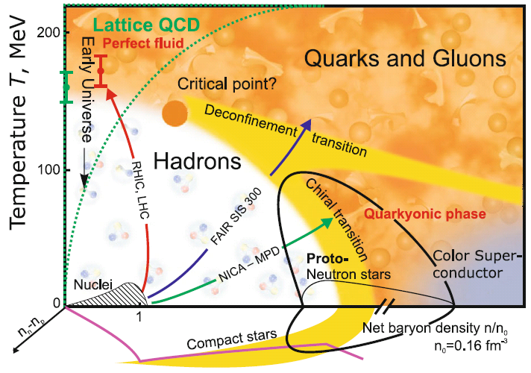
QCD Phase Diagram
QCD Phase Diagram in 3D: density, temperature, and isospin
V.E. Fortov, Extreme States of Matter – on Earth and in the Cosmos, Springer-Verlag Berlin Heidelberg 2011
Esym: Important for understanding
the EOS of strong interaction matter
and QCD phase transitions at extreme
isospin conditions
Heavy Ion Collisions (Terrestrial Lab);
Compact Stars(In Heaven); …
Quark Matter
Symmetry Energy ?
M. Di Toro et al., NPA775 (2006);
Pagliara/Schaffner-Bielich, PRD81,
(2010); Shao et al., PRD85,(2012); Chu/Chen, ApJ780 (2014); H. Liu et al., PRD94 (2016); Xia/Xu/Zong, (2016);
LWC, arXiv:1708.04433
At extremely high baryon density, the matter could be the deconfined quark matter, and there
we should consider quark matter symmetry energy (isospin symmetry is still satisfied). The
isospin asymmetric quark matter could be produced/exist in HIC/Compact Stars
p. 2

Slide 5

QCD Phase Diagram
V.E. Fortov, Extreme States of Matter – on Earth and in the Cosmos, Springer-Verlag, 2011
Probing QCD phase diagram in Heavy Ion Collisions in terrestrial labs
and in NStar-NStar Collisions (Merger) in heaven?
Small baryon chemical potential: Smooth Crossover Transition
Large baryon chemical potential: First-order Phase Transition
QCD Critical Endpoint: where the first-order phase transition ends
p. 3

Slide 6
QCD Phase Diagram
Light nuclei production as a probe of QCD phase diagram
Sun/LWC/Ko,/Xu, PLB774, 103 (2017); Sun/LWC/Ko/Pu,/Xu, PLB781, 499 (2018).
Head on Au+Au collisions
AGeV
AGeV
I.C. Arsene et al., PRC75, 034902（2007）
p. 4

Slide 7
QCD Phase Diagram
Light nuclei production as a probe of QCD phase diagram
Sun/LWC/Ko,/Xu, PLB774, 103 (2017); Sun/LWC/Ko/Pu,/Xu, PLB781, 499 (2018).
Double-peak structure for neutron density fluctuations inferred from light nuclei ratio is indeed observed in Pb+Pb collisions at SPS/AGS energies!
STAR-BES seems also to suggest a peak, but around 20-27 GeV!
p. 5

Slide 8

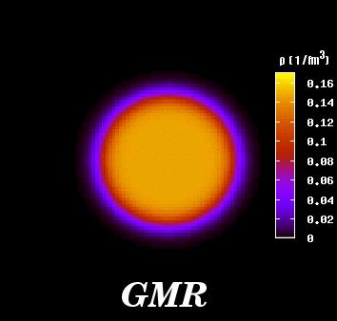
EOS of Symmetric Nuclear Matter
(1) EOS of symmetric matter around the saturation density ρ₀
Giant Monopole Resonance
K₀=231±5 MeV
Youngblood/Clark/Lui, PRL82, 691 (1999)
Recent results:
K₀=230±20 MeV
G. Colo, U. Garg,
J. Margueron,
J. Piekarewicz,
H. Sagawa, S. Shlomo et al.
Uncertainty of the extracted K₀ is mainly due to the uncertainty of
L (slope parameter of the symmetry energy) and
m*₀ (isoscalar nucleon effective mass)
(See, e.g., LWC/J.Z. Gu, JPG39, 035104(2012))
p. 6

Slide 9
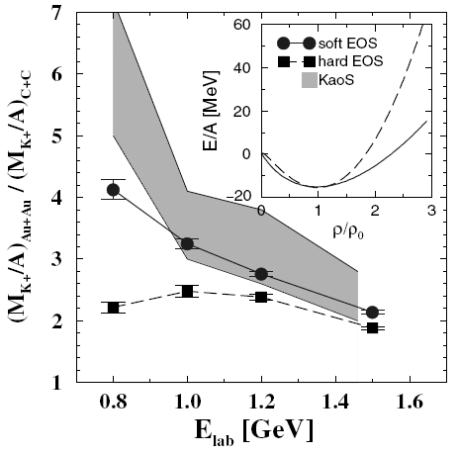
EOS of Symmetric Nuclear Matter
(2) EOS of symmetric matter for 1ρ₀< ρ < 3ρ₀ from K⁺ production in HIC’s
J. Aichelin and C.M. Ko,
PRL55, (1985) 2661
C. Fuchs,
Prog. Part. Nucl. Phys. 56, (2006) 1
C. Fuchs et al,
PRL86, (2001) 1974
Transport calculations indicate that “results for the K⁺ excitation function in Au + Au over C + C reactions as measured by the KaoS Collaboration strongly support the scenario
with a soft EOS.”
See also: C. Hartnack, H. Oeschler,
and J. Aichelin,
PRL96, 012302 (2006)
p. 7

Slide 10
(3) Constraints on the EOS of symmetric nuclear matter for 2ρ₀< ρ < 5ρ₀ using flow data from BEVALAC, SIS/GSI and AGS
EOS of Symmetric Nuclear Matter
P. Danielewicz, R. Lacey and W.G. Lynch, Science 298, 1592 (2002)
The highest pressure recorded under laboratory controlled conditions in nucleus-nucleus collisions
Use constrained mean fields to predict the EOS for symmetric matter
  Width of pressure domain reflects uncertainties in comparison and of assumed momentum dependence.
High density nuclear matter 2 to 5ρ₀
p. 8

Slide 11
Esym: Experimental Probes
Promising Probes of the E_{sym}(ρ)
(an incomplete list !)
Pigmy/Giant resonances
Nucleon optical potential
B.A. Li, L.W. Chen, C.M. Ko
Phys. Rep. 464, 113(2008)
p. 9

Slide 12
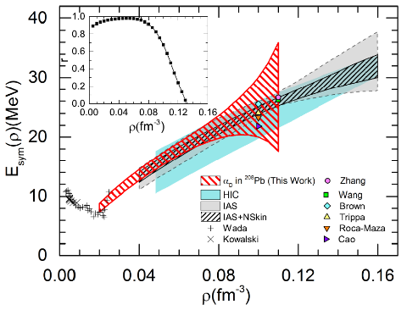
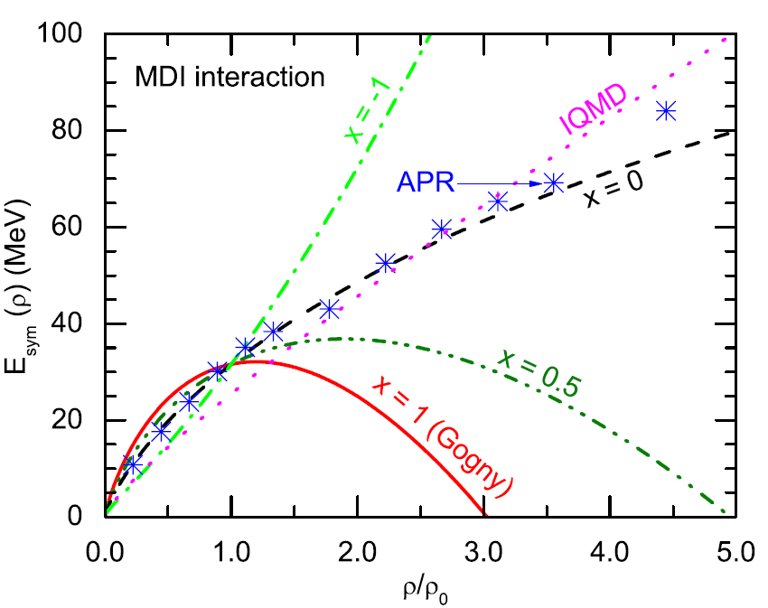
E_{sym}：Current Status
There are MANY constraints on E_{sym} (ρ₀) and L, essentially all the constraints seem to agree with:
E_{sym}(ρ₀) = 32.5±2.5 MeV
L = 55±25 MeV
The symmetry energy at subsaturation densities have been relatively well-constrained
The constraints on the high density Esym are still elusive and controversial for the moment !!!
Lattimer/Steiner,
EPJA50, 40 (2014)
Z. Zhang/LWC,
PLB726, 234 (2013);
PRC92, 031301(R)(2015)
Xiao/Li/Chen/Yong/Zhang,
PRL102, 062502 (2009)
p. 10

Slide 13
Characteristic Parameters of NM EOS
Order of the characteristic parameters according to the expansion with χ and δ:
Order-0: E₀(ρ₀); Order-2: K₀, E_{sym}(ρ₀);
Order-3: J₀, L; Order-4: K_{sym}(ρ₀), I₀, E_{sym,4}(ρ₀)
p. 11

Slide 14
Characteristic Parameters of NM EOS
Order of the characteristic parameters according to the expansion with χ and δ:
Order-0: E₀(ρ₀); Order-2: K₀, E_{sym}(ρ₀);
Order-3: J₀, L; Order-4: K_{sym}(ρ₀), I₀, E_{sym,4}(ρ₀)
Order-0
E₀(ρ₀) = -16±1 MeV
K₀ = 230±20 MeV, E_{sym}(ρ₀) = 32.5±2.5 MeV
L = 55±25 MeV, J₀=???
K_{sym}(ρ₀)=???, I₀=???, E_{sym,4}(ρ₀) =???
??????
Order-2
Order-3
Order-4
Order-5
……
J₀ ≈ -408.5 +/- 66.5 MeV and K_{sym}≈ -118.5 +/- 84.5 MeV:
Data of finite nuclei + Flow Data in HIC + Observed NStar Largest Mass +
Tidal Deformability of Neutron Star (from recent GW170817 signal)
analyzed simultaneously within the same EDF – extended SHF
p. 12

Slide 15
Outline
Nuclear matter EOS and the symmetry energy (Esym)
Dense nuclear matter from Nuclear experiments + Observed neutron star largest mass +
Tidal deformability from GW170817
Summary and outlook

Slide 16
Pulsars: Neutron Stars? Quark Stars? Hybrid Stars? Others?
Composition of Neutron Star Matter
F. Weber, PPNP54, 193 (2005)
V.E. Fortov, Extreme States of Matter – on Earth and
in the Cosmos, Springer-Verlag Berlin Heidelberg 2011
Mass: ~ 1.4 M⊙, Radius: ~ 10 km
Extremely neutron-rich matter
Density at the center: ~ 6ρ₀
Average density: ~ 2.5ρ₀
Assuming there are no phase transitions and no strangeness in NStar or they play unimportant role (for inspiral). The NStar is conventional star composed of npeμ.
p. 13

Slide 17
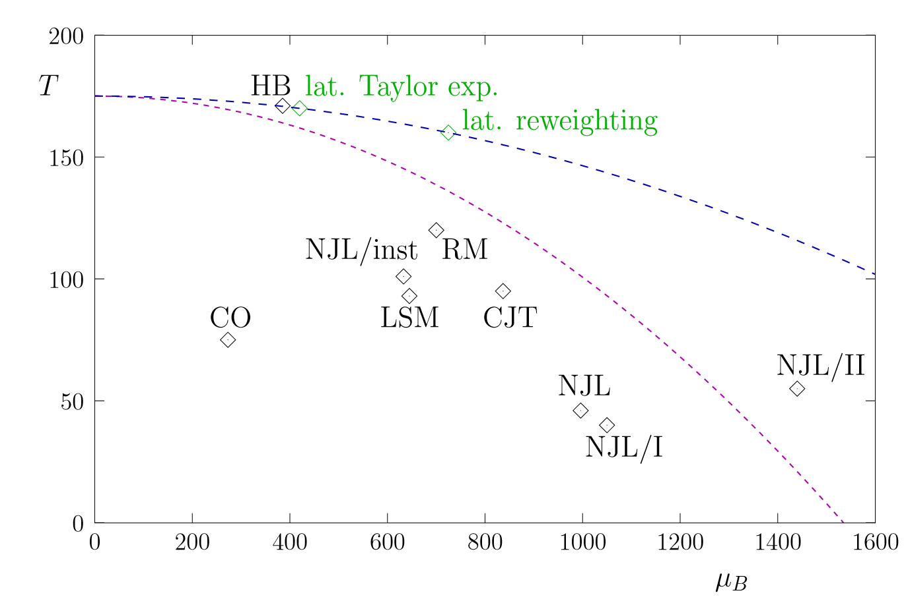
Composition of Neutron Star Matter
RMF – TW99
M.A. Stephanov, Int. J. Mod. Phys. A20, 4387 (2005).
Z. Bai/Y.X. Liu, arXiv:1904.01978
The critical density for deconfinement/chiral symmetry restoration at T = 0 could be larger than 6ρ₀ (μ_{B}~1.6 GeV)!
The maximum baryon density could reach about 10-20ρ₀ in head on AuAu collisions at 10~40 AGeV?
p. 14

Slide 18
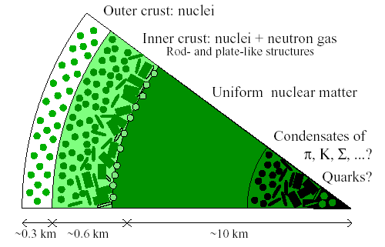
EOS of Neutron Star Matter
Core of the neutron stars consist of infinite β-equilibrium npeμ matter with charge neutrality. Its EoS is determined by the extended Skyrme-Hartree-Fock(eSHF)
The inner crust
The outer crust
n_{t} is determined self-consistently by using dynamical method
(Xu/LWC/Li/Ma, ApJ697,1549(2009))
(EOS of BPS)
Core-Crust edge
(EOS of Feynman-Metropolis-Teller)
p. 15

Slide 19
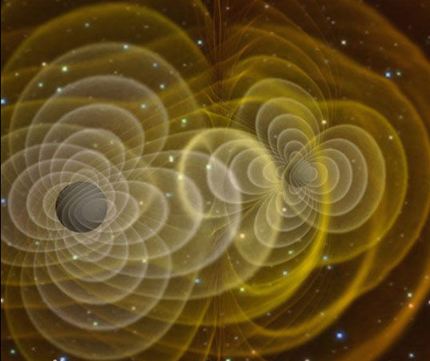
Tidal Deformability
Tidal Deformability (Polarizability)
(oscillation response coefficient λ )
Q_{ij}: Quadrupole moment
ε_{ij}: Tidal field of companion
k₂: Love number
R: Radius
M: Mass
Éanna É. Flanagan and Tanja Hinderer, Phys.Rev.D 77, 021502(R) (2008)
F.J. Fattoyev, J. Carvajal, W.G. Newton, and Bao-An Li, Phys. Rev. C 87, 015806 (2013)
p. 16

Slide 20
Binary Neutron Star Merger
Merging neutron stars
Two inspiralling neutron stars
Single mass
Tidal deformation
Inspiral Chirp signal
NS oscillation/BH formation
LIGO is sensitive to increase in orbital frequency as system loses energy to both gravitational waves and internal excitation of neutron stars. GW170817 data place limits on polarizability (deformability) Λ of NS and hence limits on NS radius.
p. 17

Slide 21
Multimessenger era: GW170817
Citation: 1867+
On August 17, 2017, the merger of two neutron stars was observed with gravitational waves (GW) by the LIGO and Virgo detectors.
The Fermi and Integral spacecrafts independently detected a short gamma ray burst.
Extensive follow up observations detected this event at X-ray, ultra-violet, visible, infrared, and radio wavelengths.
No ultra-high-energy gamma-rays and no neutrino candidates consistent with the source were found in follow-up searches. These observations support the hypothesis that GW170817 was produced by the merger of two neutron stars in NGC 4993 followed by a short gamma-ray burst (GRB 170817A) and a kilonova/macronova powered by the radioactive decay of r-process nuclei synthesized in the ejecta
p. 18

Slide 22
The extended SHF Energy Density Functional
Extended Skyrme Interaction:
N. Chamel, S. Goriely, and J.M. Pearson, PRC80, 065804 (2009)
Z. Zhang/LWC, PRC94, 064326 (2016)
LWC/Ko/Li/Xu, PRC82, 024321(2010)
Momentum-dependence of many-body forces
13 Skyrme parameters:
13 macroscopic nuclear properties:
p. 19

Slide 23
Why extended SHF EDF?
The eSHF provides a nice approach that can describe simultaneously nuclear matter, finite nuclei, and neutron stars!
The eSHF EDF is very flexible to mimic various density behaviors for EOS
(13 parameters)
p. 20

Slide 24
Extended Skyrme forces with fixed J₀ and K_{sym}
Our Strategy:
Higher-order J0 and Ksym are fixed at various values
E_{sym}(ρ_{c}) and L(ρ_{c}) at ρ_{c} =0.11 fm⁻³ are fixed at E_{sym}(ρ_{c})=26.65 MeV and L(ρ_{c})=47.3+/-7.8 MeV using heavy isotope binding energy difference and α_{D} of ²⁰⁸Pb (Z. Zhang/LWC, PLB726, 234(2013); PRC90, 064317(2014))
Other 9 lower-order parameters and W₀ are calibrated to fit data of finite nuclei
Causality
Minimizing the Chi-square χ²(p) :
p. 21

Slide 25
Observed Nstar max. mass and Tidal def.
Observed heaviest Nstar so far:
PRL121, 161101 (2018)
GW170817 (LIGO/Virgo):
Λ_{1.4} < 580
p. 22

Slide 26
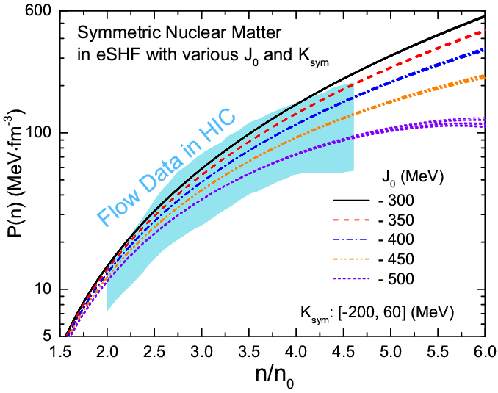
J0: Flow data in HIC’s
Y. Zhou/LWC/Z. Zhang, arXiv:1901.11364
For various J0 and
Ksym:[-200, 60] MeV
E_{sym}(ρ_{c})= 26.65 MeV L(ρ_{c})= 47.3 MeV
Pressure of SNM is very sensitive to J0 but essentially independent of Ksym
-550 MeV ~ < J₀ < -342 MeV: Flow Data in HIC’s
p. 23

Slide 27
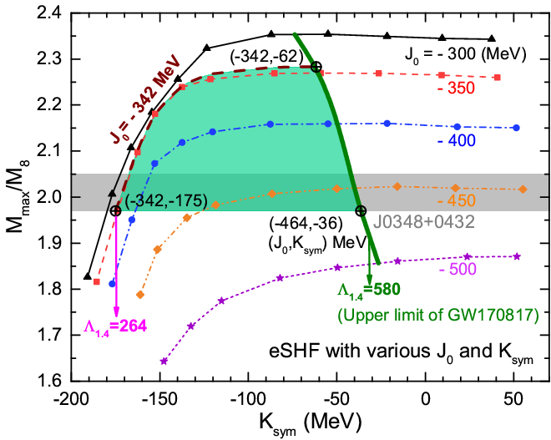
J0 and Ksym: Flow data, NStar Mass, Λ
Y. Zhou/LWC/Z. Zhang, arXiv:1901.11364
J0 = -342 MeV
J0 = -464 MeV
Ksym < - 36 MeV
Λ_{1.4} < 580
GW170817 (LIGO/Virgo)
Λ_{1.4} > 264
Consistent with EM counterpart of GW170817, see, e.g.,
D. Radice et al., ApJL852, L29(2018); M.W. Coughlin et al., MNRAS 480, 3871(2018)
K_{sym} affects strongly M_{max}
for K_{sym}< - 100 MeV
Flow Data in HIC+Mmax+ Λ_{1.4} :
-464 MeV < J₀ < -342 MeV:
-175 MeV < K_{sym} < -36 MeV:
Flow Data in HIC +Mmax:
K_{sym} > -175 MeV, Λ_{1.4} >264
p. 24

Slide 28
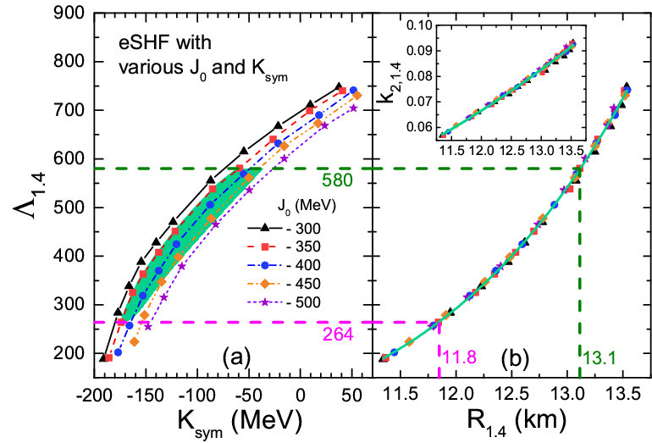
R1.4: Flow data, NStar Mass, Λ
Y. Zhou/LWC/Z. Zhang, arXiv:1901.11364
R_{1.4} : 11.8-13.1 km !
p. 25

Slide 29
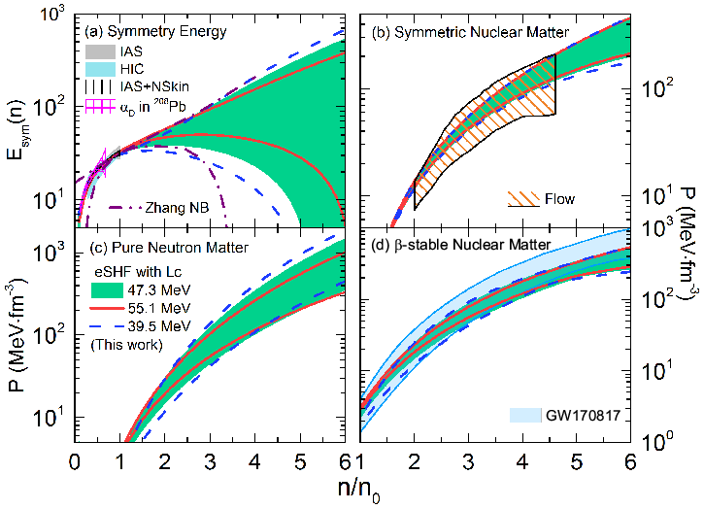
EOS: Flow data, NStar Mass, Λ
Y. Zhou/LWC/Z. Zhang, arXiv:1901.11364
L(ρ_{c})=47.3+/-7.8 MeV using α_{D} of ²⁰⁸Pb (Z. Zhang, LWC, PRC90, 064317(2014) )
L(ρ_{c}) indeed affects the extraction of Esym at high densitities but does not change much the Nstar matter EOS!
L(ρ_{c})=47.3 MeV:
J0:[-464,-342] MeV,
K_{sym}:[-175,-36] MeV
E_{sym}(2ρ₀):[39.4, 54.5] MeV
L(ρ_{c})=39.5 MeV:
J0:[-475,-342] MeV,
K_{sym}:[-203,-34] MeV
E_{sym}(2ρ₀):[33.0, 51.3] MeV
L(ρ_{c})=55.1 MeV:
J0:[-455,-342] MeV,
K_{sym}:[-138,-38] MeV
E_{sym}(2ρ₀):[46.9, 57.6] MeV
p. 26

Slide 30
High-Order Bulk Characteristic Parameters
Estimates from systematic analysis
based on Skyrme-Hartree-Fock energy density functionals
LWC, Sci. China 54, s124 (2011)
[arXiv:1101.2384]
p. 27

Slide 31
High-Order Bulk Characteristic Parameters
J0 from NL-RMF models
Cai/LWC, arXiv:1402.4242
Nucl. Sci. Tech., 2017
p. 28

Slide 32
High-Order Bulk Characteristic Parameters
Ksym from Esym systematics
p. 29

Slide 33
Outline
Nuclear matter EOS and the symmetry energy (Esym)
Dense nuclear matter from Nuclear experiments + Observed neutron star largest mass +
Tidal deformability from GW170817
Summary and outlook

Slide 34
Summary and outlook
A lower limit of Λ_{1.4} >193 for the tidal deformability of 1.4 solar mass
neutron star can be obtained by using the flow data in HIC and the
observed largest mass of neutron stars
The skewness coefficient J0 of symmetric nuclear matter can be constrained
to be J0 = -408.5 +/- 66.5 MeV by using the flow data in HIC, the observed
largest mass of neutron stars, and the tidal deformability from
GW170817
The density curvature parameter Ksym of the symmetry energy can be
constrained to be Ksym = -118.5 +/- 84.5 MeV, E_{sym}(2ρ₀) ≈ 45.3 +/- 12.3 MeV,
R1.4 ≈ 12.2 +/- 1.1 km, by using the flow data in HIC, the observed largest
mass of neutron stars, and the tidal deformability from GW170817, ruling out
too stiff and too soft high density behaviors of symmetry energy.
More data from experiments and observations are expected to improve the
constraints on the EOS. Heavier Nstar will lead more stringent constraints
p. 30

Slide 35
Acknowledgements
Collaborators：
Bao-Jun Cai (Shanghai U)
Peng-Cheng Chu (QTU, Qingdao)
Wei-Zhou Jiang (SEU. Nanjing)
Che Ming Ko, Kai-Jia Sun (TAMU. Texas)
Bao-An Li (TAMU-Commerce, Texas)
Xiao-Hua Li (USC, Hengyang)
De-Hua Wen (SCUT, Guanzhou)
Zhi-Gang Xiao (Tsinghua, Beijing)
Chang Xu (NJU, Nanjing)
Jun Xu, Rui Wang (SINAP, CAS, Shanghai)
Gao-Chan Yong (IMP, Lanzhou)
Zhen Zhang (Sen-Yat-Sen U, Zhuhai)
Xin Wang, Ying Zhou, Jie Pu, Si-Pei Wang, Xu-Run Huang (SJTU, Shanghai)
Funding：
National Natural Science Foundation of China
Major State Basic Research Development Program (973 Program) in China
Shanghai Rising-Stars Program
Shanghai “Shu-Guang” Project
Shanghai “Eastern Scholar”
Science and Technology Commission of Shanghai Municipality

Slide 36
谢 谢！
Thanks!

