Slide 1
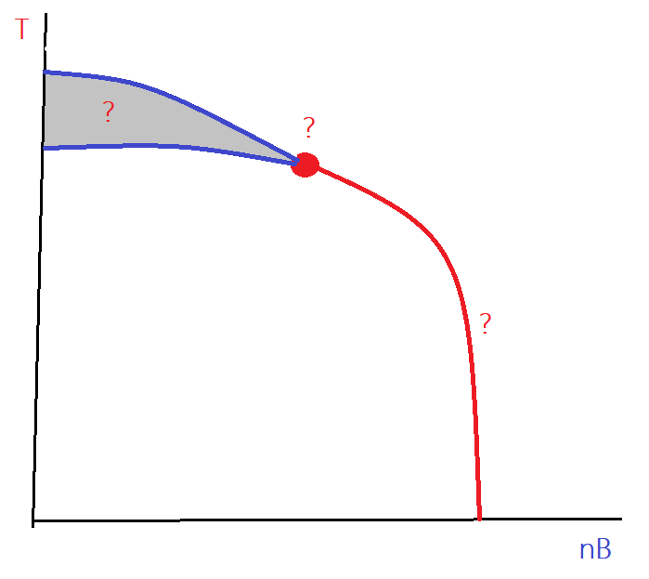
Chiral Crossover
Pengfei Zhuang Tsinghua University, Beijing 100084
The chiral phase transition line is not fixed, even at T=0.
Pengfei Zhuang, CBM workshop 2019, Yichang, 20190413-14 1

Slide 2
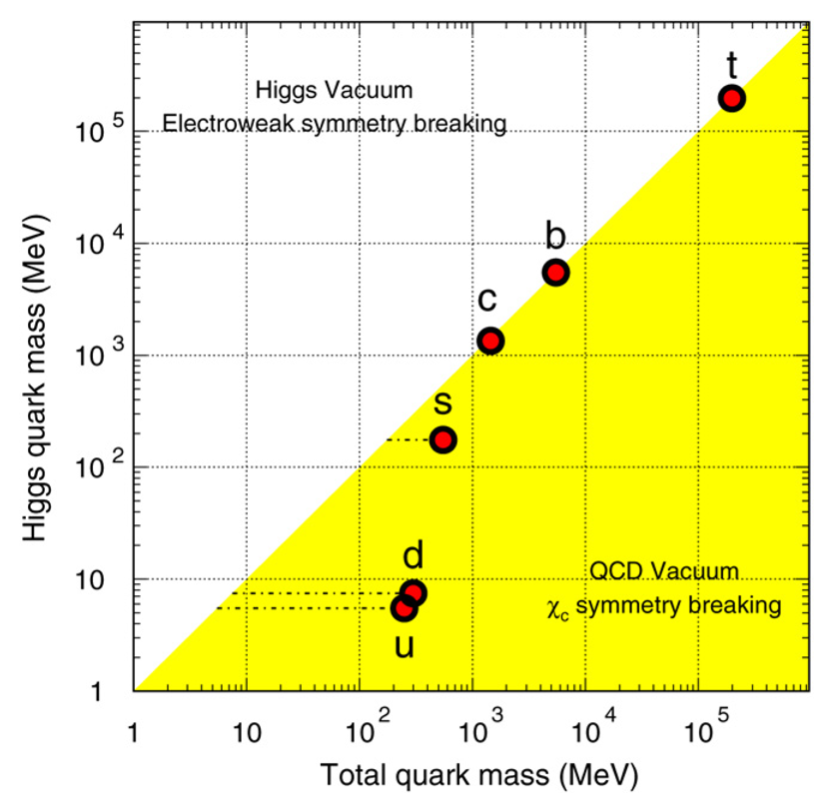
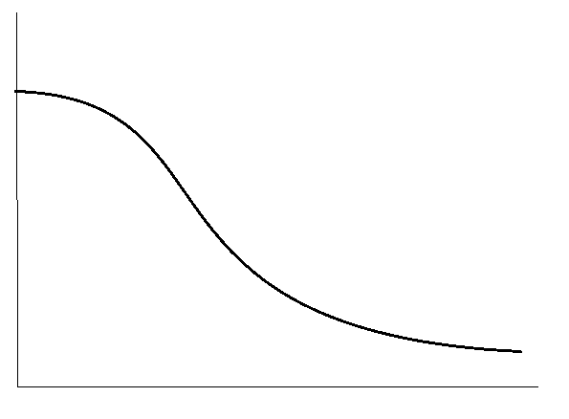






Chiral Symmetry
Light quark (hadron) mass is controlled by chiral symmetry.
● Chiral limit: $m_{q}=0 → m_{π}=0$ (Goldstone mode)
● Real case: $m_{q}≠0 → m_{π}≠0$ (Pseudo-Goldstone mode)
$$m_{0}$$
X.Zhu, M.Bleicher, S.Huang, K.Schweda, H.Stoecker, N.Xu, P.Zhuang, PLB647, 366(2007)
$$m_{q}$$
$$\left\langle T | \overline{ψ}ψ | T\right\rangle$$
T
$$\left\langle T | \overline{ψ}ψ | T\right\rangle$$
chiral crossover
$$T_{c}$$
chiral phase transition
T
Pengfei Zhuang, CBM workshop 2019, Yichang, 20190413-14 2

Slide 3

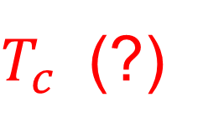
Chiral Crossover Temperature
$$m_{q}(T)$$
T
$T_{c}$ (?)
Chiral crossover is a region, not a point !
How to properly define the so-called crossover temperature ?
Pengfei Zhuang, CBM workshop 2019, Yichang, 20190413-14 3

Slide 4
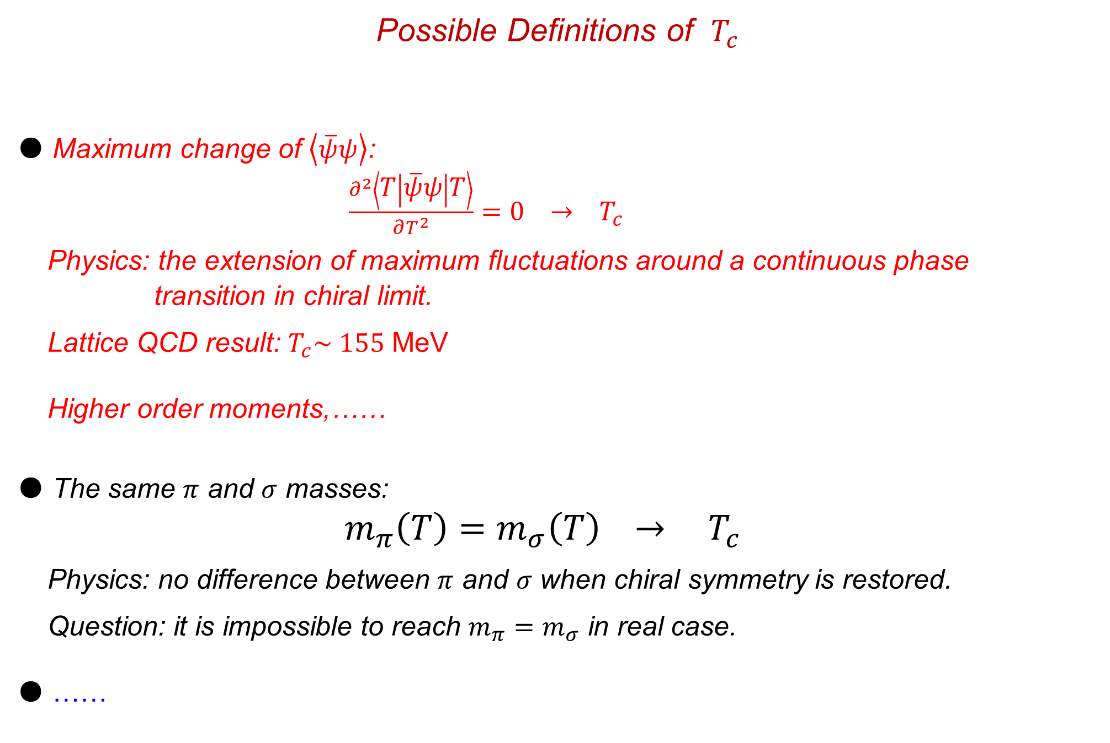
Possible Definitions of $T_{c}$
● Maximum change of $\left\langle \overline{ψ}ψ\right\rangle$:
$\frac{∂^{2}\left\langle T | \overline{ψ}ψ | T\right\rangle }{∂T^{2}}=0 → T_{c}$
Physics: the extension of maximum fluctuations around a continuous phase
transition in chiral limit.
Lattice QCD result: $T_{c}\sim 155$ MeV
Higher order moments,……
● The same $π$ and $σ$ masses:
$m_{π}\left(T\right)=m_{σ}\left(T\right) → T_{c}$
Physics: no difference between $π$ and $σ$ when chiral symmetry is restored.
Question: it is impossible to reach $m_{π}=m_{σ}$ in real case.
● ……
Pengfei Zhuang, CBM workshop 2019, Yichang, 20190413-14 4

Slide 5
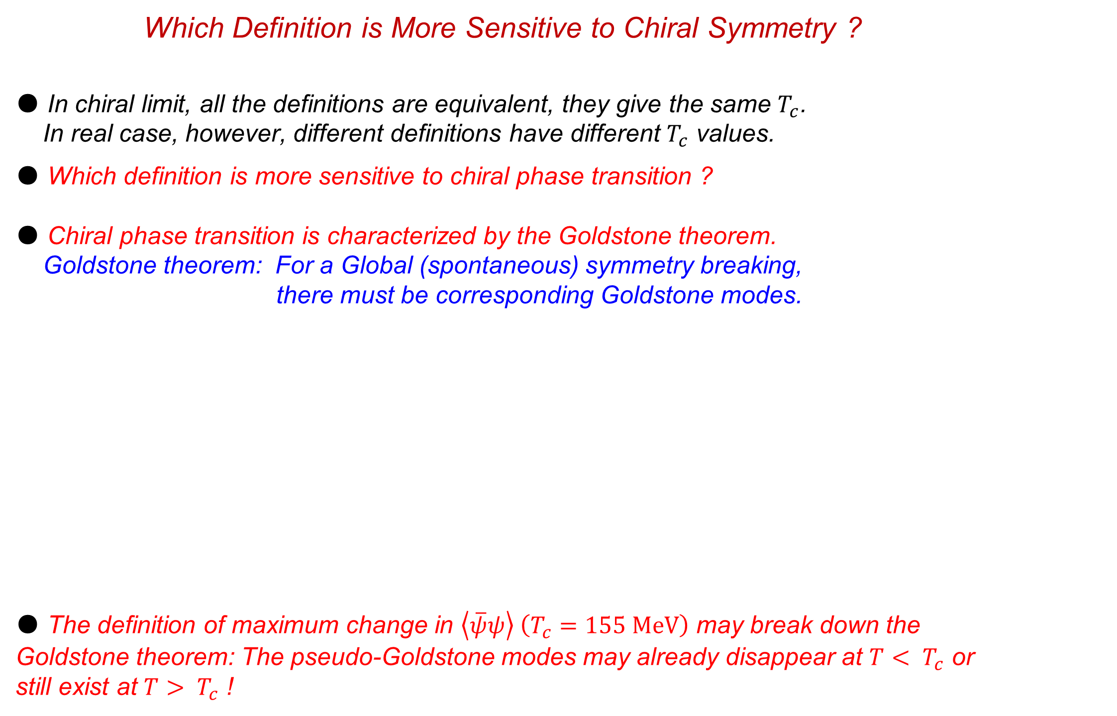

Which Definition is More Sensitive to Chiral Symmetry ?
● In chiral limit, all the definitions are equivalent, they give the same $T_{c}$.
In real case, however, different definitions have different $T_{c}$ values.
● Which definition is more sensitive to chiral phase transition ?
● Chiral phase transition is characterized by the Goldstone theorem.
Goldstone theorem: For a Global (spontaneous) symmetry breaking,
there must be corresponding Goldstone modes.
● The definition of maximum change in $\left\langle \overline{ψ}ψ\right\rangle \left(T_{c}=155 MeV\right)$ may break down the Goldstone theorem: The pseudo-Goldstone modes may already disappear at $T< T_{c}$ or still exist at $T> T_{c}$ !
Without (Pseudo-)Goldstones
With (Pseudo-)Goldstones
$$T_{c}$$
Pengfei Zhuang, CBM workshop 2019, Yichang, 20190413-14 5

Slide 6
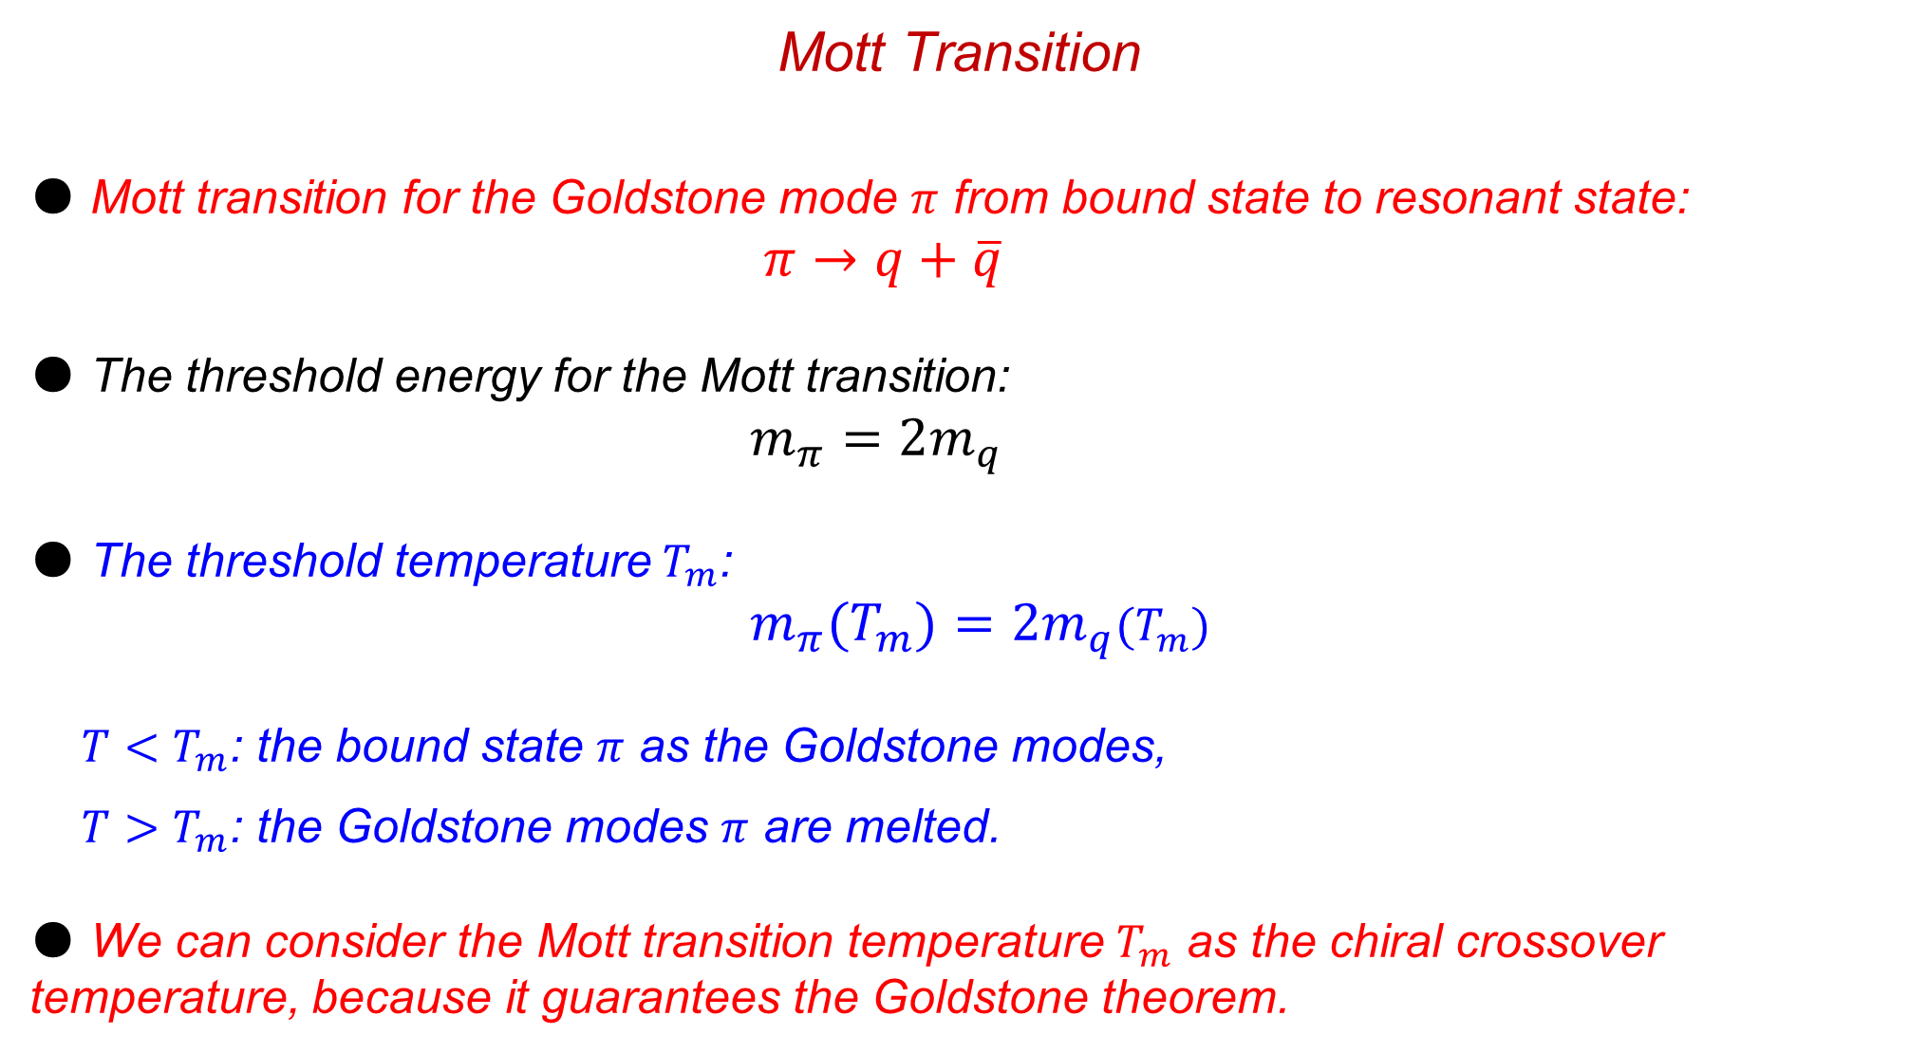
Mott Transition
● Mott transition for the Goldstone mode $π$ from bound state to resonant state:
$π→q+\overline{q}$
● The threshold energy for the Mott transition:
$m_{π}=2m_{q}$
● The threshold temperature $T_{m}$:
$m_{π}(T_{m})=2m_{q}(T_{m})$
$T<T_{m}$: the bound state $π$ as the Goldstone modes,
$T>T_{m}$: the Goldstone modes $π$ are melted.
● We can consider the Mott transition temperature $T_{m}$ as the chiral crossover temperature, because it guarantees the Goldstone theorem.
Pengfei Zhuang, CBM workshop 2019, Yichang, 20190413-14 6

Slide 7

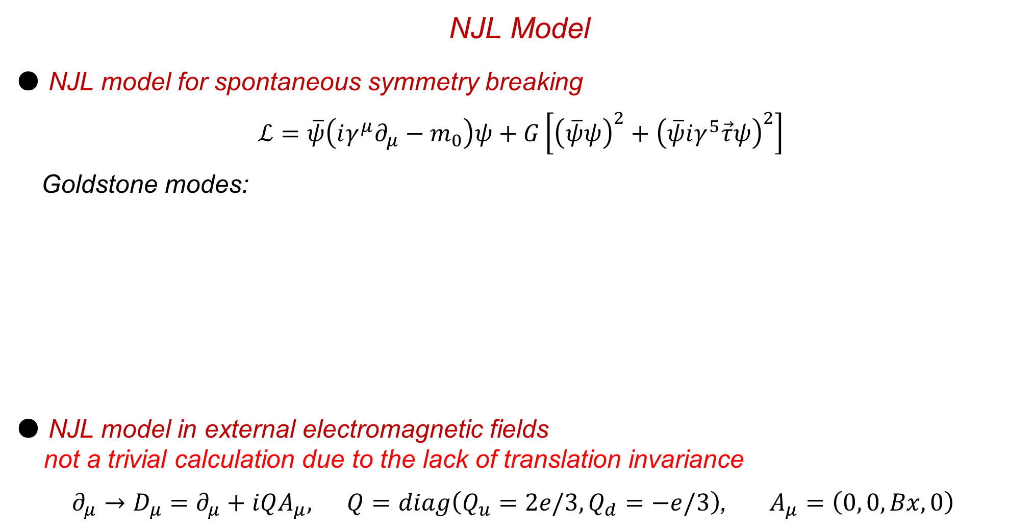
NJL Model
● NJL model for spontaneous symmetry breaking
$ℒ=\overline{ψ}\left(iγ^{μ}∂_{μ}−m_{0}\right)ψ+G\left[{\left(\overline{ψ}ψ\right)}^{2}+{\left(\overline{ψ}iγ^{5}\vec{τ}ψ\right)}^{2}\right]$
Goldstone modes:
● NJL model in external electromagnetic fields
not a trivial calculation due to the lack of translation invariance
${∂_{μ}→D}_{μ}=∂_{μ}+iQA_{μ}, Q=diag\left(Q_{u}=2e/3,Q_{d}=−e/3\right)$, $A_{μ}=\left(0, 0, Bx, 0\right)$
Original idea: Y.Nambu and G.Jona-Lasinio, PR122, 345(1961) and 124, 246(1961).
Review papers: U.Vogl and W.Weise, Prog. Part. Nucl. Phys. 27, 195(1991); S.P.Klevansky, Rev. Mod. Phys. 64,
649(1992); M.K.Volkov, Phys. Part. Nucl. 24, 35(1993); T.Hatsuda and T.Kunihiro, Phys. Rep. 247, 221(1994); M.Buballa, Phys. Rep. 407, 205(2005)
Thermodynamics: P.Zhuang, J.Huefner and S.P.Klevansky, NPA576, 525(1994).
S.P.Klevansky, Rev. Mod. Phys. 64, 649(1992)
H.Liu, L.Yu, …… and M.Huang, PRD91, 014017(2015), 94, 113006(2016) and 97, 076008(2018)
G.Cao, X.Huang, …… and P.Zhuang, PRD92, 105030(2015), PLB757, 1(2016), PRD93, 01600792016), D93, 076007(2016) and D97, 034014(2018)
R.Zhang, W.Fu and Y.Liu, EPJC76, 307(2016)
S.Mao, PLB758, 195(2016), PRD94, 036007(2016) and 96, 034004(2017)
X.Guo, Z.Wang and P.Zhuang, PRD97, 034026(2018) and 98, 016007(2018)
……
Pengfei Zhuang, CBM workshop 2019, Yichang, 20190413-14 7

Slide 8
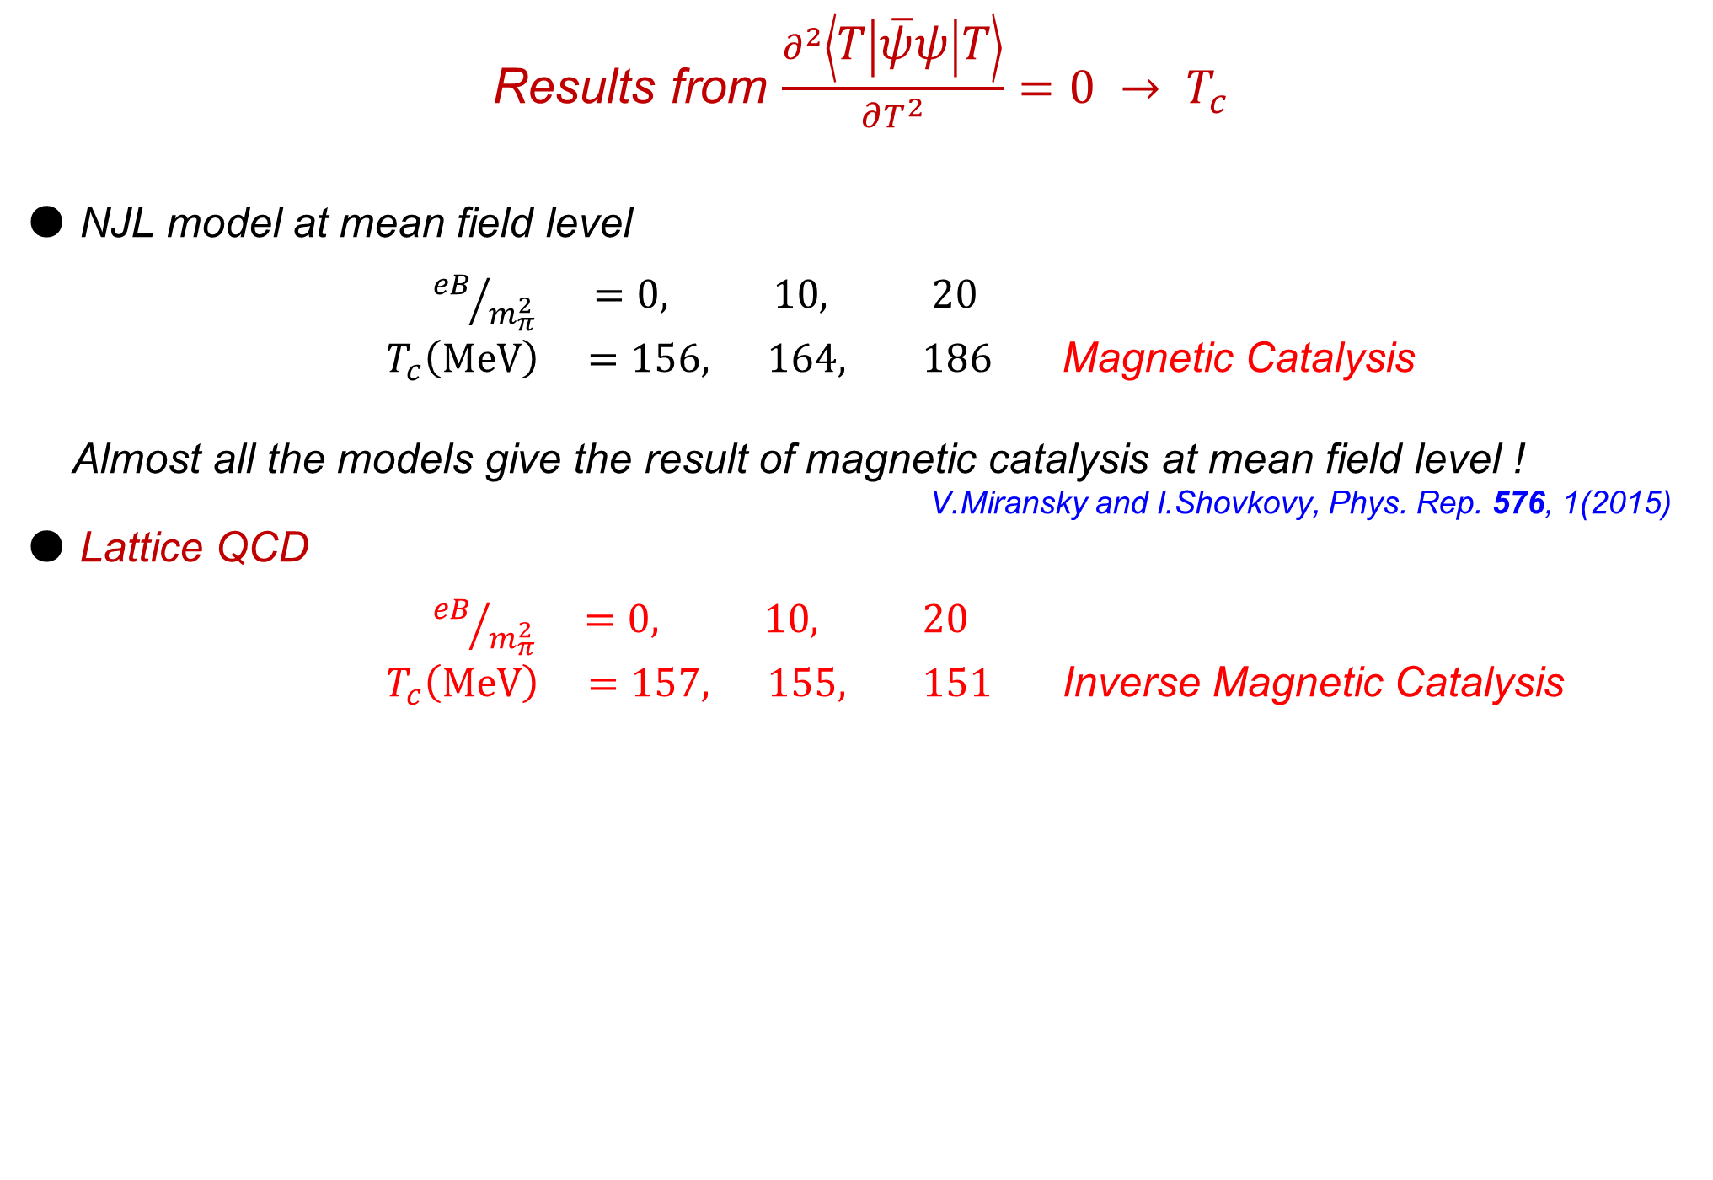
Results from $\frac{∂^{2}\left\langle T | \overline{ψ}ψ | T\right\rangle }{∂T^{2}}=0 → T_{c}$
● NJL model at mean field level
${eB}/{m_{π}^{2}} =0, 10, 20$
$T_{c}\left(MeV\right) =156, 164, 186$ Magnetic Catalysis
Almost all the models give the result of magnetic catalysis at mean field level !
V.Miransky and I.Shovkovy, Phys. Rep. 576, 1(2015)
● Lattice QCD
${eB}/{m_{π}^{2}} =0, 10, 20$
$T_{c}\left(MeV\right) =157, 155, 151$ Inverse Magnetic Catalysis
G.Bali, F.Bruckmann, G.Endrodi, Z.Fodor, S.Katz, S.Krieg, A.Schafer, and K.Szabo, JHEP1202, 044(2012), PRD86, 071502(2012), JHEP1304, 130(2013).
Y.Hidaka and A.Yamatomo, PRD87, 094502(2013),
E.Luschevskaya, O.Solovjeva, O.Kochetkov and O.Teryaev, NPB898, 627(2015), PLB761, 393(2016).
G.Bali, B.Brandt, G.Endroedi and B.Glaessle, PRD97, 034505(2018).
Pengfei Zhuang, CBM workshop 2019, Yichang, 20190413-14 8

Slide 9
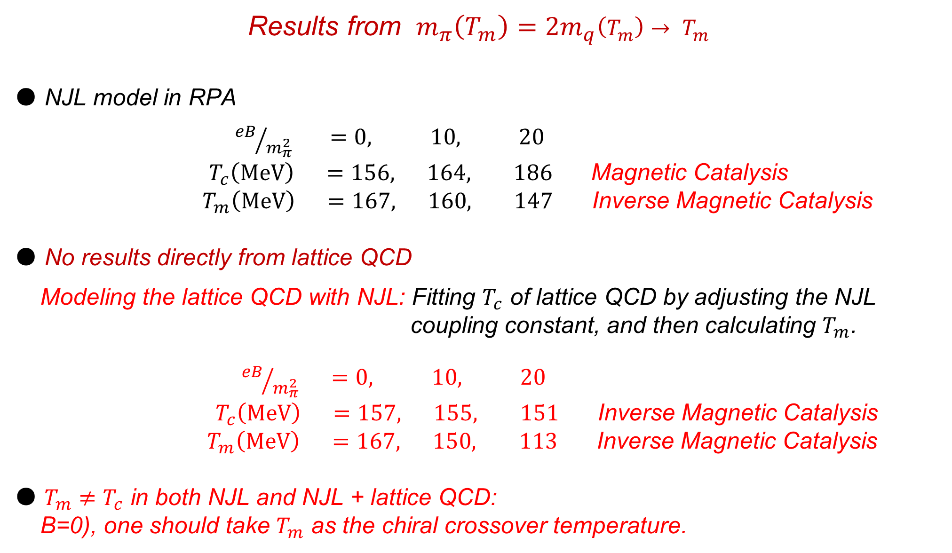
Results from $m_{π}\left(T_{m}\right)=2m_{q}\left(T_{m}\right)→ T_{m}$
● NJL model in RPA
${eB}/{m_{π}^{2}} =0, 10, 20$
$T_{c}\left(MeV\right) =156, 164, 186$ Magnetic Catalysis
$T_{m}\left(MeV\right) =167, 160, 147$ Inverse Magnetic Catalysis
● No results directly from lattice QCD
Modeling the lattice QCD with NJL: Fitting $T_{c}$ of lattice QCD by adjusting the NJL
coupling constant, and then calculating $T_{m}$.
${eB}/{m_{π}^{2}} =0, 10, 20$
$T_{c}\left(MeV\right) =157, 155, 151$ Inverse Magnetic Catalysis
$T_{m}\left(MeV\right) =167, 150, 113$ Inverse Magnetic Catalysis
● $T_{m}≠T_{c}$ in both NJL and NJL + lattice QCD:
B=0), one should take $T_{m}$ as the chiral crossover temperature.
Pengfei Zhuang, CBM workshop 2019, Yichang, 20190413-14 9

Slide 10
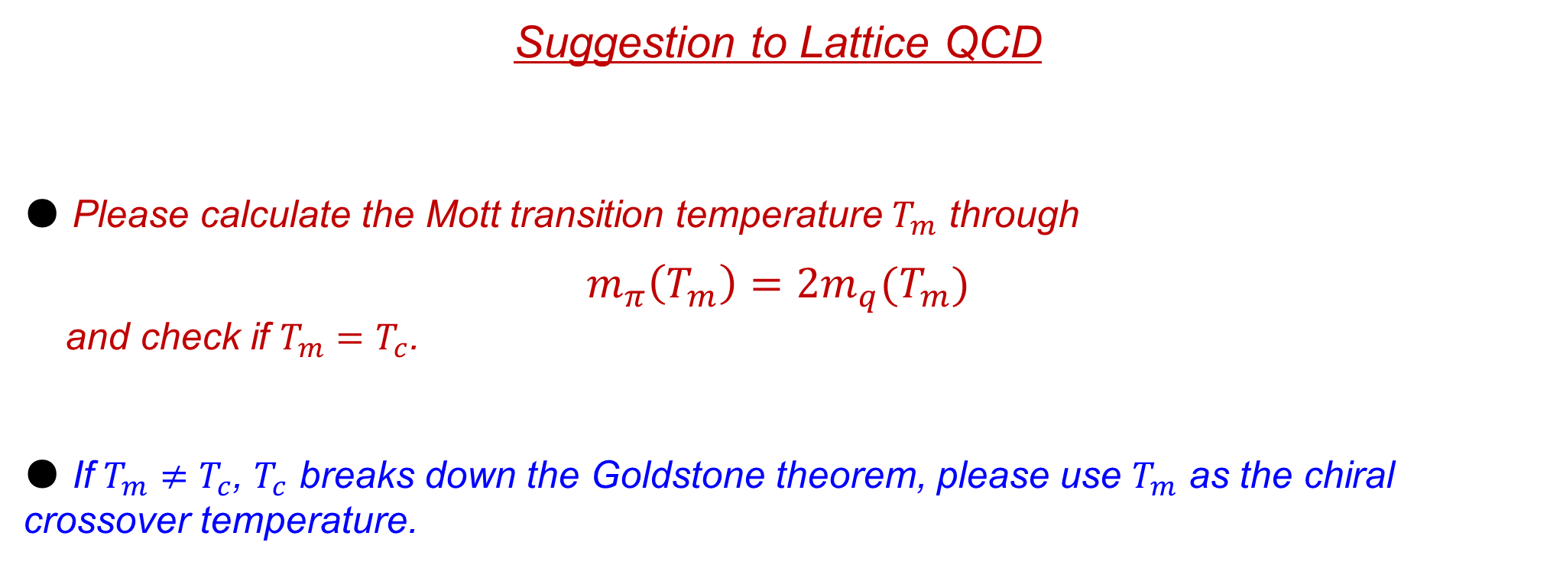
Suggestion to Lattice QCD
● Please calculate the Mott transition temperature $T_{m}$ through
$$m_{π}\left(T_{m}\right)=2m_{q}(T_{m})$$
and check if $T_{m}=T_{c}$.
● If $T_{m}≠T_{c}$, $T_{c}$ breaks down the Goldstone theorem, please use $T_{m}$ as the chiral crossover temperature.
Pengfei Zhuang, CBM workshop 2019, Yichang, 20190413-14 10

Slide 11
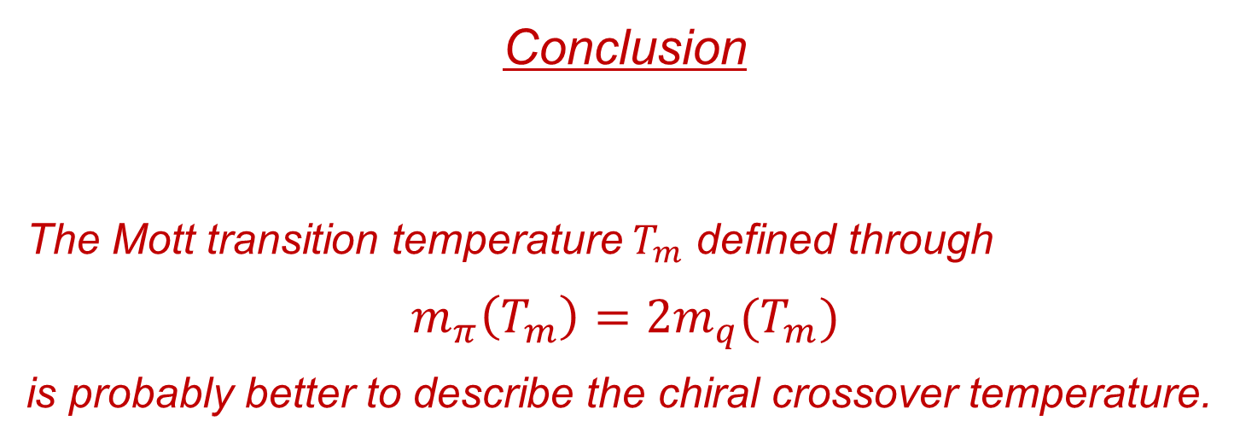
Conclusion
The Mott transition temperature $T_{m}$ defined through
$$m_{π}\left(T_{m}\right)=2m_{q}(T_{m})$$
is probably better to describe the chiral crossover temperature.
Pengfei Zhuang, CBM workshop 2019, Yichang, 20190413-14 11

