Slide 1
Status of high rate MRPC for CBM-TOF
  Wang Yi
  Department of Engineering Physics, Tsinghua University

Slide 2
Outline
  Introduction on FAIR and CBM-TOF
Development of low resistive glass
High rate MRPC for CBM-TOF
Status of STAR-eTOF and mCBM
Conclusions

Slide 3
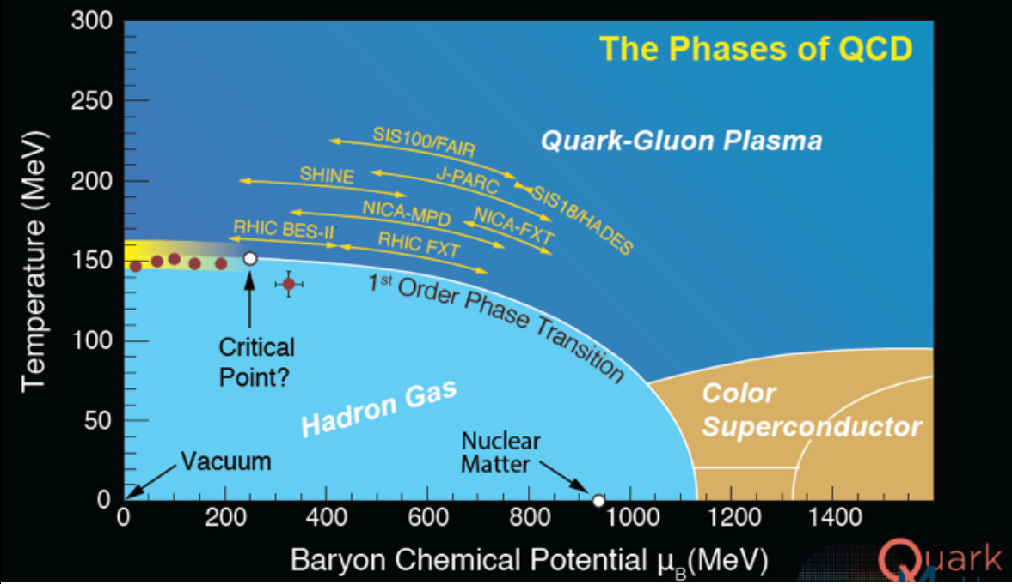
The phase diagram of strongly interacting matter

Slide 4
Facility for Antiproton &Ion Research: FAIR

Slide 5
Layout of CBM detector

Slide 6
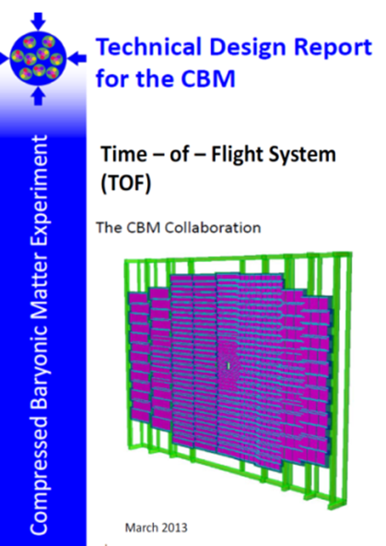
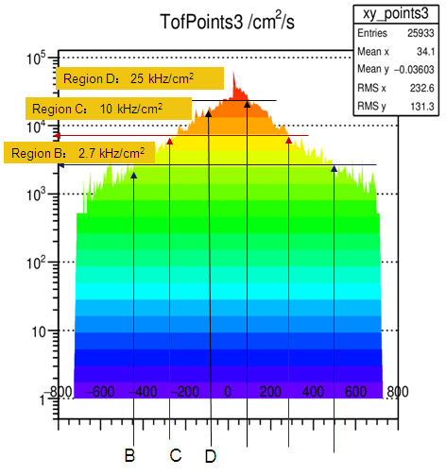
The structure of CBM-TOF wall
CBM-ToF Requirements
Full system time resolution σ_{T} ~ 80 ps
Efficiency > 95 %
Rate capability ≤ 30 kHz/cm²
Polar angular range 2.5°– 25°
Occupancy < 5 %
Low power electronics
(~100.000 channels)
Free streaming data acquisition
Au+Au, Center, 10AGeV
Simulated with CBM ROOT

Slide 7
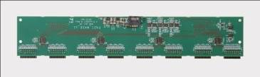
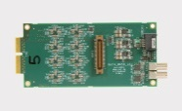
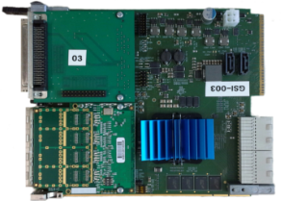

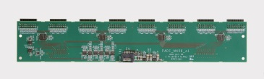

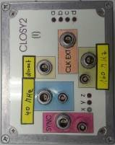
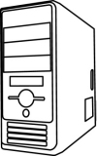
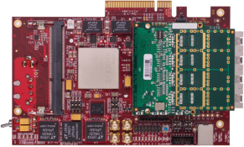
Electronics & Readout chain
MRPC
2
3
MRPC
MRPC
MRPC
CAVE
CBM CLK (40MHz)
Example for 192 Channel
ToF CLK (160MHz)
Counting-Room
ToF SYNC Signal
Optic (~50m)

Slide 8
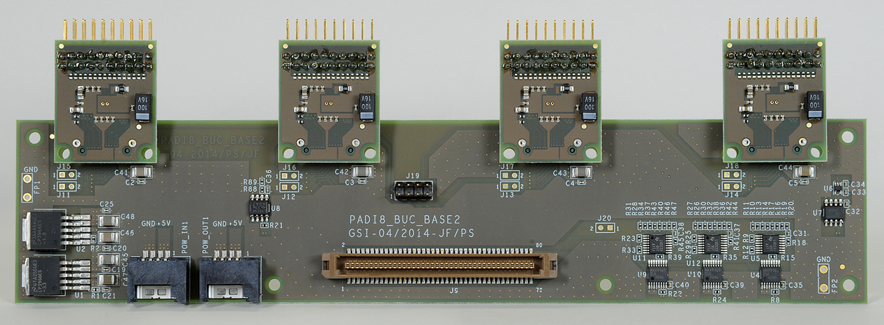
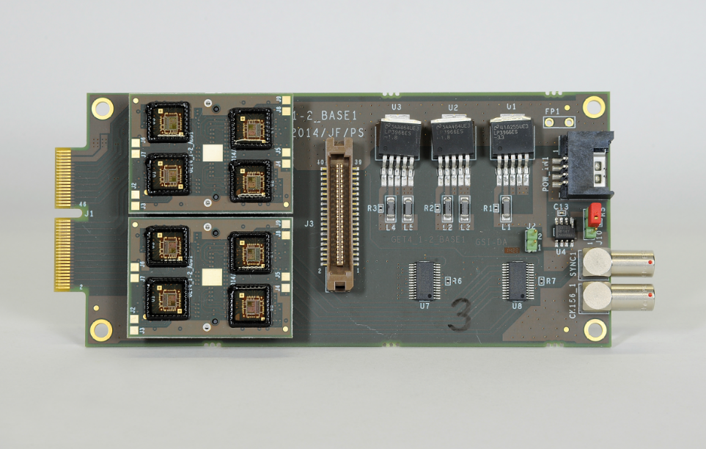
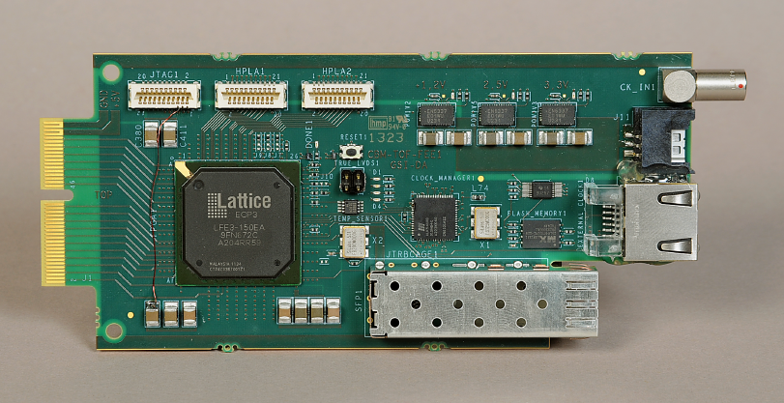
TOF electronics
Padi8
GET4
FPGA - TDC

Slide 9
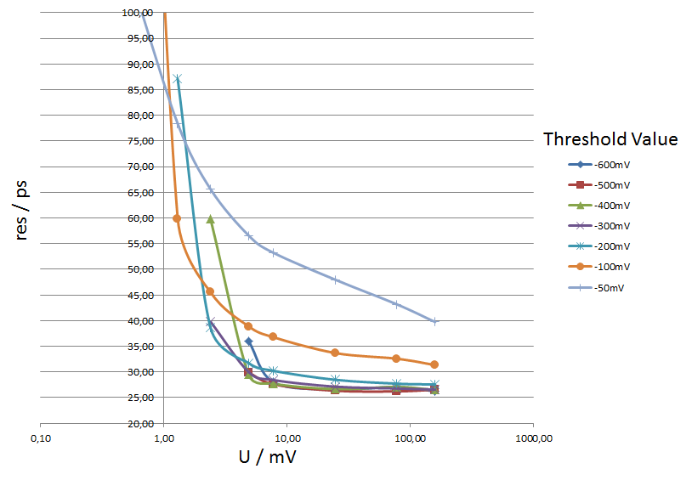
Pulser test of PADIX & GET4
Precision between two channels
PADI X & GET4 V1.23
below 30ps
below 30ps
below 30ps

Slide 10
How to increase rate of MRPC
The voltage drop in the gas gap:
The smaller the voltage drop, the higher efficiency and higher rate capability!
Two main ways to improve rate capability:
Reducing bulky resistivity of electrode glass (CBM)
Reducing the avalanche charge (ATLAS)

Slide 11
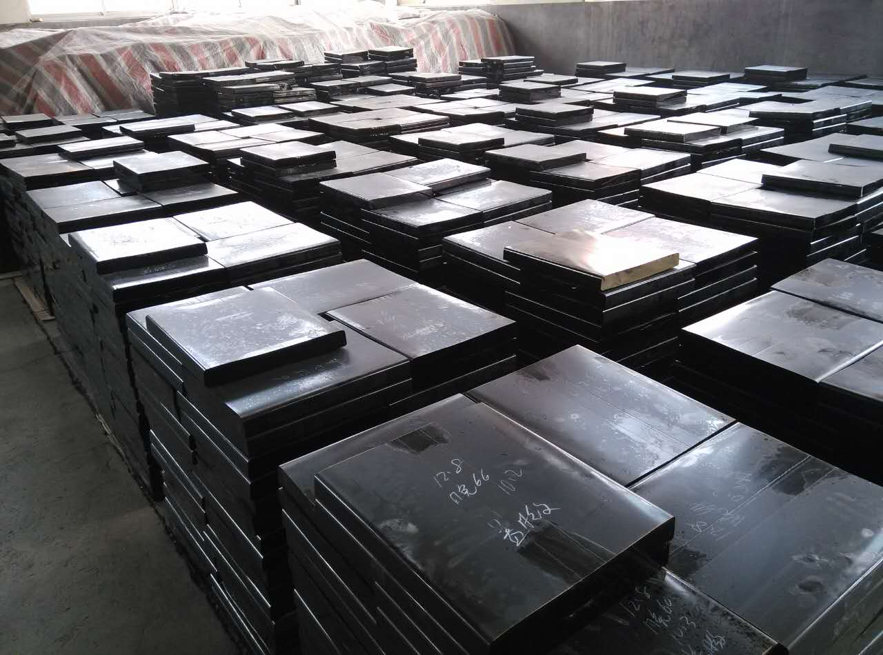
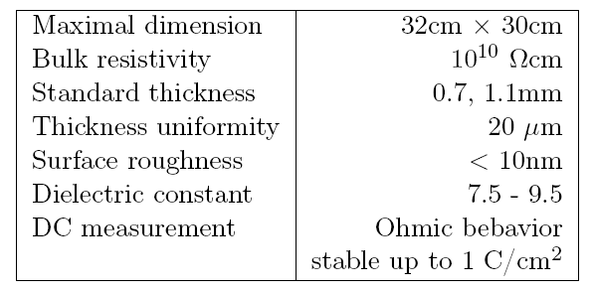
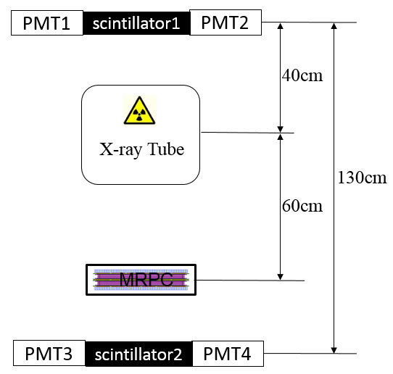
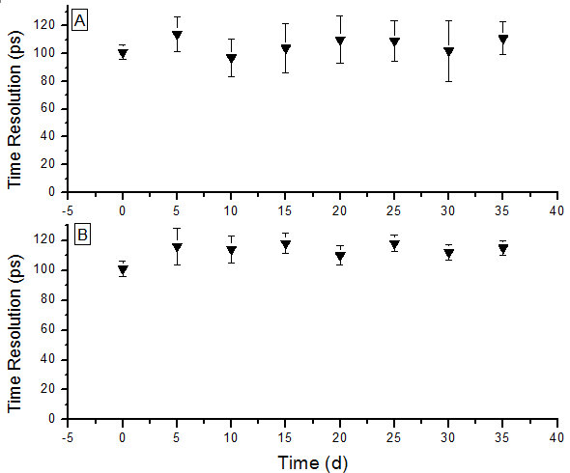
Development of low resistive glass
Performance of the glass
Glass mass production
Yield >100m²/month
Online test system. The efficiency and time resolution can be obtained by cosmic ray while irradiated by X-rays. 0.1C/cm² charge is accumulated in 35 days.
Aging test with X-ray source

Slide 12
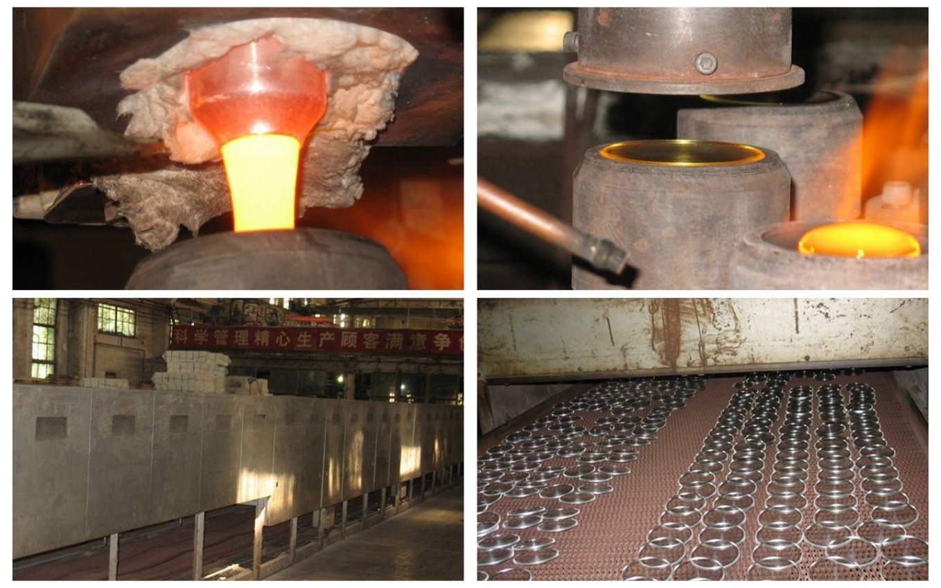
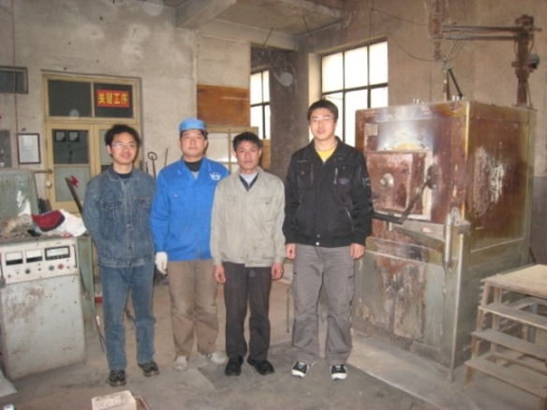
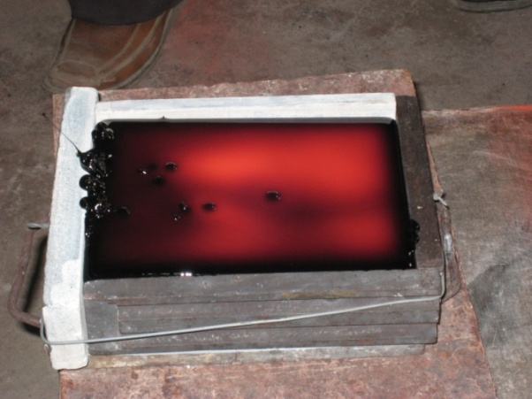
Glass R&D and mass production
Continuous melting
Continuous pouring
Continuous annealing
Technology of R&D

Slide 13
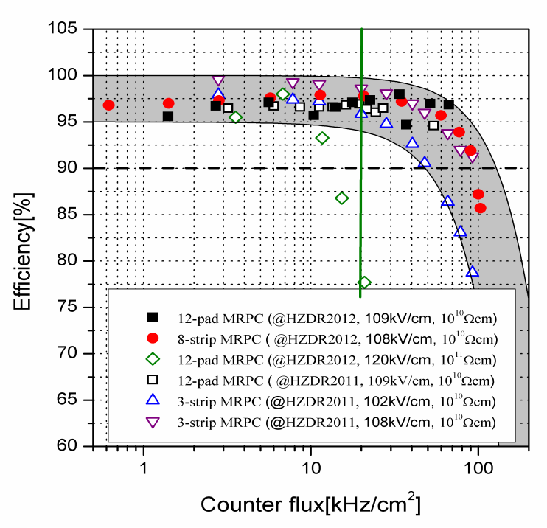
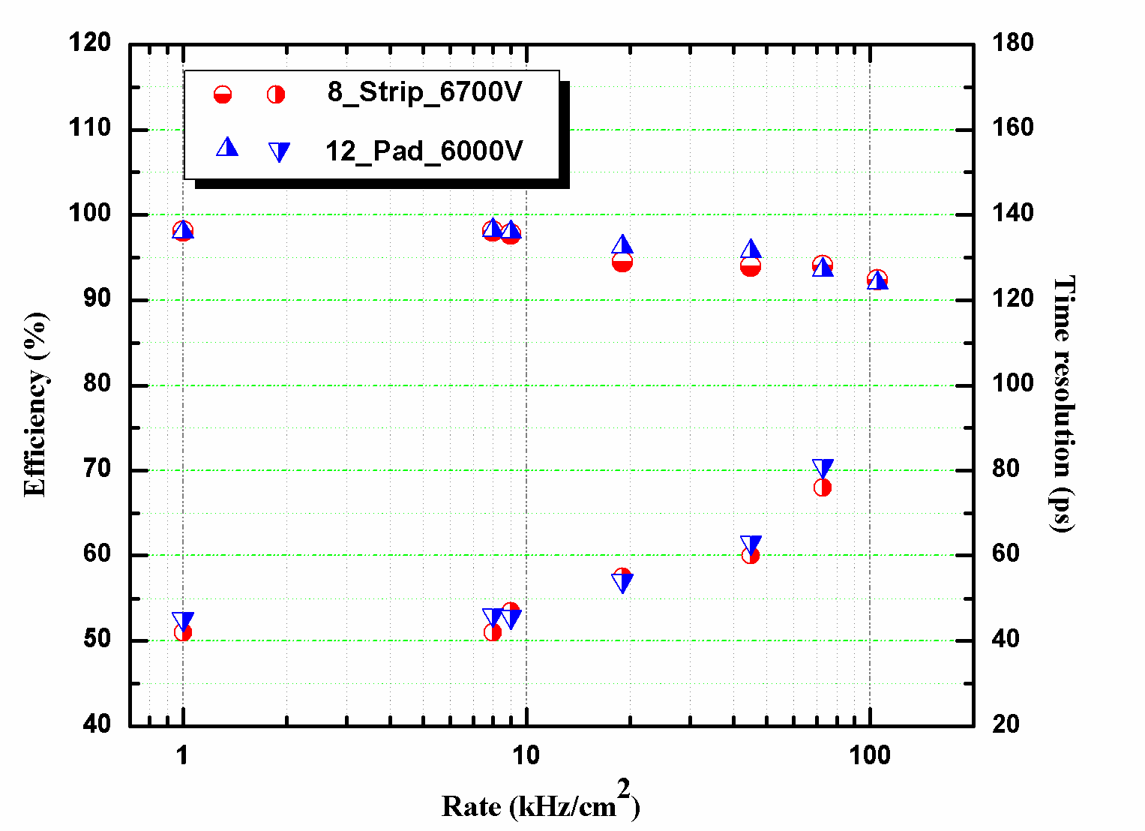
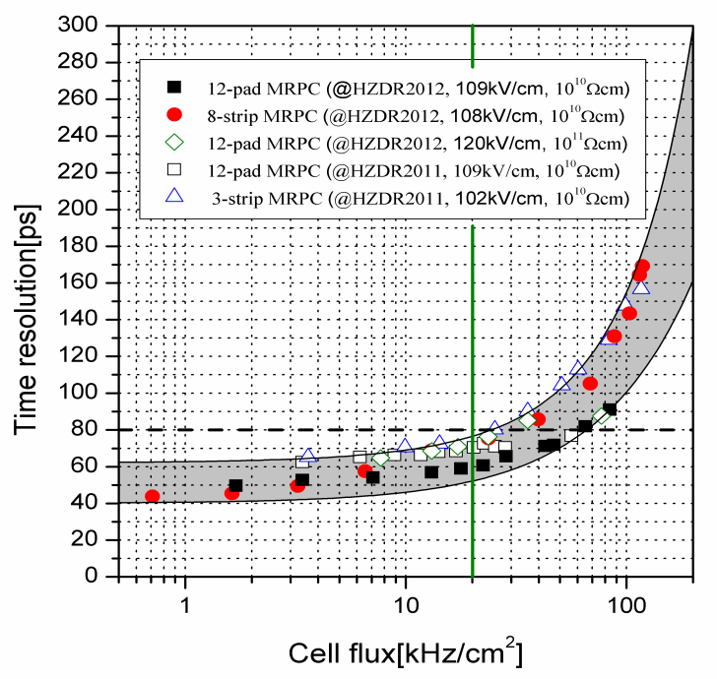
Rate capability of high rate MRPC
Test results at Nuclotron, Dubna
Rate: 70kHz/cm²
Time resolution: 40 ps
Even though the rate is 70kHz/cm², the efficiency is still higher than 90% and the time resolution is about 80ps.

Slide 14
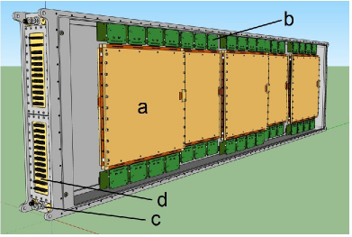
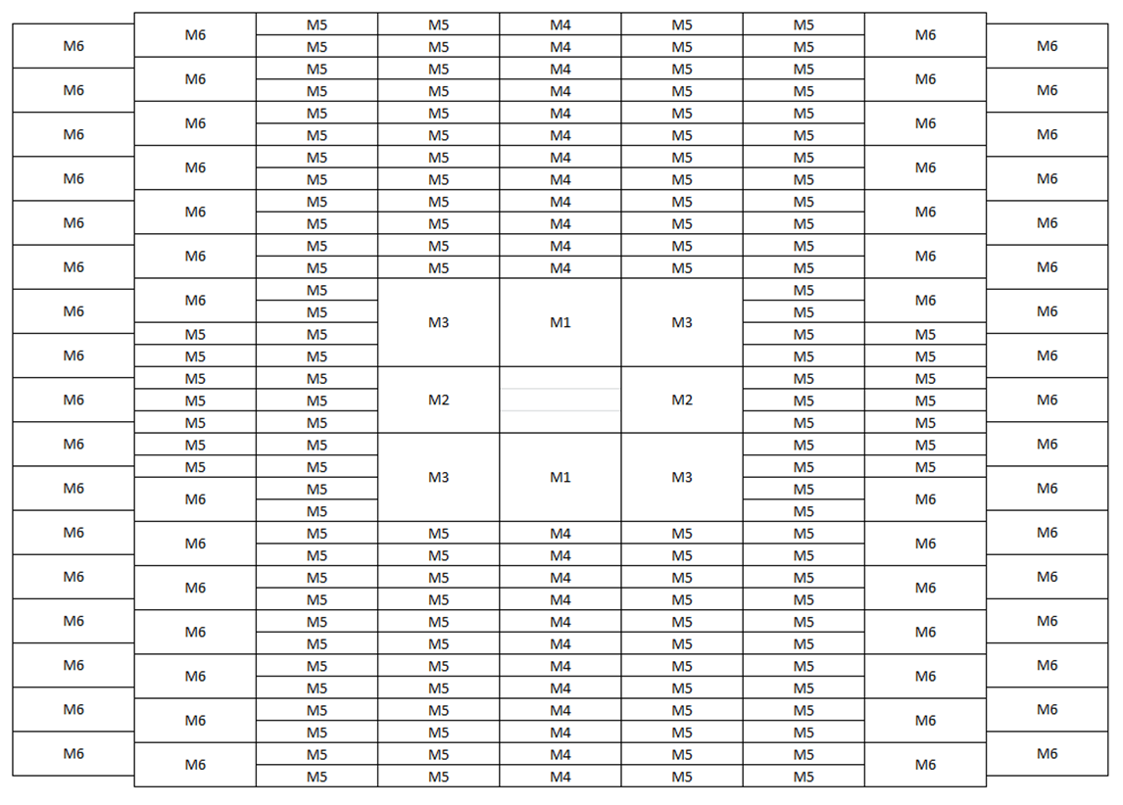
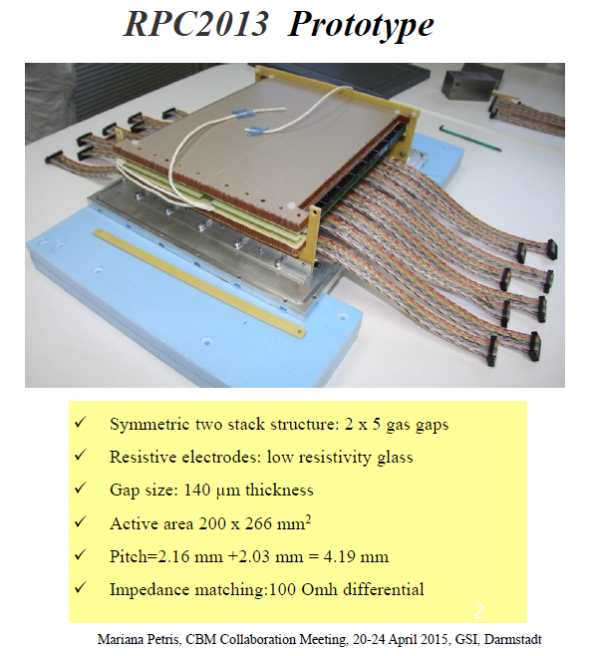
Prototype design for CBM-TOF
Strip-MRPC
Inner zone-MRPC

Slide 15
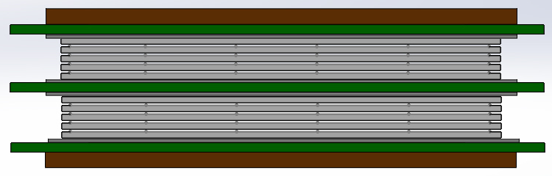
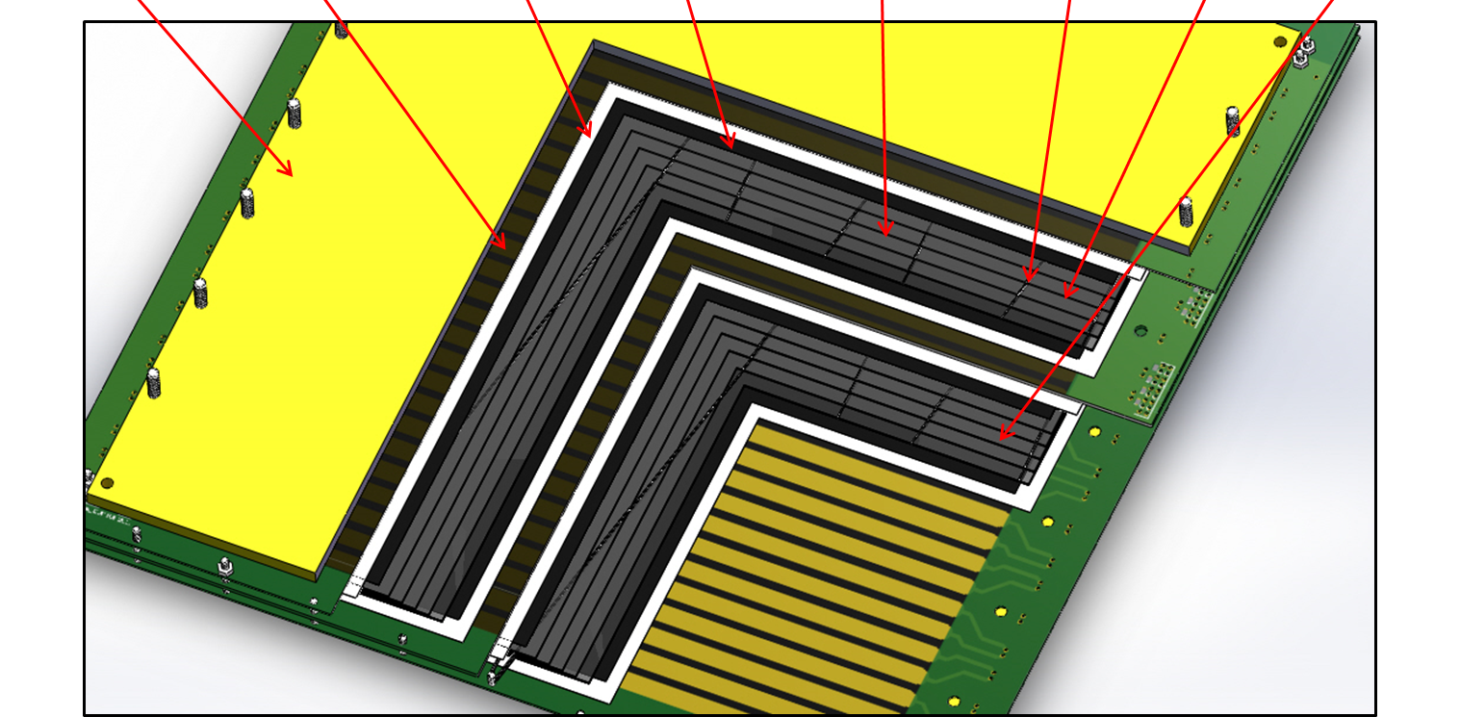
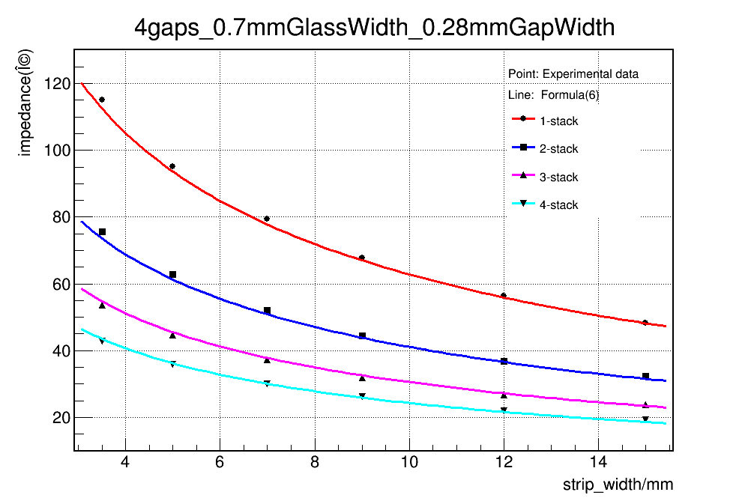
Design of strip-MRPC for high rate region
Glass: low resistive glass
0.7mm thick, 33cm x 27.6cm
Strip: 27cm x 0.7cm, 0.3cm interval, 32 strips
Gas gap: 8 x 0.25mm, two stacks
Honey
PCB
Mylar
Graphite
Glass
Fish line
Upper stack
lower stack
$$Z_{0}=\frac{\frac{\left.a(1\right)}{\sqrt{\left.ε+a(2\right)}}×\log{\frac{a\left(3\right)×n×w2+a(4)×\left(n+1\right)×w1}{\left.w−a(5\right)} }+a\left(6\right)×\sqrt{\frac{w}{n×w2+\left(n+1\right)×w1}}+a(7)×\log{\frac{w1}{w2}}}{\left.ns+a(8\right)}$$
15
15

Slide 16
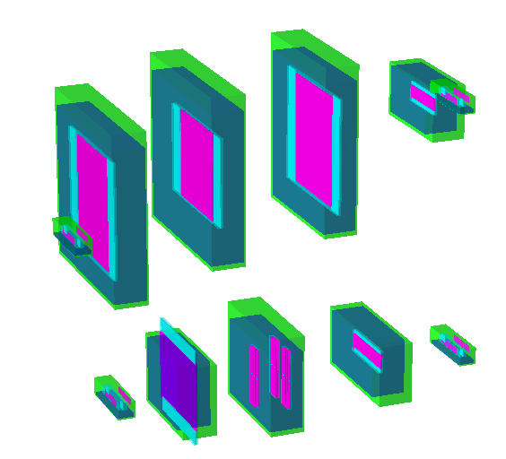
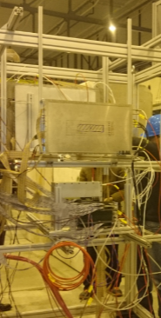
Beam test @ SPS Feb 2015
Experimental Setup:
USTC
THU-Strip
HD-Ref
HD-P2
Up setting
PMT
Down setting
High rate test in February 2015 at SPS CERN
13 GeV Ar beam
Flux rate around 1kHz/cm²
Buc-Ref
Buc-2013
THU-Pad
16

Slide 17
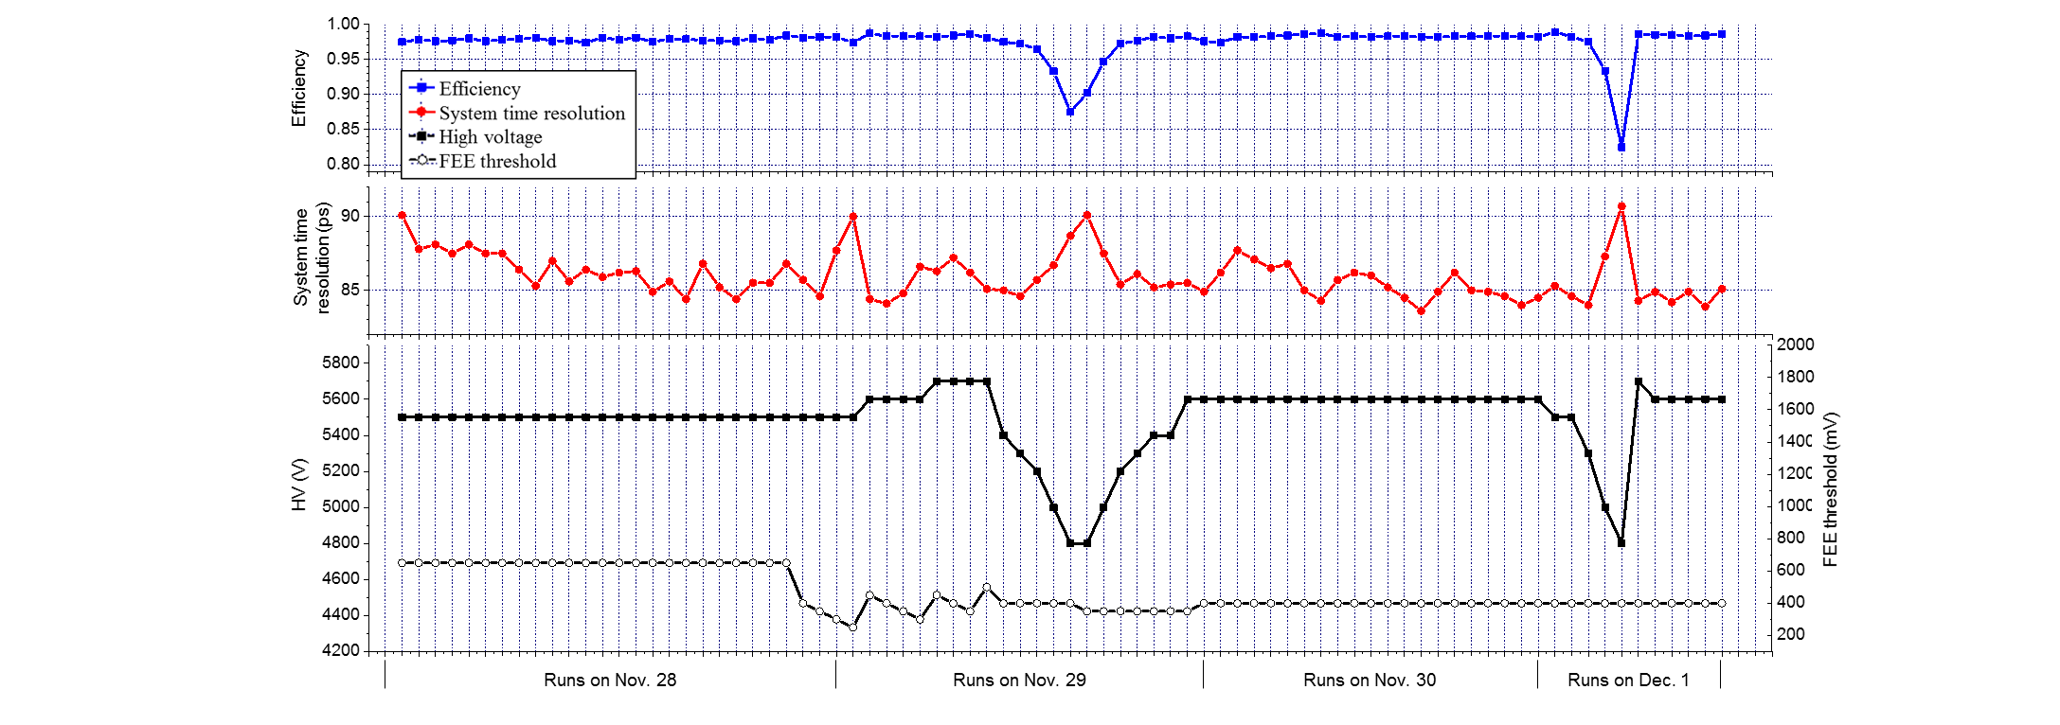
Performance of the prototype
SPS Nov 2015 THU-DU results
Results of each run
Time resolution from tracking method

Slide 18
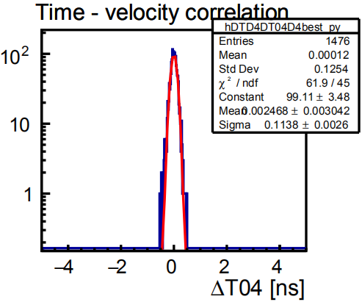
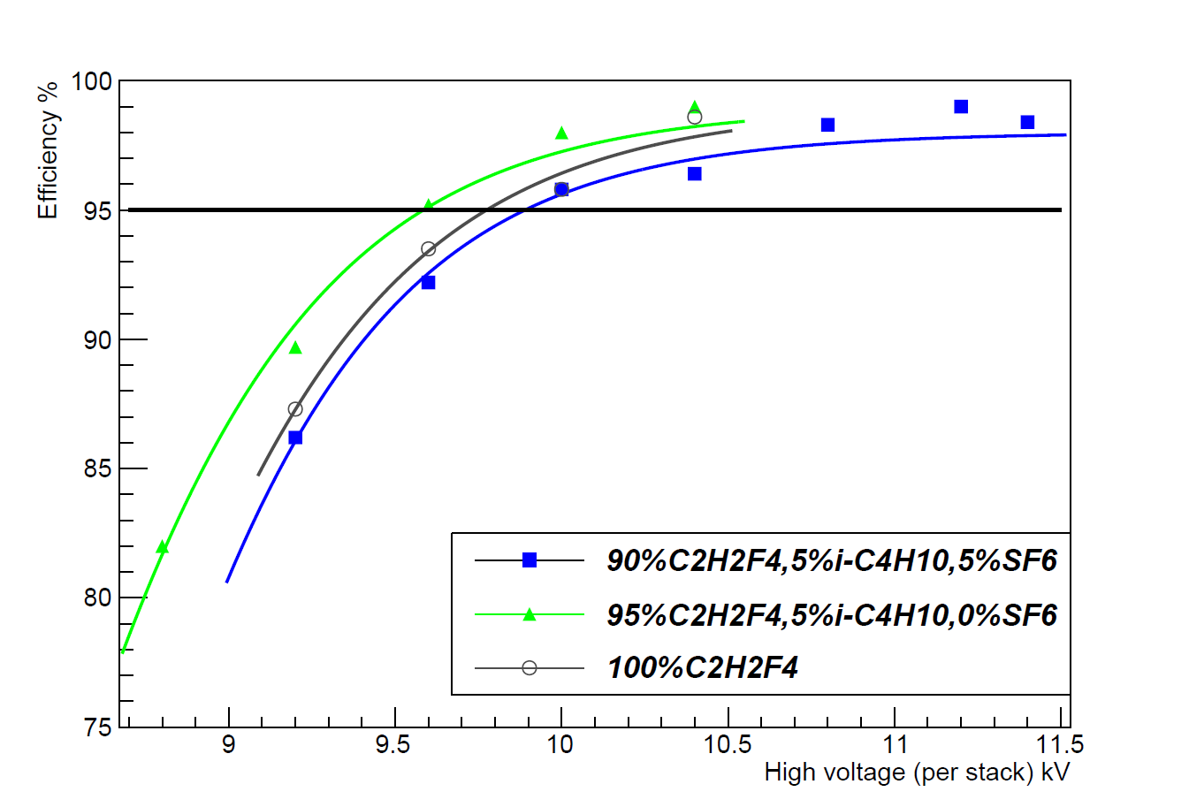
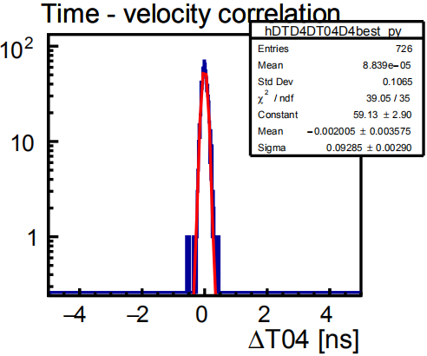
Performance in different working gas
CBM-TOF: 90% C₂H₂F₄+5% i-C₄H₁₀+5% SF₆
STAR-eTOF: 95% C₂H₂F₄+5% i-C₄H₁₀
STAR gas, ±5200 V
Time Res: 113.8 ps
CBM gas, ±5600 V
Time Res: 92.9 ps
The efficiency curve with STAR gas is shifted 300 V behind compared to CBM gas.

Slide 19
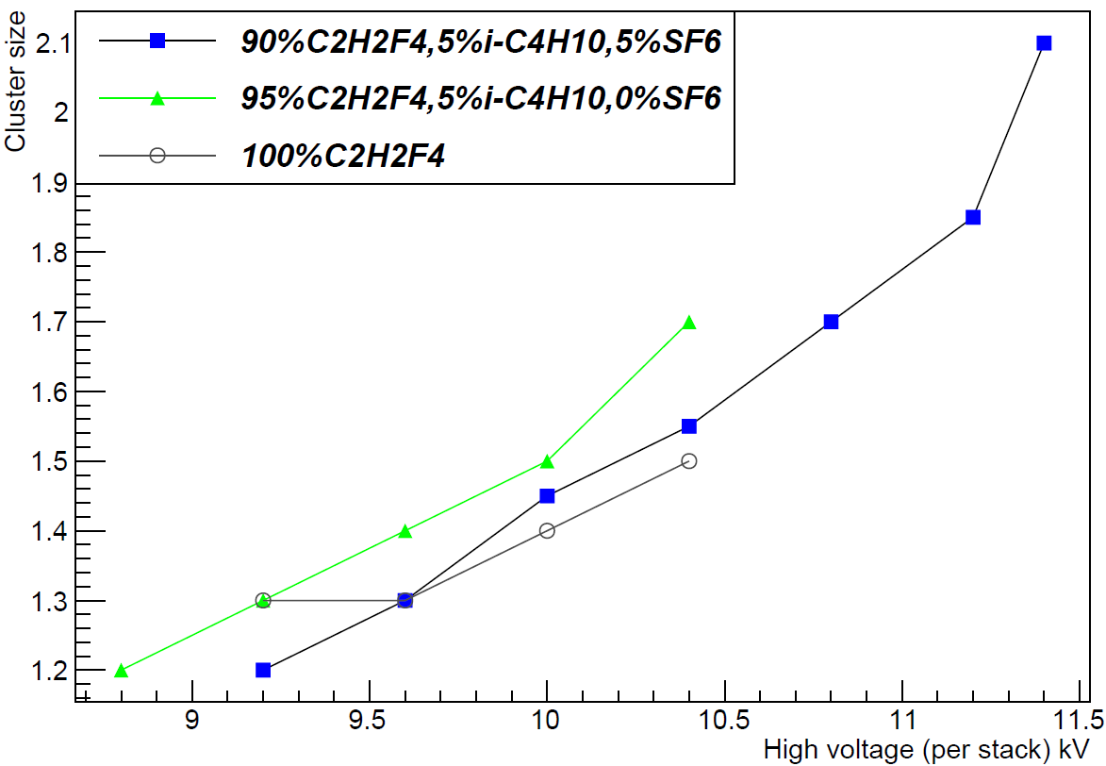
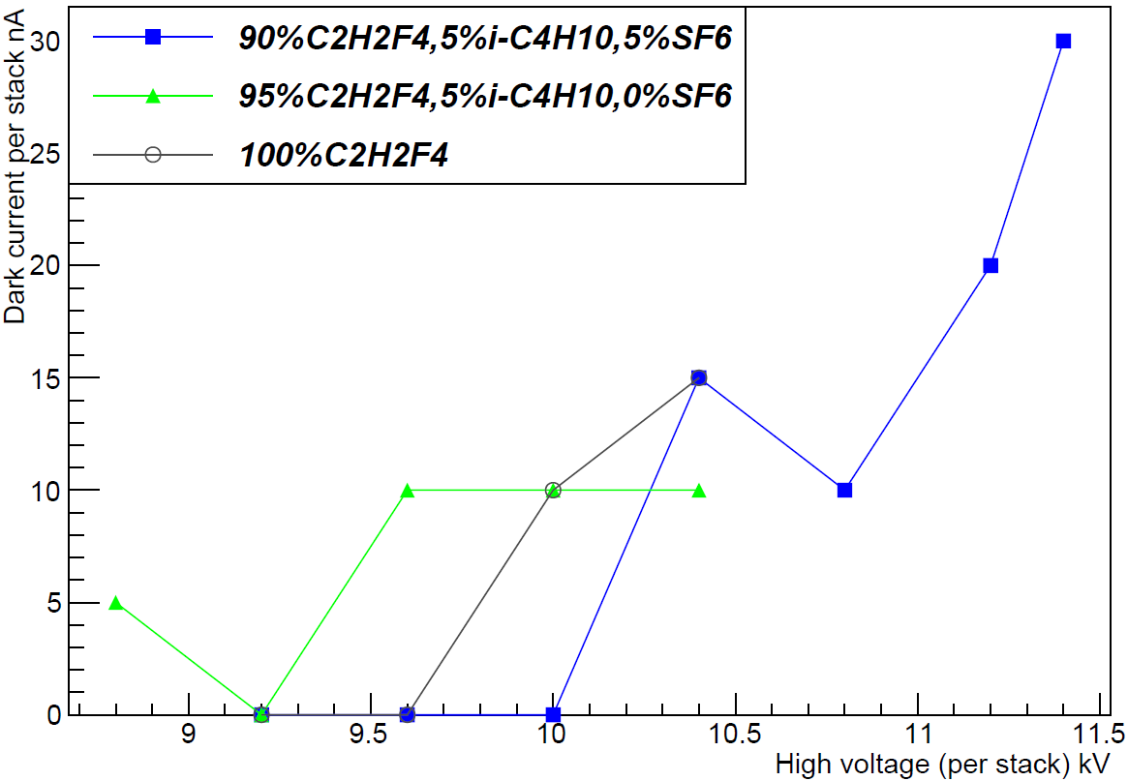
Performance in different working gas
The dark current and cluster size increases a little without SF₆ in the gas mixture because of the expanded avalanche. At the working point, the performances still satisfy the requirements.

Slide 20
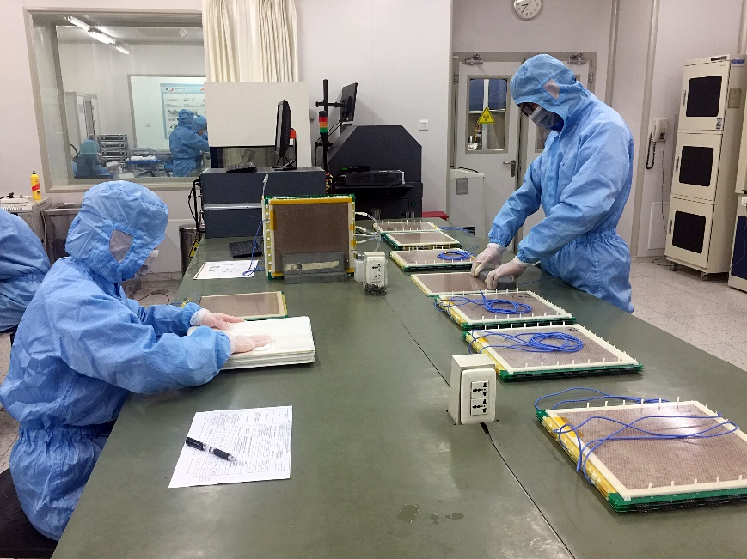

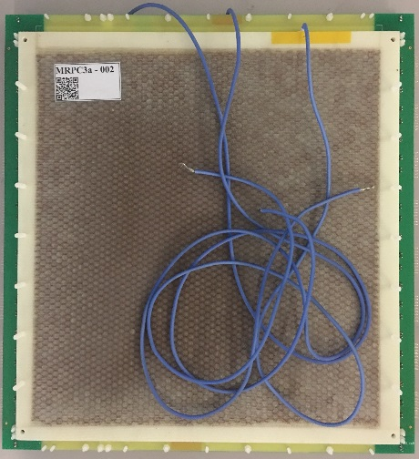
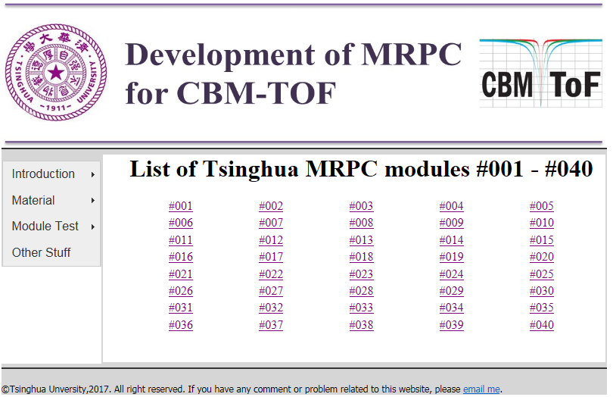
Mass production of high rate MRPC
Two-dimensional code of MRPC
Producttion website:
http://hepd.ep.tsinghua.edu.cn/CBM_TOF/

Slide 21
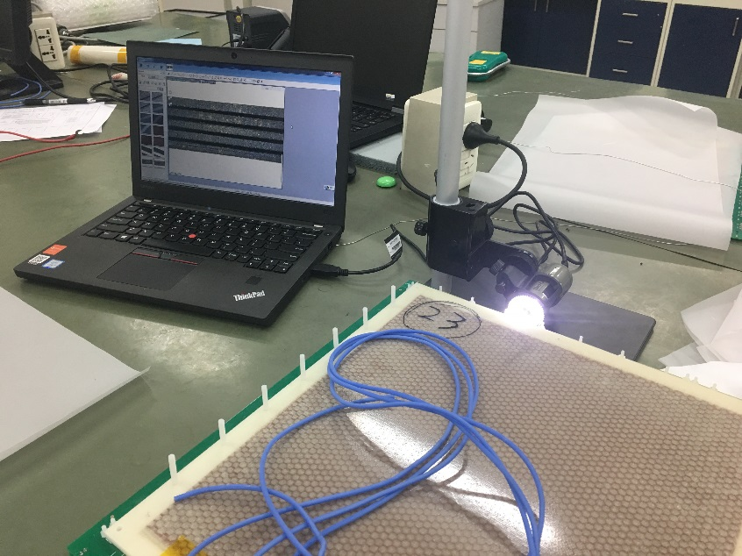
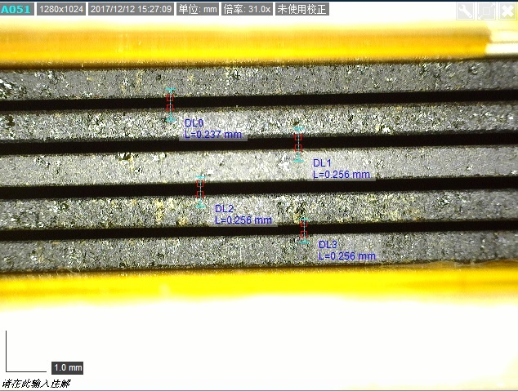
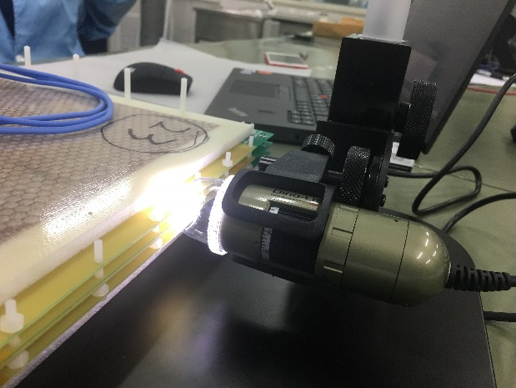
Visual check of gas gap
1 cm
The automatic boundary recognition method makes the measurement more accurate.

Slide 22
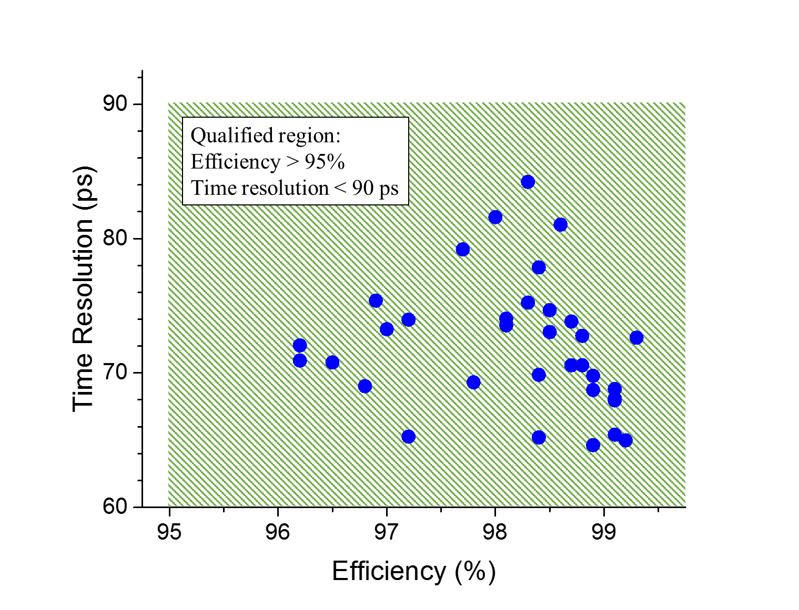
Test results of 33 MRPC
Each spot reprsents the efficiency and time resolution of one produced counter.
All the points are in the qualified region, and most of the counters show a stable performance of 70 ps time resolution and 98% efficiency.

Slide 23
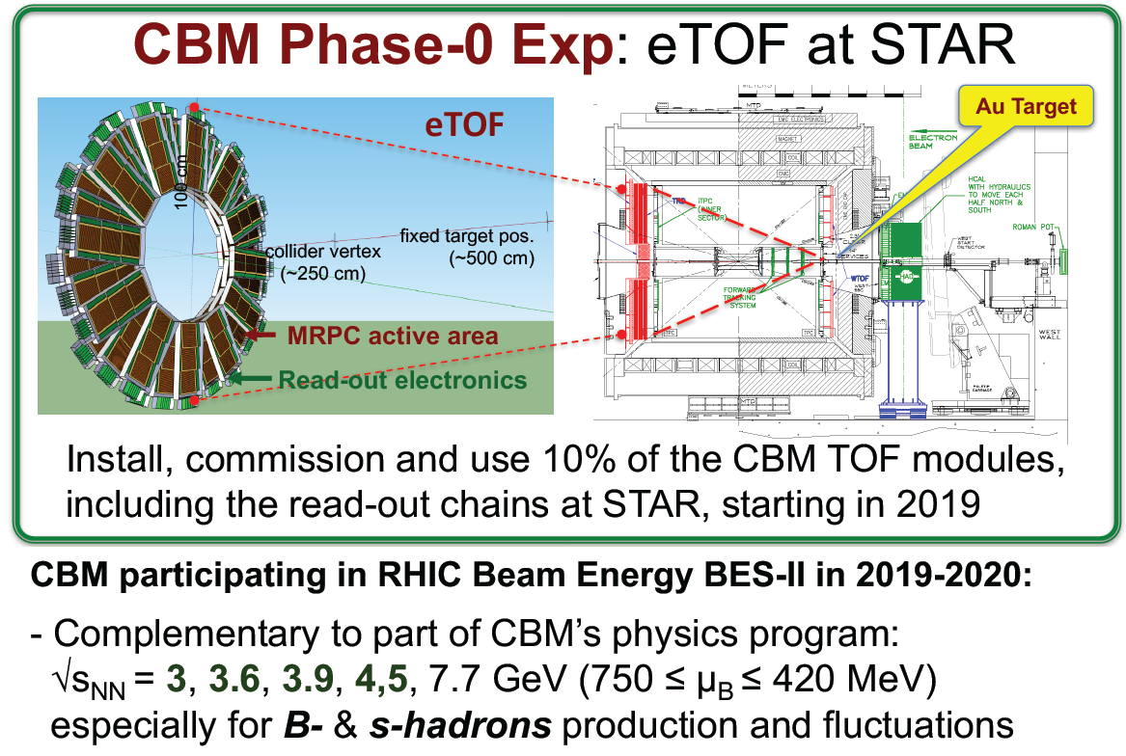

Slide 24
Picture of STAR-eTOF

Slide 25
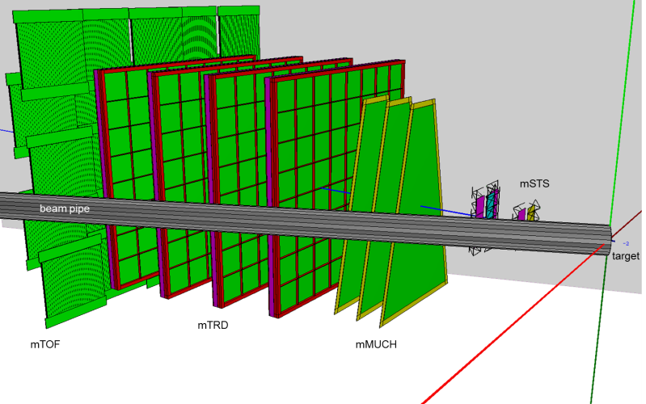
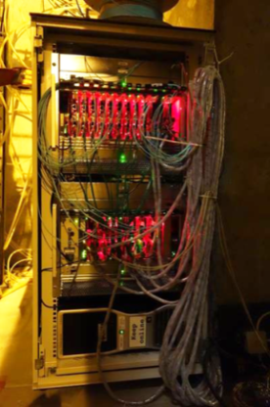
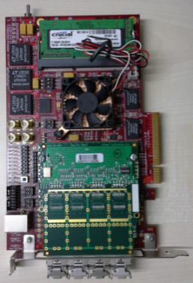
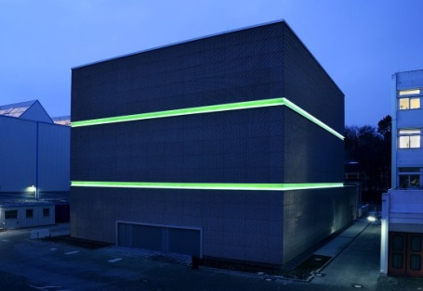
mCBM@SIS18
Schedule
10/2017 | HTD cave & beam line: preparation of construction, start of procurement
11/2017 | HTD cave & beam line: start of construction
11/2017 | mDAQ test stand @ Heidelberg operational
11/2017 | installation of detector subsystems: mechanical design freeze
03/2018 | HTD cave construction completed
04/2018 | mFLES cluster @ Green IT Cube installed
05/2018 | installation of detector stations
06/2018 | start commissioning w/o beam
09/2018 | start commissioning with beam
green IT cube
25

Slide 26
Production of modules for eTOF and mCBM

Slide 27



Time resolution of STAR-eTOF
eTOF was included in the calibration production for Au+Au at 27GeV
  ~ 2M events available in total
  ~ 600k events with good timing eTOF information after firmware fix
Choose π (0.8-1.2 Gev/c)
System time resolution is 85ps
The time resolution of MRPC is around 60ps

Slide 28


PID of STAR-eTOF
The (π,k)/p separation can reach 2.5~3Gev/c

Slide 29
Summary
Low resistive glass (~10¹⁰ Ω.cm) was developed
The rate capability of high rate MRPC can reach 70kHz/cm²
The construction of CBM-TOF goes smoothly
STAR-eTOF is successful
time resolution<100ps
(π,k)/P separation: 3GeV/c
mCBM is ready and run soon…

Slide 30
Thanks for your attention !

