Slide 1

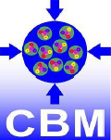
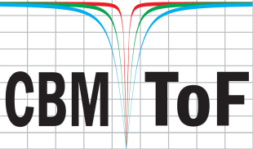
Status on CBM MRPC @USTC
-- R&D on the noise rate
Yongjie Sun State Key Laboratory of Particle Detection and Electronics, China
University of Science and Technology of China

Slide 2

Outline
Introduction
Simulation and preliminary results
Prototype design
Summary

Slide 3
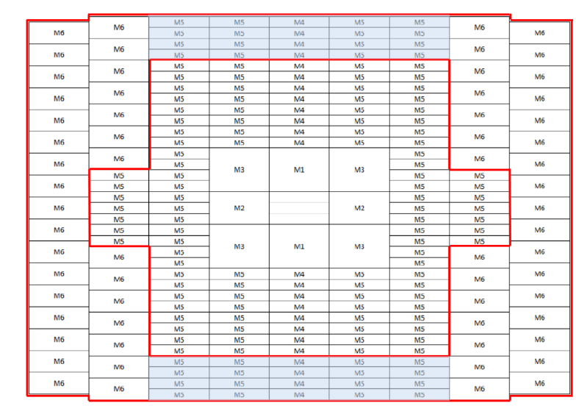
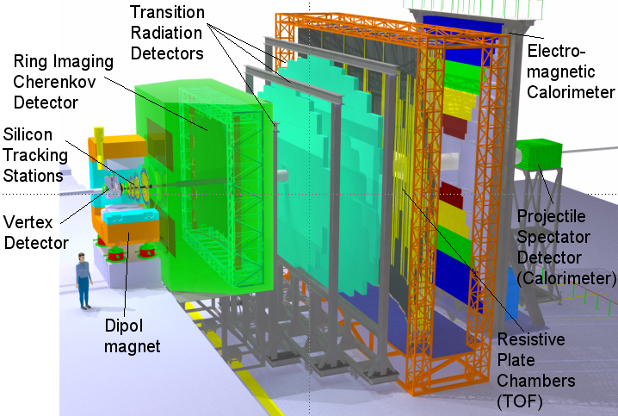
CBM TOF
Large area: ~120 m²
Large rate range: 1-25 kHz/cm²
“Streaming” readout: Low noise rate
USTC: MRPC3b (200) + MRPC4 (310)

Slide 4
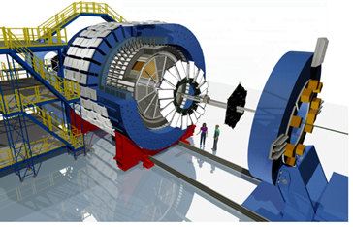
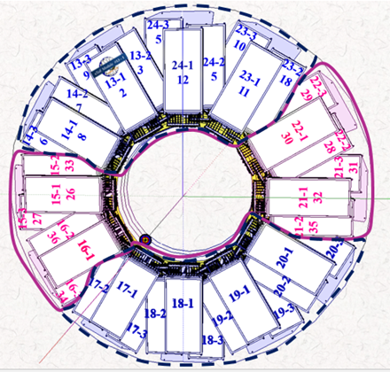
CBM/STAR endcap TOF Upgrade
MRPC3b for CBM - STAR: eTOF installation by 2018-12
24 modules ( =72+8 MRPCs) from USTC
- 3 layers
- 8 sectors
- 6912 channels

Slide 5
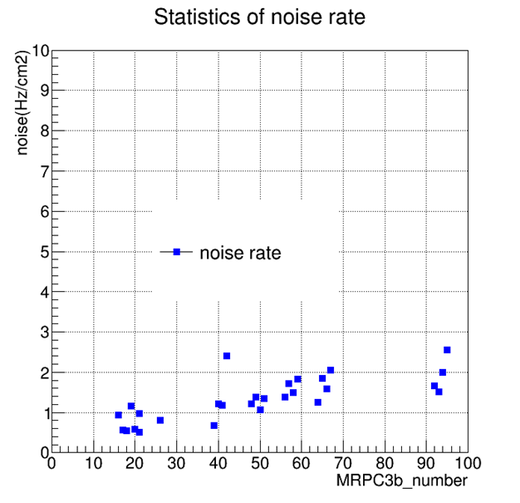
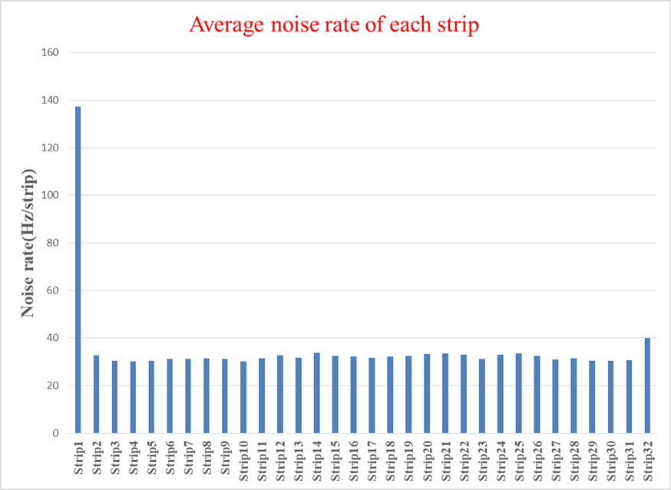
Noise rate of batch testing
Problem
Noise rate of the strip close to the HV connection much higher than other strips.

Slide 6
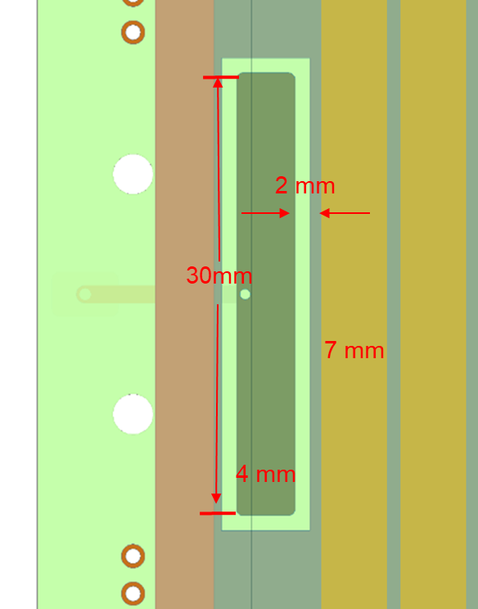
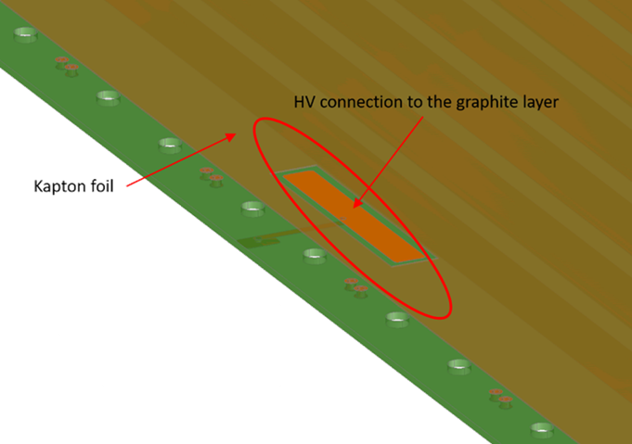
HV connection
?
What are the main causes of the phenomenon
Guesses
HV connection pad is too close to the strip (2mm)
HV connection pad is too long
Other HV connection pad shapes...

Slide 7
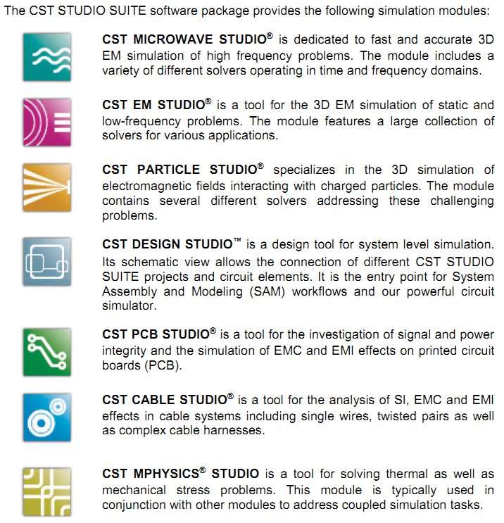
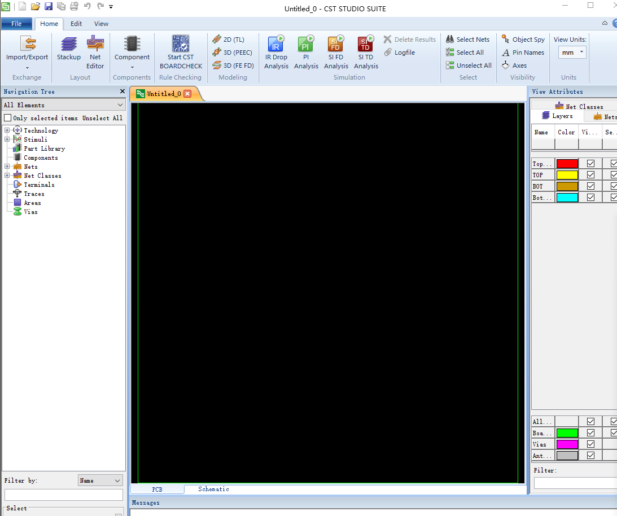
CST introduction
Computer Simulation Technology(CST): the powerful simulation platform for all kinds of electromagnetic field problems and related applications
PCB STUDIO interface
Website: https://www.cst.com/

Slide 8
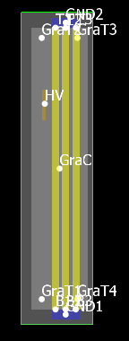
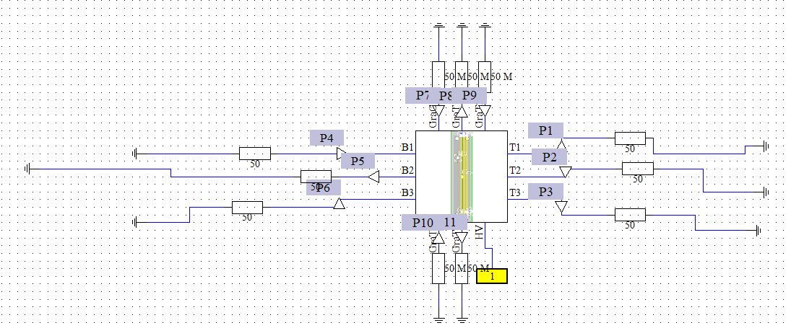
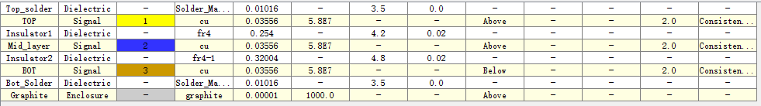
Model_1 simulation
Inject signal: sine signal
Amplitude: 5mV
Period: 1GHz
HV pad: 4mm*30mm
Distance between HV pad and strip: 6mm

Slide 9
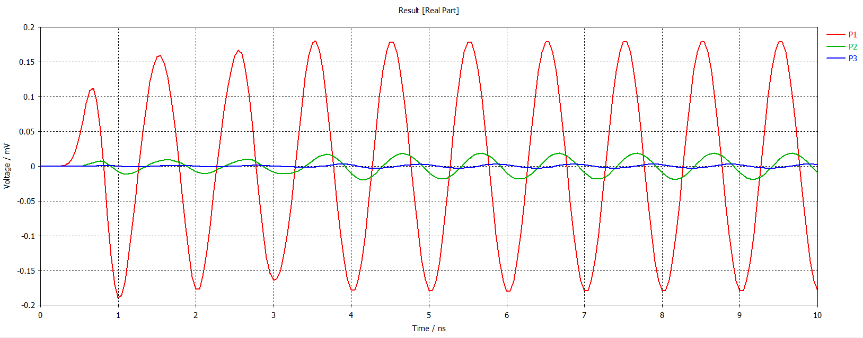
Model_1 simulation results
From the side of HV connection pad (the latter result is the same)
P1: first strip P2: second strip P3: third strip
Amplitude of the closest strip is about 0.17mV,which is about 1/30 of the original signal.
Amplitude of other 2 strips are much smaller than the first strip.

Slide 10
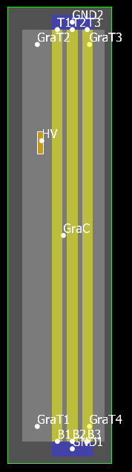
Model_2 simulation
Input signal: sine signal
Amplitude: 5mV
Period: 1GHz
HV pad: 4mm*15mm
Distance between HV pad and strip:6mm

Slide 11
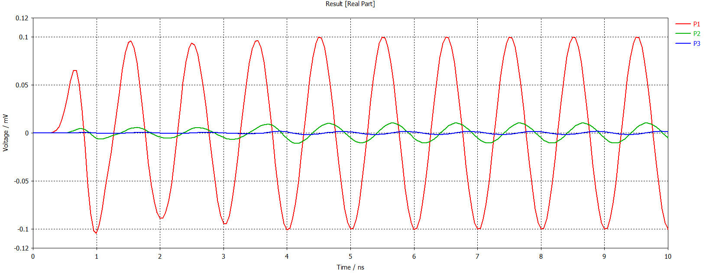
Model_2 simulation results
Results:
Amplitude of the closest strip is about 0.1mV,which is about 1/50 of the original signal.
Amplitude of other 2 strips are much smaller than the first strip.
Amplitude of the model_2 is smaller than the model_1.

Slide 12
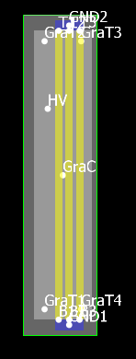
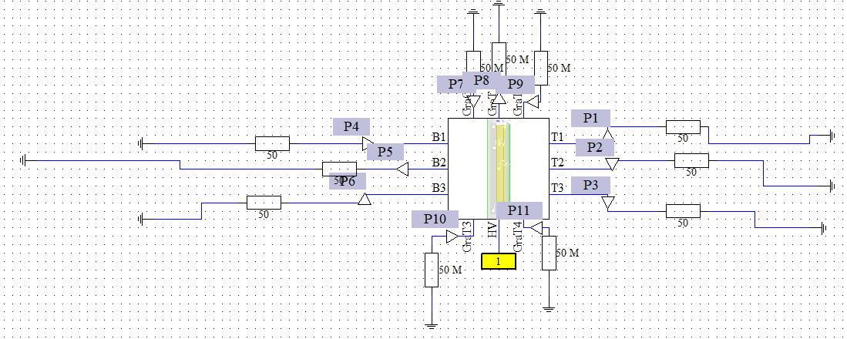
Model_3 simulation
Input signal: sine signal
Amplitude: 5mV
Period: 1GHz
No HV pad
Distance between HV pad and strip:6mm

Slide 13
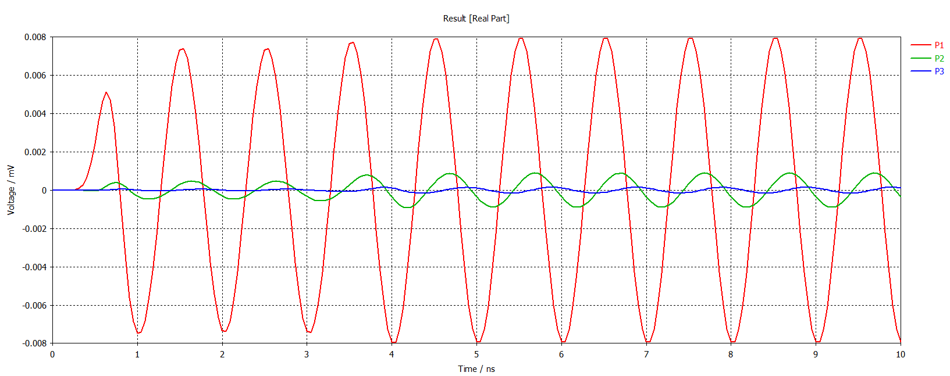
Model_3 simulation results
Results:
Amplitude of the closest strip is about 0.008mV,which is about 1/625 of the original signal.
Amplitude of other 2 strips are much smaller than the first strip.
Amplitude of the model_3 is the smallest among the 3 models.
HV connection pad has a significant effect on the first strip.

Slide 14

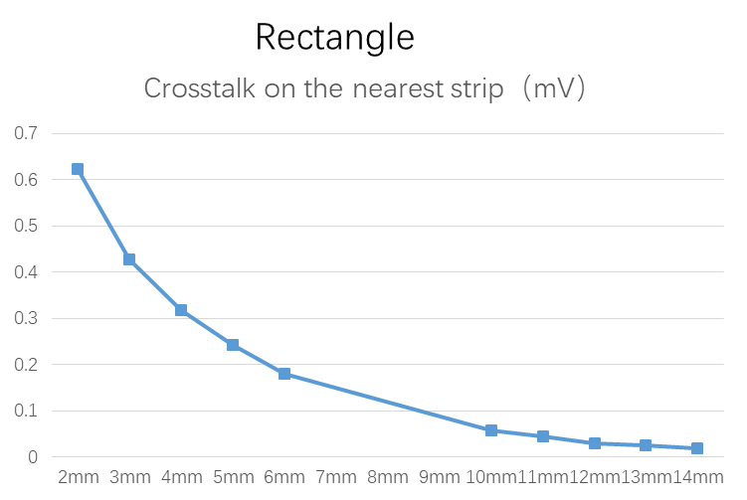
Model_1modification (position)
Change HV pad position
2mm
As the distance increases, crosstalk decreases significantly!

Slide 15
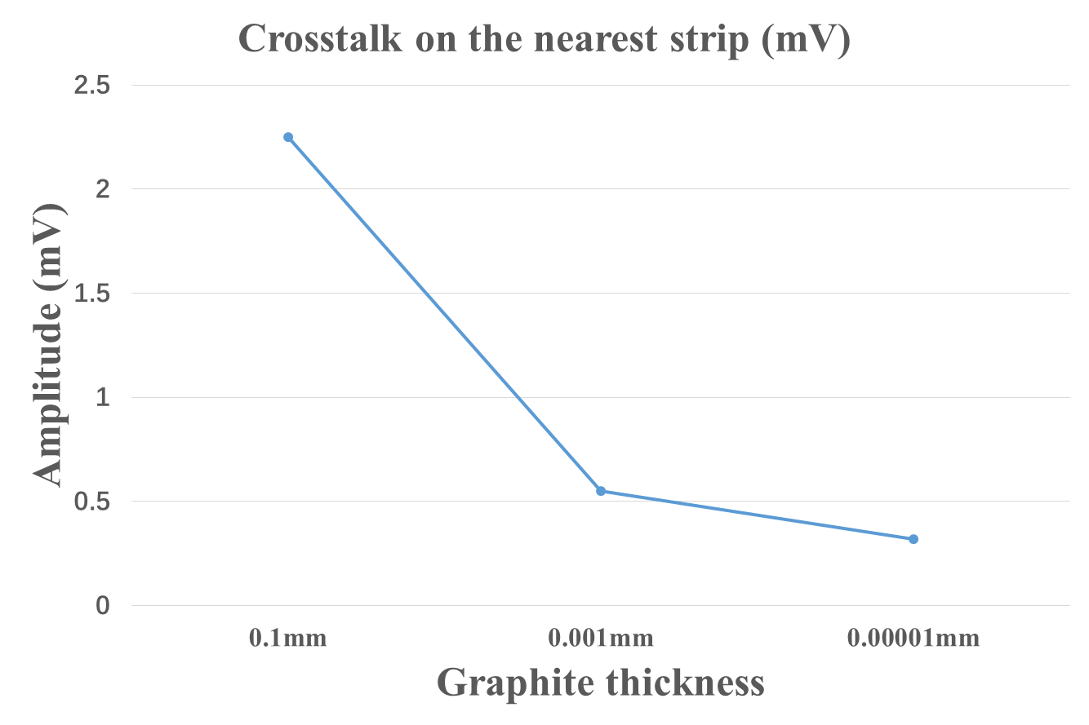
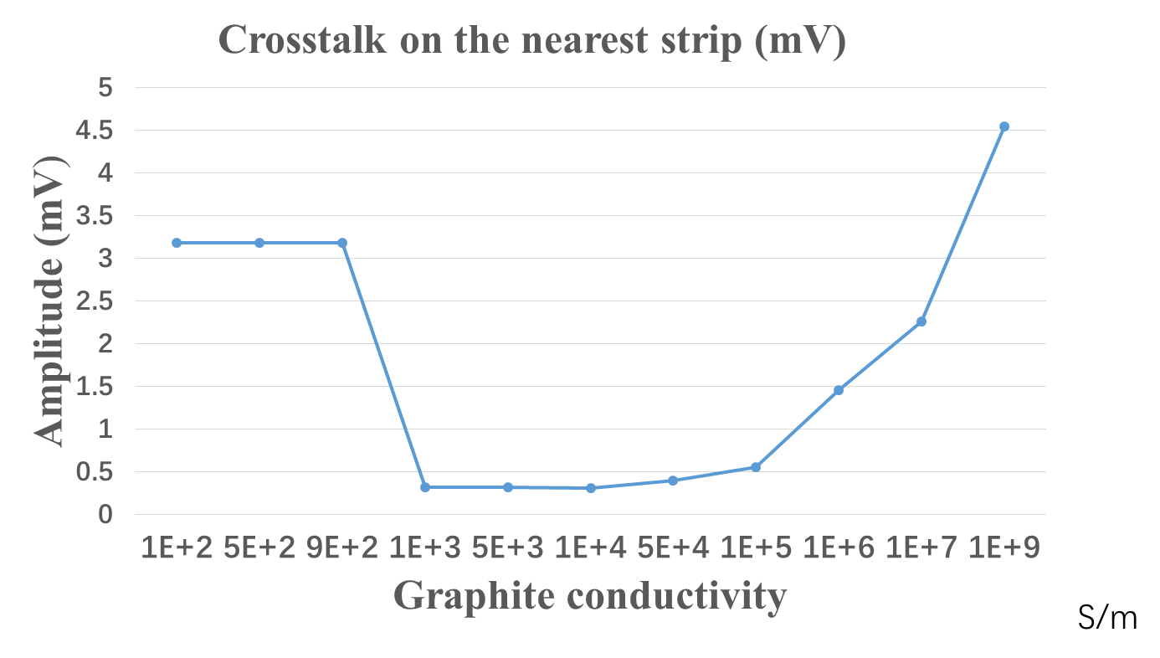
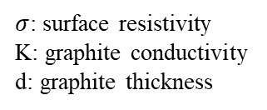

Model_1modification (surface resistivity)
Parameter setting limitation of the software
$$σ=\frac{1}{Kd}$$
$σ$: surface resistivity
K: graphite conductivity
d: graphite thickness
Crosstalk and surface resistance are significantly correlated

Slide 16
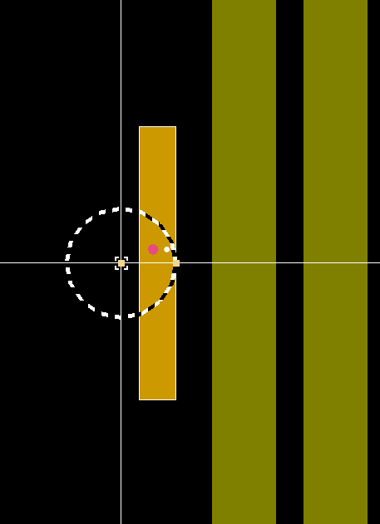
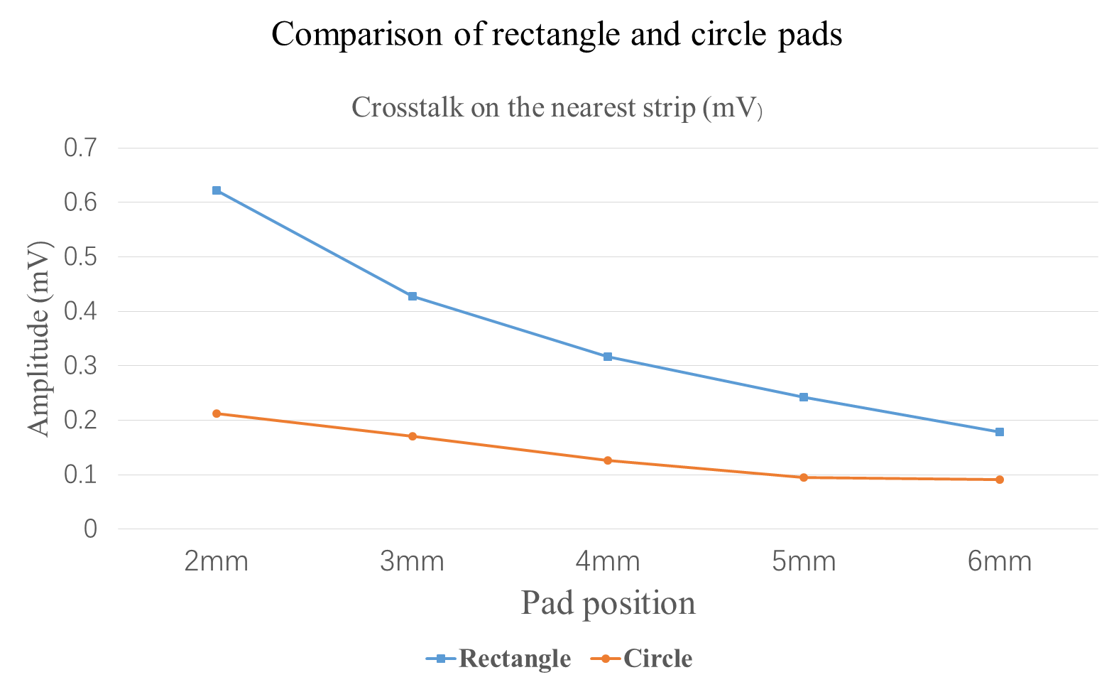

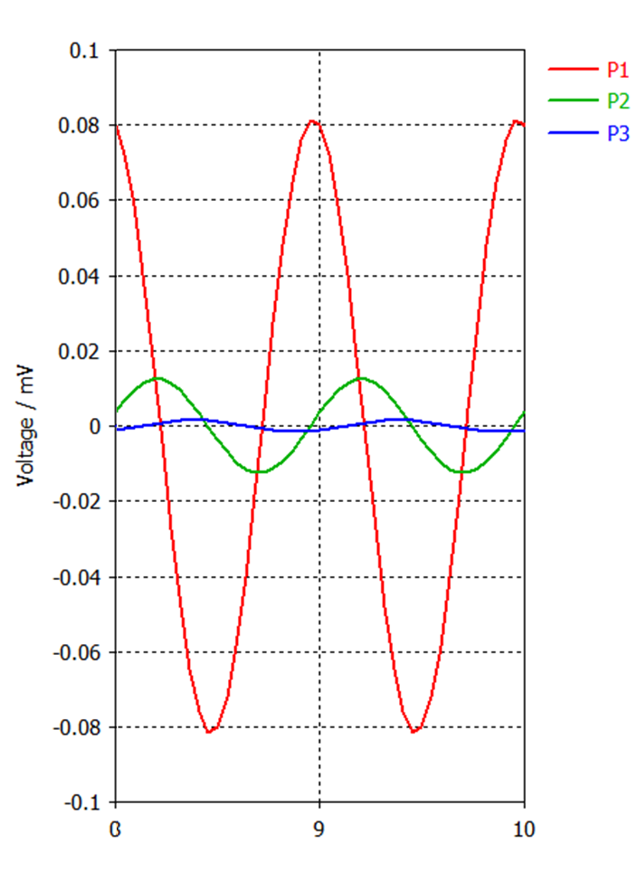
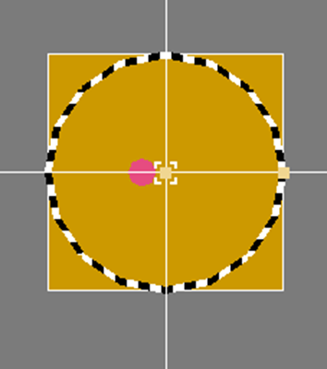
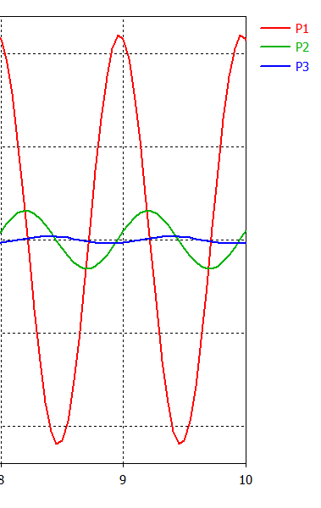
Model_1 modification (pad shape)
Under the same area, the circle looks better than the rectangle.
As the distance increases, crosstalk decreases in these two situation
When the length along the direction of the strip are same, the circle is a bit better than the rectangle.
In fact, The length along the strip is one of the main causes of crosstalk
rectangle pad
circle pad

Slide 17

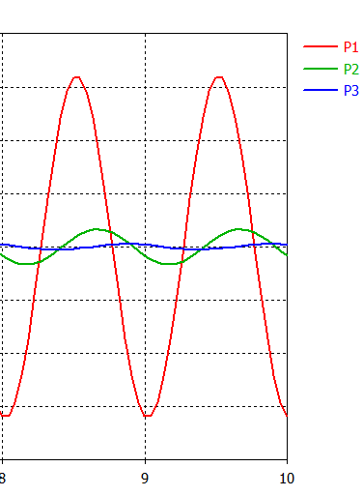

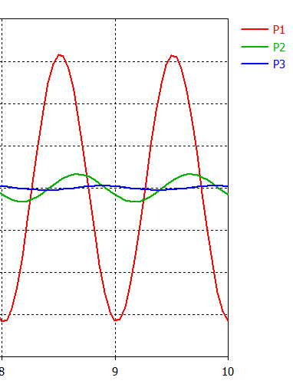

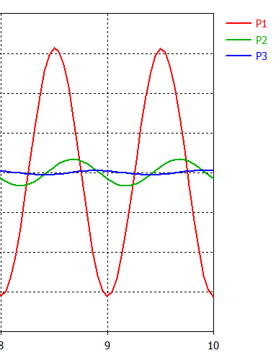





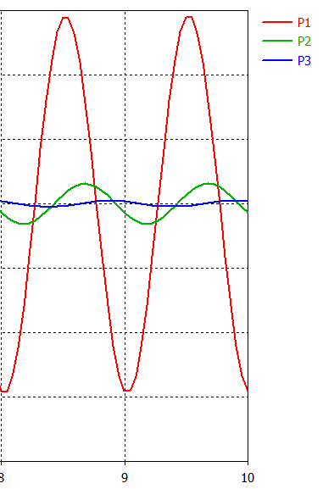


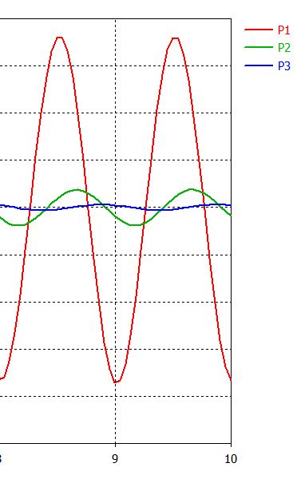
Model_1 modification(pad shape)
Area of the pad is not the cause of crosstalk!

Slide 18
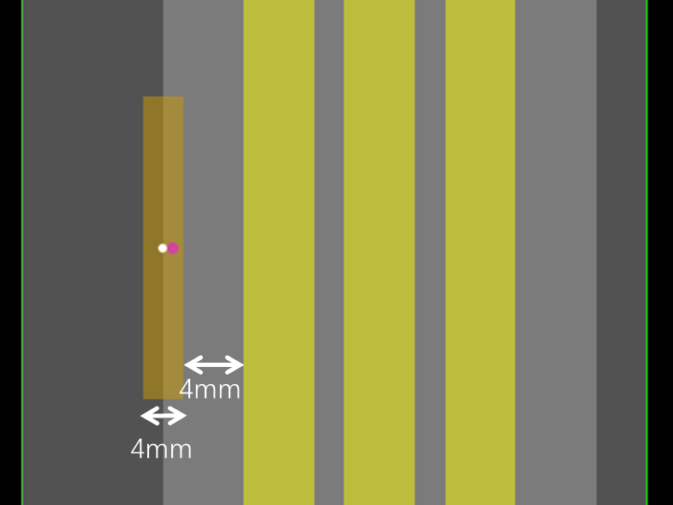



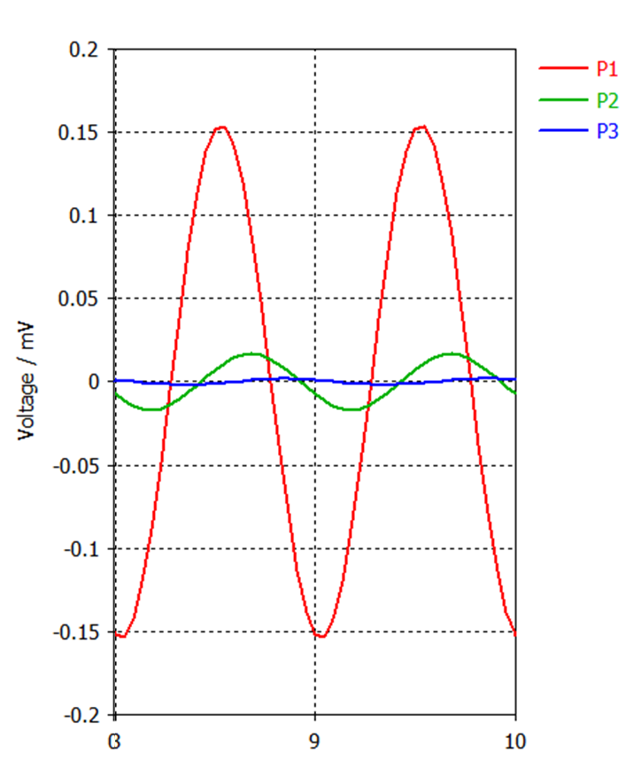

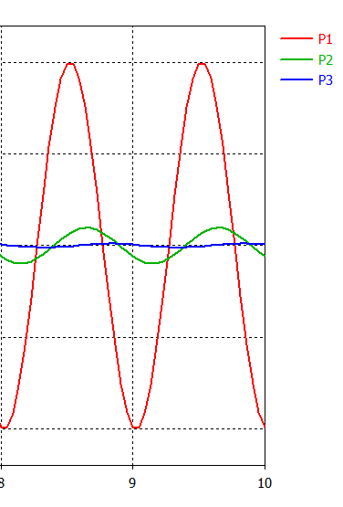
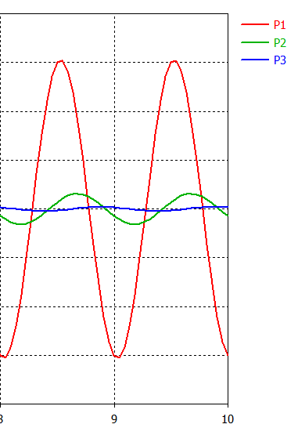
Prototype design -- plan 1
Plan1: Change the position of the rectangular pad(4mm,6mm,8mm)

Slide 19

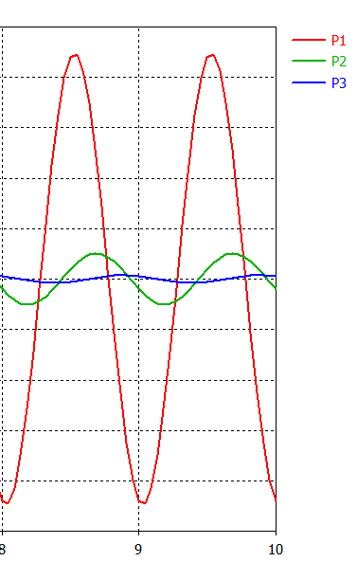
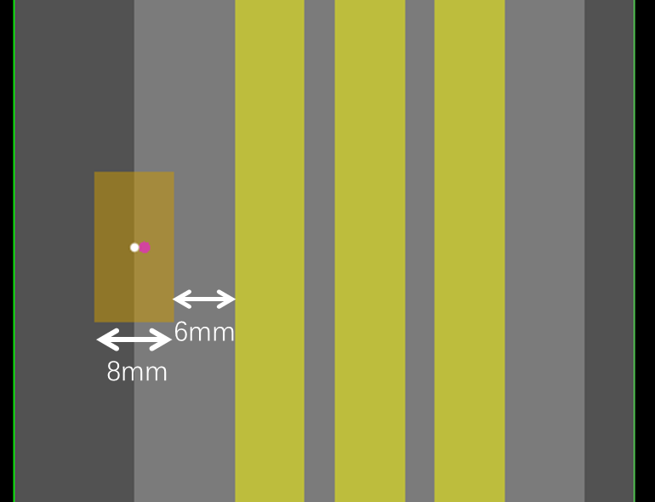
Prototype design -- plan 2
Plan2: Keep the area unchanged, the length of the rectangle is reduced by half

Slide 20
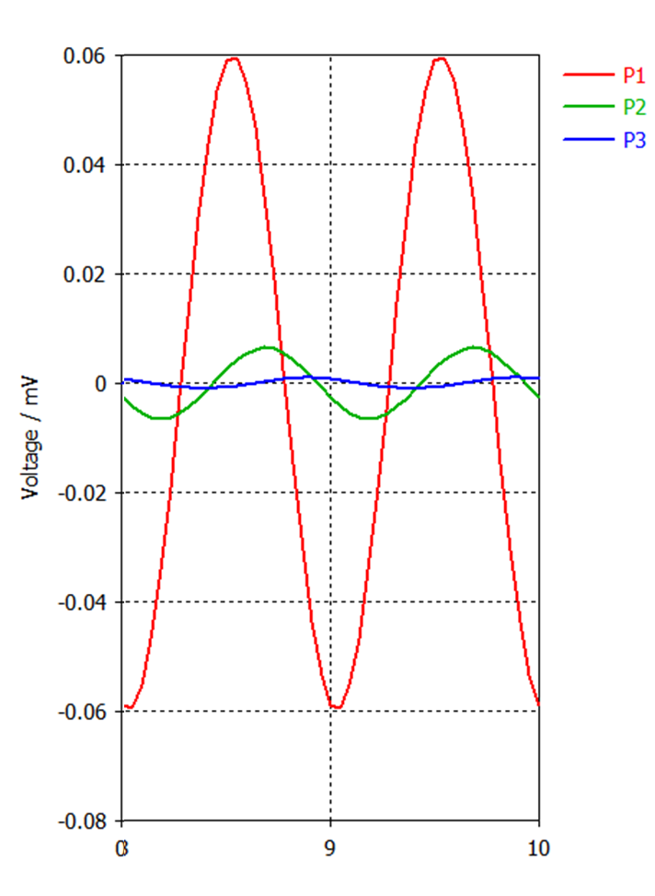
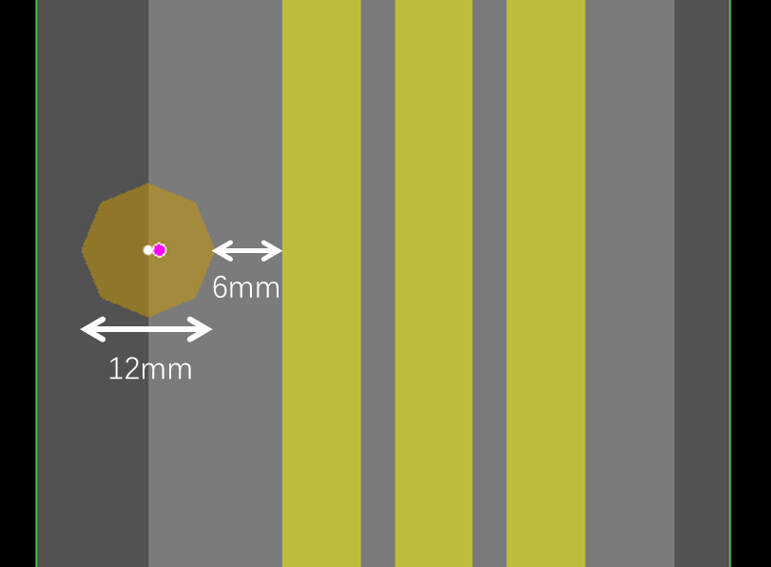
Prototype design -- plan 3
Plan3: use circle pad

Slide 21
Summary
The noise rate of the strip close to the HV pad was found higher than that of other strips.
We use CST software to study the causes of the phenomenon.
From the results of the simulation, we can get follow conclusion:
As the distance increases, crosstalk decreases significantly.
Crosstalk and surface resistance are significantly correlated.
The length along the strip is one of the main causes of crosstalk.
The circle is a bit better than the rectangle
Based on the simulation results, we have designed some prototypes and the PCB is being produced.
Next step, more simulations will continue and experimental tests will start to verify the simulation results.
Thank you !

