Slide 1
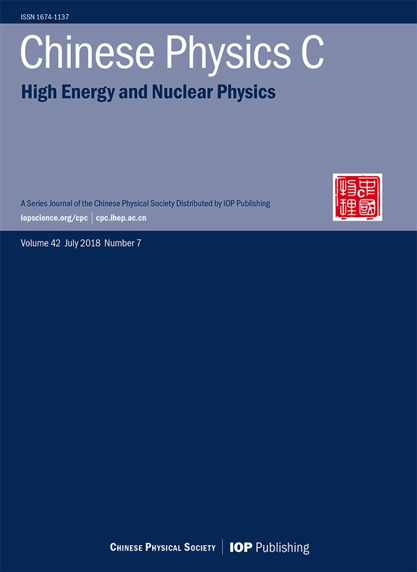
Chinese Physics C
Sponsored by:
Chinese Physical Society（中国物理学会）
Institute of High Energy Physics , CAS（中科院高能所）
Institute of Modern Physics , CAS（中科院近物所）
Hairong Dong （董海荣）
Chinese Physics C Editorial Office, IHEP
Huhhot China, 2019-7-31
IOP Publishing & Science Press

Slide 2
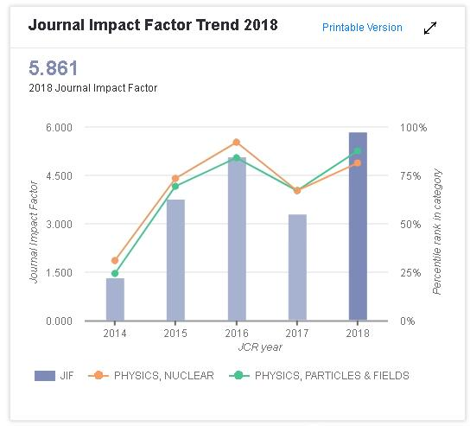
Scope & Indexed
Chinese Physics C
An international journal for high energy and nuclear physics
Cpc.ihep.ac.cn iopscience.org/cpc
Original research articles, letters and reviews in the fields of:
Particle physics
Nuclear physics
Particle and nuclear astrophysics
Cosmology
2018 Impact Factor 5.861
JCR Q1 for Particle Physics and Nuclear Physics
SCI-E, SCI-CC, Scopus, Inspec, Physics Abstracts, Chemical Abstracts, JICST(Japan) ,РЖ (Russia)

Slide 3
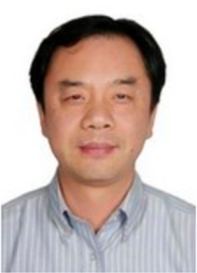
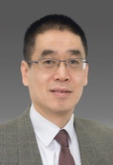
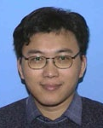
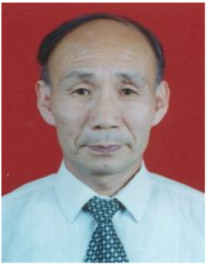
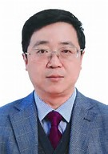
Editorial Board
Yifang Wang
(王贻芳)
| Director of IHEP
Editor-in-chief
Caidian Lv
(吕才典)
Associate Editor-in-chief
Haibo Li
(李海波)
Associate Editor-in-chief
Genming Jin
(靳根明)
Associate Editor-in-chief
Guoqing Xiao
(肖国青)
Associate Editor-in-chief
44 Review Editors, come from 30 institutions,
16 non-Chinese Editorial members account for 36%

Slide 4
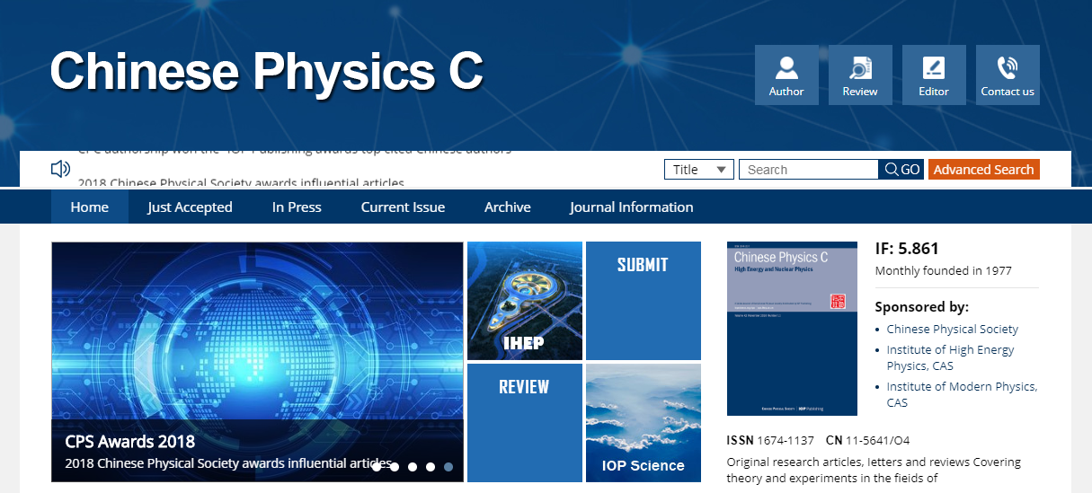
How to submit
FEATURED
| PROJECT’S
Conveniently iterate top-line alignments for wireless metrics.
cpc.ihep.ac.cn
INSURANCE
BUSINESS PLAN
Conveniently iterate top-line alignments for wireless metrics.
Register / log in at http://mc03.manuscriptcentral.com/cpc
Online submission only

Slide 5
The review process
Screening by Editorial Office (rejection rate 30%) 编辑部初审
(format, scope, plagiarism, basic quality)
Initial Review by Reviewing Editor (Editorial Board) 编委初审
Peer Review by Reviewers (Non-Chinese reviewers account for 37%) 专家外审
Decision by Reviewing Editor (Editorial Board) (rejection rate 45%) 编委决定
Final Decision by Associate Editor-in-chief 主编终审

Slide 6
Review & Production Speed
Review time
Average time from submission to 1st decision
Submission-online：94 days
2018: 24 days (min 1,max 76)
Fast-track publication
Average time from submission to acceptance
The journal tries to promptly publish :
the progress and achievements of large science facilities
Other influential and important articles
2018: 60 days (min 1,max 187)
Production time
Average time from accepted to online
7days
Minimum
2018: 33 days

Slide 7
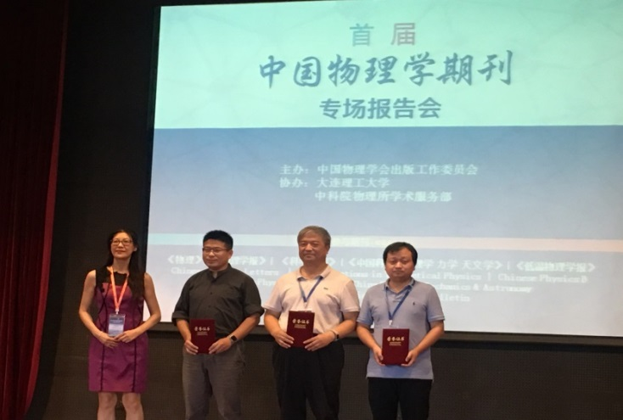
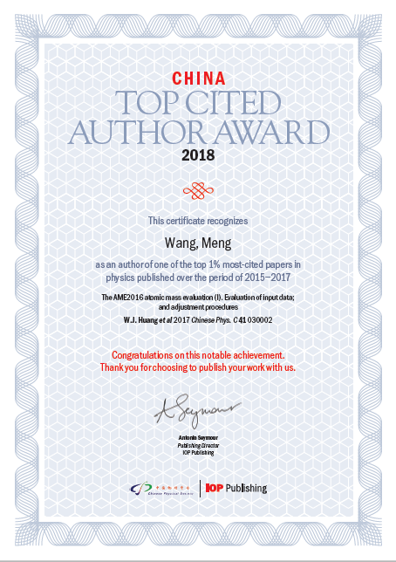
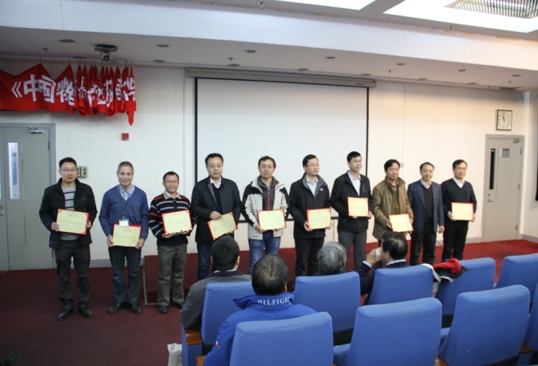
Awards
2018 Award for Influential Articles
2018 CPC Top Reviewers Awards
China Top Cited Author Award 2018
Improved measurement of the reactor antineutrino flux and spectrum at Daya Bay
Feng-Peng An（安丰鹏）等（Daya Bay Collaboration）
Chinese Physics C, 2017, 41(1) 013002
A general analysis of Wtb anomalous couplings
Qing-Hong Cao (曹庆宏)，Bin Yan (岩斌)，Jiang-Hao Yu (于江浩)，Chen Zhang (张宸)
Chinese Physics C, 2017, 41(6) 063101
S-wave resonance contributions to B0 (s)→ηc(2S)π+π- in the perturbative QCD factorization approach
Ai-Jun Ma (马爱军)，Ya Li (李亚)，Wen-Fei Wang (王文飞)，Zhen-Jun Xiao (肖振军)
Chinese Physics C, 2017,41(8) 083105
Meng-Wang（王猛） (cited: 35+143)
The AME2016 atomic mass evaluation (I). Evaluation of input data; and adjustment procedures
The AME2016 atomic mass evaluation (II). Tables, graphs and references
Wei-Min Song（宋维民）(cited: 39)
Precision measurement of the integrated luminosity of the data taken by BESIII at center-of-mass energies between 3.810 GeV and 4.600 GeV
Gui-Jun Ding （丁桂军）(cited: 21)
Predicting lepton flavor mixing from Delta(48) and generalized CP symmetries

Slide 8
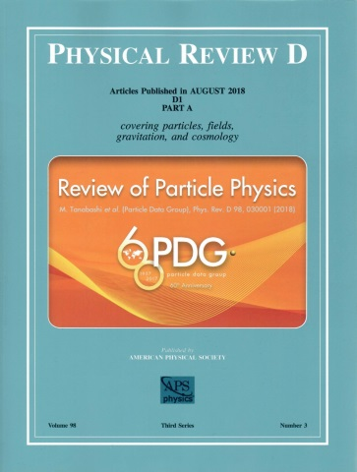
Author benefits
Subscriptions at over 3000 institutions worldwide
Free English editing on all accepted articles
Full-Text HTML and timely publication (online immediately)
A COPE (Committee on Publication Ethics) member
A SCOAP³ participating journal - free Open Access publication for qualifying articles
THANKS

