Slide 1

Welcome to Shanghai
April 24-27, 2019
https://indico.ihep.ac.cn/event/9587

Slide 2

Welcome to Shanghai – 欢迎！
SJTU-Guest Wifi
  Username: FCPPL201901 Password: fcppl201901
  Username: FCPPL201902
  Password: fcppl201902
Eduroam
141 Participants
- 48 French colleagues
- 93 Chinese colleagues

Slide 3
Scientific Program

Slide 4
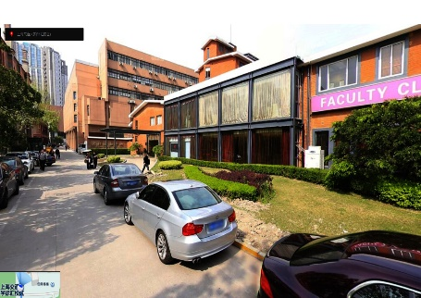
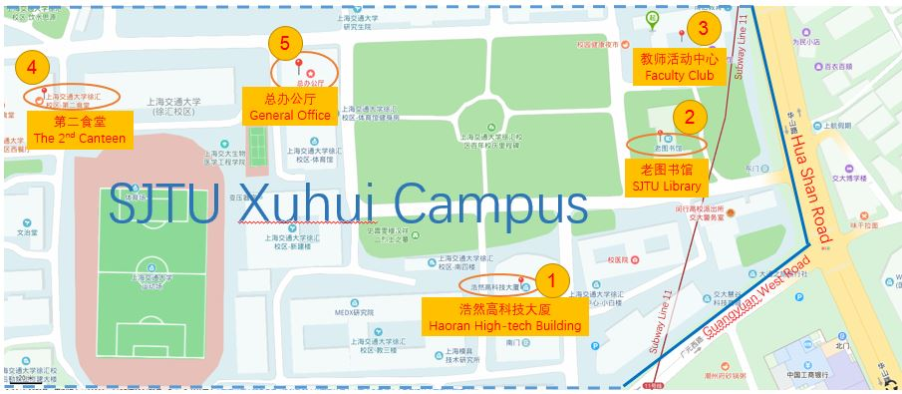
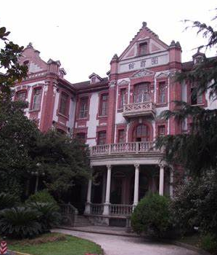
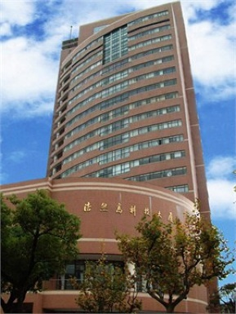
Campus Map
Haoran High-tech Building Room 102 (浩然高科技大厦102会议室）
SJTU Library Room 108 (交大图书馆108会议室）
Faculty Club (教师活动中心） 4. The 2nd Canteen （第二食堂）

Slide 5
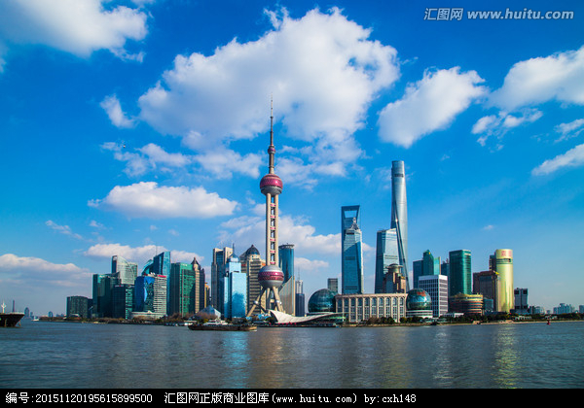
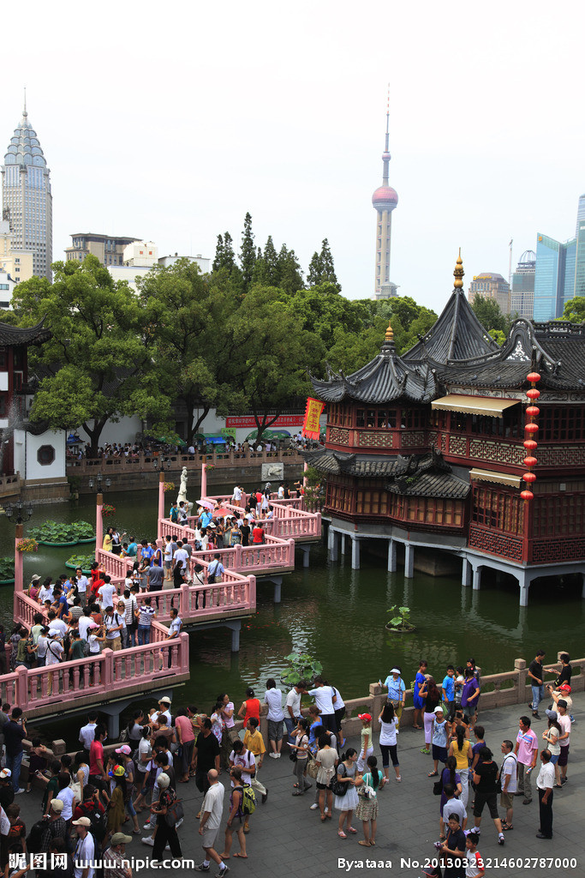
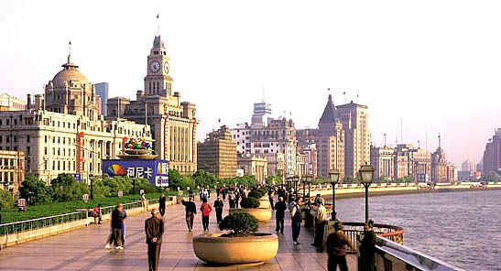
Excursion on April 26 (1:30 – 6:00PM)
➔ Route 1: Campus → The Bund → Yu Garden → Banquet

Slide 6
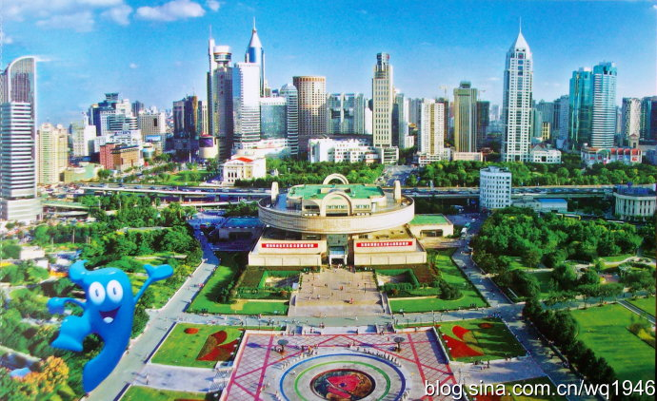

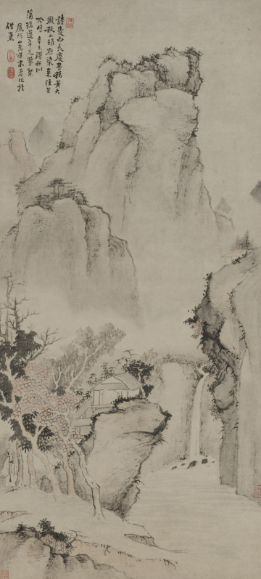
Excursion on April 26 (1:30 – 6:00PM)
➔ Route 2: Campus → Museum → The Bund → Banquet

Slide 7
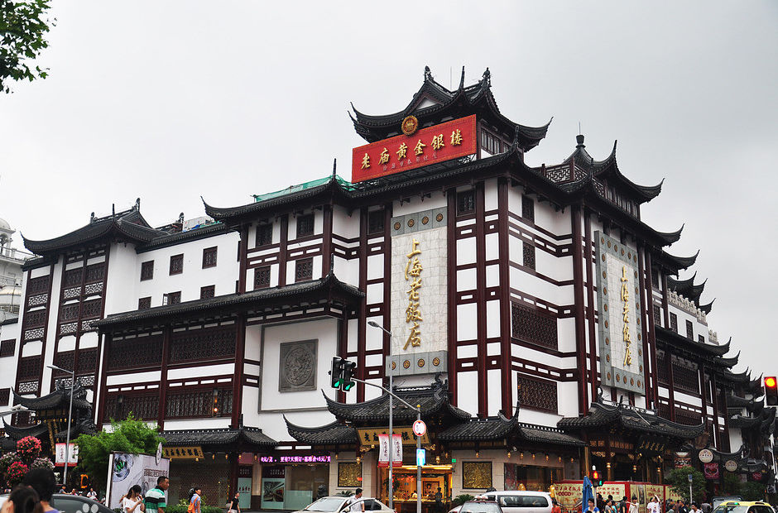
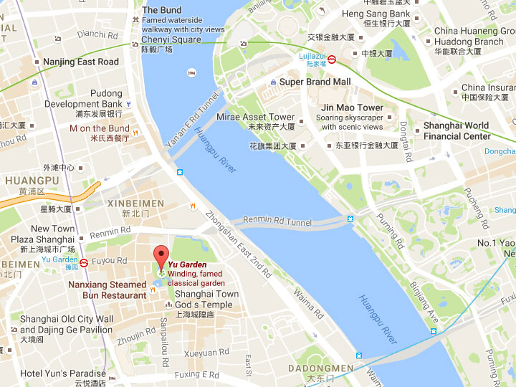
Banquet (6:30 – 9:00PM)
Shanghai Classical Restaurant
Address: No. 242 Fuyou Road, Shanghai, next to Yu Garden
上海老饭店，豫园傍边，福佑路242号

Slide 8
Welcome to Shanghai
April 24-27, 2019
https://indico.ihep.ac.cn/event/9587

Slide 9
Scientific Committee
Nicole Bastid (LPCC)
Vincent Boudry (LLR)
Anatael Cabrera (LAL)
Angeles Faus-Golfe (LAL)
Olivier Leroy (CPPM)
Emmanuel Monnier (CPPM)
Daniel Santos (LPSC)
Charling Tao (CPPM)
Zhen Cao (IHEP)
Guoming Chen (IHEP)
Jie Gao (IHEP)
Fazhi Qi (IHEP)
Manqi Ruan (IHEP)
Changgen Yang (IHEP)
Zhenwei Yang (THU)
Daicui Zhou (CCNU)

Slide 10
Organization Committee
Gang Chen (IHEP)
Esthere Ganier (CPPM)
Jun Guo (SJTU)
Wenyuan Jin （IHEP)
Eric Kajfasz (CPPM)
Shu Li (TDLI/SJTU)
Meng Wang (SDU)
Haijun Yang (SJTU/TDLI)
Secretary
Gang He (SJTU)
Fangying Qiu (SJTU)
Zi Yang (TDLI/SJTU)
Contact:
fcppl2019@ihep.ac.cn

Slide 11
Campus Map

