Slide 1
Low background screening methods and cleaning scheme for JUNO calibration system
Frédéric Perrot, Lin Si and Yue Meng
FCPPL, Shanghai, April 24th-27th, 2019

Slide 2
Content
JUNO experiment and calibration system
Challenges for low background assay
Bordeaux and SJTU groups
Low background techniques for JUNO calibration system
High purity Germanium detectors
Radon emanation measurement
Laser ablation ICPMS and alpha detector

Slide 3
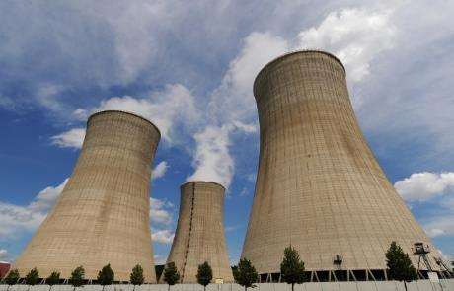
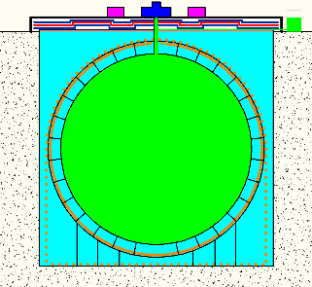
JUNO experiment
Main goal : determination of mass hierarchy at 3σ sensitivity in 6 years
10⁵ events required → 20,000 tons of liquid scintillator
number of photoelectrons ~1200 pe/MeV → large photon coverage (78%) and high liquid scintillator transparency (>20 m)
Neutrino detection method
Source
Neutrino flux
JUNO
Detector
Baseline : 53 km
Reactor at 3 GWth ~ 10²⁰ ν/s
(26.6 GWth available in 2020)
Only 60 neutrinos/day
(or 0.0007 neutrino/s !!)
How to identify neutrinos from background events in JUNO ?

Slide 4
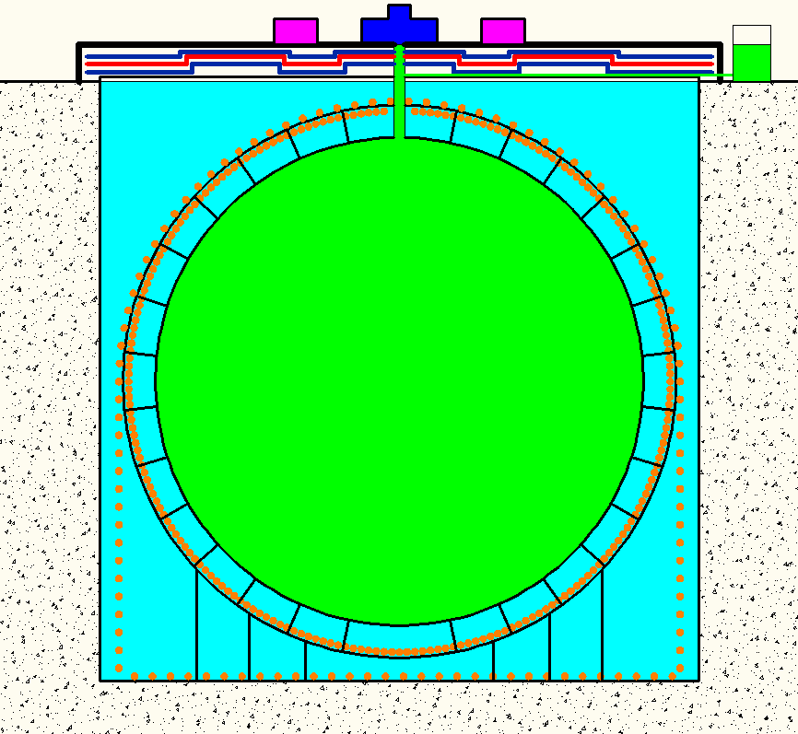
Backgrounds
Origin : natural radioactivity of the JUNO materials in ²³⁸U/²³²Th/⁴⁰K
Scenario : 2 events in coincidence that mimic the prompt and delayed signal
Criteria for IBD identification:
Prompt signal : 0.7 MeV < E_{p} < 12 MeV
Delayed signal : 1.9 MeV < E_{D} < 2.5 MeV
Time coincidence ΔT < 1 ms
Distance between two vertex < 1.5 m
γ
γ
γ
Number of events/day for E>0.7 MeV
Rate of radioactivity events in the full active volume (20 ktons!) must be <100 Hz to have <1 event/day of accidental background !

Slide 5
JUNO calibration strategy
The JUNO challenge is to keep energy scale uncertainty below 1%
5 complementary calibration systems under development
using e⁻, e⁺, γ and n sources
Cable Loop System (CLS)
2D plane inside the vessel
Automatic calibration unit (ACU)
1D along detector z-axis
Guide Tube (GT)
2D around outer surface vessel
+ Laser fiber system
1D like, fixed position on PMT
Remotely Operated Vehicle (ROV)
3D anywhere in the vessel

Slide 6
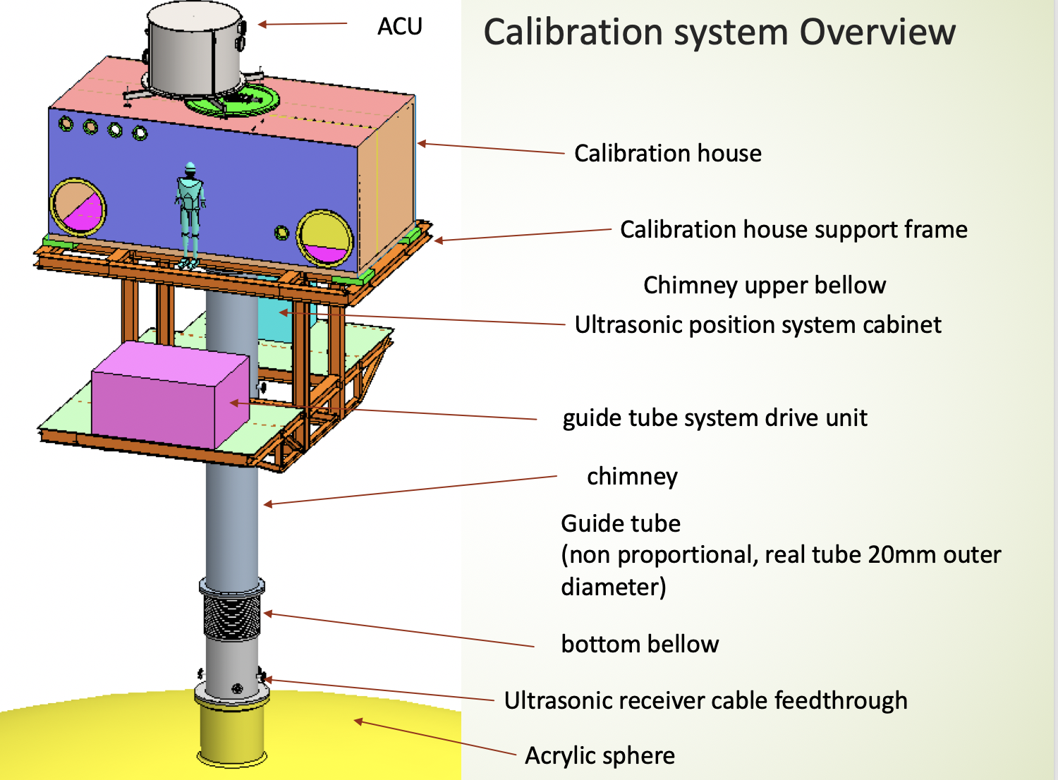
Calibration system
A dedicated calibration of the detector energy nonlinearity response is another critical factor to obtain reliable sensitivity of the mass hierarchy determination.
Risks:
1 .Direct contact the LS
2. Radon emanation may diffuse into LS
3. Radon daughters plate-out
4. Dust contamination

Slide 7
Challenging for low background assay
Neutrino event rate for JUNO experiment: 0.0007 neutrinos/s
Background single rate: 100 events/s (>0.7MeV without FV cut)
How to select radiopurity materials (bulk)
Need ppt/sub-ppt level measured techniques (HPGe, ICPMS, NAA for the bulk radioactivity)
How to ensure the cleanliness of the parts/materials (surface)
Better surface cleaning protocol and protection
How to measure (radon emanation and laser ablation ICPMS)

Slide 8
Bordeaux and SJTU collaboration on low background tasks
 | Bordeaux | SJTU
FCPPL project coordinator | Frederic Perrot | Yue Meng
People involved | 4 | 4
Experiments worked on | JUNO NEMO3/SuperNEMO Double Chooz | JUNO PandaX-4T Daya Bay
Facilities | Bordeaux campus and Modane Underground Laboratory | SJTU campus and Jinping Underground laboratory
Jan. 2019 -- kick-off meeting
Apr. 2019 -- 1st meeting for project
May 2019 -- LRT conference discussion
Regular meeting and discussion, and concrete experience about the low background techniques, cross-calibration for surfacic radioactive contamination

Slide 9
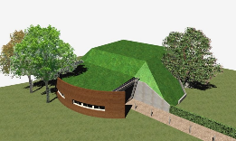
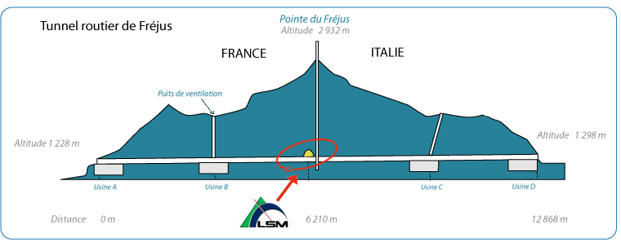
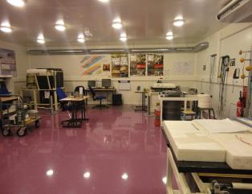
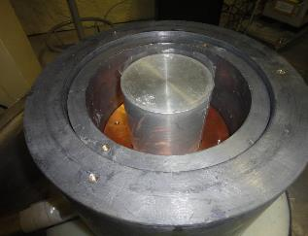
Facilities for low-background γ spectrometry @ Bordeaux
PRISNA platform (Bordeaux)
Building with 6 m.w.e
Coaxial and well-type HPGe detectors
LSM platform (Modane)
Underground lab. with 4800 m.w.e
Coaxial and planar HPGe detectors
LSM HPGe detector
PRISNA HPGe main room
→ sensitivity for ²³⁸U/²²⁶Ra
~ 50 mBq/kg
→ sensitivity for ²³⁸U/²²⁶Ra
~ 0.5 mBq/kg

Slide 10
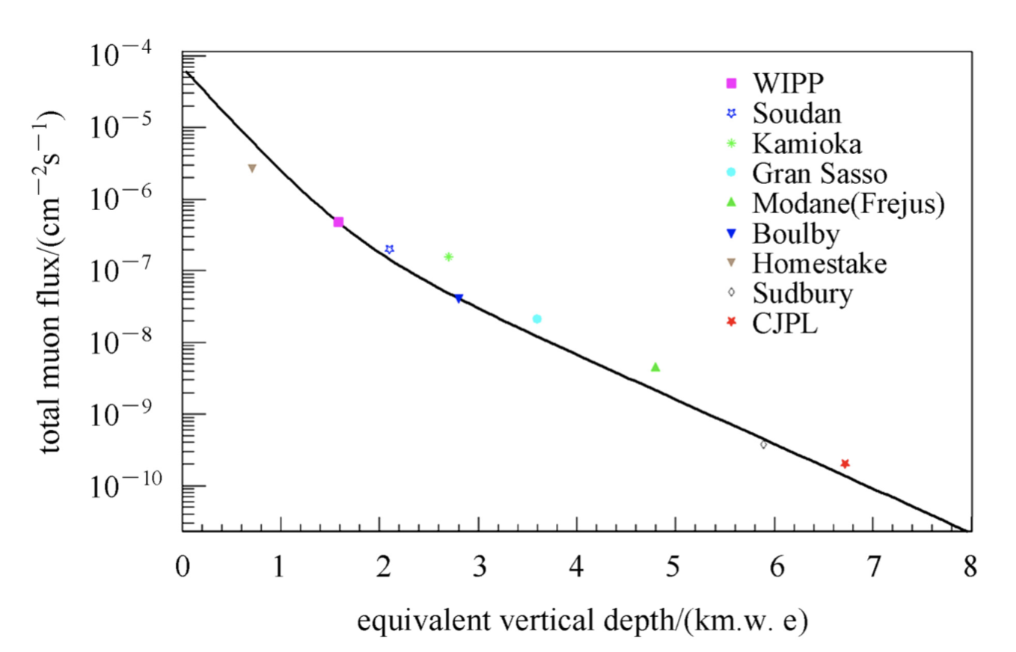
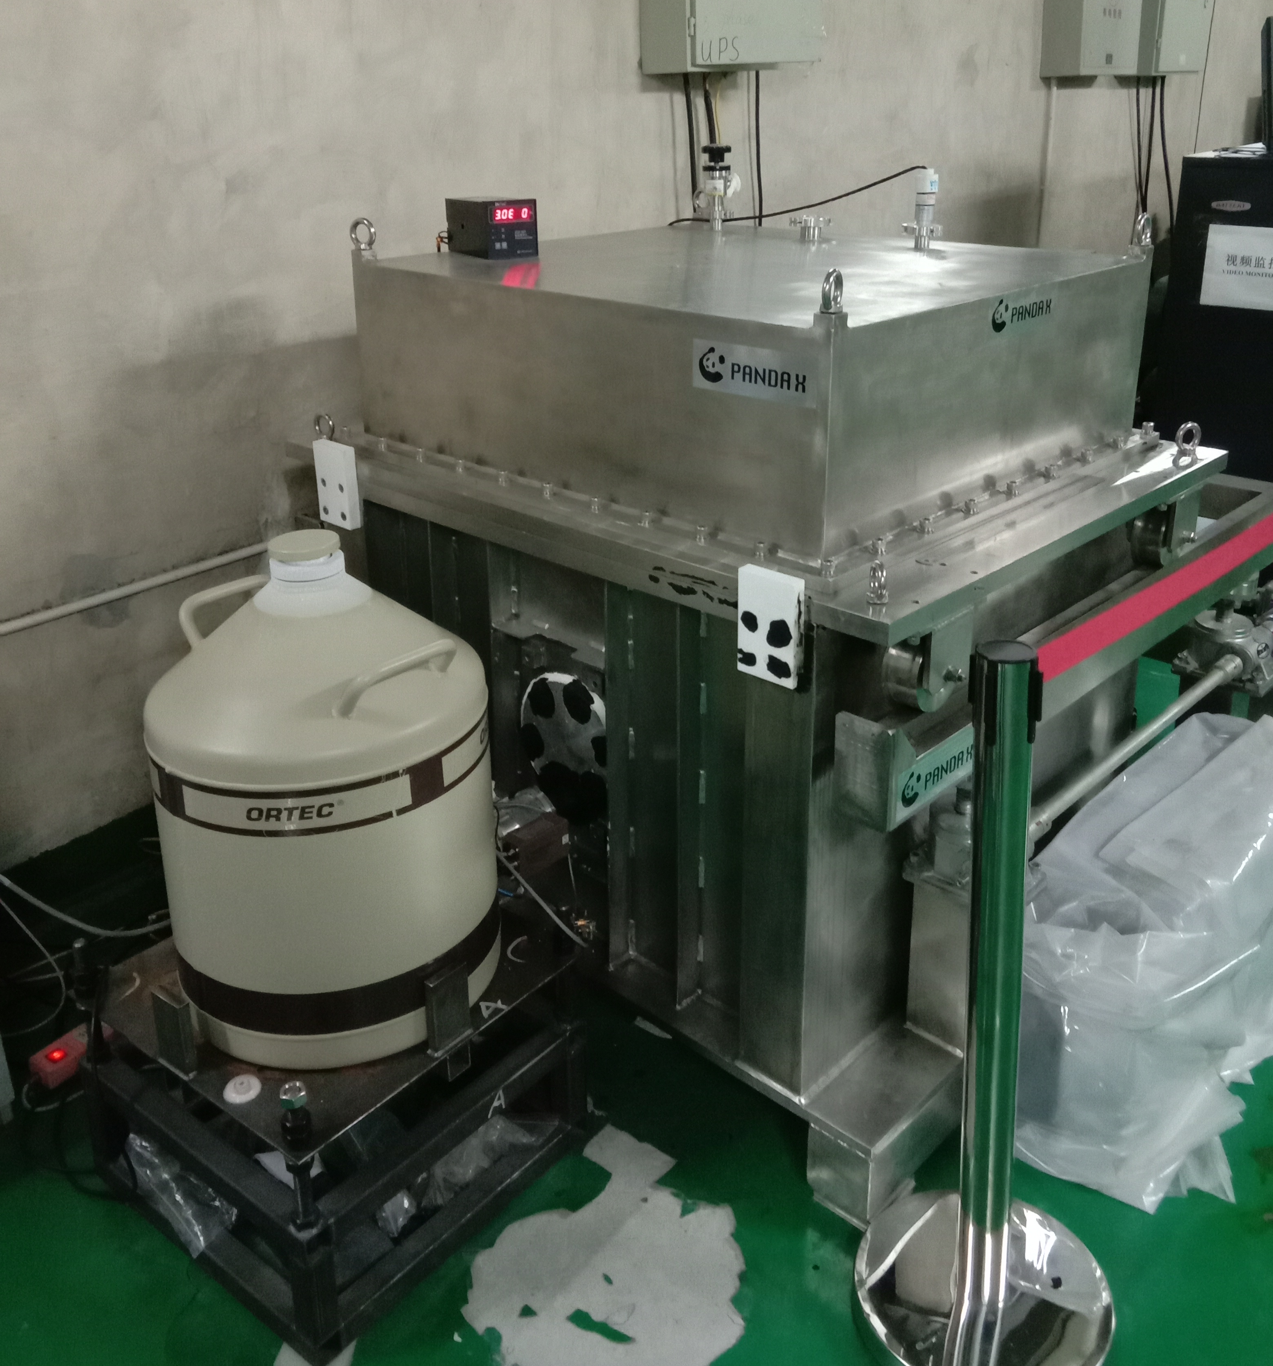
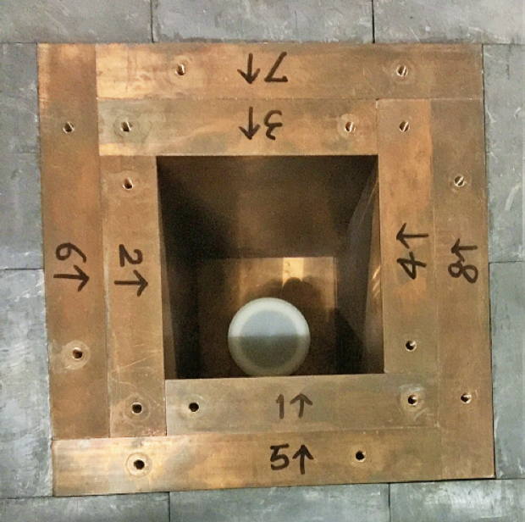
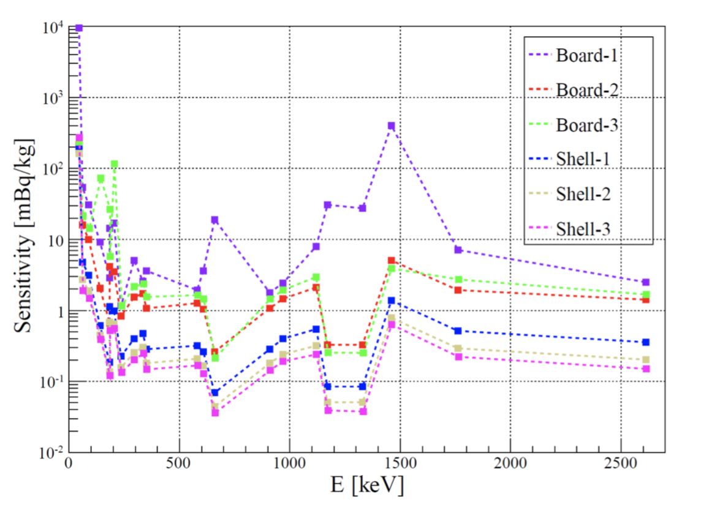
SJTU HPGe detectors
Purpose: detect gamma rays(K-40, Co-60, Cs-137, U-235, U-238 and Th-232) by high purity Ge detectors
HPGe detectors are located in the deep underground laboratory (Jinping).
 | Type | Energy scale [keV] | Weight of Crystal [kg] | Relative efficiency | Chamber size
detector1 | ORTEC P-type | 10 - 3000 | 3.69 | 175% | 20cm x 20cm x 20cm
detector2 | Canberra P-type | 3-3000 | 0.63 | 34% | 20cm x 20cm x 20cm

Slide 11
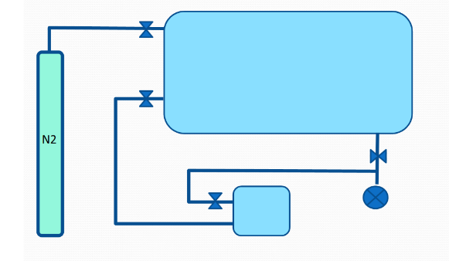
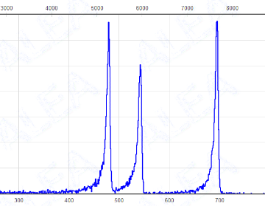
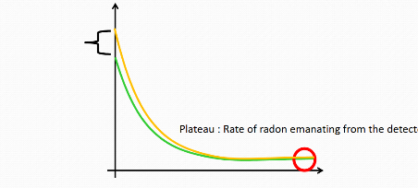
Principle of the radon emanation measurement
Large emanation chamber
Alpha spectrum
Rn
Rn
Rn
²¹⁰Po
(5.3 MeV)
²¹⁴Po
(7.7 MeV)
Rn
²¹⁸Po
(6.0 MeV)
Sample
Rn
Pump
Rn
Rn
Rn
Rn detector
Energy
Sample
Rn decay in the detector
Background
(~21 cts/d)
T_{1/2}(Rn)~3.8d
Determination of the Radon emanation rate from the sample
Det. Background (~3 cts/d)

Slide 12
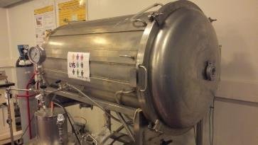
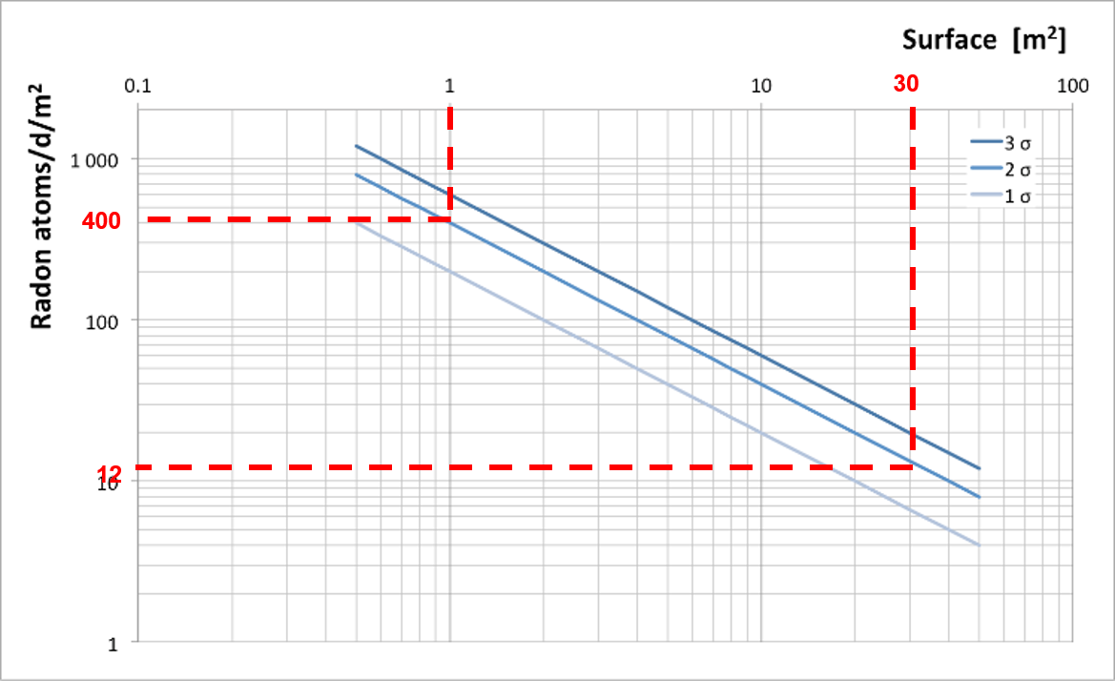
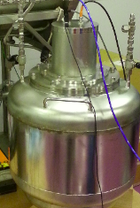
Facility for Rn emanation measurements
A 710L large chamber in stainless steel for large samples to be qualified
An electrostatic detector using a 70L stainless steel vessel and a PIN Si diode to perform alpha-spectrometry
Large emanation chamber
Radon detector
for 30 m² surface sample → emanation rate < 12 Rn atoms/day/m² (95% C.L.)
→ High sensitivity for large surface samples for JUNO calibration house

Slide 13
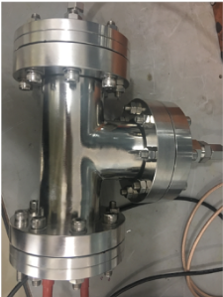
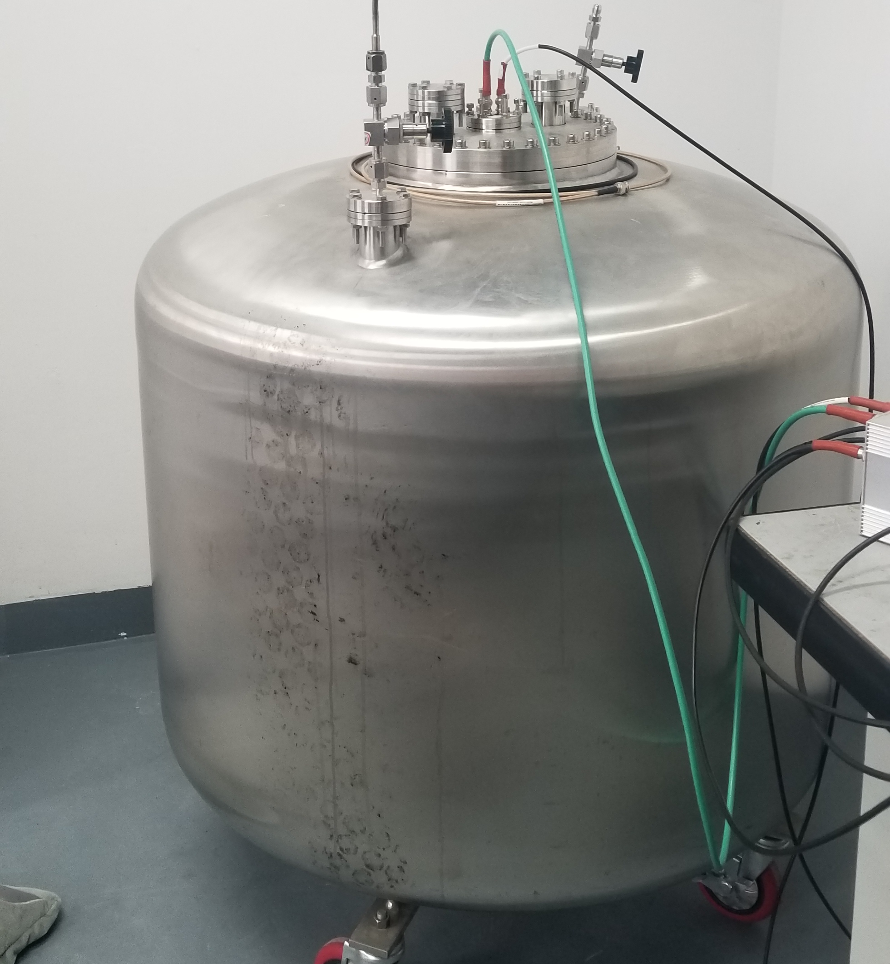
SJTU radon systems
For small samples (0.7L and 7L chambers)
place the sample in the Tee chamber(sample volume is less than 0.2 L, and the length is less than 5 cm)
bkg | 0.07mBq
eff | 12.7%
Up limit(3$σ$) | 1.65mBq
place the sample in the 7.4L chamber(sample volume is less than 0.7 L, and the length is less than 20 cm)
bkg | 3.03mBq
eff | 15.4%
Up limit(3$σ$) | 59.02mBq
For big samples (400L chambers)
bkg | 22.4mBq
eff | measuring

Slide 14
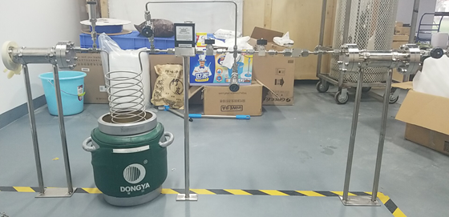
Measurement step(chamber sample)
Tot_bkg | 0.5mBq
Tot_eff | 5%
Up limit(3$σ$) | 30mBq

Slide 15
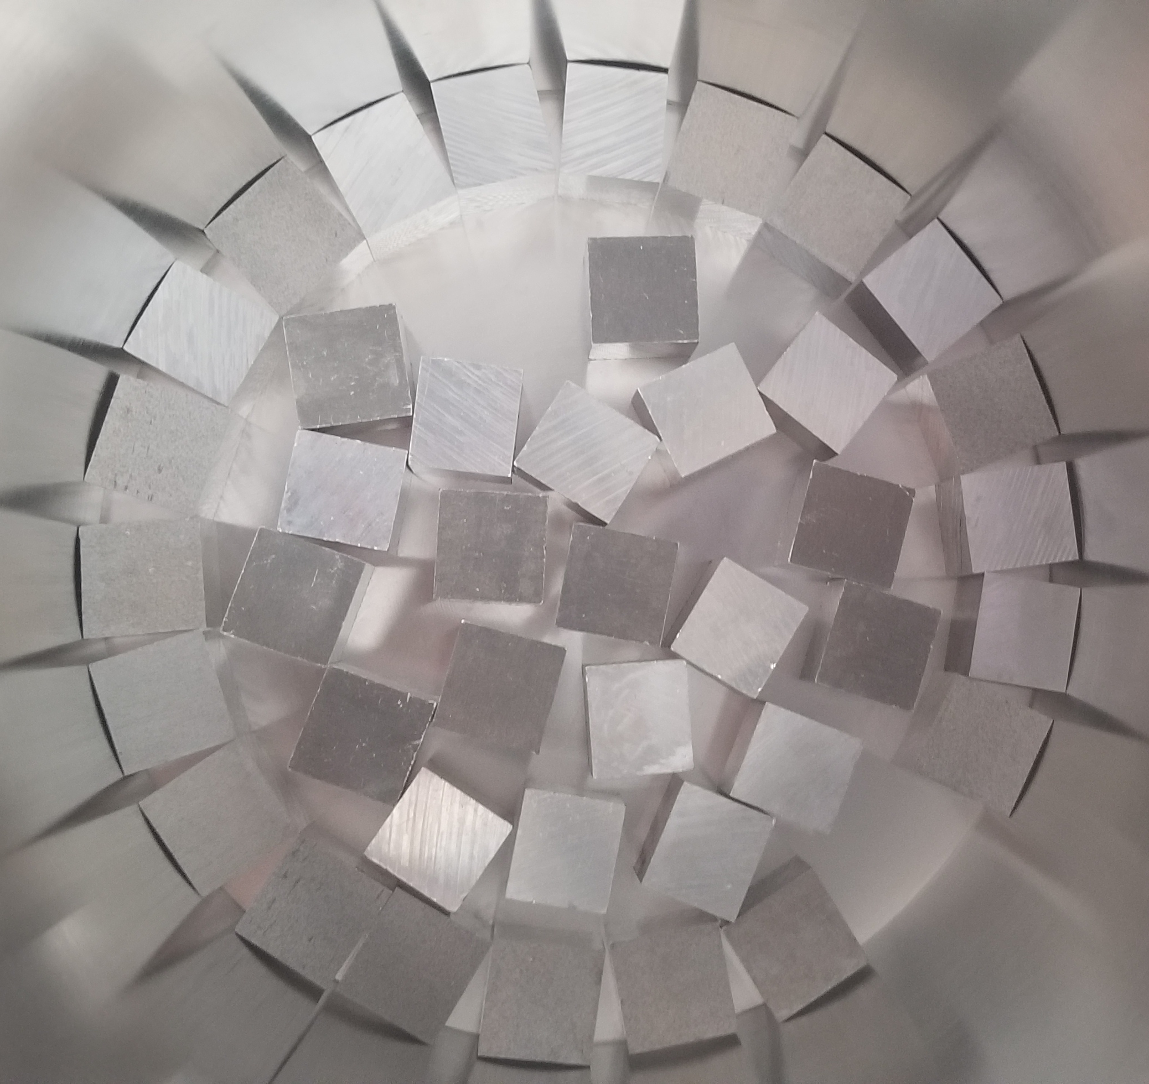
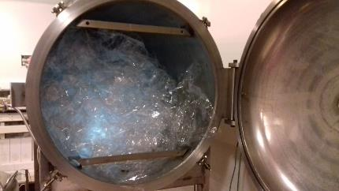
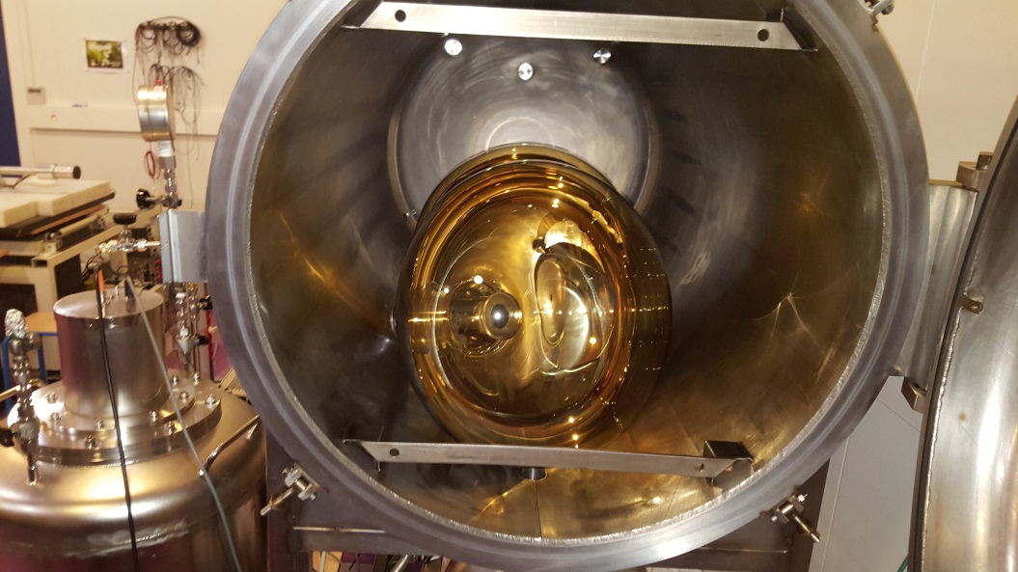
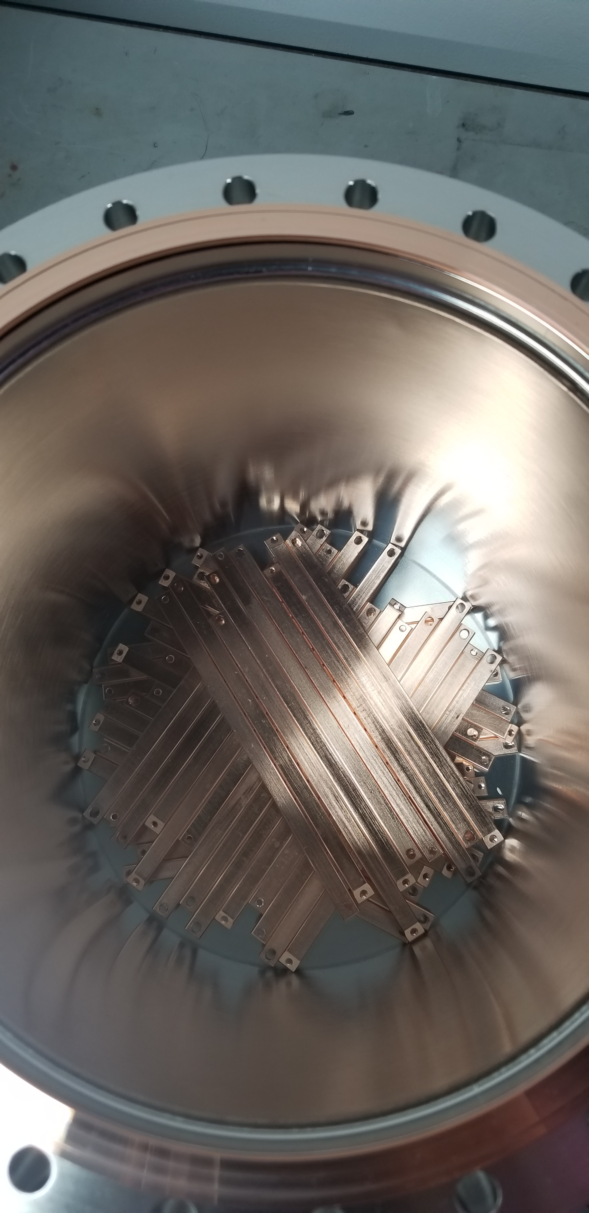
Illustration of Rn facilities for experiments
Al₂O₃ for LS purification for JUNO
Large surface nylon film for SuperNEMO
2 x NNVT 20’’ PMTs for JUNO
Copper for PandaX-4T

Slide 16
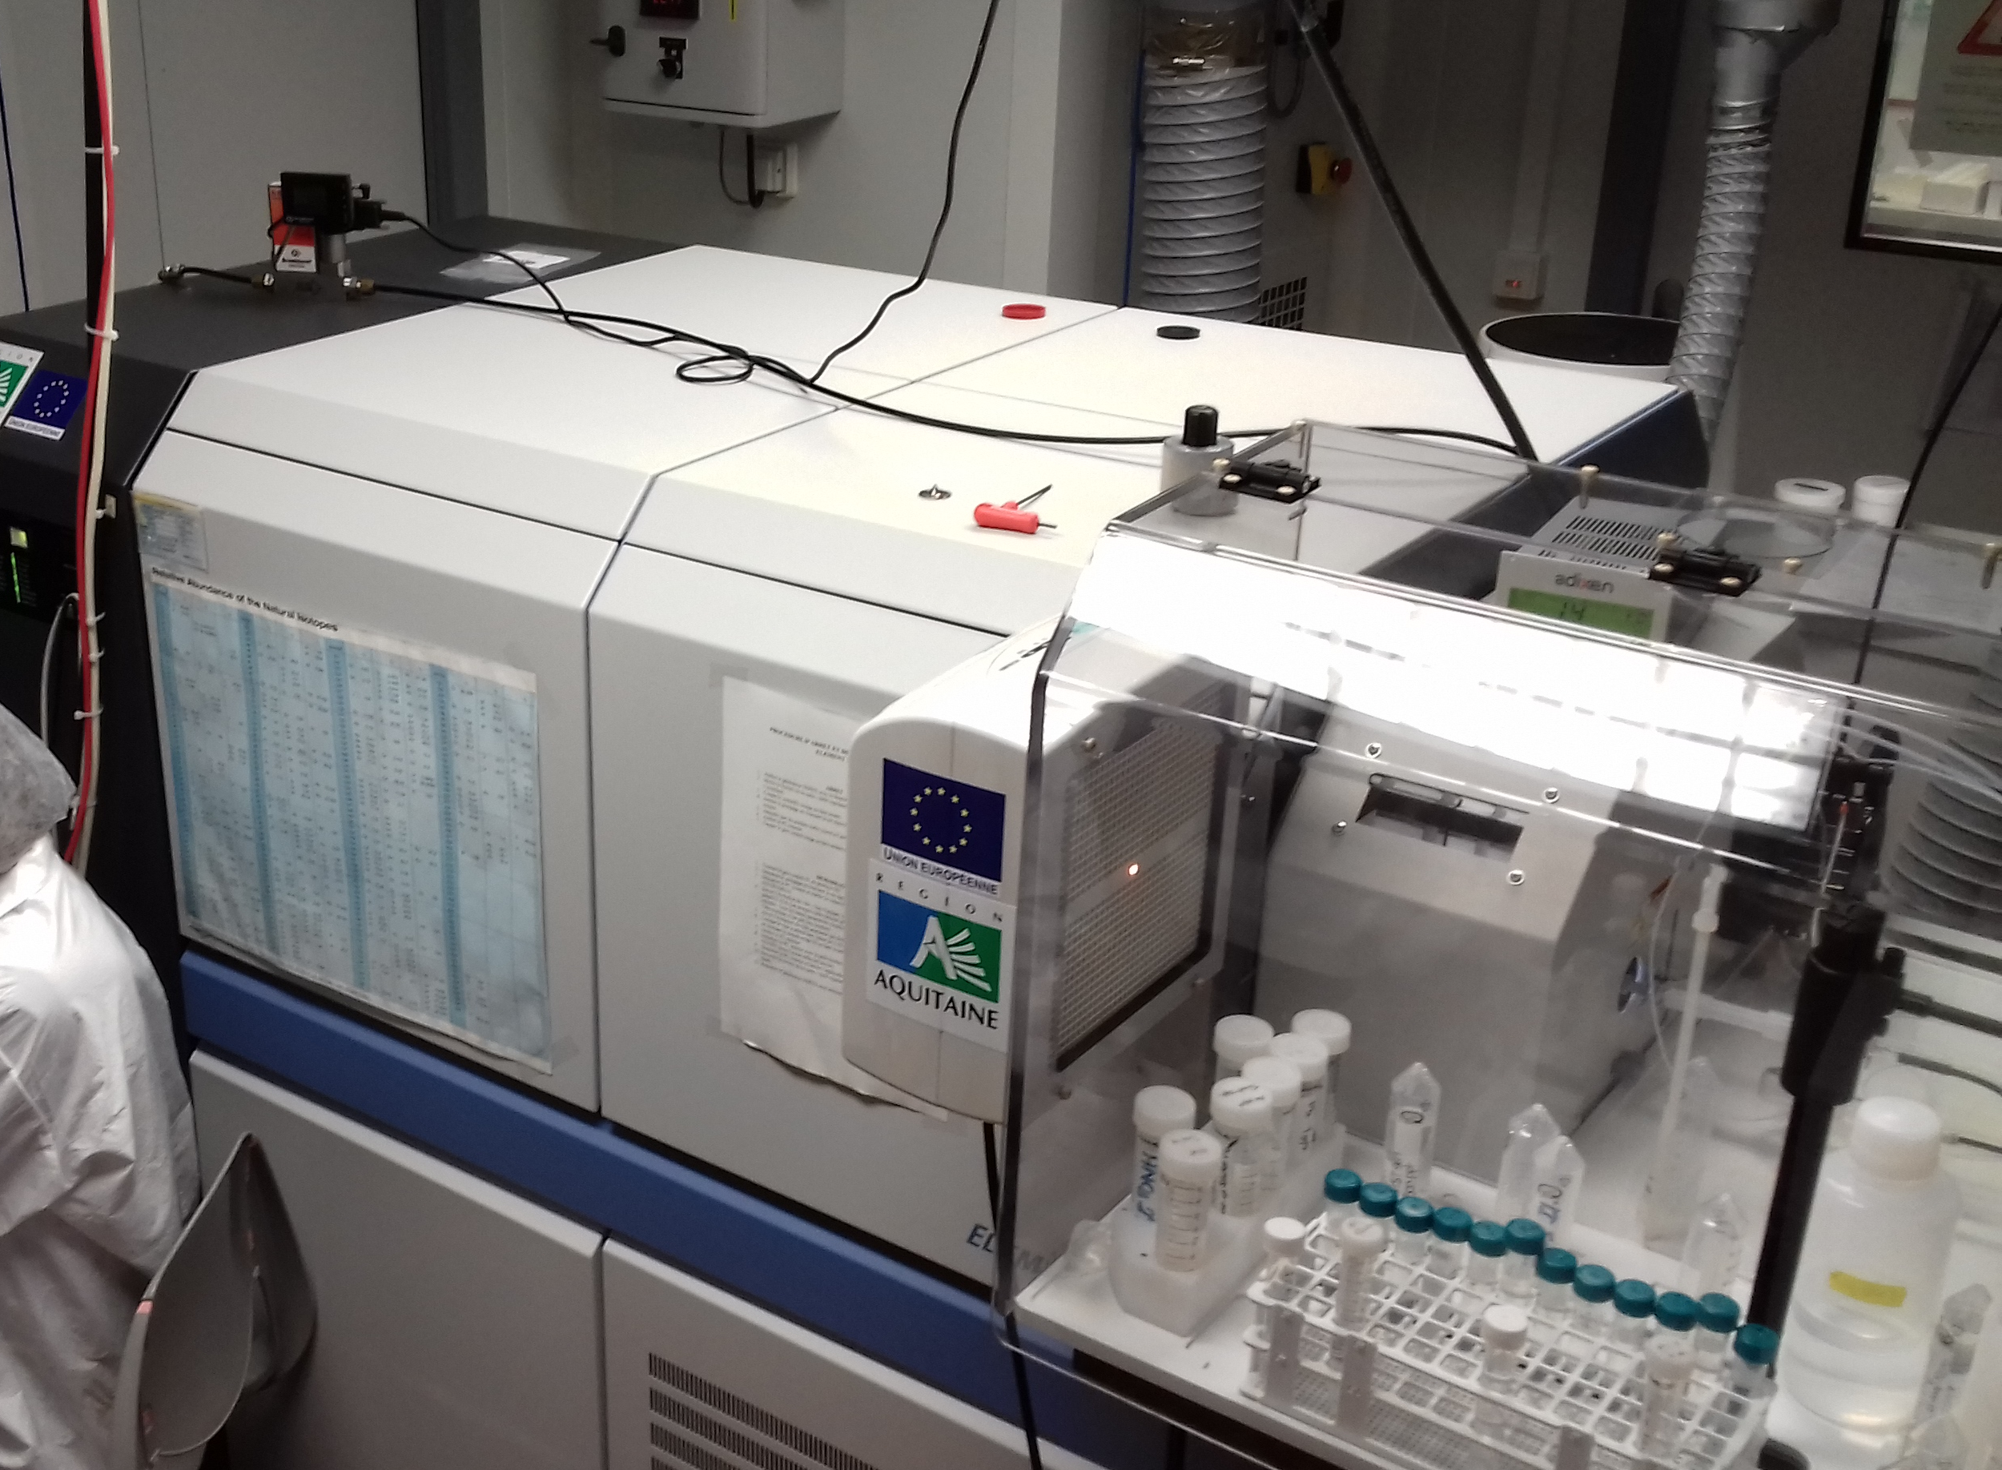
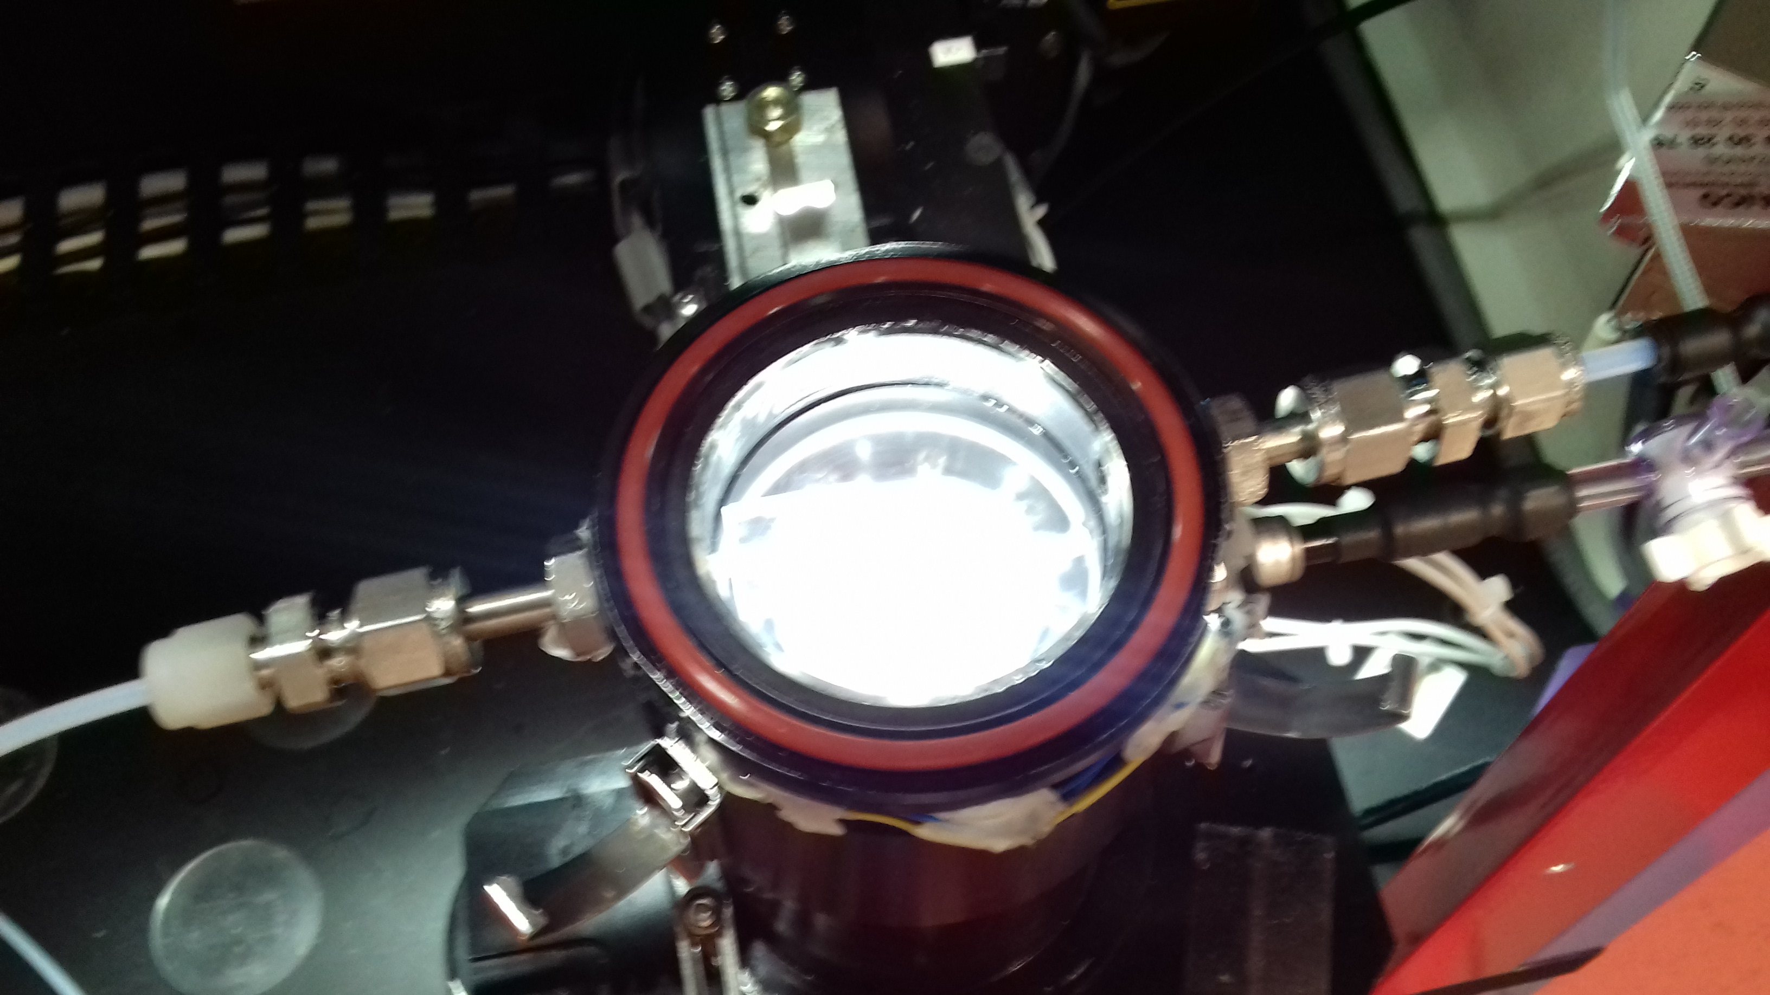
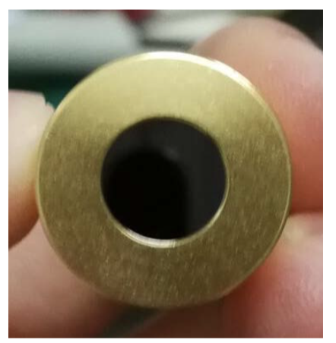
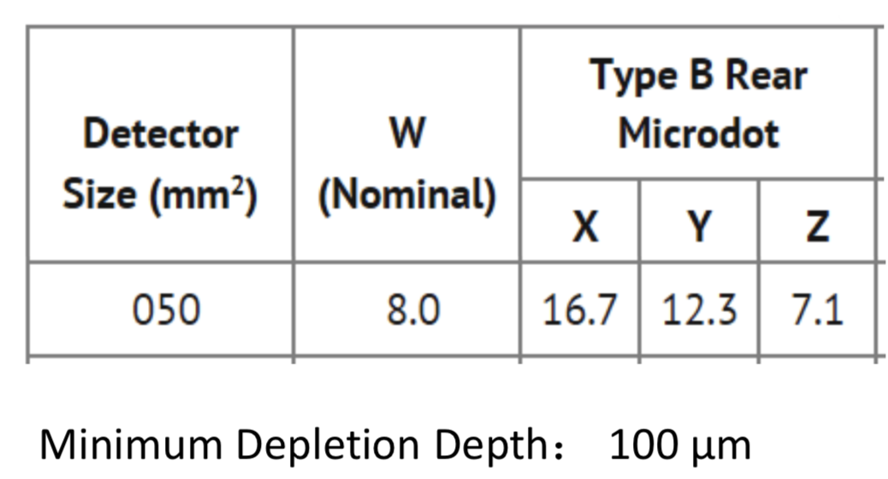
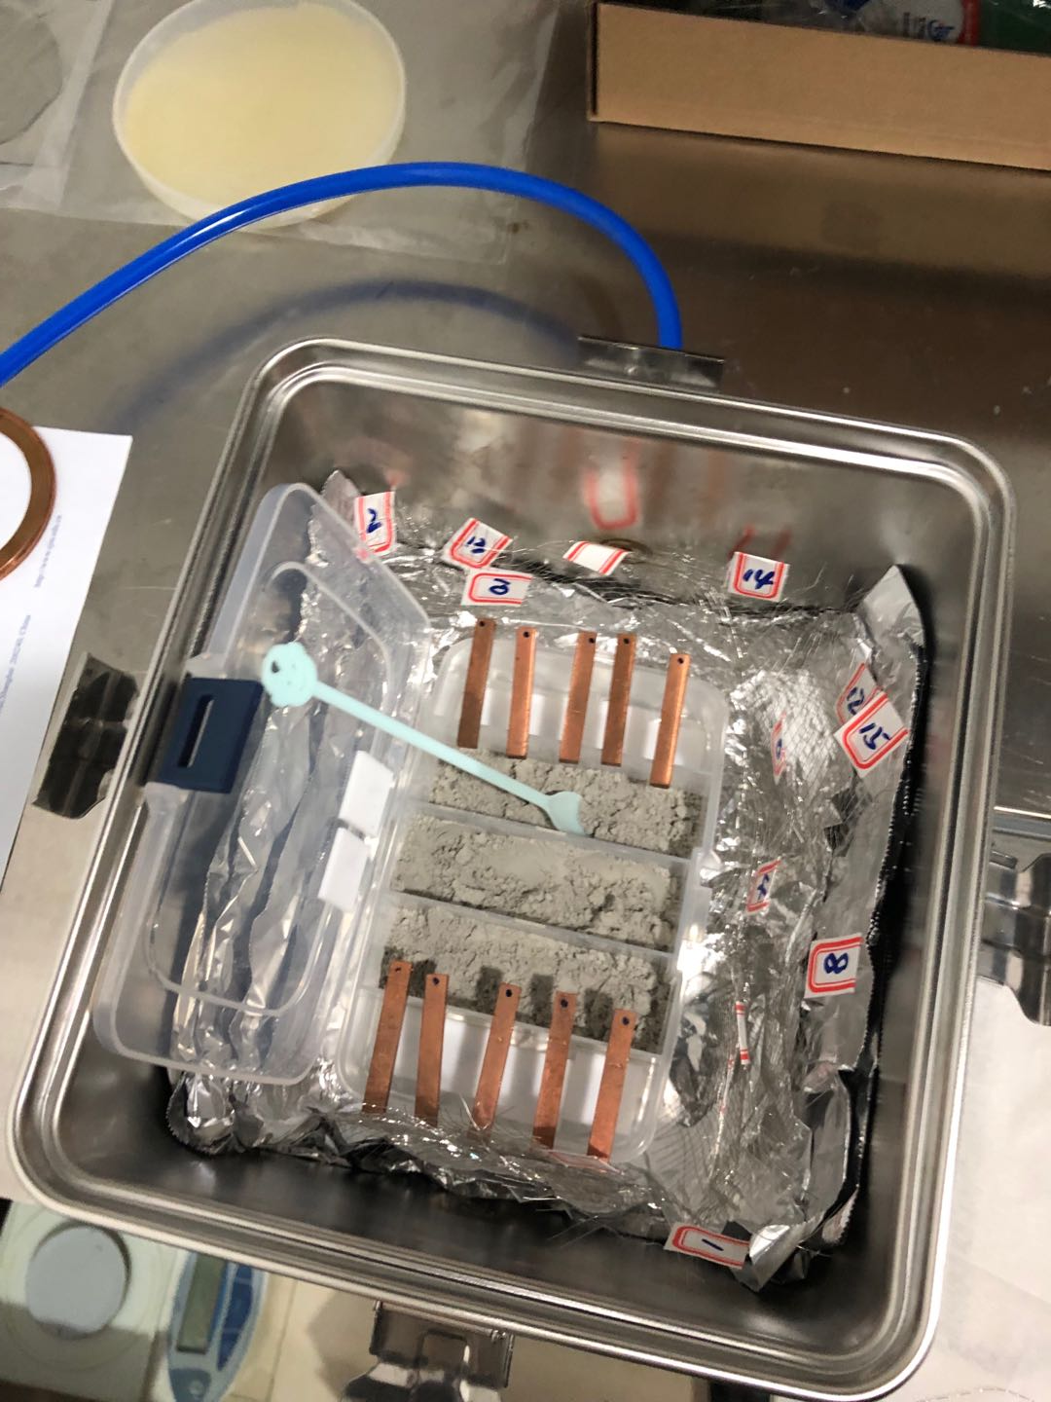
Laser ablation ICPMS and alpha detector
Laser ablation ICPMS
Bordeaux group has started a new collaboration with experts in laser ablation coupled to ICPMS detection to measure U/Th contamination
Investigate the surface radon daughters (Pb-210 and Po-210) before/after multiple cleaning methods or packing methods.
Gas transfer
ICPMS
Chamber for laser ablation
Advantages of the technique:
No chemical preparation of the sample
Small risk of contamination
Microanalysis at the level of ~10 µm precision
Possibility to measure U/Th concentration both in surface and bulk → access to the U/Th profile
Opportunity to test the efficiency of cleaning process
→ very promising for the JUNO cleanliness strategy

Slide 17
Summary
Both of groups are involved in the JUNO experiment
Complementary facilities for low background assay
Share the expertise and experience about background control and cleanliness protocol
Project has just started
FCPPL radiopurity studies for the JUNO calibration system project between Bordeaux and SJTU will be fruitful for the JUNO experiment.
Furthermore, this is an opportunity to start a collaboration within two underground laboratories (Jinping and LSM)

Slide 18
Backups

Slide 19
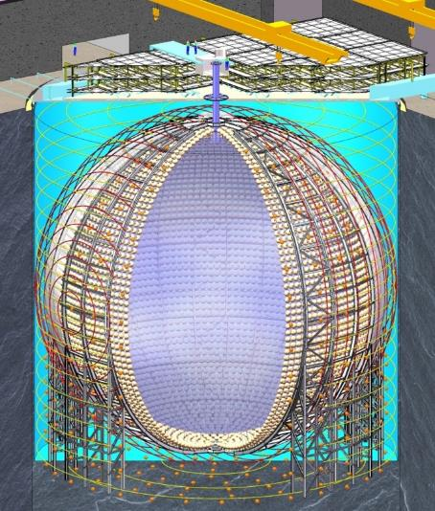
JUNO detector: size and concept
100,000 events required in 6 years of data taking at 53 km distance
→ 20 ktons of target detector needed (liquid scintillator) in a sphere of ~35 m diameter
Energy resolution of 3%/√E(MeV)
→ high LS transparency + very high photodetection coverage (~78%)
→ 1200 p.e. with 18,000 20-inch PMTs
D_{in}= 35.4 m
JUNO will be the largest liquid scintillator detector ever built !
Experiment | Daya Bay | Borexino | KamLAND | JUNO
LS mass (tons) | 20 /detector | ~300 | ~1,000 | 20,000
Nb of collected p.e. per MeV | ~160 | ~500 | ~250 | ~1200
Energy resolution @ 1 MeV | ~7.5% | ~5% | ~6% | ~3%

