Slide 1

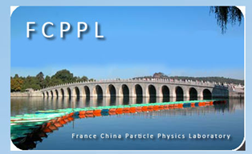






CMS in FCPPL: 12 years and counting!
Guoming CHEN (1), Suzanne GASCON-SHOTKIN (2)
(1)IHEP/CAS Beijing , (2) IPN Lyon➔IP2I Lyon (IN2P3-CNRS)/Université Claude Bernard Lyon 1
Qiang LI(4), Nicolas CHANON (2), Jeremy ANDREA (3)
(3) IPHC Strasbourg, (4) Peking University Beijing
FCPPL 2019
Shanghai Jiao Tong University, Shanghai, China
April 25 , 2019

Slide 2
12 years of exchanging people and ideas
IHEP-IPNL: Collaboration started in 2007 (one of the longest-lived in FCPPL), on virtually all aspects touching photons in CMS. Current focus: Standard Model Higgs boson measurements through the H◊γγ channel and searches for a second, low-mass (<125 GeV) Higgs boson in that channel. Since 2007, FCPPL-financed exchanges have included:
  8 IHEP doctoral students (some for multiple visits) and 1 IHEP postdoc to IPNL
  6 IPNL doctoral students (a first for FCPPL) and 2 IPNL postdocs to IHEP
  Making possible significant contributions to 35 CMS published papers/public results
  And support in establishing 2 co-PhD theses financed by prestigious scholarships (CSC, Eiffel)
  2018-2019 team: IPNL : Camille CAMEN, Linda FINCO, Suzanne GASCON-SHOTKIN, Antoine LESAUVAGE, Morgan LETHUILLIER, Sijing ZHANG (co-PhD) IHEP Beijing : Guoming CHEN, Mingshui CHEN, M. Aamir SHAHZAD, Junquan TAO, Jin WANG, Sijing ZHANG (co-PhD)
PKU-IPHC-IPNL: Collaboration started in 2015 as PKU-IPHC, then added IPNL in 2017. Focus: Matrix element and deep learning techniques for top-Higgs and WW scattering. FCPPL-financed exchanges: 2 PKU students (2 visits each), 1 to each of IPHC and IPNL making possible significant contributions to 6 published papers/public results
  2018-2019 team: IPNL: Nicolas CHANON IPHC: Jeremy ANDREA, Nicolas TONON PKU: Junho LEE, Jing LI, Qiang LI, Yajun MAO
IHEP, IPNL and IPHC have hosted FCPPL workshop, regularly contribute members of scientific committee

Slide 3
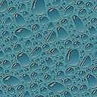
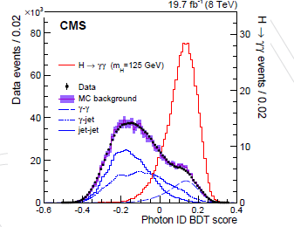
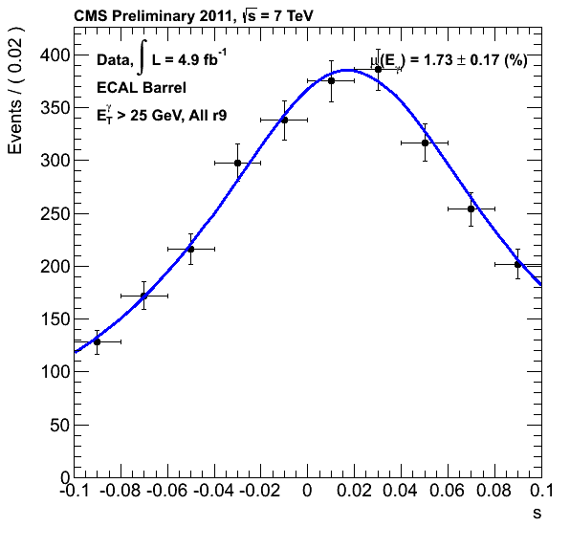
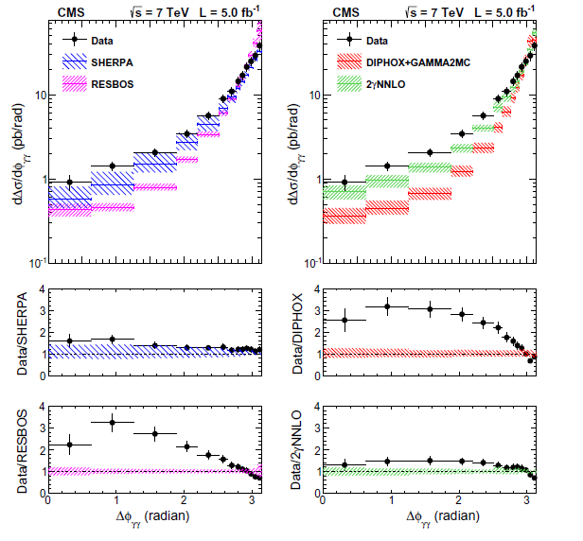
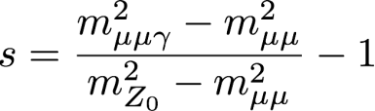
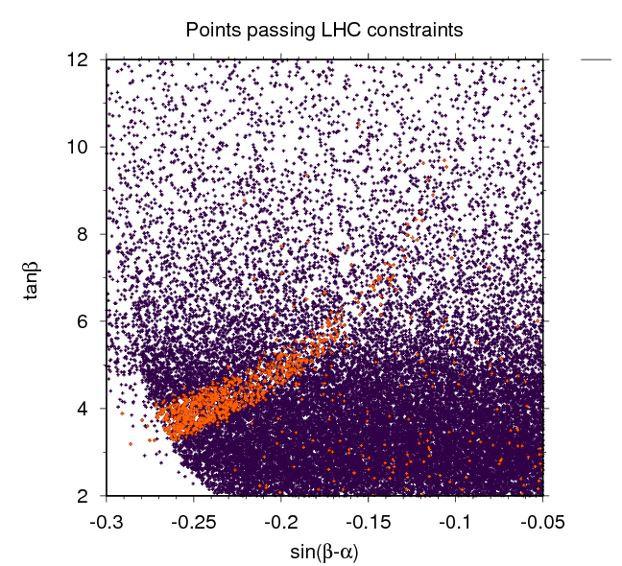
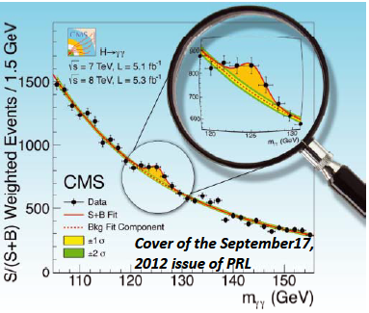
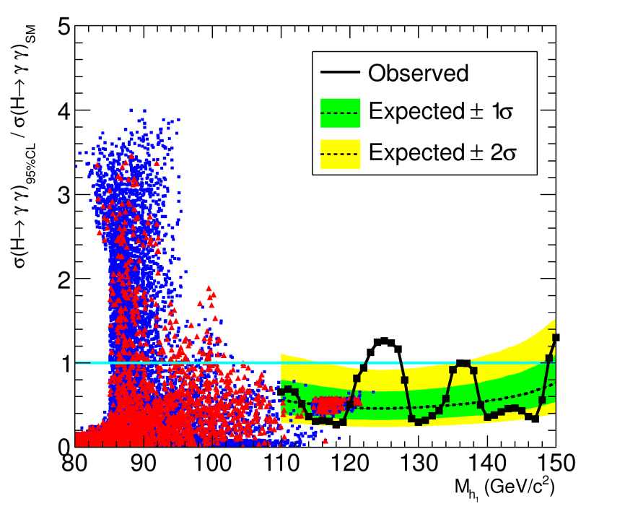
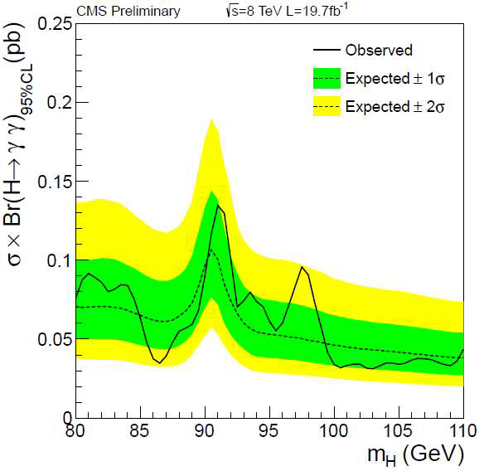
IHEP-IPNL: 12 years of important results on photons and Higgs bosons: Run 1 (2007-2016)
γγ + X differential cross section measurement (2010-…)
γ/π⁰ discrimination for photon ID (2008-…)
.
Cluster/Photon commissioning, Runs 1&2 (2008-…)
.
Photon energy scale extraction with Z→μμγ (2007-…) .
Eur.Phys.J. C74 (2014) 3129
EPJ C 74 (2014) 3076
CMS-PAS-EGM-10-005
σ_{ϕ}/σ_{η}
CMS-DP-2012/024
Phys. Lett. B 716 (2012)
JHEP12 (2016) 068
CMS-PAS-HIG-14-037
Chinese Phys. C 38 073101
Discovery and measurement of a Higgs boson (2012-…)
.
Feasibility study for a 2nd lighter Higgs boson (2013-…)
.
2HDM interpretation w/Th: Search for a 2nd lighter Higgs boson, 8 TeV data (2016) (orange excluded)
Search for a 2nd lighter Higgs boson in 8 TeV data (2013-...…)
Notes:
, correct animation

Slide 4
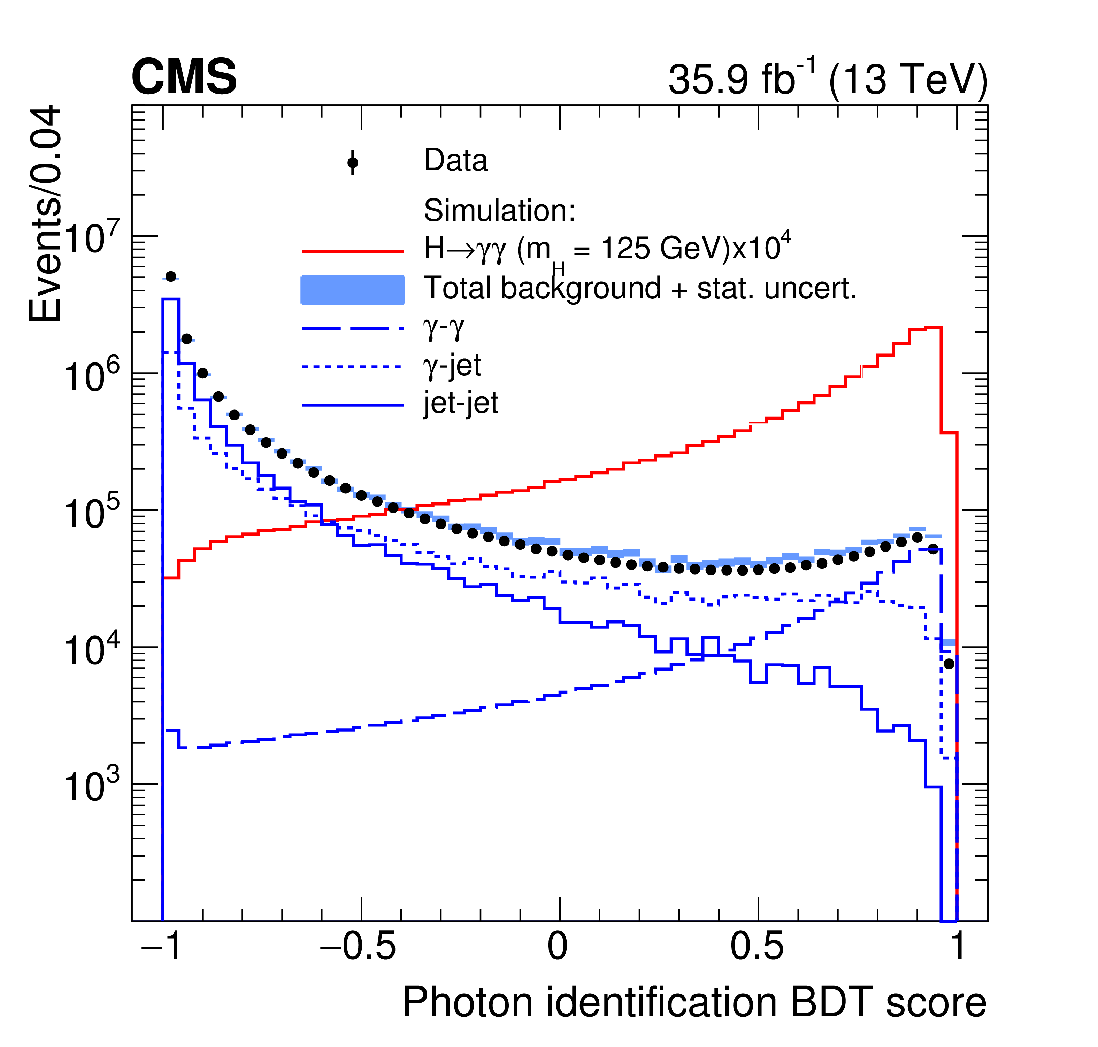
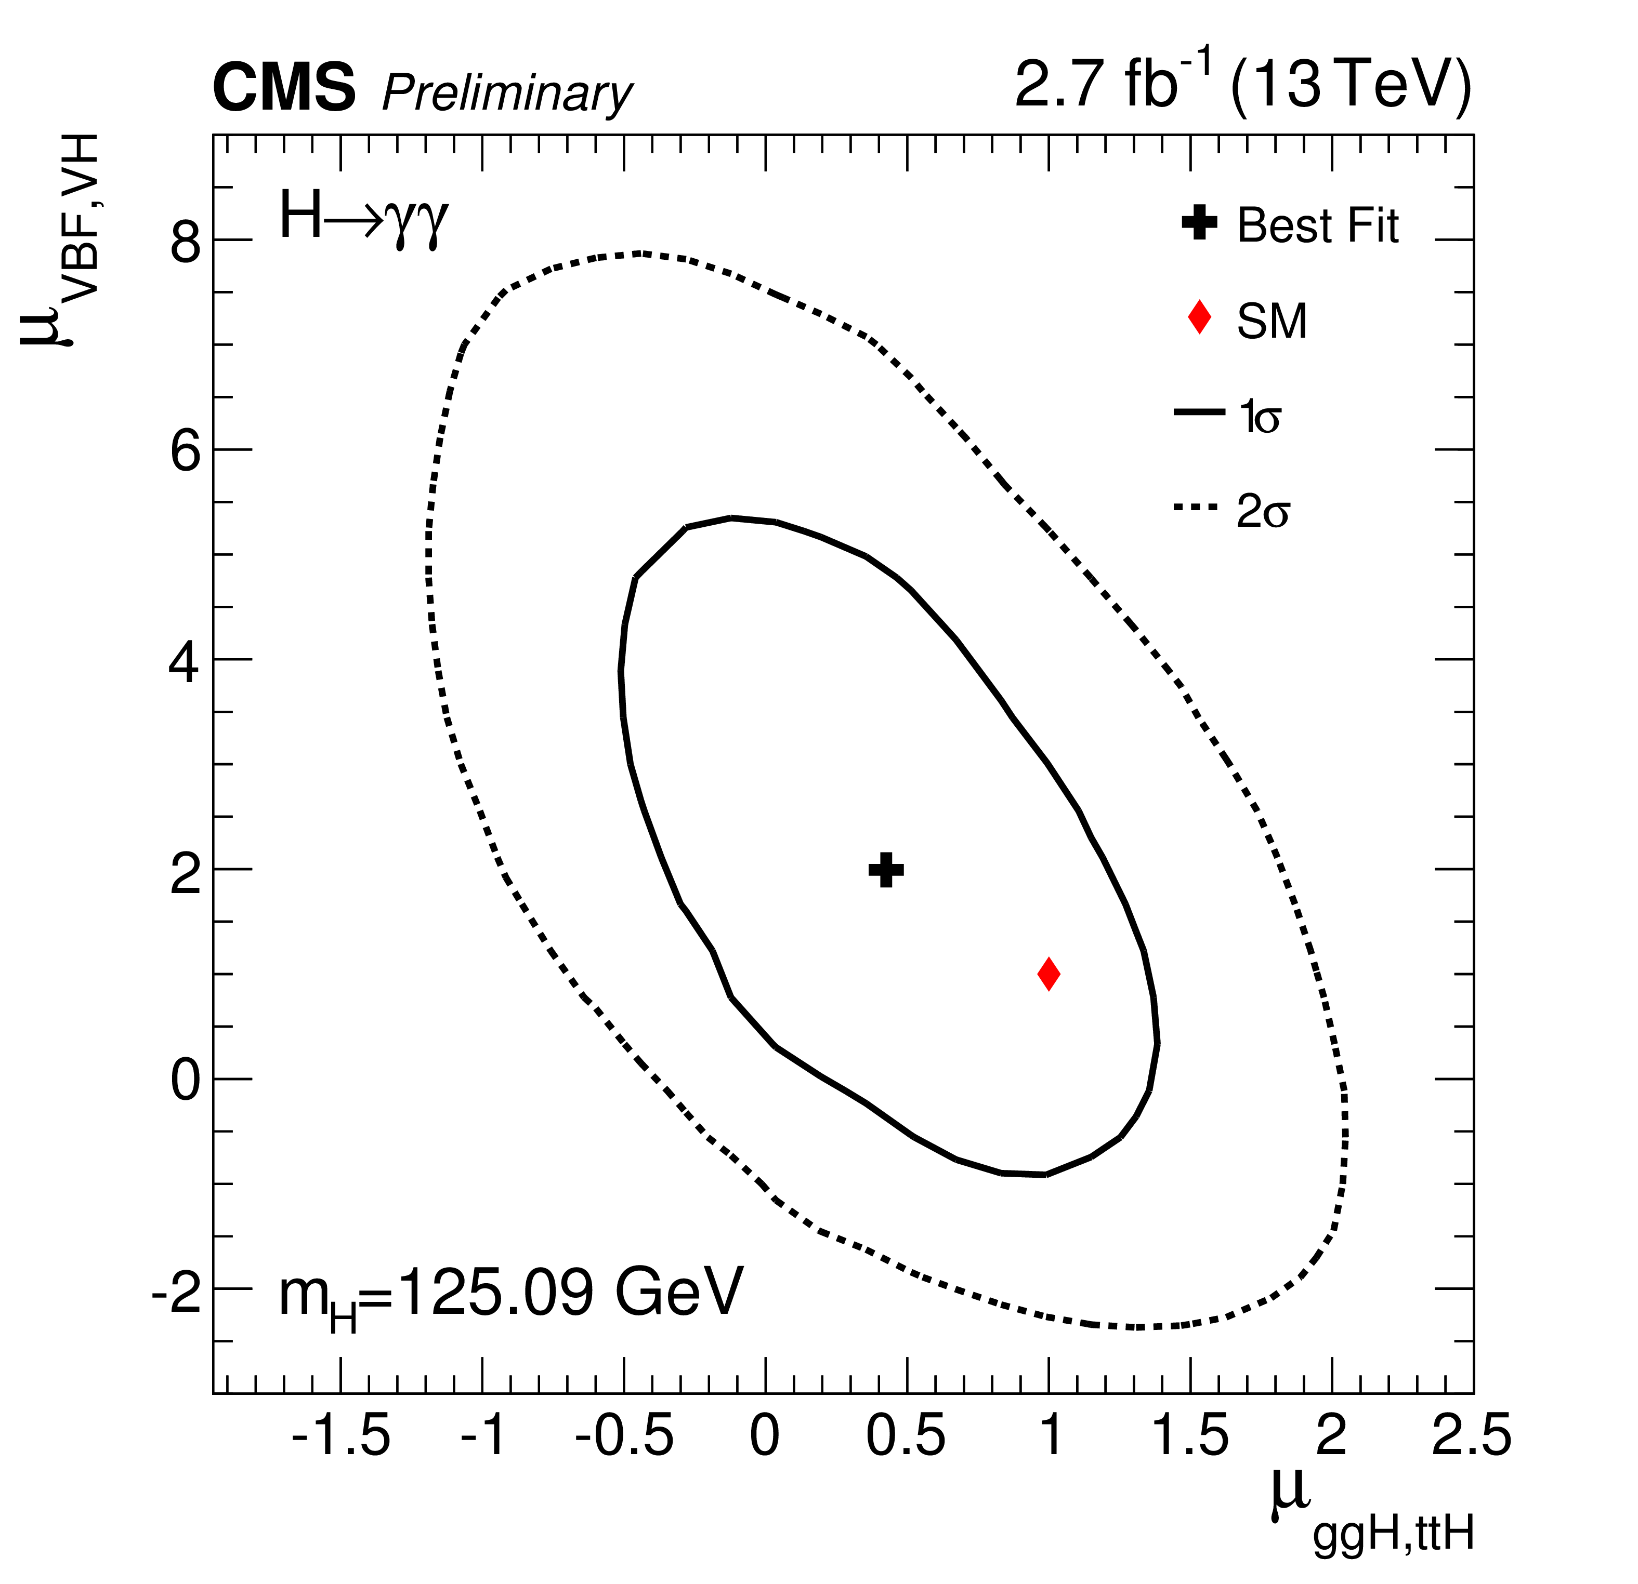
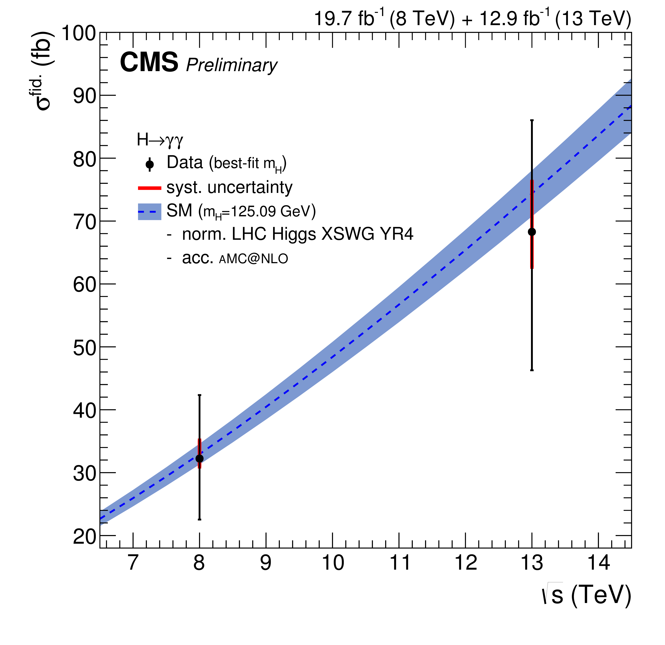
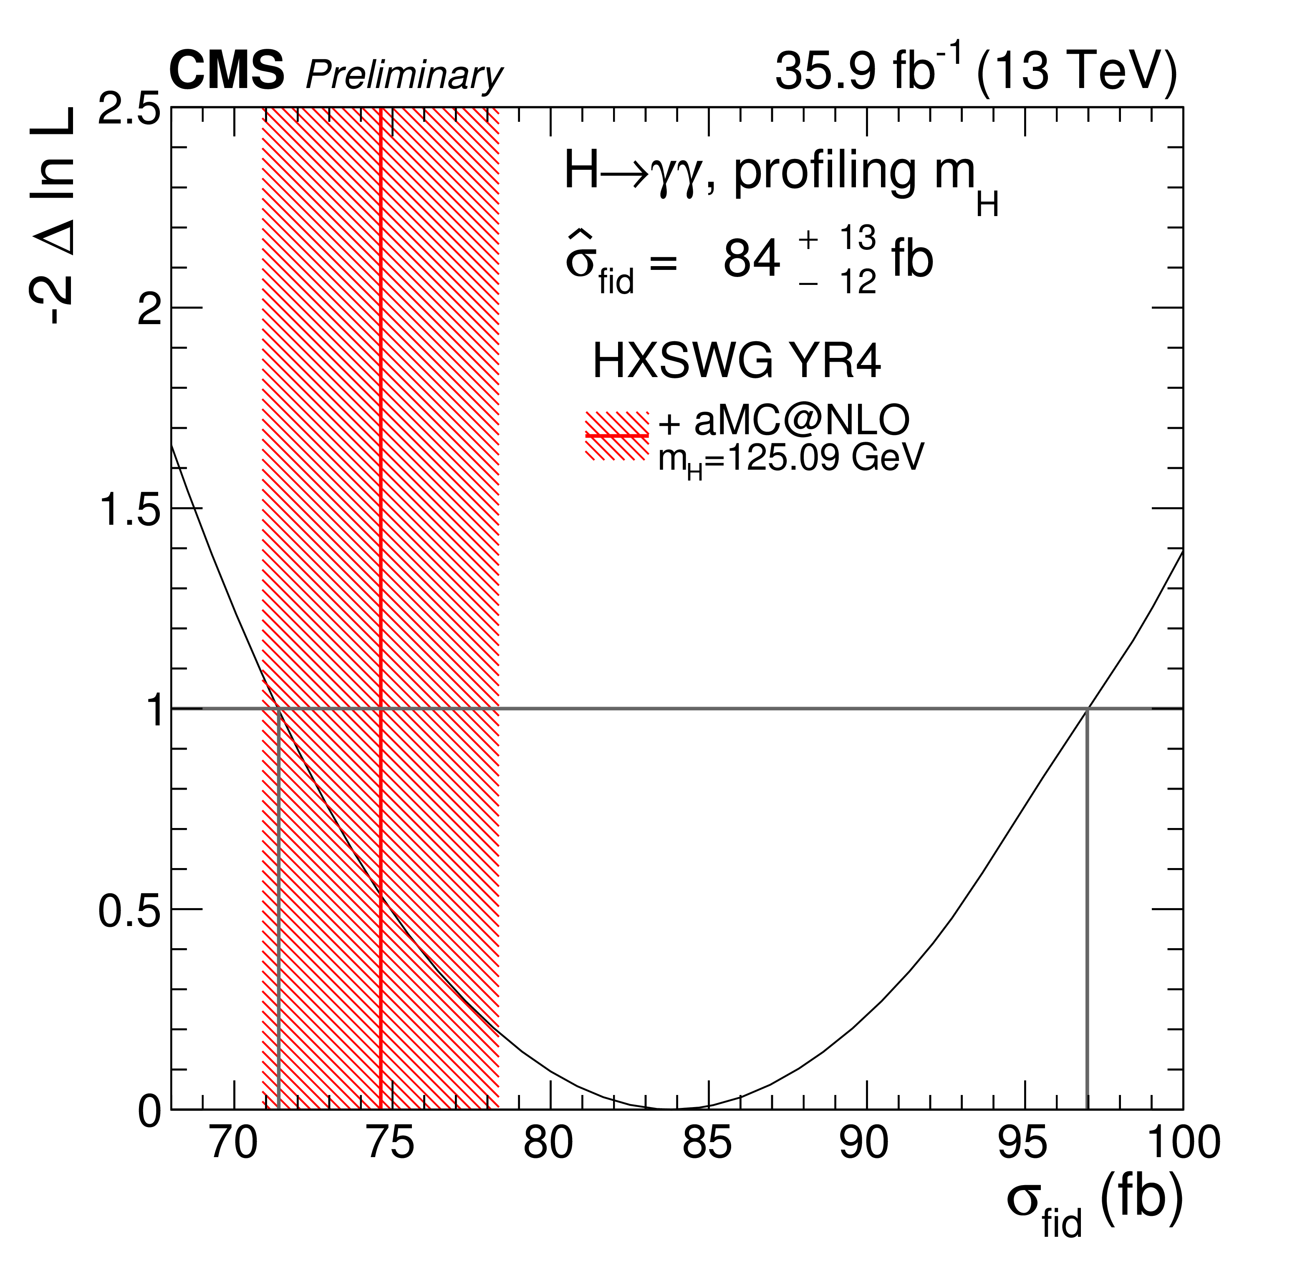
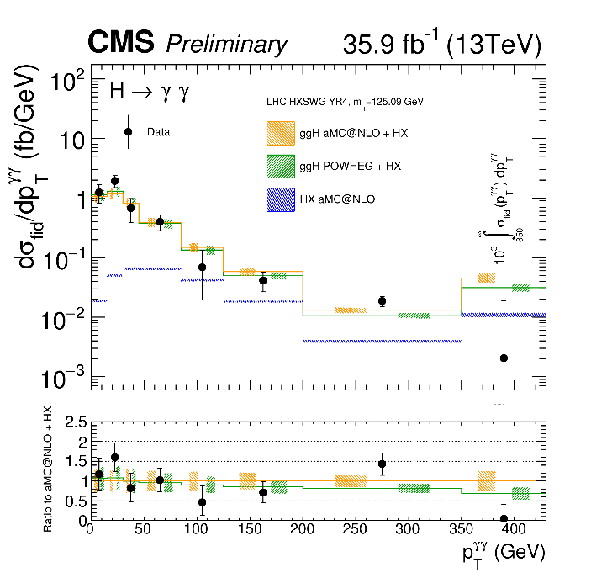
IHEP-IPNL: 12 years of important results on photons and Higgs bosons: Run 2 (2013-2017)
Photon energy scale extraction with Z→μμγ (2007-…) .
γ/π⁰ discrimination for photon ID (2008-…)
.
ReDiscovery and measurement of a Higgs boson (2015-…)
.
CMS-PAS-HIG-15-005
CMS-DP-2012/024
JHEP 11 (2018) 185
CMS-PAS-HIG-16-020
CMS-PAS-HIG-17-015
ReDiscovery and measurement of a Higgs boson (2015-…)
.
Fiducial and differential cross section measurements (2016-…)
.
Notes:
, correct animation

Slide 5

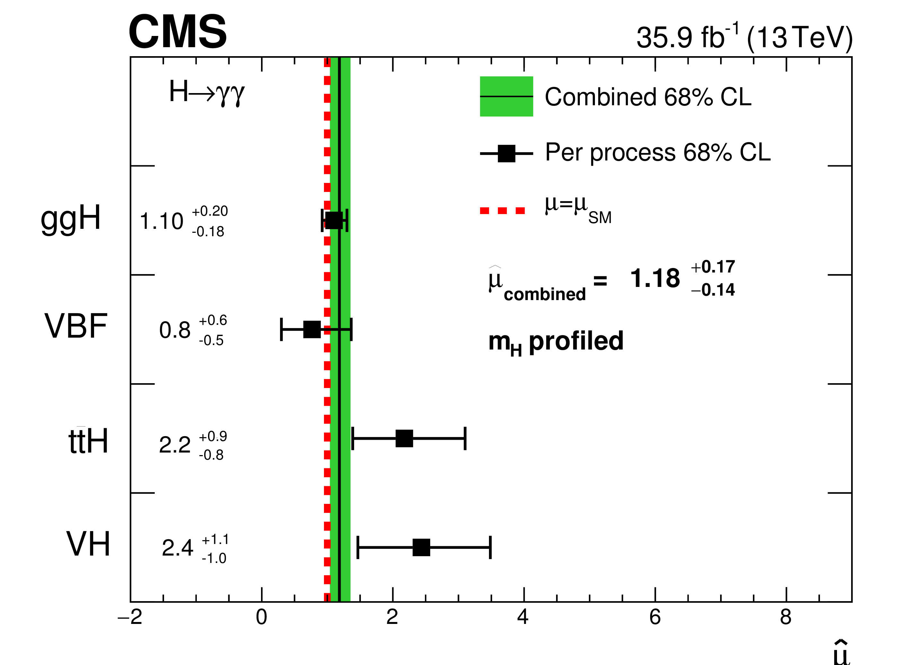
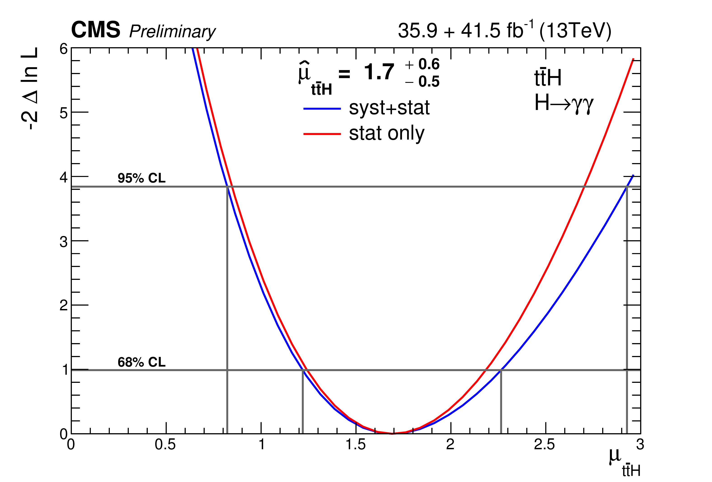
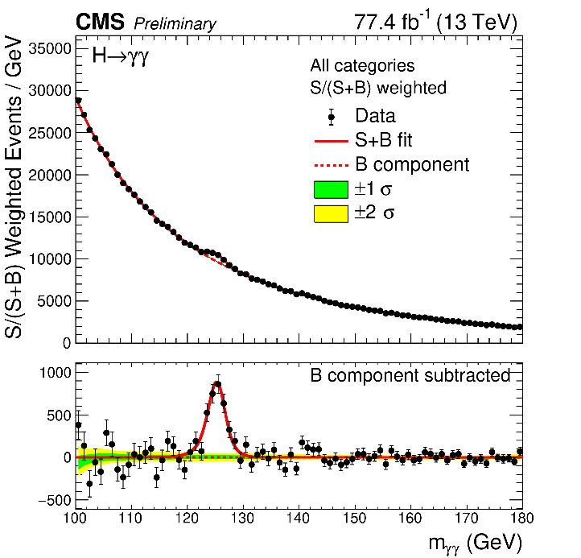
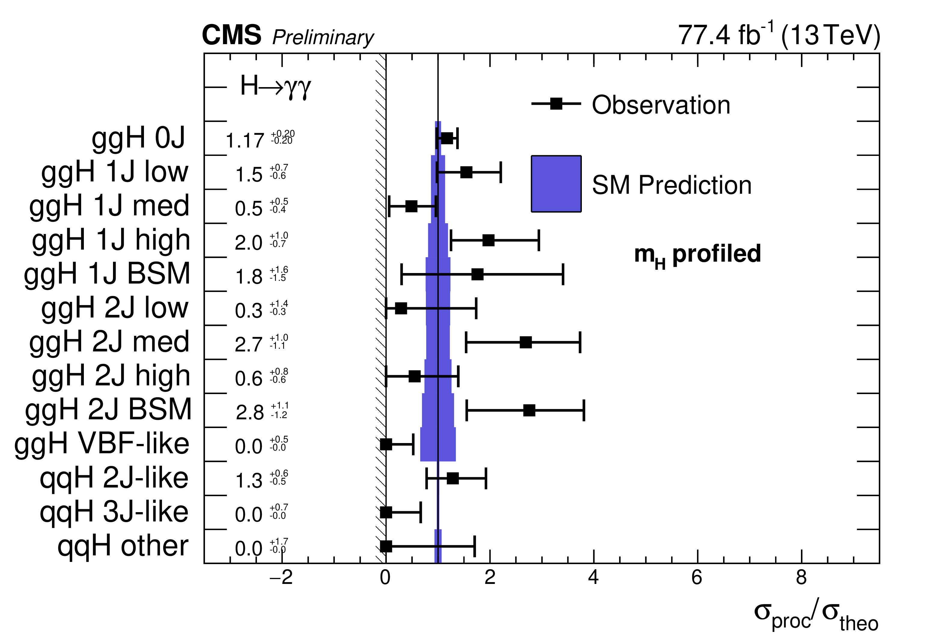
IHEP-IPNL 2015-2018: Run2 H→γγ measurements:
Progress in 2018-2019
JHEP 11 (2018) 185
Major contributions: High-level trigger development and maintenance, photon ID MVA development, electron veto efficiency, Z→μμγ validation
Public results: 2016 data (JHEP 11 (2018) 185), ttH, H→γγ (CMS-PAS-HIG-18-018) and STXS (‘Simplified Template Cross Section’) results for ggh+VBF (CMS-PAS-HIG-18-029, Moriond 19) both with 2016+2017 (see dedicated talk by Sijing ZHANG)
CMS PAS HIG-18-029
Future plans: Run 2 legacy results
Study gg→γγ/gg→H→γγ interference:
  Run 2 legacy: Mass measurement precision
  Run 3: Constrain width, measure spin (BSM?)
CMS PAS HIG-18-029

Slide 6
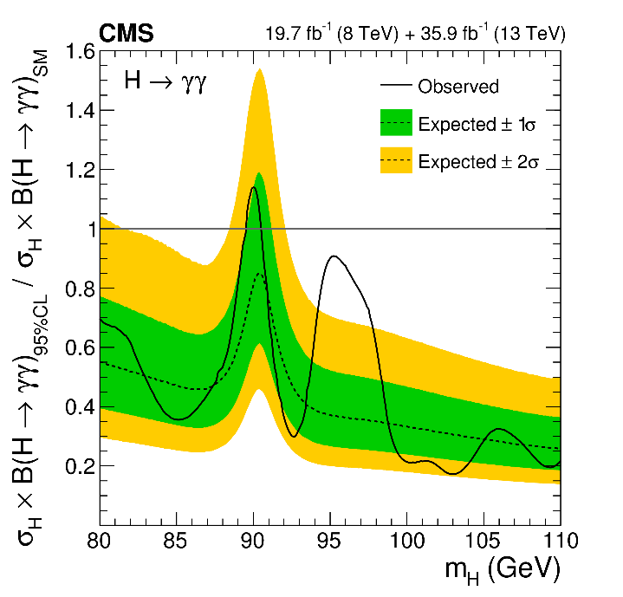
IHEP-IPNL 2013-2019: Run 1/2 low-mass (<125 GeV) H→γγ search and interpretations: Progress in 2018-2019
Initiators and leaders of this search in CMS (+ SINP Kolkata since 2016): any 2nd Higgs boson→unequivocal proof of BSM
Run 2 2016 results and Run1 (2012)/Run 2(2016) combination: Main result: 2.8σ observed at m~95.3 GeV, CMS-HIG-17-013, arXiv 1811.08459, accepted by PLB (see dedicated talk by Antoine LESAUVAGE), cannot be excluded by preliminary ATLAS result (2016+2017)
Interpretations: Run 1 results using effective field theory parameters (Les Houches workshop proceedings, arXiv:1803.10379 [hep-ph] (2018), first FR-CH CMS participation) and Run 2 results in the NMSSM (Chin.Phys. C42 (2018) 103107)
CMS-HIG-17-013,arXiv 1811.08459,
accepted by PLB
Chin.Phys. C42 (2018) 103107
Future plans: Results with 2017-2018 data in progress, plan for more interpretations (e.g. IPNL theorists), prepare Run 3 and prospects for HL-LHC
2019 FCPPL grant will be used to support a 3-month stay at IPNL in Autumn 2019 for IHEP student Aamir SHAHZAD on these topics

Slide 7
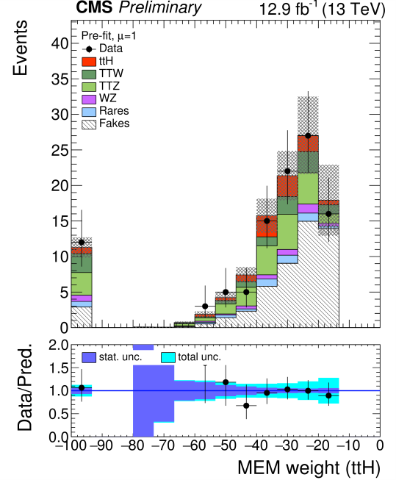
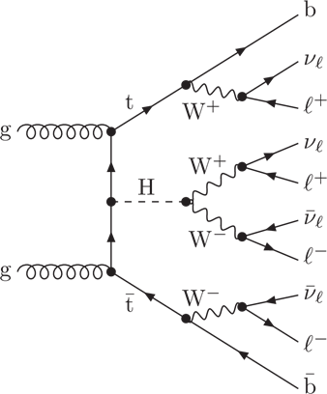
PKU-IPNL 2015-2019: Matrix element and deep learning for top-Higgs and WW scattering
Matrix Element Method (MEM) is complementary to usual multivariate methods, and was used to improve the discovery potential in ttbarH. Main result: ttbarH observation, Phys. Rev. Lett. 120, 231801 (2018): direct measurement of the top-Higgs coupling
Also exploring the impact of Deep Learning in Neural Networks for HL-LHC. Published a phenomenology study “Polarization Fraction Measurement in same sign WW scattering using Deep Learning”, Phys. Rev. D 99, 033004 (2019) (see dedicated talk by Junho LEE)
ttH multilepton
arXiv 1812.07591
CMS PAS HIG-17-004
WW scattering
FCPPL grant will be used to support a 3-month stay at IPNL in Autumn 2019 for a PKU student on these topics

Slide 8
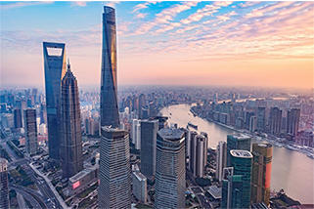

Acknowledgements
THANKS to the FCPPL
We are looking forward to your continued support!
For many more years!

Slide 9

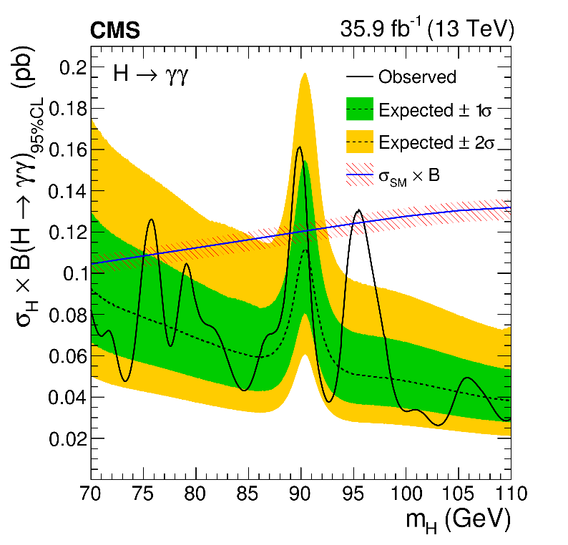
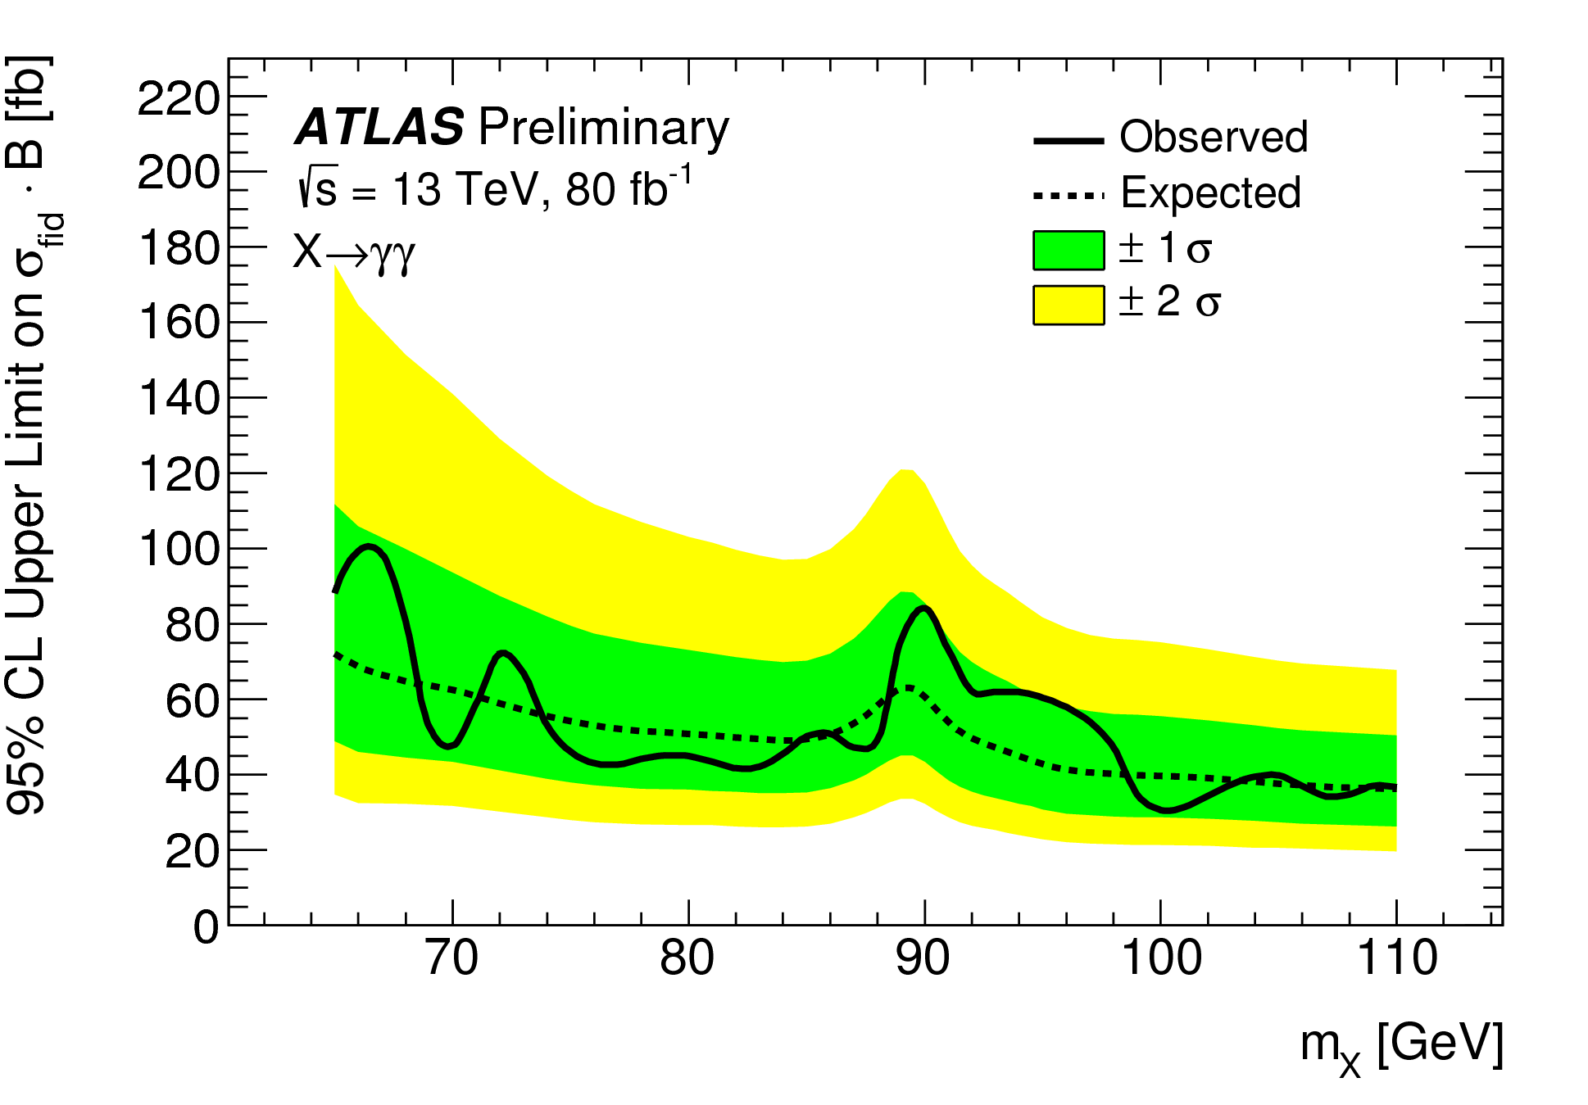
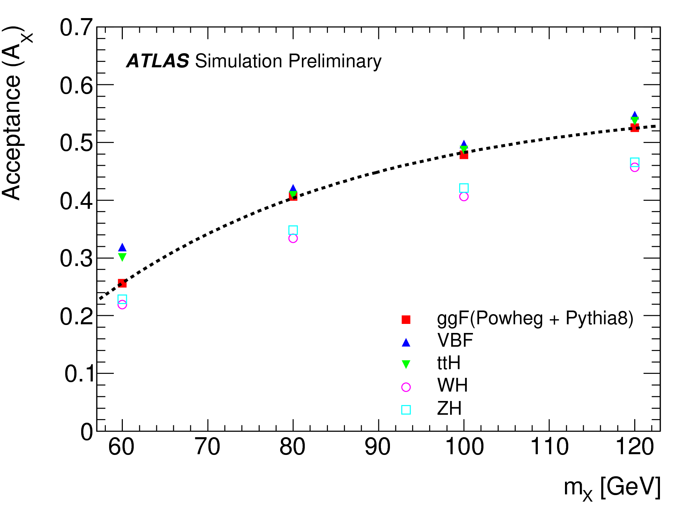
Presentation of Results
CMS-HIG-17-013, arXiv 1811.08459,
accepted by PLB
ATLAS-CONF-2018-025
CMS: Limit on total cross section X B
ATLAS: Limit on fiducial cross section X B

