Slide 1

“Study of QCD matter with the ALICE detector”
within the FCPPL
Outline
France and China in ALICE and FCPPL
FCPPL ALICE report (2018)
FCPPL ALICE project (2019)
Conclusion
Nicole Bastid, LPC, Clermont-Ferrand, France
Daicui Zhou, CCNU, Wuhan, China
12th Workshop of the France China Particle Physics Laboratory
Shanghai Jiao Tong University, China
April 24-27, 2019

Slide 2


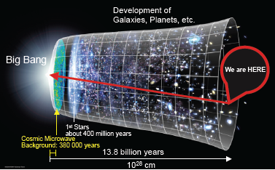
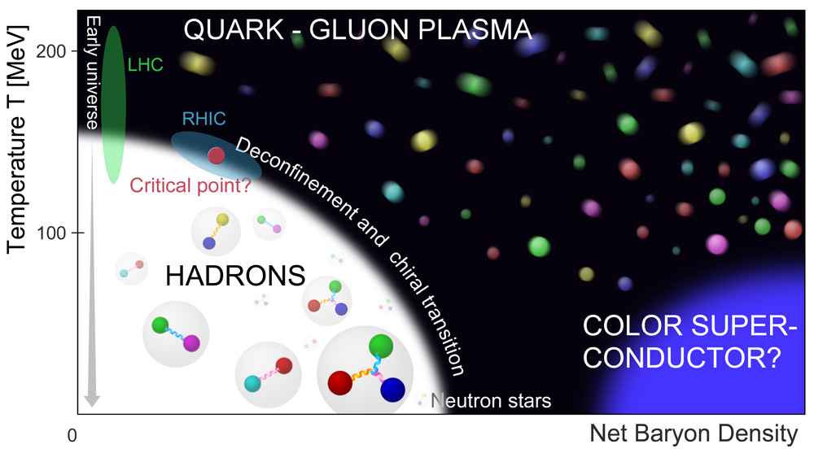
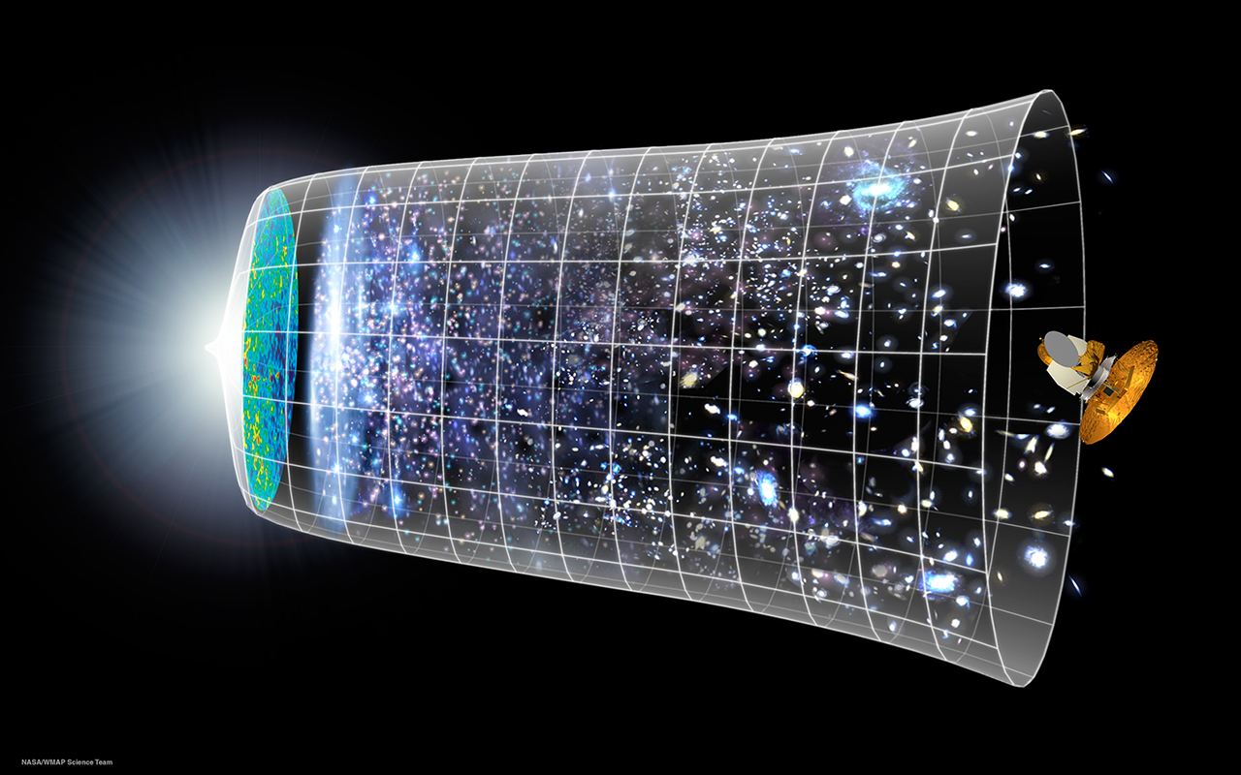
Quark-Gluon Plasma
Characterization of a state of deconfined quarks and gluons in extreme conditions of temperature and net baryon density,
the Quark-Gluon Plasma (QGP), predicted by QCD
  How to create such matter?
    Via ultra-relativistic heavy-ion collision experiments
  Where to perform these experiments?
    At the LHC (among others) with the ALICE detector designed for the study of nucleus-nucleus collisions, among other experiments

Slide 3
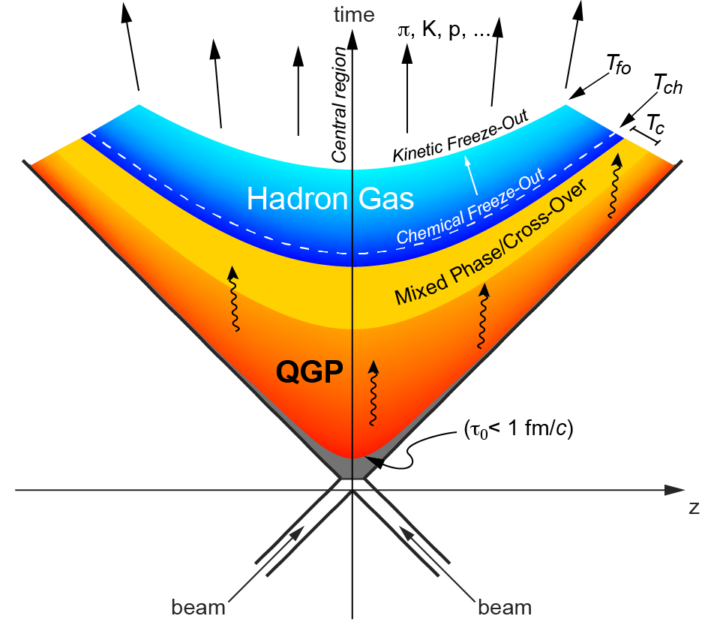
How to probe QCD matter?
  Soft probes
  Low-p_{T} particles
  Hard probes
  Open heavy flavours
  (charm & beauty)
  High-p_{T} hadrons,
  Quarkonia
  Jets
  γ, W, Z
References:
p-Pb collisions
  reference for AA collisions
  cold nuclear matter effects
  collectivity
pp collisions
  reference for p-Pb and Pb-Pb collisions
  test QCD
  production mechanisms
  collectivity

Slide 4
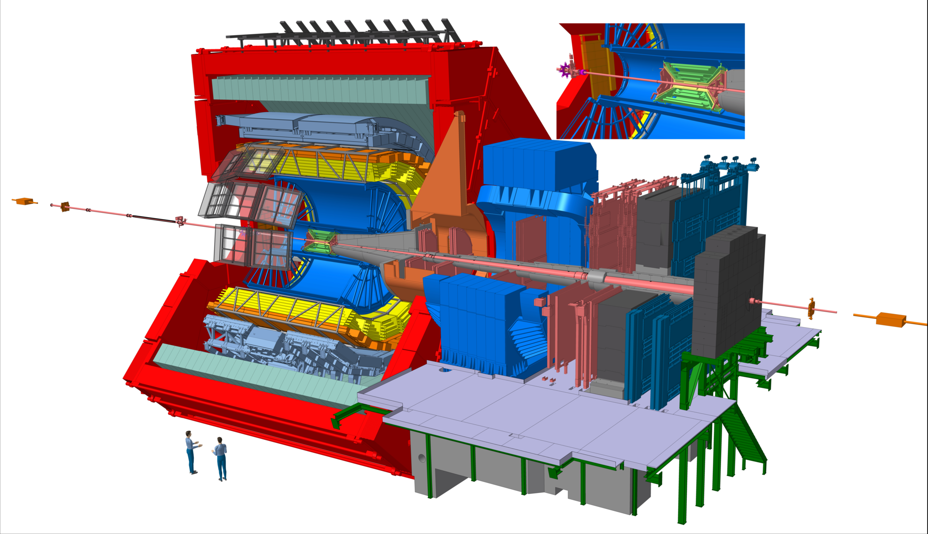
A Large Ion Collider Experiment
Central Barrel, |η| < 0.9
vertexing (ITS),
tracking (ITS, TPC),
PID (ITS, TPC, TOF, TRD, HMPID,
Calorimeters)
Muon
Spectrometer
-4< η < -2.5
Forward
Detectors
(V0, T0, ZDC):
Trigger
Timing
Multiplicity
Centrality
Event plane

Slide 5
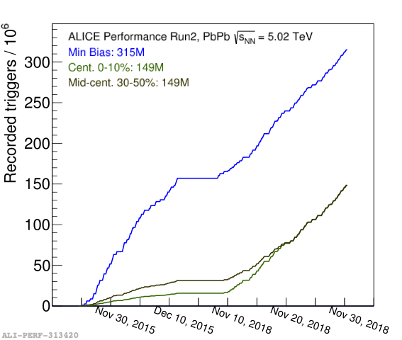
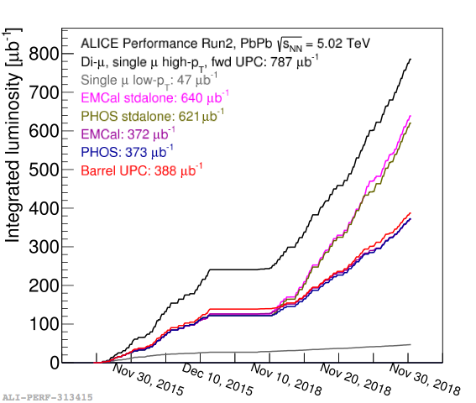
ALICE data sample collected
System | Year(s) | √sNN (TeV) | Lint
pp | 2009-2013 2015,2017 2015-2018 | 0.9, 2.76, 7, 8 5.02 13 | ~200 μb⁻¹, ~100 nb⁻¹, ~1.5 nb⁻¹, ~2.5 nb⁻¹ ~1.3 nb⁻¹ ~25 nb⁻¹
p-Pb | 2013 2016 | 5.02 5.02, 8.16 | ~15 nb⁻¹ ~3 nb⁻¹, ~25 nb⁻¹
Xe-Xe | 2017 | 5.44 | ~0.3 μb⁻¹
Pb-Pb | 2010-2011 2015-2018 | 2.76 5.02 | ~75 μb⁻¹ ~250 μb⁻¹,~1 nb⁻¹
LHC run 2 finished end
of 2018 (December 2018)
Rich trigger menu
Largest statistics collected
for Pb-Pb in the 2018 run
  Min. bias: ~1 x 2015
  Central: ~9 x 2015
  Mid-central: ~4 x 2015
  μ high p_{T}: ~3 x 2015
Many run 2
results in which
FCPPL@ALICE
cooperation
is strongly
contributing

Slide 6
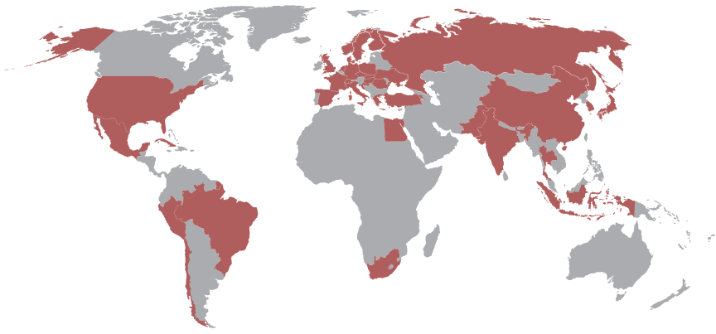
China and France in ALICE
ALICE today: 41 countries, 177 institutes, 1800 members
France (8 institutes)
IPNL and CC-IN2P3, Lyon,
IPNO, Orsay
IPHC, Strasbourg
LPC, Clermont-Ferrand
LPSC, Grenoble
Subatech, Nantes
IRFU, Saclay
44 physicists, 4 Post-docs, 13 PhDs, 72 (~25 FTE) technical staff,
23 invited
China (6 institutes)
IOPP-CCNU, Wuhan
CIAE, Beijing
HUST*, Wuhan
HBUT*, Hubei
USTC, Hefei
SINAP, Shanghai
18 physicists, 12 technical staff,
14 PhDs

Slide 7
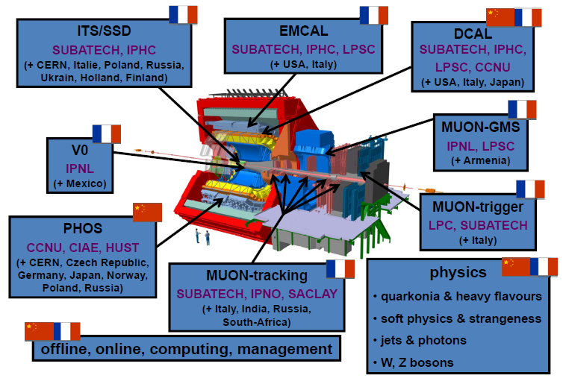
China and France in ALICE
China and France in ALICE
Detector involvements: MUON, V0, ITS, Electromagnetic Calorimeters,
ITS & MUON-MFT upgrades

Slide 8
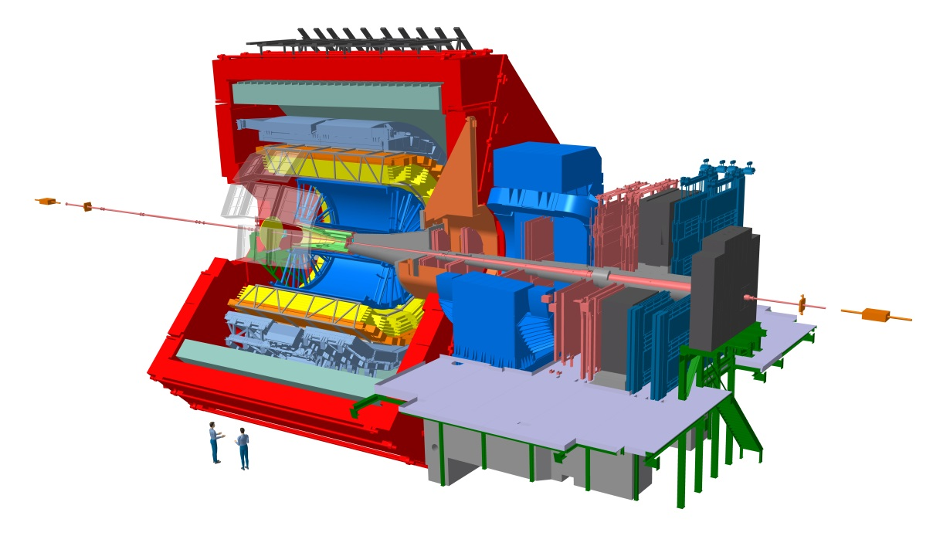
ALICE France-China within FCPPL
Very strong cooperation program between the ALICE Chinese Cluster and IN2P3/CEA institutes since several years
Data analysis
  Hard probes
  γ/π⁰-jet correlations
  Low mass resonances
Performance studies
  Open heavy flavours with MUON & MFT
  γ(π⁰) & jets with EMCAL, DCal & PHOS
  D fragmentation function with UITS
Offline, online, computing
Hardware: R&D, production/installation, commissioning, operation
Upgrade projects: UITS-MFT
Present responsibilities:
  Management Board, Conference Committee, Physics Analysis Group, Physics Working Group, detectors & upgrades
Still room to extend the collaboration between French & Chinese institutes
LHC Run-2 analyses, detector upgrade & preparation of physics program beyond
2021 (Run-3 & Run-4)

Slide 9
ALICE within FCPPL: a brief history of our collaboration
Co-PhD students: 8 since 2008, main funding from China (CSC, French embassy)
  7 co-PhD defended their PhD:
  Y. Mao (LPSC-CCNU, 2011), R. Wan (IPHC-CCNU, 2011),
  X. Zhang (LPC-CCNU, 2012), S. Li (LPC-CCNU, 2015), M. Wang (Subatech-
  CCNU, 2016), J. Zhu (Subatech-CCNU, 2017), Z. Zhang (LPC-CCNU, 2018)
  1 co-PhD in preparation: S. Tang (LPC, 2018-2021)
  3 co-PhD CSC applications submitted (IPNL-CCNU, LPSC-CCNU, IPHC-USTC)
Post-docs: 3 since 2009
Master students: ~15 since 2007 + several ongoing demands for 2019 for the
analysis of large amount of Run-2 data and ALICE run-3 & 4 preparation
Several visits of senior physicists & engineers/technicians: data analysis & detector upgrade and physics performance
Numerous presentations in international conferences, ALICE meetings
Direct contribution in several publications
Numerous conference proceedings, internal analysis ALICE notes
Numerous approved analysis results
Organization of the 2nd FCPPL workshop (CCNU) & 7th FCPPL workshop (LPC) and co-organization of the 9th FCPPL workshop (IPHC)

Slide 10
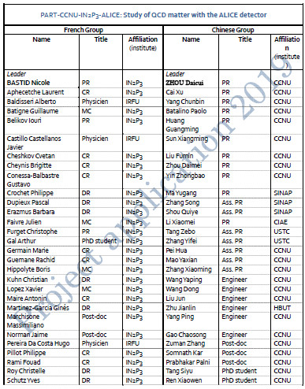
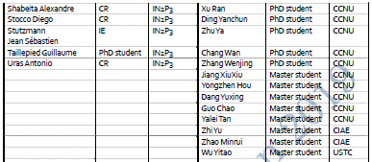
FCPPL-ALICE project: members
PART-CCNU-IN2P3-ALICE
Study of QCD matter with the ALICE detector
Composed of several projects
  MUON
  Calorimeters: EMCal/Dcal
  PHOS
  ITS-MFT upgrade
36 members in 2009, …,
Today: 74 members
    China-France Collaboration
    still growing

Slide 11
FCPPL-ALICE 2018 report: summary
Student exchanges (physics analyses):
Co-PhD
  Zuman ZHANG: CCNU-LPC, 2015-2018 (2-year CSC grant)
  Siyu TANG, CCNU-LPC, 2018-2021 (3-year CSC grant)
  Trainings (Master)
    Siyu TANG: CCNU/LPC, Dec. 2017-Feb. 2018 (FCPPL, LPC-CCNU)
    Yuxing DANG, CCNU/IPHC, Jan.-April 2019 (FCPPL, CCNU)
  Yongzhen HOU, CCNU/LPSC, Jan.-April 2019 (FCPPL, LPSC-CCNU)
  Yanchun DING, CCNU/IPNL and LPC, ~5 weeks (FCPPL, IPNL-CCNU)
Visits
Several visits of senior physicists from France to China and vice-versa for common activities related to:
  Physics analyses
  Detector upgrades: MFT readout electronics, ITS silicon pixel design
  Participation to the ITS upgrade, MFT and O2 workshop (each 6 months in Asia)
  Future collaboration plans
11th FCPPL workshop in Marseilles
  6 physicists/PhDs/Post-docs in total and 5 talks

Slide 12
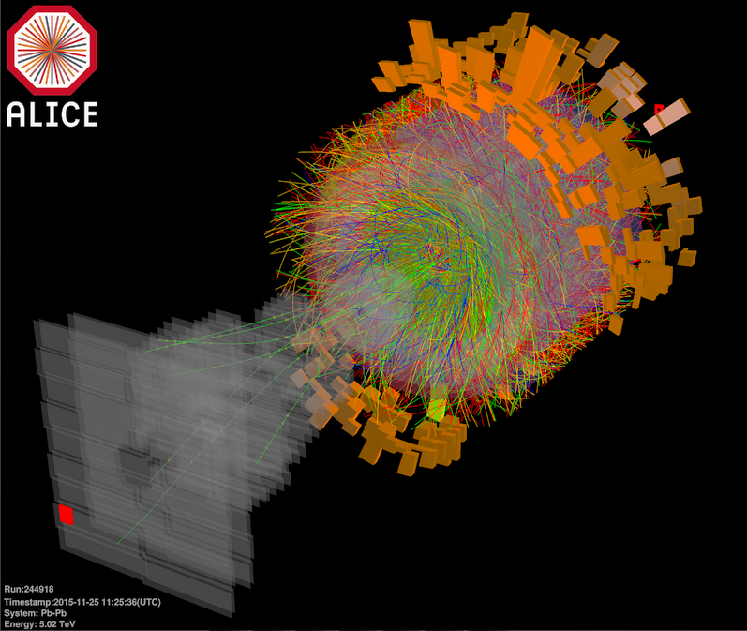
FCPPL-ALICE 2018 report: physics
Production and flow of open heavy flavours via muons in pp, Xe-Xe and Pb-Pb
(Z. Zhang PhD defense, S. Tang, X. Zhang, with LPC/CCNU)
Flow of open heavy flavours via muons in p-Pb and Pb-Pb
(S. Tang co-PhD, X. Zhang, with LPC/CCNU)
Strange D⁺_{s}-meson production in pp collisions, √s = 13 TeV
(Y. Dang Master, Y. Mao, with IPHC/CCNU)
Bottomonium production vs. charged-particle multiplicity in pp collisions, √s = 13 TeV
(Y. Ding PhD CCNU, X. Zhang, with IPNL/LPC/CCNU)
Charged-jet production vs. charged-particle multiplicity in pp collisions, √s = 13 TeV
(Y. Hou, Y. Mao, with LPSC/CCNU)
Isolated photons-π⁰/jet correlations in pp collisions, √s = 13 TeV
(R. Xu PhD, Y. Mao, with LPSC/CCNU)
Electroweak probes: W-boson production in p-Pb and Pb-Pb
(M. Zhao PhD, X. Zhang, with LPC/CIAE/CCNU)

Slide 13
Why to study heavy quarks?
Heavy quarks (c, b) are important probes of the QGP properties
  Heavy quarks produced early in the collision
  Flavour conserved by the strong interaction
      Experience the full collision history
  Heavy quarks loose energy by collisional and/or radiative
  processes while propagating through the medium
  A fraction of heavy-quark pairs bind to form quarkonia
      Quarkonium suppression by colour screening in the QGP
      Recombination of deconfined heavy quarks at hadronization (statistical approach) or in the QGP (kinetic approach)
Measurements in pp collisions
  Test QCD-based calculations
  Crucial reference for p-Pb, Xe-Xe and Pb-Pb collisions
Measurements in p-Pb collisions
  Control experiment to study cold nuclear matter (CNM) effects
pp and p-Pb colllisions not so “simple”
  Multi-parton interactions (MPI)
  Collectivity in small systems

Slide 14
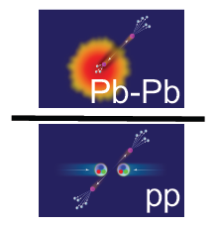
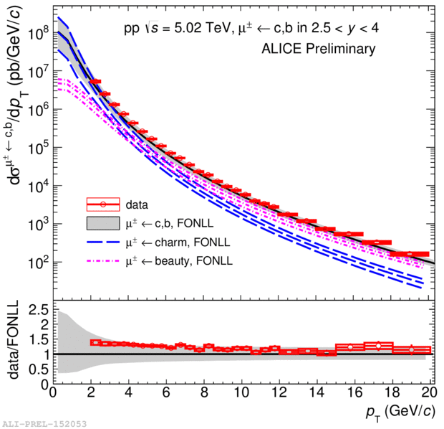
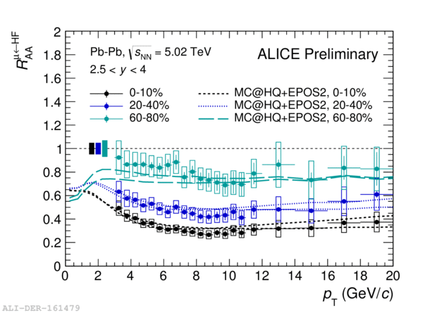
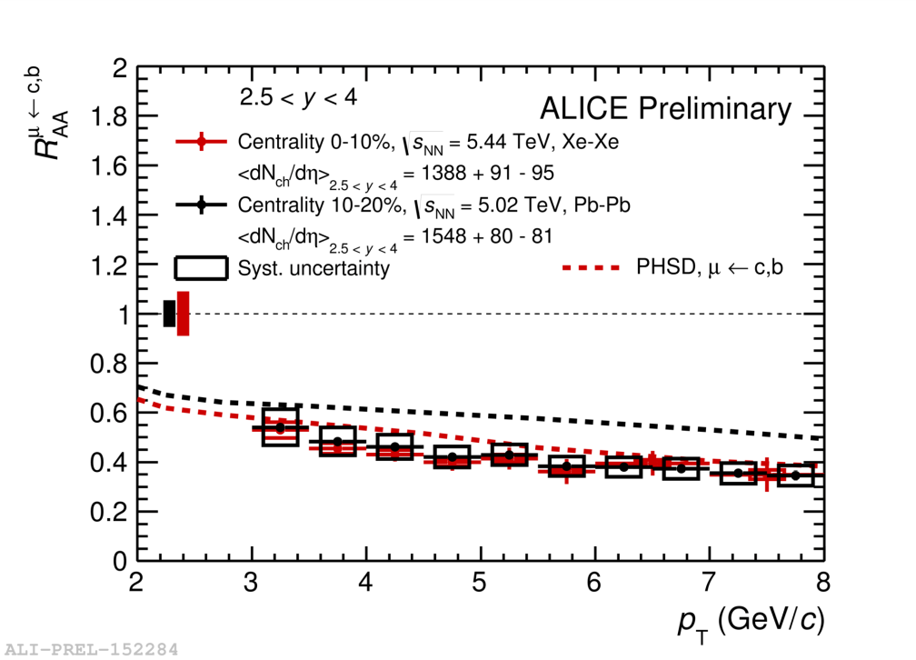
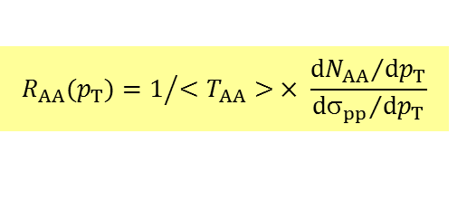
Heavy-flavour hadron decay μ at forward y in pp and AA collisions
$$R_{AA}(p_{T})=1/{<T_{AA}> × \frac{{dN_{AA}}/{dp_{T}}}{{dσ_{pp}}/{dp_{T}}}}$$
pp
Pb-Pb
pp reference: crucial for A-A, well described by
pQCD-based calculations
Strong suppression in Xe-Xe, as in Pb-Pb
Improved precision w.r.t. to LHC Run-1
Potential to constrain transport models
pp: paper submission very soon
Pb-Pb, Xe-Xe: papers in preparation
Talk at HP2018 (Aix-Les-Bains, Oct. 2018)
Zuman Zhang: co-PhD LPC/CCNU, defense on Nov 22nd , 2018, now position at HUE-Wuhan
Pb-Pb vs. Xe-Xe

Slide 15
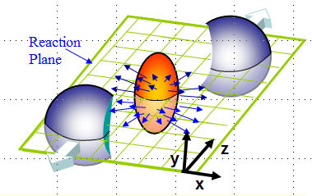
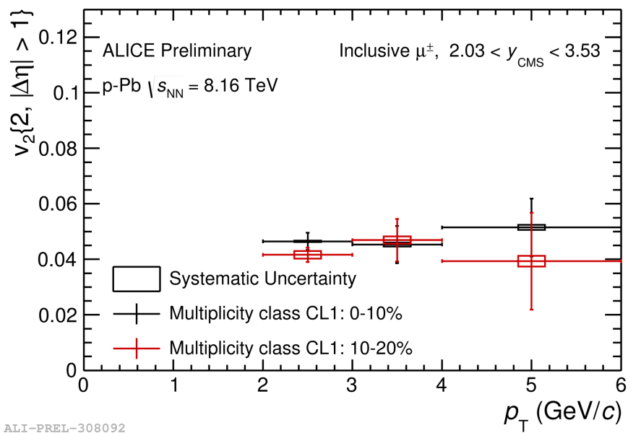
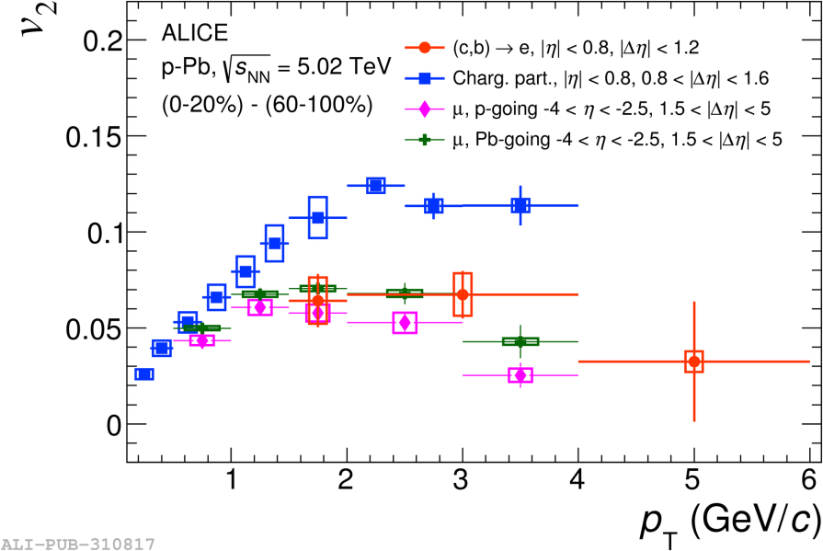
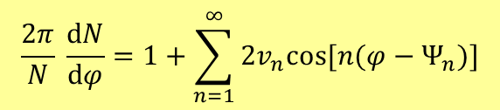
Collectivity of heavy-flavour hadron decay μ in p-Pb collisions
initial spatial anisotropy → momentum anisotropy
$$\frac{2π}{N} \frac{dN}{dφ}=1+\sum_{n=1}^{∞}{2v_{n}cos⁡[n(φ−Ψ_{n})]}$$
v₂ = elliptic flow
p-Pb, √s_{NN}= 8.16 TeV
PRL 122 (2019) 072301
Evidence for collectivity at high multiplicity in p-Pb, √s_{NN}=8.16 TeV at forward y
    Positive muon v₂ with σ > 3 in 2 < p_{T} < 6 GeV/c
Results approved for HP2018 (Aix-Les-Bains, Oct. 2018)
Aim: analysis completed/paper proposal for QM2019 (Wuhan, Nov. 2019)
Next: v₁, v₂ and higher Fourier coefficients in Pb-Pb (high statistics 2018 sample)
Siyu Tang: now co-PhD LPC/CCNU (3-year CSC: 2018-2021)

Slide 16
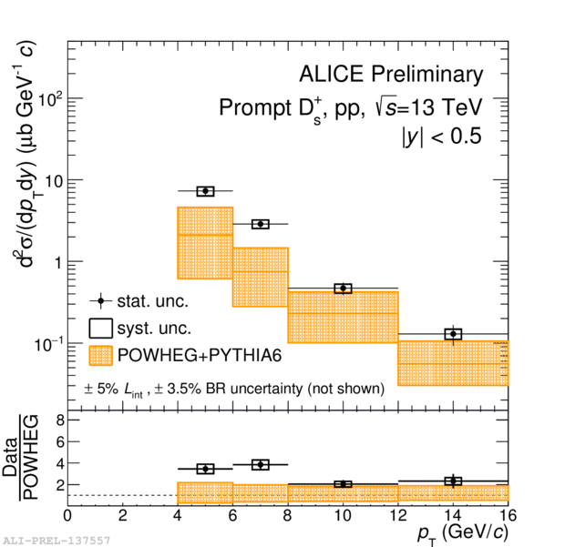
Strange D-meson production
in pp collisions, √s = 13 TeV
D_{s}⁺ → Φ (K⁺K⁻) π⁺ (BR ~ 2.27%)
Reference for measurements in AA collisions
Test production mechanisms and pQCD-based calculations
Ongoing: measurement of the p_{T}-differential D_{s}⁺ production cross section at mid-rapidity
  Analyzing the full run-2 statistics to extend
  the p_{T} interval down to lower p_{T} and up to
  higher p_{T} compared to approved results
  Using machine learning techniques to further improve the statistical significance
Next: differential yields vs. charged-particle multiplicity, D-jet correlation measurements
Yuxing Dang: master student (CCNU), 3-month training at IPHC
In discussion: CSC-grant application for co-PhD CCNU-IPHC in 2020
More: see Xiaoming Zhang’s talk

Slide 17
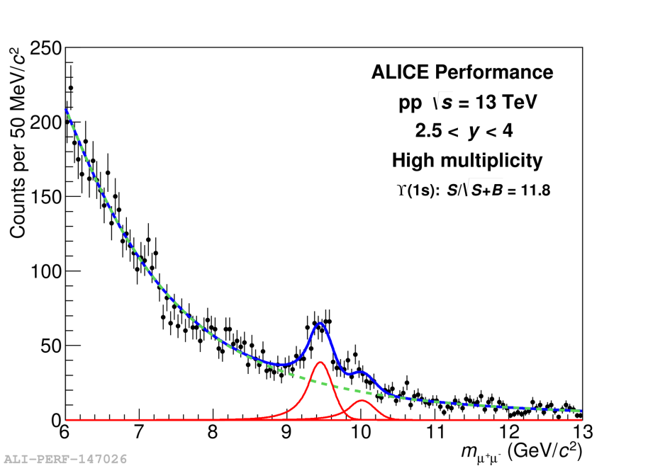
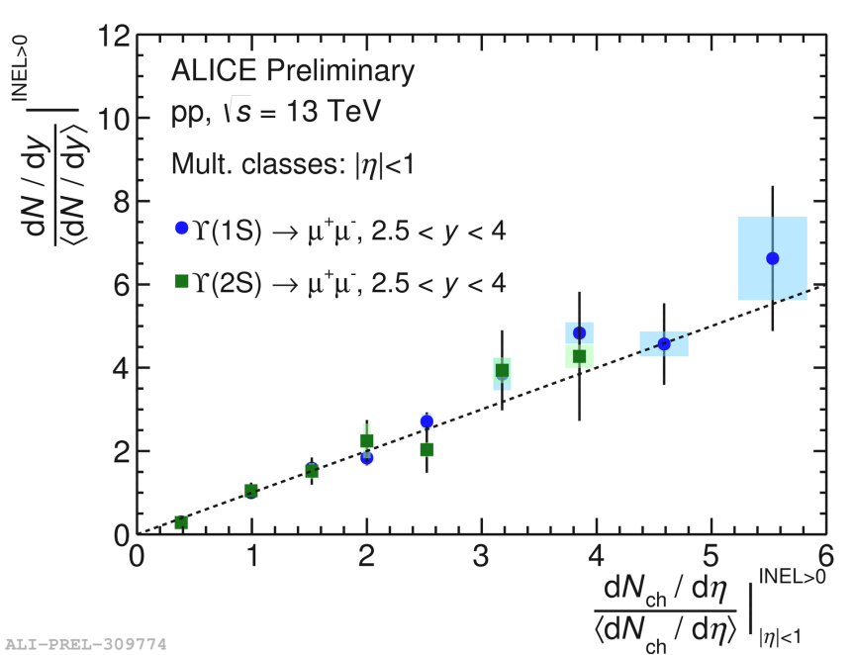
Υ production vs. multiplicity in
pp collisions, √s = 13 TeV
Quarkonium production vs. charged-particle multiplicity: important observable for addressing Multiple Parton Interactions (MPI) and studying interplay between
hard and soft particle production mechanisms
Approximately linear increase of bottomonium yields in pp collisions at √s = 13 TeV
  Results approved for HP2018 (Aix-Les-Bains, Oct. 2018)
  Presented at ATHIC2018
  Ongoing: analysis with full run-2 statistics
Yanchun Ding: PhD student CCNU working with LPC and IPNL, several weeks visit at IPNL & LPC,
2-year CSC grant application for co-PhD CCNU-IPNL submitted
More: see Yanchun Ding’s talk

Slide 18
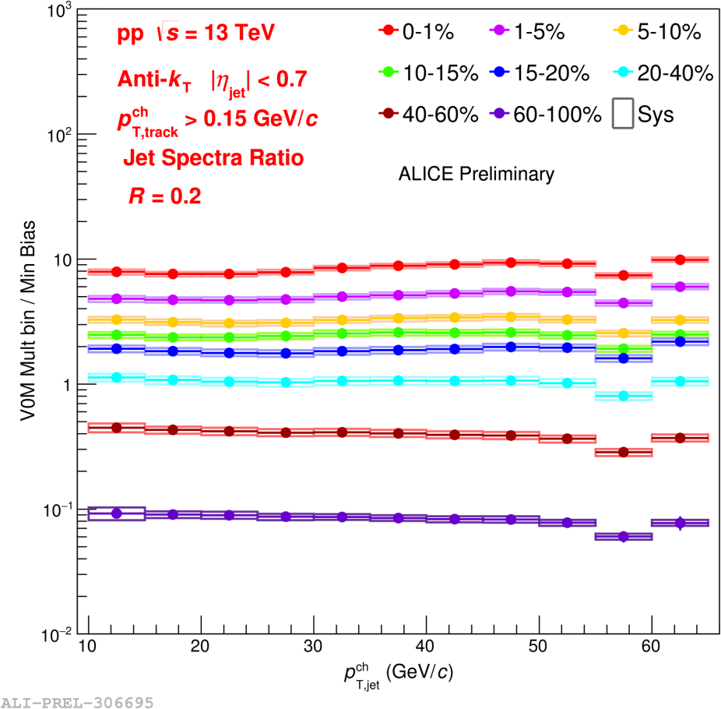
Jet production vs multiplicity in pp collisions, √s = 13 TeV
First measurement of charged-particle jet
production cross section in pp, √s = 13 TeV
Charged-particle jet yield with respect to
inclusive one increases with increasing
multiplicity with no significant dependence on
charged-particle jet p_{T}
Can provide constraints on pQCD-based
calculations and jet-production mechanisms
Results approved for HP2018 (poster)
Analysis being finalized (aim: publication)
Further plans: extend the study to hadron-jet
and/or γ-jet correlations in Pb-Pb
Yongzhen HOU: Master student CCNU, 3-month training at LPSC
In discussion: CSC-grant application for co-PhD CCNU-LPSC in 2020
More: see Yaxian Mao’s talk

Slide 19
2018 ALICE scientific production
(from students, post-docs)
Publications with direct contribution and/or conference proceedings: 9
  With 5 publications in preparation, expected to be submitted this year
    Heavy-flavour hadron decay μ production in pp, Pb-Pb, Xe-Xe (run-2 data), 3 papers
    (Zuman Zhang, Xiaoming Zhang, Siyu Tang)
    K⁰_{S} and Λ production in jets in p-Pb, 1 paper (Xiaoming Zhang)
    Charged-jet cross sections in pp, 1 paper (Y. Mao)
Several internal analysis notes
Many results approved as preliminary
Talks/posters in international conferences & workshops: 27
  “Heavy-flavour production at LHC energies using the ALICE Muon Spectrometer” (India, Feb. 2018), ALICE Physics Week (Italy, Feb. 2018), LHCC (CERN, Feb. 2018), QM2018 (Italy, May 2018), FCPPL (May, 2018), Charm Physics (Russia, May 2018), “Opportunities and Challenges with jets and beyond” (China, June 2018), QGP France (France, July 2018), “Symposium on Multi-particle Dynamics” (Singapore, Sep. 2018), HP2018 (France, Oct. 2018), ATHIC2018 (China, Nov. 2018), “ALICE ITS Upgrade, MFT and O² Asian Workshop” (Japan, June 2018; Korea, Nov. 2018)
Many presentations in weekly ALICE Physics Analysis Group meetings & monthly ALICE Physics Working Group meetings, ALICE Physics Forum

Slide 20

ALICE upgrade for run 3-4 (2021-2029)
High precision measurements of rare probes down to the low p_{T} region
  → x 100 larger minimum-bias sample compared to Run 2 (~10¹¹ events)
Increase readout rate to 50 kHz, presently limited to ~1 kHz
Improvement of pointing resolution at both central and forward rapidity
New Readout
Electronics
New MB
FIT
New Inner
Tracking System
New
beam pipe
Muon Forward
Tracker
New TPC GEM
Chambers
Integrated Offline-Online O²
More: see Antonio Uras’s talk

Slide 21
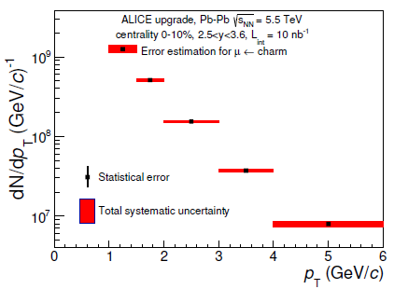
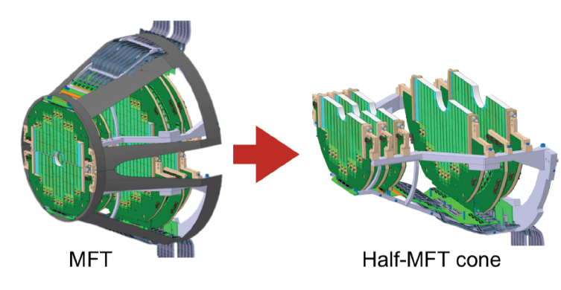
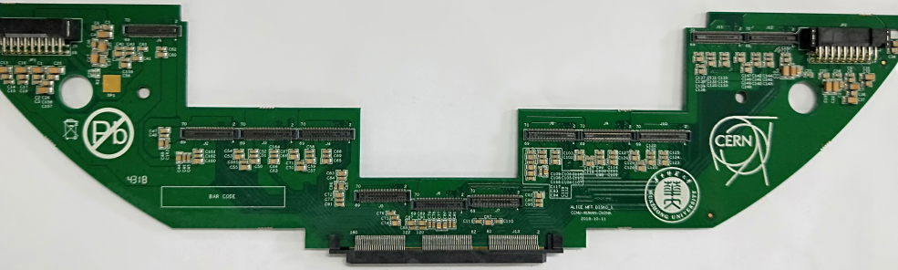
Common contributions to ALICE upgrade
Involvement of CCNU in the ITS-MFT upgrade:
Performance studies for both UITS & MFT: charm
& beauty measurements via muons with MFT-MUON
(LPC/CCNU) and D-meson fragmentation function
with UITS
Contribution to the global readout electronics
of MFT, Printed Circuit Boards (PCB):
  Design optimization, pre-series PCB produced/tested
  Final production started end of 2018, will be finished
  in summer 2019 (with IPNL, in particular)
charm
CERN-LHCC-2015-001
Ex: PCB disk 0/1
10 half-disks, 2 detection plane each in the muon spectrometer
acceptance, between absorber & interaction point
920 silicon pixel sensors on 280 ladders of 2 to 5 sensors each
More: see Antonio Uras’s talk

Slide 22
Prospects in 2019 (I)
ALICE China cluster-IN2P3/CEA strongly involved in Run-2 analyses (pp,
p-Pb, Xe-Xe and Pb-Pb collisions)
  Open heavy-flavour measurements in small and heavy systems at forward y
  LPC/CCNU Collab.: Siyu Tang (co-PhD), WenJing Zhang (Master), Xiaoming Zhang
  (physicist), Zuman Zhang (physicist HUE-CCNU)
  Bottomonium measurements at forward y in pp and Pb-Pb collisions
  IPNL/CCNU Collab.: Yanchun Ding (PhD, application for a CSC
  grant submitted), Xiaoming Zhang (physicist)
  Quarkonia-jet and open heavy-flavour hadron-jet correlations in pp, Pb-Pb
  IPHC/USTC Collab.: Yitao Wu (Master, co-PhD CSC application
  submitted), Zebo Tang (physicist)
  Jet-hadron measurements at mid-rapidity
  LPSC/IPHC/CCNU Collab.: Yongzhen HOU (Master), Yuxing Dang (Master),
  Yaxian Mao (physicist)
  γ/π⁰-jet correlation measurements in pp
  LPSC/CCNU Collab.: Ran Xu (PhD, application for a CSC grant submitted),
  Yaxian Mao (physicist)
  W-boson production in Pb-Pb
  LPC/CCNU/CIAE Collab.: Mingrui Zhao (PhD), Xiaoming Zhang (physicist)
  Magnetic field effects on directed flow
  SINAP/CCNU Collab.: Qiye Shou (physicist), Xiaoming Zhang (physicist)

Slide 23
Prospects in 2019 (II)
Continue to strengthen the involvements in the ALICE upgrade projects
  Technical involvements (UITS-MFT):
    UITS: module assembly, IPHC/ LPSC and CCNU/USTC
    MFT: LPC/IPNL/Subatch/IRFU-Saclay and CCNU
  Participation to production, Installation, commissioning of both UITS and MFT
  Software developments (UITS with O² framework): IHPC/CCNU Collaboration
  Preparation of physics program with Run-3 & Run-4, ongoing performance studies
    MFT: measurements of charm and beauty decay muons, separetely,
  quarkonia and low mass resonances:
    UITS: charmed baryons and mesons via hadronic and semi-electronic decays, jet measurements, ϒ-neutral meson correlations with charged jets
  MFT: Siyu Tang, Yanchun Ding, Wenjing Zhang, Mingrui Zhao + physicists
  UITS: Yitao Wu, Ran Xu, Yongzhen Hou, Yuxing Dang + physicists
FCPPL support needed for student, senior physicist & technician/engineer exchanges between China-France

Slide 24
Prospects in 2019 (III)
Funding from FCPPL
  Travel and stay costs for attending the 12th FCPPL workshop (Shanghai)
  Travel and stay costs for 4 Master students (2-3 month each, to be followed by co-PhDs end of 2020 if CSC grant successful)
  Travel and stay costs for 2-3 PhDs depending on CSC results
  Travel and stay costs for 3 senior physicists from China (CCNU, USTC) in French institutes
  Travel and stay costs for 7 senior physicists from France to China
            Estimated costs to realize 2019 prospects~ 31kEuros
Other fundings
  Three ongoing co-PhD demands, CSC application submitted (IPNL, IPHC, LPSC)

Slide 25
Conclusion
Solid China-France cooperation
in the ALICE scientific program
with a recognized visibility within ALICE
Strong contribution to data taking, data analysis and performance studies
  Excellent contributions of students
  Significant contributions to scientific production
  Many talks in conferences
Contributions to ALICE upgrades: detector and software developments
Preparation of the Run-3 & Run-4 physics program
Continue to extend the collaboration in more and more
common activities
Need to strengthen manpower (new student exchanges and short stay physicists) and funding

Slide 26
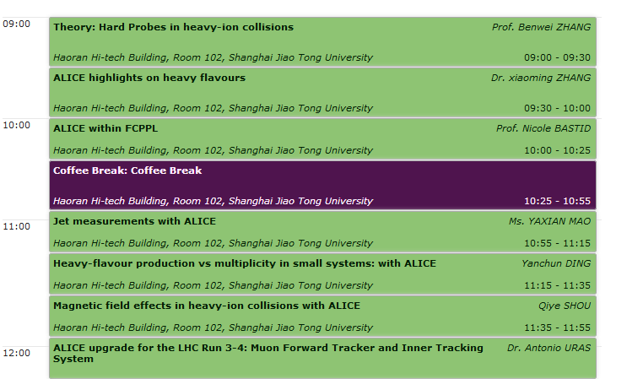
Timetable of the session

Slide 27
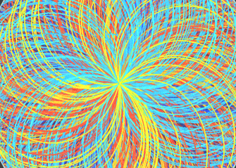
Thank you for your attention
Merci pour votre attention
感谢您的聆听

Slide 28
Why to study heavy quarks?
Heavy quarks (c, b) are important probes of the QGP properties
  Heavy quarks produced early in the collision
  Flavour conserved by the strong interaction
      Experience the full collision history
  Heavy quarks loose energy by collisional and/or radiative processes while propagating through the medium
  A fraction of heavy-quark pairs bind to form quarkonia
      Quarkonium suppression:by colour screening in the QGP
      Recombination of deconfined heavy quarks at hadronization (statistical approach) or in the QGP (kinetic approach)
Measurements in pp collisions
  Test QCD-based calculations
  Crucial reference for p-Pb, Xe-Xe and Pb-Pb collisions
Measurements in p-Pb collisions
  Control experiment to study cold nuclear matter (CNM) effects
      Nuclear modification of parton distribution functions (PDF),
      k_{T} broadening, energy loss, nuclear absorption...
pp and p-Pb colllisions not so “simple”
  Multi-parton interactions (MPI)
  Collectivity in small systems

Slide 29
France and China in ALICE involvements within FCPPL
Very strong cooperation program between the ALICE groups from
IN2P3/CEA (France) and CCNU-Wuhan since several years
Data analysis
  Hard probes: open and hidden flavours, jets,
  W bosons
  Low mass resonances
  γ/π⁰-jet correlations
Performance studies
  Open heavy flavours with MUON & MFT
  γ(π⁰) & jets with EMCAL, DCal & PHOS
  D fragmentation function with UITS
Data taking
Offline, online, computing
Detector: R&D, installation, operation
Upgrade projects: UITS-MFT
Present responsibilities:
  Management Board, Conference Committee, Physics Analysis Group, Physics Working Group, detectors & upgrades
Future: extend the collaboration between French & Chinese institutes
LHC Run-2 analyses, detector upgrade & preparation of physics program beyond
2021 (Run-3 & Run-4)

Slide 30
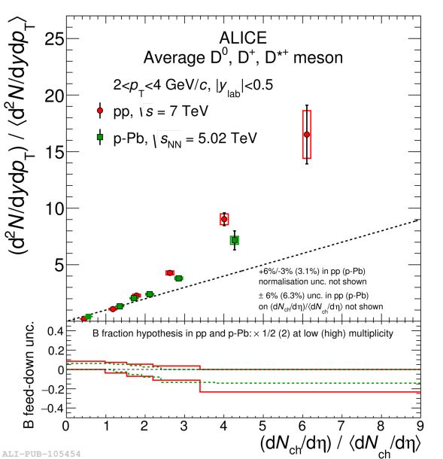
Double-parton scattering measurements in p-Pb collisions with ALICE
Particle yields vs. charged-particle multiplicity
  Key observable to study Multi-Parton Interactions
Investigate Double Parton Scattering (DPS)
in the heavy-flavour sector focusing on
p-Pb collisions (enhanced probability of DPS
compared to pp collisions)
  High-p_{T} muons at forward rapidity
  (heavy-flavour decay muons, mainly)
  search for same-sign high-p_{T} muons
Feasibility study ongoing with MC
ALICE, JHEP 09 (2015) 148
Paolo Bartalini (CCNU),
Diego Stocco (Subatech)
ALICE, PLB 708 (2012) 265

Slide 31
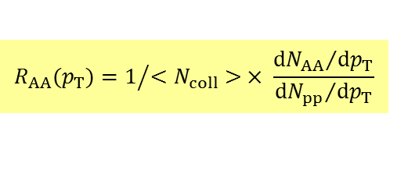
Open heavy-flavour production in heavy-ion collisions
Charm and beauty quarks produced in initial hard scatterings with a short formation time, experience the full collision history
  Sensitive probes of the medium properties
Open heavy flavours in heavy-ion collisions probe
  In-medium parton energy loss
  Heavy quark participation in the collective expansion
Strong suppression of heavy-flavour hadron decay muons in Xe-Xe collisions, similar to
that measured in Pb-Pb collisions
Improved precision w.r.t. to LHC Run-1
New constraints on energy loss models
Results presented at QM2018 (Venice, Italy)
Publications of pp and Pb-Pb results in preparation
Zuman Zhang (co-PhD LPC/CCNU), Xiaoming Zhang (CCNU)
More: see Zuman Zhang’s talk
$$R_{AA}(p_{T})=1/{<N_{coll}> × \frac{{dN_{AA}}/{dp_{T}}}{{dN_{pp}}/{dp_{T}}}}$$

Slide 32
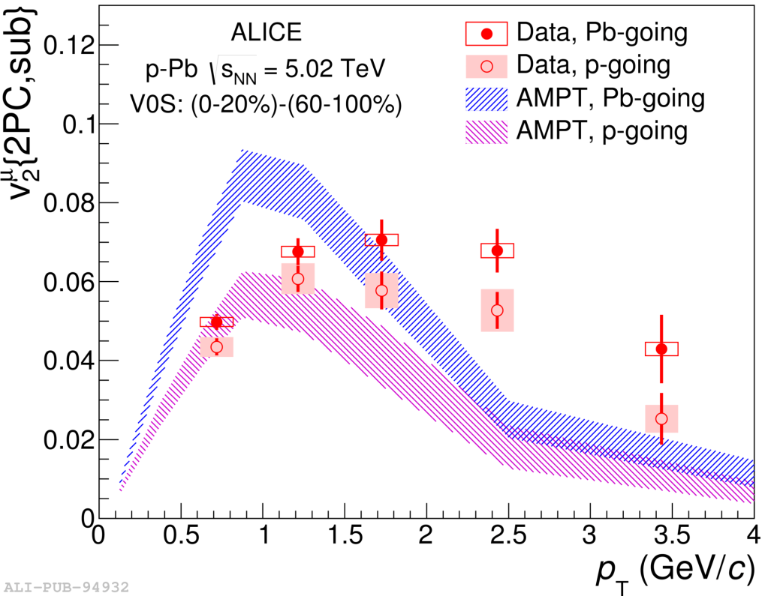

Collectivity of heavy-flavour hadron decay μ in small collision systems
initial spatial anisotropy → momentum anisotropy
$$\frac{2π}{N} \frac{dN}{dφ}=1+\sum_{n=1}^{∞}{2v_{n}cos⁡[n(φ−Ψ_{n})]}$$
v₂ = elliptic flow
Complements R_{pPb} measurements
Positive v₂ in central (0-20%) collisions as
observed in Pb-Pb collisions
→ evidence for collectivity in small
systems
  Analysis ongoing with run-2 p-Pb data at
  8.16 TeV with cumulants by extending the
  measurement to higher p_{T} and with
  improved precision
Aim: analysis to be approved for HP2018 (Oct. 2018, Aix Les bains)
Siyu Tang (master II, 3-month training at
LPC then co-PhD (CSC grant application submitted), Xiaoming Zhang (CCNU)
Phys. Lett. B 753 (2016) 126

Slide 33
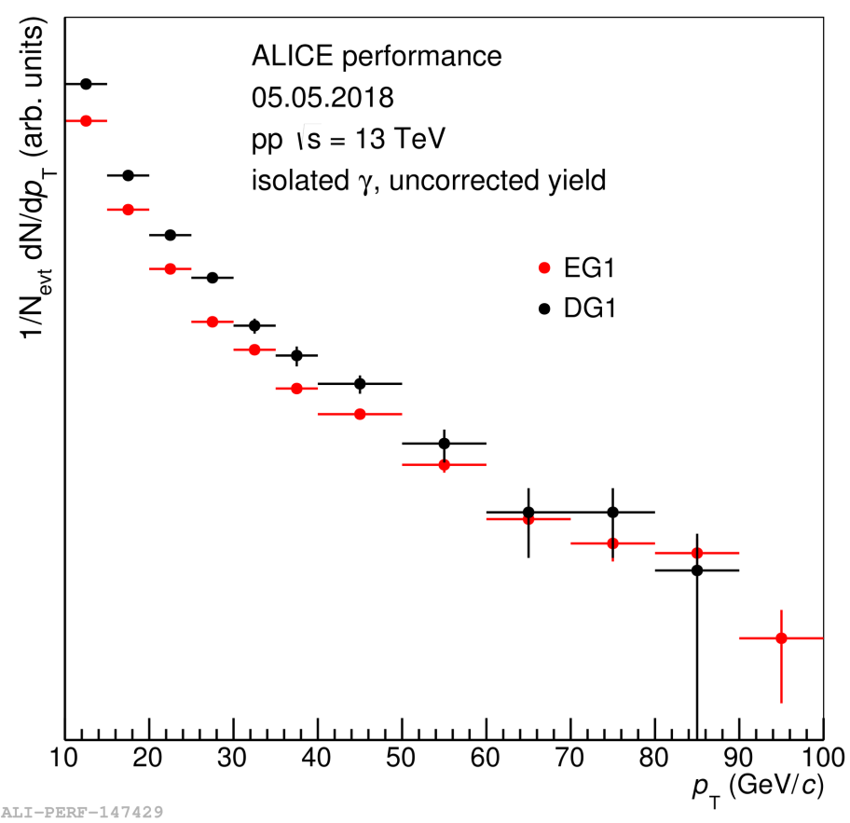
Isolated photon - π⁰ correlations in pp collisions, 13 TeV
Isolated γ-hadron correlations in pp collisions:
  Baseline for measurements in heavy-ion collisions
  Study of parton fragmentation function
  Constraints on pQCD-based calculations
Measurement of isolated ϒ-π⁰ correlations in pp
collisions at √s = 13 TeV ongoing
  Performance results approved and shown as a poster at HP2018
Ran Xu: PhD student at CCNU, work in collaboration with LPSC
2-year CSC grant application for co-PhD CCNU-LPSC submitted
More: see Yaxian Mao’s talk

Slide 34
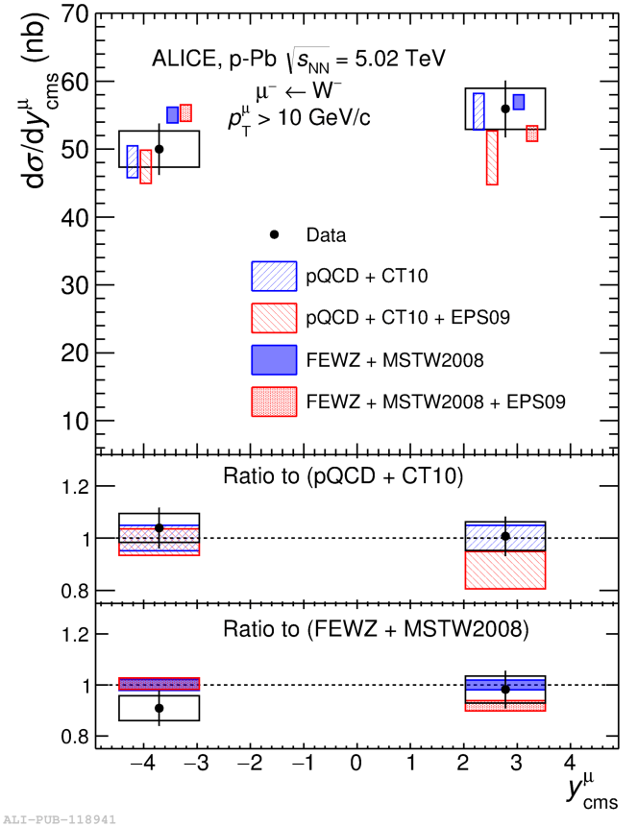
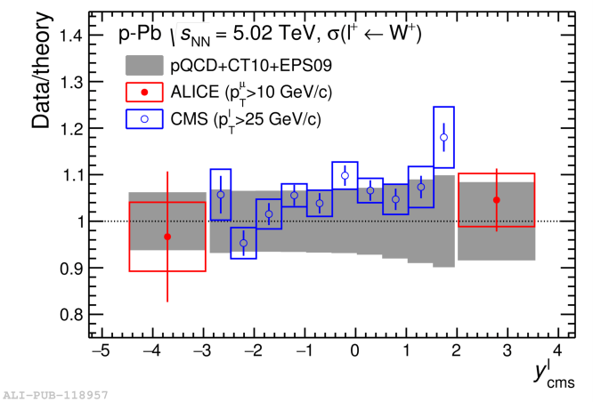
W-boson production via muons in p-Pb collisions
W bosons in heavy-ion collisions: produced in initial hard scatterings, unaffected by the strong interaction
Sensitive to the nuclear modification of the PDFs
Reference for hard-probe measurements
First measurement at forward & backward rapidity in
p-Pb collisions
In agreement with model predictions with and without including nPDFs
Calculations with nPDFs describe ALICE & CMS data over the full rapidity range
Published in JHEP 02 (2017) 077
Jianhui Zhu (co-PhD Subatech/CCNU)
PhD defense: April 1st, 2017
Measurements in Pb-Pb ongoing
Mingrui Zhao, PhD at CIAE Beijing

Slide 35
Double-parton scattering measurements in p-Pb collisions with ALICE
Particle yields vs. charged-particle multiplicity
  Key observable to study Multi-Parton Interactions
Investigate Double Parton Scattering (DPS)
in the heavy-flavour sector focusing on
p-Pb collisions (enhanced probability of DPS
compared to pp collisions)
  High-p_{T} muons at forward rapidity
  (heavy-flavour decay muons, mainly)
  search for same-sign high-p_{T} muons
Feasibility study ongoing with MC
ALICE, JHEP 09 (2015) 148
Paolo Bartalini (CCNU),
Diego Stocco (Subatech)
ALICE, PLB 708 (2012) 265

Slide 36
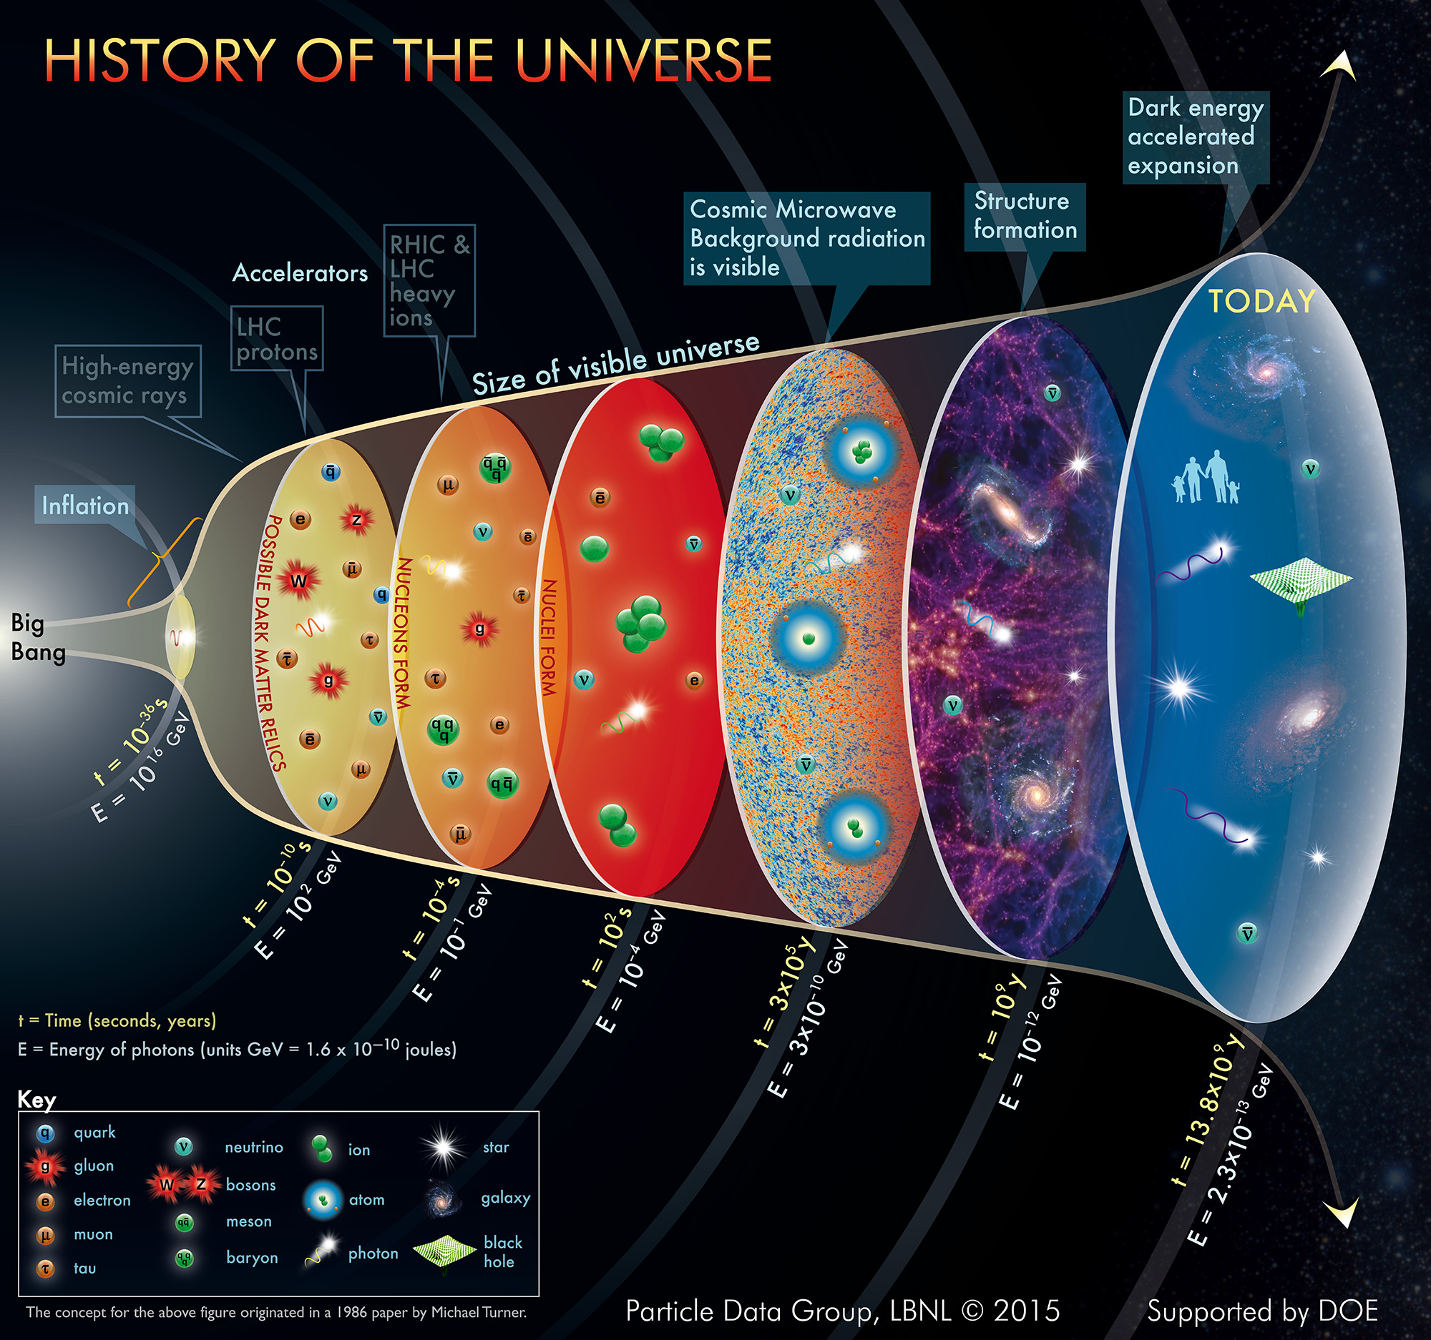
ALICE at the LHC CERN
Quark-hadron
phase transition

