Slide 1
EXCURSION
(This file can be downloaded from excursion session.)
Buses will be waiting next to the canteen, with labels
‘FCPPL2019 Shanghai Museum’, contact: Ms. YANG Zi，86-150 2667 7730
‘FCPPL2019 Yu Garden’ ， contact, Ms. FANG Ying，86-182 1725 3266
Please bind the route you registered. One of the buses is already FULL.
Buses will depart at 13:30!

Slide 2
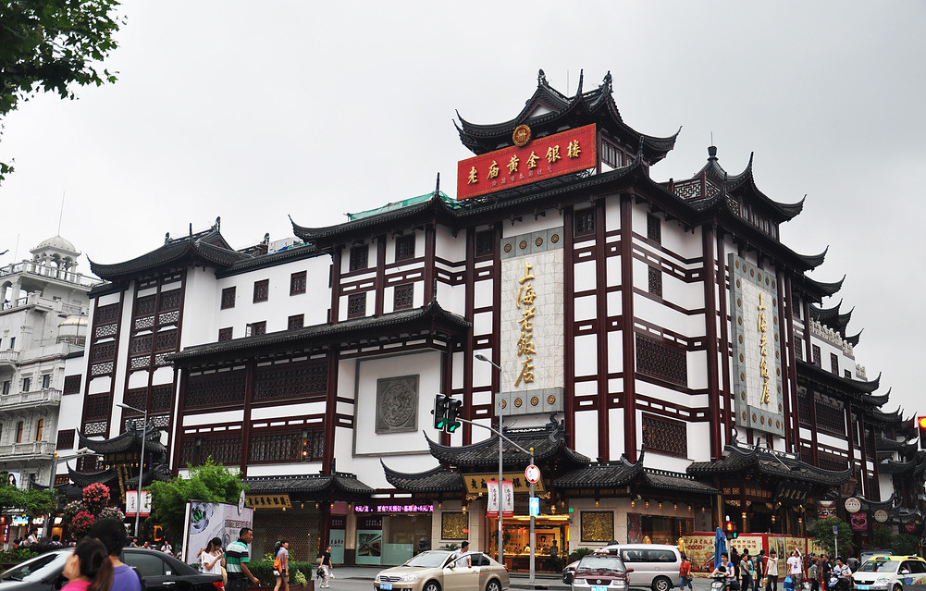
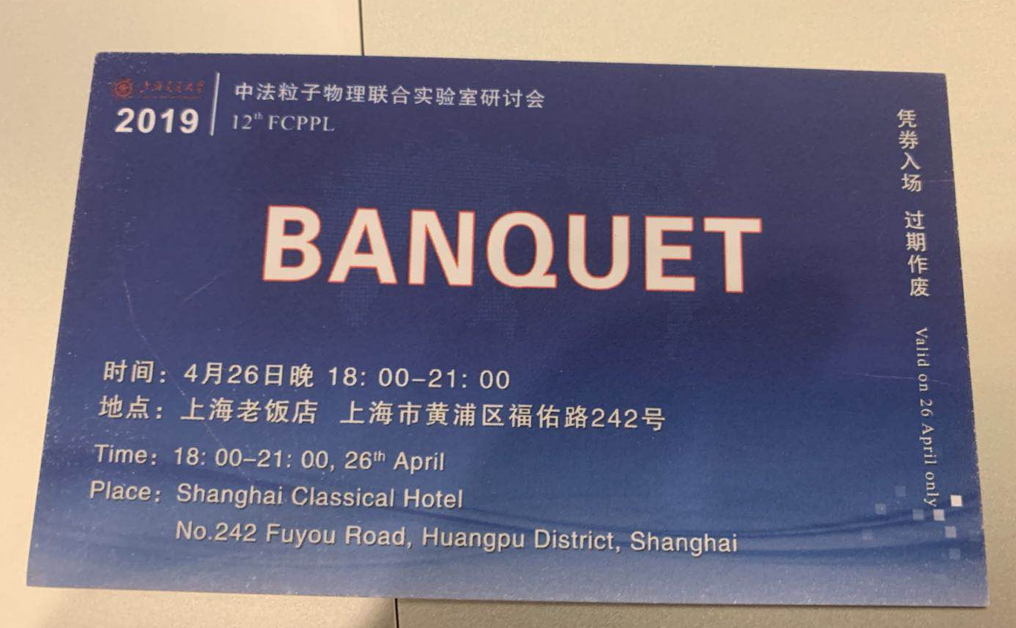
BANQUET
Banquet will take place at 18:30, at Shanghai Classic Restaurant (上海老饭店),
No. 242 Fuyou Road (福佑路242号)
Phone: +86 21 63111777
A transportation for Steering Committee will be arranged
In case you missed bus or want to go there yourself, show the following card for help.
No Bus after banquet! You are suggested to hang out around the area!

