Slide 1
The initial and final temperatures in some high energy collisions
Reporter : Qi Wang(王琪）
Supervisor : Fu-Hu Liu(刘福虎）
The 18th national congress on medium and high energy nuclear physics（2019.6.21）

Slide 2
Results and discussion
Formalism and method
Background
Outline
Summary and conclusion

Slide 3
Background
The hagedorn function(inverse power-law)
The initial
state temperature
The Erlang distribution
The final
state temperature
Distribution of transverse momentum
The blast-wave model
The simplest standard distribution
The simplest Boltzmann distribution

Slide 4
Background
Analysis of transverse momentum spectra
The Erlang distribution
(the folding of n exponential functions)
The initial state temperature

Slide 5
Background
Analysis of transverse momentum spectra
Blast-wave model
The final state temperature
Boltzmann-Gibbs statistics
Tsallis statisics

Slide 6
Background
The comparisons between a few distributions of transverse momenta are useful to understand carefully different distributions in high energy collisions.
The excitation functions of the initial and final state temperatures are very interesting for us to study the properties of high energy collisions.
Although there are many similar studies on this topic, the results seem to be inconsistent.

Slide 7
Formalism and method
The hagedorn function( inverse power-law ) and its modified forms
R. Odorico, Phys. Lett. B
118, 151 (1982).
K.Aamodt et al.(ALICE Collaboration) Phys. Lett. B 693, 53 (2010).
A.De Falco (for the ALICE Collaboration)
J. Phys. G 38, 124083 (2011).
B.Abelev et al.(ALICE Collaboration)
Phys. Lett. B 708,265 (2012).

Slide 8
Formalism and method
The simplest standard distribution and its modified forms
J. Cleymans, D. Worku
Eur. Phys. J. A 48, 160 (2012).
E. Schnedermann, J. Sollfrank, U. W. Heinz
Phys. Rev. C 48, 2462 (1993).
H. Zhao, F.-H. Liu
Adv.High Energy Phys. 2014, 742193 (2014).

Slide 9
Formalism and method
The simplest Boltzmann distribution and its modified forms
J. Cleymans, D. Worku,
Eur. Phys. J. A 48, 160 (2012).

Slide 10
Formalism and method
The Erlang distribution
The initial state temperature
F.-H. Liu, J.-S. Li, Phys. Rev. C 78, 044602 (2008).
[1] Gutay L G, Hirsch A S, Pajares C, Scharenberg R P and Srivastava B K 2015 Int. J. Mod. Phys. E 24 1550101.
[2] Hirsch A S, Pajares C, Scharenberg R P and Srivastava B K 2018 (arXiv:1803.02301 [hep-ph]).

Slide 11
Formalism and method
The blast-wave fit
Boltzmann-Gibbs statistics
Tsallis statistics
E. Schnedermann, J. Sollfrank, U. Heinz
Phys. Rev. C 48, 2462 (1993)
Z.B. Tang, Y.C. Xu, L.J. Ruan, G. van Buren, F.Q.
Wang, Z.B. Xu, Phys. Rev. C 79, 051901(R) (2009).

Slide 12
Formalism and method
G. Agakishiev et al. (STAR Collaboration), Identified hadron compositions in p+p and Au+Au collisions at high transverse momenta at . Phys. Rev. Lett. 108, 072302 (2012). https://doi.org/10.1103/PhysRevLett.108.072302
The blast-wave fit
The boost angle
The self-similar flow profile
The transverse flow velocity
The final state temperature T₀

Slide 13
Results and discussion
The experiental data
Collabration | Particles | Energy
STAR | Au+Au | 7.7, 11.5, 19.6, 27, 36, 62.4, 130 GeV
LHCB | p+He | 110 GeV
STAR/PHENIX | Au+Au | 200 GeV
STAR | d+Au | 200 GeV
ALICE | Pb+Pb | 2.76 TeV

Slide 14
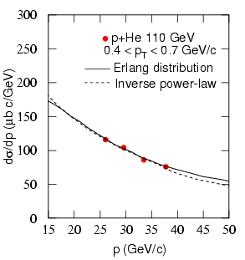
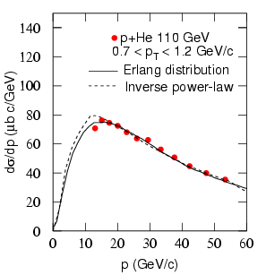
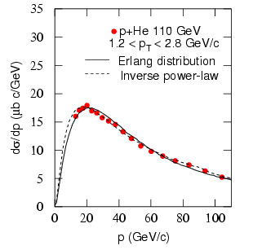
Results The hagedorn function( inverse power-law ) and its modified forms

Slide 15
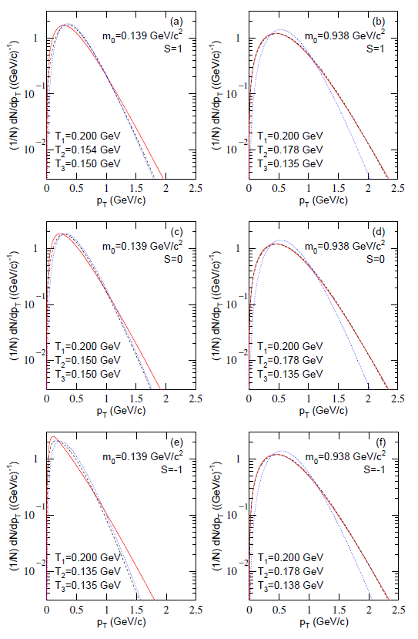
Results The simplest standard distribution and its modified forms

Slide 16
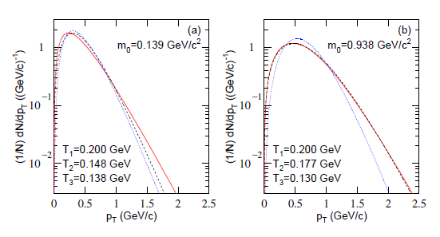
Results The simplest Boltzmann distribution and its modified forms

Slide 17
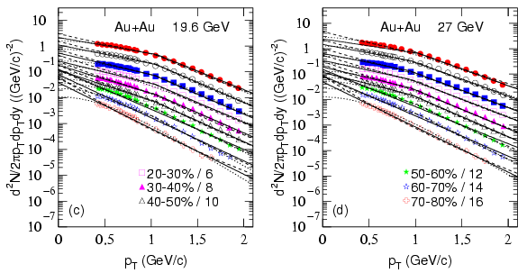
Results The Erlang distribution, the inverse power-law and blast-wave model

Slide 18
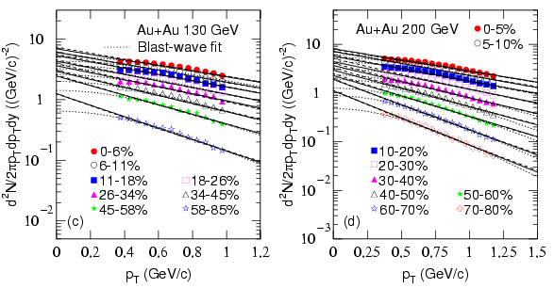
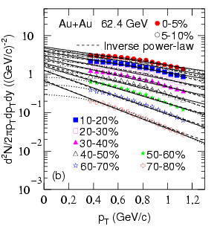
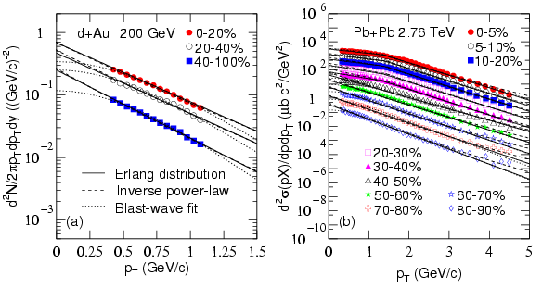
Results The Erlang distribution, the inverse power-law and blast-wave model

Slide 19
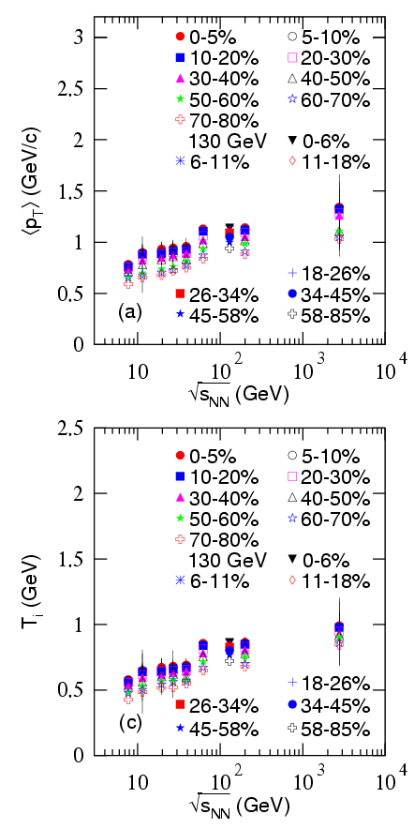
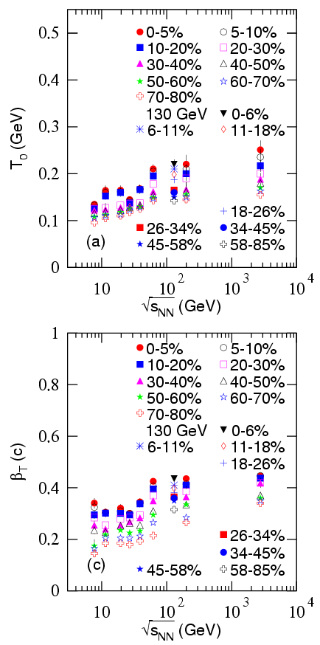
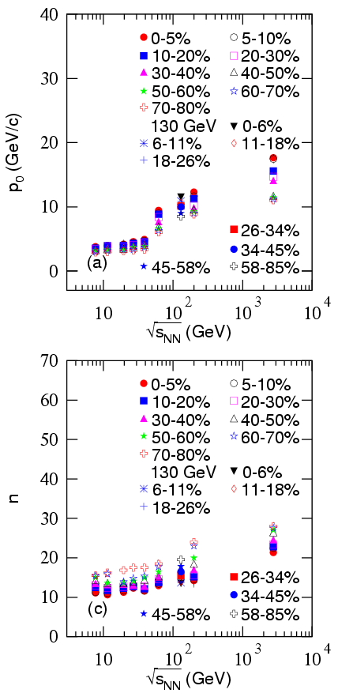
Results Dependences of parameters on energy in different centrality intervals

Slide 20
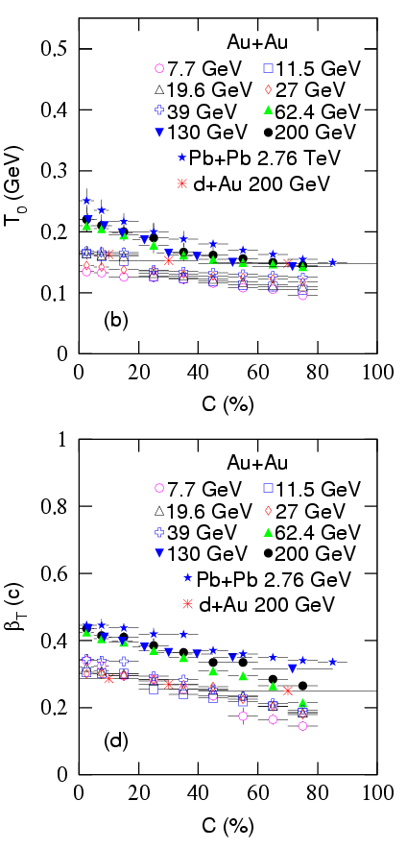
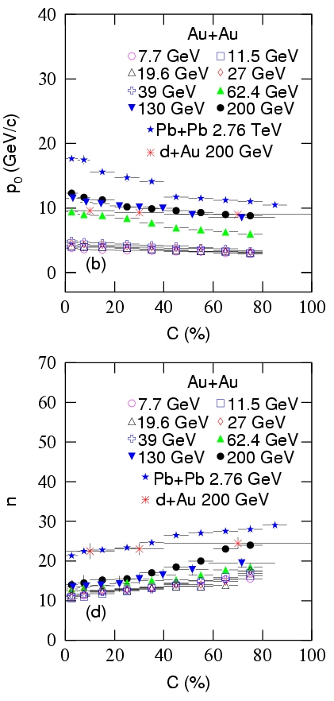
Results Dependences of parameters on centrality at different energies

Slide 21
Summary and conclusion
For the Hagedorn function, the effect of rest mass in the first modified form is very small due to large transverse momentum. The other two modified forms describe narrow transverse momentum range. For the simplest standard and Boltzmann distributions, the modified forms contribute a wider transverse momentum range than the original distributions.
The excitation functions of show a drop at 27 GeV, and an increase from dozens of GeV to 2.76 TeV. The excitation functions of show an increase from 7.7 GeV to 2.76 TeV.
The mean transverse momentum and the initial state temperature increase approximately linearly with the increase of logarithmic collision energy.
It is a long-term target to search for the relation between the value of prameter and logarithmic collision energy.

Slide 22
Thank for your attention!
This work was supported by the National Natural Science Foundation of China under Grant Nos.11575103 and 11747319, the Shanxi Provincial Natural Science Foundation under Grant No. 201701D121005, and the Fund for Shanxi “1331 Project” Key Subjects Construction.

