Slide 1
第十八届全国中高能核物理大会
Fluctuations and correlations of conserved charges in the 2 + 1 flavor low energy effective model
Rui Wen
wwrr09@mail.dlut.edu.cn
2019.6.24
Based on: R.W. , Hunag Chuang, Wei-jie Fu, Phys. Rev. D 99, 094019
R.W. , Wei-jie Fu, in preparation

Slide 2
Outline
Introduction
Effective action and flow equation
Result
Summary and outlook

Slide 3
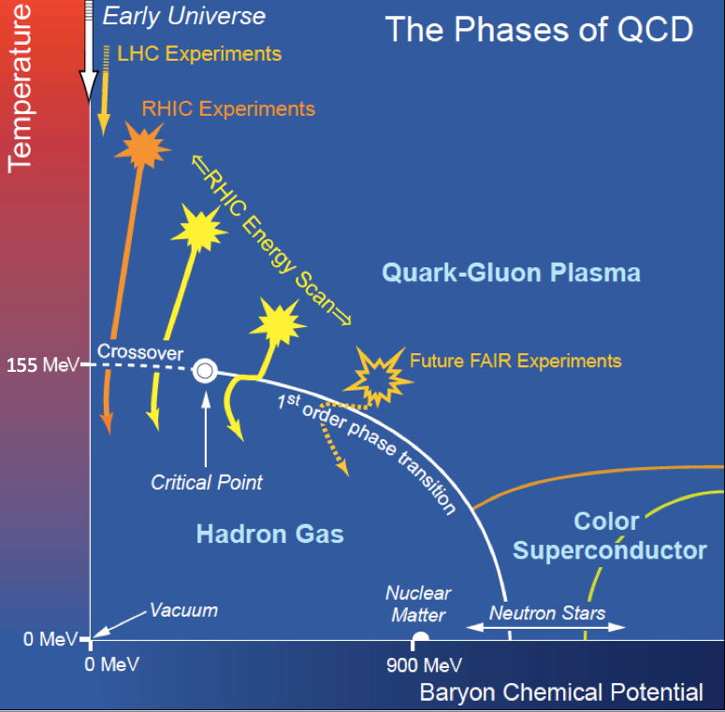
Introduction
The Wetterich equation:
The Hot QCD White Paper (2015)

Slide 4
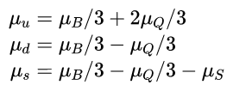
The 2 + 1 flavor PQM scale-dependant effective action
local potential approximation (LPA):
The quark chemical potential:

Slide 5
The 2 + 1 flavor PQM scale-dependant effective action
$Σ$means the meson field:
The covariant derivative of meson fields:
The meson effctive potential:

Slide 6
The 2 + 1 flavor PQM scale-dependant effective action
The Polyakov loops:
Glue potential
[arXiv:1307.5958] Pok Man Lo et al.

Slide 7
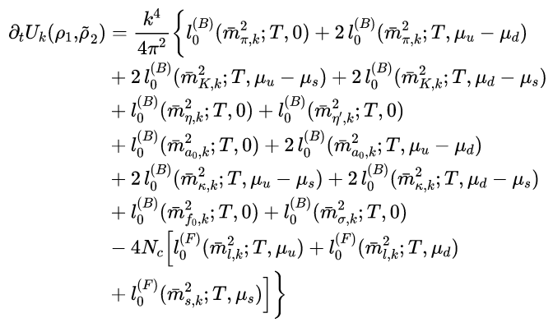
Flow equation

Slide 8
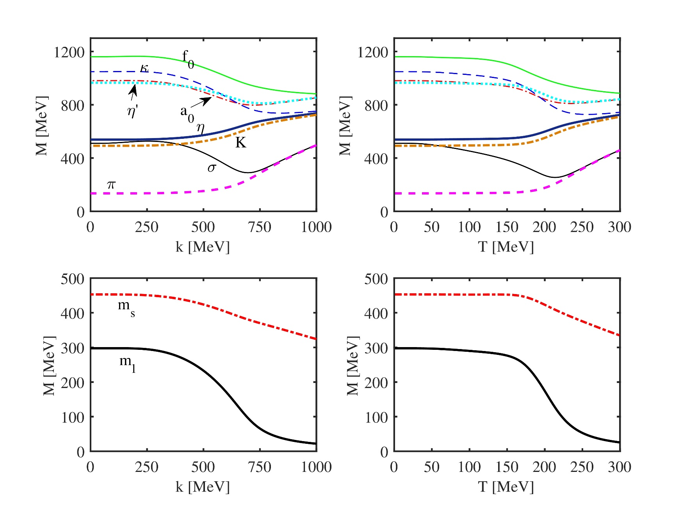
The meson and quark masses

Slide 9
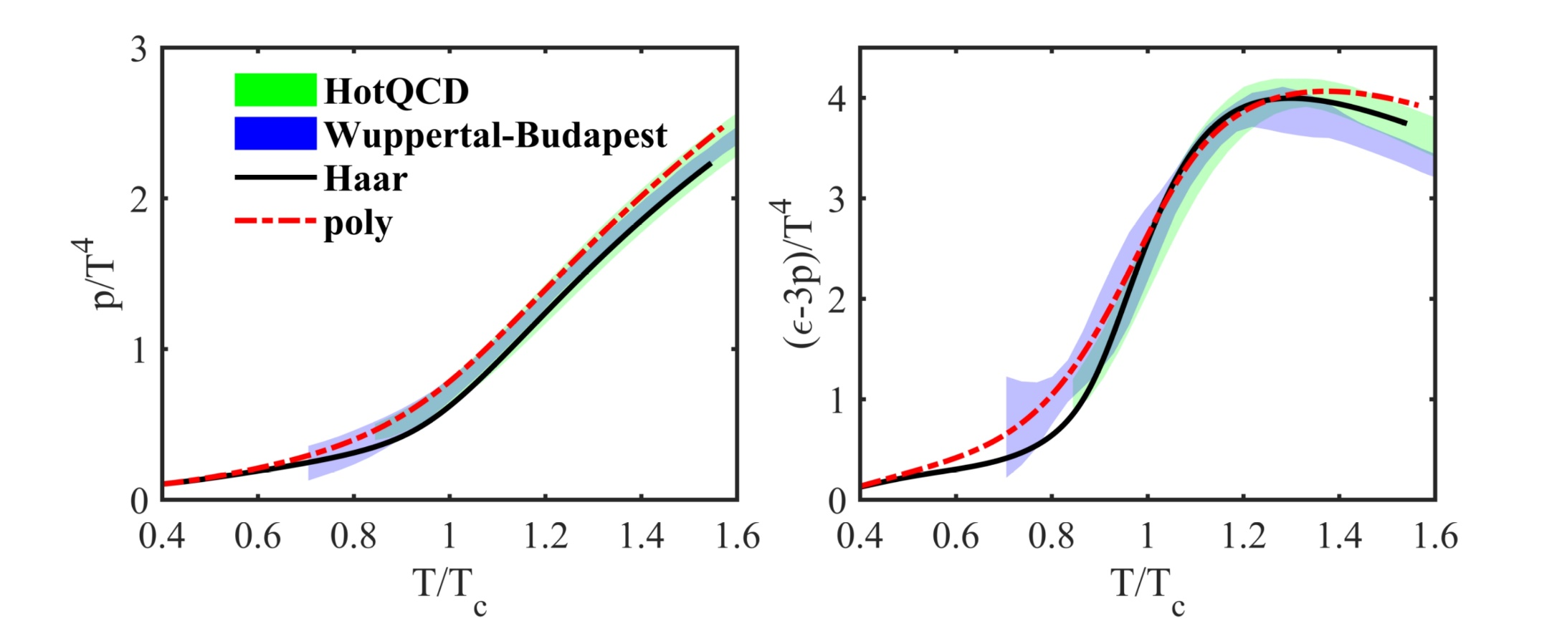
The pressure and the trace anomaly
Tc=194[MeV]
HotQCD [arXiv:1407.6387] Tc=154[MeV]
Wuppertal-Budapest [arXiv:1309.5258] Tc=156[MeV]

Slide 10
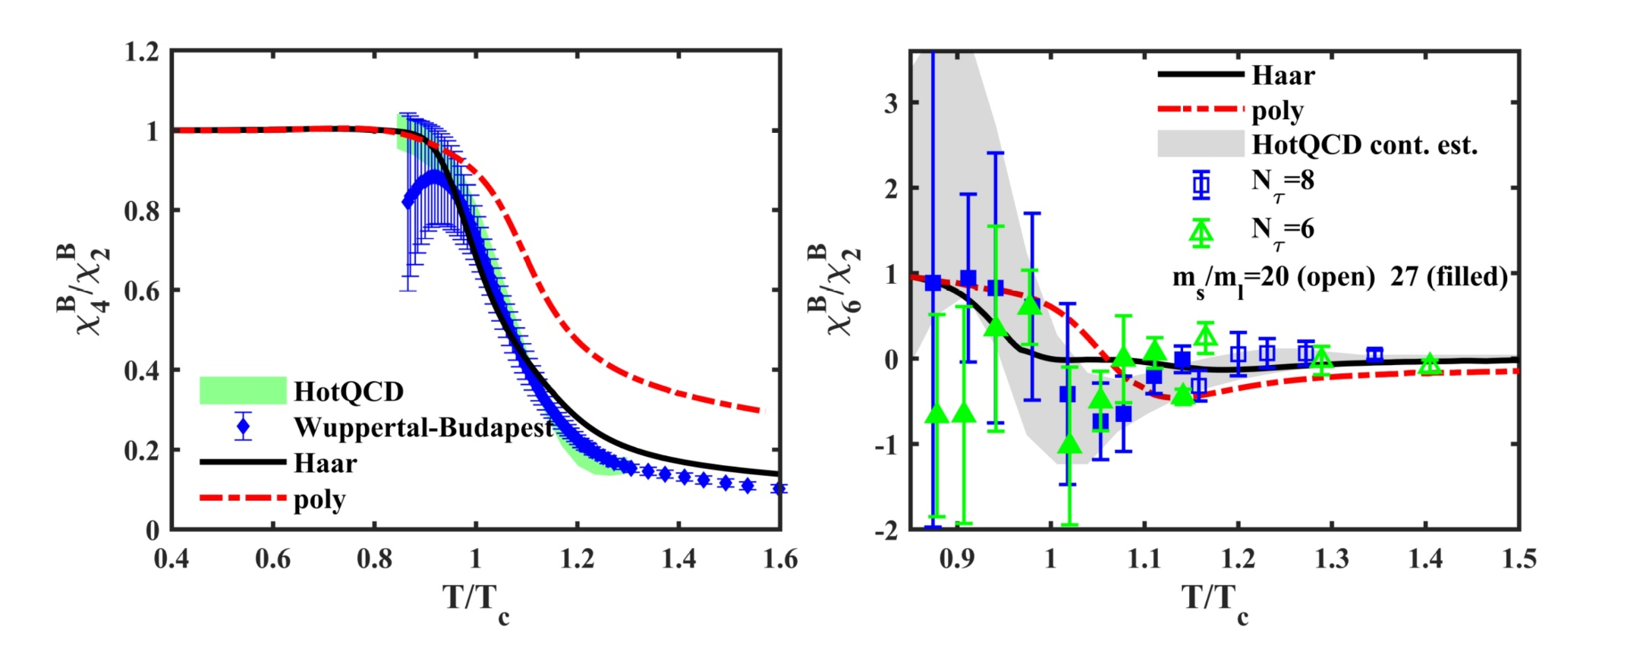
Baryon number fluctuations
HotQCD [arXiv:1708.04897]
Wuppertal-Budapest[arXiv:1305.5161]

Slide 11
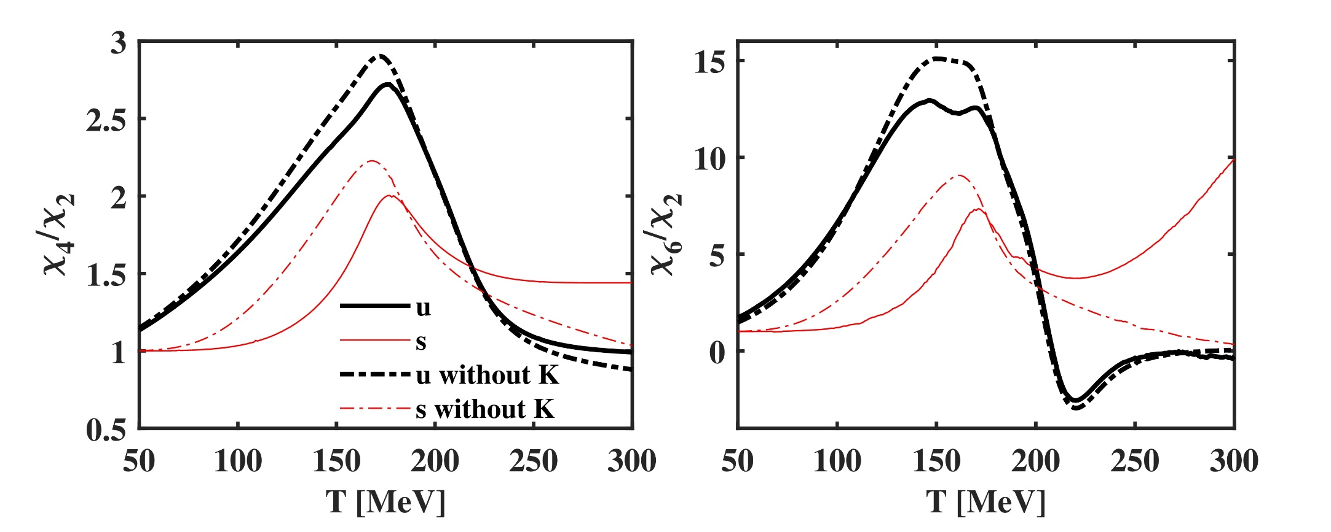
The quarks fluctuations

Slide 12
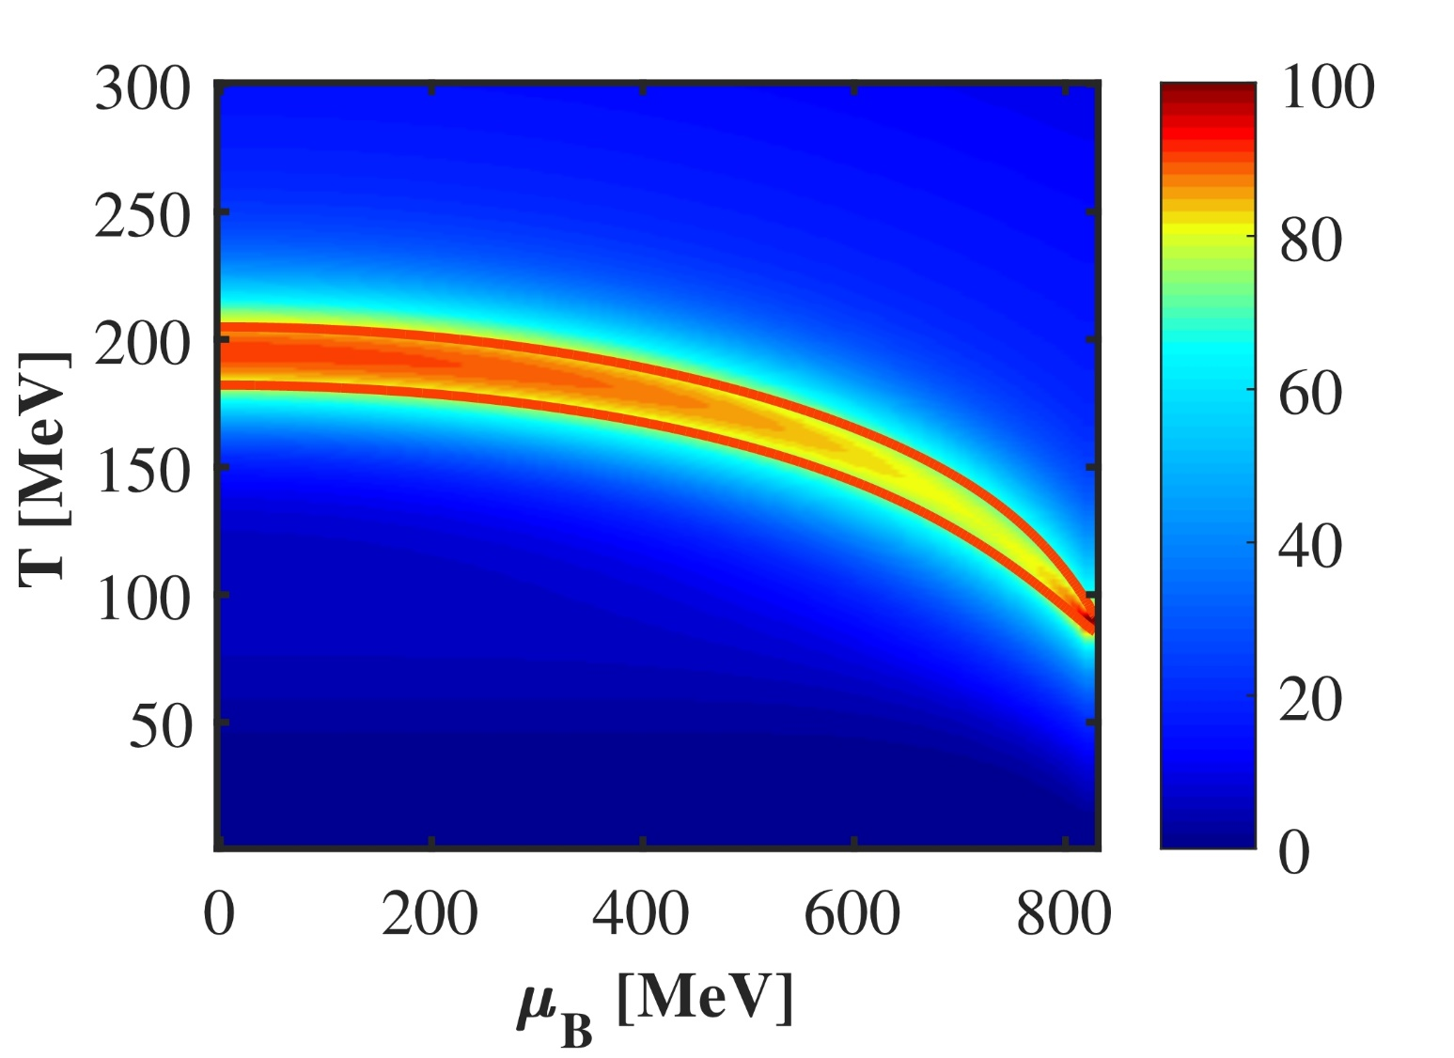
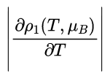
Phase diagram

Slide 13
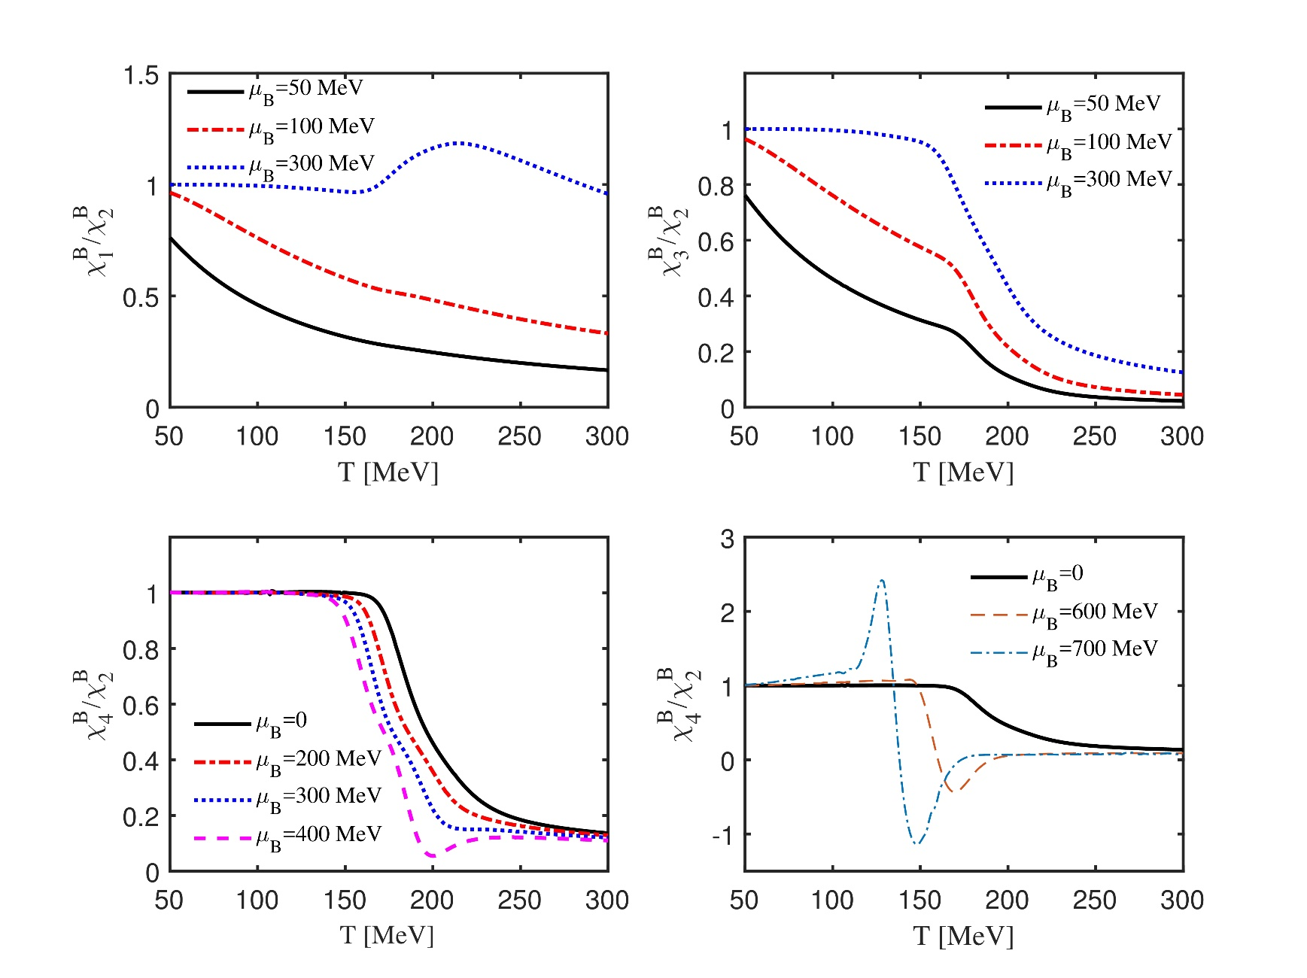
Ratios of baryon number fluctuations

Slide 14
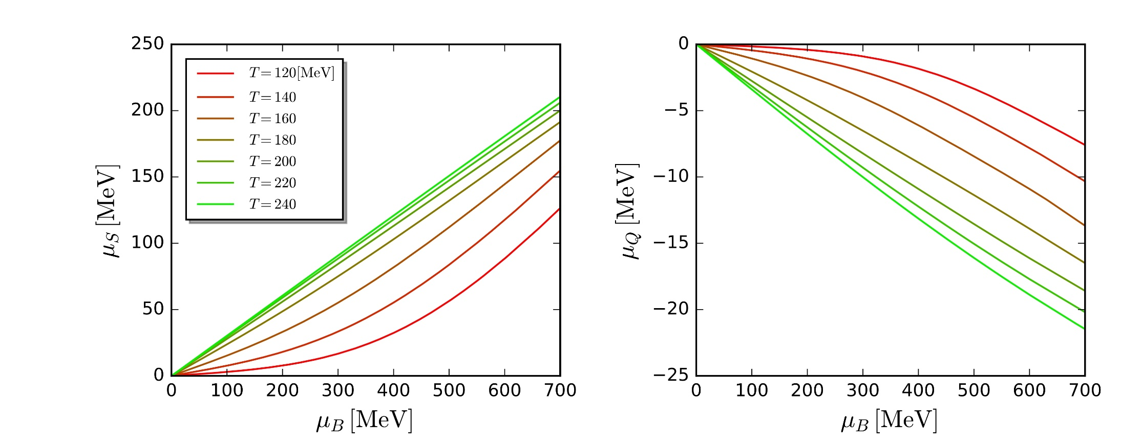
Strange neutrality and fixed electric-baryon ratio

Slide 15
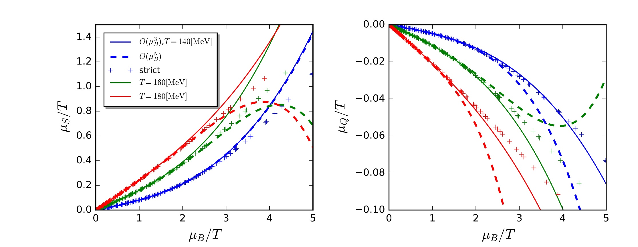
Convergence radius

Slide 16
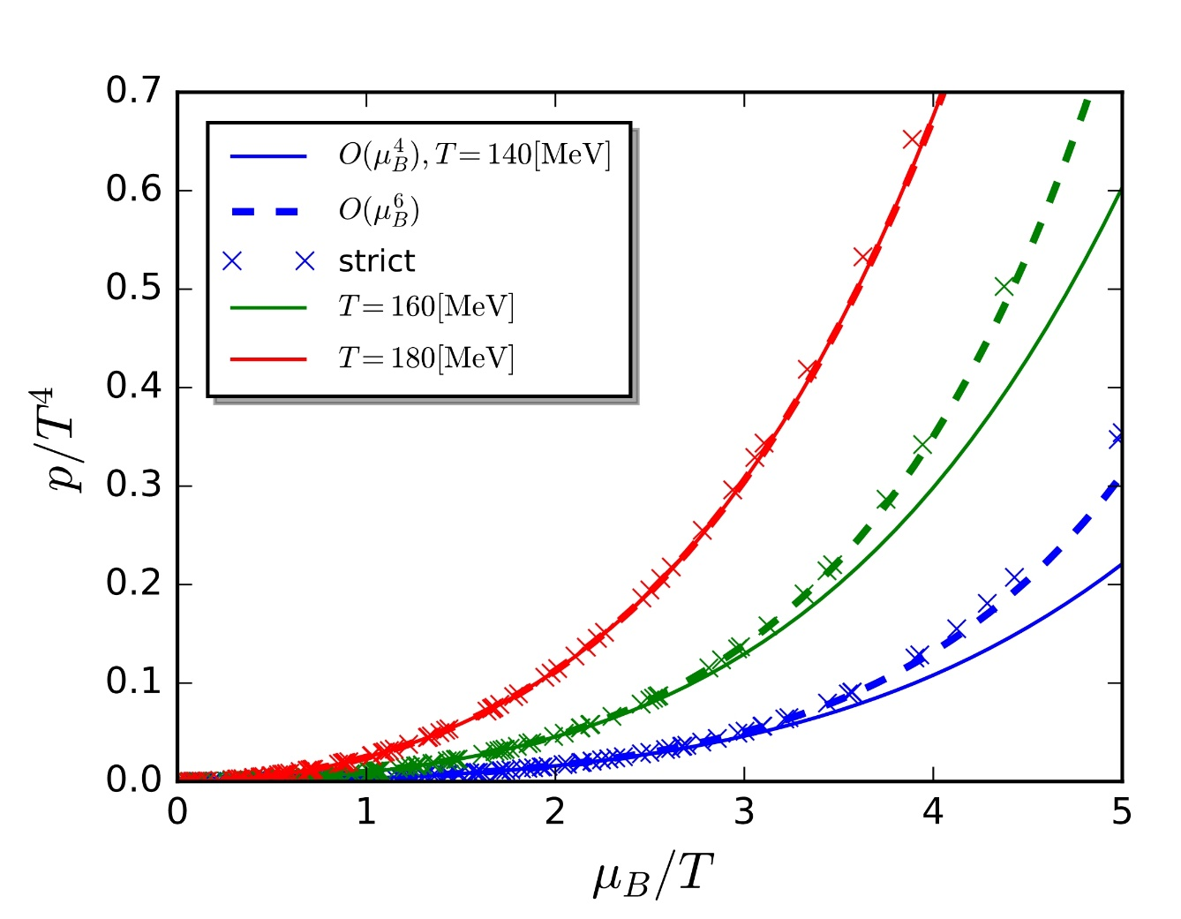
Convergence radius

Slide 17
Summary and Outlook
The equation of state and baryon number fluctuations up to 6th order agree with the lattice results.
Strange neutrality and fixed electric-baryon ratio r=0.4 conditions are considered.
Going beyond the LPA truncation and extending the low energy effective theory to the 2+1 flavor rebosonized QCD
Thank you

