Slide 1
Emergence of complete heavy-quark spin symmetry multiplet: seven molecular pentaquarks in light of the latest LHCb analysis
Ming-Zhu Liu(刘明珠)
Beihang University
Collaborators: Li-Sheng Geng, Ya-Wen Pan, Fang-Zheng Peng and Manuel Pavon Valderrama (Beihang University)
Atushi Hosaka(Osaka University,Japan)
Mario Sánchez Sánchez(Bordeaux University, France)
Phys. Rev. Lett. 122, 242001

Slide 2
Contents
Introduction
Background of hadronic molecule
Heavy quark spin symmetry
Effective potential
Results and discussion
Summary

Slide 3
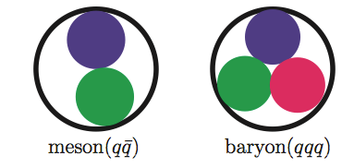
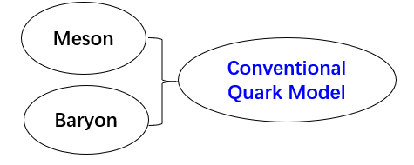
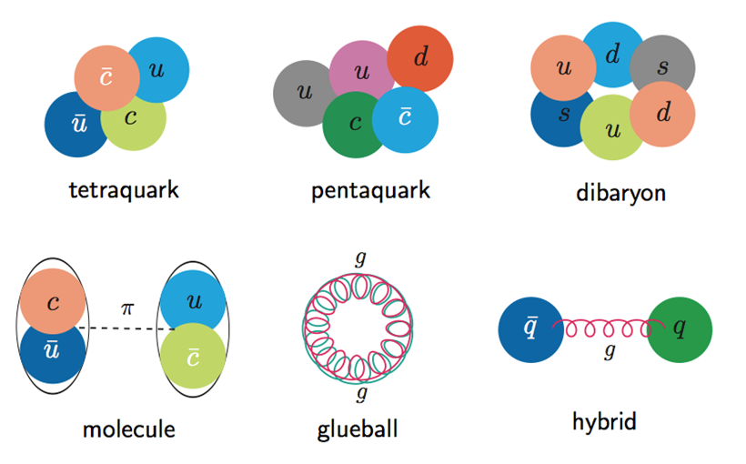
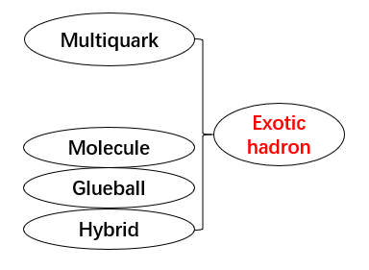
Background of hadronic molecule
hexaquark

Slide 4
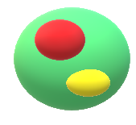
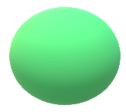
Background of hadronic molecule
Possible hadronic molecules
Molecular pictures
$$D_{s0}\left(2317\right) 0\left(0^{+}\right) DK$$
D(1869)
$$D_{s0}\left(2317\right)$$
Phys.Rev.Lett. 111 (2013) 222001 Daniel Mohler, C. B. Lang, Luka Leskovec, et. al Lattice QCD
K(496)
Mass relationship
$$Λ\left(1405\right) 0{(1/2)}^{−} N\overline{K}$$
$$m_{D}+m_{K}−m_{Ds0}=48 MeV$$
Phys.Rev.Lett. 114 (2015) 132002 Jonathan
M. M. Hall, Waseem Kamleh, et. al Lattice QCD
Isospin conservation
$$I_{D}⊗I_{K}=1⊕0$$
$$I_{Ds0}=0$$
$$X\left(3872\right) { 0}^{+}\left(1^{++}\right) \overline{D}D^{∗}$$
Angular momentum and party
$$S_{D}⊗S_{K}=S=0$$
$$S⊗L=J=L$$
Phys.Rev.Lett. 111 (2013) 192001 Sasa Prelovsek
and Luka Leskovec Lattice QCD
$${(−1)}^{L}P_{D,K}={(−1)}^{L}=P_{Ds0}$$
$$L=S$$

Slide 5
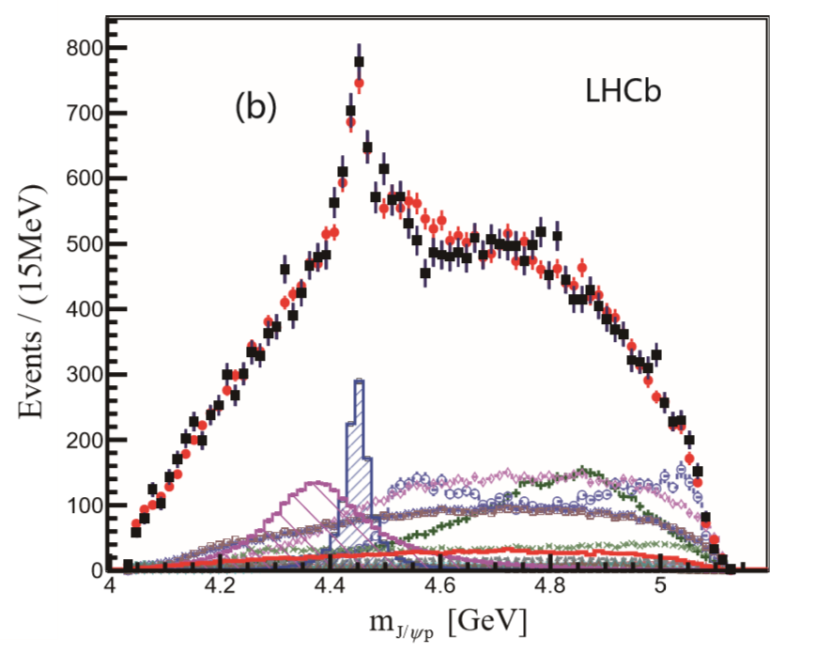
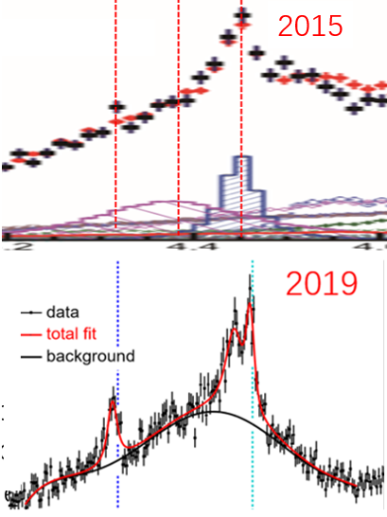
Background of hadronic molecule
Magnify 4.2-4.6 GeV
2015 and 2019 experiment
2015
4320
4380
4450
$$P_{c1}=4380±8±29$$
$$+\frac{i}{2}205±18±86$$
2015
$$P_{c2}=4449.8±1.7±2.5$$
$$+\frac{i}{2}39±5±19$$
2019
$$Λ_{b}^{0}→J/ψpK^{−}$$
$$P_{c}\left(4312\right)→7.3σ$$
$$P_{c}\left(4440\right)→5.4σ$$
$$P_{c1}=4311.9±{0.7}_{−0.6}^{+6.8}$$
$$+\frac{i}{2}9.8±{2.7}_{−4.5}^{+3.7}$$
$$P_{c}\left(4457\right)→5.4σ$$
4320
4380
$$P_{c2}=4440.3±{1.3}_{−4.7}^{+4.1}$$
$$+\frac{i}{2}20.6±{4.9}_{−10.1}^{+8.7}$$
$$Λ_{b}^{0}→J/ψpK^{−}$$
$$P_{c3}=4457.3±{0.6}_{−1.7}^{+4.1}$$
$$+\frac{i}{2}6.4±{2.0}_{−1.9}^{+5.7}$$
$\overline{D}Σ_{c}$
${ \overline{D}}^{∗}Σ_{c}$
Phys.Rev.Lett. 115 (2015) 072001
Phys.Rev.Lett. 122 (2019), 222001

Slide 6
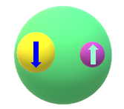
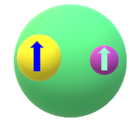
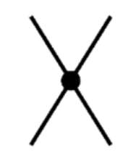
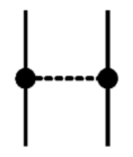
Heavy quark spin symmetry
$$m_{Q}→∞$$
QCD interaction cannot flip the spin of heavy quark
$$J=J_{l}−\frac{1}{2}$$
Heavy quark
Brown muck made of light quark and glouns
$$J=J_{l}+\frac{1}{2}$$
$$\left[D\left(0^{−}\right) D^{∗}\left(1^{−}\right)\right]→142 MeV$$
$$\left[Σ_{c}\left({1/2}^{+}\right) {Σ_{c}}^{∗}\left({3/2}^{+}\right)\right]→64 MeV$$
$$\left[B\left(0^{−}\right) B^{∗}\left(1^{−}\right)\right]→46 MeV$$
$$\left[Σ_{b}\left({1/2}^{+}\right) {Σ_{b}}^{∗}\left({3/2}^{+}\right)\right]→21 MeV$$
The mass of hadron within spin multiplet would be degenerate
Effective field theory
Contact
Leading order
One pion exchange
Next to leading order
OPE is perturbative in charm hadronic interactions
。。。
Phys.Rev. D99 (2019) 074026

Slide 7
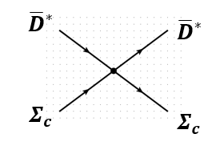
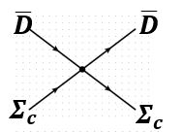
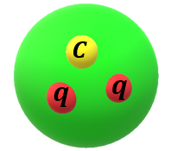
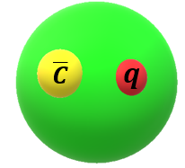
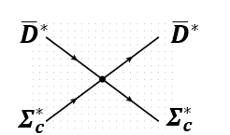
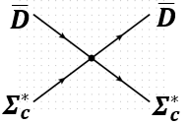
Effective potential
Lagrangian
$L=C_{a}Tr[{H_{c}^{†}H}_{c}]{\vec{S}}_{c}∙{{\vec{S}}_{c}}^{†}$+$C_{b}\sum_{i=1}^{3}{Tr[{H_{c}^{†}σ_{i}H}_{c}]{\vec{S}}_{c}∙{(J}_{i}{{\vec{S}}_{c}}^{†})}$
$$H_{c}=\frac{1}{\sqrt{2}}(D+{\vec{D}}^{∗}\vec{σ})$$
HQSS
Spin multiplet hadrons
Superfields
$${\vec{S}}_{c}=\frac{1}{\sqrt{3}}(Σ_{c}\vec{σ}+{{\vec{Σ}}^{∗}}_{c})$$
Simplify interaction
Single channel
S-wave

Slide 8
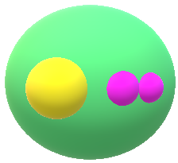
Effective potential
Light quark
$$\left\langle S_{1l}S_{2l};S_{L} | H | S_{{1l}^{′}}S_{{2l}^{′}};S_{L^{′}}\right\rangle$$
$$F_{1/2L}=\left\langle S_{1}S_{1/2};S_{1/2} | H | S_{1}S_{1/2};S_{1/2}\right\rangle$$
$$1⨂\frac{1}{2}=\frac{1}{2}⨁\frac{3}{2}$$
$$F_{3/2L}=\left\langle S_{1}S_{1/2};S_{3/2} | H | S_{1}S_{1/2};S_{3/2}\right\rangle$$
Spin basis transformation
$$|\left.S_{1l}{,S}_{1c},j_{1};S_{2l}{,S}_{2c},j_{2};J\right\rangle =\sqrt{\left(2j_{1}+1\right)\left(2j_{2}+1\right)\left(2S_{L}+1\right)\left(2S_{cc}+1\right)}$$
$\left(\begin{matrix}S_{1l} & S_{2l} & S_{L} \\ S_{1c} & S_{2c} & S_{cc} \\ j_{1} & j_{2} & J\end{matrix}\right)$ $|\left.S_{1c}{,S}_{2c},S_{cc};S_{1l}{,S}_{2l},S_{L};J\right\rangle$
The interaction is dependent on the spin of light quark
$\left.{|Σ}_{c}\overline{D}({1/2}^{−})\right\rangle =\frac{1}{2}0_{cc}⨂({\frac{1}{2})}_{L}+\frac{1}{2\sqrt{3}}$ $1_{cc}⨂({\frac{1}{2})}_{L}$ $+\frac{\sqrt{2}}{\sqrt{3}}$ $1_{cc}⨂({\frac{3}{2})}_{L}$
$$F_{1/2L}=\left\langle {\frac{1}{2}}_{L} | H | {\frac{1}{2}}_{L}\right\rangle$$
$\left.{|Σ}_{c}{\overline{D}}^{∗}({1/2}^{−})\right\rangle =\frac{1}{2\sqrt{3}}0_{cc}⨂({\frac{1}{2})}_{L}+\frac{5}{6}$ $1_{cc}⨂({\frac{1}{2})}_{L}$ $−\frac{\sqrt{2}}{3}$ $1_{cc}⨂({\frac{3}{2})}_{L}$
$$F_{3/2L}=\left\langle {\frac{3}{2}}_{L} | H | {\frac{3}{2}}_{L}\right\rangle$$
$\left.{|Σ}_{c}{\overline{D}}^{∗}({3/2}^{−})\right\rangle =\frac{1}{\sqrt{3}}0_{cc}⨂({\frac{3}{2})}_{L}−\frac{1}{3}$ $1_{cc}⨂({\frac{1}{2})}_{L}$ $+\frac{\sqrt{5}}{3}$ $1_{cc}⨂({\frac{3}{2})}_{L}$

Slide 9
Effective potential
$$C_{a}=\frac{1}{3}F_{1/2L}+\frac{2}{3}F_{3/2L}$$
$$C_{b}=−\frac{1}{3}F_{1/2L}+\frac{1}{3}F_{3/2L}$$
From Lagrangian
$\left.{\left\langle Σ_{c}\overline{D}\right.|V({1/2}^{−})|Σ}_{c}\overline{D}\right\rangle =\frac{1}{3}F_{1/2L}+\frac{2}{3}F_{3/2L}=C_{a}$ ${V({\frac{1}{2}}^{−},Σ}_{c}\overline{D} )=C_{a}$
$\left.\left\langle Σ_{c}^{∗}\overline{D}\right.|V({3/2}^{−})|Σ_{c}^{∗}\overline{D}\right\rangle =\frac{1}{3}F_{1/2L}+\frac{2}{3}F_{3/2L}=C_{a}$ $V({\frac{3}{2}}^{−},Σ_{c}^{∗}\overline{D})=C_{a}$
$\left.\left\langle Σ_{c}{\overline{D}}^{∗}\right.|V({1/2}^{−})|Σ_{c}{\overline{D}}^{∗}\right\rangle =\frac{7}{9}F_{1/2L}+\frac{2}{9}F_{3/2L}=C_{a}−\frac{4}{3}$ $C_{b} V({1/2}^{−},Σ_{c}{\overline{D}}^{∗})=C_{a}−\frac{4}{3} C_{b}$
$\left.\left\langle Σ_{c}{\overline{D}}^{∗}\right.|V({3/2}^{−})|Σ_{c}{\overline{D}}^{∗}\right\rangle =\frac{1}{9}F_{1/2L}+\frac{8}{9}F_{3/2L}=C_{a}+\frac{2}{3}$ $C_{b} V\left({3/2}^{−},Σ_{c}{\overline{D}}^{∗}\right)=C_{a}+\frac{2}{3} C_{b}$
$\left.\left\langle Σ_{c}^{∗}{\overline{D}}^{∗}\right.|V({1/2}^{−})|Σ_{c}^{∗}{\overline{D}}^{∗}\right\rangle =\frac{8}{9}F_{1/2L}+\frac{1}{9}F_{3/2L}=C_{a}−\frac{5}{3} C_{b}$ $V\left({1/2}^{−},Σ_{c}^{∗}{\overline{D}}^{∗}\right)=C_{a}−\frac{5}{3} C_{b}$
$$\left.\left\langle Σ_{c}^{∗}{\overline{D}}^{∗}\right.|V({3/2}^{−})|Σ_{c}^{∗}{\overline{D}}^{∗}\right\rangle =\frac{5}{9}F_{1/2L}+\frac{4}{9}F_{3/2L}=C_{a}−\frac{2}{3} C_{b} V\left({3/2}^{−},Σ_{c}^{∗}{\overline{D}}^{∗}\right)=C_{a}−\frac{2}{3} C_{b}$$
$$\left.\left\langle Σ_{c}^{∗}{\overline{D}}^{∗}\right.|V({5/2}^{−})|Σ_{c}^{∗}{\overline{D}}^{∗}\right\rangle =F_{3/2L}=C_{a}+ C_{b} V\left({5/2}^{−},Σ_{c}^{∗}{\overline{D}}^{∗}\right)=C_{a}+ C_{b}$$

Slide 10
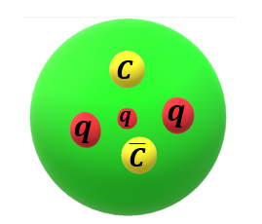
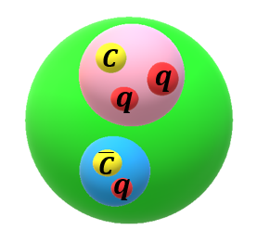
Results and Discussion
Lippmann-Schwinger Equation
$$\left.\left\langle {\vec{k}}^{′}\right.|T|\vec{k}\right\rangle =\left.\left\langle {\vec{k}}^{′}\right.|T|\vec{k}\right\rangle +\int{\frac{d^{3}\vec{q}}{{(2π)}^{3}}\left.\left\langle {\vec{k}}^{′}\right.|V|\vec{q}\right\rangle }\frac{1}{E−\frac{{\vec{q}}^{2}}{2μ}}\left.\left\langle \vec{q}\right.|T|\vec{k}\right\rangle$$
$$\left.\left\langle \vec{k}\right.|V|\vec{q}\right\rangle =C(Λ)θ(Λ−\left|\vec{k}\right|)θ(Λ−\left|\vec{q}\right|)$$
Separate potential
$1+\int{\frac{d^{3}\vec{q}}{{(2π)}^{3}}}\frac{{C(Λ)θ}^{2}(Λ−\left|\vec{q}\right|)}{B+\frac{{\vec{q}}^{2}}{2μ}}$=0
Strategy
Binding energy
Input
Determine coupling constants
Test
Predict
Hadronic molecule picture
New states
LHCb Experiment
Experimental data

Slide 11
Results and Discussion
Contact-range potential
Experimental data
$${V({1/2}^{−},Σ}_{c}\overline{D} )=C_{a}$$
$$P_{c1}=4311.9±{0.7}_{−0.6}^{+6.8}+\frac{i}{2}9.8±{2.7}_{−4.5}^{+3.7}$$
$$V({3/2}^{−},Σ_{c}^{∗}\overline{D})=C_{a}$$
$$P_{c2}=4440.3±{1.3}_{−4.7}^{+4.1}+\frac{i}{2}20.6±{4.9}_{−10.1}^{+8.7}$$
$$V({1/2}^{−},Σ_{c}{\overline{D}}^{∗})=C_{a}−\frac{4}{3} C_{b}$$
$$V\left({3/2}^{−},Σ_{c}{\overline{D}}^{∗}\right)=C_{a}+\frac{2}{3} C_{b}$$
$$P_{c3}=4457.3±{0.6}_{−1.7}^{+4.1}+\frac{i}{2}6.4±{2.0}_{−1.9}^{+5.7}$$
$$V\left({1/2}^{−},Σ_{c}^{∗}{\overline{D}}^{∗}\right)=C_{a}−\frac{5}{3} C_{b}$$
Three experimental data and two unknown coupling constants
$$V\left({3/2}^{−},Σ_{c}^{∗}{\overline{D}}^{∗}\right)=C_{a}−\frac{2}{3} C_{b}$$
Ca and Cb can be determined !
$$V\left({5/2}^{−},Σ_{c}^{∗}{\overline{D}}^{∗}\right)=C_{a}+ C_{b}$$
$${A \overline{D}}^{∗}Σ_{c} \left({3/2}^{−}\right) Pc\left(4457\right) {\overline{D}}^{∗}Σ_{c} \left({1/2}^{−}\right) Pc\left(4440\right)$$
Input
$${B \overline{D}}^{∗}Σ_{c} \left({1/2}^{−}\right) Pc\left(4457\right){ \overline{D}}^{∗}Σ_{c} \left({3/2}^{−}\right) Pc\left(4440\right)$$

Slide 12
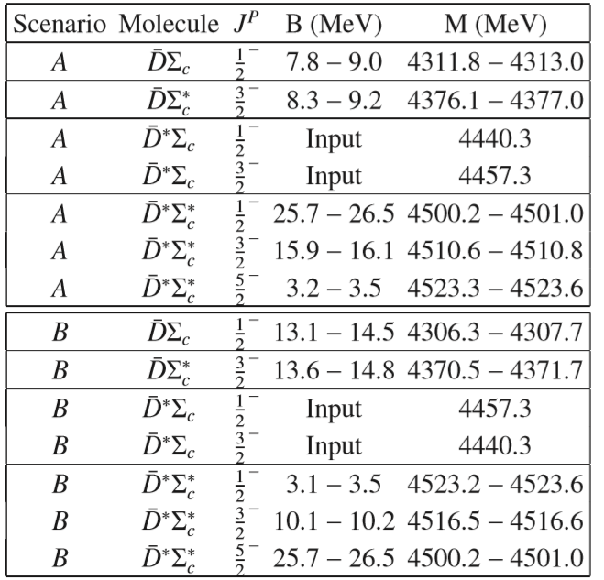
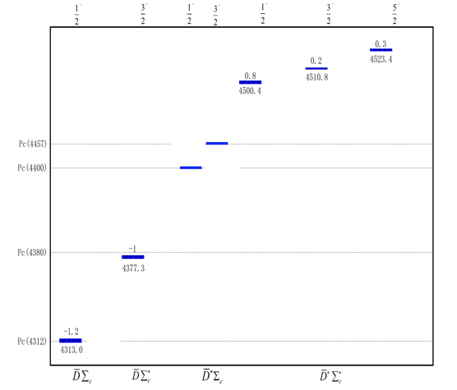
Results and Discussion
Seven molecular pentaquarks in light of Pc(4440) and Pc(4457)
Hadronic molecular multiplet picture

Slide 13
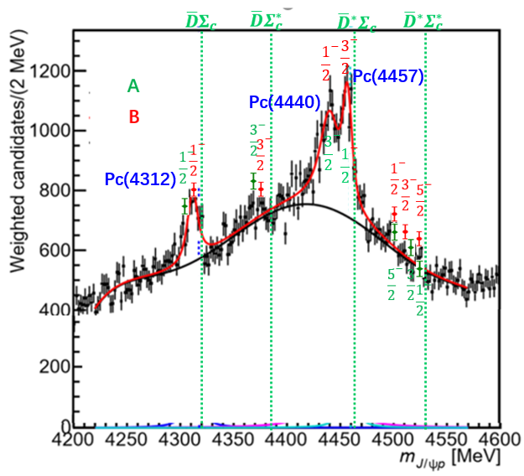
Results and Discussion
Scenario A is more likely to happen
A
B
The results of Pc(4312) is favor of scenario A.
Pc(4380) may be a hadronic molecule near $\overline{D}Σ_{c}^{∗}$ threshold.
There are 3 multiplet pentaquarks near the ${ \overline{D}}^{∗}Σ_{c}^{∗}$ threshold, which does not appear in the LHCb analysis.

Slide 14
Summary
We employ effective field theory of contact-range potential constrainted by heavy quark spin symmetry to describe three Pc states in the molecular picture.
Our calculation prefers that Pc(4312), Pc(4440), and Pc(4450) are hadronic molecules near $\overline{D}Σ_{c}$ $(1/2)$, ${ \overline{D}}^{∗}Σ_{c}$ $(1/2)$, and ${ \overline{D}}^{∗}Σ_{c}$ $(3/2)$ threshold, respectively.
We also predict 4 hadronic molecules, one is near $\overline{D}Σ_{c}^{∗}$ threshold, which may correspond to Pc(4380), and other three are near ${ \overline{D}}^{∗}Σ_{c}^{∗}$ threshold.
With LHCb experimental data and our predictions a list of molecular states exist in a complete heavy quark spin symmetry multiplet.

Slide 15
Thanks for your attention!

