Slide 1
High-energy collision and parton physics
Xiangdong Ji
Shanghai Jiao Tong University
十八届中高能核物理大会，湖南师大2019.6.23

Slide 2
Outline
Heavy-ion collision and Feynman partons
Gauge dependence and gauge link from final and initial state interactions
Gauge dependence for TMD parton distributions
Calculating parton distributions on lattice
Conclusion

Slide 3
Standard Story of Heavy-ion Collisions
Requires just a few miracles！

Slide 4

How does the early parton-parton scattering lead to thermal equilibrium?

Slide 5
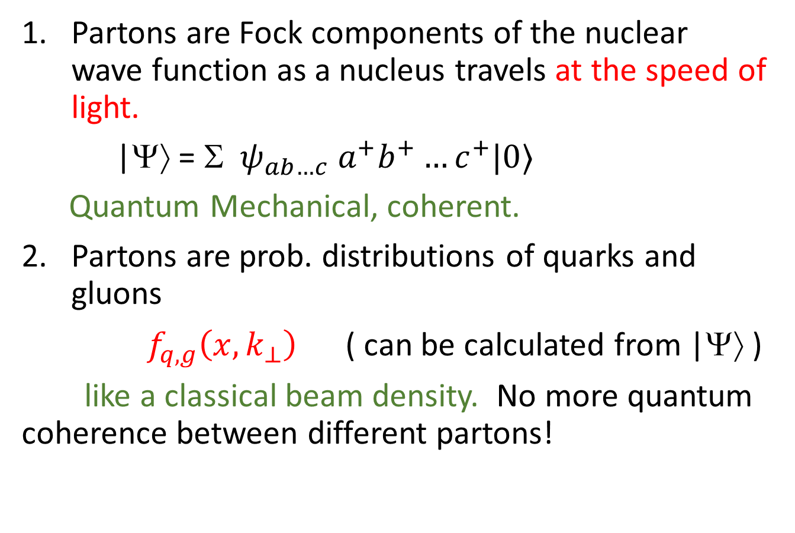
What are partons?
Partons are Fock components of the nuclear wave function as a nucleus travels at the speed of light.
|Ψ⟩ = Σ $ψ_{ab…c} a^{+}b^{+}…c^{+}|0〉$
Quantum Mechanical, coherent.
Partons are prob. distributions of quarks and gluons
$f_{q,g}\left(x, k_{⊥}\right)$ ( can be calculated from |Ψ⟩ )
like a classical beam density. No more quantum coherence between different partons!

Slide 6
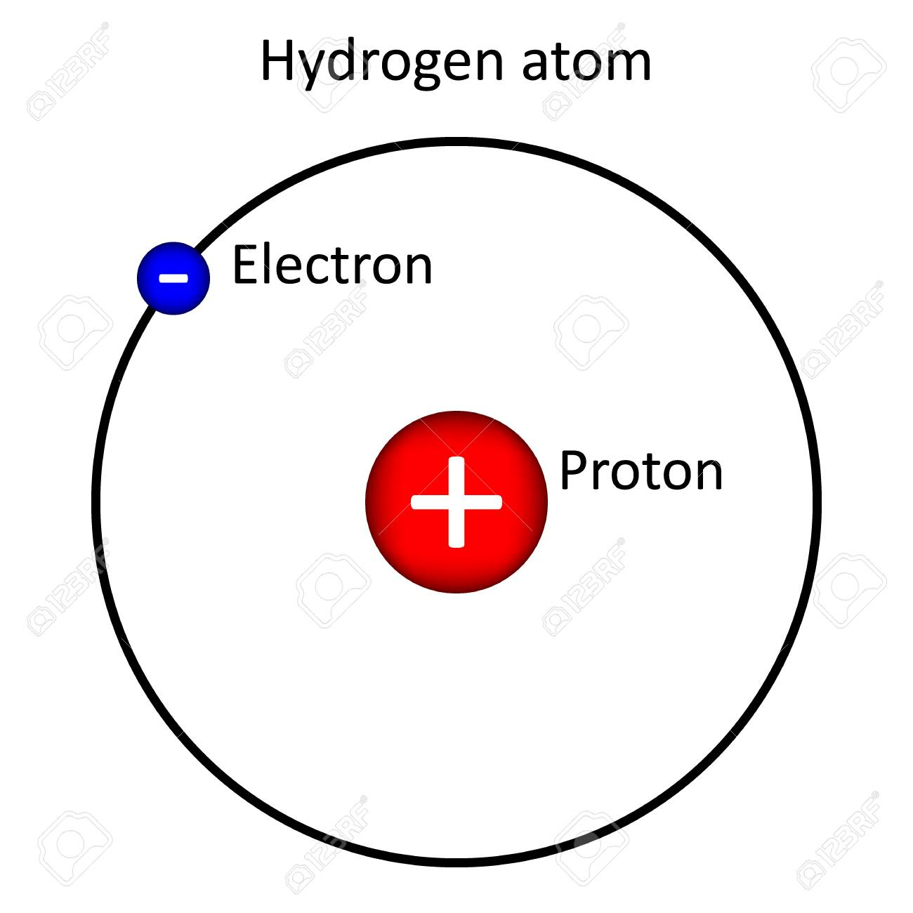

What are parton densities?
Introduced by Feynman in 1969.
Can be understood simply from a H-atom
Momentum density is just $n\left(k\right)={\left|ψ\left(k\right)\right|}^{2}$

Slide 7
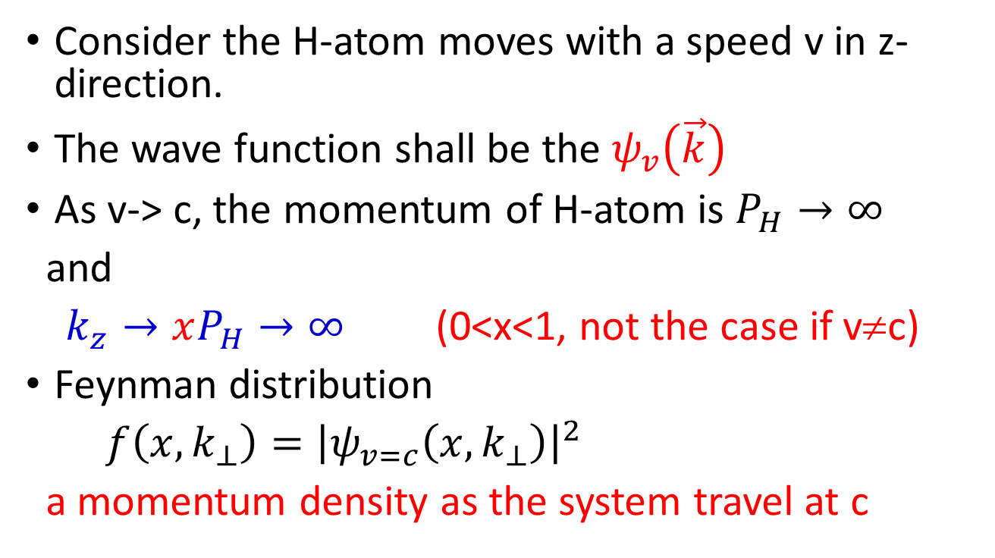
Feynman parton density
Consider the H-atom moves with a speed v in z-direction.
The wave function shall be the $ψ_{v}\left(\vec{k}\right)$
As v-> c, the momentum of H-atom is $P_{H}→∞$
and
$k_{z}→xP_{H}→∞$ (0<x<1, not the case if v≠c)
Feynman distribution
$f\left(x,k_{⊥}\right)={\left|ψ_{v=c}\left(x,k_{⊥}\right)\right|}^{2}$
a momentum density as the system travel at c

Slide 8
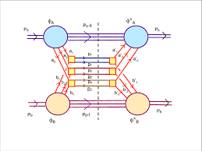
Uses of partons:
High-energy scattering cross sections can be factorized into parton distributions plus parton scattering
Partons are intermediate objects connecting the bound state wave function and high-energy scattering subprocesses.

Slide 9
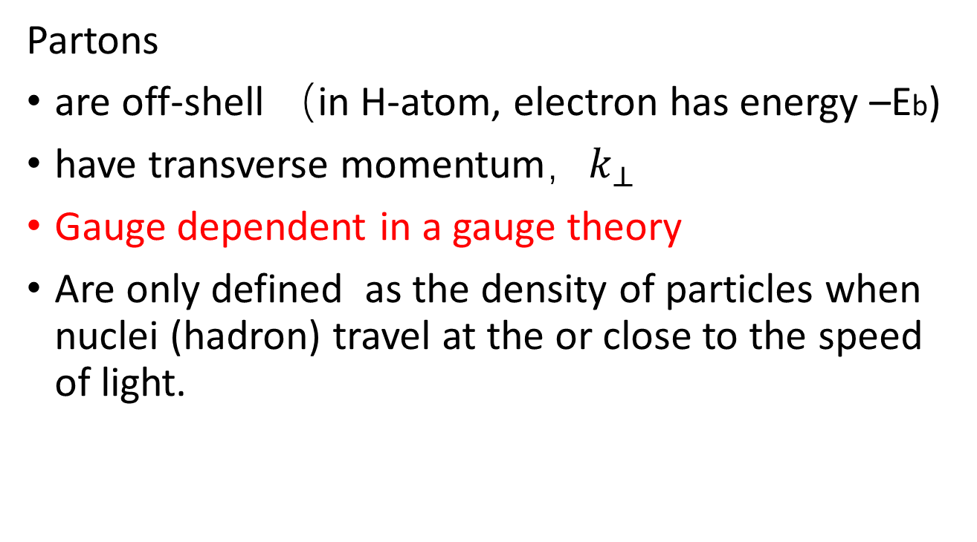
In wave functions
Partons
are off-shell （in H-atom, electron has energy –Eb)
have transverse momentum，$k_{⊥}$
Gauge dependent in a gauge theory
Are only defined as the density of particles when nuclei (hadron) travel at the or close to the speed of light.

Slide 10
In hard scattering
Partons are a beam of massless, collinear, onshell particles, thus one can ignore
  Parton coherence (incoherent superposition)
  Parton off-shellness
  Parton transverse momentum
  Parton’s gauge choice

Slide 11
Gauge dependence

Slide 12
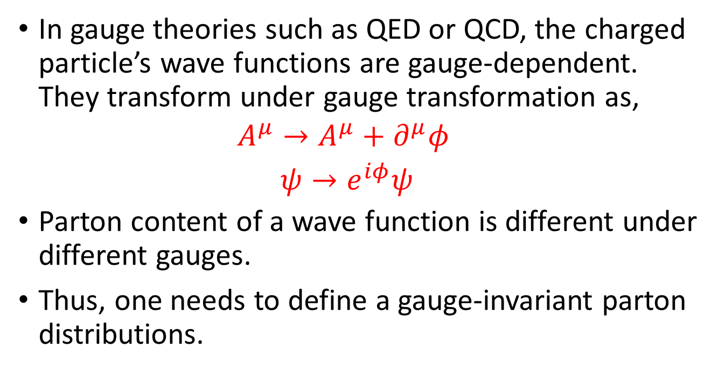
Gauge dependence
In gauge theories such as QED or QCD, the charged particle’s wave functions are gauge-dependent. They transform under gauge transformation as,
$${\begin{aligned}A^{μ}→A^{μ}+∂^{μ}φ \\ ψ→e^{iφ}ψ\end{aligned}}^{}$$
Parton content of a wave function is different under different gauges.
Thus, one needs to define a gauge-invariant parton distributions.

Slide 13
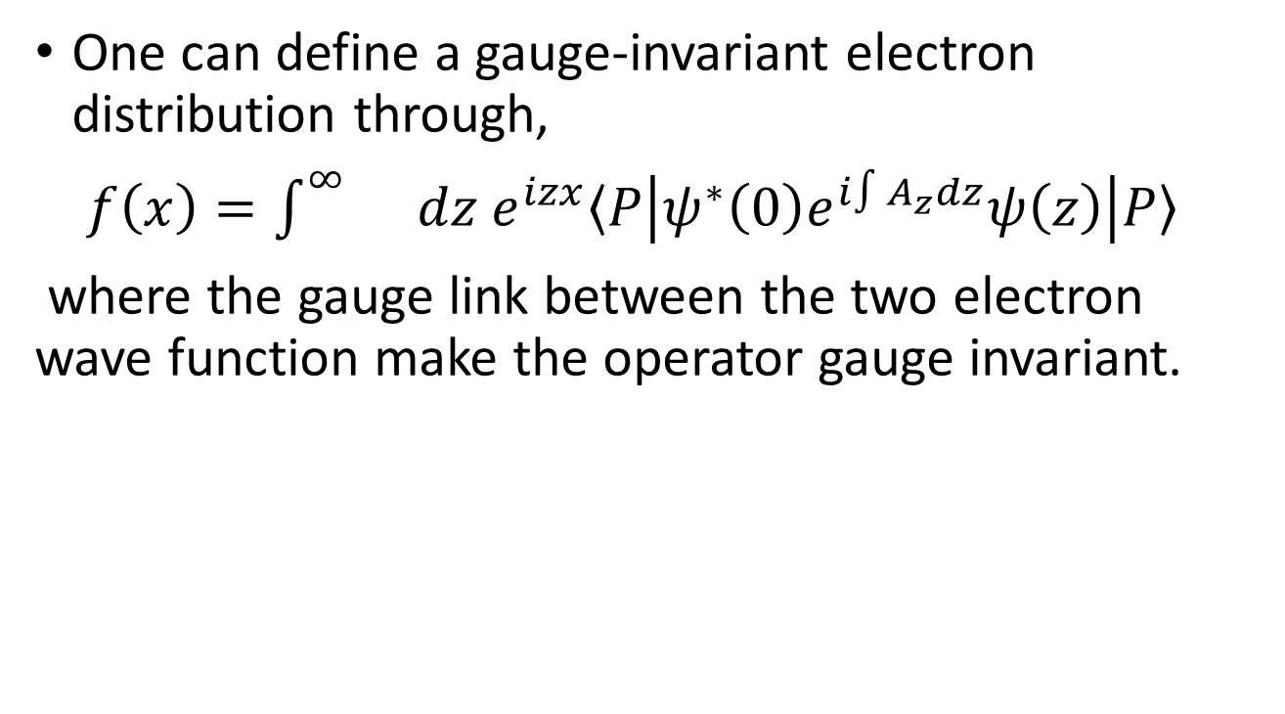
Gauge-invariant bilocal operator
One can define a gauge-invariant electron distribution through,
$f\left(x\right)=\int^{∞}{}dz e^{izx}〈P\left|ψ^{∗}\left(0\right)e^{i∫A_{z}dz}ψ\left(z\right)\right|P〉$
where the gauge link between the two electron wave function make the operator gauge invariant.
𝜉⁰
⁰
^{Z}
𝜉³

Slide 14
Comments
The wave function must be in the frame that the system is moving with the speed of light v=c,
in which the distribution has the significance of a momentum density.
In such a frame Az no longer vanishes, which can be obtained from a boost.
In principle, any gauge link going from 0 to z will make it gauge-invariant. Different links will lead to different parton densities.

Slide 15
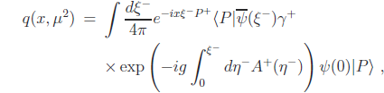
Rest-frame parton distribution
Starting from a rest-frame hadron wave function
The high-energy probe probes the light-cone correlations
Therefore, we need to study the light-cone dynamics in this language: light-front quantization
𝜉⁻
𝜉⁰
𝜉⁺
𝜉³

Slide 16
Where does the gauge link come from?

Slide 17
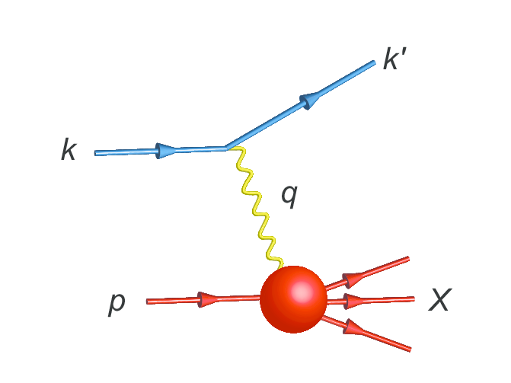
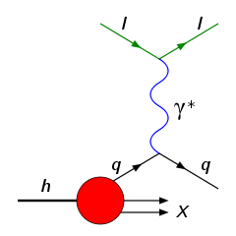
Deep-inelastic scattering
Quarks entering into a scattering do not know about gauge-invariance.

Slide 18
Final state interactions
Gauge invariance is a result of summing many Feynman diagrams.
The outgoing quarks scatter successively in the background fields of the nucleon.

Slide 19
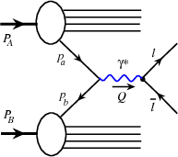
Drell-yan process
Simple process
Considering higher-order processes

Slide 20
Factorization of Drell-Yan process
Parton distribution in the Drell-Yan process.
which contains the gauge-link needed for gauge symmetry.
This gauge link comes from initial state interactions.
A general proof does not exist for other processes.

Slide 21
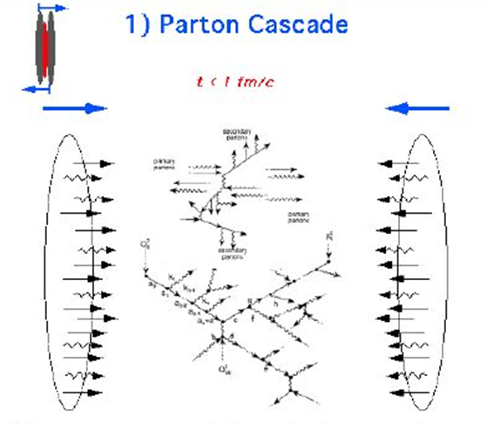
Where does the gauge link come from in HI collision?

Slide 22
Transverse-momentum dependent (TMD) distributions

Slide 23
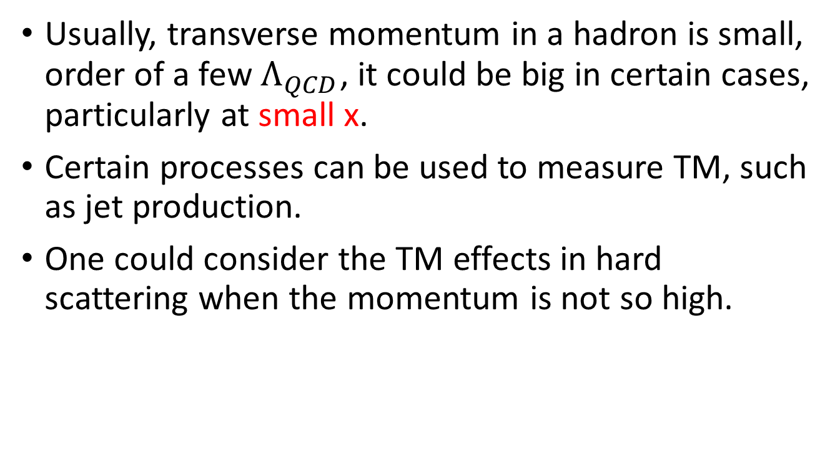
Transverse momentum
Usually, transverse momentum in a hadron is small, order of a few $Λ_{QCD}$, it could be big in certain cases, particularly at small x.
Certain processes can be used to measure TM, such as jet production.
One could consider the TM effects in hard scattering when the momentum is not so high.

Slide 24
What is the gauge link?
In DIS process, one can show that the final state interaction leads to

Slide 25
Alternatives
In Drell-Yan, one has the initial-state gauge link.
Two different gauge links (DIS and Drell-Yan) lead to different results!
One other possibility is a straight-line gauge line.

Slide 26
J. W. Qiu

Slide 27
Small-x parton distribution
In very high-energy scattering, small-x partons play important role.
Particularly, small-x partons might acquire large transverse momentum due to incoherence between color sources
This parton saturation might be significant for gluons.

Slide 28
B.W.Xiao

Slide 31
Straight-line gauge link
For straight line gauge link, there is no phenomenon of parton saturation.

Slide 32
How did parton scattering lead to thermal equilibrium?
The answer is still open

Slide 33
Lattice calculation of parton distributions
Parton distributions have not been calculable from the first-principle QCD for many years.
In 2013, a breakthrough came from the large-momentum effective theory, with which one can calculate PDF with controlled errors.
X. JI, Phys. Rev. Lett. 110, 112001 (2013)
Early calculations demonstrate the power of the approach.

Slide 34
Comparison with data

Slide 35
Conclusion
Partons are a concept useful only in high-energy processes, in which pert. theory works.
Partons are gauge-dependent, depending on specific hard processes.
How does incoherent parton scattering lead to thermal plasma in HIC is still an open question.
Parton distributions now can be calculated precisely from lattice QCD.

