Slide 1

第十八届全国中高能核物理大会 长沙 Jun 21-25
Stochastic Schrodinger equation (SSE)
for heavy quark thermalization in QGP
陈保义
天津大学 物理系
Collaborators: Biaogang Wu, Xingbo Zhao,
Ralf Rapp, Carsten Greiner
Also many thanks to Prof. Pengfei Zhuang for extensive discussions.

Slide 2
Outline
Introduction
Open quantum system
2. Stochastic Schrodinger equation : (open quantum system)
stochastic potential
charm wave function evolution based on SSE
extract Diffusion coefficient Ds
3. Schrodinger equation for charmonium:
schrodinger equation + color screening (static effect)
4. Summary

Slide 3
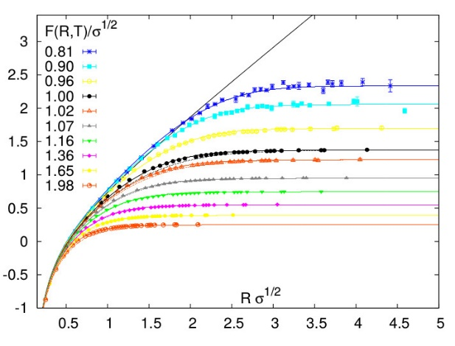
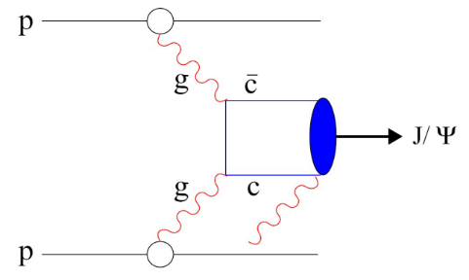
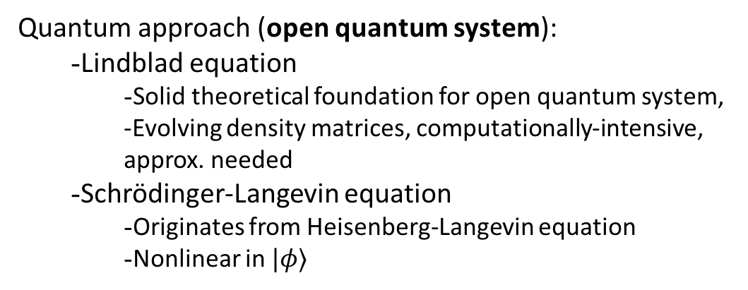
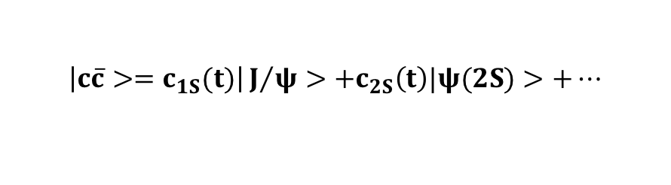
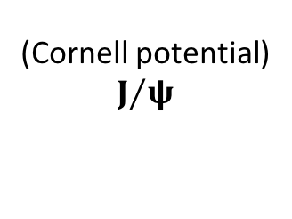
Thermal medium effect
Quantum approach (open quantum system):
  Lindblad equation
    Solid theoretical foundation for open quantum system, -Evolving density matrices, computationally-intensive, approx. needed
  Schrödinger-Langevin equation
    Originates from Heisenberg-Langevin equation
    Nonlinear in $|φ⟩$
[Lindblad et al, 1976, …]
[Gossiaux et al, 2016, …]
Can be employed in
Spin thermal theory,
Bose-Einstein conden.
Thermalization process, et al.
- Generalized Langevin approach J. P. Blaizot, et al
- Stochastic Schrodinger equation (our approach)
(Cornell potential)
$$J/ψ$$
S.Digal, et al, EPJ, 05’
QGP evolution
time
$$\left|c\overline{c}>=c_{1S}(t)\right|J/ψ>+c_{2S}\left(t\right)|ψ(2S)>+…$$
$c\overline{c}$ dipole potential in QGP is COLOR SCREENED

Slide 4
stochastic potential and SSE

Slide 5
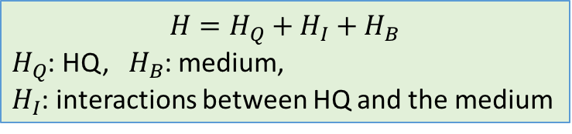
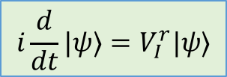

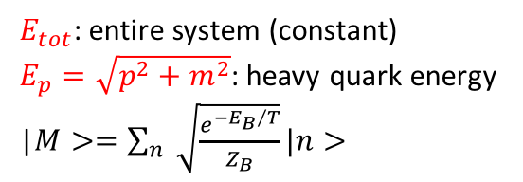


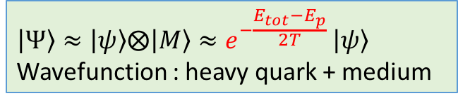
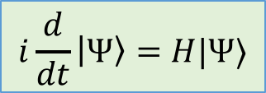
Framework of SSE
$$i\frac{d}{dt}\left|Ψ\right\rangle =H|Ψ⟩$$
HQ: sub-system
QGP: thermal bath(environment)
$$H=H_{Q}+H_{I}+H_{B}$$
$H_{Q}$: HQ, $H_{B}$: medium,
$H_{I}$: interactions between HQ and the medium
  $$\left|Ψ\right\rangle ≈\left|ψ\right\rangle ⨂\left|M\right\rangle ≈e^{−\frac{E_{tot}−E_{p}}{2T} }\left|ψ\right\rangle$$
Wavefunction : heavy quark + medium
Ignore medium part
$i\frac{d}{dt}ψ\left(p,t\right)e^{\frac{E_{p}}{2T} }=Σ_{p^{′}}(H_{I}+H_{Q})ψ\left(p′,t\right)$ $e^{\frac{E_{p‘}}{2T} }$
$E_{tot}$: entire system (constant)
$E_{p}=\sqrt{p^{2}+m^{2}}$: heavy quark energy
|$M>=\sum_{n}{\sqrt{\frac{e^{−{E_{B}}/T}}{Z_{B}}}|n>}$
Switch to interaction picture
$$i\frac{d}{dt}|ψ⟩=V_{I}^{r}|ψ⟩$$
$Z_{B}:$ partition function of thermal bath
$$V_{I}^{r}=H_{I}e^{\frac{{E_{p‘}−E}_{p}}{2T} }e^{i\left(E_{p}−E_{p‘}\right)t}$$

Slide 6
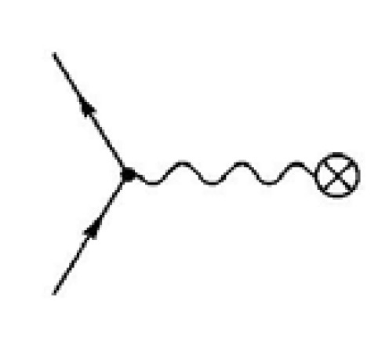
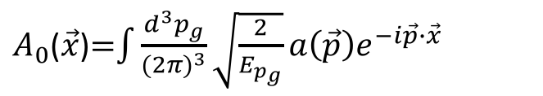
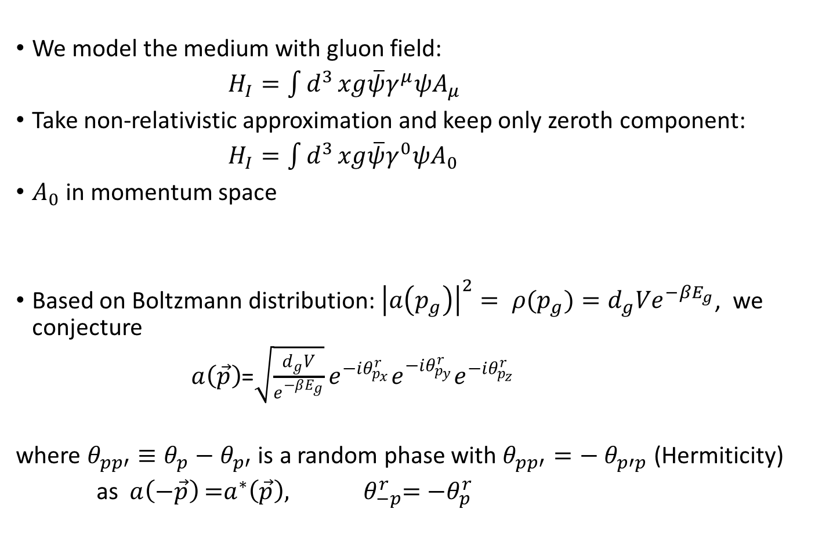
Heavy quark-Medium interaction
Like QED
We model the medium with gluon field:
$H_{I}=\int{d^{3}}xg\overline{ψ}γ^{μ}ψA_{μ}$
Take non-relativistic approximation and keep only zeroth component:
$H_{I}=\int{d^{3}}xg\overline{ψ}γ^{0}ψA_{0}$
$A_{0}$ in momentum space
Based on Boltzmann distribution: ${\left|a\left(p_{g}\right)\right|}^{2}= ρ(p_{g})=d_{g}Ve^{−βE_{g}}$, we conjecture
$a\left(\vec{p}\right)$=$\sqrt{\frac{d_{g}V}{e^{−βE_{g}}}}e^{−iθ_{p_{x}}^{r}}e^{−iθ_{p_{y}}^{r}}e^{−iθ_{p_{z}}^{r}}$
where $θ_{pp′}≡θ_{p}−θ_{p′}$ is a random phase with $θ_{pp′}=−$ $θ_{p′p}$ (Hermiticity)
as $a\left(−\vec{p}\right)$=$a^{∗}\left(\vec{p}\right), θ_{−p}^{r}$= ${−θ}_{p}^{r}$
$A_{0}$($\vec{x}$)=$\int{\frac{d^{3}p_{g}}{{(2π)}^{3}}}\sqrt{\frac{2}{E_{p_{g}}}}a\left(\vec{p}\right)e^{−i\vec{p}∙\vec{x}}$

Slide 7
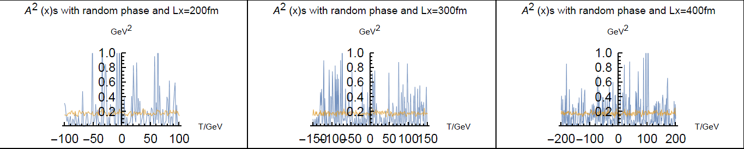
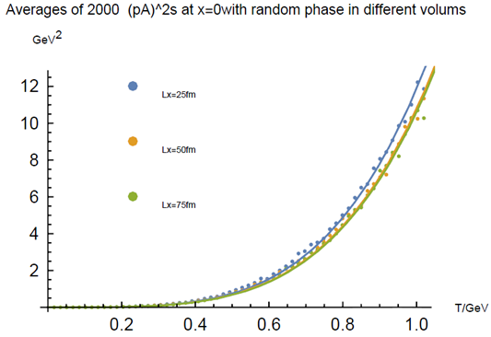
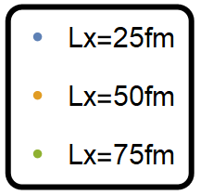





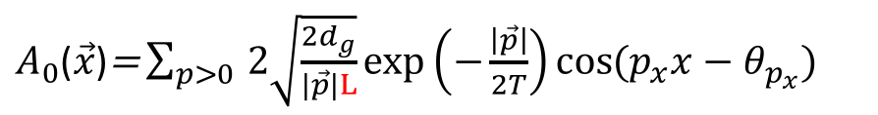


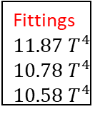
$A_{0}$($\vec{x}$) field is intensive
L fm
L fm
L fm
$A_{0}$($\vec{x}$)$\text{=}\sum_{p>0 }{2\sqrt{\frac{{2d}_{g}}{|\vec{p}|L}}\exp\left(−\frac{\left|\vec{p}\right|}{2T}\right)cos{(p_{x}x−θ_{p_{x}})}}$
$$p=\frac{2π}{L}$$
$$d_{g}=16$$
$E\left[{\left(∇A_{0}\text{(}\text{x}\text{)}\right)}^{2}\right]$ is independent of x
$${GeV}^{4}$$
2000 averages of ${\left(∇A_{0}\text{(}\text{x}\text{)}\right)}^{2}$
( Choose the point $x=0$ )
Field energy
Gluon gas energy
Fittings
11.87 $T^{4}$
10.78 $T^{4}$
10.58 $T^{4}$
U =$\int{d^{3}x}\frac{1}{2}{(∇A_{0}\text{(}\text{x}\text{)})}^{2} =\int{\frac{d^{3}p}{{(2π)}^{3}}}$ $E_{p}$ $a^{2}(\vec{p})$ $=\frac{3d_{g}VT^{4}}{π^{2}}$
Numerical results show that ${A_{0}\text{(}\text{x}\text{)}}^{2}\text{s}$’ mean value are intensive, not extensive

Slide 8
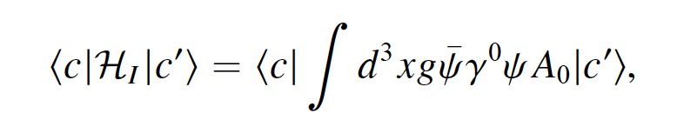
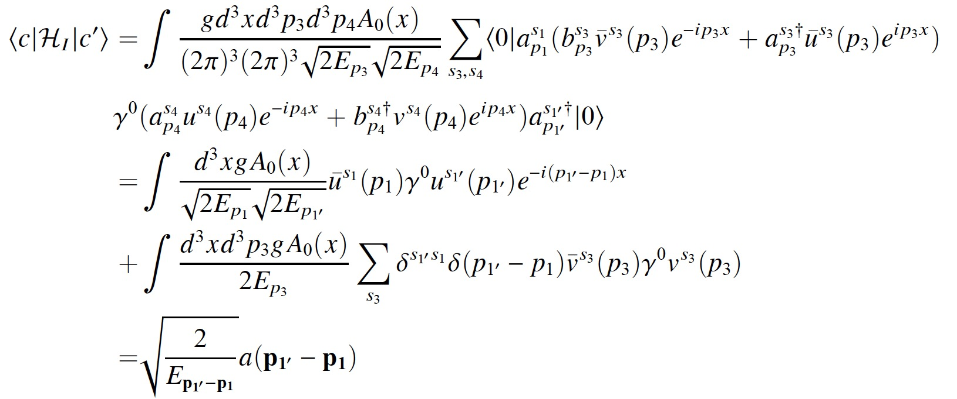
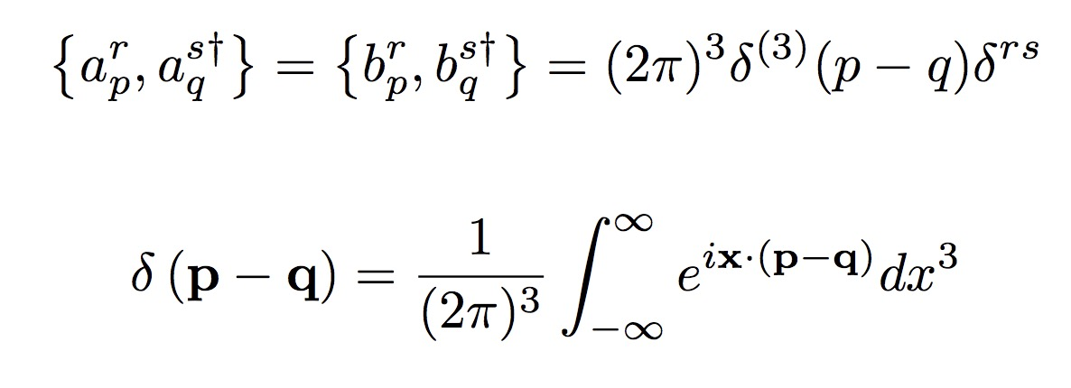

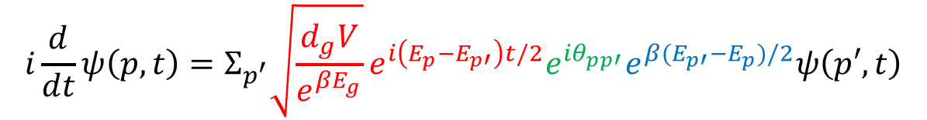



Stochastic Schrodinger Equation (SSE)
$$i\frac{d}{dt}|ψ⟩=V_{I}^{r}|ψ⟩$$
$$<c\left|Η_{I}\right|c^{′}>=\sqrt{\frac{2}{E_{p_{1^{′}}−p_{1}}}}a(p_{1^{′}}−p_{1})$$
SSE in momentum space and interaction picture
$$i\frac{d}{dt}ψ\left(p,t\right)=Σ_{p^{′}}\sqrt{\frac{d_{g}V}{e^{βE_{g}}}}e^{i\left(E_{p}−E_{p′}\right)t/2}e^{{iθ}_{pp′}}e^{β(E_{p′}−E_{p})/2}ψ\left(p′,t\right)$$
Square root of distribution of gluon field
“damping” factor: from ensemble average; weighting transition matrix elements with number of microscopic states of the medium
$θ_{pp′}$ is time-dependent, updating period is a parameter, currently is taken at $1/T$.
$E_{p^{′}}−E_{p}$ lead to non-Hermitian Hamiltonian
$$E_{g}\sim |E_{p}−E_{p^{′}}|$$

Slide 9
dynamical evolutions

Slide 10
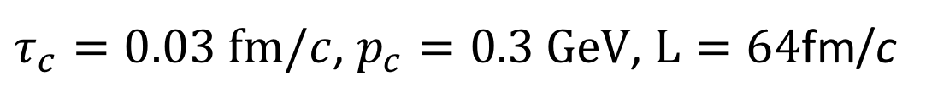
Wave function in momentum space
$τ_{c}=0.03 fm/c$, $p_{c}=0.3 GeV$, $L=64$fm/c
broad -> equili.
narrow -> equili.
Like ’jet’

Slide 11
Wave function in spatial space
$τ_{c}=0.03 fm/c$, $p_{c}=0.3 GeV$, $L=64$fm/c

Slide 12
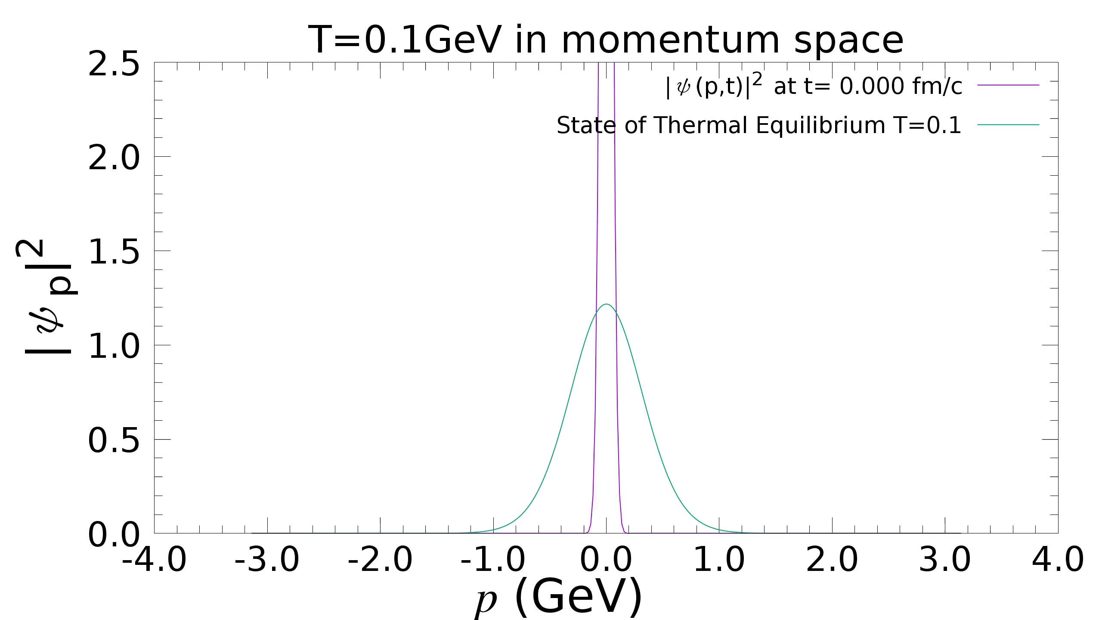
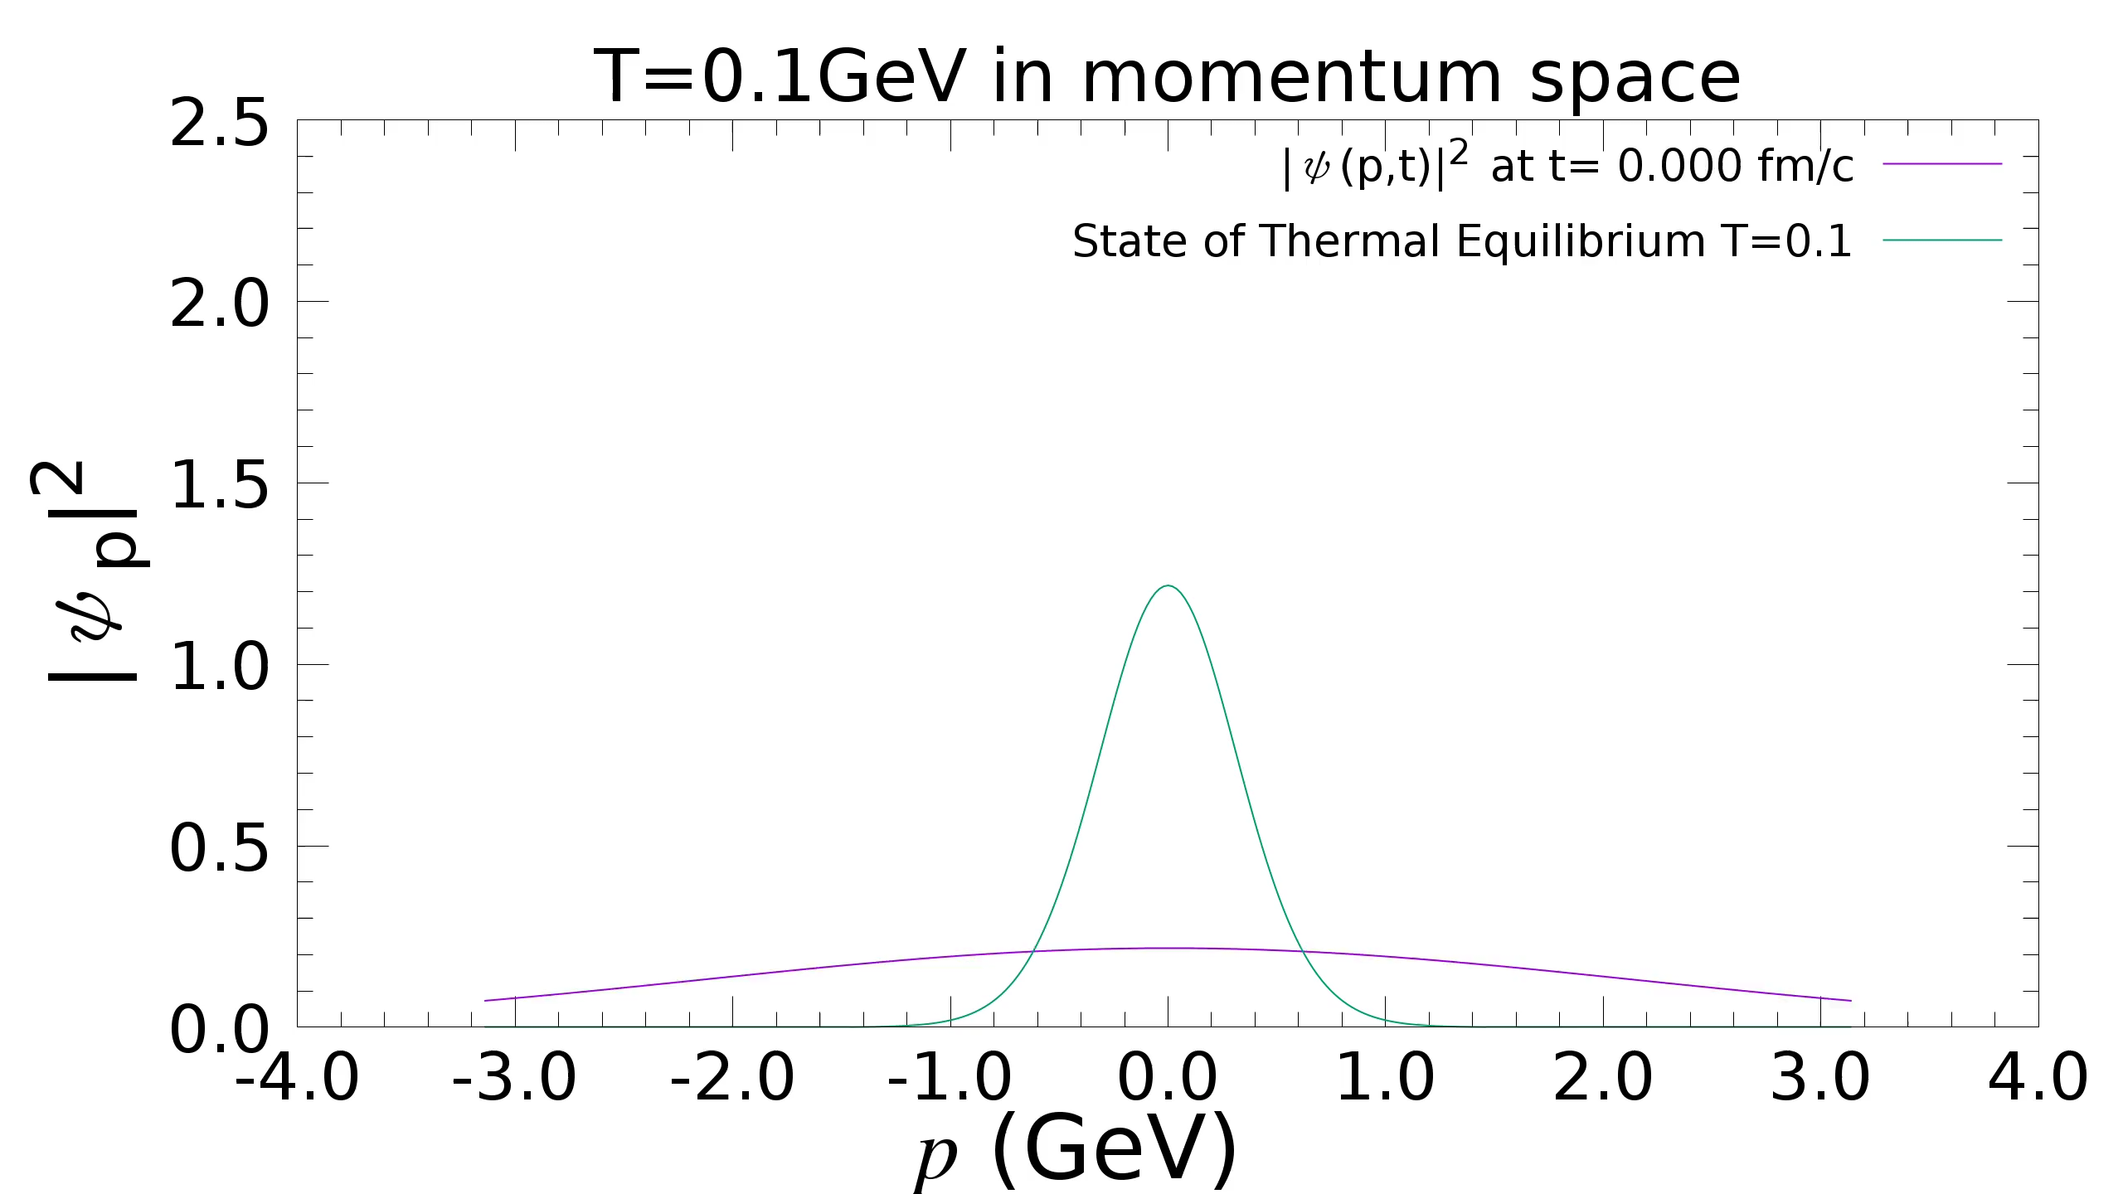
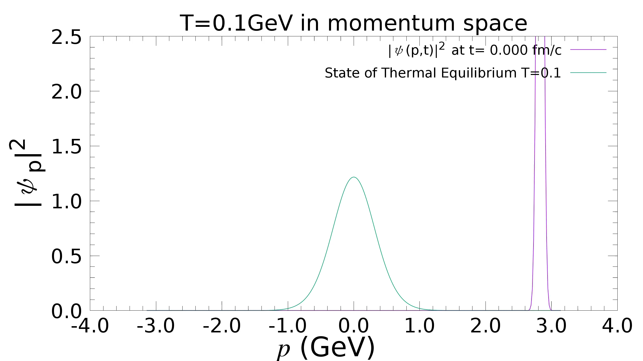
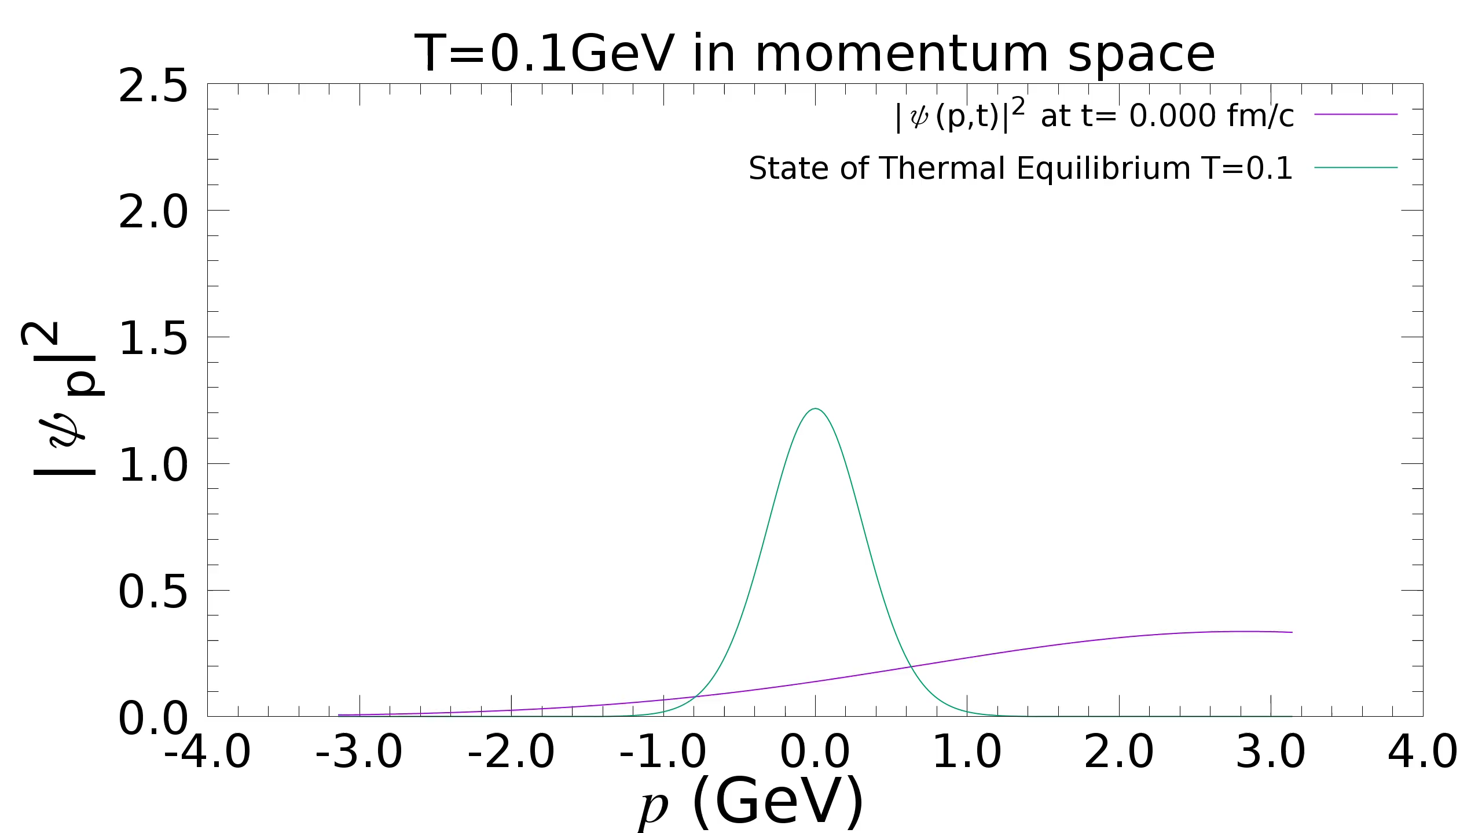
Wave function in momentum space
$τ_{c}=0.03 fm/c$, $p_{c}=0.3 GeV$, $L=64$fm/c

Slide 13
Properties of noise & Ds

Slide 14
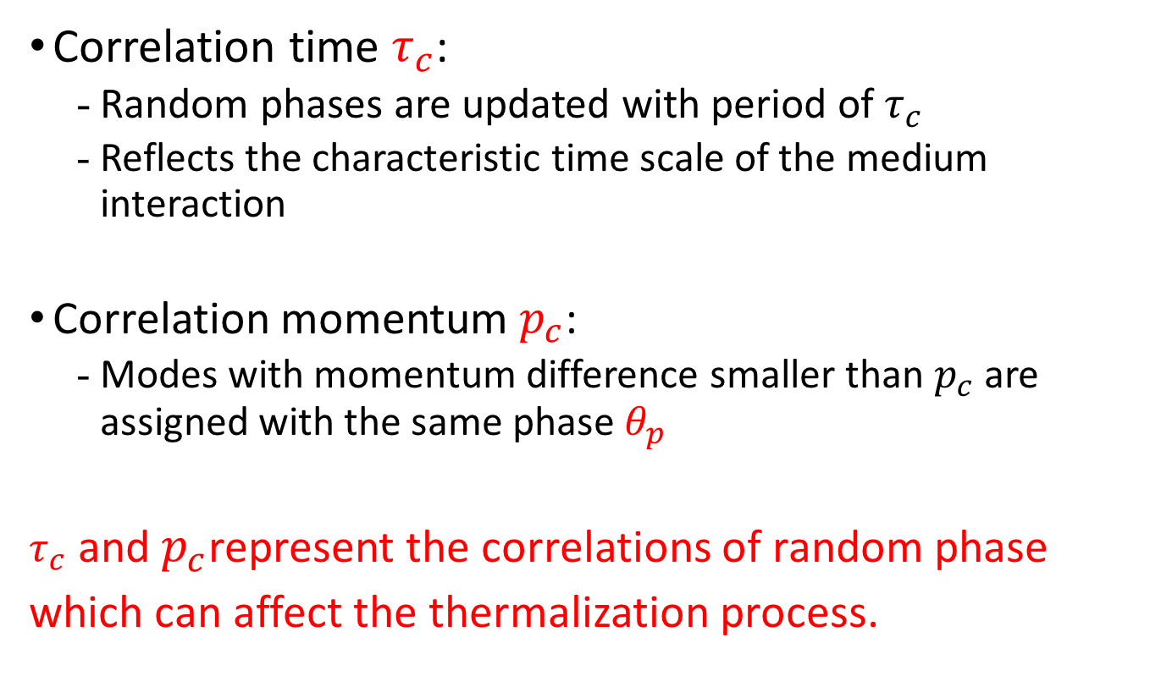
Correlations of random phase
Random phase factor in Stochastic potential have a correlation scale $τ_{c}$, $p_{c}$ :
Correlation time $τ_{c}$:
  Random phases are updated with period of $τ_{c}$
  Reflects the characteristic time scale of the medium interaction
Correlation momentum $p_{c}$:
  Modes with momentum difference smaller than $p_{c}$ are assigned with the same phase $θ_{p}$
$τ_{c}$ and $p_{c}$represent the correlations of random phase
which can affect the thermalization process.

Slide 15

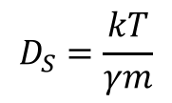
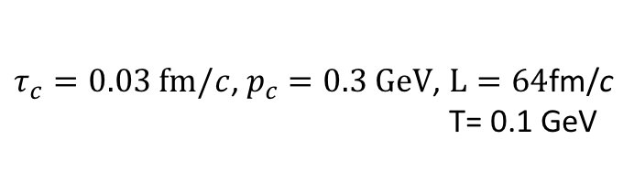
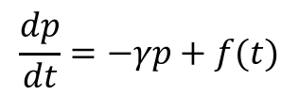

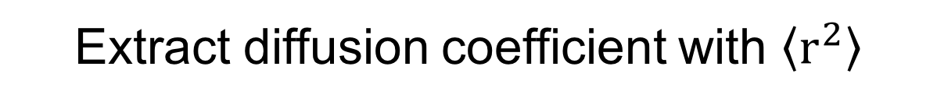
Extract diffusion coefficient with $\left\langle r^{2}\right\rangle$
$τ_{c}=0.03 fm/c$, $p_{c}=0.3 GeV$, $L=64$fm/c
T= 0.1 GeV
Based on classical Langevin equation:
$$\frac{dp}{dt}=−γp+f(t)$$
$$D_{S}=\frac{kT}{γm}$$
$\left\langle x^{2}\right\rangle =\frac{2kT}{γm}t+C_{1}e^{−γt}+C_{2}$,
Preliminary: $2<D_{S}\left(2πT\right)<3$

Slide 16
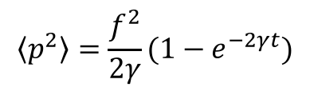
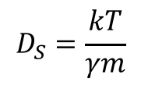
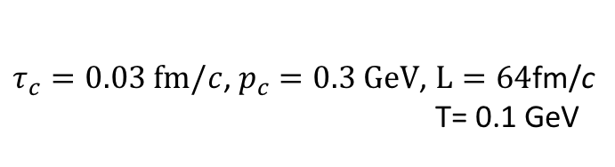

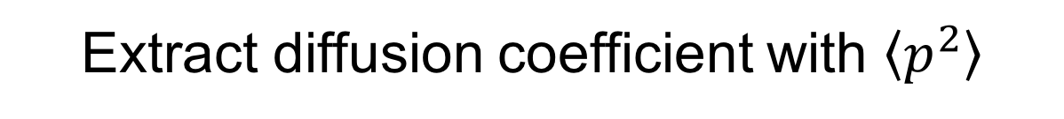
Extract diffusion coefficient with $\left\langle p^{2}\right\rangle$
$τ_{c}=0.03 fm/c$, $p_{c}=0.3 GeV$, $L=64$fm/c
T= 0.1 GeV
Based on classical Langevin equation:
$$\frac{dp}{dt}=−γp+f(t)$$
$$\left\langle p^{2}\right\rangle =\frac{f^{2}}{2γ}(1−e^{−2γt})$$
$$D_{S}=\frac{kT}{γm}$$
Preliminary: $2<D_{S}\left(2πT\right)<3$

Slide 17
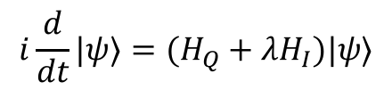

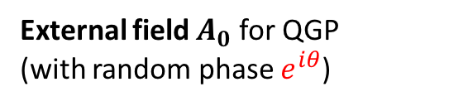
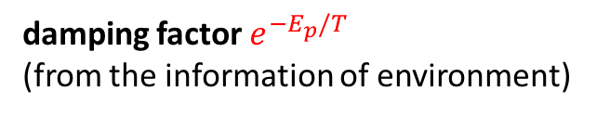
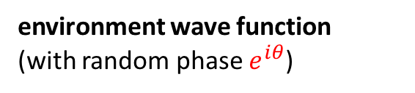
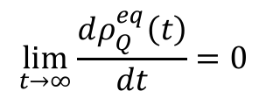
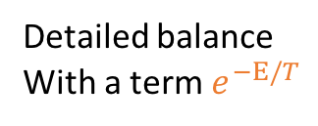

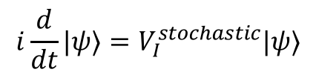
compare
Our SSE
Other SSE
J.Phys.Condens.Matter, 24(2012) 273201
(1) Equation (interaction picture)
$$i\frac{d}{dt}|ψ⟩=V_{I}^{stochastic}|ψ⟩$$
$$i\frac{d}{dt}|ψ⟩=(H_{Q}+{λH}_{I})|ψ⟩$$
Taylor expansion of $λ$
(2) ingredients
environment wave function
(with random phase $e^{iθ}$)
External field $A_{0}$ for QGP
(with random phase $e^{iθ}$)
sub-system equilibrium condition:
damping factor $e^{−E_{p}/T}$
(from the information of environment)
$$\lim_{t→∞}{\frac{dρ_{Q}^{eq}\left(t\right)}{dt}}=0$$
Detailed balance
With a term $e^{−E/T}$
Detailed balance
(3) properties of random phase term
Random phase term satisfies a correlation function (not delta-function)
Introduce $τ_{c}$, $p_{c}$ for its correlation in momentum and time.

Slide 18
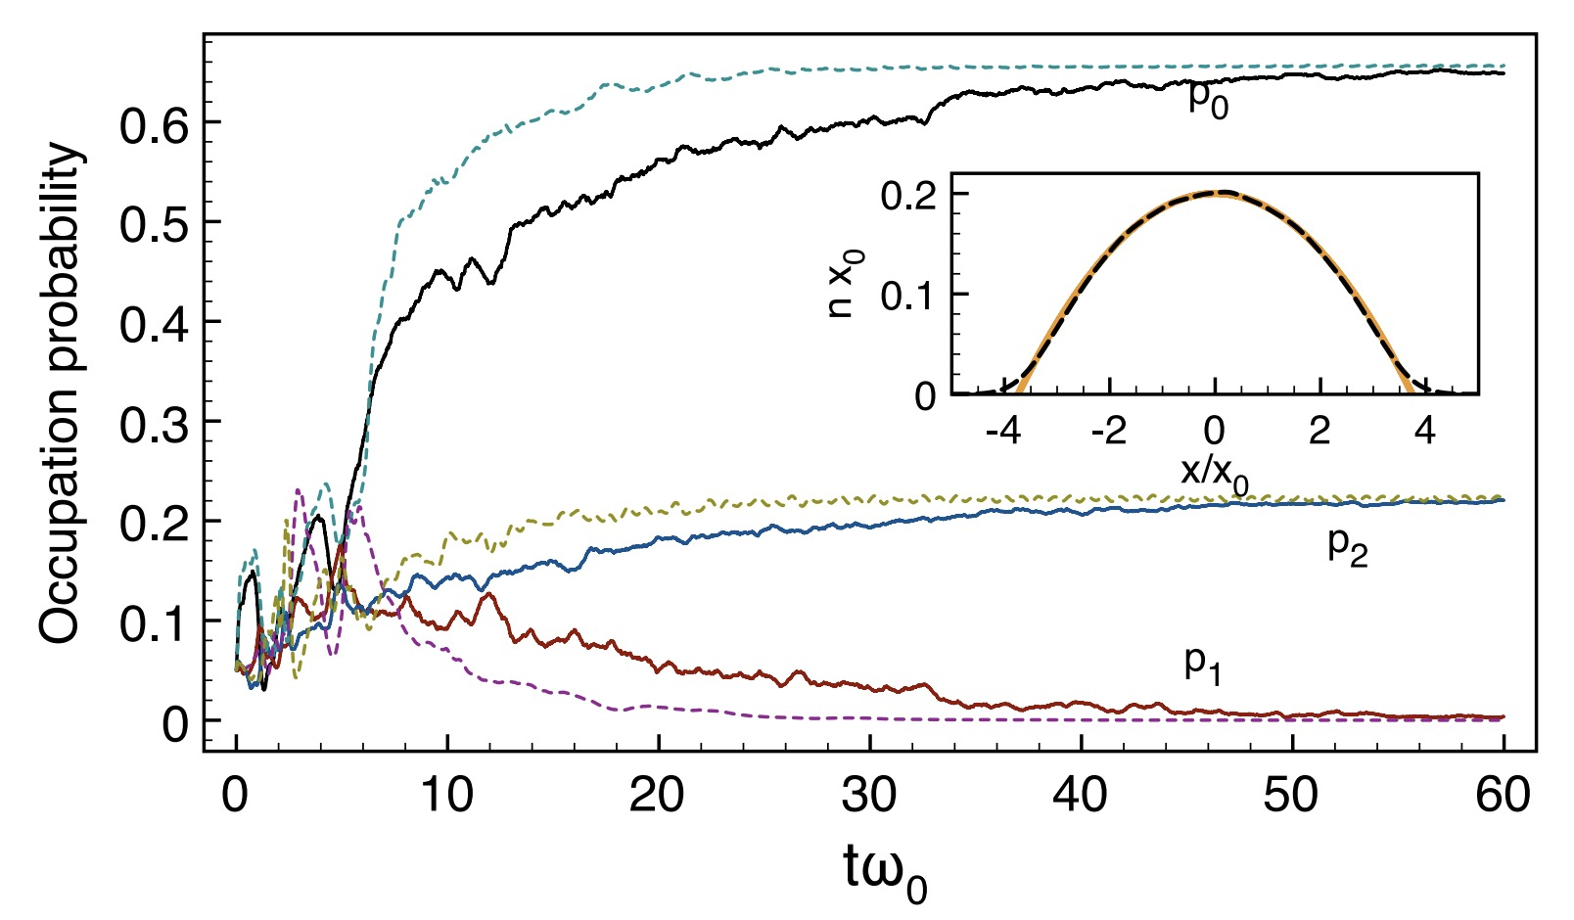
Compare with master equation
J.Phys.Condens.Matter, 24(2012) 273201
Thermalization process from SSE and master equation of density matrix
are diefferent.

Slide 19
Charmonium (two-body)

Slide 20
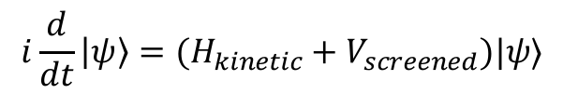
charmonium
Baoyi, Xiaojian, Carsten, Ralf, in preparation
color screened potential
yield evolution
$$i\frac{d}{dt}\left|ψ\right\rangle =(H_{kinetic}+V_{screened})|ψ⟩$$
Wave function evolution
at different T
Charmonium with color screened potential in QGP,
treated as an isolated system temporarily.
Lack of stochastic potential (particle scattering).

Slide 21
charmonium
Baoyi, Xiaojian, Carsten, Ralf, in preparation
Its suppression is mainly due to the internal evolution of wavefunction,
Particle inelastic dissociation is now absent.
P-Pb system:
More suitable to study the internal evolutions of ccbar system.
Such as 1S-2S transition mechanism
Wave function evolution
at different T

Slide 22
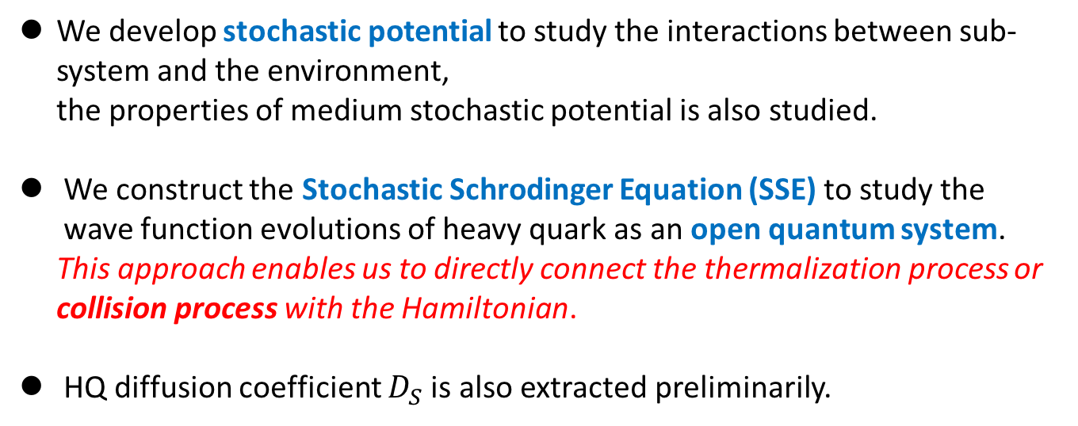
Summary
We develop stochastic potential to study the interactions between sub-system and the environment,
the properties of medium stochastic potential is also studied.
We construct the Stochastic Schrodinger Equation (SSE) to study the wave function evolutions of heavy quark as an open quantum system.
This approach enables us to directly connect the thermalization process or
collision process with the Hamiltonian.
HQ diffusion coefficient $D_{S}$ is also extracted preliminarily.
Next steps:
1. connect the stochastic potential with the Langevin approach.
2. connections between random phase term and the “damping factor”,
both of which plays the role of detailed balance.
3. SSE + color screened potential + EM fields + vortical fields + spin effect ….

Slide 23
More slides

Slide 24
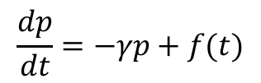
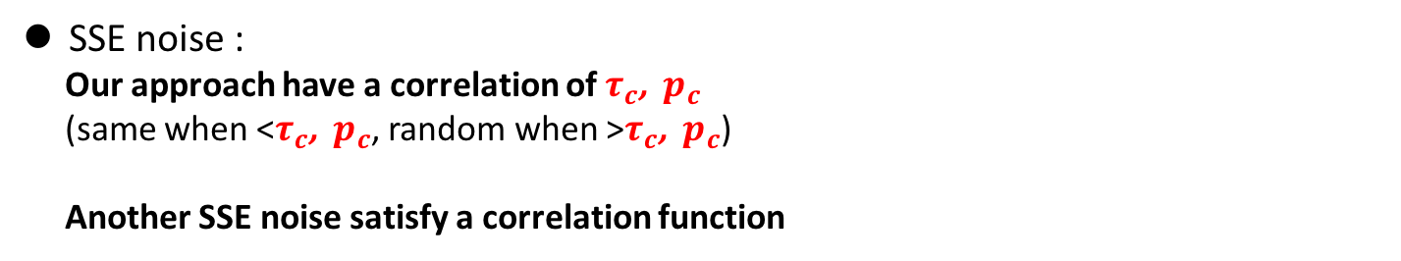
Compare with Langevin
Compare with Langevin noise term:
Pure white noise is not enough for thermalization process. It needs Color noise (thermalization-history dependent).
Langevin noise can be white noise:
time-dependent drag force term + white noise term
$$\frac{dp}{dt}=−γp+f(t)$$
SSE noise :
Our approach have a correlation of $τ_{c}$, $p_{c}$
(same when <$τ_{c}$, $p_{c}$, random when >$τ_{c}$, $p_{c}$)
Another SSE noise satisfy a correlation function

Slide 25

不同体积的$\left\langle r^{2}\right\rangle$

Slide 26
Cornell potential

Slide 27
Cornell potential

Slide 28
Potential = 0

Slide 29
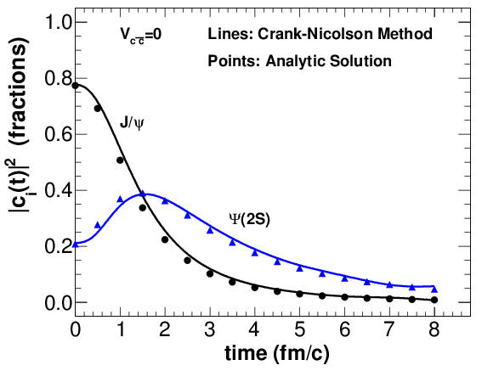



Check codes
Evolutions of one $c\overline{c}$ with different potential
Testing codes
$$V_{c\overline{c}}\left(r\right)=0$$
$V_{c\overline{c}}\left(r\right)=$ Cornell Potential
With weak potential, the $c\overline{c}$ dipole becomes a loosely bound dipole, its wavefunction expands outside.
the overlap between $ψ_{c\overline{c}}(r,t)$and $Ψ(2S)$ increase at first, then decrease

