Slide 1
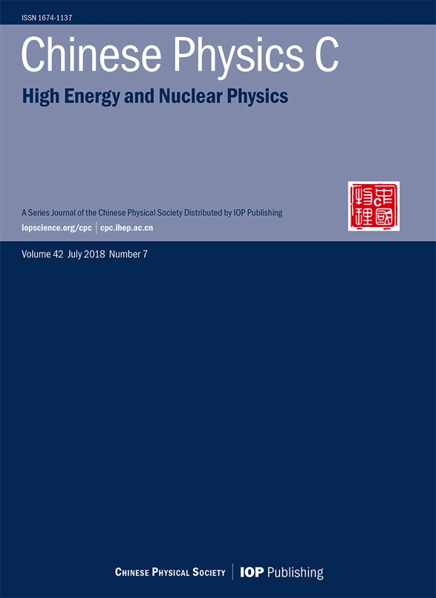
Chinese Physics C
High energy and nuclear physics
中国物理学会
中科院高能物理研究所
中科院近代物理研究所
联合主办
cpc.ihep.ac.cn
iopscience.org/cpc
科学出版社出版 | IOP 出版社

Slide 2
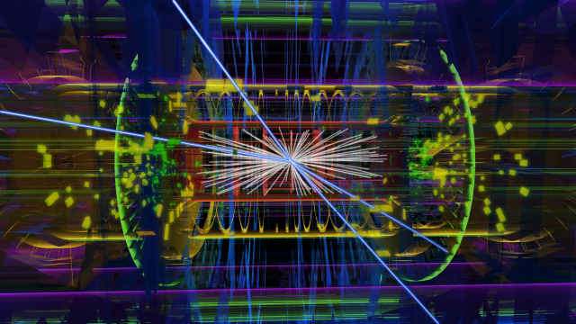
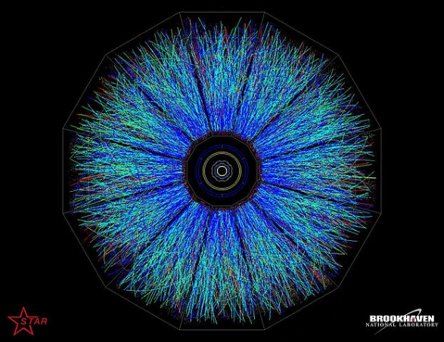
Scope
Original research articles, letters and reviews in the fields of:
Particle physics
Nuclear physics
Particle and nuclear astrophysics
Cosmology
Images: (top) © CERN; (middle) Brookhaven National Laboratory, https://www.flickr.com/photos/11304375@N07/6799740261/, CC BY 2.0; (bottom) NASA, public domain

Slide 3
CPC
2017 Impact Factor 3.298 (2018 Impact Factor 5.861)
SCI-E, SCI-CC, Scopus, Inspec, Physics Abstracts, Chemical Abstracts, JICST(Japan) ,РЖ (Russia)
Subscriptions at over 3000 institutions worldwide
Average 24 days to first decision
Fast-track publication for selected articles
Free English editing on all accepted articles
A SCOAP3 participating journal - free Open Access for qualifying articles
A COPE (Committee on Publication Ethics) member

Slide 4
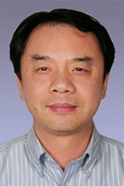
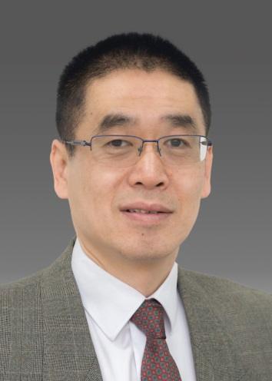
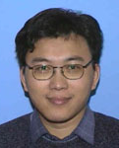
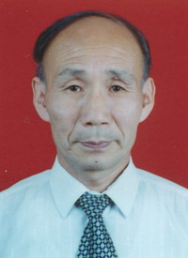
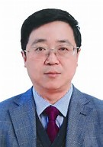
Editors-in-Chief
Yifang Wang, Editor-in-Chief
王贻芳院士 主编
Cai-Dian Lü, Associate EIC
吕才典研究员 副主编
Hai-Bo Li, Associate EIC
李海波研究员 副主编
Gen-Ming Jin, Associate EIC
靳根明研究员 副主编
Guo-Qing Xiao, Associate EIC
肖国青研究员 副主编

Slide 5
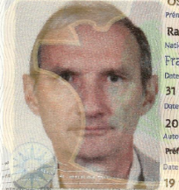
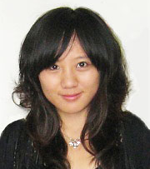
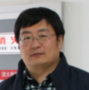
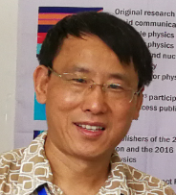
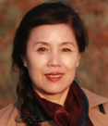
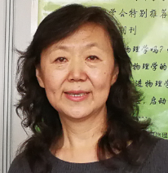
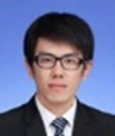
Editors
英文编辑
（CERN&UK）
北京编辑部
（中国科学院高能物理研究所）
兰州编辑部
（中国科学院近代物理研究所）
① 
Ranko Ostojic
英文编辑
English-Editor
董海荣
编辑部主管
Manager-Editor
吴岳峰
编辑
Editor
.
王金川
编辑
Editor
Vacancy open
① ②  
① ②  
① ②  
英文编辑
English-Editor
肖梅
资深编辑
Editor
.
刘金鹏
编辑
Editor
.
赵莉莉
编辑
Editor
① ②  
① ②  

Slide 6
Editor Recruitment
We are currently looking for an Editor (English Language & International Communications) to join our editorial team in Beijing.
Read the full job posting below for details of this exciting opportunity!
http://cpc-hepnp.ihep.ac.cn:8080/Jwk_cpc/EN/column/item100.shtml

Slide 7
Impact Factor
2017 Impact Factor 3.298
2018 Impact Factor 5.861
Now in Q1 for both Particle Physics and Nuclear Physics

Slide 8
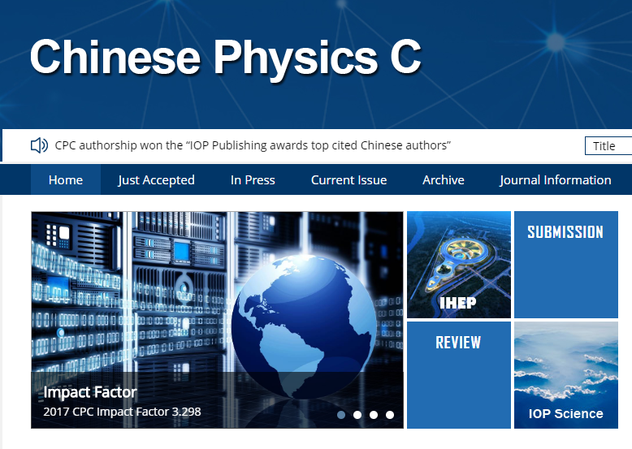
How to submit
Register / log in at http://mc03.manuscriptcentral.com/cpc
Online submission only
ScholarOne System (since Jan 2016)

Slide 9
The review process
Editorial Office check (format, scope, plagiarism, basic quality)
Reviewing Editor (Editorial Board)
Peer Review
Reviewing Editor (Editorial Board)
Associate Editor-in-Chief
编辑部初审
编委初审
外审
编委决定
副主编决定

Slide 10
Editorial Board
43 Review Editors, come from 29 institutions,
15 non-Chinese Editorial members account for 35%
Name | Institute
Adrian Bevan | Queen Mary University of London, London, UK
Xiao-Jun Bi (毕效军) | Institute of High Energy Physics, CAS, Beijing, China
Jun Cao(曹俊) | Institute of High Energy Physics, CAS, Beijing, China
Zhen Cao (曹臻) | Institute of High Energy Physics, CAS, Beijing, China
Zhe Chang(常 哲) | Institute of High Energy Physics, CAS, Beijing, China
Lie-Wen Chen(陈列文) | Shanghai Jiaotong University, Shanghai, China
Shao-Min Chen(陈少敏) | Tsinghua University, Beijing, China
Simon I. Eidelman | Budker Institute SB RAS and Novosibirsk State University, Novosibirsk, Russia
Evgeny Epelbaum | Ruhr-Universität Bochum, Bochum, Germany
Hong-Bo Hu (胡红波) | Institute of High Energy Physics, CAS, Beijing, China
Mei Huang (黄梅) | Institute of High Energy Physics, CAS, Beijing, China
Masaaki Kimura | Hokkaido University, Sapporo, Japan
Emi Kou | Université Paris-Sud, Paris, France
Andrzej Kupsc | Uppsala University, Uppsala, Sweden
Mingzhe Li(李明哲) | University of Science and Technology of China, Hefei, China
Jinfeng Liao(廖劲峰) | Indiana University, Bloomington, Indiana, USA
Haozhao Liang（梁豪兆） | University of Tokyo, Tokyo, Japan
Cheng-Jian Lin(林承键) | China Institute of Atomic Energy, Beijing, China
Chuan Liu (刘 川) | Peking University, Beijing, China
Jiang-Lai Liu(刘江来) | Shanghai Jiaotong University, Shanghai, China
Yu-Gang Ma (马余刚) | Shanghai Institute of Applied Physics, CAS, Shanghai, China
Nicola Neri | Universita di Milano & INFN, Milano, Italy
Stephen Olsen | Institute of Basic Science, Daejeon, Korea
Emilie Passemar | Indiana University, Bloomington, Indiana, USA
Cong-Feng Qiao (乔从丰) | University of Chinese Academy of Sciences, Beijing, China
Zhong-Zhou Ren (任中洲) | Nanjing University, Nanjing, China
Gary Shiu | University of Wisconsin, Madison, USA
Zong-Guo Si(司宗国) | Shandong University, Ji’nan, China
Shufang Su(苏淑芳) | University of Arizona, Tucson, Arizona, USA
Xiao-Dong Tang(唐晓东) | Institute of Modern Physics, CAS, Lanzhou, China
An-Zhong Wang(王安忠) | Baylor University, Texas, USA
Jian-Min Wang(王建民) | Institute of High Energy Physics, CAS, Beijing, China
Lian-Tao Wang(王连涛) | University of Chicago, Chicago, Illinois, USA
Meng Wang(王猛) | Institute of Modern Physics, CAS, Lanzhou, China
Wei Wang(王伟) | Shanghai Jiaotong University, Shanghai, China
Yi Yang(杨毅) | NCTU, Hsinchu, Taiwan, China
Zhong-Bao Yin(殷中宝) | Central China Normal University, Wuhan, China
Changzheng Yuan (苑长征) | Institute of High Energy Physics, CAS, Beijing, China
Qiang Zhao (赵强) | Institute of High Energy Physics, CAS, Beijing, China
Yangheng Zheng(郑阳恒) | University of Chinese Academy of Sciences, Beijing, China
Shan-Gui Zhou(周善贵) | Institute of Theoretical Physics, CAS, Beijing, China
Shun Zhou(周顺) | Institute of High Energy Physics, CAS, Beijing, China
Shi-Lin Zhu(朱世琳) | Peking University, Beijing, China

Slide 11
Review and publication speed
Average time from submission to…
…first decision: 24 days (min 1, max 76)
…acceptance: 60 days (min 1, max 187)
online after acceptance
33 days

Slide 12
Online publication
cpc.ihep.ac.cn
Free downloads within China
Current issue highlighted on front page
“In Press” section with final versions of papers, ahead of print publication

Slide 13
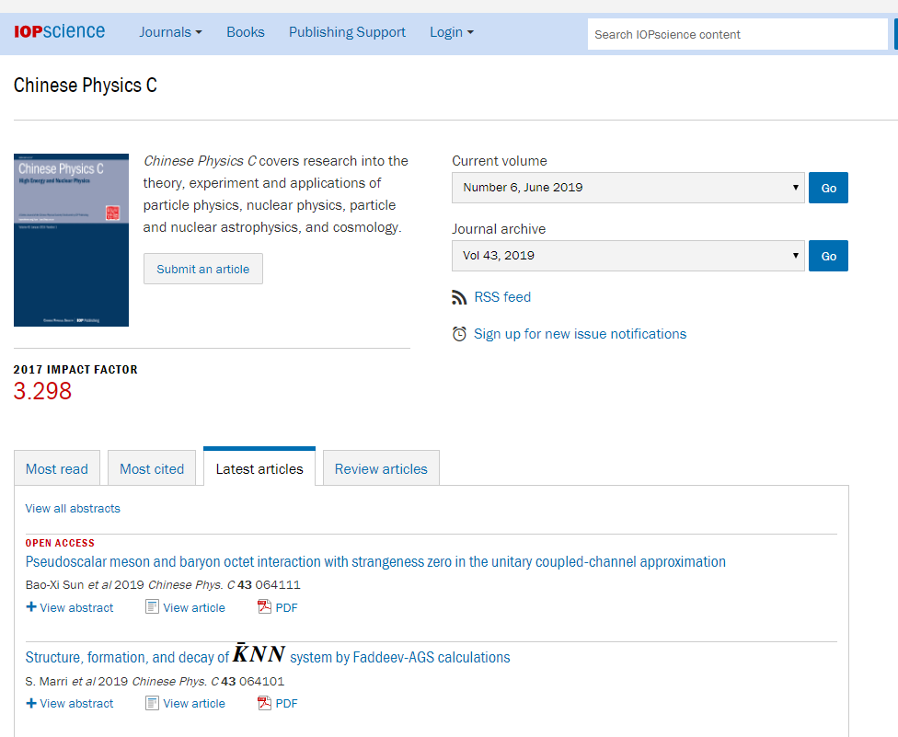
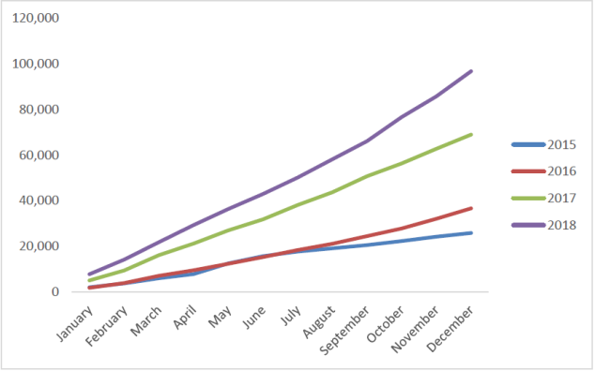
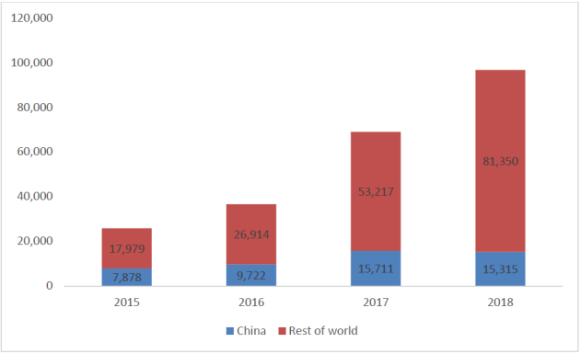
Online publication
iopscience.org/cpc
There were 2,859 institutions globally with access to CPC
The total number of full-text downloads for CPC on IOP science was 96,665
An 40% increase from 2017
Divided by China and Rest of World

Slide 14
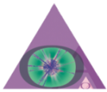
SCOAP³
Sponsoring Consortium for Open Access Publishing in Particle Physics
Funded through CERN
Free Open Access publication for all articles in hep-* categories of arXiv
Open Access: authors retain copyright, article is freely available without subscription
More information: scoap3.org

Slide 15
COEP
Committee on Publication Ethics

Slide 16
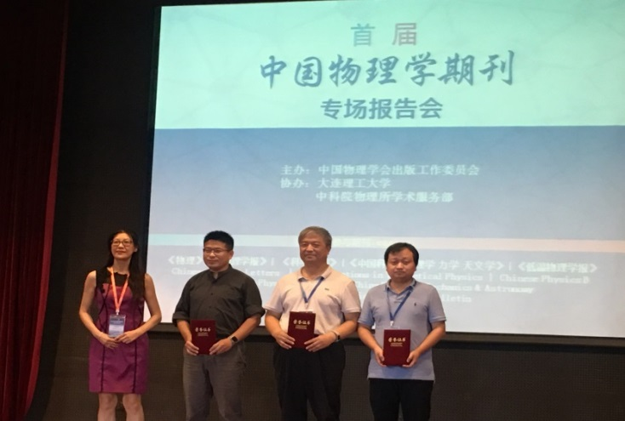
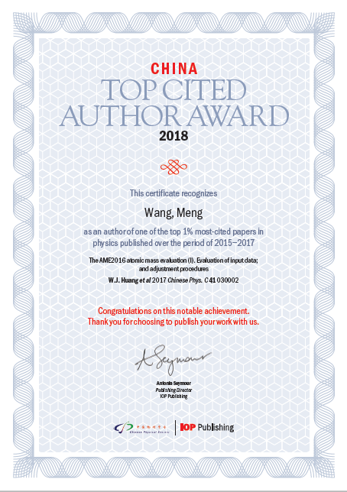
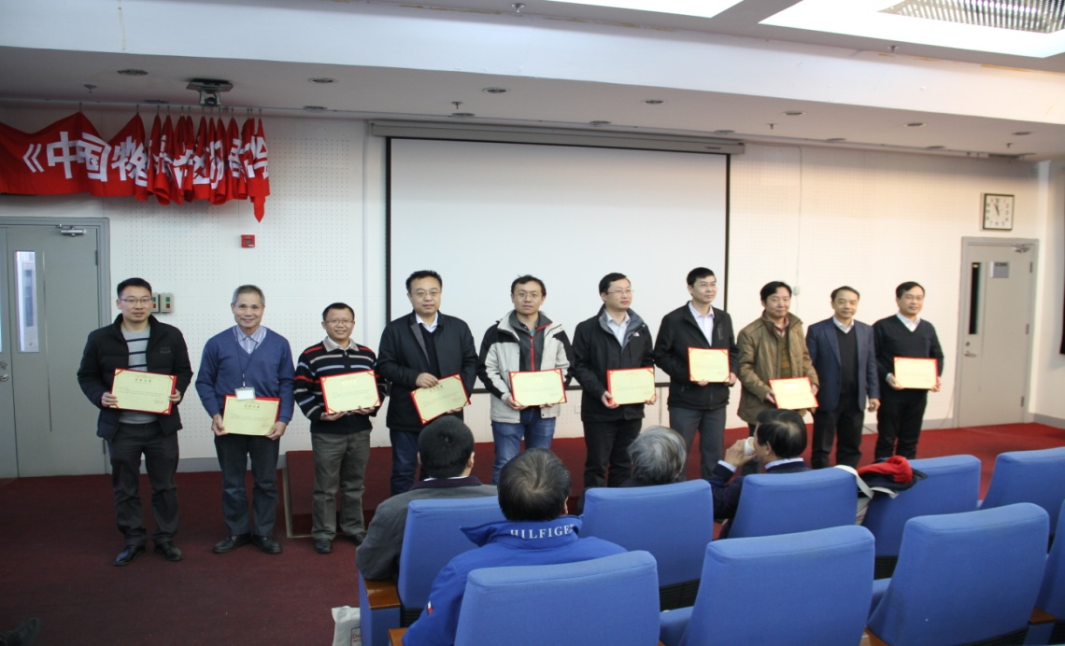
Awards
2018 Award for Influential Articles
2018 CPC Top Reviewers Awards
China Top Cited Author Award 2018
Improved measurement of the reactor antineutrino flux and spectrum at Daya Bay
Feng-Peng An（安丰鹏）等（Daya Bay Collaboration）
Chinese Physics C, 2017, 41(1) 013002
A general analysis of Wtb anomalous couplings
Qing-Hong Cao (曹庆宏)，Bin Yan (岩斌)，Jiang-Hao Yu (于江浩)，Chen Zhang (张宸)
Chinese Physics C, 2017, 41(6) 063101
S-wave resonance contributions to B0 (s)→ηc(2S)π+π- in the perturbative QCD factorization approach
Ai-Jun Ma (马爱军)，Ya Li (李亚)，Wen-Fei Wang (王文飞)，Zhen-Jun Xiao (肖振军)
Chinese Physics C, 2017,41(8) 083105
Meng-Wang（王猛） (times cited: 35+143)
The AME2016 atomic mass evaluation (I). Evaluation of input data; and adjustment procedures
The AME2016 atomic mass evaluation (II). Tables, graphs and references
Wei-Min Song（宋维民）(times cited: 39)
Precision measurement of the integrated luminosity of the data taken by BESIII at center-of-mass energies between 3.810 GeV and 4.600 GeV
Gui-Jun Ding （丁桂军）(times cited: 21)
Predicting lepton flavor mixing from Delta(48) and generalized CP symmetries

Slide 17
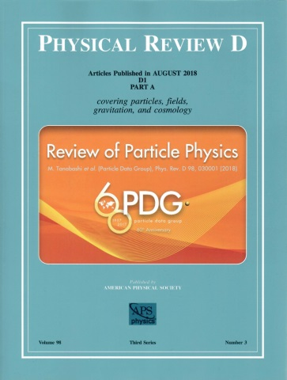
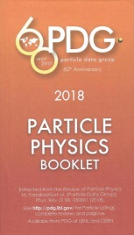
PDG
2018 Particle Data Group
Review of Particle Physics (PDG)
Please send
Chinese name,
Phone number ,
Address
To
cpc@ihep.ac.cn

Slide 18
Q&A
cpc@ihep.ac.cn

