Slide 1
Toward a relativistic ab initio description for nuclear structure
原子核结构的相对论第一性原理研究
第十八届全国中高能核物理大会
2019年6月21～25日 湖南长沙
孟 杰
北京大学物理学院
Notes:
Toward an ab initio covariant density functional description of the nuclear structure

Slide 2


Slide 3
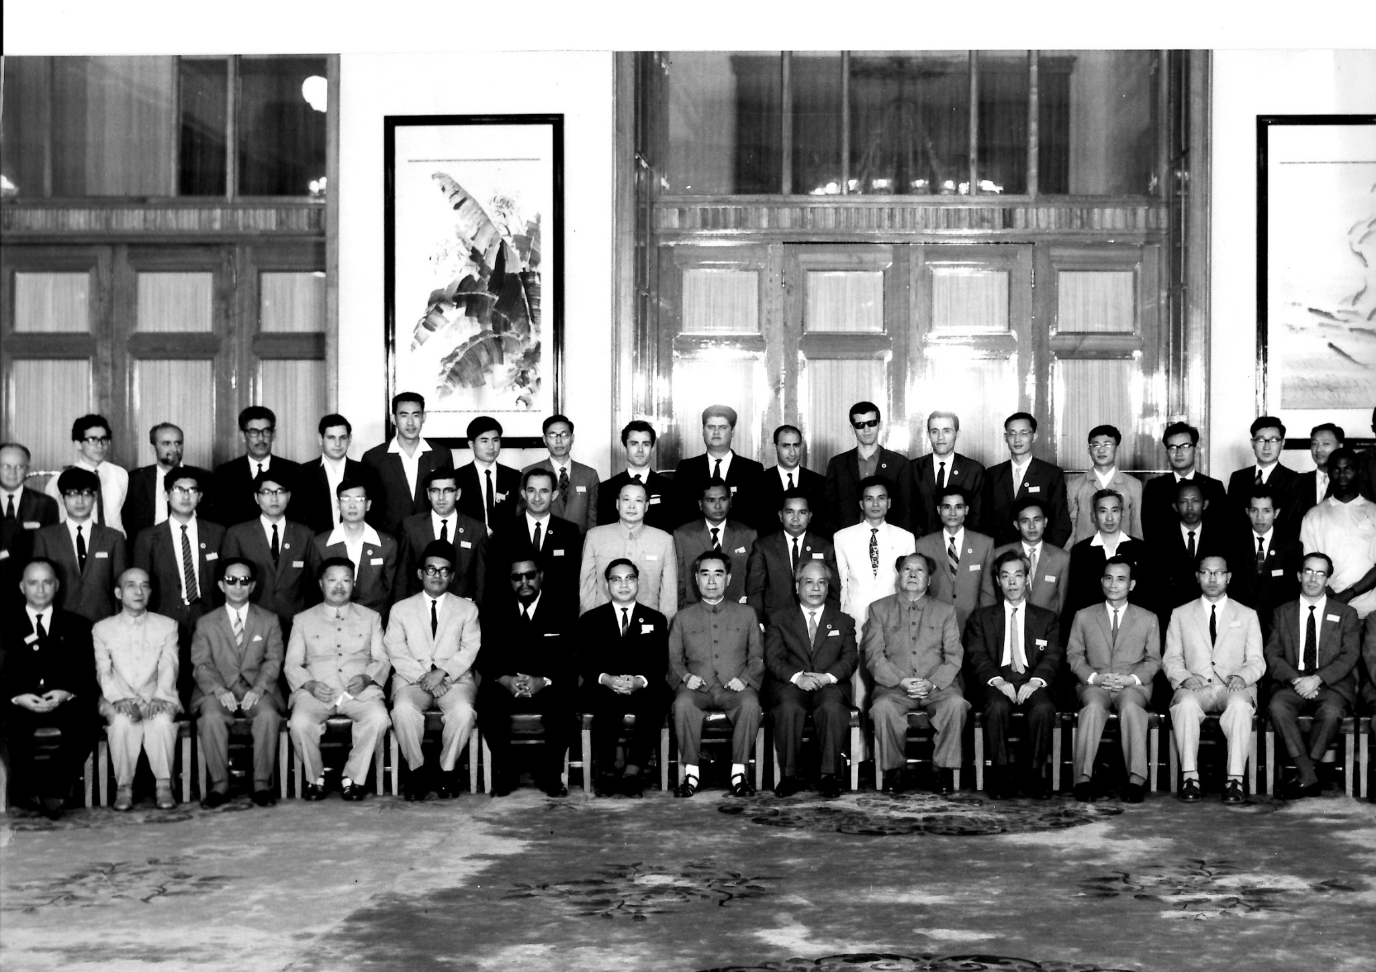
不忘初心，牢记使命

Slide 4


Slide 5
1966-08-01《人民日报》社论
为反帝反殖和发展民族科学文化而斗争——庆祝北京科学讨论会一九六六年暑期物理讨论会胜利闭幕
北京科学讨论会一九六六年暑期物理讨论会胜利闭幕了…… 这次物理讨论会，长了四大洲各国人民和科学家的志气，灭了帝国主义及其科学“权威”的威风。那种认为物理学，特别是核物理学，只能由欧美某些大国所垄断的神话，早已破灭了。会议的光辉成果，对于那些妄想在世界科学领域内称王称霸的人，是当头一棒。四大洲各国发展民族科学文化事业的根本问题，首先是政治问题。
……
我国物理学工作者，在科学实践中，努力掌握毛泽东思想，掌握正确的认识论和方法论。他们以毛泽东思想来指导科学实践，来改造人的世界观，破除迷信，解放思想，敢想、敢说、敢做、敢闯、敢革命。他们高举毛泽东思想的伟大红旗，在现代物理学领域里，闯出自己的一条路子来。
……

Slide 6
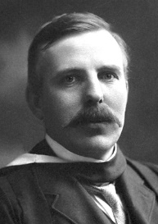
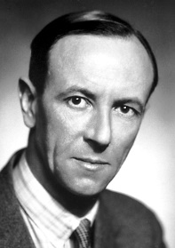
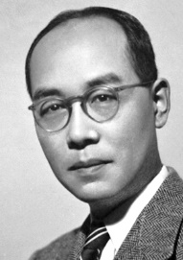
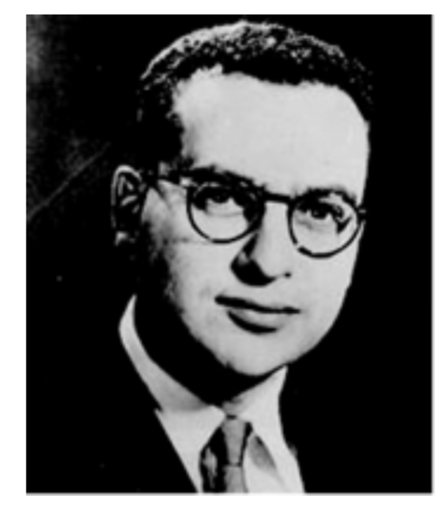
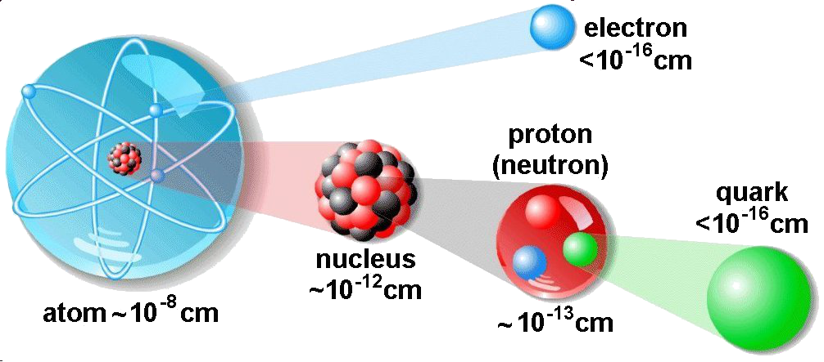
原子核的基本认识
1896 贝克勒尔发现铀原子核的天然放射性
1911 卢瑟福实验确认了原子核的存在
1932 查德威克发现中子
1935 汤川秀树提出核力的介子交换模型
原子核：物质核芯、恒星燃料，是物质结构的一个基本层次。
第一性原理研究：从强相互作用基本理论出发研究原子核是当前基础物理研究的重要科学问题。
1. 核力的复杂性
2. 核多体问题的复杂性
强相互作用理论的建立
1964 盖尔曼提出了夸克理论
1967 弗里德曼、肯德尔和泰勒实验确认了 夸克的存在
1973 格罗斯、维尔切克和波利策发现了强相互作用理论的渐近自由性质，建立了量子色动力学(QCD)理论

Slide 7
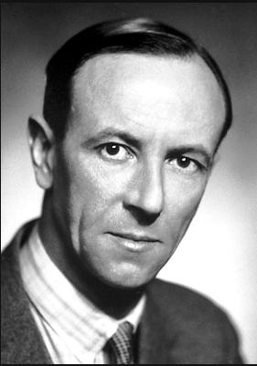


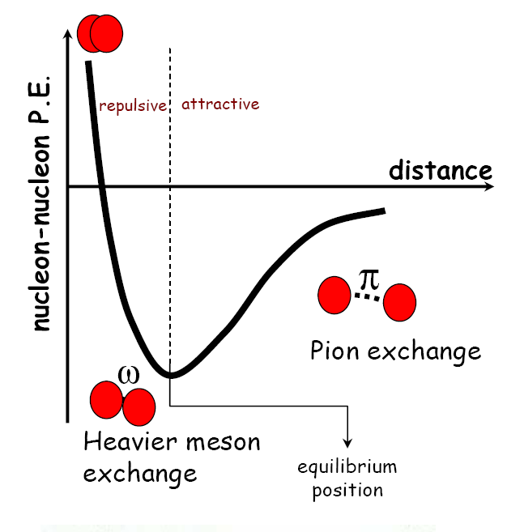
Milestone toward the nuclear model
During the hundred years’ struggling, in the development of nuclear physics itself, there emerged a lot of significant milestones, including
The discovery of neutron by Chadwick which verified the composition of nucleus as protons and neutrons
The meson-exchange theory for the interaction between nucleons by Yukawa
H. Euler, Z. Physik 105, 553 (1937)
Heisenberg's student who calculated the nuclear matter in 2nd order perturbation theory

Slide 8
第一代核模型：平均场近似

Slide 9
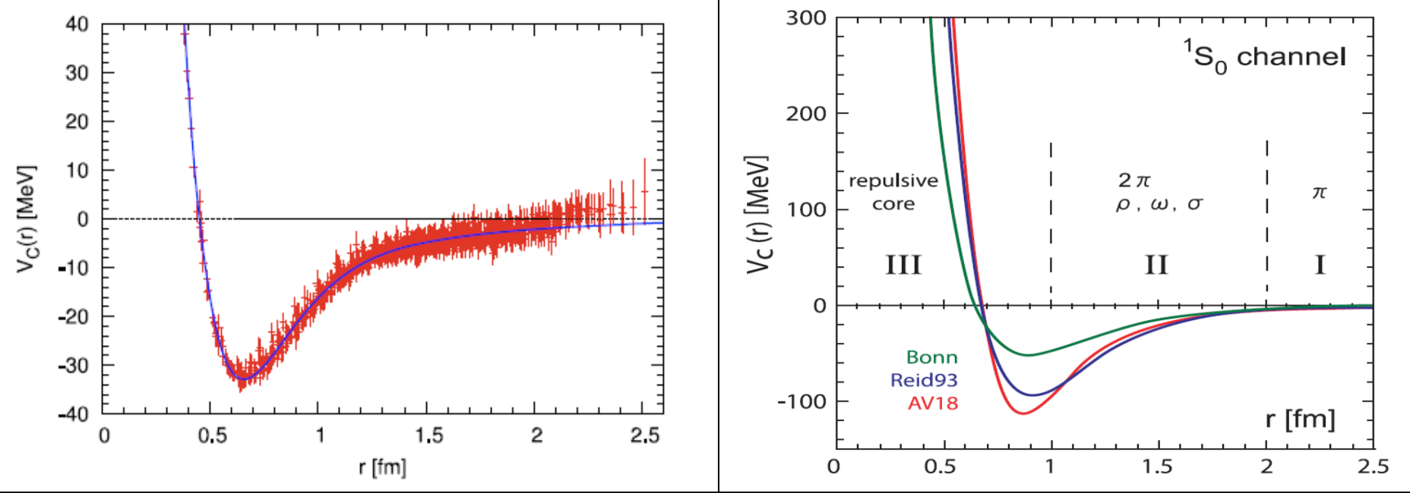
核力
通过直接拟合两体散射实验数据得到的各种高精度唯象核力有不确定性.
因此，从强相互作用的基本理论QCD出发来构建核力具有重要意义.
QCD在低能区具有不可微扰的特性，所以需要发展各种非微扰的计算方法.
各种唯象核力
格点QCD初步计算
Ishii, Aoki, Hatsuda, Phys. Rev. Lett. 92 (2007) 022001
The achievement is both a computational tour de force and a triumph for theory.
-----《Nature》 2007 Research Highlights

Slide 10
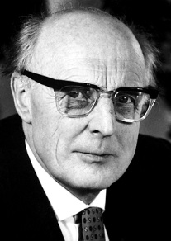
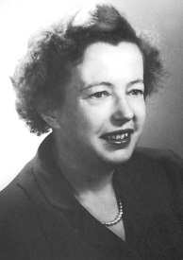
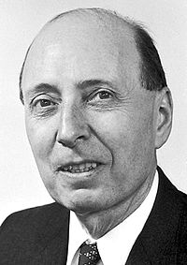
平均场壳模型
J. H. D. Jensen
M. G. Mayer
E. P. Wigner
Nobel Prize in Physics 1963
Strong spin-orbit interaction
Great for:
magic numbers
ground state properties
some low lying excited states
Lead to deformed Nilsson model
S. G. Nilsson, Mat. Fys. Medd. Dan.
Vid. Selsk. 29, No.16(1955).
S. G. Nilssion, et al., Nucl. Phys.
A131(1969) 1.
Totally fails for nuclear bulk properties

Slide 11
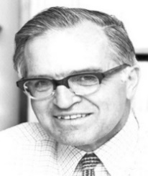
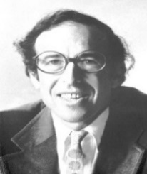
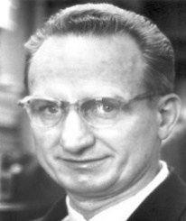
平均场壳模型与集体模型
The independent particle shell model of nucleus by Mayer and Jensen et al., and the collective Hamiltonian for nuclear rotation and vibration by Bohr and Mottelson, etc. However, since 1950s, nuclear physics stepped into a more challenging stage.
Although the independent particle shell model could describe the single-particle motion in a nucleus with a phenomenological mean potential, it cannot provide even a qualitative description for the nuclear bulk properties.
J. H. D. Jensen
M. G. Mayer
E. P. Wigner
Nobel Prize in Physics 1963
On the contrary, a unified phenomenological description of nuclear vibration and rotation can be achieved by the collective Hamiltonian whereas it is helpless in understanding the motion of a single nucleon.
A. N. Bohr
B. R. Mottelson
J. Rainwater
Nobel Prize in Physics 1975

Slide 12
Strutinsky 壳修正
Compromise between Shell model and collective model
Great success for
FRDM
WS4 …
V.M. Strutinsky,
Shell effects in nuclear masses and deformation energies, Nuclear Physics A 95 (1967) 420
Times Cited: 1,664
“Shells” in deformed nuclei, Nuclear Physics A 122 (1968) 1
Times Cited: 1,040

Slide 13
质量模型
Finite-Range Droplet Model (FRDM)
P. Möller, J.R. Nix, W.D. Myers, W.J. Swiatecki, At. Data Nucl. Data Tables 59, 185 (1995). Times Cited: 2,385 Error of the mass model is 0.669 MeV
Weizsäcker-Skyrme (WS) formula
“Isospin for S-O & E_sym + mirror nuclei”
inspired by the Skyrme energy-density functional and a macroscopic-microscopic mass formula, with an rms deviation of 336 keV with respect to the 2149 measured masses in 2003 Atomic Mass Evaluation.
N. Wang, M. Liu and X. Z. Wu, Phys. Rev. C 81, 044322 (2010).
N. Wang, Z. Y. Liang, M. Liu and X. Z. Wu, Phys. Rev. C 82, 044304 (2010).
M. Liu, N. Wang, Y. G. Deng, and X. Z. Wu, Phys. Rev. C 84, 014333 (2011).
Taking into account the surface diffuseness effect, the rms deviation with 2353 known masses falls to 298 keV.
N. Wang, M. Liu, X. Z. Wu and J. Meng, Phys. Lett. B 734, 215 (2014).

Slide 14
第二代核模型：有效相互作用

Slide 15
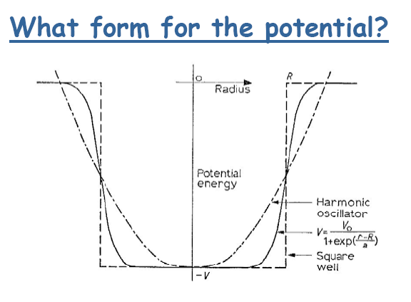
核力
How to achieve microscopically and self-consistently a unified description of the single-nucleon and collective motions of nucleus based on the strong interaction theory is a crucial question to be answered by nuclear scientists.

Slide 16
核多体理论
2019/6/23
Many-body problems
Mean field potential
Residual interaction
The self-consistent mean-field approach to nuclear structure is
analogous to Kohn-Sham Density Functional Theory.
Density functional theory (DFT) , with the name comes from the use of functionals of the particle density, is aquantum mechanical theory used in physics and chemistry to investigate the structure (mainly the ground state) of many-particle systems.
16

Slide 17
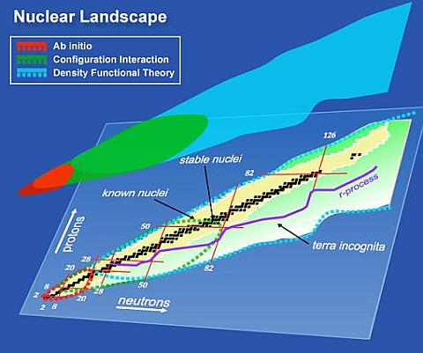
核多体理论
Ab inito
Navratil, Vary, Barrett Phys. Rev. Lett. 84 (2000) 5728
Bogner, Furnstahl, Schwenk
Prog. Part. Nucl. Phys. 65 (2010) 94
…
Shell model
Caurier, Martínez-Pinedo, Nowacki, Poves, Zuker,
Rev. Mod. Phys. 77 (2005) 427
Otsuka, Honma, Mizusaki, Shimizu, Utsuno,
Prog. Part. Nucl. Phys.47(2001)319
Brown, Prog. Part. Nucl. Phys. 47 (2001) 517
…
Density functional theory
Jones and Gunnarsson,
Rev. Mod. Phys., 61 (1989) 689
Bender, Heenen, Reinhard,
Rev. Mod. Phys., 75 (2003) 121
Ring, Prog. Part. Nucl. Phys.37(1996)193
Meng, Toki, Zhou, Zhang, Long, Geng,
Prog. Part. Nucl. Phys. 57 (2006) 470
…
http://www.unedf.org/
密度泛函理论有希望给出核素图上所有原子核性质的统一描述
Relativistic Density Functional for Nuclear Structure，International Review of Nuclear Physics Vol 10（World Scientific, 2016）
Notes:
Theoretically the main weapons can be classified as 3 classes: ab inito, shell model and density functional.

Slide 18
Nuclear Density functional theory
Nuclear DFT has been introduced by effective Hamiltonians: by Vautherin and Brink (1972) using the Skyrme model as a vehicle
Based on the philosophy of Bethe, Goldstone, and Brueckner one has a density dependent interaction in the nuclear interior G(ρ)
At present, the ansatz for E(ρ) is phenomenological:
Skyrme: non-relativistic, zero range
Gogny: non-relativistic, finite range (Gaussian)
CDFT: Covariant density functional theory

Slide 19
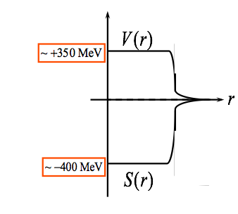
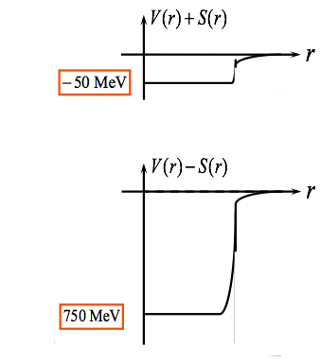
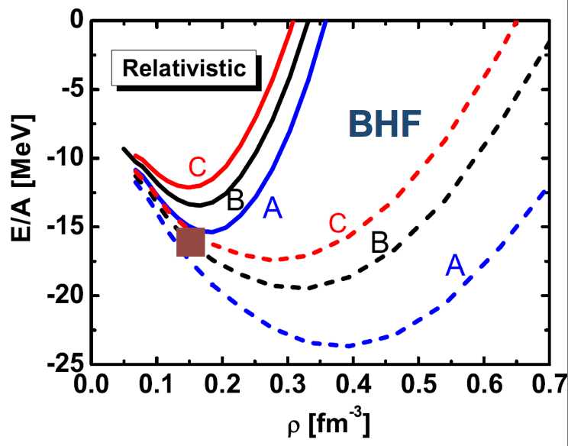
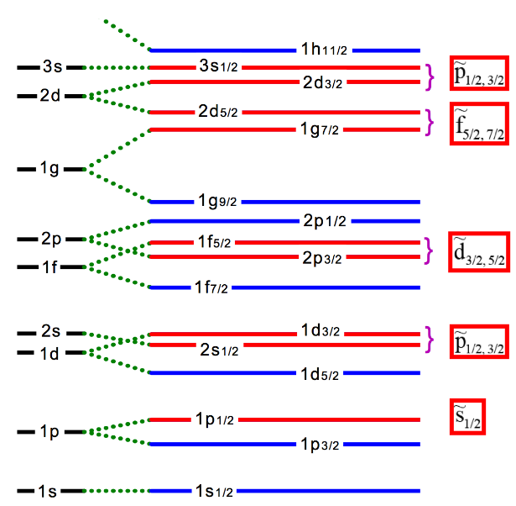
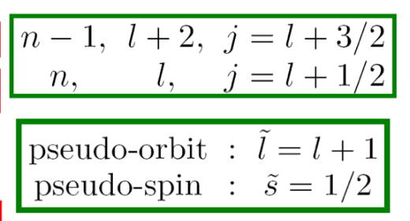
Why Covariant?
P. Ring Physica Scripta, T150, 014035 (2012)
Spin-orbit automatically included
Lorentz covariance restricts parameters
Pseudo-spin Symmetry
Connection to QCD: big V/S ~ ±400 MeV
Consistent treatment of time-odd fields
Relativistic saturation mechanism
…
Pseudospin symmetry
Hecht & Adler
NPA137(1969)129
Arima, Harvey & Shimizu
PLB 30(1969)517
Ginocchio PRL 78, 436
Brockmann & Machleidt, PRC42, 1965 (1990)
Notes:
Now, we come to this question why a functional should be covariant? There are some advantages for the Covariant density functional theory. For example, because it includes the spin degree of freedom naturally, it explains naturally the large spin-orbit splitting and pseudo-spin symmetry. There is a great success of rela. Brueckner calculations for the nuclear matter. One can treat the time-odd fields consistently which are important to nuclear rotations. Later we will see, we have two large fields of vector and scalar potentials, and this provides the relativistic saturation mechanism.

Slide 20

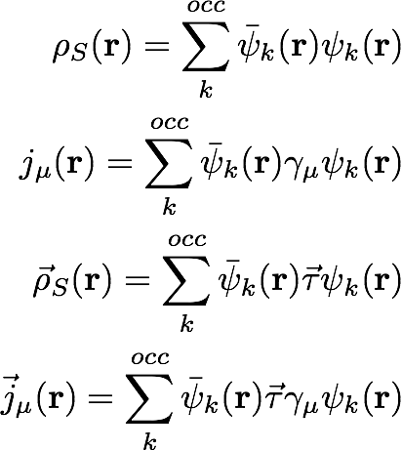



Covariant Density Functional Theory
Elementary building blocks
Energy Density Functional
Densities and currents
Isoscalar-scalar
Isoscalar-vector
Isovector-scalar
Isovector-vector
Notes:
The elementary building blocks for a point-coupling density functional could have such 10 terms. At the present, we build our density functional with the densities and currents coming from only the most important 4 channels including the isocalar-scalar, …. Finally, our energy density functional has such a form, it contains the kinetic term, 2nd order term, high order term, derivative term, and the electromagnetic term. As will see later, the coupling constants in this functional would be determined by fitting to the properties of finite nuclei.

Slide 21
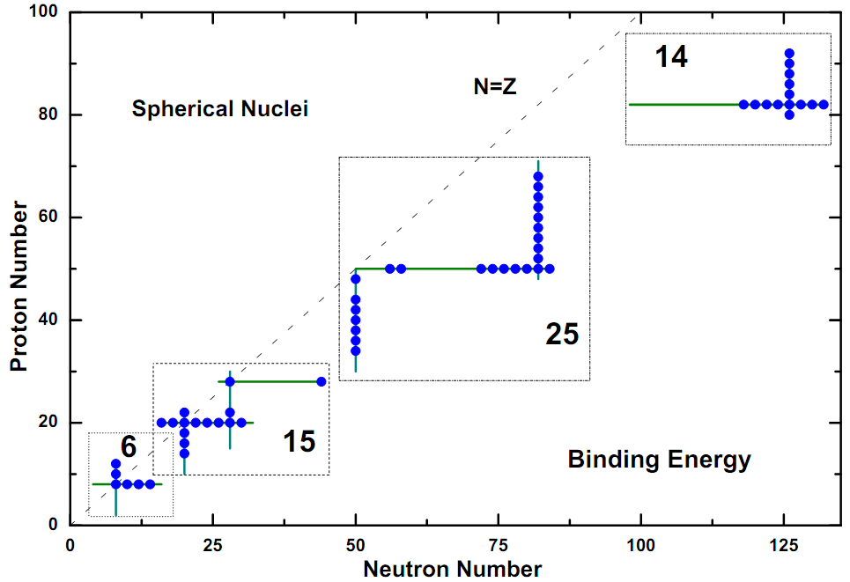
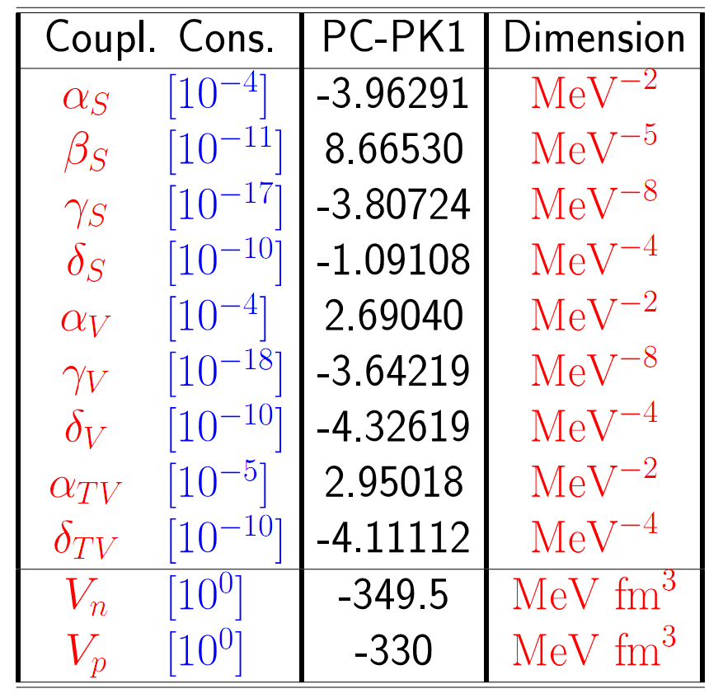
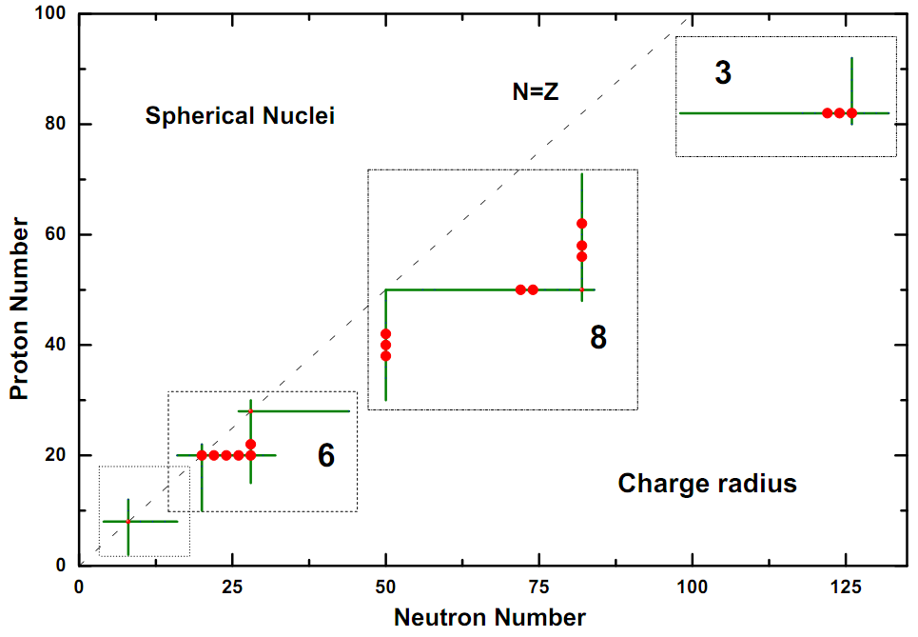
Relativistic functional PC-PK1
Zhao, Li, Yao, Meng, PRC 82, 054319 (2010)

Slide 22
Related review articles
基于核子自由度，通过介子交换或者点耦合考虑核子之间的相互作用，构建相对论密度泛函，通过变分得到核子满足的 Dirac 方程。
自洽求解 Dirac 方程，得到核子谱和反核子谱，给出原子核基态和晕现象的微观自洽描述。
自洽求解非惯性系和动态的 Dirac 方程，分别给出原子核多重手征双带和自旋-同位旋激发的微观自洽描述。
孟杰,郭建友,李剑,李志攀,梁豪兆,龙文辉,牛一斐,牛中明,尧江明,张颖,赵鹏巍,周善贵,原子核物理中的协变密度泛函理论, 物理学进展, 第31卷04期 (2011) 199-336
J.Meng, H.Toki, S.-G.Zhou, S.Q.Zhang, W.H.Long, and L.S.Geng, Prog. Part. Nucl. Phys. 57 (2006) 470-563
J. Meng, J. Peng, S.Q. Zhang, and P.W. Zhao, Front. Phys. 8 (2013) 55-79
H. Z. Liang, J. Meng, and S.-G. Zhou, Physics Reports 570 (2015) 1-84
J. Meng and S.-G. Zhou, J. Phys. G42 (2015) 093101

Slide 23
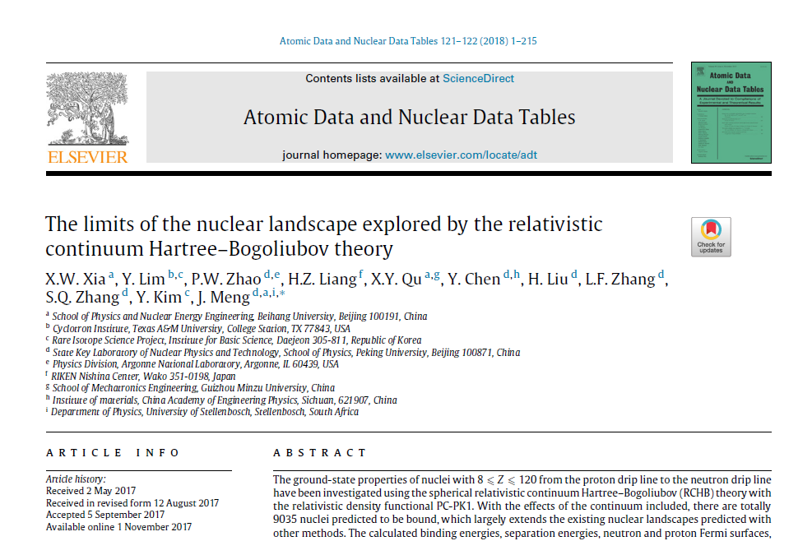
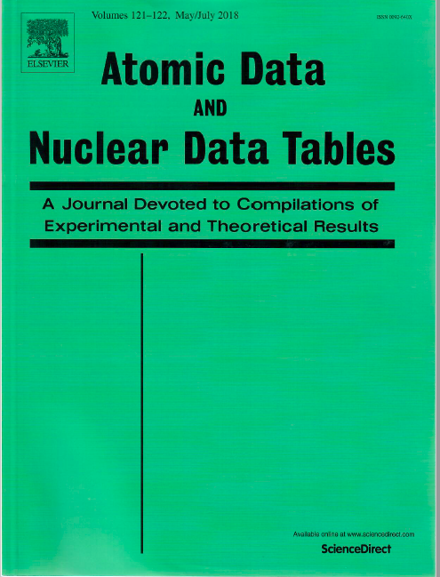
基于协变密度泛函，建立了唯一考虑了连续谱效应的原子核质量表

Slide 24
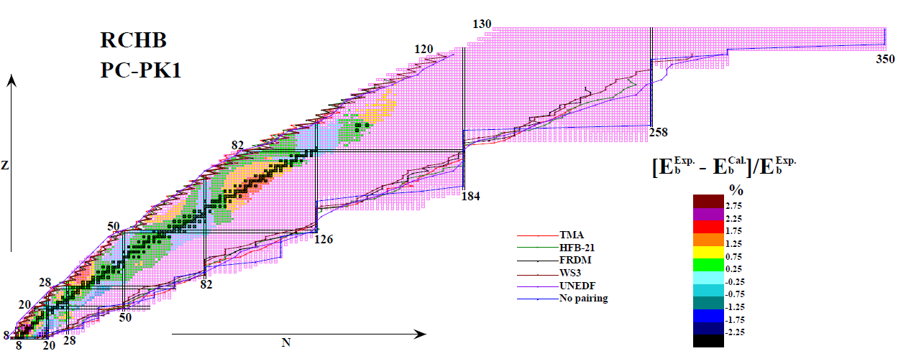
Drip-lines in variant models
The number of bound nuclides with between 2 and 120 protons is around 7,000 2 8 J U N E 2 0 1 2 | V O L 4 8 6 | N AT U R E | 5 0 9
Atomic Data and Nuclear Data Tables 121–122 (2018) 1–215
8 ⩽ Z ⩽ 120：9035 nuclei predicted to be bound
10532 bound nuclei from Z=8 to Z=130 predicted by RCHB theory with PC-PK1. For 2227 nuclei with data, binding energy differences between data and calculated results are shown in different color. The nucleon drip-lines predicted TMA, HFB-21, WS3, FRDM , UNEDF and without pairing correlation are plotted for comparison.
See also: Afanasjev, Agbemava, Ray, Ring, PLB726(2013)680

Slide 25
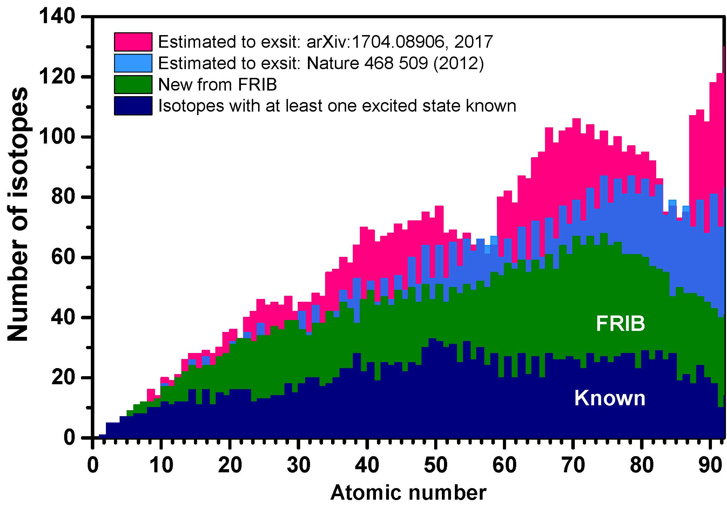
Possible existing isotopes
Atomic Data and Nuclear Data Tables 121-122(2018)1-215

Slide 26
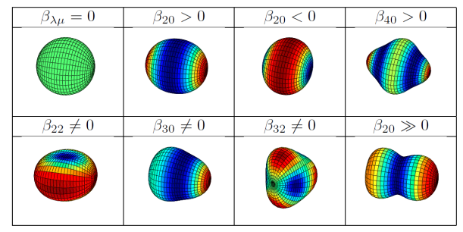
Nuclear Shape
By Bing-Nan Lu

Slide 27
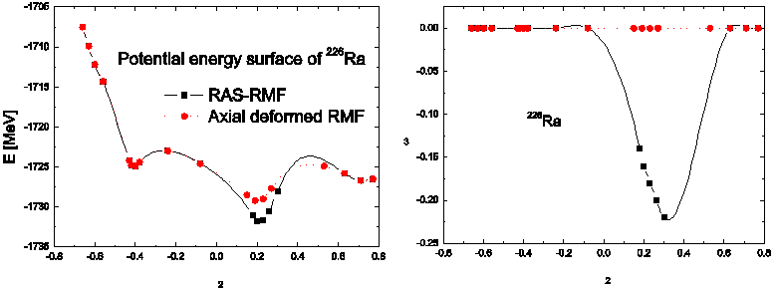
Stability against reflection asymmetry
L.-S. Geng, J. Meng, and H. Toki, Chin. Phys. Lett. 24, 1865 (2007).

Slide 28
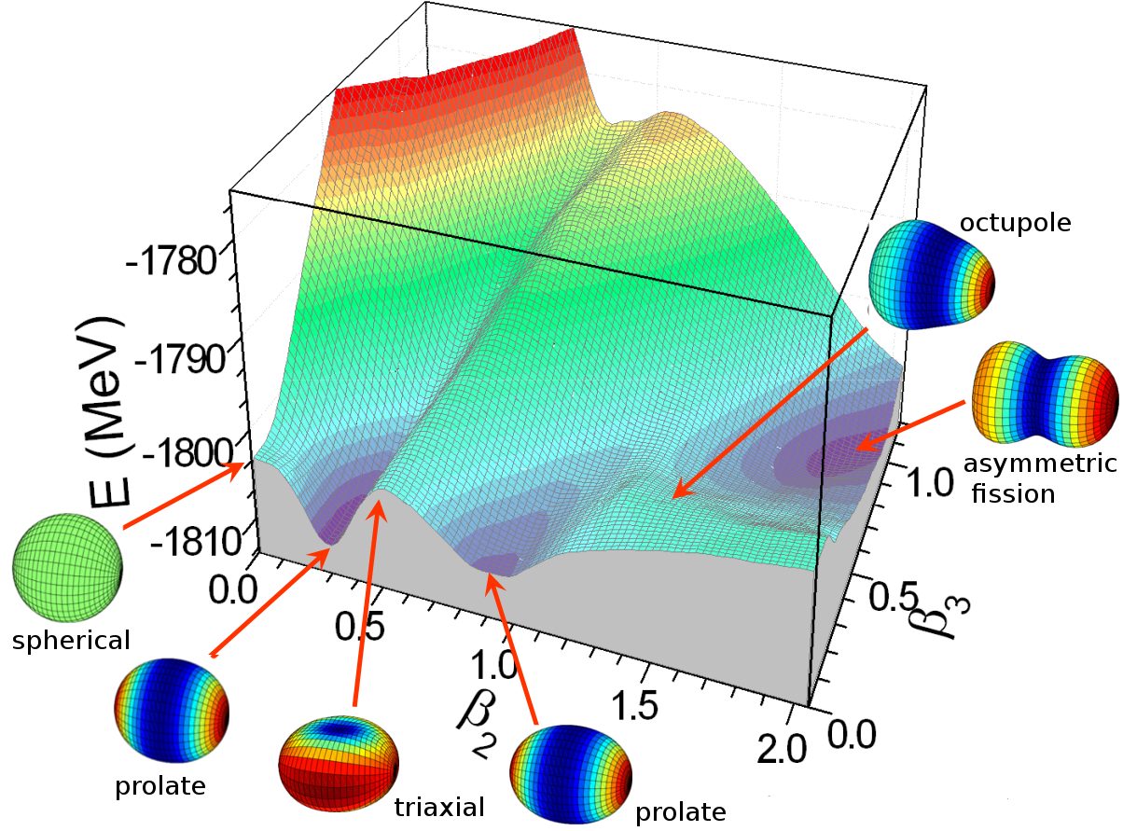
Deformation map of ²⁴⁰Pu
Lu, Zhao, Zhou, PRC 85, 011301 (2012)
Zhao, Lu, Zhao, Zhou, PRC 86, 057304 (2012)
Lu, Zhao, Zhao, Zhou, PRC 89, 014323 (2014)
Zhao, Lu, Vretenar, Zhao, Zhou, arXiv:1404.5466 (2014)
courtesy of B.N. LU

Slide 29
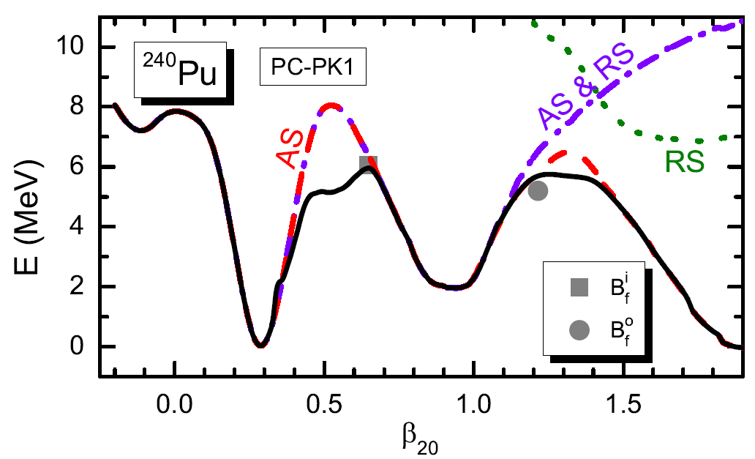
Multidimentionally constrained CDFT
MDC-CDFT: all β_{λμ} with even μ included
Triaxial & octupole shapes both crucial around the outer barrier
Figure: Potential energy curve of ²⁴⁰Pu
Lu, Zhao, Zhou, PRC 85, 011301 (2012)
Zhao, Lu, Zhao, Zhou, PRC 86, 057304 (2012)
Lu, Zhao, Zhao, Zhou, PRC 89, 014323 (2014)
Zhao, Lu, Vretenar, Zhao, Zhou, arXiv:1404.5466 (2014)
Figure: 3D PES of ²⁴⁰Pu
Triaxial deformation only: Abusara, Afanasjev, Ring PRC 85, 024314 (2012)
Notes:
Multidimensionally constrained covariant density functional theories (MDC-CDFTs) have been developed. In these models, all shape degrees of freedom \beta_{\lambda\mu} with even \mu are allowed, e.g., \beta_{20}, \beta_{22}, \beta_{30}, \beta_{32}, and so on.
MDC-CDFTs have been used to investigate the potential energy surfaces and fission barriers of actinide nuclei, including possible triple-humped structure in barriers, and the non-axial (Y32) correlations in N=150 isotones. For example, in the study of fission barriers, it was found that the triaxial deformation lowers not only the first, but also the second fission barriers considerably.
Further information:
MDC-CDFTs: the first CDFT with both non-axial and reflection asymmetric shapes.
For the first time, the influence of triaxiality on the outer barrier height was revealed: The triaxial deformation lowers the outer barrier height by 0.5 to 1 MeV for even-even actinide nuclei, amounting for 10 to 20% of the total height.
Results in this slide: PC-PK1; BCS with delta force
Figure on the left [Fig. 1 in Lu, Zhao, Zhou, PRC 85, 011301 (2012)]: Potential energy curves of 240Pu with various self-consistent symmetries imposed. The solid black curve represents the full calculation, i.e., with all shape degrees of freedom \beta_{\lambda\mu} with even \mu allowed, the red dashed curve that with axial symmetry (AS) imposed, the green dotted curve that with reflection symmetry (RS) imposed, the violet dot-dashed line that with both symmetries (AS & RS) imposed. The empirical inner (outer) barrier height B_\mathrm{emp} is denoted by the grey square (circle). The energy is normalized with respect to the binding energy of the ground state.
Figure on the right [Fig. 3 in Lu, Zhao, Zhou, PRC 85, 011301 (2012)]: Sections of the three-dimensional PES of 240Pu in the (\beta_{22},\beta_{30}) plane calculated at \beta_{20}= 0.3 (around the ground state), 0.6 (around the first saddle point), 0.9 (around the fission isomer), 1.3 (around the second saddle point) and 1.6 (beyond the outer barrier), respectively. The energy is normalized with respect to the binding energy of the ground state. The contour interval is 0.5 MeV. Local minima are denoted by crosses.
In MDC-CDFTs, the functional can be one of the following four forms: the meson exchange or point-coupling nucleon interactions combined with the non-linear or density-dependent couplings; pairing is treated either by BCS (MDC-RMF) or Bogoliubov (MDC-RHB) with delta force or separable finite-range force; axially deformed harmonic oscillator (ADHO) basis

Slide 30

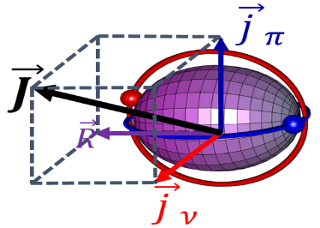
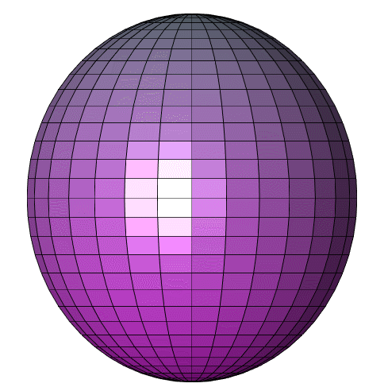
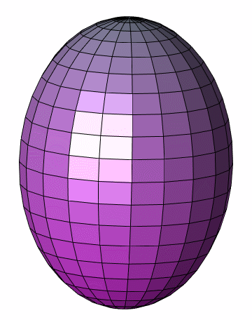
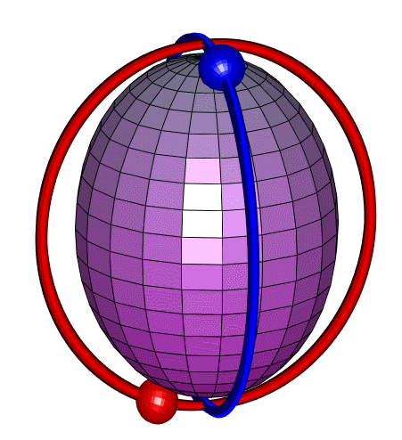
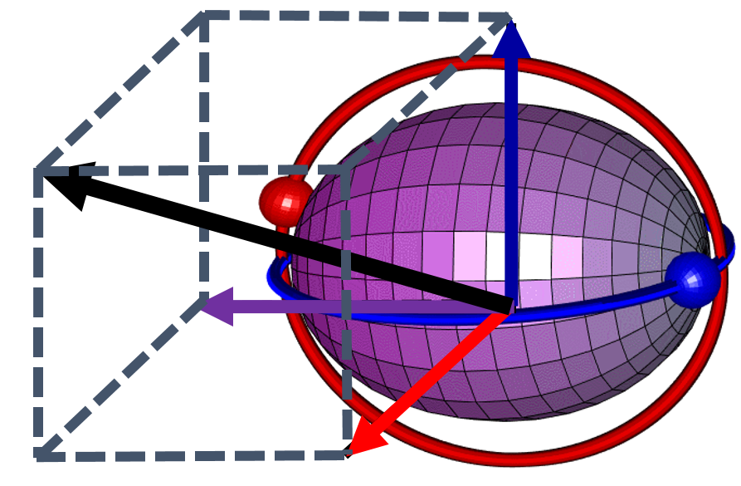



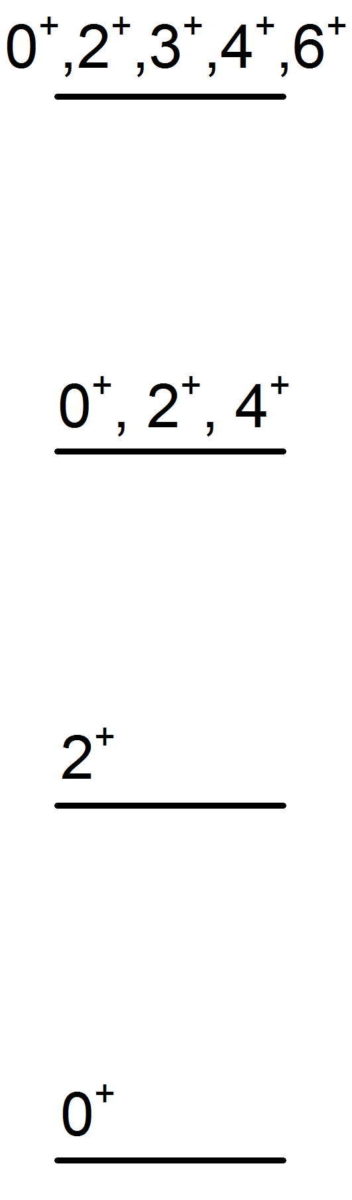
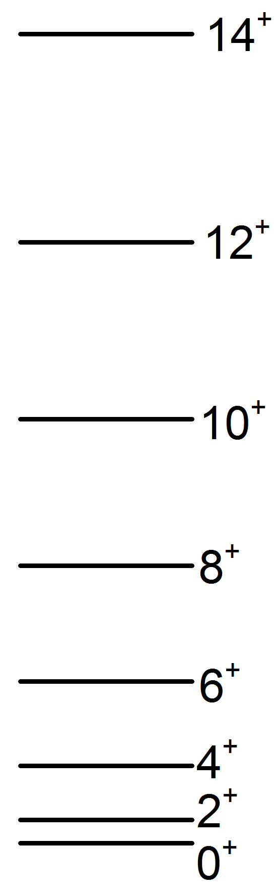
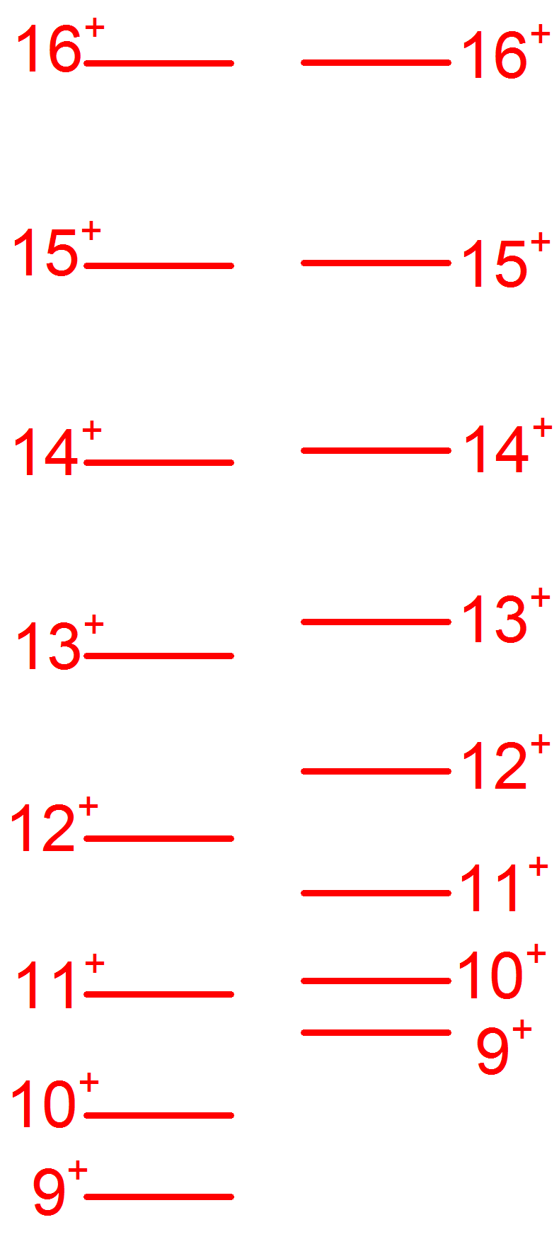
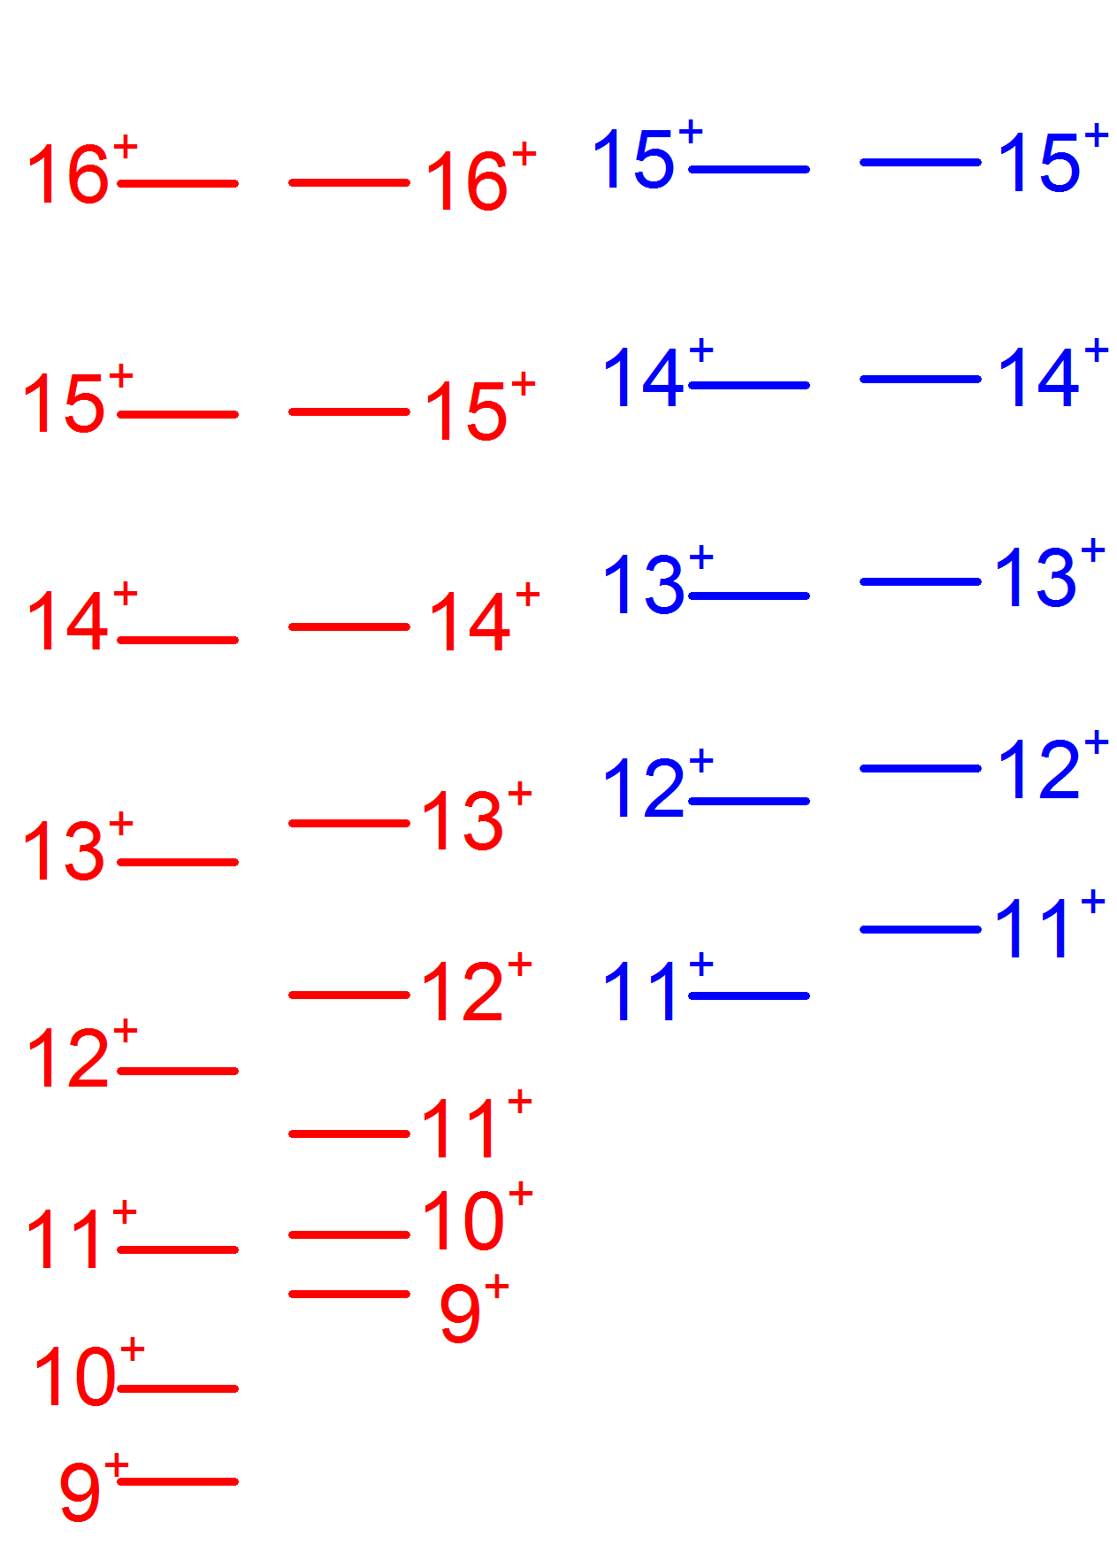

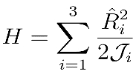

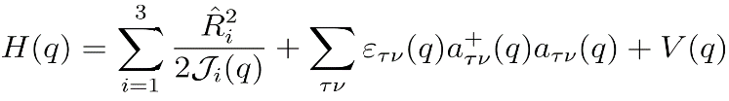

推动并参与实验证实原子核手征对称性的多样性
vibration
Rotation
Chiral Rotation
Bohr & B. Mottelson
Frauendorf & Meng,
NPA 617 (1997) 131
Meng, Peng, Zhang, Zhou, PRC73 (2006) 037303

Slide 31
手性原子核的结构多样性
First observation of the MχD bands
美国圣母大学的核物理实验组在美国Argonne国家实验室先后于2008和2011年进行。
2012年3月至5月，实验组负责人 U. Garg 教授获得北京大学海外学者讲学计划资助访问中国，
中国负责物理分析和理论解释，共同合作完成该文章。
Level Scheme
Theoretical description

Slide 32
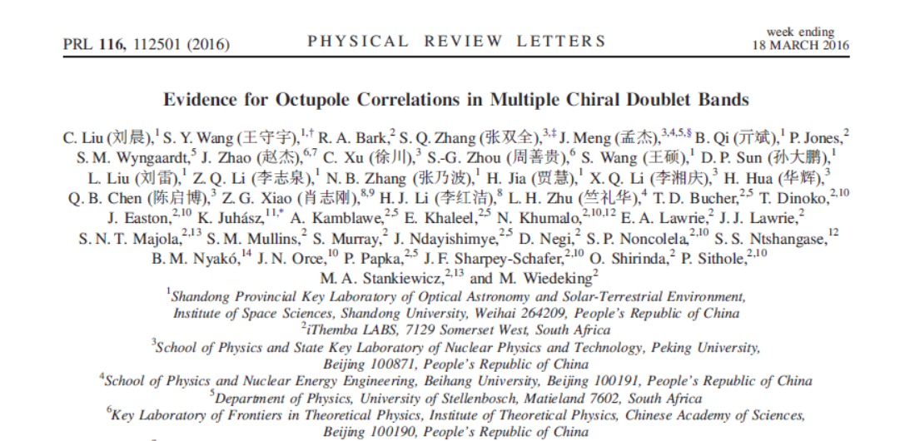
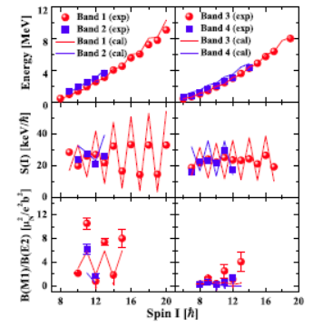
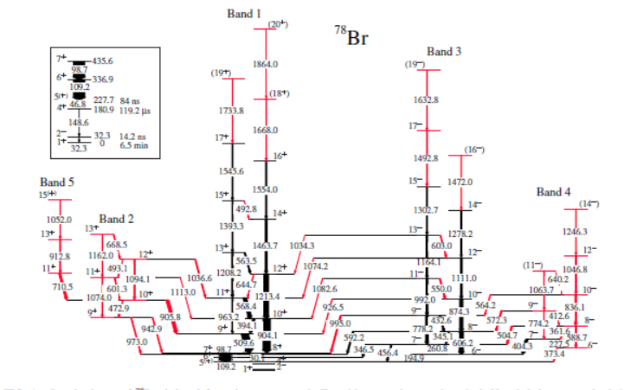
手性原子核的结构多样性
中国、南非、匈牙利、德国等国的合作组首次发现了原子核中手性和空间反射对称性的联立自发破缺的证据
给出手性原子核的下边界；
证实存在正负宇称的ΜχD；
确认正负宇称ΜχD间的E1跃迁。
该工作入选 2016 年度中国高等学校十大科技进展。
URL：http://www.moe.gov.cn/jyb_xwfb/gzdt_
gzdt/s5987/201612/t20161229_293386.html
论文被遴选为《Physical Review Letters》封面文章。这是核物理领域，中国学者在该刊发表的首篇封面文章。

Slide 33
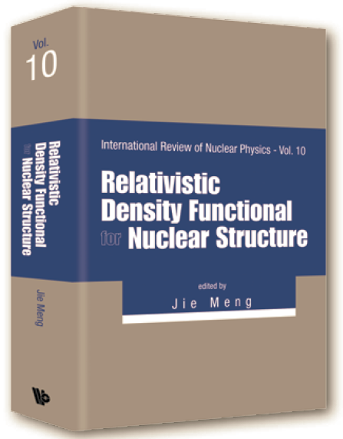
International Review of Nuclear Physics (Vol 10)
Relativistic Density Functional for Nuclear Structure
World Scientific, Singapore (2016)
700 Pages
Editor: Jie Meng
Authors include:
China: J. Y. Guo, Z. P. Li , W. H. Long, Z.M. Niu, B.H.Sun, S.Q. Zhang, E.G. Zhao, S.-G. Zhou
Croatia: N. Paar, T. Niksic, D. Vretenar, J. Zhao
France: N. Van Giai
Germany: B.N. Lv, P. Ring, P.-G. Reinhard
Italy: Y. Niu,
Japan: K. Hagino, H. Z. Liang, J. M. Yao
USA: A. V. Afanasjev, E. Litvinova, J. Piekarewicz, P. W. Zhao

Slide 34
Open questions regarding in the existing functionals
Properties such as symmetry energy are difficult to be constrained from data:.
No unique ansatz to write down a functional, e.g., the role of tensor terms within nuclear DFT.
Difficult in connecting observables to the tensor force uniquely.
Difficult in disentangling the effects of the isovector-scalar and isovector-vector channels by the nuclear ground-state properties。
Additional adjustment is needed for charge-exchange spin-flip excitations, such as Gamow-Teller resonances and spin-dipole resonances.
ab initio calculations should become a benchmark.
provide valuable information for the derivation of nuclear energy density functionals.

Slide 35
第三代核模型：第一性原理计算

Slide 36
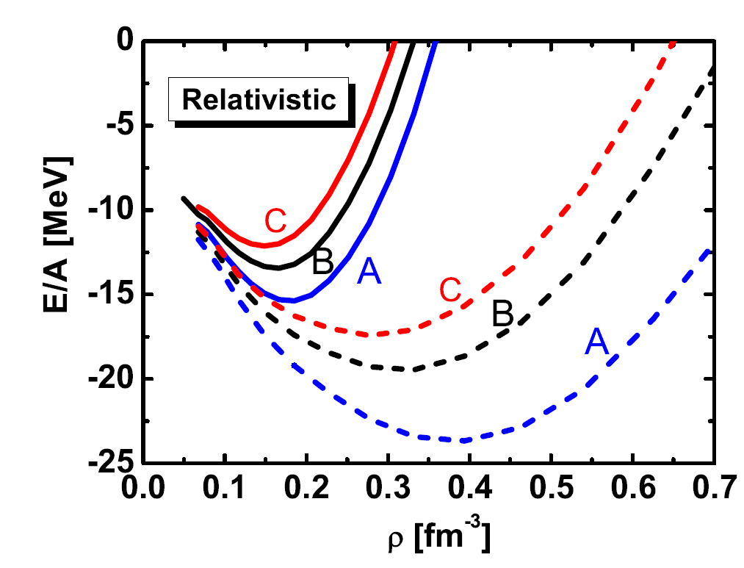
ab initio calculation has become one of hot topics in current nuclear physics
ab initio----- “from the beginning”
without additional assumptions
without additional parameters
ab initio in nuclear physics
with realistic nucleon-nucleon interaction
with few-body or many-body methods, such as Monte Carlo method, shell model and energy density functional theory
ab initio in nuclear matter
Variational method Akmal PRC1998
Green’s function method Dickhoff PPNP2004
Chiral Perturbation theory Kaiser NPA2002
Brueckner-Hartree-Fock (BHF) theory Baldo RPP2012
Relativistic BHF theory Brockmann PRC1990
...........
BHF
36

Slide 37


ab initio calculation for finite nucleus
2019/6/23
ab initio calculation for light nuclei
Gaussian Expansion Method Hiyama PPNP2003
Green Function Monte Carlo Method Pieper PRC2004
Lattice Chiral Effective Field Theory Lee PPNP2009
No-Core Shell Model Barrett PPNP2012
……
ab initio calculation for heavier nuclei
Coupled Channel method Hagen PRL2009
BHF theory Hjorth-Jensen Phys.Rep.1995
With HJ potential Dawson Ann.Phys.1962
With Reid potential Machleidt NPA1975
With Bonn potentials Muether PRC1990
¹⁶O in BHF method in Bonn potential

Slide 38
ab initio calculation for finite nucleus
Among all ab initio methods, the Brueckner theory is one of the most promising theories for heavy nuclei.
Inspired by the success of early relativistic investigations for finite nucleus, the relativistic Brueckner theory is developed and achieved great success in the study of nuclear matter Anastasio PRep 1983 Brockmann PLB 1984 ter Haar PRep. 1987
For finite nuclei , the Local Density Approximation (LDA) is used, i.e., the density dependence of the G matrix in nuclear matter is mapped onto a density-dependent relativistic Hartree or HF model. Brockmann PRC1990 Brockmann PRL 1992 Fritz PRL 1993
This mapping is far from unique and therefore suffers from large ambiguities

Slide 39
Fully self-consistent relativistic Brueckner theory
In 2016, RBHF equations are solved directly for finite nuclei. The adopted Dirac Woods-Saxon basis guarantees the full relativistic structure of the Dirac spinors.
Shen, Hu, Liang, Meng, Ring, Zhang, Chin. Phys. Lett. 33 (2016) 102103
For the first time, RBHF equations are solved for finite nuclei in a fully self-consistent basis. The center-of-mass motion is treated in projection before variation.
Shen, Liang, Meng, Ring, Zhang, Phys. Rev. C 96, 014316 (2017)

Slide 40


Realistic Nucleon-Nucleon Interaction
Starting point: Bonn interaction R. Machleidt, Adv. Nucl. Phys. 19, 189 (1989)
The interaction Lagrangians
  Bosons exchanged include σ, δ (scalar); ω, ρ (vector); η, π (pseudoscalar).
  A monopole-type form factor is attached to each vertex
  Coupling constants are determined by NN scattering and deuteron properties R. Machleidt, Adv. Nucl. Phys. 19, 189 (1989).
σ ω η
δ ρ π
.

Slide 41



Bethe-Goldstone Equation
K. A. Brueckner, C. A. Levinson, and H. M. Mahmoud, Phys. Rev. 95, 217 (1954)
Sum up ladder diagrams to infinite order
Bethe-Goldstone equation is solved self-consistently
  Starting energy W depends on the position of G-matrix in the diagram.
  RHF single particle energies ε_{m} , ε_{n}.
  Pauli operator Q forbids the state scattering below Fermi surface.

Slide 42









Relativistic Brueckner-Hartree-Fock Theory
Relativistic Hartree-Fock equation in complete basis, details in, e.g.
where D are the expansion coefficients:
RBHF total energy
together with exchange term,
W. Long, N. Van Giai, and J. Meng, PLB 640, 150 (2006)
RHF
=
RBHF
a b
+ + + . . .
a b

Slide 43
Numerical details for finite nuclei
Nuclei: ⁴He, ¹⁶O, ⁴⁰Ca, ⁴⁸Ca.
Interaction: Bonn A potential. R. Machleidt, Adv. Nucl. Phys. 19, 189 (1989)
Cut-offs for basis: l_{cut} = 20, ε_{cut} = 1100 MeV, ε_{Dcut} = -1700 MeV.
Basis: Dirac Woods-Saxon basis / self-consistent RHF basis.
Coulomb exchange term: relativistic local density approximation.
Center-of-mass correction: included in variation.
as in density functional SLy6 E. Chabanat, et al., NPA 635, 231 (1998).
Box size: R = 7 fm.
S. Zhou, J. Meng, and P. Ring, PRC 68, 034323 (2003)
H. Gu, et al., PRC 87, 041301 (2013)

Slide 44

Energies and charge radii for ¹⁶O
Energies and charge radii of ¹⁶O in RBHF in comparison with EDA and BHF
RBHF improves the description over EDA or BHF.
EDA and BHF taken from
H. Müther, R. Brockmann, and R. Machleidt, PRC 42, 1981 (1990).
Shi-Hang Shen, Hao-Zhao Liang, Jie Meng, Peter Ring, Shuang-Quan Zhang,
Fully self-consistent relativistic Brueckner-Hartree-Fock theory for finite nuclei.
Phys. Rev. C 96, 014316 (2017)

Slide 45

Single particle energy in ¹⁶O
Single particle energy in RBHF with Bonn A, B, C
data from
L. Coraggio, et al., PRC 68, 034320 (2003).
Bonn A provides the best agreement with the data.
The gap at Fermi surface suggests the lack of higher order configurations
E. Litvinova and P. Ring, PRC 73, 044328 (2006).

Slide 46

Charge density distributions for ¹⁶O
Charge density distributions in RBHF with Bonn A, B, C
Data from H. De Vries, C. De Jager, and C. De Vries, At. Data Nucl. Data Tables 36, 495 (1987).

Slide 47

Effects of tensor forces in nuclear spin–orbit splittings
As an important component in the NN interaction, the tensor force in the form of the two pion exchange provides the main part of the nuclear attraction, which is taken into account by the scalar σ meson. However, the role of the tensor force on the spin properties in finite nuclei is much less clear.
In configuration interaction shell model it is found that the tensor force plays an important role in exotic nuclei.
In contrast, tensor forces have been neglected in almost all the successful nuclear energy density functional, due to the difficult in data only connected to tensor forces and therefore suitable for an adjustment of their parameters.
Otsuka et al., Phys. Rev. Lett. 95, 232502 (2005)

Slide 48

Effects of tensor forces in nuclear spin–orbit splittings
Neutron drop is a neutron system confined in an external field. It is an ideal and simple system to investigate the neutron-rich environment by ab initio methods and phenomenological density functional theory. Pudliner et al., PRL 76, 2416 (1996). Gandolfi, Carlson, Pieper, PRL 106, 012501 (2011). Maris et al., PRC 87, 054318 (2013). Potter et al., PLB 739, 445 (2014). Zhao & Gandolfi, PRC 94, 041302(R) (2016).
……
A neutron drop provides also an ideal and simple system to investigate the effects of tensor forces.
From fully self-consistent relativistic Brueckner theory, a systematic and specific pattern due to the tensor forces is found in spin–orbit splitting in neutron drops, which forms a guide for the derivations of relativistic and nonrelativistic nuclear energy density functional.
Shen, Liang, Meng, Ring, Zhang,
Effects of tensor forces in nuclear spin–orbit splittings from ab initio calculations.
Phys. Lett. B778 (2018) 344–348

Slide 49



Numerical details for neutron drop
Neutron drops with N from 4 to 50.
External field: spherical harmonic oscillator (HO) potential
with
Interaction: Bonn A R. Machleidt, Adv. Nucl. Phys. 19, 189 (1989)
Cut-offs for basis space: l_{cut} = 24, ε_{cut} = 1000 MeV, ε_{Dcut} = -1700 MeV.
Total angular momentum cut-off J_{cut} = 12.
Basis: self-consistent RHF basis.
Box size: R = 8 fm.
S. Shen, et al., Phys. Rev. C 96, 014316 (2017)

Slide 50


Energies and Radii
Energies and radii for N-neutron drops in RBHF with Bonn A
Gandolfi, Carlson, Pieper, PRL 106, 012501 (2011)
Maris et al., PRC 87, 054318 (2013)
Potter et al., PLB 739, 445 (2014)
Shen, Liang, Meng, Ring, Zhang,
Phys. Lett. B778 (2018) 344–348
Energies E and radii R_{N} are consistent with JISP16 or AV8’.
R_{N} follows the N^{1/6} law.

Slide 51

Spin-Orbit Splitting
Otsuka et al., Phys. Rev. Lett. 95, 232502 (2005)
The SO splitting decreases as the spin-up j> = l + 1/2 orbitals are filled, while the SO splitting increases as the spin-down j< = l + 1/2 orbitals are filled.
Shi-Hang Shen, Hao-Zhao Liang, Jie Meng, Peter Ring, Shuang-Quan Zhang,
Effects of tensor forces in nuclear spin–orbit splittings from ab initio calculations.
Phys. Lett. B778 (2018) 344–348
Relativistic Brueckner-Hartree-Fock theory for neutron drops
Phys. Rev. C 97, 054312 (2018)

Slide 52

Spin-Orbit Splitting
Comparison with the phenomenological relativistic density functionals.
σωρ
σωρπ
None of them can reproduce this tensor behavior!
Shi-Hang Shen, Hao-Zhao Liang, Jie Meng, Peter Ring, Shuang-Quan Zhang,
Effects of tensor forces in nuclear spin–orbit splittings from ab initio calculations.
Phys. Lett. B778 (2018) 344–348
Relativistic Brueckner-Hartree-Fock theory for neutron drops
Phys. Rev. C 97, 054312 (2018)

Slide 53

Spin-Orbit Splitting
Comparison with the phenomenological relativistic Hartree-Fock (RHF) energy density functionals (EDF).
σωρ
σωρπ
RHF shows similar pattern, mainly contributed by πNN tensor interaction.
Neither RBHF nor CDFT includes beyond-mean-field effects ➔ a fair comparison!
Shi-Hang Shen, Hao-Zhao Liang, Jie Meng, Peter Ring, Shuang-Quan Zhang,
Effects of tensor forces in nuclear spin–orbit splittings from ab initio calculations.
Phys. Lett. B778 (2018) 344–348
Relativistic Brueckner-Hartree-Fock theory for neutron drops
Phys. Rev. C 97, 054312 (2018)

Slide 54
小结与展望

Slide 55

Guide for Nuclear Density functional
A new Skyrme functional SAMi-T inspired by the fitting protocol of the successful SAMi functional, with further information on ntensor terms provided by ab initio calculations.
The new functional SAMi-T does not decrease the accuracy of describing ground state properties but gives a good description of the excitation energies and sum rules of Giant Resonances.
Skyrme functional with tensor terms from ab initio calculations,
Shihang Shen, Gianluca Colò, Xavier Roca-Maza arXiv:1810.09691 [nucl-th]

Slide 56
满足协变性与手征对称性的高精度核力
需求
建立满足协变性与手征对称性的高精度核力
相对论手征核力的有效性
格点QCD计算不同夸克质量参数空间的核子散射相移
通过描述核子散射相移，发展核力的相对论手征微扰理论
困难
协变形式核力的数幂规则与截断方案
大规模数值计算的耗时问题
Xiu-Lei Ren et al 2018 Chin. Phys. C 42 014103

Slide 57
A first ab initio relativistic calculation for finite nuclei by RBHF theory
  Binding energies and radii of ¹⁶O and ⁴⁰Ca ➔ a benchmark for LDA study
  Spin-orbit splitting is well reproduced ⬅ bare NN interaction together with relativistic scheme
Tensor effects on spin-orbit splitting in neutron drops
  Effects of πNN tensor interaction
  Important guideline for phenomenological EDF
Future Work
  Expedite code to investigate isospin dependent properties in finite nuclui
  Provide information to EDF from the G-matrix.
  Combining with relativistic LQCD or chiral force.
  Higher order effects beyond RBHF
  …...
Ren et al., Chinese Physics C 42 (2018) 014103

Slide 58
ab initio calculation
Relativistic Brueckner Hartree-Fock Theory
Shi-Hang Shen, Jin-Niu Hu,Hao-Zhao Liang, Jie Meng, Peter Ring, Shuang-Quan Zhang,
Relativistic Brueckner–Hartree–Fock Theory for Finite Nuclei .
Chin. Phys. Lett. 33 (2016) 102103
Shi-Hang Shen, Hao-Zhao Liang, Jie Meng, Peter Ring, Shuang-Quan Zhang,
Fully self-consistent relativistic Brueckner-Hartree-Fock theory for finite nuclei.
Phys. Rev. C 96, 014316 (2017)
Shi-Hang Shen, Hao-Zhao Liang, Jie Meng, Peter Ring, Shuang-Quan Zhang,
Effects of tensor forces in nuclear spin–orbit splittings from ab initio calculations.
Phys. Lett. B778 (2018) 344–348
Shi-Hang Shen, Hao-Zhao Liang, Jie Meng, Peter Ring, Shuang-Quan Zhang,
Spin symmetry in the Dirac sea derived from the bare nucleon–nucleon interaction
Phys. Lett. B781(2018)227–231
Shi-Hang Shen, Hao-Zhao Liang, Jie Meng, Peter Ring, Shuang-Quan Zhang,
Relativistic Brueckner-Hartree-Fock theory for neutron drops
Phys. Rev. C 97, 054312 (2018)
Hui Tong, Xiu-Lei Ren, Peter Ring, Shi-Hang Shen, Si-Bo Wang, and Jie Meng
Relativistic Brueckner-Hartree-Fock theory in nuclear matter without the average momentum approximation
Phys. Rev. C 98, 054302 (2018)

Slide 59
arXiv:1904.04977 [nucl-th]
Towards an ab initio covariant density functional for nuclear structure
Shihang Shen, Haozhao Liang, Wen Hui Long, Jie Meng, Peter Ring
Nuclear structure models built from phenomenological mean fields, the effective nucleon-nucleon interactions (or Lagrangians), and the realistic bare nucleon-nucleon interactions are reviewed. The success of covariant density functional theory, which starts from effective Lagrangians, to describe nuclear ground-state and excited-state properties and its influence on Brueckner theory within the relativistic framework are focused upon. The challenges and ambiguities of predictions for unstable nuclei without data or for high-density nuclear matter, arising from covariant density functionals, are discussed. The basic ideas in building an ab initio covariant density functional for nuclear structure from ab initio calculations with realistic nucleon-nucleon interactions for both nuclear matter and finite nuclei are presented. The current status of fully self-consistent relativistic Brueckner-Hartree-Fock (RBHF) calculations for finite nuclei or neutron drops (ideal systems composed of a finite number of neutrons and confined within an external field) is reviewed. The guidance and perspectives towards an ab initio covariant density functional for nuclear structure derived from the RBHF results are provided.
Thank you for your attention!

