Slide 1
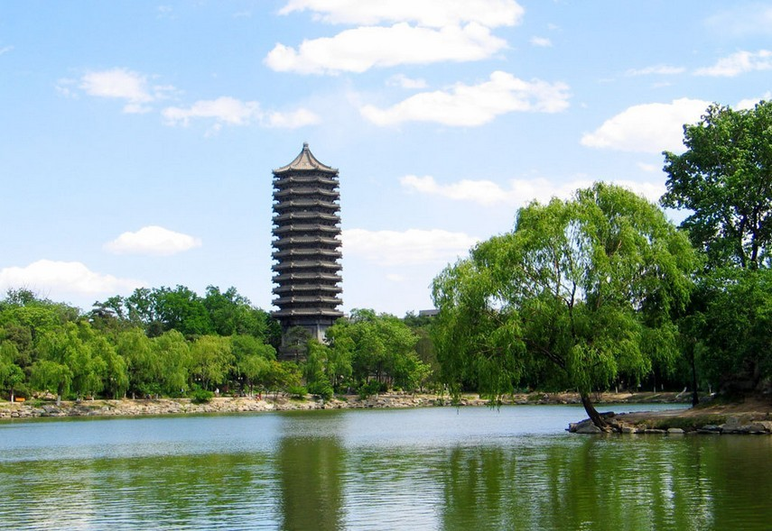
Applications of Machine Learning
in Relativistic Heavy Ion Collisions
Huichao Song
宋慧超
Peking University
第 18届全国中高能核物理大会
湖南 长沙 2019年 6月21-25日
June 23, 2019

Slide 2
What is Machine Learning / Deep Learning?
AI ：the broadest term, applying to any technique that enables computers to mimic human intelligence.
ML：A subset of AI aiming at optimizing a performance criterion using example data or past experience, but without explicit instruction.
DL：A subset of ML aiming at understanding high-level representations of data using a deeper structure of multiple processing layers

Slide 3
Broad Applications of Machine Learning
Computer vision
-Image identification
-Image style transition
-Image generation
… … … …
Language processing
-Machine translation
-Speech recognition
-Chinese poetry generation
… … … …
Playing Games
-AlphaGo (by Google DeepMind)
… … … …
Autonomous Driving
… … … …

Slide 4
Categories:
-Supervised learning
-Unsupervised learning
-Reinforcement learning
… … … …
Ian Goodfellow, Yoshua Bengio, and Aaron Courville, http://www.deeplearningbook.
org MIT Press, 2016

Slide 5
An example of Supervised Learning
-Identify cats and dogs
Supervised learning:
Training on a dataset contains many features and associated with a label or target.

Slide 6
An example of Unsupervised Learning
-Classify cats and dogs
Unsupervised learning
-experience a dataset contains many features but without labels, and learn useful properties of the structure of this dataset.

Slide 7
Deep Neural Network
Neuron

Slide 8
Deep Neural network
-Loss function, back propagation & gradient decent
Back propagation and gradient decent
-Deep neural network can reduce fitting error by updating model parameters through back propagation and gradient decent.

Slide 9
Applications of Machine Learning in Physics

Slide 10
Why Machine Learning in Physics?
“Unlike earlier attempts … Deep Learning systems can see patterns and spot anomalies in data sets far larger and messier than human beings can cope with.”
Can “Black-box” models learn patterns and models solely from data without relying on scientific knowledge?

Slide 11
Why does deep and cheap learning work so well? arXiv:1608.08225

Slide 12
Applications of Machine Learning in Physics

Slide 13
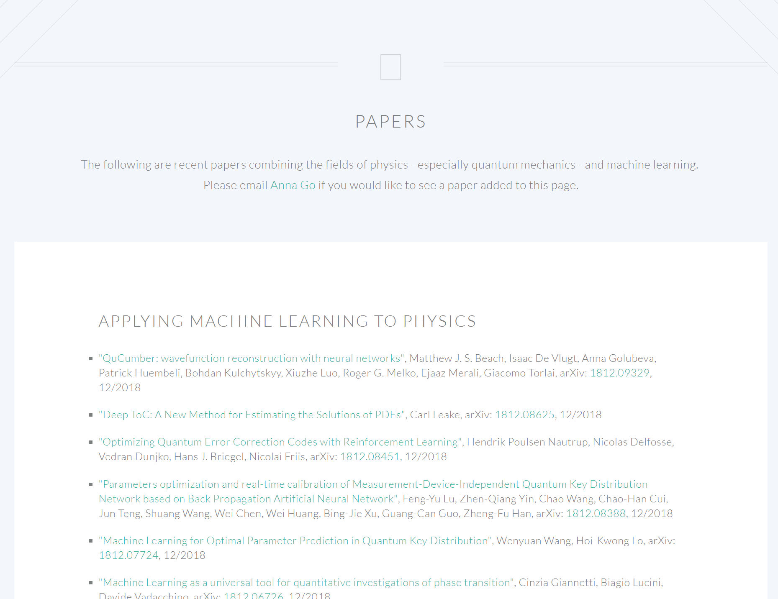
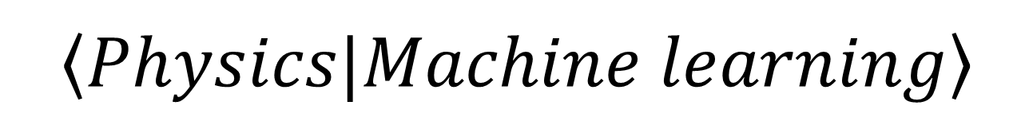
$$\left\langle Physics|Machine learning\right\rangle$$
https://physicsml.github.io/pages/papers.html

Slide 14
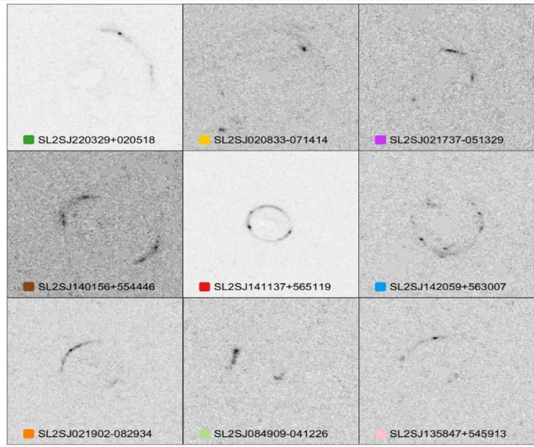

Classifying the Phase of Ising Model
Deep neural net work can identify the phase transition of Ising Model
J. Carrasquilla and R. G. Melko. Nature Physics 13, 431–434 (2017)
Gravitational Lensing
Parameter estimation with Neural network
${10}^{7}$ times faster than traditional method
Y. D. Hezaveh, L. P. Levasseur, P. J. Marshall Nature volume548, pages555–557
Solving Schrodinger Equation
A trained deep neutral network could successfully predict the ground state energy of 2-d potential
K. Mills, M. Spanner, I. Tamblyn, Phys. Rev. A 96, 042113 (2017)

Slide 15
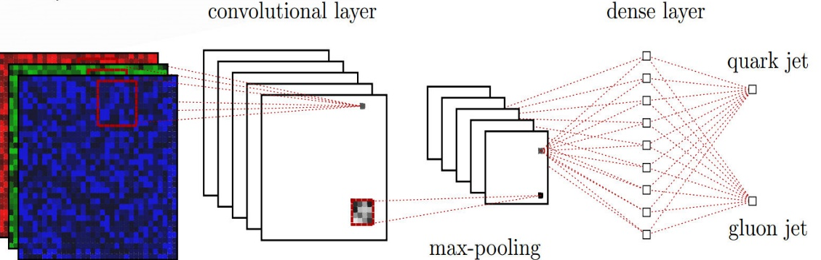
Searching for Exotic Particles in High-Energy Physics
Deep learning can improve the power for the collider search of exotic particles
P.Baldi,P.Sadowski,& D.Whiteson Nature Commun.5, 4308 (2014)
Gluon / quark jet tagging
Deep learning can outperform traditional methods in discriminating between quark jet and gluon jet
P. T. Komiske, E. M. Metodiev, M. D. Schwartz JHEP 1701 (2017) 110
Identify QCD Phase Transition with Deep Learning
DNN efficiently decode the EOS information from the complex final particle info event by event
LG. Pang, K.Zhou, N.Su, H.Petersen, H. Stoecker, XN. Wang. Nature Commun.9 (2018) no.1, 210

Slide 16
Applications of Machine Learning
for Relativistic Heavy Ion Collisions & hot QCD matter
-Identify QCD Phase Transition with Deep Learning
LG. Pang, et. al Nature Commun.9 no.1, 210 (2018)
-Applications of deep learning to relativistic hydrodynamics
H.Huang, B.Xiao, H.Xiong, Z.Wu, Y. Mu and H.Song arXiv: 1801.03334; NPA2019
-Principle Component Analysis for Flow
Z. Liu, W. Zhao, and H. Song, arXiv: 1903.09833
-Identify gluon /quark jet of hot QCD matter
Y.T.Chien and R.K. Elayavalli, arXiv:1803.03589 [hep-ph], NPA 2019
-Lattice Scalar Field Theory with finite T & μ
K. Zhou, G. Endrődi, L. G. Pang and H. Stöcker, arXiv:1810.12879 [hep-lat].
… … … …

Slide 17
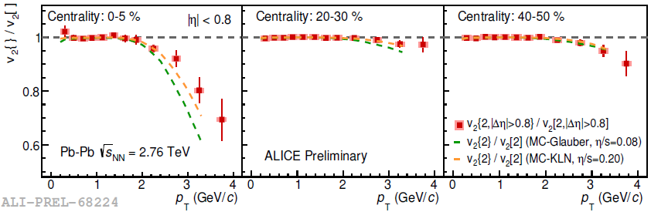
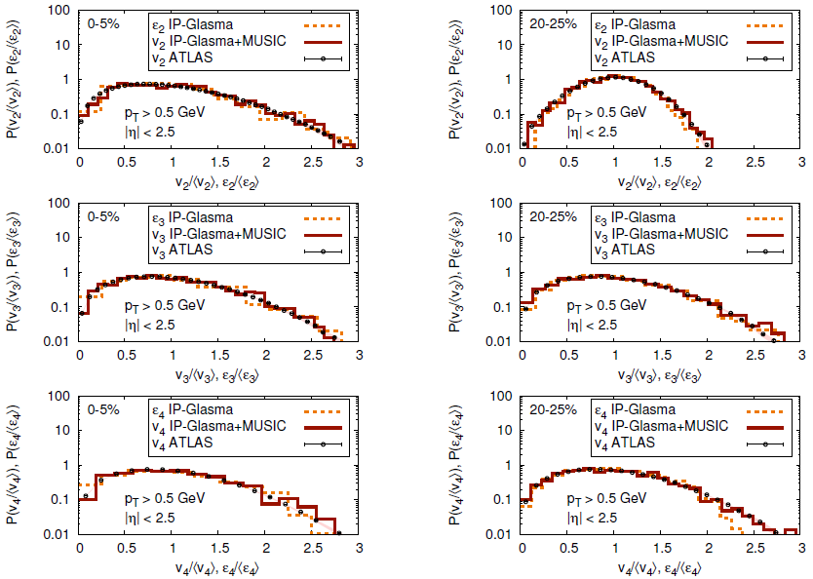
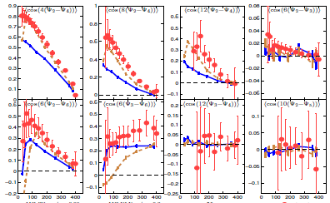
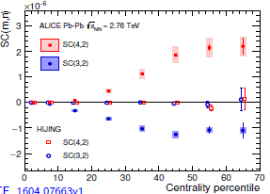
Identify QCD Phase Transition with Deep Learning
Motivation:
-Traditionally, the properties of the QCD matter are extracted from the event averaged observables
-Can deep learning identify different EoS from the raw data of heavy ion collisions?
LG. Pang, K.Zhou, N.Su, H.Petersen, H. Stoecker, XN. Wang. Nature Commun.9 (2018) no.1, 210

Slide 18
Identify QCD Phase Transition with Deep Learning
A）Generating training/testing data:
C) testing the trained net work
-Run Hydro with EOS L and EOS Q
-particle spectra - image (15*48 pixels)
B）Training CNN
Hydro CLVis (AMPT)
One can efficiently decode the EOS information from the complex final particle info event by event using deep learning
LG. Pang, K.Zhou, N.Su, H.Petersen, H. Stoecker, XN. Wang. Nature Commun.9 (2018) no.1, 210

Slide 19
Applications of deep learning to relativistic hydrodynamics
H.Huang, B.Xiao, H.Xiong, Z.Wu, Y. Mu and H.Song arXiv: 1801.03334; NPA2019

Slide 20
Image identification
Dog or Cat ?
Higgs signal or background?
P.Baldi,et al,Nature Commun.(2014)
High temperature or low temperature phase?
Carrasquilla & Melko. Nature Physics (2017)
EoS L or EOSQ ?
Pang,et al Nature Commun.(2018)

Slide 21

Image generation
For hydrodynamics can we use deep learning to learn/predict the pattern transformation between initial and final profiles?
Initial energy density profiles
-------- > final energy density velocity profiles
For the non-linear hydro system, can the black-box network could learn pattern transformations solely from data without relying on scientific knowledge?
( conservation laws)

Slide 22
Traditional hydrodynamics
Deep Learning
-Such deep learning systems do not need to be programmed with the hydro
equation Instead, they learn on their own

Slide 23
Deep Learning
Step1）Generate the training/testing data sets from hydro
Step2）Design & train the deep neural network
The Training Data Sets
hydro VISH2+1 | MC-Gl
 | 10000
Step3）Test the deep neural network
The Testing Data Sets
hydro VISH 2+1 | MC-Gl | MC-KLN | AMPT | Trento
 | 10000 | 10000 | 10000 | 10000

Slide 24
Stacked U-net for 2+1-d hydro
The activation function:
The loss function:
normalized MAE loss
H.Huang, B.Xiao, H.Xiong, Z.Wu, Y. Mu and H.Song arXiv: 1801.03334, NPA 2018

Slide 25
sUnet prediction vs. hydro simulations

Slide 26
sUnet prediction vs. hydro simulations
-for a closer look

Slide 27
sUnet prediction vs. hydro simulations
Eccentricity distributions:

Slide 28
Simulation time: sUnet vs. hydro
P
With the well trained network, the final state profiles can be quickly generated from the initial profiles. (5-10 times faster for GPU based calculations)

Slide 29
1+1-d Lattice Scaler Field Theory with finite T & μ
-Configuration production using GAN
K. Zhou, G. Endrődi, L. G. Pang and H. Stöcker, arXiv:1810.12879 [hep-lat].
-Phase diagram generated by c-GAN on mu with limited ensemble of training set
-The potential uses of such a generative
approach for sampling outside the training
region, but near the critical point?
training sample: n= 0.4, 0.5,
0.6, 0.7

Slide 30
Principal Component Analysis for Flow
Z. Liu, W. Zhao, and H. Song, arXiv: 1903.09833

Slide 31
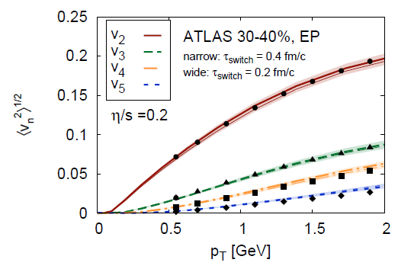
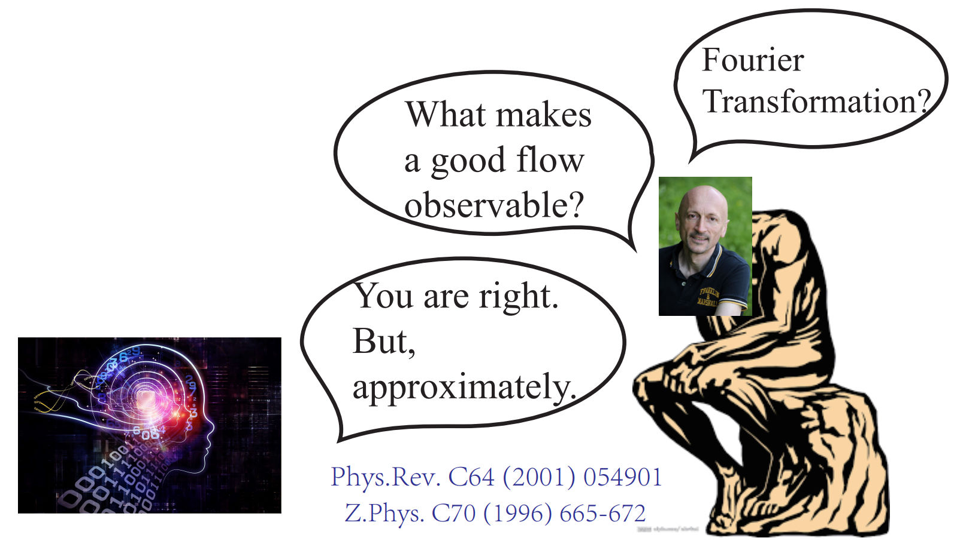
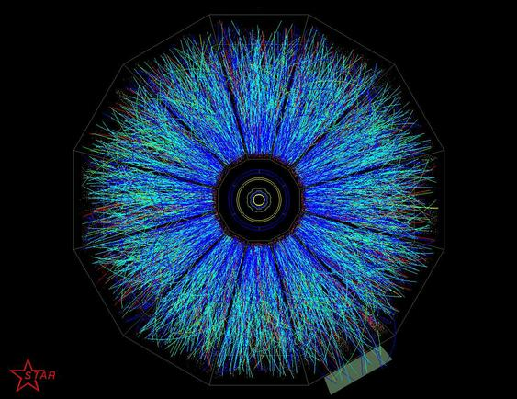
Flow definition：human-being vs. Machine
Flow definition since 1992
Can machine directly discover flow from data without explicit instructions from Human-being?
??? flow

Slide 32
What is Principal Component Analysis (PCA)
-a statistical procedure that uses an orthogonal transformation to convert a set of observations into a set of values of linearly uncorrelated variables called principal components.
PCA for FACE analysis
Data sets: many many faces
top eigenvectors:µ1,µ2,µ3 … …
mean µ
PCA
With PCA, each face is decomposed into superposition of eigenfaces.

Slide 34
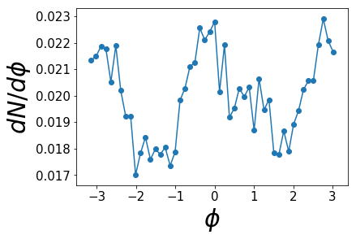
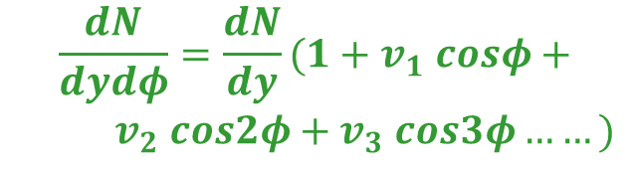
PCA for flow analysis –results(I)
events
eigenvector (PCA)
from a single events
The eigenvector (PCA) is similar to the Fourier ones
$$\frac{dN}{dydφ}=\frac{dN}{dy}(1+v_{1} cosφ+$$
$v_{2} cos2φ+v_{3} cos3φ……)$
Z. Liu, W. Zhao, and H. Song, arXiv: 1903.09833

Slide 35
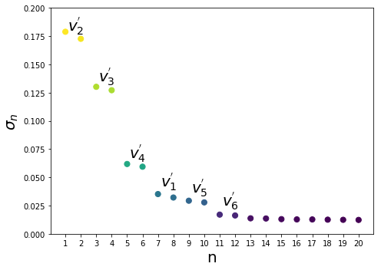
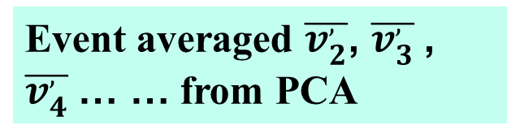
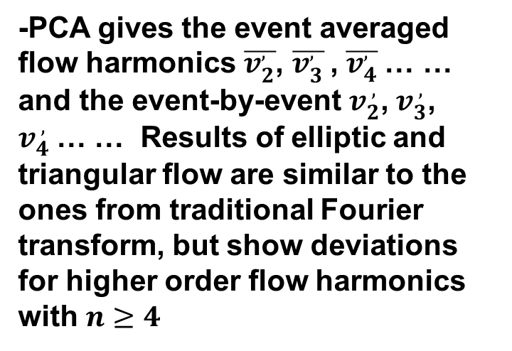
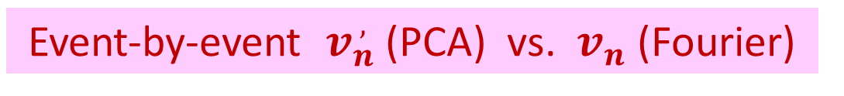
Event averaged $\overline{v_{2}^{,}}$, $\overline{v_{3}^{,}}$, $\overline{v_{4}^{,}}$… … from PCA
-PCA gives the event averaged flow harmonics $\overline{v_{2}^{,}}$, $\overline{v_{3}^{,}}$, $\overline{v_{4}^{,}}$… … and the event-by-event $v_{2}^{ ,}$,${ v}_{3}^{ ,}$, $v_{4}^{ ,}$… … Results of elliptic and triangular flow are similar to the ones from traditional Fourier transform, but show deviations for higher order flow harmonics with $n≥4$
Z. Liu, W. Zhao, and H. Song, arXiv: 1903.09833
,
Event-by-event ${ v}_{n}^{ ,}$(PCA) vs. ${ v}_{n}^{ }$ (Fourier)

Slide 36

${ v}_{n}^{ ,}$(PCA) vs. ${ v}_{n}^{ }$ (Fourier)
？
？
？
Symmetric Cumulants
Pearson Coefficients

Slide 37
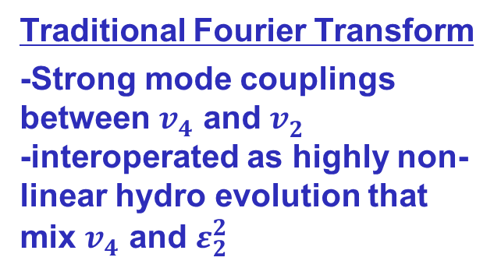
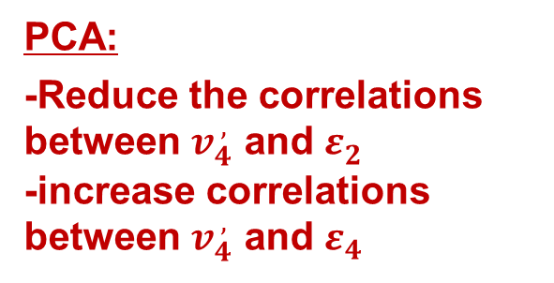
${ v}_{n}^{ ,}$(PCA) vs. ${ v}_{n}^{ }$ (Fourier)
？
？
？
Traditional Fourier Transform
-Strong mode couplings between $v_{4}^{ }$ and $v_{2}^{ }$
-interoperated as highly non-linear hydro evolution that mix $v_{4}^{ }$ and $ε_{2}^{2}$
Pearson Coefficients
PCA:
-Reduce the correlations
between $v_{4}^{ ,}$ and $ε_{2}^{ }$
-increase correlations between $v_{4}^{ ,}$ and $ε_{4}^{ }$
Z. Liu, W. Zhao, and H. Song, arXiv: 1903.09833

Slide 38
Summary & outlook

Slide 39
Traditional hydrodynamics
Deep Learning (sUnet)
Outlook
Final particle profiles
-------- > Initial energy density profiles
Can deep learning discover knowledge (conservation laws) from the massive data generated from hydrodynamics?

Slide 40
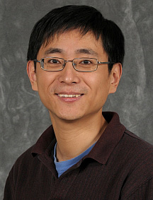
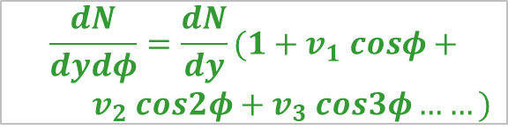
Flow: traditional Fourier Transform
$$\frac{dN}{dydφ}=\frac{dN}{dy}(1+v_{1} cosφ+$$
$v_{2} cos2φ+v_{3} cos3φ……)$
Unsupervised Learning (PCA)
It independently discovered the flow harmonics
without explicit instructions from human being!
Outlook
Can PCA detect modes or structures from the massive data that is not realized or easily defined by human being?

Slide 41
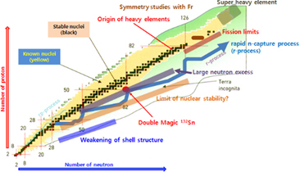
Outlook
Machine Learning for
Nuclear Physics
-- A proper field for Machine Learning
-- It is jut beginning
-- Many many more to explore … …
-- What ML can bring us after 10 years?
Enjoy it! have fun!

Slide 42
Thank You

