Slide 1
Cosmic ray reconstruct
王宏鹏
618
2019 -1-17

Slide 2
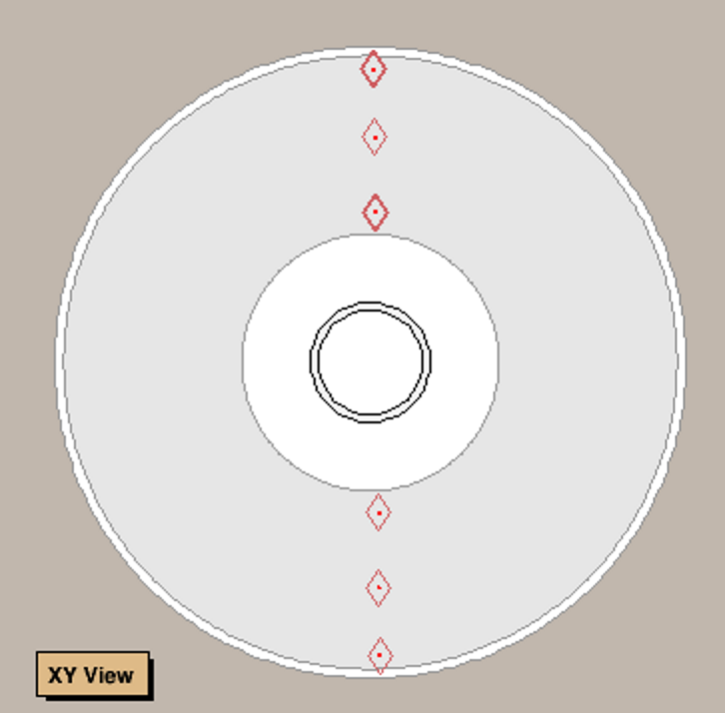
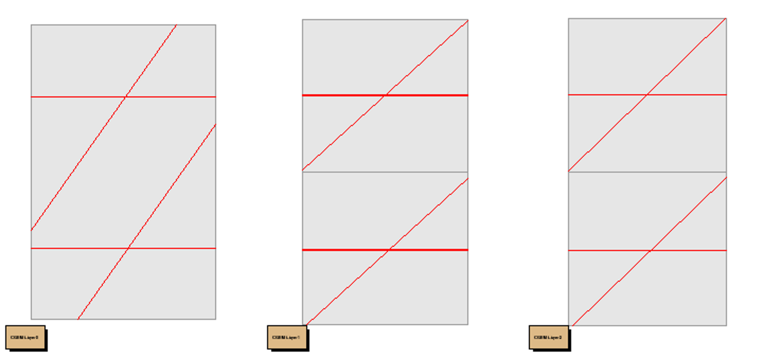
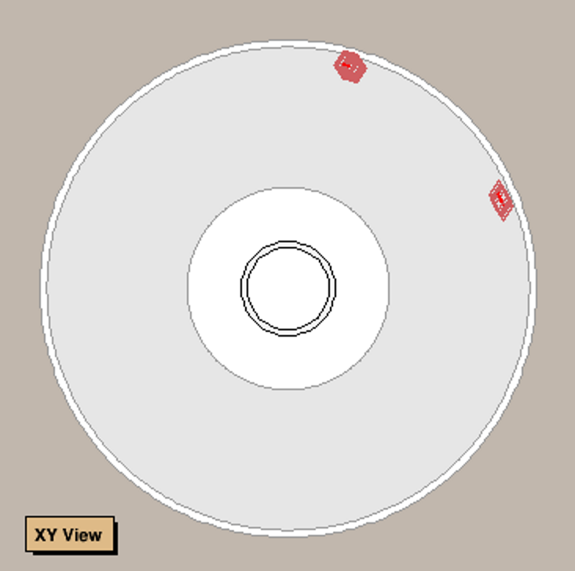
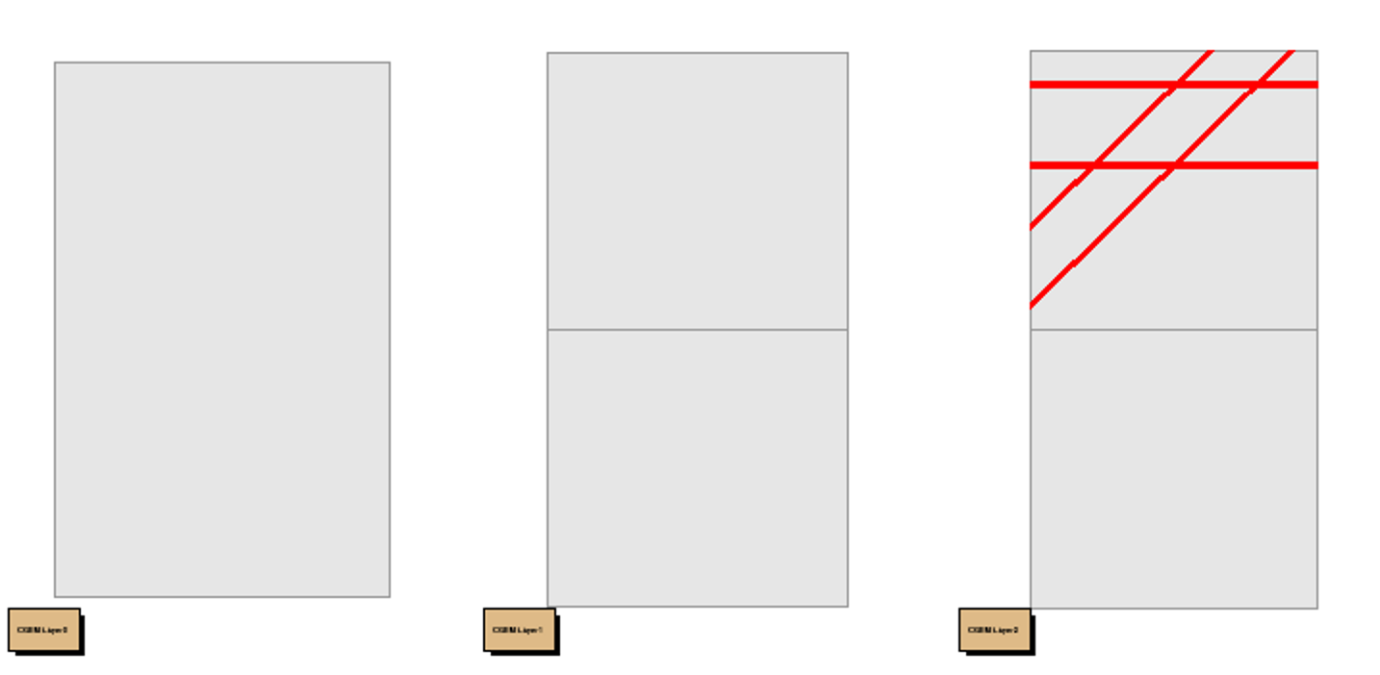
Simulation
X-Y plane
Inner middle outer
200000 samples
Single $μ^{+}$ from (0,20cm,0)
Angles cover outer barrel

Slide 3
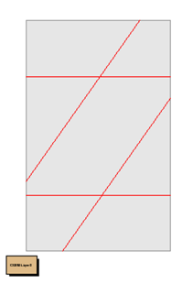
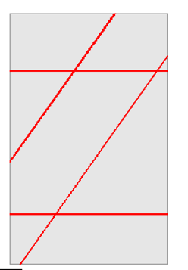
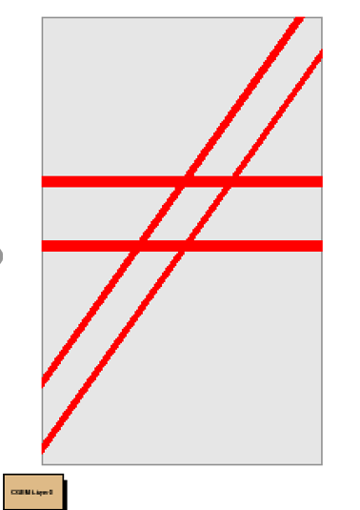
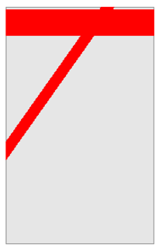
Cluster
RecCgemCluser
X cluster
…..
V cluster
….
Z cluster
…..
2+2+2=6 clsuters
2+2+3=7 clsuters
2+2+4=8 clsuters
1+1+1=3 clsuters

Slide 4
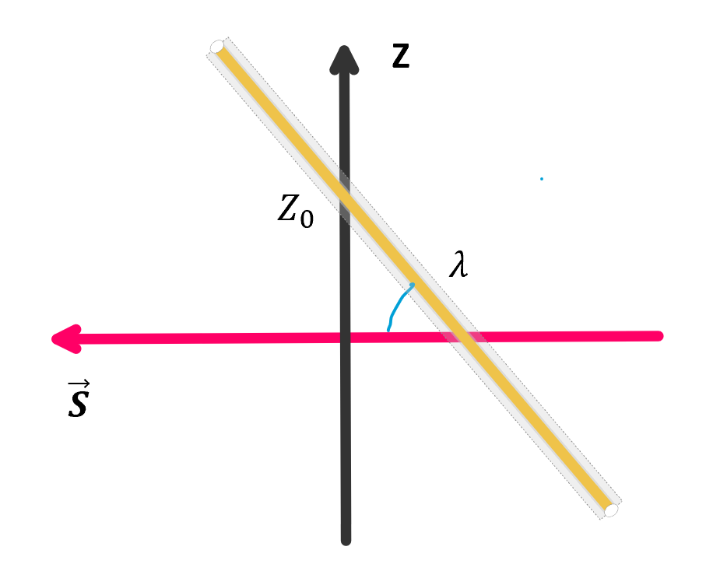
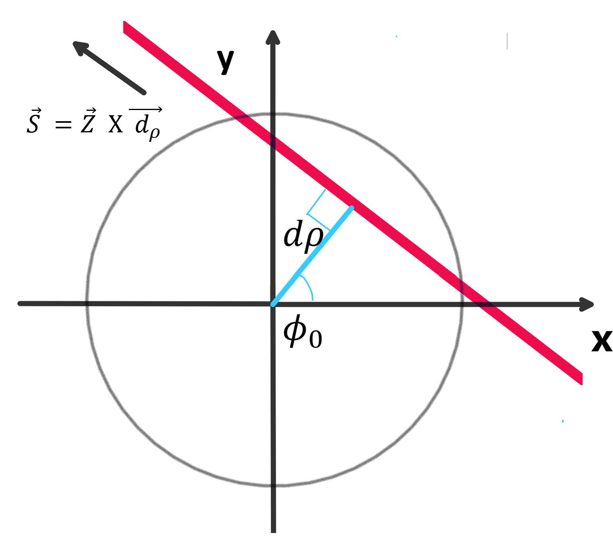
Parameter $d_{ρ} φ_{0} Z_{0} tgλ$

Slide 5
Parameter $d_{ρ} φ_{0} Z_{0} tgλ$
$$d_{ρ}>0$$
$φ_{0}:(0,2π)$

Slide 6
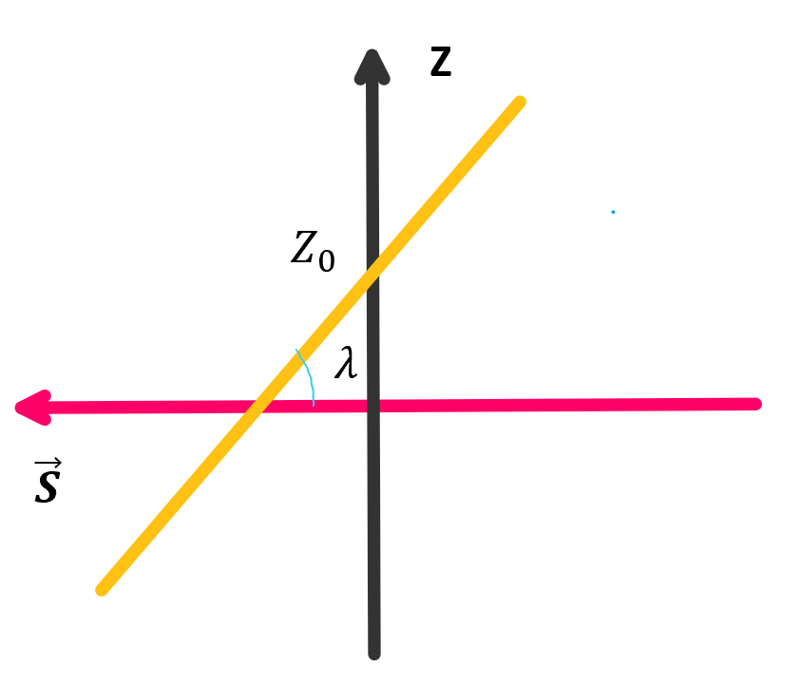
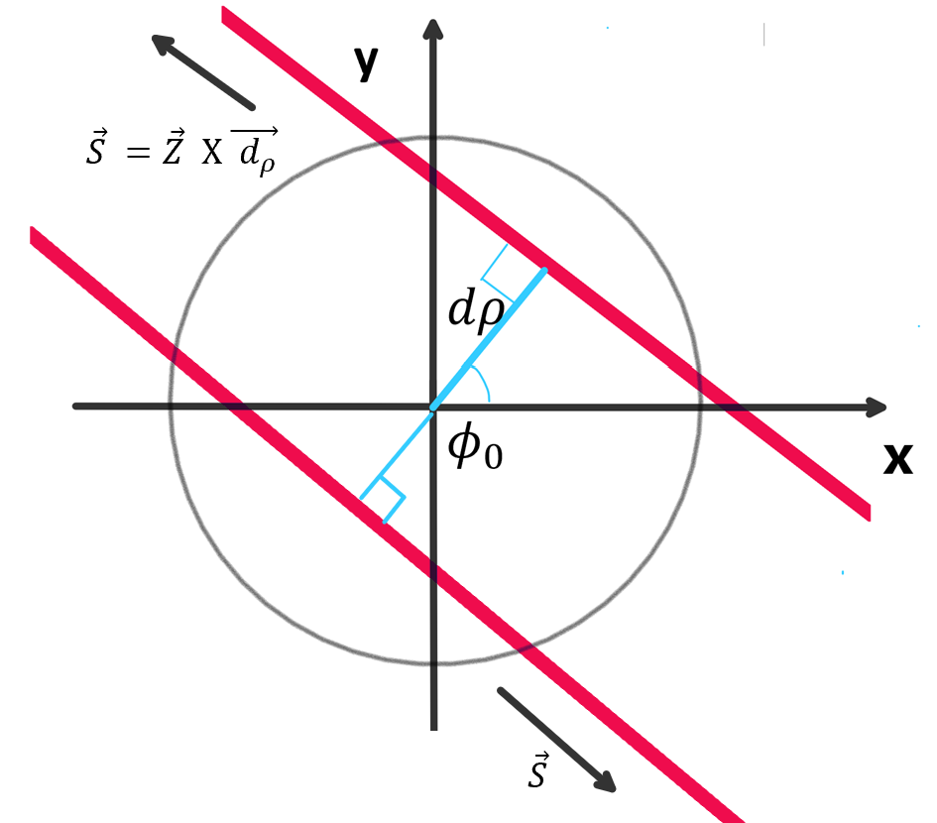
When $d_{ρ}→0$
$$l(d_{ρ},φ_{0},Z_{0},tgλ)$$
$$l′(d_{ρ}′,φ_{0}+π,Z_{0},−tgλ)$$

Slide 7
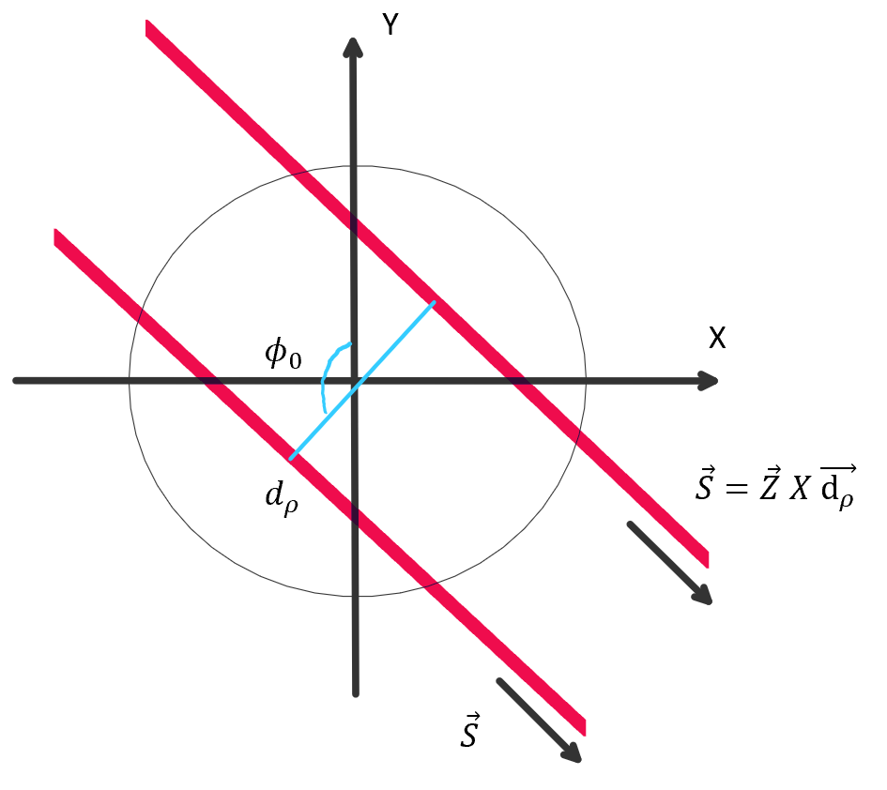
$d_{ρ}>0$
$φ_{0}:\left(0,2π\right)$
Polar axis: $\vec{X}$
$d_{ρ} : ±$
$φ_{0}:(0,π)$
Polar axis : $\vec{Y}$
$$l(d_{ρ},φ_{0},Z_{0},tgλ)$$
$l′(d_{ρ}′,φ_{0}+π,Z_{0},−tgλ)$
$$l(d_{ρ},φ_{0},Z_{0},tgλ)$$
$$l′(−d_{ρ}′,φ_{0},Z_{0},tgλ)$$

Slide 8
FCN
$χ_{1}^{2}={\left(\frac{φ−φ^{′}}{\frac{σ}{R_{n}}}\right)}^{2}$ $χ_{2}^{2}={\left(\frac{V−V′}{σ}\right)}^{2}$
$φ=φ\left(d_{ρ},φ_{0}\right) V=V(d_{ρ},φ_{0},Z_{0},tgλ)$
$σ=130 um$ deviation of cluster
$R_{n}:radius of layer$

Slide 9
Z CLUSTER = 2
34500 EVENTS

Slide 10
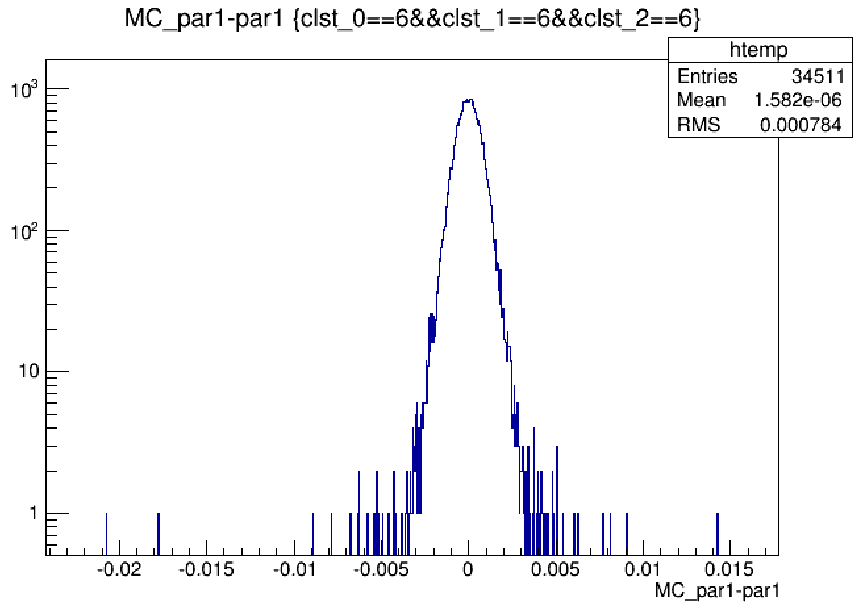
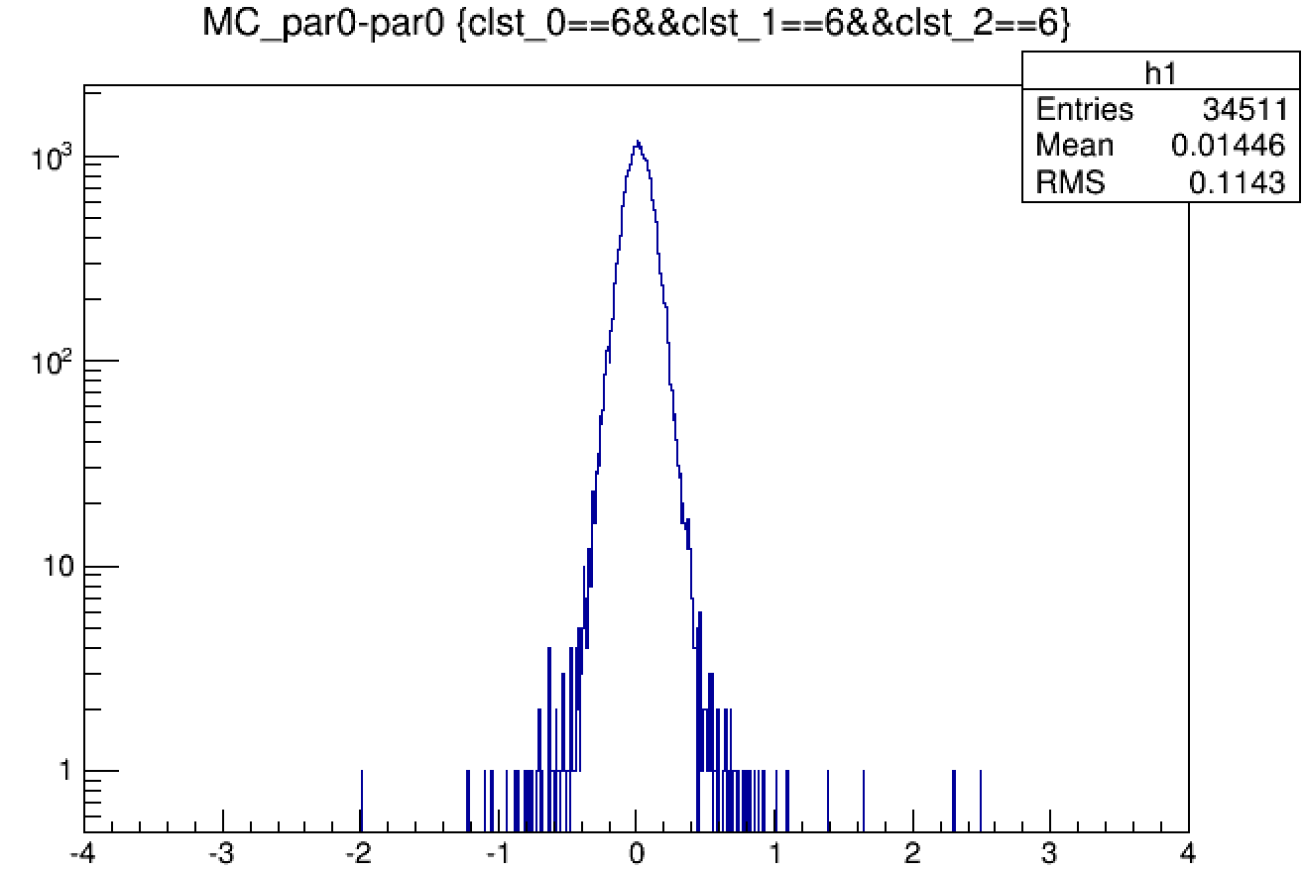
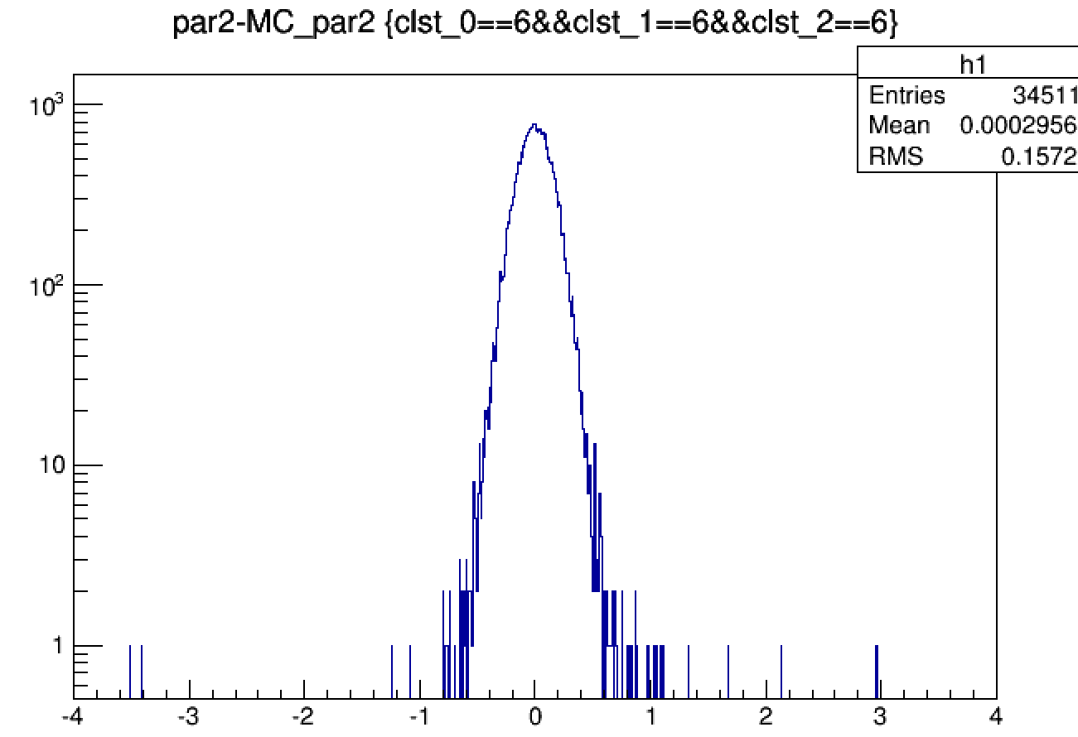
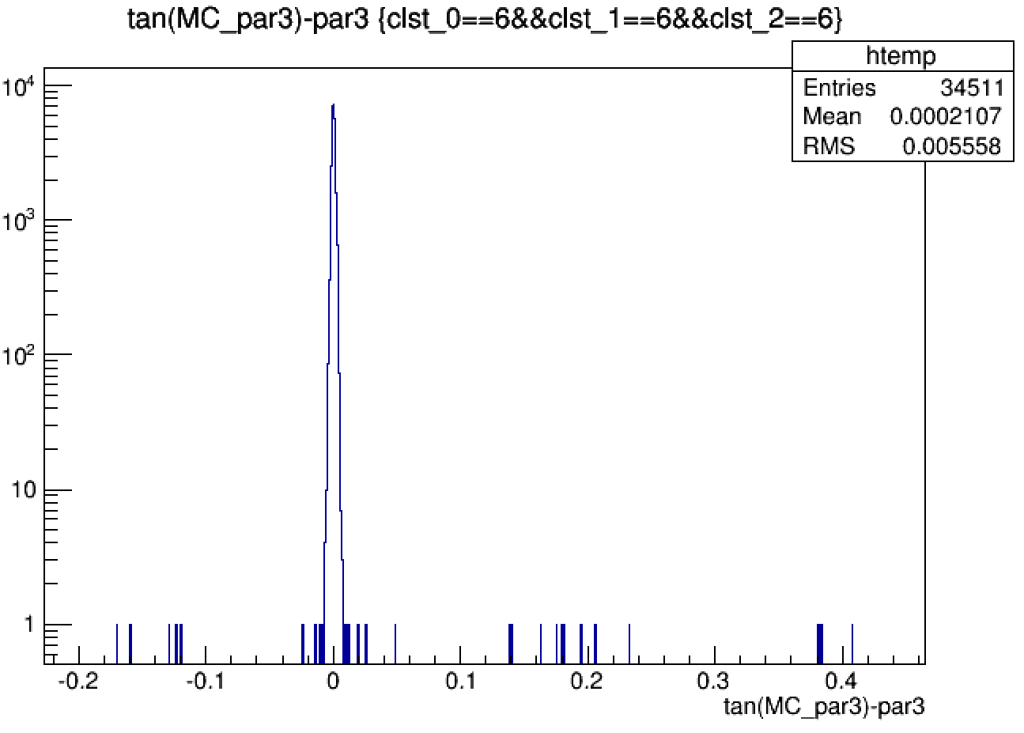
$$d_{ρ}:mm$$
$${ φ}_{0}:rad$$
$Z_{0}:mm$
$$tgλ$$

Slide 11
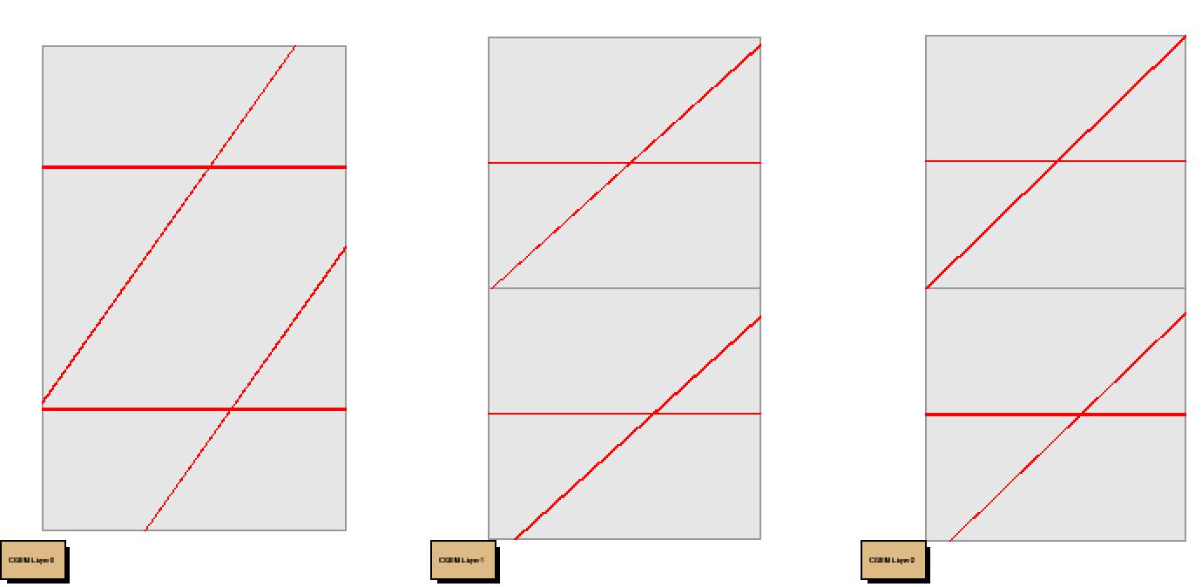
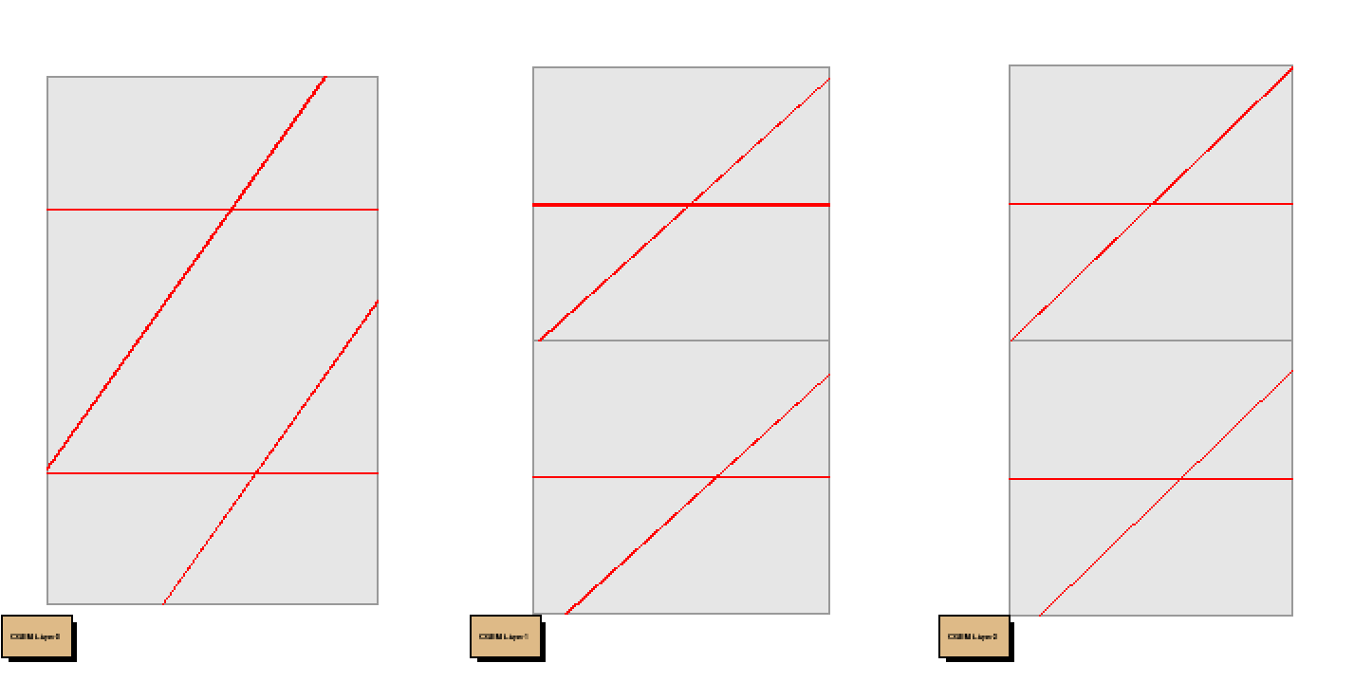
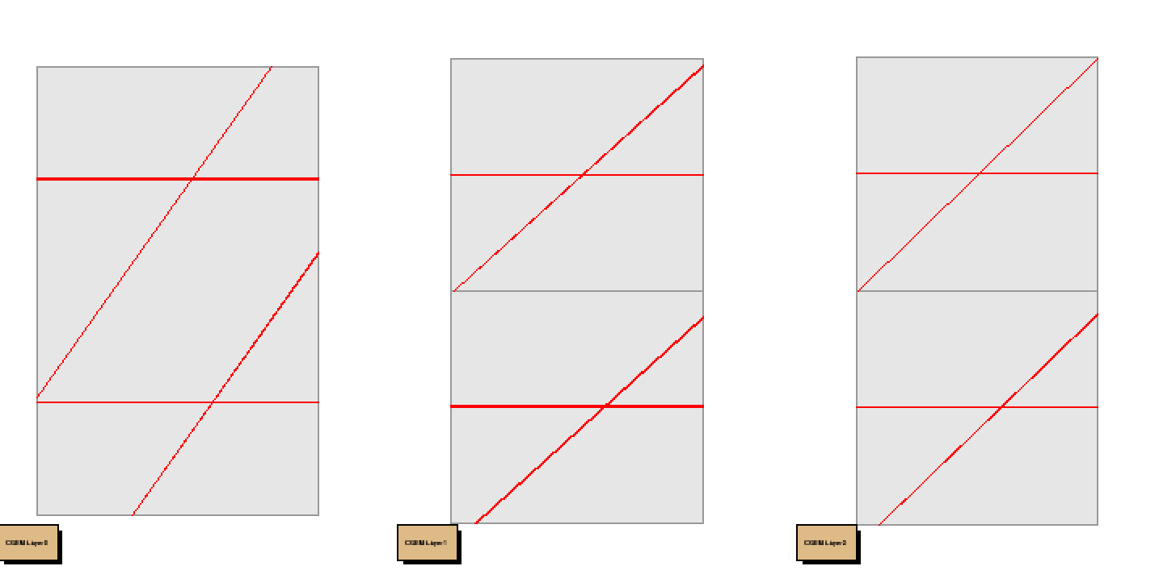
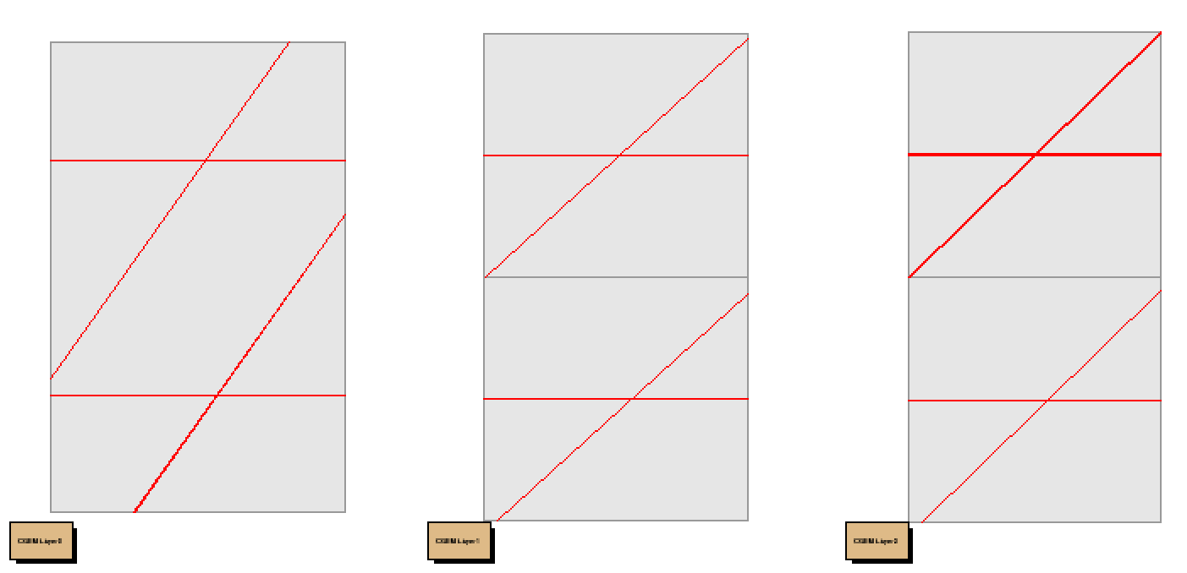

Slide 12
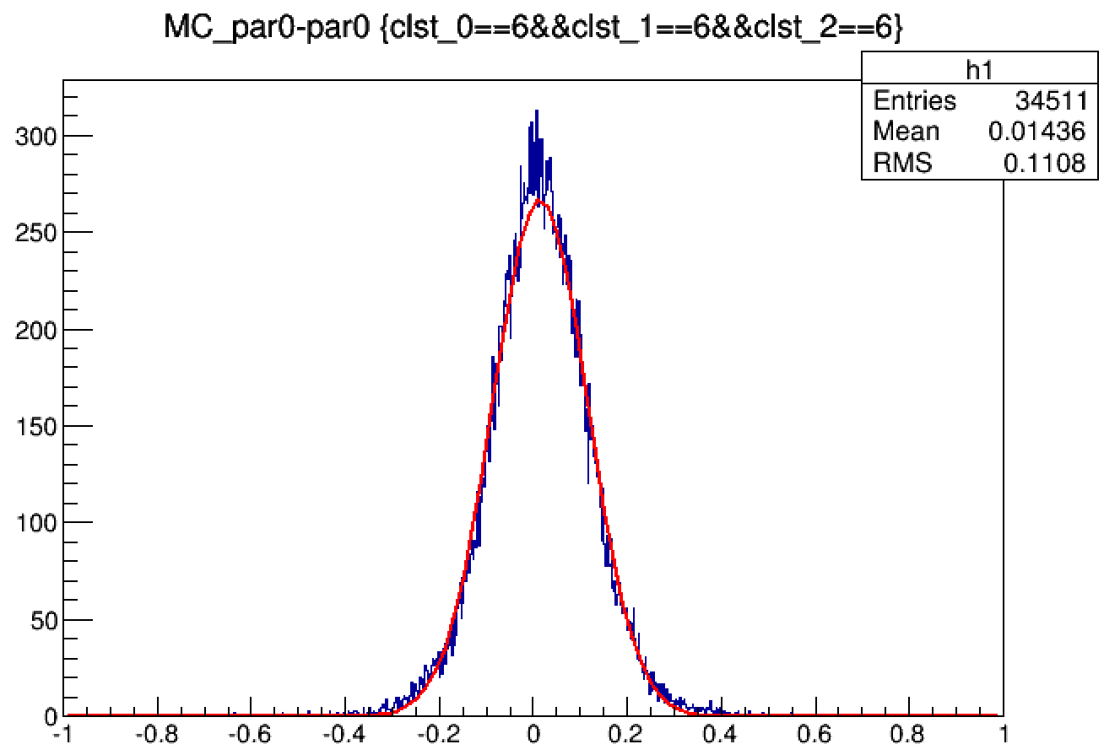
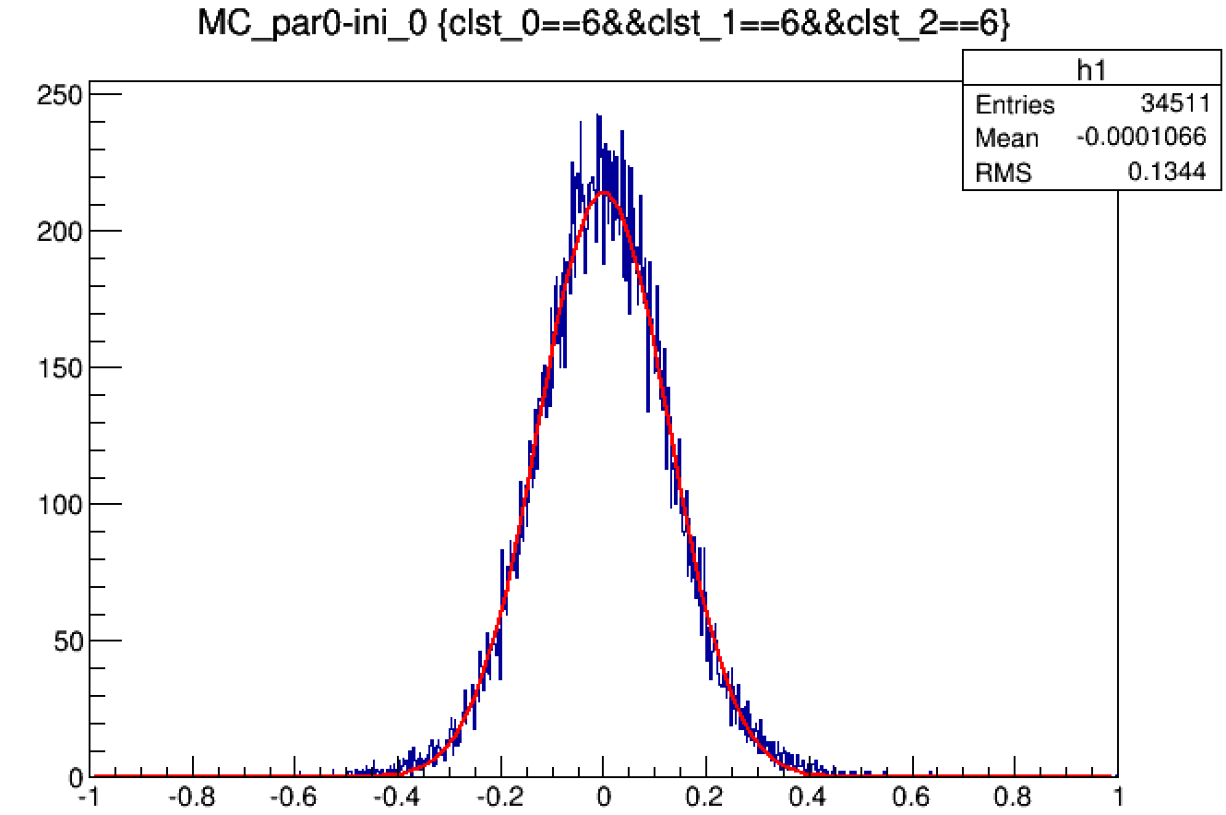
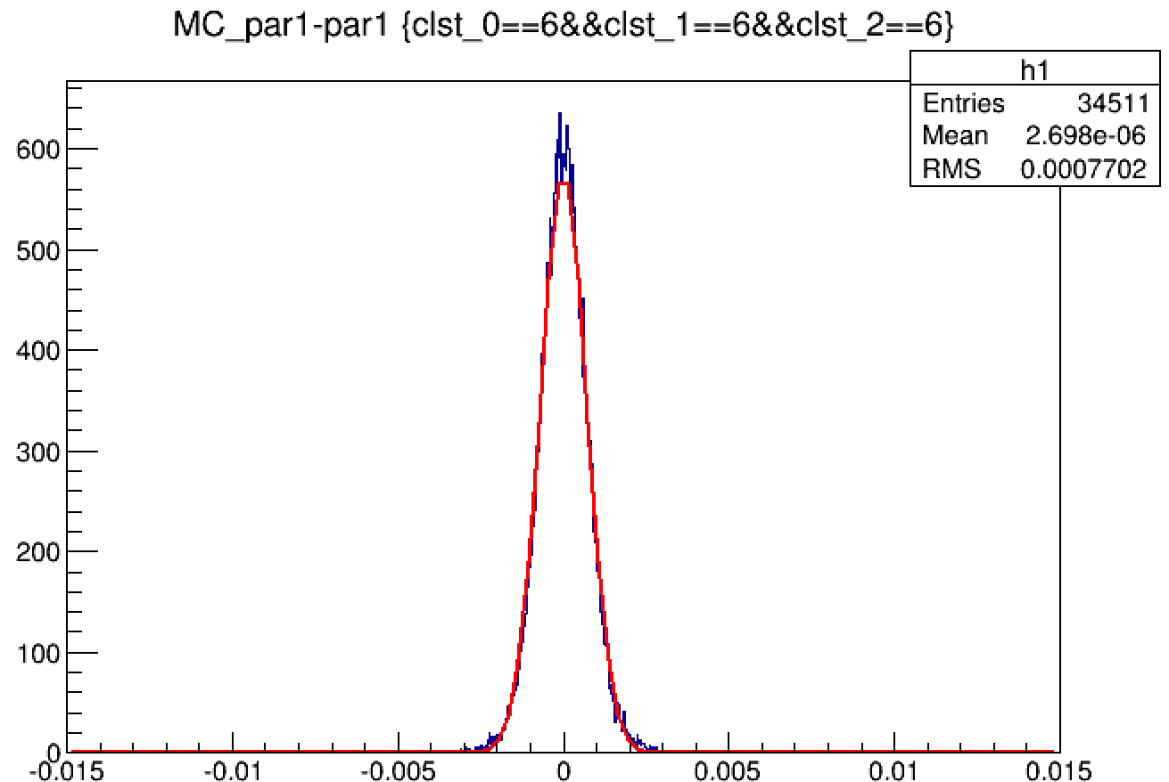
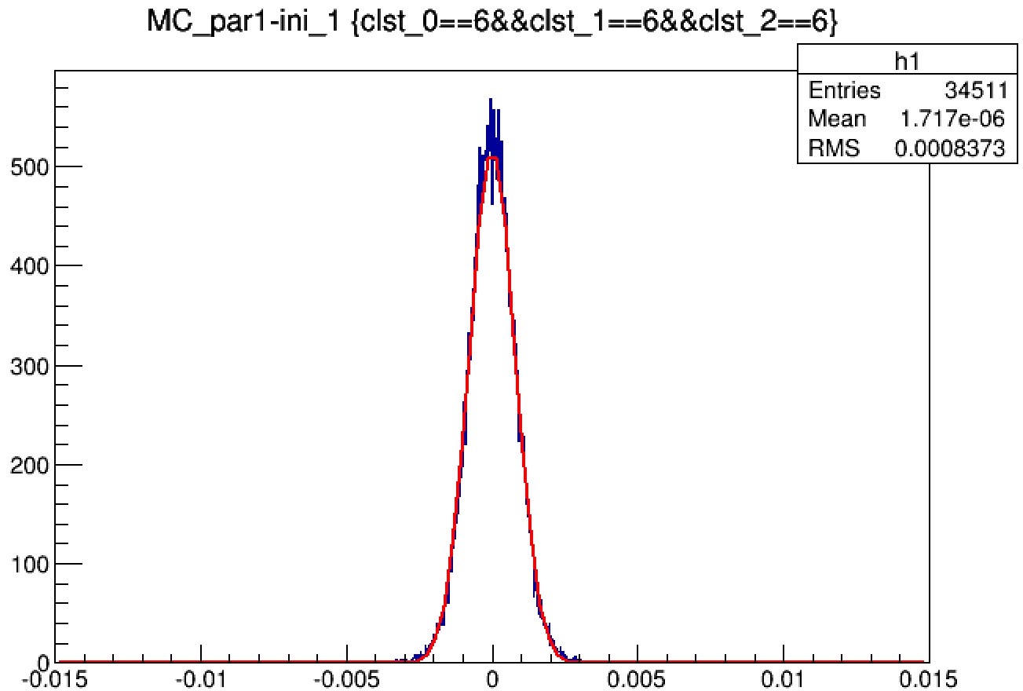
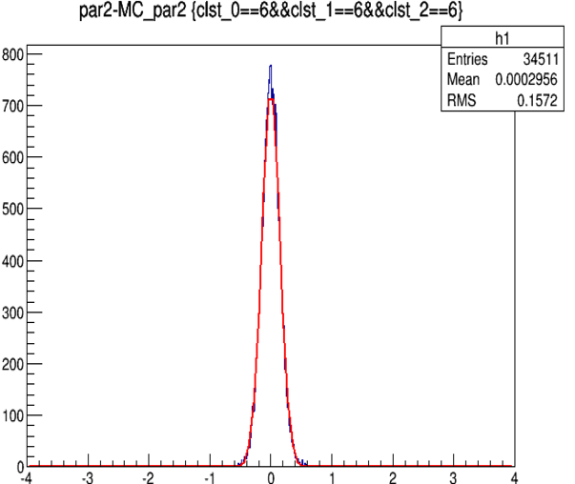
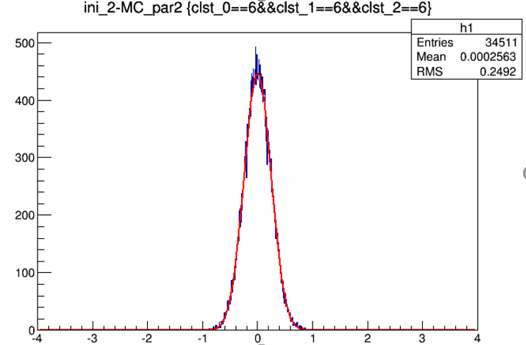
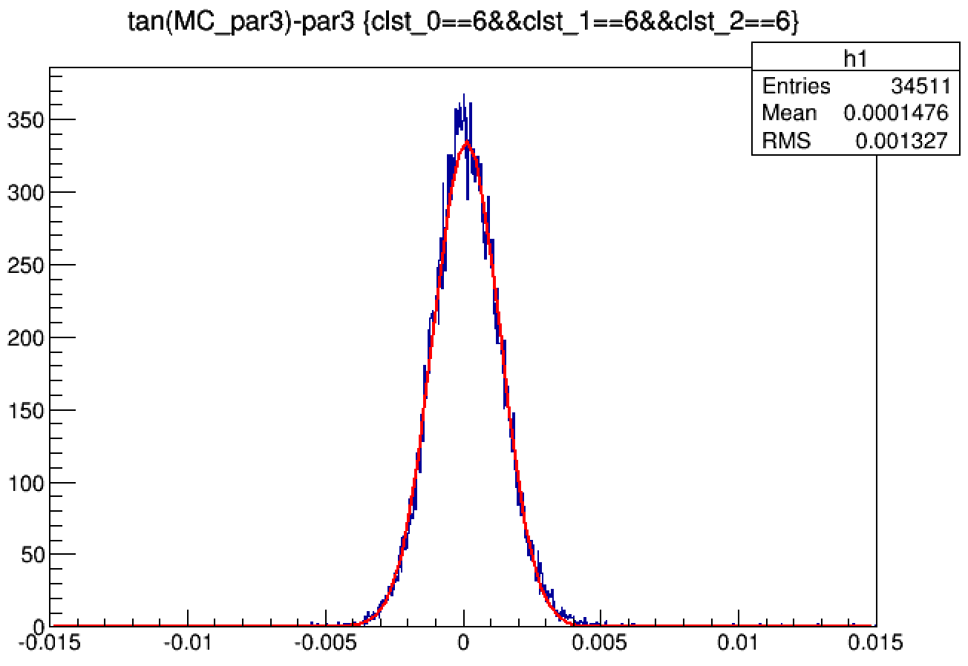
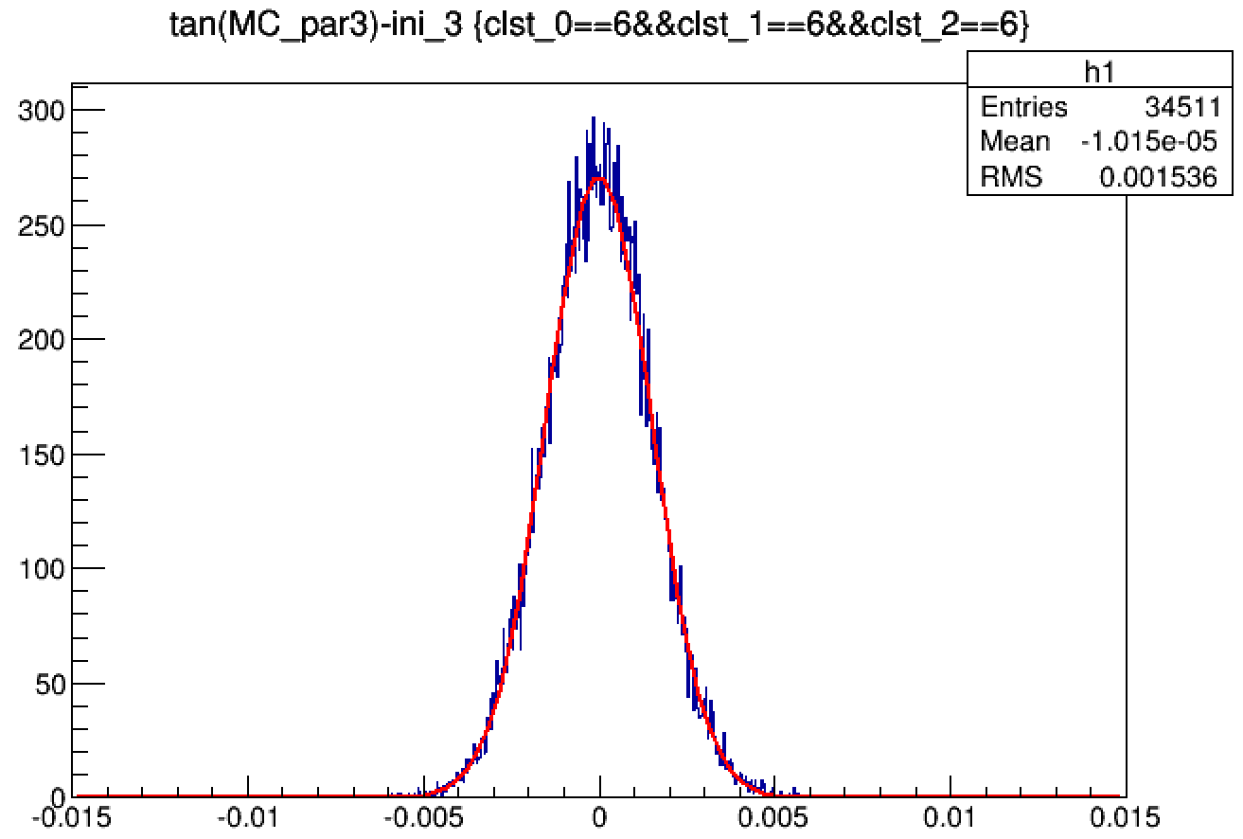
fit vers initial
$σ_{fit}/ σ_{ini}$=0.61
$$d_{ρ}:mm$$
$σ_{fit}/ σ_{ini}$=0.801
$$φ_{0}:rad$$
$σ_{fit}/ σ_{ini}$=0.893
$Z_{0}:mm$
$σ_{fit}/ σ_{ini}$=0.616
$$tgλ$$
$σ_{fit}/ σ_{ini}$=0.804

Slide 13
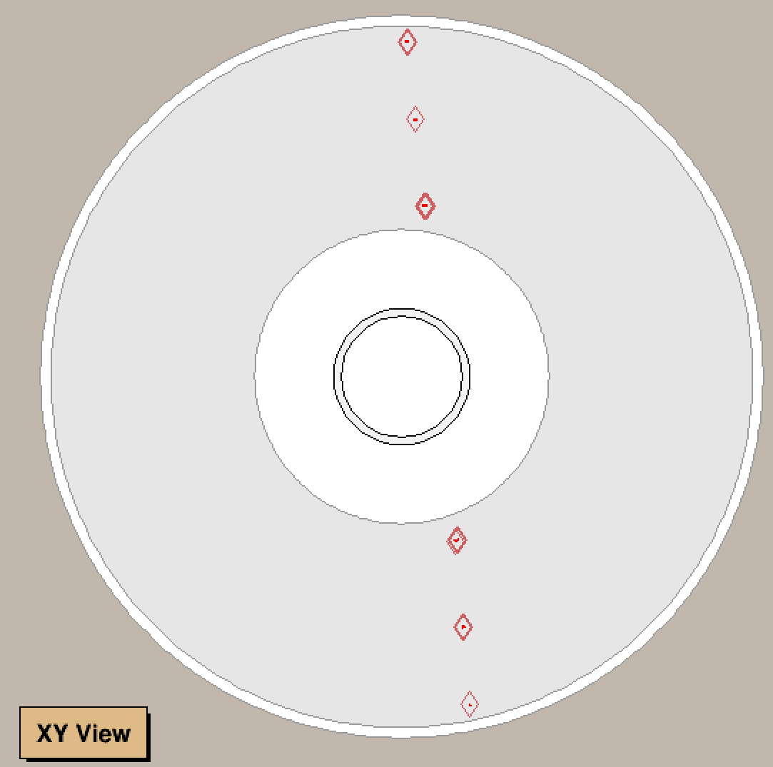
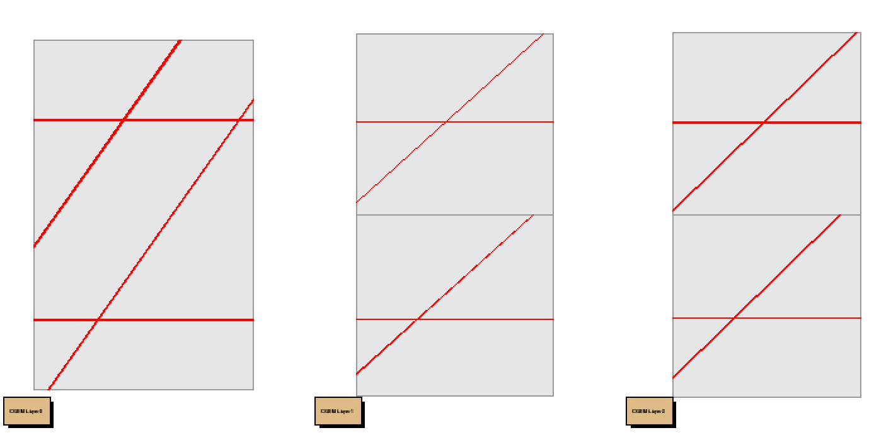
Z cluster =3

Slide 14
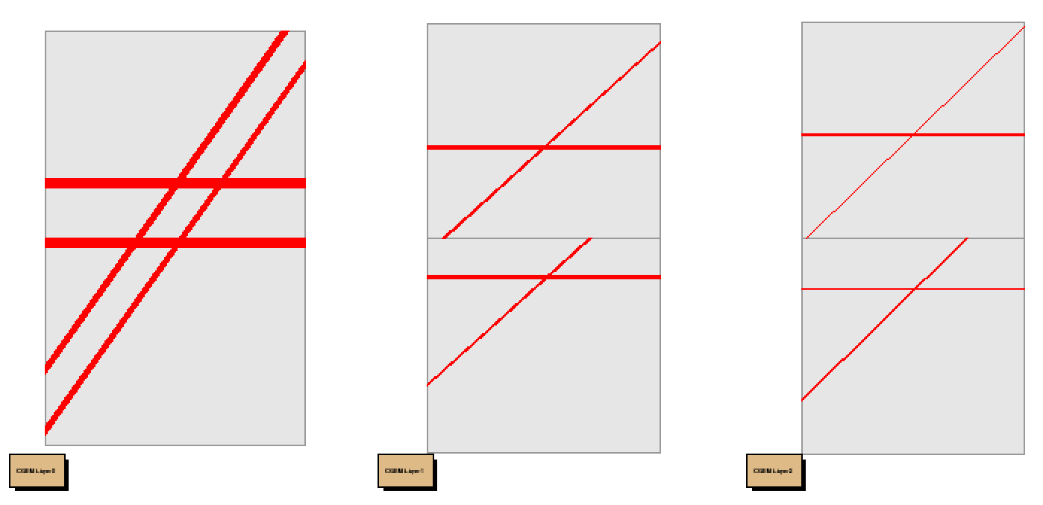
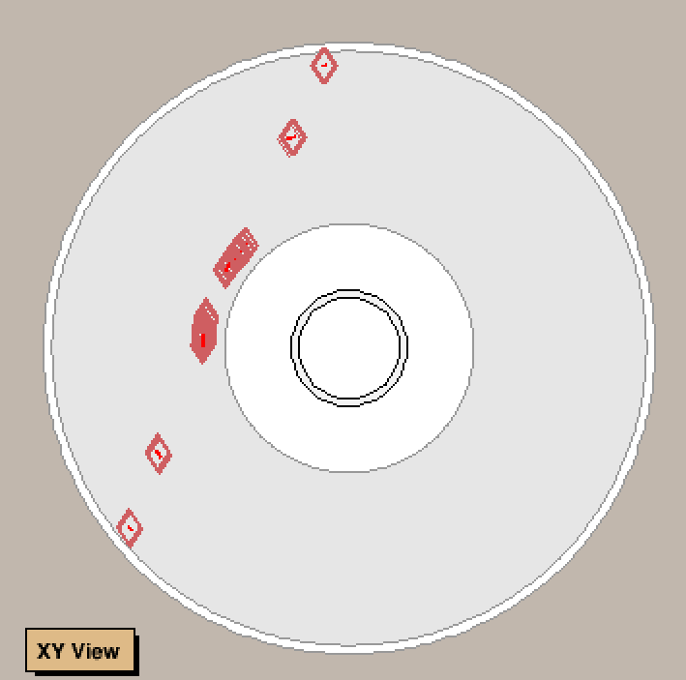
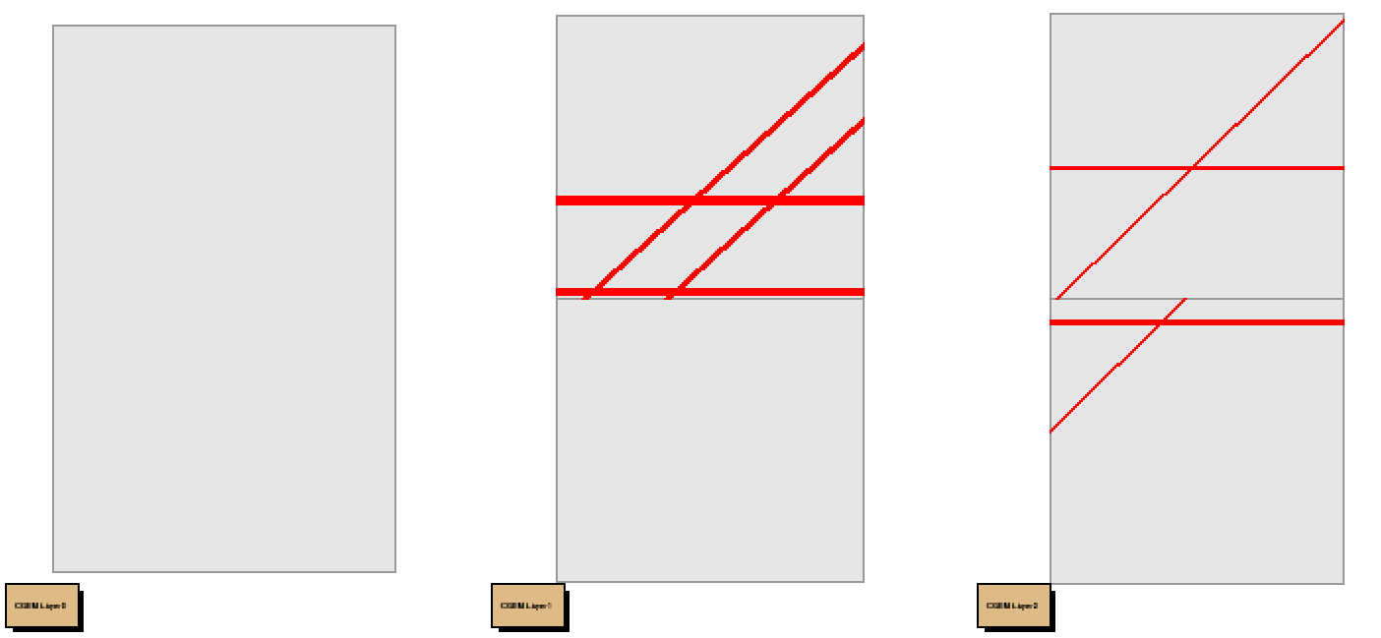
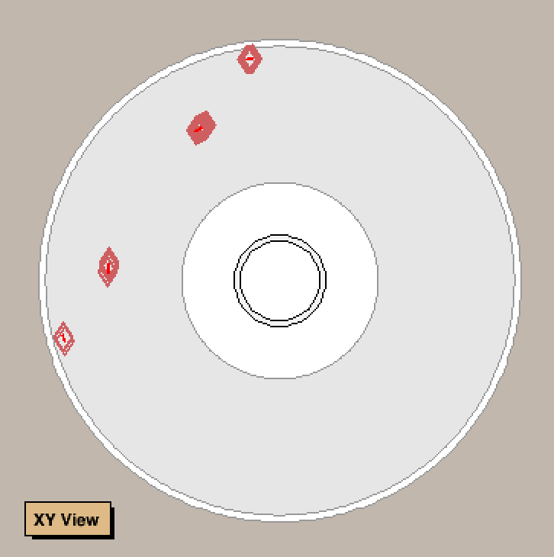
Z cluster =4

Slide 15
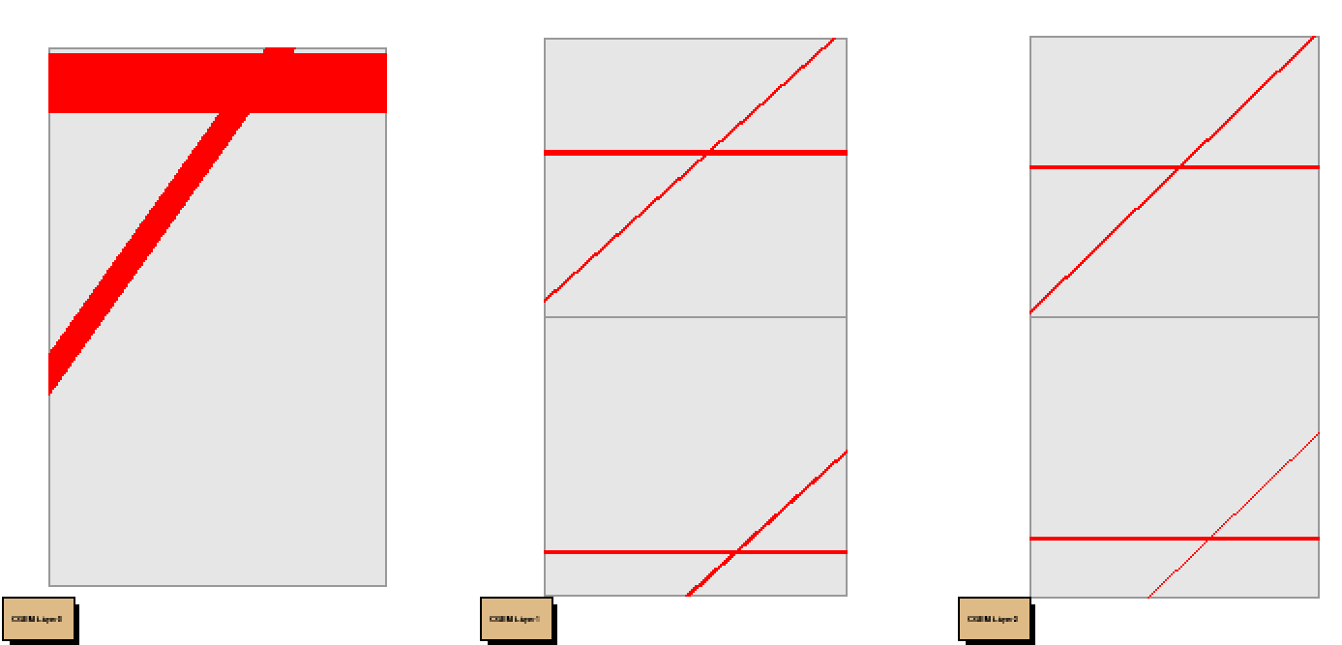
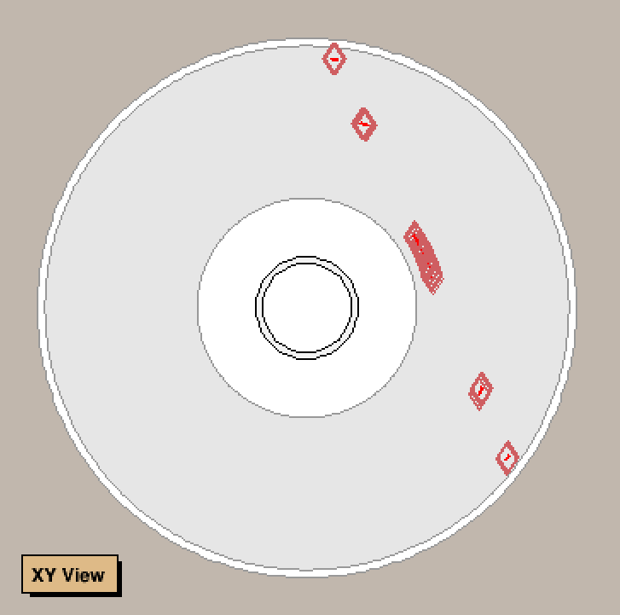
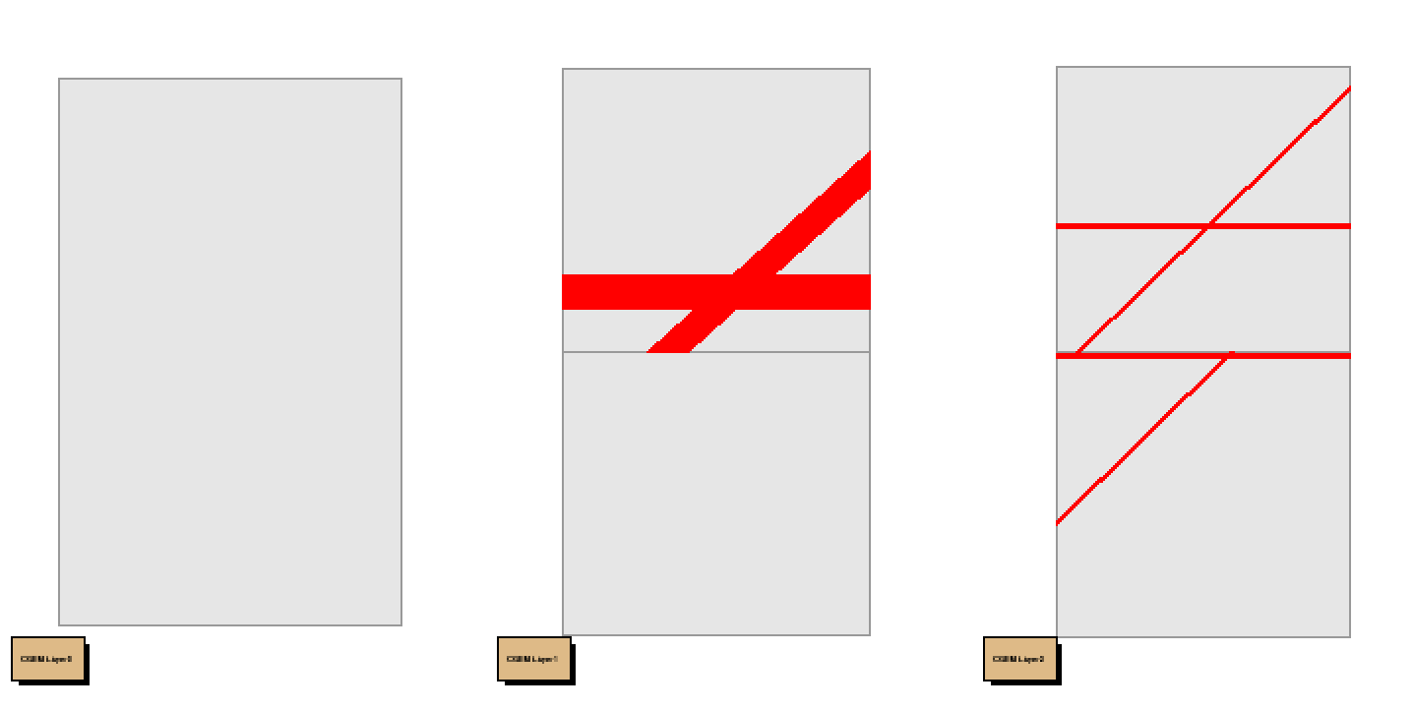
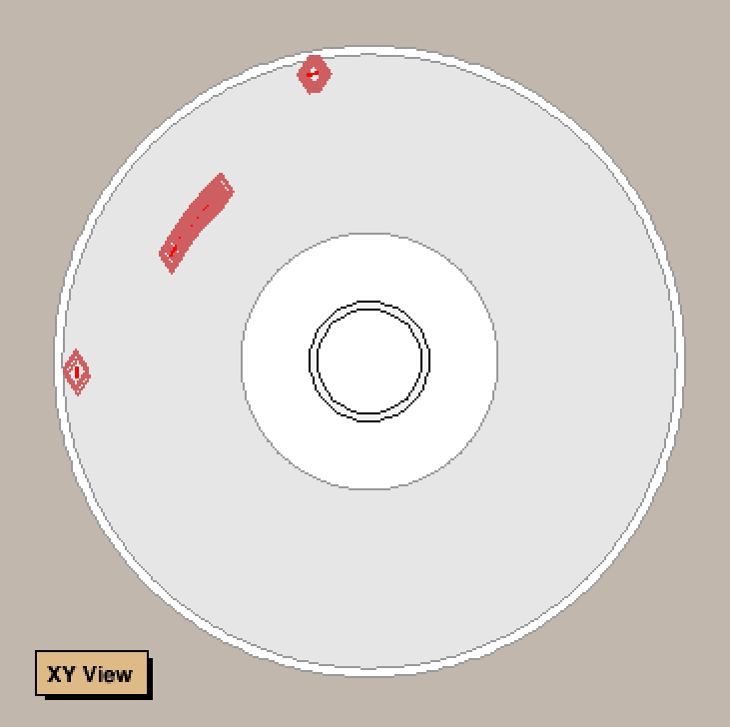
Z cluster =1

Slide 16
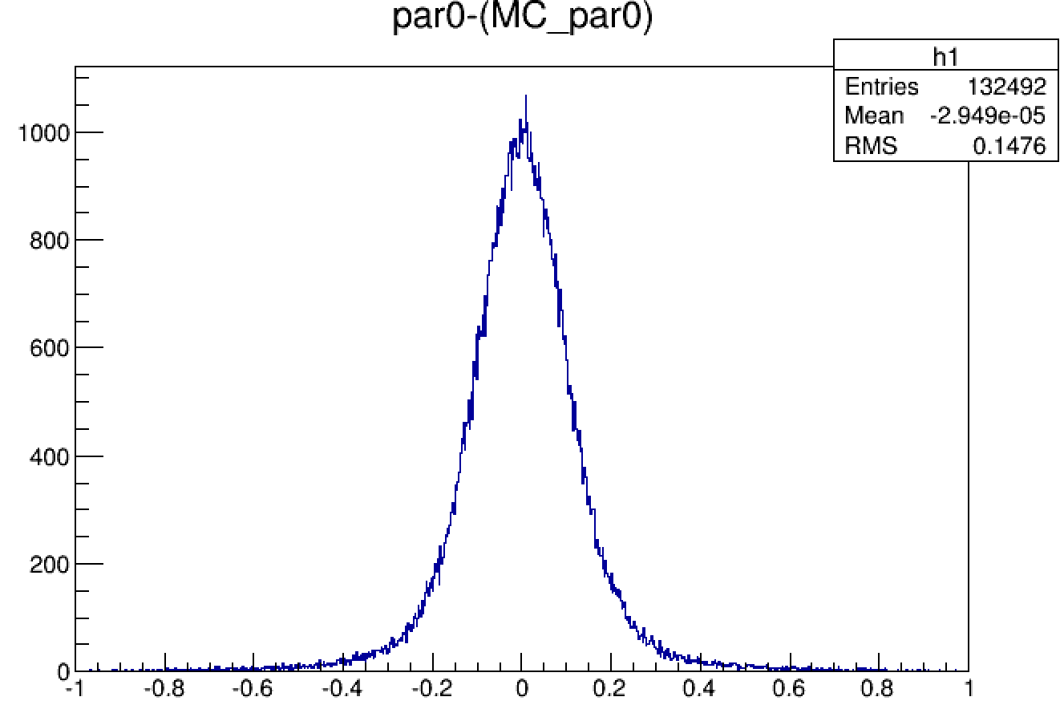
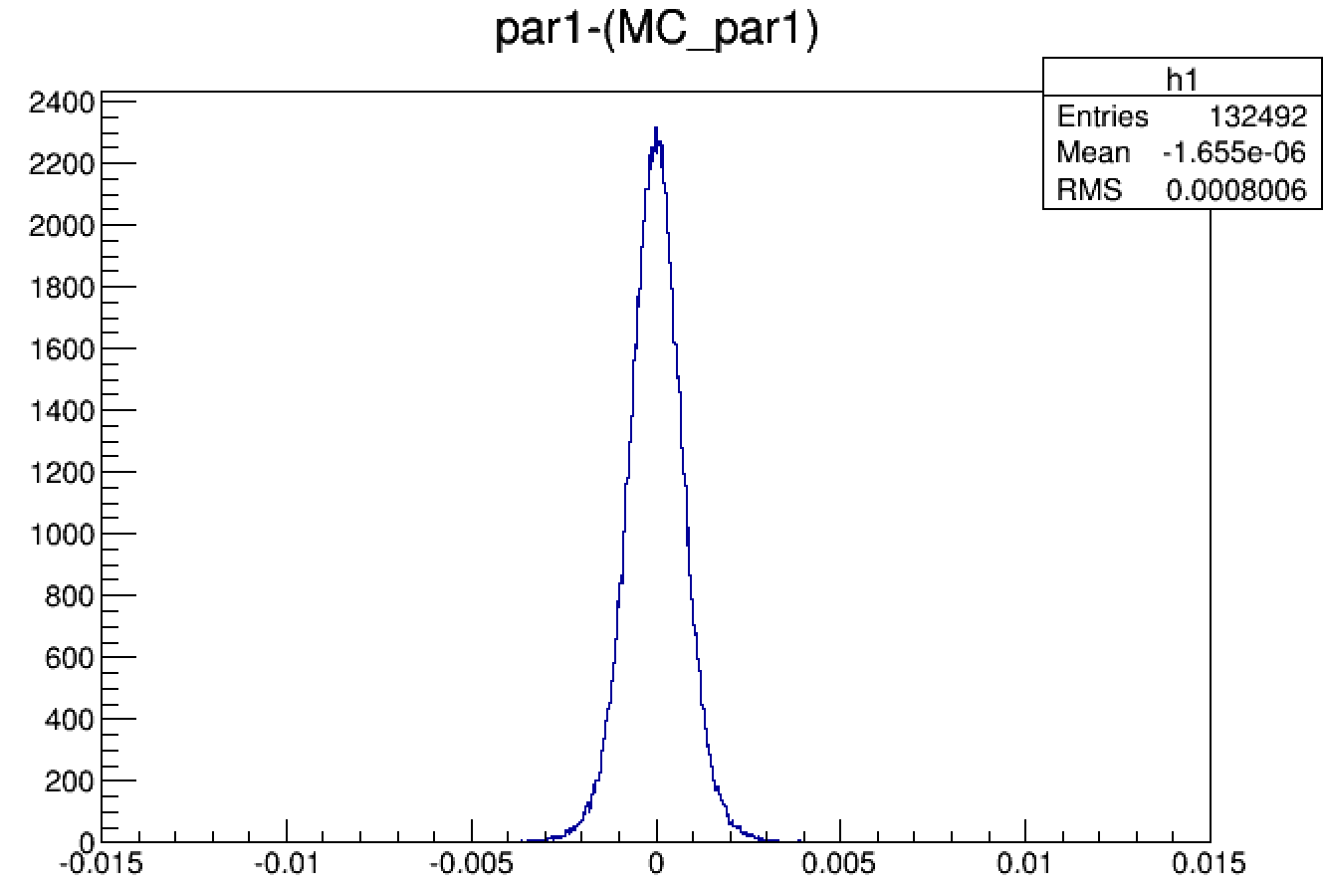
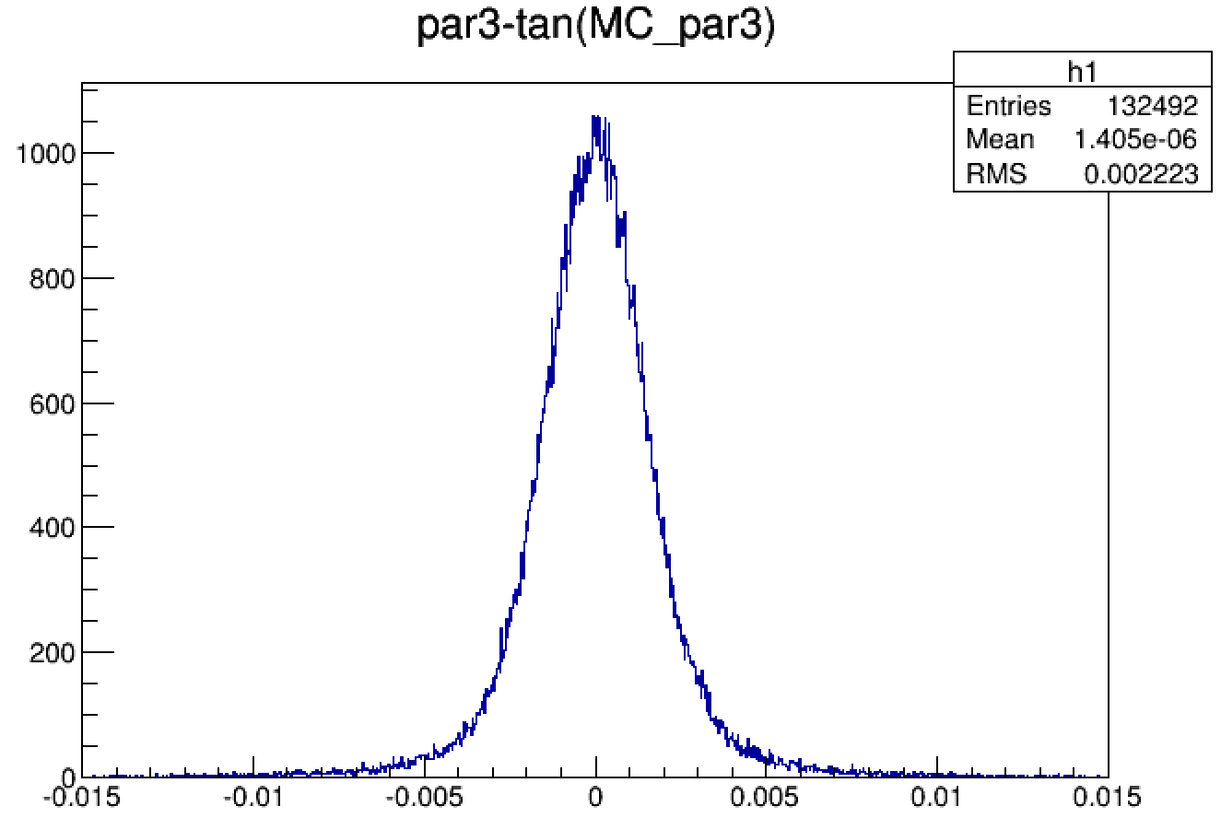
132492 events
$$φ_{0}:rad$$
$$d_{ρ}:mm$$
$$tgλ$$
$Z_{0}:mm$

Slide 17
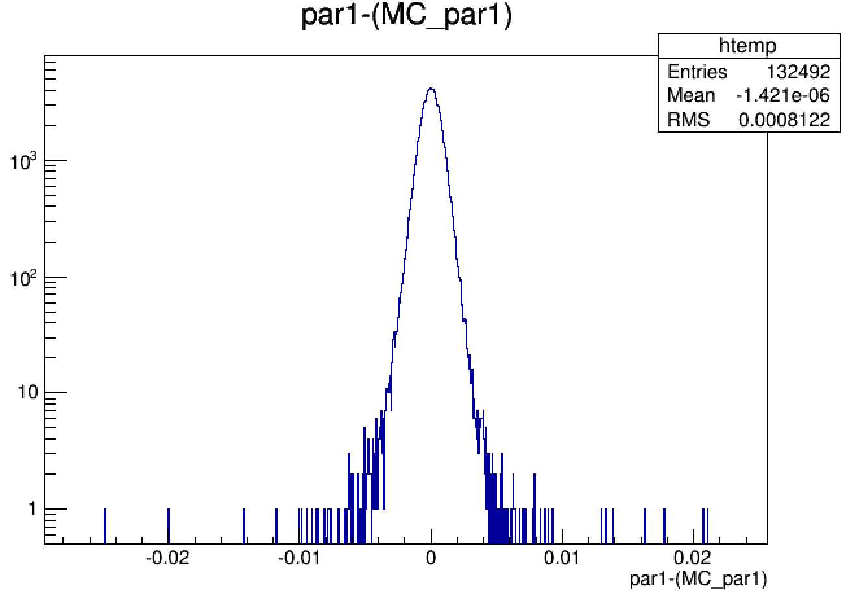
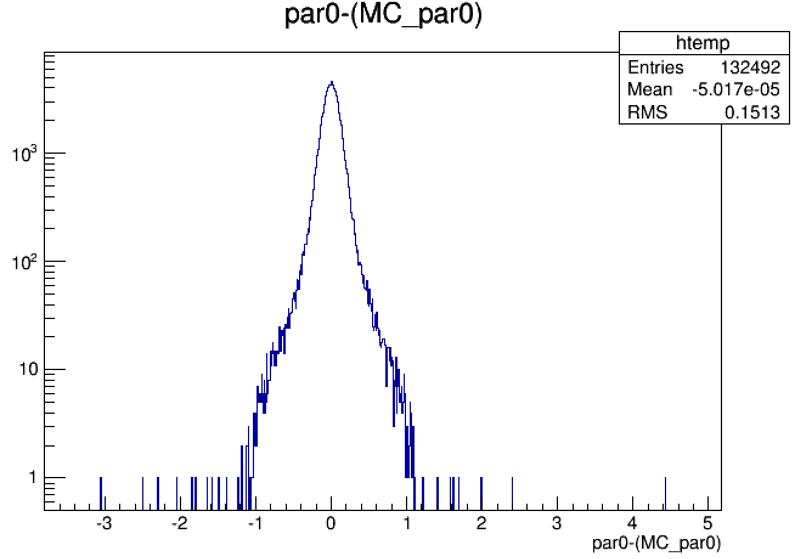
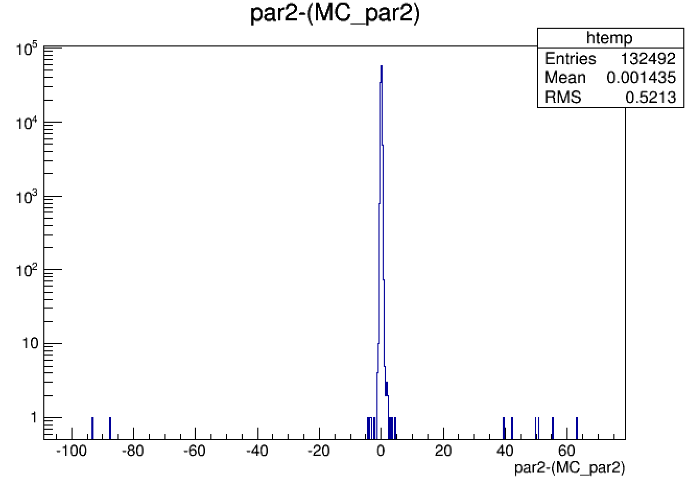
132492 events

Slide 19
