Slide 1
The dependency of cross-section on cut of $z$ mass cut in $zz$ process
Hao Liang
2019/1/18

Slide 2
$$ZZ→τ^{−}τ^{+}u\overline{u}$$
Fey. Diagram
Naturally, $Q_{ττ}>2M_{τ}$
For $Q_{qq}$, the $2M_{q}$ is not a good cut, since the $M_{q}$ is lower than $M_{QCD}$. The low energy QCD needed to be considered.
$Q_{qq}>10GeV$, the default cut set in CEPC official generator, WHIZARD

Slide 3
$$ZZ→τ^{−}τ^{+}u\overline{u}$$
Will acceptance cut save the world?
$|cos⁡(θ_{f_{i}})|>0.99$, $i$=1,2,3,4
Efficiency = 0.99, The acceptance cut can not let the x-section converge, not like 2fermions process of t-channel.
Answer: No.

Slide 4
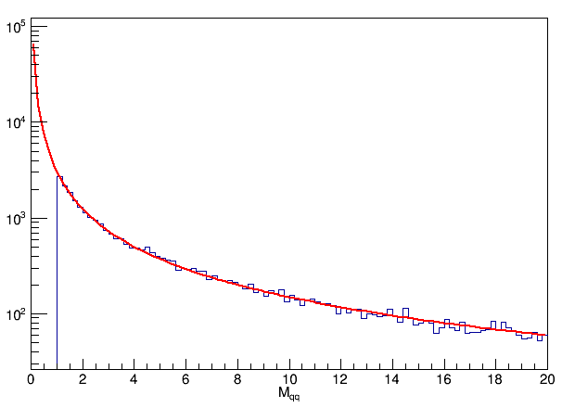
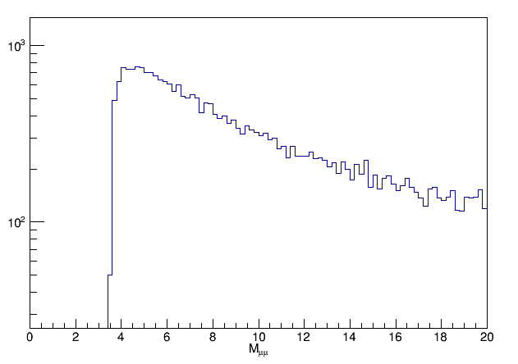
$$ZZ→τ^{−}τ^{+}u\overline{u}$$
Is the problem serious?
C.M.E = 240GeV
3.1/$M_{qq}^{1.32}$

