Slide 1
LHAASO-ENDA FADC Progress
----ENDA
董春辉
(Dong Chunhui)
Supervisor: Yang Chaowen ，Zhou Rong
四川大学
(Sichuan University)

Slide 2
Outline
1. Framework of the FADC
2. Program flowchart for the FADC
3. Test
4. summary

Slide 3
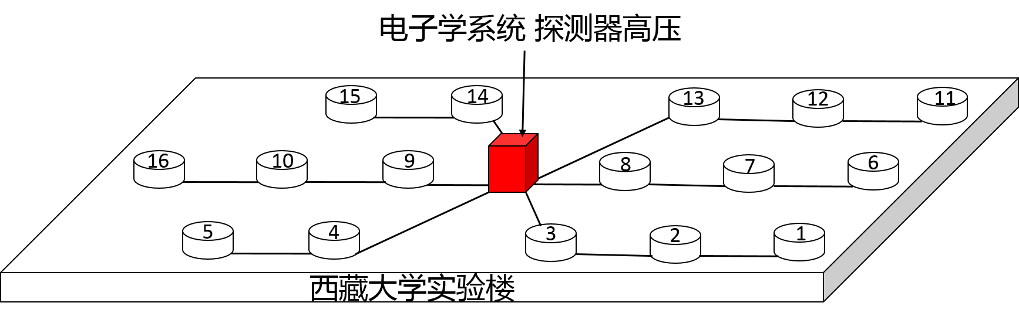

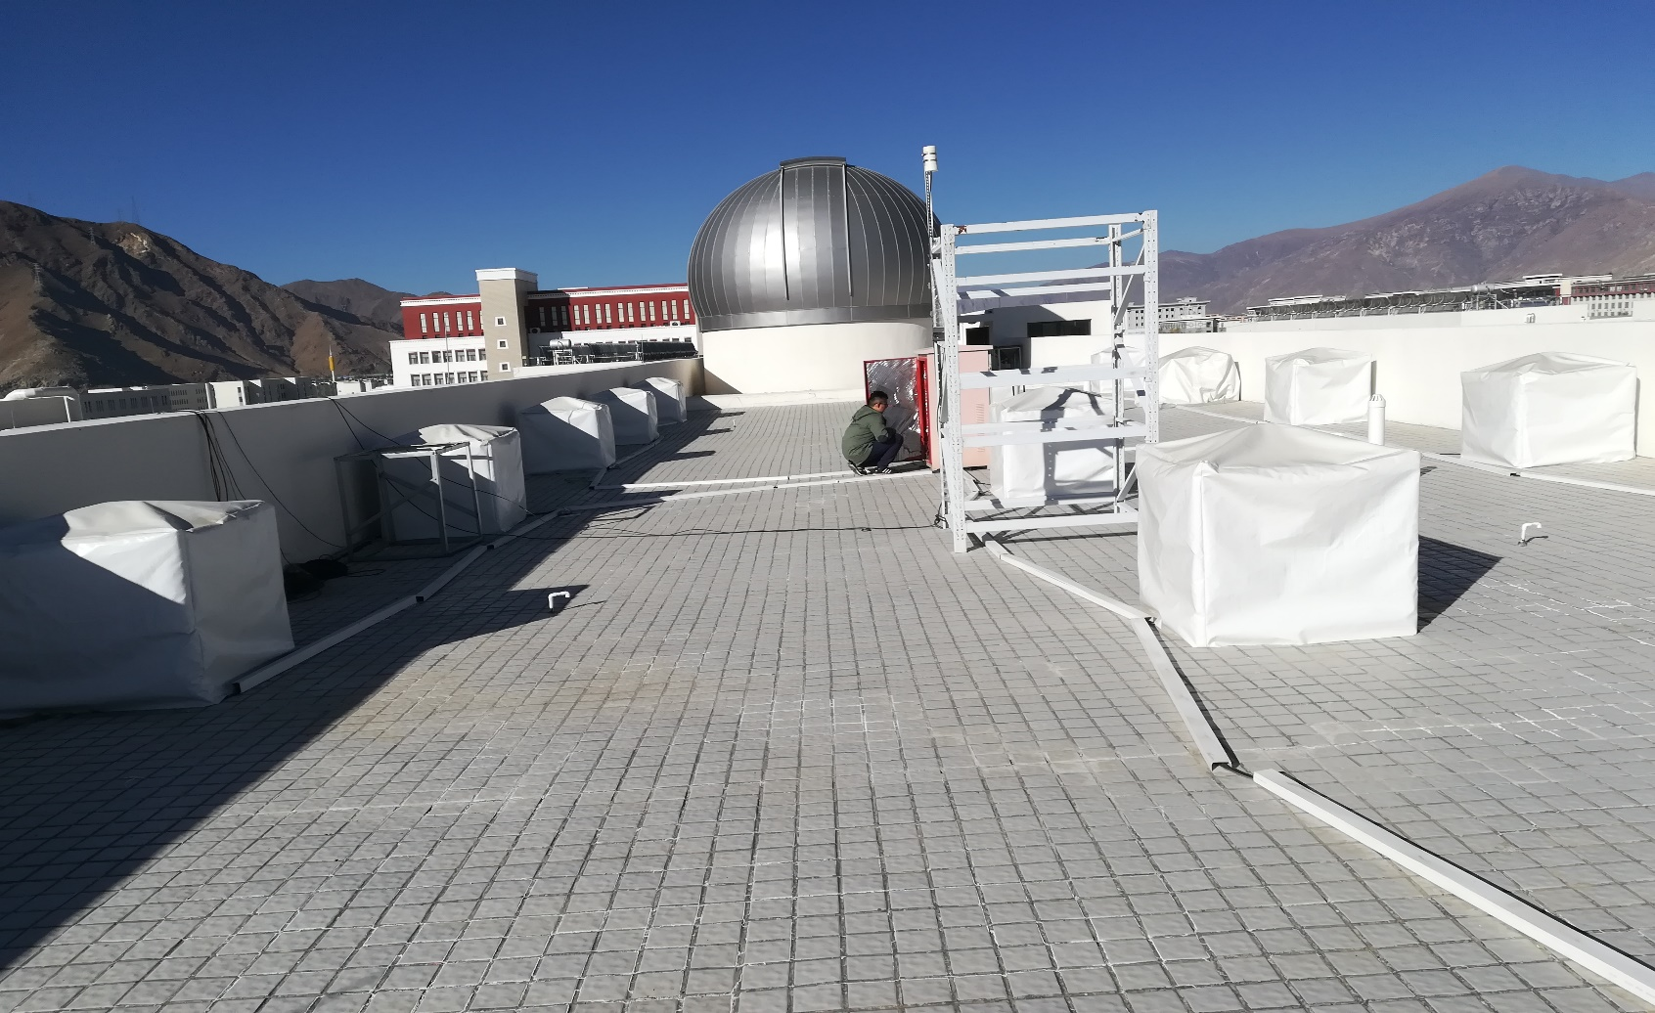
FADC
Detector
In March 2017, the
detector array was
completed at the top
of a four-story building
at Tibet University

Slide 4

Schematic of the system
Analog circuit
digital circuit
NB
Network circuit

Slide 5
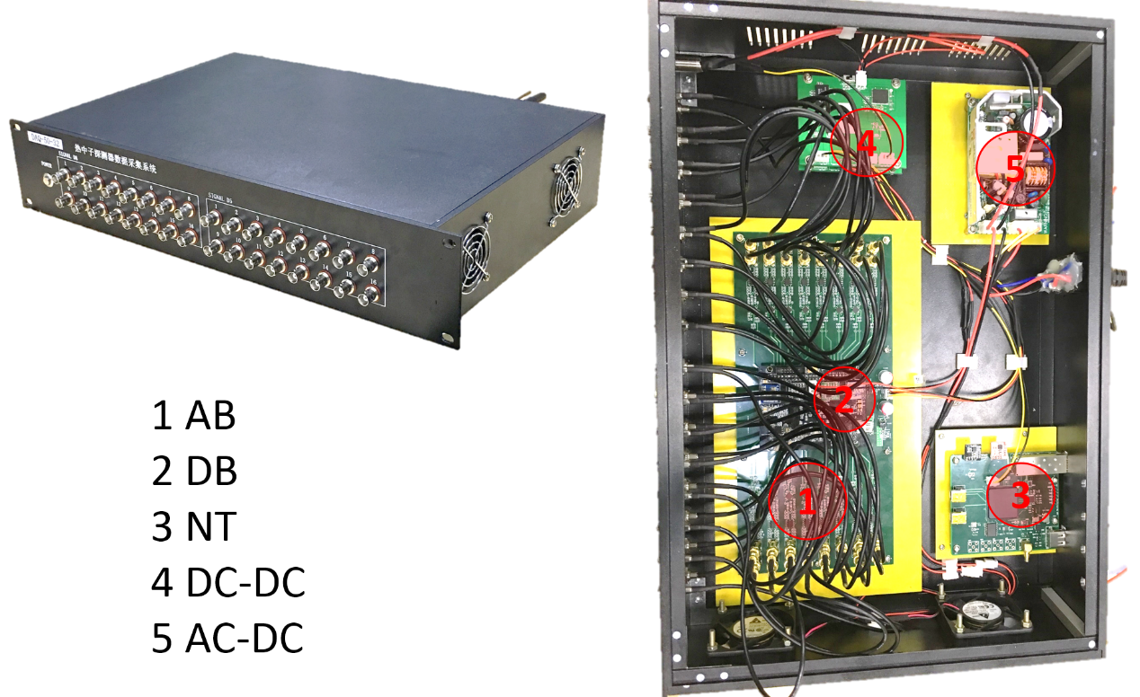
Photographs of the actual instruments

Slide 6
Framework of the AB

Slide 7
Framework of the DB

Slide 8
Framework of the NB

Slide 9
Program flowchart for the entire system

Slide 10
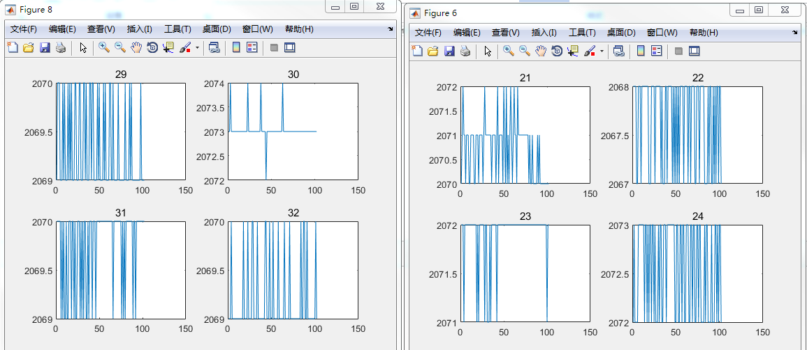
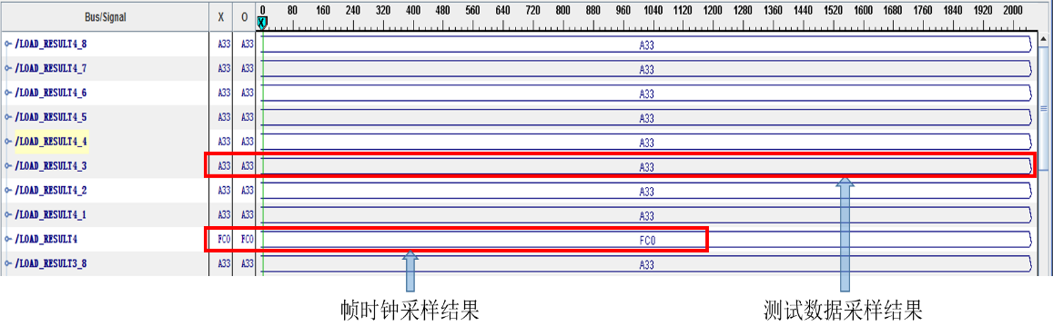
PC Forced Trigger
Test Mode

Slide 11
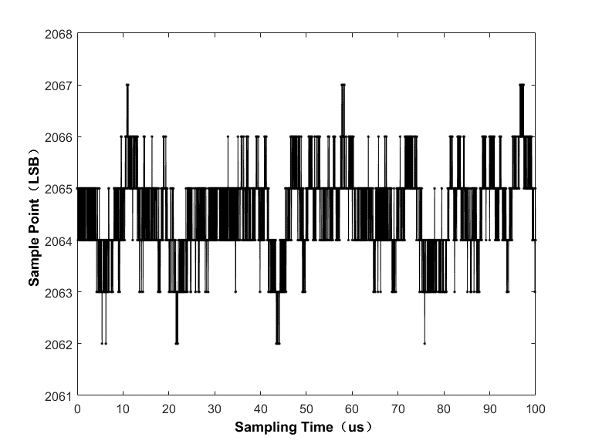
Baseline information that is output when a channel has no signal input

Slide 12
Baseline peak-to-peak amplitudes of the 32 channels

Slide 13
The Test Of Resolution and Relative Deviation
The resolution is η=σ/Vin,
the relative deviation is Dδ = |(Dtest－Dideal)/Dideal|×100%.
Signal Amplitude/mV | Resolution |  |  | Relative Deviation
 | Mean/ % | Max Value / % | Min Value / % | Mean/ % | Max Value/ % | Min Value / %
5 | 9.6 | 11.6 | 7.42 | 11.77 | 19.93 | 0.35
10 | 7.6 | 9.25 | 6.04 | 10.71 | 18.04 | 2.85
15 | 5.67 | 6.24 | 4.78 | 9.29 | 16.36 | 1.2
25 | 4.33 | 5.14 | 3.48 | 5.95 | 12.18 | 1.42
50 | 2.71 | 3.61 | 2.08 | 2.46 | 6.02 | 0.45
100 | 1.55 | 1.9 | 1.18 | 0.61 | 1.44 | 0.08
250 | 0.75 | 0.93 | 0.58 | 3.07 | 4.25 | 0.18
500 | 0.56 | 0.72 | 0.43 | 2.63 | 3.73 | 0.55
1000 | 0.43 | 0.49 | 0.36 | 1.55 | 2.5 | 0.15
2000 | 0.24 | 0.29 | 0.17 | 0.2 | 0.5 | 0

Slide 14
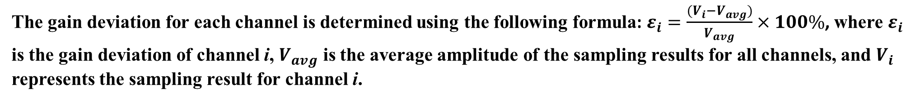
Gain deviations of the 32 channels
The gain deviation for each channel is determined using the following formula: $ε_{i}=\frac{(V_{i}−V_{avg})}{V_{avg}}×100\%$, where $ε_{i}$ is the gain deviation of channel i, $V_{avg}$ is the average amplitude of the sampling results for all channels, and $V_{i}$ represents the sampling result for channel i.
2

Slide 15
Short-term stability test results

Slide 16
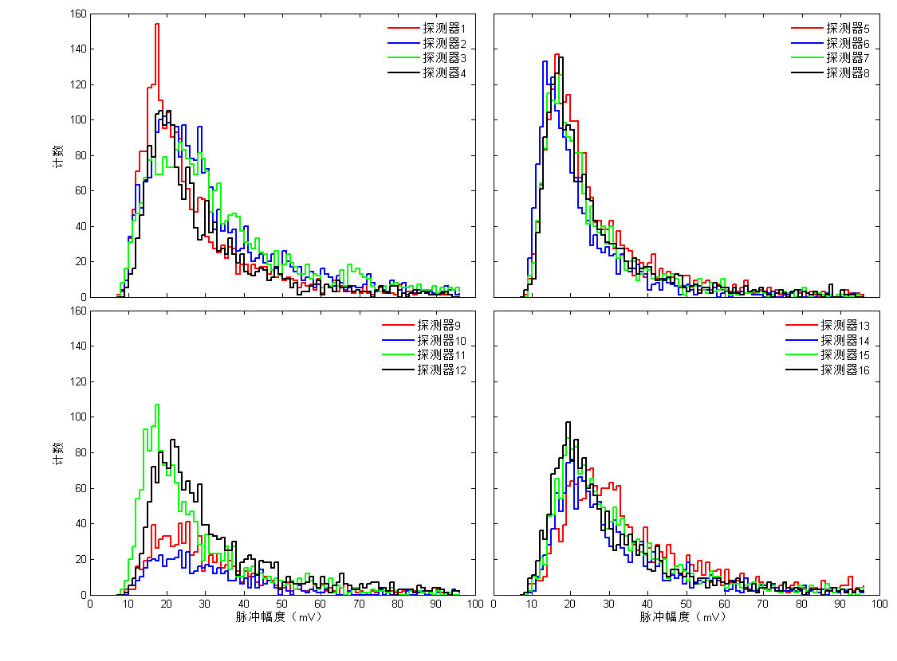
Signal amplitude spectrum in one day
Count
Count
Pulse amplitude(mV)
Pulse amplitude(mV)

Slide 17
Test results for long-term stability

Slide 18
The Time Difference Between Two Channels

Slide 19
The VAR_SAMPLER Output and the Restored Result

Slide 20
The Fitting Curve of Time Coincidence

Slide 21
Summary：
① Noise peak-to-peak value does not exceed 7mV.
Small signal(5mV) :resolution ＜ 12%， relative deviation ＜20%， gain deviation ＜20%。
Big signal(2000mV) :resolution ＜ 0.3%， relative deviation ＜0.5%， gain deviation ＜2%。
The time resolution of a single channel is 12.7 ns。
Coincidence and variable sampling are realized on FPGA 。
The deviation does not exceed 2 LSB in the short term stability test and does not exceed 3 LSB in the long term stability test 。
Thanks

