Slide 1
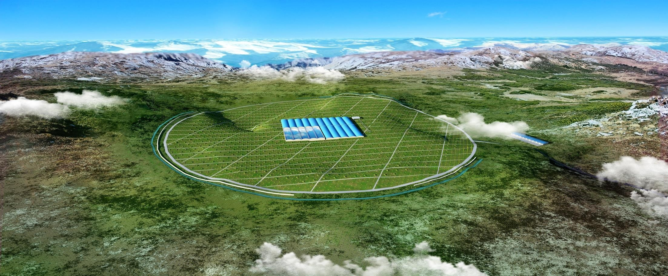
Calibration system & 20 inch MCP-PMT of WCDA
Bo Gao
20190415

Slide 2
Outline
Time calibration system
Work on 20 inch MCP-PMT
design & test
assembly & installation
calibration method
some results
WCDA requirements
what have we done
now and next ...

Slide 3
Calibration system

Slide 4
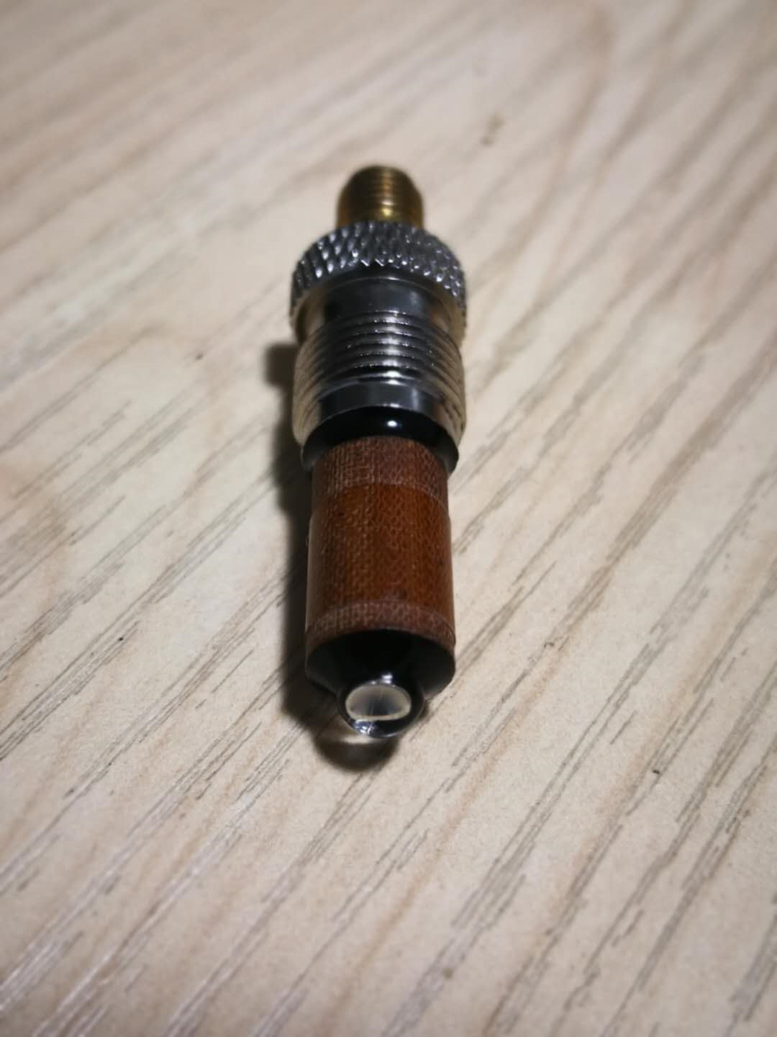
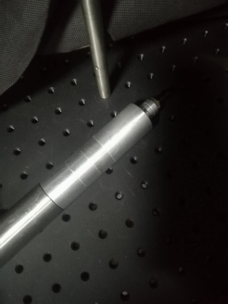
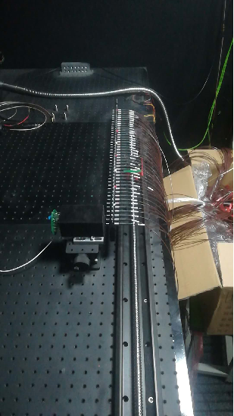
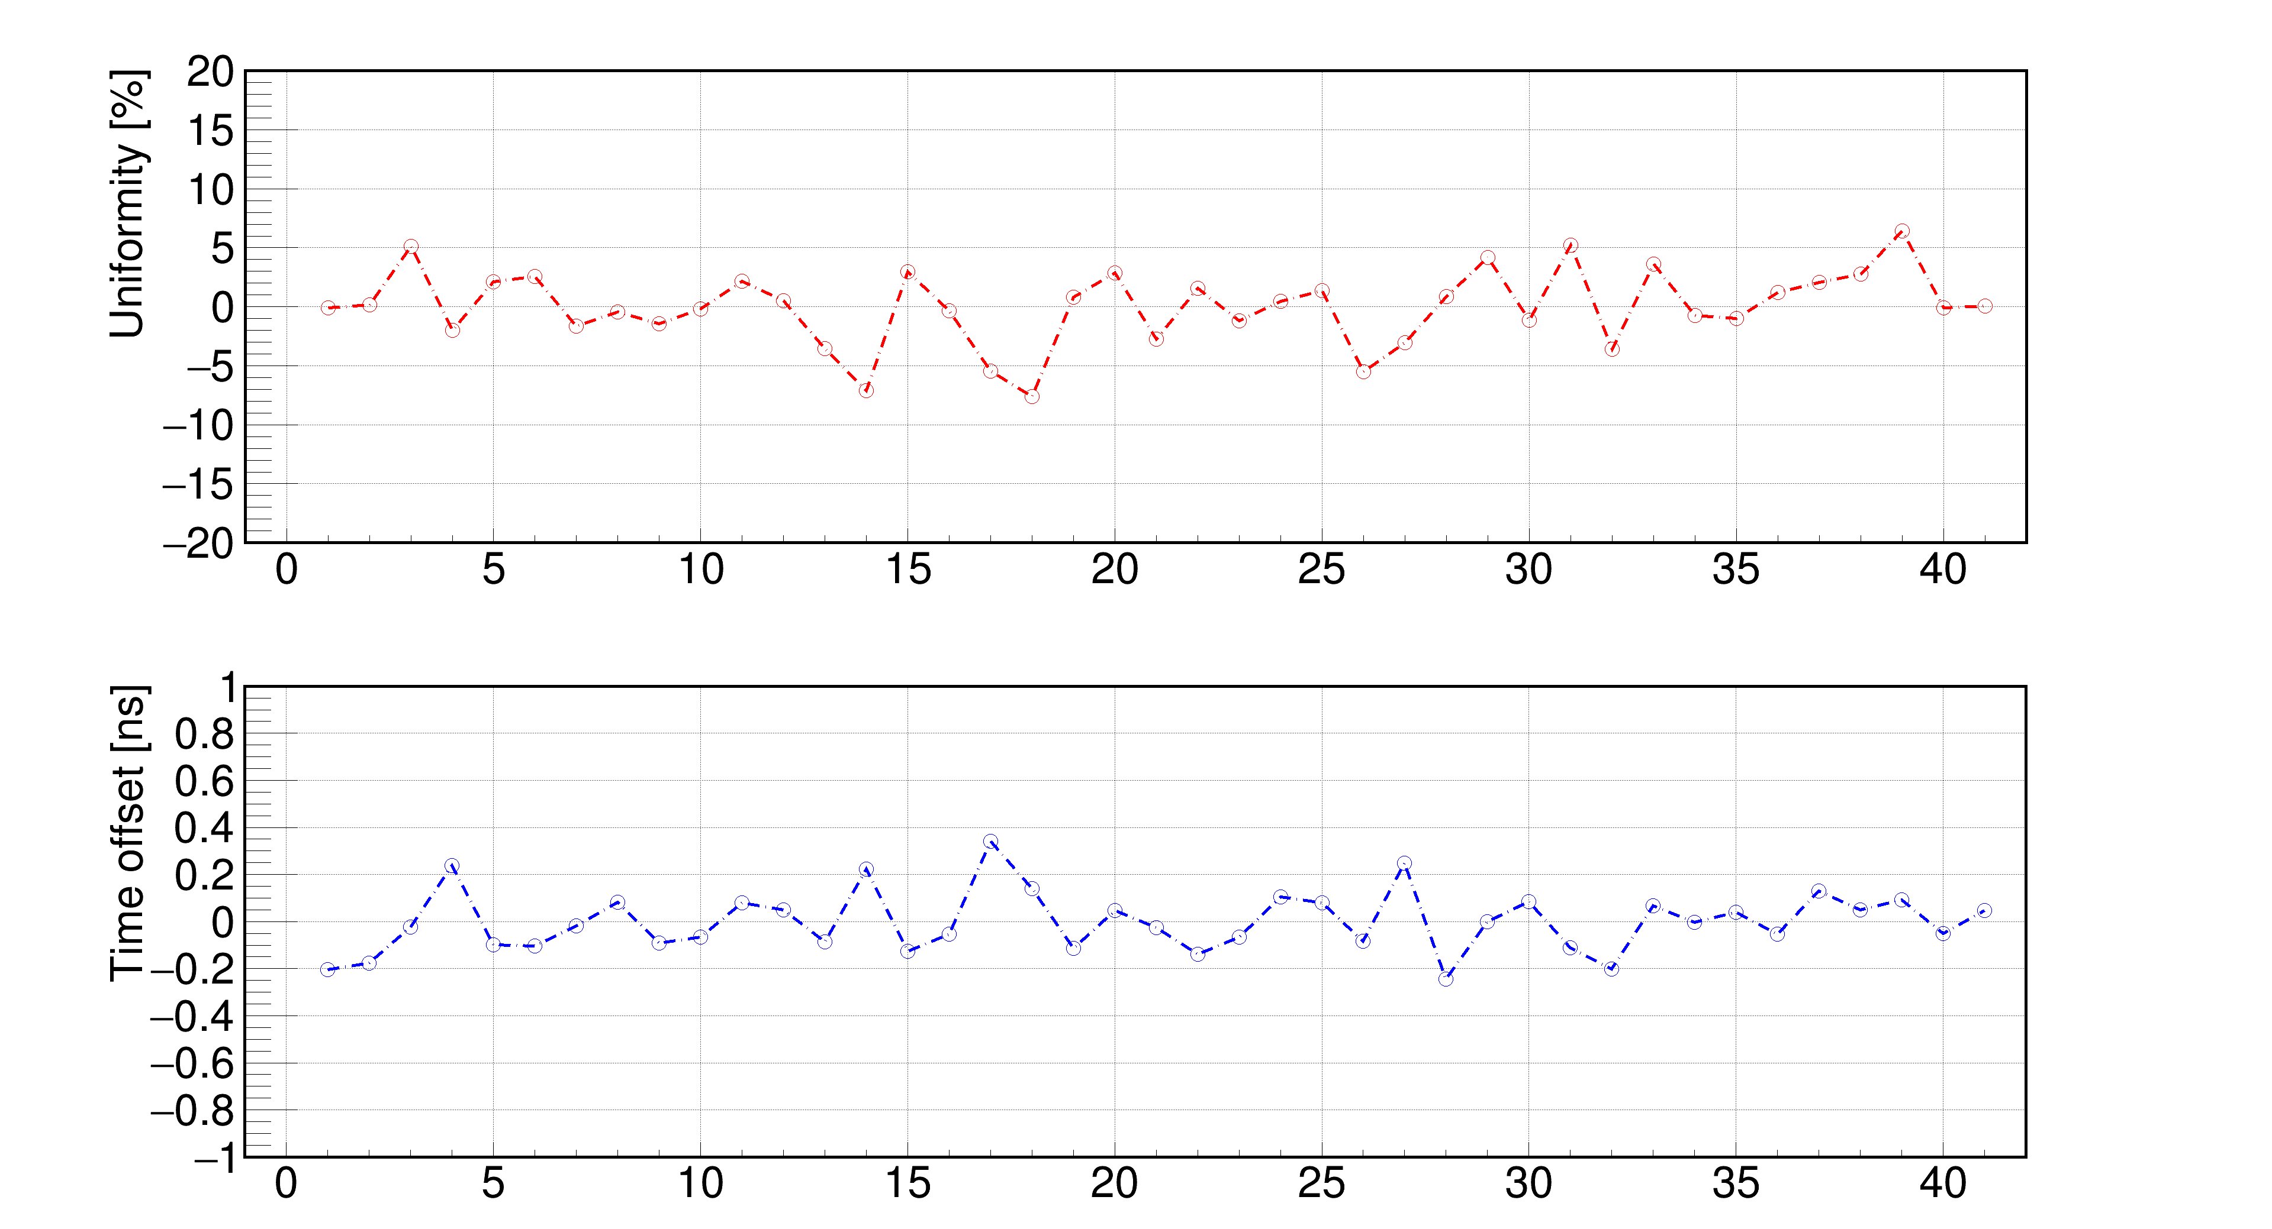
Design & Test
Hardware
wide angle LED (468nm / 120°)
PMMA fiber bundle （41 fiber/ 40m length / 50 bundles）
LED driver （based on FPGA, 5 ns width）
Test
output uniformity
fiber time offsets

Slide 5
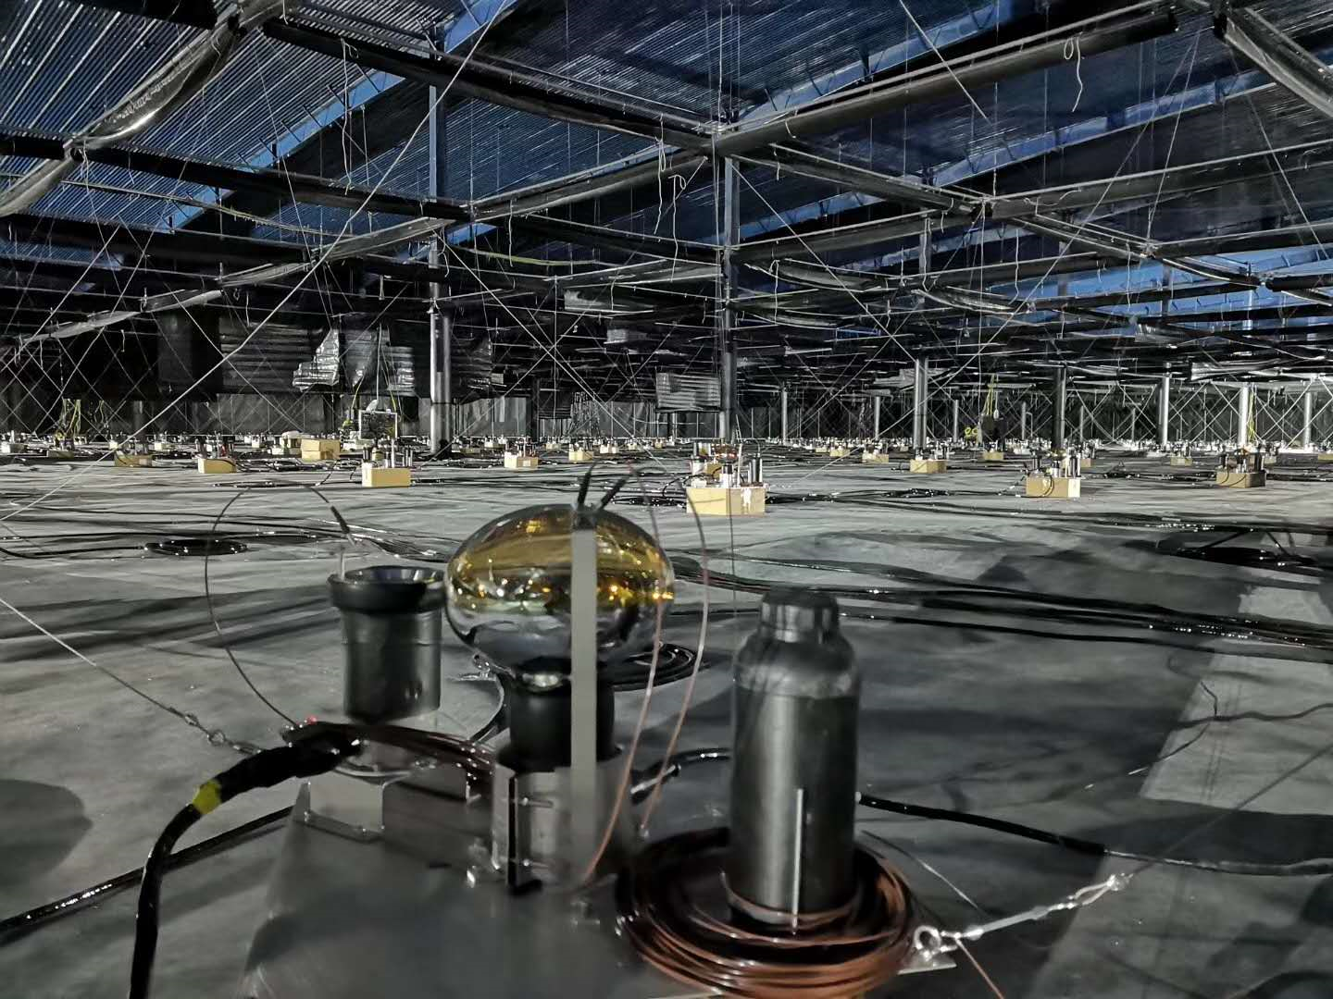
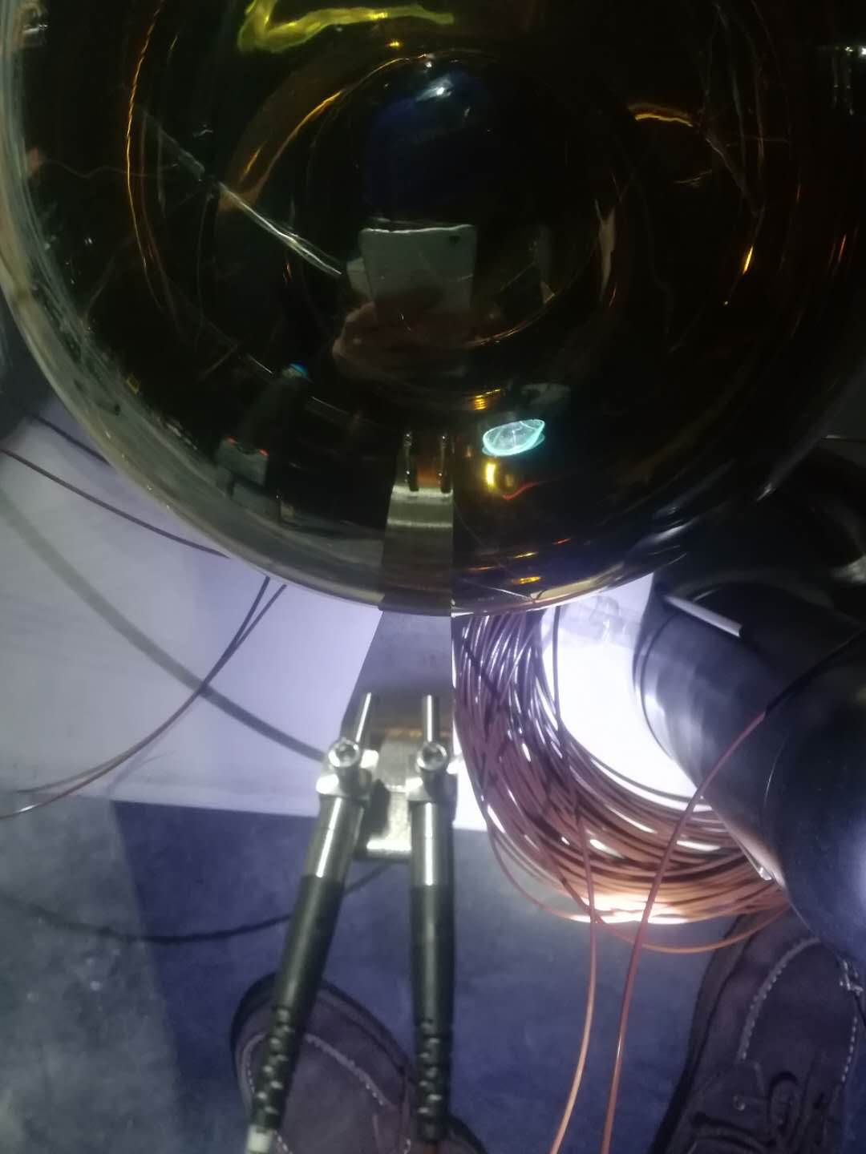
Assembly & Installation
waterproof
fiber intalled

Slide 6
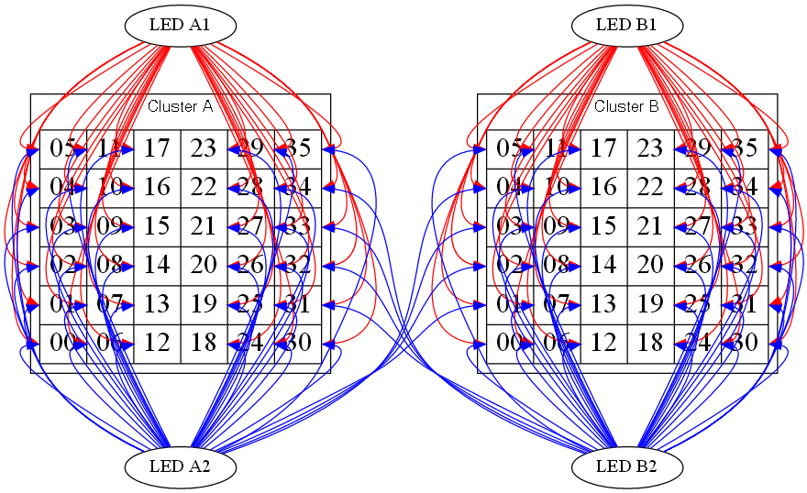
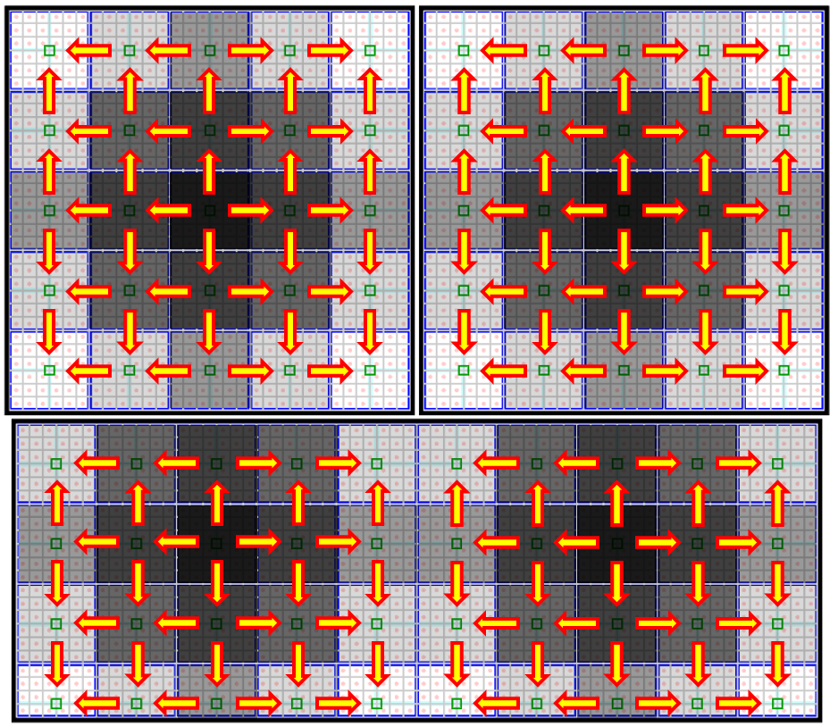
Calibration method
“cross calibration”
2 fiber bundle for 1 cluster
1 for inside calibration
2 for neighbour cluster calibration
calculation
basic concept : A-C = (A-B)+(B-C)
T_{ci_chi} - T_{c0_ch0}
= (TIN_{ci_chi}-TIN_{ci_chx})-(TCR_{ci_chx}-TCR_{c0_ch0})
ci_chi : test cluster & channel
c0_ch0: ref cluster & channel
ci_chx: the “pedal” channel
TIN: inside fiber calibration result
TCR: cross fiber calibration result

Slide 7
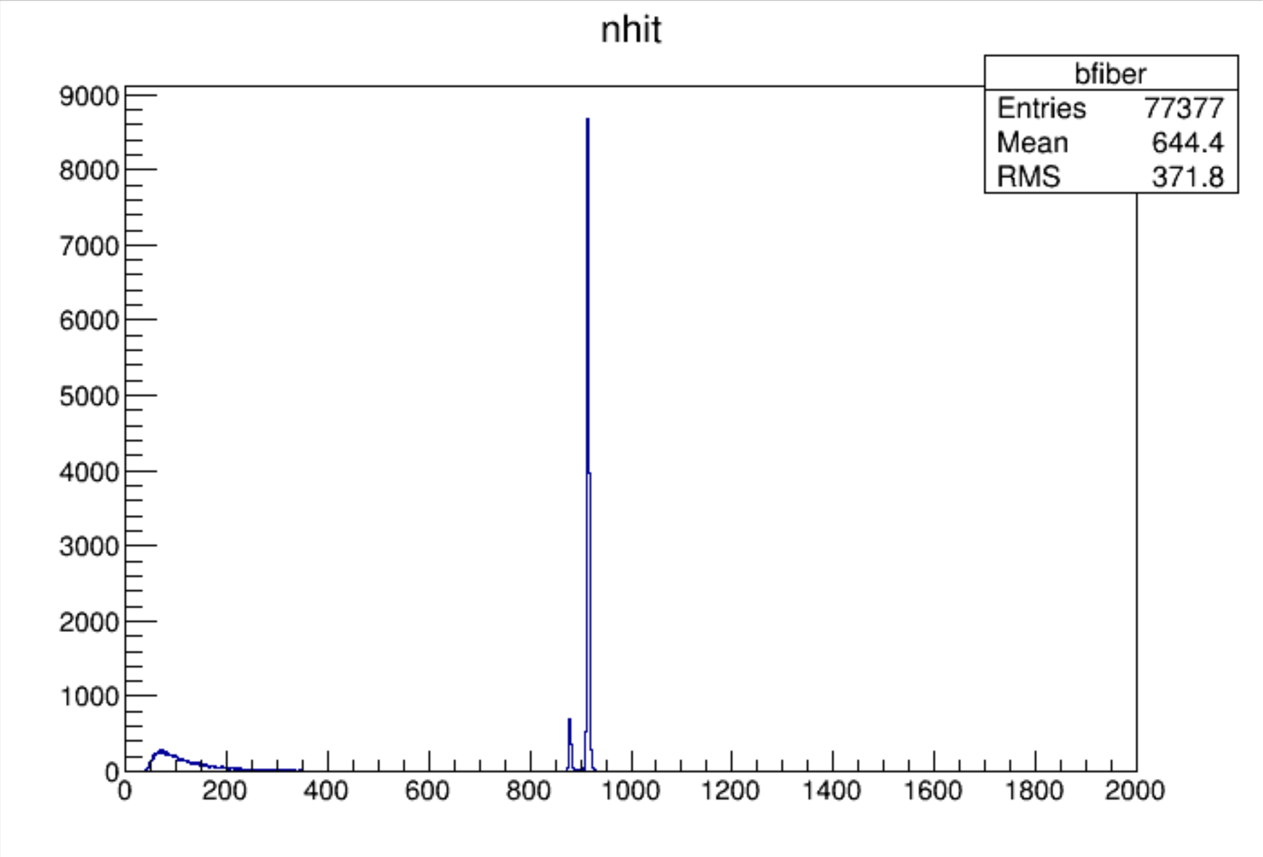
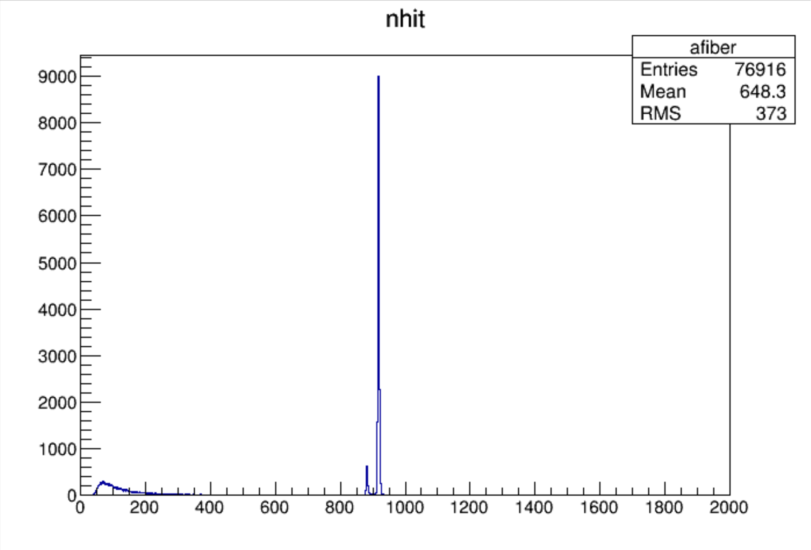
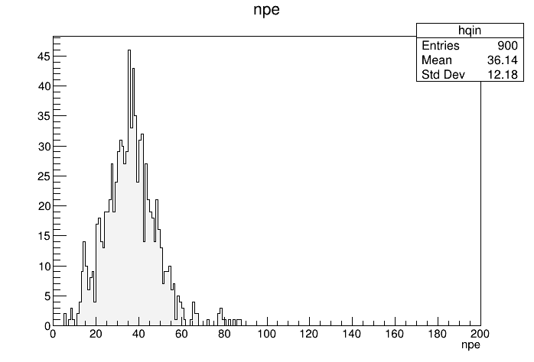
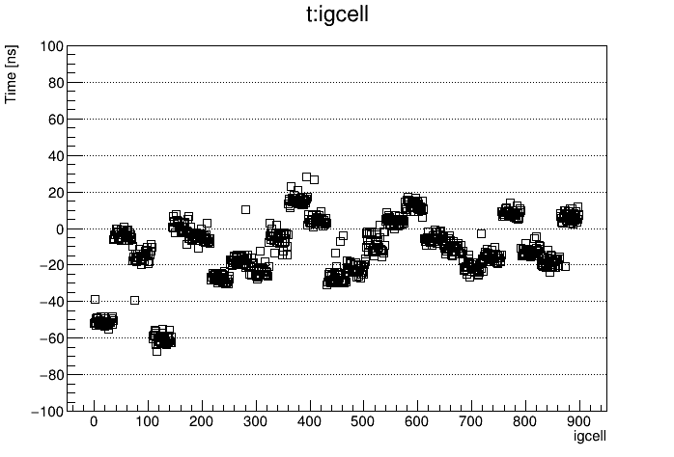
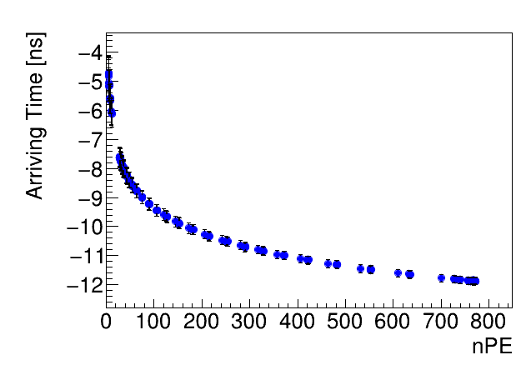
the data
LED signal selection
LED triggered seperatly
event mode (nhit > 900)
LED charge & time
Q-T recorrection
T(q) = 20.*pow(q,-1.2)+10.*pow(q,-0.8)
normalized to 30 PE
cr fiber
in fiber
infiber
Charge
infiber
Time
crossfiber
Charge
crossfiber
Time

Slide 8
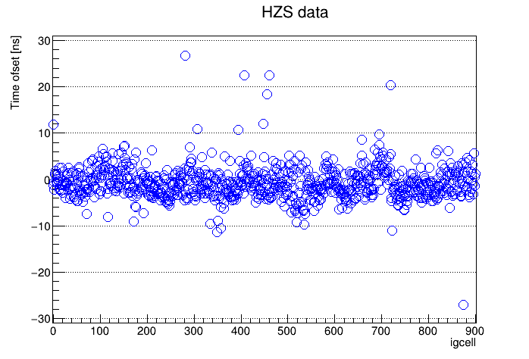
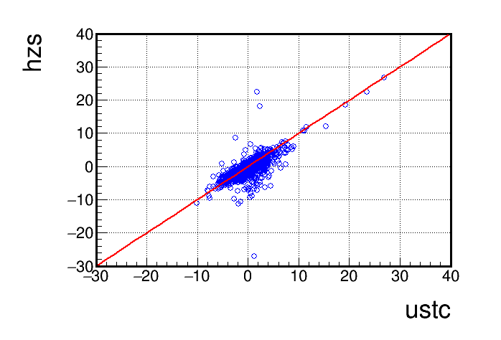
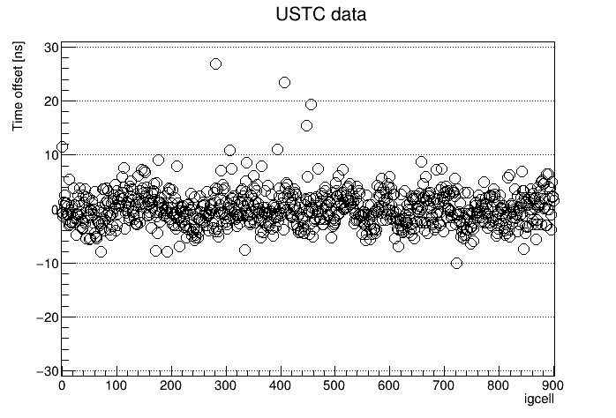
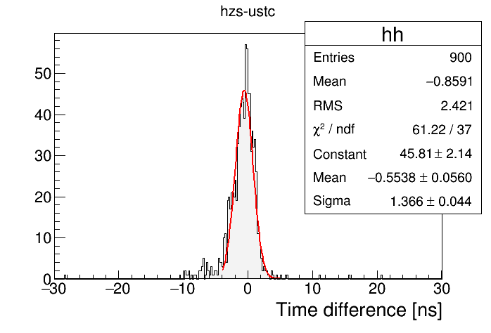
some results - to USTC data

Slide 9
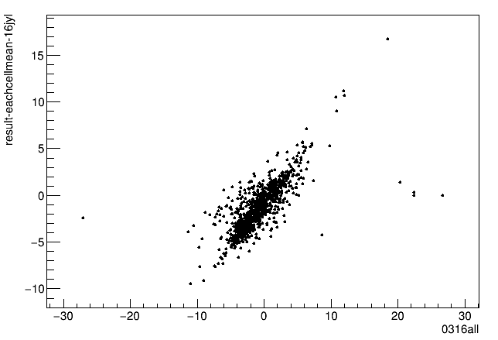
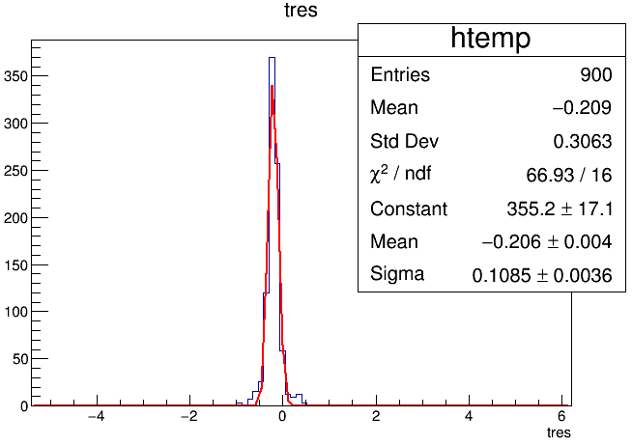
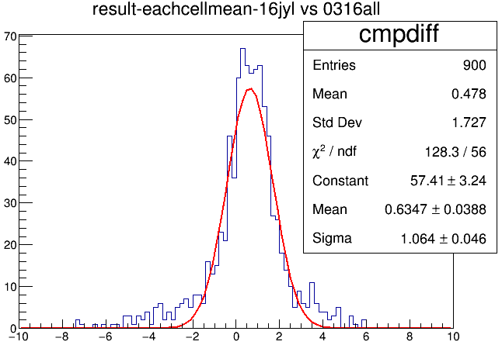
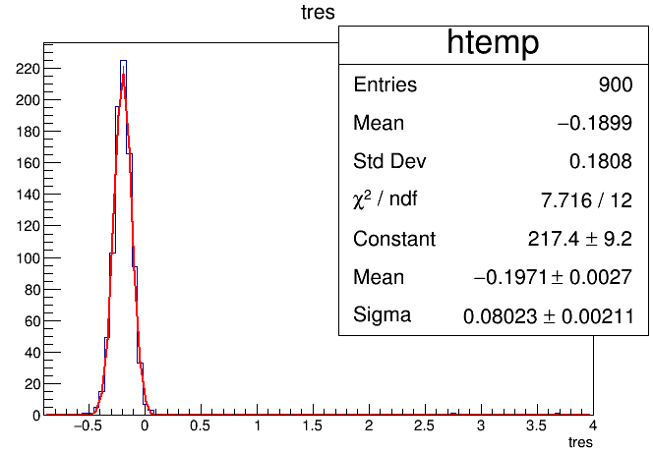
some results - to offline calibration
hardware
iteration
offline
iteration

Slide 10
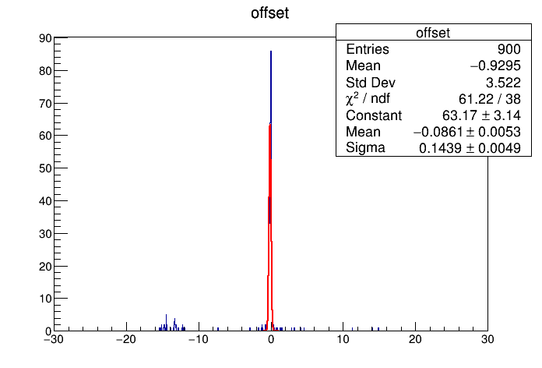
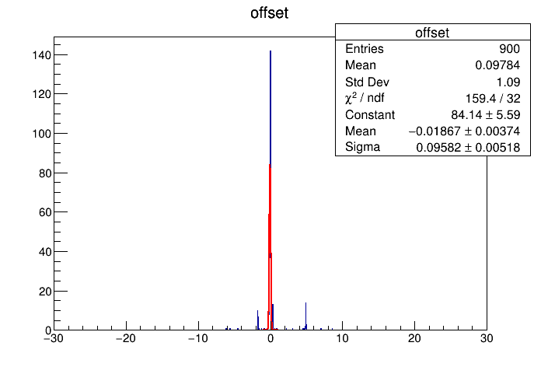
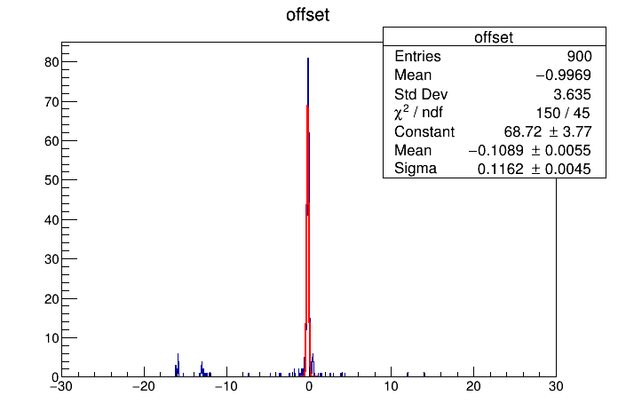
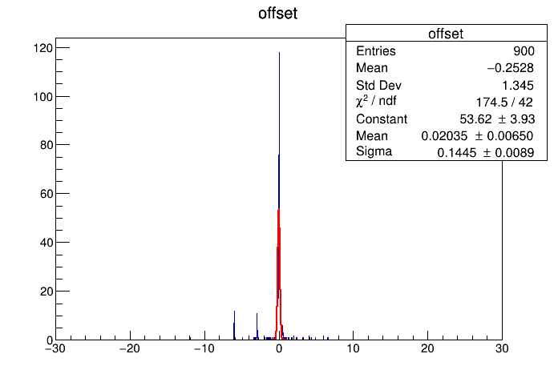

Slide 11
the results
calibration system : PMT & FEE
ustc calibration : PMT only
offline calibration : detector cells (PMT & position & water & FEE)
most of WCDA channel calibration result matchs USTC calibration data and offline calibration result；
some channels are still in check.

Slide 12
Work on 20 inch MCP-PMT

Slide 13
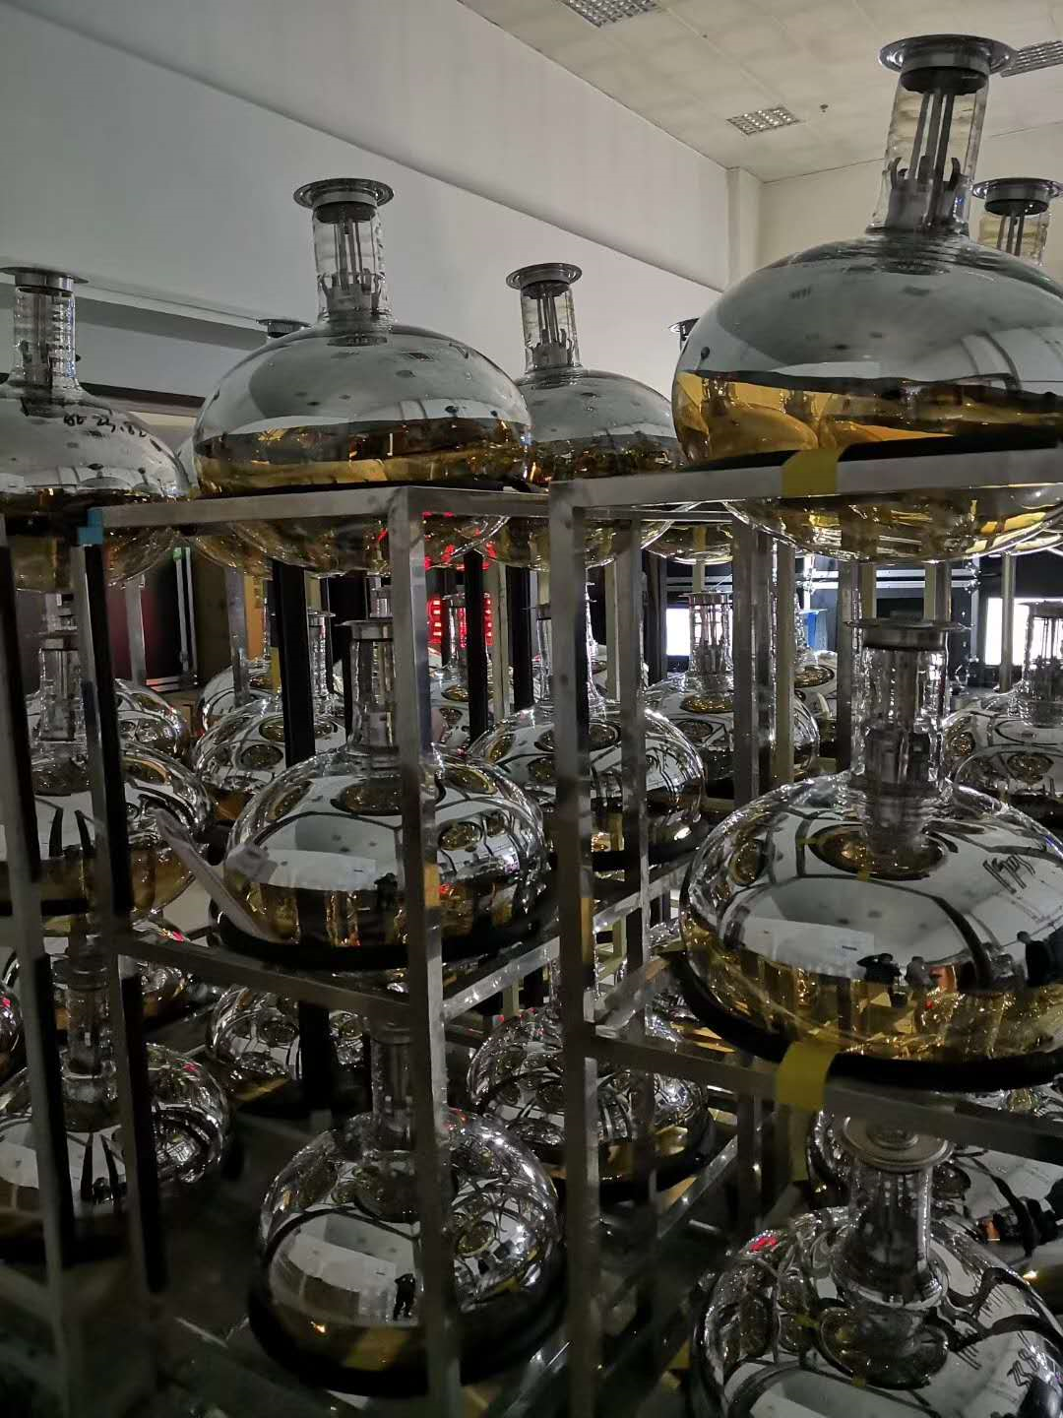
WCDA requirements
2# 3# pool, 2220 PMTs are needed
Special design for WCDA
Test
SPE
tts / cttd
linearity
afterpulse
dark rate
etc ...
HV divider
Potting

Slide 14
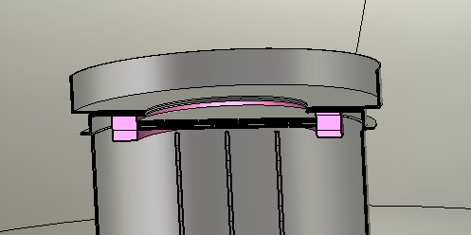
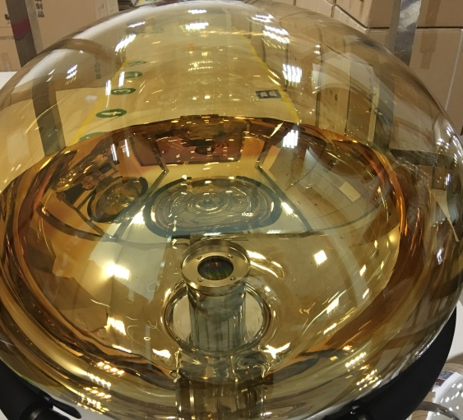
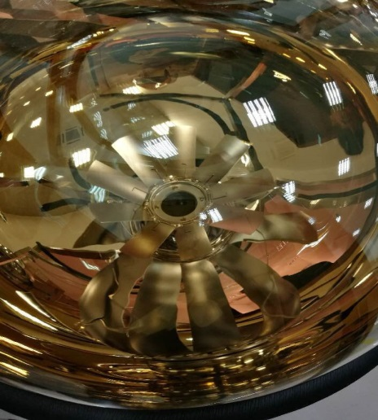
what have we done - special design
普通聚焦极
扩张型莲花座聚焦极
NNVT optimized the focus electrode design for WCDA, considering both collection efficiency and TTS (< 7 ns).

Slide 15
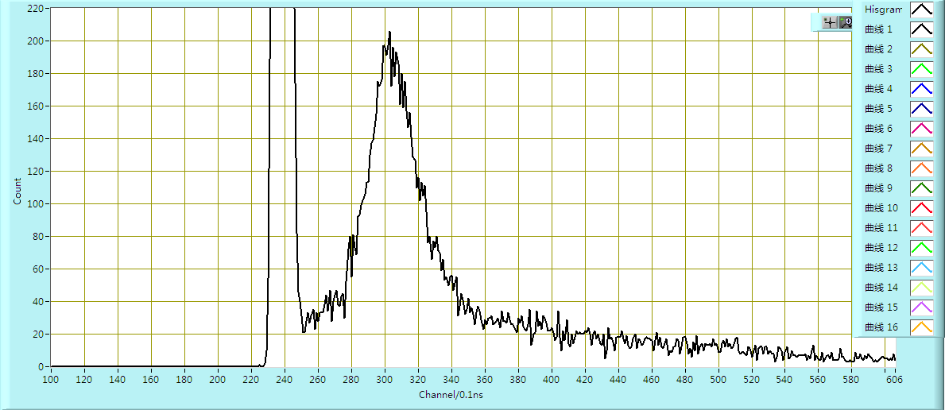
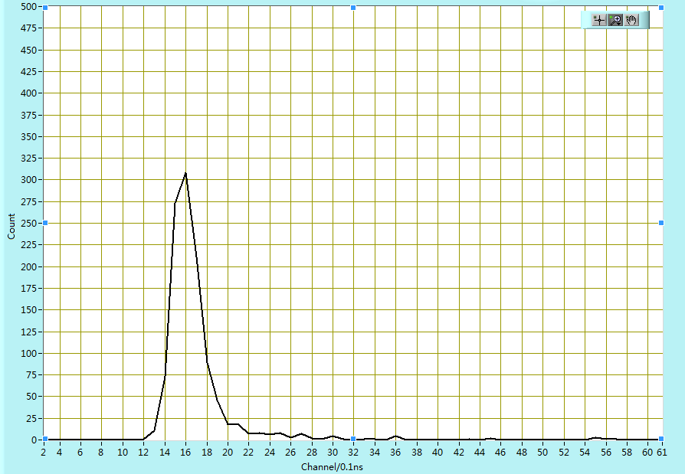
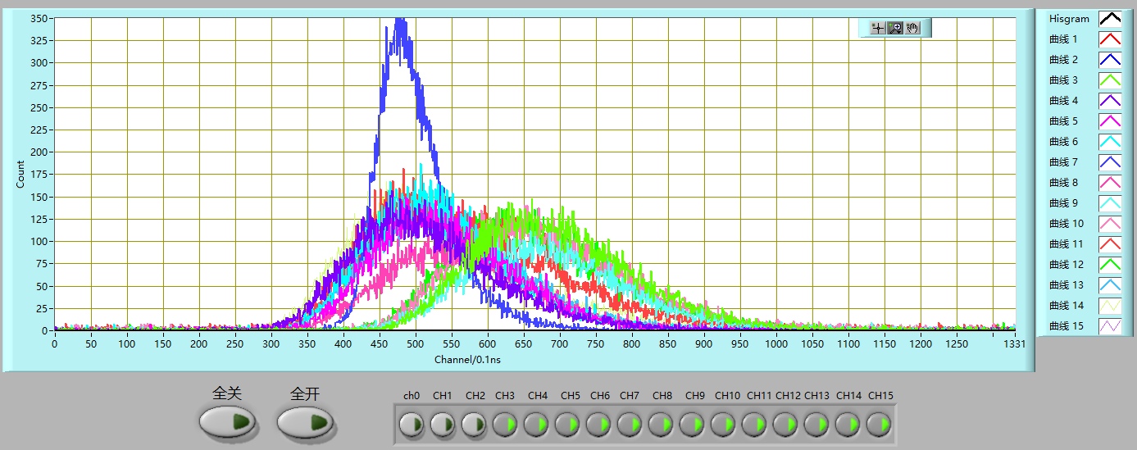
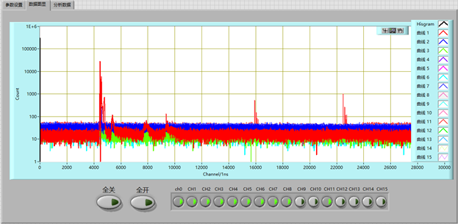
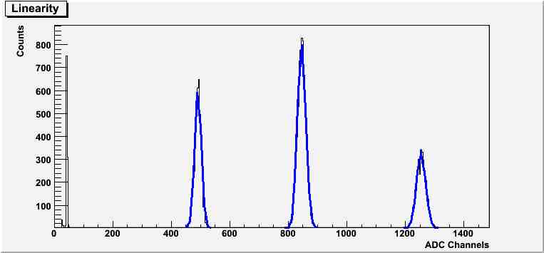
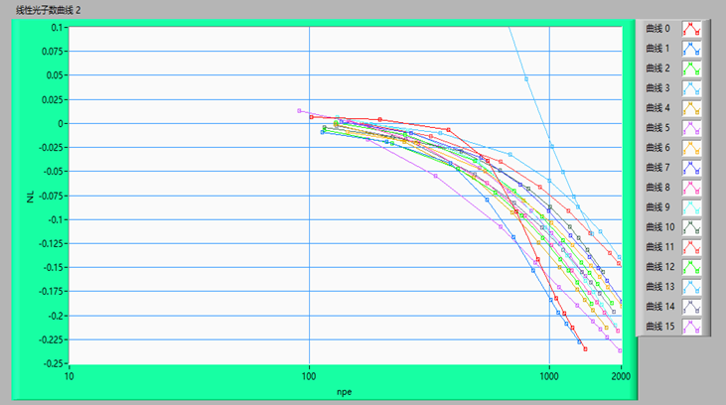
N_{p}
PMT test
SPE @ Gain = 5×10⁶
Dark rate (1/3 PE, cooling after 16 hours)
TTS (LED ratio < 10%)
Risetime (10GHz scope)
Afterpulse (500ns - 20μs)
non-linearity (A-B method)
N_{V}
Pedestal
A
B
C=A+B

Slide 16
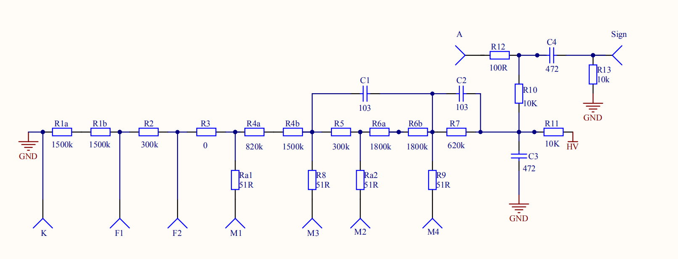
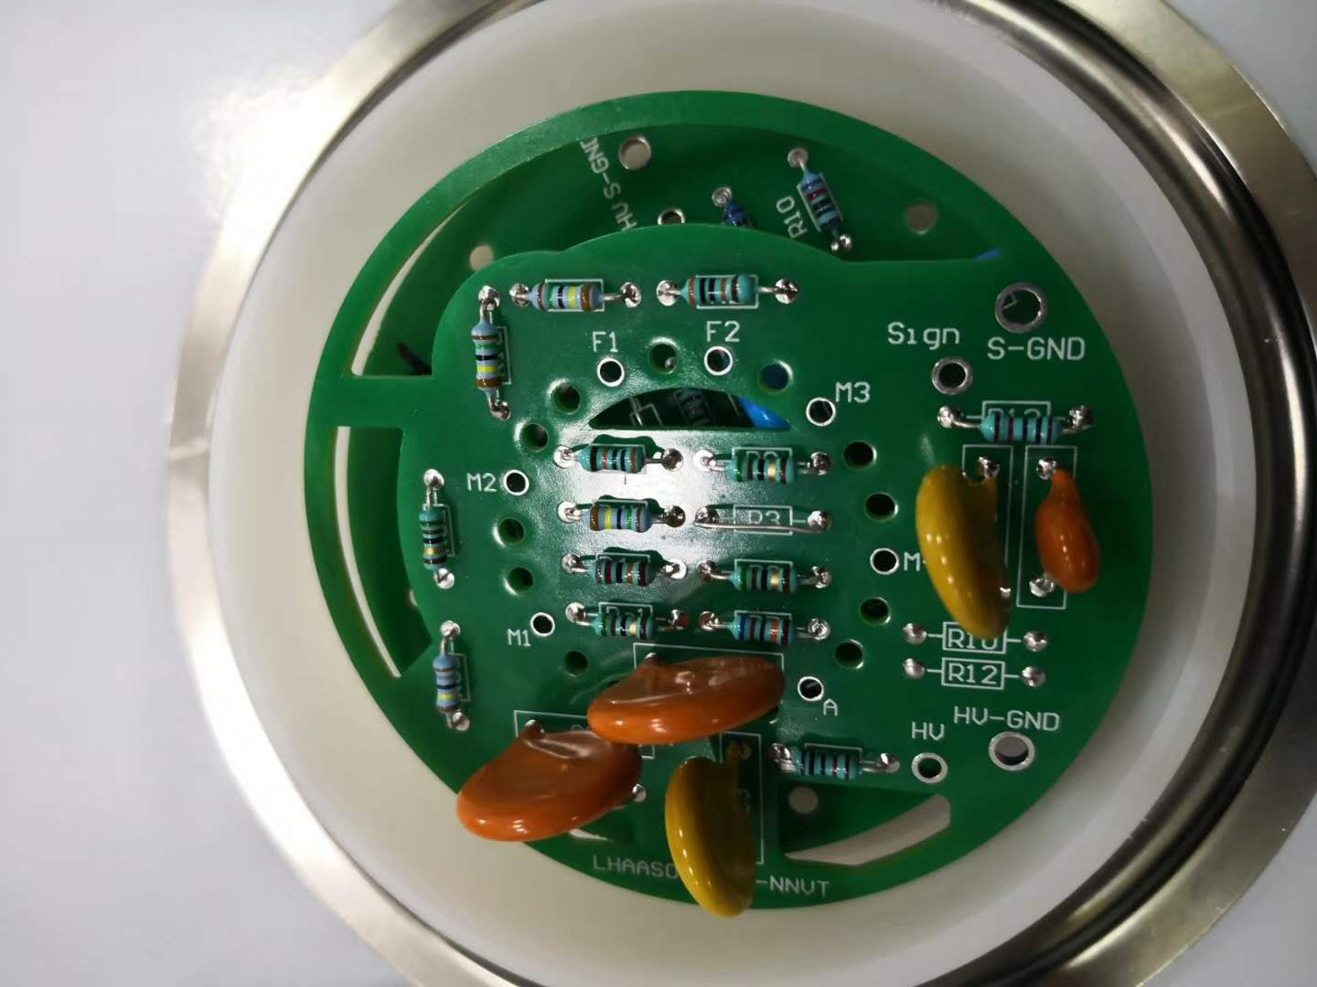
HV divider
Final design （2019.02）
HV / signal seperated
special drill drawing for potting glue and cable fasten
reduce number of welding point to 12

Slide 17
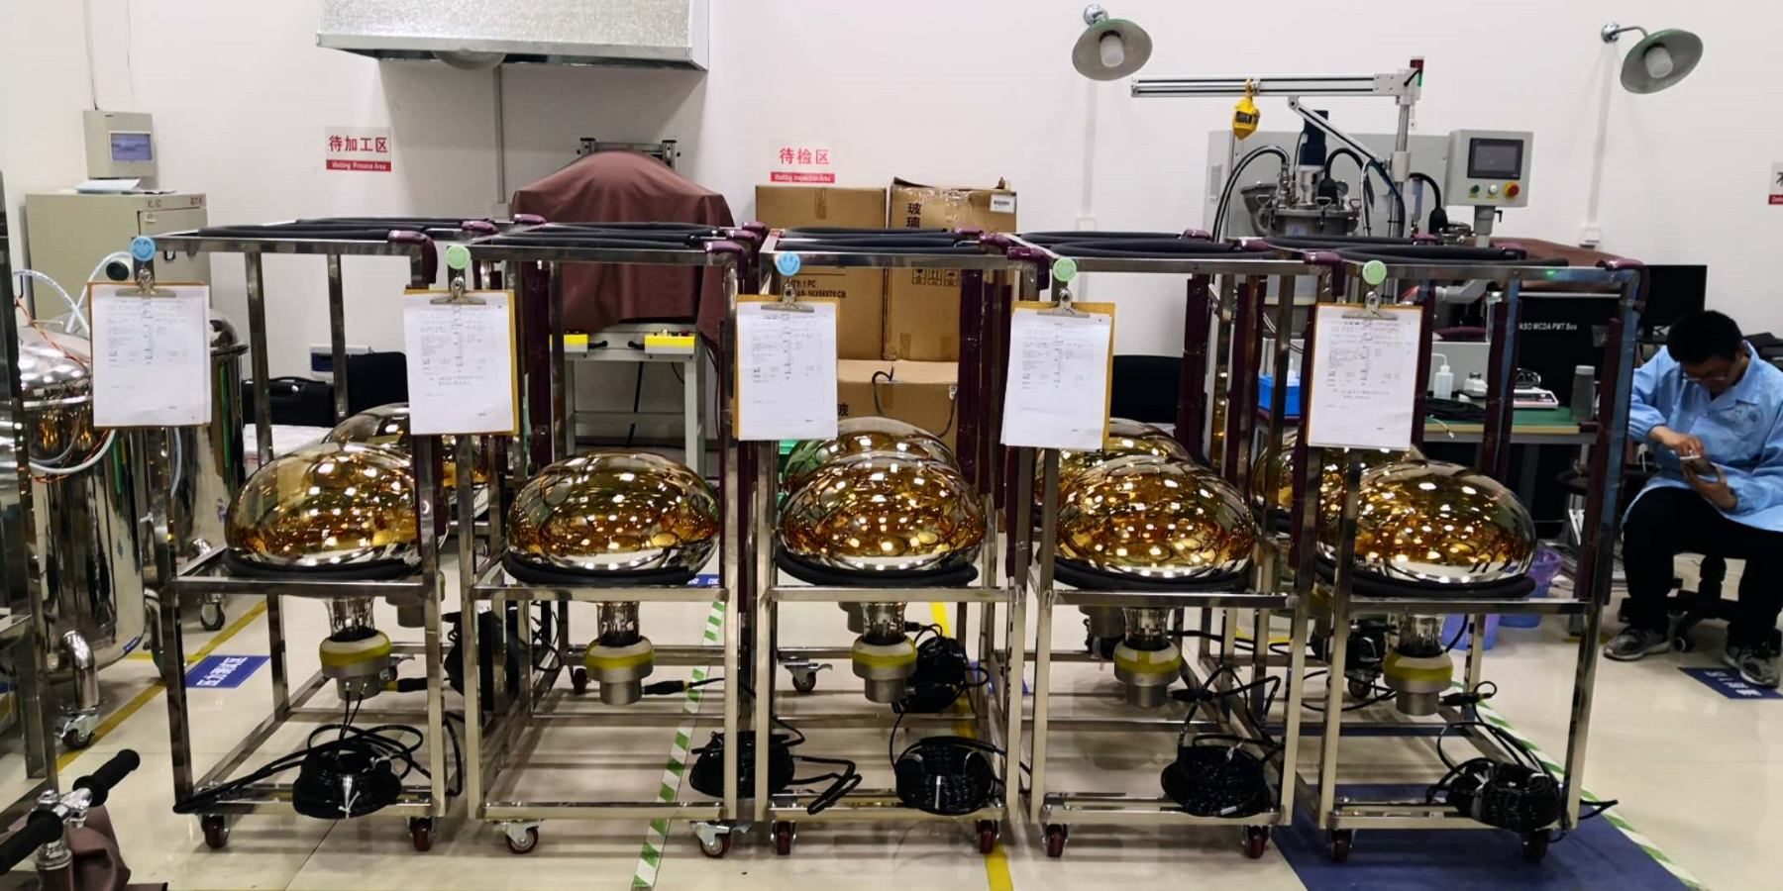
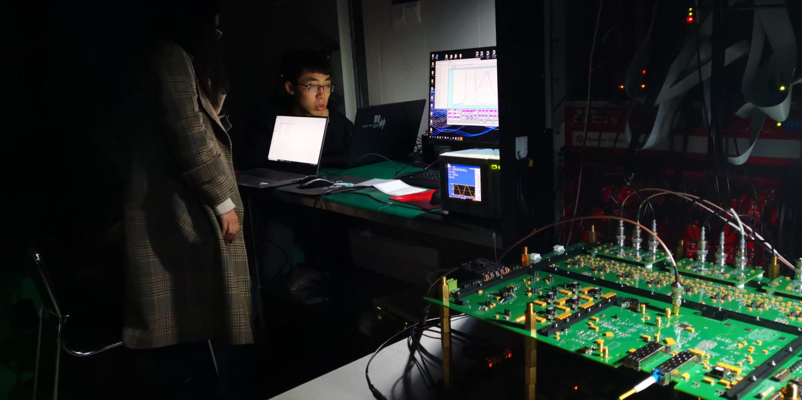
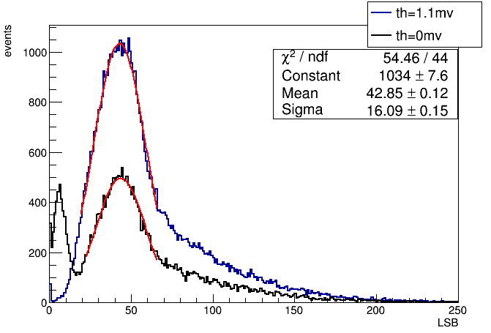
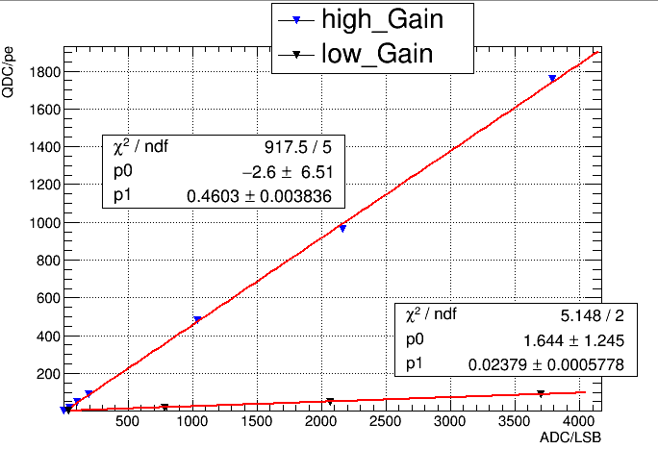
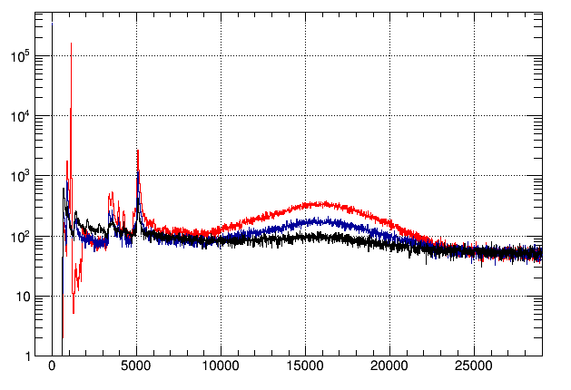
Potting & FEE debug
Potting based on JUNO potting technique
2019.01 - sample tube potting
2019.02-2019.03 - potting production line are setup
FEE debug @ 2019.04
FEE debug with 3 potting PMTs
1st batch (15 PMTs) finished and retested
PMT channel | FEE LSB | NNVT qdc | risetime | falltime | amplitude
18 | 42.85 | 5.15E6 | 3.2 ns | 17.6 ns | 6 mV
19 | 41.4 | 4.90E6 | 3.4 ns | 17.2 ns | 6 mV
20 | 42.5 | 5.24E6 | 3.4 ns | 16.8 ns | 6 mV

Slide 18
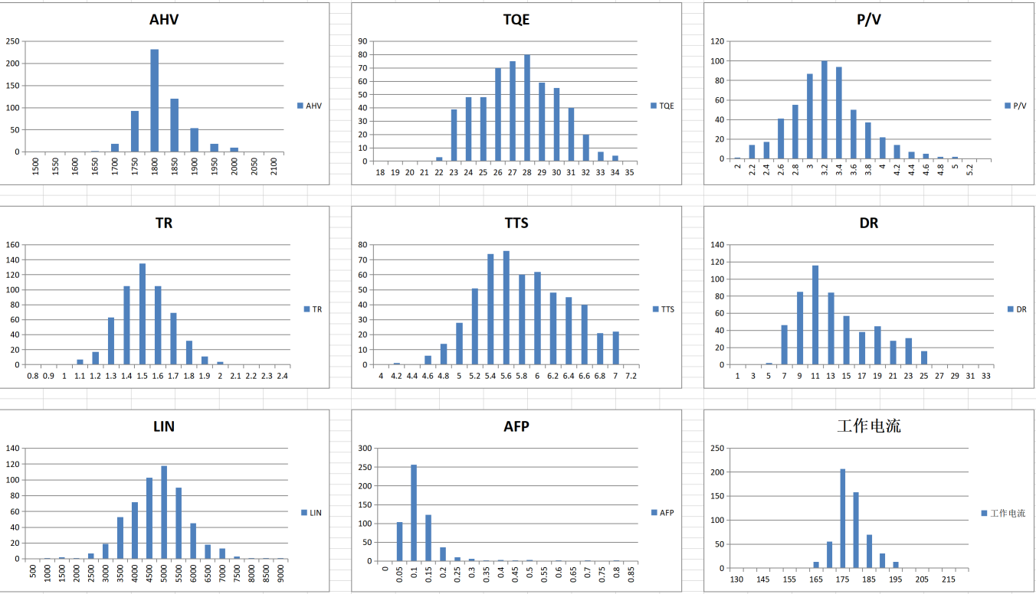
now and next - PMT production
PMT procudtion
about 800 good PMTs are produced in NNVT， ready to potting， all 2270 PMTs will produced in 2019；

Slide 19
now and next - potting & installation
Potting plan
252 PMTs / month，> 1500 PMTs delivery in 2019
batch test platform setup on HZS
water pressure test
parameter test platform
installation
structure
installation procedure
protection in delivery
more ...

Slide 20
Conclusion
LHAASO-WCDA is the first ground-based cosmic ray & gamma ray detector to use 20 inch MCP-PMT in whole world, and the PMTs are made in China !
We work with pressure and proud !

Slide 21
二、稳定性研究
1. 性能一致性

Slide 22
二、稳定性研究
1. 性能一致性

Slide 23
二、稳定性研究
3. 增益稳定性
下降14%
暗计数率
下降32%

Slide 24
10只样管性能测试
莲花座聚焦极
@22℃ @Gain = 5×10⁶
管号 | 工作电压（V） | 峰谷比 | 量子效率(%) | 暗计数率 (kHz) | TTS (ns) | 上升时间 (ns) | 后脉冲比例(%) | 趋势10%线性
PC1710-2 | 1711.5 | 3.0 | 30.46 | 14.92 | 6.39 | 1.83 | 0.16 | 2710
PC1710-6 | 1841.5 | 4.4 | 23.85 | 8.77 | 6.29 | 1.87 | 0.15 | /
PC1710-7B | 1781.5 | 6.5 | 28.45 | 12.81 | 6.31 | 1.48 | 0.19 | 1310
PC1710-8 | 1791 | 2.6 | 30.41 | 12.93 | 6.12 | 1.83 | 0.19 | 1610
PC1711-1 | 1801.5 | 3.6 | 28.02 | 9.98 | 6.68 | 1.34 | 0.22 | 1480
PC1711-2 | 1821 | 3.8 | 27.96 | 13.83 | 6.68 | 1.45 | 0.18 | 2120
PC1711-3 | 1822 | 5.8 | 30.05 | 14.74 | 6.21 | 1.29 | 0.19 | 1730
PC1711-6 | 1761 | 2.6 | 26.91 | 16.20 | 6.11 | 1.21 | 0.24 | 1205
PC1711-7 | 1841 | 5.3 | 22.46 | 9.94 | 5.3 | 1.87 | 0.33 | 2950
PC1711-8 | 1791 | 3.7 | 31.45 | 3.98 | 5.93 | 1.82 | 0.31 | 2150

Slide 25
光电倍增管与分压器指标要求
光阴极尺寸 | 直径为20英寸，椭球面
外形尺寸公差 | 玻壳在垂直轴线的平面里的投影直径公差 ≤ 2mm，高度差 ≤ 10mm
光阴极大小 | 在垂直轴线的平面里的投影直径与玻壳投影直径之比大于90%
玻壳气泡 | 光阴极表面玻壳气泡：没有大于等于5 mm直径的，直径[2 mm, 5 mm)的不超过5个。其它玻璃部分：没有直径大于5 mm的，直径[2 mm, 5 mm)的不超过10个
玻壳耐压 | ＞ 3 atm，典型值为10 atm
正常工作高压值 | 在5×10⁶增益下，工作电压小于2000 V，每批次最大偏差在平均值的±120 V之内
工作电流 | 小于300 µA
单光电子峰谷比 | ＞ 2 @ 5×10⁶
频谱响应曲线 | 300 nm − 650 nm
量子效率 | 在频谱响应曲线的最高点＞ 22%
上升时间 | ＜ 3 ns @ 5×10⁶，典型值为1.4ns
渡越时间分散 | ＜ 7 ns @ 5×10⁶
CTTD | ＜ 4 ns @ 5×10⁶
暗噪声计数率 | ＜ 25 kHz @ 5×10⁶，阈值为1/3 个光电子，环境温度22±3摄氏度
后脉冲比率 | ＜ 2%
稳定性 | 在加上工作高压3小时后到12个小时期间，增益变化小于5%，暗噪声率变化小于10%
抗振稳定性 | 经过振幅1 mm、频率25 Hz正弦波，持续时间30 s振动后，无机械损伤，且产品性能满足远距离运输要求
寿命 | 累计阳极输出电荷75库仑时增益降低程度小于20%
阳极电荷非线性 | ≥ 1800光电子（±10%）@ 5×10⁶，均值大于2000光电子，输入脉冲光源脉宽≤30 ns
元器件与电路板 | 选用精度好于1%和额定功率大于等于1/4 W的金属膜电阻，电容选用耐压3千伏以上的陶瓷电容

Slide 26
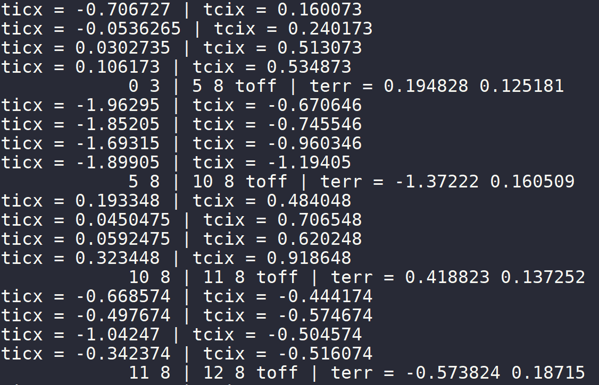
计算结果-时间差传递
以某一单元（igcell = 3）为例，阵列参考单元igcell=440（cluster12，cell8）
传递路径1：(0,3)->(5,8)->(10,8)->(11,8)->(12,8)

Slide 27
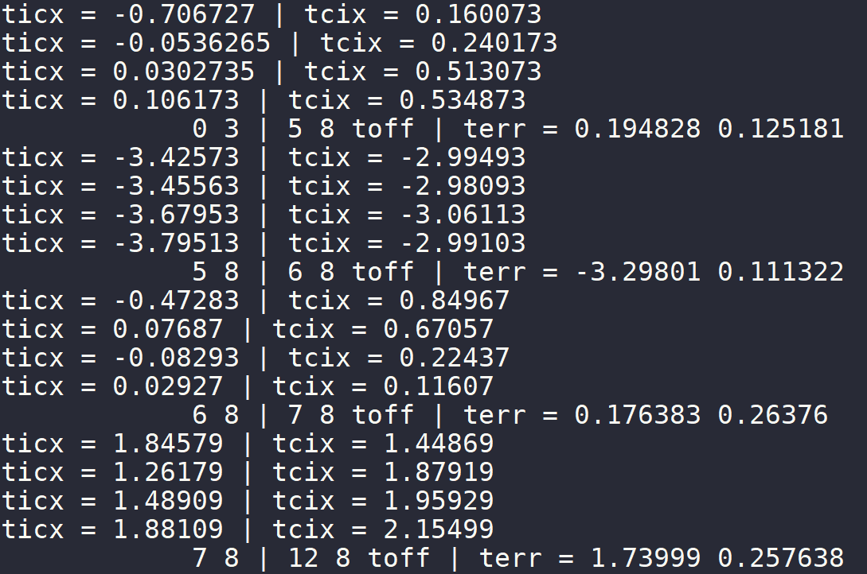
以某一单元（igcell = 3）为例，阵列参考单元igcell=440（cluster12，cell8）
传递路径2：(0,3)->(5,8)->(6,8)->(7,8)->(12,8)

Slide 28
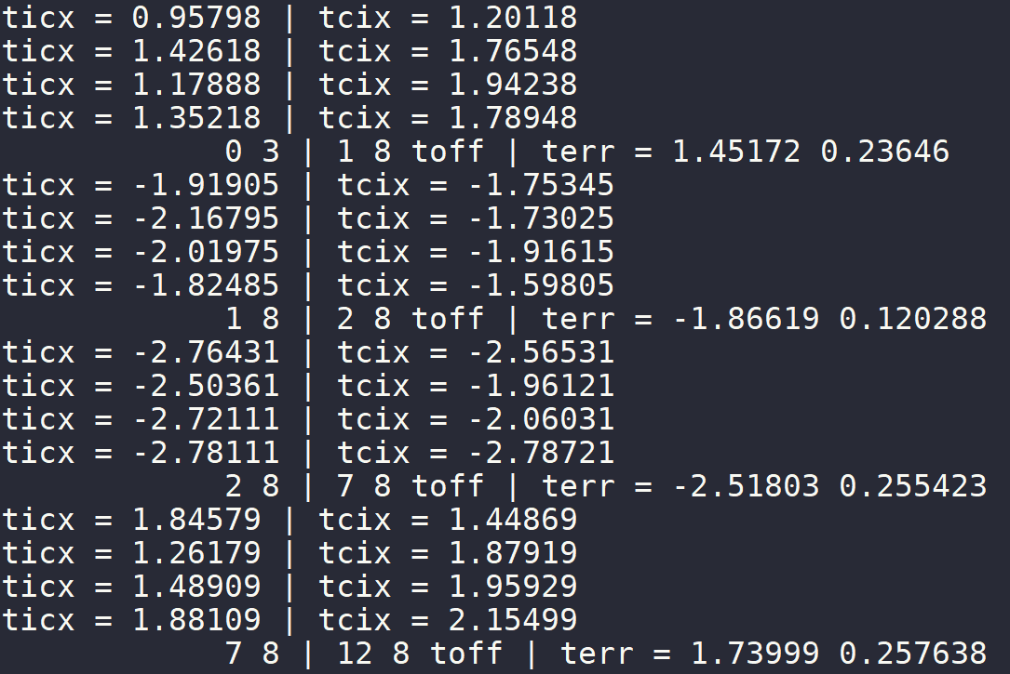
以某一单元（igcell = 3）为例，阵列参考单元igcell=440（cluster12，cell8）
传递路径3：(0,3)->(1,8)->(2,8)->(7,8)->(12,8)

Slide 29
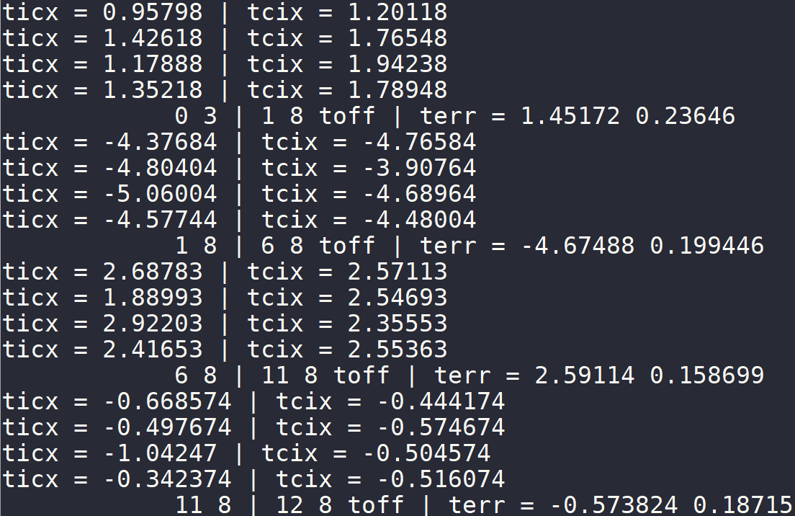
以某一单元（igcell = 3）为例，阵列参考单元igcell=440（cluster12，cell8）
传递路径4：(0,3)->(1,8)->(6,8)->(11,8)->(12,8)

