Slide 1
Study the turbulence in supernova remnant with pulsar scintillation
Hui Zhu, NAOC
zhuhui@bao.ac.cn
Apr 15, 2019

Slide 2
Outline
1. What is interstellar scintillation(星际闪烁)?
---refraction(折射) and diffraction(衍射)
2. How to study the ISM property with scintillation?
---dynamic spectrum and secondary spectrum
3. Can we use pulsar scintillation to study the turbulence in supernova remnant (SNR)?
---target and telescope

Slide 3
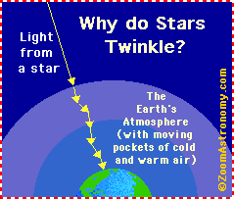
1. What is interstellar scintillation?
Cradle song：Twinkle Twinkle Little Star（小星星）
Hundred Thousand Whys（十万个为什么）
Why do stars twinkle？
Stars (except for the Sun) appear as tiny dots in the sky; as their light travels through the many layers of the Earth's atmosphere, the light of the star is bent (refracted) many times and in random directions (light is bent when it hits a change in density - like a pocket of cold air or hot air). This random refraction results in the star winking out (it looks as though the star moves a bit, and our eye interprets this as twinkling).
https://www.enchantedlearning.com/subjects/astronomy/stars/twinkle.shtml

Slide 4
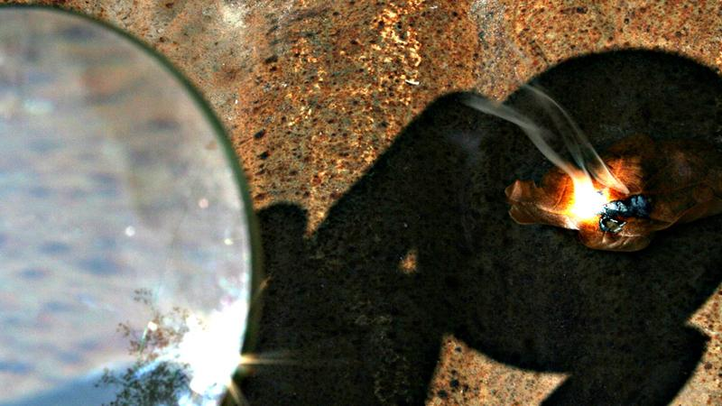
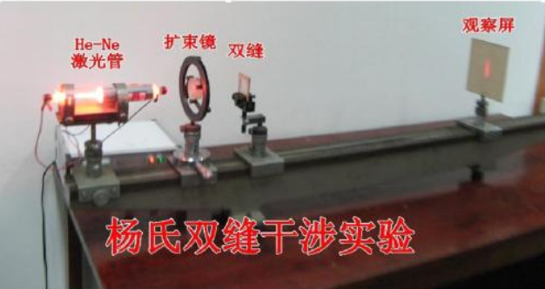
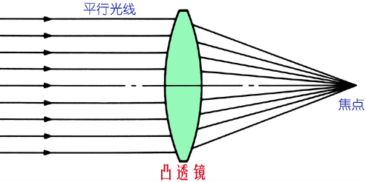
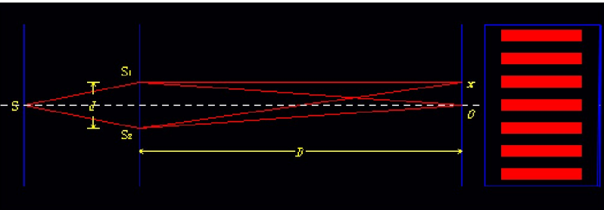
1. What is interstellar scintillation?
Scintillation
Study the turbulence in supernova remnant with pulsar scintillation
Interstellar---the scintillation is caused by ISM
Refraction vs diffraction
Fresnel scale:
Refraction
diffraction
Lens-like
(Twinkle star)
Scattering
(Young’s interference experiment)
Effective distance(de)
D is the distance from the source to observer and sD is the distance from scattering screen to the source.
Refraction: caused by irregularities larger than the Fresnel scale
Diffraction: caused by irregularities smaller than the Fresnel scale

Slide 5
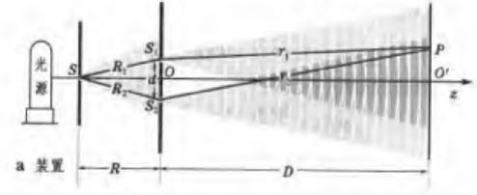
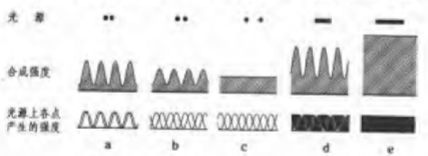
1. What is interstellar scintillation?
Why twinkle, twinkle, little star?
Study the turbulence in supernova remnant with pulsar scintillation
Why pulsar?
1) Only point sources can produce obvious scintillation.
2) For ionized diffuse interstellar medium, only radio scintillation is observable.
Pulsar: size~a few 10 km, radio bright
How about twinkle, twinkle, planet?

Slide 6
1. What is interstellar scintillation?
Study the turbulence in supernova remnant with pulsar scintillation
Supernova remnant: origin of Galactic cosmic ray
Turbulence: created by the shockwave and link tightly with cosmic ray acceleration and diffusion
1) The maximum energy of the accelerated cosmic ray depends on the diffusion coefficient (Df). Assume that Df has a powerlaw form: Df~E^b
For Bohm diffusion, b is 1. For Kolmogorov turbulence, b=1/3 and it is 1/2 for Iroshnikov-Krachnan turbulence

Slide 7
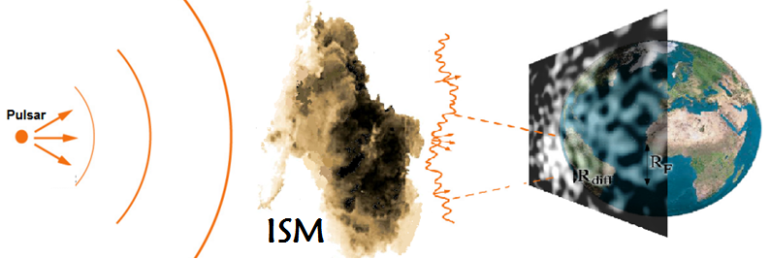
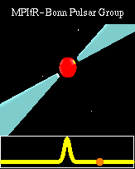
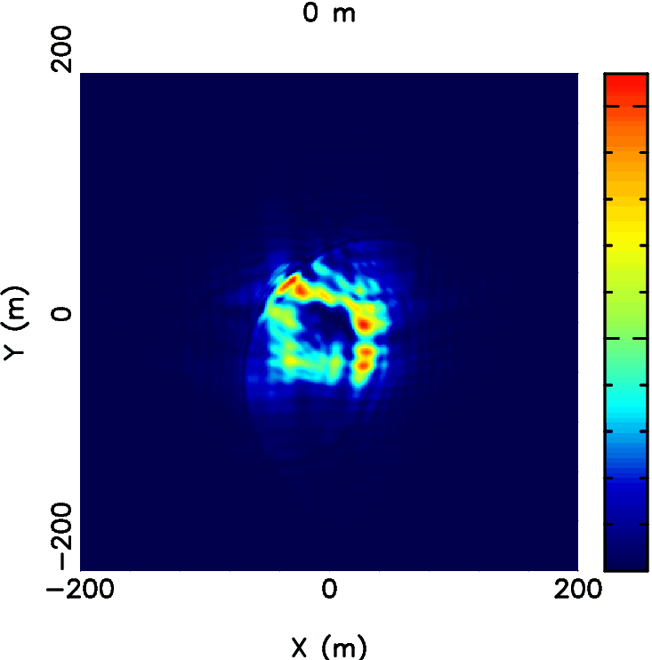
2. How to study the ISM property with scintillation?
Created by Han J.L. for pulsar summer school

Slide 8
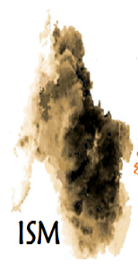
2. How to study the ISM property with scintillation?
Created by Han J.L. for pulsar summer school

Slide 9
2. How to study the ISM property with scintillation?
Turbulence spectrum
Ve
sD
D
D: the distance between pulsar and observer
sD:the distance between scattering screen and pulsar
Ve: relative velocity between pulsar, screen and observer

Slide 10
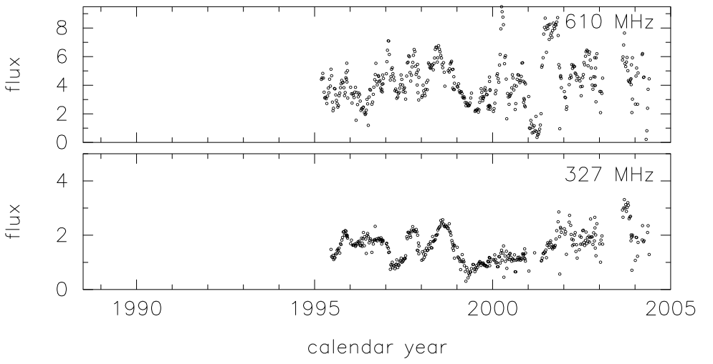
2. How to study the ISM property with scintillation?
ISM clump is larger than Fersnel scale
Refractive scintillation
Strength of pulsar scintillation
ISM clump is smaller than Fersnel scale
diffractive scintillation
Refractive scintillation:
Long term variation (week to month) and sensitive to 10^10 -10^12 cm (Rickett et al. 1984)
Ramachandran et al 2006

Slide 11
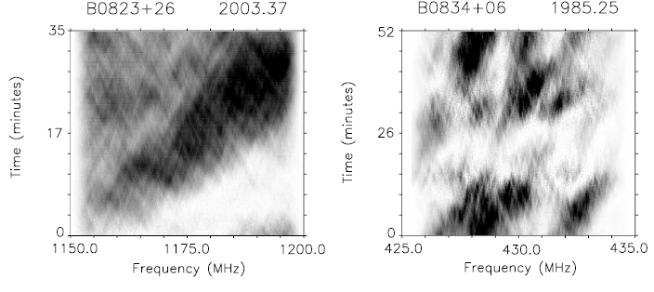
2. How to study the ISM property with scintillation?
ISM clump is larger than Fersnel scale
Refractive scintillation
Strength of pulsar scintillation
ISM clump is smaller than Fersnel scale
Diffractive scintillation
Diffractive scintillation:
Short term variation (minute to hour) and sensitive to 10^6 -10^8 cm (Rickett et al. 1977)
Cordes et al 2006

Slide 12
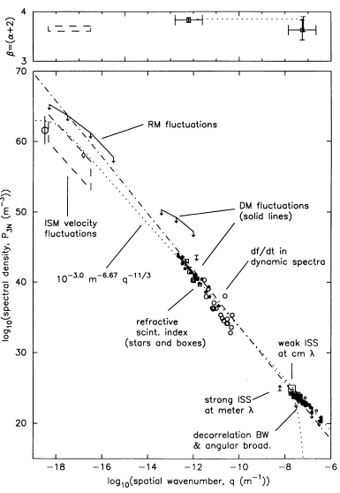
2. How to study the ISM property with scintillation?
Electron density power spectrum can be well described by Kolmogrov turbulence
Where A=1 and alpha=5/3
However, there are evidences support other kind of turbulence.
e.g. scintillation study of PSR B0329+54 indicate the turbulence is belonging to the Iroshnikov-Kraichnan spectrum (Shishov et al. 2003)
And PSRs B0540 + 23, B2324 + 60, and B2351 + 61 do not favor Kolmogrov turbulence too (Wang et al. 2018)
Amstrong et al 1995

Slide 13
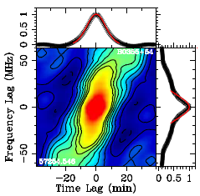
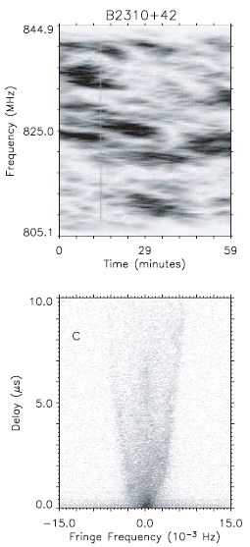
2. How to study the ISM property with scintillation?
If we want to study the turbulence with diffractive scintillation, what do we need?
2D autocorrelation
Correlation timescale
and
Decorrelation bandwidth
β<4
Stinebring 2007
β>4
Fourier transform
Kolmogorov turbulence (β=11/3)：
v：frequency D: distance of the pulsar and Vs: the effective velocity

Slide 14
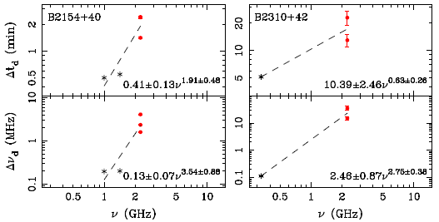
2. How to study the ISM property with scintillation?
If we want to study the turbulence with diffractive scintillation, what do we need?
β<4
β>4
v：frequency D: distance of the pulsar and Vs: the effective velocity
Wang et al. 2018
If we measure the correlation timescale and decorrelation bandwidth at different frequencies, then we could use them to determine the index, β, and check whether the turbulence can be described by Kolmogorov spectrum.
A telescope with Wideband Receiver are very suable to do this.
Gupta et al. 1994

Slide 15
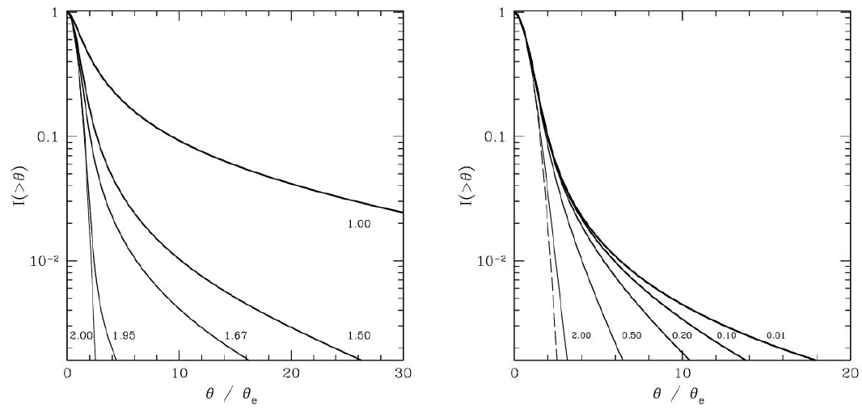
2. How to study the ISM property with scintillation?
If we want to study the turbulence with diffractive scintillation, what do we need?
Kolmogorov turbulence (β=11/3=α+2)
Fresnel–Kirchoff integral
Stinebring 2007
Fourier transform
Flux vs scattered angular. Left: powerlaw turbulence spectrum without a cutoff (inner scale). Right: Kolomgorov spectrum with a cutoff (inner scale). Cordes et al. 2006

Slide 16
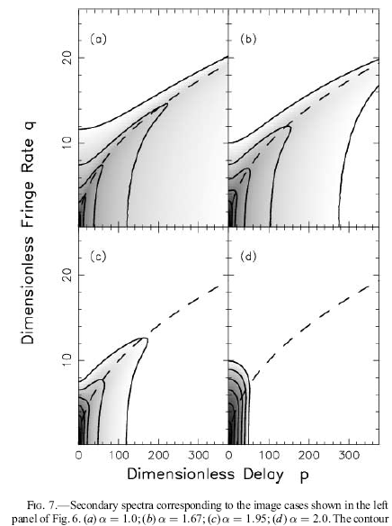
2. How to study the ISM property with scintillation?
If we want to study the turbulence with diffractive scintillation, what do we need?
Kolmogorov turbulence (β=11/3=α+2)
Flux vs scattered angular. Left: powerlaw turbulence spectrum without a cutoff (inner scale). Right: Kolomgorov spectrum with a cutoff (inner scale). Cordes et al. 2006
Only flat powerlaw spectrum (β<4) can produce the parabolic structure. Match the simulated image with observed image to determine β.

Slide 17
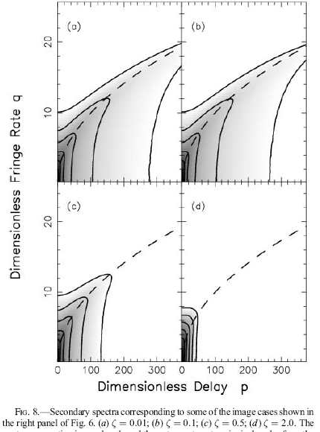
3.Can we use pulsar scintillation to study the turbulence in supernova remnant?
If we want to study the turbulence with diffractive scintillation, what do we need?
Kolmogorov turbulence (β=11/3=α+2)
Flux vs scattered angular. Left: powerlaw turbulence spectrum without a cutoff (inner scale). Right: Kolomgorov spectrum with a cutoff (inner scale). Cordes et al. 2006
Only small cutoff can produce the parabolic structure. This can be used to constrain the application scope of kolmogrov spectrum.

Slide 18
2. How to study the ISM property with scintillation?
Scintillation, turbulence and electron column density (or dispersion measure)
Pulsar A
Pulsar A
Pulsar A
Turbulent ISM (contribute small part of the DM)
uniform ISM (contribute majority part of the DM)
Dynamic spectrum
Uniform distributed image with pulsar pulse
Although the contribution on DM is small for SNR, it should dominate the total turbulence in the line of sight to pulsar which is inside the SNR.

Slide 19
2. How to study the ISM property with scintillation?
Turbulence from the SNR or other ionized medium
For dynamic spectrum
For secondary spectrum
The SNR shell is very close to the pulsar
For dynamic spectrum,
η should be very small.
For secondary spectrum,
S should be very small.
Gupta et al. 1994
Stinebring 2007
Notes:
.

Slide 20
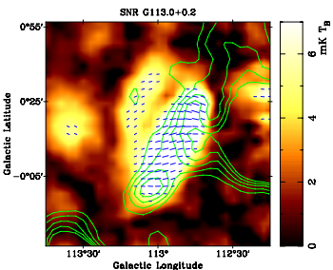
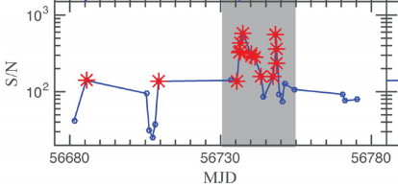
2. How to study the ISM property with scintillation?
Why people never try to study turbulence in the SNR with pulsar scintillation?
High signal to noise ratio is needed
(the pulsar is very bright or the telescope is very sensitive)
Sometimes the SNR shell is radio bright and it will input more white noise to the final data.
Xu et al. 2018
PSR B0355+54: Right points mean the successful detection of parabolic structure in the secondary spectrum
Sun et al. 2011

Slide 21
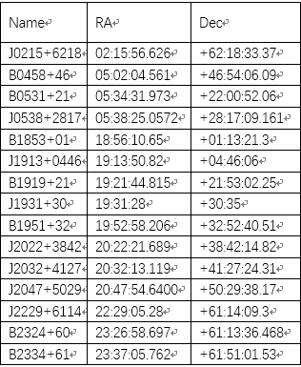
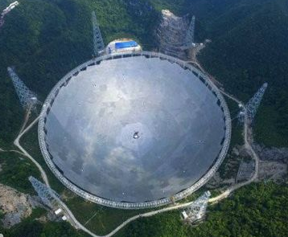
2. How to study the ISM property with scintillation?
We need a big single dish telescope or a telescope array (both should have large effective area) to do the pulsar scintillation observation
FAST: Diameter ~ 500 m
19beam receiver: bandwidth ~1.05-1.45 GHz (this year)
Wideband receiver:270-1620MHz (next year?)

Slide 22
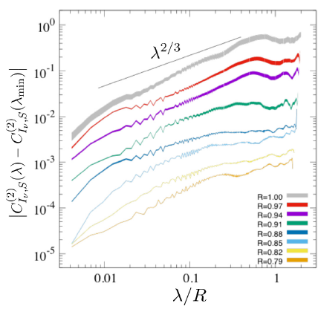
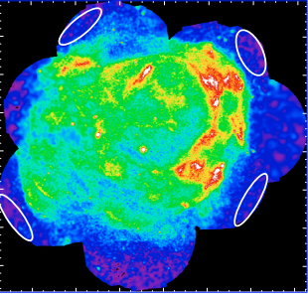
2. How to study the ISM property with scintillation?
We will apply this method with pulsar scintillation at the same time.
Two-point correlation of the X-ray synchrotron intensity
RX J1713.7-3946
Acero et al. 2009
Tycho’s SNR

Slide 23
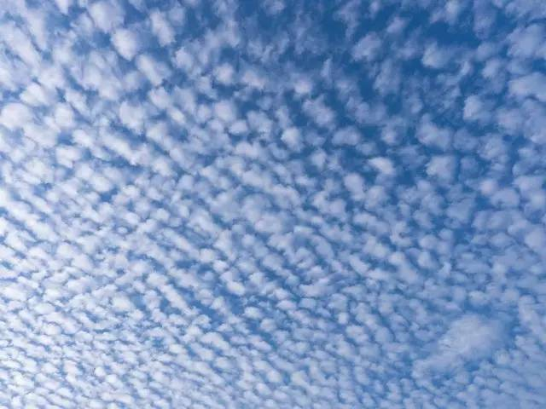
Thank you!

