Slide 1
LHAASO-KM2A Muon Detector On-site Test System
MD Group Members
赵世平

Slide 2
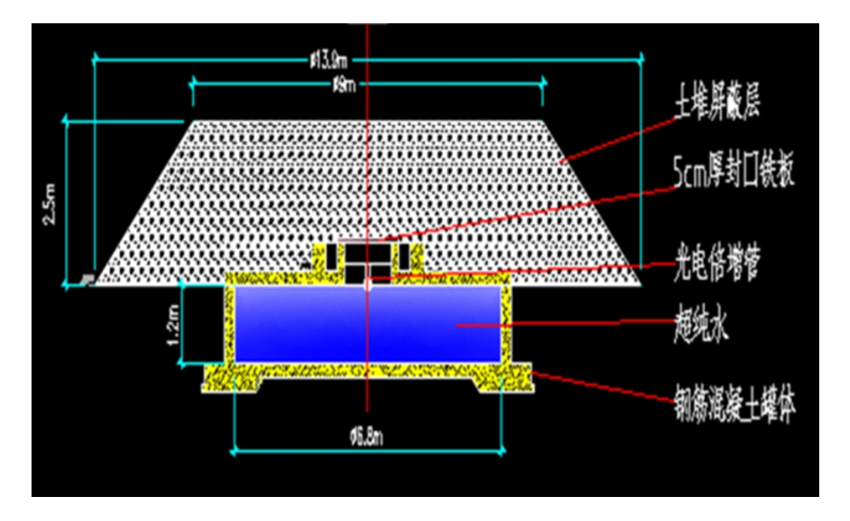
Design of Muon Detectors In KM2A Experiment
The 2.5m thick layer of soil prevents electrons or γ-rays from reaching the detector.
(左雄，2015)
Around 95% purity of muon
will be got.

Slide 3
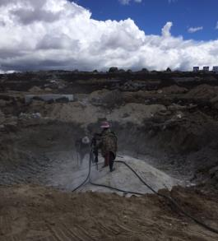
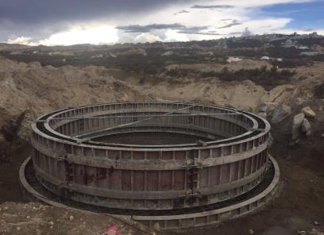
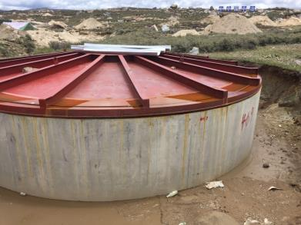
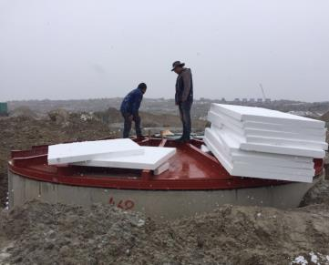
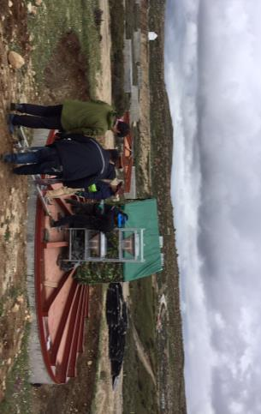
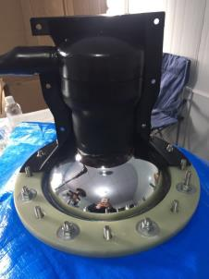
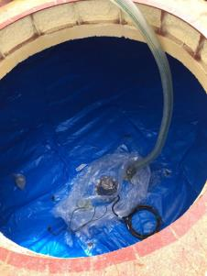
Installation of Muon Detectors
1
2
3
4
1~3: build the tank
4: winterize the tank
5: install the PMT
6: inject ultrapure water
7: test the detector
5
6
7

Slide 4
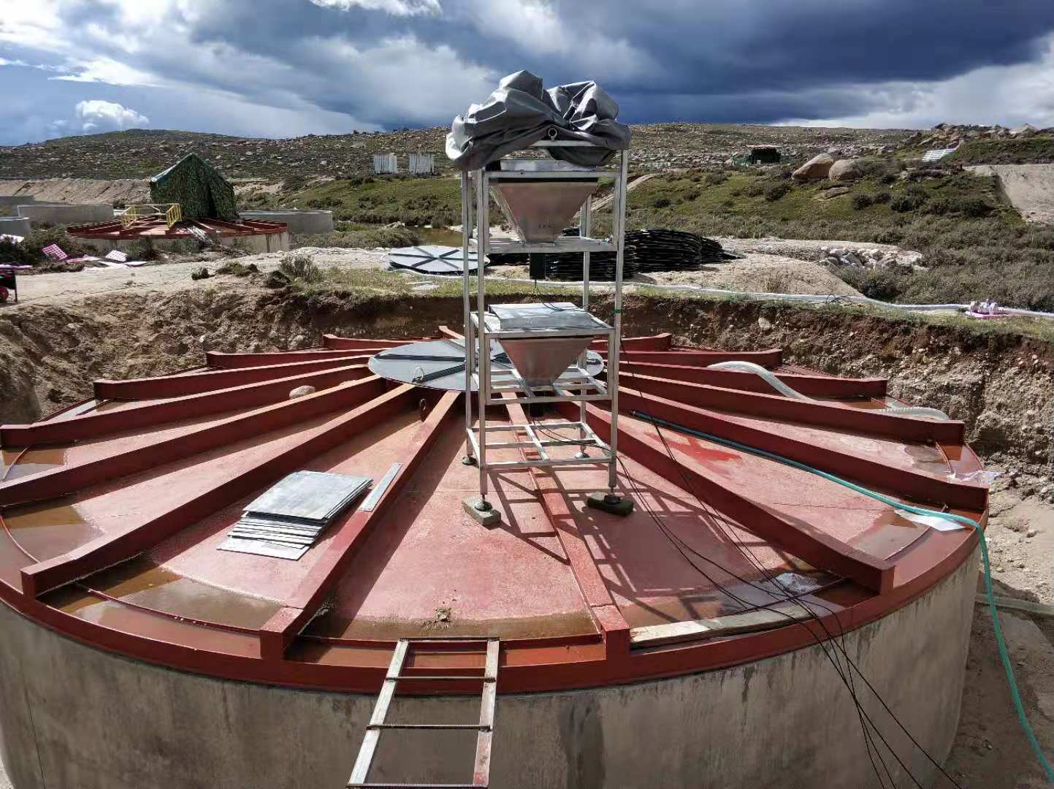
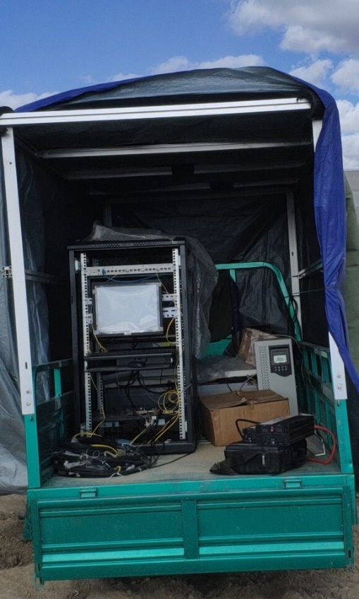
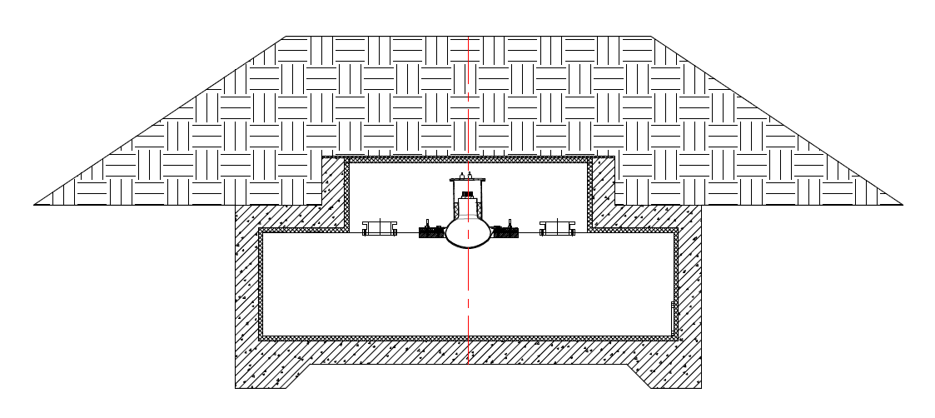
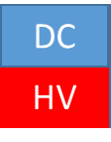



On-site Test System
望远镜
基本构造
10cm Pb
挑选出Muon事例
Scintillator
PC
$$μ Events$$
WR Switcher
ED电子学
ED电子学
MD电子学
Readout Crate System
DC
$±5V直流$，电子学电源
HV
可控PMT高压源

Slide 5
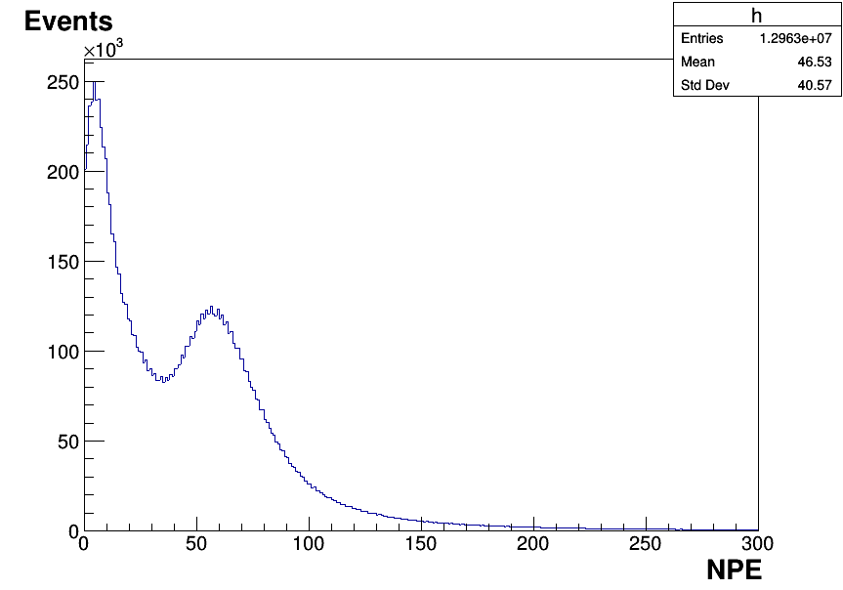
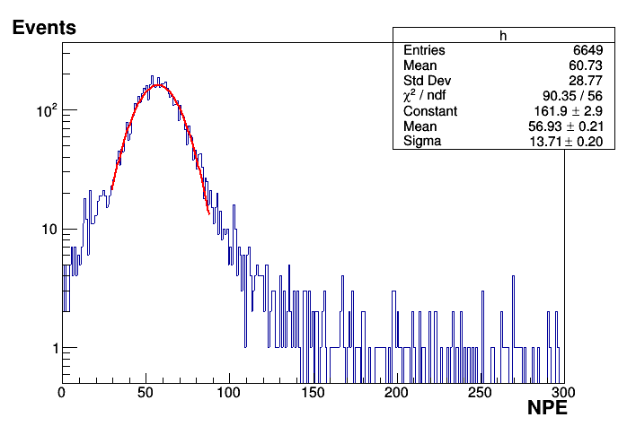
Off-line Trigger, Events Selection
Background
事例挑选前
利用符合得到的事例，采用类似的方法
从MD信号中挑选出缪子事例
NPE: Number of Photoelectron

Slide 6
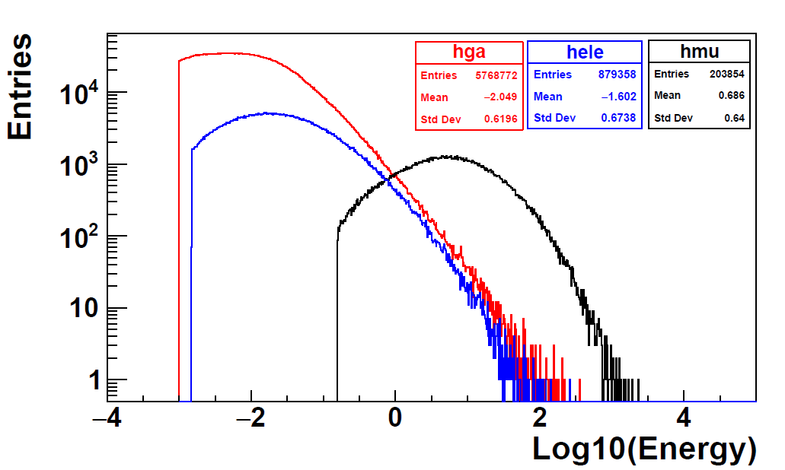

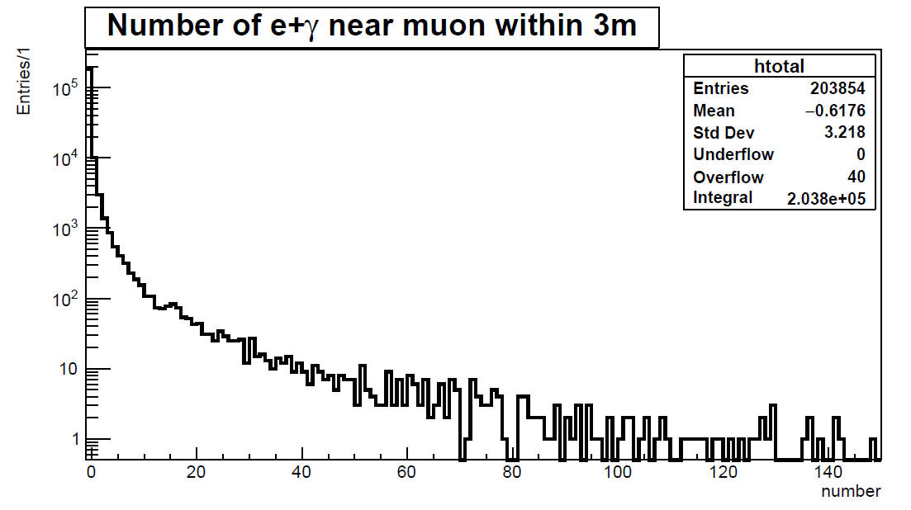
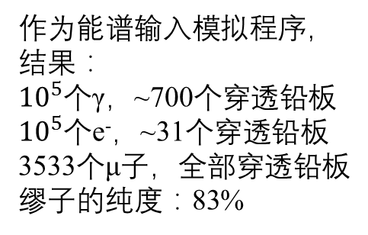
Off-line Trigger
作为能谱输入模拟程序，
结果：
${10}^{5}$个γ，~700个穿透铅板
${10}^{5}$个e⁻，~31个穿透铅板
3533个μ子，全部穿透铅板
缪子的纯度：83%
γ
Shower中
γ，电子和
缪子三种次
级粒子能量
分布
e
闪烁体
探测器
μ
铅板盒
Shower次级
缪子事例3m
范围内的电
子/γ光子数
分布
3m内无e⁻或者γ的概率90.8%
偶然符合概率不超过9.2%

Slide 7
1st Arguments—Number of Photoelectron (NPE)
Fitted by Gauss function
Mean: NPE
Charge Distribution of MD Anode Signals
Trigger
& Events
Selection

Slide 8
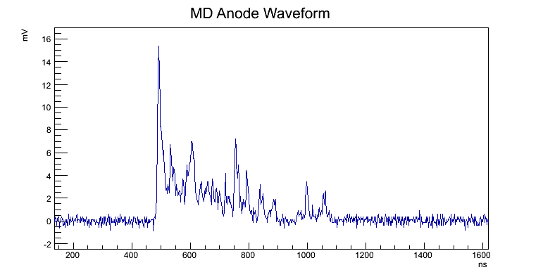
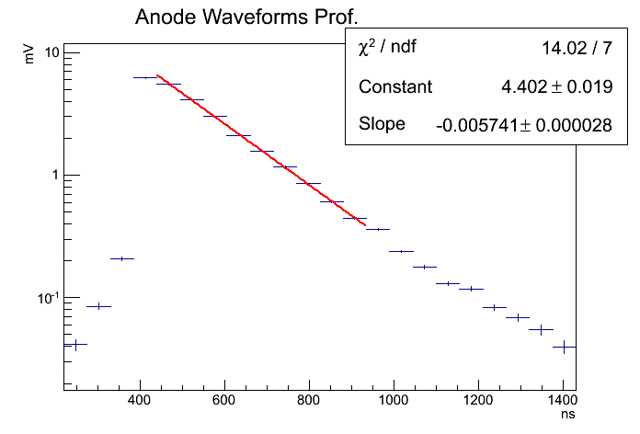


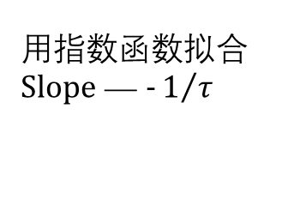
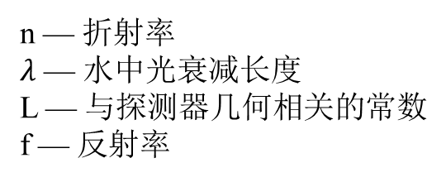
2nd Argument—Attenuation Time of Signals
$$I=I_{0}e^{\left.−t∙\frac{c}{n}∙(\frac{1}{λ}−\frac{lnf}{L}\right)}=I_{0}e^{−t/τ}$$
探测器内壁反射峰
n — 折射率
$λ$ — 水中光衰减长度
L — 与探测器几何相关的常数
f — 反射率
用指数函数拟合
$Slope$ — $−1/τ$
平均波形
$τ$ = 174ns

Slide 9
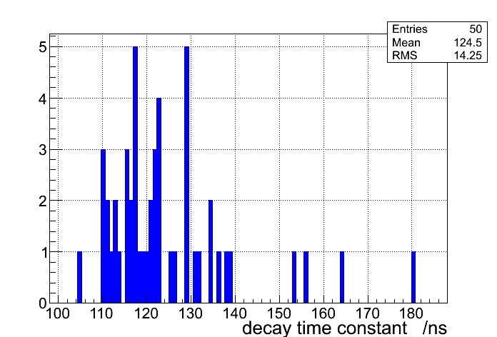
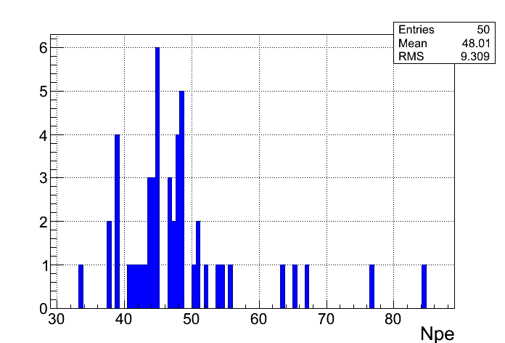
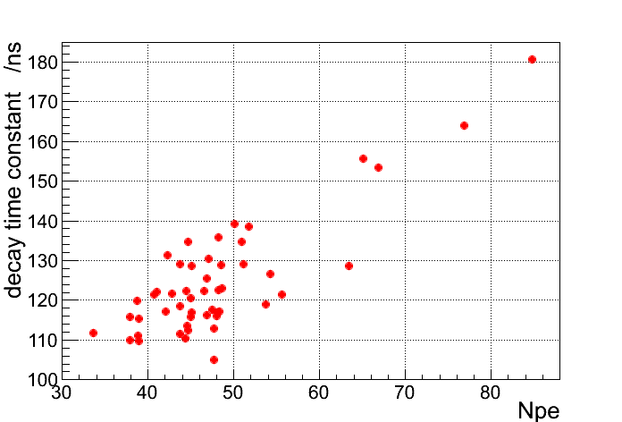
50 Muon Detectors
50台探测器的衰减时间和平均光电子数
基本击中在120ns，45NPE附近
信号衰减时间与NPE呈正相关

Slide 10
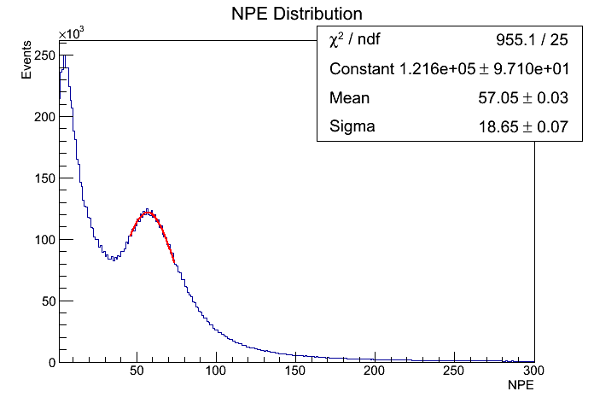
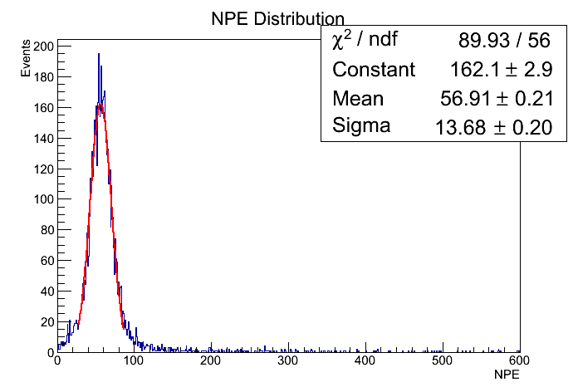

Make the Test System More Effective
Using the
telescope
NPE Distribution (Before Events Selection)
NPE Distribution (After Events Selection)
Mean = 57.05
$$≈$$
56.91 = Mean
Telescope
（1）too heavy
（2）almost no affection on measuring NPE
（3）no affection on measuring decay time
Exclude the telescope, WR switcher…

Slide 11


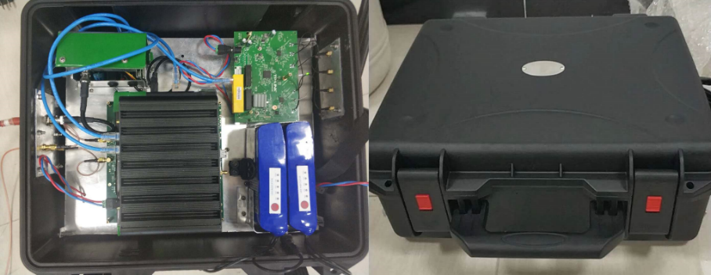
Simplified Test System
Battery
阳极
Network Connection
（1）Using batteries, DC 12V
（2）Using wireless network
打拿极
PC
Electronics
高压
PMT
High-Volt
WiFi
单片机
高压模块
USB转TTL

Slide 12
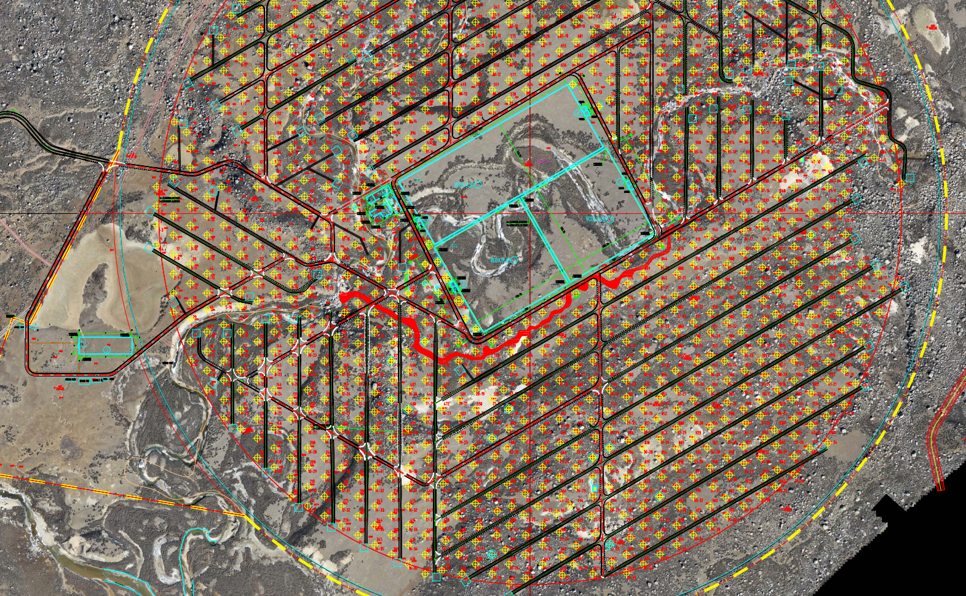
Installing the ¼ Array
The new system
will be used to
do the test work

